Slide 1
Colorado’s leading technology incubator
Core focus: Supporting and growing high-tech jobs in the communities we serve.

Slide 2
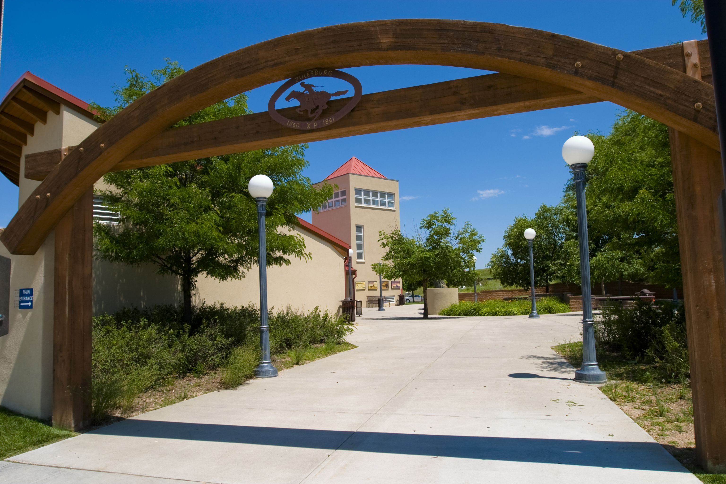

Slide 3

How Innosphere began
Incubation and innovation can be replicated at any scale
Started with needs and resources
Public Private Partnerships
Let’s hear from an entrepreneur!

Slide 4
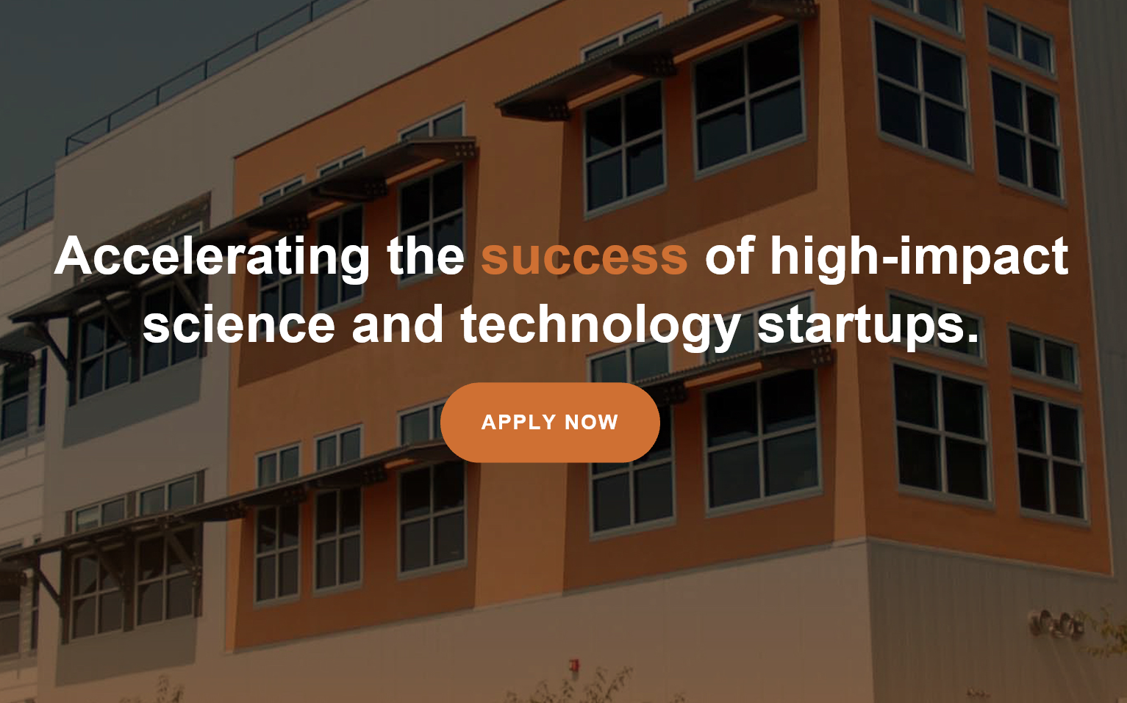

Slide 5
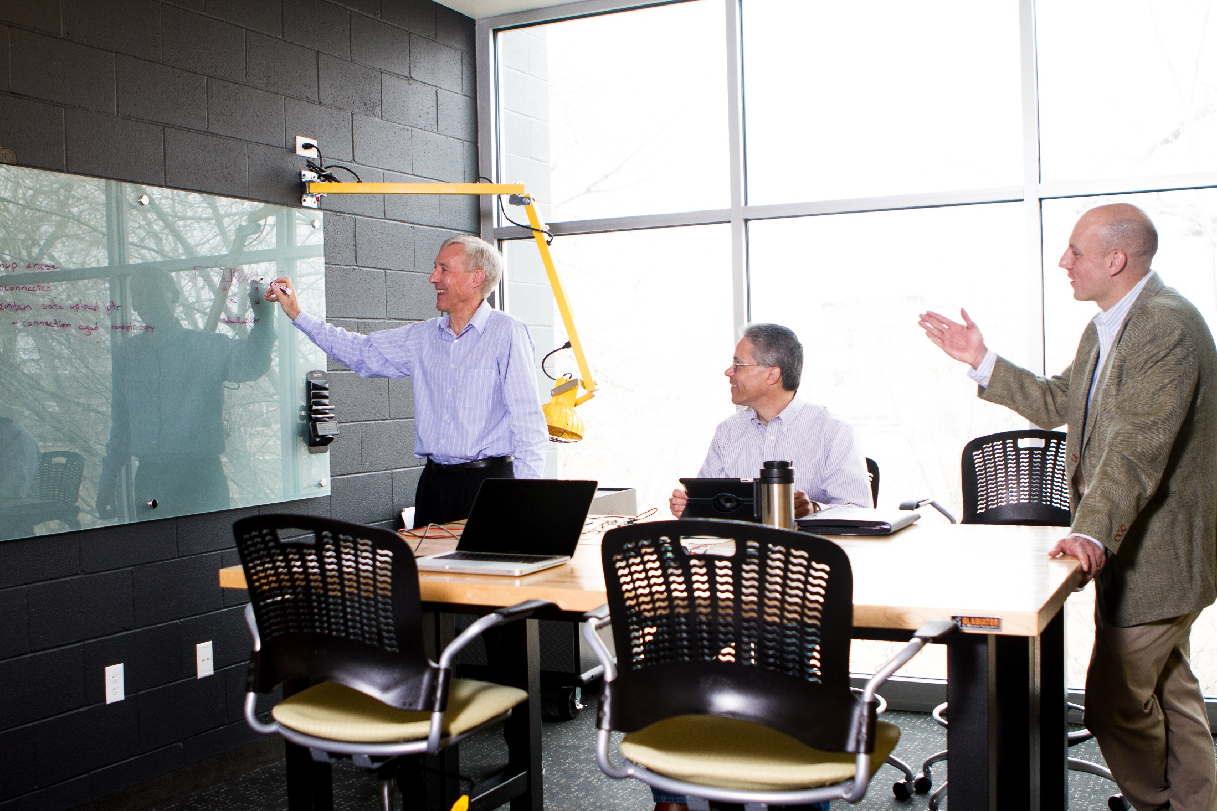
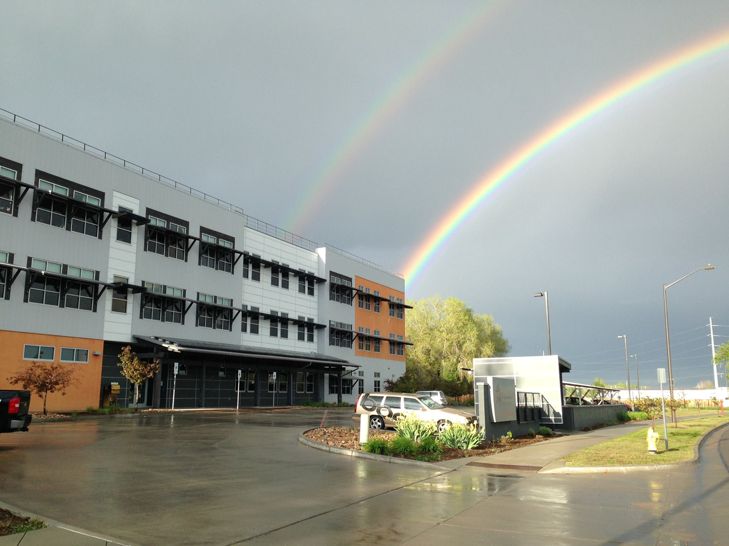
Class A Office Space with Perks

Slide 6
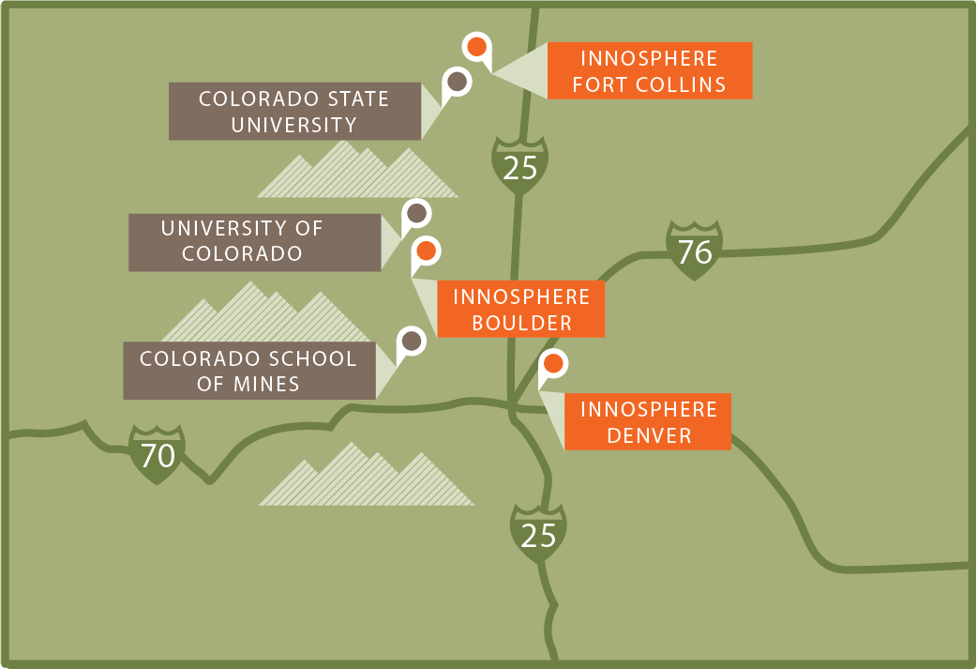
Innosphere’s Undeniable Startup Impact
$236M
$70M
Capital raised
Revenue generated
1,600+
71
Jobs created
Graduate companies
18
3
Years of Operation
Front Range Locations
2011 – 2016
Successful Track Record
Notes:
There is no question that with our focus over many years that we have made a significant impact in the startup phase of company growth.

Slide 7
Physical Space or Virtual…but it had to be:
Needs Driven
Take inventory of the players
What do all the stakeholders need
Public Private Partnerships: Stakeholders that are committed to innovation, take ownership, and share the cost burden because no one entity can do it all
Greeley Downtown Revitalization: DDA, Private Business Owners
Julesburg Hippodrome Arts Center

Slide 8
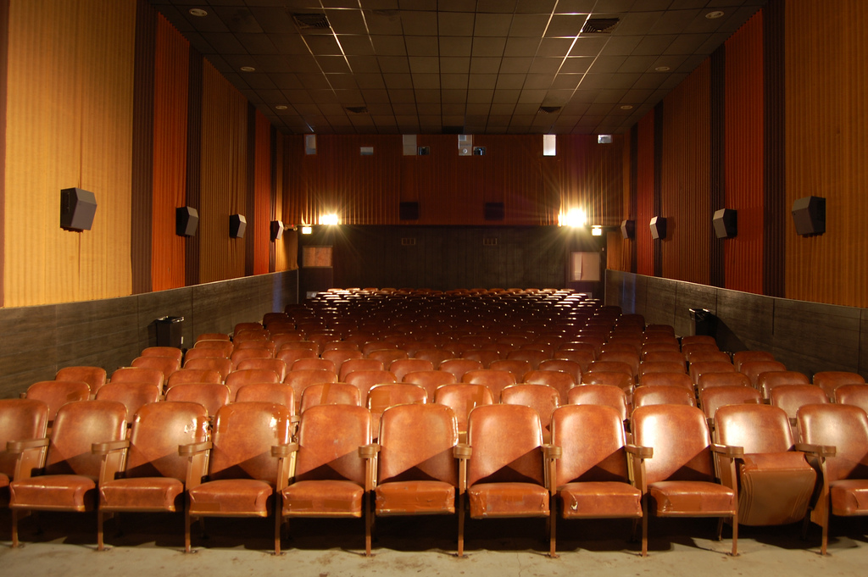

Slide 9
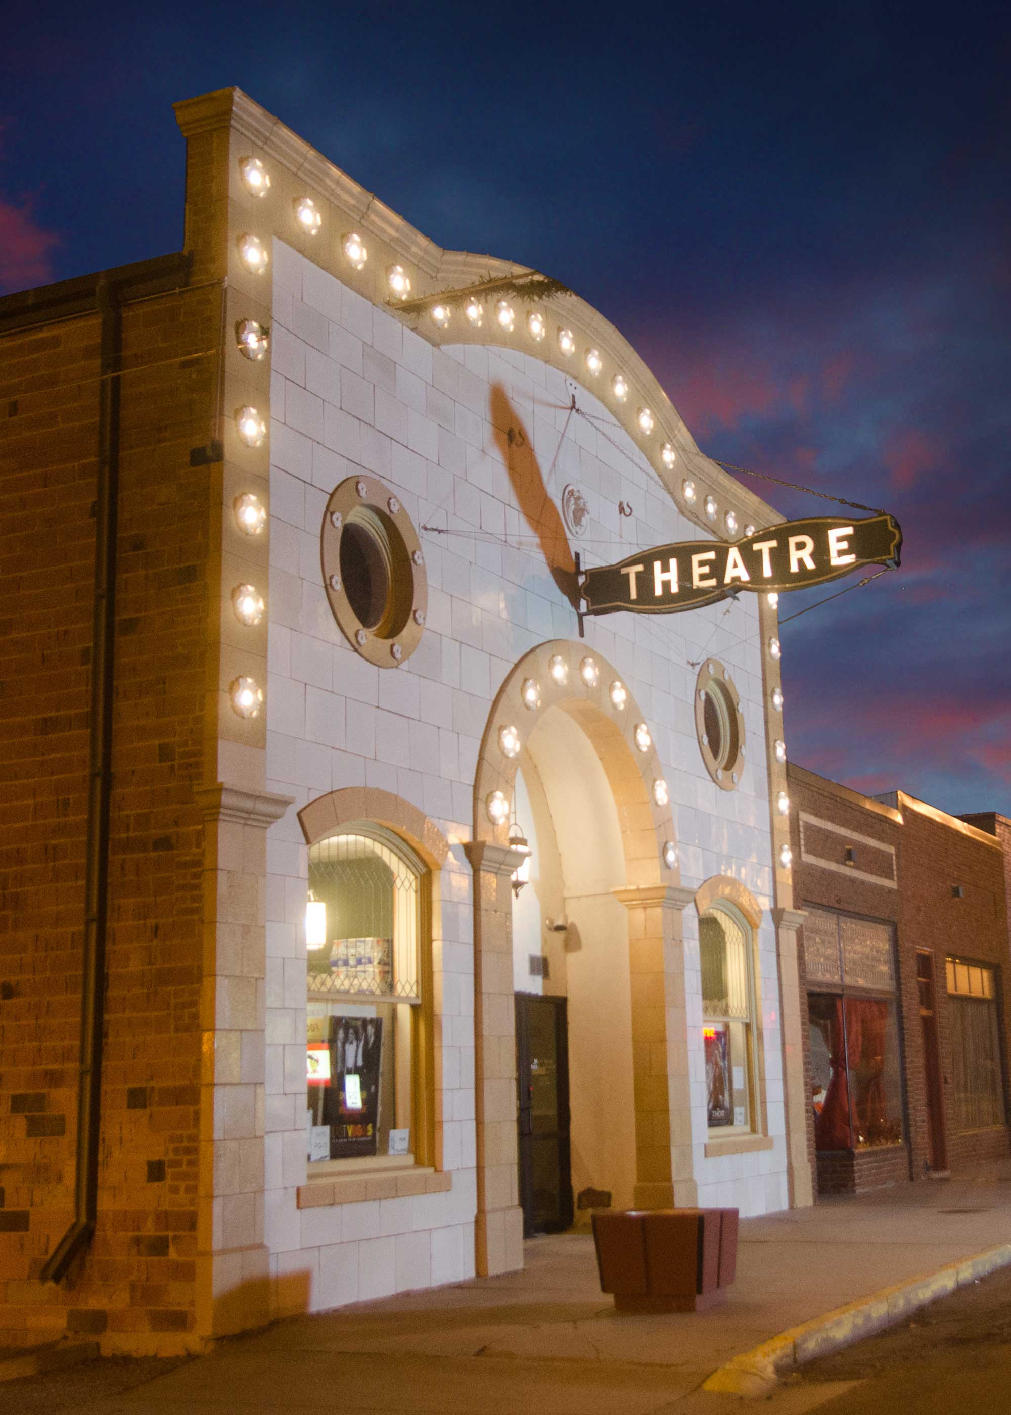
Public Private Partnerships
County owns the building
Town helps with utilities
Nonprofit 501(c)(3) has management
Brining in sales tax
Marketing attention

Slide 10
Innosphere Industries
Life Sciences | Bioscience
Energy | Water | Advanced Materials
Hardware | Enterprise Software
City of Fort Collins Economic Health Strategic Plan

Slide 11
Innosphere Facts
Technology Incubator
19 years in operation
501(c)(3) nonprofit organization
Boulder, Denver, Fort Collins
Science & Engineering
Universities: Colorado State University, School of Mines, and University of Colorado

Slide 12















Innosphere Partners and Funders
Federal Labs
Universities
Funding Partners & Preferred Providers
Cities

Slide 13
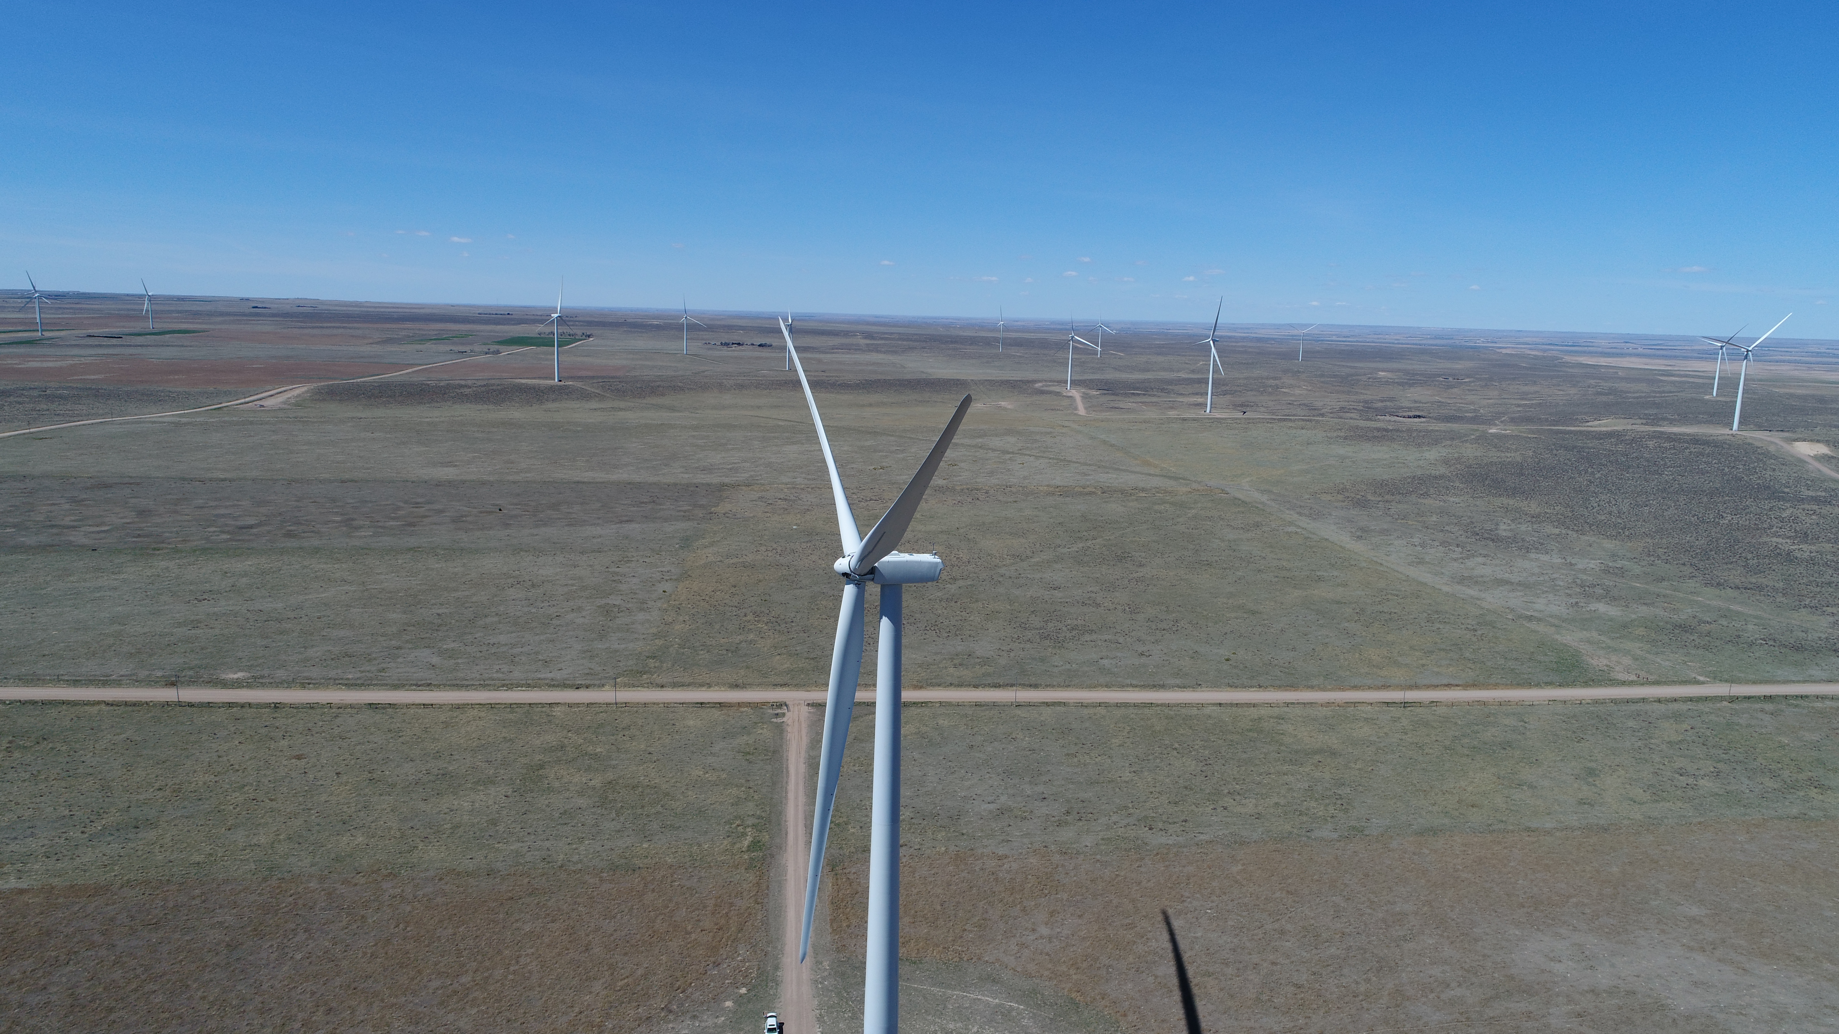

Slide 14
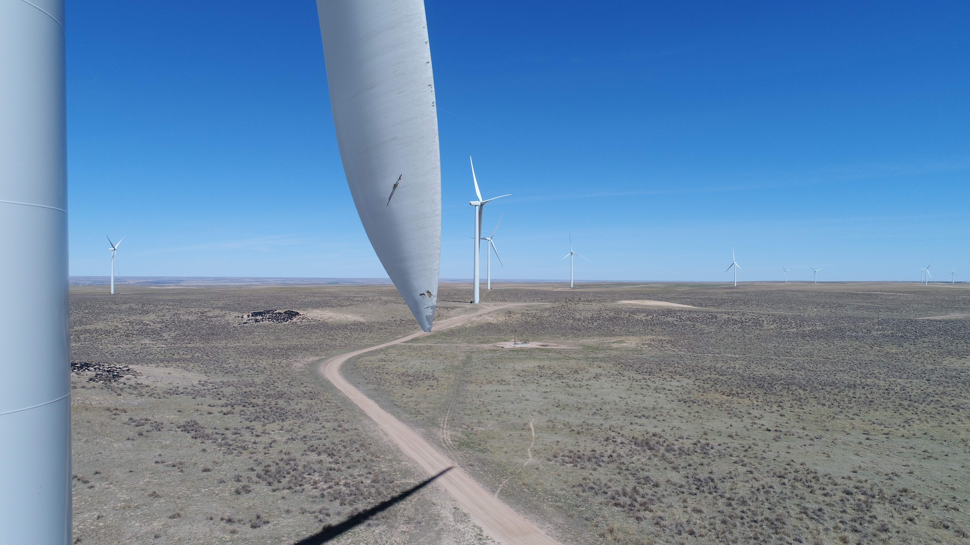

Slide 15
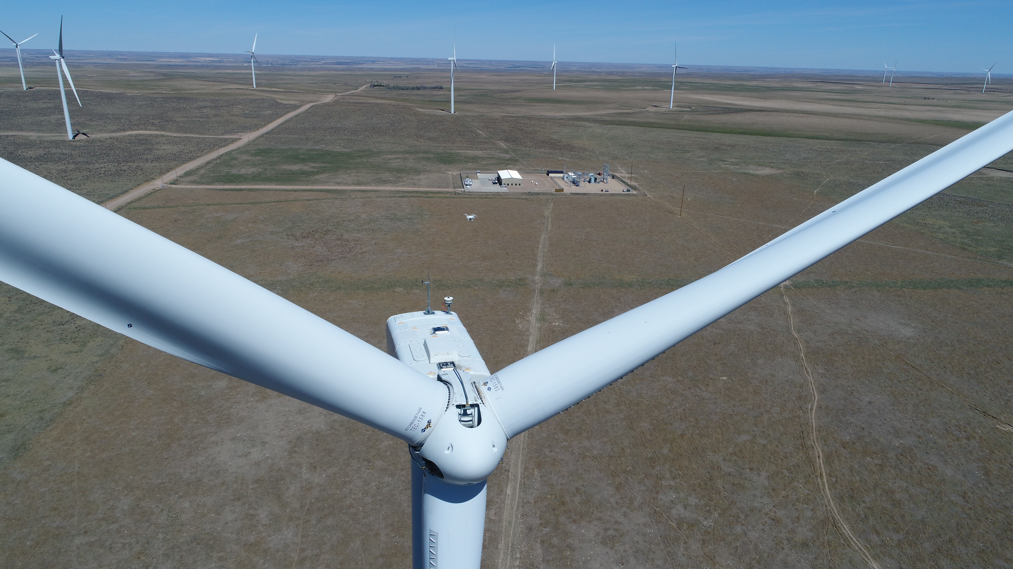

Slide 16
Thank You

