Slide 1


w
Colorado Option Plan
March 2020

Slide 2


We believe sound fiscal and economic research
is essential to uphold Colorado's economy,
vitality, future, and individual opportunity.

Slide 3

Board of Directors
Don Childears
Dave Davia
Heidi Ganahl
Jack Graham
Byron Haselden
Jim Johnson
Buz Koelbel
Elizabeth Peetz
Charlie McNeil
T. Scott Martin
Terry Stevinson
Robin Wise
Earl L. Wright

Slide 4



Health Care in Colorado Today
2019 Scorecard on State Health System Performance
9th in the nation
8th in the nation
2018 Health Rankings
7th in the nation
2019 Health Care Quality Rankings

Slide 5
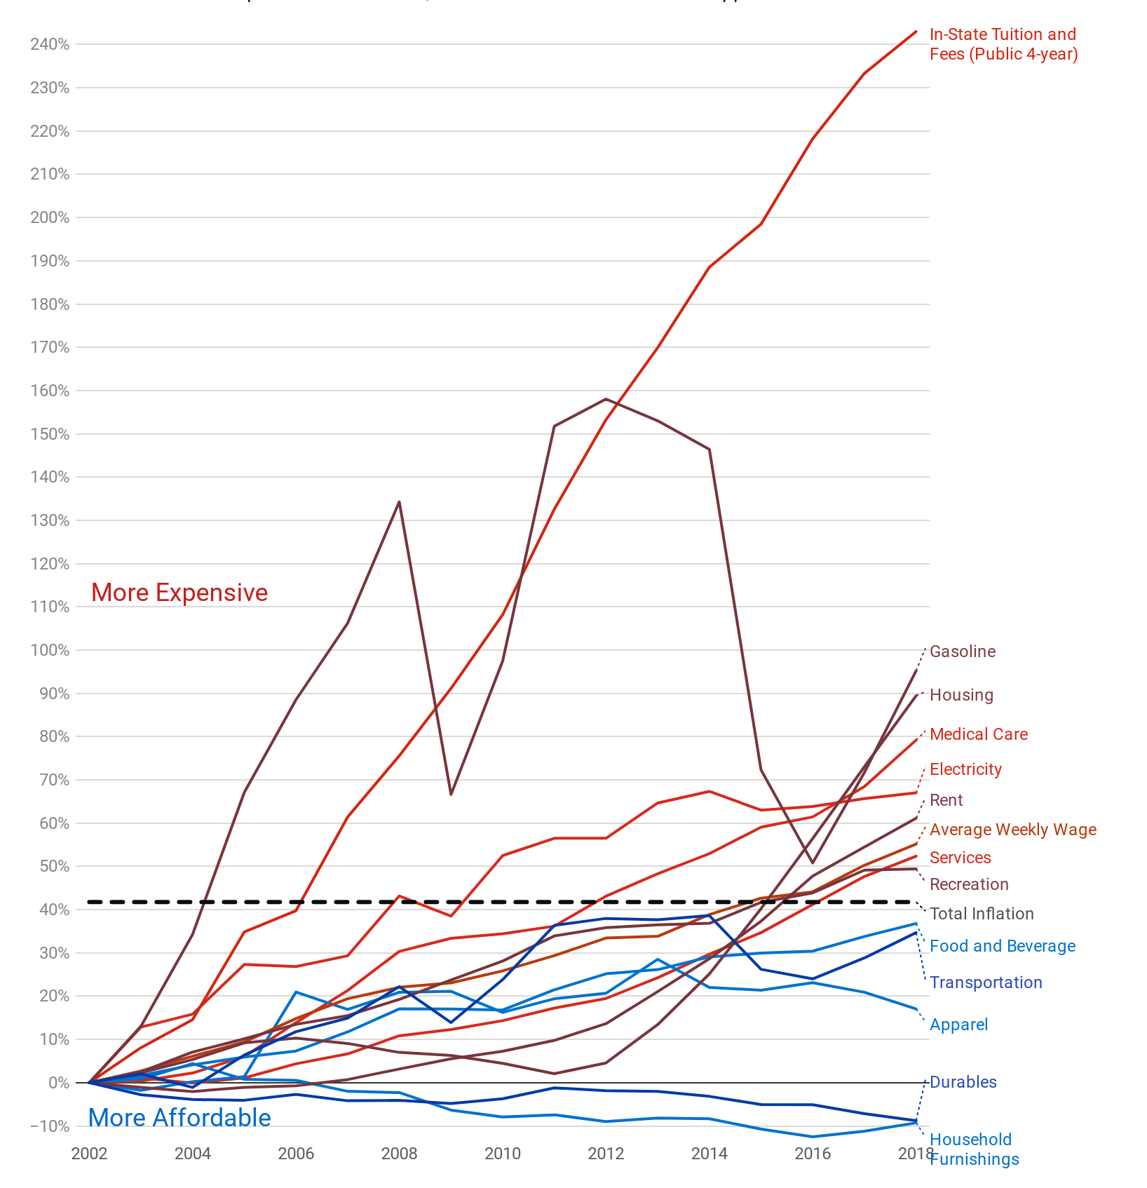
Colorado Prices in the 21st Century

Slide 6
What is the Colorado Option Plan?
Original Objectives of HB19-1004
Lower premiums
Increase competition
Public-private partnership
Leverage's "our state's existing infrastructure"
Colorado Option Plan
Insurance carrier mandates
Hospital mandates
Hospital rate setting formula

Slide 7
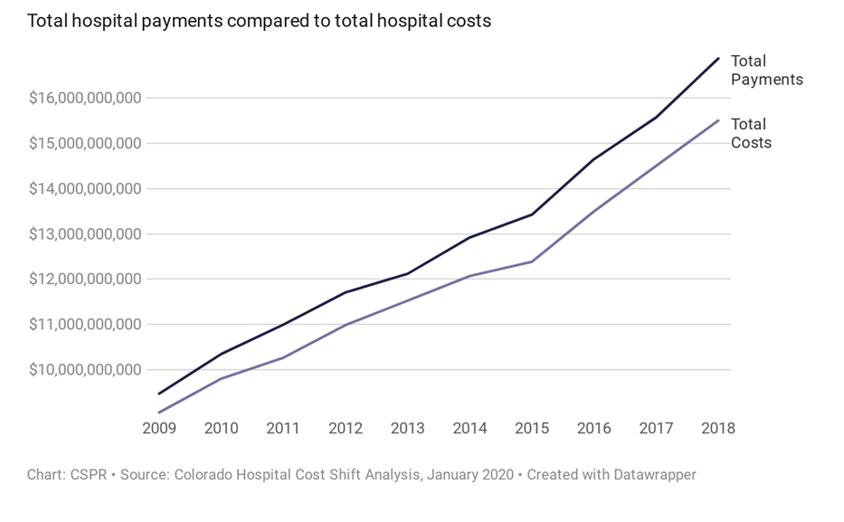

Slide 8
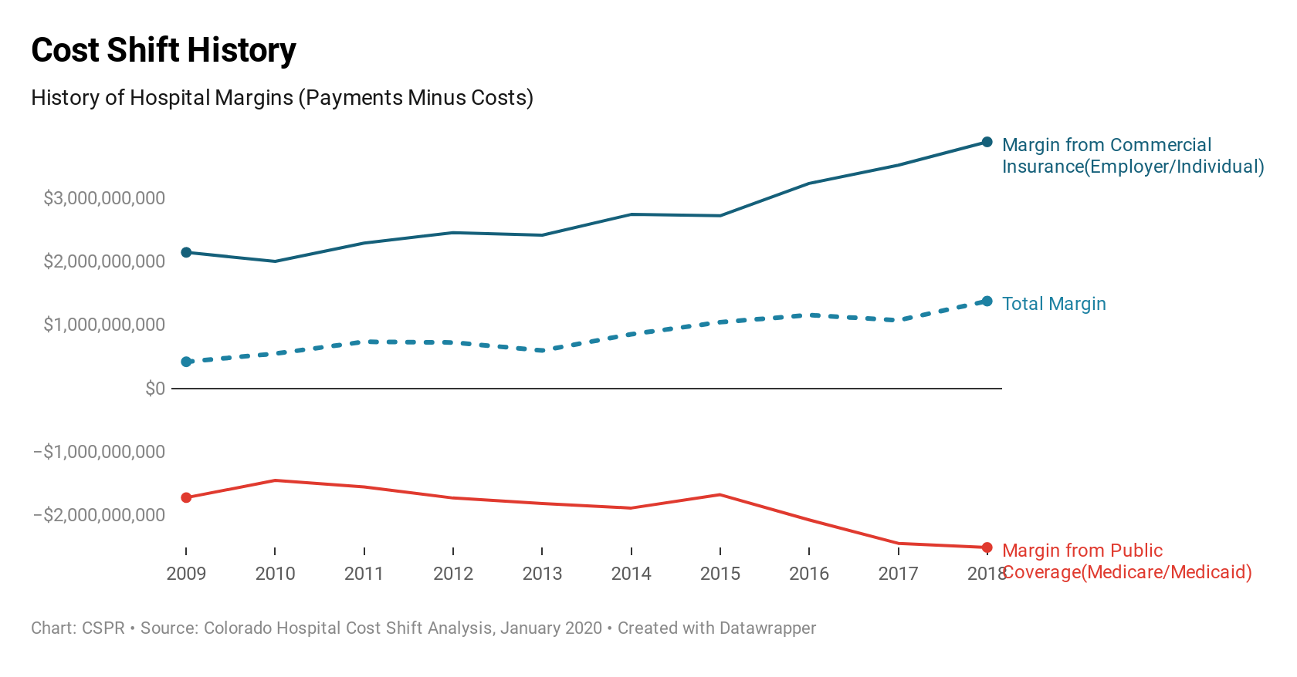

Notes:
Baumgarten Report suggested Denver area profits are $2.1B. Outside Denver = $822B. 72% of profits within Denver area

Slide 9
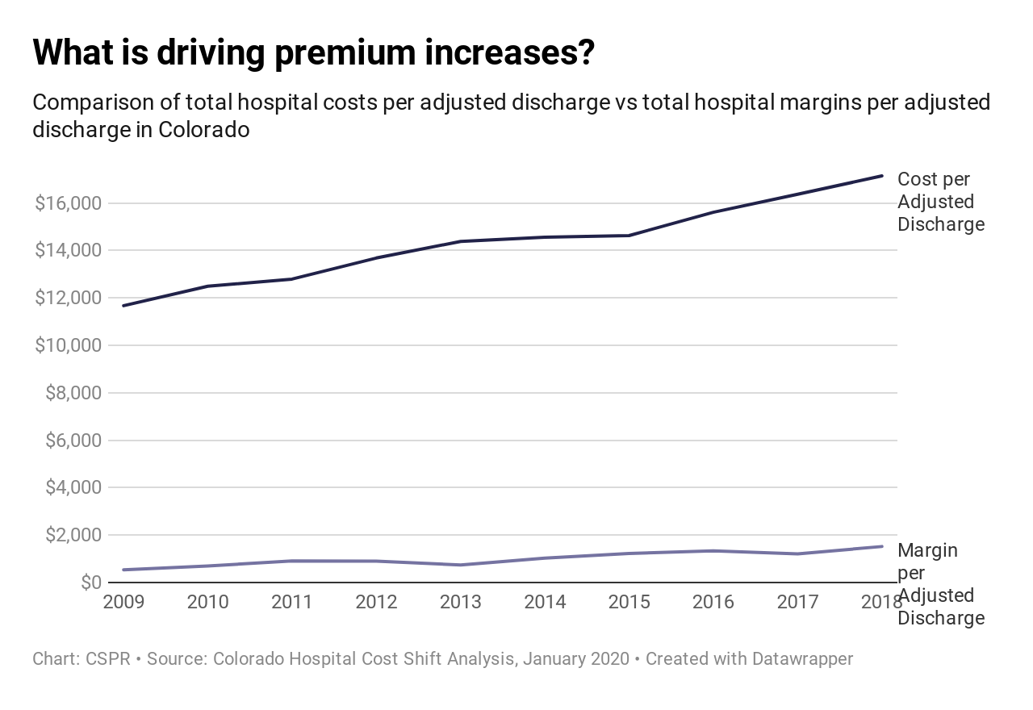
Adjusted Discharge Post ACA
Cost increase =
5.3X Margin Increase
Cost increases = $2,582
Margin increases = $492
Notes:
Margin as percent of payment = 8% was 7% in 2014
Margin relative to total payments equals 8%. It has jumped around, but was 7% year before Medicaid expansion. 7% last year.

Slide 10
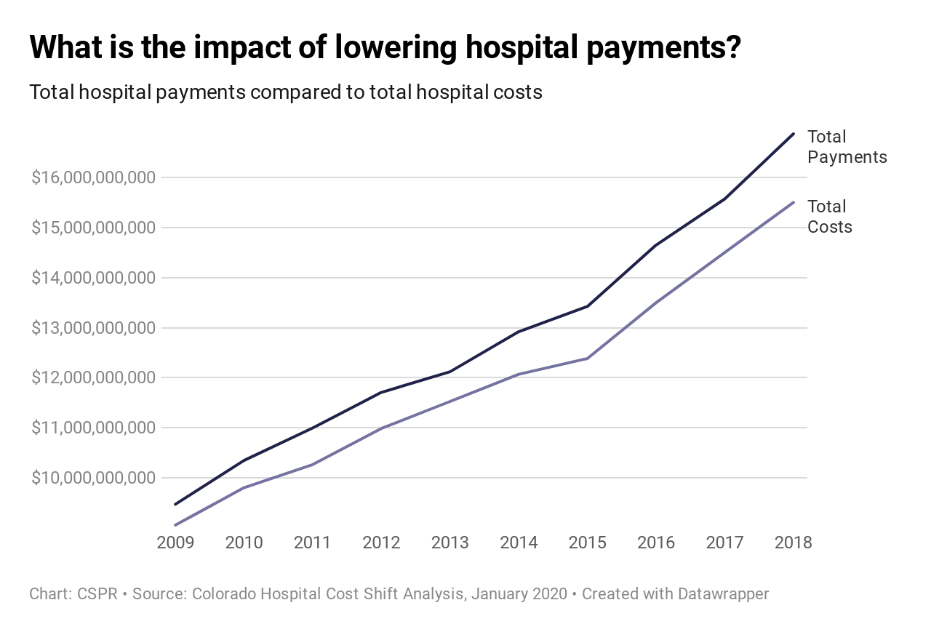
Savings at What Cost?

Slide 11
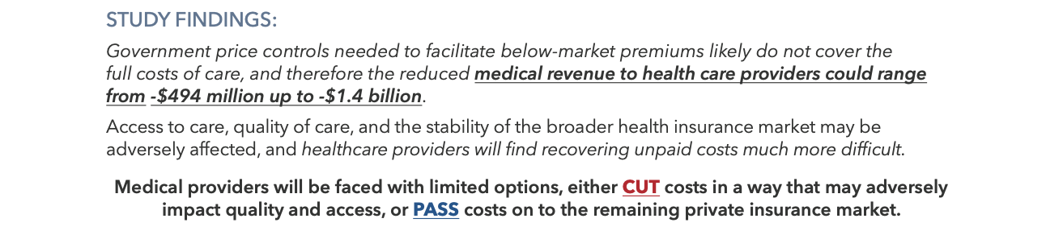
September 2019 Study -Economic Impacts
Notes:
It depends. Administration has suggested they can thread the needle with a pricing formula, and pay just enough so that hospitals can stay in business, but not so much that they can generate a high margin. Now, I may just

Slide 12
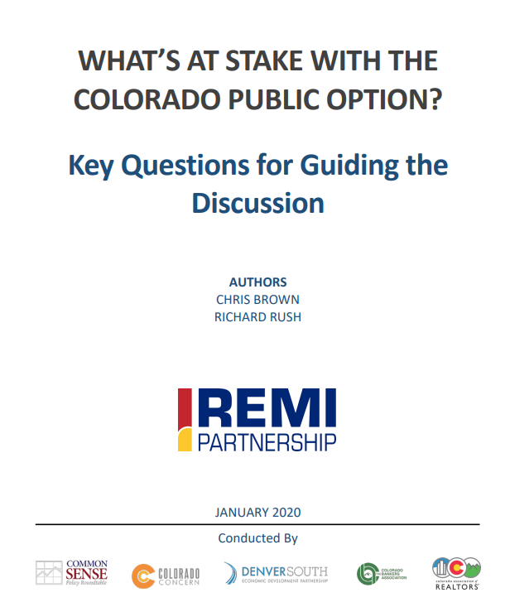




CSPR Recent Research
Hospitals
Insurance Carriers
Employers
Insured Patients and Uninsured Patients
Notes:
For example, questions we have posed?
­­HOSPITALS
Reduced expansion and less profitable services
Cost shift to less-regulated payors and markets
Diversification into less regulated ventures
Departures or closures in rural areas
EMPLOYERS
Cancellation of employer-sponsored insurance plans, forcing employees into lower-cost public option plans
· Employers passing on higher group costs through higher employee contribution requirements and/or reduced benefits
CARRIERS
· Departure from fully insured programs
· Departure from Colorado
· Fewer services and/or increased pricing to other services
INSUREDS/PATIENTS
Increased premiums and/or contribution requirements
Fewer carrier choices
Limited networks and/or access to services
Displacement from employer-sponsored coverage to individual market

Slide 13
Questions

Slide 14
w
For more information or the latest research please visit:
www.CommonSensePolicyRoundtable.org

