Slide 1
ALL IN ON THE SESQUISEMIQUIN

Slide 2
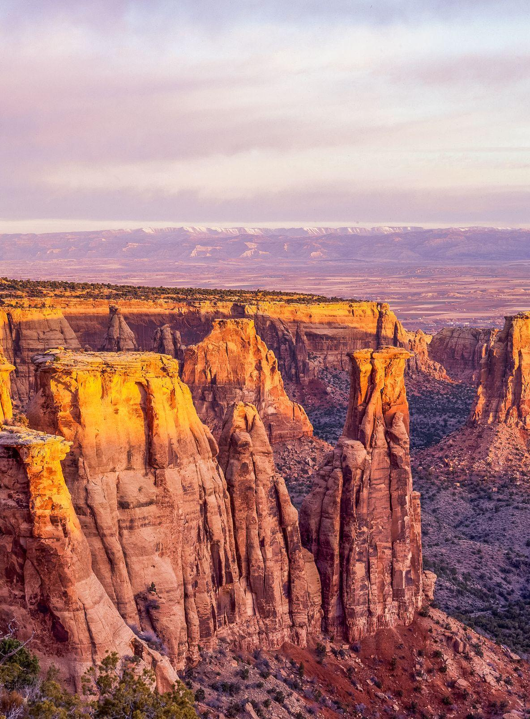
Say it because you can:
Semiquincentennial.
Sesquicentennial.
Sesquisemiquincentennial.
In 2026, America will celebrate the 250th anniversary of the Declaration of Independence—our Semiquincentennial.
At the same time, Colorado will celebrate our 150th anniversary of entering the Union—our Sesquicentennial.
Together they make a commemoration like none other in the nation—Colorado’s Sesquisemiquincentennial.
You’re part of something big.
Colorado 150 | America 250
John Fielder, Colorado National Monument 4
History Colorado, 2023.1.295

Slide 3
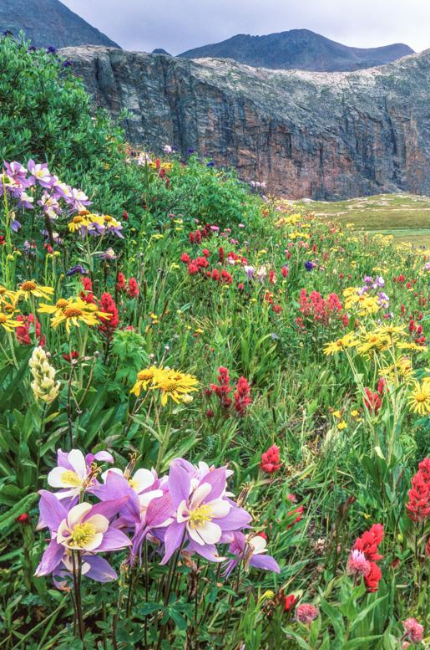
WHAT IS THE SESQUISEMIQUIN?
AN OPPORTUNITY
The America 250 - Colorado 150 Commission is committed to recognizing that our shared history includes the experiences of all who have called Colorado home, and that Colorado’s story does not end at our state borders but is part of the broader American story.
Starting in the fall of 2025 and throughout 2026, Colorado’s Sesquisemiquincentennial will be an opportunity for every Coloradan to come together as we:
Celebrate Colorado by acknowledging our complete history
Honor what makes Colorado unique
Embrace our shared destiny as we strive toward a more perfect union.
John Fielder, Colorado Trail Columbines
History Colorado, USE.259.12

Slide 4
Colorado’s commission
“Identify, celebrate, and build knowledge around the history of Black communities, Indigenous communities, communities of color, women, and people with disabilities in the history and development of the United States and the State of Colorado, including the history that predates the founding of both nation and state.”
Created by legislation with bipartisan support in 2022
Expanded by additional legislation in 2023
Housed at History Colorado
Statewide community engagement and outreach underway
Developing statewide signature programs
Projected budget: $17-20 million
From SB2022-011

Slide 5
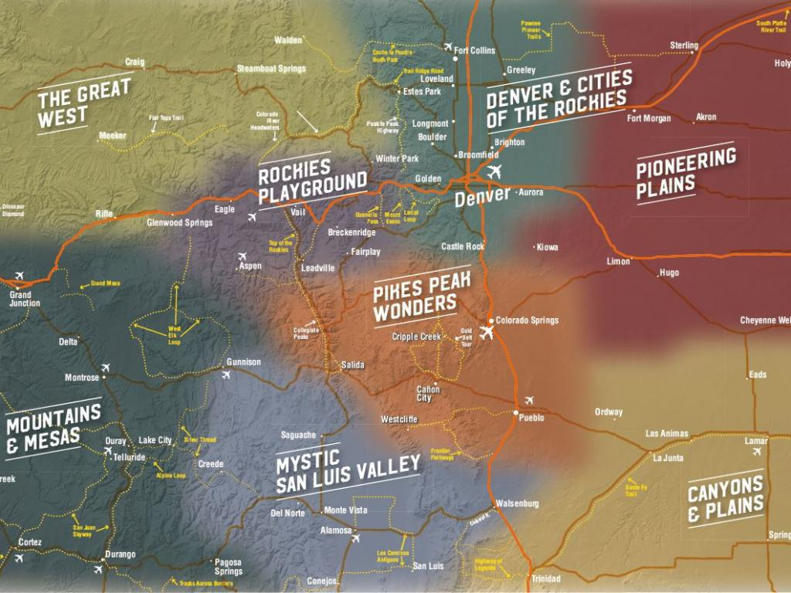
Advisory panel
The Commission’s work is complemented by Advisory Panel members who represent the 8 regions of Colorado.
Advisory Panel representatives throughout Colorado are forming Local Organizing Committees
Communities are identifying ways to participate in the commemoration

Slide 6
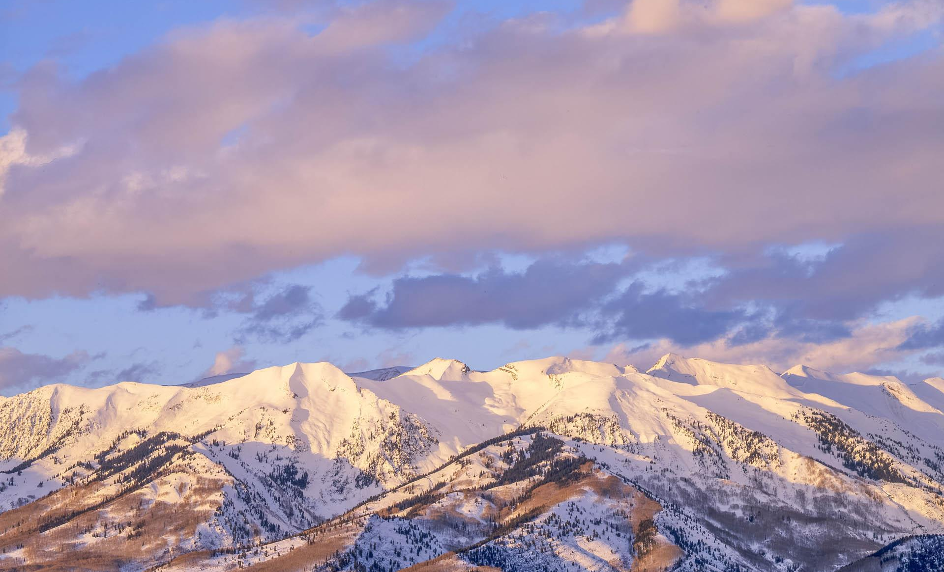
COLORADO 150 | AMERICA 250
Signature initiatives
John Fielder, Snowy Mountain Range in Kebler Pass
History Colorado, 2023.1.190
Notes:
This is a divider slide.

Slide 7
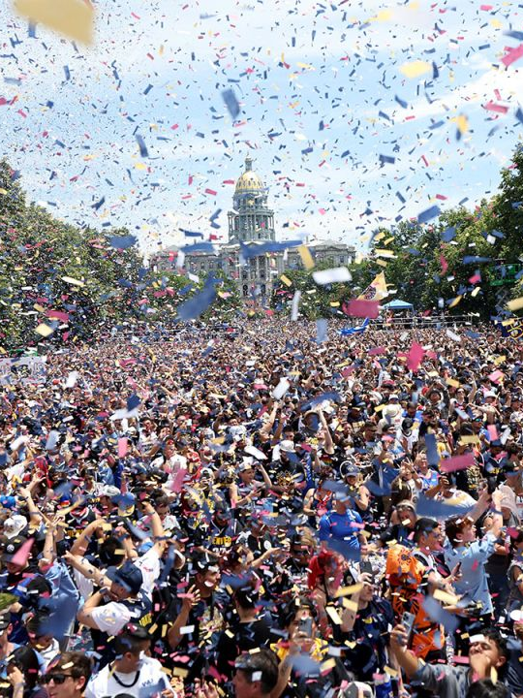
SIGNATURE INITIATIVES: ENGAGE
CREATING MEMORABLE
EXPERIENCES
Celebrate Colorado Together
Throughout the Sesquisemiquincentennial, the Commission will create and support opportunities for communities to come together, celebrate, and experience something new:
4th of July celebrations
Flyovers and air shows
Fireworks and drone shows
Festivals and concerts
Special events at the State Fair
The largest Celebrate Colorado week ever
And more!
Denver Nuggets 2023 Championship Parade
credit: Jerilee Bennett, The Gazette

Slide 8
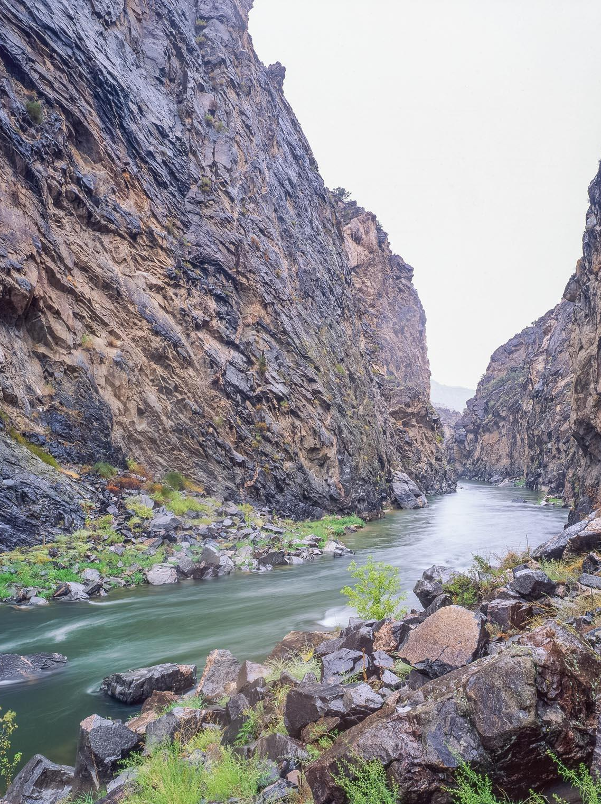
SIGNATURE INITIATIVES: ENGAGE
CREATING MEMORABLE
EXPERIENCES
Destination: Colorado
A statewide passport program will encourage Coloradans of all ages to explore the Centennial State in 2026 and beyond.
The program will encourage families and young people to experience Colorado and encounter our shared history, diverse communities, and unique geography in every part of our state.
John Fielder, Gunnison River in the Gunnison Gorge Wilderness
History Colorado, 2023.1.526

Slide 9
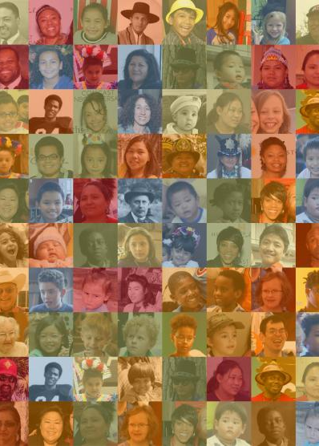
SIGNATURE INITIATIVES: ENGAGE
CREATING MEMORABLE
EXPERIENCES
We Are Colorado
A statewide storytelling initiative will create a portrait of Colorado at 150 by inviting Coloradans to share their stories and those of their communities.
John Fielder, Gunnison River in the Gunnison Gorge Wilderness
History Colorado, 2023.1.526
Credit: History Colorado

Slide 10
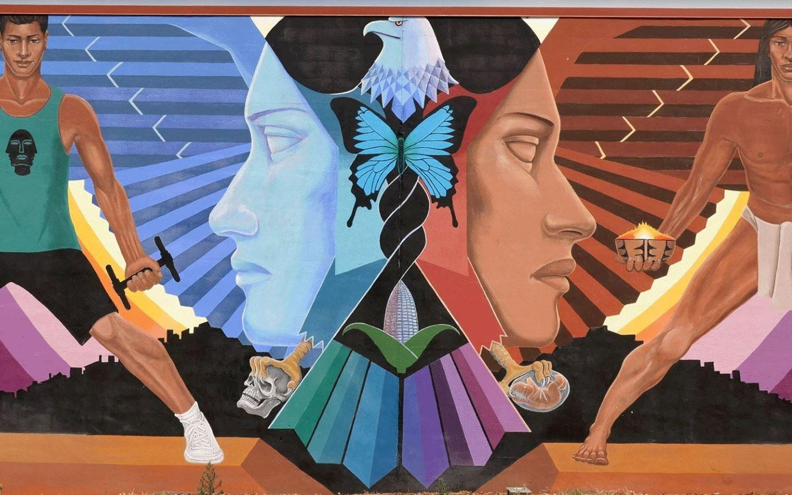
SIGNATURE INITIATIVES: ENGAGE
CREATING MEMORABLE
EXPERIENCES
Welcome to Colorful Colorado
New public art pieces commemorating the Sesquisemiquincentennial throughout the state will create moments of education and delight. Long after 2026, these expressions of our Colorado spirit will remain iconic touchstones for future generations.
Emmanuel Martinez, La Alma (detail)
Credit: History Colorado

Slide 11
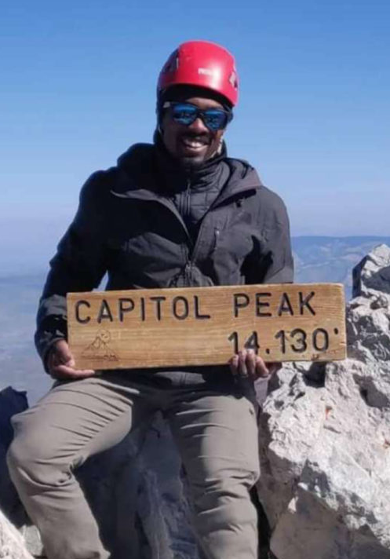
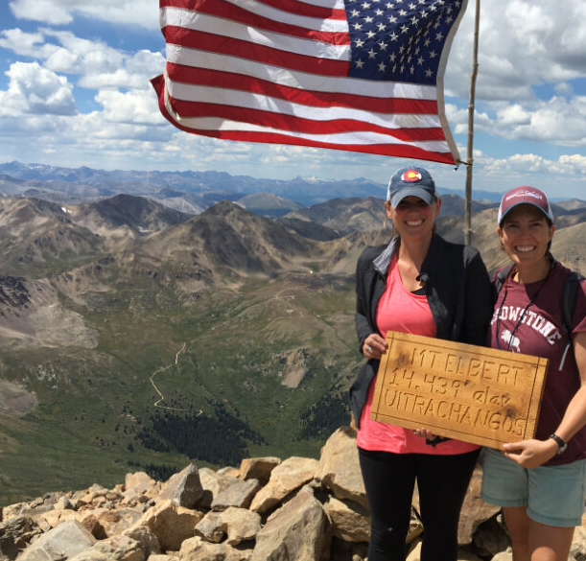
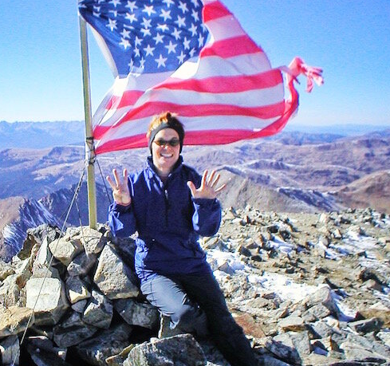
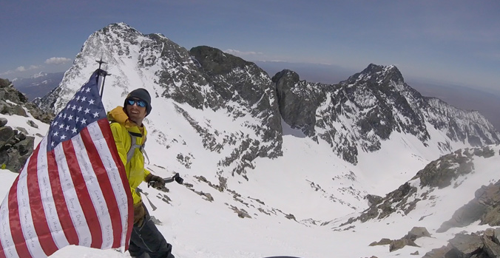
SIGNATURE INITIATIVES: ENGAGE
CREATING MEMORABLE
EXPERIENCES
Commemoration: Colorado Style
Carrying forward a tradition begun with the Bicentennial— and celebrating like no other state can—teams of Coloradan climbers will summit each of the state’s Fourteeners on Independence Day 2026.
Clockwise: Evan Gill on Capitol Peak (5280); Summiting Mt Elbert (Colorado Hikes and Hops); Sarah, aka Miss Adventure Pants, on Greys Peak (missadventurepants.com) ; Josh Jeperson honoring Navy SEALS on Ellingwood Point (Backcountry Magazine)
John Fielder, Gunnison River in the Gunnison Gorge Wilderness
History Colorado, 2023.1.526

Slide 12
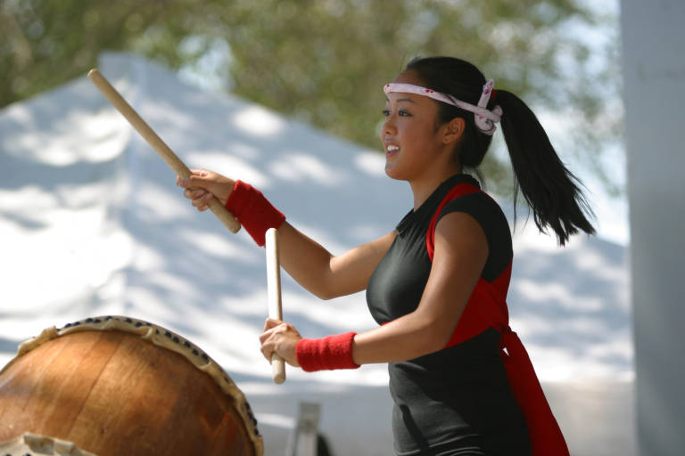
SIGNATURE INITIATIVES: EDUCATE
COMMEMORATING
OUR sHARED HISTORY
COauthoring the Stories of US
Colorado’s museums and cultural institutions will create exhibitions and programs that invite us to reflect on our shared history and our role in America’s story.
From new museums to groundbreaking major exhibitions to traveling and digital exhibitions accessible to all Coloradans, the state’s vibrant cultural sector will offer us new perspectives on how we got to now and what we want our shared future to be.
A member of Mirai Daiko, a four-woman Japanese drum group, performs at the 2004 Colorado Dragon Boat Festival. Credit: Rocky Mountain News, via Denver Public Library, RMN-025-5988

Slide 13
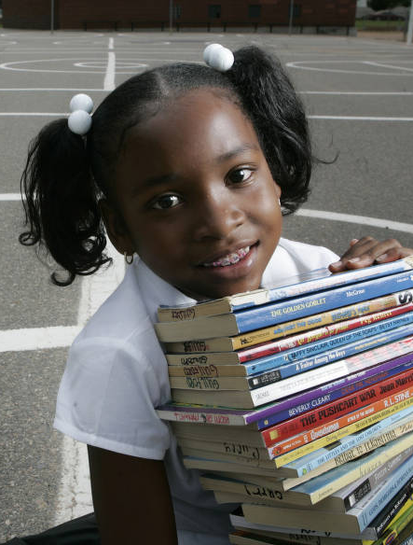
SIGNATURE INITIATIVES: EDUCATE
COMMEMORATING
OUR sHARED HISTORY
Supporting Colorado’s Students
The Sesquisemiquincentennial is focused on preparing for Colorado’s future as much as it is about commemorating our past. The Commission will support the creation of classroom instructional materials to teach American history and the role Colorado has placed in our nation’s story.
Students at institutions of higher learning will have opportunities for professional development by helping to organize the Sesquisemiquincentennial effort.
Shelby Anderson, 5th grader at Maxwell Elementary in Denver. Credit: Ellen Jaskol, Rocky Mountain News, Aug 10, 2005, via Denver Public Library, RMN-025-4208

Slide 14
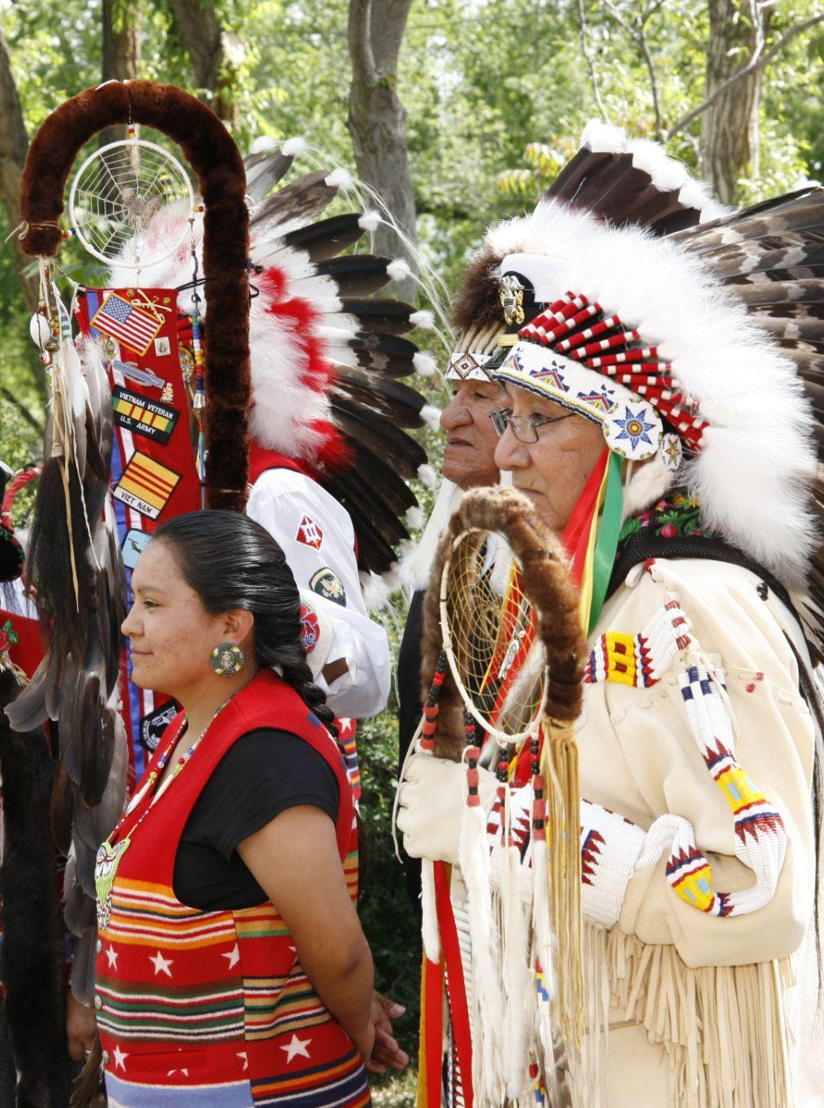
SIGNATURE INITIATIVES: EDUCATE
COMMEMORATING
OUR sHARED HISTORY
Scholarado:
Generating New Knowledge
The Commission will support the creation of new scholarship exploring Colorado’s complete history across a variety of formats, from new books and scholarly articles to entries in the Colorado Encyclopedia and writing prizes for emerging historians.
At the grand reopening of the Ute Indian Museum in Montrose in 2018. History Colorado

Slide 15
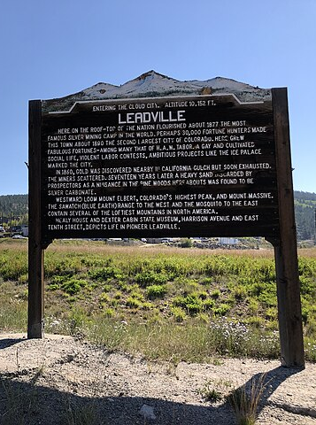
SIGNATURE INITIATIVES: EDUCATE
COMMEMORATING
OUR sHARED HISTORY
History Where It Happened
History is best appreciated where it was made. Commission programs will invest in expanding the inclusive story of Colorado by updating existing and adding new roadside markers and historical signage throughout the state.
Historical Markers along Highway 24 in Leadville
Credit: Famartin, via Wikicommons

Slide 16
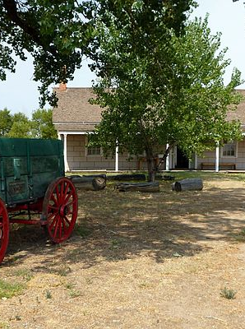
SIGNATURE INITIATIVES: EDUCATE
COMMEMORATING
OUR sHARED HISTORY
Colorado Heritage for All
Currently, fewer than 4% of the sites listed on Colorado’s State Register of Historic Properties represent the stories of Colorado’s Black, Indigenous, Latino/a, Chicano/a, Asian American, women, and LGBTQ+ communities. The Colorado Heritage for All initiative will increase representation on the Colorado Register of Historic Properties by adding 150 new sites that preserve and spotlight these underrepresented histories.
Shelby Anderson, 5th grader at Maxwell Elementary in Denver. Credit: Ellen Jaskol, Rocky Mountain News, Aug 10, 2005, via Denver Public Library, RMN-025-4208
Boggsville
Credit: ERoss99, via Creative Commons

Slide 17
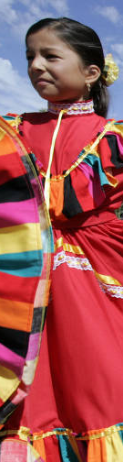
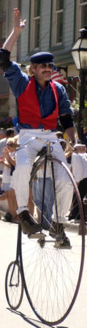
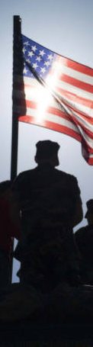
SIGNATURE INITIATIVES: UNITE
SUPPORTING
COLORADO cOMMUNITIES
A Sesquisemiquin For Everyone
The Commission will support local communities in a variety of ways as Coloradans create moments of unity and lasting impacts throughout the Sesquisemiquincentennial.
The Commission aims to offer grants to support commemorations and celebrations hosted by communities throughout Colorado.
Pauline Villa Senior dances in Lafayette’s Labor Day Parade in 2002, credit: Judy DeHass, Rocky Mountain News via Denver Public Library, RMN-042-2199; Fourth of July Parade in Georgetown in 2005, credit: Maria J. Avila, Rocky Mountain News via Denver Public Library, RMN-025-1269; Members of the Aurora, Colorado, Mile High Young Marines stand atop a float with an American flag in 2007, credit: Andy Piper, Rocky Mountain News via Denver Public Library, RMN-038-5582.

Slide 18
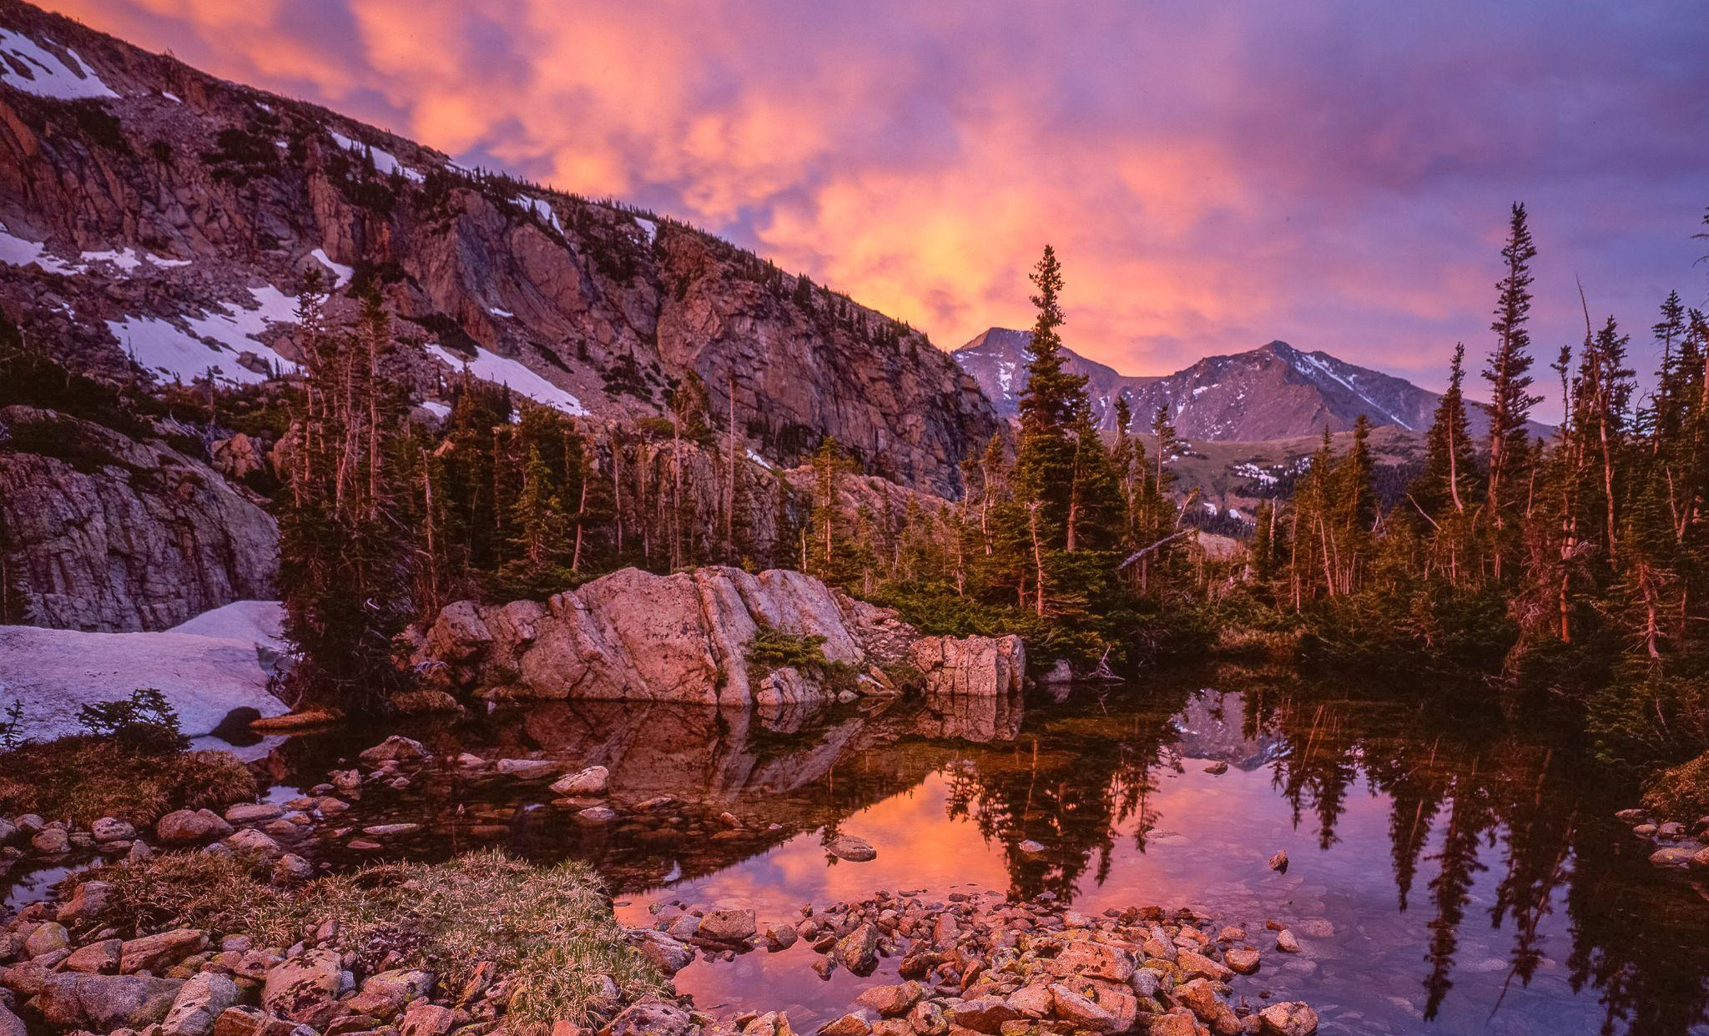
COLORADO 150 | AMERICA 250
Get involved in the
sesquisemiquin
John Fielder
History Colorado, 2023.1.2078
Notes:
This is a divider slide.

Slide 19
Get involved
A Sesquisemiquin for all of Colorado
Support local efforts:
Join regional Advisory Panel members and Local Organizing Committees as they plan for 2026
Contact your regional representatives on am250co150.org
Showcase your event:
Post your event to the statewide calendar
The calendar is available for all events in Colorado
Submit your event on am250co150.org
Use the 250-150 logo:
Use the logo to highlight your Sesquisemiquin events and programs
The logo is free to use and can be downloaded on am250co150.org
You’re Part of Something Big.

Slide 20


Building a
Better Colorado
Dedicating Lasting Legacies
Dedicated in honor of Colorado’s Sesquisemiquincentennial
Is your city investing in building a better Colorado?
A new rec center
A community park
A city bridge
Soccer fields
New trails
Community improvement projects
Make it part of the Sesquisemiquin commemoration. We’d love to hear about it!
Contact the Commission to learn about plaque templates for your community projects.
2026
For illustration only

Slide 21

Wear it with pride
am250co150.org
am250co150.org has everything you need to get the perfect Sesquisemiquin look and show out with your Colorado pride.
Proceeds will support a community grant program to ensure that every Colorado community can participate in the Sesquisemiquin.

Slide 22

Be a part of Making it Happen
Show Your Colorado Pride by Becoming a Supporter
Sponsorship opportunities are available at a variety of levels
To learn more about how you can help make it happen, please contact us today
Sponsor contact: Amy Slothower amy@causeeffectadvisory.com
Visit us at am250co150.org

Slide 23
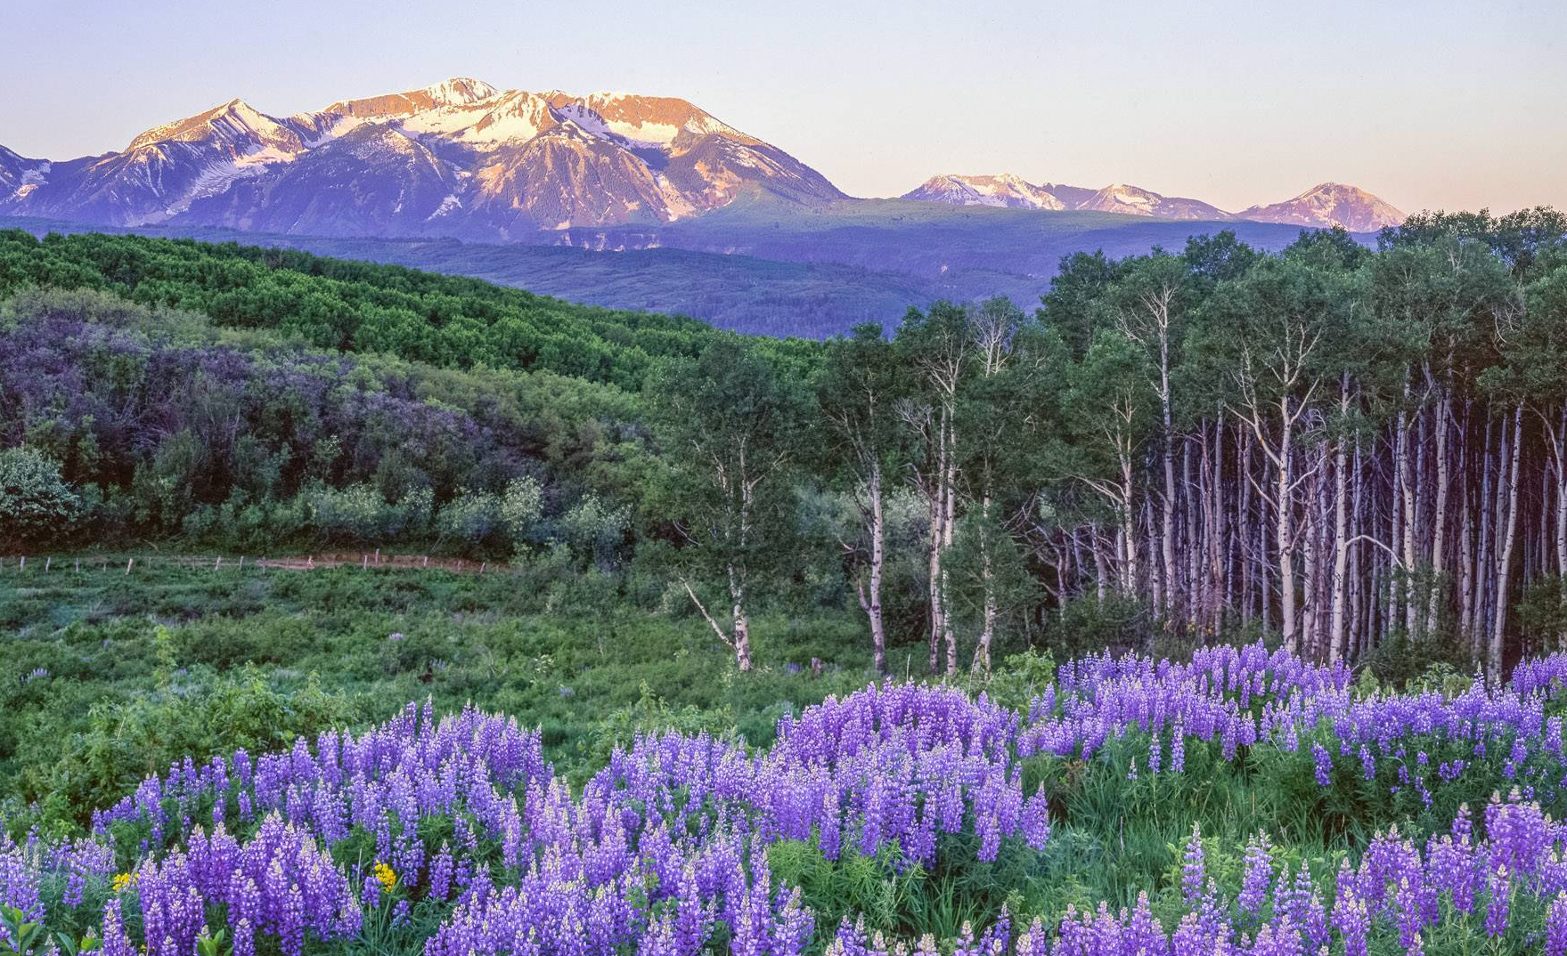
COLORADO 150 | AMERICA 250
Be Part of Something Big
Am250co150.org
John Fielder, Lupines in Mt Gunnison near Kebler Pass 2
History Colorado, 2023.1.196

