Slide 1
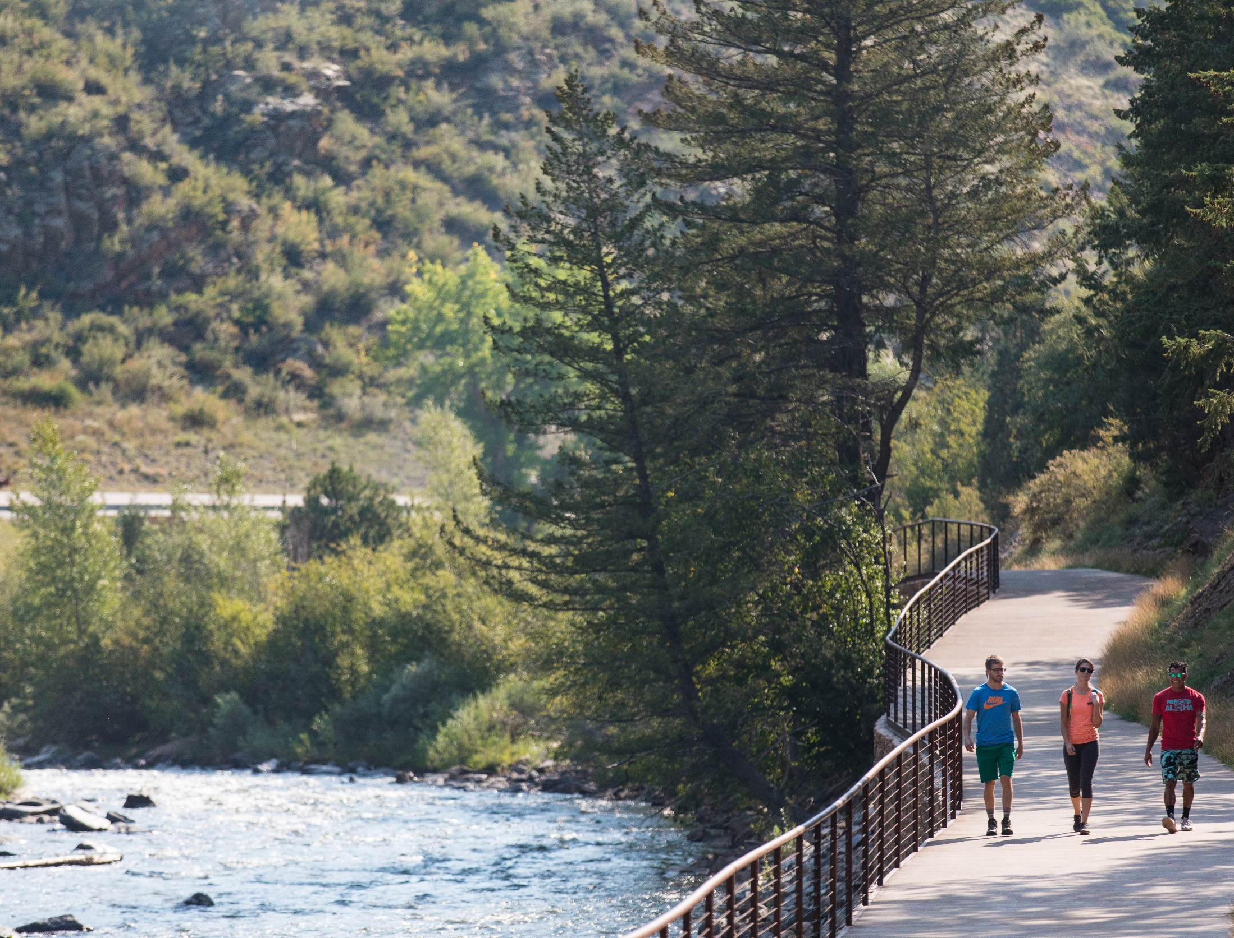

Laura Cardon
Communications Coordinator
Amanda Hill
Open Space Program Coordinator

Slide 2
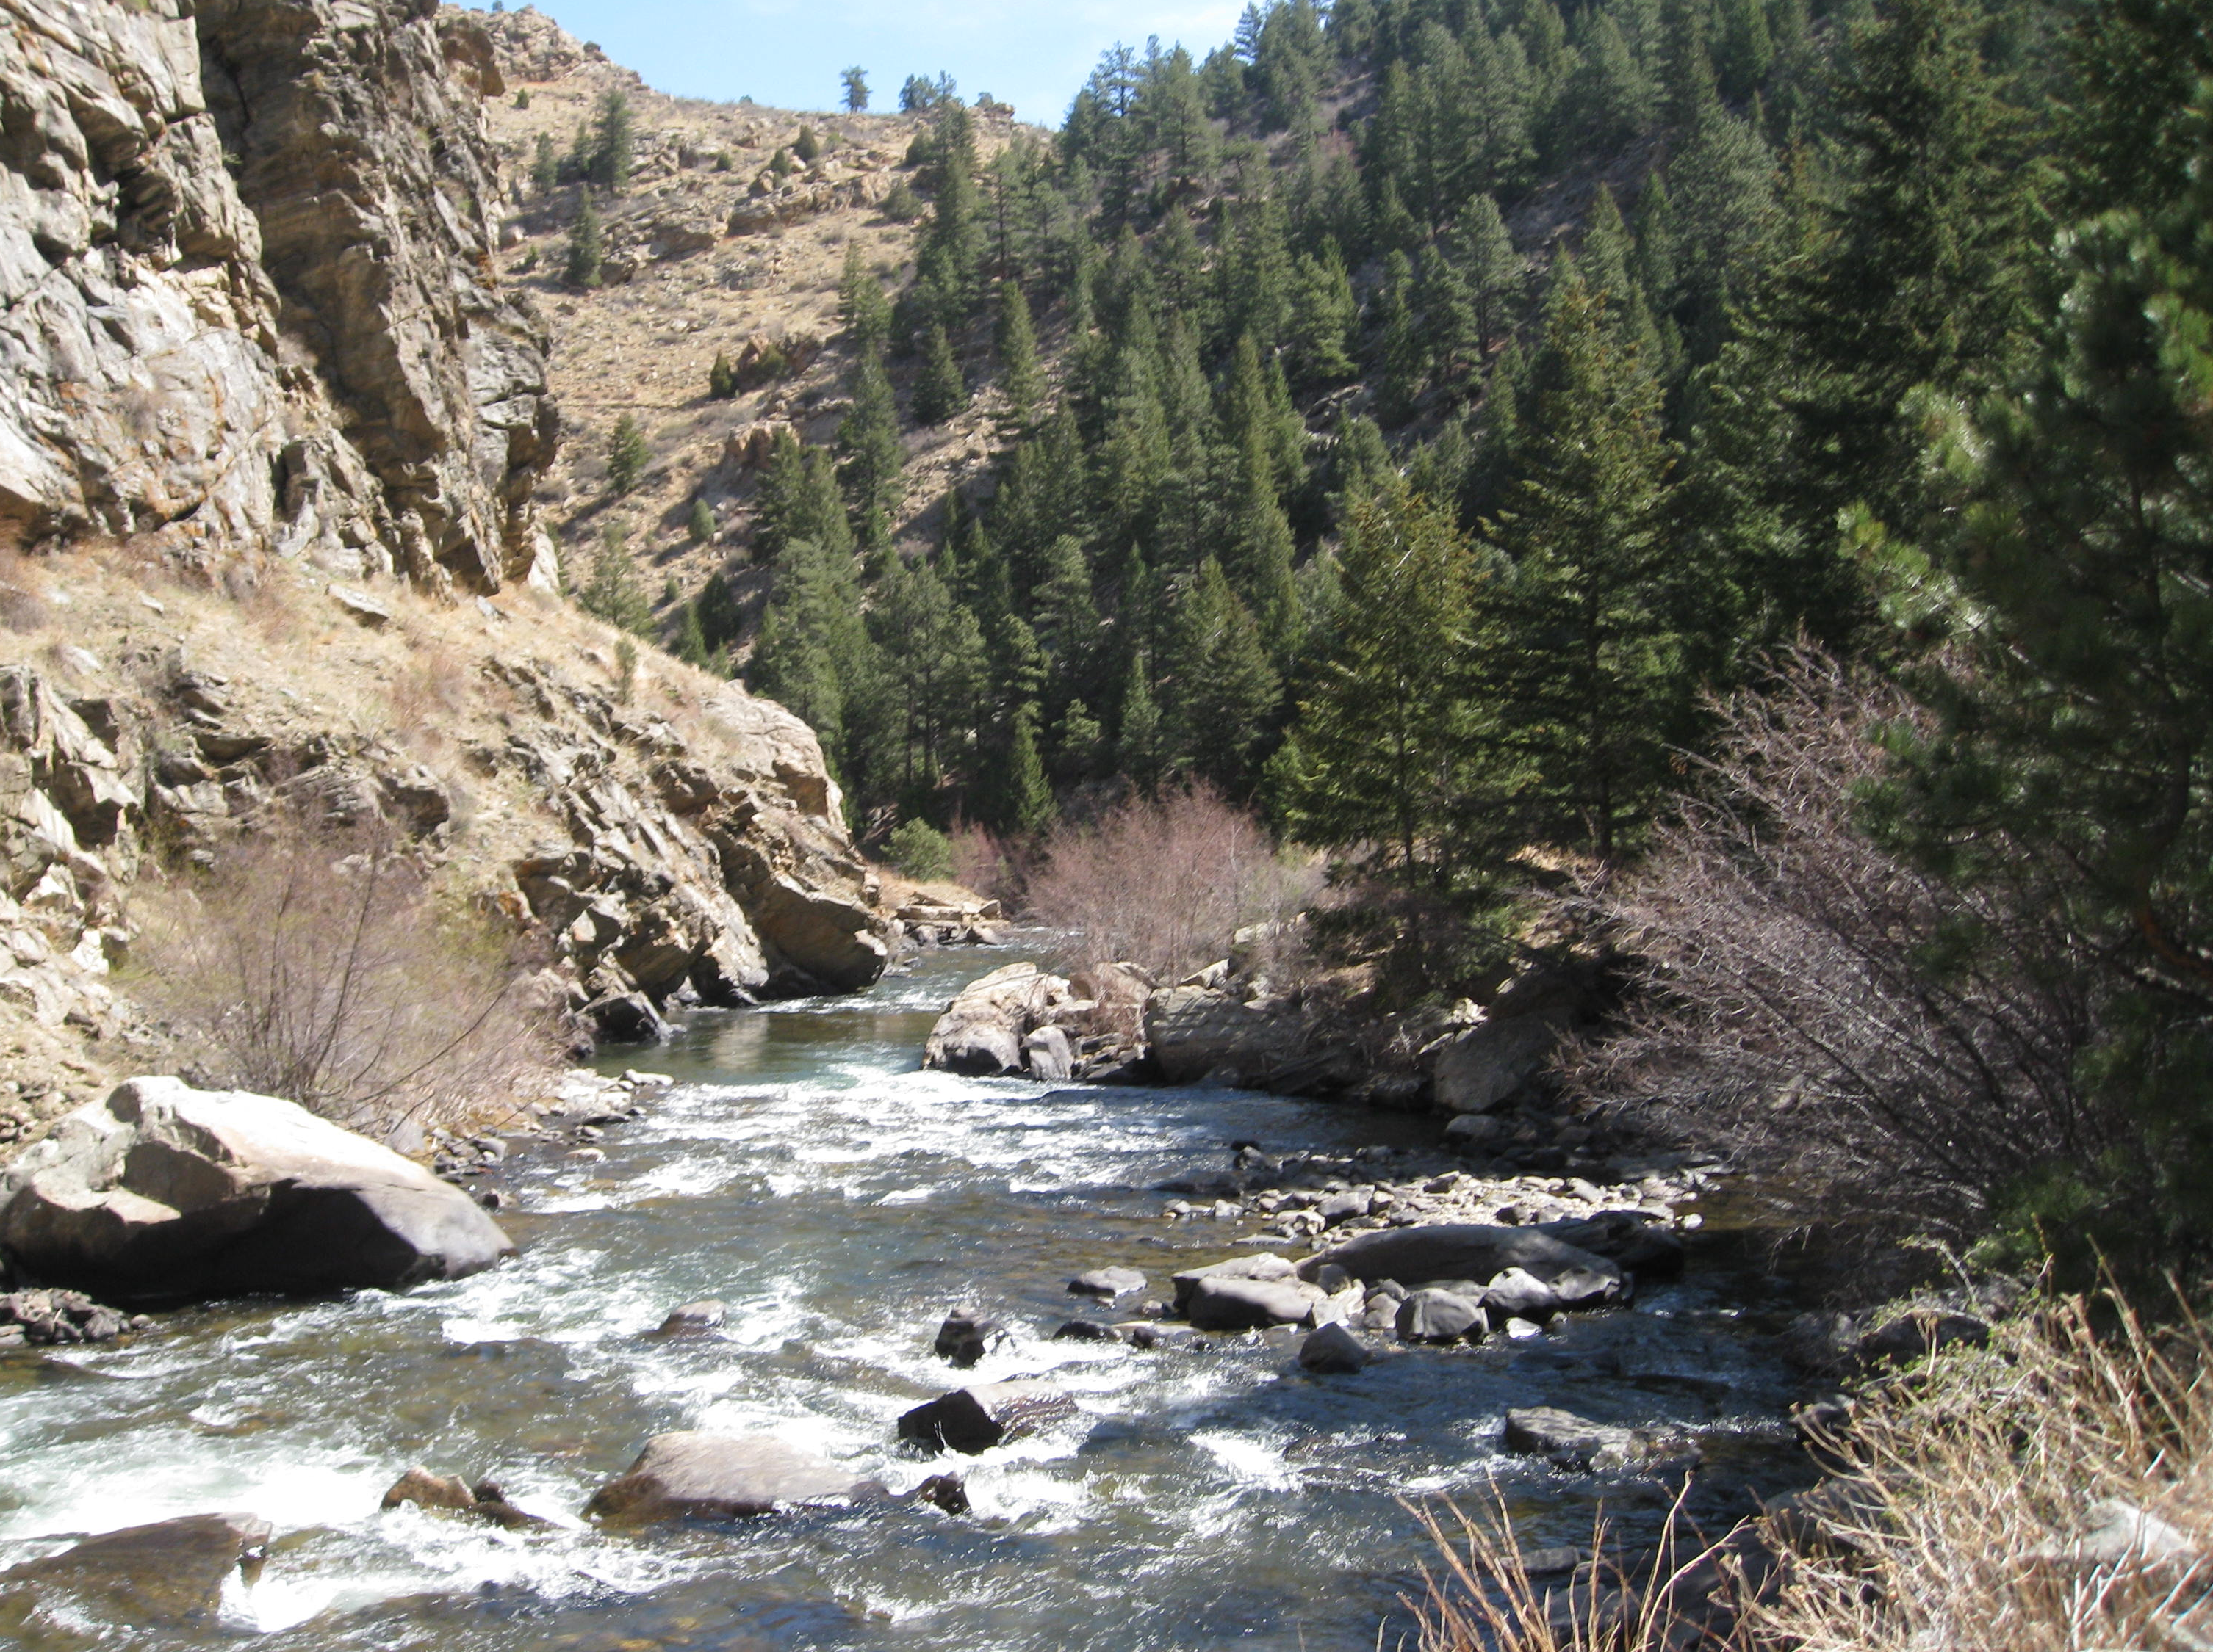
GOCO’s History
Created in 1992 by a Constitutional Amendment
17 member, independent board appointed by the governor
Clear Creek Canyon, Idaho Springs
Notes:
GOCO was born out of a desire from Coloradans to protect the very things that makes Colorado an amazing place to live, work and play -
Our rivers, trails, parks, open spaces, and wildlife.
Citizens passed a ballot initiative in 1992 with overwhelming support, creating an organization charged with leveraging funding and integrating agencies and non-profits to accomplish projects across the state for our citizens to enjoy from our backyards to the back country

Slide 3
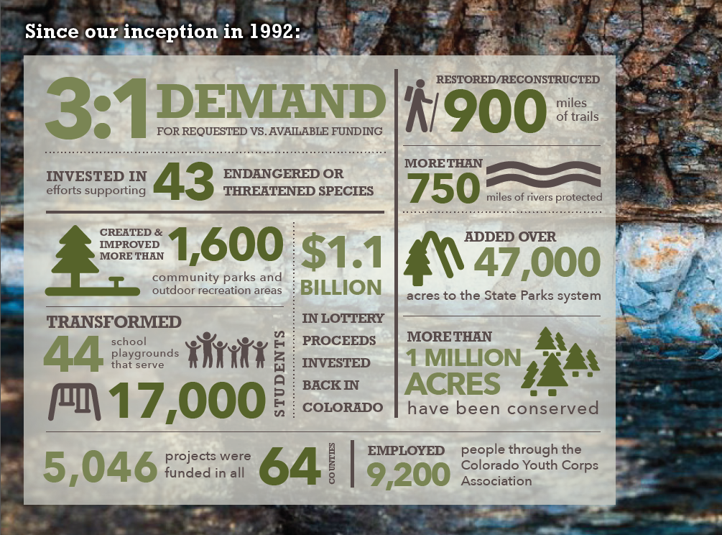
Trinidad Lake State Park, Trinidad
Notes:
Since 1992, GOCO has a remarkable impact on the state. We’ve invested more than $1 billion to build trails, improve parks, give schools new playgrounds, protect wildlife, and conserve what makes our state unique.

Slide 4
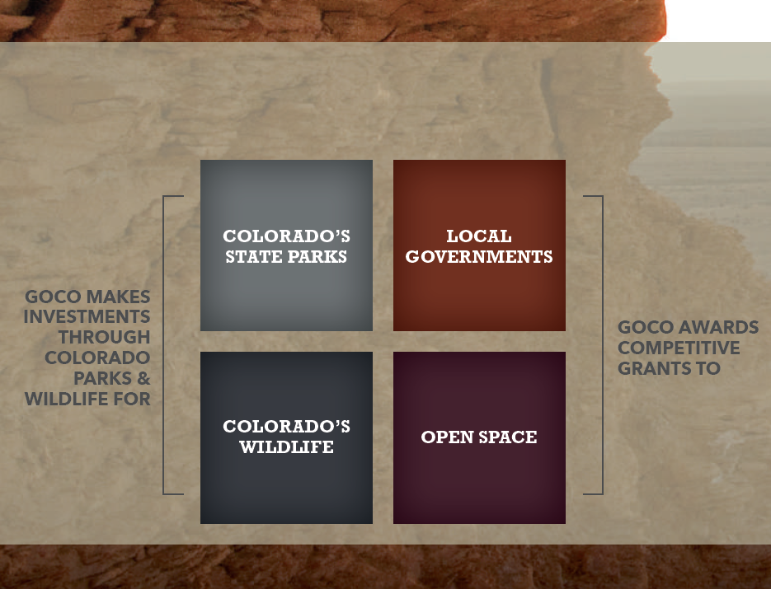
Substantially Equal
Apishapa Ranch, Otero County
Notes:
We are charged with funding four areas in substantially equal amounts over time:
Through investments in Colorado Parks and Wildlife
And through competitive grants for parks, trails, outdoor recreation and land conservation.

Slide 5
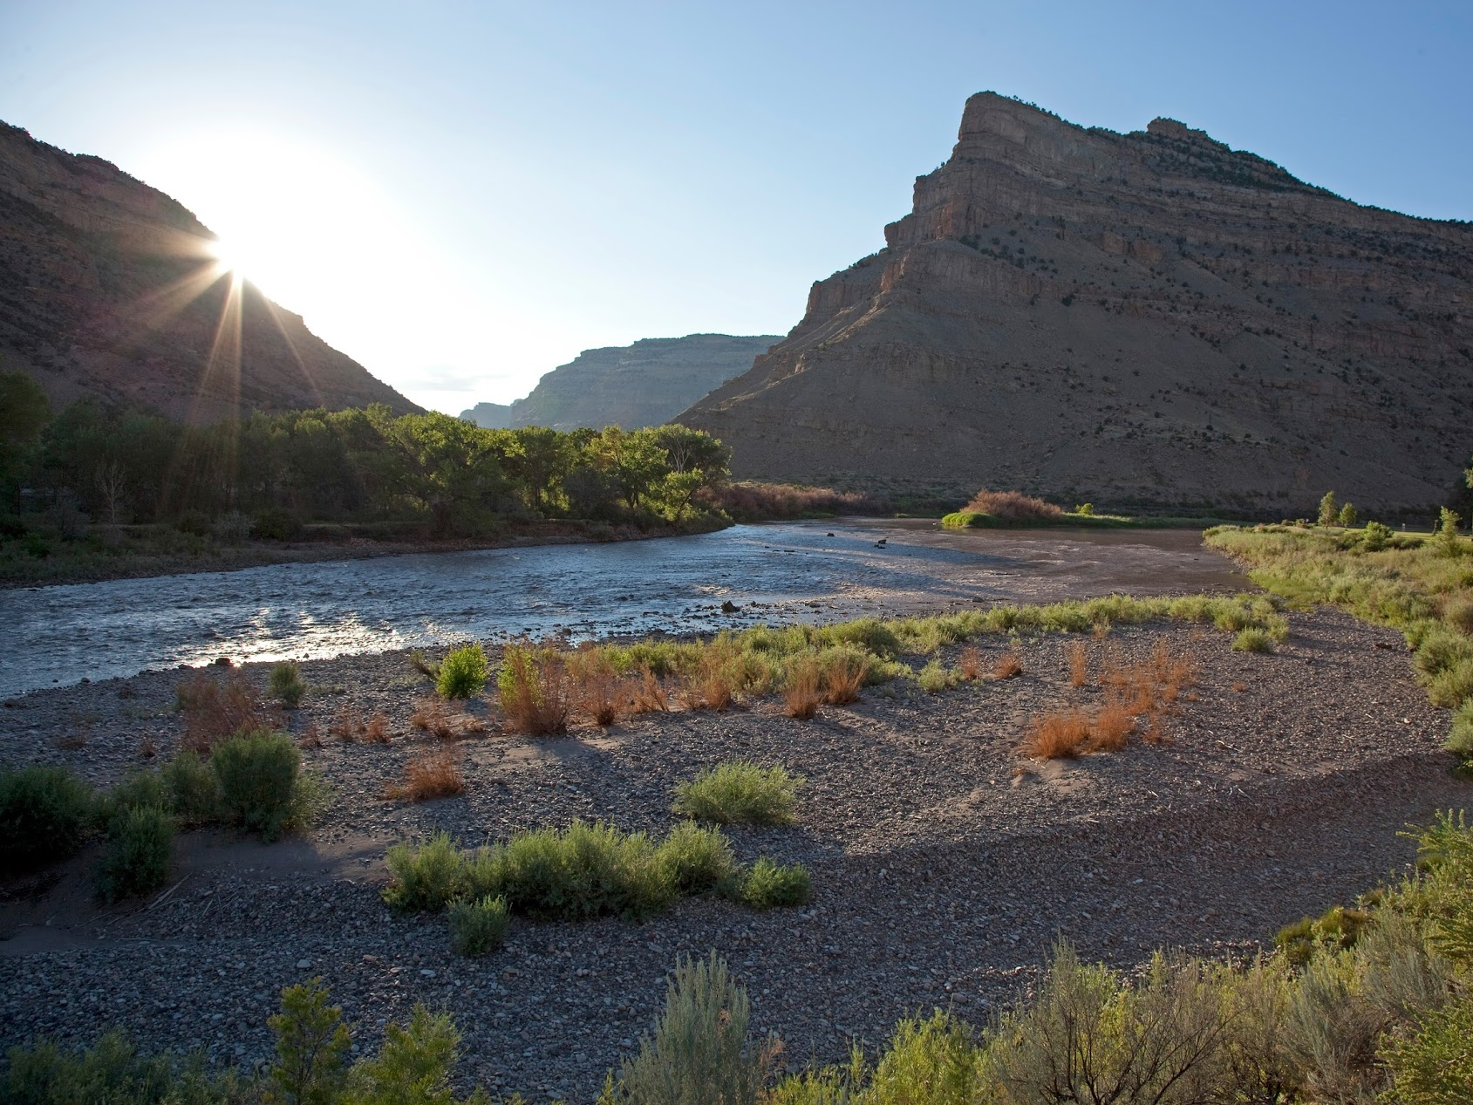
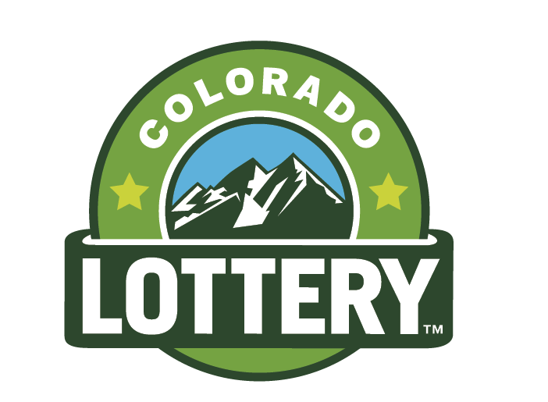
How GOCO Is Funded
Up to 50% of Colorado Lottery net proceeds
Capped at $64.4M for FY17
No tax dollars
James M Robb Colorado River State Park, Palisade
Notes:
Colorado is the only state where Lottery proceeds are specifically earmarked for the outdoors.
If you can all prove that your 18 or at least promise not to report me to the authorities for corrupting minors, I have some scratch off tickets for you all.
Even if you don’t win anything, you are contributing to the more than $60 million that GOCO receives every year from the Lottery. That means we’ve done all of this work with no taxpayer money.

Slide 6
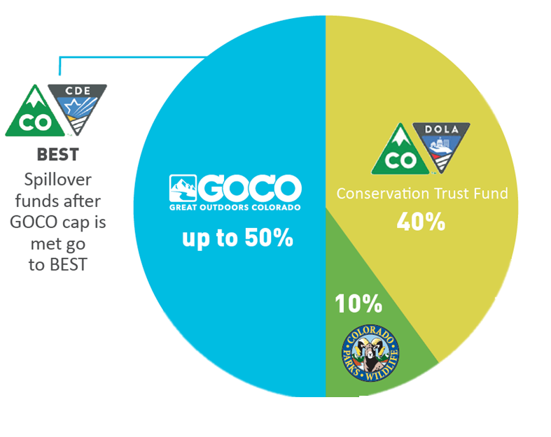
Lottery Beneficiaries
Notes:
Colorado is the only state where Lottery proceeds are specifically earmarked for the outdoors.
If you can all prove that your 18 or at least promise not to report me to the authorities for corrupting minors, I have some scratch off tickets for you all.
Even if you don’t win anything, you are contributing to the more than $60 million that GOCO receives every year from the Lottery. That means we’ve done all of this work with no taxpayer money.

Slide 7
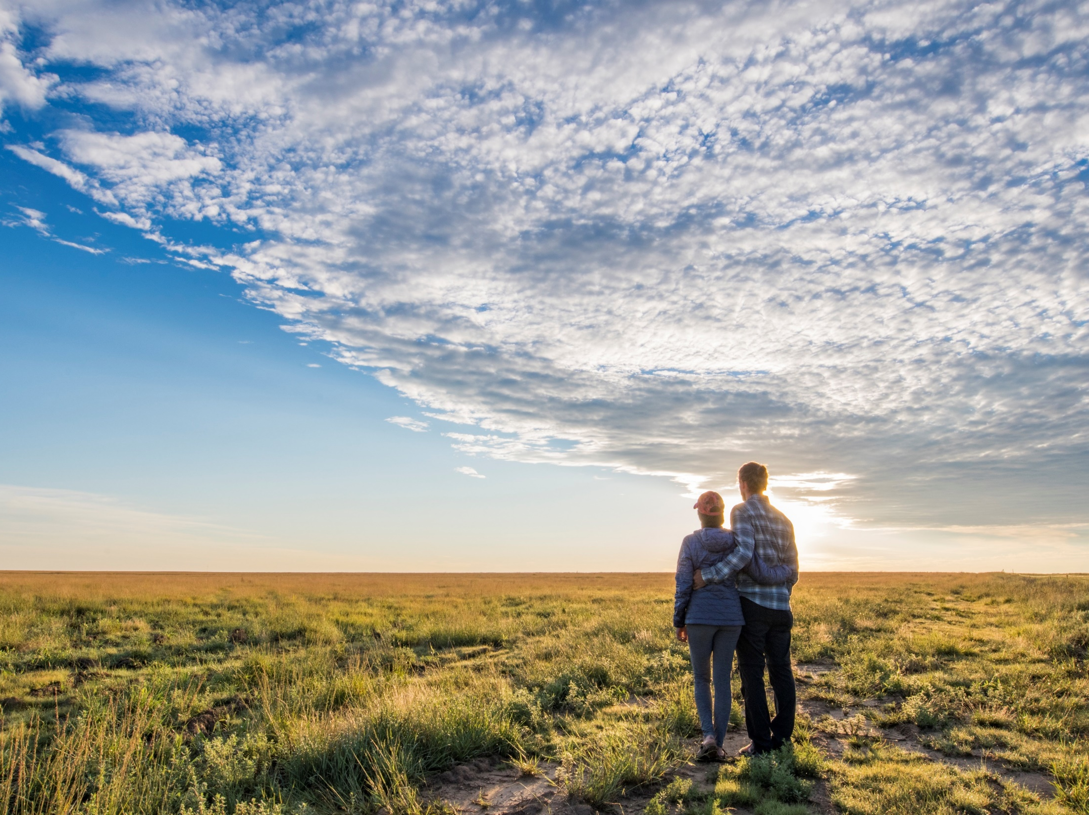
Lottery Reauthorization
Lottery is set to sunset 2024
Legislature will consider a bill in 2018 session
Lamar, Colorado
Notes:
Colorado is the only state where Lottery proceeds are specifically earmarked for the outdoors.
If you can all prove that your 18 or at least promise not to report me to the authorities for corrupting minors, I have some scratch off tickets for you all.
Even if you don’t win anything, you are contributing to the more than $60 million that GOCO receives every year from the Lottery. That means we’ve done all of this work with no taxpayer money.

Slide 8
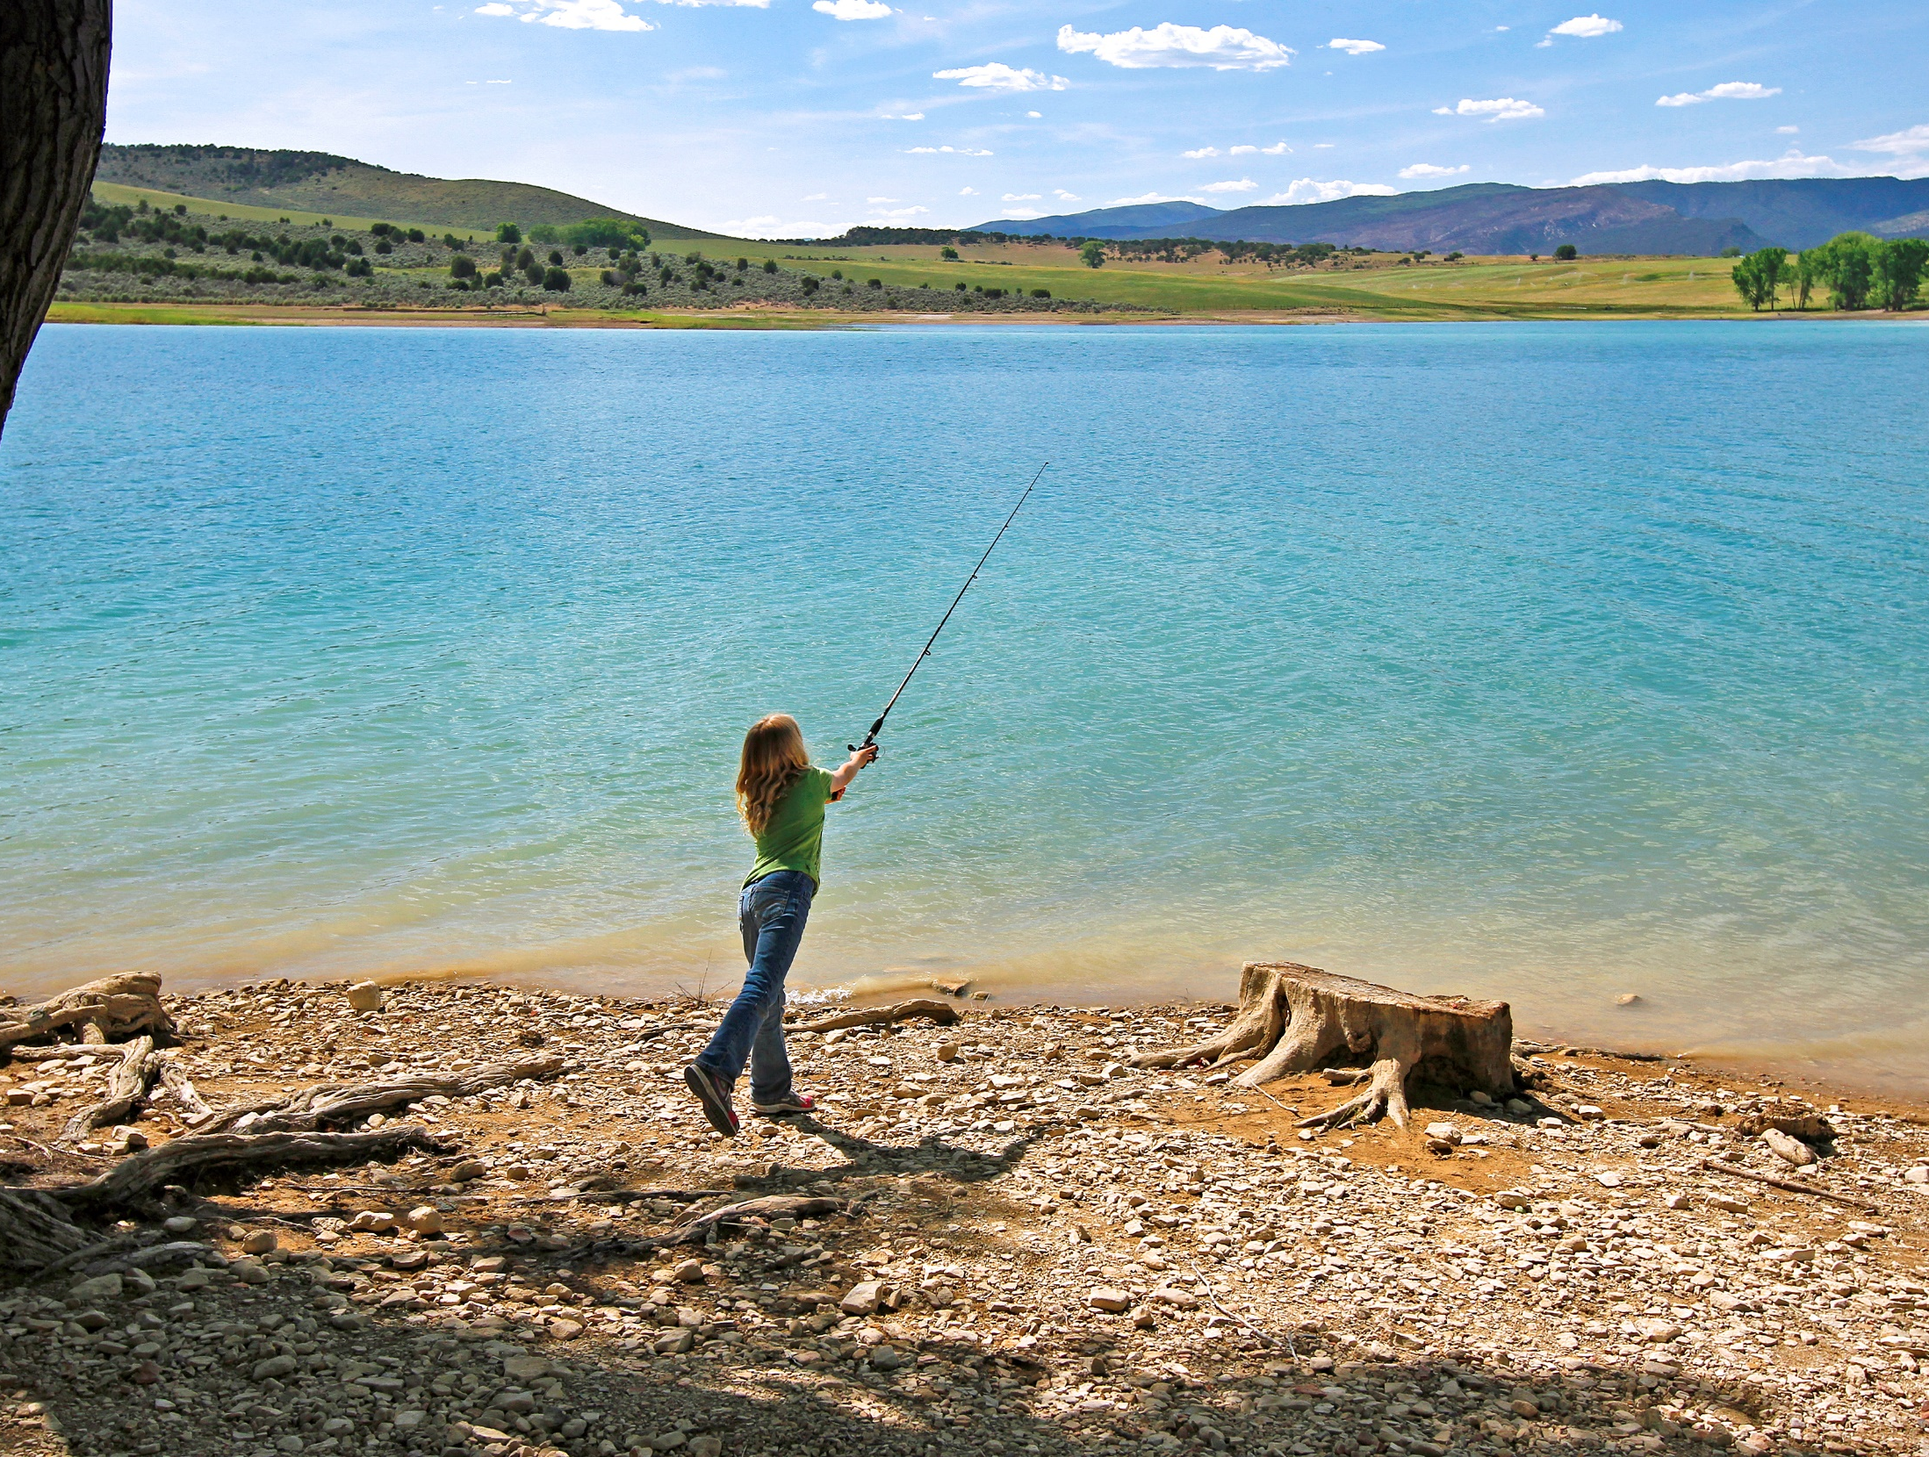
Keep It Colorado Coalition
Collecting resolutions and letters of support
Amanda Hill
ahill@goco.org
Geoff Wilson
gwilson@mdkrlaw.com
Lamar, Colorado

Slide 9
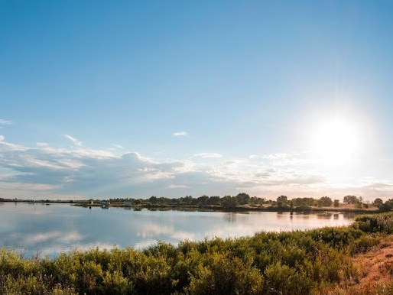
Impact in Northeast Colorado
$211 million across Pro 15 counties
195,000 + acres protected
$349 million in local funding leveraged
880 projects
Willow Bay Protect Initiative Project, Brighton
Notes:
Locally, GOCO has invested more than $211 million in the 15 counties that make up this organization.
That funding has gone to nearly 1,000 projects, including Brighton’s acquisition of a 174-acre property, pictured here, for new public recreation. Other funded projects include Estes Park’s popular Hermit Park and Open Space, Greeley’s new universally accessible playground, Cheyenne County’s fairgrounds, Elizabeth’s trail system, Stratton’s town park, Peetz’s school playground, Fort Morgan’s Riverside Park, and more.
Denver is also home to several coalitions in the Westwood, Cole, North Park Hill, and Montbello neighborhoods funded by GOCO’s Inspire Iniatiative to get kids outside more often in underserved areas of the city.

Slide 10




Slide 11





Notes:
Digital display ads also build awareness and drive action. Reached 2.1M in first three weeks.

Slide 12
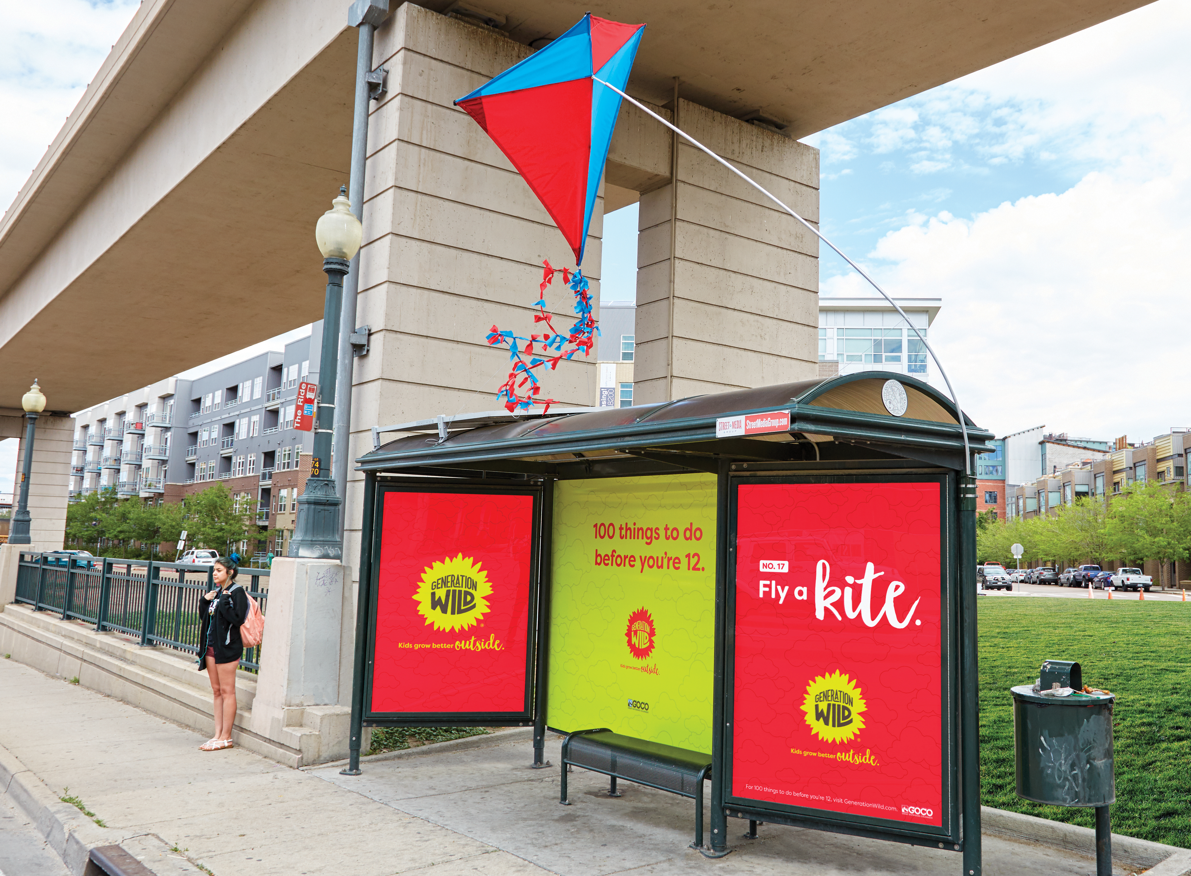

Slide 13
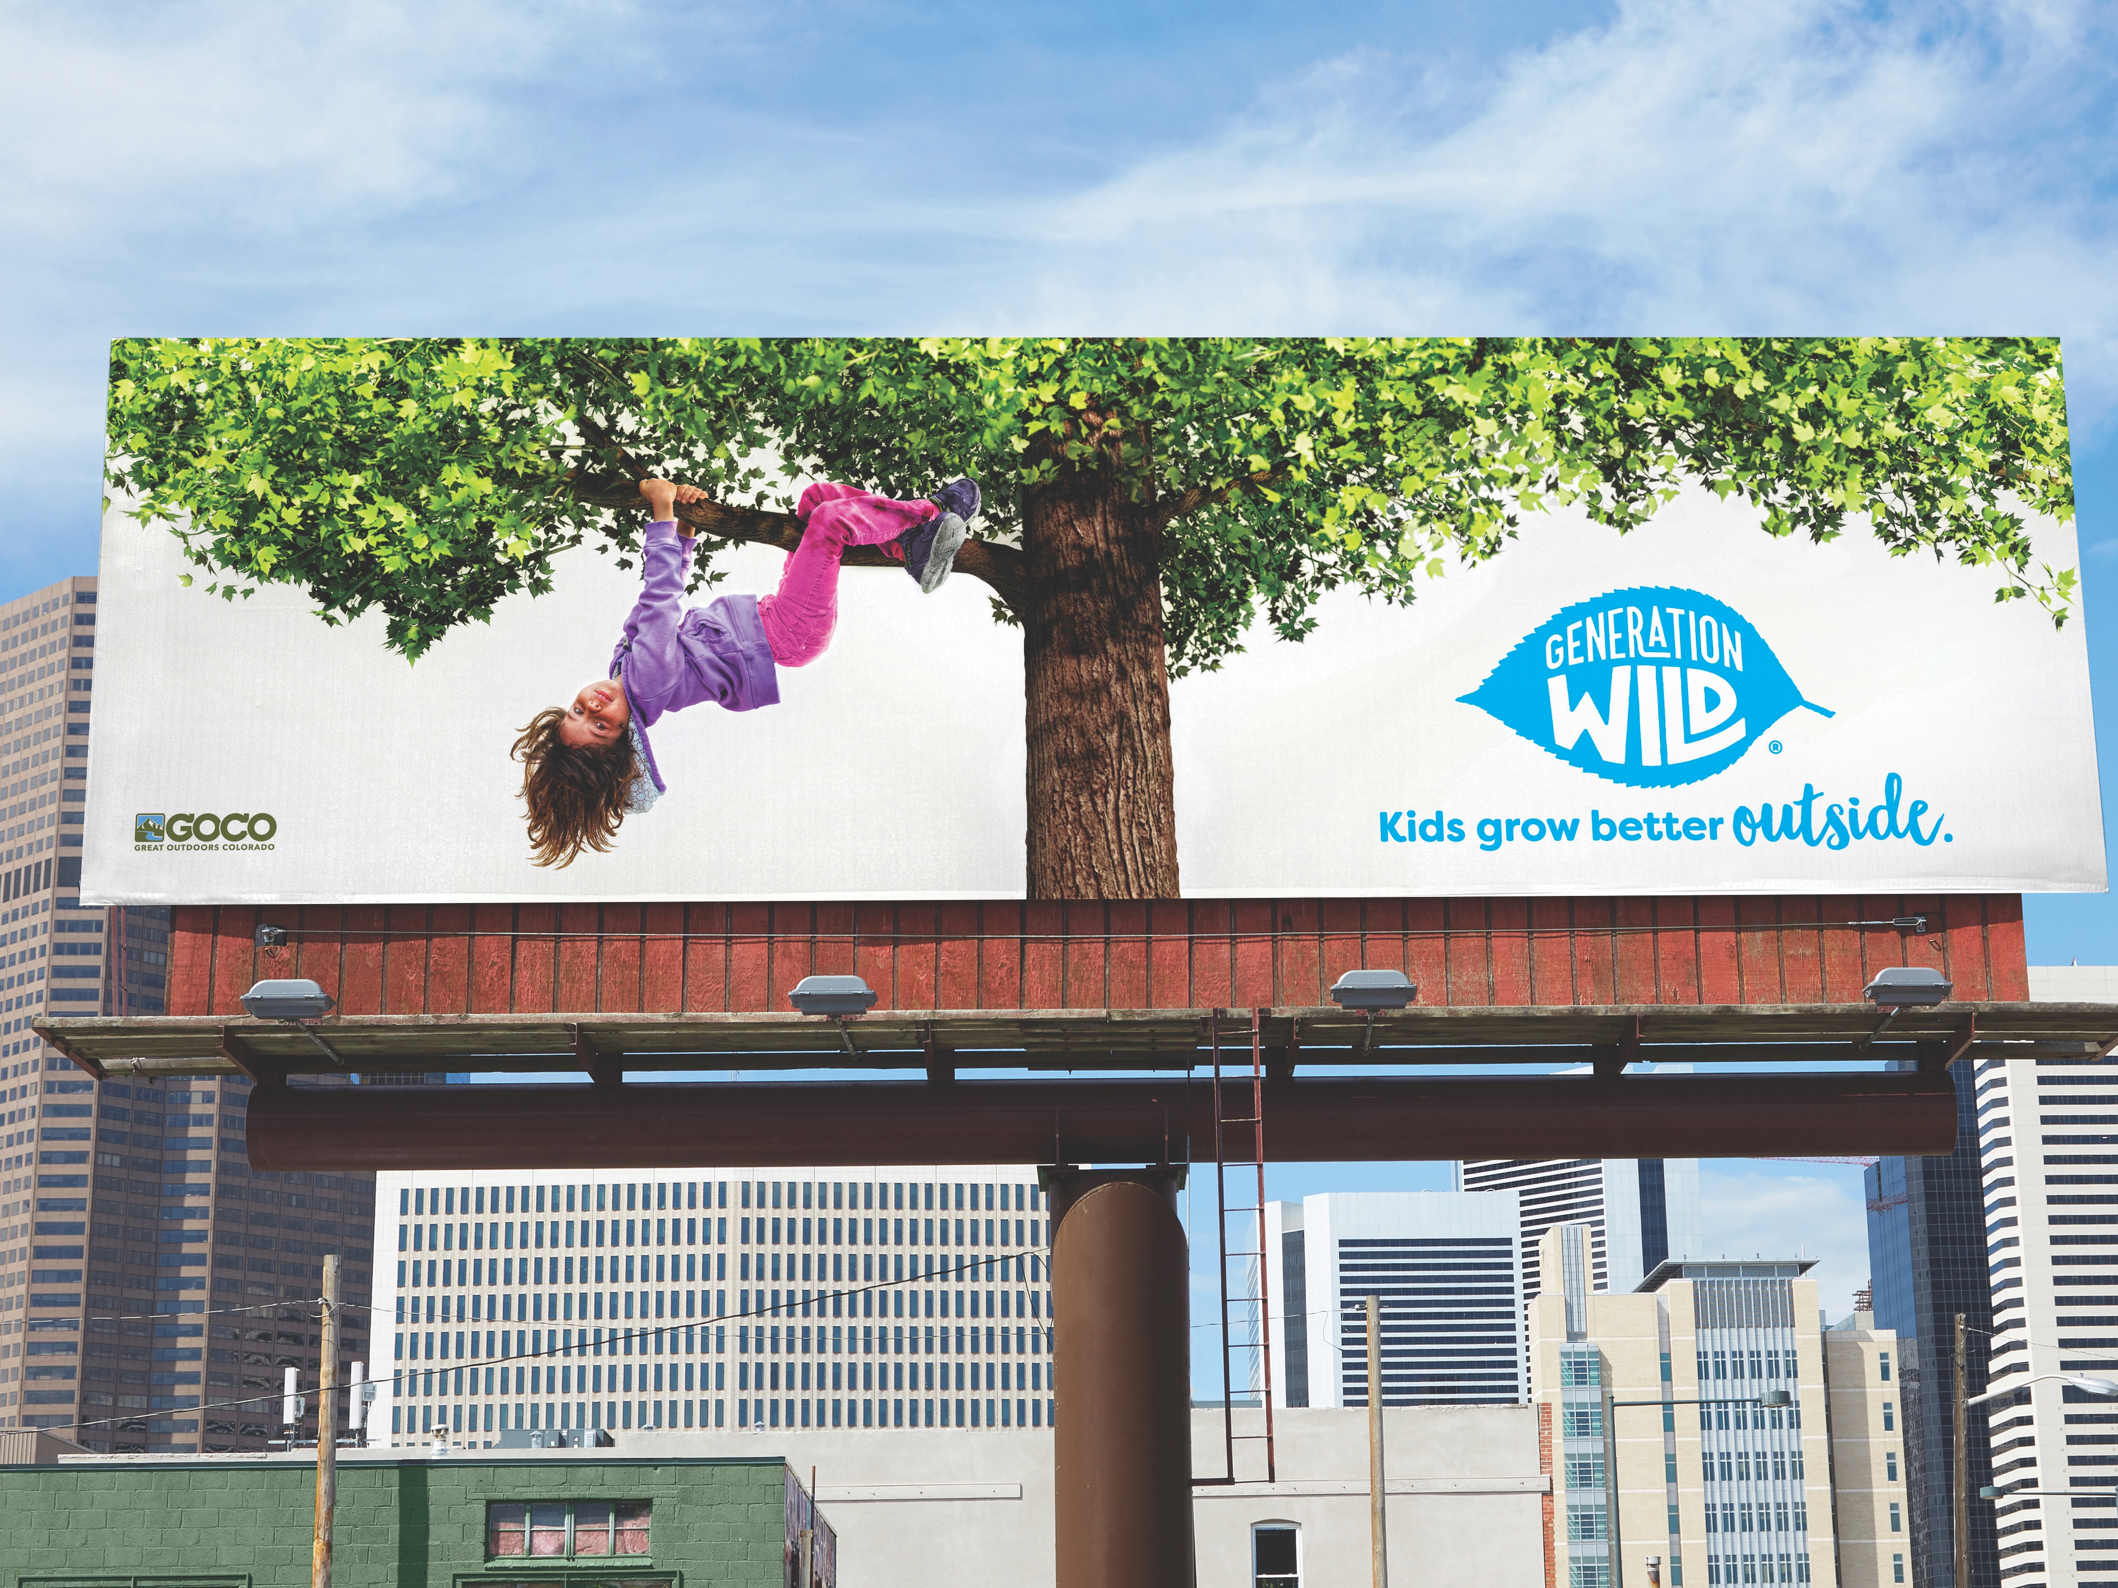

Slide 14
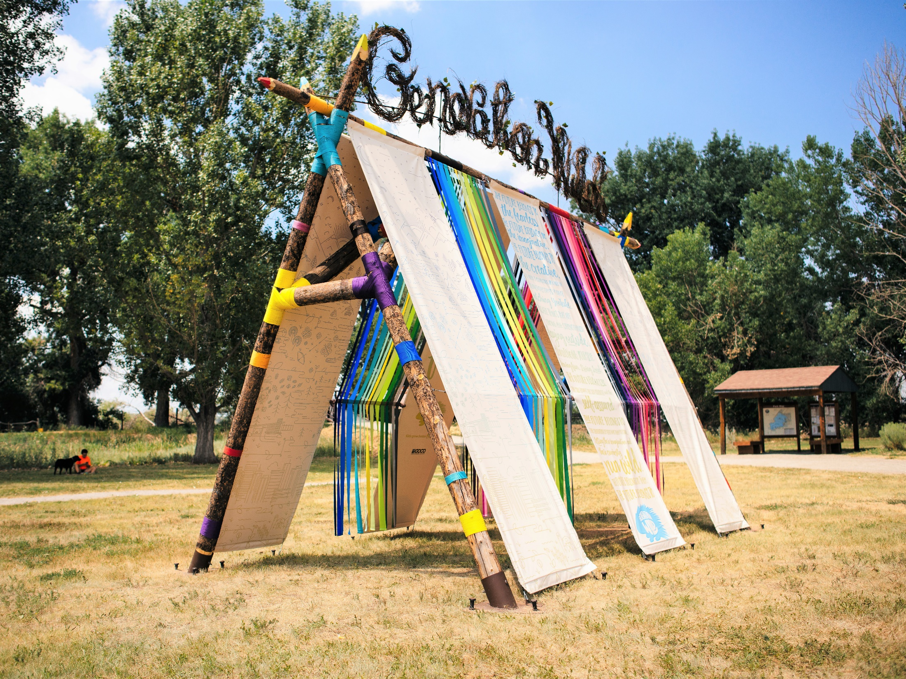

Slide 15
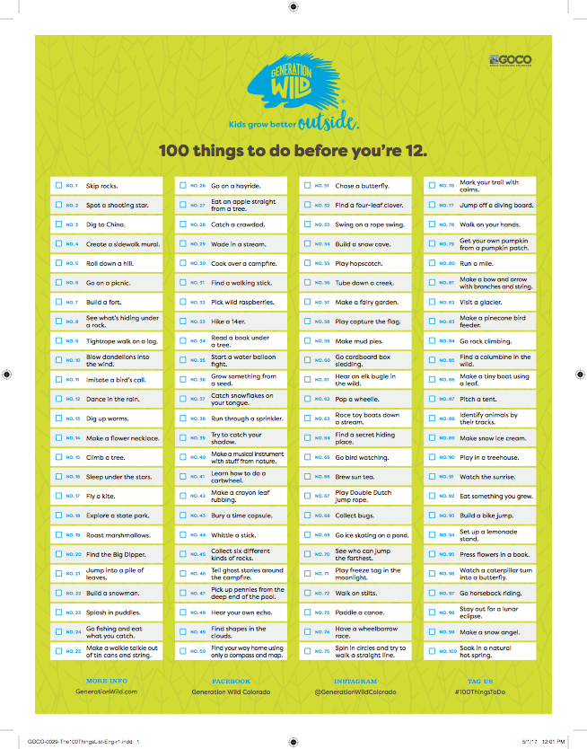
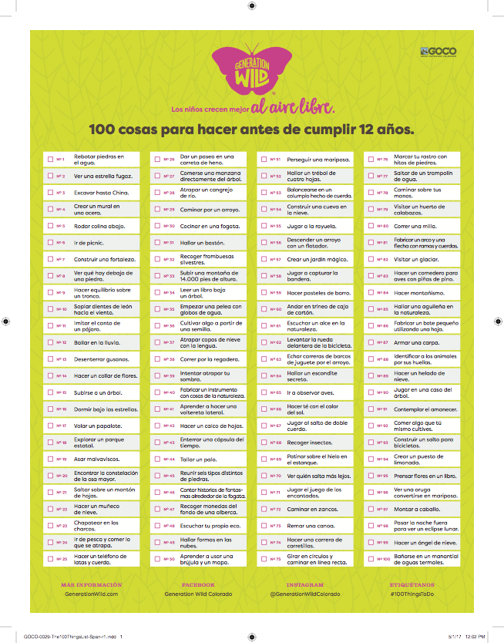

Slide 16
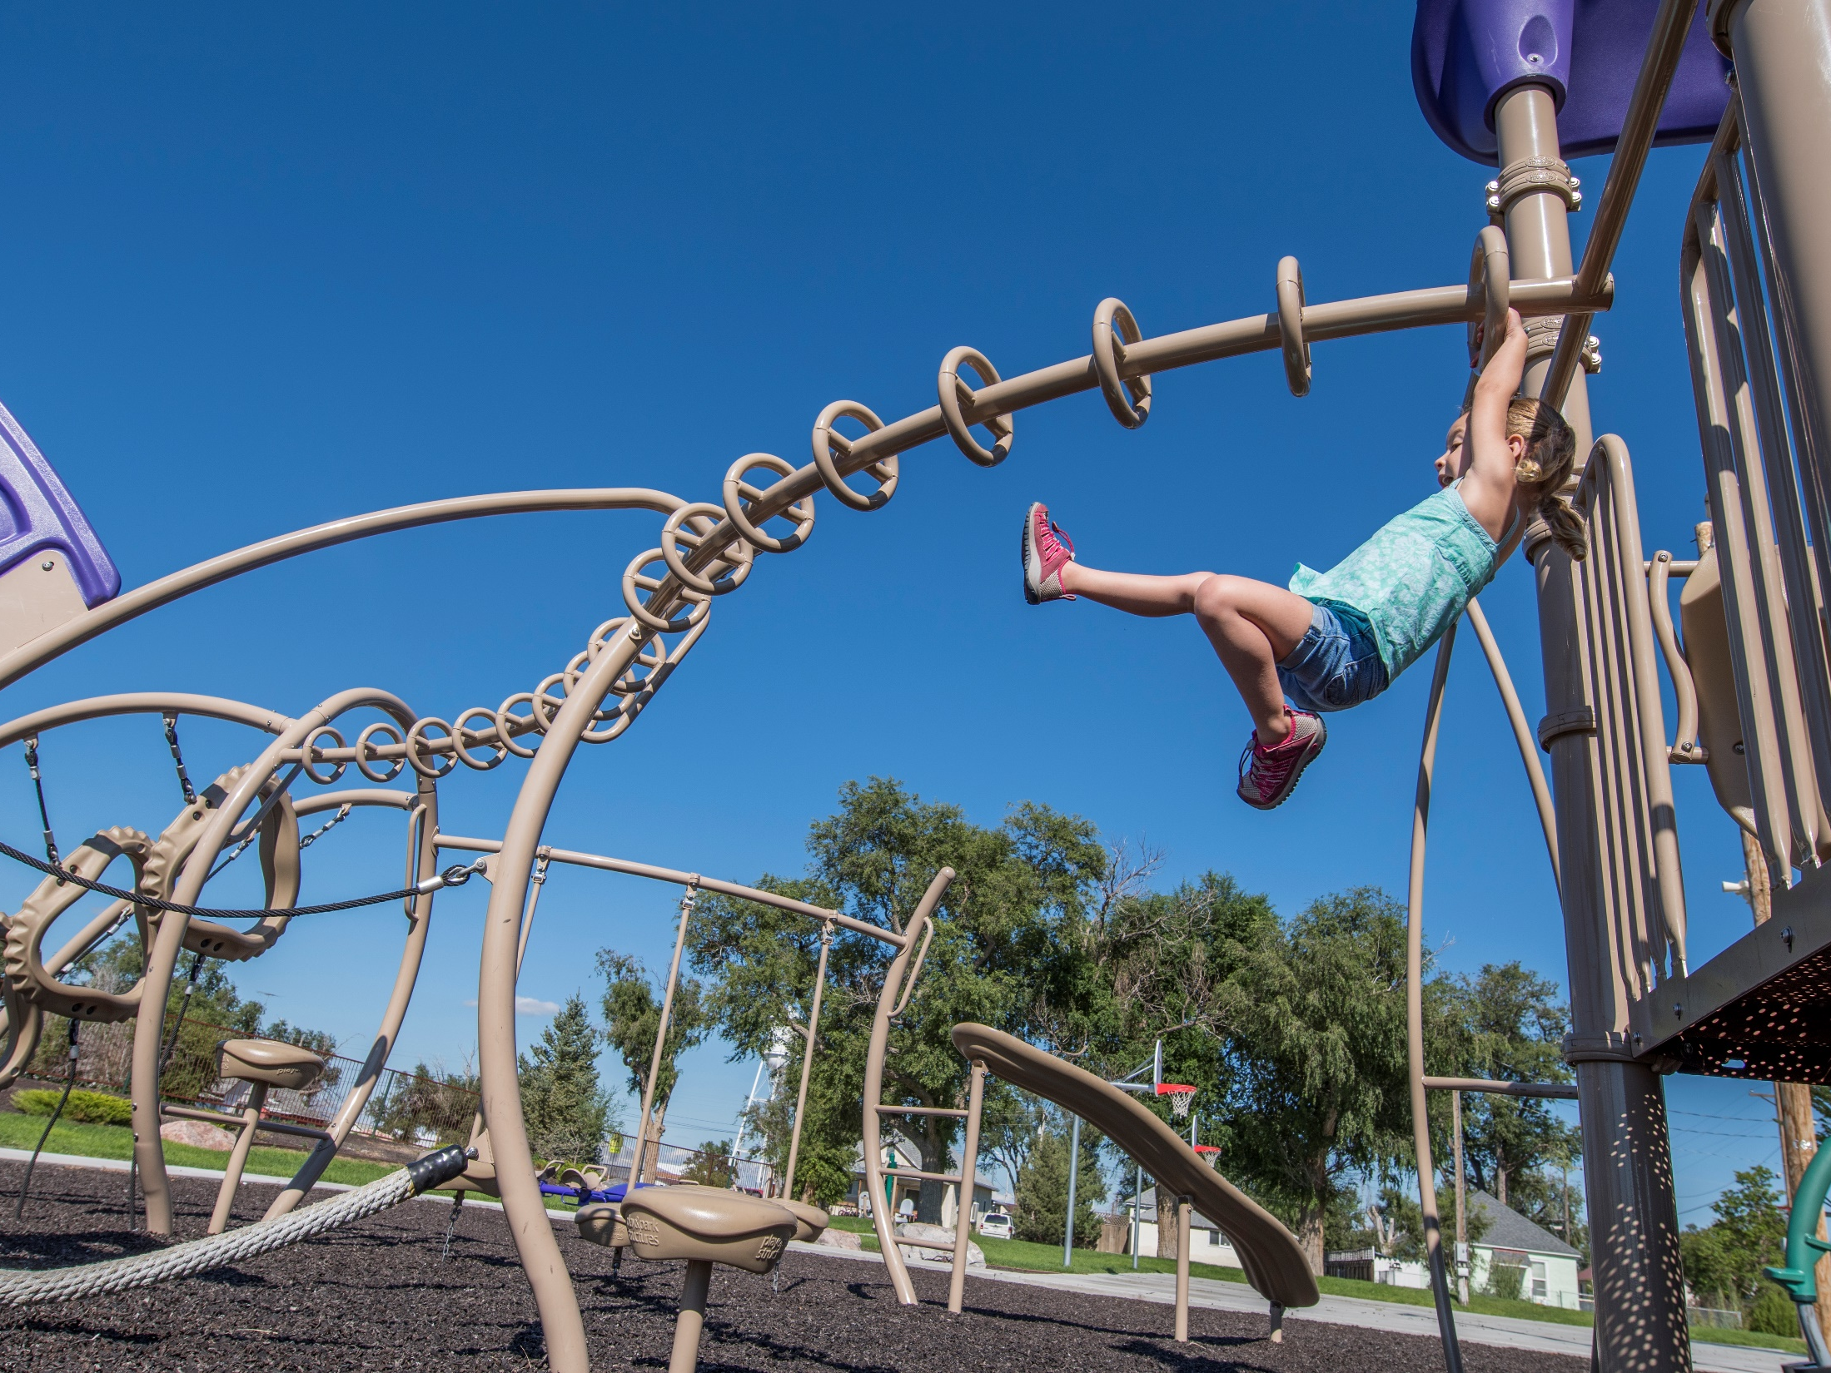
How We Made The List
Engaged partners with expertise
Spectrum of experiences
Mostly free activities
Reynolds Park, Swink

Slide 17
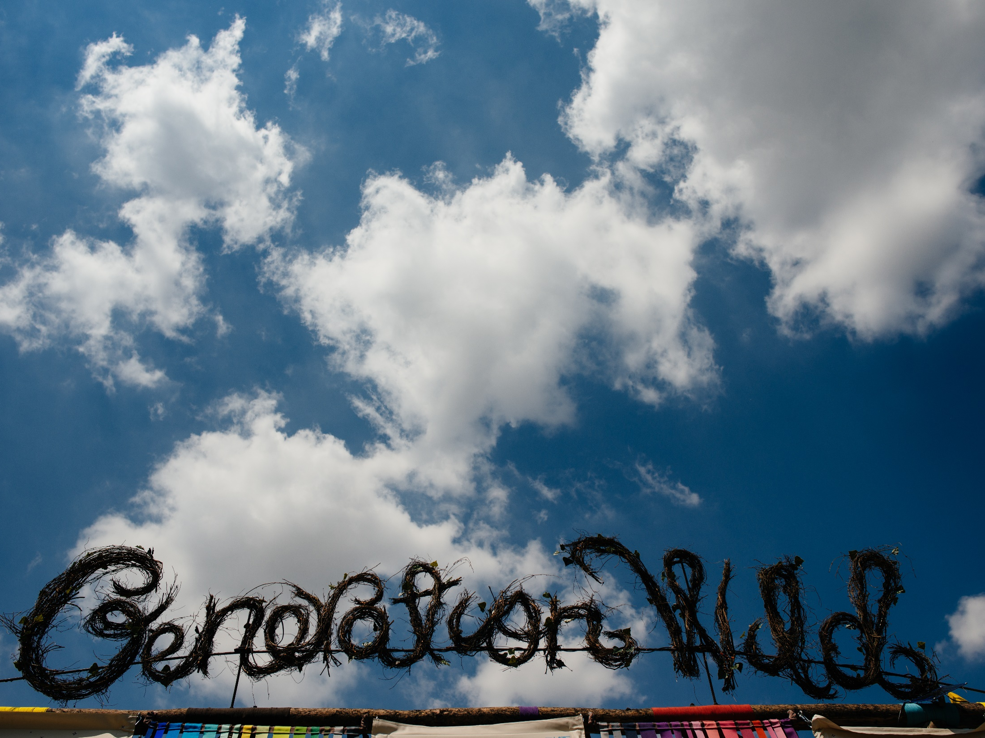
Where We Sent The List
Where We Sent The List
State library system
State library system
Inspire coalitions
Schools
State parks
State parks
Reynolds Park, Swink

Slide 18



www.GOCO.org
info@goco.org
303-226-4500
Notes:
The best way to continue to learn about GOCO is to stay in touch. You can sign up for our enewsletter, like us on Facebook, follow us on Twitter and Instagram, and connect with us on LinkedIn.
Everything I talked about today can be found in detail on the GOCO website, but we have time for questions now so ask away.

