Slide 1


Recruiting Package
Skyline Acres
Chastity Weichselbaum
918.990.2051
Founded [2026]

Slide 2

Our Vision
Examples
At Skyline Acres we take pride in offering a tech-forward, friction-free transaction for our customers by offering tech tools that empower our agents to work more efficiently and eliminate time-consuming tasks so they can spend more time developing meaningful relationships with their buyers and sellers.
Our goal is to build wealth in agents and clients. The Big W way:
Wealth in knowledge
Wealth in support
Wealth in relationships
Generational Wealth through land and home ownership.
At Skyline Acres we strive to provide outstanding, continuous training for real estate agents to always keep learning and stretch our goals. We are a team of enablers who believe in sharing knowledge for the stronger we are as a group, the stronger we are individually.
5 WAYS Skyline Acres WILL HELP YOU REACH YOUR BUSINESS GOALS
Provide ongoing coaching mentorships to set, track and reach goals.
Lend in-house social media marketing support for effective lead gen.
Provide best-in-class CRM and transaction management tech to close more deals.
Showcase listings with custom property websites.
Offer a proven presentation formula to help agents acquire more listings.
Notes:
PRO TIP

Slide 3


Our Culture
We aim to delight and surprise our clients, deliver exceptional service, and exceed their expectations at every step in the transaction. Our goal is to make the real estate process memorable and one that our clients want others to experience.

Slide 4

The Marketing Plan
Skyline Acres offers a comprehensive marketing plan designed to help our agents elevate the exposure of every listing.
We empower our agents’ marketing success by supplementing advertising costs and offering best-in-class design and social media services.
Brochure Creation & Printing
Web & Digital Marketing
Social Media Content
Access to Staging Materials
Open House/Virtual Showing Assistance Printed Collateral Materials
Brand Recognition Programs
Networking Events
Lead Generation
Notes:
PRO TIP

Slide 5

Training for Success
At Skyline Acres, training is the momentum that keeps the wheels of success turning now and into the future. We take pride in ensuring the long-term success of both new and veteran agents with a comprehensive assortment of training options to meet every agent’s desired style of learning:
Team Trainings
Frequency: Quarterly
One-on-One Coaching
Quarterly or As-Needed
Peer Support
Role playing, scripting, success strategy sharing
Lunch and Learns
Frequency: Bi-Weekly
Contests
Frequency: Monthly
Examples: Best listing strategies, most social interactions, most first-time homebuyers, etc.
Growth Opportunities
In abundance!
Notes:
PRO TIP

Slide 6

An Integrated
Tech Stack
Technology is the difference-maker between the offer that gets accepted and the one that hits the listing agent’s phone too late. Technology is the success driver that connects your CRM to your transaction management system for effortless document management, compliance and integration with all your favorite real estate apps. Technology is the key that unlocks a five star-rated mobile app that lets you transact anywhere, anytime. Technology is how we at Skyline Acres work best:
IDX feed on website for clients to search, view, save and schedule listing
CRM for powerful lead gen, email nurture and integration with dotloop transaction management, as well as integrated lead platforms of Zillow & Realtor.com
Dotloop transaction management software for all-in-one document management, compliance and collaboration
Printers and color copies

Slide 7
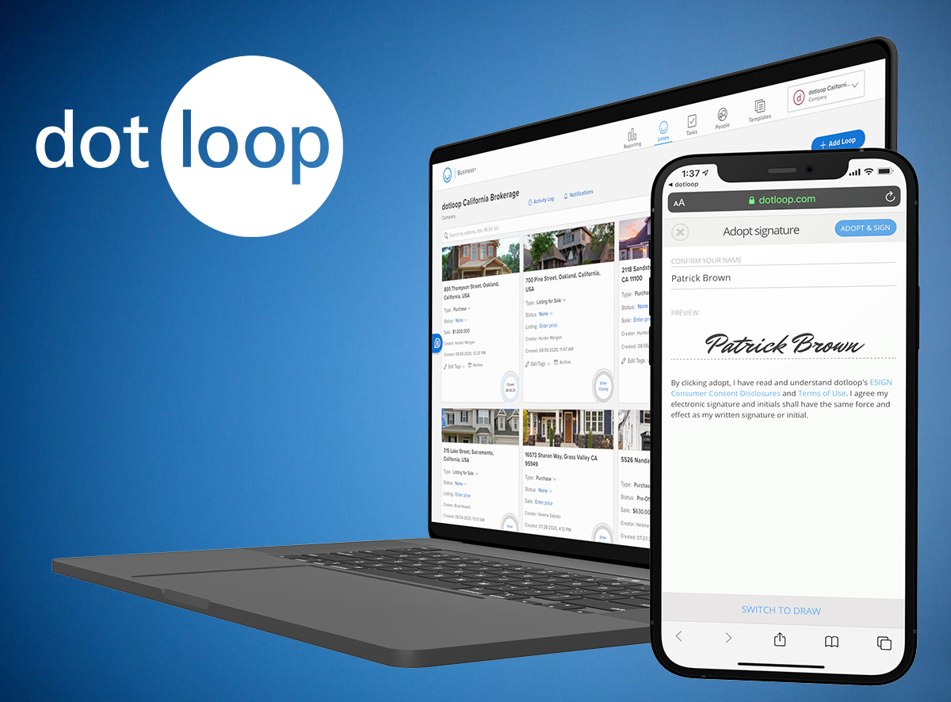
dotloop
Your All-in-One
Transaction Management Partner
Dotloop’s leading transaction management software connects agents, transaction coordinators, admins and customers on one collaborative platform to edit, eSign and share documents; gain compliance; and close deals faster and more efficiently. In online banking, you wouldn’t use a different app to transfer funds, another one to deposit, and yet another to pay bills. So why would you use different apps to manage your transactions? Dotloop is the real estate industry’s one start-to-finish, contract-to-close transaction management platform that brings all of the following together on one turnkey platform:
Comprehensive association forms coverage
Unlimited eSignatures with multiple ways to sign - text, email & in-person
Document Templates - customized to how you work
Loop Templates – the ultimate productivity tool
Automated Tasks - customize and assign people and dates
Submit for Review - mobile or desktop
Compliance Workflows - customized and automated
75+ Integrations with leading real estate software partners
Five star-rated mobile app to make offers, edit, eSign, submit for review & text docs
Free training on your terms - online, private 1:1s, video, certifications and more!
How to Get Started
The office admin will email you a setup email
Create your login from the email
Go to https://www.dotloop.com/resource-center/training/ for online videos & tutorials
Notes:
PRO TIP

Slide 8

Competitive Compensation
Skyline Acres offers a competitive compensation package, including:
Commission Splits
75/25 – Year 1 & 2
80/20 – Starting Year 3
50/50- Office Leads
Commission Cap: $17,500
Personal Transaction Fee: $500 (no commission split)
1 Yearly Transaction Fee: $450
No Monthly Fees
Omission & Error Policy
Company Events
Specialized Training
Personal Branding
Notes:
Personal Branding:
Free personal website
Content Creation
Business Cards – 1st box
1st sign rider

Slide 9


Thank You

