Slide 1
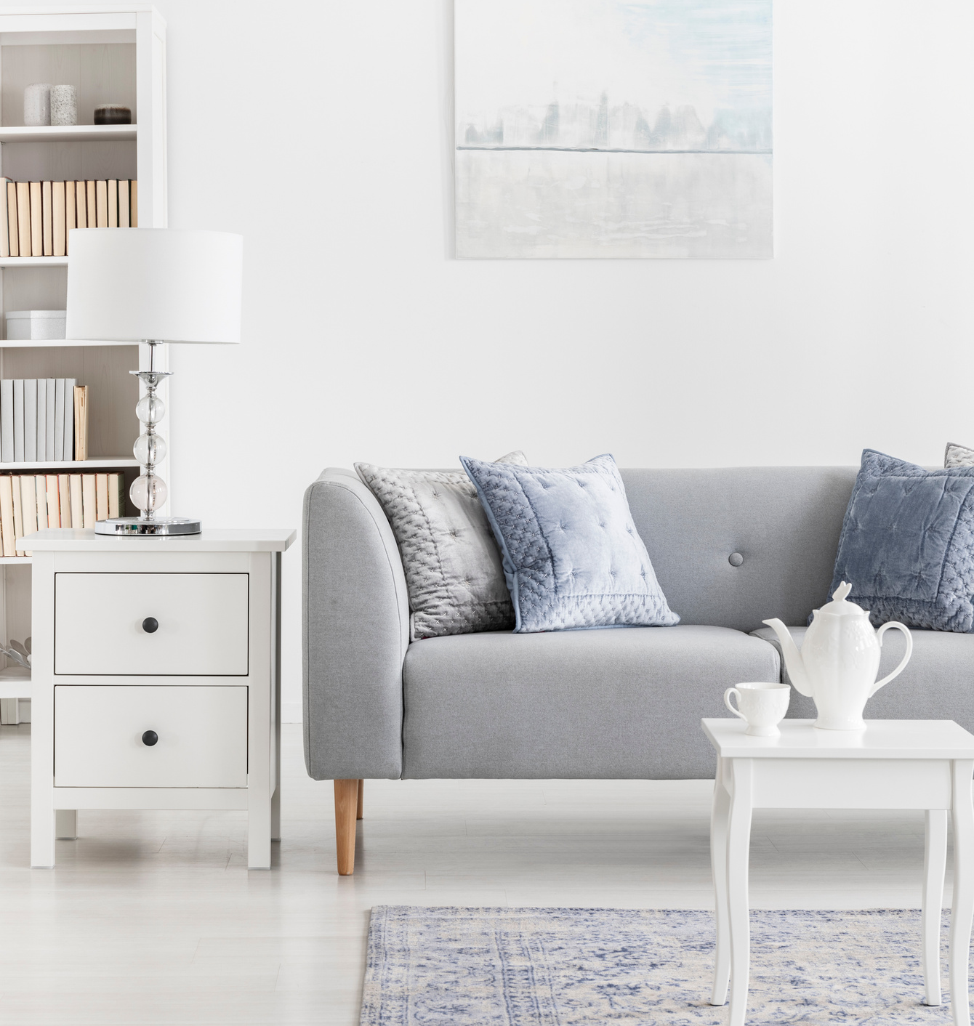
sold
TAKING YOUR HOME FROM LISTED TO
CHASTITY WEICHSELBAUM
Your Local REALTOR®

Slide 2
ABOUT ME:
Real Estate has been a passion of mine since before I can remember. My husband and I own several companies and work all aspects of real estate. I am a real estate investor who owns rental homes as well as flip houses and also operate a Staging Company. As a seasoned real estate professional with a background in business management and interior design, I bring a unique blend of skills to the table. I understand the importance of creating an attractive and welcoming environment that appeals to buyers and use this knowledge to help clients prepare their homes for sale. One of the things that sets me apart is my dedication to clients. I take the time to understand my client's needs and preferences and work tirelessly to help them achieve their real estate goals. Whether it's finding the perfect home or getting the best possible price for a property, I am committed to achieving my clients' objectives.
Chastity Weichselbaum
YOUR LOCAL REALTOR®
918.990.2051
cwrealty918@gmail.com
chastity,yourtulsahomesearch.com

Slide 3
ABOUT ME
PRICE
Owners who sell on their own typically generate &35,000 less than homeowners who sell with Chastity.
MARKETING EXPERTISE
Chastity knows the best way to advertise to attract buyers, plus they can use the marketing muscle of their brokerage to promote your home
TIME
Chastity has the time and expertise to handle open houses, showings, inspections, and the dozen other tasks that would take you away from your work and regular routine.
SALES SKILLS
Chastity can evaluate your home and suggest improvements to get you the maximum value, and they're skilled at handling showings to generate a positive response.
EXPERIENCE HANDLING PAPERWORK
Buying and selling a home involves reams of paperwork that can be hard to understand. Chastity thrives in this world.
NEGOTIATION SKILLS
With years of barging experience and an expert understanding of the market, Chastity can help you close the deal at the price and terms you want.
KNOWLEDGE OF NEIGHBORHOODS
Chastity knows local communities and can help you find a replacement home in the nicest neighborhoods and with the best schools.
ADVICE AFTER CLOSING
Chastity will continue to support you as questions pop up after the deal is done.
ACCESS TO BUYERS
Through the Multiple Listing Service, professional contacts, and their own database of prospects, Chastity can help you reach the widest range of customers
KNOWLEDGE OF SERVICE PROVIDERS
Chastity can refer you to their network of top-quality lenders, inspectors, contractors, and insurance agents to make sure you get the best results in every stage of your deal.
chastity.yourtulsahomesearch.com

Slide 4

THE PATH TO #SOLD
01
02
03
MEETING
PRICING
STAGING
04
05
06
PHOTOS
MLS & OTHER SITES
MARKETING
07
08
09
OFFER
UNDER CONTRACT
INSPECTIONS
10
CLOSING
chastity.yourtulsahomesearch.com

Slide 5
MARKETING PLAN
Let's work together to establish the best value for your home. We'll review similar listings in your area and what homes have sold for recently to determine what the market values your property's listing price will be.
+ Property Website
+ Property Flyers
+ Property Brochures
+ Property Postcards
+ Facebook Marketing
+ Other Social Platform Marketing
+ Listing Your Home on Zillow
+ Listing Your Home on Realtor.com
+ Showcased On MLS
+ Open Houses & Open House
Sign-In For Follow-Up
+ Property Videos For YouTube
+ Email Blasts To Local Buyers
+ Syndicating Your Listing To
Thousands Of Agent Websites
+ And More Unique Marketing
Techniques!
chastity.yourtulsahomesearch.com

Slide 6
IMPORTANT NOTES
chastity.yourtulsahomesearch.com

Slide 7
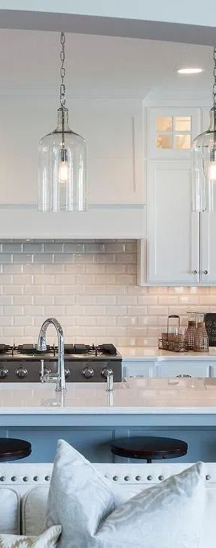
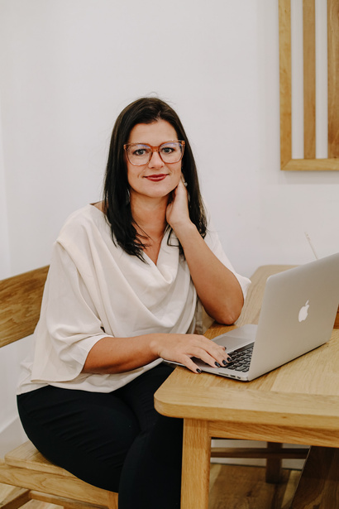

Chastity Weichselbaum
(M) 918.990.2051
cwrealty918@gmail.com
104 N Broadway, Suite 1
Inola, OK 74036
chastity.yourtulsahomesearch.com

