Slide 1
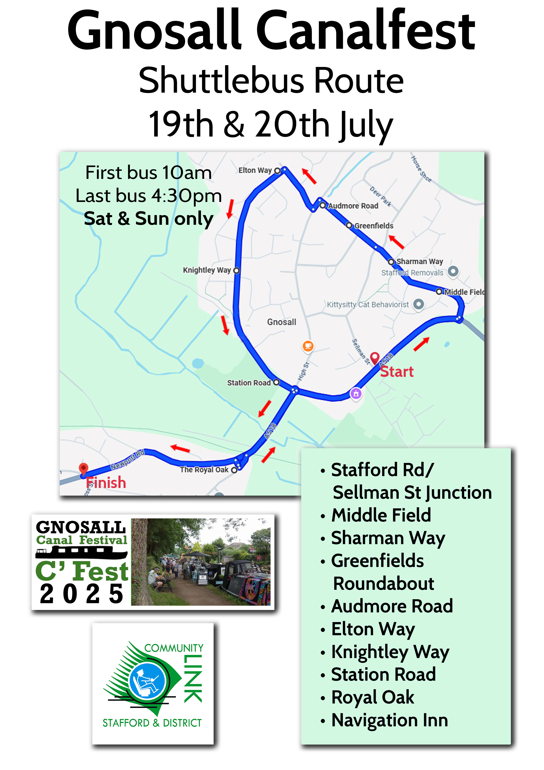
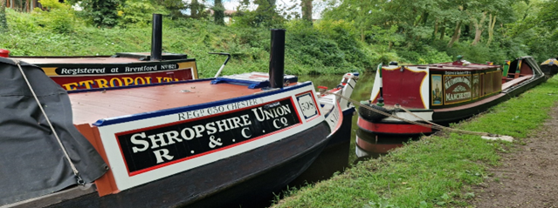
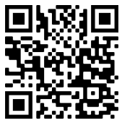


Trade Boats
Joanna - Barista coffee, cakes, ice creams and crepes
Tamarisk - Crochet and knitwear *Demonstration 10am
Wandering Snail - 'Olly's Carved Creations' - Handcrafted gifts *Demonstration 10-11am
Bear Necessities - Decoupage gifts *Demonstration 11am-12pm
Free Spirit - Candles, melts and diffusers *Demonstration 1-2pm
Jenny Wren - Fair trade clothing, accessories & coffee *Demonstration 2-3pm (making earrings)
Lazy Daze - Painted canal ware *Demonstration 2-3pm
Waratah - Emma Bradley Art - Watercolour artwork
Forget me knot - Pizza. Trading during the day taking orders for collection early evening (5/6pm)
Scorcher - Cakes, ice creams, hot dogs and fudge
Gloria - 'The Curry Cruiser' - Indian street food (may continue to serve into the evening)
Kimberley - Vintage/antique items
That’s Driculous - Cheese truckles, chutneys & cheesy gifts
Ardea - Candle maker
Deltic - Gemstone jewellery, crystals, crafts
Francesca Leah - Charity painted ware
Ghost of Cain - Bookmarks, jewellery, etchings, dog items
West Riding - Felt characters, bodycare, ceramics
Crooked Mouth - Slate and wood gifts
Open for trade Friday, Saturday and Sunday 10am-5pm.
Mostly moored between Bridge 34 (The Boat Inn) and
Bridge 35 (The Navigation Inn).
Historic Boats
Saltaire, Swift, Darley, Bainton, Stanton, Elk,
Saturn, Nansen ii
2pm Meet ‘Flower’ the boat horse by Saturn.
Gnosall Canal Festival 18-20 July
2025 Programme
Free
bus
Welcome to three days of activities on one of the UK’s prettiest canals. We are a community festival, locally managed and locally enjoyed, run by volunteers and mostly free.
A free shuttle bus will run on Sat & Sun 10:00-4:30 along the service bus route to/from the Navigation Inn, every 20-30 mins. Any donations at the GTR stand in the Navigation car park appreciated. For up-to-date information, please visit our website www.gnosallcanalfest.co.uk Free car parking (at owner’s risk) is available via Wharf Road.
For more information and to book specific activities, look for the green GTR stands or volunteers.
THANK YOU TO ALL VENUES AND VOLUNTEERS

Slide 2
Festival Garden Daytime Timetable
The Festival Garden is at the Navigation Inn and is pedestrians only apart from the shuttle bus. For pedestrian access, please use the brick steps from the towpath. DO NOT use the steps at Bridge 35 to/from the A518 main road.
In addition to the visiting stalls, GTR are pleased to offer the events below. They are all in (or meet at) the large marquee.
The boat trips are free, but you must have a ticket. Collect your tickets from the GTR stand in the Festival Garden. Boats leave hourly on the half hour and last about 50 minutes. Some of the trips include a Gnosall history talk, please enquire when booking.
As pub seating is limited, you’re welcome to bring your own folding chairs to enjoy the evening entertainment.
Festival Garden - Food, Music and Entertainment
Food - available Saturday & Sunday
Music
Friday 5:00pm - The Oss Road (a Stafford-based band playing semi-acoustic pop/jazz/folk)
Saturday
11:30am - The Oss Road
3:00pm - The Oss Road
5:00pm - Chris Del Manso as Elton John
8:00pm - Earl Grey & the Charwallahs
Sunday
11:30am - Simple Folk
2:30pm - Simple Folk
The Boat Inn - Food and Music
Food - Jacket Potatoes/Burgers/Hot Dogs
Saturday & Sunday 12-2:30pm & 4:30-7pm
Music
Friday 7:00pm - Sexual Chocolate (Acoustic duo playing crowd pleasers)
Saturday 6:00pm - Massive Surfboard (popular rock/pop, blues, 80s, 90s and more!)
Raffle - Drawn Saturday & Sunday. Prizes include a trip on a day boat plus many others.
Time | Saturday | Sunday
09:30 | Boat trips start | Boat trips start
10:00 | Stalls open | Stalls open
11:00 | Children’s fun activities | Children’s fun activities
11:30 | Band - The Oss Road | Singers - Simple Folk
14:00 | Children’s fun activities | Children’s fun activities
14:30 |  | Simple Folk
15:00 | The Oss Road
16:30 | Last boat trip | Last boat trip
17:00 | Stalls close/Raffle drawn | Stalls close/Raffle drawn

