Slide 1
Fundamentals of Baking
LIVE. LOVE. BAKE.

Slide 2
History –
Baking is one of the oldest occupations dating as far back as prehistoric times. The worlds oldest oven, approximately 6500 years old, was discovered in Croatia in 2014. Bread making began in Ancient Greece approximately 600 BC. The Egyptians were pioneers in baking and were the first ones to use yeast in bread making.
Advantages of Baking –
Aromas and flavors are enhanced during baking and will fill any place with an enchanting excitement of mouthwatering delight.

Slide 3



Using Formulas
A set of instructions for producing a certain dish is called a recipe.
Baker’s talk in formulas. The term formulas refer only to the list of ingredients and quantities.
Despite their importance, recipes and formulas have limitations. Each method assumes that you already have a basic knowledge of measuring correctly.

Slide 4
Recipes and Formulas cont. Standardized vs. Instructional
Standardized
Instructional
A set of precise instructions describing the way an establishment prepares and item.
Functions:
Controls quality
Controls quantity
Limitation:
An establishment must supervise any new employee to make sure they understand the procedure to any given recipe.
The purpose is to teach basic baking and cooking techniques.
The formulas are examples of the general procedure, to offer experience. It is intended for you to think and learn a technique.
Many formulas are followed by variations. This allows you to see the patterns and learn specific techniques. Idealistically the purpose is to allow one to look at a recipe/formula and to know what method you are doing without consistently looking at the procedure.

Slide 5

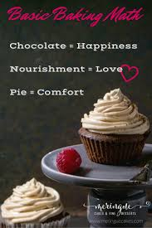
Baker’s Percentages
Also known as Baker’s Math
Why is Baker’s percentages important?
Baker’s percentages indicate the amount of each ingredient used as a percentage of the amount of flour used. Flour is used as the basis of baker’s percentages because it is the main ingredient in nearly all baked goods.
A proper knowledge base in baker’s percentages will allow anyone to readily convert any recipe in a pinch. If done correctly, it will prevent waste in product and cost.

Slide 6
Baker’s Percentages cont.
Calculations: Repeat for each ingredient
1. Convert ALL weights to ounces.
2. To calculate new flour weight:
NEW YIELD (OZ) / TOTAL % YIELD
= NEW FLOUR WEIGHT
3. To calculate new ingredient weight:
NEW FLOUR WEIGHT (OZ.) X INGRED. %
= NEW INGREDIENT WEIGHT (OZ)

Slide 7
Baker’s Percentage cont.
To find the percentages when you have weights:
Formula:
Weight of ingredient / Weight Of Flour = ______ X 100 = (% of ingredient)
Example: Flour 10 oz.
Water 5 oz.
10oz / 10oz = 1.00 X 100 = 100%
5oz / 10oz = .50 X 100 =50%
Hint: Always move the decimal right two spaces to find the %.

Slide 8
Baker’s Percentage cont.
To figure out new ingredient weights when you only have ingredient %’s
Tip: Must decide on flour weight, then calculate the rest of ingredients or must decide your new desired total yield and figure new flour weight
Formula:
New Flour Weight (oz.) X Ingredient % =
New Ingredient Weight (oz.)
Example: New Flour Wt. - 20 oz.
New Flour Wt. X Ingredient % (in decimal form) =
New Ingredient Wt. (oz.)
flour - 100% 20 oz. X 100% or (1.0) = 20 oz.
water - 60% 20 oz. X 60% or (.60) = 12 oz.
salt - 2% 20 oz. X 2% or (.02) = 0.4 oz.
yeast - 1% 20 oz. X 1% or (.01) = 0.2 oz.

Slide 9
Ingredient and their Functions
Sugar and Spice that’s what…
All good things are made of.

Slide 10
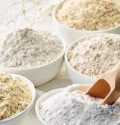
Flour
There are four basic types of flour traditionally used in a bakeshop.
Bread Flour: made from hard wheat with enough quality gluten to make it ideal for yeast breads. High protein count of 11 to 13.5%.
All-Purpose Flour (also known as AP): A general purpose flour with a protein count of 10 to 11.5%. It is formulated to be slightly weaker so it can be used for pastries as well.
Pastry Flour: It is a weak or low-gluten flour. Pastry flour is used for pie doughs and some cookies, biscuits, and muffins. It has a protein count of 9%.
Cake Flour: weak or low-gluten flour with a soft smooth texture. Primarily used for cakes and delicate baked goods. It has a protein content of 8%.
Additionally there is Self-Rising Flour. This flour contains baking powder, sometimes salt. It is limited by two factors.
1. Not all recipes call for baking powder.
2. Baking powder loses its leavening power over time.

Slide 11

Flour Cont.
Flour provides the bulk of the structure in a product, the amount you use can alter the texture.
Example: A small amount of flour compared to butter (a ratio of 1 to 1 or less) will give you cookies that spread out into a wafer-like lace cookie. Extra flour (a ratio of 1.3 to 1 or higher) will give you cookies that barely spread at all as they bake, with centers that stay dense and dough-like, even after being almost fully cooked.
More Bread Flour = Chewier Cookies / More Cake Flour = Softer Cookies

Slide 12
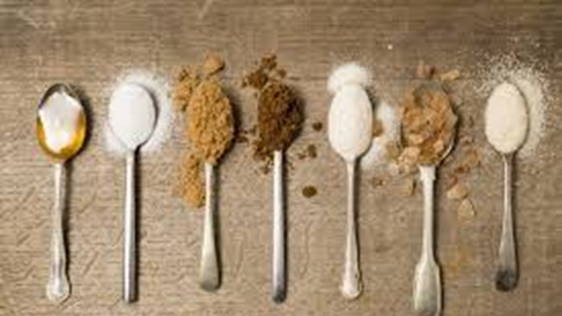

Sugars
There's more to sugar than just sweetness! The type of sugar you use, and its method of incorporation can have a profound effect on the finished product.
White sugar is crystallized sucrose, a disaccharide consisting of a fructose molecule and a glucose molecule linked together. It is mildly hygroscopic (that is, it likes to retain moisture), and relatively neutral in pH.
Brown sugar is mostly crystallized sucrose, but also contains a good amount of glucose and fructose, along with trace minerals that give it its flavor and a slightly acidic pH. Glucose and fructose are far more hygroscopic than sucrose.
White Sugar = Thin and Crisp / Brown Sugar = Tall and Moist
Example: A mixture of the two provides a good balance, dissolving too much sugar can lead to a texture that's too uniform. With sugar left in distinct grains, the pockets of melted sugar that caramelize within the cookie as it bakes remain irregular, giving the cookie more textural interest.
Brown sugar has another advantage over white: it caramelizes more readily, leading to more intense flavor and darker color.
Corn Syrup = Soft, Wide, Dark, and Flexible Cookies
Corn syrup is a powerful ingredient, in fact, that even a small amount of it will completely alter the texture of your cookie. Typically, you want no more than a 10% ratio.

Slide 13
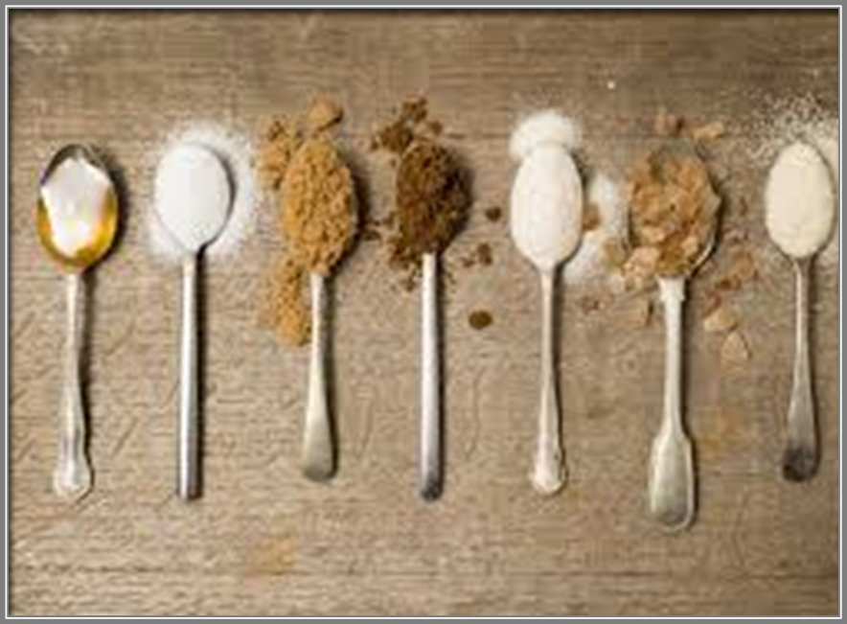
Functions of Sugar and Sweeteners
They add sweetness and flavor
They create tenderness and fineness of texture, partly by weakening the gluten structure.
They give crust color.
They increase keeping qualities by retaining moisture.
They act as a creaming agent with fats and foaming agents with eggs.
They provide food for yeast.

Slide 14
Fats
Butter, Shortening, Milk…Oh My!
It’s all about the fat baby!

Slide 15
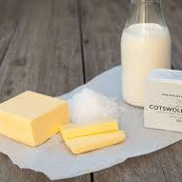
Fats cont.
FUNCTIONS:
Adds moistness and richness
Increases tenderness
Increases shelf life
Adds flavor
Assists in leavening of the creaming method or a leavening agent in puff pastry, pie dough, and other similar products.

Slide 16

Fats cont.
Butter: Butter is essential for flavor. Substituting butter with a less flavorful fat like shortening, lard, or margarine yields sub-par product. Butter is about 80 to 83% butterfat, 15% water, and 3 to 5% milk protein. It comes in salted and unsalted. Butter melts in the mouth or at room temperature. Low melting point.
Shortening: Has a fairly tough, waxy texture, and tends to hold its shape in a dough or batter. It is made from vegetable oils, animals fats, or both. Has a high melting point. Can be used in pie crusts, biscuits, and certain cakes, cookies, and quick breads. Does NOT have any flavor.
Oils: It is a liquid fat. Not often used in the bakeshop but just a few cakes, breads, and quick breads. Its main use is in greasing pans, deep-frying doughnuts, and as a wash for some kinds of rolls.

Slide 17
Fats…does it ever end…cont.
Milk Products
Milk: Next to water, it is the most important ingredient in the bakeshop. It contributes to the texture, flavor, crust color, shelf life, and nutritional value. Traditionally, whole milk is primarily used. It contains 3.5% fat, 8.5% nonfat milk solids, and 88% water. Skim and low-fat milk consist of less than 2% fat. You CANNOT interchange whole milk and skim/low-fat milk as the fat contents will change the whole makeup of your product.
Buttermilk: Producing buttermilk the lactose in milk is converted to lactic acid. When replacing buttermilk for milk in a recipe you must neutralize the acidity by adding baking soda and reducing the baking powder.
Cream: Not often used as a liquid in doughs and batters because of its fat content (10%-40%). It is typically used in productions of fillings, toppings, and cold desserts.

Slide 18

Eggs
Egg whites: They provide a good amount of water, as well as protein. Egg proteins are particularly good at trapping and retaining bubbles of air or water vapor. The higher the proportion of egg white in a product, the more it rises during baking. Because of the extra water, you also get more gluten formation. Other than the small amount in the butter, eggs are the main source of water in a recipe.
Egg yolks: They provide some moisture and protein, but more importantly they provide a well-emulsified source of fat. When cooked, egg yolk forms a tender protein coagulum that can keep products tender.
Example:
Egg Whites = Taller Cookies / Egg Yolks = Fudgier Cookies
By keeping the total mass of egg added to a dough the same but altering the proportion of white to yolk, you can achieve a variety of textures. Two whites and a yolk, for instance, produces the more open structure of the cookie, while three yolks and no whites produce the denser, fudgier texture of the cookie on the bottom.
Typically, the 1 egg white to 1 egg yolk ratio is a consistent ratio to use

Slide 19
Eggs
Eggs need to be understood by the baker as they are used in large quantities in a bakeshop.
Yolks: High in fat and protein and contains iron and several vitamins.
Whites: Primarily albumin protein, which is clear and soluble but white and firm when coagulated. The white also contains sulfur.
Shell: Fragile and porous. Can allow odors and flavors to be absorbed even if unbroken.
Functions:
Structure, Emulsifier, Leavening, Moisture, Color, Flavor, and Nutritional value.

Slide 20
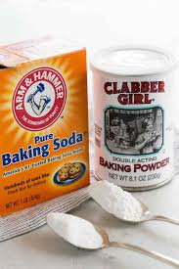
Chemical Leaveners
Leavening—the introduction of air to the internal structure of baked goods—can come in many forms. In bread, it's the carbon dioxide produced by yeast. In a cream puff, it comes from expanding water vapor. In the case of cookies, we get it from egg proteins capturing expanding gases, creamed butter, and most importantly, chemicals, namely baking powder and baking soda.
What's the difference between the two?
Baking Soda: Pure sodium bicarbonate—an alkaline powder (aka, a base). When dissolved in liquid and combined with an acid, it rapidly reacts, breaking down into sodium, water, and carbon dioxide.
Baking Powder: It is baking soda with powdered acids built right in. In its dry state, it's totally inert. But once you add a liquid, the powdered acid and base dissolve and react with each other, creating bubbles of carbon dioxide without the need for an external acid source. Most baking powders these days are double acting, which means that it contains two different powdered acids. One that reacts immediately upon mixing with water, and another that only reacts after it's heated, giving cakes and cookies a little boost early in the baking phase

Slide 21
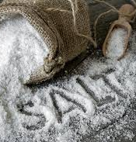
Salt
Salt is essential to balance the flavor of caramelized sugars.
Table Salt: Table salt consists of fine, evenly shaped crystals, which makes it denser than other salts. It's typically mined from salt deposits underground and may also contain anti-clumping agents, such as calcium silicate. As the name implies, it's good for keeping out on the table for last-minute seasoning. It's also good for salting pasta water or seasoning soups.
Kosher Salt: Kosher salt is less refined than table salt. Its larger flakes don't compact together as neatly, so a pinch is a little coarser and not as dense. Kosher salt is the most versatile. It's great for seasoning before, during and after cooking. It's especially good for seasoning meat before cooking.
Sea Salt: Sea salt undergoes the least processing. Flakes are collected from evaporated seawater and may contain residual minerals that could alter the color. The unevenly shaped flakes don't stack up evenly and create a less dense pinch. Sea salt is typically more expensive, which means you'll want to use it with caution. It's best for finishing.
You can use these salts interchangeably if you must, but it's worth using the proper kind of salt for the right occasion.

Slide 22
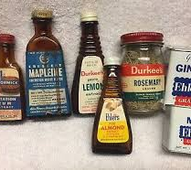
Extracts/Spices
Vanilla is the most important flavoring in the bakeshop; even imitation vanilla flavoring will do just fine.
Extracts are flavorful oils and other substances dissolved in alcohol.
Spices are plant or vegetable substances used to flavor foods.
You can also interchange other extract/spice flavors.
Obviously, consider the pungency of heavier flavors such as cloves and almond.

Slide 23
Mixing Methods
The method in which you mix a product will affect your final product. This is essential in maintaining a quality product.

Slide 24
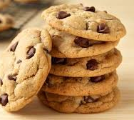
Creaming
The most common used method in a bakeshop.
Method:
Solid fat (butter or shortening) and sugar creamed; eggs added slowly, then liquids (if any) added alternately with sifted dry ingredients at low speed.
Example: Cookies and cake-like muffins

Slide 25
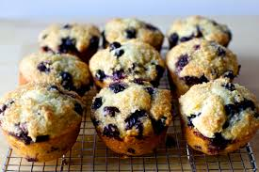
Muffin
Method:
Sifted dry ingredients one bowl; liquid fat and other liquid ingredients added in separate bowl add liquid to dry and mix until combined
Example: Muffins, quick breads, quick coffee cakes

Slide 26
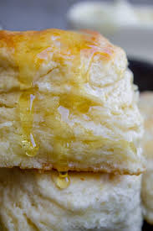
Biscuit
Method:
Sifted dry ingredients stirred or blended on low speed; solid fat cut into flour mixture; liquid stirred in gently
Note: best if all ingredients cold – especially fat.
Tip: freeze fat and grate it then add easily info flour
Example: Biscuit, scones, pie pastry, blitz puff pastry

Slide 27
Importance of Temperatures
Never underestimate the importance of controlling temperatures, beginning with raw ingredients to finished products
Be mindful; ingredients change properties with temperature
Practice tempering when introducing ingredients of two widely different temperatures or when bringing an ingredient from one extreme temperature to another
Tempering ingredients together can avoid curdling in egg and milk products and tiny rubbery balls in gelatin products
Example: When baked at a lower temperature, cookie dough has more of a chance to spread out, leading to flatter, wider cookies. Conversely, cookies baked at higher temperatures spread less. Even a difference of as little as 50°F makes a big difference.
Cooler Oven = Wide Cookies / Hotter Oven = Compact Cookies
Warmer Dough = Wide Cookies / Cooler Dough = Compact Cookies

Slide 28
When you bake a cookie, here's what's going on, step-by-step.
The dough spreads. As the butter warms, it slackens. The cookie dough begins to turn more liquid and gradually spreads out.
The edges set: As the cookie spreads, the edges thin out. This, coupled with the fact that they are fully exposed to the heat of the oven and are constantly reaching hotter areas of the baking pan, causes them to begin to set long before the center of the cookie does.
The cookie rises: As the butter melts and the cookie's structure loosens, this frees up water, which in turn dissolves baking soda. This baking soda is then able to react with the acidic components of brown sugar, creating gases that cause the cookies to rise up and develop a more open interior structure.
Egg proteins and starches set: Once they get hot enough, egg proteins and hydrated starches will begin to set in structure, finalizing the shape and size of the finished cookie.
Sugar caramelizes: At its hottest areas—the edges and the underbelly in direct contact with the baking dish—sugar granules melt together, turning liquid before starting to caramelize and brown, producing rich, sweet flavors.
The Maillard reaction occurs: Proteins in the flour and the eggs brown along with the sugar in a process called the Maillard reaction—the same reaction responsible for giving your hamburger or bread a brown crust. It produces nutty, savory, toasted flavors.
Maillard Reaction: A chemical reaction that causes the browning of proteins and sugars together when subjected to heat.
The cookie cools. Once it comes out of the oven, the process isn't over yet. Remember that liquefied sugar? Well as the cookie cools, that liquid sugar hardens up, which can give the cookie an extra-crisp, toffee-like texture around the edges. Meanwhile, the air inside cools, which causes the cookie to deflate slightly, though when fully baked, the structure lent by eggs and flour will help it retain some of its rise.

Slide 29
In the end, one very important item to consider in ALL baked products,
DO NOT OVERMIX YOUR INGREDIENTS.
This can be a personal preference amongst all bakers, but overmixing will create a tougher, denser product. Just let those ingredients do their magic.

