Slide 1
Nutrition for Foodservice and Culinary Professionals
Tenth Edition
CHAPTER 5
Protein

Slide 2
Outline
Protein in Food
Protein in the Body
Vegetarian Eating
Dietary Recommendations for Protein
Plant-Forward Cooking
Culinary Focus: Meat, Poultry, and Fish

Slide 3
Introduction
Protein: Nutrients in all living cells in animals and plants that have important roles.
Whereas carbohydrates and fats are used mostly to give you sources of energy, protein functions to build and maintain your body.
Protein is in your:
  Hair
  Skin
  Muscles
  Blood
  Nails
  And all your cells!

Slide 4
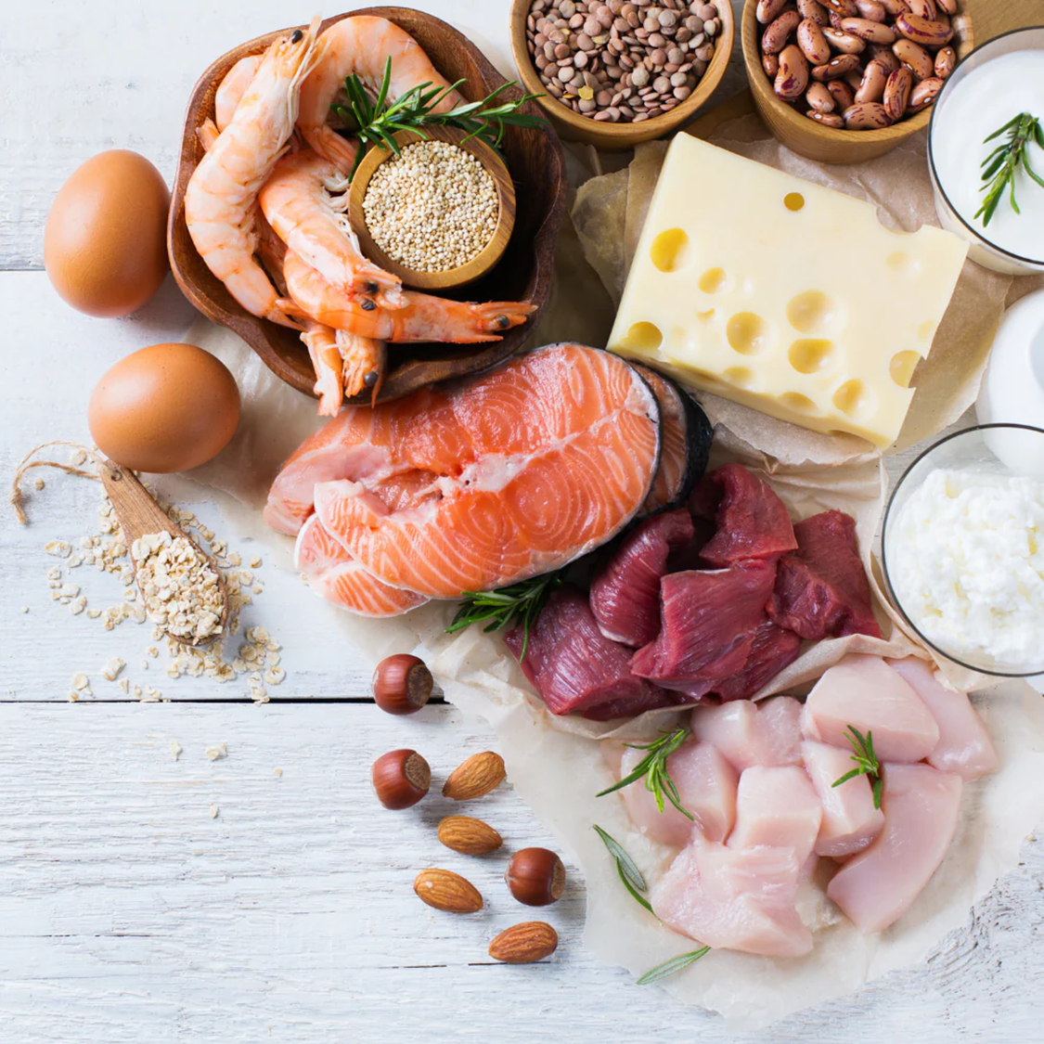
What exactly are proteins and amino acids?
What do they do for our bodies?
What are the best types of proteins?
What are the best types of amino acids?
We have thousands of unique proteins in your body. Your protein-rich muscles enable you to swim, walk, stand and hold your head up so you can read this information. Without adequate protein, your immune system wouldn’t be able to fight off infections, your hair wouldn’t grow, your fingernails would be mere stubs, and you wouldn’t be able to digest your food.

Slide 5
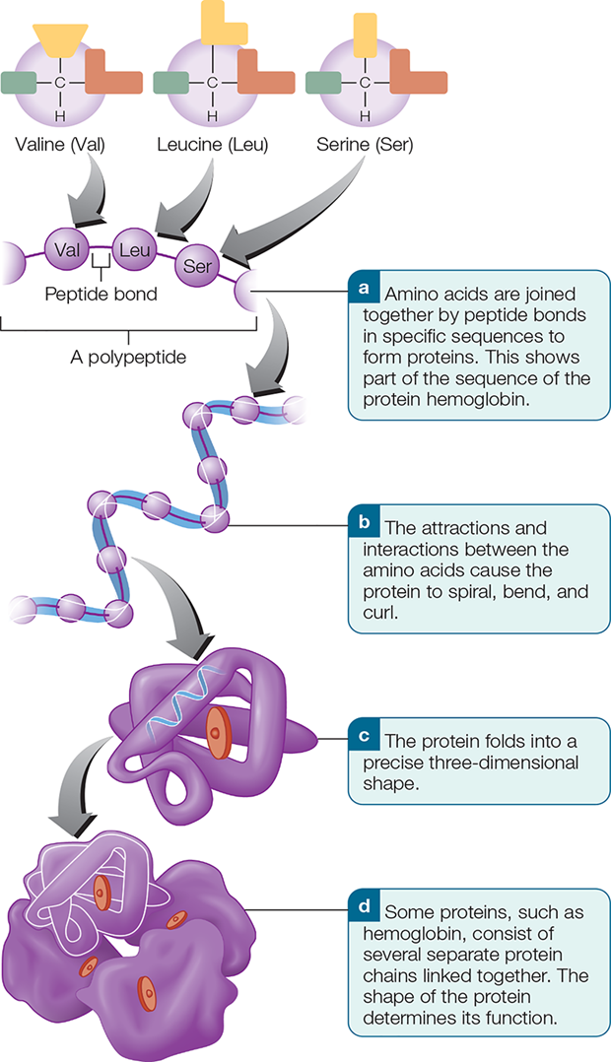
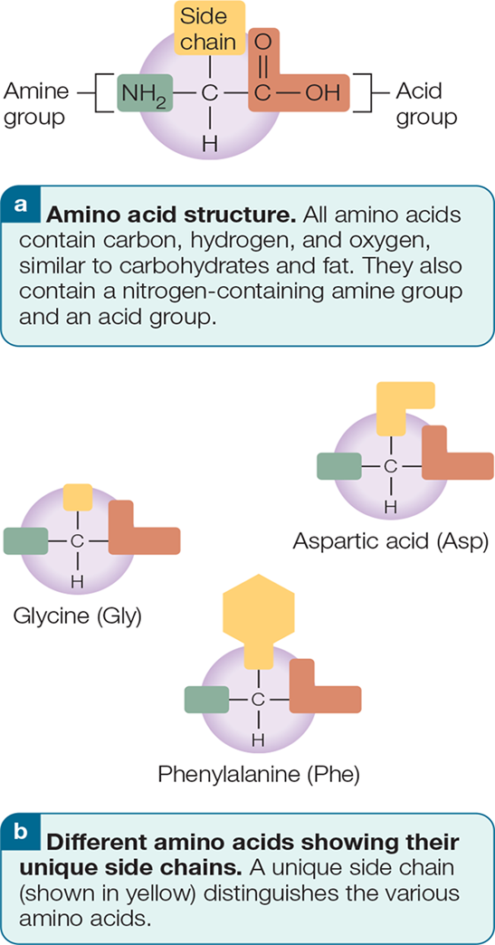
1. Protein in Food
Proteins are long chains of amino acids.
Amino acids are the building blocks of protein.

Slide 6
Essential & Nonessential Amino Acids
Essential amino acids
Amino acids that either can’t be made in the body or can’t be made in the quantities needed – so you have to get them from food.
Nonessential amino acids
These are made in the body.

Slide 7
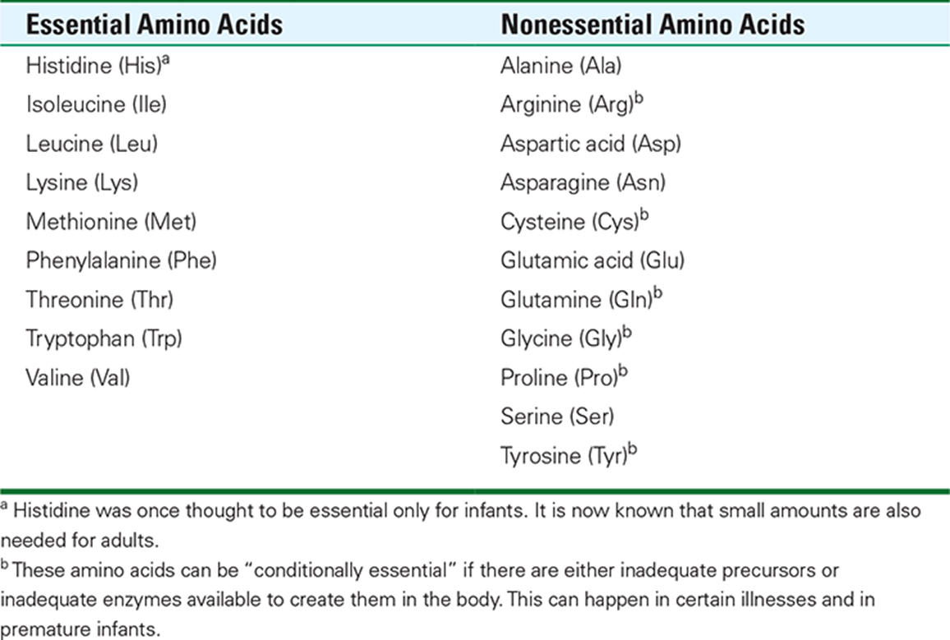
The Mighty Twenty

Slide 8
Protein in Foods
Animal foods (beef, chicken, dairy) have more protein per ounce than plant foods (20 grams in 3 oz. meat, poultry, fish or 8 grams in 1 cup of milk)
Among plant foods, legumes and nuts are very good sources of protein (5-8 grams/svg).
Grains and veggies have some protein – about 2-4 grams/serving.
Fruits have no protein.

Slide 9
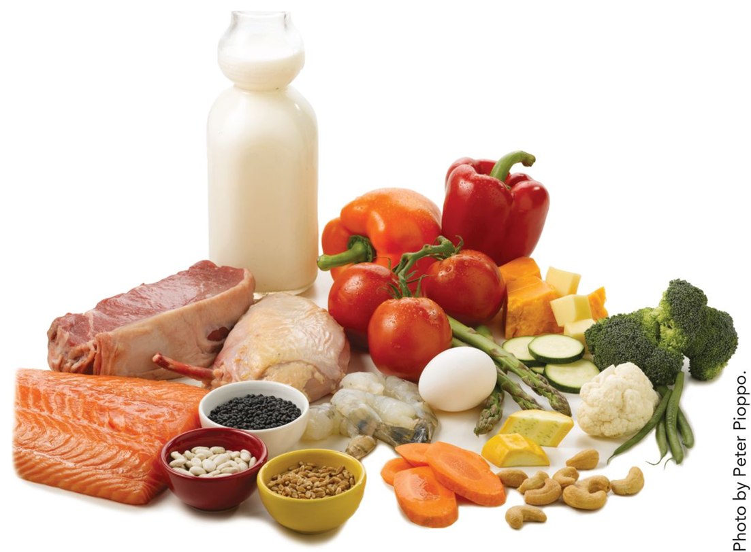
Animal and Plant Sources of Protein

Slide 10
Fat in Protein Foods
Most plant foods have little to no saturated fat.
Nuts and seeds contain fat but mostly good fats – polyunsaturated and monounsaturated fatty acids.
Most fish and shellfish contain small amounts of fat.
Even fatty fish, such as salmon, are close to chicken breast (skinless) in fat and saturated fat.
Much of the fat in seafood is good fat – polyunsaturated.

Slide 11
Complete vs. Incomplete Proteins
Complete proteins
  Animal proteins
  Contain all the essential amino acids in the proportions needed by the body.
Incomplete proteins
  Plant proteins (except soybeans and quinoa)
  Such as dried beans and peas, grains, vegetables, nuts, seeds
  Low in one or more essential amino acids—called the limiting amino acid.

Slide 12
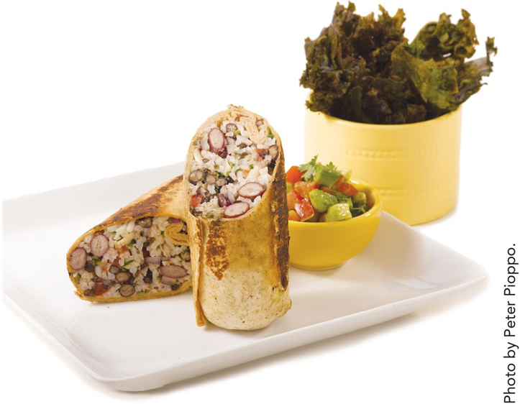
Complementary Protein
The ability of two protein foods to make up for the lack of certain amino acids in each other when eaten over the course of a day.

Slide 13
Protein Pairings: Complementary Protein
Table 5-2 Complementary Proteins
Complementary Proteins | Examples
Legumes with grains | Retried beans on tortilla, combread and pinto beans, falafel with whole-wheat pita, peanut butter on whole-wheat bread, black bean quinoa burger
Legumes with nuts/seeds | Hummus (ground sesame seeds and chickpeas), lentil walnut burgers
Legumes with dairy | Black bean and cheese burritos, chili with shredded cheese
Grains with dairy | Oatmeal and milk, whole-wheat macaroni and cheese, cheese sandwich on whole-grain bread
Nuts/seeds with dairy | Yogurt dressing and toasted almonds on salad, feta/walnut pate
Soybeans (and the protein in soybean products such as soy milk and tofu) contain complete protein.

Slide 14
2. Protein in the Body
Proteins you eat are broken down into single amino acids during digestion and then used by your cells to make new proteins.
Amino acid pool in the body provides amino acids to the cells as needed.
**If an amino acid is not available to build a protein, the protein is not made.
Instructions to make protein reside in your genes – part of your D N A.

Slide 15
Digestion and Absorption 1
Stomach: stomach acid helps uncoil proteins so enzymes can start separating amino acids.
Small intestine: enzymes break down proteins into almost all single amino acids..
Amino acids travel in blood to the liver.

Slide 16
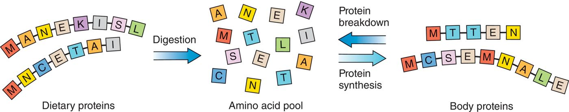
Digestion and Absorption 2
Amino acids enter the amino acid pool from the diet and the breakdown of body proteins. Amino acids in the pool are then used to make new body proteins, or may be used to provide energy or other functions if absolutely necessary.

Slide 17
Functions of Protein
Acts as a structural component of the body.
Builds and maintains the body.
Found in many enzymes and hormones and all antibodies.
Transports iron, fats, minerals, and oxygen.
Maintains fluid and acid-base balance.
Provides energy as last resort.
Helps blood clot.

Slide 18
3. Vegetarian Eating
Types of vegetarians
  Lacto-ovo vegetarians
  Lacto vegetarians
  Vegans
Why become vegetarian?
  Health benefits
  Sustainability
  Economics
  Ethics
  Religious beliefs

Slide 19
Can Vegetarian Diets Be Nutritionally Adequate?
YES – when appropriately planned, varied, and adequate in kcalories.
Most vegetarian diets have enough protein and their diets are lower in fat and saturated fat.

Slide 20
Table 5.4 Nutrients of Concern for Vegetarian? 1
Nutrient | Sources
Vitamin B ₁₂ Vitamin B₁₂ is found only in animal foods. Vegans should eat vitamin B₁₂-fortified foods such as many cold cereals, many meat analogs, and soy beverages. | Dairy products Eggs Fortified foods such as cereals, meat analogs, and soy beverages
Vitamin D Milk is fortified with vitamin D, and vitamin D can be made in; the skin with sunlight. Some cold cereals, orange juice, and soy beverages are fortified with vitamin D. | Sun exposure Fortified milk and soymilk Fortified cereals Fortified orange juice
Calcium Vegetarians who drink cow's milk generally don't have a problem here, but vegans sometimes do if they don't eat enough calcium-fortified foods as well as plant foods that contain calcium. | Milk, yogurt, cheese Legumes Dark-green leafy vegetables (broccoli, collard greens, kale) Calcium-fortified soy milk and other soy products Almonds, sesame seeds

Slide 21
Table 5.4 Nutrients of Concern for Vegetarian? 2
Nutrient | Sources
Iron Because iron from plants is not absorbed as well as iron from animal sources, and because the vegetarian diet contains substances that interfere with iron absorption, vegetarians need as much as 1.8 times the RDA. Iron's absorption is greatly enhanced by vitamin C-containing fruits and vegetables that are consumed at the same time. | Iron-fortified breads and cereals Bean and lentils Dried fruits Cashews Dark-green leafy vegetables (spinach) Milk, cheese, yogurt
Zinc Zinc is highest in animal foods, but is found in legumes, whole grains, and fortified cereals. | Milk, cheese, yogurt Fortified cereals and grains Whole grains Legumes Nuts and seeds Peanut butter
Omega-3 Fatty Acids (DHA and EPA) Since DHA and EPA are primarily in fatty fish, supplements (made from algae, not fish oils) may be needed. Some foods are fortified with DHA and/or EPA, but the amounts may be small. | Walnuts, soybeans, soybean oil Supplements (consult your physic

Slide 22
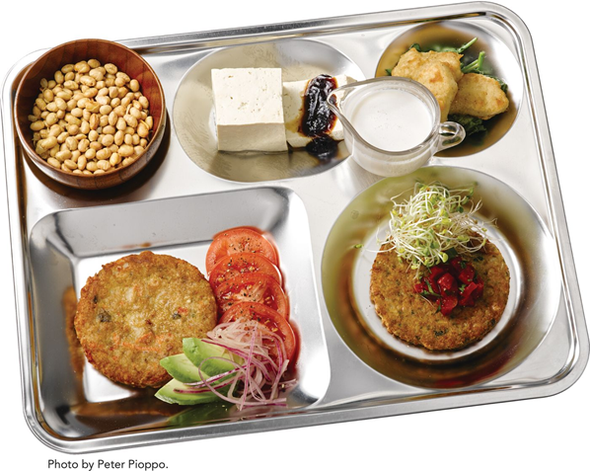
What Do Vegetarians Eat in Place of Meat and Milk?
Grains with legumes and/or vegetables, nuts and seeds.
Soyfoods such as tofu, tempeh, edamame.
Also meat substitutes or alternatives which use soy- or vegetable-based protein and may be fortified with important nutrients such as B12.

Slide 23
Vegetarian Menu Planning Guidelines
Use a variety of plant proteins at each meal.
Use a wide variety of vegetables.
Choose low-fat and fat-free varieties of milk and limit the use of eggs.
Offer dishes made with soybean-based products.
For vegan diets, avoid honey or gelatin.

Slide 24
Menu Planning Guidelines (cont’d)
For menu ideas, look at other countries’ cuisines.
  Africa: Spicy vegetable stew, peanut soup
  Asian: Meatless stir-fries, vegetable moo shu wraps
  Caribbean: Spinach and potato croquettes
  France: Ratatouille
  Indian: Dal, vegetable curries
  Mexican: Vegetarian tacos, quesadillas
  Middle East: Falafel, tabbouleh, hummus

Slide 25
For Vegans
Substitutions for eggs:
  1/4 cup soft tofu blended with the liquid ingredients
  1/4 cup mashed banana
  1/4 cup soy yogurt
  1.5 teaspoons Ener-G Egg Replacer mixed with 2 T water
Subs for dairy:
  Soy milk, rice milk, nut milk
  Soy cheese
  Use crumbled tofu for cottage cheese or ricotta cheese
  Nondairy cream cheese is available
  Soy yogurt

Slide 26
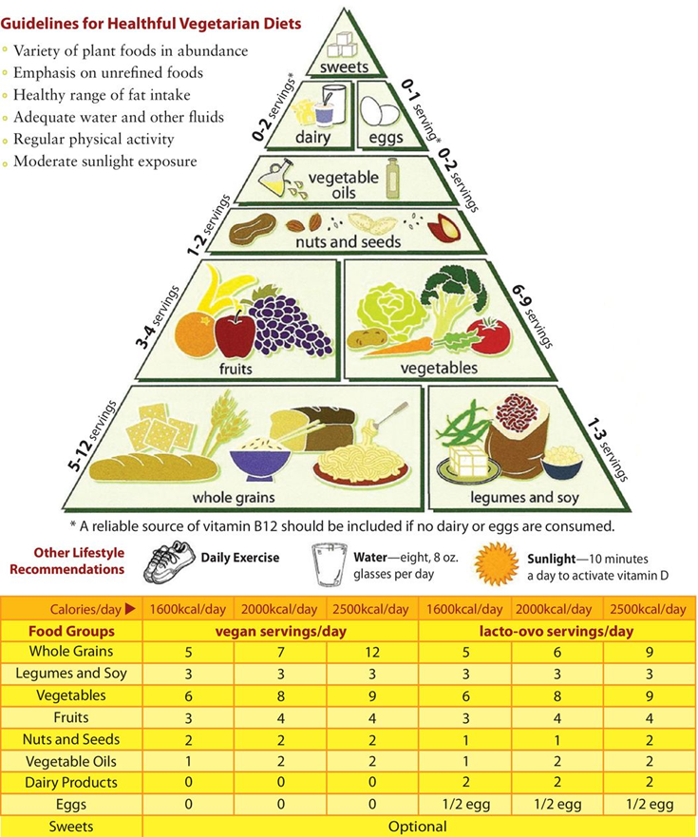
Vegetarian Food Pyramid

Slide 27
4. Dietary Recommendations for Protein
R D A: 0.8 grams of protein/kilogram OR 0.36 grams of protein/pound (your weight).
You should eat protein from both animal and plant sources.
Plant sources of protein contain little saturated fat & more fiber than animal sources.
Teen boys and adult men get too much protein and should reduce their intake of meat, poultry, and eggs.

Slide 28
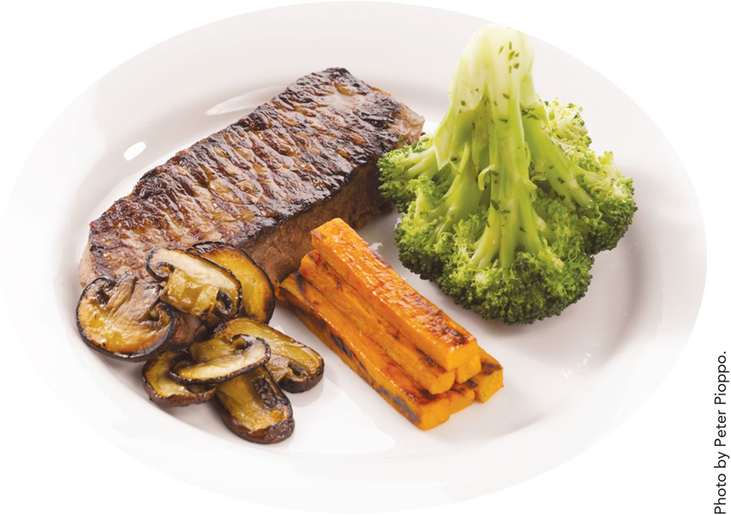
Dietary Recommendations 1
This 5-ounce steak (after cooking) has 40 grams of protein and much of the protein you need for 1 day.

Slide 29
Dietary Recommendations 2
Endurance and power (strength or speed) athletes can benefit from more protein—from 1.2 to 1.7 grams/kg body weight.
Protein and amino acid supplements are rarely needed for athletes or nonathletes. Since they eat more, they take in more protein.

Slide 30
Dietary Recommendations 3
It is best to eat your protein evenly across your meals because it:
  Makes you feel fuller
  Helps the body maintain muscle tissue —especially as you get older

Slide 31
Eating Too Much Protein
Eating excessive protein does NOT:
  Result in bigger muscles
  Give you stronger bones
  Pump up your immune system
Only strength-training and exercise will help you build muscles.

Slide 32
Eating Too Much Protein MAY:
  Result in too many kcalories taken in and weight gain (due to more fat cells).
  Result in high intake of saturated fat – increases your risk of heart disease.
  Increase work of kidneys (concern for people with kidney disease).

Slide 33
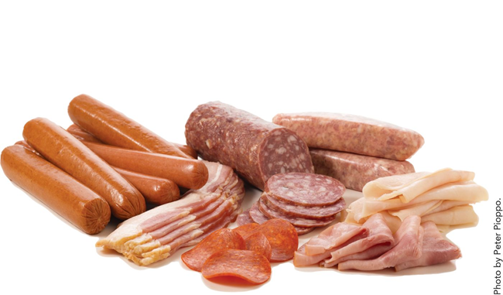
Eating Too Much:
Long-term consumption of red meat and processed meat is strongly linked with a modest, but significant, increase in the risk of developing colorectal cancer.

Slide 34
Eating too little protein….
Eating too little protein:
  A number of body systems don’t work as well – such as the immune system, kidneys, etc.
  Growth slows down for children.

Slide 35
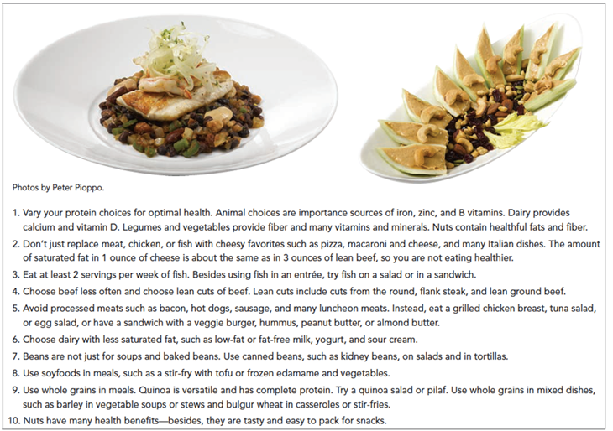
Ten Ways to Eat Healthy Protein
Figure 5-10 Ten ways to eat healthy protein.

Slide 36
5. Plant-Forward Cooking
Plant-forward cooking means that your dishes have a more dedicated emphasis on vegetables, fruits, whole grains, legumes, nuts, and seeds.
Animal proteins may be included, but it’s usually not the main feature of the meal, meaning the portion size can be significantly reduced.
When using animal proteins, you should choose leaner, well-trimmed cuts, skinless poultry, fish, and very limited processed such as deli meats, sausages, and bacon typically high in salt and nitrates.

Slide 37
Plant-Forward Cooking
Consider cooking techniques:
  Stir-frying
  Grilling
  Vapor braising
  Searing
  Roasting
  Pickling
  Fermenting
Beet dogs, mushroom lentil burgers, black bean sweet potato cake, as well as chickpea and quinoa vegetable patties are recognizable plant-based ingredients turned into familiar menu terms.

Slide 38
6. Culinary Focus: Meat, Poultry, & Fish
Denaturation: The process in which proteins become firm, shrink in size, and lose moisture as they are cooked or whipped.
Think of eggs being cooked, heavy cream being whipped, meats being cooked.

Slide 39
Poultry and Fish
Chicken breast and turkey breast (meaning white meat) without skin are low in saturated fat—there is only about 1 gram of saturated fat in 4 ounces of chicken or turkey. Poultry skin can be left on during cooking, then removed for service.
Most fish is lower in fat and saturated fat than are meat and poultry (skin on).

Slide 40
Lean Cuts of Beef 1
Bottom round steak or roast
Flank steak
Eye round roast
Top sirloin steak
Tenderloin filet
Top round roast or steak
90/10 or 95/5 ground beef

Slide 41
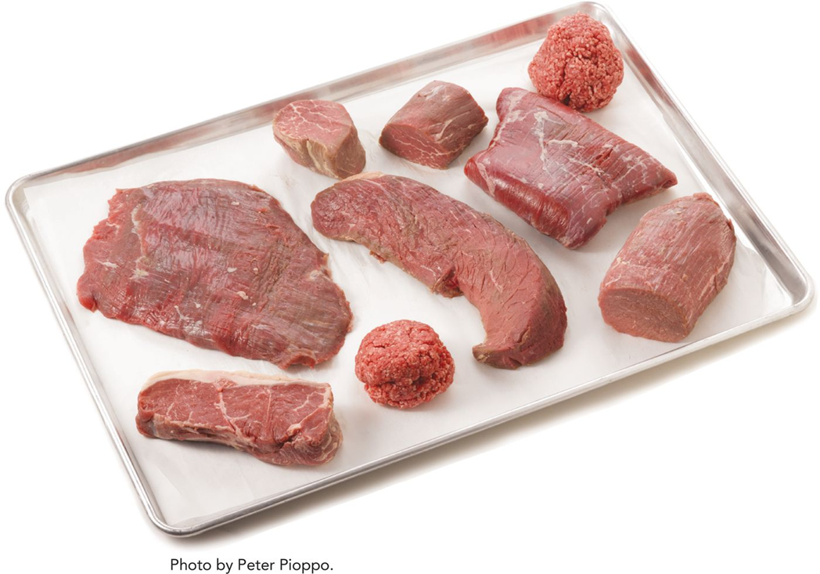
Lean cuts of beef 2

Slide 42
Other Lean Animal Proteins
Veal: Loin or rib chops and top round
Pork: pork tenderloin, top loin chops
Poultry: breast (skinless or skin removed after cooking)
Seafood: all fish and shellfish
Worldwide we are depleting fish populations. Check out the Monterey Bay Aquarium Seafood Watch or SeaChoice for help choosing sustainable fish.

Slide 43
Meat & Poultry: Rubs and Marinades
Use flavorful rubs—dry or wet. The larger the protein is, the longer the rub can stay on. The rub flavors the exterior, and penetrates slightly into the interior of the meat as it cooks.
Marinades build flavor profiles naturally so you don’t need as much fat, cream, or sauces.
To give marinated foods flavor, try minced fruits and veggies, low-sodium soy sauce, mustard, fresh herbs, and spices.

Slide 44
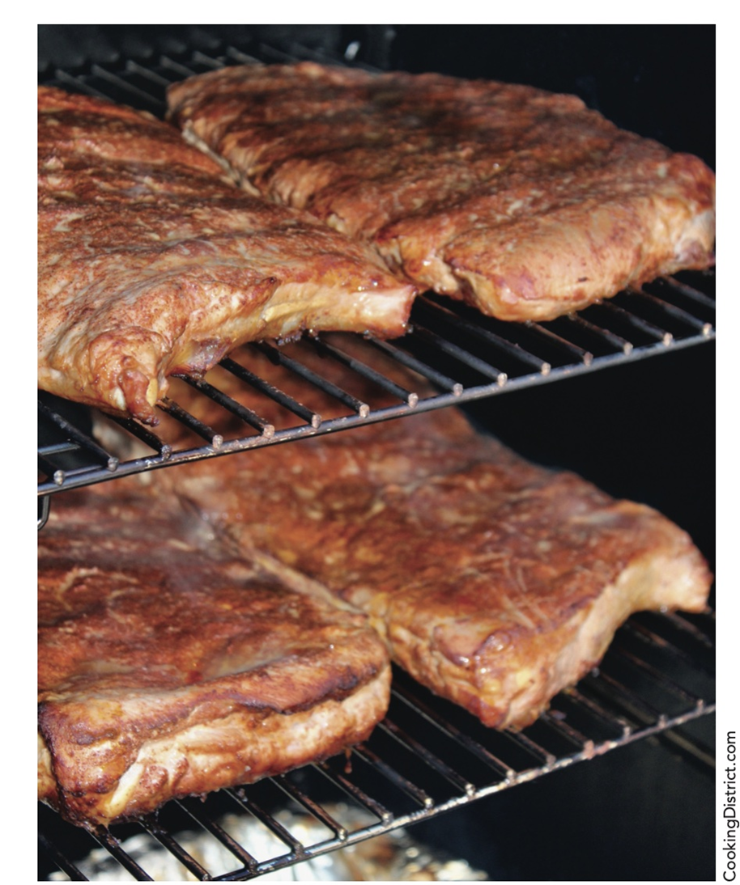
Smoking Meats

Slide 45
Fish & Shellfish: Prepare & Cook
Marinate without citrus.
Try a marinade that includes fish stock, white wine, chives, tarragon, thyme, black pepper, and a touch of olive oil. The fish will absorb some liquid, which will keep it moister during cooking.
Cooking methods: roast, grill, broil, dry saute, poach, braise
Smoking can add flavor

Slide 46
Menuing and Presentation
Simple presentations. Take into consideration portion size, color, balance, texture, customer, and flow.
When plating, an attractive (yet easy) presentation is to serve entrees in an oversized pasta bowl with a bed of grain and vegetable salad, a few pieces of roasted asparagus, and then placing the fish or protein on top. Garnish with a fine-shaved lemon fennel salad, micro herbs, or shaved radishes.

Slide 47
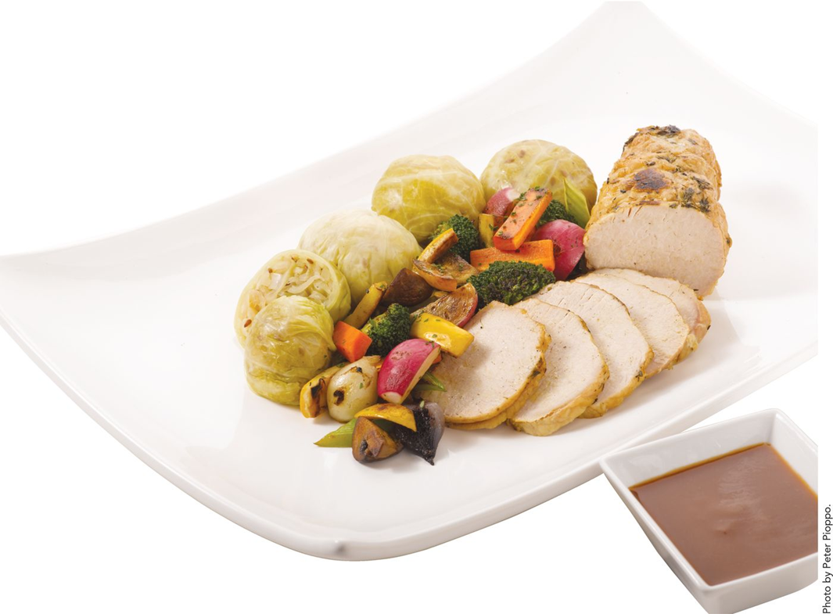
Slice meats and poultry thin and fan around a base such as wilted spinach, stewed greens, or pureed cauliflower.

Slide 48
Copyright
Copyright © 2021 John Wiley & Sons, Inc.
John Wiley & Sons, Inc. or the author, all rights reserved. Instructors who are authorized users of this course are permitted to download these materials and use them in connection with the course. Except as permitted herein or by law, no part of these materials should be reproduced, stored in a retrieval system, or transmitted, in any form or by any means, electronic, mechanical, photocopying, recording or otherwise.
Readers should be aware that websites listed in this work may have changed or disappeared between when this work was written and when it is read. Neither the publisher nor authors shall be liable for any loss of profit or any other commercial damages, including but not limited to special, incidental, consequential, or other damages.

