Slide 1
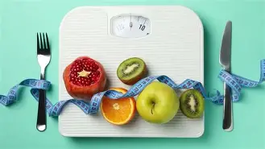
Nutrition for Foodservice and Culinary Professionals
Tenth Edition
CHAPTER 12
Weight Management

Slide 2

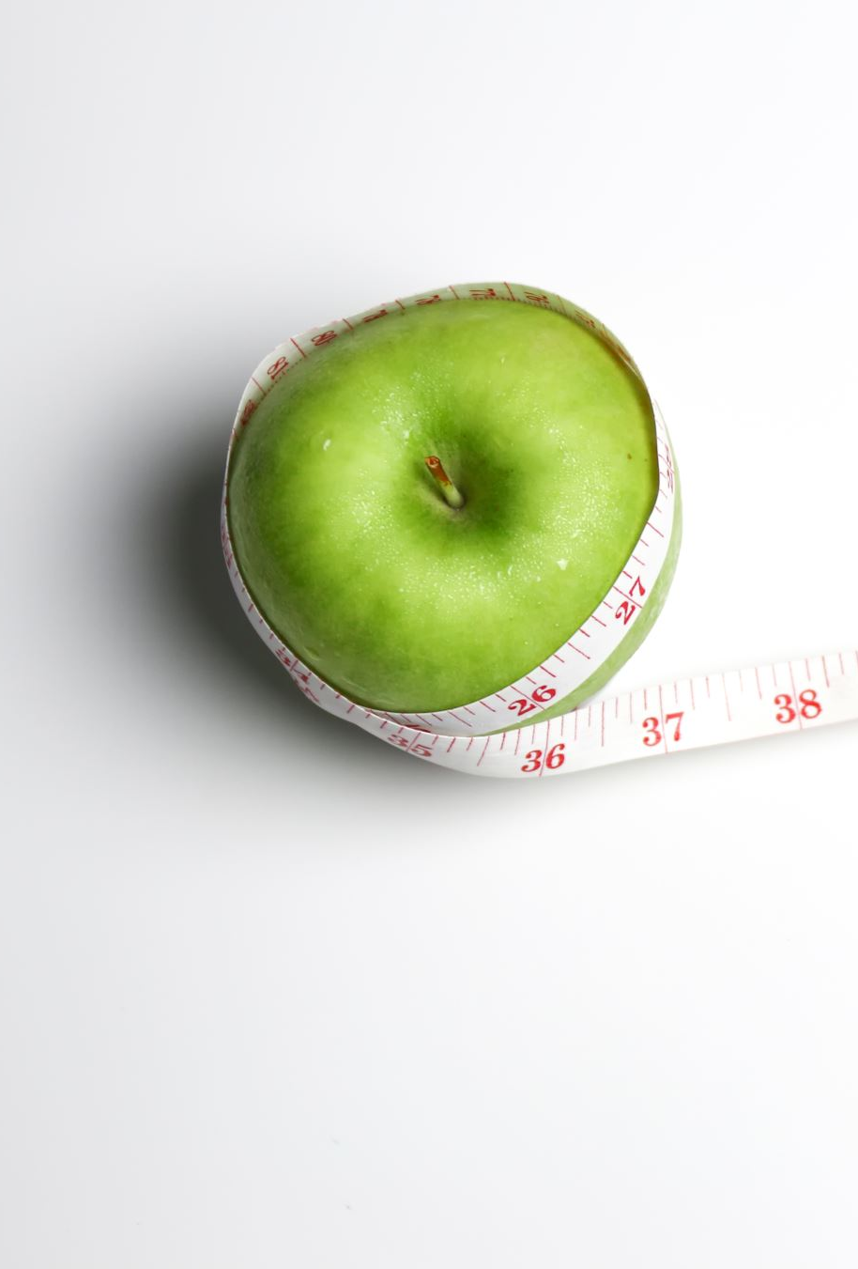




Outline
Basics of Weight Management
How to Lose Weight
Weight-Loss Myths

Slide 3
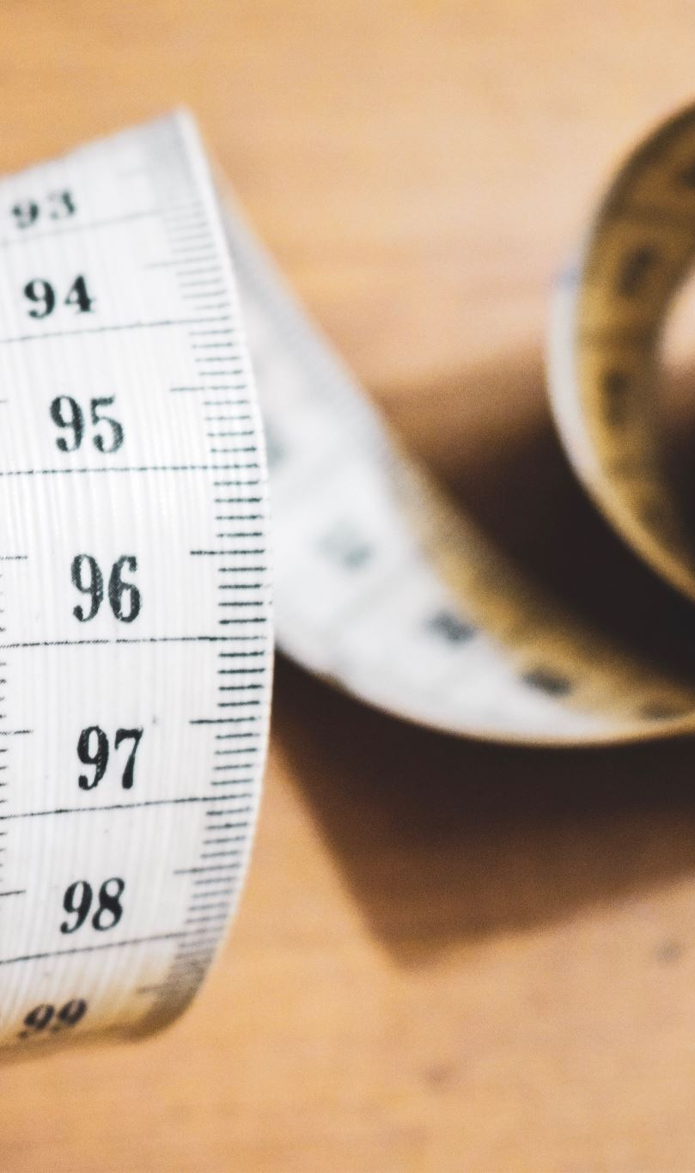
Introduction
Overweight and obesity are among the most pressing challenges in the United States.
More than 70% of American adults are either overweight or obese.
About 40% of children and adolescents are overweight or have obesity.
Being overweight or obese are both terms for having more body fat than what is considered healthy. However, the term “obese” means having a higher amount of body fat than “overweight.”

Slide 4
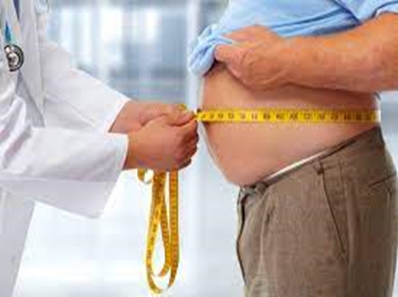
Americans currently spend more than $65 billion on everything from over-the-counter diet pills to books, magazines, online support groups, and commercial dieting centers to help shed excess weight. Unfortunately, these programs usually aren’t successful, and the U.S. healthcare system bears more than $145 billion in costs of treating the medical complications associated with being overweight. No matter what you personally weigh, some of your tax dollars are supporting these costs. Despite spending so much money on the battle of the bulge, we are not winning the war for weight control.

Slide 5
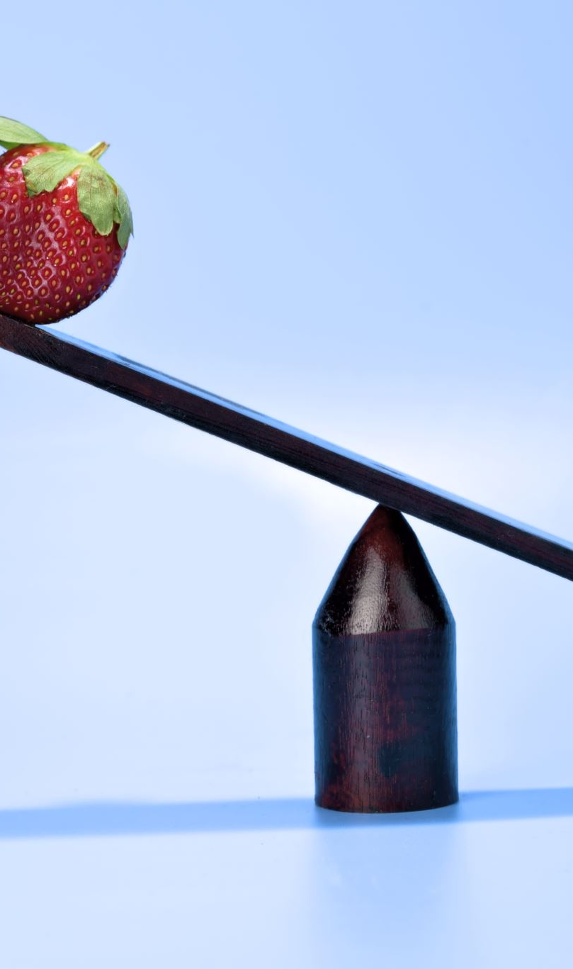
1. Basics of Weight Management
Kcalorie balance refers to the relationship between the kcalories you take in from food and beverages and the kcalories you use through physical activity and your basal metabolism.
If kcalories consumed = kcalories used, then you maintain the same body weight.
If you eat fewer kcalories than you use, then you lose weight.
If you eat more kcalories than you use, then you gain weight.

Slide 6
Factors that play a role in obesity:
Your eating habits
Ready availability of tasty ultra—processed foods
Your physical activity level
Your cultural and/or socioeconomic background
Your genetics
Environmental
Increase in portion sizes
Lack of safe places to be active
Food marketing and promotion

Slide 7
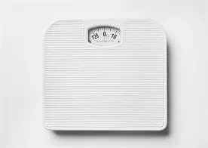
How Much Should I Weigh? 1
Normal weight: B M I under 25
Overweight: B M I of 25 to 29.9
Obese: B M I of 30 or greater
Body Mass Index
A measure of weight relative to height.
A reasonably reliable indicator of total body fat
B M I over 25 raises risk for heart disease, high blood pressure, and diabetes.

Slide 8
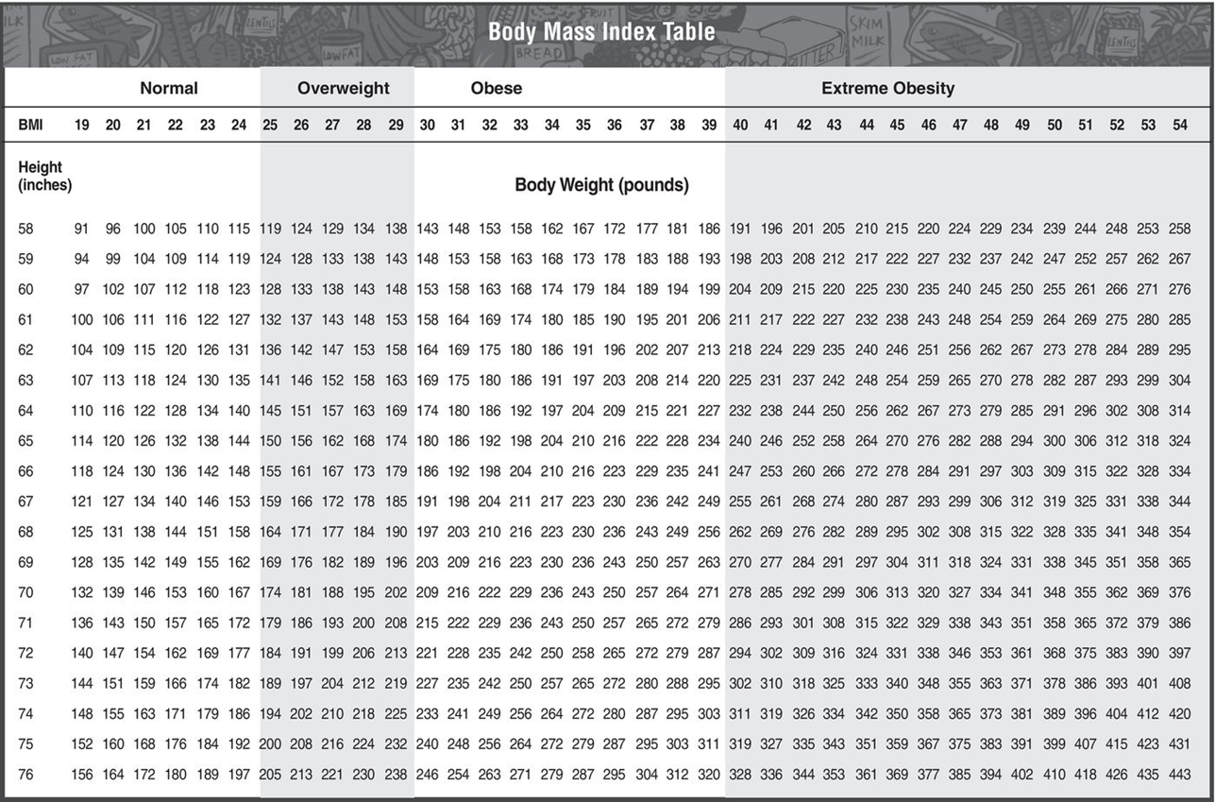
How Much Should I Weigh?

Slide 9
How Much Should I Weigh?
Because B M I doesn’t tell you how much of your excess weight is fat, a physician will also measure your waist circumference.
Excessive abdominal fat is more health-threatening than fat in the hips or thighs.
Women—desirable to keep waist below 35 inches
Men—desirable to keep waist below 40 inches

Slide 10

How Do You Know If You’re at a Healthy Weight?
Today, the typical cover girl is more than 20 percent thinner. The male physique is being held to a similarly unattainable standard. Witness the change from average to beefy in toy action figures over the years. Although models, celebrities, and dolls may reflect the “in” look, they don’t necessarily correlate with good health, nor should they be your reference for the body weight that you should strive to obtain. However, there are some signs that healthy body weight is being more represented and celebrated in our culture, such as the new realistic Barbie dolls.

Slide 11
How Obesity Affects Your Health
An obese individual is at increased risk for:
Type 2 diabetes
High blood cholesterol levels
High blood pressure
Heart disease
Stroke
Certain types of cancer
Liver and gallbladder disease
Sleep apnea
Losing weight often decreases blood pressure and cholesterol levels.

Slide 12
How Do You Know If You’re at a Healthy Weight?
One of the most common and inexpensive ways to assess a healthy weight is to measure body mass index (BMI). BMI is a calculation of weight in relationship to height using the following formula:
BMI = weight (pounds) x 703
-------------------------------------
Height squared (inches 2)

Slide 13
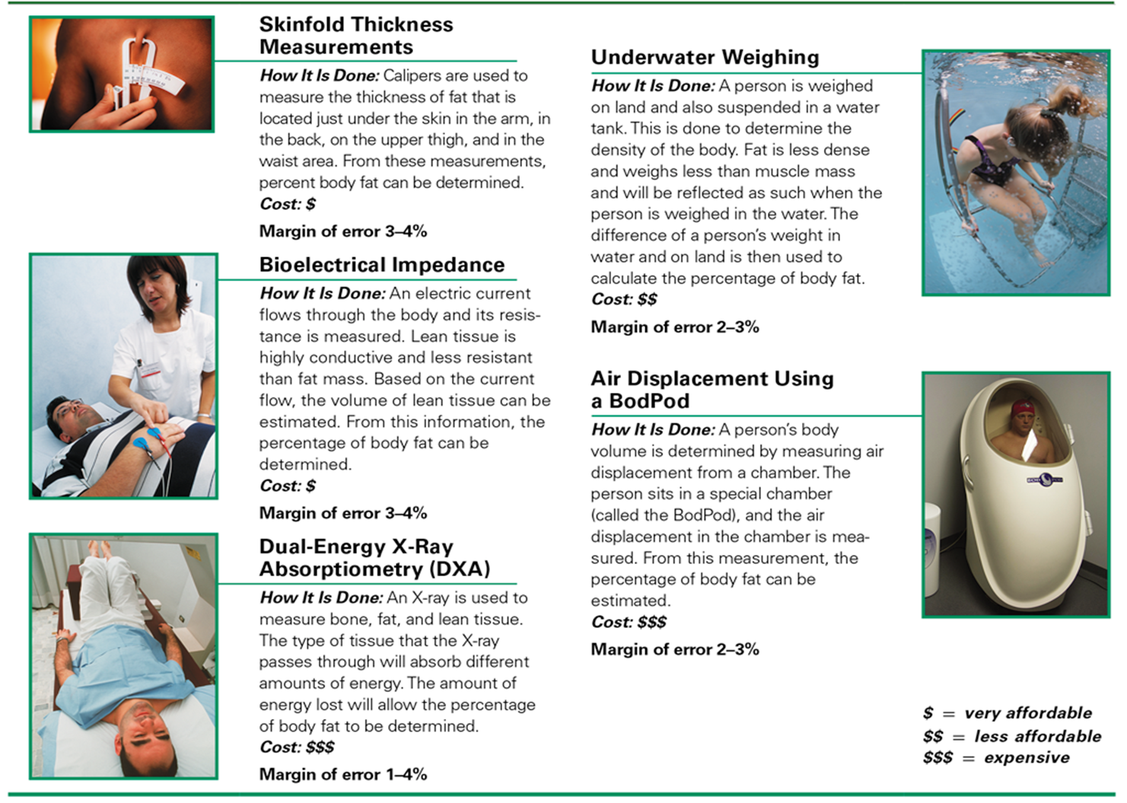
Other Ways to Measure Percentage of Body Fat

Slide 14
How Do You Know If You’re at a Healthy Weight?
BMI is used as a screening tool to identify potential weight problems and should not be used as a diagnostic tool for specific medical conditions. Also, because BMI is not a direct measure of percentage body fat, it may not be accurate for everyone. This is particularly true for athletes. Many athletes have a BMI that should put them in the “unhealthy” category, but they aren’t unhealthy because their body weight is predominantly muscle, not fat
Underweight = under 18.5
Healthy weight = between 18.5 – 24.9
Overweight = between 25 – 29.9
Obese = 30 and over

Slide 15
2. How to Lose Weight
You need to eat and drink fewer kcalories and/or burn more kcalories in physical activity.
Set a realistic weight loss goal.
Even modest weight loss can produce health benefits—lower cholesterol, blood pressure, etc.
About 25% of the weight dieters lose is lean tissue – mostly muscle.

Slide 16
Components of a weight loss program:
A. Eating plan
B. Exercise
C. Behavioral and attitude modification
D. Social support
E. Support to maintain weight loss

Slide 17
A. Eating Plan
You have to restrict kcalories.
Weight loss isn’t just about a “diet”—it’s about an ongoing lifestyle that includes long-term changes in daily eating and exercise habits.

Slide 18
A. Eating Plan 2
Your food choices should:
Emphasize fruits, vegetables, whole grains, seafood and legumes.
Use moderate amounts of dairy products (choose low and non-ft versions) and alcohol
Is low in meats, sugar-sweetened foods and beverages, and refined grains.
One diet is no better than the next when it comes to weight loss, as long as you are eating fewer kcalories and taking in adequate nutrients through the foods listed above.
You can lose weight by eating more whole foods and fewer processed and ultra-processed foods.

Slide 19
Eating Plan – Intermittent Fasting 1
Daily time-restricted fast - only eat during a certain period of time such as from 8 A M to 4 P M.
5:2 intermittent fasting – Eat normally 5 days a week and only 1 moderate meal on the other 2 days.

Slide 20
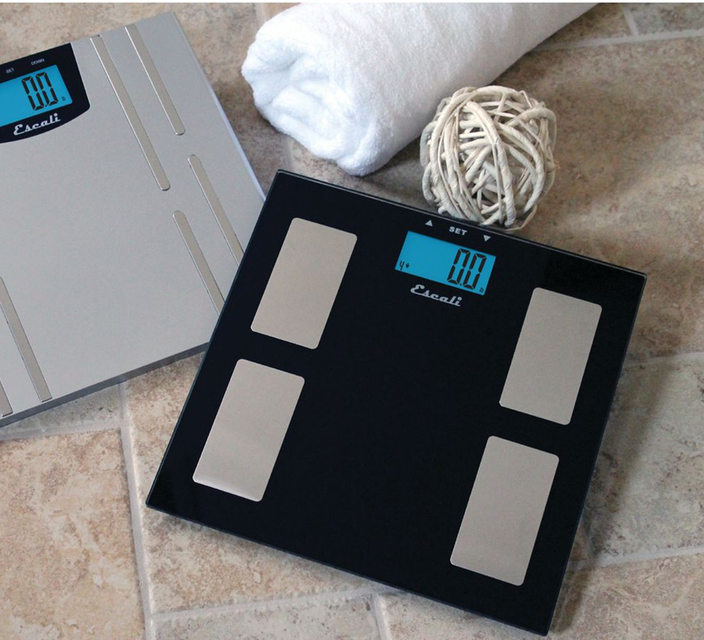
Eating Plan – Intermittent Fasting 2
Weigh yourself frequently—at least weekly.

Slide 21
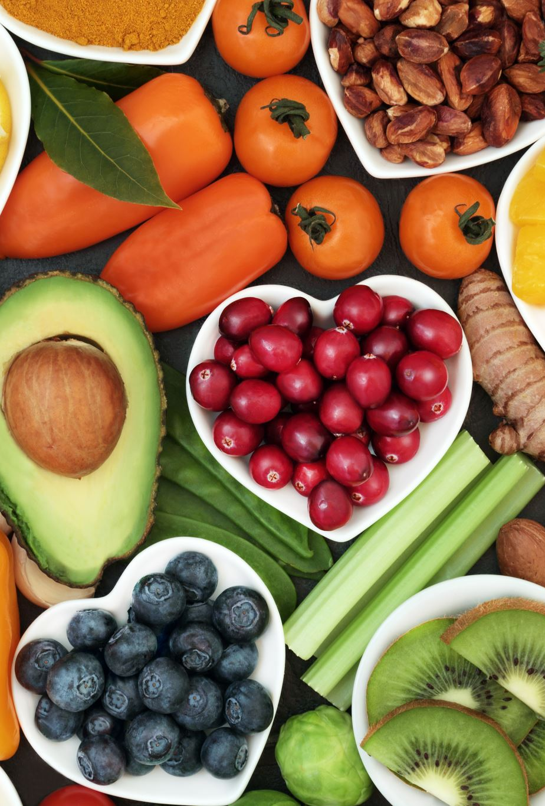
Eating Tips 1
To cut kcalories without feeling hungry, you need to replace some higher kcalorie foods with foods that are lower in kcalories and fat and will fill you up—choose foods with lots of water and fiber such as fruits, vegetables, broth-based soups, whole grains, and legumes.

Slide 22
Eating Tips 2
Also eat smaller portions.
Pay more attention to how hungry you are rather than how much food is on the plate.
Start a meal with foods that fill you up (salad soup, water).
No foods should be forbidden.
Low-fat and fat-free foods are not necessarily low in kcalories.

Slide 23

Eating Tips 3
Figure 12.4 Eating breakfast is very important if you want to lose weight.

Slide 24
Eating Tips 4
Choose your carbohydrates carefully—pick fruits, vegetables, whole grains, and dairy. Fiber in these foods will help you feel full. Limit foods with added sugars and primarily white flour.
Don’t cut back on protein foods – preserve your muscle!
Drink plenty of fluids.
Watch out for empty kcalories in alcoholic beverages and mixers, as well as fancy coffee drinks.

Slide 25
Very-low-kcalorie diet
A very-low-kcalorie diet is a doctor supervised diet that usually uses commercially prepared formulas to promote rapid weight loss in obese patients.
The formulas—usually liquid shakes or bars—replace all food intake for several weeks or months. They are fortified with nutrients.

Slide 26
B. Exercise
When losing weight, more physical activity increases the number of kcalories you body uses for energy—you burn more kcalories during the activity and also for a few hours after vigorous prolonged activity.
Dieters who exercise tend to lose more fat and retain more muscle. They are also more likely to follow their diet plans and keep the weight off.
Best to include aerobic training AND strength-training.

Slide 27
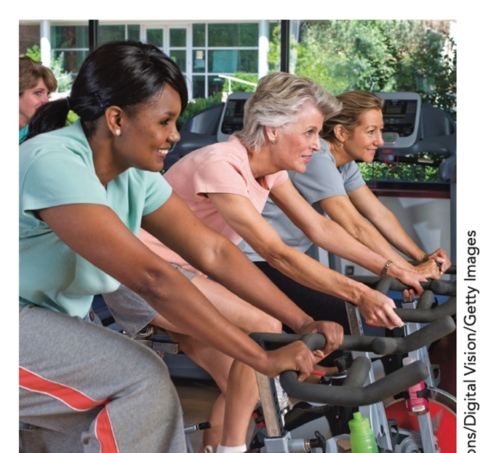
Exercising improves your mood.

Slide 28
Benefits of Exercise
Controls appetite
Reduces high blood pressure
Reduces risk for Type 2 diabetes and cardiovascular disease
Reduces risk for some cancers (breast, colon)
Reduces stress, anxiety, & depression
Improves self-esteem
Increases stamina and resistance to fatigue
Improves bone density and body composition

Slide 29
2. Nutrition and Menu Planning for Adolescents
To maintain your weight—150 minutes or
hours of moderate intensity
or 75 minutes of vigorous intensity each week
To lose weight and keep it off— 300+ minutes/week of moderate-intensity
The optimal fitness routine includes aerobic training, strength-training, and stretching activities.

Slide 30
Moderate & Vigorous Activities
Moderate Intensity
Walking briskly
Yard work
Dancing
Golf (walking and carrying clubs)
Biking less than 10 mph
Weight training
Vigorous Intensity
Running
Biking over 10 mph
Swimming laps
Aerobics
Most competitive sports
Jumping rope

Slide 31
C. Behavior and Attitude Modification
Behavior modification—changing some of your behaviors so that you make healthier choices and lose weight
Set goals that are specific, realistic, and forgiving, such as walking 30 minutes a day, 5 times a week.

Slide 32

Elements of Behavior & Attitude Modification
Self-monitoring
Stimulus or cue control
Eating behaviors
Reinforcement or self-reward
Self-control
Attitude modification

Slide 33
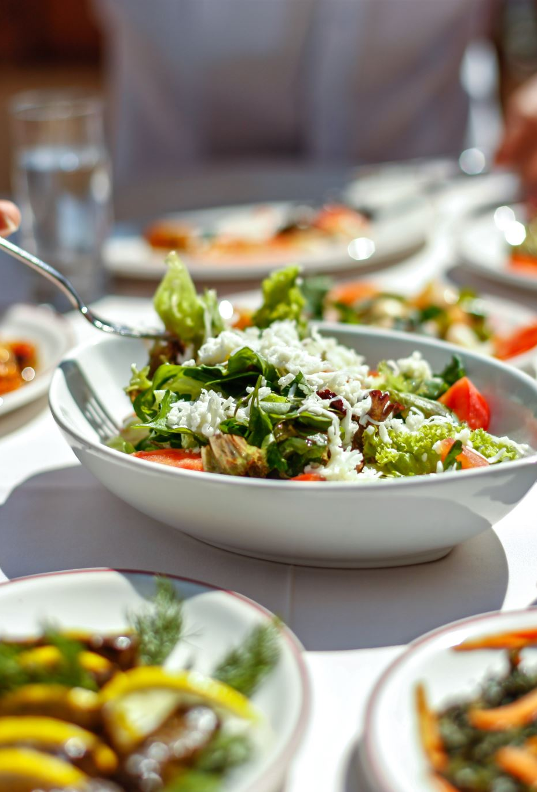
Self-Monitoring
Keeping a record of what you eat
May include when and where you ate, your mood at the time and degree of hunger
Self-monitoring helps you see your eating habits and cues to overeating
Hunger vs appetite

Slide 34
Stimulus or Cue Control
Plan
Plan meals.
Make
Make a shopping list.
Do
Do food shopping after eating.
Store
Store food out of sight.
Keep
Keep low-kcal snacks on hand.
Do not serve
Do not serve food at the table.
Leave
Leave the table right after eating.
Decide
When eating out, decide what you will eat ahead of time.

Slide 35
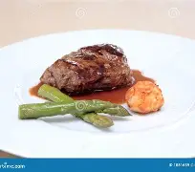
Modifying Eating Behaviors
Only let yourself eat in 1 or 2 places, such as at the kitchen or dining room table—don’t eat in bed, in front of T V, etc.
Plan regular meals and snack.
Eat slowly.
Take smaller bites—savor each bite.
Use a smaller plate—don’t clean your plate.

Slide 36
Reward Yourself
Reward yourself for positive steps—but don’t use food!
Pick something that is desirable and timely.

Slide 37

Eating Due to Stress
To relieve stress, you can exercise or use relaxation techniques.
You can switch to a new activity when you need to get your mind off food.
If you want to grab a cookie, for instance, give yourself five minutes before you do it. In that time you will likely go on to something else and forget about the food.
Positive self-talk is good for self-control.

Slide 38
Attitude Modification
Unrealistic statements:
I will always control my desire for chocolate.
I will exercise every day.
Goals stated like this decrease the likelihood that you will accomplish them.
Avoid terms such as “always,” “never,” and “every.”
If you do overeat, stay calm, realize no one is perfect and tomorrow is another day.

Slide 39
D. Support
Family and friends
Internet and technology: exercise and weight reduction applications
MyFitnessPal
Noom
WeightWatchers
SparkPeople

Slide 40
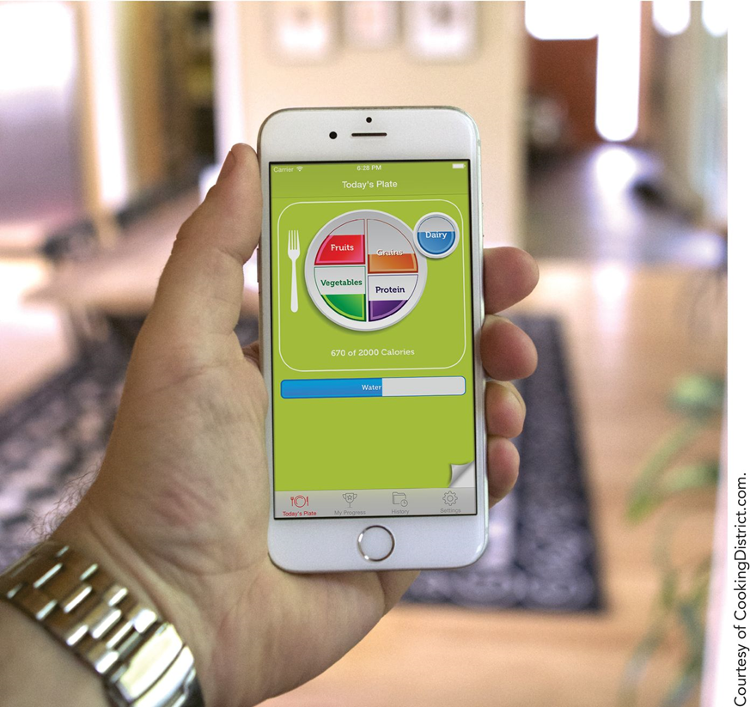
Mobile exercise and weight-reduction applications

Slide 41
E. Maintenance Support
Keep monitoring your kcal and activity.
Exercise 60 minutes/day.
Watch less than 10 hours of T V/week.
Monitor your weight at least weekly.
Continue to get support form family, friends and others.
Continue to follow a healthy eating pattern lower in kcal when compared to diet prior to weight loss.
Keep eating patterns consistent regardless of changes in your routine (weekends).
Eat breakfast every day.

Slide 42
3. Weight Loss Myths
Fad diets work for permanent weight loss.
Certain foods, like grapefruit, celery, or cabbage soup, can burn fat and make your lose weight.
A high-protein diet is better for losing weight than a low-fat diet.
A weight loss product that claims to be “natural” or “herbal” should be safe and effective.

Slide 43
Weight Loss Myths 1
Low-fat or fat-free means no kcalories.
Fast foods are always an unhealthy choice.
Skipping meals is a good way to lose weight.

Slide 44
Weight Loss Myths 2
Lifting weights is not good to do if you want to lose weight, because it will make you “bulk up.”
Nuts are fattening and you should not eat them if you want to lose weight.
Dairy products are fattening and unhealthy.

Slide 45
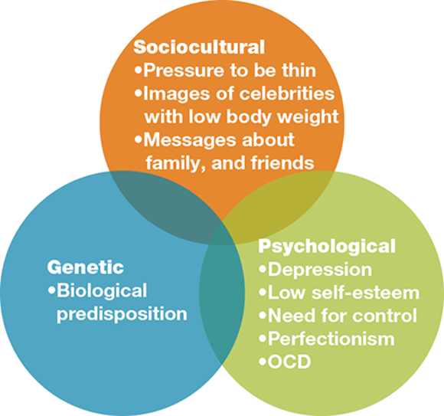
No Single Factor Causes Eating Disorders
Sociocultural Factors
Genetic Factors
Environmental Factors
Psychological Factors

Slide 46
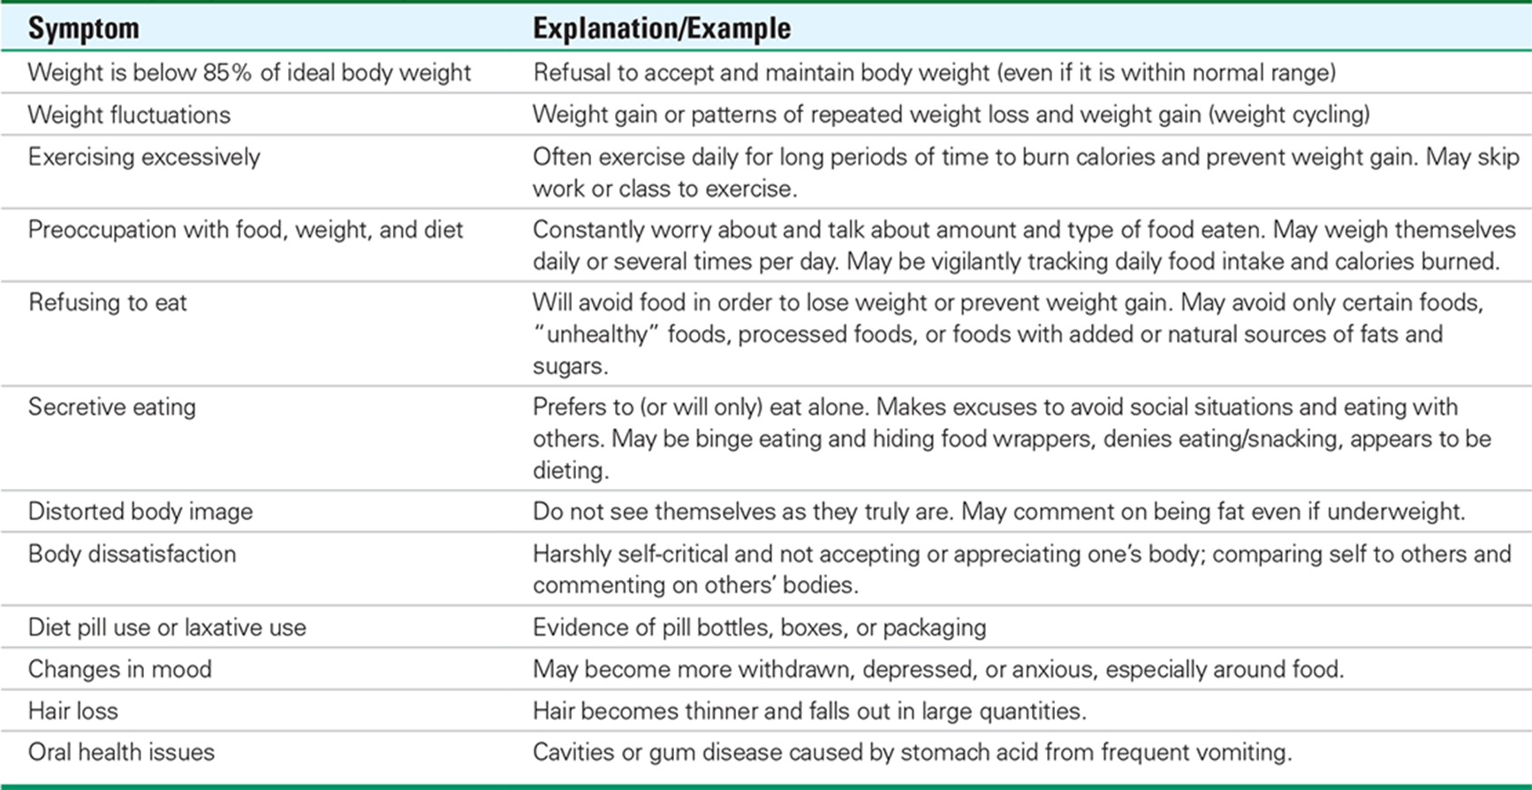

Slide 47
Copyright
Copyright © 2021 John Wiley & Sons, Inc.
John Wiley & Sons, Inc. or the author, all rights reserved. Instructors who are authorized users of this course are permitted to download these materials and use them in connection with the course. Except as permitted herein or by law, no part of these materials should be reproduced, stored in a retrieval system, or transmitted, in any form or by any means, electronic, mechanical, photocopying, recording or otherwise.
Readers should be aware that websites listed in this work may have changed or disappeared between when this work was written and when it is read. Neither the publisher nor authors shall be liable for any loss of profit or any other commercial damages, including but not limited to special, incidental, consequential, or other damages.

