Slide 1
PT Steel Pipe Industry of Indonesia Tbk
Company Presentation
for 2025 Results

Slide 2
Disclaimer
Materi dalam presentasi ini telah disiapkan oleh PT Steel Pipe Industry Indonesia Tbk (“Spindo”) dan merupakan informasi bersifat umum tentang kinerja bisnis Spindo terkini pada tanggal presentasi dan dapat berubah tanpa pemberitahuan sebelumnya. Informasi ini diberikan dalam bentuk ringkasan dan tidak dimaksudkan untuk dianggap sebagai laporan lengkap. Informasi dalam presentasi ini, termasuk perkiraan informasi keuangan, tidak boleh dianggap sebagai saran atau rekomendasi kepada investor atau calon investor sehubungan dengan keputusan memegang, membeli atau menjual sekuritas atau produk atau instrumen keuangan lainnya dan tidak mempertimbangkan tujuan investasi khusus, situasi atau kebutuhan keuangan. Sebelum bertindak berdasarkan informasi apa pun, pembaca harus mempertimbangkan kesesuaian informasi yang berkaitan dengan hal-hal ini, dokumen penawaran yang relevan dan khususnya, pembaca harus mencari nasihat keuangan independen. Presentasi ini dapat berisi pernyataan berwawasan ke depan termasuk pernyataan mengenai niat, keyakinan, atau harapan kami saat ini sehubungan dengan bisnis dan operasi Spindo, kondisi pasar, hasil operasi dan kondisi keuangan, kecukupan modal, ketentuan khusus, dan praktik manajemen risiko. Pembaca diperingatkan untuk tidak menempatkan kepercayaan yang tidak semestinya pada pernyataan berwawasan ke depan ini; kinerja masa lalu bukan merupakan indikasi kinerja masa depan yang dapat diandalkan. Spindo tidak memiliki kewajiban apa pun untuk secara terbuka merilis hasil dari setiap revisi terhadap pernyataan berwawasan ke depan ini untuk mencerminkan peristiwa atau keadaan setelah tanggal pernyataan ini untuk mencerminkan terjadinya peristiwa yang tidak terduga. Kami melepaskan tanggung jawab atau kewajiban apa pun yang timbul yang dapat ditanggung atau diderita oleh siapa pun sebagai akibat dari bertindak berdasarkan kepercayaan pada seluruh atau sebagian dari isi laporan ini dan Spindo dan / atau perusahaan afiliasinya dan / atau masing-masing karyawan dan / atau agen tidak menerima tanggung jawab atas kesalahan, kelalaian atau sebaliknya, dalam laporan ini dan ketidakakuratan apa pun di sini atau kekurangan di sini yang mungkin terjadi
The materials in this presentation have been prepared by PT Steel Pipe Industry of Indonesia Tbk (“Spindo”) and are general background information about Spindo business performances current as at the date of this presentation and are subject to change without prior notice. This information is given in summary form and does not purport to be complete. Information in this presentation, including forecast financial information, should not be considered as advice or a recommendation to investors or potential investors in relation to holding, purchasing or selling securities or other financial products or instruments and does not consider their particular investment objectives, financial situation or needs. Before acting on any information, readers should consider the appropriateness of the information having regard to these matters, any relevant offer document and, readers should seek independent financial advice. This presentation may contain forward looking statements including statements regarding our intent, belief or current expectations with respect to Spindo businesses and operations, market conditions, results of operation and financial condition, capital adequacy, specific provisions and risk management practices. Readers are cautioned not to place undue reliance on these forward-looking statements; past performance is not a reliable indication of future performance. Spindo does not undertake any obligation to publicly release the result of any revisions to these forward-looking statements to reflect events or circumstances after the date hereof to reflect the occurrence of unanticipated events. We disclaim any responsibility or liability whatsoever arising which may be brought or suffered by any person as a result of acting in reliance upon the whole or any part of the contents of this report and neither Spindo and/or its affiliated companies and/or their respective employees and/or agents accepts liability for any errors, omissions, negligent or otherwise, in this report and any inaccuracy herein or omission here from which might otherwise arise.

Slide 3
Full Year Highlight
1

Slide 4
2025 Overview
Strengthened Earnings Quality and Margin Resilience
In FY2025, SPINDO recorded revenue of Rp 5.93 trillion, representing a 3.0% year-on-year decline from Rp 6.12 trillion in FY2024. The topline contraction was primarily driven by lower average selling prices following the normalization of global steel and HRC benchmarks during the year, rather than a material slowdown in underlying demand. Domestic sales remained resilient, supported by infrastructure-related activity, while export revenue increased modestly despite continued global steel oversupply. The revenue composition reflects pricing adjustment dynamics and product mix rotation rather than structural weakness, positioning the Company to maintain margin discipline and earnings stability in a more normalized steel pricing environment.
Beyond topline normalization, FY2025 reflects a structurally stronger earnings base. Adjusted EBITDA reached Rp 1.139 trillion, representing an EBITDA margin of approximately 19.2%, supported by disciplined pricing, improved product mix, and recurring scrap monetization generated from normal manufacturing processes. Despite softer steel benchmarks during the year, the Company maintained operating leverage and margin resilience, demonstrating effective cost control and yield management.Net income amounted to Rp 530 billion, while profit before tax stood at Rp 676 billion, reflecting solid earnings conversion. With adjusted EBITDA above Rp 1 trillion, leverage metrics remain comfortable and provide adequate headroom for ongoing expansion initiatives. The strengthened EBITDA base enhances financial flexibility, supports internal funding capacity, and reinforces balance sheet resilience in a more normalized pricing environment.Overall, FY2025 should be viewed not merely as a pricing adjustment year, but as a year in which earnings quality, operating efficiency, and capital structure discipline were materially reinforced.
Notes:
Presenter:
"Good [morning/afternoon], everyone. Welcome to SPINDO’s FY2024 Equity Capital Market presentation. Today, we will walk you through our financial and operational performance, growth strategy, and long-term value creation for shareholders. Let’s begin with an overview of our strong performance in 2024.
SPINDO achieved a record net profit of IDR 530 billion, reflecting a 6.4% YoY increase, despite a 5.2% revenue decline due to lower global HRC prices. However, gross margin reached 18.1%, and net margin stood at 8.7%, surpassing expectations. This resilience was driven by cost optimization, operational efficiencies, and our focus on high-margin products.
From a financial stability standpoint, we lowered our Debt-to-Equity Ratio to 0.64x, while reducing interest expenses by 11% and general/admin costs by 13%, reinforcing our ability to generate strong free cash flow. Operationally, we expanded Unit 7 in Gresik, which tripled logistics speed, while investing in advanced ERW machines to expand our high-margin API-grade pipe production. With this foundation, we are well-positioned for future growth."

Slide 5
2025 Financial Summary
Structural Earnings Reset and Sustained Profitability
Over the 2018–2025 period, SPINDO’s earnings profile has structurally strengthened across steel price cycles. While revenue has moved in line with HRC benchmarks, net profit has reset to a materially higher base post-2020 and remained resilient.
Since 2019, net profit has compounded at approximately 19% annually, reflecting improved operating discipline, product mix enhancement, and stronger cost control. Importantly, profitability has been sustained above Rp 500 billion for three consecutive years, signaling earnings durability rather than cyclical spikes.The historical trajectory demonstrates operational maturation and a more stable earnings platform, positioning the Company to enter its next expansion phase from a position of financial strength.
Revenue and Margin 2018 - 2025
(in Billion Rupiah)
in Billion Rupiah | 2024 | 2025
Revenue | 6,118.4 | 5,932.8
Cost of Sales | 5,012.4 | 4,802.4
Gross Profit | 1106.0 | 1130.4
Gross Profit Margin | 18.1% | 19.1%
Operating Expenses | 430.4 | 457.9
Net Profit | 530.0 | 534.2
NPM | 8.7% | 9.0%
5
Notes:
Kinerja keuangan kami selama 9 m 2023 mencatat pertumbuhan positif yang besar dibandingkan dengan tahun sebelumnya. Dapat kita amati bahwa kami memiliki peningkatan laba bersih sebesar 24,2% dengan jumlah 363,7 miliar rupiah. NPM dan GPM kami juga meningkat dan melampaui proyeksi FY2023 kami.

Slide 6
Improved Working Capital
Liquidity & Leverage Ratios
Strengthened Deleveraging and Coverage Discipline
Over the 2018–2025 period, SPINDO has materially reduced financial risk through sustained earnings growth and disciplined capital management. Debt-to-EBITDA has declined from above 8.0x in 2018 to approximately 3.2x in 2024–2025, reflecting structural deleveraging rather than temporary cycle effects.
At the same time, EBITDA-to-interest coverage improved from below 2.0x in earlier years to approximately 4.8x in 2025, demonstrating significantly enhanced debt servicing capacity even under normalized steel pricing conditions.
Liquidity metrics have also strengthened, supported by higher cash balances and a more balanced funding structure. The Company now enters its next investment phase with a substantially lower financial risk profile compared to prior expansion cycles.
Debt, Interest & EBITDA
In billion Rupiah
Summary Balance Sheet | 2024 | 2025
Total Asset | 8,295.61 | 8,796.37
Total Liabilities | 3,251.68 | 3,123.01
Current Liabilities | 1,611.15 | 1,628.61
Non Current Liabilities | 1,640.53 | 1,494.40
Total Equities | 5,043.93 | 5,673.36
6
Notes:
Seiring dengan terus melakukan pergeseran bagian utang jangka pendek kami ke durasi jangka panjang, rasio lancar kami mencapai 210%, peningkatan dari rasio tahun 2022 kami. Kami juga ingin menunjukkan bahwa debt equity ratio kami juga mengalami penurunan dari tahun 2017 hingga sekarang. Dapat disimpulkan kalau kami mengurangi hutang, kami membayar bunga yang lebih kecil, dan kami memindahkan ke maturitas lebih panjang.

Slide 7
Strong Cashflow
Strong Operating Cash Generation and Disciplined Capital Deployment
FY2025 reflects solid cash conversion, with operating cash flow supported by adjusted EBITDA of Rp 1.139 trillion. Earnings translated into stable cash generation, reinforcing liquidity resilience and supporting internal funding capacity.
Investment cash outflows were primarily allocated to the phased execution of Unit 7 expansion and capacity enhancement initiatives. Capital expenditure remains aligned with long-term strategic priorities and structured to match internal cash generation, limiting incremental leverage pressure.
Financing activities demonstrate continued capital structure optimization, including maturity extension and funding diversification. The Company maintains sufficient liquidity buffers and financial flexibility to support expansion while preserving balance sheet discipline.
.

Slide 8
Improving Shareholder Returns
Sustainable Returns and Shareholder Value Enhancement
With the completion of the current major expansion cycle, SPINDO enters a phase characterized by stronger capital efficiency and enhanced shareholder return capacity. Return metrics have stabilized, with ROE and ROA maintaining consistent levels despite steel price normalization, reflecting improved earnings quality and disciplined asset management.
Dividend yield has progressively strengthened, reaching approximately 6% in 2025, supported by solid earnings and strong cash generation. In the absence of significant near-term expansion capex, internal cash flow provides greater flexibility for capital return optimization and gradual balance sheet strengthening.
This marks a structural transition from an expansion-driven cycle to a capital efficiency and shareholder return phase..
Dividend Yield
ROE & ROA
8
8
8
 | 2017 | 2018 | 2019 | 2020 | 2021 | 2022 | 2023 | 2024 | 2025
EPS (Rp/Share) | 1.2 | 6.9 | 26.3 | 24.9 | 68.9 | 43.3 | 70.5 | 75.0 | 76
Notes:
Tren ROA dan ROE kami positif sejak paruh pertama tahun 2023. Perusahaan berada sesuai dengan target ROE sebesar 14% dan ROA sebesar 10%. Perusahaan juga baru-baru ini mendistribusikan dividen pada bulan Agustus dengan dividen yield sebesar 2,3%.

Slide 9
Improvement in high value product
Revenue Mix Upgrade Toward Higher-Specification Segments
FY2025 reflects a continued shift toward higher-specification products, particularly Black Pipe API and Spiral Pipe API. Growth in these segments indicates stronger participation in infrastructure and energy-related projects, where certification, compliance, and technical standards create higher entry barriers.The increasing contribution from API-certified products improves portfolio quality and reduces reliance on purely commoditized segments. Compared to standard non-API pipes, API segments typically command stronger pricing discipline and carry structurally better margin profiles.This mix evolution enhances earnings durability and mitigates exposure to short-term steel price volatility. Rather than volume-driven expansion, FY2025 demonstrates strategic repositioning toward higher-value applications and more defensible market segments..
Highly Diversified Product Mix (2024 vs 2025)
SALES COMPOSITION (Type of Pipes)
 | 2018 | 2019 | 2020 | 2021 | 2022 | 2023 | 2024 | 2025
Oil & Gas | 0% | 0% | 0% | 1% | 3% | 2% | 5% | 5%
Furniture | 14% | 16% | 19% | 18% | 18% | 17% | 19% | 18%
Automotive | 19% | 19% | 17% | 16% | 17% | 17% | 18% | 18%
Construction, Infrastructure & Utilities | 67% | 65% | 64% | 65% | 62% | 64% | 58% | 59%
Total Sales Vol (000 Ton) | 341.3 | 375.4 | 302.4 | 302.8 | 325.3 | 364.5 | 357.7 | 367.8
High Value-high margin product
9
Notes:
Penjualan kami juga meningkat karena penjualan dalam jumlah kecil melalui gudang kami yang berkontribusi pada margin keuntungan yang lebih tinggi. Untuk kinerja 9 bulan kami, kami memiliki penjualan lebih dari 268 ribu ton dan mulai pulih dan mencapai tingkat sebelum COVID. Kami juga dapat melihat bahwa sektor otomotif berkembang karena peningkatan penjualan mobil. Konstruksi, infrastruktur, dan utilitas tetap menjadi sumber utama campuran produk kami. Kami juga menikmati efek tidak langsung dari dukungan pemerintah terhadap Properti & EV.

Slide 10
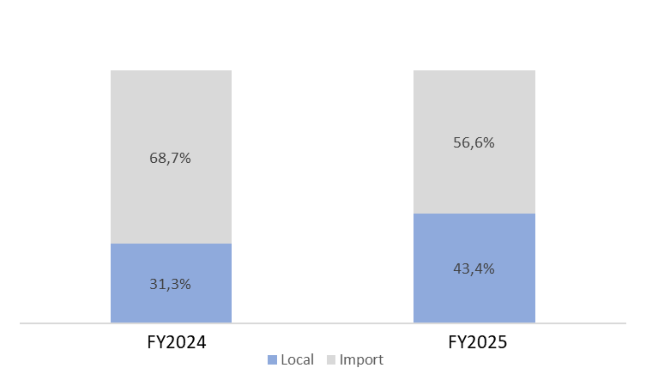
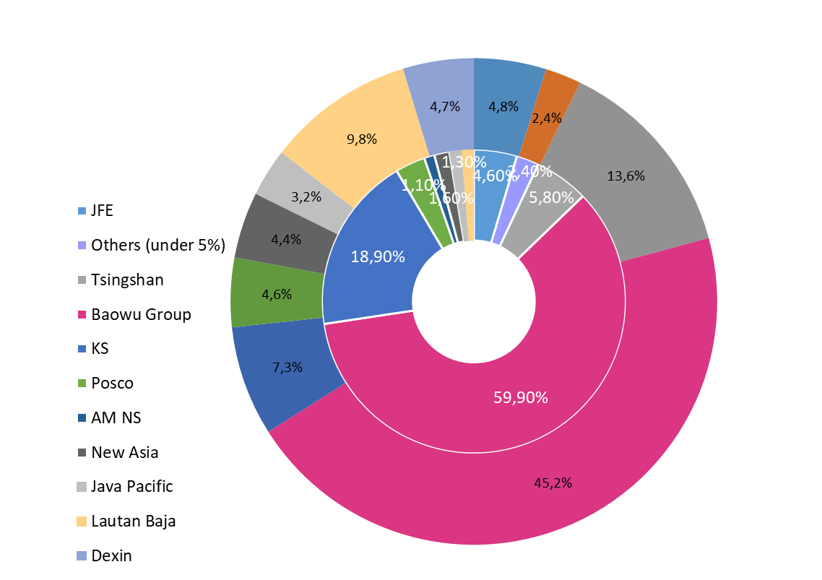
Flexible Purchasing
Enhanced Supply Resilience and Procurement Diversification
FY2025 reflects a material improvement in procurement resilience. Domestic sourcing increased to 43%, reducing exposure to FX volatility and import-related logistics risk. The shift toward local supply also enhances working capital efficiency and shortens supply lead times.
Supplier concentration has declined meaningfully, with the largest supplier’s share reduced from approximately 60% to 45%. This diversification strengthens negotiating leverage and mitigates counterparty risk.
Overall, the Company has materially enhanced upstream stability, positioning procurement strategy to better withstand global supply volatility and trade disruptions..
Top Suppliers
2024 (inside) and 2025 (outside)
Purchase of Materials
10
Notes:
Pada 9 bulan pertama tahun 2023, kami memutuskan untuk meningkatkan pembelian bahan baku dari pemasok lokal untuk mempersingkat waktu pengiriman dan dapat memberikan pengiriman yang lebih cepat untuk proyek, kecuali untuk produk yang tidak tersedia secara domestik seperti baja kelas otomotif

Slide 11
Going Forward
2

Slide 12
2025 – 2030 Strategy
Spindo is targeting to reach 1 T Net profit by 2027
2025
2026
2027
2028
2029
2030
8” Stainless Steel Pipe
New Export Opportunity, column pipe, further increase to Oil and Gas Sector
NEW MAJOR PRODUCT LINE
Up to 2.5 inch API Pipe
Big Diameter Carbon Steel Pipe (Plant 7)
Depo +2
SALES & MARKETING
Establish Rep Office in Ind. Major Cities
HUMAN RESOURCES
Major Improvement in HR Aspect
Inventory and SCM Improvement
Relocation of Unit 1,2,3,4 to Plant 7
Further Unit 7 Development
OPERATIONAL
Transformation to 4.0 Industry
Notes:
Selanjutnya kami akan bahas strategi kami 3 tahun ke depan. Kami menargetkan dapat mencapai 500.000 ton penjualan pada 2025. Kami juga berencana untuk membuat pipa API dengan ukuran sampai 2.5 inci pada akhir 2023 dan dibangunnya unit 7. SPINDO ingin mengeksplor sektor baru untuk penjualan pipa baja dan meningkatkan penjualan di sektor migas.

Slide 13
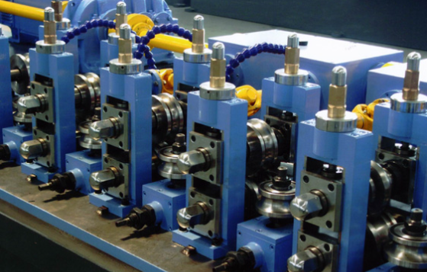
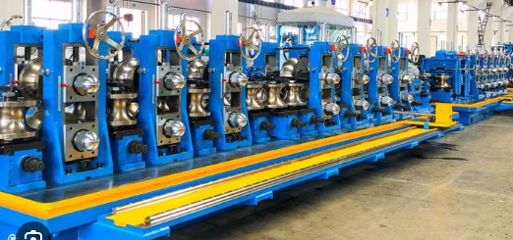
Unit 7: Building for the Future of Growth
Capture High-Growth Segments
Indonesia’s oil & gas, energy transition, and infrastructure projects are driving demand for API-grade and premium steel pipes. Unit 7 ensures SPINDO can supply this demand domestically, reducing reliance on imports.
Strengthen Market Leadership
With >95% sales in Indonesia, expanding capacity and moving up to higher-value products allows SPINDO to maintain dominance against foreign competition, particularly Chinese imports.
Technology & Efficiency Leap
Unit 7 is designed with automation, advanced machinery, and Industry 4.0 integration to improve production cycles, reduce downtime, and increase product consistency.
Support National Priorities
Unit 7 aligns with Indonesia’s industrial policies: infrastructure build-out, energy security, and downstream industrialization, contributing directly to GDP growth and local job creation.
ESG & Long-Term Sustainability
Incorporates energy-efficient systems and waste reduction initiatives, supporting SPINDO’s ESG commitments and positioning the company for sustainable growth.
*not real picture – for illustration purposes only
CONFIDENTIAL – FOR DISCUSSION PURPOSES ONLY
4

Slide 14
Recent Government Policies (2019-Present) Driving Demand for Large-Diameter Pipes
Policy / Regulation | Objective / Key Points | Relevance for Pipes & Unit 7
Omnibus Law on Job Creation (Law No. 11/2020) | Streamline licensing, accelerate strategic projects, attract FDI. | Fast-tracks approval for National Strategic Projects (dams, refineries, pipelines). Simplifies land acquisition. Directly increases demand for transmission pipelines.
Mandatory Domestic Gas Allocation (ESDM No. 45/2017, reinforced post-2019) | Requires new gas production to prioritize domestic market. | Drives construction of domestic pipelines to power plants & industries (e.g., Jawa-1 Gas Power Plant, Krakatau Steel). High demand for large-diameter transmission pipes.
Downstream Oil & Gas Revitalization (GR 36/2021) | Incentivizes refinery, petrochemical & gas processing investment. | Projects like Tuban GRR Refinery & Bontang Fertilizer Plant require extensive pipe networks for utilities & product flows.
Tightened TKDN Rules (ESDM No. 54/2022; PUPR regulations) | Mandates higher local content (40–85%) in oil/gas & infra projects. | Strong competitive edge for local pipe producers like SPINDO. Imports face high barriers. Pertamina refinery upgrades mandate >60% TKDN.
Government policies strongly favor local capacity expansion like Unit 7. The Omnibus Law accelerates strategic projects and land clearance, while mandatory domestic gas allocation ensures steady pipeline development for power and industrial needs. Downstream revitalization drives long-term refinery and petrochemical investment, all of which are pipe-intensive. At the same time, tightened TKDN rules create a protective barrier against imports, giving SPINDO a clear competitive edge as the primary domestic supplier of large-diameter pipes.
CONFIDENTIAL – FOR DISCUSSION PURPOSES ONLY
5

Slide 15
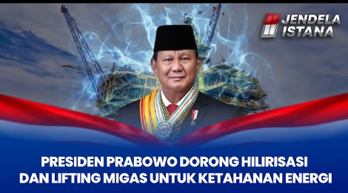
Pipe-Intensive National Projects
Program / Project | Scope / Details | Pipe Demand Implications
National Gas Grid Expansion (ESDM priority, 2020–present) | Cirebon–Semarang (257 km, operational 2023), Dumai–Sei Mangke (target 2025), Kalimantan–Java (proposed long-term). | High demand for 18”–24” large-diameter transmission pipes.
National Strategic Projects (PSP) (Bappenas list 2021–2024) | New Capital (IKN), 59 new dams (e.g., Karian–Serpong), Pertamina RDMP (Balikpapan, Cilacap, Dumai). | Requires water, drainage & utility pipelines, plus refinery pipe replacements/expansions.
Infrastructure & Energy Projects under RPJPN 2025–2045 | Ongoing investment in transport, power, and renewable energy facilities. | Long-term stable demand for API & structural pipes.
Indonesia’s pipeline-heavy National Strategic Projects create a strong demand base for Unit 7. The National Gas Grid expansion alone involves hundreds of kilometers of large-diameter pipes connecting gas fields to industries across Java and Sumatra. Major infrastructure programs such as the New Capital (IKN), 59 new dams, and Pertamina’s refinery upgrades will further require extensive water, drainage, and utility pipelines. These projects together ensure a multi-year, diversified demand pipeline that Unit 7 is designed to serve.
CONFIDENTIAL – FOR DISCUSSION PURPOSES ONLY
6

Slide 16
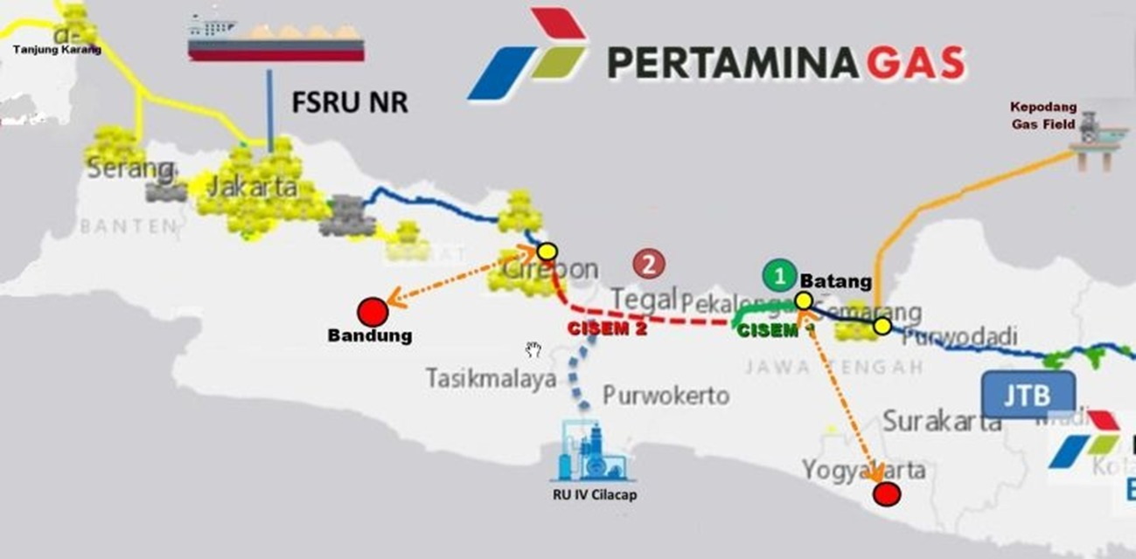
Cirebon – Semarang Gas Transmission Pipeline
The Ministry of Energy and Mineral Resources (ESDM) plans to expand the Cirebon-Semarang (CISEM) gas transmission pipeline to Bandung and Yogyakarta.
The project, valued at Rp1.7 trillion, will be divided into the Cirebon-Bandung (132km) and Semarang-Solo-Yogyakarta (148km) lines. The budget, allocated for 2025-2026, aims to boost the development of the national gas network and will be openly tendered [PT Pertamina (Persero) – PERTAMINA GAS].
The total budget for the 132-kilometer Cirebon-Bandung transmission pipeline is Rp865.07 billion, with Rp10.94 billion allocated for 2025 and Rp854.13 billion for 2026. Meanwhile, the total budget for the 148 kilometer Semarang-Solo-Yogyakarta pipeline is Rp895.63 billion: Rp13.13 billion in 2025 and Rp882.50 billion in 2026.
Source: kumparan.com, 3 September 2025
CONFIDENTIAL – FOR DISCUSSION PURPOSES ONLY

Slide 17
Recent Gas Discoveries & Developments (2019–Present)
Indonesia’s Gas Discoveries Translate Directly into Future Pipeline Demand
Block / Project | Operator | Discovery / Milestone | Relevance for Unit 7 (Pipe Demand)
Andaman Block II (South Sumatra) | Mubadala Energy (UAE) | “Cengkih-1” discovery (Nov 2023), 2+ TCF. FID 2024, first gas 2029. | New large-diameter pipelines to Grissik Hub for domestic/export markets.
West Ganal Block (East Kalimantan) | Eni (Italy) | “Geng North-1” discovery (Oct 2023), deepwater gas. | Expansion of Jangkrik fields or FLNG; requires subsea pipelines.
Abadi LNG (Masela Block) | Inpex (Japan) | $20B LNG project, FID approved Mar 2024. | Hundreds of km of subsea & onshore large-diameter pipelines — largest near-term driver of ERW demand.
Sakakemang Block (South Sumatra) | Pertamina Hulu Energi | “Maha-1” (2019, 2 TCF) & “Maha-2” (2023) extension. | Pipeline development to feed South Sumatra industrial corridor.
Other Discoveries | Pertamina, Husky-CNOOC | Onshore finds in Jambi & South Sumatra (2022–23); Bangka exploration (2022). | Localized pipeline networks — additional pipe demand.
Recent gas discoveries across Indonesia add significant long-term momentum to pipeline demand, directly reinforcing the rationale for Unit 7. World-class projects like Abadi LNG (Masela Block) and Andaman Block II will require hundreds of kilometers of subsea and onshore transmission lines, while discoveries in West Ganal and Sakakemang ensure sustained development in Sumatra and Kalimantan. Smaller finds by Pertamina and Husky-CNOOC also generate localized pipeline networks, collectively creating a broad and scalable market for large-diameter pipes that Unit 7 will supply.
7
CONFIDENTIAL – FOR DISCUSSION PURPOSES ONLY

Slide 18
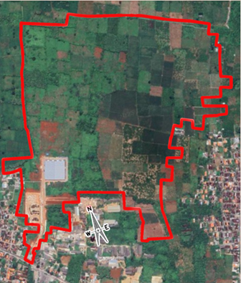
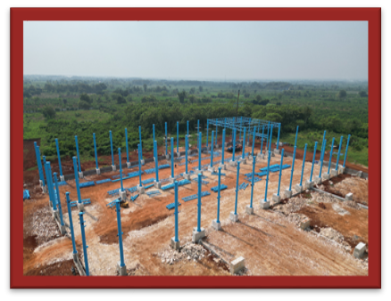
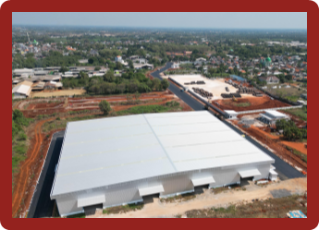
Unit 7 Project Phase Overview
Phase 1: North Distribution Centre (Warehouse) – Completed 2024
Construction of new 1 Ha Warehouse, to be functioned as distribution centre with significantly better layout to substantially reduce loading time and excellent handling
Phase 2: New 8 inch Machine and 20 inch Machine – Ongoing
Capacity: Adds ~24k tons API and ~36k tons non-API black pipe by 2027 (total ~50-70k tons new output).
Technology: Equipped with advanced ERW (Electric Resistance Welding) mills, Robotic automation, and Industry 4.0 monitoring systems for higher efficiency and quality control.
ESG Considerations: Incorporates energy-efficient equipment, waste heat recovery, and compliance with TKDN/local content requirements.
Timeline: Groundbreaking 2023 → Machinery installation 2025 - 2026 → Final Commissioning 3Q2026.
Phase 3: Relocation of East Java Unit (Tba)
Further efficiency improvement on logistic cost, human capital, and other resources due to single location. Also refurbishment of existing and new automated machinery
CONFIDENTIAL – FOR DISCUSSION PURPOSES ONLY
8

Slide 19
Market Outlook
3

Slide 20
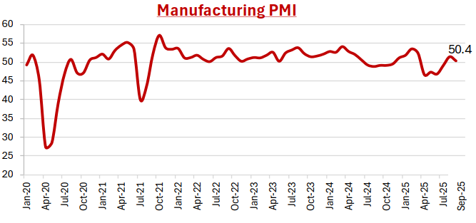
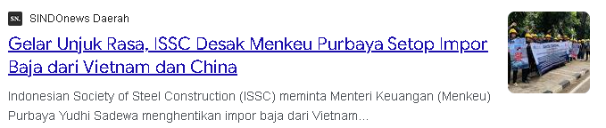
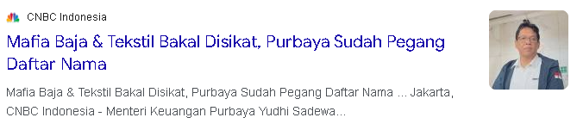
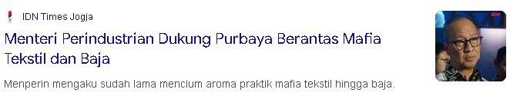
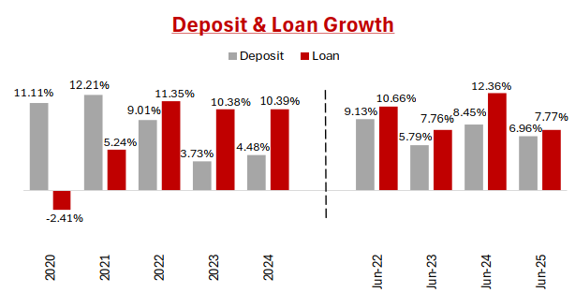
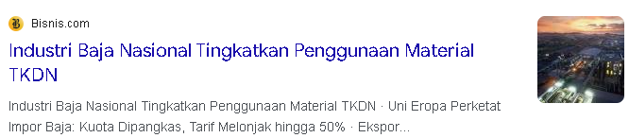
Domestic Support

Slide 21
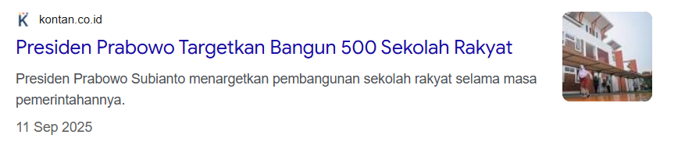
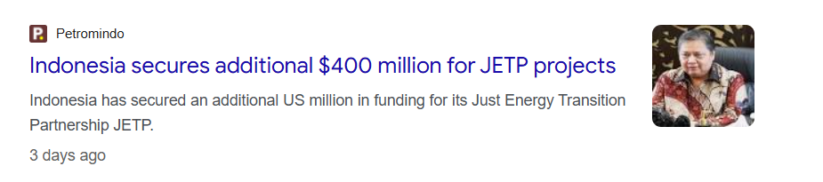
Government iniatives
The construction of 500 community schools nationwide during 2025–2029 is estimated to require 9,500 tons of steel pipes. The pipes will be used for sprinkler systems, hydrants, pump headers, and clean water headers. We aim to collaborate with major contractors involved in these projects.
Indonesia is collaborating with the IPG and the Glasgow Financial Alliance for Net Zero through the Just Energy Transition Partnership, which provides funding to accelerate the clean energy transition in Indonesia. One of the projects is the Saguling Floating Solar Power Plant, which is expected to reduce carbon emissions by 63,000 tons per year. We have the potential to supply structural pipes, water pipes, stainless steel pipes, and API pipes for future projects such as solar power plants, hydropower plants, and geothermal plants.

Slide 22
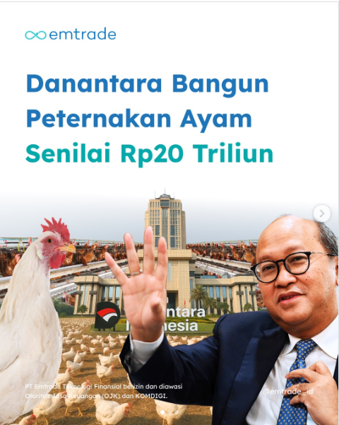
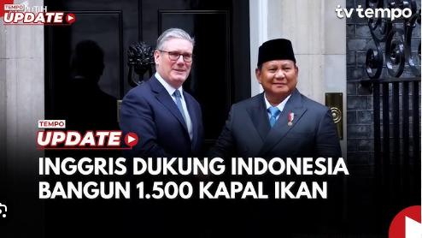
Government iniatives
Danantara will build 12 broiler and layer chicken farming units to control fluctuations in day-old chick (DOC) prices. We have the potential to contribute to these projects by supplying round and square GI pipes.
The construction of fishing vessels requires Schedule 40 steel pipes in various diameters. In addition to shipbuilding, we also have the potential to contribute to the development of docks and ports to accommodate these vessels.

Slide 23
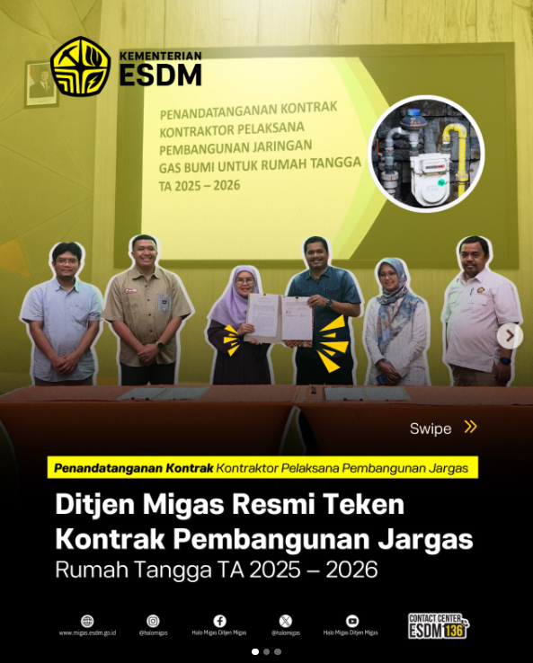
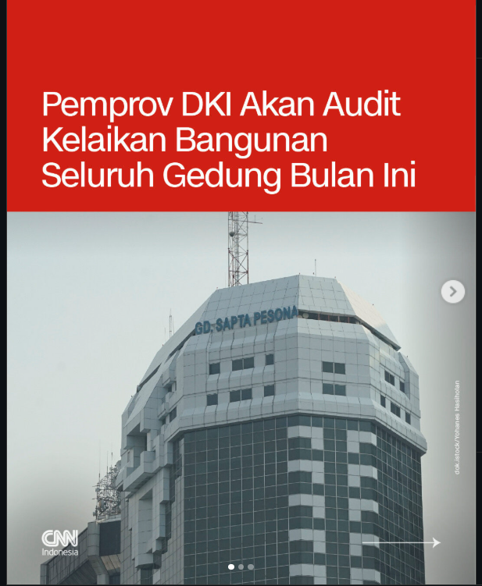
Government iniatives
In 2025–2026, 115,264 household connections will be built under the City Gas Network (Jargas) program. We have the potential to contribute to this development by supplying API 5L pipes. With Unit 7 nearing completion, we expect to participate in more oil and gas projects.
One of the audits conducted covers fire protection systems such as sprinklers. We have the potential to supply structural pipes for the development of these systems.

Slide 24
Spindo ESG
4

Slide 25
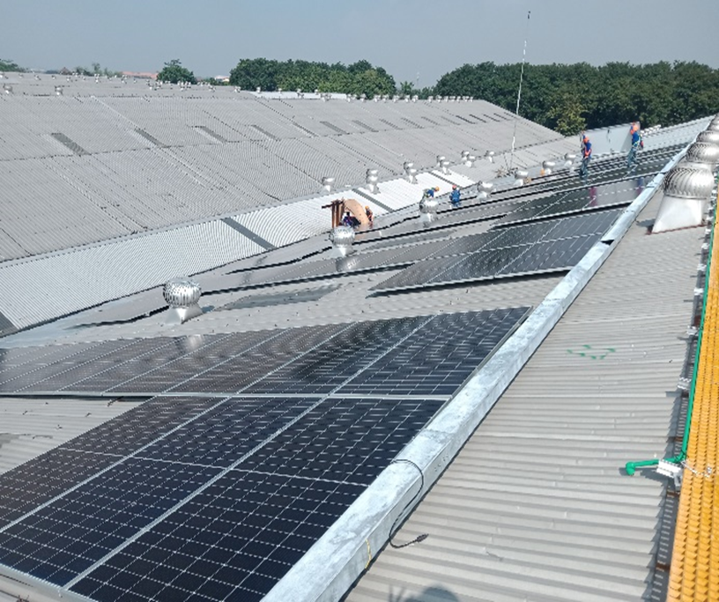
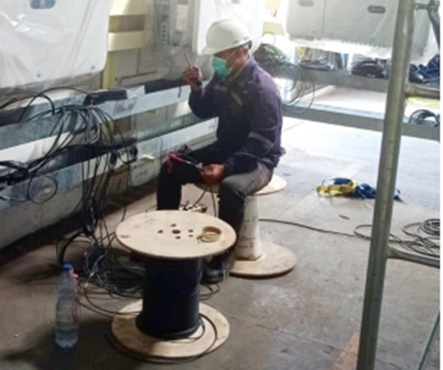
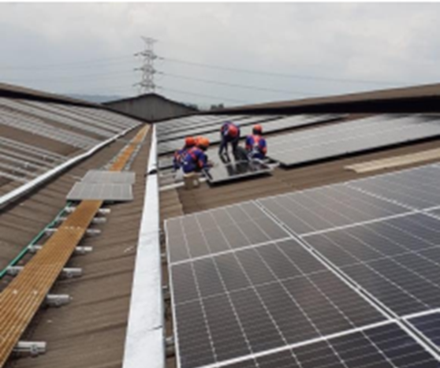
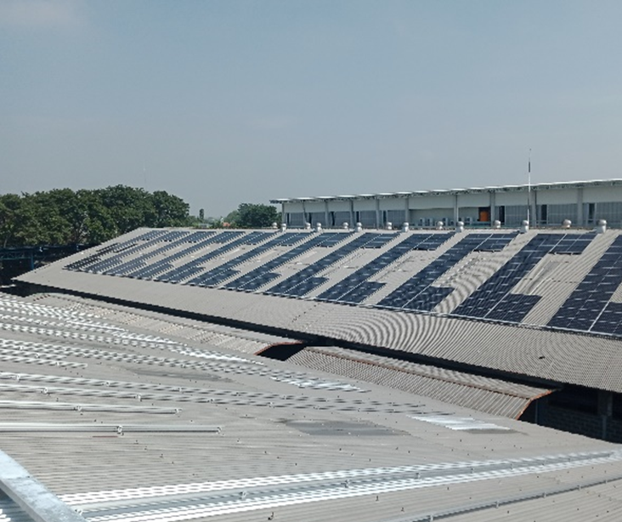

ESG Initiatives
Solar Panel Installation in Plant IV & VI
PLN Tariff Discount for 25 Years*
12-18% *PLN Tariff assumption 6% CAGR growth
Accumulated Cost Saving for 25 Years
IDR 8-25 Billion
Accumulated CO2 Reduction in 25 Years
7,536-16,658 tons
Immediate Solar Panel Installation in Plant I, III & V
Implementation of GCG Practices
Code of Conduct
Vendor Code of Conduct
Whistleblowing mechanism
Audit Committee
KP5 Committee
Board Manual
Regular CSR activity and Other Social Initiatives
Empowering the employment of the local community
Establishing a Training Centre
Published the Sustainability Report 2020
25
Notes:
Pada unit pabrik IV dan VI, kami telah memasang panel surya untuk mengurangi penggunaan listrik dan gas. SPINDO juga menerapkan Tata kelola Perusahaan yang Baik dan kegiatan CSR.

Slide 26
SLB Achievement Report
Target 2025 |  | Pencapaian 2025 |  | Persentase Peningkatan (%) | Tindakan yang Dilakukan
Kapasitas (kWp) | Estimasi Pengurangan Emisi Karbon (kg CO₂eq) | Kapasitas (kWp) | Estimasi Pengurangan Emisi Karbon (kg CO₂eq)
715 | 895.752 | 4.122,37 | 3.706.193,74 | 476 | Penambahan kapasitas Solar Cell Unit 6 dari 340 kWp menjadi 650 kWp pada Oktober 2024 Pemasangan Solar Cell baru di Unit 5 dengan kapasitas 1.030 kWp pada Juli 2024 Pemasangan Solar Cell di Unit 3 dengan kapasitas 715 kWp pada September 2025 Pemasangan Solar Cell di Unit 1 dan 2 dengan kapasitas 615,75 jWp dan 759 kWp pada November 2025
The installation of Solar PV panels at Plants 1, 2, and 3 was successfully completed in February 2025. The total installed capacities are 651.75 kWp for Plant 1, 759 kWp for Plant 2, and 715 kWp for Plant 3. As of September 2025, there is an additional operation for solar panel in Plant 3. The system is currently awaiting the issuance of the Operational Worthiness Certificate (SLO) from the Ministry of Energy and Mineral Resources (ESDM) and PLN before commencing operation.

Slide 27
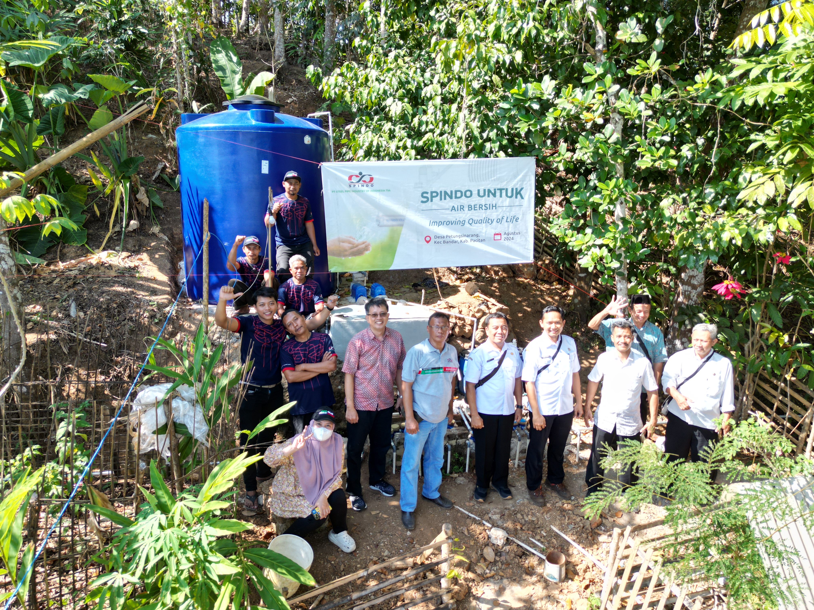
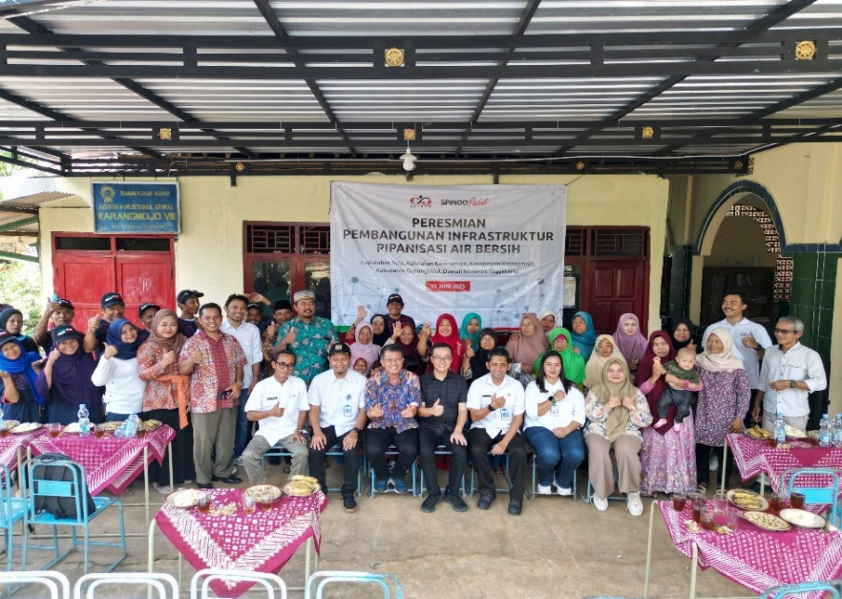
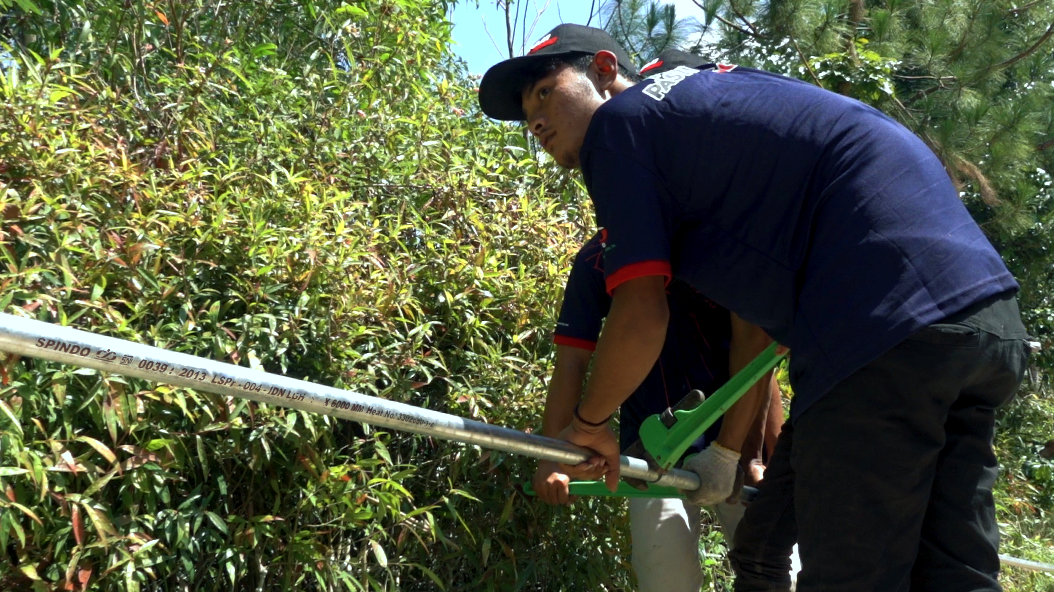
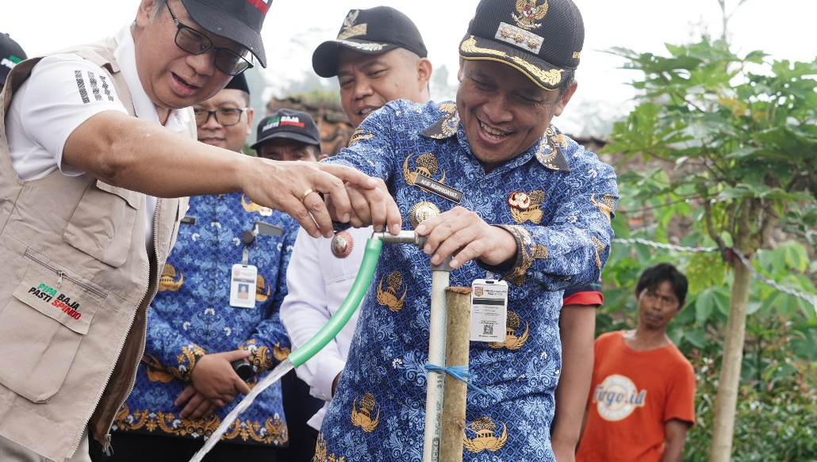
SPINDO Peduli
CSR Program by SPINDO that supports SDG 6: Clean Water and Sanitation
Conducted three times in three villages on the island of Java during 2024 and 2025:
- Petungsinarang Village, Pacitan
- Dusun Undakan, Wonosobo
- Padukahan Bulu, Gunungkidul
We helped install water pipelines from bore wells to storage reservoirs, which were then distributed to residents’ homes.

Slide 28
Guidance & Outlook
5

Slide 29
Navigating Uncertainty with Expansion, Financial Strength & Market Leadership : Guidance for 2025 - 2029
While SPINDO's financial projections indicate strong revenue and profit growth, it is essential to consider market uncertainties and operational challenges that may influence actual performance.

Slide 30
Selected Projects
6

Slide 31
Selected Projects January – December 2025
Logistik
Proyek Pembangunan Dermaga A Petrokimia Gresik
Proyek Pekerjaan Bracing Jetty Wanam Merauke
Proyek Upgrading Jetty 1 di IT Pontianak
Proyek Dermaga Lapuko 2025
Proyek Revitalisasi Breasting Dolphin Kanan Jetty 2 IT Manggis
Proyek Pembangunan Dermaga Pulau Balang Bentang Pendek II – IKN
Peningkatan Fasilitas Pelabuhan Lampia
Proyek Pelabuhan MIDAI 2025
Proyek Pembangunan Dermaga Kap. 50.000 di FT Biak
Proyek Jetty PT Ganda Alam Makmur
Proyek Peningkatan Faspel Laut Bungin
Proyek Sungai Musi Banyuasin Sumatera Selatan
Proyek Kalianget 2025
Pengadaan Tiang Pancang untuk Breakwater di Kolam Area Pengembangan 1 Pelabuhan Benoa
Proyek Marapokot 2025-2026
Proyek PT AKR Corporindo
Proyek Sapudi 2025
Proyek Marapokot 2025-2026
Proyek Kalianget 2025
Infrastructure
Proyek Pembangunan Palaran Samarinda, Kaltim
Proyek Rekonstruksi Jembatan Palu 4
Proyek Jalan Tol Probolinggo - Banyuwangi Paket 3
Proyek PDAM Jaya – Jakarta
Proyek BPIPI Sidoarjo
Proyek PT Semen Indonesia
Proyek Pembangunan Jalan Akses Jembatan Sei Nibung 2
Proyek Sungai Musi Banyuasin Sum-Sel
Proyek Saluran Air
Proyek Construction of KSCS Package 1
Oil and Gas Machinery
Proyek Coal Crushing System dan Loading Terminal Kapasitas 36 Juta Ton Per Tahun di Tanah Grogot
Proyek PT Batubara Duaribu Abadi
Proyek PT AKS Bangka
Perbaikan Tangki No. 05 Fuel Terminal Palopo
Pembangunan Tangki Timbun di Fuel Terminal Banggai
Perbaikan Tangki Timbun No. 05 di Fuel Terminal Pulau Raha
Perbaikan Tangki Timbun No. 02 & 03 di Fuel Terminal Tual
Proyek PT Kideco Jaya Agung
Proyek Batu Hijau
Proyek PT Fajar Sakti Prima, Saban
Proyek PT Pertamina
31
31

Slide 32
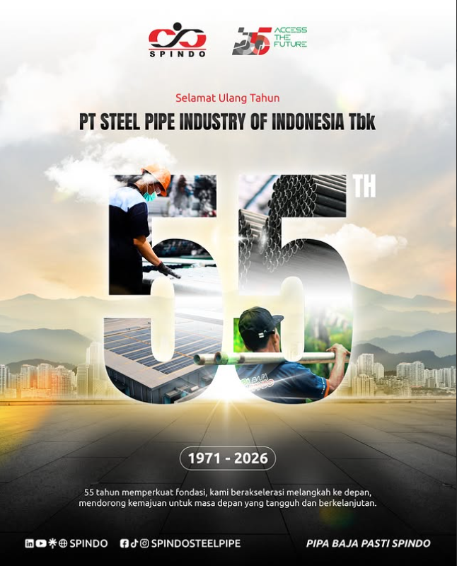
THANK YOU
“SPINDO’s strategic roadmap focuses on sustainable growth by balancing sector diversification, operational excellence, and strategic partnerships, ensuring resilience and profitability in Indonesia’s evolving steel market landscape.”

Slide 33




facebook.com/spindosteelpipe
youtube.com/c/spindosteelpipe
@spindosteelpipe
linkedin.com/company/spindo
For more information please contact:
PT Steel Pipe Industry of Indonesia Tbk.
Gd. Baja Lantai 7B
Jl. Pangeran Jayakarta no 55 Jakarta
Indonesia
Up:
Johanes W Edward
Corporate Secretary & Investor Relations
Chief Strategy & Business Development Officer
Email: johanes.edward@spindo.co.id
Ph: +62-21 6231 3502 ext. 6062

