Slide 1
PT Steel Pipe Industry of Indonesia Tbk
Company Presentation
for 1H2025 Results

Slide 2
Disclaimer
Materi dalam presentasi ini telah disiapkan oleh PT Steel Pipe Industry Indonesia Tbk (“Spindo”) dan merupakan informasi bersifat umum tentang kinerja bisnis Spindo terkini pada tanggal presentasi dan dapat berubah tanpa pemberitahuan sebelumnya. Informasi ini diberikan dalam bentuk ringkasan dan tidak dimaksudkan untuk dianggap sebagai laporan lengkap. Informasi dalam presentasi ini, termasuk perkiraan informasi keuangan, tidak boleh dianggap sebagai saran atau rekomendasi kepada investor atau calon investor sehubungan dengan keputusan memegang, membeli atau menjual sekuritas atau produk atau instrumen keuangan lainnya dan tidak mempertimbangkan tujuan investasi khusus, situasi atau kebutuhan keuangan. Sebelum bertindak berdasarkan informasi apa pun, pembaca harus mempertimbangkan kesesuaian informasi yang berkaitan dengan hal-hal ini, dokumen penawaran yang relevan dan khususnya, pembaca harus mencari nasihat keuangan independen. Presentasi ini dapat berisi pernyataan berwawasan ke depan termasuk pernyataan mengenai niat, keyakinan, atau harapan kami saat ini sehubungan dengan bisnis dan operasi Spindo, kondisi pasar, hasil operasi dan kondisi keuangan, kecukupan modal, ketentuan khusus, dan praktik manajemen risiko. Pembaca diperingatkan untuk tidak menempatkan kepercayaan yang tidak semestinya pada pernyataan berwawasan ke depan ini; kinerja masa lalu bukan merupakan indikasi kinerja masa depan yang dapat diandalkan. Spindo tidak memiliki kewajiban apa pun untuk secara terbuka merilis hasil dari setiap revisi terhadap pernyataan berwawasan ke depan ini untuk mencerminkan peristiwa atau keadaan setelah tanggal pernyataan ini untuk mencerminkan terjadinya peristiwa yang tidak terduga. Kami melepaskan tanggung jawab atau kewajiban apa pun yang timbul yang dapat ditanggung atau diderita oleh siapa pun sebagai akibat dari bertindak berdasarkan kepercayaan pada seluruh atau sebagian dari isi laporan ini dan Spindo dan / atau perusahaan afiliasinya dan / atau masing-masing karyawan dan / atau agen tidak menerima tanggung jawab atas kesalahan, kelalaian atau sebaliknya, dalam laporan ini dan ketidakakuratan apa pun di sini atau kekurangan di sini yang mungkin terjadi
The materials in this presentation have been prepared by PT Steel Pipe Industry of Indonesia Tbk (“Spindo”) and are general background information about Spindo business performances current as at the date of this presentation and are subject to change without prior notice. This information is given in summary form and does not purport to be complete. Information in this presentation, including forecast financial information, should not be considered as advice or a recommendation to investors or potential investors in relation to holding, purchasing or selling securities or other financial products or instruments and does not consider their particular investment objectives, financial situation or needs. Before acting on any information, readers should consider the appropriateness of the information having regard to these matters, any relevant offer document and, readers should seek independent financial advice. This presentation may contain forward looking statements including statements regarding our intent, belief or current expectations with respect to Spindo businesses and operations, market conditions, results of operation and financial condition, capital adequacy, specific provisions and risk management practices. Readers are cautioned not to place undue reliance on these forward-looking statements; past performance is not a reliable indication of future performance. Spindo does not undertake any obligation to publicly release the result of any revisions to these forward-looking statements to reflect events or circumstances after the date hereof to reflect the occurrence of unanticipated events. We disclaim any responsibility or liability whatsoever arising which may be brought or suffered by any person as a result of acting in reliance upon the whole or any part of the contents of this report and neither Spindo and/or its affiliated companies and/or their respective employees and/or agents accepts liability for any errors, omissions, negligent or otherwise, in this report and any inaccuracy herein or omission here from which might otherwise arise.

Slide 3
1st Half Highlight
1

Slide 4
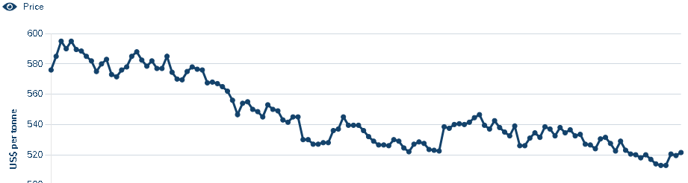
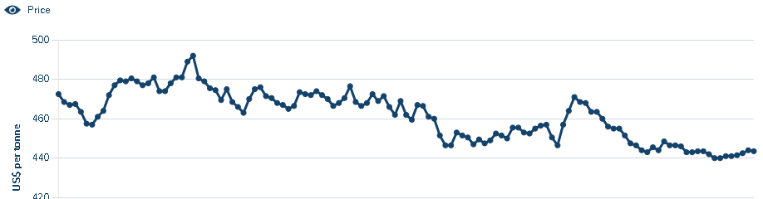
1H2025 Overview
Built for Cycles: Stable Margins, Stronger Liquidity, Poised for 2H Upswing
In the first half of 2025, PT Steel Pipe Industry of Indonesia Tbk (ISSP) posted resilient performance amid softer demand and normalizing steel input prices. Revenue declined 6.5% year-on-year to Rp 2.61 trillion, primarily due to the moderation in global Hot Rolled Coil (HRC) prices—a key input that directly impacts SPINDO’s topline. Despite the softer revenue, gross profit rose 5.9% to Rp 521.1 billion, as gross margin improved from 17.6% to 19.9%, supported by tighter cost control and a healthier product mix. Net profit increased to Rp 213.5 billion (+1.8% YoY), showing SPINDO’s operational agility in protecting bottom-line performance.
This result must be viewed within the context of SPINDO’s cyclical exposure to steel price and seasonal infrastructure activity. While 1H2024 delivered Rp 2.80 trillion in revenue, the second half was notably stronger at Rp 3.32 trillion, pushing FY2024 to Rp 6.12 trillion. This structural pattern—where 2H outperforms 1H—is typical for SPINDO, driven by accelerated project activity, restocking, and stronger private sector demand in the second semester.
Additionally, SPINDO further strengthened its balance sheet. Cash and equivalents rose to Rp 809.7 billion, while short-term bank loans were reduced by more than Rp 400 billion. Inventory and receivables were also managed tightly, reinforcing a healthy working capital position. These moves reflect the company’s proactive stance in maintaining liquidity buffers, optimizing its capital structure, and positioning itself to benefit from a typically stronger second half of the year.
HRC Price 2024 – Jun 2024
4
HRC Price 2025 – Jun 2025
Notes:
Presenter:
"Good [morning/afternoon], everyone. Welcome to SPINDO’s FY2024 Equity Capital Market presentation. Today, we will walk you through our financial and operational performance, growth strategy, and long-term value creation for shareholders. Let’s begin with an overview of our strong performance in 2024.
SPINDO achieved a record net profit of IDR 530 billion, reflecting a 6.4% YoY increase, despite a 5.2% revenue decline due to lower global HRC prices. However, gross margin reached 18.1%, and net margin stood at 8.7%, surpassing expectations. This resilience was driven by cost optimization, operational efficiencies, and our focus on high-margin products.
From a financial stability standpoint, we lowered our Debt-to-Equity Ratio to 0.64x, while reducing interest expenses by 11% and general/admin costs by 13%, reinforcing our ability to generate strong free cash flow. Operationally, we expanded Unit 7 in Gresik, which tripled logistics speed, while investing in advanced ERW machines to expand our high-margin API-grade pipe production. With this foundation, we are well-positioned for future growth."

Slide 5
1H2025 Financial Summary
Steady Earnings in a Normalizing Environment
SPINDO recorded revenue of Rp 2.61 trillion in 1H 2025, reflecting a 6.5% YoY decline due to softening HRC prices and the high base from early 2024. Despite the lower topline, gross profit improved to Rp 521 billion, and gross margin rose to 19.9% — up 230 bps from 1H 2024 — demonstrating effective cost control and a healthier product mix.Net profit reached Rp 213.3 billion, growing modestly by 1.8% YoY. This performance reflects solid operational execution amidst elevated distribution and financial expenses.
Managing the Middle Line: Discipline Amid Cost Pressures
After achieving stronger gross profit in 1H 2025, SPINDO navigated a challenging cost landscape with strategic control. Selling and distribution expenses rose 43.4% YoY, reaching Rp 108.2 billion, mainly due to increased freight as part of Project Base sales (Rp 79.4B).
Finance costs increased 22.4% YoY to Rp 114.8 billion, largely driven by interest on sukuk and bonds (Rp 74.9B), following a deliberate shift from short-term bank loans to longer-tenor instruments. While this led to higher near-term expenses, it significantly reduces refinancing risk, improves funding visibility, and aligns with the long-cycle nature of SPINDO’s operations.
In contrast, general and administrative expenses decreased 7.4%, from Rp 64.3B to Rp 59.6B, as reductions in amortization, permitting, and other overheads offset salary and maintenance increases. Meanwhile, other expenses dropped 54.7% YoY to Rp 22.4B, aided by lower FX losses and minimal impairments. Supported by a slightly lower tax provision (Rp 54.5B),
SPINDO delivered a 1.8% net profit growth to Rp 213.3 billion—demonstrating resilience in protecting earnings despite margin headwinds..
Revenue and Margin 2018 - 2025F
(in Billion Rupiah)
5
Notes:
Kinerja keuangan kami selama 9 m 2023 mencatat pertumbuhan positif yang besar dibandingkan dengan tahun sebelumnya. Dapat kita amati bahwa kami memiliki peningkatan laba bersih sebesar 24,2% dengan jumlah 363,7 miliar rupiah. NPM dan GPM kami juga meningkat dan melampaui proyeksi FY2023 kami.

Slide 6
Improved Working Capital
Liquidity & Leverage Ratios
Strong Liquidity and Prudent Balance Sheet Support Capex-Driven Growth
SPINDO entered the second half of 2025 with a healthy liquidity profile and conservative leverage. The current ratio stood at 234% and quick ratio at 87%, supported by a strong increase in liquid assets. This was largely driven by the rise in cash and cash equivalents to Rp 809.7 billion, a significant improvement from Rp 503.6 billion at year-end 2024.
Meanwhile, trade receivables declined from over Rp 1.1 trillion to Rp 754 billion, reflecting tighter credit control and more stable collection cycles.Inventory levels remained steady at Rp 3.48 trillion, indicating disciplined procurement and efficient inventory turnover, even in a softer demand environment.
On the funding side, SPINDO maintained a stable debt-to-equity ratio of 63%, with a clear shift in its liability structure—reducing short-term bank loans by over Rp 400 billion while increasing long-term funding through sukuk and bonds. This shift reduces refinancing risk and better matches the company’s long-cycle project profile.
These improvements are particularly timely as SPINDO enters a multi-year investment phase. The company has allocated approximately Rp 700 billion in capex for 2025, primarily for the development of Unit 7 and maintenance across other production facilities, followed by Rp 300 billion in 2026 and Rp 80 billion in 2027. With improved liquidity, stable leverage, and structured long-term financing in place, SPINDO is well-positioned to fund this expansion while maintaining financial resilience and strategic flexibility amid ongoing macroeconomic uncertainty..
Debt, Interest & EBITDA
6
Notes:
Seiring dengan terus melakukan pergeseran bagian utang jangka pendek kami ke durasi jangka panjang, rasio lancar kami mencapai 210%, peningkatan dari rasio tahun 2022 kami. Kami juga ingin menunjukkan bahwa debt equity ratio kami juga mengalami penurunan dari tahun 2017 hingga sekarang. Dapat disimpulkan kalau kami mengurangi hutang, kami membayar bunga yang lebih kecil, dan kami memindahkan ke maturitas lebih panjang.

Slide 7
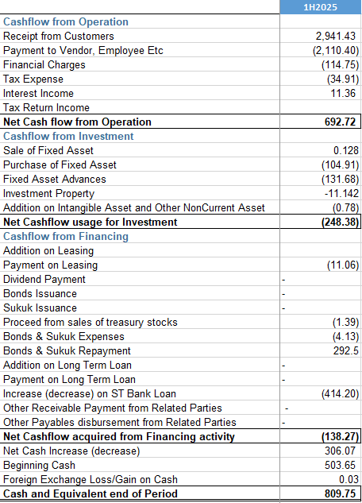
Strong Cashflow
Disciplined Cash Management Supports Investment Readiness
In 1H 2025, SPINDO generated Rp 691.3 billion in operating cash flow, primarily driven by collections from customers totaling Rp 2.94 trillion. Operating outflows—including payments to vendors and employees (Rp 2.11 trillion), interest (Rp 114.8 billion), and tax (Rp 34.9 billion)—remained manageable, reflecting stable operational efficiency and cost control.
This strong cash generation reinforces the company’s ability to self-fund working capital and maintain liquidity strength.Investment cash outflows totaled Rp 248.4 billion, mainly for fixed asset purchases and advances linked to Unit 7 development and other facility upgrades. This capex deployment aligns with SPINDO’s long-term asset strategy and is consistent with its Rp 700 billion full-year investment commitment. The controlled pace of deployment ensures capital is matched to project readiness without overextending cash reserves. From a financing perspective, SPINDO used Rp 136.9 billion in net financing outflows, largely due to the repayment of short-term bank loans (Rp 414.2 billion). The issuance of sukuk and bonds (Rp 292.5 billion) partially offset this, consistent with the company’s tenor restructuring plan.
As a result, SPINDO closed the first half with Rp 809.7 billion in cash, up significantly from Rp 503.6 billion at year-end 2024—providing ample headroom for ongoing investment and financial risk mitigation heading into the second half..
  .

Slide 8
Improving Shareholder Returns
  ROE & ROA
Sustained Returns and Strengthening Shareholder Value
In 1H 2025, SPINDO maintained steady profitability metrics amid softer revenue conditions, booking a Return on Equity (ROE) of 8.3% and Return on Assets (ROA) of 5.1%. Though slightly lower than the prior two years (also due to cyclicality), these ratios remain healthy given the HRC price correction and reflect the company's ability to preserve margin and asset efficiency across the cycle. Earnings per share (EPS) reached Rp 30.3, providing a strong interim base toward maintaining annual earnings consistency.
SPINDO’s dividend track record underscores its shareholder-friendly capital policy. From 2020 to 2024, dividends per share steadily increased from Rp 6 to Rp 16, while the dividend payout ratio targeted to be around 25%-30%, signaling prudent balance between growth funding and return distribution. The recently declared Rp 16/share dividend for FY2024 reflects a payout ratio of 21.3% and a yield of 5.97%, one of the highest in its peer group—highlighting confidence in cash flow quality and balance sheet strength. With growing internal cash generation, manageable capex requirements, and a stable funding structure, SPINDO is well-positioned to continue rewarding shareholders, even as it executes on its multi-year investment plan. The company's consistent dividend growth reaffirms its commitment to long-term value creation.
 | 2017 | 2018 | 2019 | 2020 | 2021 | 2022 | 2023 | 2024 | 1H2025
EPS (Rp/Share) | 1.2 | 6.9 | 26.3 | 24.9 | 68.9 | 43.3 | 70.5 | 75.0 | 30.3
  Dividend Yield
8
8
8
Notes:
Tren ROA dan ROE kami positif sejak paruh pertama tahun 2023. Perusahaan berada sesuai dengan target ROE sebesar 14% dan ROA sebesar 10%. Perusahaan juga baru-baru ini mendistribusikan dividen pada bulan Agustus dengan dividen yield sebesar 2,3%.

Slide 9
Improvement in high value product
Improves Sales Mix
  In 1H 2025, SPINDO maintained stable sales volume at 158.9 thousand tons, but with a significant shift in product mix. The company reduced exposure to lower-margin segments like spiral pipes (non-API), down 34.3%, while sharply increasing API-grade pipes for oil & gas, with spiral pipe API up 738%. This drove oil & gas contribution to 10% of total sales, double the prior year. At the same time, strips & plates rose 84.1%, and poles and service-related products also grew, helping offset declines in black pipes and stainless steel. These changes reflect a strategic rebalancing toward high-value, margin-supportive products, positioning SPINDO for stronger profitability in 2H 2025..
Highly Diversified Product Mix (1H2024 vs 1H2025)
SALES COMPOSITION
 | 2018 | 2019 | 2020 | 2021 | 2022 | 2023 | 2024 | 1H2025
Oil & Gas | 0% | 0% | 0% | 1% | 3% | 2% | 5% | 10%
Furniture | 14% | 16% | 19% | 18% | 18% | 17% | 19% | 19%
Automotive | 19% | 19% | 17% | 16% | 17% | 17% | 18% | 19%
Construction, Infrastructure & Utilities | 67% | 65% | 64% | 65% | 62% | 64% | 58% | 52%
Total Sales Vol (000 Ton) | 341.3 | 375.4 | 302.4 | 302.8 | 325.3 | 364.5 | 357.7 | 158.8
High Value-high margin product
9
Notes:
Penjualan kami juga meningkat karena penjualan dalam jumlah kecil melalui gudang kami yang berkontribusi pada margin keuntungan yang lebih tinggi. Untuk kinerja 9 bulan kami, kami memiliki penjualan lebih dari 268 ribu ton dan mulai pulih dan mencapai tingkat sebelum COVID. Kami juga dapat melihat bahwa sektor otomotif berkembang karena peningkatan penjualan mobil. Konstruksi, infrastruktur, dan utilitas tetap menjadi sumber utama campuran produk kami. Kami juga menikmati efek tidak langsung dari dukungan pemerintah terhadap Properti & EV.

Slide 10
Flexible Purchasing
Supplier Diversification and Strengthening of Local Steel Sourcing
In 1H 2025, SPINDO increased its local raw material purchases to 44%, up from 29.2% in 1H 2024, while imports declined to 57%. This shift reflects a deliberate strategy to reduce reliance on overseas suppliers, improve logistics efficiency, and mitigate external risks.Notably, three new domestic steel mills—Lautan Steel, New Asia Steel, and Dexin Indonesia—have begun supplying HRC, expanding local options and contributing to a more balanced supplier base. As a result, Baowu Group’s share fell to 44.8%, from 59.9% in FY2024, while newer players like JFE, AM/NS, and Lautan gained ground.These moves strengthen SPINDO’s procurement flexibility and support its long-term growth and capex execution by ensuring greater supply security and cost competitiveness.
Top Suppliers
FY2024 (inside) and 1H2025 (outside)
Purchase of Materials
10
Notes:
Pada 9 bulan pertama tahun 2023, kami memutuskan untuk meningkatkan pembelian bahan baku dari pemasok lokal untuk mempersingkat waktu pengiriman dan dapat memberikan pengiriman yang lebih cepat untuk proyek, kecuali untuk produk yang tidak tersedia secara domestik seperti baja kelas otomotif

Slide 11
Price Movement
  Local & Import HRC Price VS our Black Pipe ASP
14757
9566
8700
Source : www.lme.com, company calculation
Our Black Pipe ASP remains strong at IDR 15,534/kg, maintaining a healthy margin over local HRC (IDR 9,600/kg) and imported HRC (IDR 8,927/kg). While HRC prices have fluctuated, the overall trend shows a decline from mid-2023 to early 2025, creating a more favorable cost environment. The consistent gap between raw material costs and selling prices supports profitability. Moving forward, maintaining pricing discipline and cost efficiency will be key to sustaining margins amid market fluctuations.
Notes:
Kondisi ekonomi domestik yang lebih baik dibandingkan dengan ekonomi global menyebabkan harga baja domestik menunjukkan volatilitas yang lebih rendah daripada harga baja global. Perusahaan juga berhasil menjaga harga jualnya.

Slide 12
Going Forward
2

Slide 13
2022 – 2025 Strategy
Spindo is targeting to reach 500,000 Ton sales by 2025
2022
2023
2024
2025
8” Stainless Steel Pipe
NEW MAJOR PRODUCT LINE
Up to 2.5 inch API Pipe
Big Diameter Carbon Steel Pipe
Depo +2
New Export Opportunity, further increase to Oil and Gas Sector
SALES & MARKETING
Establish Rep Office in Ind. Major Cities
HUMAN RESOURCES
Major Improvement in HR Aspect
Improve Inventory & SCM
Relocation of Unit 1,2,3,4 to Factory 7
OPERATIONAL
Transformation to 4.0 Industry
Notes:
Selanjutnya kami akan bahas strategi kami 3 tahun ke depan. Kami menargetkan dapat mencapai 500.000 ton penjualan pada 2025. Kami juga berencana untuk membuat pipa API dengan ukuran sampai 2.5 inci pada akhir 2023 dan dibangunnya unit 7. SPINDO ingin mengeksplor sektor baru untuk penjualan pipa baja dan meningkatkan penjualan di sektor migas.

Slide 14
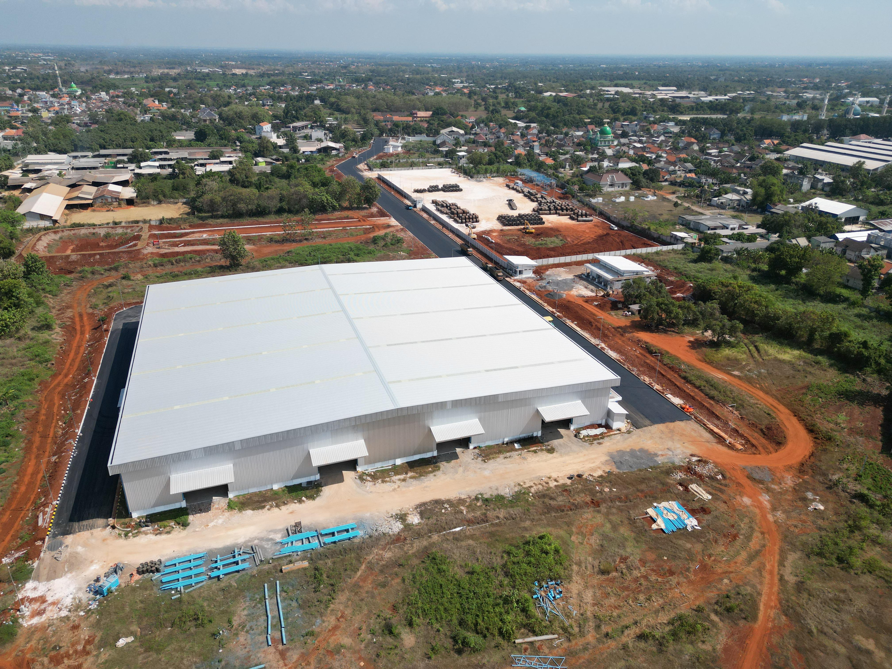
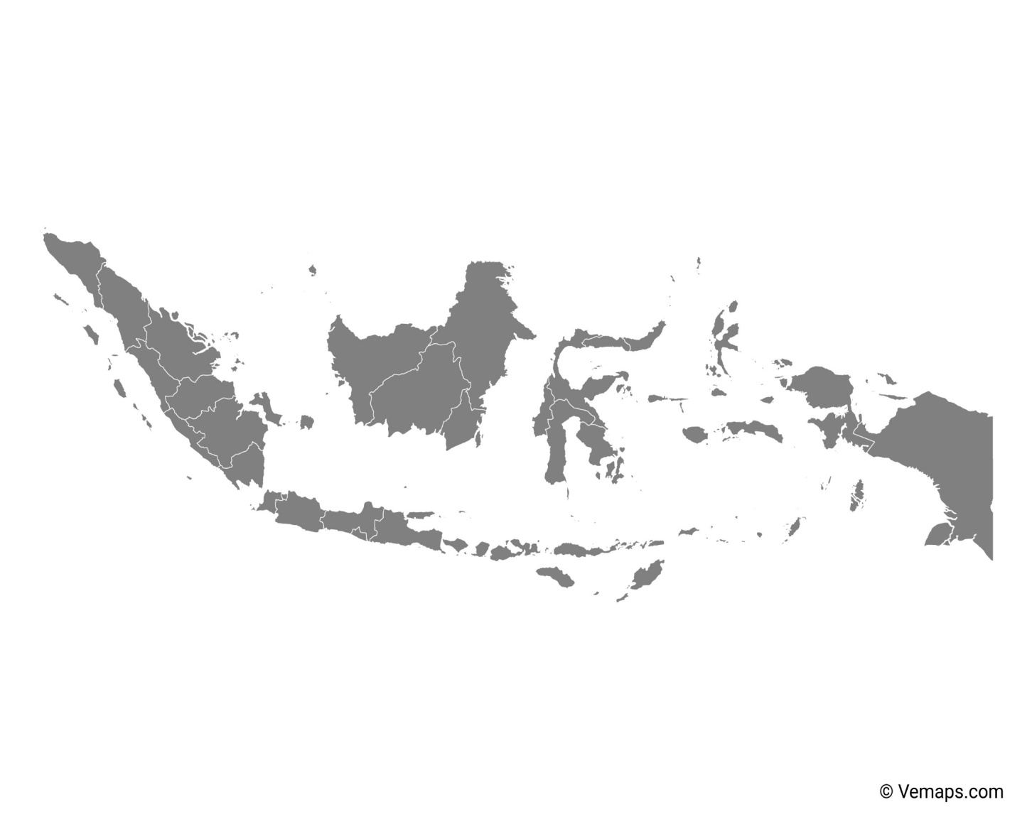
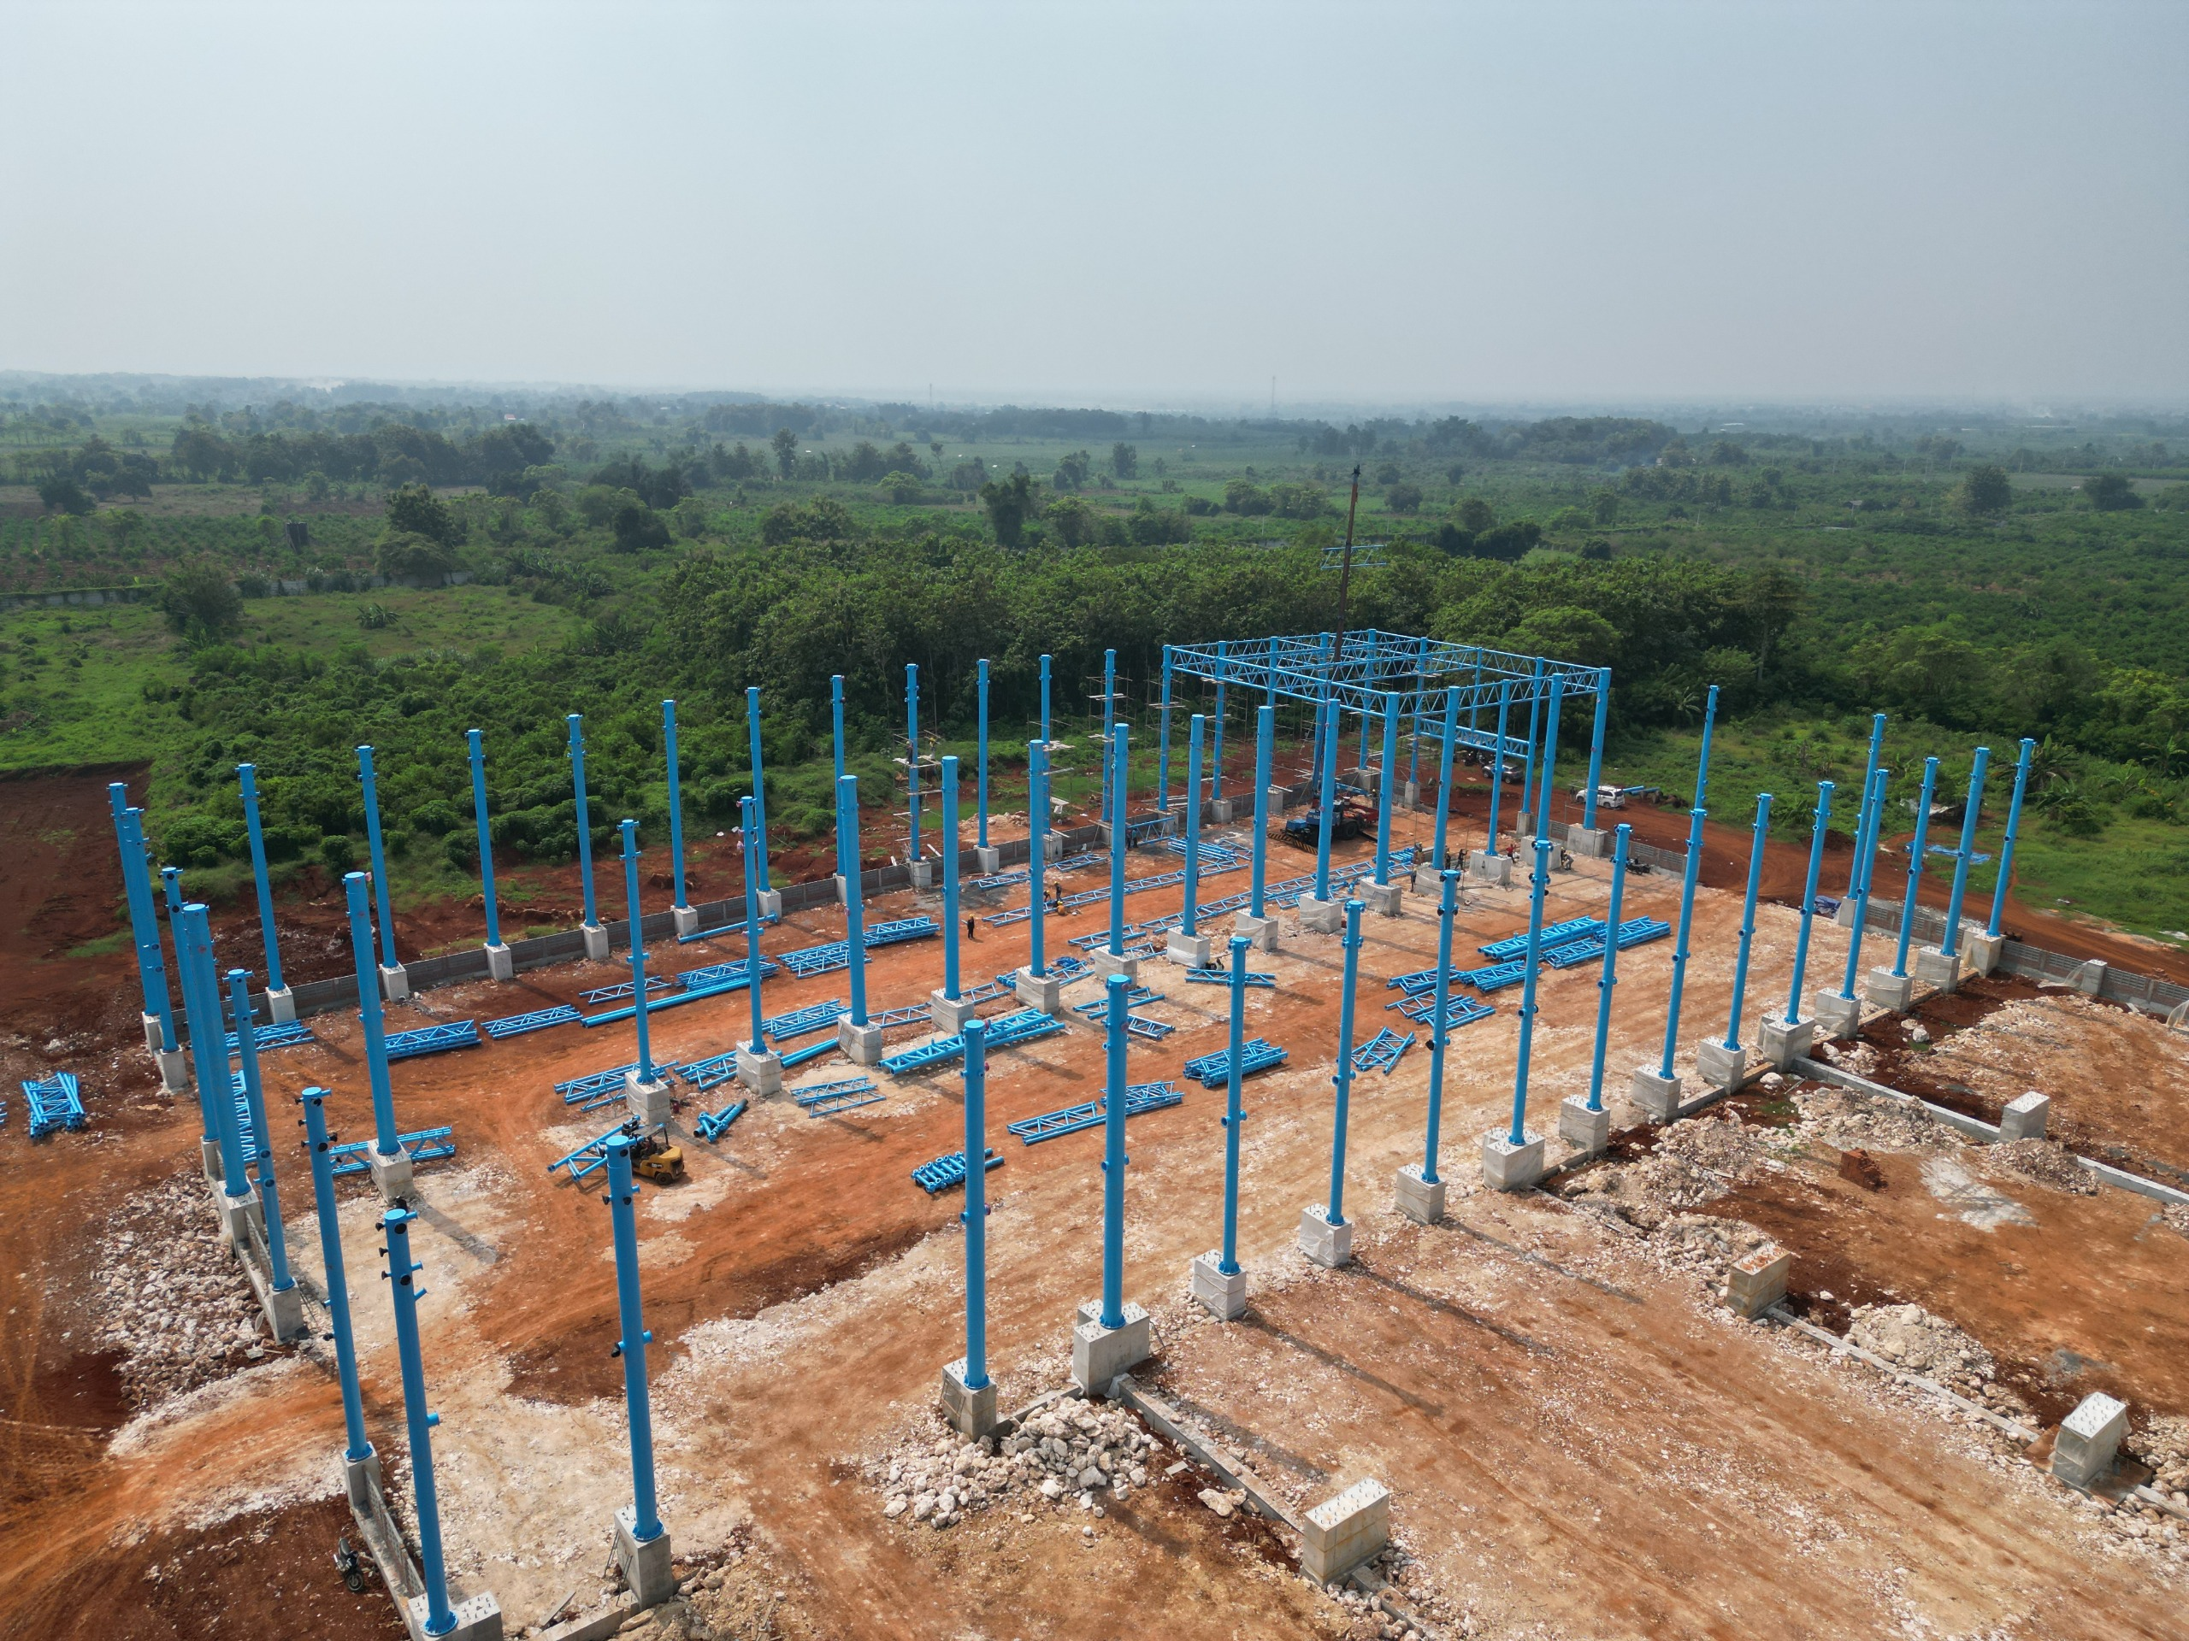
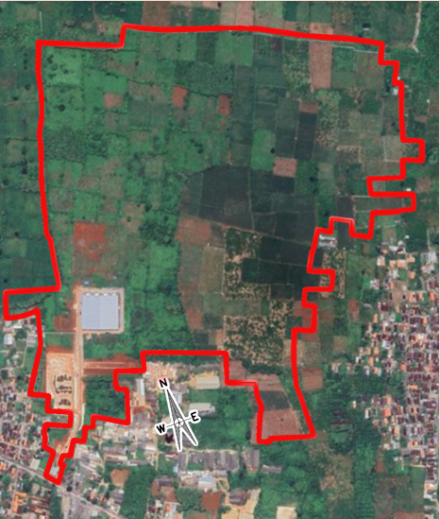
Unit 7 Construction
Pekanbaru
Representative Office
Samarinda
Warehouse
Makassar
Warehouse
Spindo Karawang
Production Unit 5
Bandung/
West Jakarta
Warehouse
Spindo Surabaya
Production Unit 1, 2, 3
Spindo Sidoarjo
Production Unit 6
Jakarta
Representative Office
Spindo Pasuruan
Production Unit 4
Semarang
Representative Office
Surabaya
Warehouse
14
Notes:
] SPINDO didirikan pada tahun 1971 sebagai perusahaan investasi asing oleh PT Gayantara, Itochu Corporation, dan Kawasaki Steel Corporation. Saat ini, SPINDO memiliki 6 unit pabrik dan 4 depo di Indonesia. Kami baru saja membuka depo di Makassar pada bulan Juni untuk menjangkau lebih banyak pelanggan di Sulawesi. Komposisi pemegang saham kami 55.9% oleh PT. Cakra Bhakti Para Putra dan 44.1% dimiliki masyarakat dan termasuk saham yang dimiliki Pemberton dan saham treasury

Slide 15
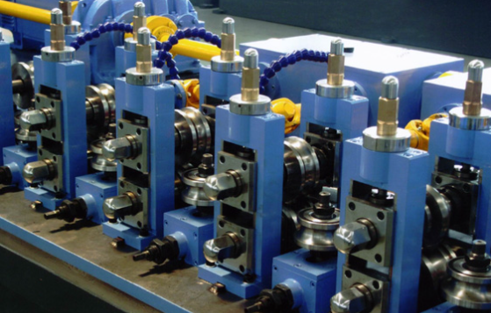
High Tech New Machine
Unit 7 is expanding with two brand-new, high-tech ERW machines:
Small-diameter machine for for pipes up to 8 inches
Large-diameter machine up to 24 inches
Both machines feature advanced robotic technology. The large-diameter ERW machine boasts a monthly capacity of up to 50,000 tons, while the 8-inch ERW machine can produce up to 20,000 tons per month, reinforcing our commitment to cutting-edge innovation and increased production efficiency. Also, this investment aligns with the President’s strategy to strengthen energy security, reinforcing our commitment to innovation and national energy resilience.
*not real picture – for illustration purposes only
EACH of API-Standard pipe follow a comprehensive range of tests to ensure quality and safety, including material, dimensional, and performance tests

Slide 16
Innovating for Growth, Built for Resilience: Navigating Tomorrow’s Opportunities with Disciplined Risk Management.
Now Product coming full effect in 2026 and 2027
  Our new 8 inch pipe is expected to be starting production in early 2026 and the new big diameter machine will commence in early 2027. This new addition to production capacity, production, and eventually sales will further improve our margin expansion. API Standard pipe priced at typically >50% more expensive than standard black pipes.
  Our new facilities will be equipped with cutting edge technology that will enable us to improve loading time and pursue efficiency for us and our customer
  New product in Automotive sector
  Continuation of our turnaround strategies
  As we see that current stategy is effective to improve branding and increase sales, we will continue and more intensely approach our end users. This approach will also make way for new users previously using seamless pipe, and other non-standard pipes
  Further pursue inventory reduction and maintain AR days to improve Cash Conversion Cycle.
  Optimise and reduce Debt to improve credit risk
  Continue with funding diversification to reduce financial cost, outperforming the interest rate declining trend
  Improve our HC productivity and capability with digital transformation.
  Accelerating process to reach industry 4.0 which provide more efficiencies and competitive advantages
  Actively pursuing our Vision : Improving quality of life
  Continue and expand our CSR coverage to provide fresh water for more people. (2025 1st semester in Gunung Kidul)
16
Notes:
Untuk mengeksplor sektor dan menambah customer baru, target kami adalah ekspansi produk dengan mengembangkan mesin kami agar dapat memproduksi pipa baja dengan tipe spesifik seperti pipa industri dan pipa API diameter kecil.

Slide 17
Market Outlook
3

Slide 18
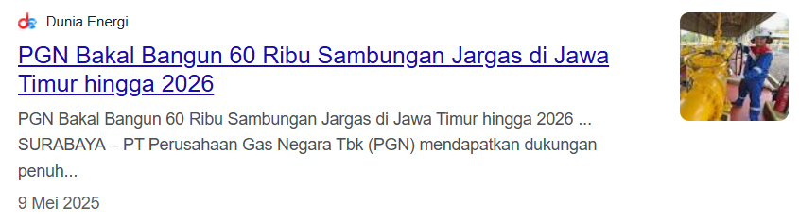
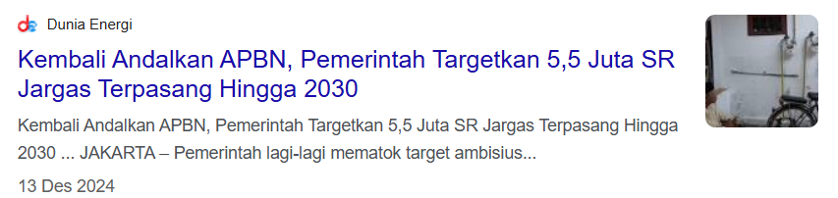
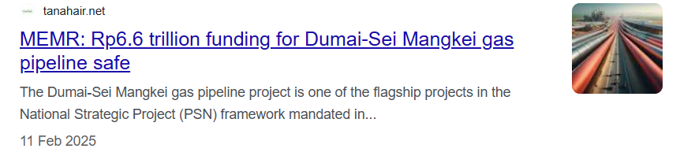
Government Infrastructure Plans Favoring Large-Diameter ERW Pipes
Indonesia’s national infrastructure agenda strongly supports the expansion of pipeline networks across oil & gas, utilities, and industrial sectors—driving demand for large-diameter steel pipes. Ministry of Energy (ESDM) prioritizes connecting gas sources to industrial zones via new pipelines. Strategic National Projects (PSN) include multiple large-diameter pipelines, such as the 245 km Cirebon–Semarang (Cisem) Phase II gas line and the 400 km Dumai-Sei Mangkei Pipeline.
Further projects span across Sumatra, Kalimantan, and Papua, with major trunk lines planned to support gas delivery and industrial expansion. Additionally, the construction of Indonesia’s new capital city, IKN Nusantara, includes large water transmission systems that also utilize steel pipelines. The government’s 5–10 year plan continues to favor pipeline infrastructure as a backbone for economic development—supporting growing demand for domestically sourced large-diameter ERW pipes.

Slide 19
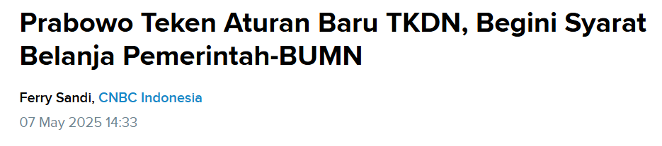
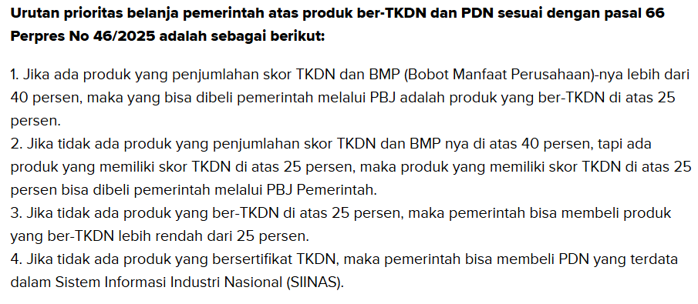
TKDN Regulations Strengthen the Competitiveness of Domestic Pipe Products
The government enforces TKDN (Domestic Content Level) regulations strictly, setting steel material localization thresholds between 40–85% for oil and gas, infrastructure, and electricity projects. Projects such as Cisem have recorded TKDN levels exceeding 60%. SPINDO’s Unit 7, which is focused on producing large-diameter ERW pipes with high specifications and high TKDN values, is strategically positioned to capture opportunities in a market that is increasingly protective of domestic products.

Slide 20
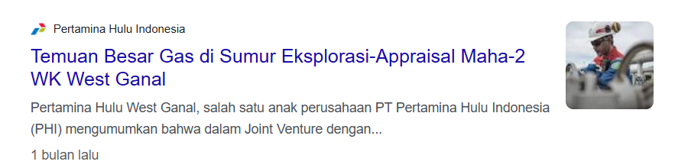
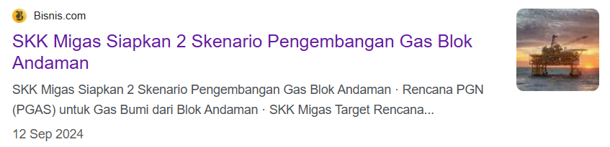
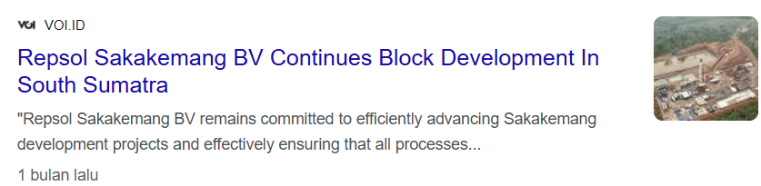
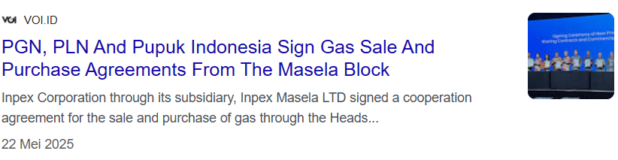
New Gas Discoveries Expand Market Opportunities
The discovery of new gas reserves—such as those in the Andaman Sea, West Ganal, and Masela—creates promising long-term market opportunities for the steel pipe industry. With Indonesia’s commitment to increasing domestic gas utilization and gas infrastructure development, demand for steel pipes, especially for transmission and distribution, is expected to rise steadily.

Slide 21
Spindo ESG
4

Slide 22
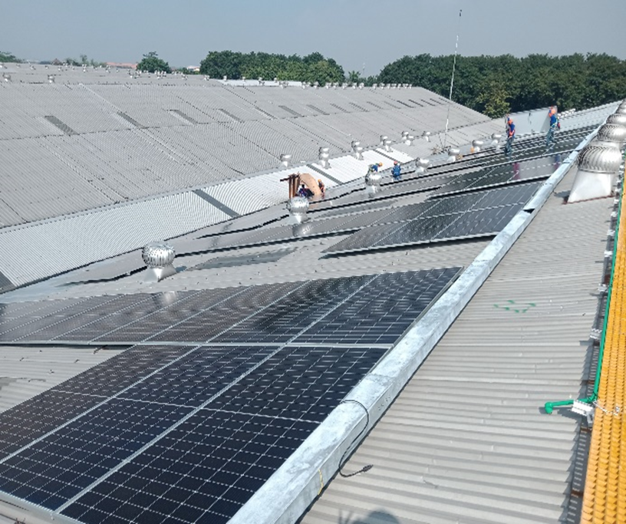
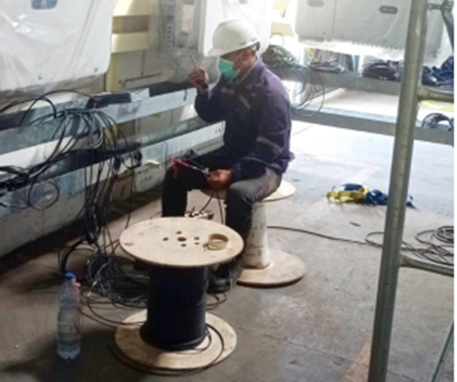
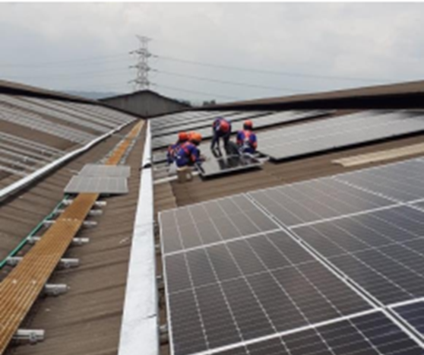
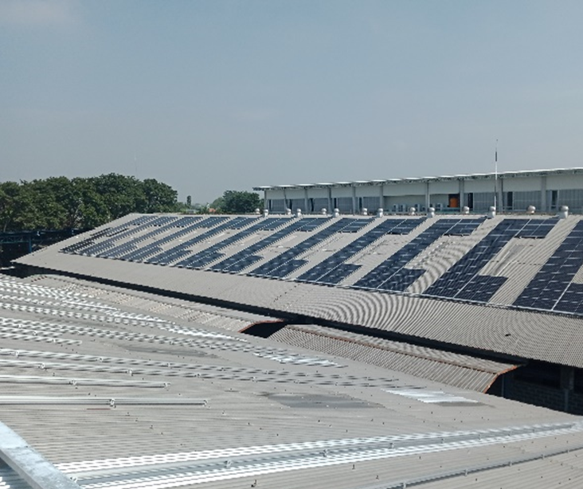

ESG Initiatives
Solar Panel Installation in Plant IV & VI
PLN Tariff Discount for 25 Years*
12-18%
*PLN Tariff assumption 6% CAGR growth
Accumulated Cost Saving for 25 Years
IDR 8-25 Billion
Accumulated CO2 Reduction in 25 Years
7,536-16,658 tons
Immediate Solar Panel Installation in
Plant I, III & V
Implementation of GCG Practices
  Code of Conduct
  Vendor Code of Conduct
  Whistleblowing mechanism
  Audit Committee
  KP5 Committee
  Board Manual
Regular CSR activity and Other Social Initiatives
  Empowering the employment of the local community
  Establishing a Training Centre
  Published the Sustainability Report 2020
22
Notes:
Pada unit pabrik IV dan VI, kami telah memasang panel surya untuk mengurangi penggunaan listrik dan gas. SPINDO juga menerapkan Tata kelola Perusahaan yang Baik dan kegiatan CSR.

Slide 23
SLB Achievement Report 1H2025
Target 2025 |  | Achievement 2025 |  | Increase Capacity (%) | Action Taken
Capacity (kWp) | Estimate Carbon Emission Reduction (kg CO₂eq) | Capacity (kWp) | Estimate Carbon Emission Reduction (kg CO₂eq)
715 | 895.752 | 1.994,0 | 2.498.183,42 | 178,9 | Addition of solar cell capacity Unit 6 from 340 kWp to 650 kWp as of October 2024 Installation of solar cells in unit 5 with a capacity of 1.030 kWp as of July 2024.
The installation of Solar PV panels at Units 1, 2, and 3 was successfully completed in February 2025. The total installed capacities are 651.75 kWp for Unit 1, 759 kWp for Unit 2, and 715 kWp for Unit 3. The system is currently awaiting the issuance of the Operational Worthiness Certificate (SLO) from the Ministry of Energy and Mineral Resources (ESDM) and PLN before commencing operation.

Slide 24

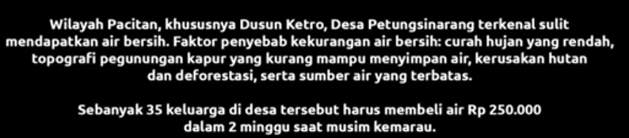
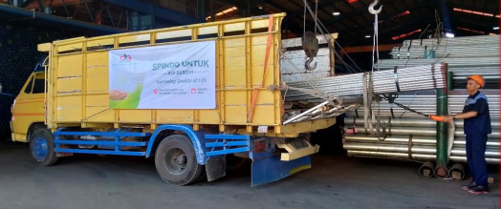
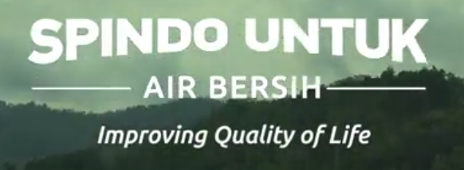
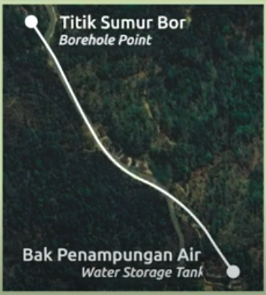
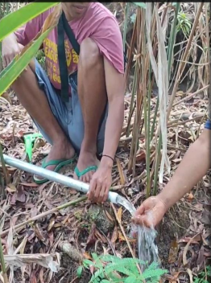
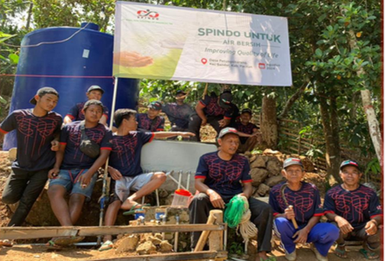
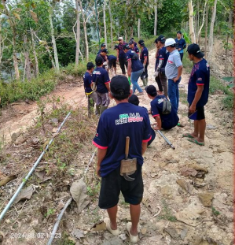
Supporting SDG 6

Slide 25
Guidance & Outlook
5

Slide 26
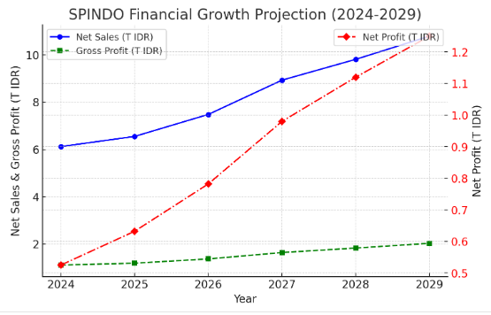
Navigating Uncertainty with Expansion, Financial Strength & Market Leadership : Guidance for 2025 - 2029
SPINDO’s 1H2025 net sales of Rp 2.61 trillion and net profit of Rp 213.3 billion reflect a solid first half, despite headwinds from lower HRC prices and softening demand. The quarter’s gross margin improvement to 19.9%, along with stable cost discipline, supports the trajectory shown in the growth forecast—where both gross profit and net profit are expected to expand steadily through 2029.
While SPINDO's financial projections indicate strong revenue and profit growth, it is essential to consider market uncertainties and operational challenges that may influence actual performance.

Slide 27
Selected Projects
6

Slide 28
Selected Projects
January – June 2025
Logistik
Proyek Pembangunan Dermaga A Petrokimia Gresik
Proyek Pekerjaan Bracing Jetty Wanam Merauke
Proyek Upgrading Jetty 1 di IT Pontianak
Proyek Dermaga Lapuko 2025
Proyek Revitalisasi Breasting Dolphin Kanan Jetty 2 IT Manggis
Proyek Pembangunan Dermaga Pulau Balang Bentang Pendek II – IKN
Peningkatan Fasilitas Pelabuhan Lampia
Proyek Pelabuhan MIDAI 2025
Proyek Pembangunan Dermaga Kap. 50.000 di FT Biak
Proyek Jetty PT Ganda Alam Makmur
Proyek Peningkatan Faspel Laut Bungin
Infrastructure
Proyek Pembangunan Palaran Samarinda, Kaltim
Proyek Rekonstruksi Jembatan Palu 4
Proyek Jalan Tol Probolinggo - Banyuwangi Paket 3
Proyek PDAM Jaya – Jakarta
Proyek BPIPI Sidoarjo
Proyek PT Semen Indonesia
Oil and Gas Machinery
Proyek Coal Crushing System dan Loading Terminal Kapasitas 36 Juta Ton Per Tahun di Tanah Grogot
Proyek PT Batubara Duaribu Abadi
Proyek PT AKS Bangka
Perbaikan Tangki No. 05 Fuel Terminal Palopo
Pembangunan Tangki Timbun di Fuel Terminal Banggai
Perbaikan Tangki Timbun No. 05 di Fuel Terminal Pulau Raha
Perbaikan Tangki Timbun No. 02 & 03 di Fuel Terminal Tual
Proyek PT Kideco Jaya Agung
28
28

Slide 29
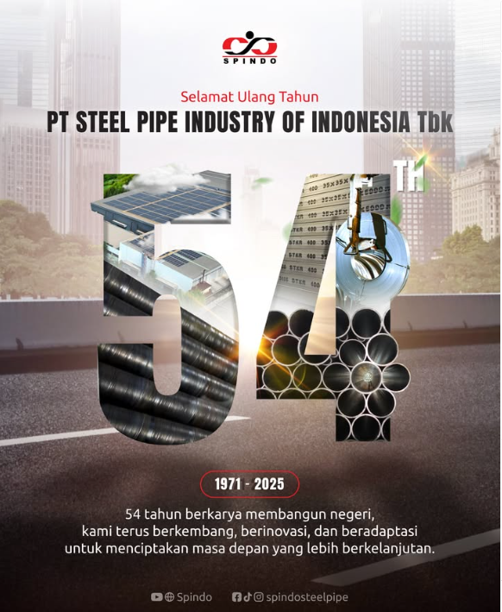
THANK YOU
“SPINDO’s strategic roadmap focuses on sustainable growth by balancing sector diversification, operational excellence, and strategic partnerships, ensuring resilience and profitability in Indonesia’s evolving steel market landscape.”

Slide 30




facebook.com/spindosteelpipe
youtube.com/c/spindosteelpipe
@spindosteelpipe
linkedin.com/company/spindo
For more information please contact:
PT Steel Pipe Industry of Indonesia Tbk.
Gd. Baja Lantai 7B
Jl. Pangeran Jayakarta no 55 Jakarta
Indonesia
Up:
Johanes W Edward
Corporate Secretary & Investor Relations
Chief Strategy & Business Development Officer
Email: johanes.edward@spindo.co.id
Ph: +62-21 6231 3502 ext. 6062

Slide 31
Appendices
7

Slide 32
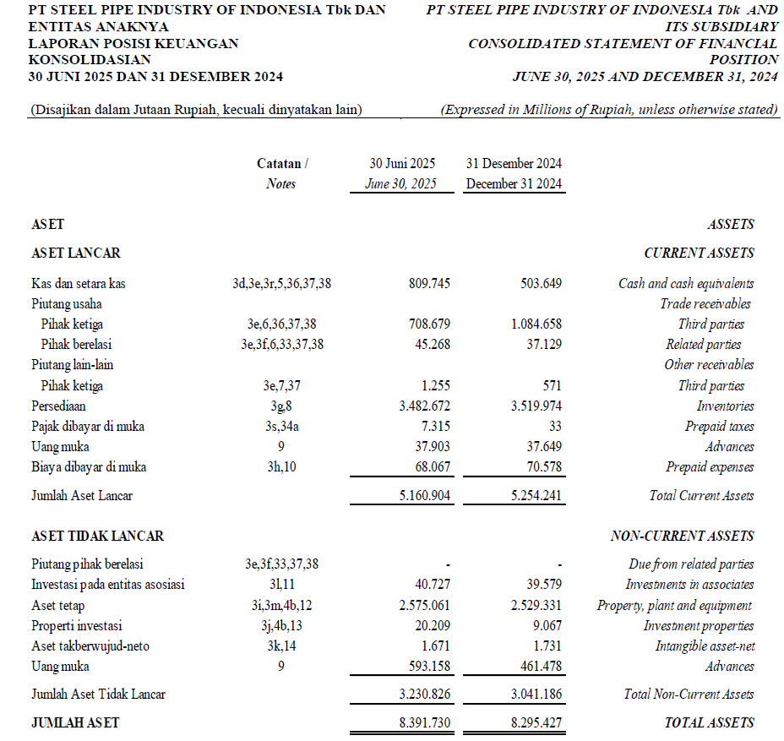
Financial Report 30 June 2025
32
Notes:
2022

Slide 33
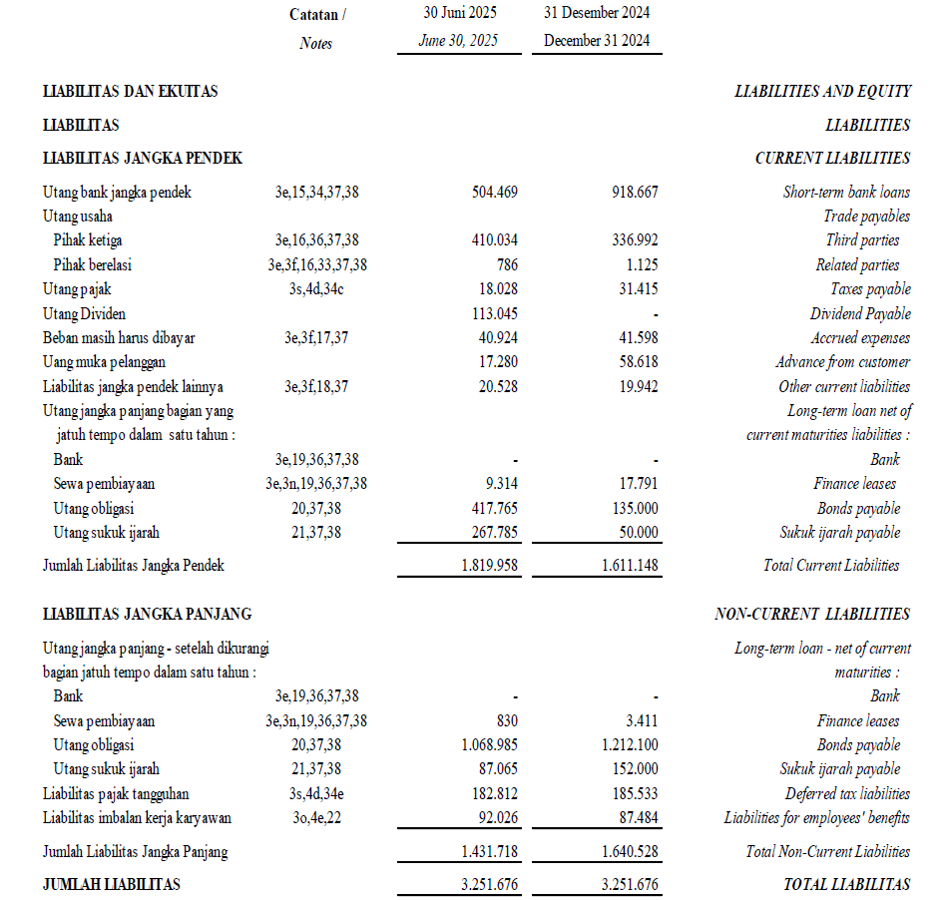
Financial Report 30 June 2025
33
Notes:
2022

Slide 34
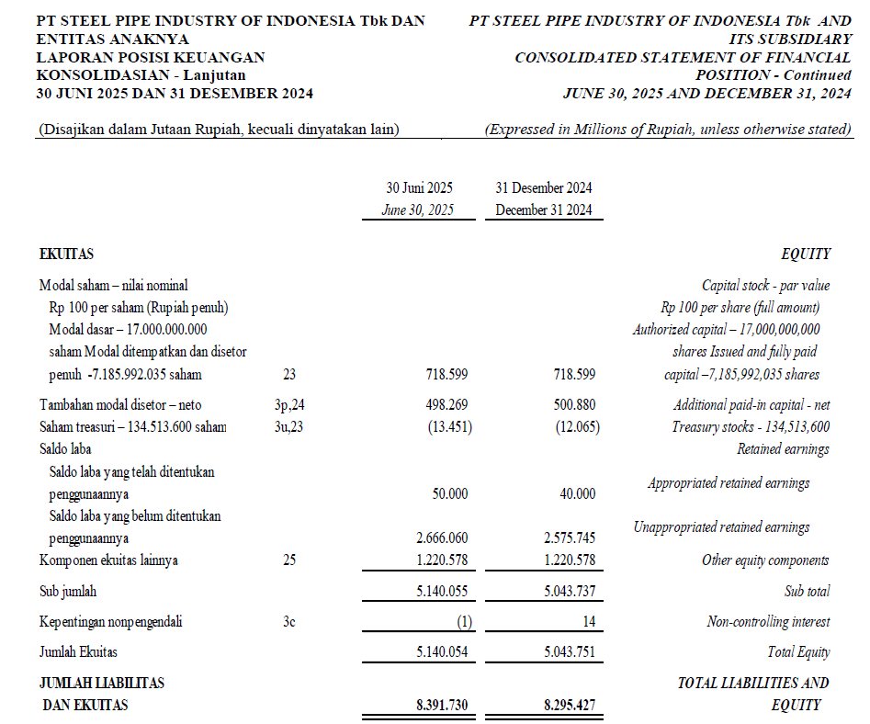
Financial Report 30 June 2025
34
Notes:
2022

Slide 35
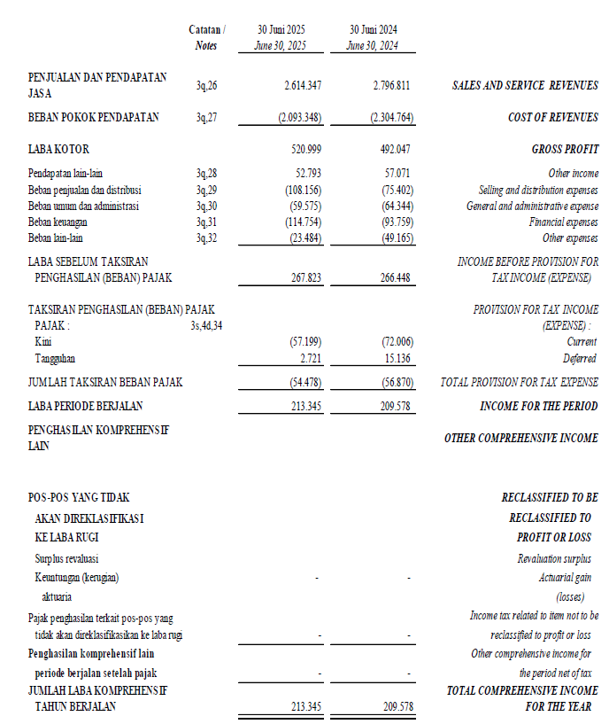
Financial Report 30 June 2025
35
Notes:
2022

Slide 36
Corporate Summary
Sustainable Competitive Advantage
SPINDO's Unique Capabilities
  Certified Export for US and Canada Fire Sprinkler Systems
  Spiral Welded Pipe Manufacturing: Large Diameter and Thickness
  High-Quality Thick Wall Stainless Steel Unthreaded Pipes
  'Blow Galvanize' Technology for Uniform Coating and Superior Quality
  Galvanized Pipe with Enhanced Tensile Strength and Elongation
Commitment to minimising environmental and having a positive social impact
  Supporting Skilled Labor Initiatives with SPINDO LSP
  Ensuring ISO 45001:2018 Compliant Occupational Health & Safety Practices
  Implementing ISO 14001:2015 Compliant Environmental Management System
The flexibility to import raw materials from global steel markets
  Global Steel Market Access for Raw Materials
  Differentiating from Competitors Captive to Local HRC Producers
  Leveraging Scale for Structural Cost Advantage
36
36
Notes:
Terdapat banyak kelebihan yang dimiliki oleh SPINDO dibandingkan dengan perusahaan manufaktur pipa baja lainnya seperti ekspor ke US dan Kanada untuk sistem sprinkler pemadam api dan produksi pipa galvanis. Diluar dari itu, range produk kami yang beragam dan ketersediaan produk juga merupakan keunggulan kami terhadap customer.

Slide 37
ESG Initiatives
Acceleration on ESG Initiatives
In 2024, Spindo accelerate its action towards ESG initiatives. Such acceleration implemented in the Operation Team KPI, where all departments have target to reduce 10% carbon footprint of Scope 1 and 2.
Spindo also initiate additional CSR activity to support Global Sustainability Development Goals, especially goal 6 that is providing fresh water for people with difficult access. This CSR is targeted to be launch on August 2024
Issuance of Spindo Sustainability Linked Bond 1 year 2024
With the issuance of SLB, Spindo also committed to generate more renewable energy by install more solar panels in our factories. With the target set conservatively at 35% increase in 7 years, we believe that we can achieve more. The planning of implementation are as follows :

Slide 38
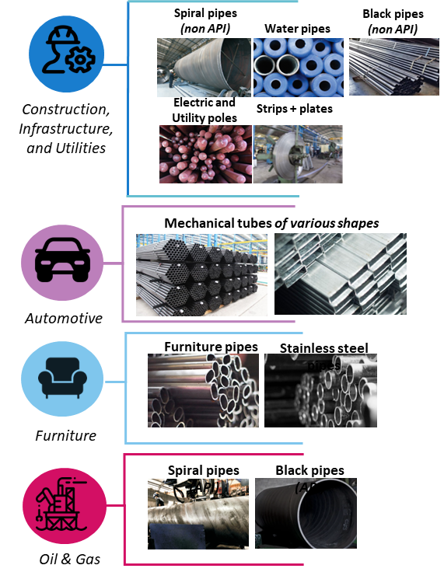
Indonesia’s Green Steel Pipe Company
ESG related Projects supplied with our products
  Potable Water distribution, Fiber optic poles, Data centre construction, Hydropower, Waste Treatments, Geothermal Projects, Bridges & Ports in remote areas
  Estimated Sales Value Annually : Approx. >IDR 2,5 Trillion
EV (Electric Cars & Motorcycles)
  Estimated Sales Value Annually : Approx. >IDR 2,5 Trillion
Electric Bus Caroserie, Green House Construction, Agriculture Piping, Bicycle Frame, Solar Panel Frame
  Estimated Sales Value Annually : Approx. IDR 200 Billion
Natural Gas house distribution
  Estimated Sales Value Annually : Approx. IDR 100 billion
38

