Slide 1
Playing To Your Strengths
Executive Alliance Mentoring Program
Thursday, September 25, 2025
Presented By: Tracy Imm

Slide 2
Agenda
I'll share the slides with you!
Learning Objectives for today’s session
What is the Clifton StrengthsFinder Tool?
The Framework & Process to Understanding Your Report
Practicing Conversations
Name, Aim, Claim (Pairs Activity)
Love, Crazy, Envy (Pairs Activity)
Team Strengths Grid discussion
Key Takeaways & Next Steps

Slide 3

Learning Objectives
Learn how to use the StrengthsFinder assessment for your personal and professional development as a leader
Get to know your fellow mentees and the mentors

Slide 4

Assessment Tools
There are many assessment tools on the market. Strengths Finders is a DEVELOPMENTAL tool and not meant to be used for recruiting or hiring.
Your assessment is the starting point for a strengths-based development process.

Slide 5

What is a Strength according to Gallup?
Strength n. the ability to consistently produce a positive outcome through near-perfect performance in a specific task. To finish with strength, start with talent.

Slide 6
What's Your Number 1 Strength? What was your first reaction?
Round Robin Introduction
This session is about you investing in your talents.

Slide 7
Discovery
When you discover your greatest talents, you realize your greatest opportunity for excellence and strength.
All people have strengths - the unique combination of talent, knowledge and skill that help them do what they do best every day.

Slide 8

Committing to Becoming the Best Version of Yourself
Talent (A natural way of thinking, feeling, or behaving)
X
Investment (Time spent practicing, developing your skills, and building your knowledge base)
Strength (The ability to consistently provide near-perfect performance)
Change is inevitable, personal growth is a choice

Slide 9
The Clifton StrengthsFinder Tool
A person's talents – those thoughts, feelings, and behaviors that come naturally – are the source of his/her greatest potential and power.
Background & Key Elements

Slide 10
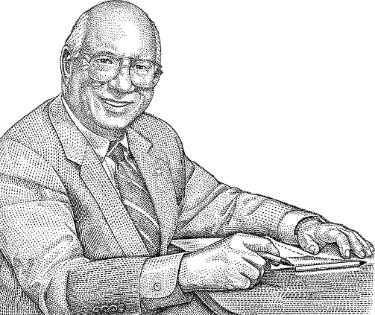
“What will happen when we think about what is right with people rather than fixating on what is wrong with them?”
He thought about the impact on the organizational culture, employee engagement and customer experience
Don Clifton (1924 – 2003)
Industrial Psychologist

Slide 11
Background
Gallup has been studying what makes people successful for 50 years (examined various industries and over 50 countries)
Over 25 million people have taken the Clifton StrengthsFinder survey
Based in positive psychology
The odds are 1 in 33 million that someone has the same sequence of themes as you

Slide 12
Everyone has talent. It's hardwired.
Do you ever wonder why you make certain choices?
Why you do what you do?
Why you like certain things?
Why are you better at some things than others?
There's a reason. It's your TALENTS.
[Talent n. a naturally recurring pattern of thought, feeling, or behavior that can be productively applied.]
CTA: Find more ways to apply your talents.

Slide 13




The Four Strengths Domains (Categories or Groupings)
Executing
Influencing
Relationship Building
Strategic Thinking
Know how to make things happen.
Know how to take charge, speak up, and make sure the team is heard.
Have the ability to build strong relationships that can hold a team together and make the team greater than the sum of its parts.
Help teams consider what could be. They absorb and analyze information that can inform better decisions.

Slide 14
Domains & Signature Themes
Executing | Influencing | Relationship Building | Strategic Thinking
Achiever | Activator | Adaptability | Analytical
Arranger | Command | Connectedness | Context
Belief | Communications | Developer | Futuristic
Consistency | Competition | Empathy | Ideation
Deliberative | Maximizer | Harmony | Input
Discipline | Self-Assurance | Includer | Intellection
Focus | Significance | Individualization | Learner
Responsibility | Woo | Positivity | Strategic
Restorative |  | Relator
Keep in mind: These four categories can help you think about how you have used your talents for success –but don’t let this limit your thinking.
We all have all 34 themes, they are just in a different order.

Slide 15





Your Top 5 Themes Reveal Who You Are, What Makes You Unique and Successful
Strategic
Relator
Connectedness
Learner
Intellection
Your Insight Report is the starting point...

Slide 16



Strengths-Based Development Framework
Name It
Claim It
Aim It
Read Your Insights Report
Begin to Understand Your Top 5 Themes
Make your Themes your own. Identify what each theme means to you.
You Own It – appreciate the value you bring to others
You Bring It to the Team & Your Work Activities Every Day
You Honor and Develop Your Talents & Your Teammates' Talents

Slide 17
Name It! Claim It! Aim It!
Pick a partner and discuss the following:
Which of your TOP five do you most strongly identify with and why?
When has this theme helped you be successful in the past or in your current role?
In what ways could you start using one of the themes more intentionally tomorrow? (It’s helpful to think about this in the context of a specific goals of yours, whether personal or professional.)
STUDY YOUR PRIOR SUCCESSES FOR CLUES

Slide 18



Benefits of Working with Your Strengths
6 times more engaged at work; tell their friends they work for a great company; look forward to going to work; have more positive interactions with coworkers; achieve more on a daily basis
Treat customers better
3 times more likely to report having an excellent quality of life
GALLUP’S DATA BACKS UP THESE CLAIMS

Slide 19
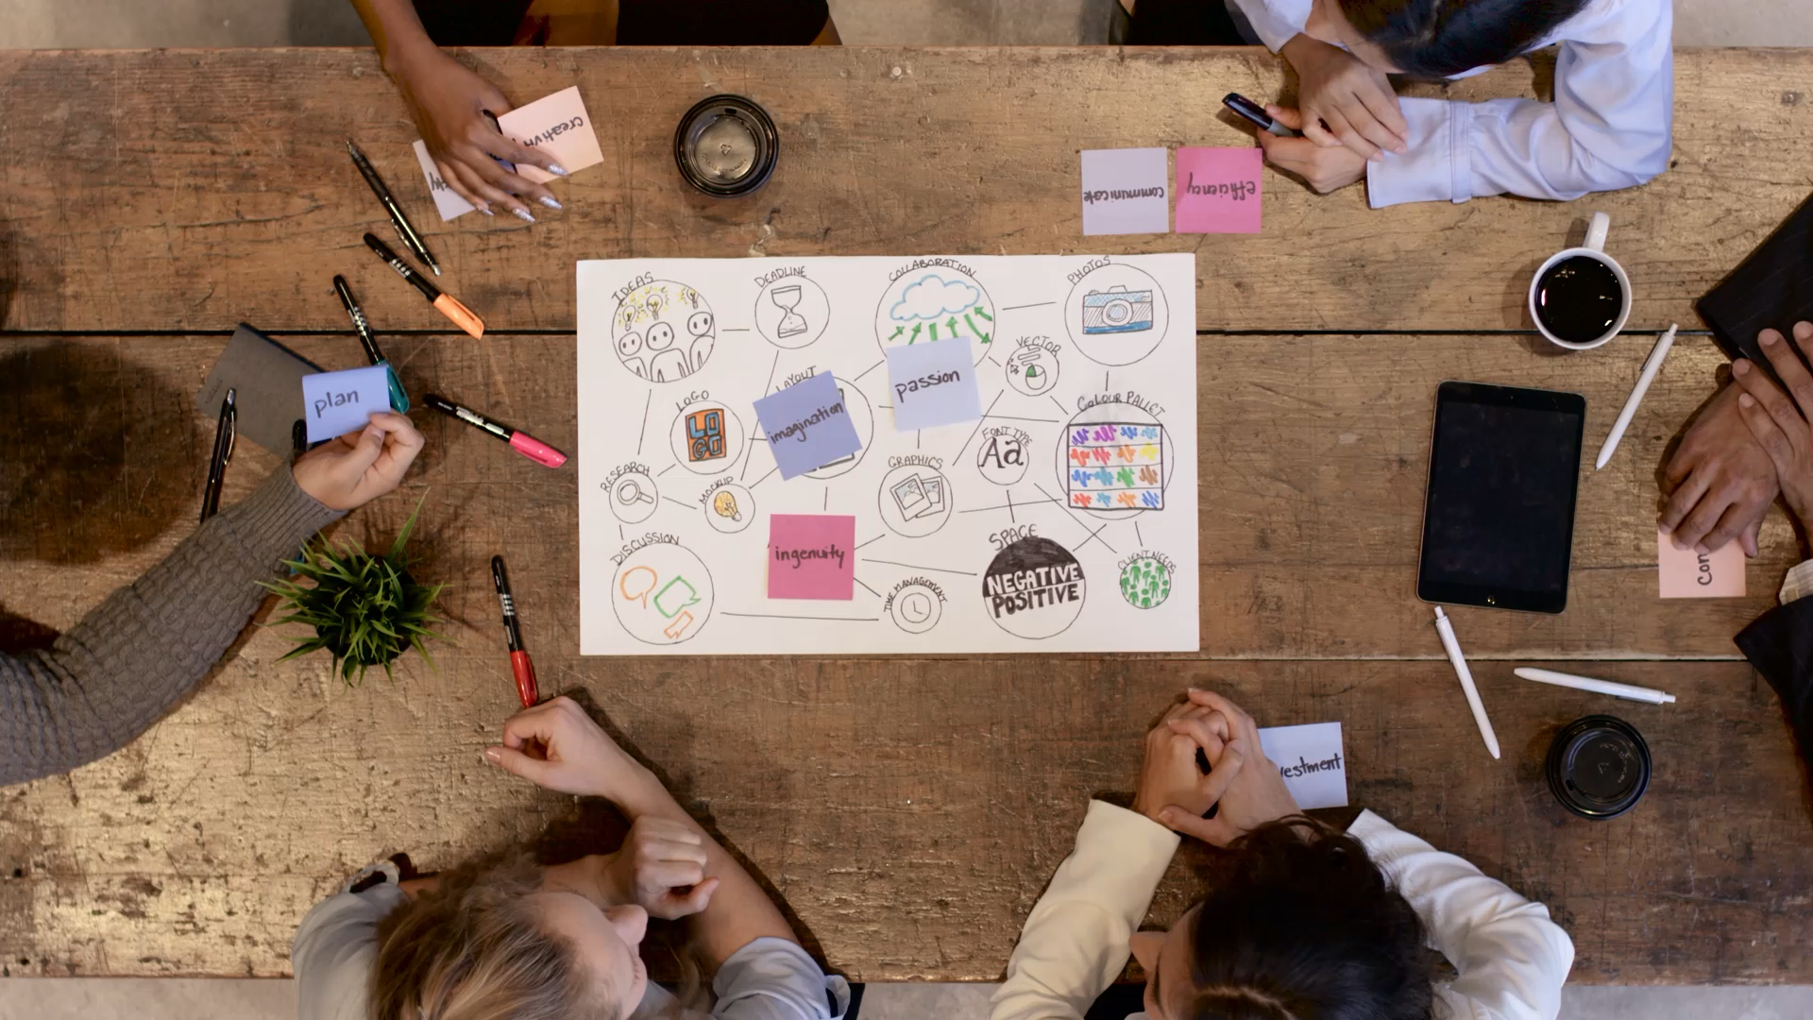
Your Signature Themes: Investing in your Talents
Recognize and appreciate your talents. Learn more about how to leverage them successfully and practice intentionally.
Find more ways to apply your talents
Acquire new skills and knowledge
Share your strengths

Slide 20
Love, Crazy, Envy
Share your top five strengths
Then discuss the three questions:
What strength do you have that you LOVE to have?
What strength drives you CRAZY that you have it?
What strength do you ENVY of your partner?

Slide 21
Leveraging Everyone's Strengths
When teams use the common language of strengths, it immediately changes the conversations. Using strengths language creates a positive dialogue and boosts team's engagement and performance.
High Performance Teamwork: Every team is the sum of its parts.

Slide 22
Strengths-Based Teams
A strengths-based team is a group of imperfect but talented contributors valued for their strengths, who need one another to realize individual and team excellence.
Know and intentionally use their own unique talents and strengths
Know and appreciate each other’s strengths
Combine their strengths with those of others on their team to achieve success

Slide 23

What's Different About Strengths-Based Organizations?
PURPOSE versus paycheck
DEVELOPMENT versus Satisfaction
COACH versus Boss
CONVERSATIONS versus Reviews
STRENGTHS versus Weaknesses
LIFE versus Job.
” Well-Being at Work”

Slide 24
Team Strengths Grid

Slide 25
Key Takeaways
Everyone has talents – and your greatest potential lies within your natural talents.
Your reports are just the starting point; you must invest in your talents to develop your strengths.
To make the most of your talents, take time to recognize and appreciate them, learn more about how to leverage them successfully, and practice intentionally.
Within your teams, recognize that a person's dominant talent themes represent needs that must be met – and look for and reinforce strengths in action!

Slide 26

Understanding + Action = Success
The key to personal development is to fully understand how to apply your greatest talents and strengths to in your everyday life.
One's greatest potential for success is grounded in taking action that is consistent with one's unique nature.
Share Your Strengths with the World

Slide 27
Your 1:1 Coaching Session
Name It
Review of Your Top 5 Themes
Review of the 4 Domains
Identify what resonates with you and how you have used this in the past to be successful
Discuss how you will honor your strengths and nurture them by being more intentional

Slide 28
Homework after your 1:1 Coaching Session
Claiming Your Talents
How does this theme influence how you make things happen?
How does this theme affect how you influence others?
How does this theme affect how you build and nurture relationships?
How does this theme affect how you think about and analyze information and situations?

Slide 29
Next Steps
Read Your Report in depth and write down any questions you have
Schedule your 1-1 coaching session with Tracy to discuss Your Top 5 Themes from your Insights Report and determine how best to apply your strengths in your current leadership role
Share and discuss with your Executive Alliance Mentor in a future coaching conversation

Slide 30
Gallup Resources
You Tube Channel
Podcast
Website

Slide 31
THANK YOU!
Go Play To Your Strengths!

