Slide 1
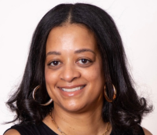
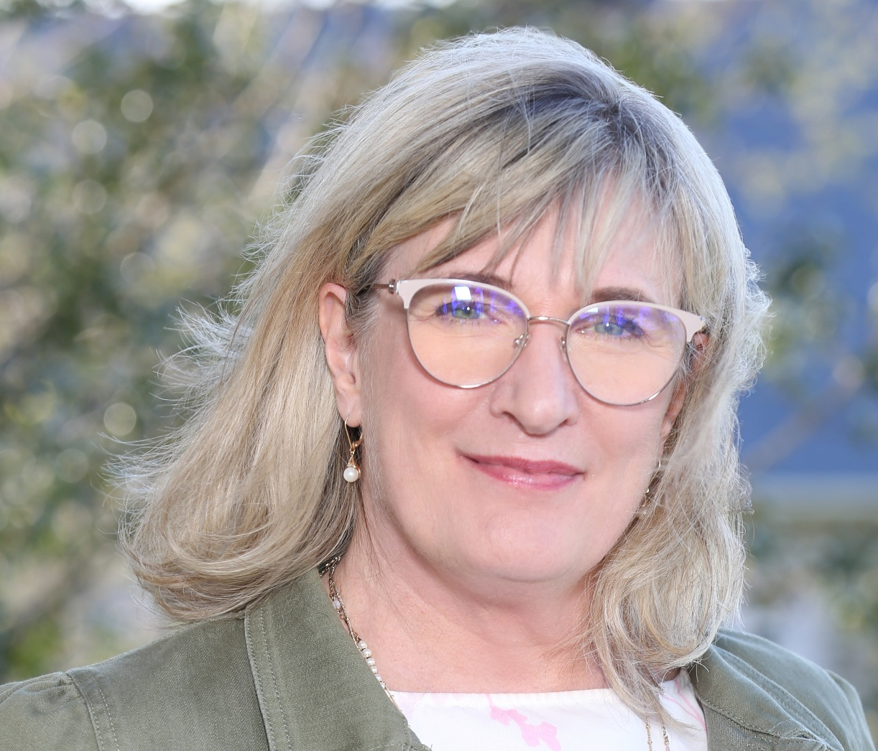
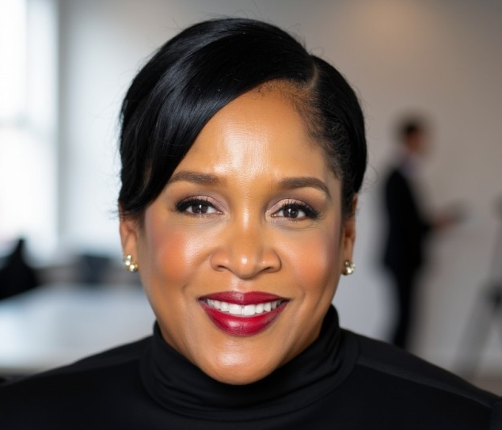
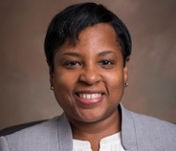

FROM HERE TO THERE:
REAL STORIES OF GROWTH & LEADERSHIP
Lynnea Cornish
mother mary lange school
Julie east
Julie east consulting
Candace osunsade
the ramsay group
Teresa woodard
t. rowe price

Slide 2

Bridging the gap:
Strategic growth & raising your visibility
November 2025

Slide 3
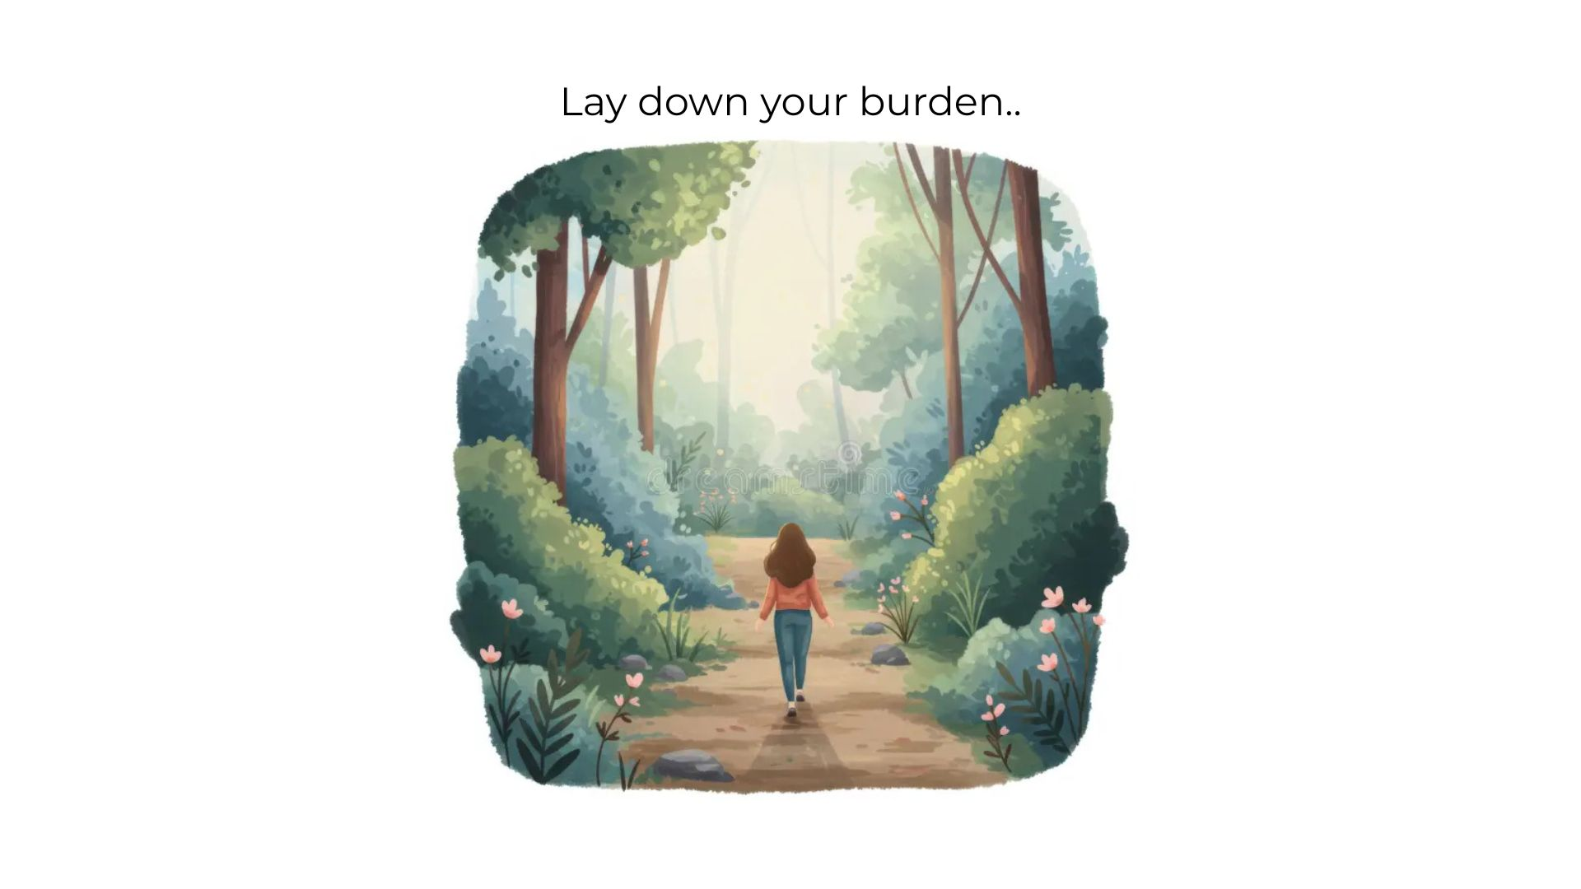
Centering ourselves
Notes:
Take a moment…

Slide 4
Bridging the gap: strategic growth & raising your visibility agenda
Weave together your values, strengths, goals and accomplishments to create a gap analysis
Perform a “personal brand audit” for your visibility within your workplace, industry and wider professional network
Understand ways to raise your visibility
Create a simple, actionable roadmap to close the gap
Notes:
Distribute handout, ask people to get out laptops

Slide 5

Gap Mapping
Fill out sections 1 & 2 of your worksheet
Partner and discuss your Goals, Accomplishments and Gaps/Blind Spots – note on worksheet
Group reflections on exercise – common gaps?
Group discussion: Strategies for closing the gap

Slide 6


Raising your visibility
Exercise: Personal Brand Audit using checklist at end of worksheet
How can we raise visibility?
Tips for LinkedIn

Slide 7
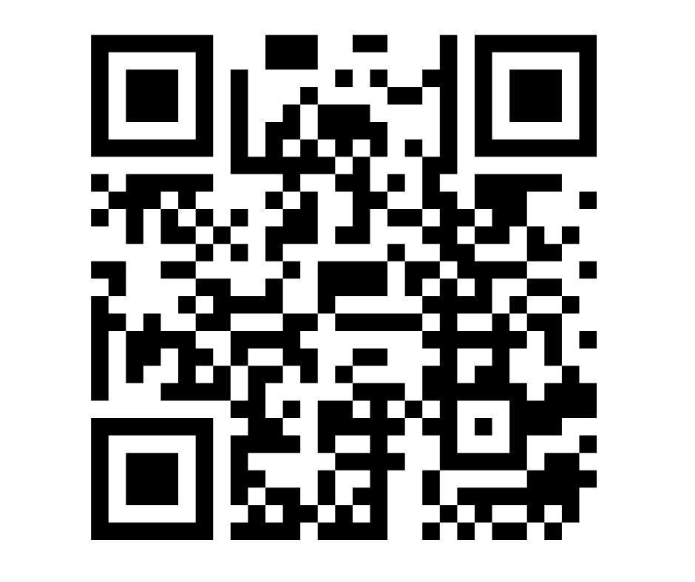
Where are my gaps?
Input your worksheet answers into your private Google form.
During the break, your Personal Gap Analysis will be generated.
When we come back, we’ll share
and reflect on the plans and adjust.

Slide 8
Owning your path
What is my roadmap?
How can I close my caps
Own your action plan. What are the next steps?

Slide 9



A NOTE TO YOURSELF
Write a note to yourself on the provided postcard.
What action steps do you need to take?
We’ll mail it to you in mid-December.

Slide 10
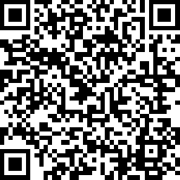
Next Steps
Holiday Party – December 9
Next session – January 15
Advocate for your Value
Survey

