Slide 1
Board-Readiness Session #1
Setting the foundation:
identify Your Board Value Proposition and target market

Slide 2
Board-readiness framework
1. Identify your board-facing value proposition and target market
2. Develop your board resume and board biography
3. Optimize LinkedIn and shape your go-to-market campaign
4. Explore board credentials and educational associations, and develop your networking strategy
5. Prepare for the board interview and launch your campaign

Slide 3
Today’s AGENDA
Review Board Structure, Committees and Where You Fit
Understand the Skills Matrix
Learn What’s Needed in the Corporate Boardroom
Identify Your Target Market
Learn What’s Happening in the Boardroom, and Develop Your Vocabulary

Slide 4
Board structure, committees and where you fit
Shareholders
--OWNS--
Board of Directors
--GOVERNS--
CEO
--MANAGES--
Board of Advisors
--ADVISES--
Leadership Team
--OPERATES--

Slide 5
Board Director responsibilities
Hire and fire the CEO
Establish policies for corporate oversight
Set broad corporate goals
Monitor performance
Encourage ethical behavior
Assess Board’s own effectiveness
Review and Approve:
Management’s strategic and business plans
Financial objectives, plans, actions
Limits of authority for corporate officers
CEO and board compensation
Non-ordinary transactions

Slide 6
Director’s Fiduciary Duties
Duty of Loyalty: Act in a manner reasonably believed to be in the best interests of the corporation
Place corporation’s and shareholders’ interests above personal interests
Avoid conflicts of interest/be aware of disclosure obligations
Do not usurp “corporate opportunities”
Do not improperly compete with the corporation
Maintain confidentiality and do not misuse confidential info
Think and act independently
Duty of Care: Act as a “reasonably prudent person” would in a similar position under like circumstances
Directors have a duty to act—cannot be “mere figureheads”
Follow a rational process to become informed
Base decisions upon all information reasonably available
Duty of Disclosure: The legal requirement of all directors to take every reasonable step to provide the company’s shareholders with any material information that they may require to affect any company-related action for which they may be required.

Slide 7
Committee structures
Typical committees and key responsibilities include:
Audit Committee
External audit
Internal controls
Risk management
Nominating and Governance
Board composition and structure
Self-evaluation
Compensation
Senior management compensation structure
CEO evaluation
Many companies have additional committees to support business needs:
Strategy
Strategic planning
Evaluating special opportunities such as M&A
Digital/Technology
Product development
AI and Cybersecurity analysis and deployment

Slide 8
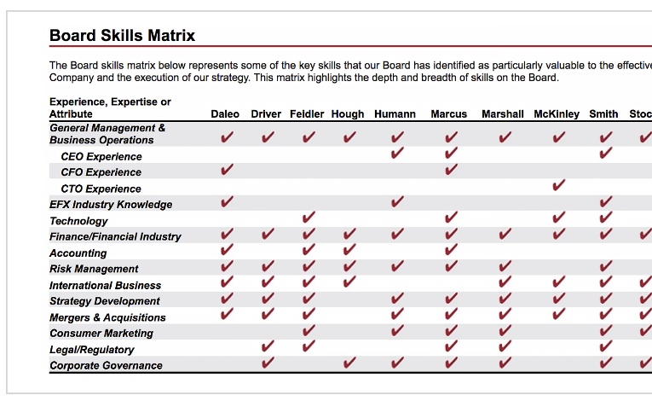
Sample Board Matrix

Slide 9
What’s needed in the corporate boardroom
Governance & Board Leadership
Corporate Governance & Structures
Public Company & IPO Experience
Board Dynamics & Decision Making
Risk Management
Legal Experience
Committee Service
International Experience
Managing Shareholder Activism
Strategy & Business Acumen
Strategic Growth & Business Transformation
Financial Expertise & Risk Management
Operational and Supply Chain Expertise
General Business Management
Brand/Reputation Management
Innovation & Future-Readiness
AI & Emerging Technologies
Geopolitics
Cybersecurity & Data Privacy
ESG & Sustainability Practices
Climate Change
Leadership & People Strategy
C-Suite & Executive Leadership Experience
Talent & Workforce Strategy
Succession Strategy
Crisis Management & Resilience
Business Transformation
Culture Building & Diversity Strategy
Financial Acumen & Transactions
Capital Markets & Capital Allocation
Regulatory & Government Affairs
M&A & Corporate Development
Investor Relations
Audit

Slide 10

Focusing Your Target Market
Your First Independent Role:
Target direct or closely adjacent domain and functional skills
Your Second Role:
OK to expand into loosely adjacent markets or products, and highlight new skills learned during from your first board role

Slide 11
Narrowing your Corporate Board Targets
Private vs. Public
If private: PE- or venture-backed; Family owned; ESOP
Board structure
Size: Revenue, funding, profitability
Stage: Maturity based on market penetration, product stage(s)
Location: regional, national, international
Market segment (keeping in mind conflicts of interest)

Slide 12

Ownership
$300M
Only 13% of US companies over $100 million are publicly-traded
PE,
Family- owned, Micro-Cap
$50M
PE,
Publicly-traded
Venture,
Family- owned, PE, Nano-Cap
<$5M
Angel, Friends & Family
Pre-revenue
$Billions
Bootstrapped
Publicly-traded

Slide 13
Marketing & GTM Innovation
Strategic Focus
Process
Innovation
$300M
Application and Product
Innovation
(de-risked product)
PE,
Venture,
Family- owned, Micro-Cap
Business Model
Innovation
$50M
PE,
Venture,
Publicly-traded
PE,
Venture,
Family- owned, Nano-Cap
Disruptive
Innovation
<$5M
Angel, Friends & Family
Pre-revenue
$Billions
Bootstrapped

Slide 14
Pay Structure
Pay + Equity
$300M
Pay, Short and Long-term Incentives
Equity + Stipend
PE,
Venture,
Family- owned, Micro-Cap
$50M
PE,
Venture,
Publicly-traded
PE,
Venture,
Family- owned, Nano-Cap
Equity
<$5M
Angel, Friends & Family
Pre-revenue
$Billions
Bootstrapped

Slide 15
Finding companies in your Target Market
Forbes Largest Private Company list
Wikipedia List of Largest Private, Non-governmental Companies
Forbes Most Successful Mid-Cap Companies (sortable by industry)
Middle Market Private Equity
Top Private Equity Firms in the Mid-Market
Segmentation by NAICS Codes

Slide 16
Learn What’s Happening in the Boardroom and Develop Your Vocabulary
It’s critical that you understand board vernacular and learn how to utilize that language to shape your dialogue – both in your board materials and when you interview for a board role.
Key Resources:
EY Center for Board Matters
Deloitte Center for Board Effectiveness
KPMG Board Leadership Center
PWC Governance Insights Center
Nasdaq Center for Board Excellence

Slide 17
Assignments
Learn What’s Happening in the Boardroom and Develop Your Vocabulary
Subscribe to suggested resources on slide 16
Define your Unique Board Values
From your readings, slide 9 and the worksheet, select 10+ competencies, and identify your top 4
Determine your Committee Alignment (slide 7)
Articulate your Target Market and Research Target Companies (slides 10-15)

