Slide 1
Board-Readiness
Session #2
Board Resume & Bio
Career stories

Slide 2
Pop Quiz!

Slide 3
Let’s hear from you
(in one minute or less)
Hello, my name is …..
My career background is …. (market sectors, company sizes, your focus areas)
To board service, I bring…. (your board value proposition)
I look forward to serving as an independent board director for companies ….
(describe your target market)

Slide 4
The Board Resume
Detailed outline of your board positioning and work history
Designed to be shared with recruiters and when applying for open board roles
Features your Unique Value Proposition, history with boardroom interactions and the breadth of skills you can bring to a board role
Re-casts work history through a board lens
Keep to two pages if possible

Slide 5
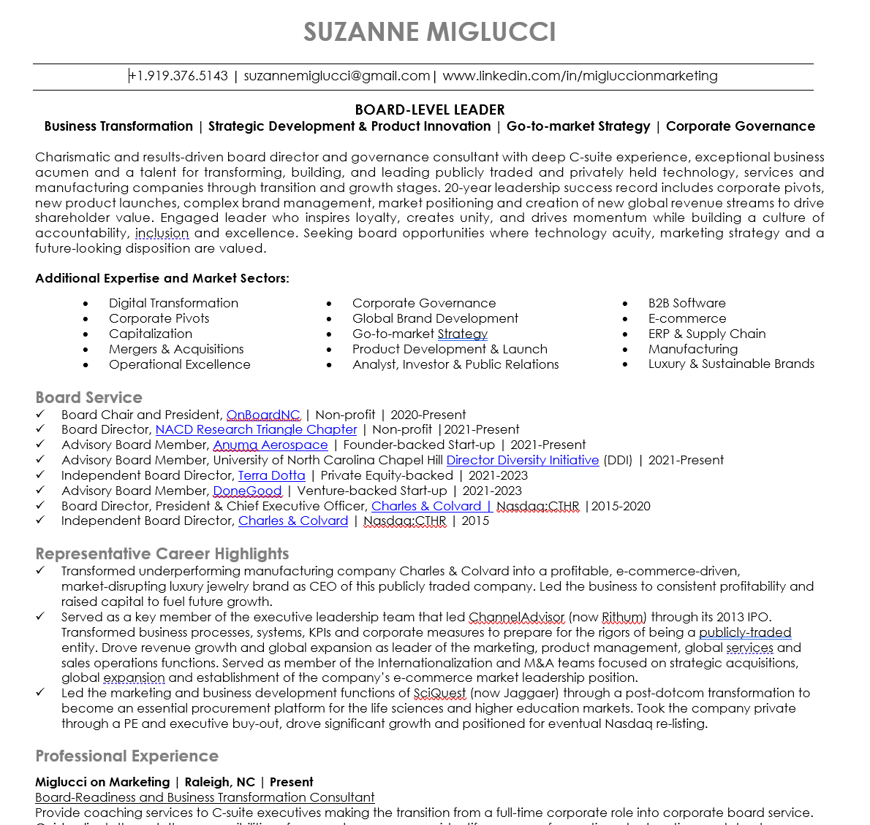
The Board Resume – Page One
Here are your Unique Values!
Your opening paragraph speaks to your personality, leadership style, and key contributions to a potential board. We’ll use your selected adjectives, and highlight market segments if appropriate
Optional but helpful, this section can be used to tease out additional competencies that didn’t make it in your Unique Values. Also a place where you can outline select markets to serve.
This is your assignment!
Develop 5-10 career stories that highlight your most significant accomplishments – keeping in mind that you should list those that align with your unique values and primary boardroom topics. Utilize outcomes and ‘board speak’ in your descriptions. These stories will also become the basis for your interview discussions.
We’ll list any board service including non-profits, with recent and active service at the top. If you don’t have prior board service, we’ll list the various ways you have interfaced with boards (e.g., as a consultant, or as a C-Suite executive who presented to the board, serviced board committees, etc.)

Slide 6
The Board Biography
High-level, story telling version of your history
Designed to be shared with your network so they can pass you along to others in their network, but not giving away extensive detail
Sometimes used by recruiters as a first filter before considering full board resumes
A good tool for you to use if you’re introducing yourself to Nom & Gov chairs and search firms
Keep to one page, and use your photo
Lots of creative options for layout

Slide 7
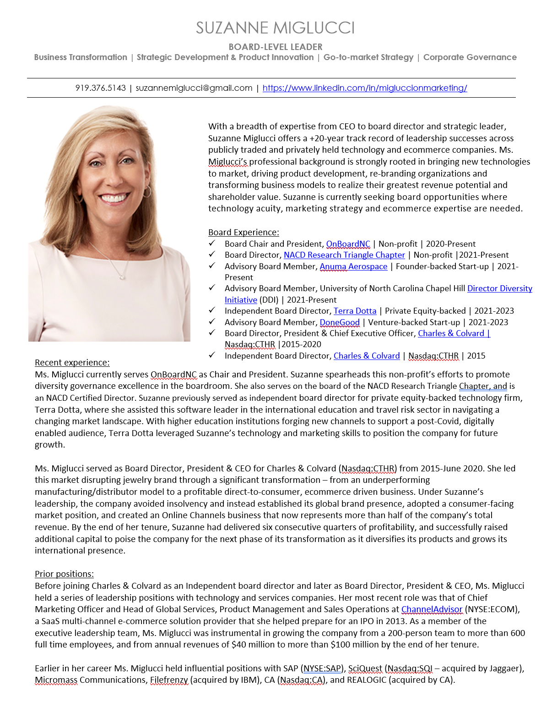
Key value propositions directly aligned with resume
Opening paragraph nearly identical to resume, in a storytelling voice
Current positions including your law practice and board roles
Board service – same as resume
Immediately past positions
Past positions, education, associations

Slide 8
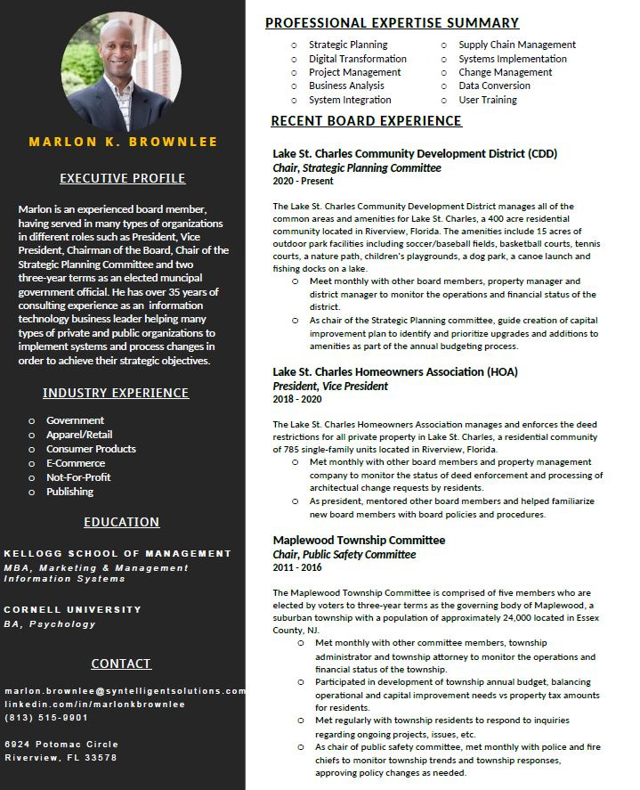
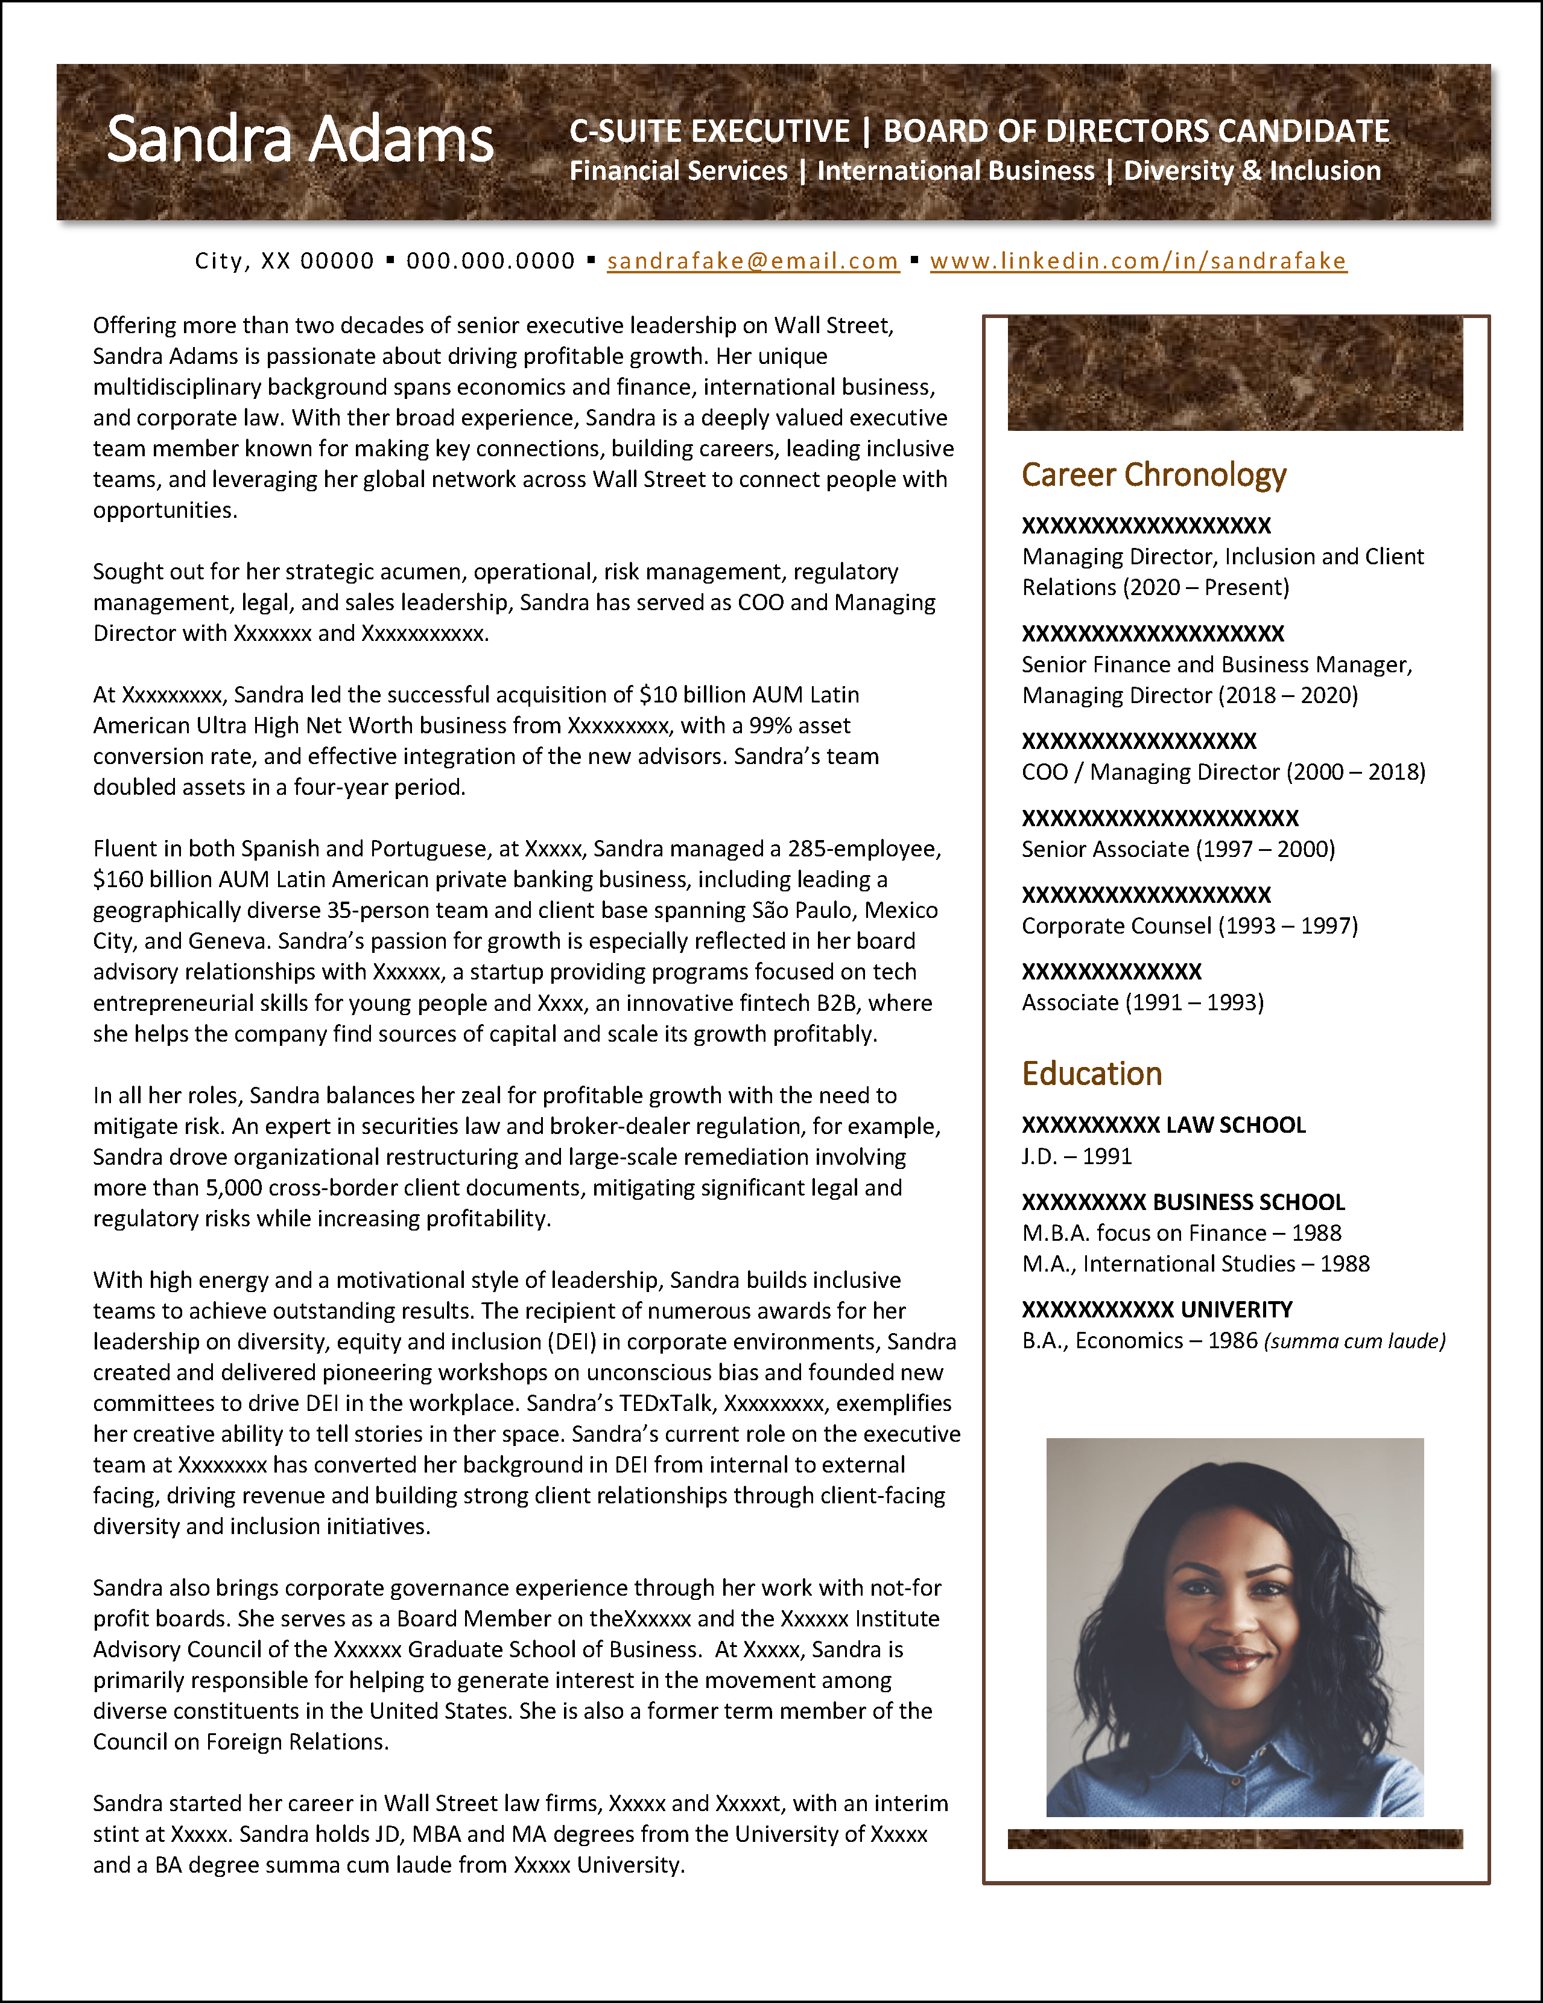
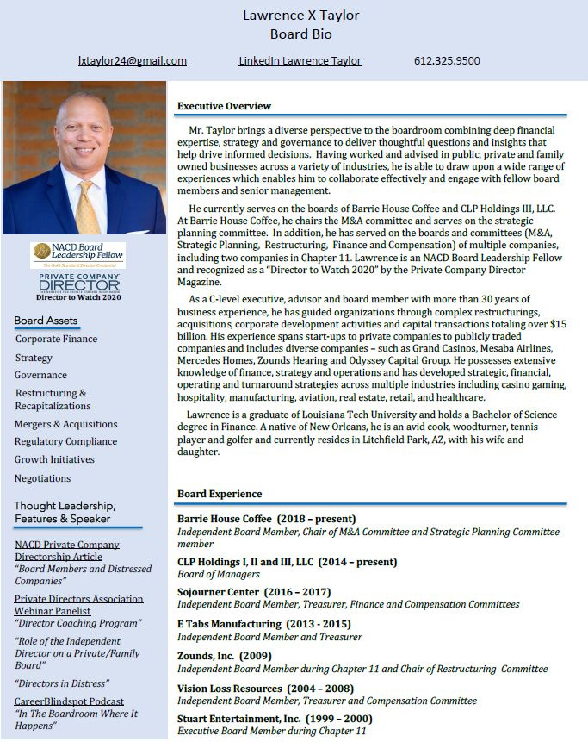

Slide 9
formatting Tips
Judicious use of color
Columns OK
Spell out acronyms 1st use
Photos
  Bio - Yes
  Résumé - no unless international
Third person for bio, first person for resume
Size font 10 or 10.5
Margins
  Top/bottom - .5
  Left/right -.8 or .7

Slide 10
Learn What’s Happening in the Boardroom and Develop Your Vocabulary
It’s critical that you understand board vernacular and learn how to utilize that language to shape your dialogue – both in your board materials and when you interview for a board role.
Key Resources:
  EY Center for Board Matters
  Deloitte Center for Board Effectiveness
  KPMG Board Leadership Center
  PWC Governance Insights Center
  Nasdaq Center for Board Excellence

Slide 11
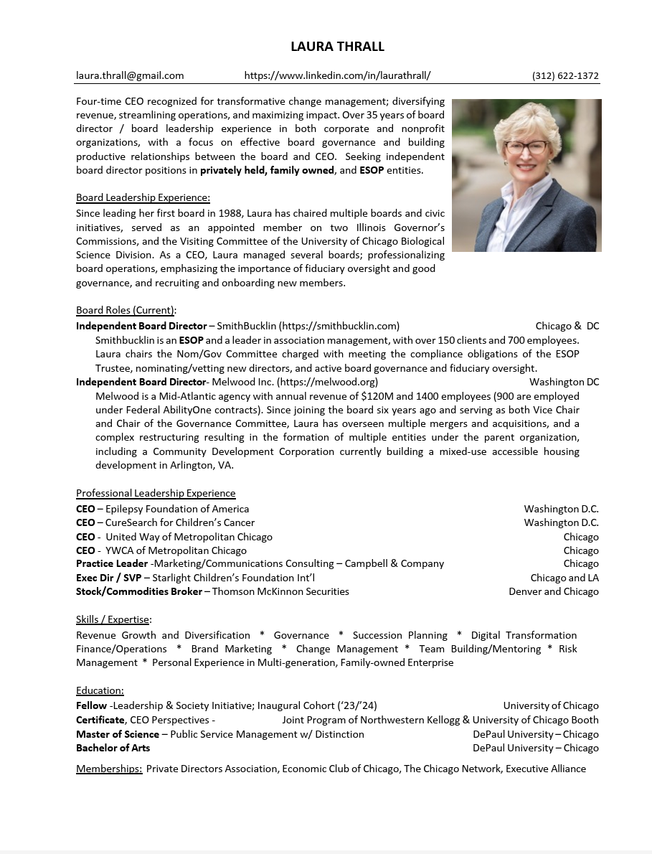
Lessons from Laura
Experienced CEO
Practicing board director
Diverse C-suite and boardroom skills
Non-traditional background

Slide 12
Session #2 Exercises
Draft page one of your board resume (Unique board values, opening paragraph, board service, career highlights); re-cast Experience section with a board lens
Choose a format, and draft your board biography
Develop up to 10 long-form career stories that highlight your key skills and support your value proposition; choose the top 3-4 in short form for your resume

