Slide 1
Board-Readiness Session #4
Strategic Networking and credentials:
- Your Linkedin Profile
- Thought leadership and preparing your campaign
- Associations and certifications

Slide 2
Content used with permission from Bronia Hill, Promote Yourself
Features of a great Linkedin profile
PROFILE ELEMENT | WHY IT MATTERS FOR BOARD DIRECTORS
Headline, Banner & Picture | Convey strategic positioning, value proposition and executive/leadership presence
About Section | Shares origin story, strategic vision, and board-level capabilities
Experience | Highlights impact, governance experience, and results
Featured Postings | Bring board-related content, talks, or publications to life; Demonstrate ongoing engagement and influence in governance or industry
Recommendations | Add credibility from peers, board colleagues, and C-suite stakeholders

Slide 3
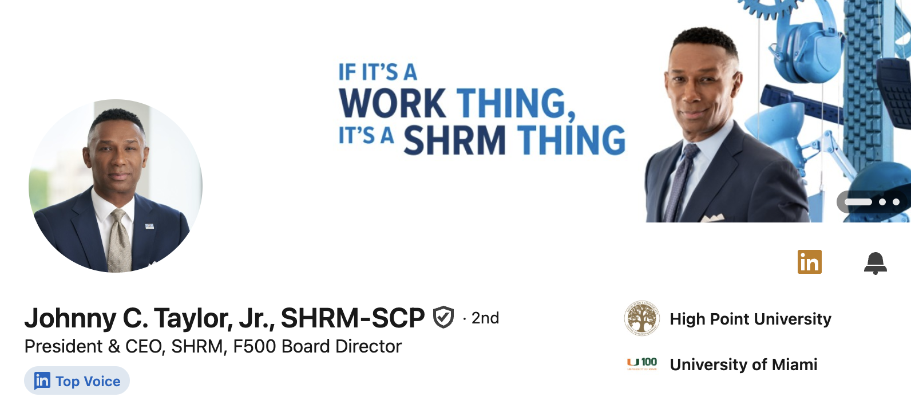
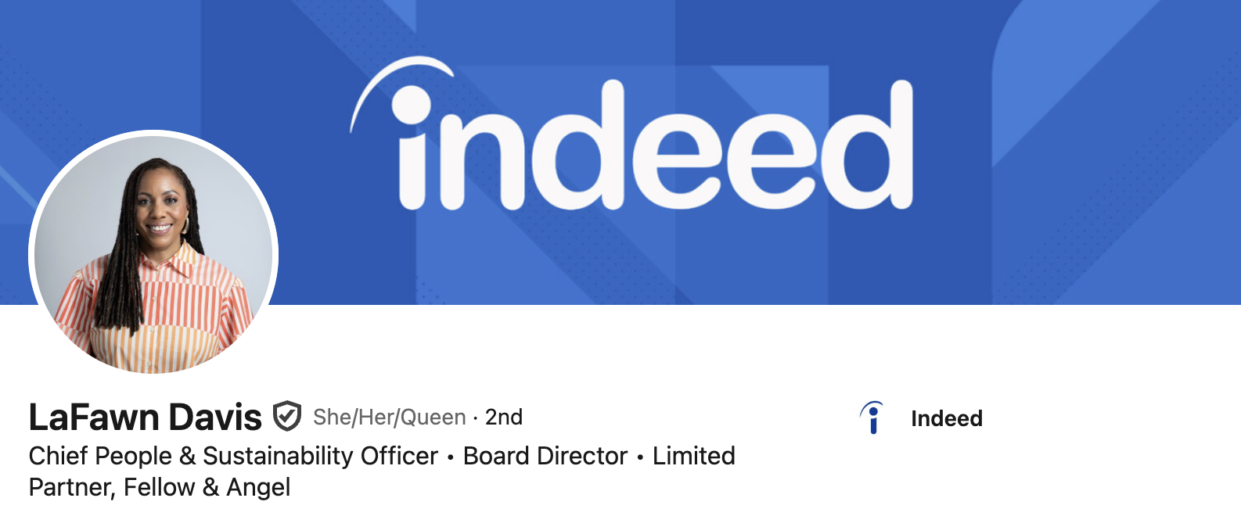
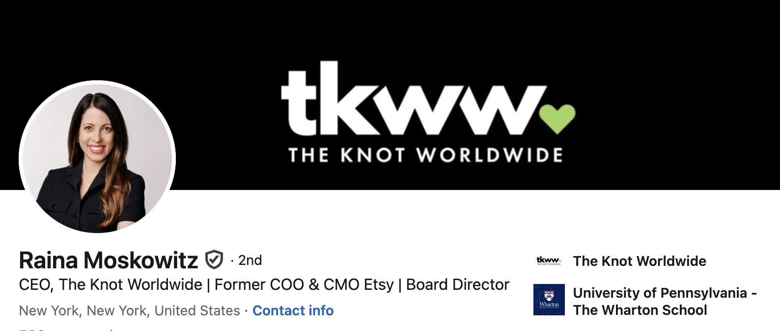
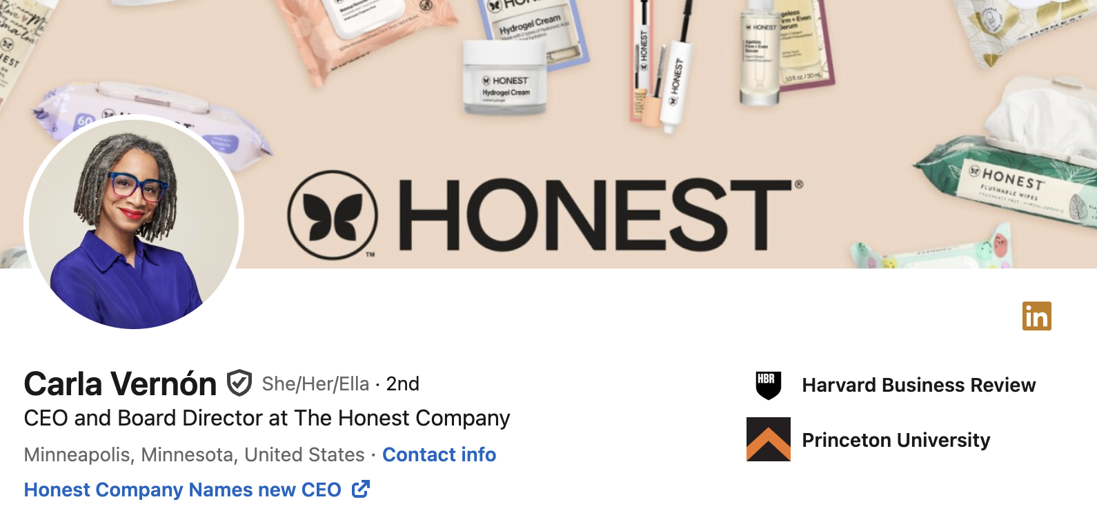
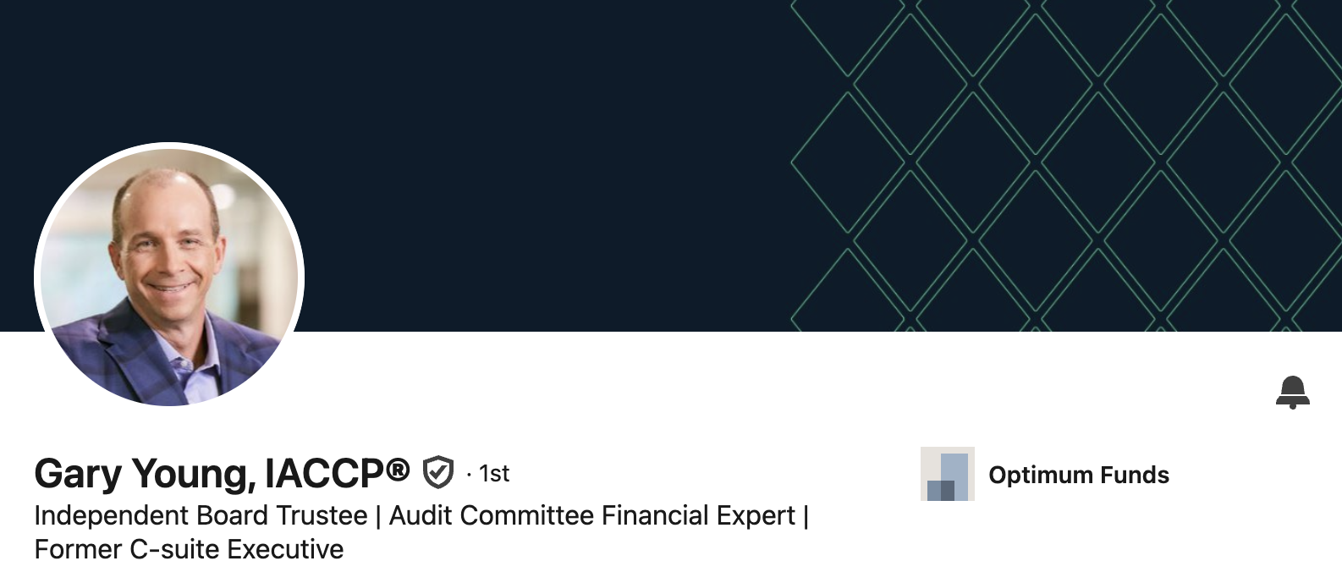
Headline, portrait & banner combi-nations that work
Content used with permission from Bronia Hill, Promote Yourself

Slide 4
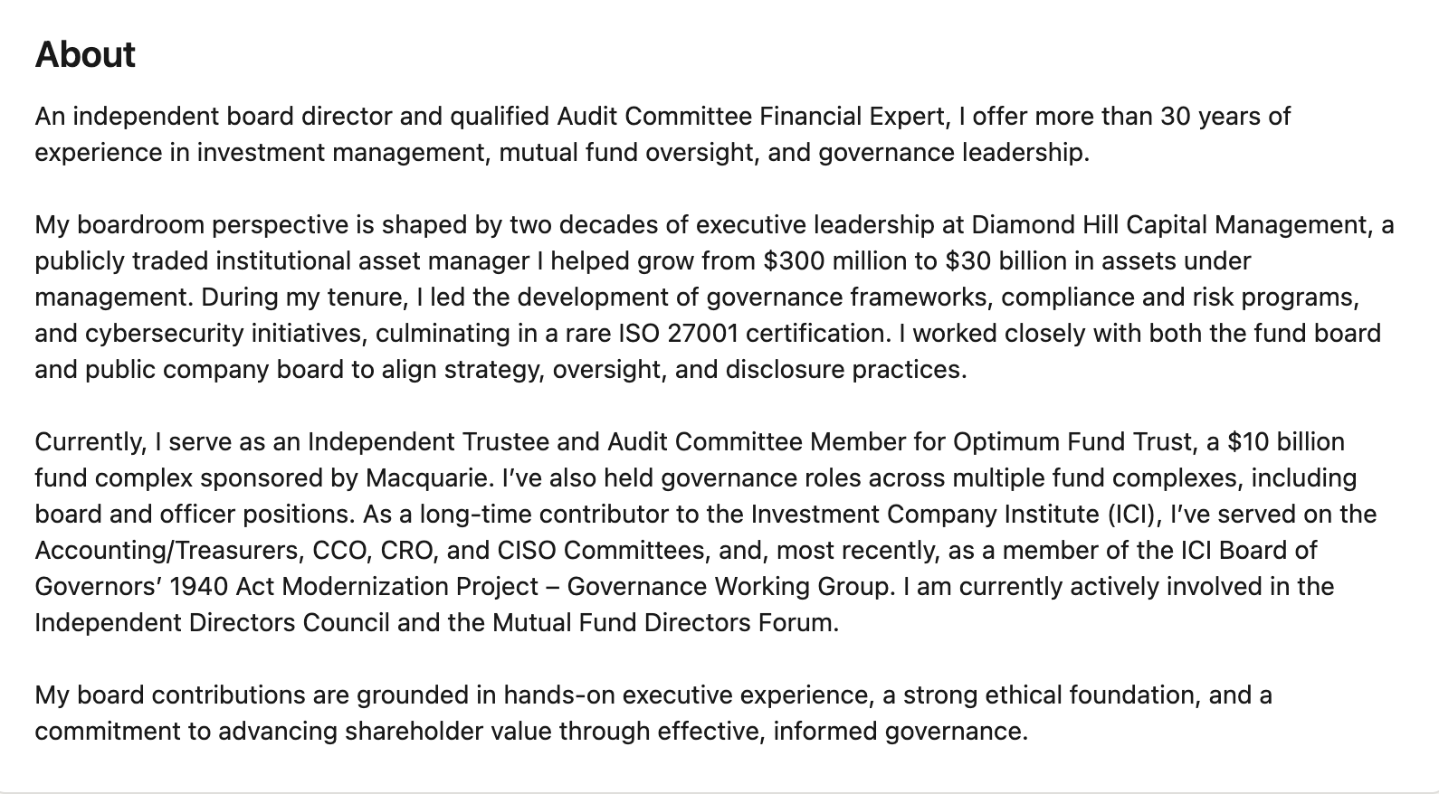

About: What hits the mark?
Content used with permission from Bronia Hill, Promote Yourself

Slide 5
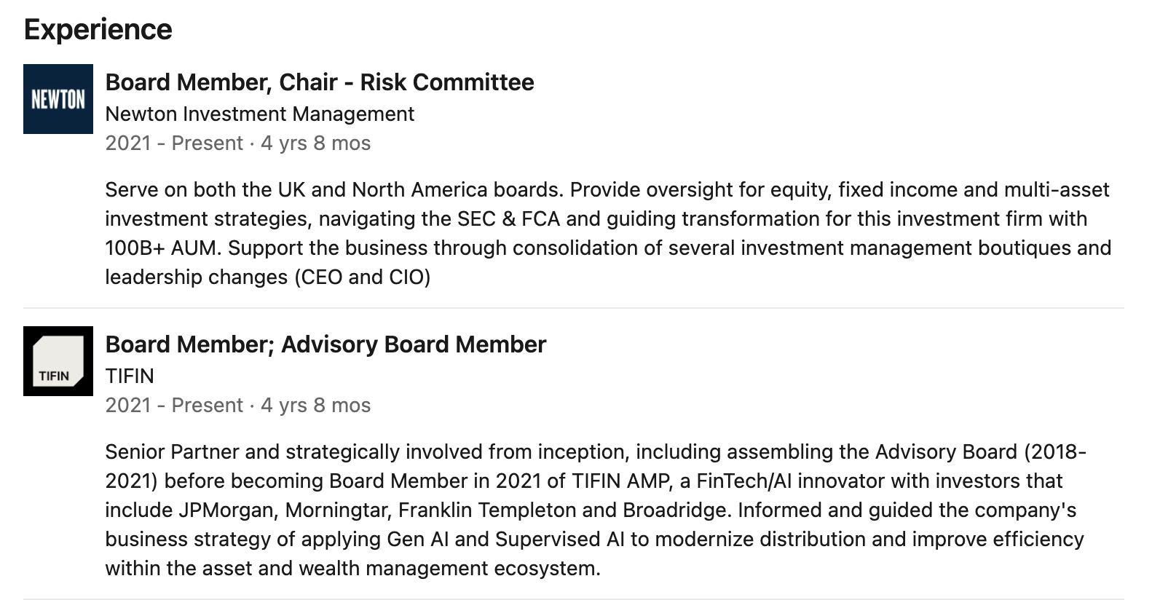
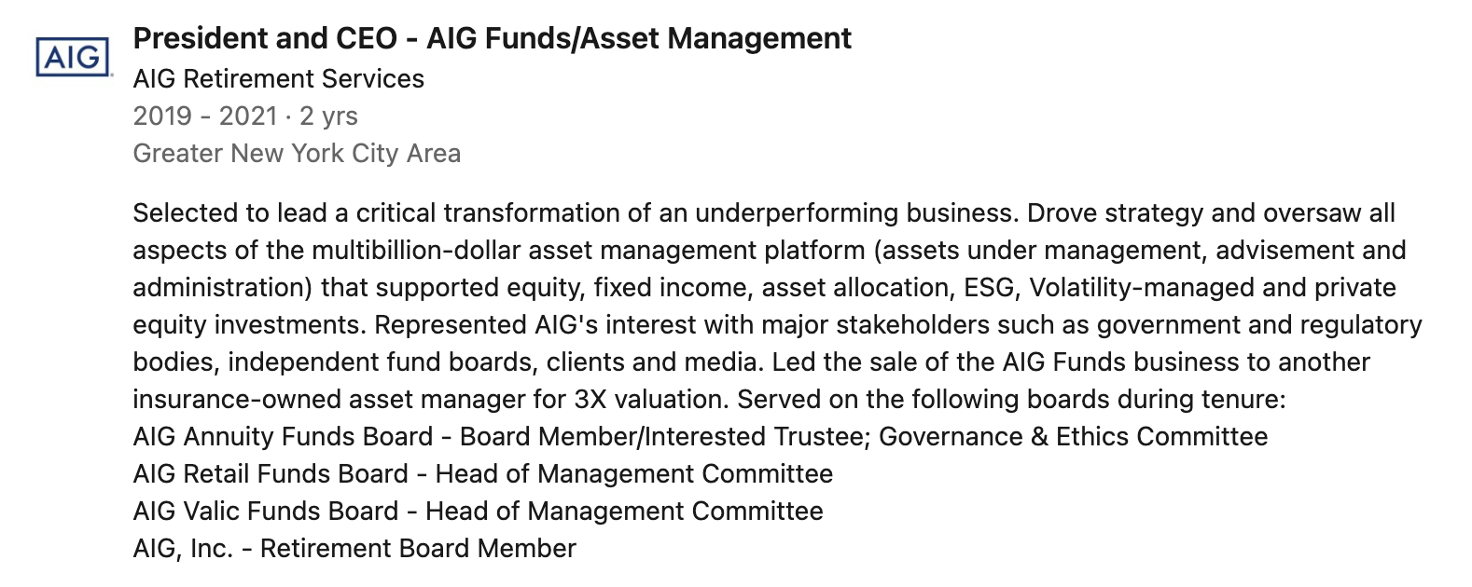
Content used with permission from Bronia Hill, Promote Yourself
Experience section; where less is more

Slide 6

Content used with permission from Bronia Hill, Promote Yourself
How thought leaders excel on Linkedin
Insightful Content Sharing
Thought leaders publish articles, data, and reflections on industry trends, governance, and strategy to showcase expertise.
Active Community Engagement
They interact by commenting, recognizing achievements, and connecting with peers to build meaningful professional relationships.
Consistent, Thoughtful Posting
Posting brief, thoughtful content helps establish them as informed and relevant voices in their field
Quality over Quantity
Focus on high-impact, purposeful posts instead of frequent updates that lack significance

Slide 7
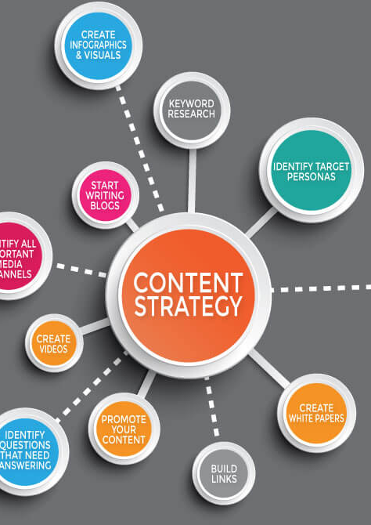
Types of High-Signal Content
Content used with permission from Bronia Hill, Promote Yourself
Lessons learned from a project, client, or boardroom + Insight
Strategic or governance trends with a personal take
Responses to a current event in your industry
Sharing a resource, tool, or article with your point of view
A question or a prompt to engage your network
Event participation
Celebrating/lifting others

Slide 8

Content used with permission from Bronia Hill, Promote Yourself
Creating a content management system for LinkedIn campaign
Define Content Pillars
Establish themes based on your unique value proposition (e.g., board leadership, trends, innovation, nonprofit strategy)
Idea Capture and Planning
Store content ideas in a digital bank using tools like Google Docs for easy organization
Batch Creation and Scheduling
Create posts in batches using templates, then schedule them with digital tools for efficiency
Track Engagement and Refine
Monitor comments, respond regularly, and review monthly results to improve your LinkedIn content strategy

Slide 9
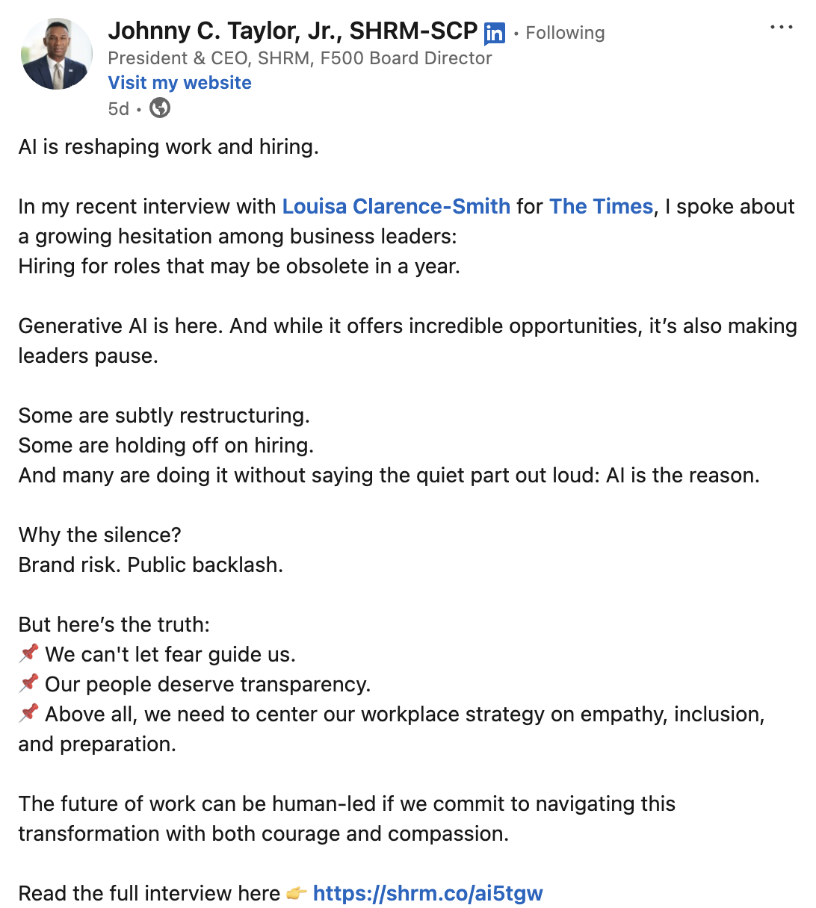
Content used with permission from Bronia Hill, Promote Yourself
Distinguish between value and noise
Strong Post If It... | Might Be Noise If It...
Offers insight, analysis, or perspective | Is just a link drop without commentary
Shares experience or a lesson learned | Feels overly self-congratulatory
Adds to an existing conversation | Repeats what others already said
Reflects your values or leadership lens | Feels generic or templated

Slide 10
Framework for Board Resources
Board Excellence & Thought Leadership
Board Governance & Accreditation Organizations
Board Training Organizations

Slide 11
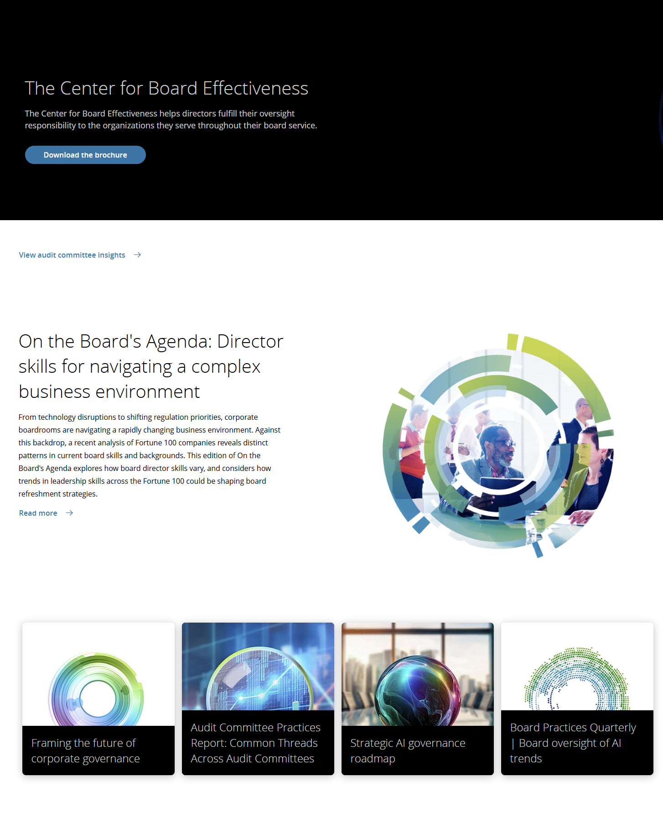
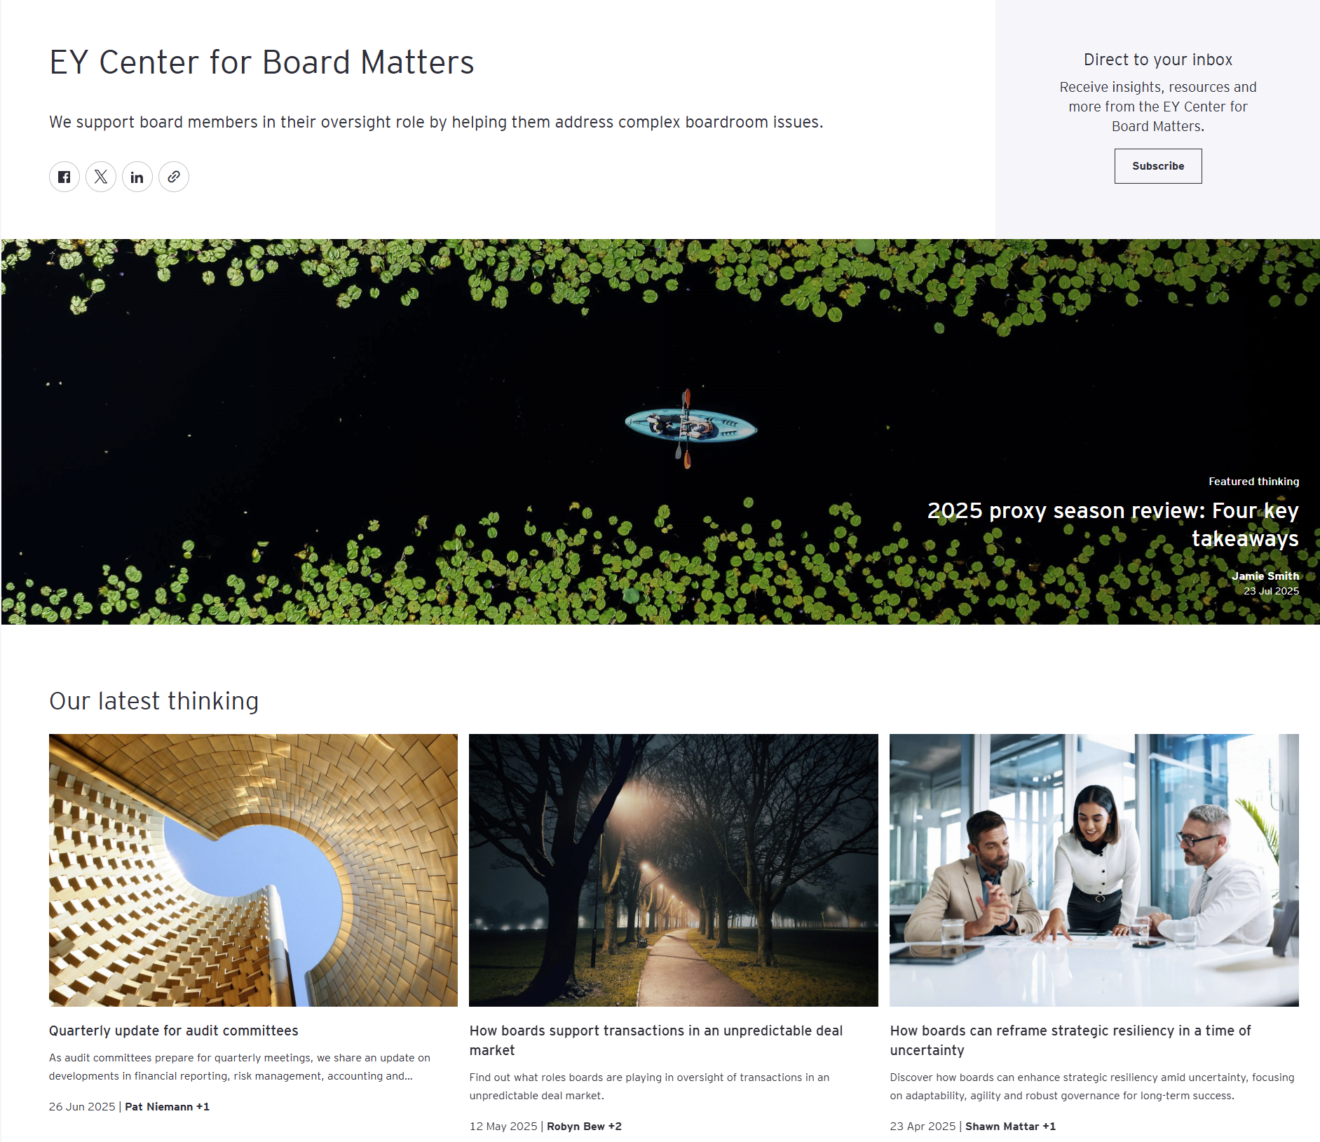
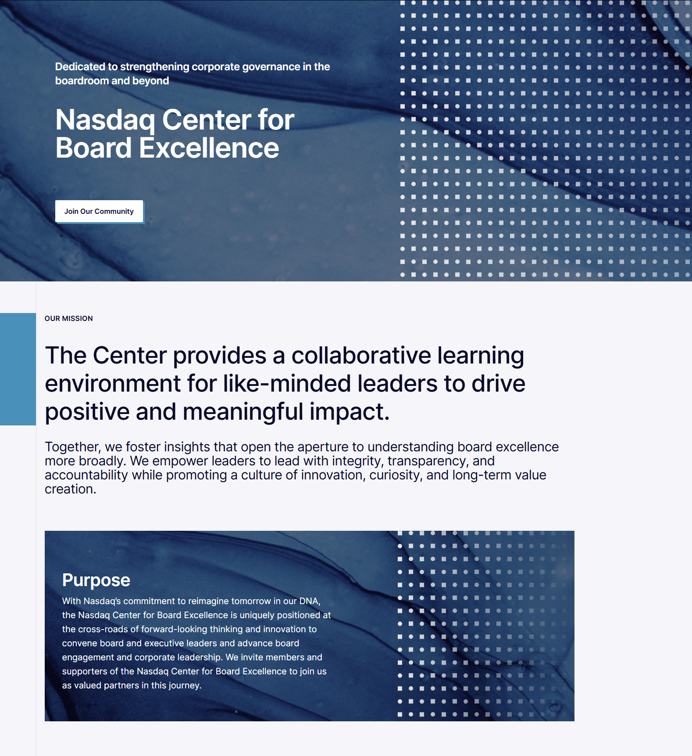
Board Excellence & Thought Leadership
Institutes
EY Center for Board Matters
Deloitte Center for Board Effectiveness
KPMG Board Leadership Center
PWC Governance Insights Center
Nasdaq Center for Board Excellence
Harvard Law School Corporate Governance Forum

Slide 12
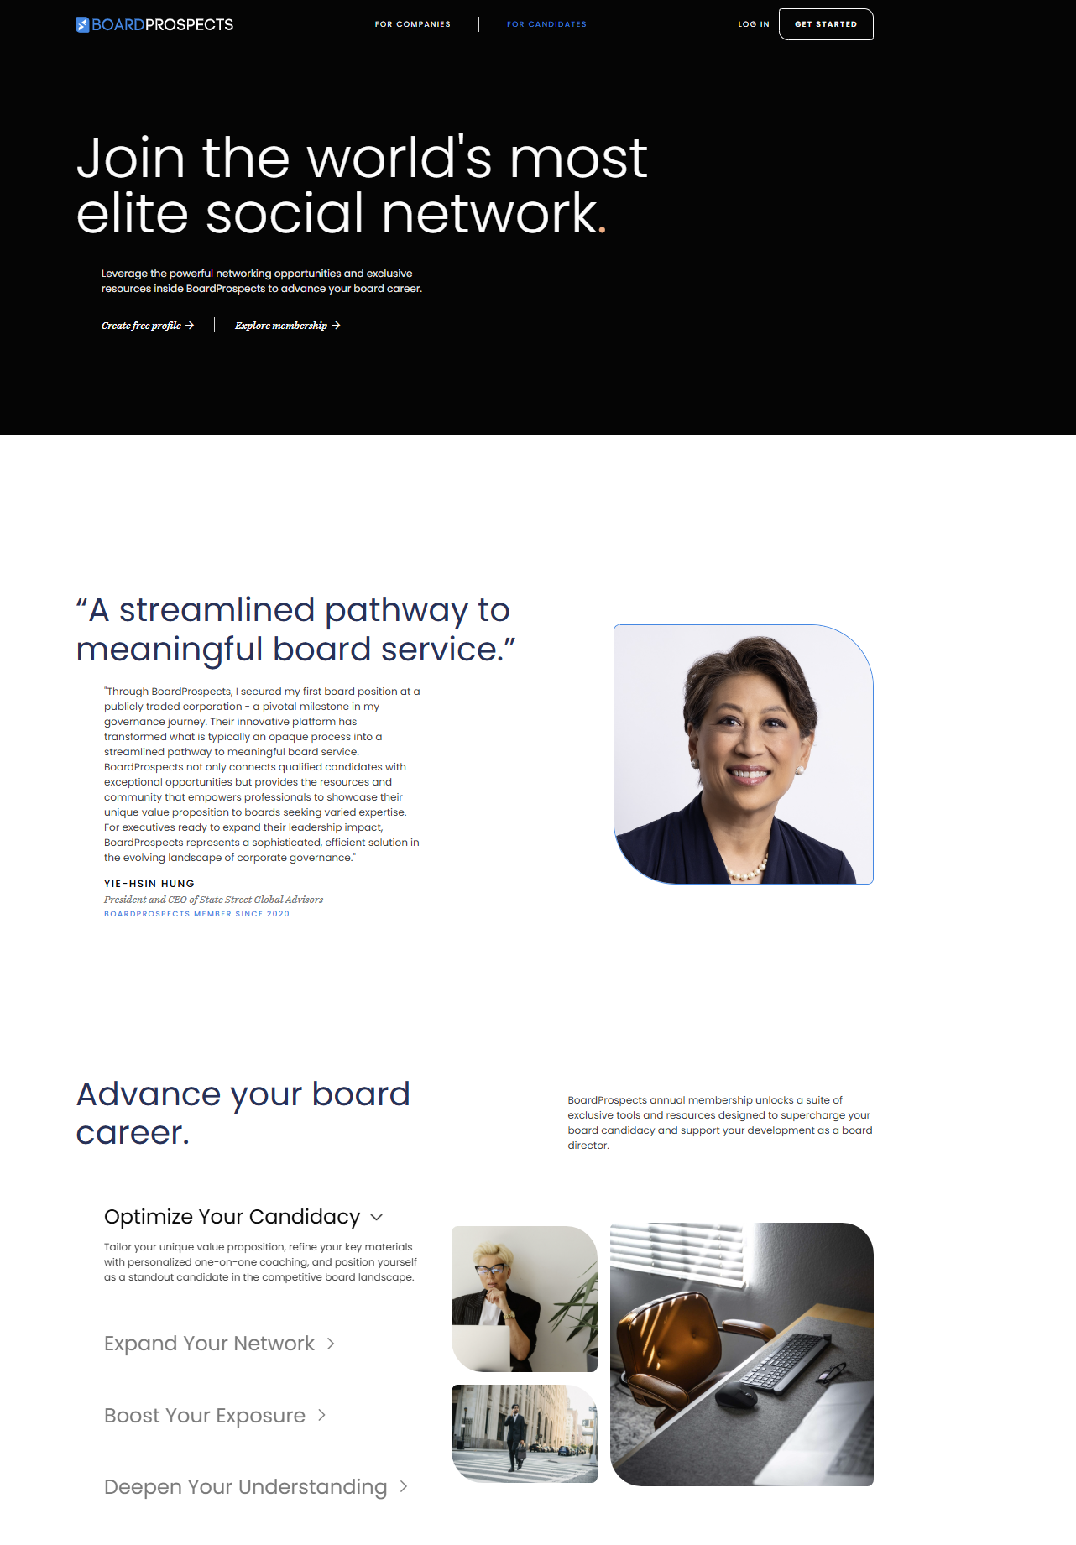
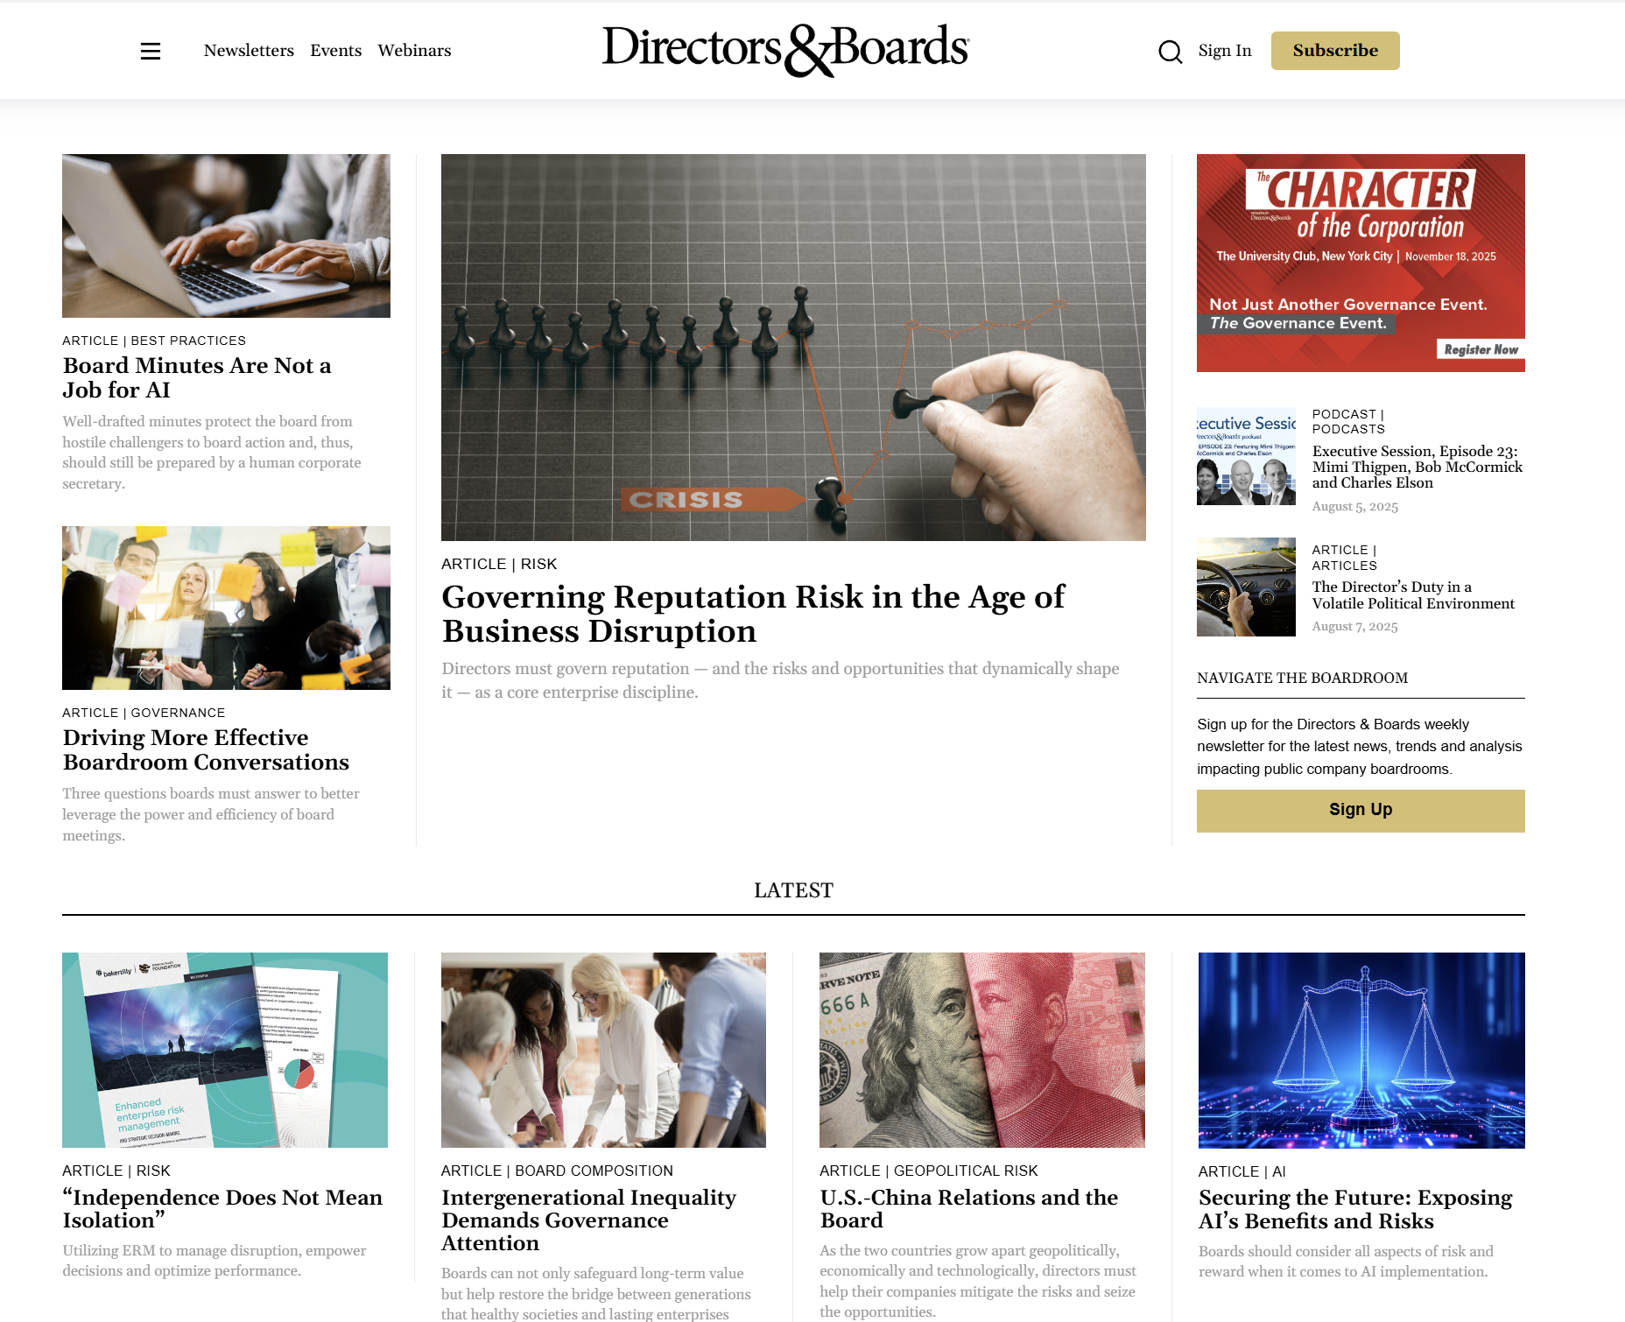
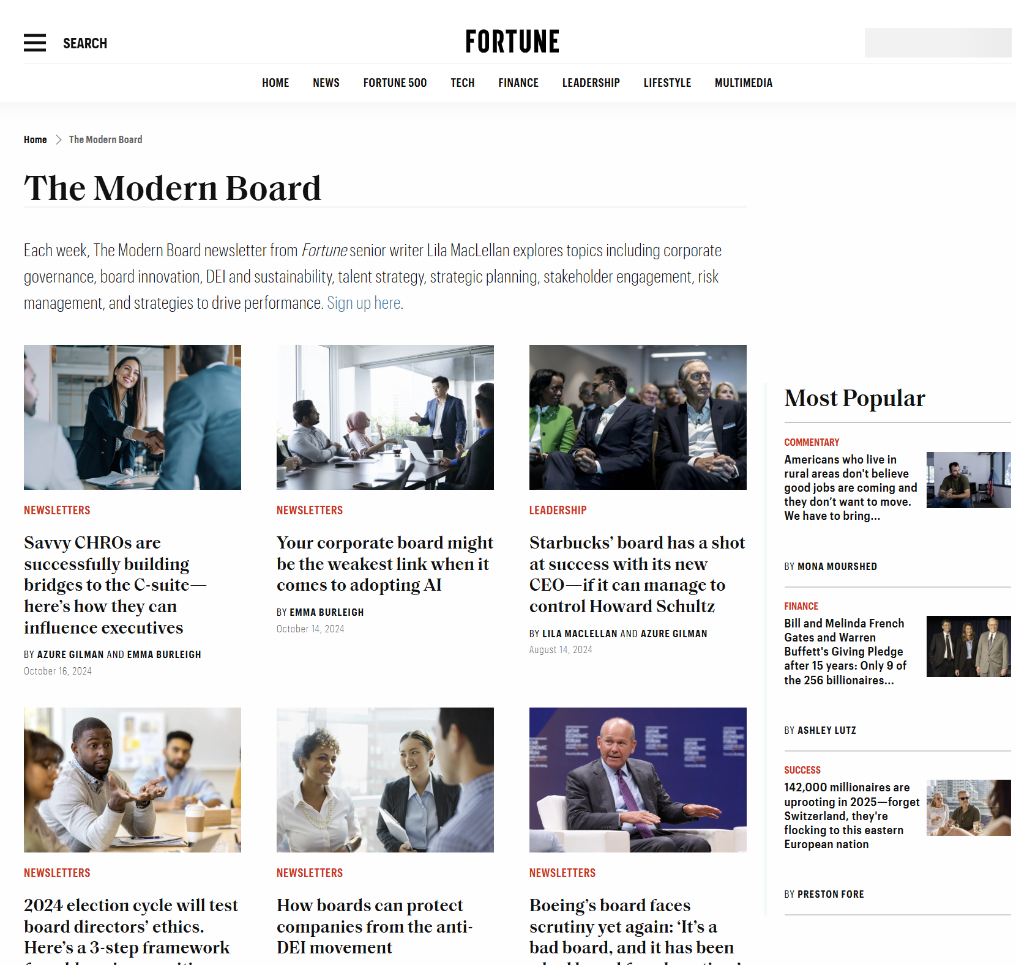
Board Excellence & Thought Leadership
Board-Focused Magazines and Newsletters
Fortune – the Modern Board (weekly newsletter)
Directors and Boards (magazine)
Private Company Director (magazine)
Boardwise (training & tools)
BoardProspects (education & board search)
Corporate Board Member (magazine)
Mutual Fund Directors Forum (education, networking & search)
Digital Directors Network (education & networking)

Slide 13
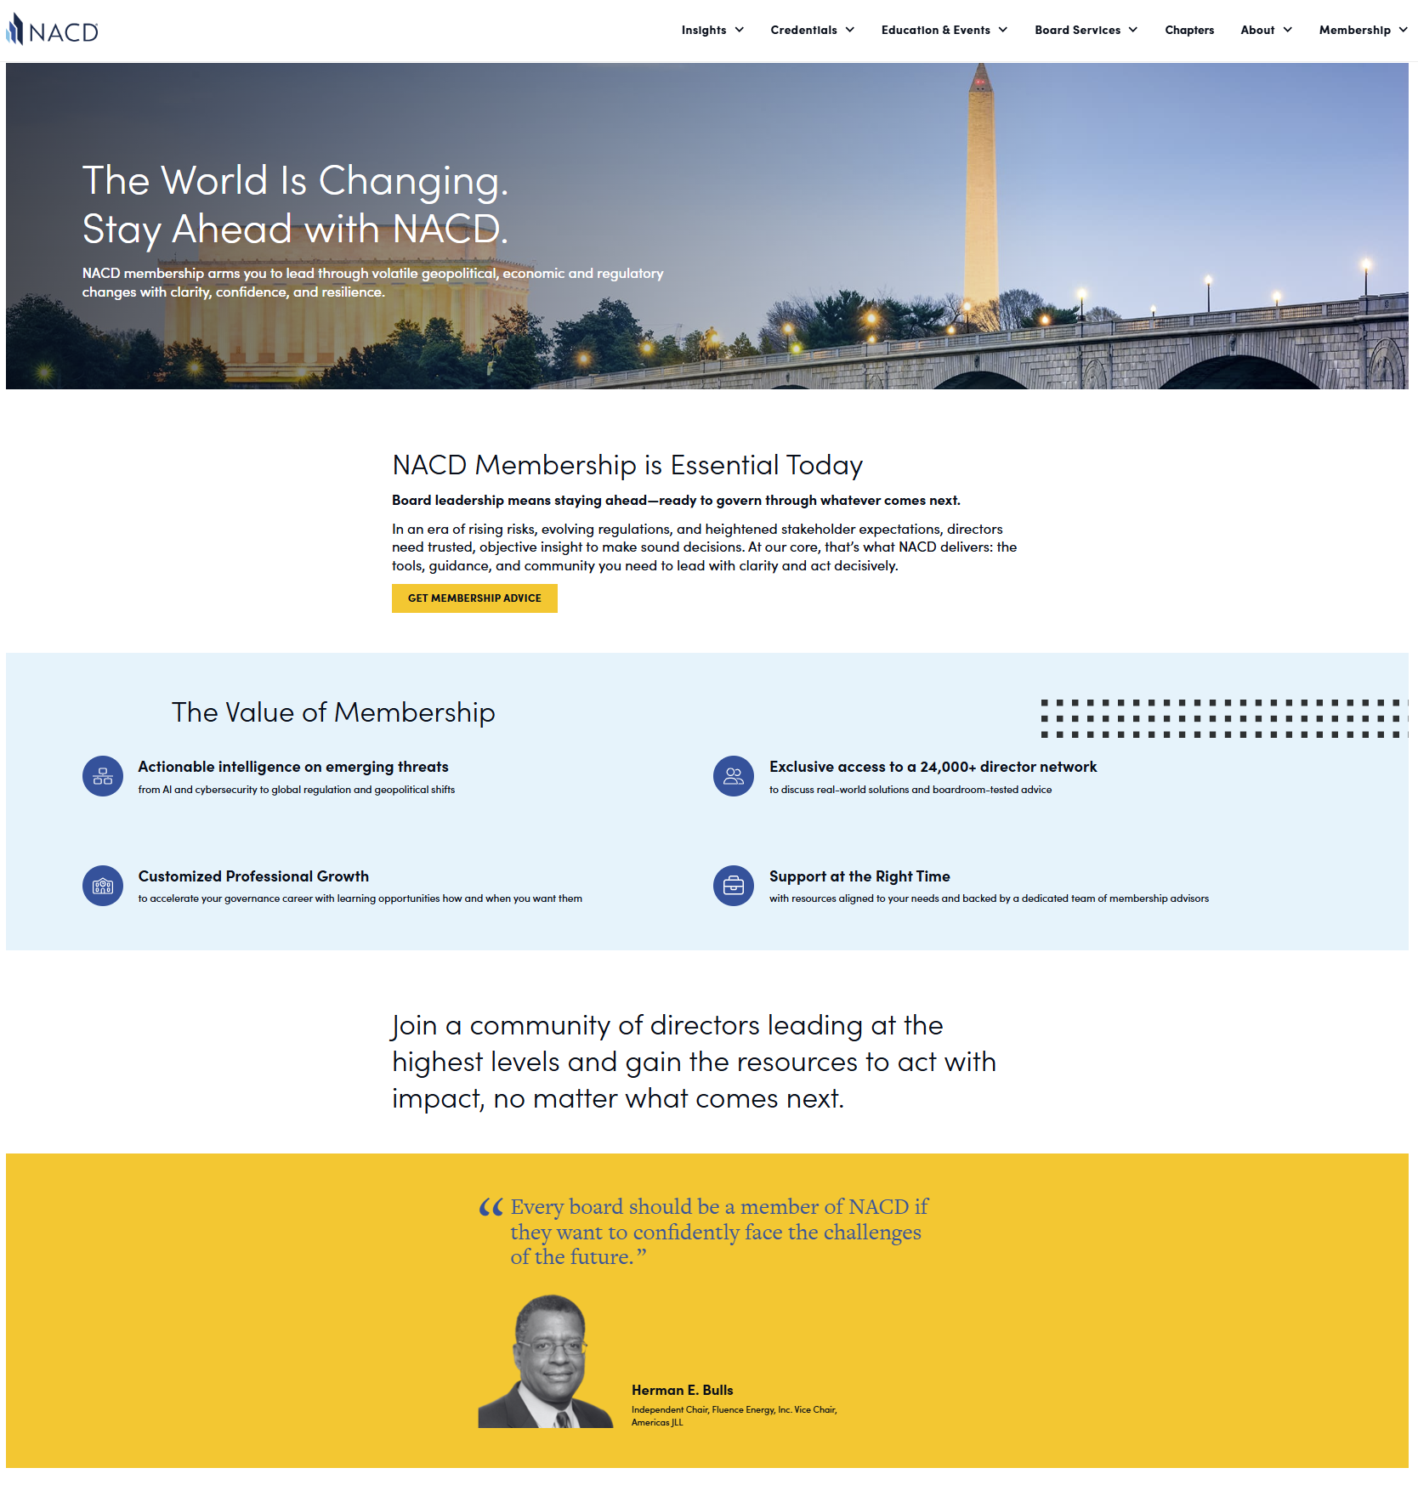
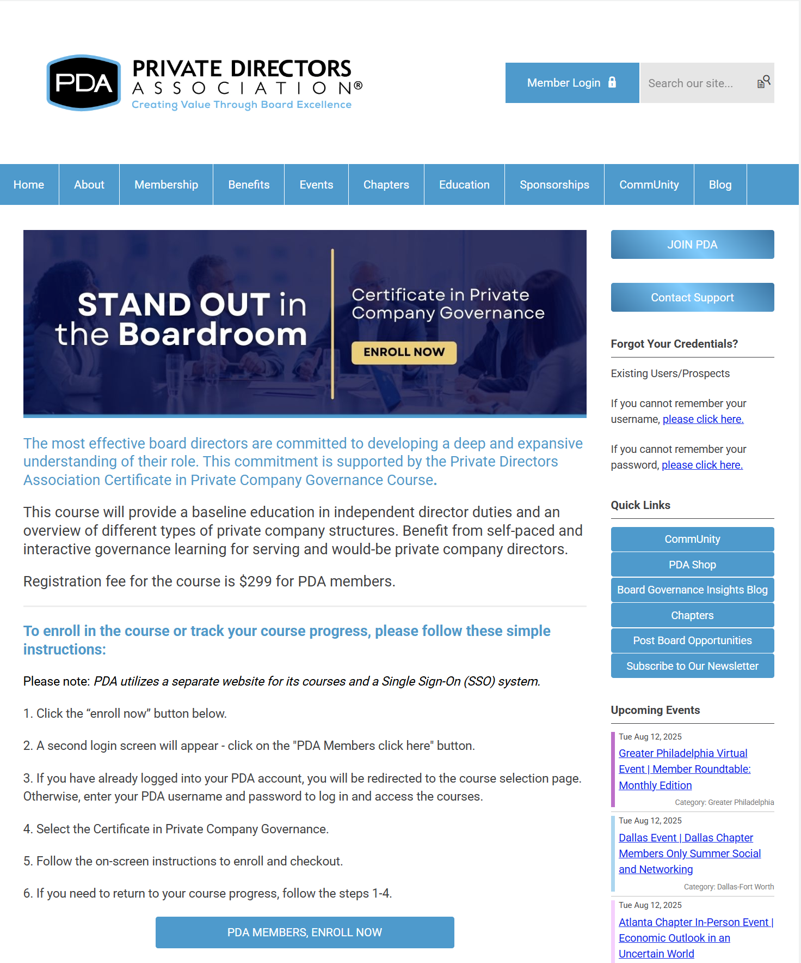

Board Governance & Accreditation Organizations
National Association of Corporate Directors (NACD)
NACD Accelerate Program
Private Directors Association (PDA)
Harvard Business School Corporate Director Certificate
International Board Director Competency Designation (IBDC.D)
Institute of Corporate Directors (ICD, Canada)
Director Fundamentals (in association with ACCD and Corporate Board Member)

Slide 14

Board Training Organizations
UNC Director Development Initiative (DDI) Annual Bootcamp
UC Berkeley Directors Academy
UC Stanford Director Training for Public and Private Company Directors
Columbia Business School Corporate Governance Program
NYU School of Law’s Program on Corporate Compliance and Enforcement (PCCE)
Northwestern Kellogg Governance Executive Programs
Wharton Board Leadership

Slide 15
Session #4 Exercises
Draft LinkedIn updates
Draft 5 topics for thought leadership
Develop target list of board influencers and key network contacts
Determine which organizations you’ll leverage to grow your network and board competencies
Prepare one career story (one minute!) to share at our next session

