Slide 1

Ryan Bowen

Slide 2

MSc in Elite Performance
BSc Science & Football
Diploma in Sports & Exercise Nutrition
FIFA® Diploma in Football Medicine
FIFA® Diploma in Safeguarding
UEFA® B Coach
UEFA® Certificate in Safeguarding
Mindsight Sport
FA Level 2 Psychology
UKAD Accredited Advisor
Certified Football Mindset Coach
Notes:
Qualifications

Slide 3

Notes:
These are some of the clubs I have worked for in the past

Slide 4

Notes:
AND THESE ARE SOME OF THE CLUBS I HAVE SPENT TIME IN, MAINLY IN THEIR ACADEMY SETUP IN THE FORM OF CLUB VISITS, EDUCATION WEEKENDS, WHERE I HAVE GAINED
SOME INSIGHTS OF HOW ELITE PROFESSIONAL CLUBS ARE NURTURING TALENT

Slide 5
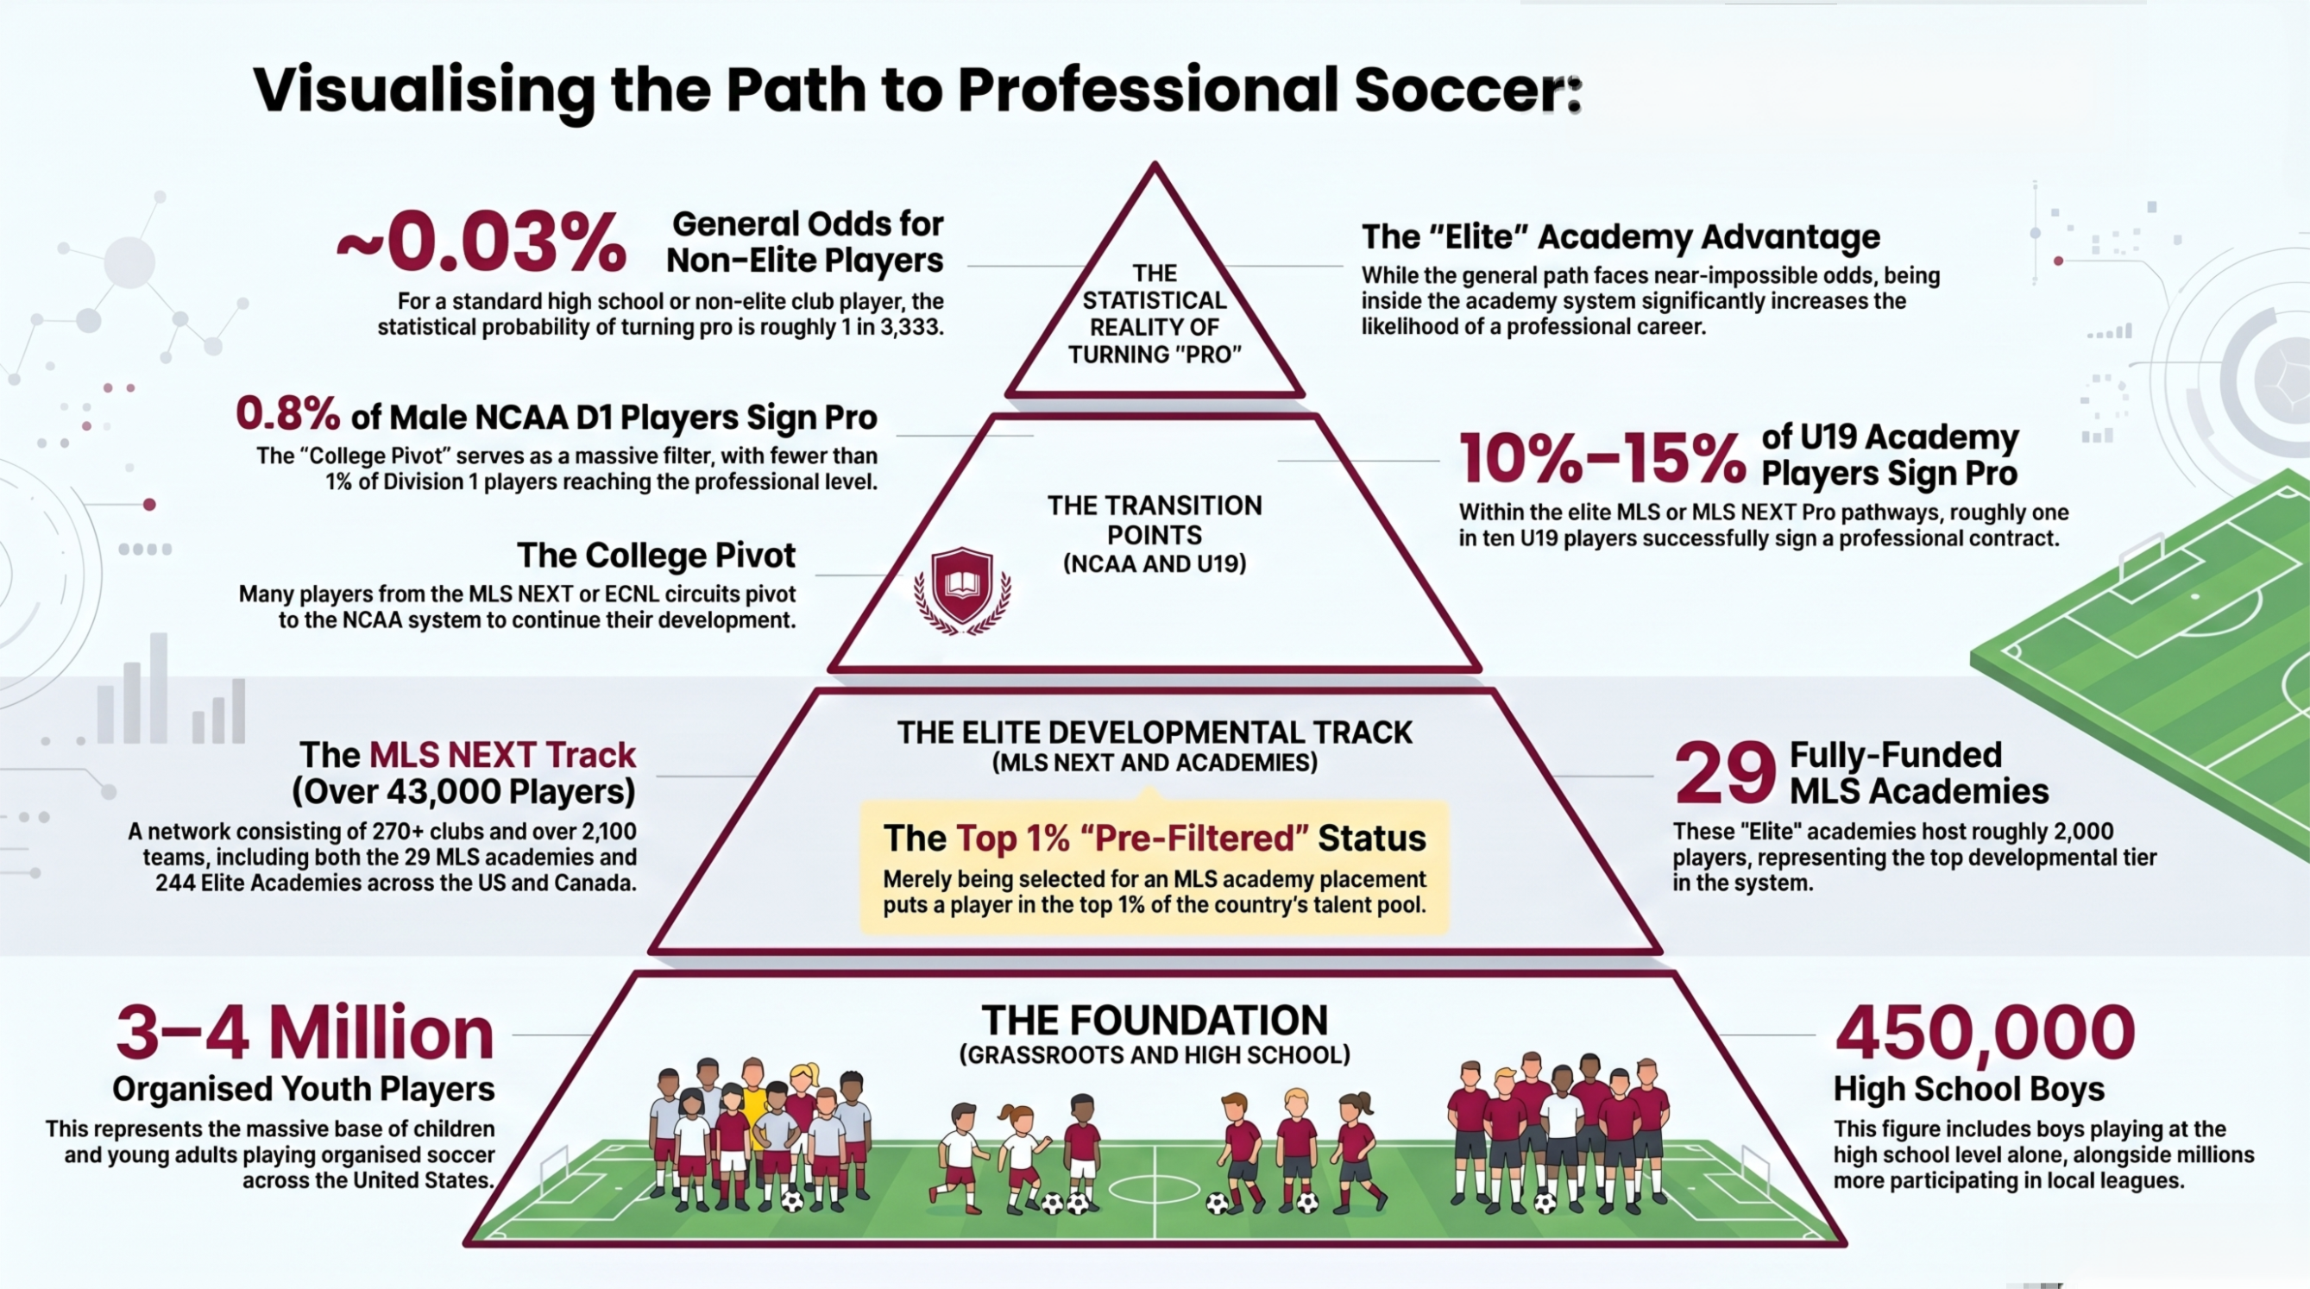
The Funnel
Notes:
SO MUCH LIKE SOCCER IN THE UK, MAKING IT AS A PRO FOOTBALLER IN THE U.S IS HARD REALLY HARD.
0.03% IN THE US WILL TURN PRO ( FOR CONTEXT IN THE UK 0.012% WILL PLAY IN PREMIER LEAGUE )

Slide 6
Why Does This Matter?
The path to professional soccer is narrow.
Our role is to develop complete, healthy, resilient people, players.
3-4M
1%
0.03%
100%
Youth players in US
Of the country’s talent pool
Potentially turn Pro
Can benefit from great coaching
The base of the pyramid
Selected by MLS Clubs
The reality of the pathway
That's our real goal
Whatever pathway your child takes — Our programme builds habits, health, and confidence that last a lifetime.
Notes:
WHY DOES THIS MATTER?
BECAUSE THIS IS THE WAY MOST CLUBS AND COACHES THINK, THEY ONLY THINK ABOUT THE TOP OF THE PYRAMID AND OFTEN FORGET THAT
THE WAY THESE ACADEMIES ARE RUN IS CHANGING CHILDRENS LIVES, BUT NOT FOR THE BETTER, MOST PLAYERS IN THESE SYSTEMS, WHEN RELEASED SUFFER WITH DEPRESSION, LOSS OF SOCIAL NETWORKS, LOSS OF IDENTITY, SHAME, HUMILIATION, BETRAYAL. THEN THERE IS THE EFFECT IT HAS ON FAMILY LIFE,
NO CHILD SHOULD BE MADE TO FEEL LIKE THAT!
IT’S THE BOTTOM OF THE PYRAMID WE ADULTS CAN HAVE THE MOST IMPACT, TO EACH AND EVERY CHILD / PLAYER

Slide 7
Youth Sports
The Challenge & The Solution
THE
SOLUTION
HOLISTIC MODEL
RESULTS
70%
+25%
Fun First
Model
of players quit
Prioritise joy,
not just performance
by age 14
long-term
participation
A crisis of early dropout in youth sport
through late adolescence
Inclusivity
Holistic models that embed inclusivity & fun-first values
Notes:
ROUGHLY 70% OF PLAYERS HAVE QUIT PLAYING TEAM SPORTS BY AGE 14
NUMBER 1 REASON FOR THIS ARE LACK OF FUN,
RESEARCH SHOWS ADOPTING HOLISTIC MODELS CAN INCREASE LONG TERM PARTICIPATION BY MORE THAN 25%

Slide 8



The Mission
Football First
Every pitch minute stays focused on soccer coaching.
Keep Kids Safe & Healthy
Evidence-based training reduces injury risk by up to 60% and protects growing bodies. More potential playing time
Whole-Person Development
Physical, nutritional, and mental wellbeing — your child develops as a complete athlete and person.
Notes:
VERY MUCH FOOTBALL FIRST.
TWEEKS IN THE PROGRAMME WILL ALLOW FOR COACHES TO DEDICATE 100% OF THE TIME TO TECHNICAL AND TACTICAL ASPECTS.
REDUCE INJURY INCIDENCE
BUT MOST IMPORTANTLY DEVELOP YOU CHILD AS A BETTER PLAYER AND PERSON

Slide 9




Holistic Development & Inclusive Environments
Grassroots soccer develops more than footballers — it shapes confident, resilient, and connected young people. A holistic, inclusive programme ensures every player — regardless of background, ability, or gender — belongs, grows, and thrives.
Mental & Emotional Wellness
Physical Literacy for All
Social Inclusion & Belonging
Nutrition & Lifestyle Support
Mindset coaching builds resilience & focus
Failure reframed as a learning tool
Safe space to express emotions & effort
Reduces anxiety; boosts self-belief
Age & stage-appropriate movement training
PHV-aware programmes prevent injury
Builds lifelong healthy habits
Every body type welcomed & developed
Team culture celebrates difference
Equal access regardless of ability or means
Players feel seen, valued & respected
Simple, accessible fuelling guidance
Education for players AND parents
Sleep & recovery normalised as skills
Notes:
THE ARE THE 4 PILLARS IN HOW WE HOPE TO DEVELOP
SUPPORT AND EDUCATE THE PLAYERS and PARENTS
MENTALLY
THROUGH PHYSICAL LITERACY AND NUTRITION HELPING THEM UNDERSTAND THEIR OWN BODIES AND FUEL IN THE CORRECT MANNER
AND BY CREATING A CULTURE & ENVIRONMENT THAT MAKES THEM FEEL COMFORTABLE, VALUED AND HEARD

Slide 10




We're Better Together
When coaches, parents, and players share the same language and goals, your child thrives.
Your Child
Coach & Staff
You, the Parent
Learns ownership of their body and health
Provides safe, age-appropriate training
Reinforce recovery habits at home
Speaks up about pain or discomfort
Monitors growth & biological maturity
Use shared language around growth, nutrition, PHV
Practises good sleep, nutrition & recovery
Promotes effort and resilience over results
Support wellbeing — not just performance
Notes:
WE WANT YOU AS PARENTS TO BE PART OF THE PROCESS ALSO.
IT’S A VERY MUCH A COLLABORATIVE EFFORT
WE WILL BE GIVING YOUR CHILDREN INFORMATION THROUGHOUT THE SEASON AND WILL MAKE AVAILABLE INFORMATION TO THE PARENTS ALSO SO YOU CAN SHARE THIS LEARNING EXPERIENCE WITH YOUR CHILD.

Slide 11

Understanding Your Child's Growth
⚡ What is PHV (Peak Height Velocity)?
PHV is the growth spurt — the period when bones lengthen faster than muscles can adapt. It's a critical window that requires adjusted training to prevent injury.
Girls
Boys
PHV typically occurs: Ages 10–12
PHV typically occurs: Ages 12–14
Training is adjusted to protect
joints during this phase.
Training is adjusted to protect
joints during this phase.
What you might notice at home:
Temporary clumsiness or coordination changes — this is normal
Growing pains or joint discomfort — always worth reporting to coaches
Rapid height changes — may affect balance and strength temporarily
Notes:
ONE OF THE FIRST THINGS WE HOPE TO MONITOR , WITH THE HELP OF THE PARENTS, IS PEAK HEIGHT VELOCITY.
PHV IS A GROWTH SPURT THE CHILD HAS THAT TYPICALLY BONES GROW QUICKER THAN MUSCLES AND SO CHILDREN MAY PRESENT WITH
BEING UNCOORDINATED OR CLUMBSY AS THEY GRAPPLE WITH HOW TO CONTROL THEIR BODIES.
THIS CAN BE A CONFUSING AND DEMANDING TIME FOR CHILDREN. WHAT WORKED FOR THEM ON THE WEEK BEFORE , MAY NOT WORK THIS
WEEK, BECAUSE THEY HAVE EXPERIENCED A GROWTH SPURT.
FOR ME THE SINGLE BIGGEST REASON TO MONITOR THIS, ISNT SO WE HAVE A DATE OF WHEN THIS MAY OCCUR. IT IS SO WE CAN HELP THE CHILD UNDERSTAND WHAT THEY ARE GOING THROUGH AND GET ACROSS TO THE CHILD THAT THIS IS PERFECTLY NORMAL.

Slide 12





Fueling Your Young Footballer
Simple nutrition habits that make a real difference to energy, recovery, and focus.
1–2 Hours Before Training
30–60 Mins After Training
Throughout the Day
✓ Banana or fruit
✓ Chocolate milk
✓ Water every hour
✓ Yogurt with granola
✓ Protein smoothie
✓ Balanced meals
✓ Wholegrain toast
✓ Chicken wrap
✓ Plenty of sleep
Carbohydrates = fuel for energy
Protein + carbs = muscle repair
Hydration & rest = recovery
Notes:
OVER THE SEASON WE WILL BE PRODUCING SOME EDUCATIONAL RESOURCES
NUTRITION AND HYDRATION,
ENERGY SYSTEMS AND HOW GOOD NUTRITION INTERACTS WITH THEM
ITS HOPED THE PLAYERS TAKE AN INTEREST IN THIS AND ALLOWS THEM TO EVENTUALLY TAKE OWNERSHIP

Slide 13



Supporting Your Child's Mindset
"I can improve with practice."
Encourage your child to say this — especially after a tough game or training session.
Praise Effort, Not Results
Normalise Mistakes
Focus on how hard they worked, not whether they won or scored.
Mistakes are how players learn. Remove negative self-talk at home.
Protect Balance
Build Confidence Slowly
School, friendships, and hobbies matter. Prevent burnout by protecting free time.
Small wins matter. Celebrate progress, not just big performances.
Notes:
LIKEWISE, WE WILL BE PRODUCING MATERIAL ON MINDSET AGAIN THIS CAN BE AIDED AT HOME AND PITCHSIDE BY THE PARENTS

Slide 14
Psychological Skills
MENTAL PREPARATION
IN-GAME SKILLS
EMOTIONAL MANAGEMENT
Confidence Building
Concentration & Focus
Emotional Regulation
Athletes develop self-belief through proper preparation and consistent practice.
Players must stay focused during matches despite distractions.
Learning to control emotions in high-pressure situations.
Self-efficacy
Attentional control
Stress management
Imagery & Visualisation
Decision-making
Resilience
Mentally rehearsing skills and scenarios to sharpen performance before competing.
Making quick and accurate decisions under competitive pressure.
Recovering effectively from setbacks and criticism to stay at peak performance.
Mental rehearsal
Cognitive speed
Mental toughness
Goal Setting
Self-talk
Motivation
Defining clear, measurable targets that drive motivation and guide training focus.
Using positive internal dialogue to maintain confidence and composure during play.
Sustaining the drive and desire to train hard and compete at the highest level.
Direction & drive
Inner voice
Drive & desire

Slide 15
Home Training: What & Why
Moving conditioning home frees 100% of pitch time for football coaching — and research shows it cuts overuse injuries by up to 50%.
Ages 10–12
Ages 13–15
Ages 16+
Foundation
Development
Performance
1–2 sessions/week | 20–30 mins
2 sessions/week | 30–60 mins
2–3 sessions/week | 45–75 mins
Spiderman crawl
Glute bridges & lateral band walks
Jump training (counter-movement jumps)
Bodyweight squats & lunges
Romanian deadlifts (bodyweight)
Rear-foot elevated split squats
A-March & skip drills
Side planks for core stability
Nordic curls for hamstrings
Short sprints with direction changes
HIIT intervals (1 min run, 1 min walk)
Speed endurance & sprint work
Fun movement, coordination & basic strength
Injury prevention & building strength foundation
Power, speed & sport-specific conditioning
Notes:
ONE OF THE FIRST THINGS WE HOPE TO INTRODUCE FOR SOME OF THE AGE GROUPS IS A TRAIN AS HOME PROGRAM
YOU PARENTS CAN HELP IN ENCOURAGING YOUR CHILD TO ENGAGE IN THESE PROGRAMS
WE DON’T WANT TO FORCE THEM TO DO IT, ITS NOT COMPULSORY, AND DON’T WANT IT TO BE DEEMED HOMEWORK AS SUCH.
IT'S HOPED THAT GIVING THE CHILDREN OWNERSHIP OF SOMETHING LIKE THIS WILL HELP THEM TAKE RESPONSIBILITY FOR THEIR OWN FITNESS – A LIFE SKILL THEY CAN TAKE INTO ADULTHOOD.
ASIDE FROM THIS, SUCH EXERCISES HAVE PROVEN TO SIGNIFICANTLY REDUCE INJURY RISK, AND WILL ENABLE THE COACHES TO DEDICATE PITCH TIME TO THE MORE TECHNICAL AND TACTICAL ASPECTS OF THE GAME

Slide 16

Questions & Next Steps
Stay Informed
Talk to Us
Support at Home
We'll share regular updates, session guides, and nutrition tips through the club channels.
Any concerns about your child's wellbeing, growth, or training — please reach out directly to coaching staff.
Encourage sleep, good nutrition, and a positive mindset. You're a key part of your child's development team.
Thank You for Being Here
Together we build better players and better people.

Slide 17
Thank you for your time
Questions ?
Ideas ?
Suggestions ?

