Slide 1
Results and Implications from a 7-year Longitudinal Study of Pre-Matriculation College Student Sense of Coherence and Student Success.
A Preliminary Summary By:
Todd Misener, PhD
Assistant Vice President of Student Affairs & Chief Wellness Officer
Oklahoma State University

Slide 2
Sense of Coherence
Sense of Coherence (SOC) is a measure of an individual’s ability to withstand and adapt to stress. SOC is defined as a global orientation that reflects the extent to which individuals perceive life as comprehensible, manageable, and meaningful. This worldview, largely established in early adulthood, influences how stressors are interpreted and coped with across the life course. Measurement of SOC employs Antonovsky’s Orientation to Life Questionnaire, short (SOC-13) form.

Slide 3
Resilience vs. Sense of Coherence
Dimension | Resilience | Sense of Coherence (SOC)
Nature | Trait-like, situationally activated (specific to domains such as academic, emotional, or physical resilience). | A generalized, stable worldview that predisposes individuals to use effective coping resources across situations.
Theoretical Origin | Rooted in stress-resistance and positive psychology (e.g., Rutter, 1987; Connor & Davidson, 2003). | Derived from the Salutogenic Model (Antonovsky, 1979, 1996) — focused on what keeps people healthy rather than what causes illness.
Focus | “Bouncing back” — recovering from disruption. | “Staying oriented” — sustaining meaning, coherence, and direction amid stress.
Temporal Focus | Reactive — mobilized after adversity occurs. | Proactive — shapes how one perceives and interprets adversity before and during stress.

Slide 4
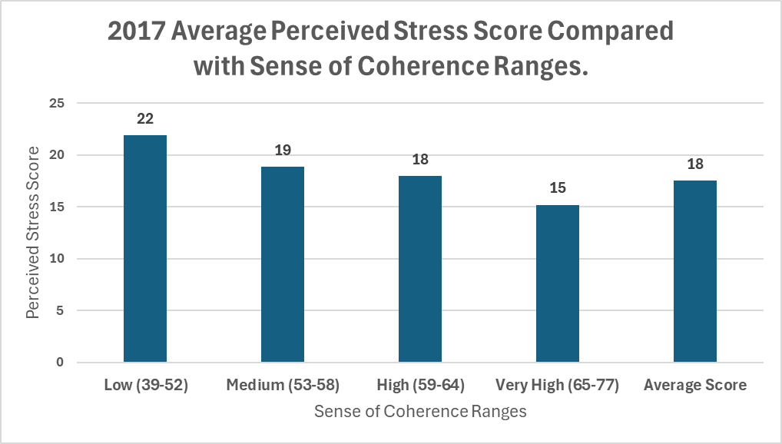

Slide 5
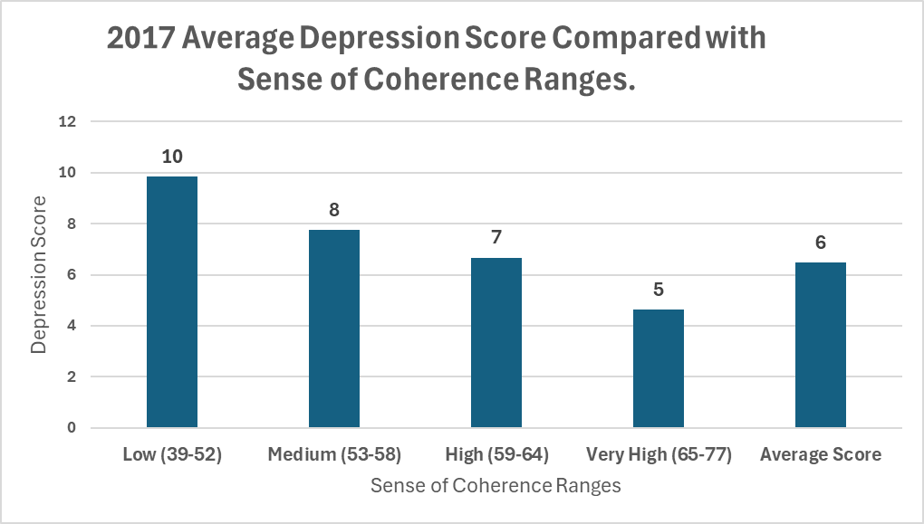

Slide 6
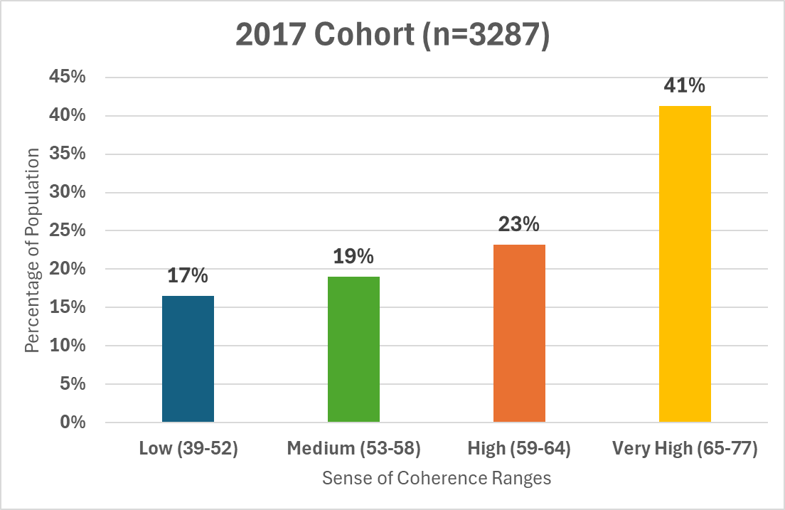

Slide 7
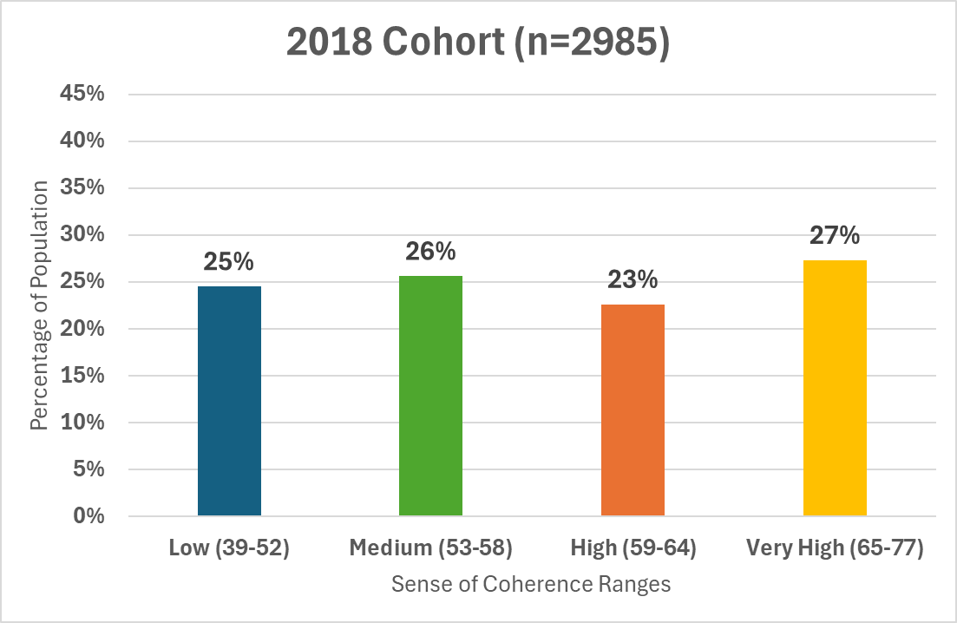

Slide 8
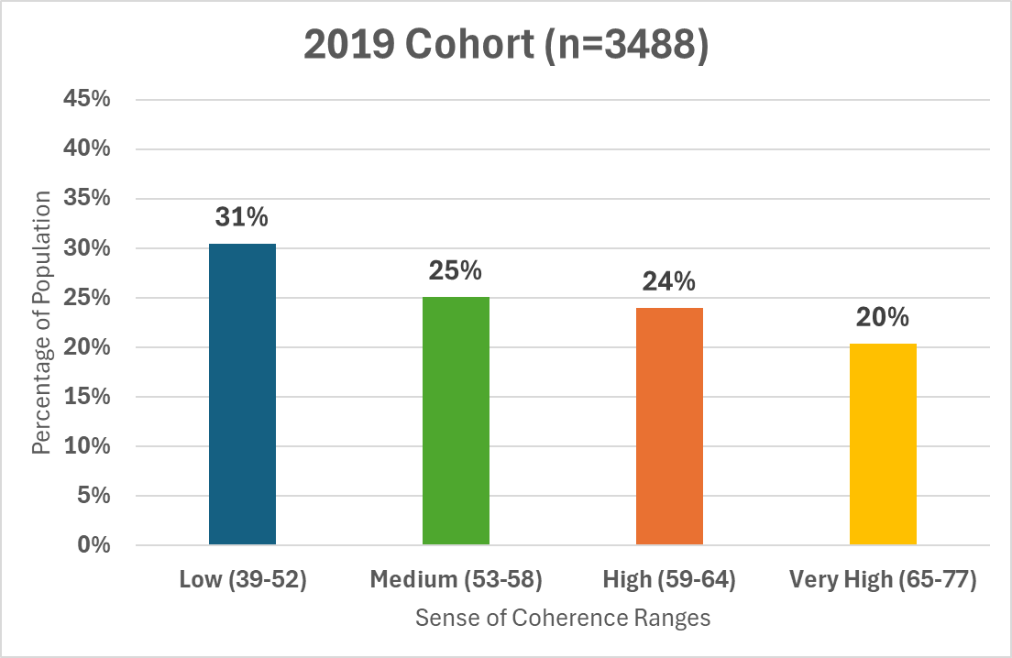

Slide 9
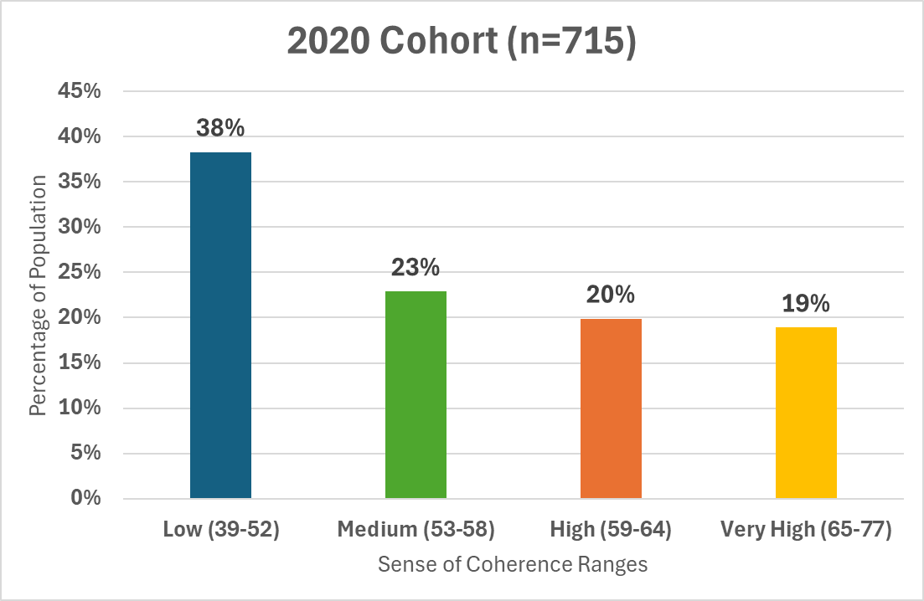

Slide 10
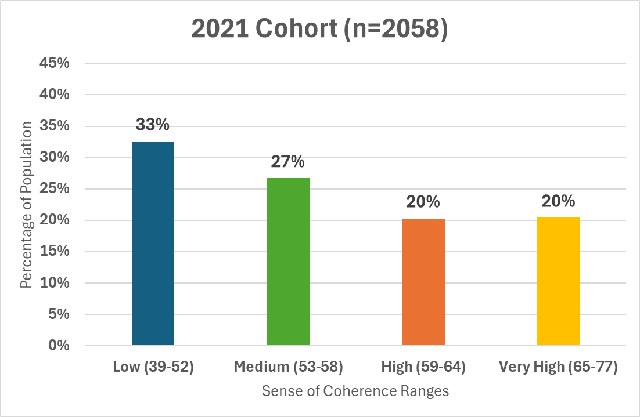

Slide 11
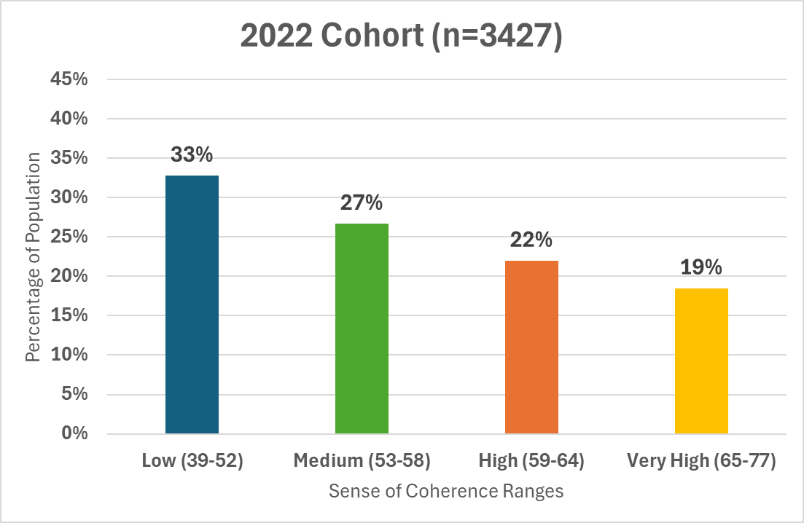

Slide 12
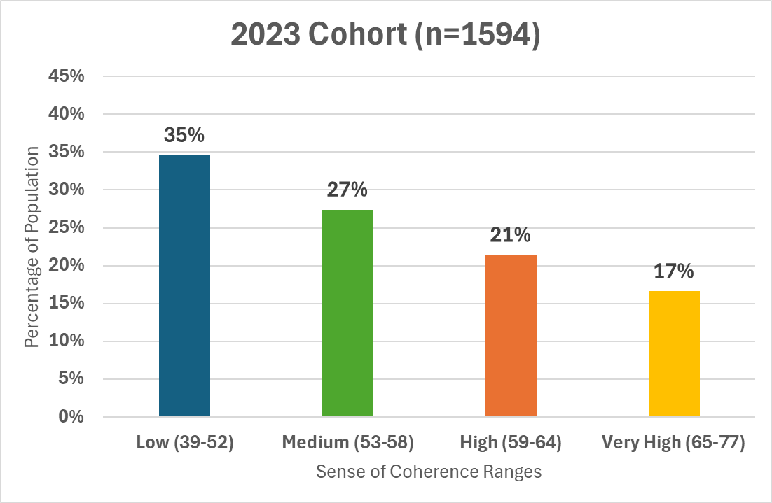

Slide 13


Spearman’s rank-order correlation was used to assess the relationship between Cohort Year and SOC Ranges. There was a weak but statistically significant negative correlation between the two variables, ρ(rho) = -0.18, p <0.001. This indicates that as the years progressed from 2017 to 2023, the strength of SOC in each population decreased.
58.5% drop in the percentage of students scoring very high.
106% increase in the percentage of students scoring low.

Slide 14
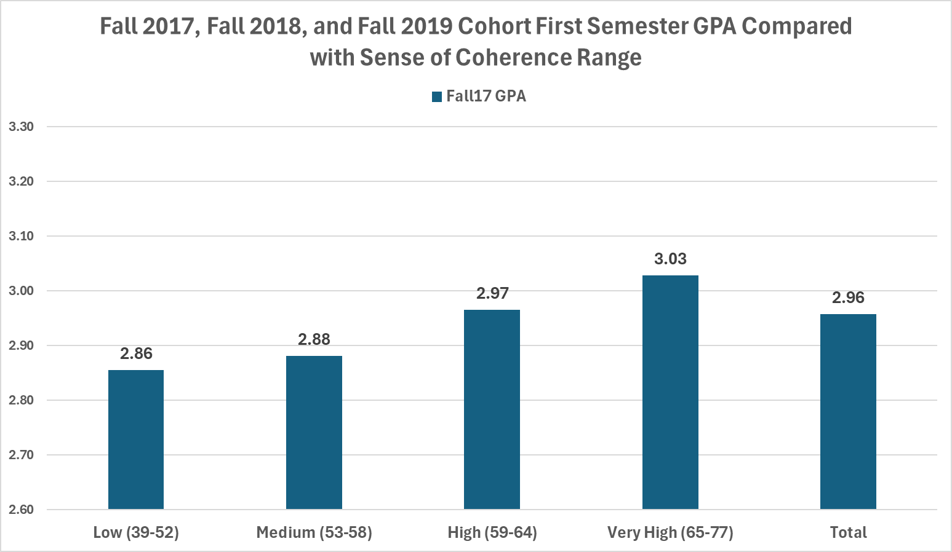

Slide 15
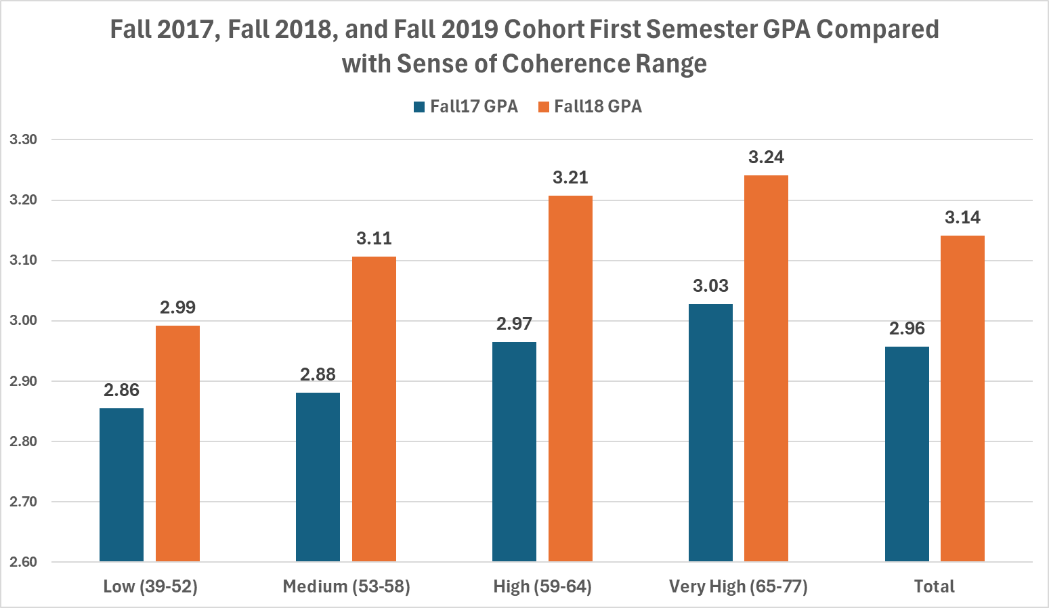

Slide 16
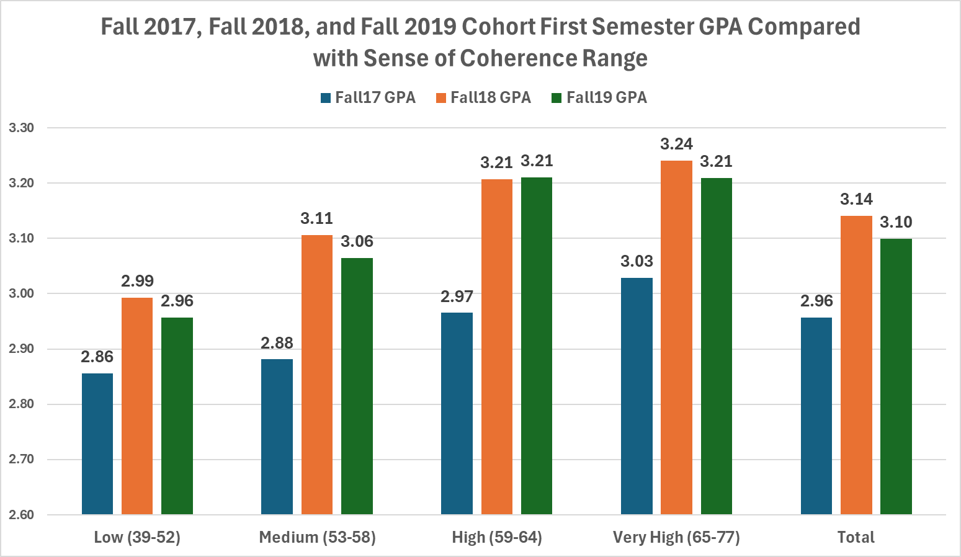

Slide 17
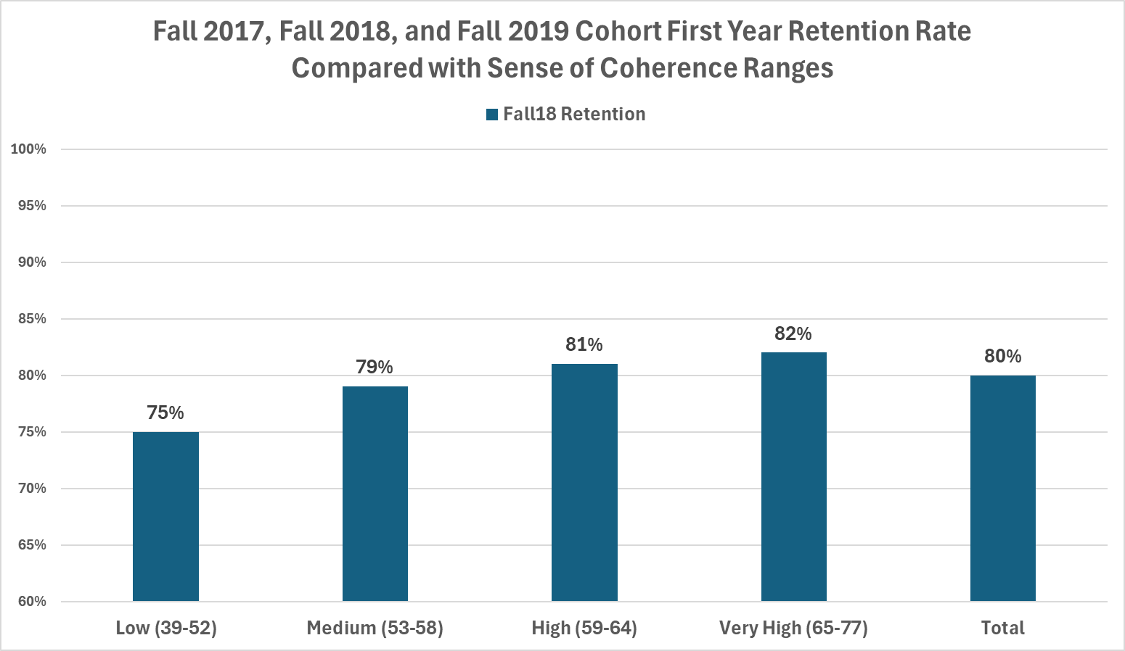

Slide 18
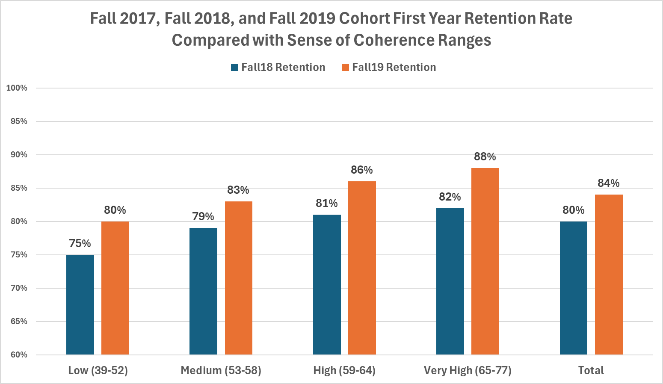

Slide 19
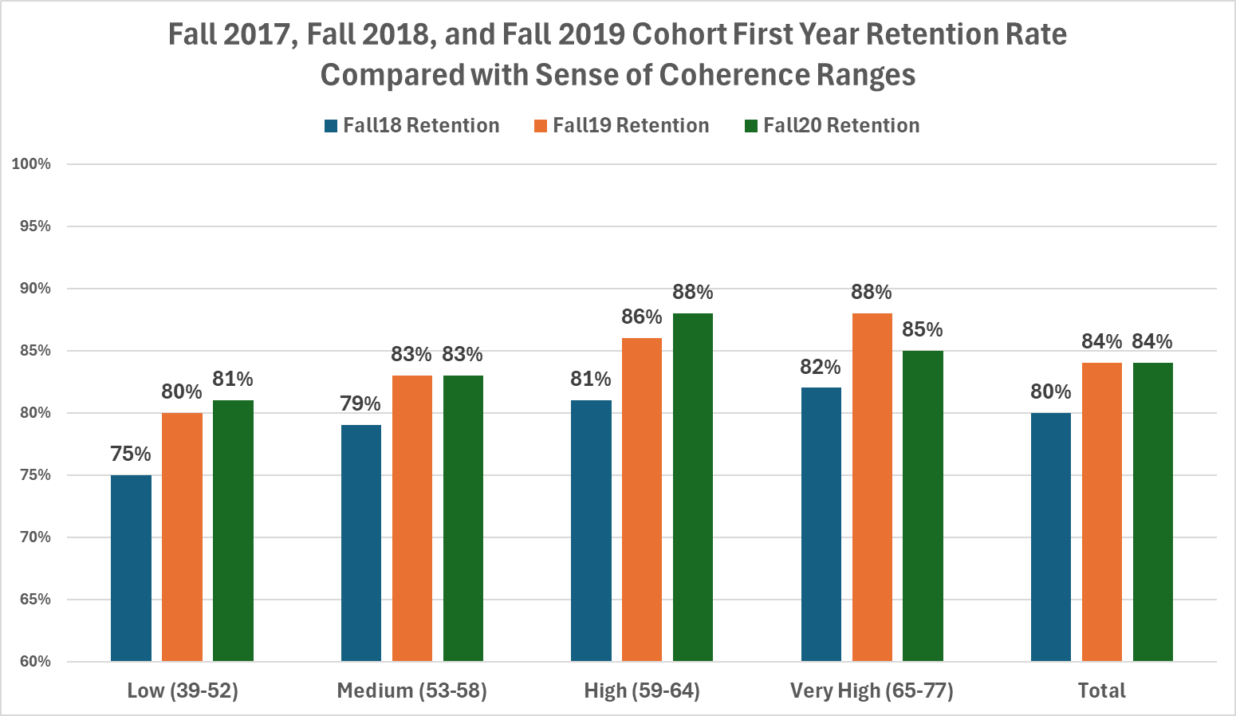

Slide 20
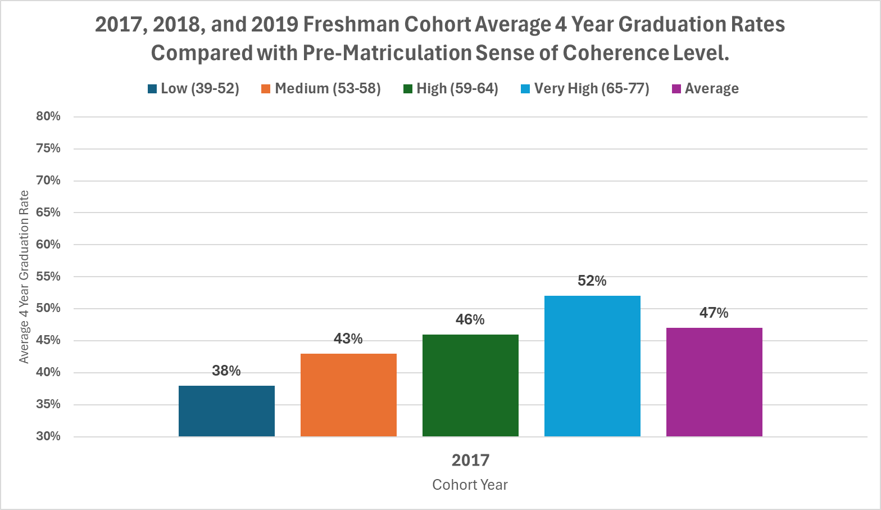

Slide 21
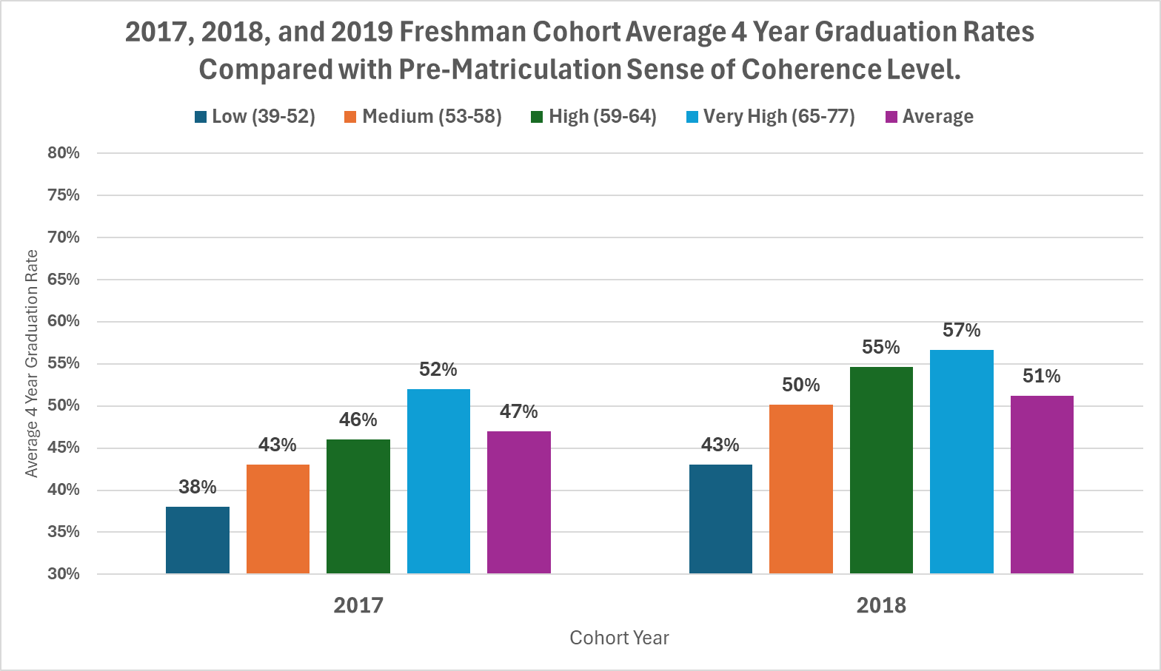

Slide 22
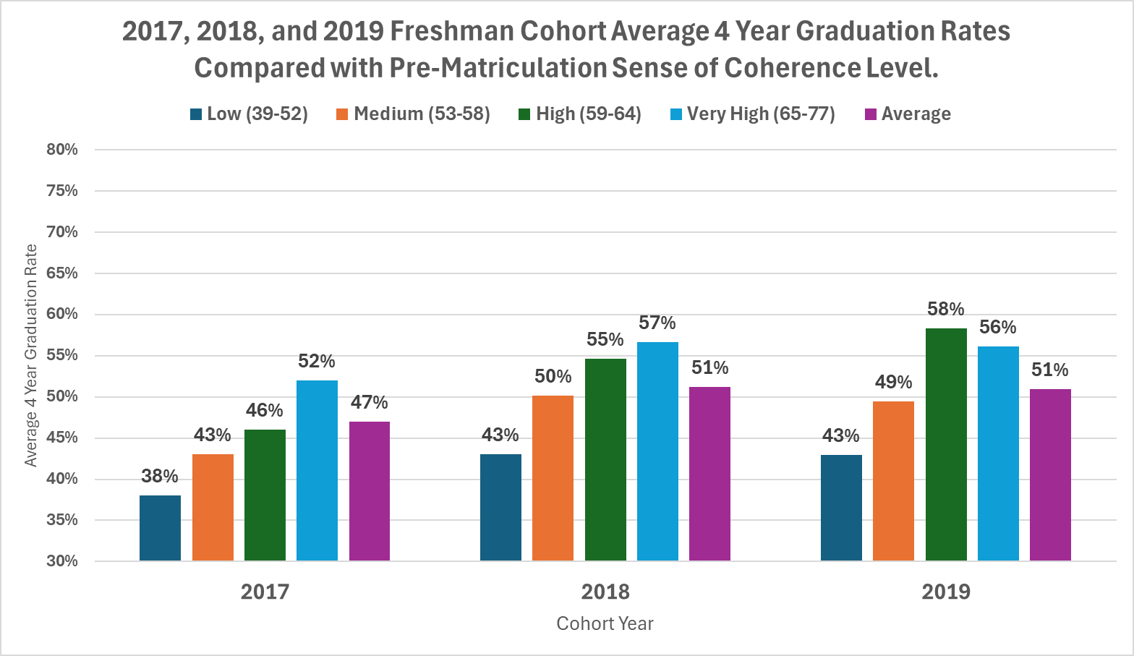

Slide 23
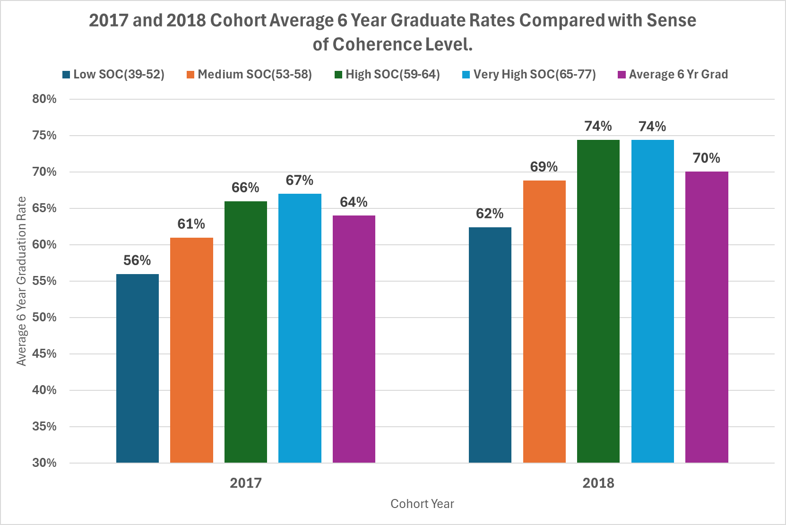

Slide 24
Implications

Slide 25
Implications

Slide 26
Implications

Slide 27
Questions?
Todd Misener, PhD
Assistant Vice President of Student Affairs and Chief Wellness Officer
Oklahoma State University
Email: todd.misener@okstate.edu

