Slide 1

Who We Are
and
What We Do

Slide 2
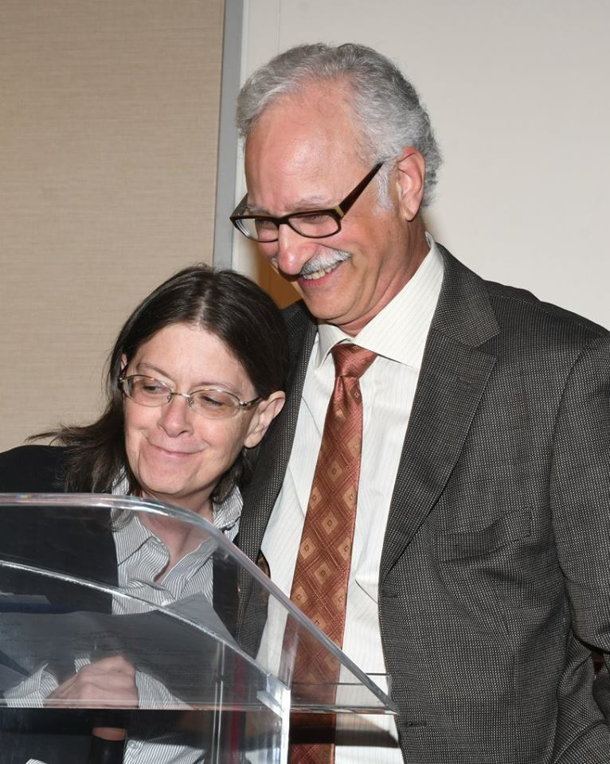
Terry D. v. Rader & Oklahoma
On January 4, 1978, Plaintiffs, represented by Legal Aid of Western Oklahoma, Inc., the National Juvenile Law Center and the Public Defender of Oklahoma County, filed this § 1983 class action lawsuit in the U.S. District Court Western District of Oklahoma challenging the conditions of confinement at the juvenile treatment centers of the State of Oklahoma. Plaintiffs sought injunctive and declaratory relief, as well as class certification. The Complaint alleged that plaintiffs were subjected to (1) summary imposition of disciplinary measures; (2) solitary confinement; (3) mechanical restraints or shackles (4) restrictions on access to counsel; and (5) lack of rehabilitative treatment, all in violation of their constitutional rights.
On November 2, 1982, the District Court entered the agreed order which placed restrictions on the use of the solitary confinement and the use of mechanical restraints or shackles. The Order also required that Oklahoma juvenile institutions be in compliance with applicable state and federal regulations regarding fire, health and safety. The District Court also certified the case as a class action.
Settlement negotiations continued and the parties reached a settlement in the form of a Consent Decree. The Decree was presented to the District Court who approved and entered it on May 31, 1984. The case was administratively dismissed at that time.

Slide 3
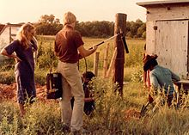
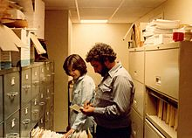
Throwaway Kids
Throwaway Kids was a two-part investigative report airing on the ABC News television series 20/20 in 1981.
The report followed a nine-month undercover investigation by producers Karen Burnes and Bill Lichtenstein. The reports detailed the documented abuse, neglect, and preventable deaths among children, the aged, and those with mental illness who were in the care and custody of the Oklahoma Department of Human Services.
The main focus of the reports were the state's "warehousing" of children, many of whom were in state custody for being abused or abandoned. In turn, the state received per diem federal funds for each child in its custody, but it failed to provide appropriate services for the children with the revenue.
At the time of the program, Oklahoma had no foster care system, so children who were abandoned, abused, neglected, or in need of supervision, were placed in large, outmoded, state-run institutions, many of which were in rural towns of the state, and were without services or proper care. Lichtenstein and Burnes obtained thousands of pages of confidential "Abuse Reports," generated by state workers and kept by the Department of Human Services, detailing the mistreatment of children in state's custody, ranging from children being beaten by often unqualified staff, to kids being locked in isolation for weeks at a time. There were also numerous unexplained deaths at the state hospital for children with mental retardation, which the investigation showed were the result of neglect and abuse by state workers.
Producer Karen Burnes filming "Throwaway Kids" for ABC News 20/20 in Oklahoma, 1981
Producer Bill Lichtenstein in Oklahoma during production of "Throwaway Kids" for ABC News 20/20, 1981

Slide 4
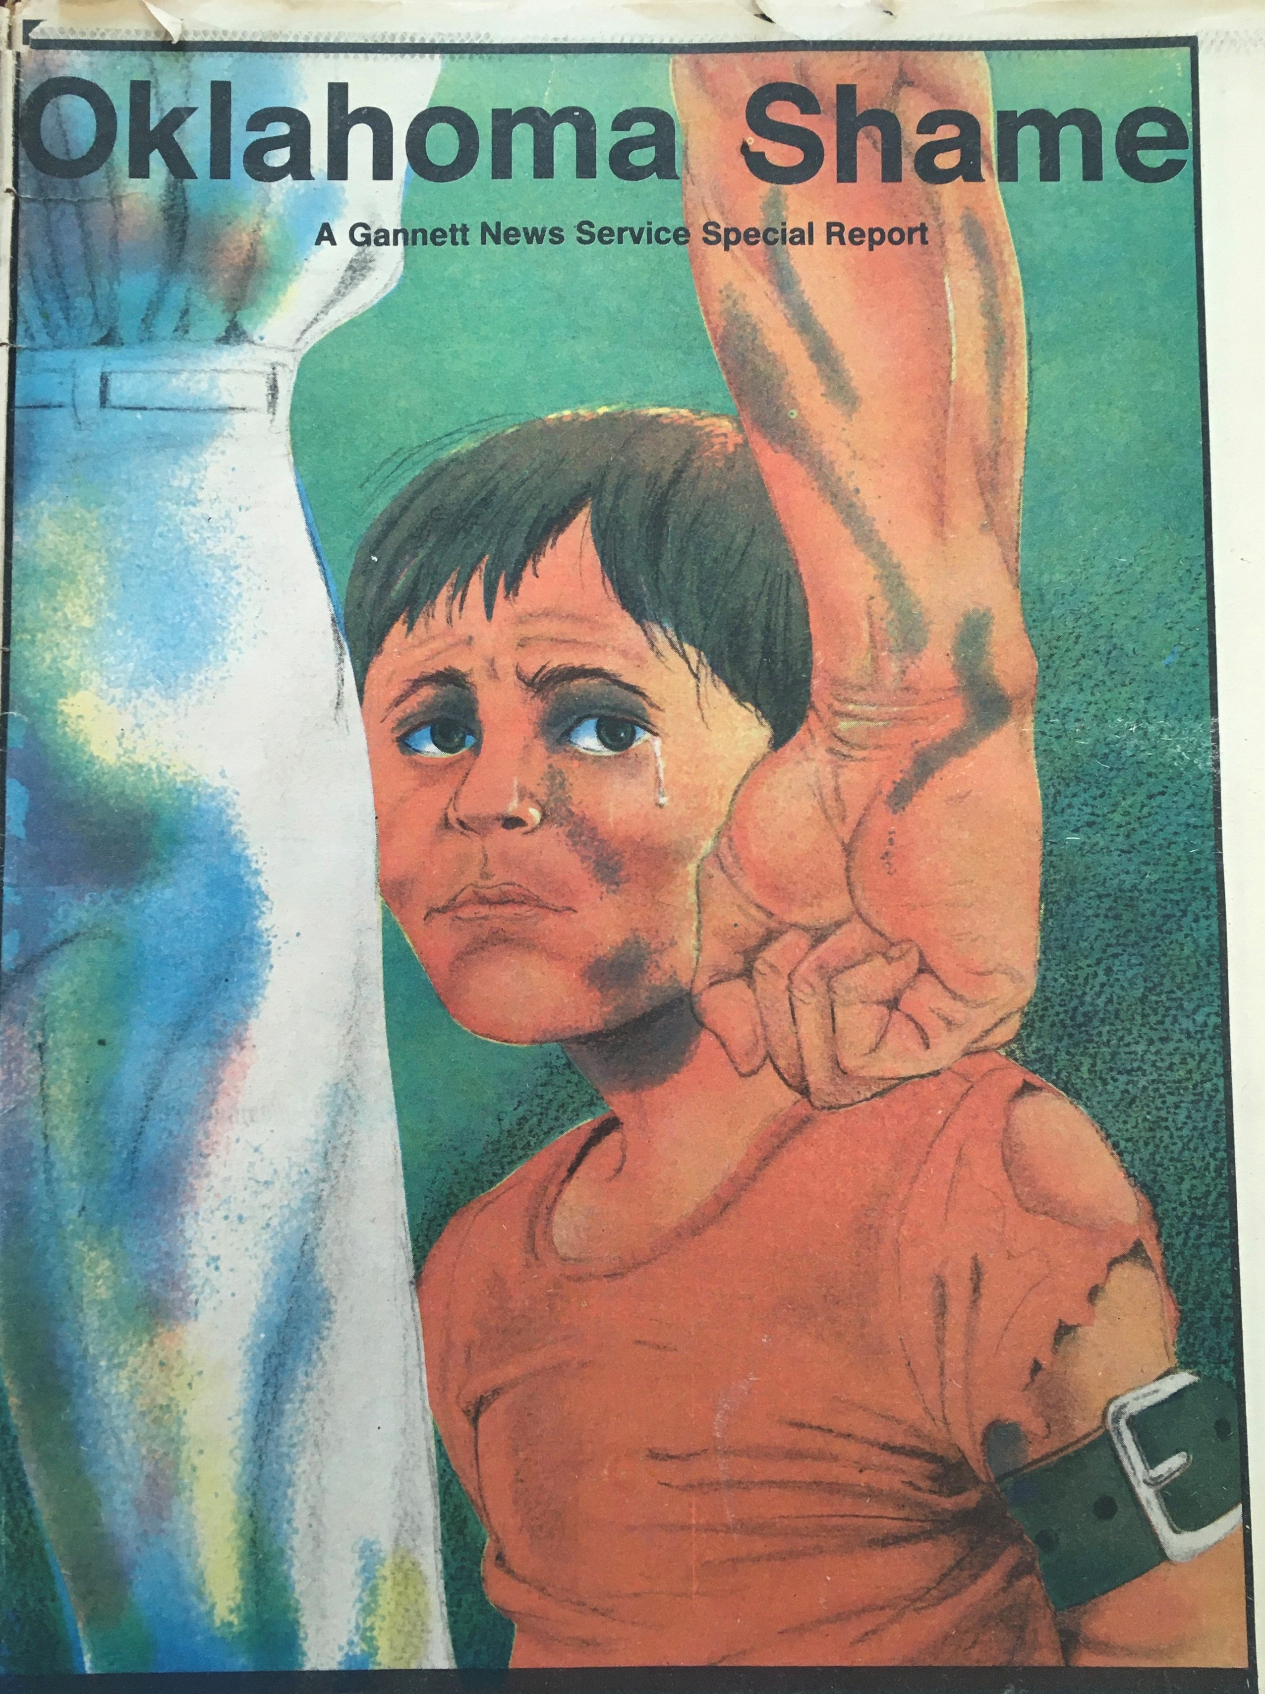
Oklahoma Shame
Burnes and Lichtenstein were part of a team of reporters who collaborated on the investigation, which included ABC's Sylvia Chase, Pulitzer Prize-winners John Hanchette and Carlton Sherwood of Gannett News Service, and the investigative team from local TV station KOCO, which is an ABC affiliate and at the time was owned by Gannett. This unprecedented investigation, involving national and local broadcast and print reporters, culminated with articles published by Gannett, a special two-part report on 20/20, "Throwaway Kids," produced by Burnes and Lichtenstein, and a series, "Oklahoma Shame," which aired locally in Oklahoma City on KOCO-TV.
The series was honored with a 1982 Peabody Award and a National Headliner Award, and was nominated for a national news Emmy Award.

Slide 5
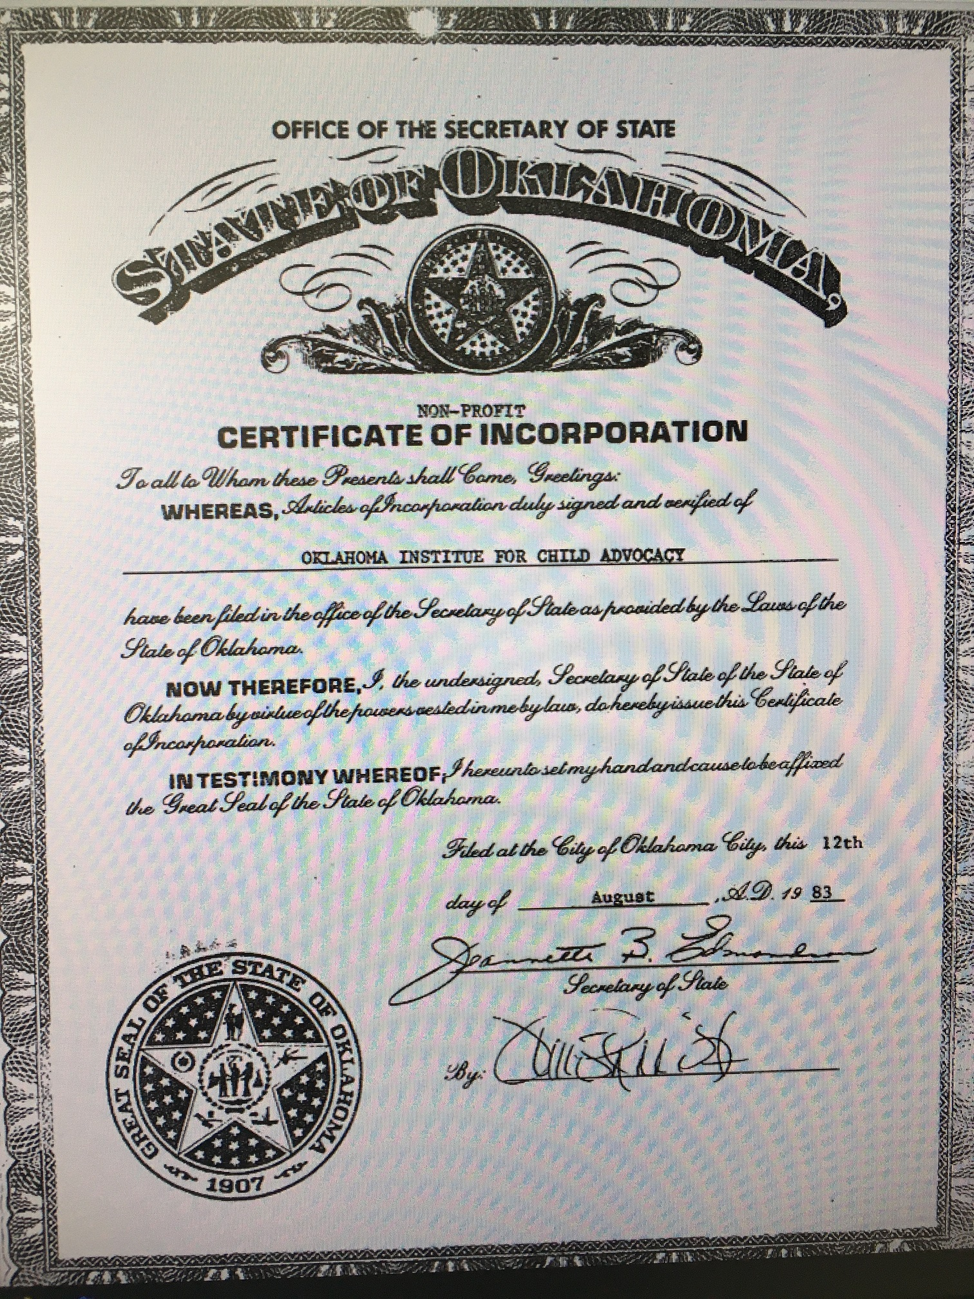
OCCY and OICA are born!
As part of these changes, in 1982, House Bill 1468 was signed into law and the Oklahoma Commission on Children and Youth (OCCY) was created to bring accountability and oversight into the child and youth service systems of Oklahoma. Over the years, OCCY has successfully worked for the establishment of effective services, has been instrumental in the remediation or elimination of substandard services, and has helped create a transparent system for children, youth, and families.
In addition, advocates felt there should be a nonprofit entity working outside the confines of government to develop and assist in the development of a broad-based citizen constituency to act on behalf of the rights of children and youth. This entity would advance research in the field, identify trends which may adversely affect the rights of young Oklahomans, and to develop a moral, ethical and professional standard for legal and social services, whether public, private and/or familial. Hence the Oklahoma Institute for Child Advocacy was created the 12th day of August, 1983.

Slide 6
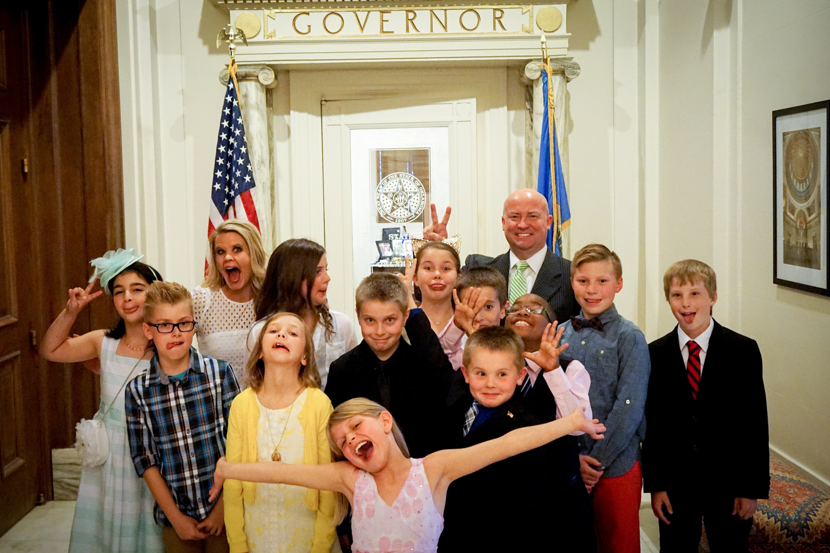
Who we are
The Board of Directors of OICA is a citizen-led group which volunteers time and effort to support the mission of the organization and maintain organization oversight. There are up to 30 board members serving from across the state.
The staff members and contract employees of OICA work to support the day-to-day mission established by the organization. This includes programing, grant oversight, operational systems, communications and support through internships.

Slide 7
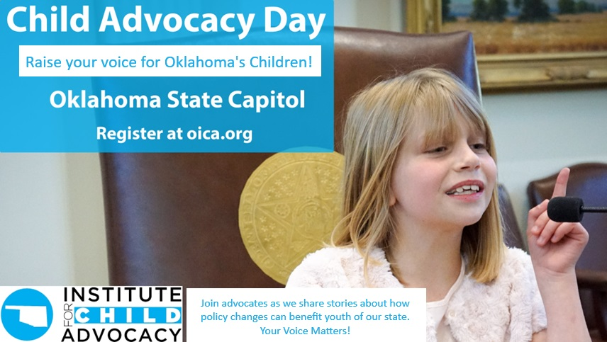
What We do
Our Mission:
“Creating awareness, taking action, and supporting policy to improve the health, safety, and well-being of Oklahoma’s children.”
OICA has remained vigilant to that mission, fighting for policies that improve the lives of children and families and being their voice at the State Capitol and in the communities where they live and learn.
Our advocacy in action:
Is Data-Driven – sharing the latest, most relevant data and research on key issues and indicators related to the well-being of children and youth.
Promotes Best Practices – translating data and research into practice and promoting best-practice program models and effective partnerships that achieve results.
Supports Policies – using data, research, and partnerships to identify solutions and inform policy-making decisions.
For more than four decades, the Institute has been informing and educating state policymakers and other citizens on the importance of investing wisely in children and families. We understand that when children thrive — our state thrives. Whether working with state policymakers and agencies, or with health, education, business, and community organizations across our state, Oklahoma’s children — and our state’s economy — are reaping the benefits of the work we do together as voices for Oklahoma’s future.
Our goal, quite simply, is to ensure that every child in Oklahoma – from birth to adulthood – is nurtured, healthy, educated, protected from harm, and thriving. We have a lot of work to do, together, to achieve that goal!

Slide 8
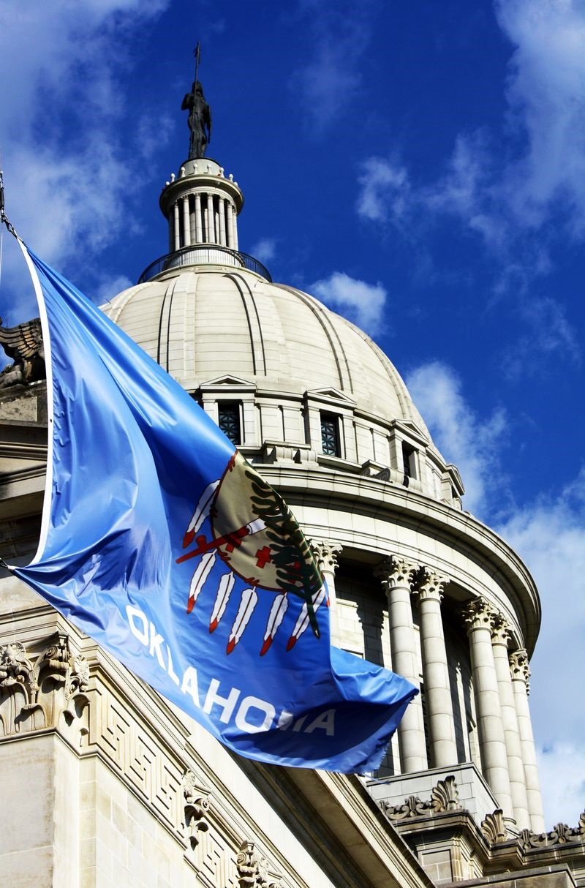

i Why is advocacy important? s advocacy important?
What is advocacy? | Why is advocacy important? | How can you be an advocate?
Advocacy is the process of making your voice heard effectively on issues that impact our lives
When done effectively, advocacy influences public policy by providing a way for individuals and organizations to voice their opinion and possibly move policy makers to respond to constituents’ needs
The first step to being an effective advocate is understanding how the political system works in Oklahoma. It is also important to understand what you can legally do when visiting with policymakers

Slide 9
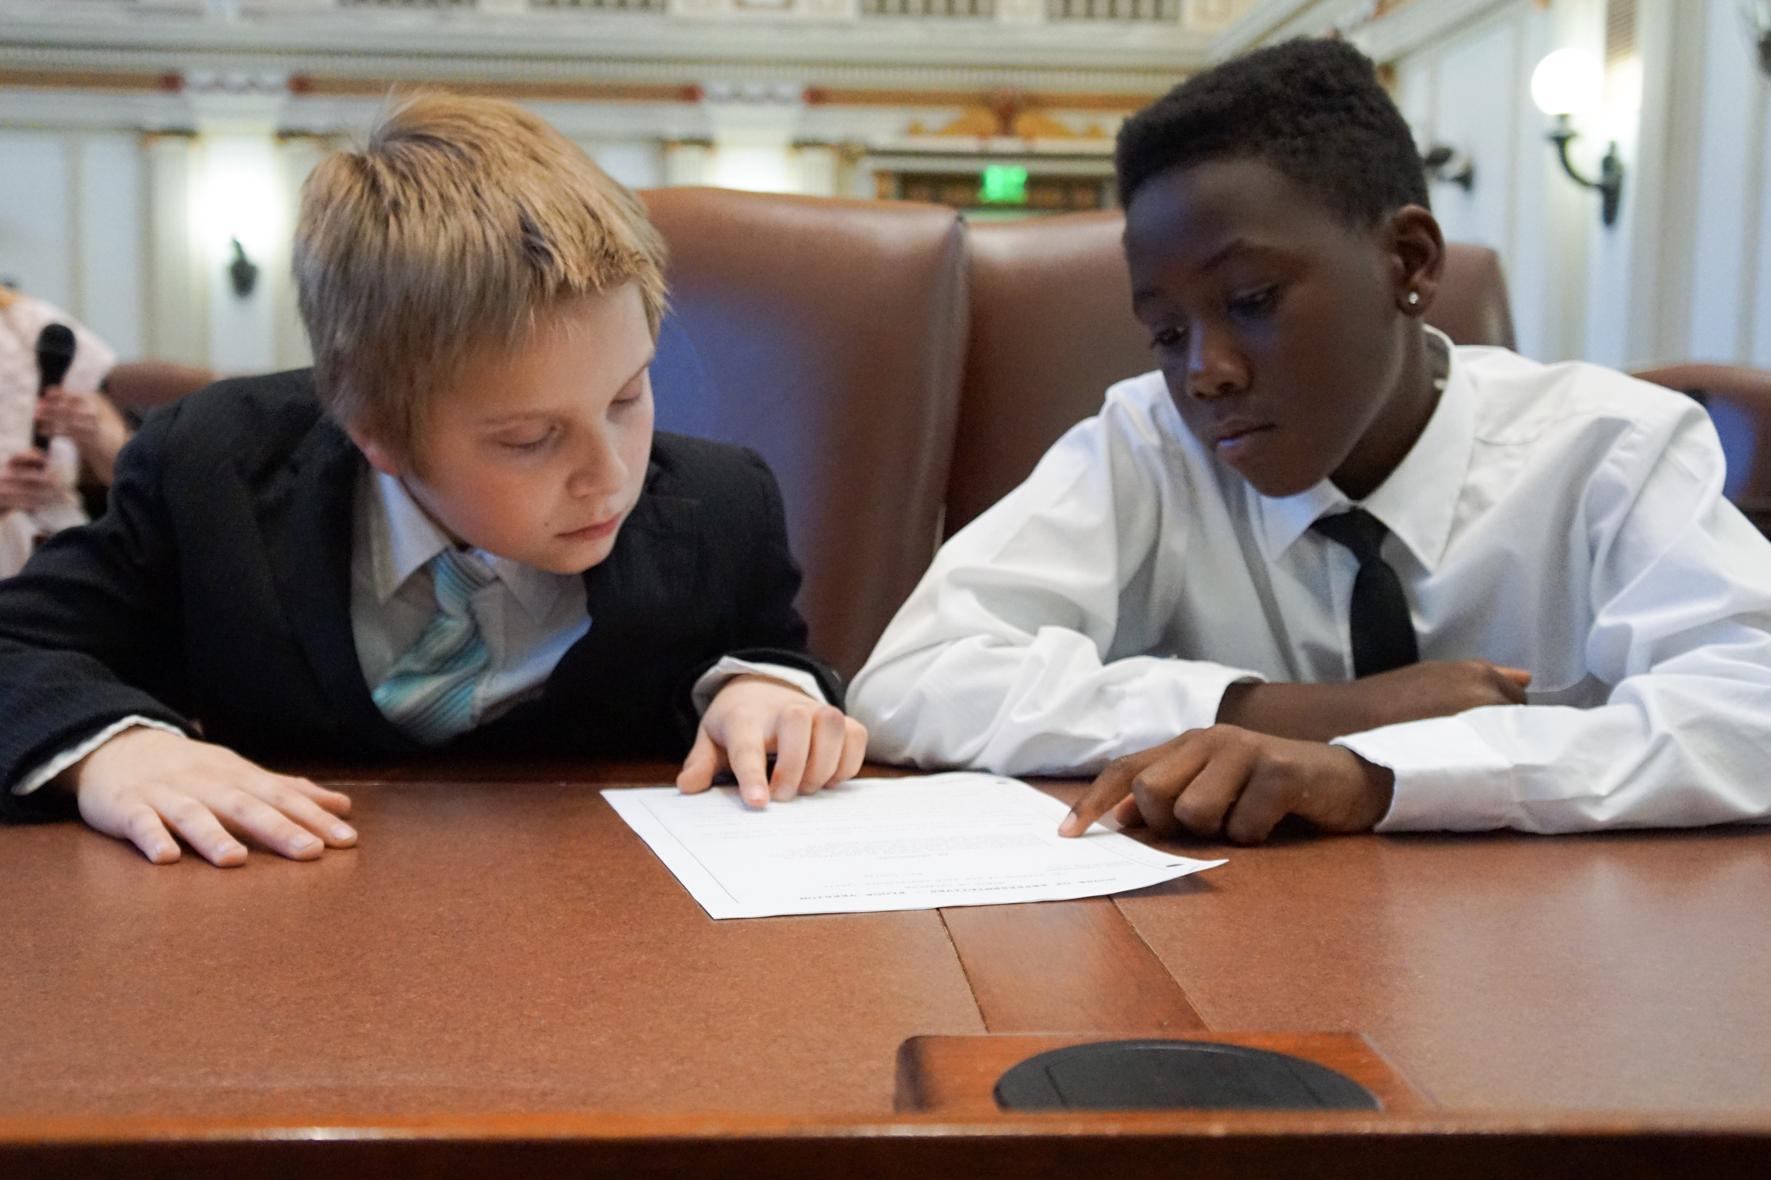
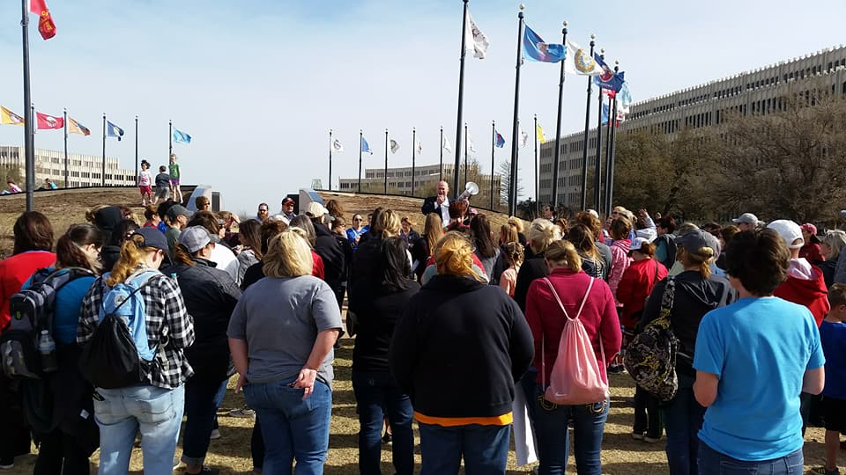
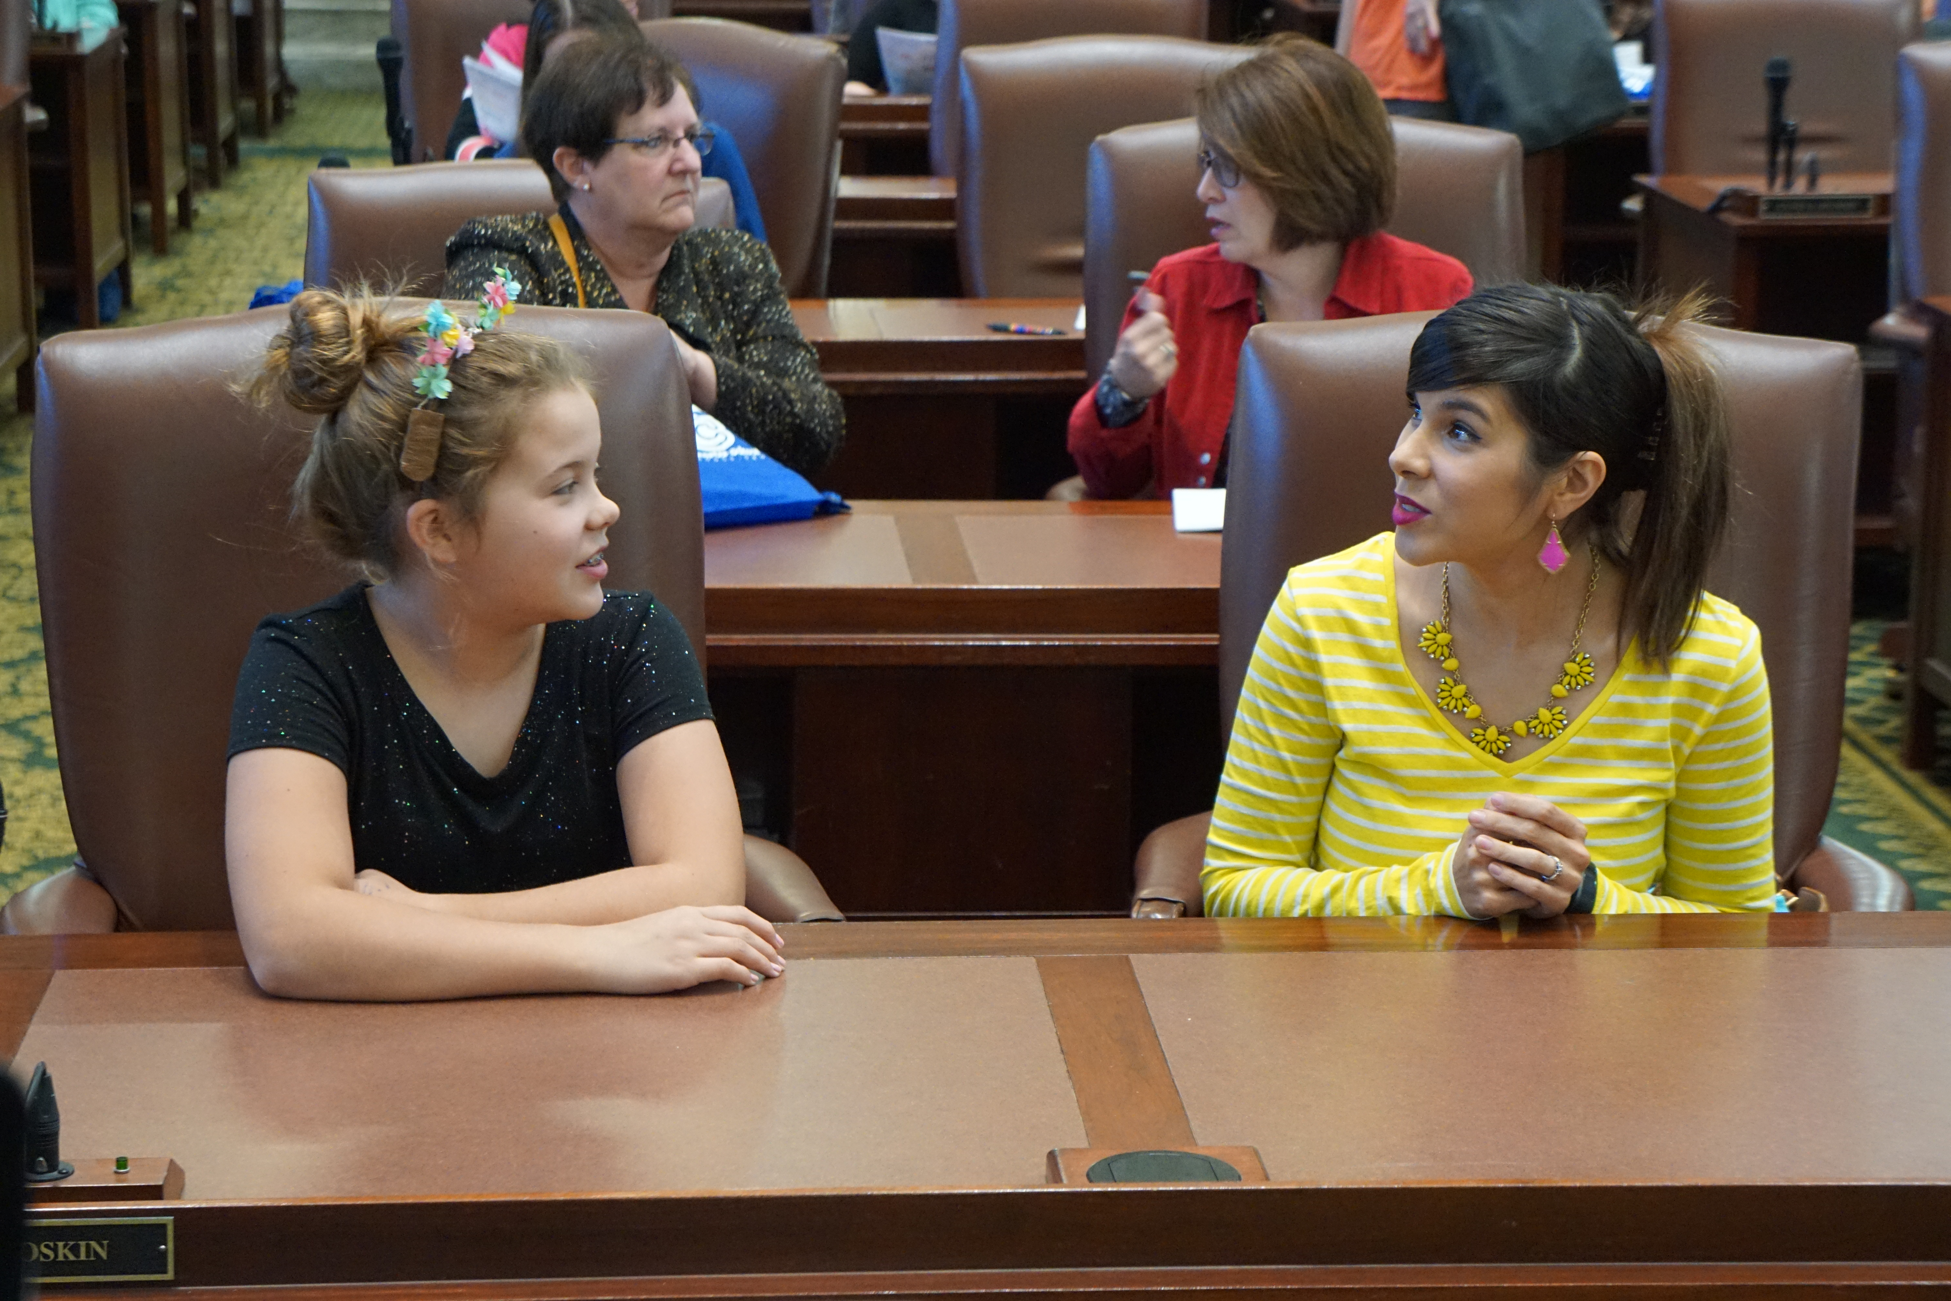
Advocacy vs. Activism vs. lobbying Advocacy vs. Activism vs. lobbying
Advocacy *Advocacy is process of making your voices heard on issues that affect our lives. *Provide information for adoption or rejection of legislation. *Urge the public to contact policy makers to advocate for adoption or rejection of legislation. *Nonprofits and service agencies can and most engage in advocacy to achieve their goals/mission. *Helps policymakers find solutions to problems. Example – inform a lawmaker about a policy impact or outcome | Activism * Activism is a doctrine or practice that emphasizes direct vigorous action especially in support of or opposition to one side of a controversial issue. *Engage on a policy issue through various means of outreach, including public protests. *Encourages Public outcry for promotion or opposition to a public policy. *Nonprofits and service agencies can and sometimes engage in activism efforts to achieve their goals/missions. *Oftentimes come into conflict with policymakers. Example – The protest at the Capitol saw people march for the outcome | Lobbying *Involves activities in direct support of or opposition to a specific piece of introduced legislation. *Nonprofits can engage in some lobbying (up to 20% of budget). *The IRS has strict rules about the portion of a nonprofit’s budget that can go toward lobbying activities. *It is prohibited to use any federal funds for lobbying. *Government employees cannot lobby while on the clock, or use government resources, unless allowed by management to provide factual information to inquiries, or if employed as a legislative liaison to fulfill a mission-specific task Example – ask a lawmaker to vote for, against, or introduce specific legislation on a policy

Slide 10
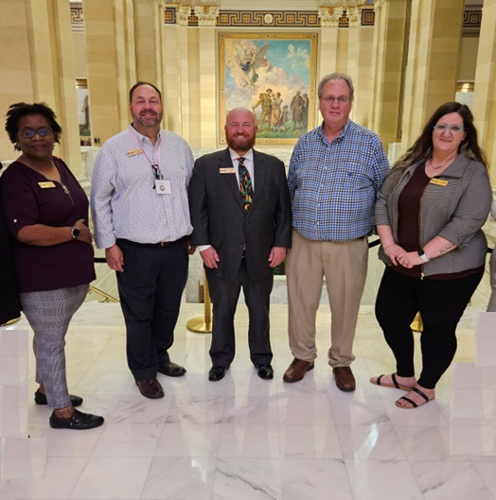
OICA works for better policies for youth
The work done by the Oklahoma Institute for Child Advocacy ranges from working with lawmakers and state agencies to shape laws and rules which benefit children, but we also work with advocates to help them better understand the process. Here are some tips:
1) Prepare a Good Advocacy Fact Sheet
2) Utilize Social Media
3) Write a Letter to the Editor or Submit a Guest Commentary to your Local Newspaper
4) Make a Phone Call
5) Visit your Elected Official in Person

Slide 11
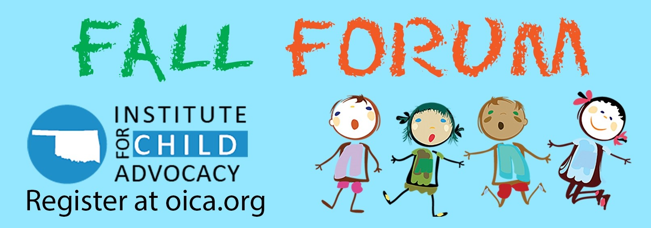
This four-day conference is a time when we gather advocates from all across the state to discuss policy priorities and develop our annual legislative agenda.
Fall Forum is held each year in October or November.
All advocates are welcome to attend.

Slide 12
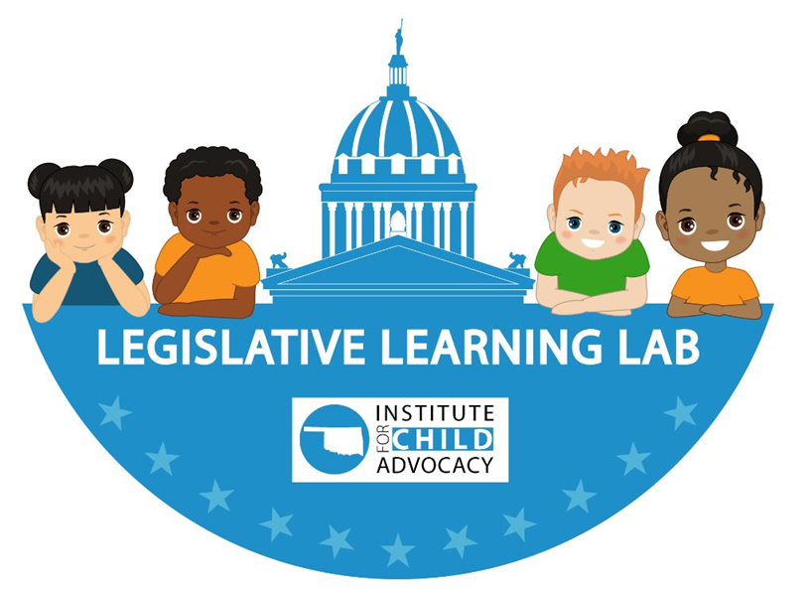
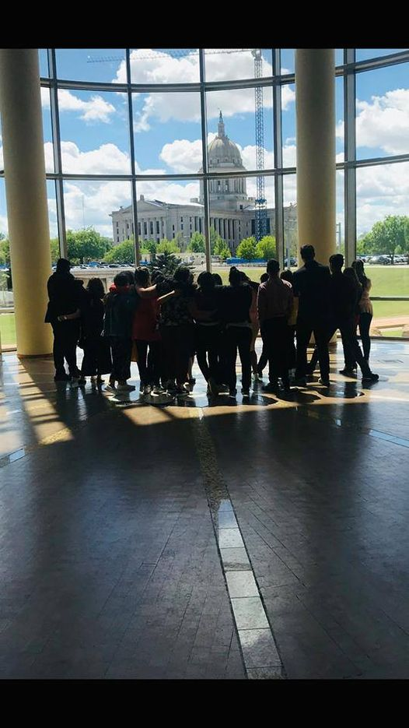
This is the training that most legislators should get but often do not receive. Our mission – now shared with the Oklahoma Center for Nonprofits – is to educate, inform, and empower advocates from all over Oklahoma to be well-prepared to follow and engage during Oklahoma’s legislative session and beyond. Through a series of workshops over the three days, advocates will learn nuances of the legislative process. This is great for beginners in the process, or as a refresher for Capitol pros.
The event will be held on the days leading up to the annual legislative session, with all days being virtual except for one. Lawmakers are included in the attendance so they can be a part of the learning process. The conference concludes with a viewing of the Governor’s annual State of the State and a follow-up panel discussing the speech.

Slide 13

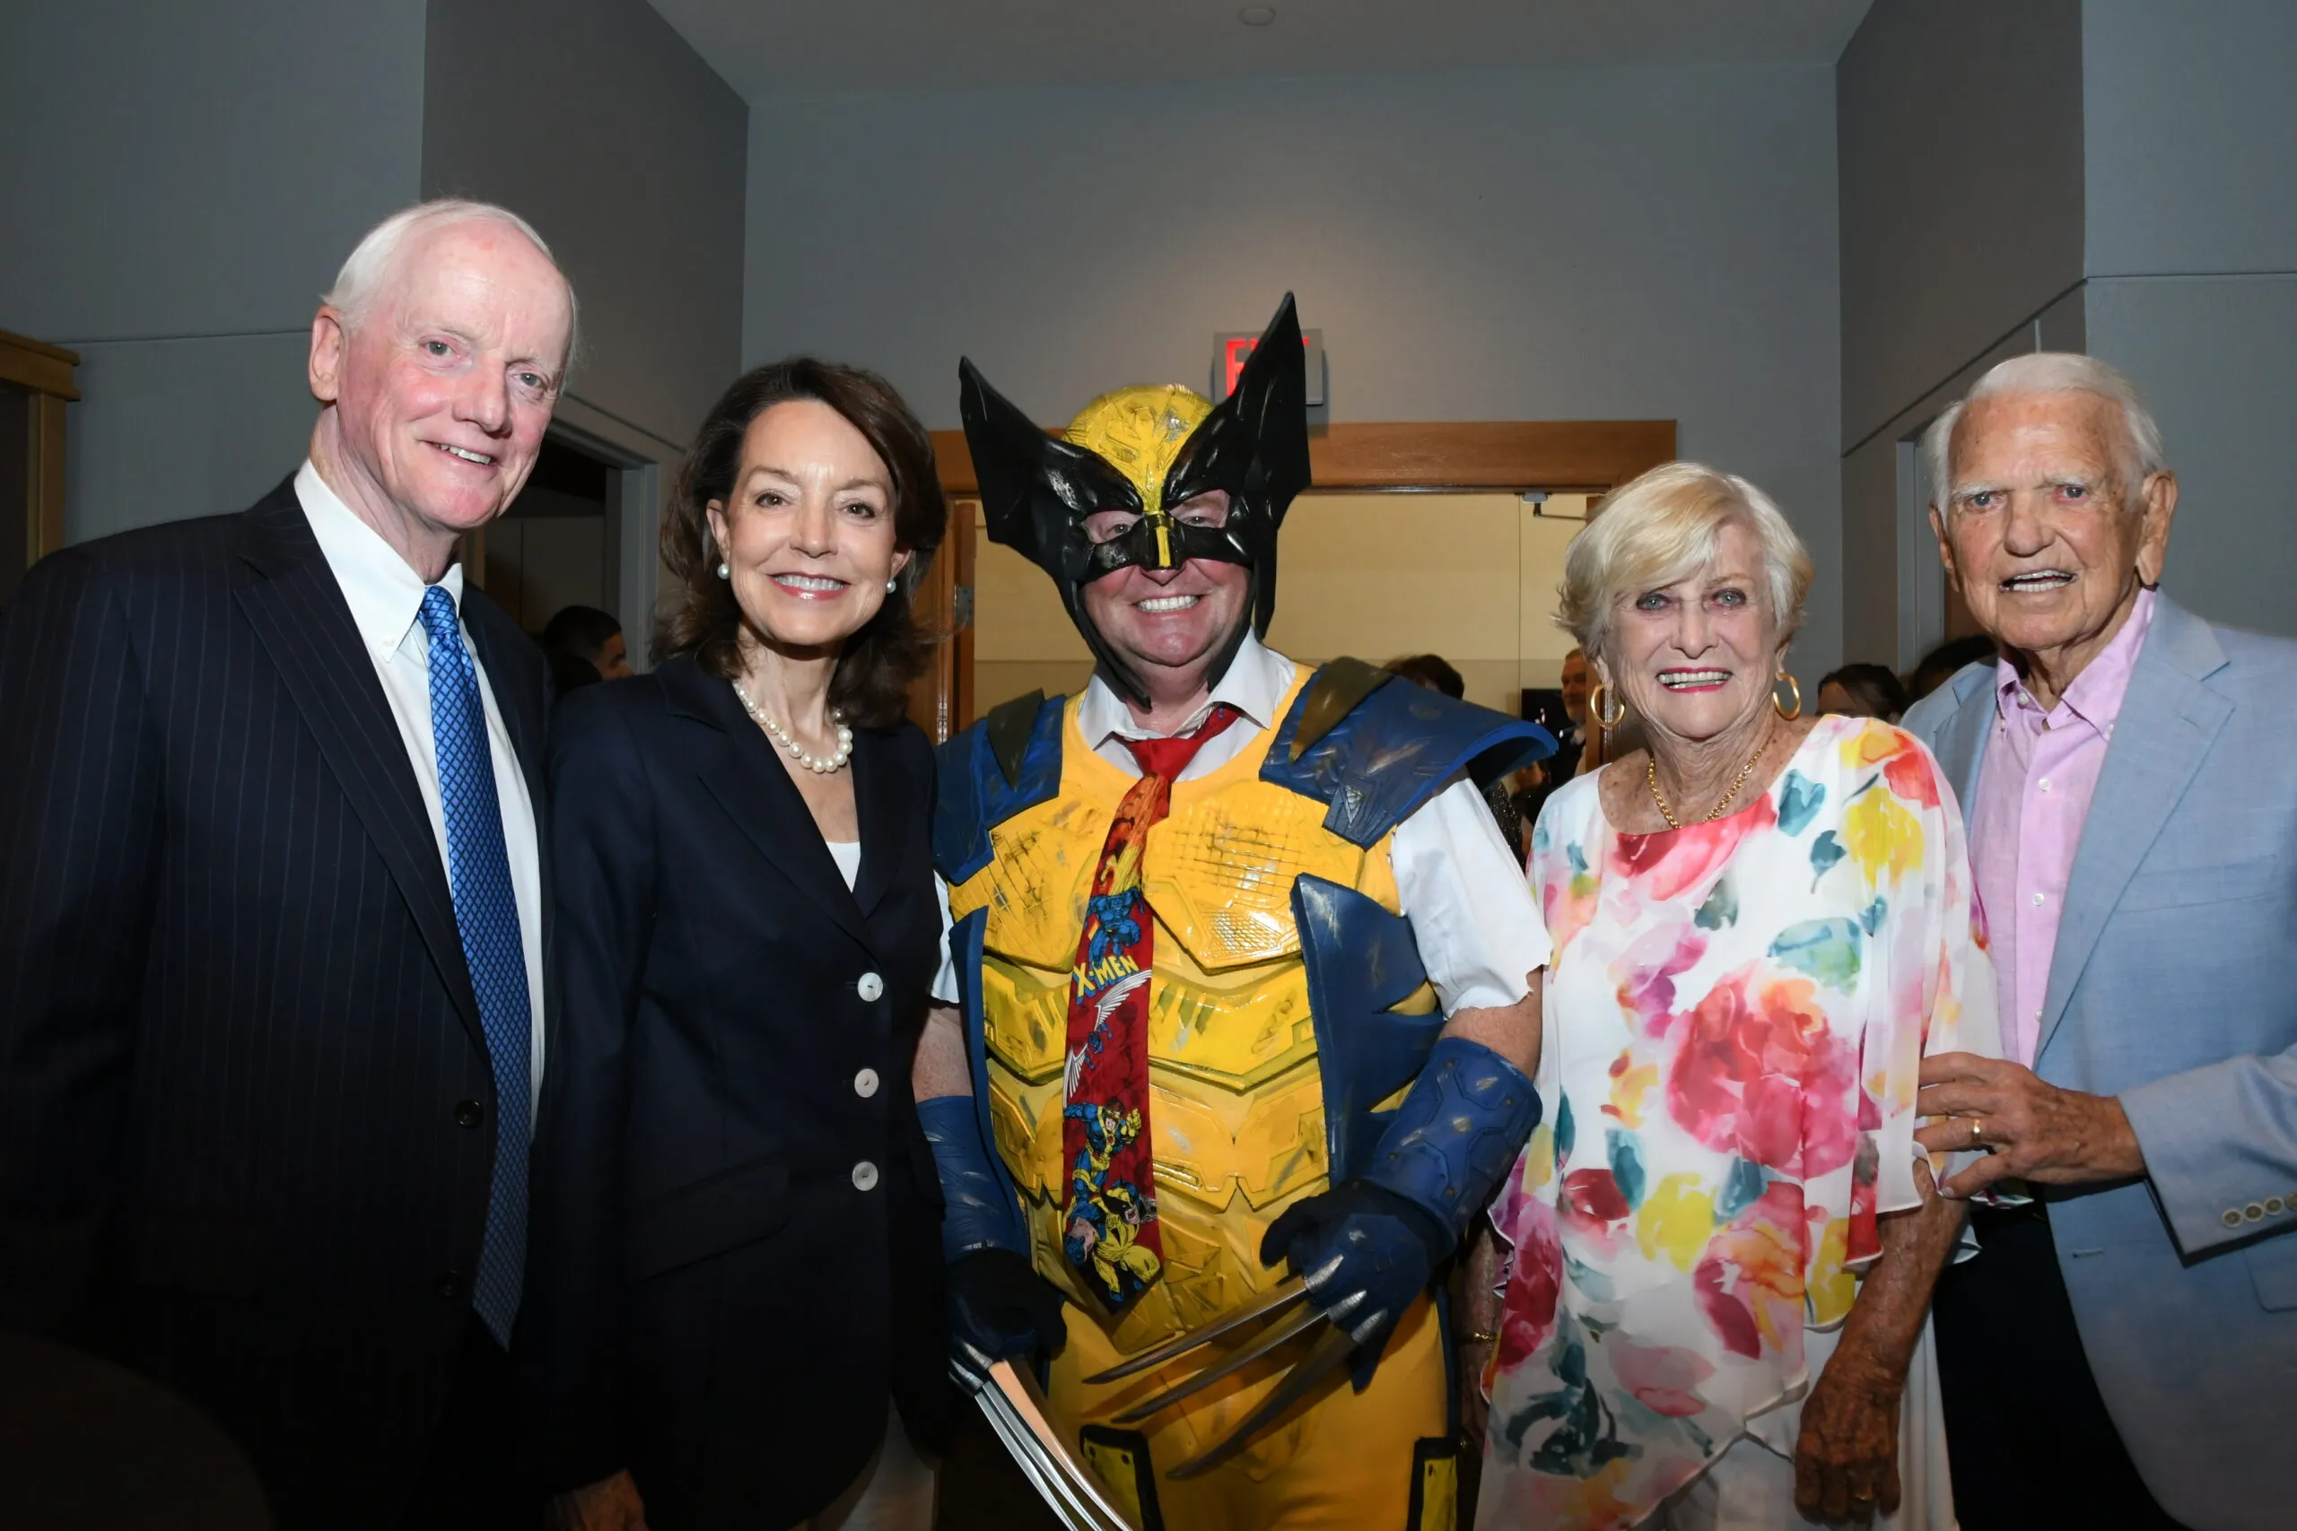
This is OICA’s premier annual event held on the final Saturday in July to recognize five “Heroes for Children,” exemplary advocates for their work on behalf of Oklahoma’s youth. It is our most visible event, with press coverage and four hundred engaged guests, from civic and political leaders to child advocates, and business leaders involved in their communities.

Slide 14
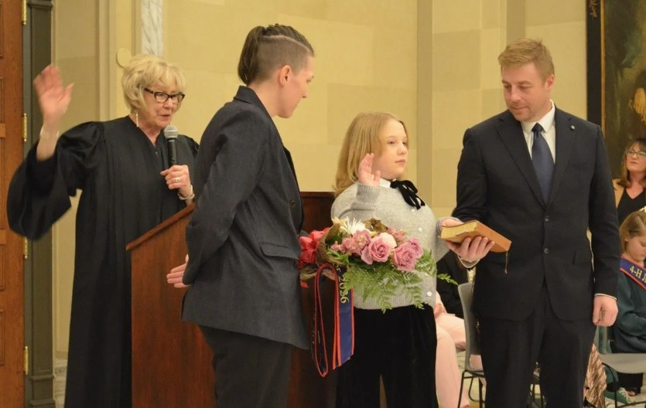

Oklahoma’s Kid Governor® empowers 5th graders to change the world. This ground-breaking approach to civics education immerses students in a real election for their state’s Kid Governor, a fellow 5th grader who will represent them during a one-year term of active leadership. More than a contest and not just about the position of governor, the program teaches important lessons about state government, voting, elections, and civic participation. All 5th grade classes and home school programs are welcome to participate.
Timed to coincide with Election Day in November, this annual program provides 5th graders the experience of nominating one student candidate from their school and voting in an authentic statewide election. Classes can vote in the election, nominate a student to run for office, or both! Free, innovative, and state-specific lesson plans and digital resources guide teachers through the program and help students explore state government and active participation in civic life. The student receiving the most votes is elected Kid Governor and serves a one-year term of leadership and advocacy. They work with Oklahoma Institute for Child Advocacy and their Cabinet to fulfill their campaign platform and encourage students to make a difference on the winning campaign issue in their own communities.
OICA privately raises the funds for this so it is provided at no cost to schools.

Slide 15
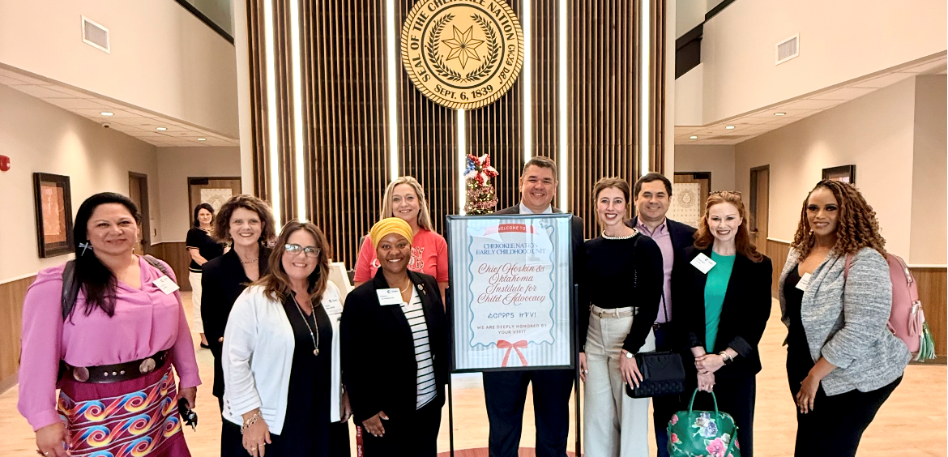


Advocacy Boot Camp
The OICA Advocacy Boot Camp is a seven-destination leadership program operated by OICA which takes participants around the state to learn about different projects that are working to better the lives of children.
The networking from ABC allows attendees, hosts, and sponsors to build a stronger base to collaborate on areas involving child policy and youth services.
The outgoing class will overlap with the incoming class in the September gathering to create a mentorship program which will continue to build upon lessons learned and strengthen the commitment of advocates.

Slide 16



Other work done by OICA
Increasing awareness about SoonerCare enrollment across 20 rural OK counties through outreach in schools and daycares.
Outreach to lawmakers for policies to reduce the need foster care for young Oklahomans through work with collaborative partners and those with lived experiences.
Publication of a civics-oriented educational comic book for grade school students.
To request brochures for distribution, contact Joe Dorman at jdorman@oica.org and to order comics, go to https://www.oica.org

Slide 17
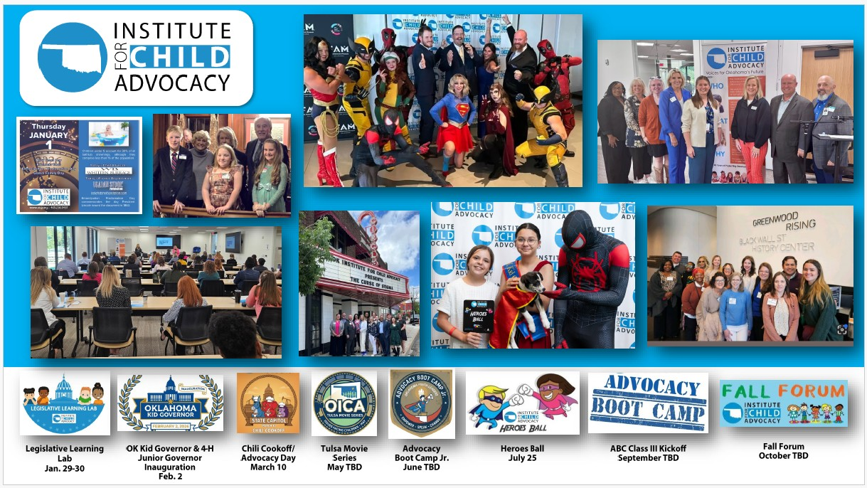

How you can help
OICA operates through donor support, both individual and organizational. In addition, grants supporting child advocacy are sought to financially assist with our mission.
Volunteers are the lifeblood of any profit, and it is no exception with OICA.
OICA publishes a daily desktop calendar which highlights a different child-related statistic, an advocate of the day, and a youth program working to support children in our state. Copies are provided to each lawmaker. Sponsorships allow these to be printed and published.
You can learn more or get involved by going to OICA.ORG or by following us on Facebook, Twitter, Instagram, and LinkedIn. You can also sign up for our weekly email newsletter by going to our website at oica.org.

Slide 18


Become a member of OICA and help support our mission! Go to https://oica.org to learn more!
Every child deserves a chance. Stand with us in the fight for Oklahoma’s children by becoming a member of OICA today and joining the fight on behalf of Oklahoma’s kids and families.
Members help us to:
Reduce child hunger;
Help place foster children in loving and safe homes;
Reduce Oklahoma’s rates of abuse and neglect;
Support quality public education;
Reform and improve our criminal justice system;
And more!
Annual Membership Levels
Educator/Student/Govt. Employee - $60
Partner organization - $100
Individual - $120
Junior Executive Business Council - $500
Executive Business Council - $1,000

Slide 19
If you care about children and take action, Thank you for being a child advocate!
Joe Dorman (405) 236-KIDS (5437) ext. 4 – work (405) 893-1117 – mobile jdorman@oica.org

