Slide 1
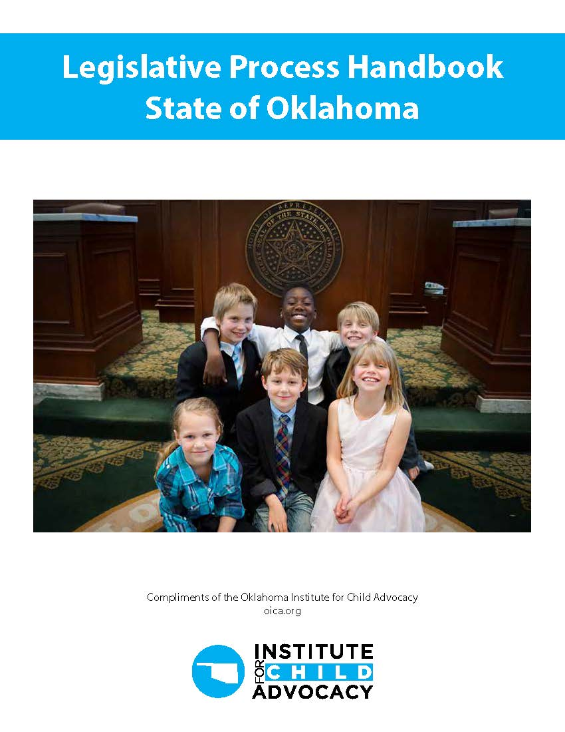


Welcome to the Legislative learning lab
Joe Dorman, CEO
Oklahoma Institute for Child Advocacy

Slide 2
ELECTIONS - Oklahoma is one of the 23 state governments under full Republican control and one of 16 with a veto-proof republican majority. Source: Ballotpedia
Every Two Years Voter Choose: | Every Four Years Voters Choose (Non-Presidential Years): | Every Six Years Voters Choose:
24 State Senators (half of the State Senate, even or odd-numbered seats) 101 State Representatives (entire State House of Representatives) 5 Members of Congress (entire U.S. House of Representatives) | 8 statewide officers: Governor Lieutenant Governor Attorney General State Treasurer Superintendent of Public Instruction Insurance Commissioner State Auditor and Inspector Labor Commissioner | 3 Corporation Commissioners 2 U.S. Senators (elected for six-year terms and elected on a staggered basis)

Slide 3
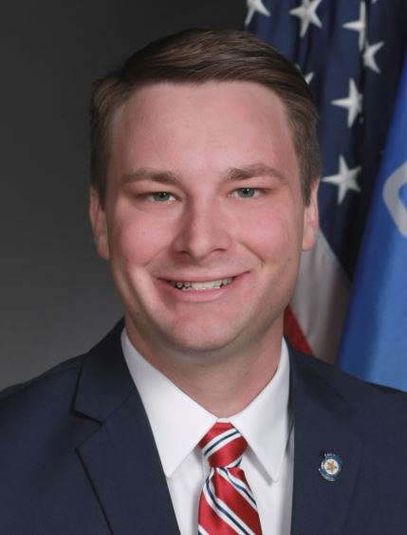
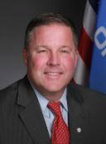
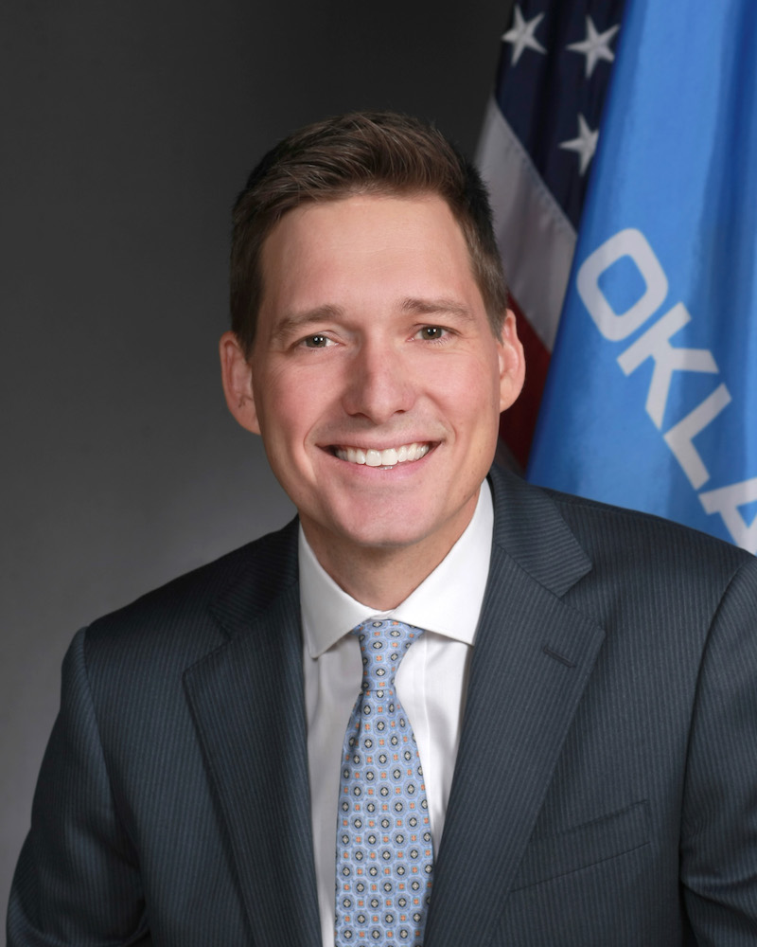
Oklahoma’s Bicameral LEGISLATURE
House of Representatives
  101 Members
  Two-Year Terms
  Republicans have controlled the House since 2004
  Current Breakdown: 81 Republicans / 20 Democrats
  Presided over by Speaker Kyle Hilbert (Youngest House Speaker in the Nation)
Senate
  48 Members
  Four-Year Staggered Terms
  Republicans have controlled the Senate since 2008
  Current Breakdown: 40 Republicans / 8 Democrats
  Presided over by President Pro Tempore Lonnie Paxton
  Lieutenant Governor Matt Pinnell is the President of the Senate; can vote only in case of a tie vote.

Slide 4
LEGISLATION
Legislation which originates in the Senate is numbered consecutively beginning with “1”:
SB 1 SJR 1 SCR 1 SR 1
Bills
have the force and effect of law
must be passed by both chambers
must be signed by the Governor (except when the measure submits a question to a vote of the people)
generally proposes changes to the Oklahoma Statutes
Legislation which originates in the House is numbered consecutively beginning with “1001”:
HB 1001 HJR 1001 HCR 1001 HR 1001
Joint Resolutions
have the force and effect of law
must be passed by both chambers
must be signed by the Governor (except when the measure submits a question to a vote of the people)
often will not become part of the Oklahoma Statutes

Slide 5
LEGISLATION
Concurrent Resolutions
do not have the force and effect of law
must be passed by both chambers
are not signed by the Governor
will not become part of the Oklahoma Statutes
are used to express the will or opinion of both chambers
Simple Resolutions
do not have the force and effect of law
must pass only the chamber which introduced the measure
are not signed by the Governor
will not become part of the Oklahoma Statutes
are used to express the will or opinion of one chamber

Slide 6
Reading a Bill or resolution
Measures being considered by the Oklahoma State Legislature pass through a variety of forms.
Introduced Version
The bill or resolution, as filed, is has the heading, “AS INTRODUCED”. The measure is introduced in this form and remains this way until it is reported out of committee in the first chamber.
Committee Version
After a measure has been heard by a committee and reported to the floor for further consideration, it is printed with changes made in committee highlighted in bold.

Slide 7
Reading a Bill or resolution
Engrossed Version
A verified copy of the bill or resolution, complete with any committee or floor amendments, is executed after Third Reading. An Engrossed Version passed by one chamber is filed for committee work in the second chamber, then in the same form as above for floor action.
Conference Committee Substitute
Frequently, bills pass the two houses in different forms and go to conference committees to have the differences resolved. A report signed by conferees and a conference committee
substitute that resembles the committee version will be considered by both chambers.
Enrolled Version
A verified, final copy of the identical bill or resolution passed by both chambers and ready for the Governor’s signature or veto is filed.

Slide 8
Reading a Bill or resolution
Bills being considered by the Legislature can do any one or any combination of the following:
Create new law
Amend existing law
Repeal existing law
Appropriate money or set budgetary limits
Most often, bills amend existing law. The changes are easy to determine since what is being amended is denoted by strikeouts in the case of language being removed or underlines for new language. The most notable exception is for new law, repealers or non-codified sections which have no strikeouts or deletions.

Slide 9
2026 Legislative deadlines
The Second Regular Session of the 60th Oklahoma Legislature Sine Die Adjournment - May 29, 2026 NLT 5:00 p.m.
Deadline for Third Reading and Final Passage of Bills and Joint Resolutions from opposite chamber - May 7, 2026
Deadline for Third Reading and Final Passage of Bills and Joint Resolutions from chamber of origin - March 26, 2026
The Second Regular Session of the 60th Oklahoma Legislature convenes - February 2, 2026 at Noon
Deadline for Filing of Bills and Joint Resolution - January 15, 2026 NLT 4:00 p.m.
Deadline for Minor Redraft Requests - January 15, 2026 NLT 10 a.m.
Deadline for details to follow - December 29, 2025
Deadline for Requesting the Drafting of House Bills and Joint Resolutions - December 5, 2025

Slide 10
Budget timeline
January | February | March | April | May | June
On the first day of legislative session, the Governor Submits the Executive Budget to the Legislature for consideration | Legislature in Session |  |  |  | State agencies submit budget work program to Office of Management & Enterprise Services for approval
 | Legislative Review of State Agency Budgets; Passage of Budgets for State Agencies
 | Final Review of Available Revenue for Expenditure by State Legislature by the State Board of Equalization
 |  |  |  |  | June 30 End of Fiscal Year
July | August | September | October | November | December
July 1 Beginning of the new Fiscal Year |  | State agencies submit budget request to the Office of Management & Enterprise Services | OMES Reviews State Agency Budget Requests; House and Senate Committees Hold Agency Performance Review Hearings
 |  |  |  |  | Preliminary Certification of State Revenue by the State Board of Equalization for next year

Slide 11

Executive branch
The Governor Serves as Chief Executive of the State
  Elected to a four-year term, two-term limit.
  Powers and Duties:
    Head of state and chief executive for the State of Oklahoma
    Commander in Chief of the Oklahoma National Guard
    Appoints (with confirmation by the state senate) cabinet secretaries and various agency directors
  Delivers yearly “State of the State” address to the Legislature on the first day of session
Governor J. Kevin Stitt (R)
  Elected 2018, term limited in 2026 – ineligible to run for re-election

Slide 12
Governor’s actions on Legislation
Upon receiving a bill or joint resolution which has passed both chambers of the Oklahoma Legislature, the Governor may:
Approve the measure
*by signing it within five days from receipt
Veto the measure
*by returning it within five days (Sundays excepted) with objections
*the Legislature might be in Session, thereby providing an opportunity to override
Pocket Passage the measure if passed prior to the last five days of a session.
*allows it to become law without action by the Governor by keeping it five days (Sundays excepted) while the Legislature is in Session
Pocket Veto the measure for bills passed during the final five days of a session.
*by keeping it up to fifteen days (Sundays excepted) without taking official action following the Legislative Session
The Legislature may override a veto of the governor by a two-thirds vote of each body, or a three-fourths vote for any action that required two-thirds for passage.

Slide 13
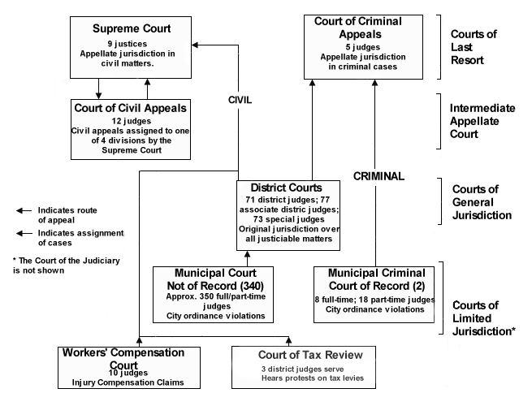
Oklahoma’s judicial branch
The Oklahoma court system is different from all other states, with the exception of Texas, in that Oklahoma has two courts of last resort: the Oklahoma Supreme Court and the Court of Criminal Appeals . Source: OKHISTOry.org

Slide 14
Supreme court cases
The nine Justices of the Oklahoma Supreme Court decide only civil cases.
The five Judges of the Oklahoma Court of Criminal Appeals decide criminal cases.
The Oklahoma Supreme Court has immediate jurisdiction with respect to new first-impression issues, important legal issues, and cases of great public interest.
In addition to appeals from the trial courts, the Oklahoma Supreme Court has jurisdiction over all lower courts, excluding the Oklahoma Court on the Judiciary, and the Oklahoma Senate, when that body is sitting as a Court of Impeachment.
Judgments of the Oklahoma Supreme Court with respect to the Oklahoma Constitution are considered final.

Slide 15
The honorable joe dorman, ceo
Oklahoma Institute for Child Advocacy
2915 n. Classen Blvd., Ste 320
Oklahoma City, OK 73106
405.236.5437 ext 4
Jdorman@oica.org website - oica.org

