Slide 1

Facilitating Health
Policy Change
Lauren Ford, TSET Policy Manager

Slide 2
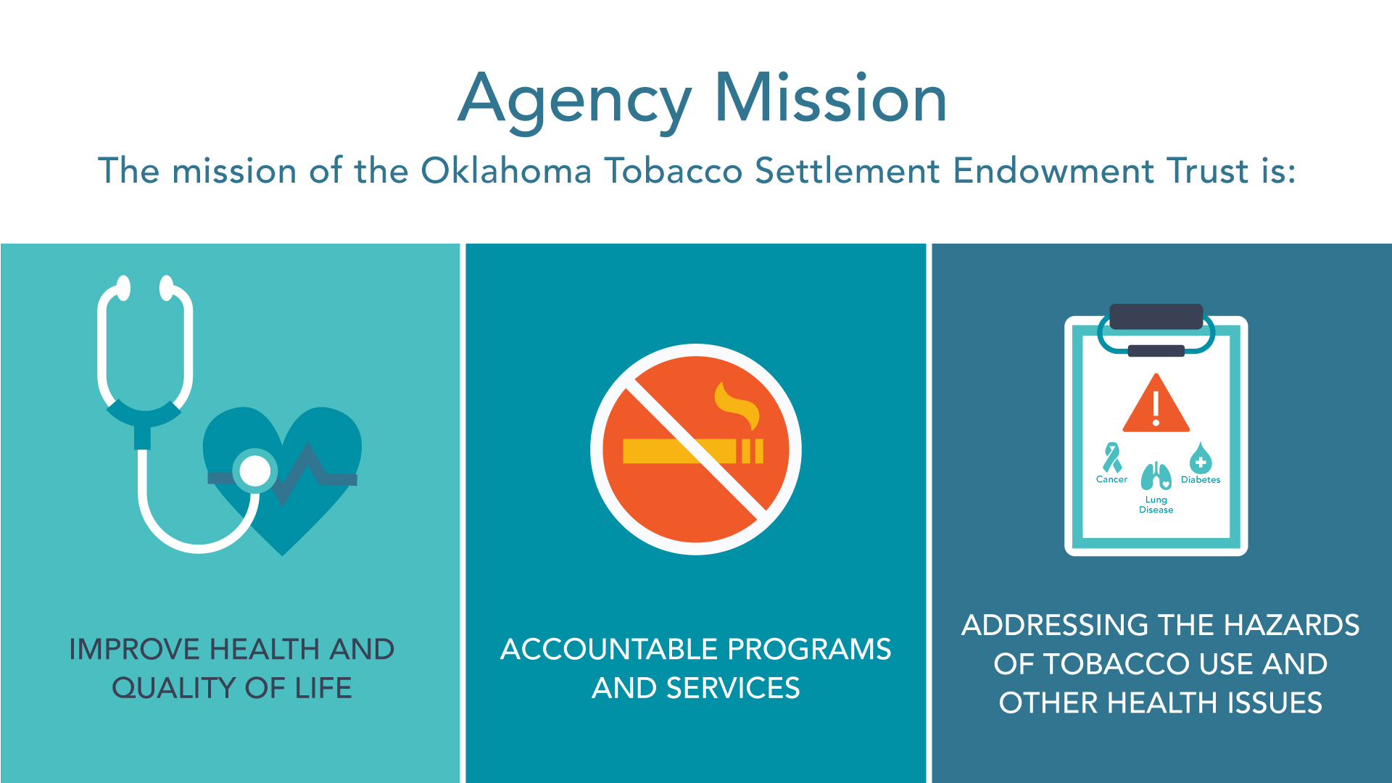


Slide 3
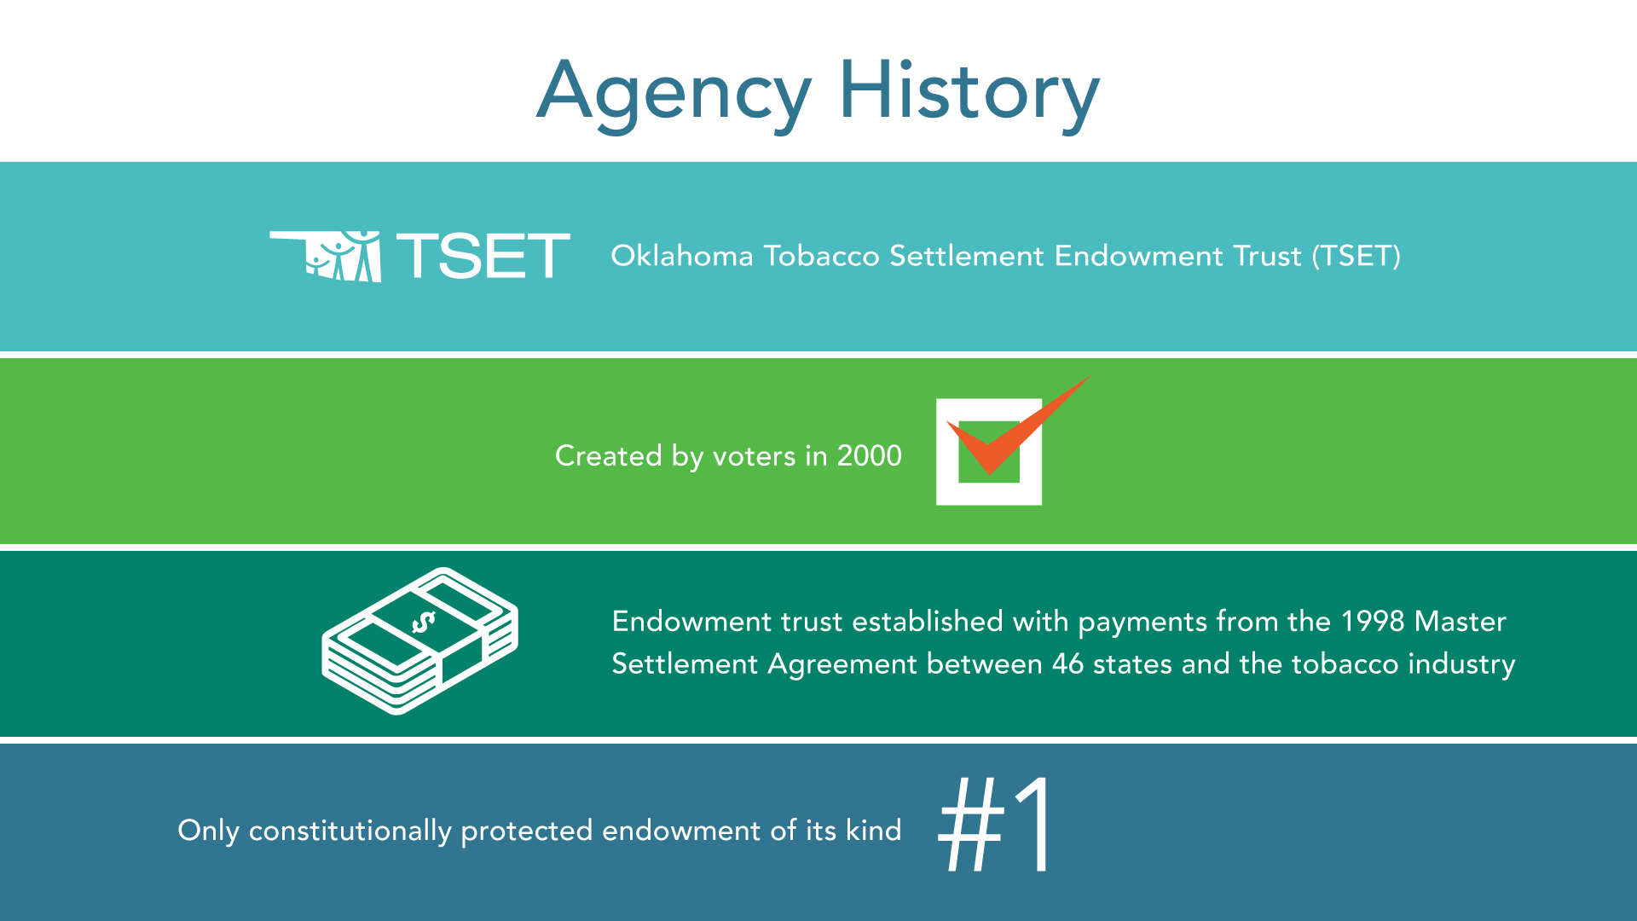

Slide 4
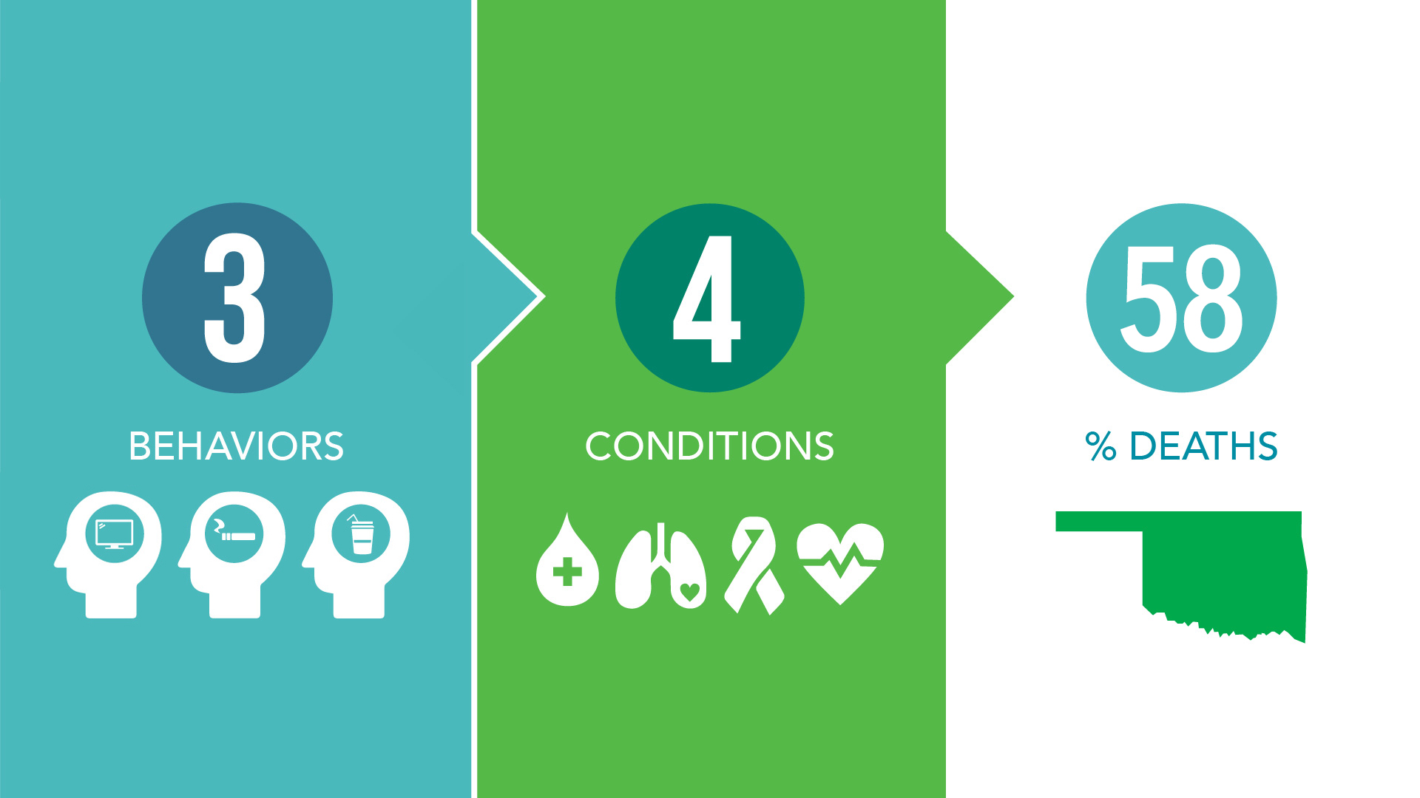


Slide 5
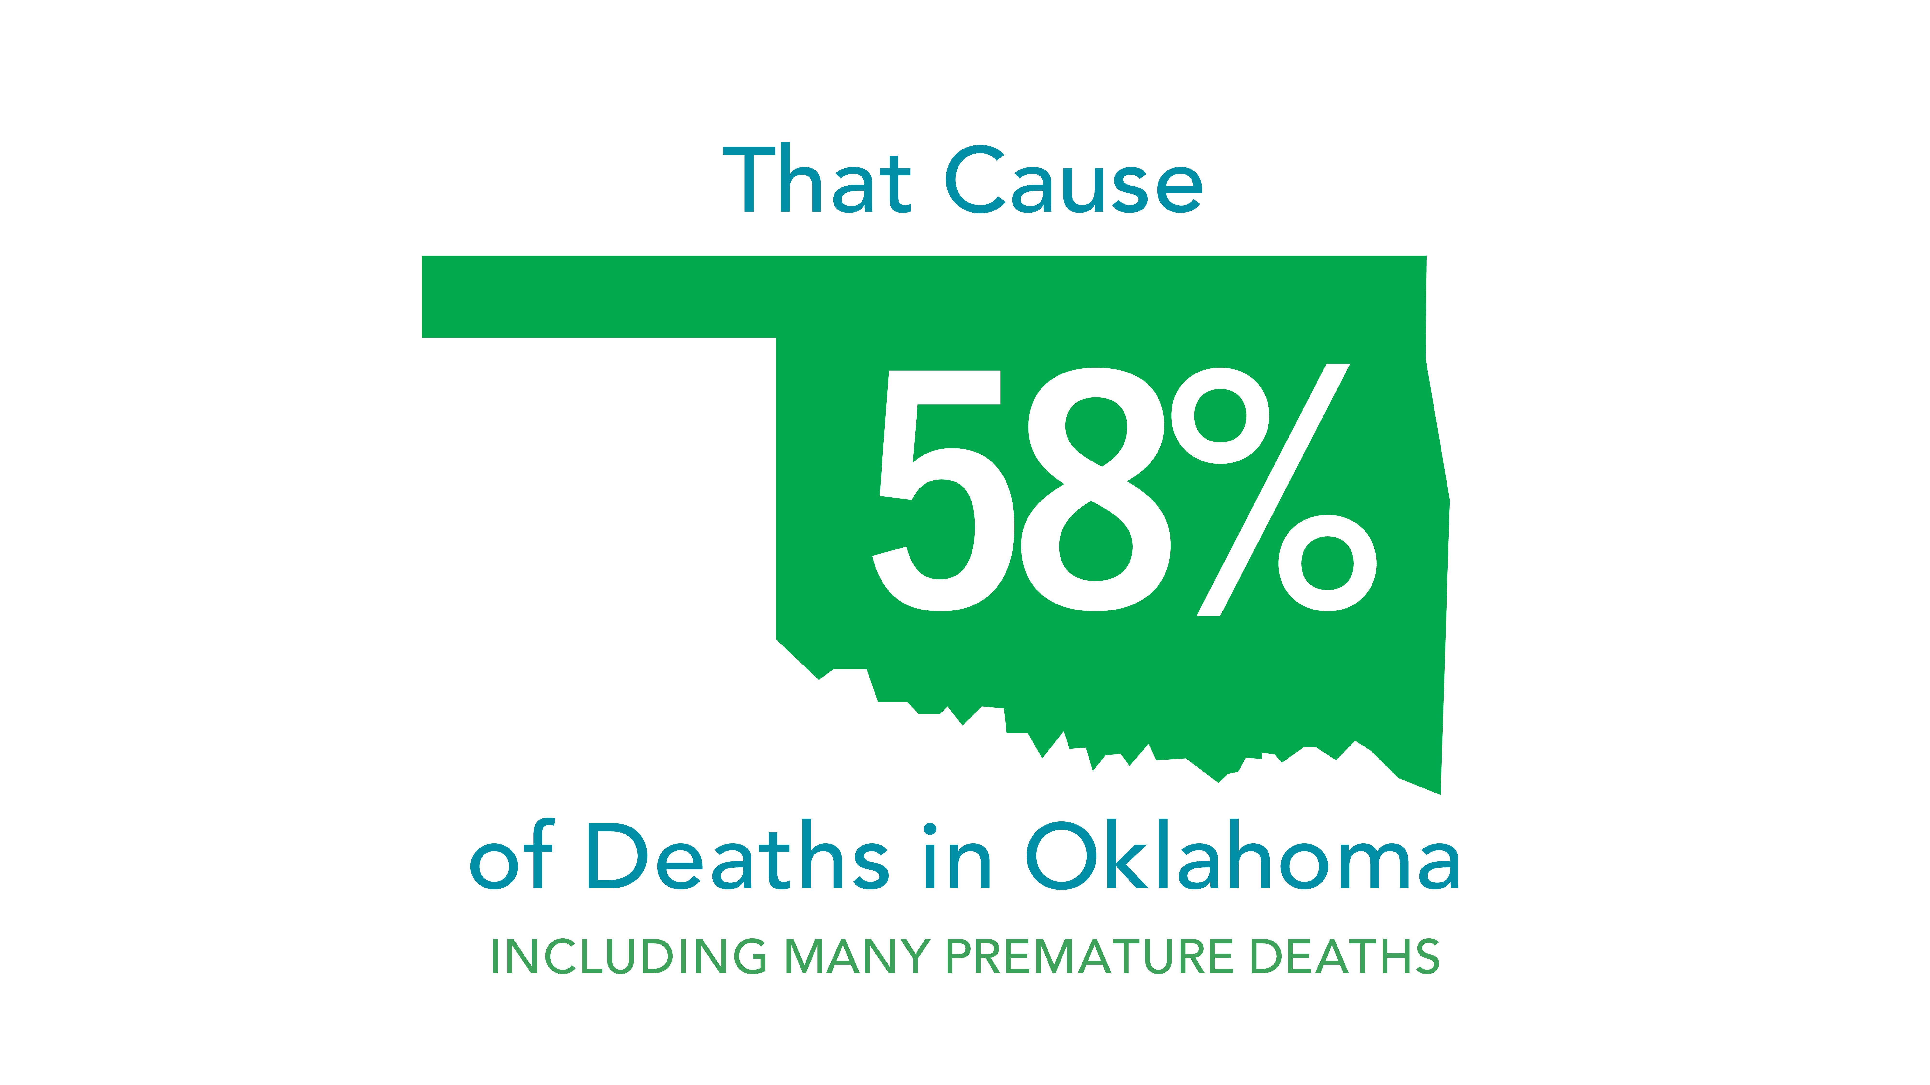

Slide 6
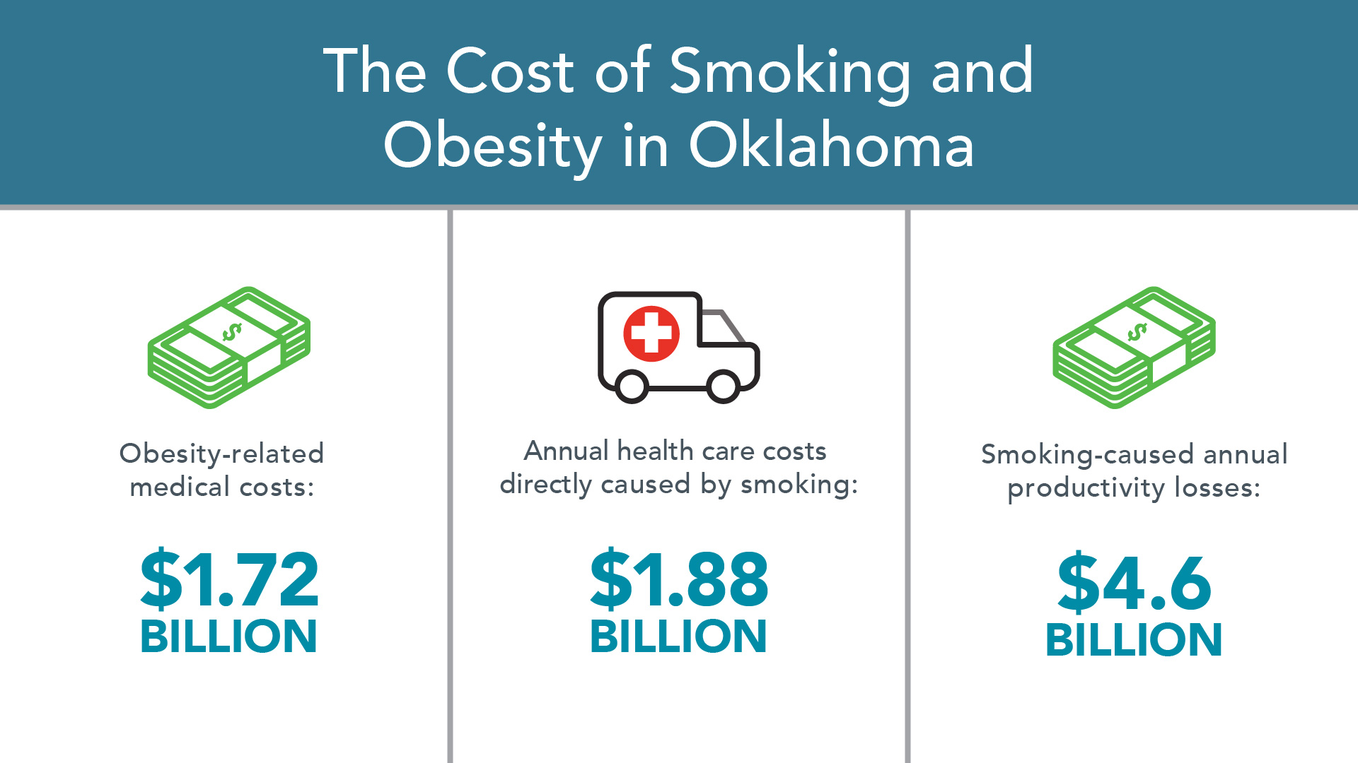
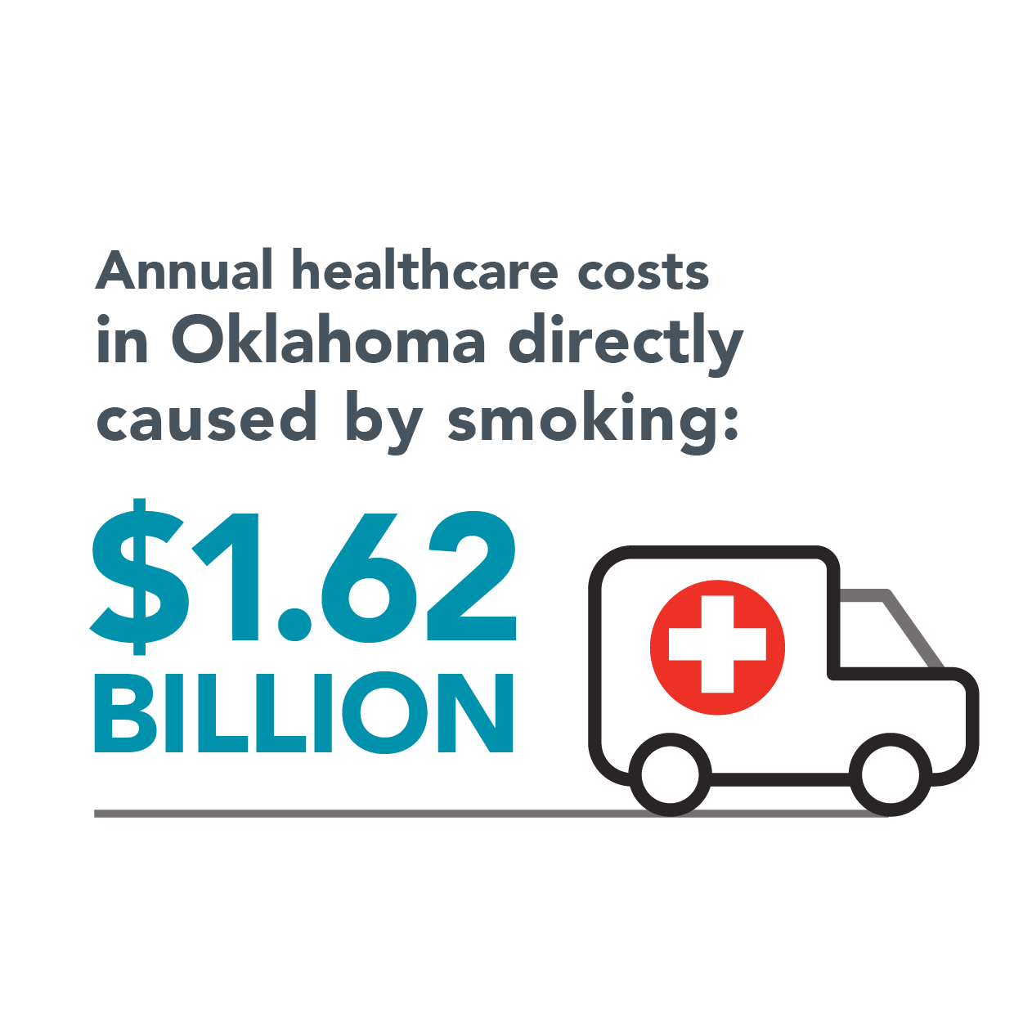
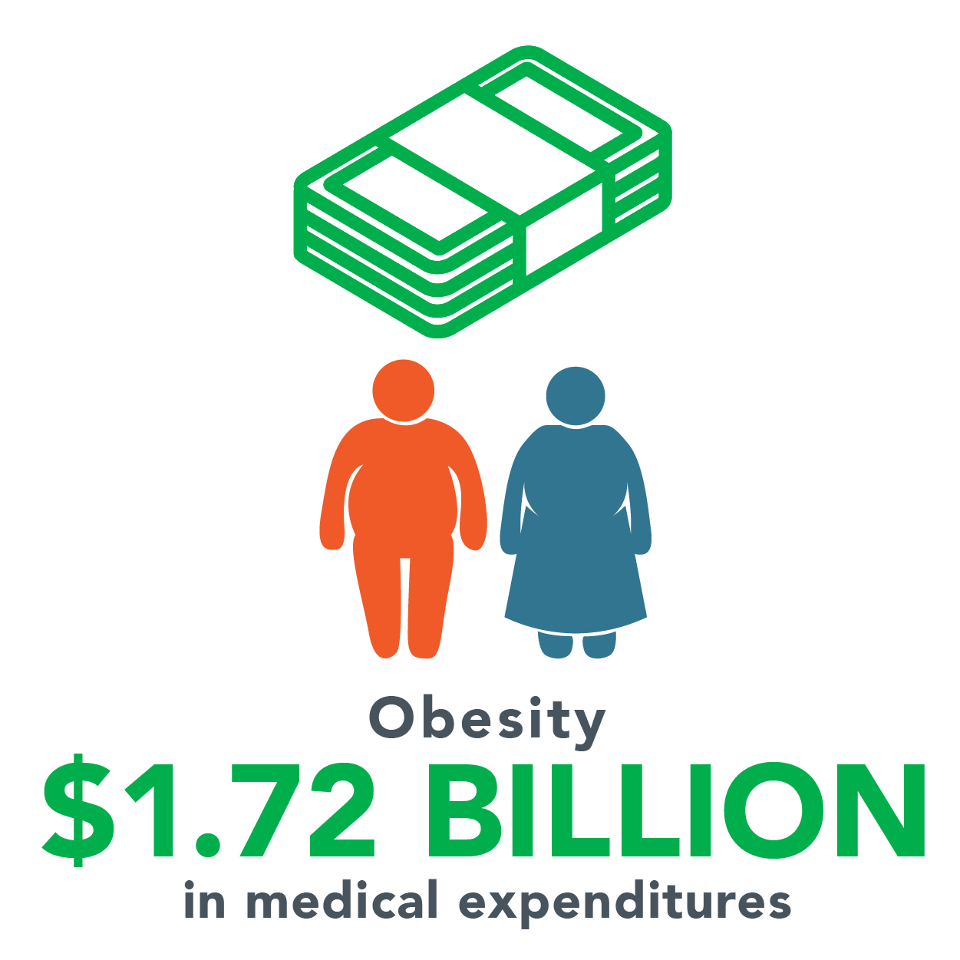
The Cost of Smoking and Obesity in Oklahoma

Slide 7
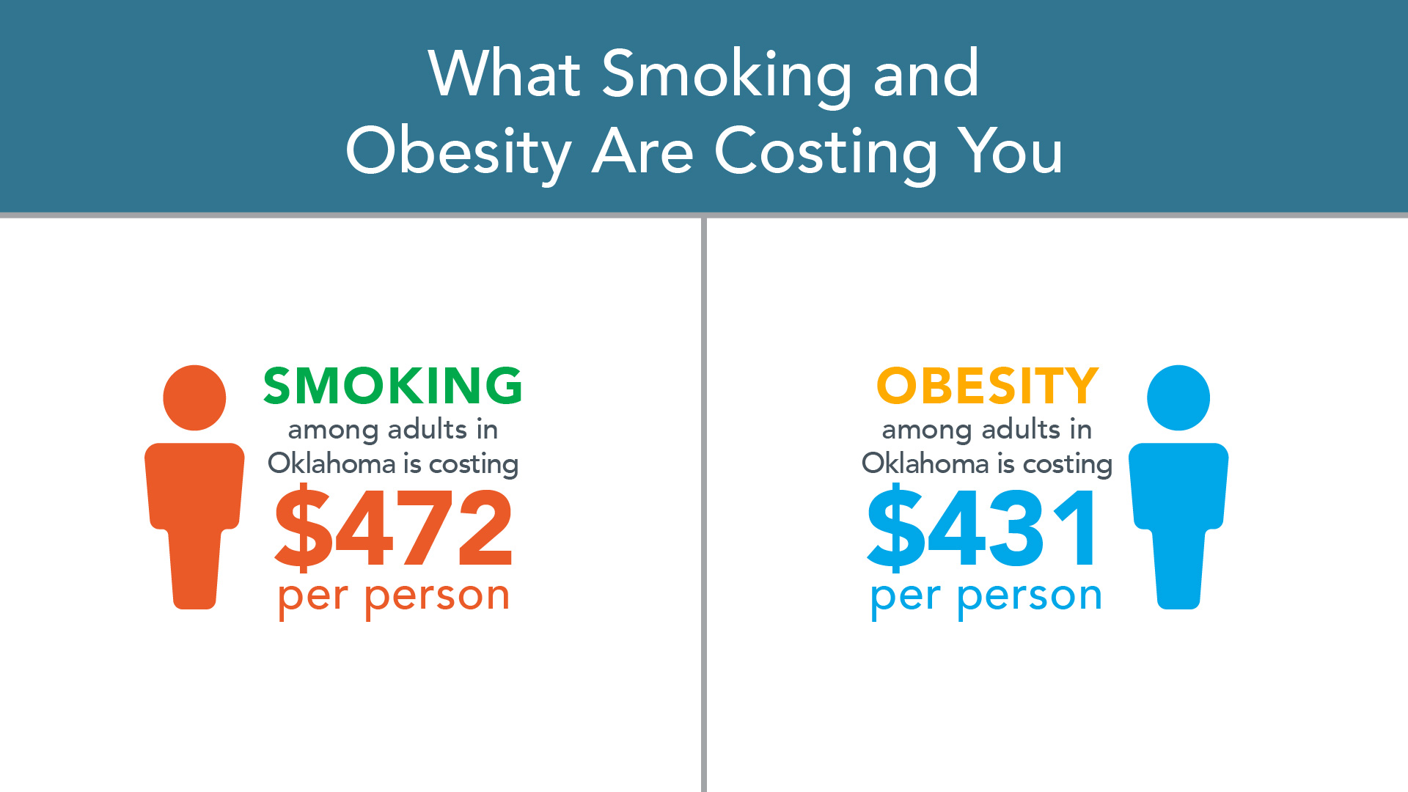

Slide 8
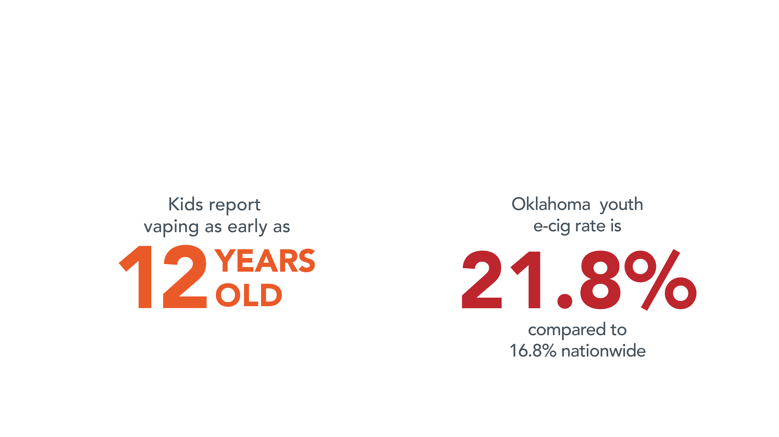
Vaping Is a Cause for Concern

Slide 9
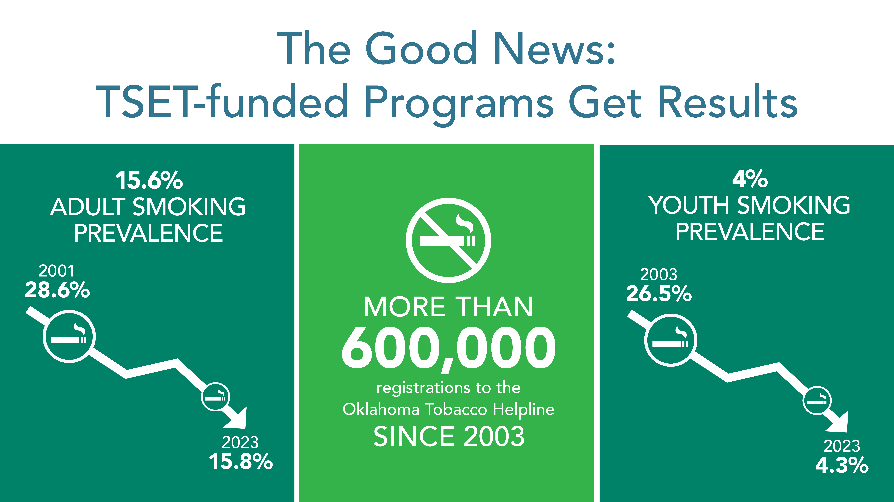


Slide 10


How Does TSET Effect Change Across Oklahoma?
Statewide Initiatives
Health Communication Interventions
Research Grants
Evaluation & Best Practice Support
TSET Healthy Incentive Grants
(Schools and Communities)

Slide 11
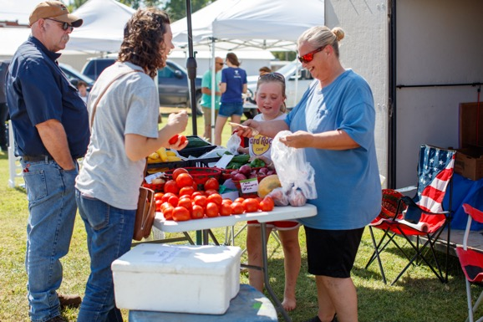
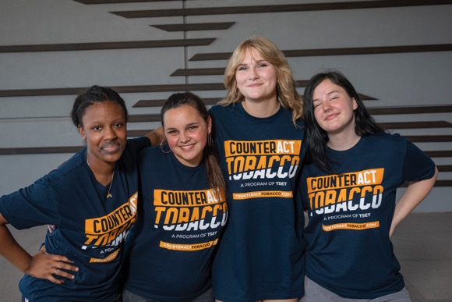
How Does TSET Effect Change Across Oklahoma?
TSET Healthy Living Program Grants
Targeted Achievement Grants
Built Environment Grants
Discovery Grants
Youth Advocacy and Character Development

Slide 12



Spike in calls since tax increase on cigarettes in 2018
FREE service available 24/7 to Oklahomans quitting tobacco
@OKHelpline
Informs about the dangers of exposure to secondhand smoke
Unifies support for state smokefree air laws,
as well as expands voluntary tobacco-free policies
@StopsWithMe
Encourages Oklahomans to eat better, move more and be tobacco free
Offers online tips and tools for healthy nutrition and increased physical activity
@ShapeFutureOK

Slide 13



Statewide program focused on preventing and reducing tobacco use and obesity for Oklahomans ages 13-18
Promotes healthy lifestyle choices for teens and provides parents resources to support their children
Tailored to prevent tobacco use by rural teens
downanddirtylife.com
A fact-based source for vaping health information for at-risk teens
behindthehaze.com

Slide 14



Free program to help Oklahoma teens quit tobacco and vapes
Offers tools most utilized by teens including, free live texting, web chat and phone calls
Free, five-week program that helps Oklahomans quit vaping over Instagram group direct messages
Offers effective quit strategies from a real guide, daily affirmations and peer support to power through cravings
Delivers nutrition messages to teens 13-18 years old by providing tangible tips to incorporate into their daily lives
Provides online tips and tools for healthy nutrition and increased physical activity
@SwapUpOK

Slide 15

Successful Futures’ purpose is to build character and strengthen leadership and service-learning skills for students in grades 3 through 8th statewide.
The program provides students with guidance and opportunities through wellness and character-building education implemented in schools as well as in out-of-school programs.
Youth Action for Health Leadership (YAHL) is a TSET-funded statewide youth-led health initiative.
The program creates a meaningful and measurable impact on Oklahoma by promoting healthy behaviors.
yahlok.org

Slide 16
TSET Legislative Outreach & Policy Support
Focus areas:
Tobacco control
Youth tobacco access
Physical activity promotion
Food security
Cancer prevention and screenings

Slide 17
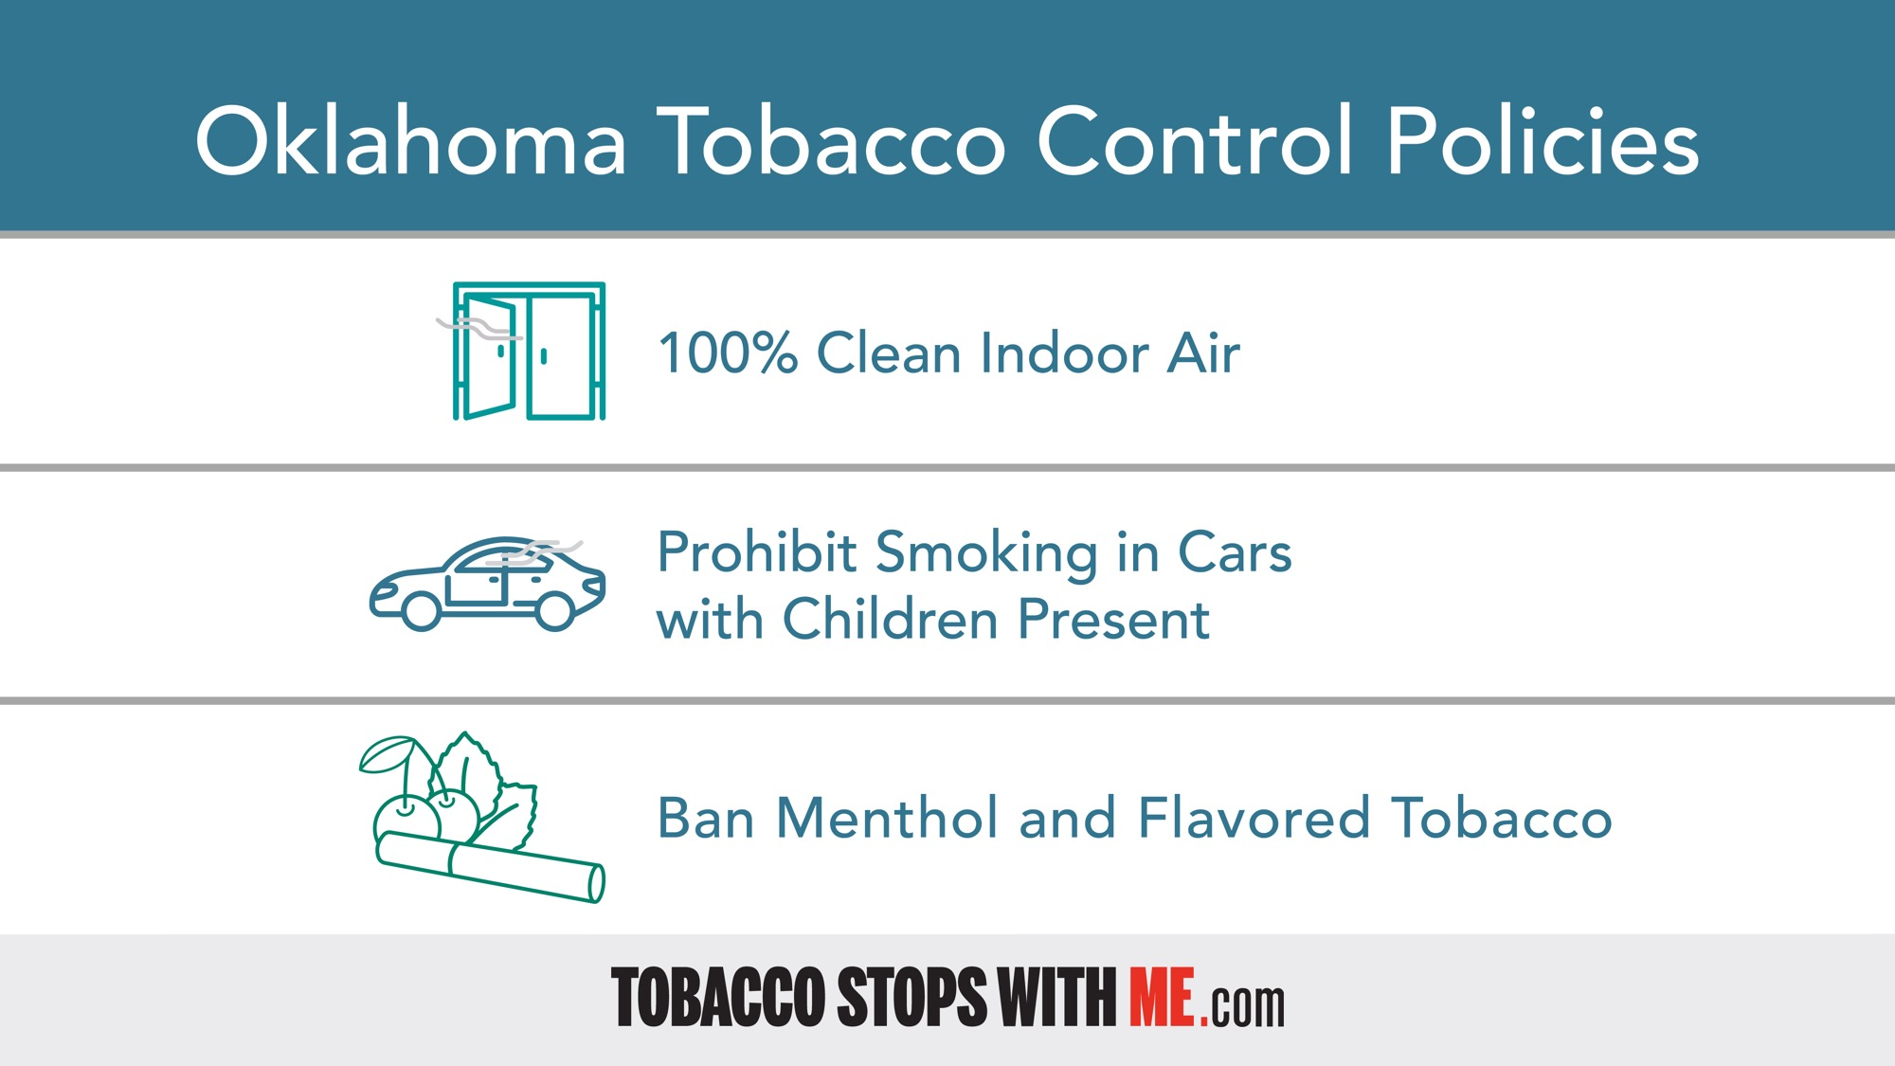

Slide 18
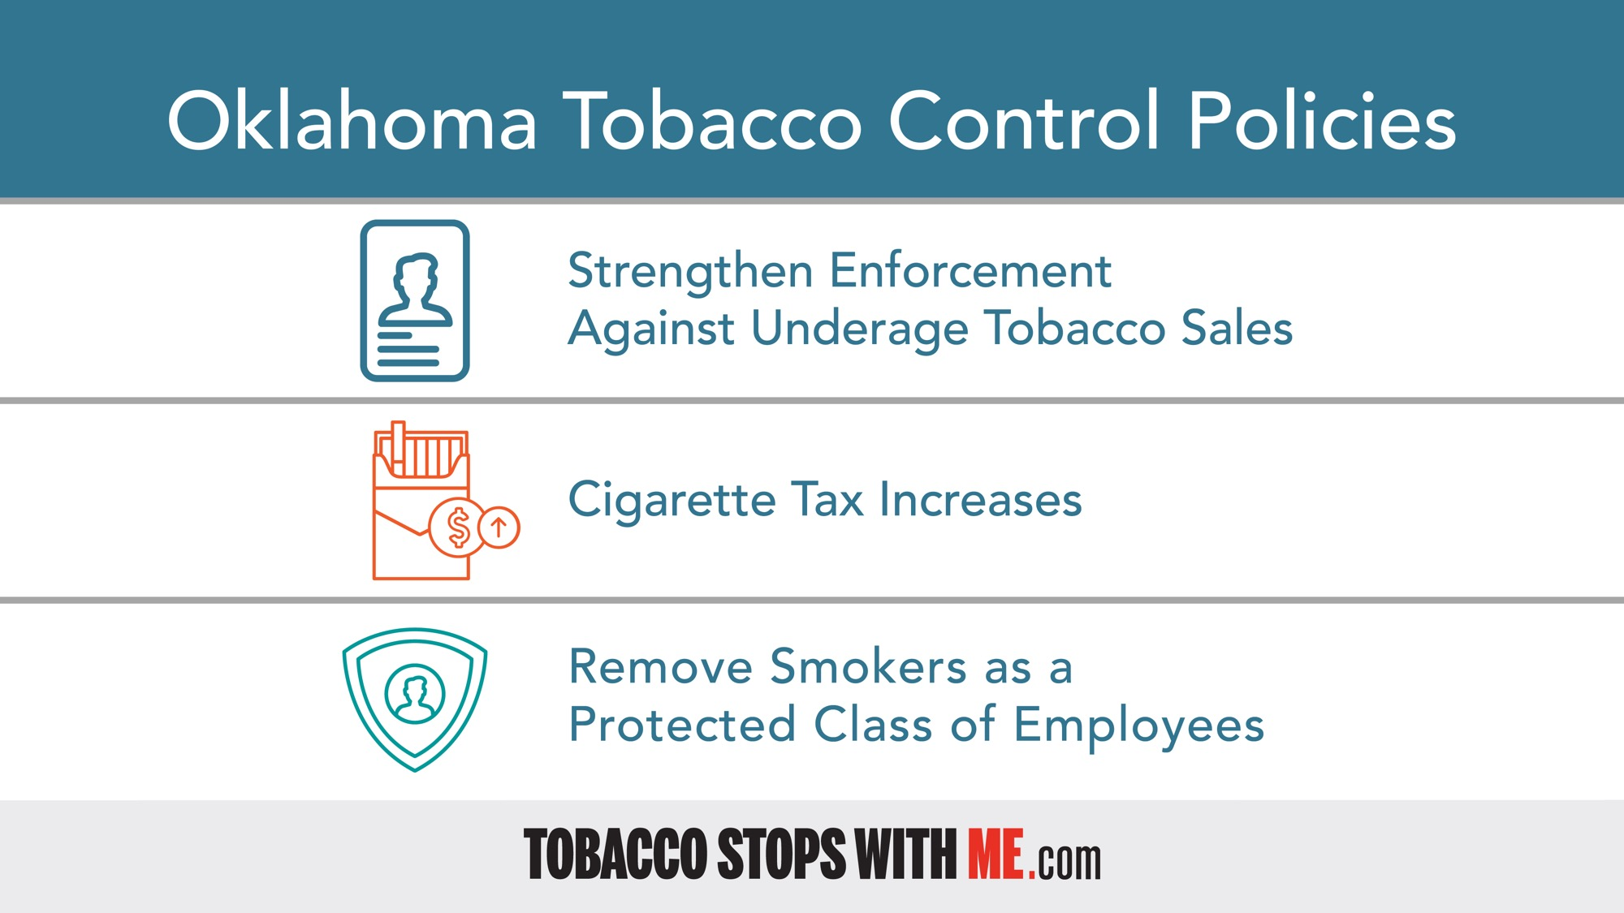

Slide 19
Legislative and Policy Support
Review and analyze health-related bills and policy trends
Identify legislation that aligns with or impends public health goals
Prepare talking points, slides, memos, fact sheets, and white papers
Conduct webinars and speaks at events about relevant health-related issues

Slide 20
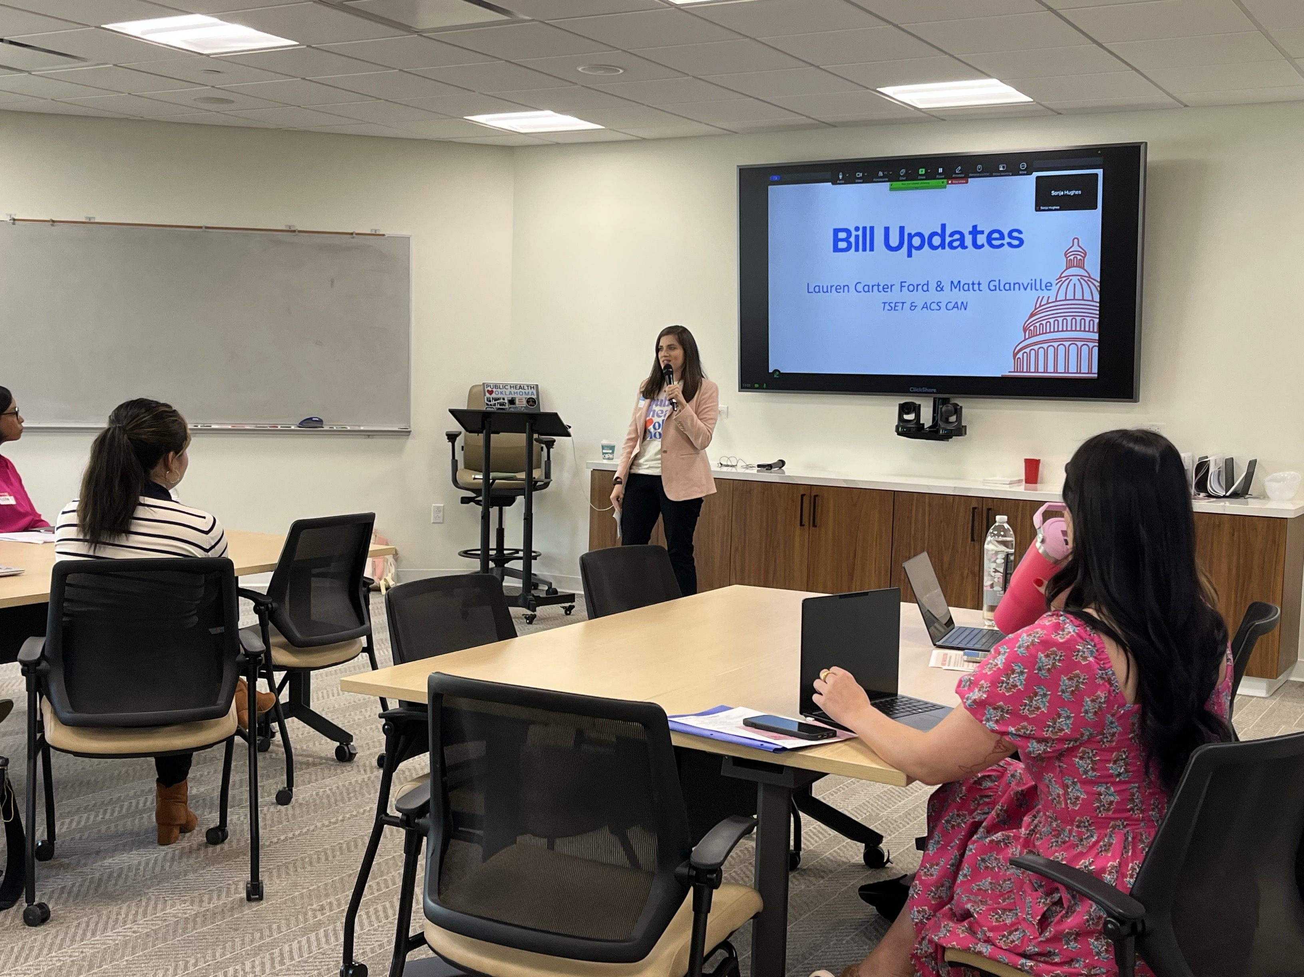
Legislative outreach
Educate legislators and partners on:
Recommended health policy solutions
Bills that may affect tobacco control, food access, or other health outcomes
Ensures stakeholders have accurate information

Slide 21

Legislation Example
SB 23, by Sen. Brenda Stanley, would prohibit smoking or vaping tobacco or marijuana in a car when a child under 18 years of age is present

Slide 22
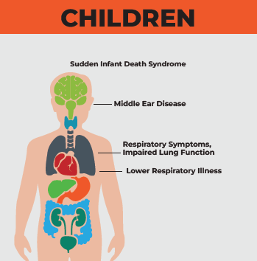
Secondhand Smoke Harms on Children
Secondhand smoke can cause 7,500 to 15,000 hospitalizations of children a year
The level of secondhand smoke exposure as a child is linked to becoming a smoker later in life
Secondhand smoke exposure is greater in cars because of limited ventilation

Slide 23
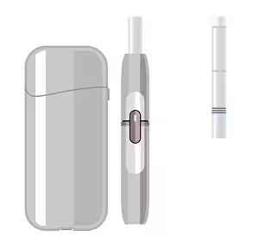
Legislation Example
SB 680, by Senate Pro Tempore Lonnie Paxton, would tax heat-not-burn tobacco products (HTPs) at half the rate of conventional cigarettes and add them to the state’s definition of tobacco products.
Passed the Senate and House committees during the 2025 session
Several health groups opposed it

Slide 24
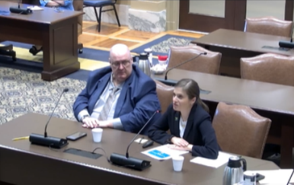
Outreach Continued
Participation in:
Interim studies
Public health policy groups
Oklahoma Tobacco Control Alliance
Work with other state agencies
State health plans
Advisory councils

Slide 25
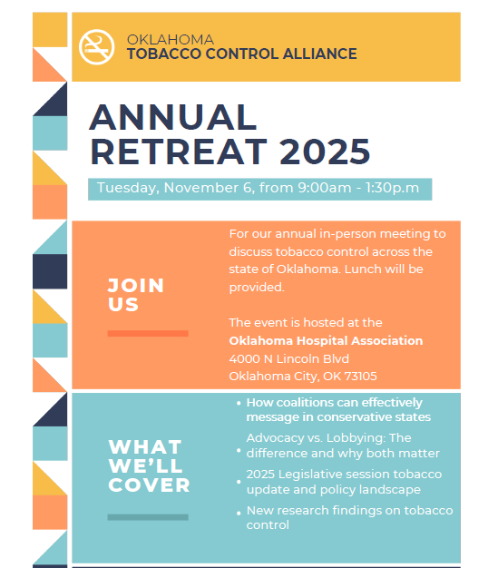
OK Tobacco Control Alliance
Join the alliance to help us reduce tobacco and nicotine use!
Receive member-exclusive education
Virtual monthly meetings
Annual in-person gathering
Interested? Email: laurenf@tset.ok.gov

Slide 26
Stakeholder & Community Engagement
TSET builds public support for improving health by:
Promoting strategic communications
Hosting and participating in community events, conferences, and forums
Inviting legislators to events and highlighting funded health initiatives in their districts
Collaborates with:
  Coalitions
  Local governments
  Nonprofits and public health groups

Slide 27
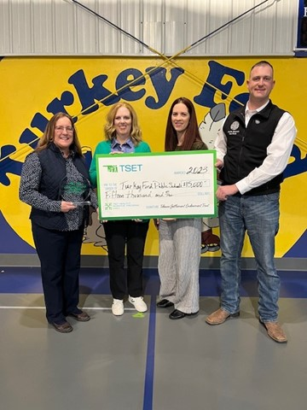
Local Outreach
Celebrates work that is being done locally to promote healthy policies
Listening sessions
Capacity building and coalition meeting attendance
Example: TSET Healthy Incentive Grants - Schools
Senator Wood attended presentation in Turkey Ford

Slide 28
Summary
Our outreach and policy work supports systemic change that promotes better health by:
Promoting policies that align with our mission
Building legislative awareness of public health needs
Supporting partners through education and collaboration
Delivering accurate, nonpartisan health information to decision-makers

Slide 29
TSET Built Environment Grants
FY26 includes expanded opportunities for Built Environment funding, with $6.9 million allocated specifically for the Physical Activity grant
Applications are due on November 18 by 4:00 p.m.
Focused on addressing chronic disease by improving access to opportunities for physical activity
Empowers local leaders to create environments that support long-term wellness and prevention

Slide 30
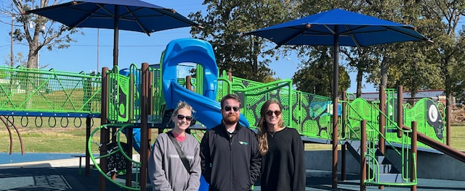
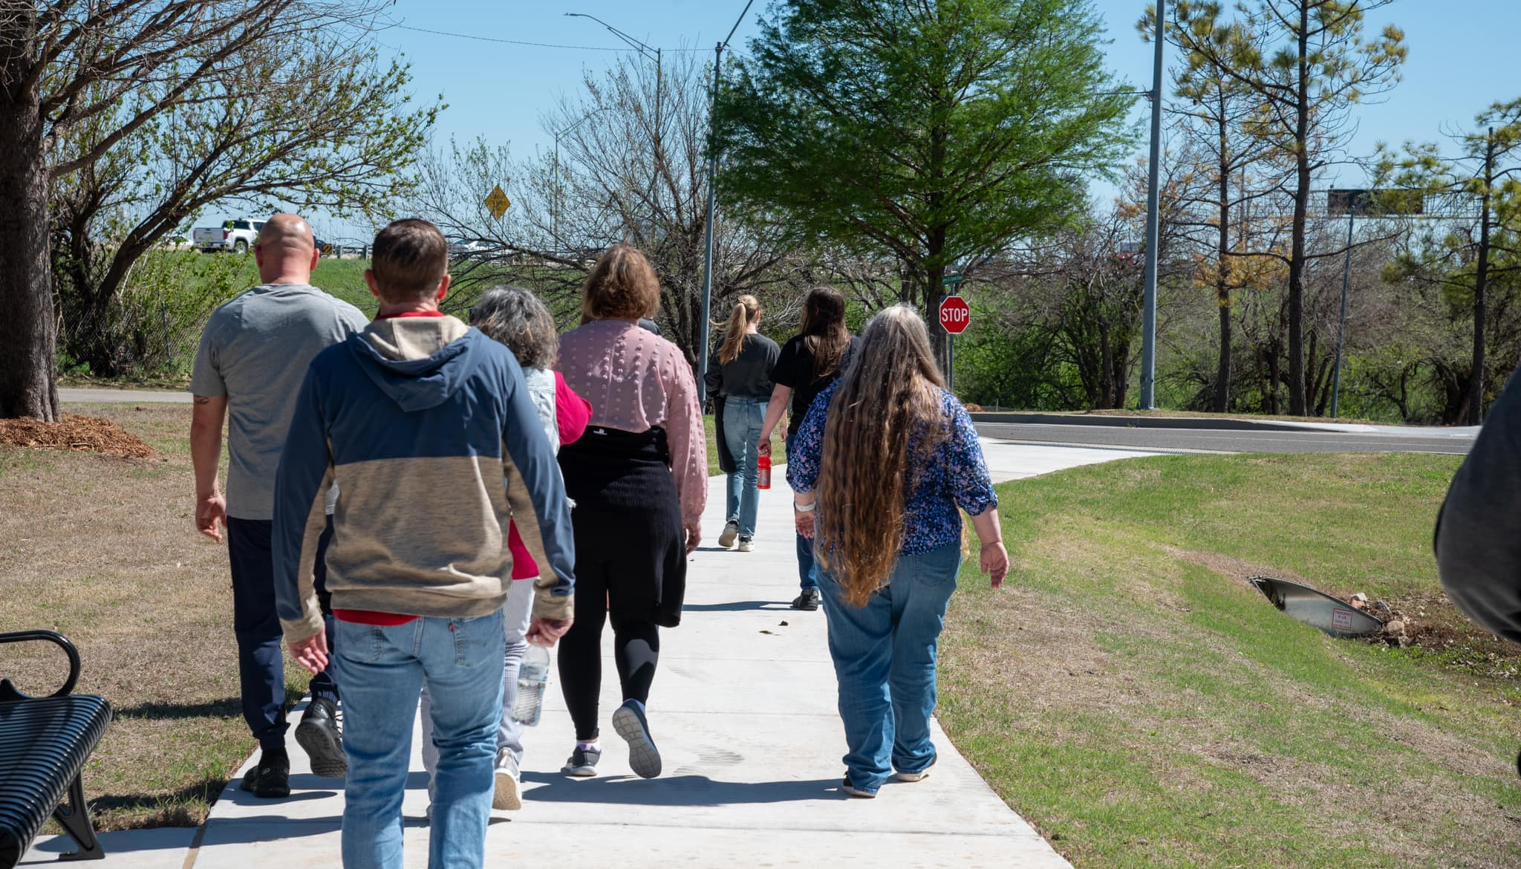

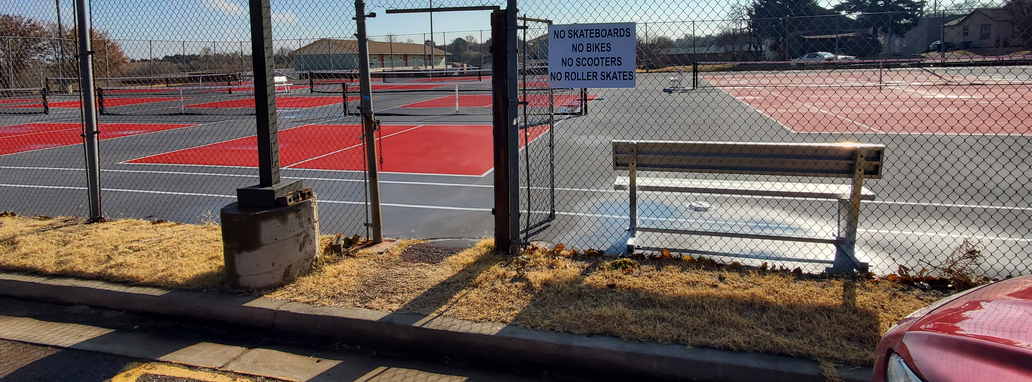

Slide 31
TSET TAG: Physical Activity
FY26 includes expanded opportunities for funding initiatives aimed to support community-based group programs that encourage movement
Applications are due on November 18 by 4:00 p.m.
Up to $30,000 per year for three (3) years; $120,000 allocated for this opportunity
Focused on supporting healthier communities through physical activity programs, such as long-term walking group programs, community exercise classes or group activities

Slide 32

TSET TAG: Physical Activity
Implementation Activity Examples

Slide 33
TSET TAG: Tobacco 21
FY26 includes expanded opportunities for TSET Targeted Achievement Grants, including Tobacco 21. Applications are due on November 18 by 4:00 p.m.
Up to $100,000 per year for three (3) years; $400,000 allocated for this opportunity
Tobacco 21 supports communities in preventing youth access to tobacco, vape and nicotine products through local ordinance adoption, retailer education, law enforcement compliance efforts and public awareness

Slide 34
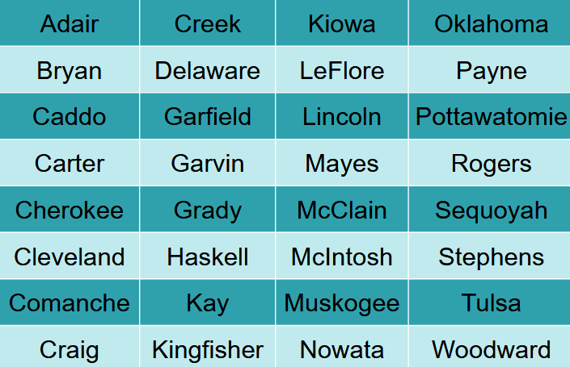
TSET TAG: 32 Counties

Slide 35
TSET Healthy Incentive Grants
These grants are awarded to communities, school districts and school sites that adopt policy and implement best and promising practices in tobacco-free environments, nutrition, physical activity and employee wellness
FY26 simplified process, larger grant awards and broader eligibility
Eligibility is open to all districts or communities, regardless of past awards
Increased individual grant amounts up to $80,000 per district and up to $100,000 per community

Slide 36



To sign up for notifications, visit:
Oklahoma.gov/TSET/opportunities
Questions about programs? Visit:
Oklahoma.gov/TSET/Public-Information
Follow @OklahomaTSET on:

