Slide 1


The Advocate’s Guide to Effective Local policy change
Joe Dorman, CEO
Oklahoma Institute for Child Advocacy

Slide 2


Why is advocacy important?
What is advocacy? | Why is advocacy important? | How can you be an advocate?
Advocacy is the process of making your voice heard effectively on issues that impact our lives
When done effectively, advocacy influences public policy by providing a way for individuals and organizations to voice their opinion and possibly move policy makers to respond to constituents’ needs
The first step to being an effective advocate is understanding how the political system works in Oklahoma. It is also important to understand what you can legally do when visiting with policymakers

Slide 3


Advocacy vs. Activism vs. lobbying
Advocacy *Advocacy is process of making your voices heard on issues that affect our lives. *Provide information for adoption or rejection of a city ordinance. *Urge the public to contact policy makers to advocate for adoption or rejection of a legal change. *Nonprofits and service agencies can and most engage in advocacy to achieve their goals/mission. *Helps council members find solutions to problems. Example – inform a council member about a policy impact or outcome | Activism * Activism is a doctrine or practice that emphasizes direct vigorous action especially in support of or opposition to one side of a controversial issue. *Engage on a policy issue through various means of outreach, including public protests. *Encourages public outcry for promotion or opposition to a public policy. *Nonprofits and service agencies can and sometimes engage in activism efforts to achieve their goals/missions. *Oftentimes come into conflict with policymakers. Example – The protest at City Hall saw people march for the outcome | Lobbying *Involves activities in direct support of or opposition to a specific local ordinance. *Nonprofits can engage in some lobbying (up to 20% of budget). *The IRS has strict rules about the portion of a nonprofit’s budget that can go toward lobbying activities. *It is prohibited to use any federal funds for lobbying. *Government employees cannot lobby while on the clock, or use government resources, unless allowed by management to provide factual information to inquiries Example – ask a council member to vote for, against, or introduce specific ordinances on a policy

Slide 4

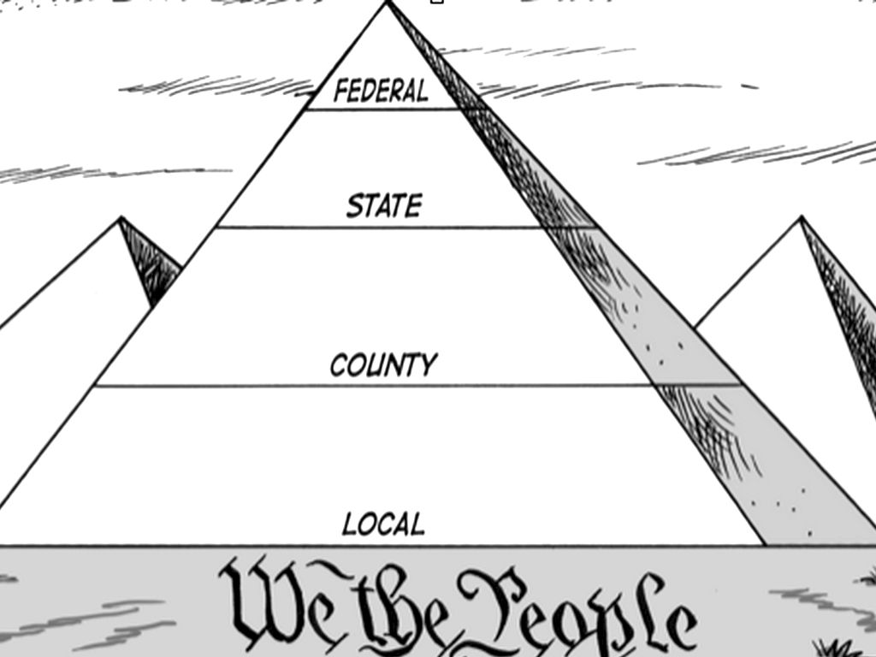
Understand which level of government you should contact
The system of government in which we follow in the United States is broken up into different levels. Be sure to research how the issue you feel is important impacts at each level.
It is important to remember that legislative officials at the state and the federal level are referred to as “Representatives” and “Senators” and that sometimes people can be confused by this.
Federal – President, legislators, Supreme Court Justices
State – Governor, legislators, Supreme Court Justices
County – Commissioner and other county elected officials
Local – Mayor (municipal) or Board President (school)

Slide 5
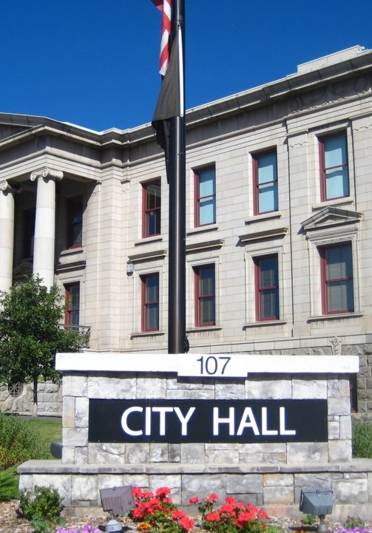

Understanding your local government
There is no consistent structure across localities. Some cities, for example, have strong mayors with a lot of policy-making and administrative powers. Localities can also have differing responsibilities relative to the state and encompassing jurisdictions. The definition of “city,” “town,” “county,” “village,” and other such terms differ by state, and the differences can be significant. Often, such differences relate to what types of services the jurisdiction can and does offer, taxing authority, and other important roles and responsibilities.
It is important to understand how your locality is structured and what it is responsible for. Advocating to a town administrator regarding a program that is run by the county will not only be a waste of your time, but it will compromise your credibility.
Take time to look through your local charter and ordinances, which are often kept at local libraries. Visit with individuals active in local government if you are not certain about a policy which you would like to change. Then, reach out to a council member who would most likely be willing to work with you for a change that you would like to see happen.

Slide 6

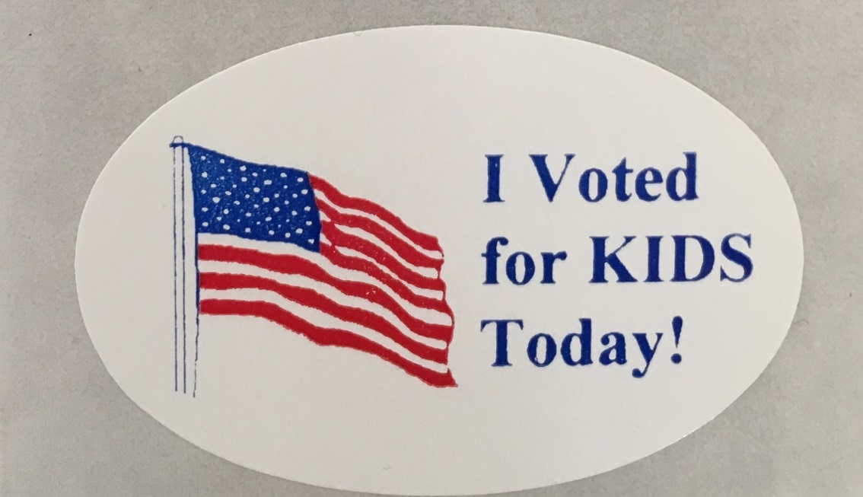
Municipal elections: | Different types of government: | Term of office:
As a reminder, all municipal elections are non-partisan unless prior to the date for notifying the county election board of the call for the election, the municipality has in effect an ordinance providing for a partisan primary election. This means there will not be a primary election unless you have passed an ordinance requiring a partisan election prior to posting the Notice of Election. Cities and towns that operate under home rule charters will need to follow their own particular charter provisions. | A. Aldermanic Form of government is found at 11 O.S. §§9-101 to 9-118. B. Council-Manager form of government is found at 11 O.S. §§10-101 to 10-121. C. Strong-Mayor-Council from of government is found at 11 O.S. §§11-101 to 11-125. D. Town from of government is found at 11 O.S. §§12-101 to 12-114. | Unless otherwise provided for by law, the term of office of an elected municipal official shall be four (4) years. The term of office of an elected official shall begin at 12:00 noon on the second Monday following the general municipal election, and such official shall serve until his successor is elected and qualified. If a newly elected official does not qualify within thirty (30) days after his term of office begins, the office shall become vacant and shall be filled in the manner provided by law. In order to complete the unexpired term, the office of an official who is holding over shall be filled at the next general election in compliance with the provisions of Sections 16-101 through 16-213 of this title.
Municipal Elections in OK

Slide 7

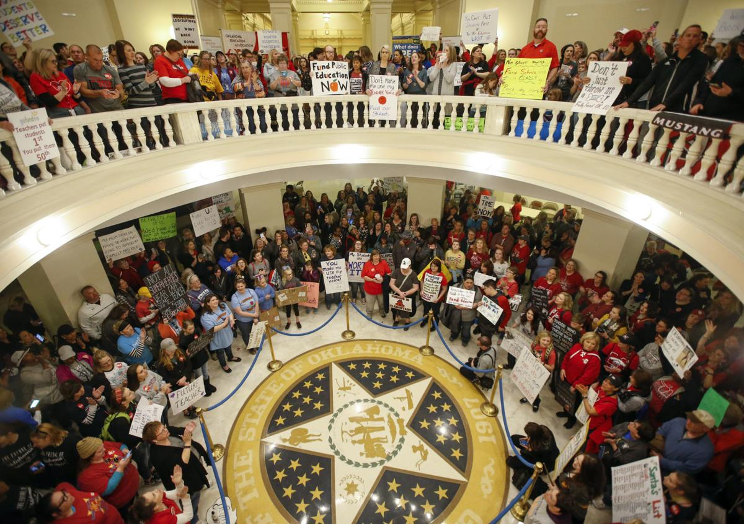
Important things to know about council meetings
Under OK law, the council shall meet regularly at least monthly at such times as it may prescribe by ordinance or otherwise.
During meetings, with actions posted on an agenda with sufficient notice, councils may enact municipal legislation subject to such limitations as may now or hereafter be imposed by the Oklahoma Constitution and law; Raise revenue, make appropriations, regulate salaries and wages, and all other fiscal affairs of the city; and oversee departments created and authorized under the municipality.
To see a change happen, you will need to work with a council member to propose a change to a town ordinance. These must be prepared well in advance and be placed on an agenda for an upcoming meeting.

Slide 8
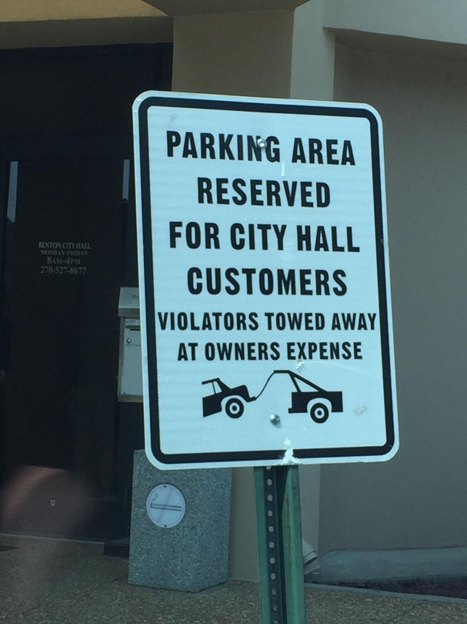

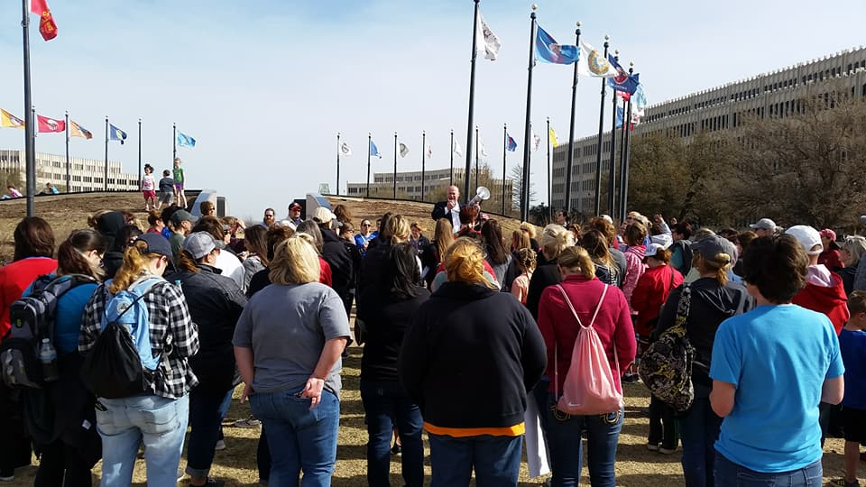
Preparing for Advocacy
Now that you know the rules of the game, how can you be effective in communicating your message to policymakers? These five tips are suggested for you to use to make the most of your time, your knowledge and to be successful in your effort!
1) Prepare a Good Advocacy Fact Sheet
2) Utilize Social Media
3) Write a Letter to the Editor or Submit a Guest Commentary to your Local Newspaper
4) Make a Phone Call
5) Visit your Elected Official in Person

Slide 9

1. Prepare a good advocacy fact sheet
The purpose of a fact sheet:
• Present the facts: key statistics, figures or comparisons.
• Identify a group with a particular issue
• Provide answers to common questions about the issues (Fact sheets are often in a Q & A format.)
• Show information using graphs, charts, or pictures
• Inform, persuade or educate
• Make an argument for a particular policy
A good advocacy fact sheet:
• Is only one to two pages long
• Doesn’t use long sentences or wordy paragraphs
• Is easy to read, with sub-heads, bullet points and graphics
• Includes only the most compelling, useful statistics and does not exaggerate
• Has a specific call to action (Be clear about what you want readers to do.)
• Includes contact information of the organizing group
FIVE PRACTICAL ADVOCACY TOOLS

Slide 10


Five practical advocacy tools
2. Utilize Social Media
A tweet with the right hashtag; a Facebook event page, status change or well-promoted update; an Instagram photo can speak a thousand words; or a blog discussion can generate a virtual “buzz” that manifests itself into true momentum. If you are not using social media to promote your cause, START!!!
Good news about social media: It’s FREE!
• Ease and accessibility for everyone - mobile devices, Wi-Fi, etc.
• Speed in creating awareness - quick check online gets attention
• Connections and reach of the posts - broad scale for target audiences
Challenges of social media: Social media is often misused because many advocates are unaware of how to efficiently and effectively get a simplified but powerful message out to the public!

Slide 11


FIVE PRACTICAL ADVOCACY TOOLS
2. Utilize Social Media, continued
Tips for better results:
• Know who to follow and how to get followed.
• Make your posts relevant and concise.
• Properly use mentions, Twitter handles of others and hashtags for specific buzz.
• Be sure your social media posts are engaging followers in conversation. Ask them specific questions or prompt them to post pictures. It’s not just about your number of likes or followers, but that people are involved in your social media discussions.
• Remember, practice makes perfect. Just maintain a constant social media presence and you’ll get better at it each day.
KEEP YOUR COOL WHEN DISCUSSING ADVOCACY ISSUES ON SOCIAL MEDIA!!!!

Slide 12
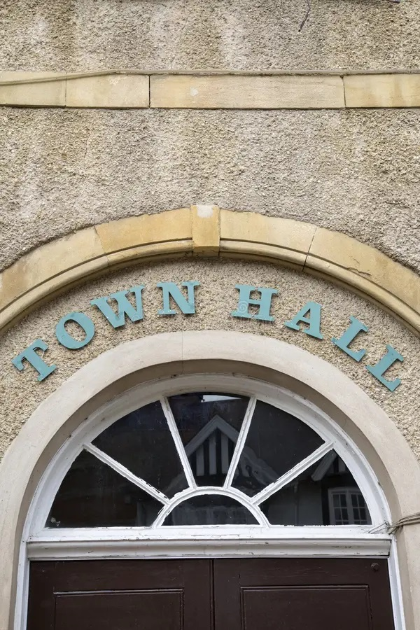

Five practical advocacy tools
3. Write a Letter to the Editor or Submit a Guest Commentary to your Local Newspaper
Every Oklahoma newspaper publishes letters to the editor. While we know only a small percentage of newspaper readers scan the Editorial page, 100 percent of your community’s decision-makers read every editorial, guest column and letter to the editor.
Key Tips for Successful Letters to the Editor and Guest Commentary
• Use e-mail.
• Refer to a recent news article or editorial in the first sentence of your letter.
• Keep your letter concise: 4-5 paragraphs, 2-3 sentences each.
• Do not take shots at political leaders by name.
• Give readers a chance to understand your stake in the issues without getting too personal.
• Never miss a chance to say “Thank You” to a business leader, civic volunteer or political official who has provided extraordinary service.
• If you have more to say than a letter permits, you may consider submitting a guest column. Call the editorial page editor and ask for the paper’s specifications (re: length limitations and best timing for submittal). You may e-mail a photo as well, if requested. Make sure the photo is a current, clear and well-composed headshot.

Slide 13


five Practical advocacy Tools
4. Make a Phone Call
You can call elected officials at their office or contact them at home. They represent you and should be easily accessible to you. Lists of local elected officials, including school board members, city council members, state legislators and statewide elected officials, can often be found on government websites:
Tips for Calling Your Elected Official:
• Identify the issue you wish to talk about by name.
• Briefly state your position and how you would like your elected official to vote.
• Ask for your elected official’s stance on the issue.
• Don’t argue if the elected official has an opposing view or hasn’t yet decided.
• If you don’t know the answer to a question, do not guess. Simply say you don’t know, but that you will find out and get back with her/him with the information.
• If elected officials or their staff need more information, supply it as quickly as possible.
• Never be abusive or use threats.
• Follow up your call with a note restating your position and thanking them for their time.

Slide 14

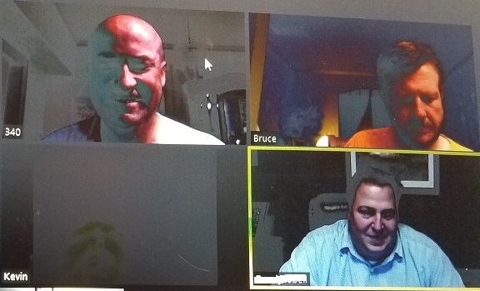
five Practical advocacy Tools
Make a Phone Call, continued
Elected officials are often away from the office, so you may end up talking with a city/town staff person instead. That’s great! Use the same basic rules. These employees are reliable and will pass along your message.
Many elected officials will publish their personal phone numbers. Respect their time after hours by calling at appropriate times!
Tips for Using Voicemail:
• State your name and address to identify if you are a constituent.
• Identify the specific issue you are calling about.
• Briefly state your position - either support, opposition or some combination.
• Keep the message simple.
Conversation via online platforms
In these days of online meetings, be willing to have that conversation online if the council member prefers. Be sure to dress presentably and have a background that is professional

Slide 15


five practical advocacy tools
5. Visit your Elected Official in Person
Personal visits are a highly effective way to help elected officials understand your position on an issue. Elected officials welcome visits from constituents. They want you to be involved. However, they are busy people so time is extremely valuable. Plan ahead and use the time well. If you make an appointment, remember there is no guarantee the elected official will be able to keep it. Their schedules can change at a moment’s notice. Don’t take it personally - that’s just how it is.
Before the Meeting:
• Make an appointment in advance and expect to get about 15 minutes.
• Make it easy for your elected official to meet with you. Offer several possibilities and do your best to accommodate them – in office or in district.
• Prepare a good fact sheet (refer to Advocacy Tool #1).
• Try to learn in advance where your elected official stands on your issue. They may have their own websites, Facebook pages or Twitter profiles.
• Be prepared to explain how the issue will affect you and other voters in their district.
• Dress for the appointment. Normal business attire is appropriate.

Slide 16

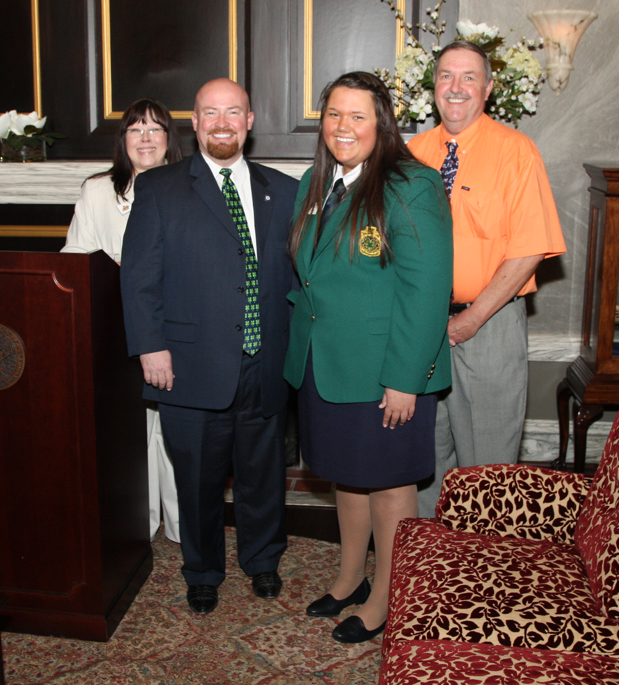
five practical advocacy tools
5. Visit your Elected Official, continued
During the Meeting:
• Be on time.
• Be prepared, polite and brief.
• Start with your 90-second speech.
• Give the elected official your fact sheet.
• Be firm but friendly. Don’t be afraid to ask for a commitment to support your issue.
• Attack the issue, not the person. Remember - you may be asking for her/his support on a completely different issue in the future.
• Don’t disparage government or politics.
• Don’t use jargon, technical terms or acronyms.
• Don’t underestimate public officials. With very rare exceptions, they are honest, intelligent and good-hearted people.
• Before leaving, ask how you can be of help to them. (Can you get them more information? Talk to others?)
• Thank them for their time, even if they will not support your cause.
After the Meeting: Follow up with a thank you note and any information that was requested.

Slide 17
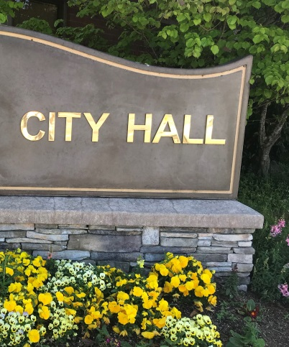
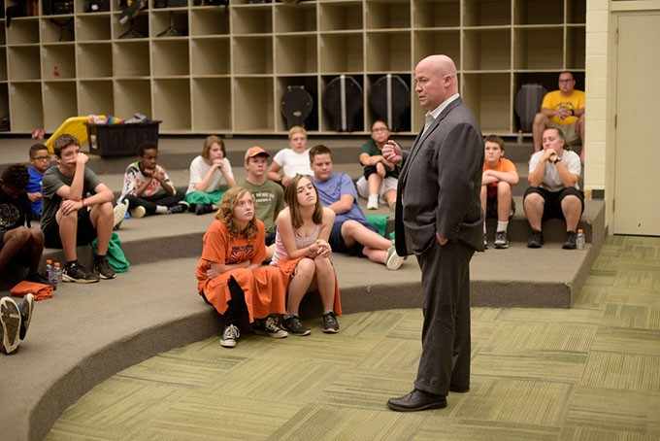
The Crucial 90-second pitch
“The pitch”
Memorize a quick “elevator pitch” before your meeting. It’s not only handy for talking to elected officials, but it will also serve you well when explaining your issue to media persons, fellow advocates, or anyone really.
Your speech should include
• Who you are and any group or coalition to which you belong.
• The topic you came to discuss and why it is important.
• What you want them to do.
• Reference the fact sheet you have brought along.
Your fact sheet is crucial. If your meeting gets interrupted, you’ll still get your point across and the elected official will know how to find you or your group if they have further questions. If not, you can elaborate your points in your fact sheet.
It’s simple: Say what you mean and mean what you say. And, of course, keep it short and simple

Slide 18



joe dorman, ceo Oklahoma Institute for Child Advocacy 2915 n. Classen Blvd., Ste 320 Oklahoma City, OK 73106 405.236.5437 Jdorman@oica.org website - oica.org

