Slide 1

Joint Equal Custody: Protecting Children’s Well-Being
Ensuring balanced parenting for child development
Presented by
The Honorable Joe Dorman, CEO
Oklahoma Institute for Child Advocacy
Notes:
---

Slide 2
Understanding Parental Alienation
Notes:
Introduction to Parental Alienation, Impact on Children’s Mental Health

Slide 3

Introduction to Parental Alienation
Definition and Behavior
  Parental alienation is when one parent undermines the child's relationship with the other through manipulation or restricting contact.
Emotional Impact on Children
  Children often experience confusion, guilt, and fear due to alienation, affecting their psychological well-being deeply.
Consequences for Family Bonds
  Alienated parents may struggle to maintain relationships, leading to long-term damage in family connections.
Importance of Addressing Alienation
  Addressing parental alienation is essential to protect children's mental health and maintain supportive parental relationships.
Notes:
---
Parental alienation is increasingly recognized as a significant issue within family law. It refers to a situation where one parent deliberately undermines the child’s relationship with the other parent, often through manipulation, negative comments, or restricting contact. This behavior can have profound emotional and psychological consequences for children, including confusion, guilt, and fear. The alienated parent may struggle to maintain a meaningful relationship with their child, which can lead to long-term damage in familial bonds. Addressing parental alienation is crucial to safeguarding children's mental health and ensuring they maintain strong, supportive relationships with both parents.
Image source: Microsoft 365 content library

Slide 4

Impact on Children’s Mental Health
Emotional Effects on Children
  Parental alienation causes anxiety, depression, and low self-esteem in children, impacting their emotional health.
Long-term Relationship Impact
  These emotional struggles can continue into adulthood, hindering healthy relationships and trust development.
Family Disruption Consequences
  Family alienation creates instability, causing emotional confusion and behavioral problems in children.
Need for Intervention
  Recognizing and addressing parental alienation is critical to support children’s mental health and development.
Notes:
---
The effects of parental alienation on children are deeply troubling. Children subjected to this dynamic often experience anxiety, depression, and low self-esteem. These emotional struggles can persist into adulthood, affecting their ability to form healthy relationships and trust others. The disruption of family unity caused by alienation creates an unstable environment, leading to emotional confusion and behavioral issues. Children may internalize the conflict, feeling responsible for the estrangement, which exacerbates their psychological distress. Recognizing and mitigating these impacts is essential for promoting children's overall well-being and development.
Image source: Microsoft 365 content library

Slide 5
Advocating for Joint Equal Custody
Notes:
Why Action is Needed, Definition and Benefits of Joint Equal Custody

Slide 6

Why Action is Needed
Need for Decisive Action
  Child welfare advocates agree that strong measures are necessary to address parental alienation.
Impact of Ignoring Issue
  Ignoring parental alienation harms family integrity and risks children’s well-being.
Promoting Joint Custody
  Joint equal custody supports balanced parenting and reduces alienation risks.
Child-Centered Decisions
  Custody choices should focus on the child’s emotional and psychological needs first.
Notes:
---
There is a growing consensus among child welfare advocates that decisive action is needed to combat parental alienation and promote healthier custody arrangements. Critics argue that failing to address this issue undermines the integrity of families and compromises the best interests of children. By advocating for joint equal custody, stakeholders aim to create a legal framework that supports balanced parenting and minimizes the risk of alienation. This approach emphasizes the importance of both parents in a child’s life and seeks to ensure that custody decisions are made with the child’s emotional and psychological needs at the forefront.
Image source: Microsoft 365 content library

Slide 7

Definition and Benefits of Joint Equal Custody
Equal Parental Responsibility
  Joint equal custody means both parents share equal responsibility and time caring for their children.
Emotional Stability for Children
  This model fosters strong relationships with both parents, supporting a child’s emotional stability and development.
Positive Child Outcomes
  Children in joint custody tend to have better academic performance, fewer behavioral problems, and higher self-esteem.
Importance of Cooperation
  The success of joint custody depends on parents’ cooperation and effective communication.
Notes:
---
Joint equal custody is a legal arrangement where both parents share equal responsibility and time with their children. This model fosters strong, ongoing relationships with both parents, which is vital for a child’s emotional stability and development. Research indicates that children in joint custody arrangements tend to perform better academically, exhibit fewer behavioral problems, and have higher self-esteem. The success of joint custody depends on the parents’ ability to cooperate and communicate effectively. When implemented correctly, it provides a balanced approach to parenting, ensuring that children receive consistent love, support, and guidance from both parents.
Image source: Microsoft 365 content library

Slide 8
Child-Centered Benefits of Joint Custody
Notes:
Emotional and Developmental Advantages, Social and Academic Outcomes

Slide 9

Emotional and Developmental Advantages
Emotional Stability
  Joint custody helps maintain strong parent-child bonds, reducing emotional distress from separation.
Behavioral Benefits
  Children in joint custody are less prone to behavioral issues and exhibit higher self-esteem.
Shared Parenting Responsibilities
  Both parents equally share caregiving roles, participating in key decisions about the child’s upbringing.
Balanced Nurturing Environment
  A balanced environment nurtures growth, helping children develop into well-adjusted individuals.
Notes:
---
Joint equal custody offers numerous benefits that directly enhance a child’s emotional and developmental well-being. Maintaining strong bonds with both parents helps minimize the emotional impact of divorce or separation. Children in joint custody arrangements are less likely to experience emotional and behavioral issues and tend to have higher self-esteem. This arrangement also distributes the responsibility of care, allowing both parents to participate in important decisions regarding the child’s upbringing. By providing a balanced and nurturing environment, joint custody supports the child’s growth and helps them develop into well-adjusted individuals.
Image source: Microsoft 365 content library

Slide 10

Social and Academic Outcomes
Improved Academic Performance
  Joint custody provides stability and support, helping children perform better in school and academic activities.
Exposure to Parenting Styles
  Children benefit from diverse parenting styles, enriching their experiences and fostering adaptability in life.
Positive Role Modeling
  Parents cooperating and resolving conflicts set positive examples, enhancing children's interpersonal skills and security.
Notes:
---
Children who grow up in joint custody arrangements often experience positive social and academic outcomes. They tend to perform better in school due to the stability and support provided by both parents. Exposure to different parenting styles and perspectives enriches their life experiences and fosters adaptability. Additionally, joint custody promotes positive role modeling, as children observe their parents resolving conflicts and cooperating for their benefit. These experiences contribute to the development of strong interpersonal skills and a greater sense of security, which are essential for success in both academic and social settings.
Image source: Microsoft 365 content library

Slide 11
Ensuring Effective Implementation
Notes:
Key Factors for Success, Challenges and Considerations

Slide 12

Key Factors for Success
Willingness to Co-parent
  Successful joint custody depends on parents' willingness to communicate openly and collaborate effectively.
Absence of Risk Factors
  Ensuring the child's safety requires absence of abuse or neglect in the custody arrangement.
Shared Emotional Involvement
  Both parents must share emotional and psychological nurturing roles for the child’s well-being.
Stable Supportive Environment
  Joint custody fosters a stable environment promoting the child’s development and happiness when conditions are met.
Notes:
---
The effectiveness of joint equal custody hinges on several critical factors. First and foremost is the willingness of both parents to co-parent, which requires open communication and collaboration. The absence of risk factors such as abuse or neglect is also essential to ensure the child’s safety and well-being. Shared involvement in the child’s life, including emotional and psychological nurturing, is vital for the arrangement to succeed. When these conditions are met, joint custody can provide a stable and supportive environment that promotes the child’s overall development and happiness.
Image source: Microsoft 365 content library

Slide 13

Challenges and Considerations
Parental Conflict Impact
  High parental conflict can harm the child’s well-being and disrupt joint custody benefits.
Logistical Challenges
  Frequent home transitions may disrupt the child’s routine and sense of stability.
Communication Importance
  Effective communication between parents is essential to prioritize the child’s needs and manage challenges.
Individual Family Assessment
  Assessing unique family circumstances ensures joint custody is suitable and supportive.
Notes:
---
While joint equal custody offers many benefits, it is not without challenges. High levels of parental conflict can undermine the arrangement and negatively impact the child’s well-being. Logistical issues, such as frequent transitions between homes, may disrupt the child’s routine and sense of stability. Effective communication between parents is crucial to navigate these challenges and ensure the child’s needs are prioritized. It is important to assess each family’s unique circumstances to determine whether joint custody is the most appropriate solution. When implemented thoughtfully, it can be a powerful tool for fostering healthy family dynamics.
Image source: Microsoft 365 content library

Slide 14
What other states are doing…
Notes:
Key Factors for Success, Challenges and Considerations

Slide 15
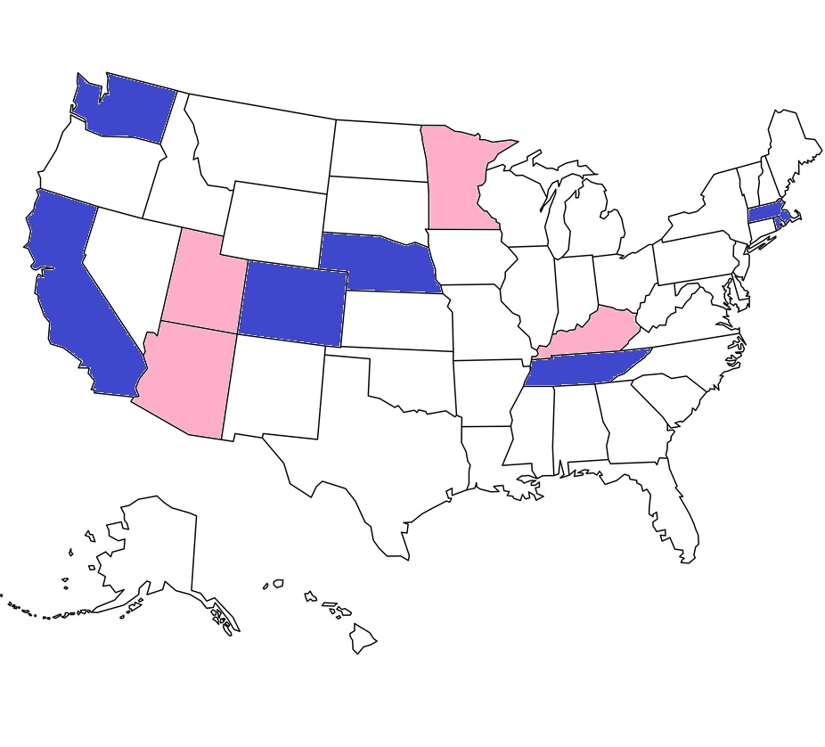
Positions of select sister states
Currently, No States Have Laws on the Books Regarding Parental Alienation
  This is not a subject that has gained much in the way of lawmaker attention.
States Cited as the Strongest in Shared Parental Rights
  Arizona, Kentucky. Minnesota and Utah are often cited for the strongest in shared parental rights.
  Those Appearing to Have the Strongest Fathers’ Rights Protections
  California, Massachusetts, Colorado, Rhode Island, Washington, Nebraska and Tennessee are often cited as strongest in fathers' rights.
  No State Require “Joint Custody,” but Most “Presume” It in Case-by-Case Situations
  Virtually All Systems Have a "Best Interest of the Children" Standard
Notes:
---
While joint equal custody offers many benefits, it is not without challenges. High levels of parental conflict can undermine the arrangement and negatively impact the child’s well-being. Logistical issues, such as frequent transitions between homes, may disrupt the child’s routine and sense of stability. Effective communication between parents is crucial to navigate these challenges and ensure the child’s needs are prioritized. It is important to assess each family’s unique circumstances to determine whether joint custody is the most appropriate solution. When implemented thoughtfully, it can be a powerful tool for fostering healthy family dynamics.
Image source: Microsoft 365 content library

Slide 16
Personal Stories
Notes:
Summary and Final Thoughts

Slide 17

Brooke Brown, Oklahoman, RN, and Parent Advocate
Guardian ad Litem and Attorney Concerns
  A Guardian ad Litem (GAL) was appointed to represent my son’s best interests. Initially, the GAL did make counseling recommendations intended to support my son’s emotional and developmental needs. However, those recommendations were never carried out because my ex-husband was allowed to manipulate and obstruct the process.
Court Orders and Lack of Enforcement
  Although the court ordered my ex-husband to pay attorney’s fees for prolonging litigation and repeatedly ignoring directives, he never paid. Instead, he appealed to the Oklahoma Supreme Court, seeking reversal of the fee order and demanding 19 months of back child support. The Supreme Court denied his request and upheld the lower court’s decision. Yet enforcement has never occurred.
Judicial Acknowledgment Without Action
  At one point, the judge directly told my ex-husband in open court: “I wouldn’t lose one night of sleep sending you to jail, because you’ve defied every order I’ve issued.“ Despite this, no consequences followed.
Systemic Breakdown
  My story is not an isolated event. It represents a systemic failure that allows one parent to weaponize silence, refusal, and influence while the other is forced to prove over and over that they deserve a relationship with their child. followed.
Path Forward for Oklahoma
  There is a model of hope and progress close to home.
  I urge this legislative body to review and consider the framework developed by Robert Garza in the State of Texas. His reform initiatives are centered on transparency, enforcement, and accountability and are an outstanding starting point for Oklahoma. The Garza model demonstrates how statutes can protect children’s relationships with both parents, ensure equal access, and restore fairness to the family-court process.
Notes:
---
In conclusion, joint equal custody represents a child-centered approach to family law that prioritizes the emotional and developmental needs of children. It offers a framework for maintaining strong parental relationships and promoting positive outcomes across various domains. While challenges exist, they can be mitigated through cooperation, communication, and a commitment to the child’s welfare. The Oklahoma Institute for Child Advocacy supports policies that enhance the well-being of children and encourages families to consider joint custody as a viable and beneficial option. For more information, visit www.oica.org or contact info@oica.org.
Image source: Microsoft 365 content library

Slide 18
Paul w. Laubach child custody history
The Primary Disagreement
  Our primary disagreements during our marriage were over where we lived and where our children would go to school. The last 10 years have been a continuation of those disagreements only under the supervision of a very flawed child custody system and the unfortunate windfall benefit to several trial lawyers, at the detriment of our minor children.
  The Case
  My children’s case if Blaine County FD 2016-11, and it is infamous, has set new law, and is ongoing and it will not end once my children have reached the age of majority unless much needed reform is enacted. Here is what in my ten years of litigation experience, hundreds of thousands of dollars, 6 trial judges, 3 lawyers, 1 guardian ad litem, 1 parenting coordinator, and many other people reaching out to me to share their stories can tell you needs to be done to help correct a very broken child custody system.
  Recommendations
  1) Joint custody with equal time should be the law of the land when there is no credible evidence of abuse or neglect. Children really do need a mom and a dad, and they need to realize that they are going to have to work together to rear their children whether they are married or not.
  2) Parents should have to watch the state required video on the effect of divorce on children before they even file for divorce not after grandiose and fanciful divorce lawyers work their client up so they can enrich their own coffers at the expense of innocent children. All judges, guardian ad litem, parenting coordinators, and divorce lawyers should watch the video too and certify the same.
  3) Judges need to have special continuing education training about the effects of single-family homes on children, parental alienation, and other child welfare issues that are affected by divorce.
  4) Mental health experts, psychologists, etc…, to be used in custody hearings as evidence or for counseling services to the adults or children should have special state certification, and those professionals should be chosen by the Courts not by the trial lawyers.
  5) Guardian ad litem and parenting coordinators should be mental health professionals that have special state certification. They should not be attorneys! When in need these professionals should be appointed by the Court not chosen by counsel. The lawyers make enough money in this unfortunate broken system; they do not make good child welfare specialists.
  6) Parents who try to alienate their children from the other parent need professional help so they understand that what they are doing is hurting their children not their former spouse. Family counseling should be mandatory when there is a dispute over custody, and once again the professionals used should be certified by the state and appointed by the Court, not by the counsel of the parties. You don’t get to pick your judge, and nobody should be able to pick the mental health professionals used in custody disputes.
  7) There should be a new section of law that either provides a three-judge panel to review bench decisions on custody or the appeals process should mandate that the state appellate courts have no more than 30 to 60 days to review custody decisions. In my case it took the appellate court in Tulsa over 6 years to do their job. Children grow up to fast for such negligence, raw arrogance, and derelict of duty. Children’s lives matter!
Notes:
---
In conclusion, joint equal custody represents a child-centered approach to family law that prioritizes the emotional and developmental needs of children. It offers a framework for maintaining strong parental relationships and promoting positive outcomes across various domains. While challenges exist, they can be mitigated through cooperation, communication, and a commitment to the child’s welfare. The Oklahoma Institute for Child Advocacy supports policies that enhance the well-being of children and encourages families to consider joint custody as a viable and beneficial option. For more information, visit www.oica.org or contact info@oica.org.
Image source: Microsoft 365 content library

Slide 19
Conclusion and Advocacy
Notes:
Summary and Final Thoughts

Slide 20
Summary and Final Thoughts
Child-Centered Custody Approach
  Joint equal custody prioritizes children's emotional and developmental needs with a child-centered legal framework.
Benefits of Joint Custody
  Maintaining strong parental relationships promotes positive outcomes for children across multiple domains.
Overcoming Challenges
  Challenges in joint custody can be mitigated through communication, cooperation, and focus on child welfare.
Support and Resources
  Institutions like the Oklahoma Institute for Child Advocacy promote policies supporting children's well-being.
Notes:
---
In conclusion, joint equal custody represents a child-centered approach to family law that prioritizes the emotional and developmental needs of children. It offers a framework for maintaining strong parental relationships and promoting positive outcomes across various domains. While challenges exist, they can be mitigated through cooperation, communication, and a commitment to the child’s welfare. The Oklahoma Institute for Child Advocacy supports policies that enhance the well-being of children and encourages families to consider joint custody as a viable and beneficial option. For more information, visit www.oica.org or contact info@oica.org.
Image source: Microsoft 365 content library

Slide 21
Questions?
The Honorable Joe Dorman, OICA CEO
2915 N. Classen Blvd., Suite 320
Oklahoma City, OK 73106
www.oica.org * jdorman@oica.org
405-236-KIDS (5437)
Notes:
Summary and Final Thoughts

