Slide 1
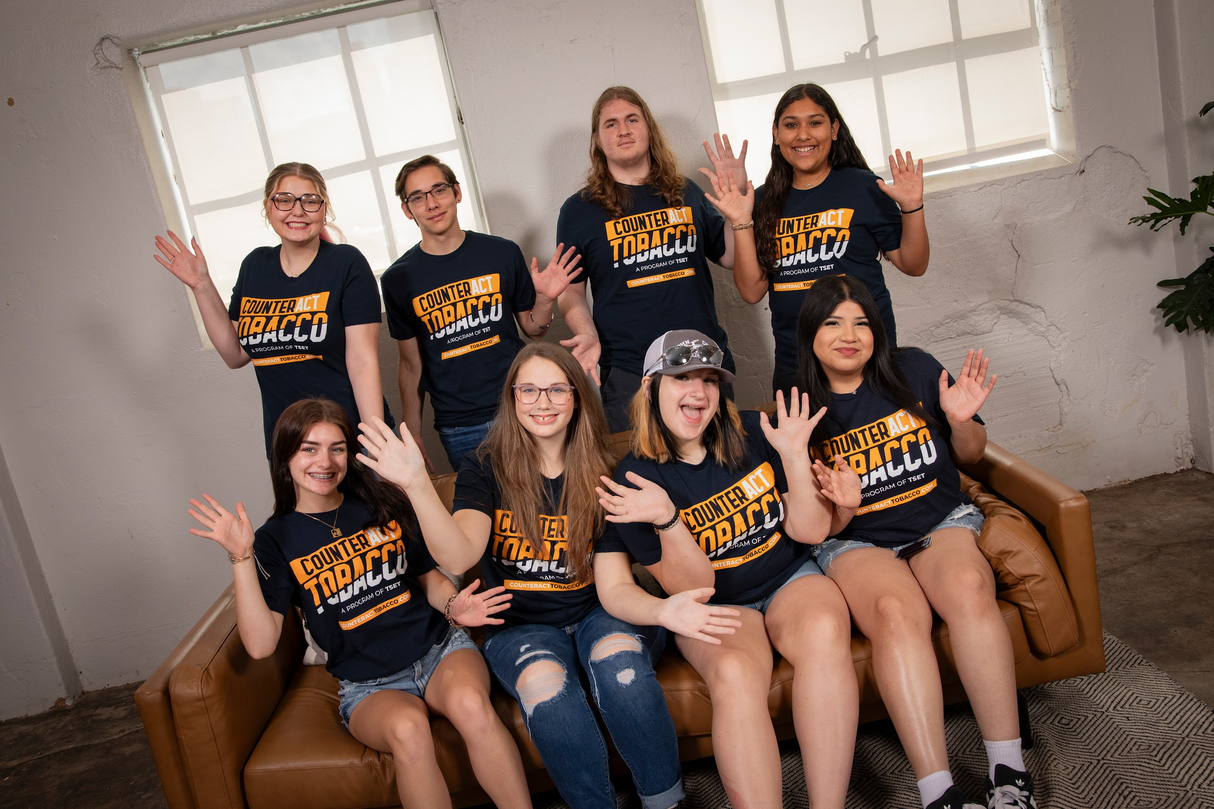
Youth Voices for a Healthier Oklahoma: How YAHL Makes an Impact
Neha Kale
Classen SAS High School
David De La Garza
John Marshall High School
Notes:
Hi my name is _______, I am a part of the YAHL LT from ____ HS and have been in YAHL for ___ years.
Neha 1st: Hi! My name is Neha Kale, this is my 3rd year with YAHL and I’m a senior from Classen SAS!
David 2nd: Hi my name is David, I am a part of the YAHL Leadership Team from John Marshall High School and this will be my second year of YAHL.

Slide 2
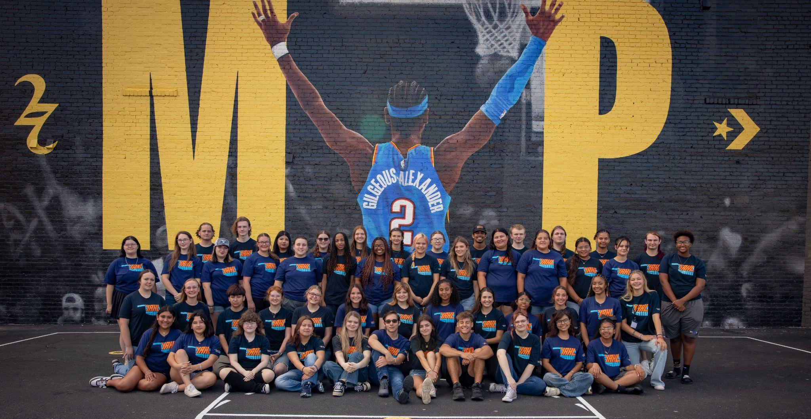

YAHL is a statewide youth-led health initiative
funded by the Tobacco Settlement Endowment Trust (TSET)
YAHL IS PROMOTING A HEALTHIER,
TOBACCO-FREE OKLAHOMA
Notes:
David: YAHL is a statewide youth-led health initiative funded by the Tobacco Settlement Endowment Trust. YAHL has two main campaigns, CounteractTobacco and Elevate Student Health. CounteractTobacco’s main objective is to pass legislation for comprehensive tobacco retail licensing in Oklahoma. While Elevate Student Health, on the other hand, is to get intuitive and bettered school wellness policies in place for every Oklahoma school district.

Slide 3

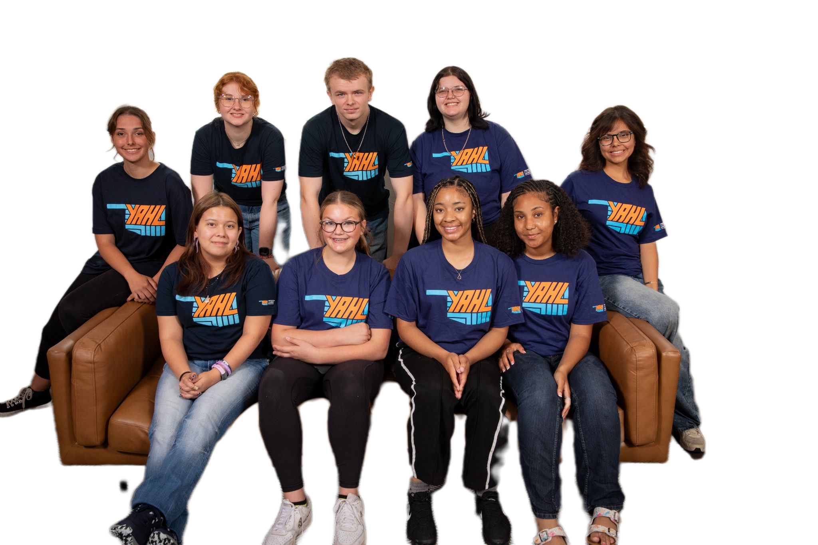

OUR MISSION:
To promote a healthy Oklahoma that is free from the harmful effects of tobacco addiction, poor nutrition and obesity
OUR STRATEGY:
Empower YOUTH to make choices that improve their lives and
the health of their community
Notes:
David: I joined YAHL to better myself and others. Change starts within, to lead others is to first learn to lead yourself. To put yourself in situations where you are least comfortable to grow and develop as a leader. To light the youth’s torches of leadership. To give, guide, and help grow their echoing voice to affect yourself and the future generations. Choose to voice reason and change, not to speak but to be heard. Here at YAHL, Our actions are our own, and proudly so.
Neha:
Unhealthy breakfast
Lack of physical activity
Wanted to make a change

Slide 4
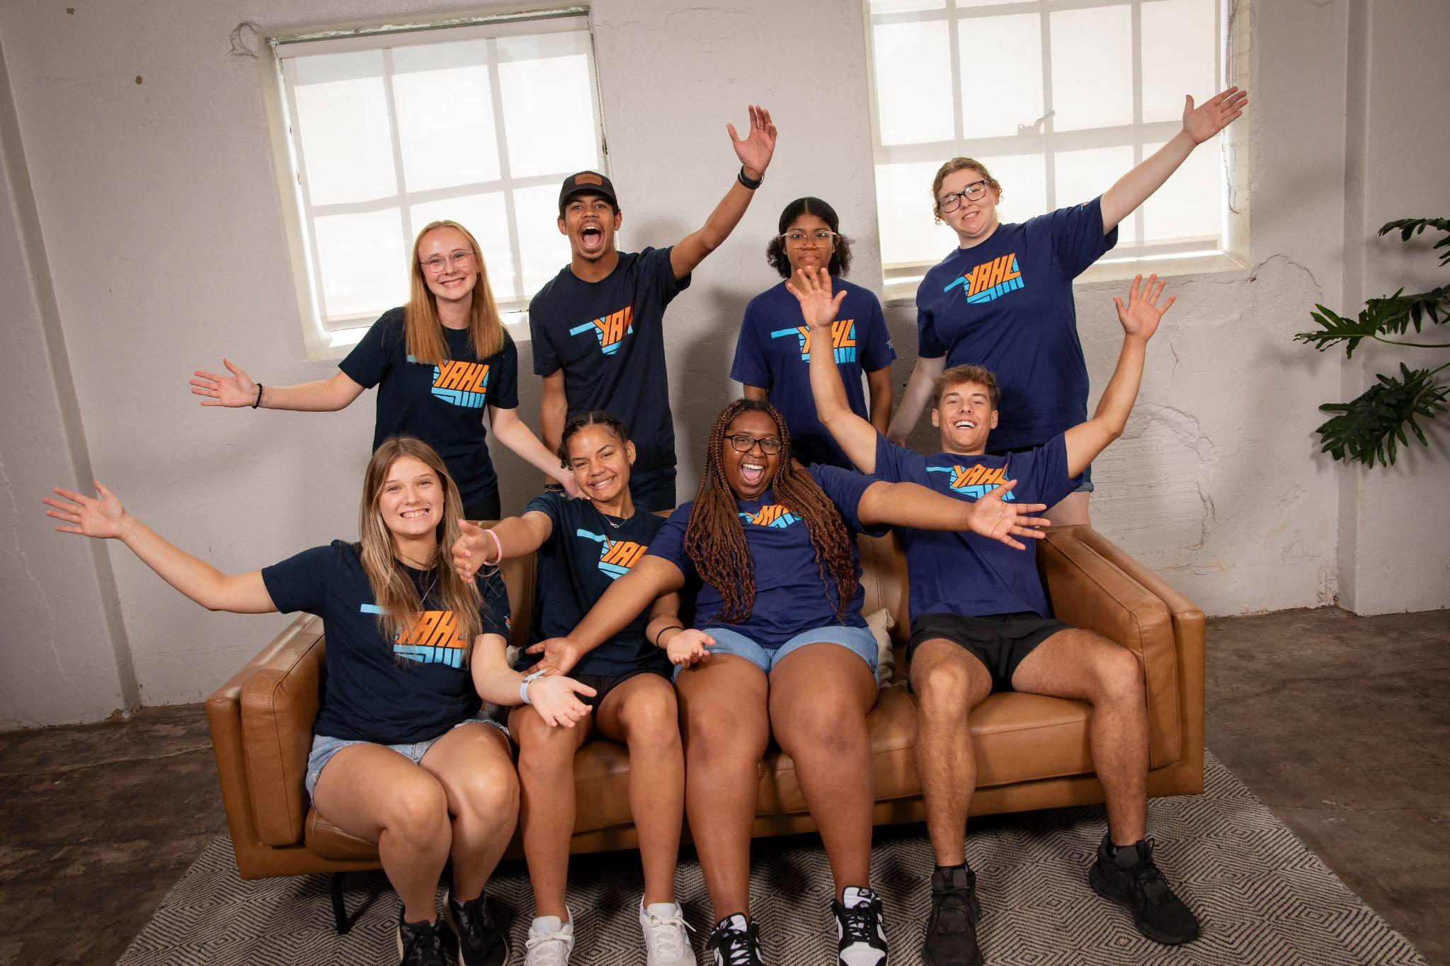

YAHL for Youth
YAHL is a youth-led movement. YOUTH make decisions on events and activities in YAHL.
Making a real, lasting impact, youth learn valuable skills that will be used in the future.
YAHL is a fun opportunity that offers:
Social fulfillment
Personal achievement
Leadership and public speaking skills
Community service hours
Letters of recommendation for college and job applications
Rewards
We aim to educate, not shame.
YAHL works with youth schedules. Youth choose when and how to participate in YAHL.
Notes:
Neha
Empower youth
How advocacy can make a difference
Public speaking skills & other career related skills
YAHL truly is a program that focuses on empowering youth and providing them with tangible skills that can be used in the future. Our goal is to equip them with the tools to advocate for healthy changes in their communities.
Neha - Practice/Share an example of one or two the opportunities that YAHL has provided you (don’t have to answer all of these): How has it helped you become a better leader? How has it helped you connect with other leaders? How has it helped you in your future career goals? What points/rewards have you been able to achieve?]

Slide 5
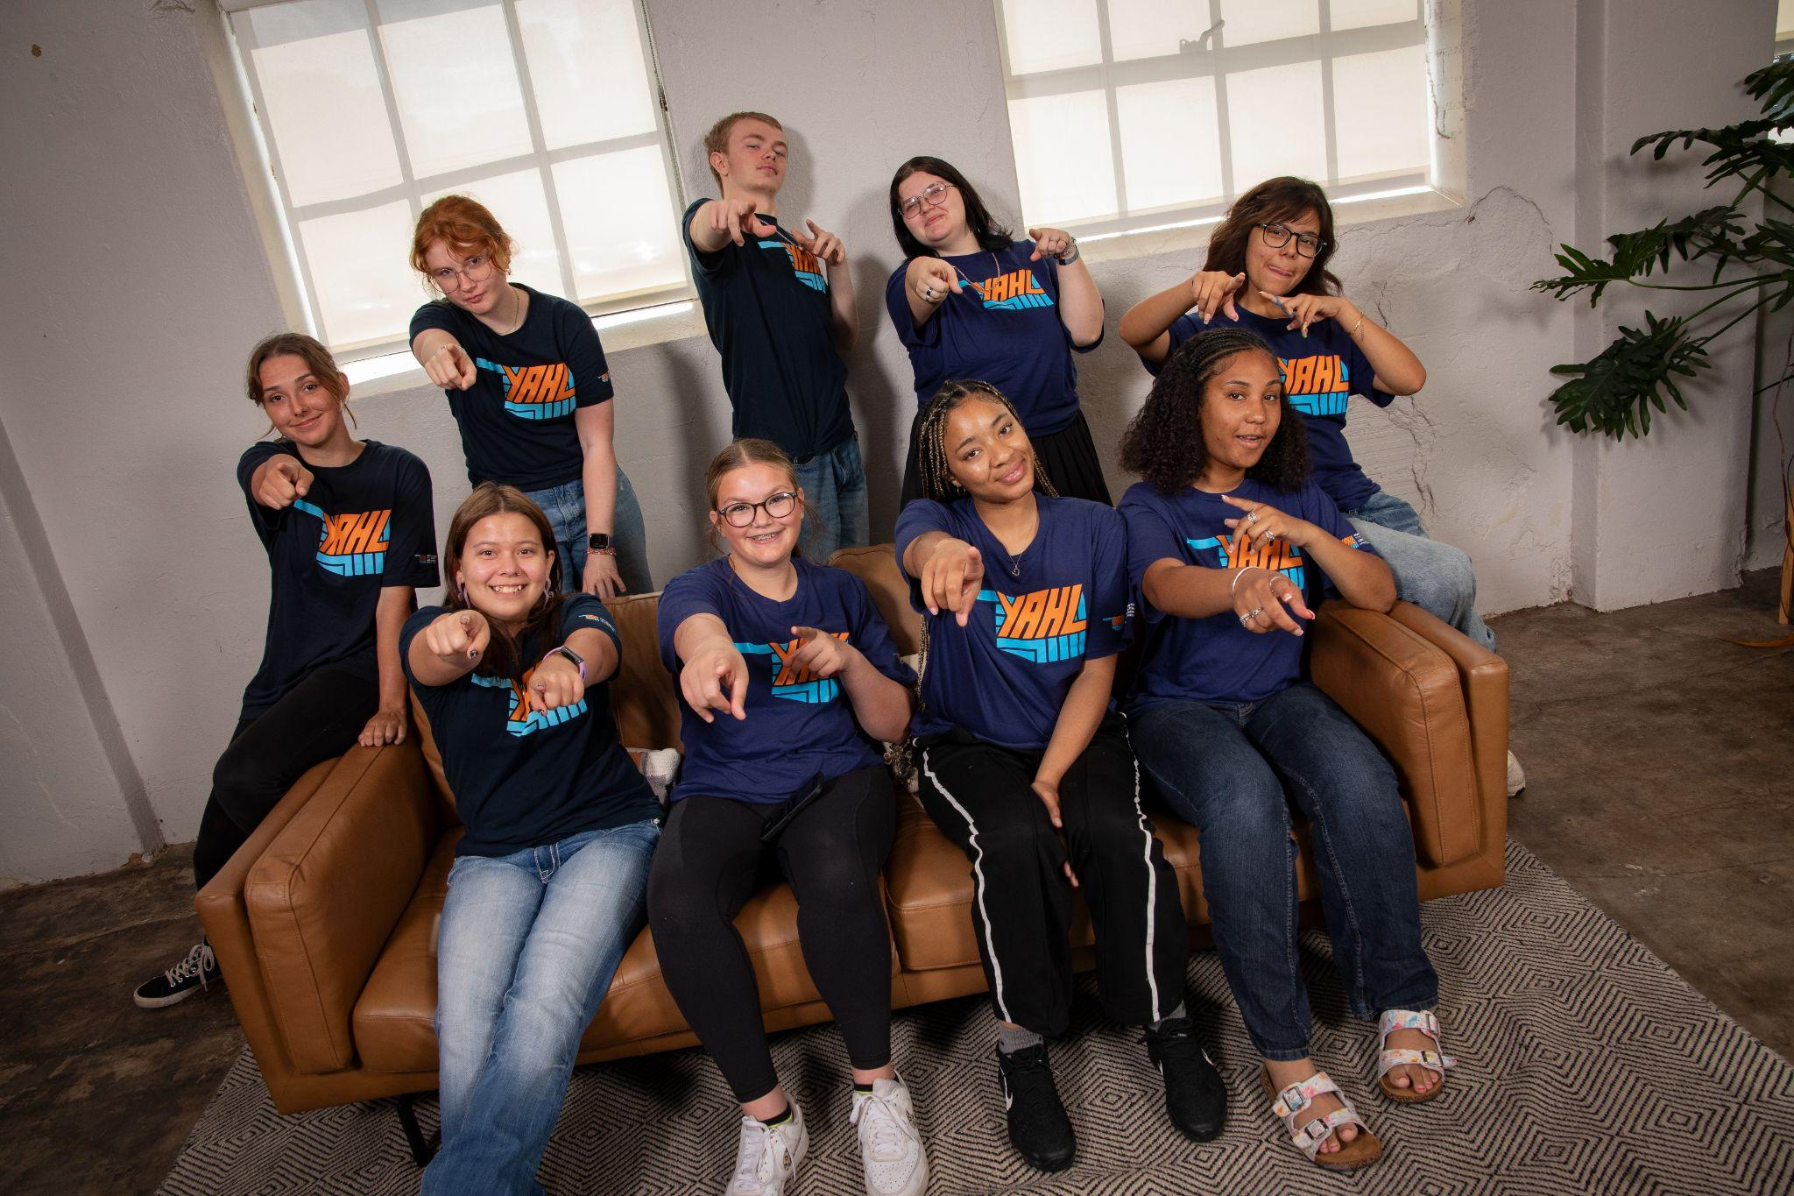
WHERE DO WE RECRUIT YOUTH?
Partnership Program
YAHL partners with high schools and community organizations
We recruit youth from the school’s entire student body
Partner schools/clubs can earn up to $2,000
“
YAHL gives students a voice and a chance to make real changes in their schools and communities. As a member, I’m committed to supporting anyone who wants to break out of these habits and live a healthier life.
- Angie, YAHL member
”
Notes:
David
Let’s get specific about how it works.
We partner with high schools throughout the state as apart of our partnership program. We currently partner with 45 high schools and community organizations throughout the state. Partners can earn up to $2,000 dollars for their school or club by partnering with us. Recruiting from the student body, YAHL gives any and all members a chance to change their school, themselves, and others for the better.

Slide 6
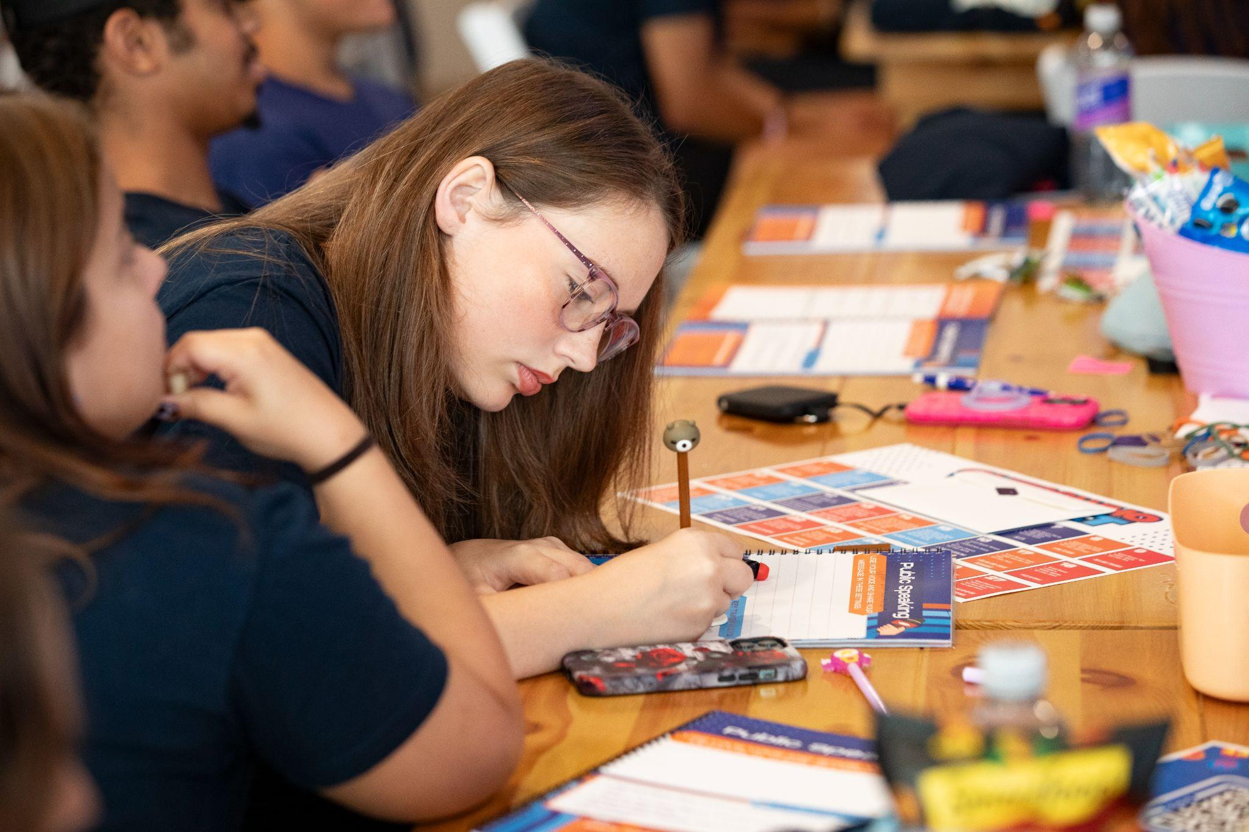
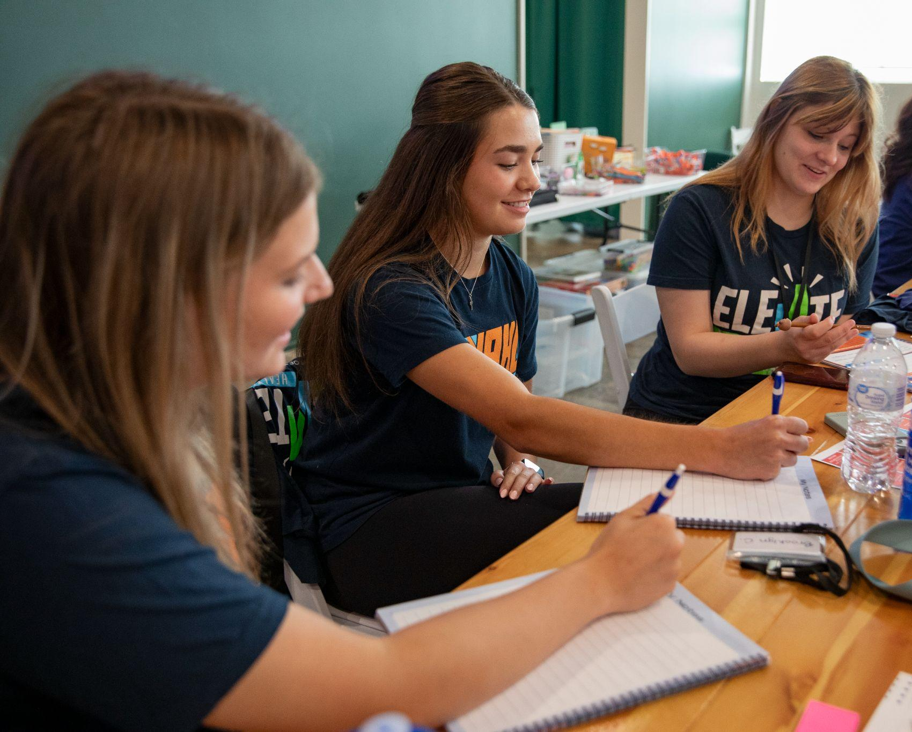
EQUIPPING AGENTS OF CHANGE
YOUTH TRAININGS
The training is 3.5 hours during school/organization time.
It is highly interactive.
It equips youth to work on the campaigns and teaches them about how the tobacco/vape industry targets groups of people.
Youth complete a training project during lunch that gives them a chance to practice survey collection and receive feedback.
Notes:
Neha
Experience recruiting youth and things you learned at training
equity vs. equality lesson - helped share how we approach advocacy
- Practice/Share your experience recruiting youth at your school
- Practice/Share some of the important things that you learn at YAHL training?
talk about exp recruiting youth and things you learned at training (equity vs. equality lesson - helped share how we approach advocacy in that sense)

Slide 7

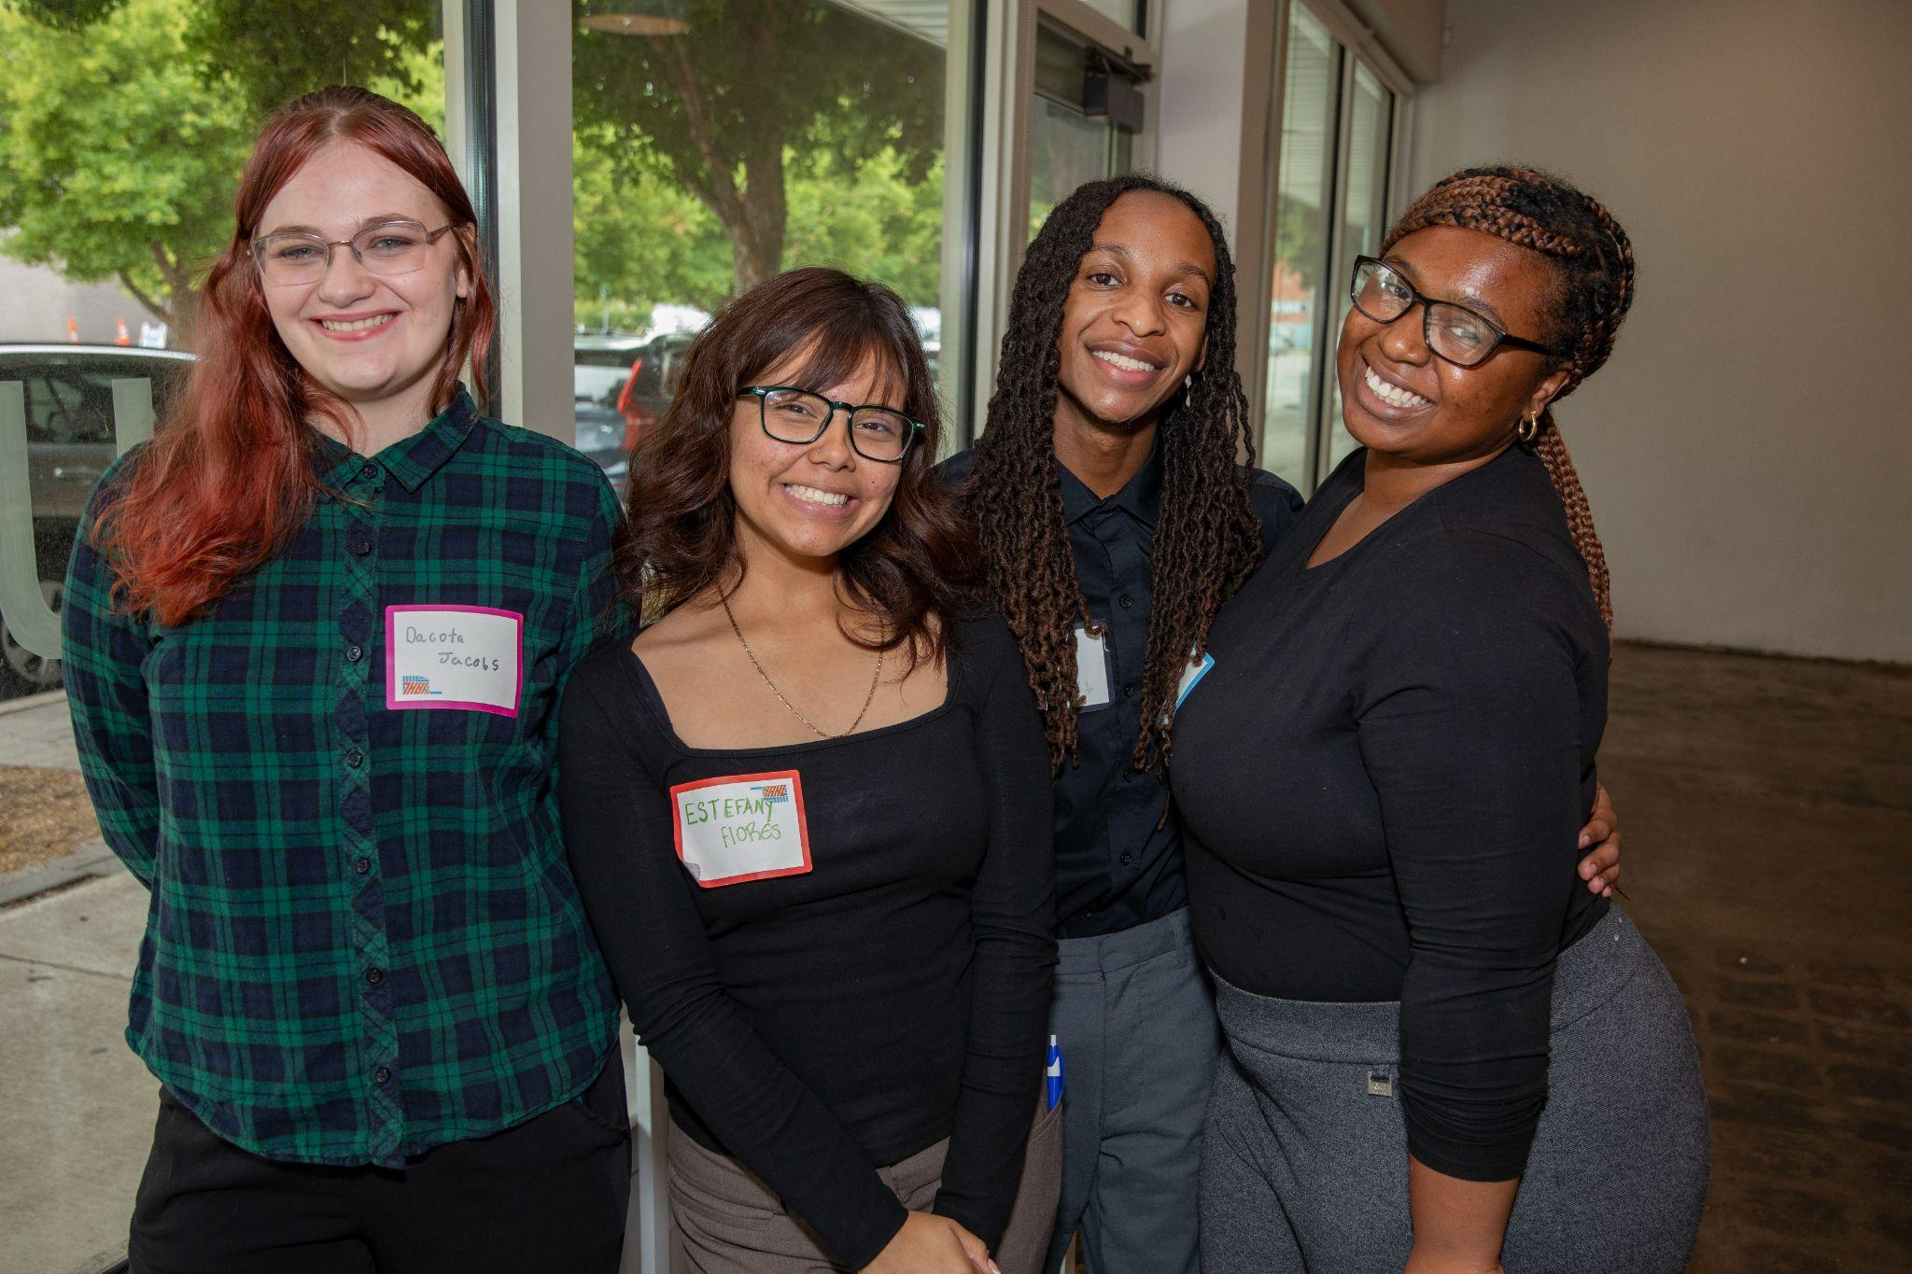
YAHL LEADERSHIP TEAM
55
= current number of leadership team members from across the state
The YAHL leadership team is a core group of leaders who help drive high-level campaign activities forward, including:
Meeting with key decision makers
Participating in public speaking opportunities
Speaking to the media
“It’s a really good opportunity to meet new people and have fun while learning. You won’t be standing in just one place, you’ll get to be active and enjoy your time.” - YAHL LT Member
Notes:
David
Another integral piece of YAHL is our Leadership Team. In the spring, Applications for a spot on the Leadership Team are sent. Judging on activity level and essay submissions for this competitive, active role with YAHL. This core group of leaders goes the extra mile for YAHL. They receive additional training and support to participate in high level program opportunities like networking, presentations, and key decision maker meetings, just like the presentation you are seeing today.
Additionally, each summer, LT members are invited to a Leadership Summit in Oklahoma City where they complete in depth trainings on things such as public speaking, media communication, and professional writing. Preparing them for their year ahead in YAHL. We wrap summit up with a networking opportunity where youth are able to put some of their skills to the test by interacting with TSET staff and other community members and partners.
It’s also important for leadership team to be geographically diverse and representative of our entire state.

Slide 8
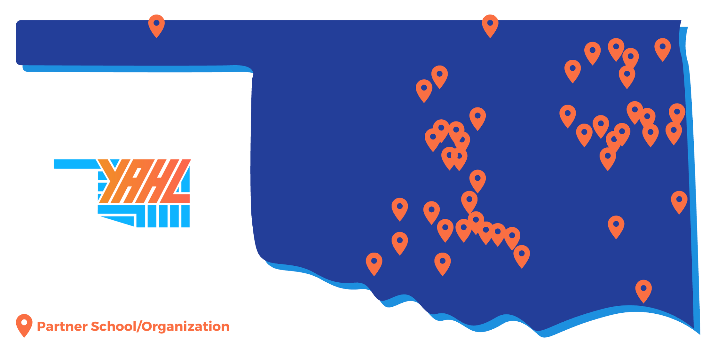
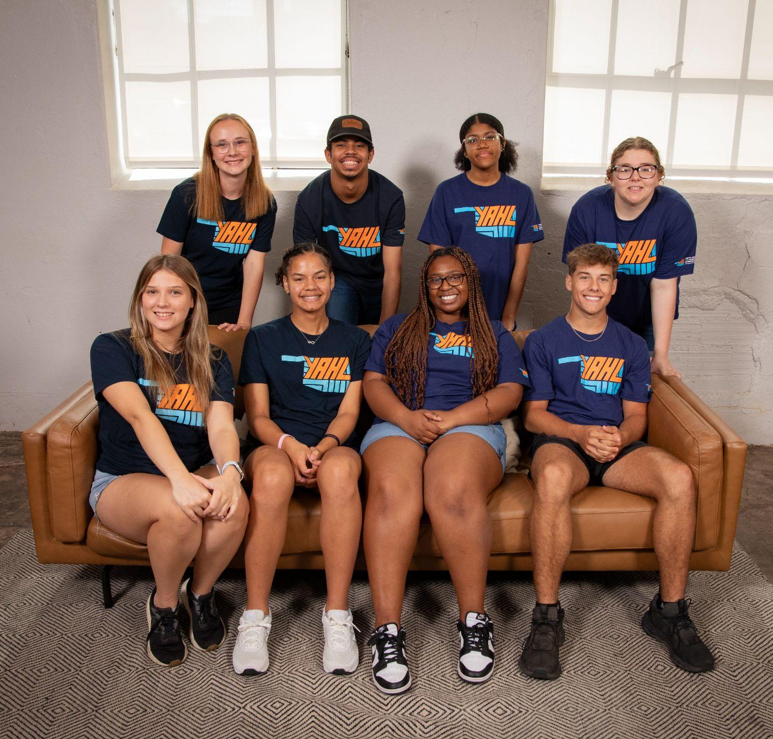


YAHL IMPACT IN FY25 (July 1, 2024 - June 30, 2025)
45 | School/organization YAHL partners in: 28 Counties 38 Cities 42 Districts
1300+ | Youth trained in the 2024-2025 school year
10,000+ | Youth volunteer hours contributed by YAHL members
Notes:
Neha
A. talk about the stats
As shown here, YAHL made quite the impact over the last school year, partnering with 45 school/organizations across 28 counties, 38 cities and 42 districts. We trained over 1,300 youth who collectively contributed 10,000 volunteer hours. Now let’s shift to talk about the policy campaigns these students were working on.

Slide 9
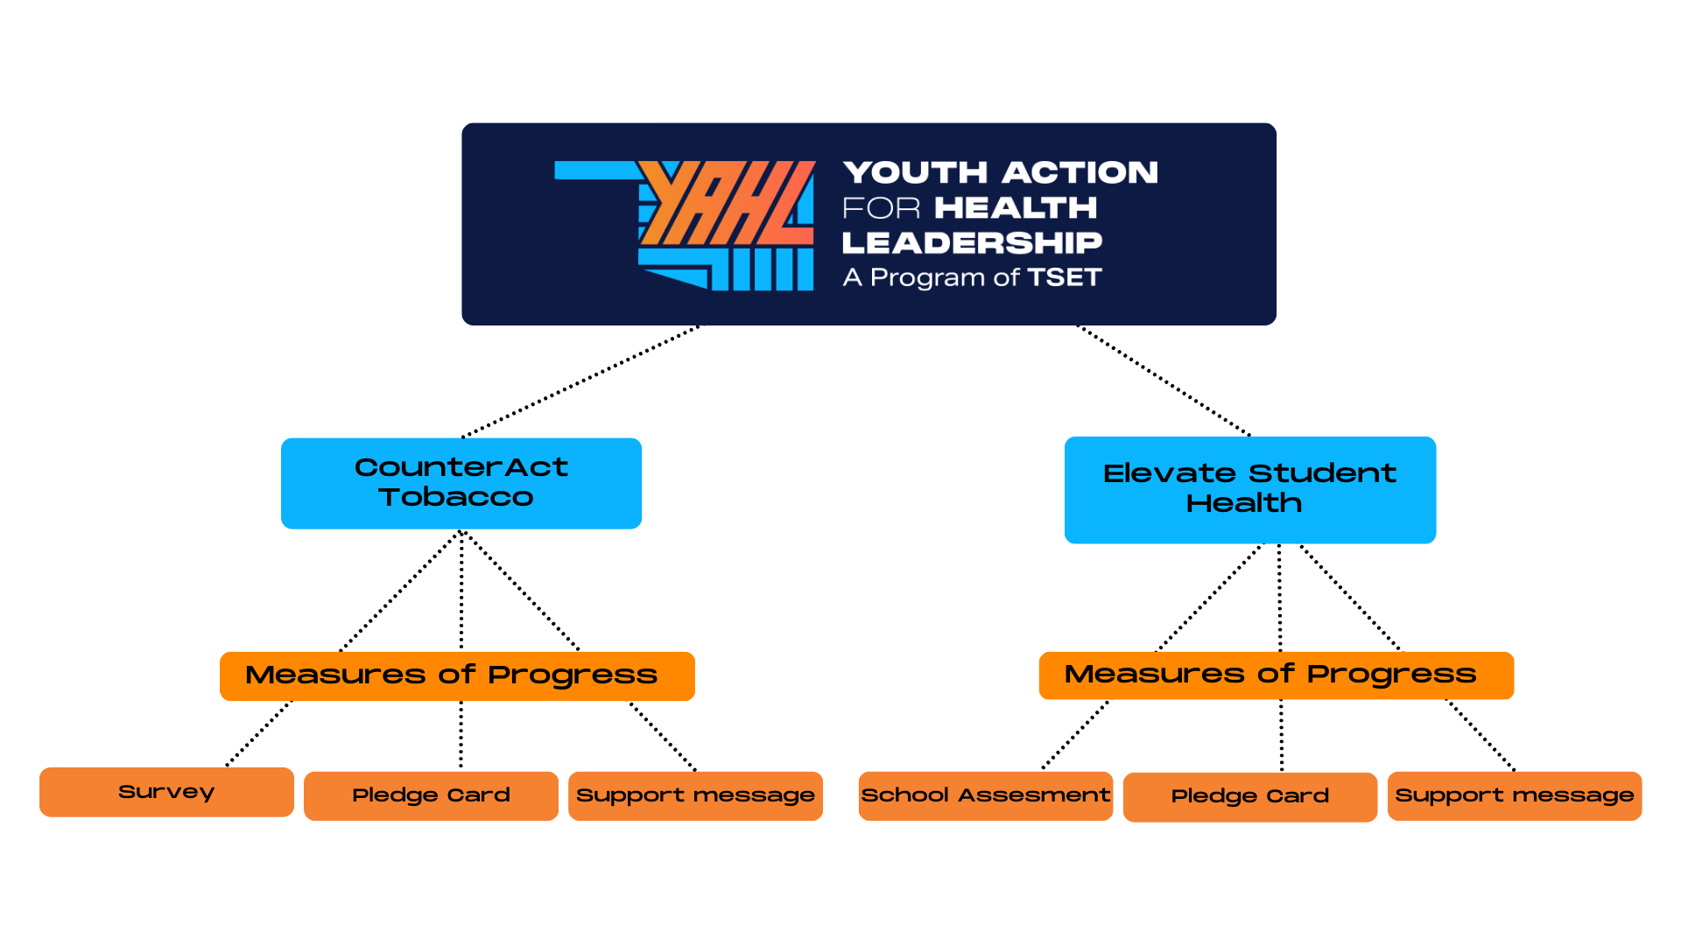
PROGRAM STRUCTURE
Notes:
David
YAHL is the overarching group of youth members, and within the YAHL program, we work on two campaigns: CounterAct Tobacco and Elevate Student Health. Within each campaign, we collect what we refer to as measures of progress, which are tangible ways for us to measure our impact. These include things like surveys, pledge cards, school assessments, and support messages.

Slide 10

Moving the power out of Big Tobacco’s hands and into ours through statewide comprehensive tobacco retail taxation and licensing
Notes:
David - Moving the power out of Big Tobacco’s hands and into ours through statewide comprehensive tobacco retail taxation and licensing.

Slide 11



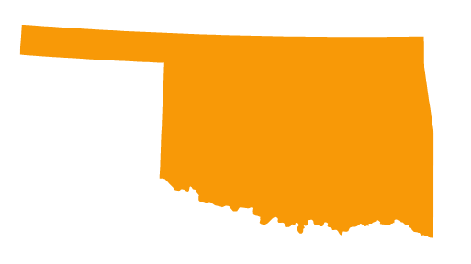
CURRENT TOBACCO LANDSCAPE
During the 2025 session, bills related to repealing tobacco preemption and taxing and/or licensing tobacco products did not pass.
21.8% of Oklahoma high school students reported using electronic vapor products, more than double the national average.
E-cigarette, vapor and nicotine-only products are not defined or taxed as a tobacco product, and thus are not required to be sold by a licensed tobacco retailer, instead only requiring a sales tax permit.
YOUR ROLE
PUP LAW
Notes:
David
Unfortunately, the 2025 session bills repealing tobacco preemption and taxing and/or licensing tobacco products did not pass. Staggeringly, 21.8% of Oklahoma’s high school students were seen and reported abusing vaping products. Doubling the national average, additionally, this statistic is only reading the reported teens. E-cigarette, vapor and nicotine-only products are not defined or taxed as a tobacco product, meaning only a sales tax permit is required to sell any of these products.

Slide 12



CounterAct Tobacco
Comprehensive Tobacco Retail Taxation and Licensure
Currently, vapes and e-cigs are not taxed the same as cigarettes.
Oklahoma is 1 of 17 states without additional taxes on e-cigarettes beyond the regular sales tax.
YOUR ROLE
Currently, vapes and e-cigs are not regulated.
Oklahoma is 1 of only 14 states without retail licensing for e-cigarettes.
Currently, local communities are restricted.
Oklahoma is 1 of only 5 states that have preemption on licensure, youth access and smoke-free indoor air.
Notes:
David
So why does Oklahoma need comprehensive tobacco retail licensing? While we have retail licensing, due to the influence of the tobacco industry, it’s got some serious loopholes. For instance, our current licensing only applies to retailers selling traditional cigarettes, and NOT vapes and e-cigarettes. This is partly because vapes don’t have an additional tax on them, as stated previously, so there’s no agency with authority to license them. Oklahoma is considered the most preempted state in the nation which means local cities and communities don’t have the power to make their own decisions about tobacco policies. Seeing my high school classmates lose opportunities and their liveliness through tobacco products such as vapes is heartbreaking to see. Regulating these products would limit the amount of people big tobacco has their grasp on, and lessen the amount of people dragged into a life of abusing substances.

Slide 13

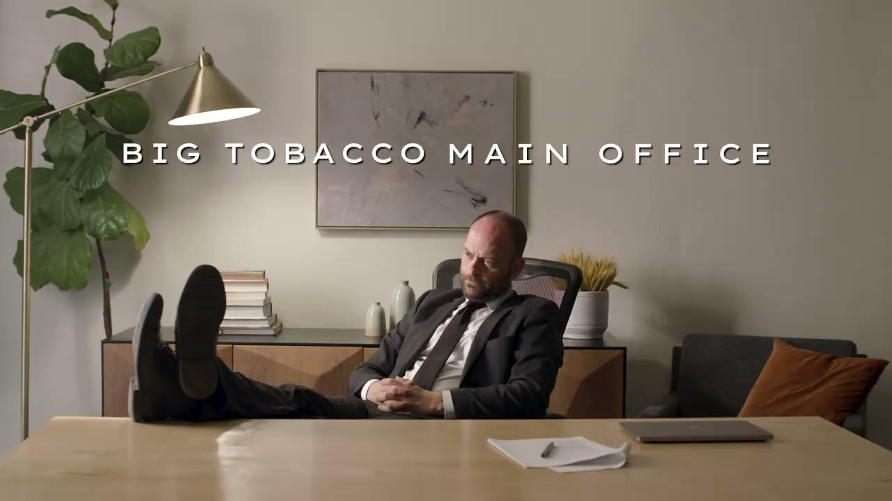
Notes:
David
Here is a quick video explaining the issue in video form.

Slide 14



Improving the health of Oklahoma youth through comprehensive physical activity and nutrition policies in schools
Notes:
Neha
Now, let’s talk about the other campaign that we work on in YAHL, Elevate student health.
Read the slide

Slide 15

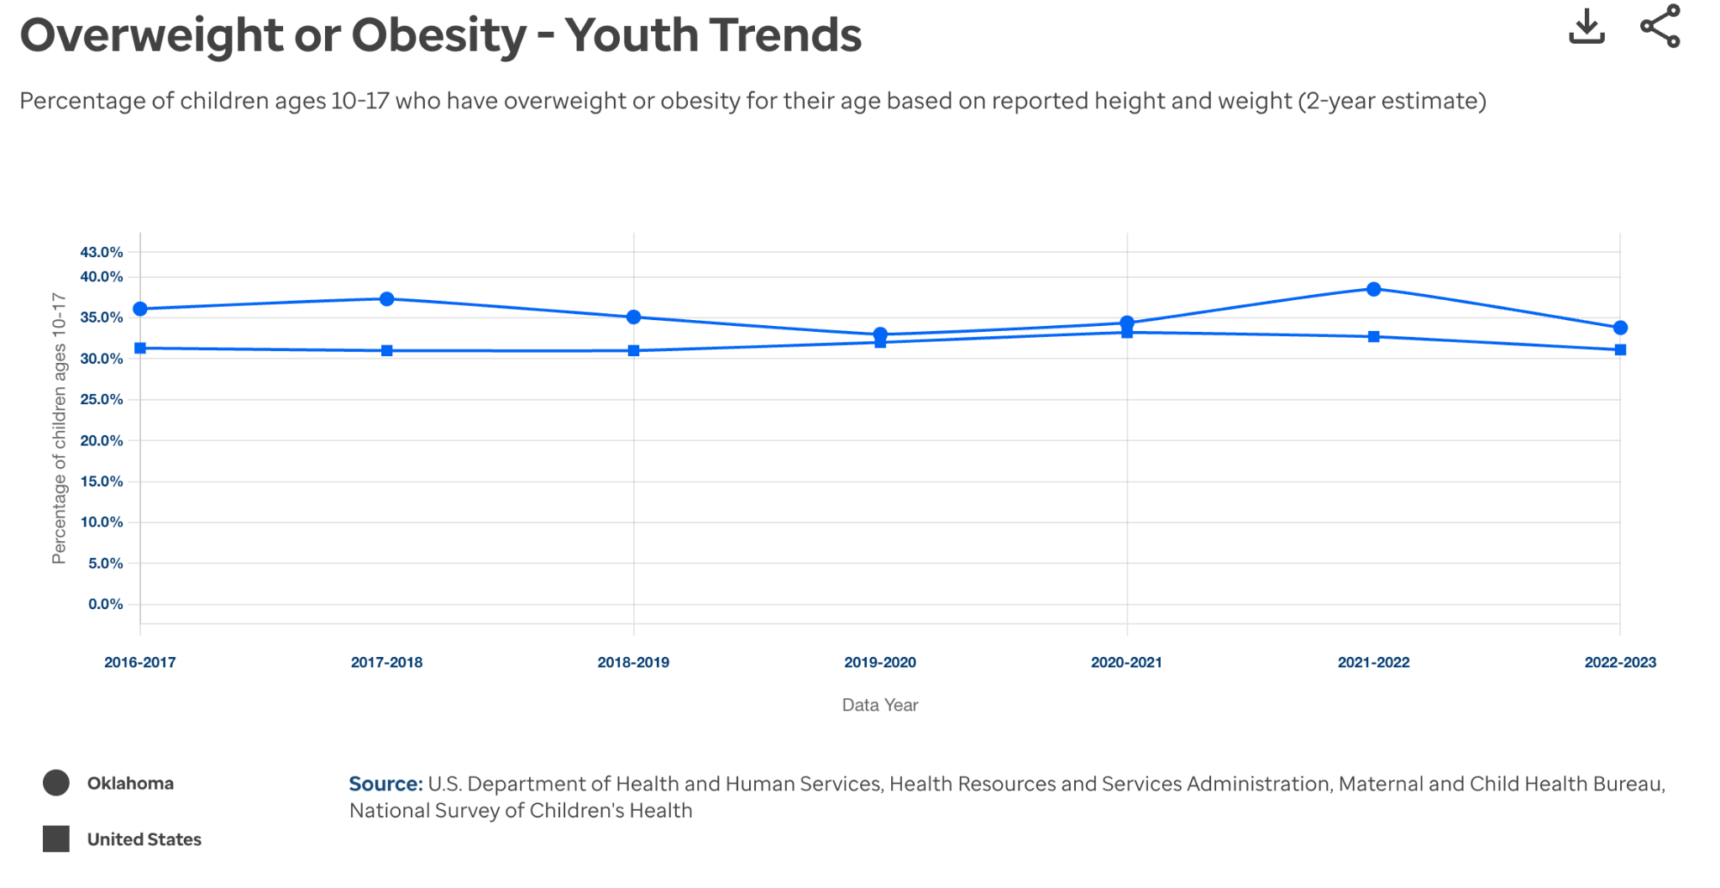
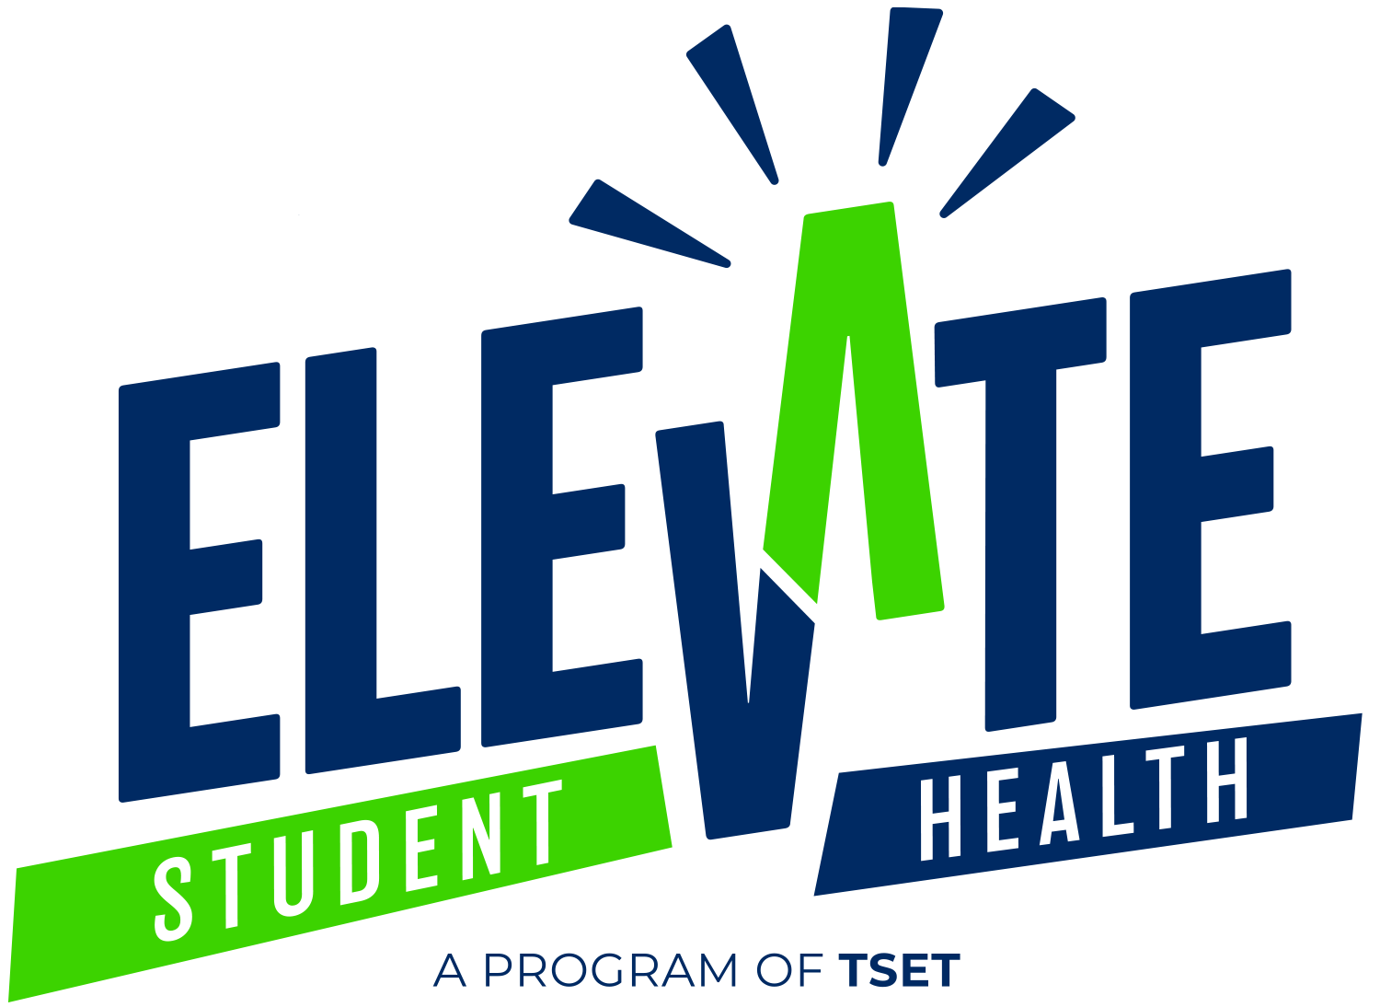
CURRENT LANDSCAPE
Children with obesity are more likely to develop chronic health conditions such as cardiovascular disease, type 2 diabetes, mental health conditions such as anxiety and depression, lower self-esteem and self-reported lower quality of life.
Only 27% of Oklahoma high school students are physically active at least 60 minutes per day.
In some districts, less than half of respondents reported that water is easy to access at their school.
Notes:
Neha
(read the bold words basically)

Slide 16

ELEVATE STUDENT HEALTH
Our main goal is for Oklahoma to pass a law requiring every district in the state to adopt our comprehensive wellness policy. This would ensure all students are better protected. First, we have a lot of work to do on the ground to spread awareness and make a difference at the local level.
1
2
3
SCHOOLS
DISTRICTS
STATEWIDE
Work with individual schools to communicate & implement wellness policies
Help districts adopt comprehensive school wellness policies
Support statewide policy standards
Notes:
Neha
highest rates of childhood obesity
Create wellness in schools
Elevate → pass law for the comprehensive wellness policy
We need to do a lot of work before we reach that
In one of the states with the highest rates of childhood obesity, one of the biggest impacts we can make is to change the wellness environments at our schools. Our main campaign goal for Elevate Student Health is for the state of Oklahoma to pass a law requiring every district in the state to adopt our comprehensive wellness policy. This would ensure that all schools in the entire state would be covered and better protected. But until then, there is a lot of work on the ground to do to spread awareness and make a difference at the local level.
The way we are working up to a state law is by first reaching out to individual districts throughout Oklahoma and helping them adopt our comprehensive wellness policy. When they make those changes, all schools in their district have to abide by those guidelines - Elementary, Middle and High Schools. Secondly, we partner with individual schools and make sure they have all the tools and resources they need to communicate and enforce a positive school wellness environment.

Slide 17

POLICY FOCUS
NUTRITION:
PHYSICAL
ACTIVITY:
WATER:
Focusing on providing healthy options, including for non-meals and after school foods
Guaranteeing physical activity for all, including middle and high school students
Providing consistent access to safe water at all times, including allowing water bottles in the classroom
Notes:
Neha
Our wellness policy focuses on three main areas: access to good nutrition, physical activity, and safe, clean drinking water. At my school, (come up with something positive and negative to say, can use infographic)

Slide 18
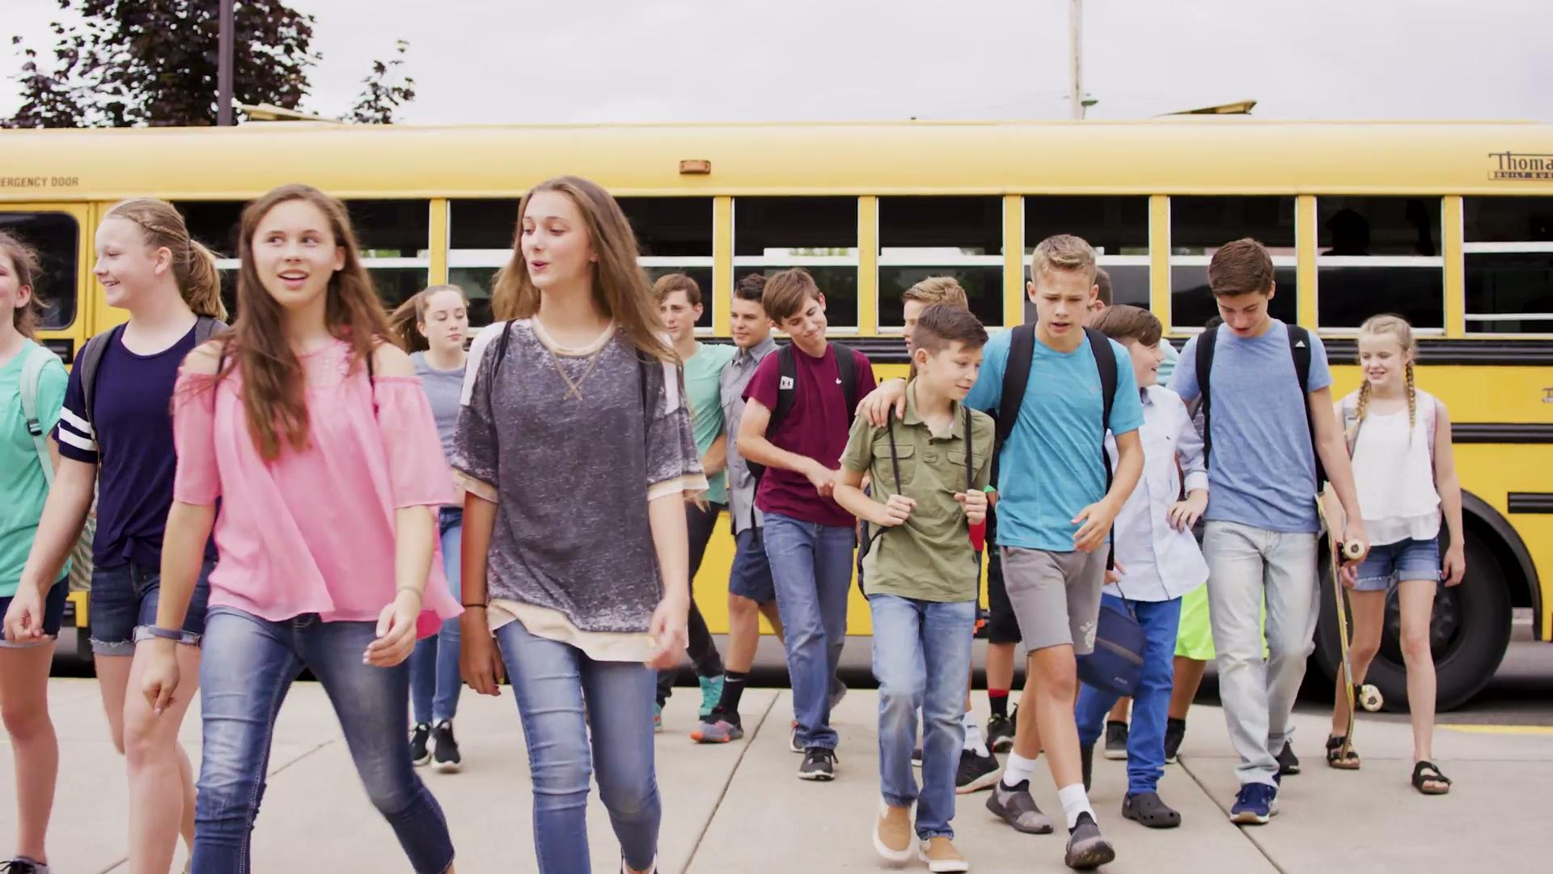
Notes:
Neha Here is another video diving more into our goal

Slide 19


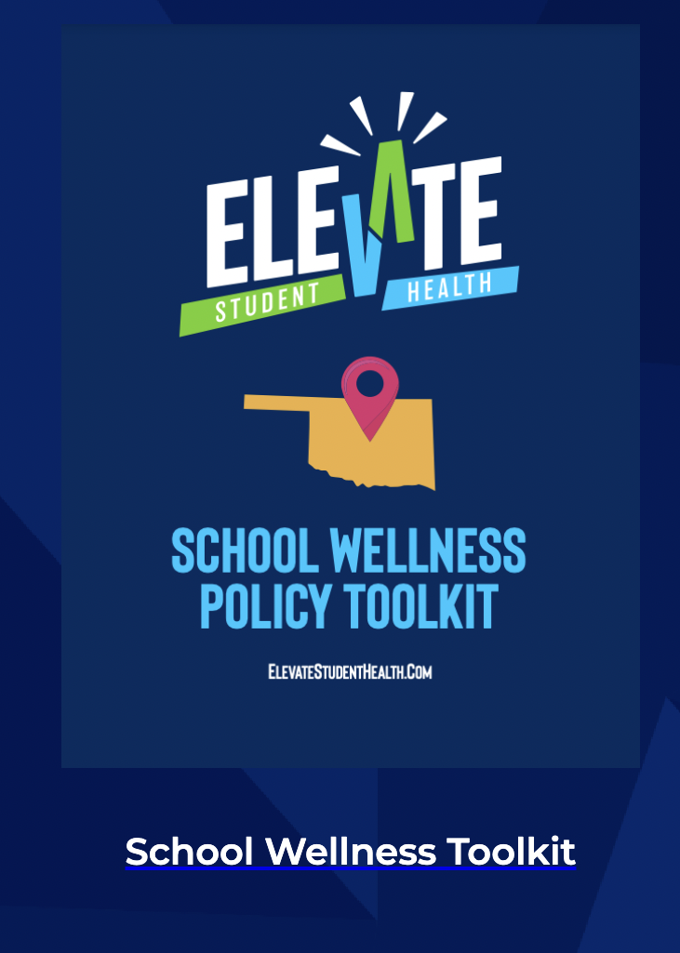
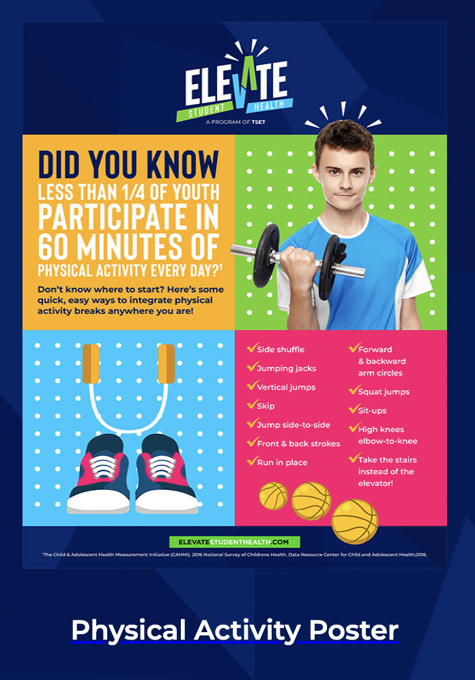
Notes:
Neha
We provide resources you need to succeed
Elevate Student Health also wants to be a good partner to schools and school districts by providing them with important resources for FREE.
In the school wellness policy toolkit school faculty can find important information about the policy and materials to help with implementation. We also offer a faculty training to schools where we can come in and train staff on the new policy.

Slide 20
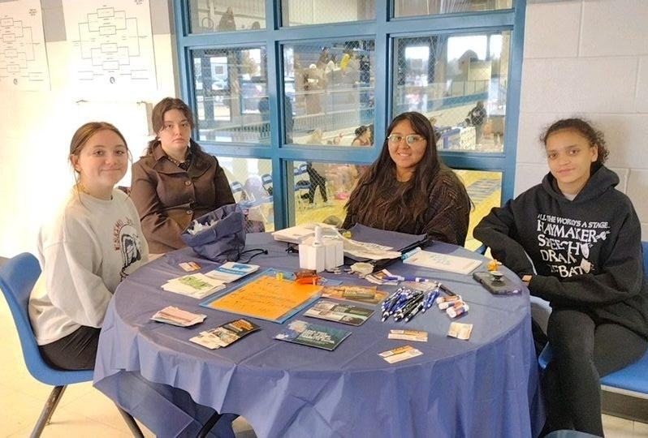
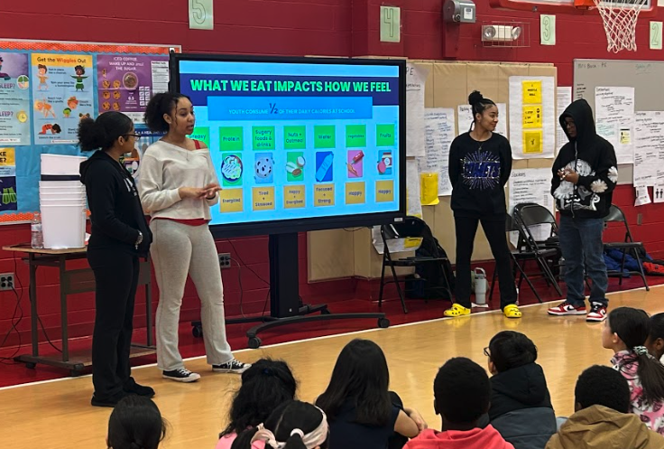
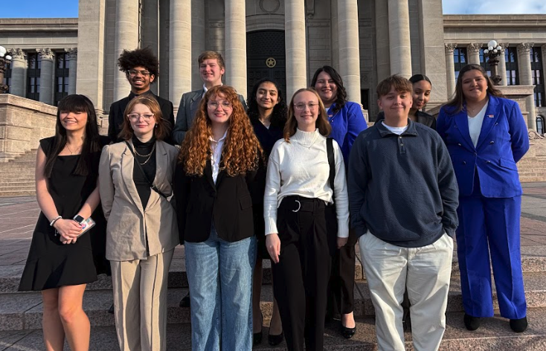
Campaign Opportunities
How YAHL Works Toward Policy Updates:
Events & Survey Collection
Youth Education
Key Decision Maker Meetings
Notes:
David
For both of YAHL’s campaigns, we provide various opportunities for the youth to work toward policy campaign goals. Events and survey collection to measure progress, youth education to better our mission, and meeting key decision makers to progress our authority and power to help better Oklahoma.

Slide 21
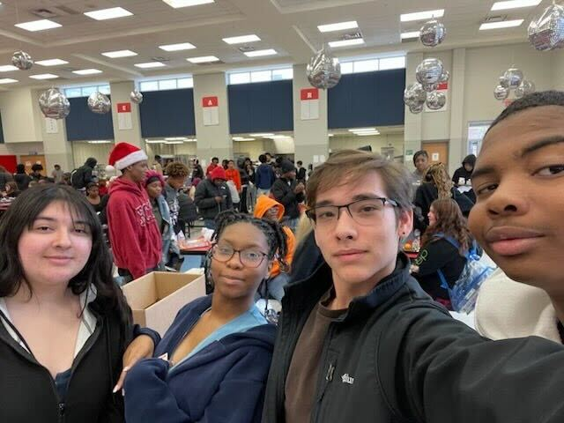
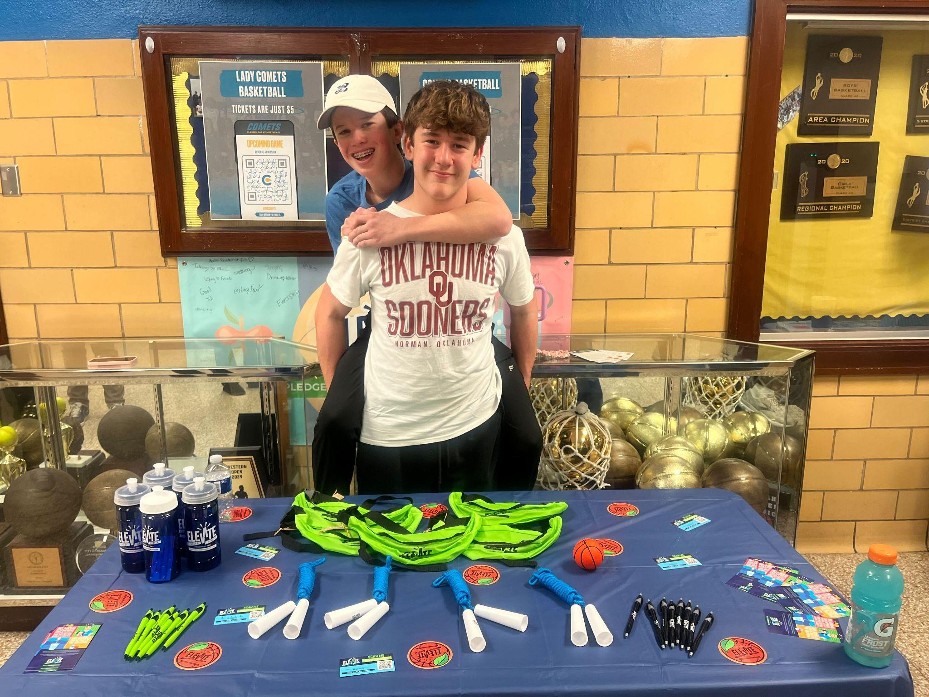
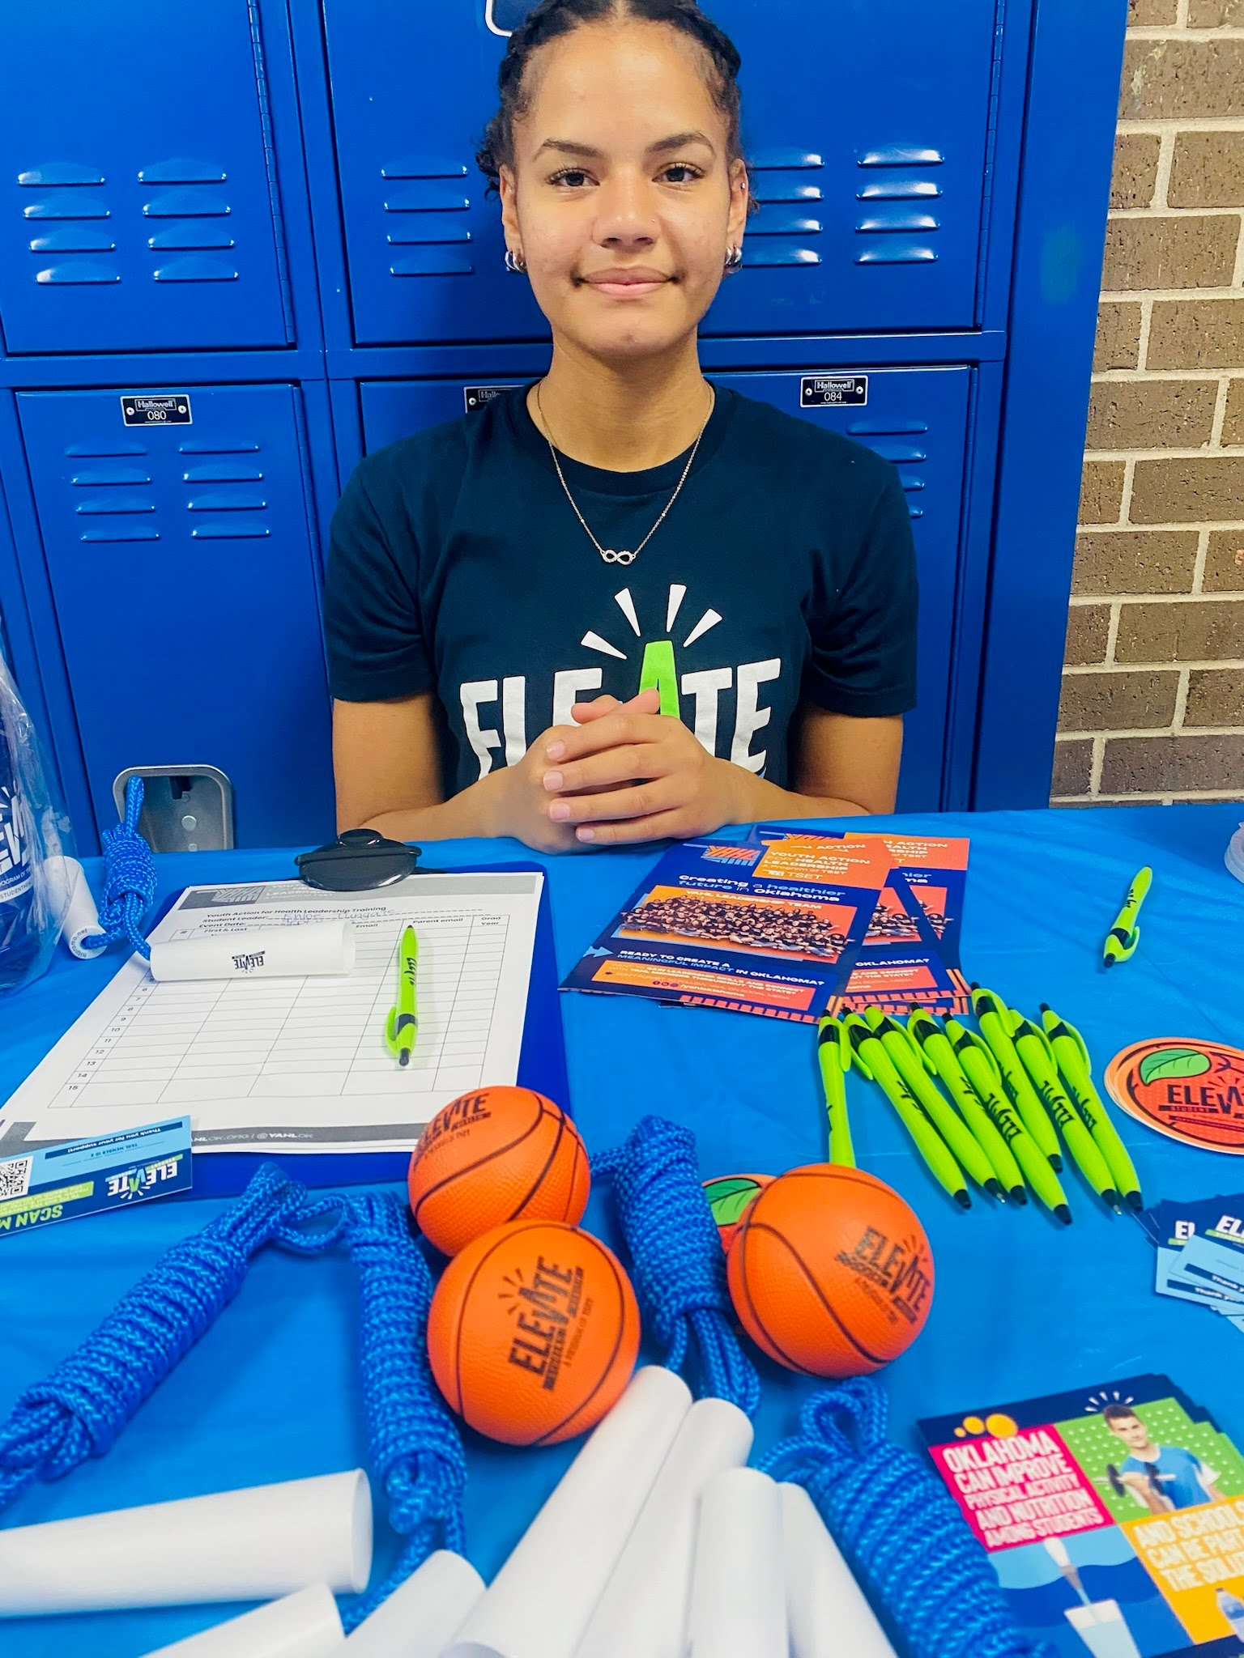
Events & Survey Collection
We educate communities and build awareness.
We help communities understand how Oklahomans feel about policy issues and use what we learn to build stronger, more effective campaigns.
Notes:
David
As you can see, I am on the left side of the screen participating in an Elevate Student Health campaign event! The SwapUp day was an event where YAHL members and LT set up a table of healthy foods and snacks to give away at the cost of a simple survey asking about their opinions. We not only gave out snacks but bags, pens, pins, and chapstick too. For both campaigns, events like this happen all over Oklahoma’s high schools that are partnered with YAHL.

Slide 22
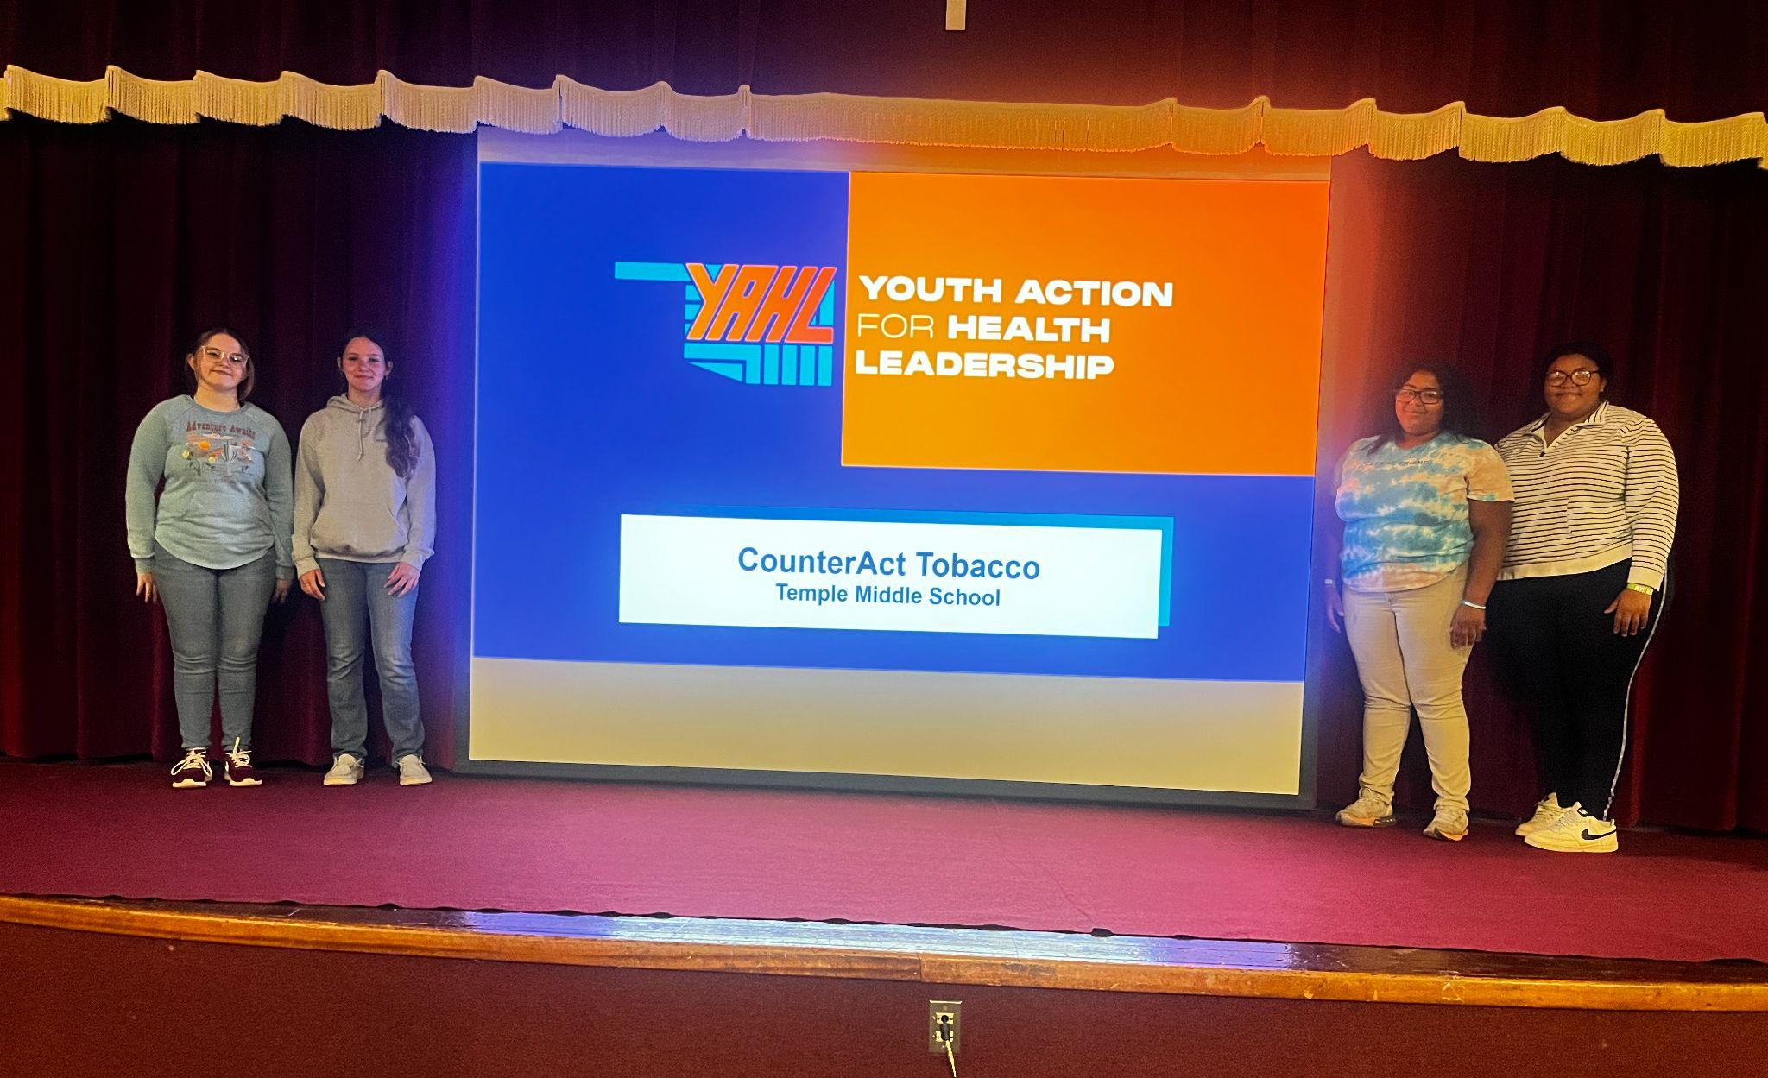
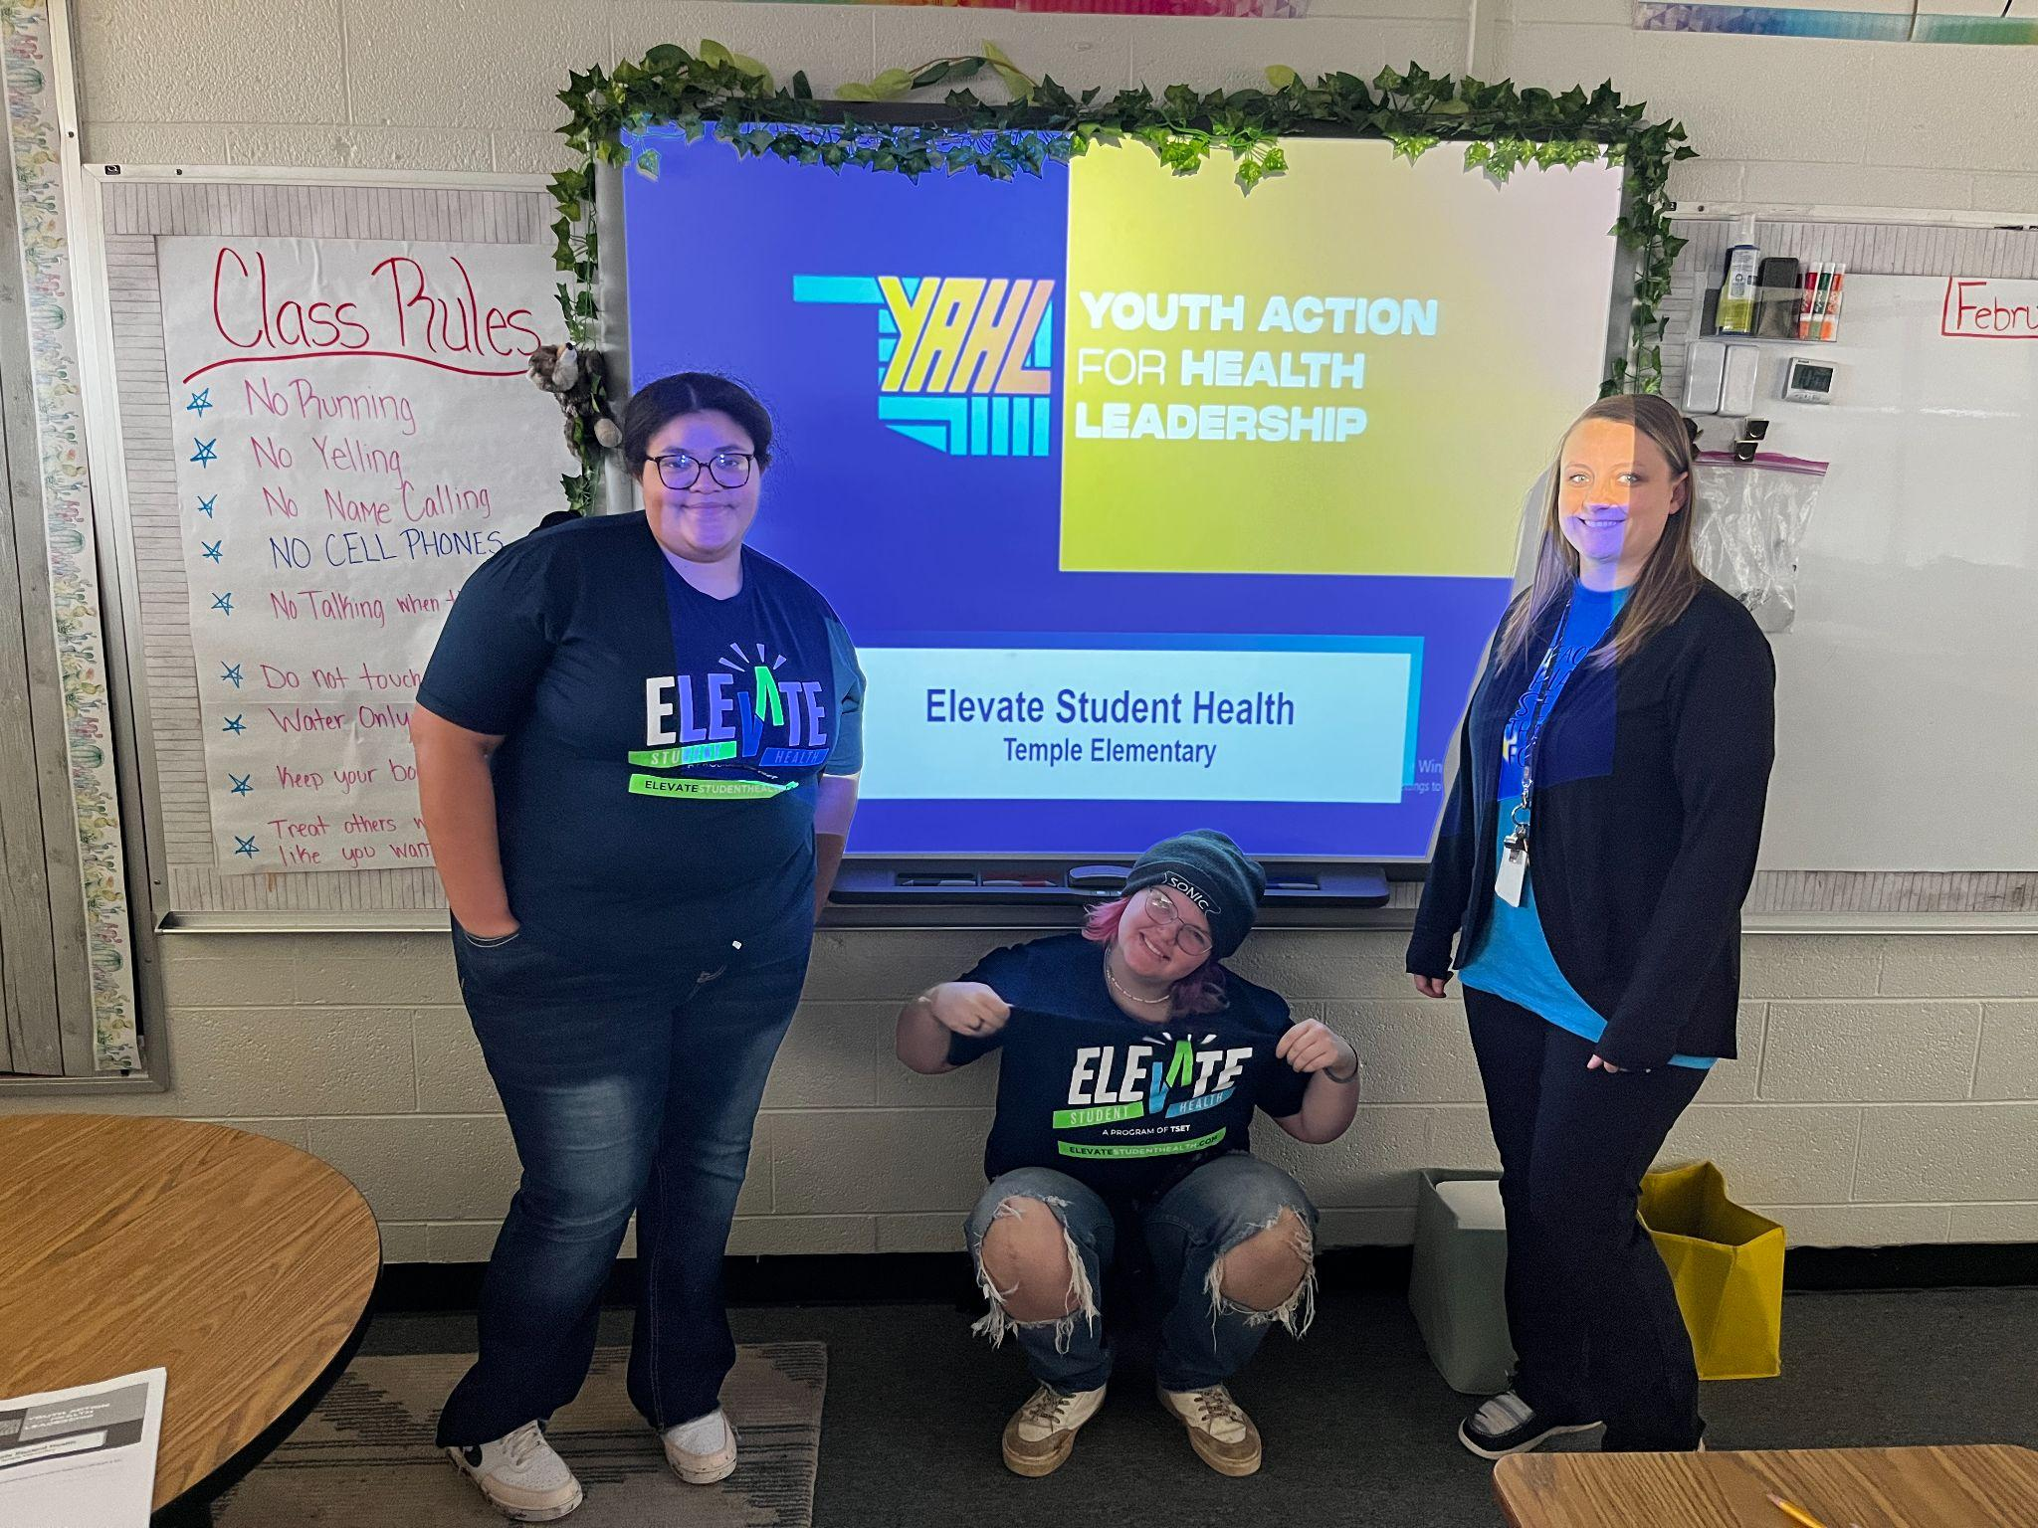
Partnering with Middle + Elementary Schools
We focus on EDUCATING younger students about physical activity and nutrition.
Notes:
Neha
A. teaching the youth how to build health lifestyles
B. preventing future ehalth issues
C. Improve overall mental and emotional well-being
For both Elevate and CounterAct, we also aim to educate younger students to try and instill positive behaviors earlier to create healthy lifelong habits, prevent future health issues, improve mental and emotional well-being, and build awareness around the issues.

Slide 23
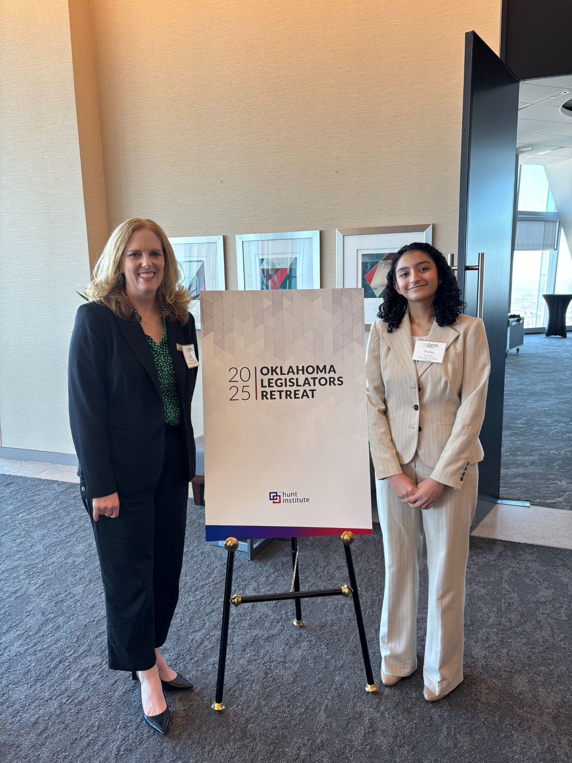
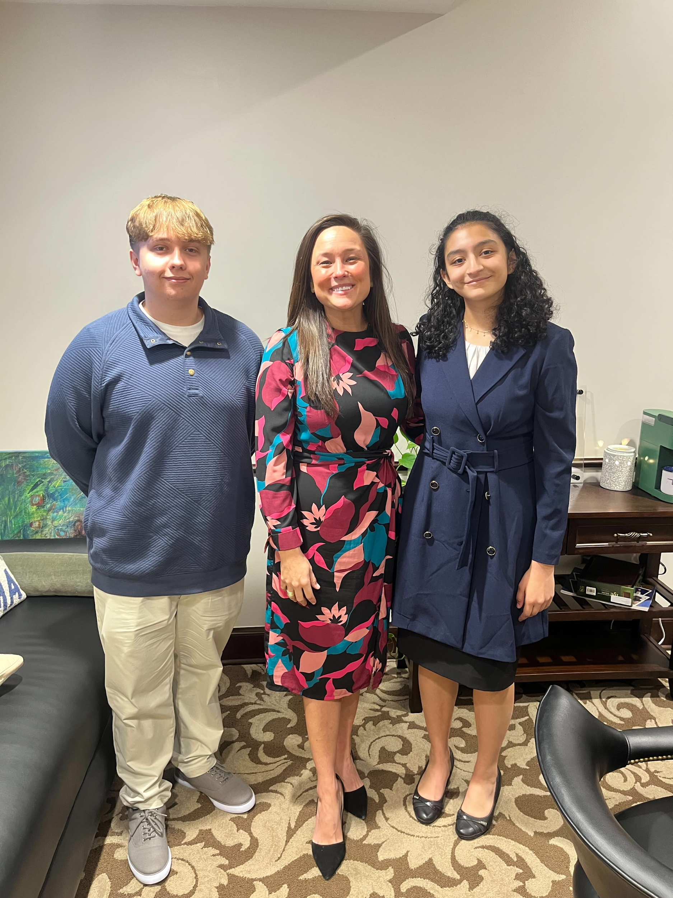
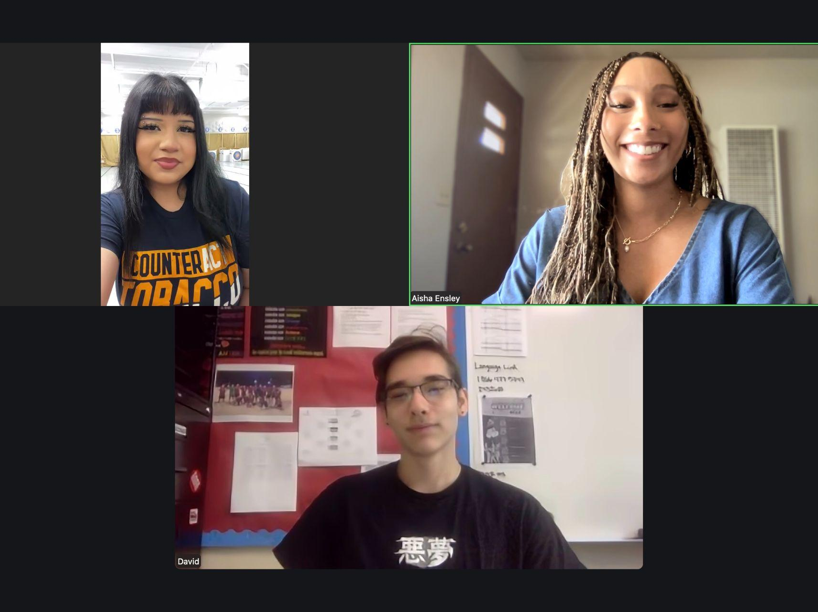

Key Decision Maker Meetings
We educate people in power and ask for their support.
Hunt Institute Panelist Speaker
Partner Presentation
Legislator Meetings
Notes:
Neha
Hunt institute:
Student perspective
Advocate on a panel
Day at the capitol
Share my personal experiences
Share the data we’ve collected to show the state-wide support and need for change
And finally, for both campaigns we meet with key-decision makers to educate them and ask for their support!
- Practice/Share some examples of key decision makers
Hunt institute and day at the capitol
- Practice Why do we want to meet with these people? What do you tell them when you meet with them?]
Notes: It’s important to meet these people to inform them of what is happening in their community as well as to get their support and educate them on our campaign goals. When we have key decision makers support, we know that they will help us reach our goal of promoting a healthier tobacco free oklahoma.

Slide 24

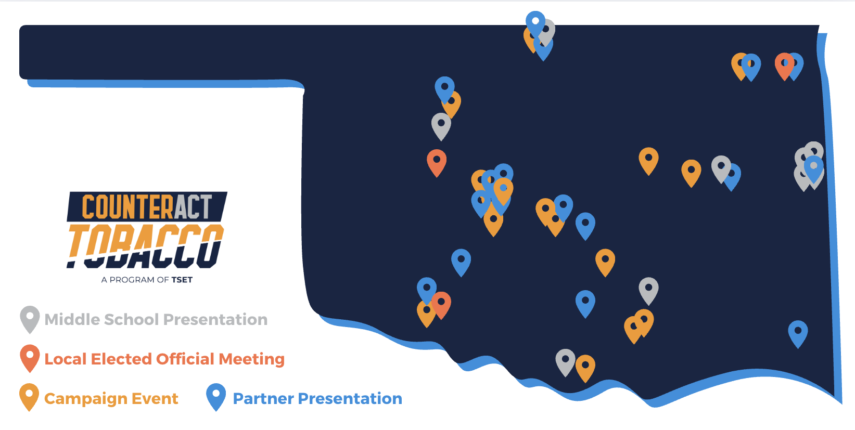


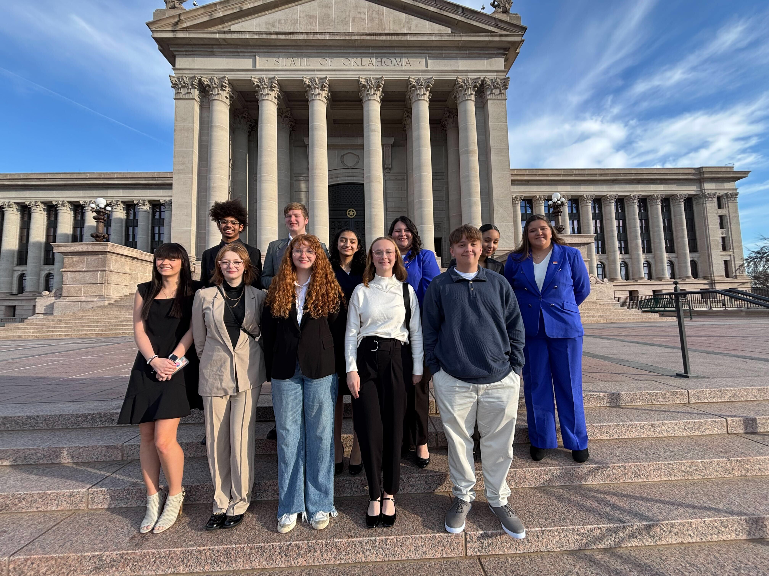
COUNTERACT TOBACCO IMPACT TO-DATE
214 Youth-Led Campaign Events
25,000+
Opinion Surveys
78
Legislator Meetings
 | 61 Presentations to Community Organizations
 | 44 Signed on as Partners
“
From this experience, I not only strengthened my speaking skills, but also furthered my understanding of tobacco and the laws that need to be put in place. The partner presentation hopefully prompted change in our community. This change will hopefully have a ripple effect throughout the entire state. - YAHL Member
“
Notes:
David
As this slide shows, we’ve had great success with CounterAct this past fiscal year! CounterAct has had 214 youth-led campaign events with more than 25 thousand opinion surveys, 78 legislator meetings, and 61 presentations to community organizations with 44 of them signed on as partners with YAHL today. That’s more than 70% of every organization we’ve presented to that partnered with us for our cause of a tobacco free and healthier Oklahoma!

Slide 25


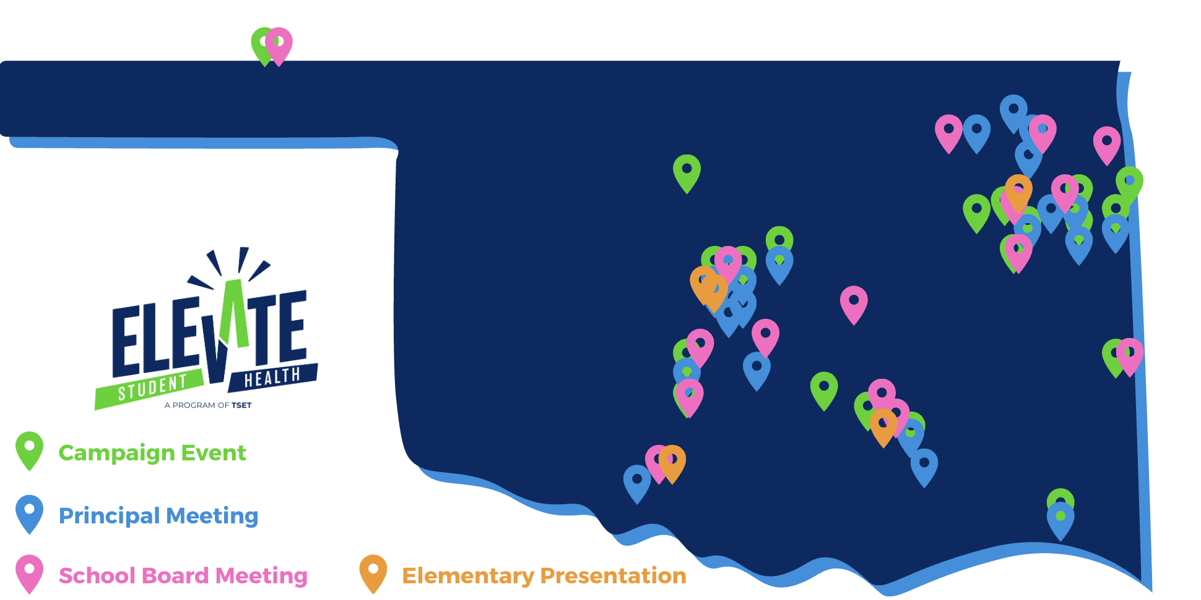

ELEVATE STUDENT HEALTH IMPACT TO-DATE
“
176 Youth-Led Campaign Events
… we have undertaken a comprehensive review and update of our school wellness policy. This decision was driven by our desire to align with current research, best practices in health education and feedback from stakeholders, educators and health professionals. In doing this, we have taken a proactive approach in updating our wellness policy to better serve our community and enhance student well-being.
- Corey Steele, Kansas School District Superintendent
24,000+ Assessments Collected
124 Youth-Led Principal Meetings
“
60 School Board or Superintendent Meetings
15
Policy Adoptions
Westville Muskogee
Stilwell Marlow
Keys Tyrone
Luther Purcell
Tahlequah Oktaha
Elmore City-Pernell Stonewall
Hulbert Ninnekah
Kansas
Notes:
As this slide shows, we’ve had great success with Elevate this past fiscal year (hit some highlights)
Neha

Slide 26




THANK YOU!
Follow us on social media:
@yahloklahoma
Youth Action for Health Leadership Oklahoma
CounterAct Tobacco
Elevate Student Health
Youth Action for Health Leadership OK
CounterAct Tobacco
Elevate Student Health
or email us at Alex@YAHLOK.org
Notes:
Neha
Thank you so much! We will now take questions and leave this slide up for more information! You can also follow us on social media to keep up with our latest efforts!

