Slide 1

WATER CHEMISTRY

Slide 2
WATER CHEMISTRY
Understanding Water Chemistry
Temperature
Dissolved Oxygen
pH
Dissolved Solids/ Conductivity
Nutrients
Transparency
Data Sheet and Methods

Slide 3
UNDERSTANDING WATER CHEMISTRY

Slide 4
WATER
All life on Earth requires water
Medium that allows necessary biological reactions to occur
Carries needed nutrients and minerals to aquatic life and carries waste away
Understanding Water Chemistry
Temperature
Dissolved Oxygen
pH
Dissolved Solids
Nutrients
Turbidity
Data Sheet & Methods
Notes:
Water
Water ----99.9% of all life on Earth requires water
It is the medium that allows necessary biological reactions to occur
Water carries needed nutrients and minerals to aquatic life and carries waste away

Slide 5
WHY MONITOR CHEMICAL PARAMETERS?
Water chemistry important to:
  Health (aquatic and human)
  Abundance/diversity of aquatic life
Changes in one parameter can affect other parameters
Understanding Water Chemistry
Temperature
Dissolved Oxygen
pH
Dissolved Solids
Nutrients
Turbidity
Data Sheet & Methods
Notes:
Why Monitor Chemical Parameters?
Chemical parameters play an important role in:
Health – of the stream
Abundance – of aquatic insects
Diversity – of aquatic organisms
The life within the stream
Remember that changes in many of the following parameters can affect another chemical parameters.

Slide 6
TOXICITY
Toxicity is the measurement of how poisonous or harmful a substance is to plants and animals
Acute Toxicity
Short term (2-4 days)
Lethal/Serious harm
Chronic Toxicity
Longer-term (1/10 of life span or more)
Harmful but usually not lethal (affects growth, reproduction)
Understanding Water Chemistry
Temperature
Dissolved Oxygen
pH
Dissolved Solids
Nutrients
Turbidity
Data Sheet & Methods
Notes:
Toxicity Definitions
Acute Toxicity is any poisonous effect produced by a single short-term exposure which results in severe biological harm or death.
Determined by the LD50 – Lethal Dose that kills 50% of those exposed
Toxicity Definitions
(from Standard Methods for the Examination of Water and Wastewater, 20th edition, 1998)
Toxicity is a measurement of how poisonous or harmful a substance is to plants and animals.
Toxic substances can be natural or synthetic.
Toxicity = Potential or capacity of a test material to cause adverse effects on living organisms, generally a poison or mixture of poisons. Toxicity is a result of dose or exposure concentration and exposure time, modified by variables such as temperature, chemical form, and availability. Rice, E.W., R.B. Baird, A.D. Eaton, and L.S. Clesceri (Eds.). 2012. Standard Methods For the Examination of Water and Wastewater (22nd Edition), American Public Health Association, American Water Works Association, and Water Environment Federation. Cenveo Publisher Services, Richmond, Virginia)

Slide 7
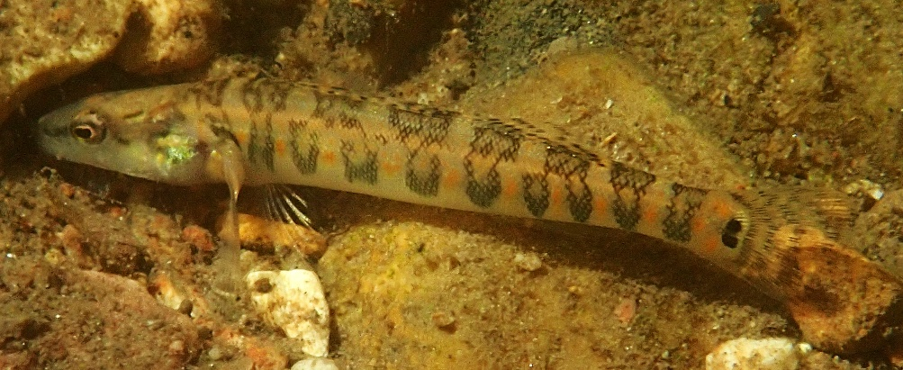
WATER QUALITY STANDARDS
Water quality must meet standards for the uses of that water body (i.e. protection of aquatic life, human health-fish consumption)
If standards are not met, human health and aquatic life may suffer
MDC photo
Understanding Water Chemistry
Temperature
Dissolved Oxygen
pH
Dissolved Solids
Nutrients
Turbidity
Data Sheet & Methods
Notes:
Niangua Darter is currently an endangered species in Missouri

Slide 8
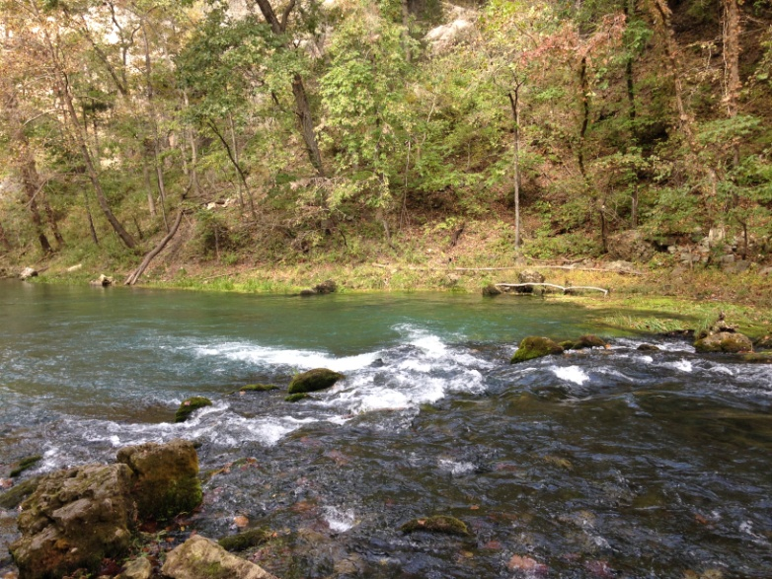
MONITORING WATER CHEMISTRY
Monitor water chemistry 4 times a year, if possible – once per season
Flow impacts chemistry –
try to also measure
stream discharge when
monitoring water
chemistry
Understanding Water Chemistry
Temperature
Dissolved Oxygen
pH
Dissolved Solids
Nutrients
Turbidity
Data Sheet & Methods

Slide 9
TEMPERATURE

Slide 10

EFFECTS OF TEMPERATURE
Amount of dissolved gas in water
Rate of plant growth and photosynthesis
Toxicity
Metabolic rate of organisms
Sensitivity of organisms
Understanding Water Chemistry
Temperature
Dissolved Oxygen
pH
Dissolved Solids
Nutrients
Turbidity
Data Sheet & Methods
Notes:
Effects of Temperature
Temperature affects the amount of dissolved gas in the water. The gas we are focusing on is oxygen (O₂).
The rate of plant growth increases with warmer temperatures. More plant growth means greater O₂ because of photosynthesis.
Rate of photosynthesis from plant growth changes with temperature. Photosynthesis is important to aquatic systems since plants produce oxygen during daylight hours.
Certain pollutants can become more toxic at increased temperatures, as well as modify the state of a chemical
As water warms, metabolic rates speed up and organisms need more oxygen, including speeding up the rate of decomposition.
Changing the temperature range of a stream can change the whole ecosystem. Many organisms require a specific temperature range so if that range is shifted to a higher one, many species of invertebrates and fish will no longer be present.

Slide 11
TEMPERATURE (WQ STANDARD)
Water temperatures shall not exceed:
Type of Water Body | Water Temperature Standard
Warm water fisheries | 32˚C (90˚F)
Cool water fisheries | 29˚C (84˚F)
Cold water fisheries | 20˚C (68˚F)
Understanding Water Chemistry
Temperature
Dissolved Oxygen
pH
Dissolved Solids
Nutrients
Turbidity
Data Sheet & Methods
Notes:
Temperature (WQ Standard)
Examples of cold water fisheries are areas which support specific aquatic taxa such as trout, hellbenders, red belly dace, etc.
Examples of cool water fisheries include the majority of our Ozark streams that support smallmouth and rock bass
This is an imperfect classification system but is a current work in progress
The Clean Water Commission states that contaminants are not to contribute to temperatures in excess of 90° F (32° C) for warm water fisheries and 84° F (29° C) for cool water fisheries. This is the Water Quality Standard for Temperature in Missouri streams and lakes. The maximum temperature allowed for cold water fisheries is 68° in order to support cold-water fish such as trout.

Slide 12
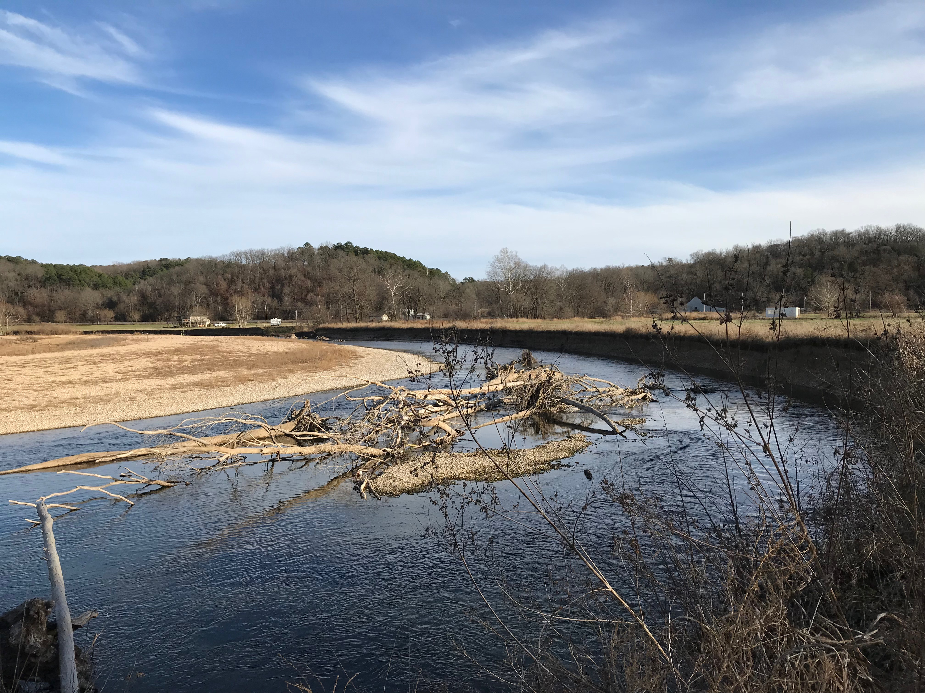
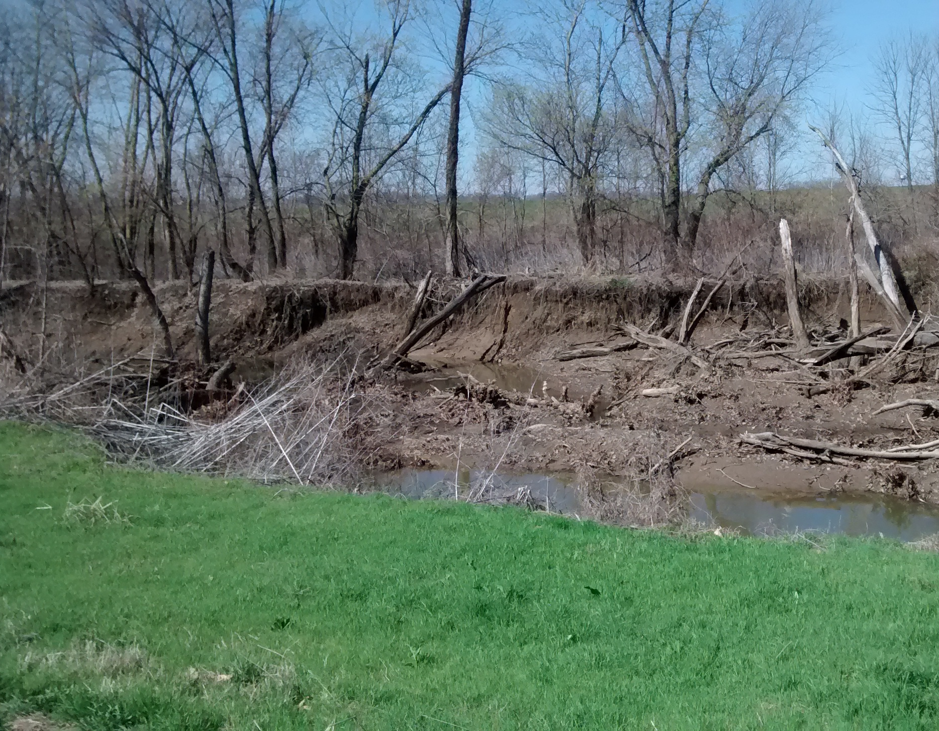
HUMAN IMPACTS
Riparian cover removal
Soil erosion: ​increased turbidity
Understanding Water Chemistry
Temperature
Dissolved Oxygen
pH
Dissolved Solids
Nutrients
Turbidity
Data Sheet & Methods
Notes:
Human Impacts on Water Temperature
Riparian cover removal
What if the trees in the riparian zone were removed from a cold-water trout stream? It is likely that our cold-water stream would not remain cold as long, because there would no longer be any shade.
Soil Erosion –> increased turbidity –> suspended solids absorb radiation and warm the waters

Slide 13
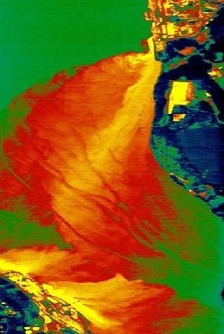
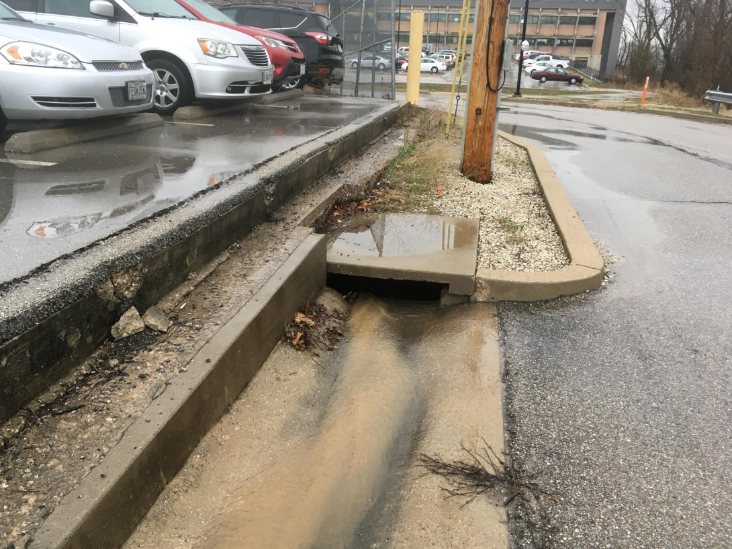
THERMAL POLLUTION
Industrial Thermal Pollution
Impervious Thermal Pollution
Understanding Water Chemistry
Temperature
Dissolved Oxygen
pH
Dissolved Solids
Nutrients
Turbidity
Data Sheet & Methods
Notes:
(Human Impacts on Water Temperature) Thermal Pollution
Left: Industrial discharges
Rright: impervious discharges
Thermal Pollution
Sources of thermal pollution include warm or hot water from a power plant or industrial discharge and runoff from impervious surfaces such as parking lots and streets.
Impervious Surfaces
Impervious surfaces are anything that does not absorb water such as concrete, asphalt, roof tops and compacted soils. Impervious surfaces get very hot in the summer and stormwater runoff from these surfaces can reach as much as 120o Fahrenheit.
Ask the students at this point, Where does the stormwater go after a rainfall event? To the stream!

Slide 14
DISSOLVED OXYGEN

Slide 15
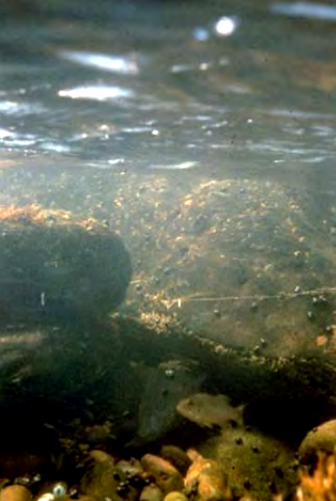
WHY MONITOR DISSOLVED OXYGEN?
Oxygen is critical for all life in a stream
Terrestrial vs. Aquatic
  Air: 210,000 ppm O₂
    21% oxygen
  Water: 5-15 ppm O₂
    0.0005% - 0.0015% dissolved oxygen
  Note: parts per million (ppm) ≈ milligrams per Liter (mg/L)
Understanding Water Chemistry
Temperature
Dissolved Oxygen
pH
Dissolved Solids
Nutrients
Turbidity
Data Sheet & Methods
Notes:
Why Monitor Dissolved Oxygen?
Terrestrial vs. Aquatic
Air: 210,000 ppm O₂
Water: 5 – 15 ppm O₂
Waves and tumbling saturate water with oxygen through aeration, just like an aquarium aerator.
The oxygen can also dissolve into the water from the atmosphere.
Note: parts per million (ppm) is approximately equal to milligrams per Liter (mg/L)

Slide 16

SOURCES OF DISSOLVED OXYGEN (D.O.)
Oxygen becomes dissolved in water by:
Waves and tumbling action
Diffusion from atmosphere
Photosynthesis
Understanding Water Chemistry
Temperature
Dissolved Oxygen
pH
Dissolved Solids
Nutrients
Turbidity
Data Sheet & Methods
Notes:
Sources of Dissolved Oxygen (D.O.)
Oxygen becomes dissolved in water by:
Waves and tumbling saturating water with oxygen through aeration
Dissolved into water from atmosphere
Photosynthesis from algae and other aquatic plants

Slide 17
IMPORTANCE OF D.O.
Aquatic Organisms need a certain level of D.O. for survival
Depletion of D.O. can cause a population shift in the organisms present in a stream from sensitive to tolerant organisms
The Water Quality Standard for D.O. is no less than 5 mg/L (5 ppm)
Understanding Water Chemistry
Temperature
Dissolved Oxygen
pH
Dissolved Solids
Nutrients
Turbidity
Data Sheet & Methods
Notes:
Importance of Dissolved Oxygen
Dissolved Oxygen (D.O.) is essential for the maintenance of healthy waterways.
Most aquatic life needs a certain level of dissolved oxygen for survival. A depletion of D.O. can cause a major shift in the organisms present in a stream from pollution sensitive to pollution tolerant species
The Water Quality Standard for Dissolved Oxygen in Missouri for warm and cool waters is no less than 5 mg/L (5 ppm). For cold water fisheries the WQ standard for D.O. is 6 mg/L or 6 ppm.

Slide 18
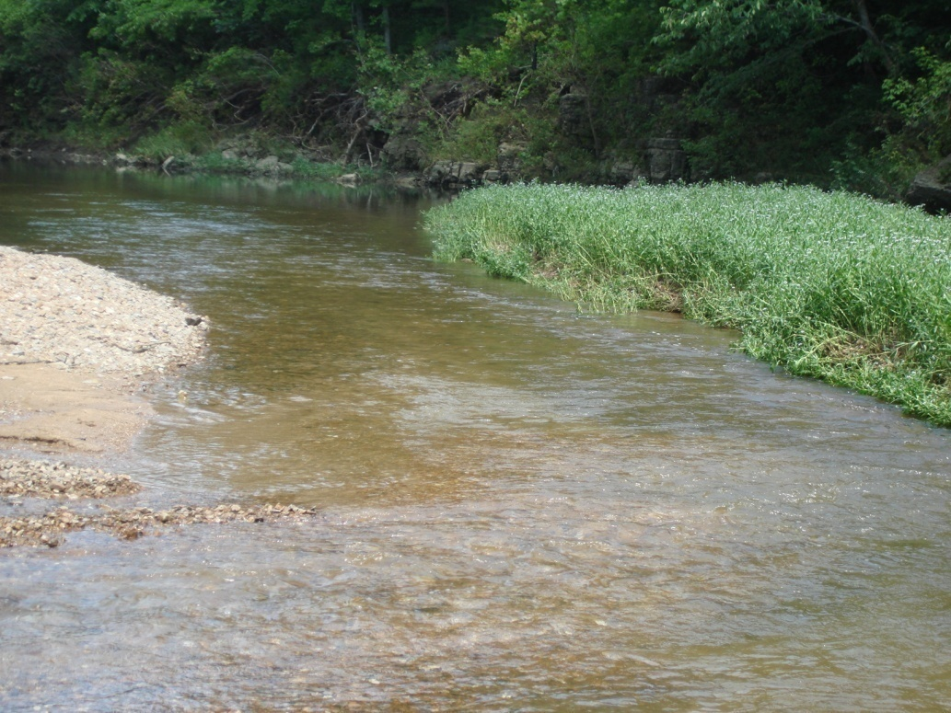
NATURAL INFLUENCES ON D.O
Temperature
Flow
Dissolved and suspended solids
Aquatic Plants:
Photosynthesis
Understanding Water Chemistry
Temperature
Dissolved Oxygen
pH
Dissolved Solids
Nutrients
Turbidity
Data Sheet & Methods
Notes:
Natural Influences on Dissolved Oxygen
Temperature
Air temperature, water temperature, groundwater influences and the seasons.
Flow
Without flow, there will be no aeration in the stream and thus less oxygen.
Dissolved and Suspended Solids
Oxygen dissolves more readily in water that does not contain a high concentration of salts, minerals or other solids. Some level of suspended solids, such as certain amounts of sediment and algae, are natural to streams.
Aquatic Plants
Suspended algae are microscopic plants that float in the water and give it its green color (phytoplankton). As long as the sun shines, algae and other aquatic plants produce oxygen through the process of photosynthesis. They do not produce oxygen at night. If algae is present in excessive quantities, it can have a great impact on D.O., as you will see in the coming slides.

Slide 19
HUMAN IMPACTS ON D.O.
Removal of riparian corridor vegetation
Dams
Organic waste – sources include:
  Stormwater/Urban Runoff
  Septic systems
  Wastewater treatment plants
  Animal feedlots
  Discharges from food processing plants
Understanding Water Chemistry
Temperature
Dissolved Oxygen
pH
Dissolved Solids
Nutrients
Turbidity
Data Sheet & Methods
Notes:
Human Impacts on Dissolved Oxygen
Removal of Riparian Corridor Vegetation
Increases temperature
Dams
Water discharged from dams can be supersaturated with D.O. or nearly devoid of it. It depends on where the water comes from in the lake. If it is taken from the bottom of the lake it may be almost devoid of D.O. On the other hand if the water comes form the top layer of the lake is may be high in D.O. In this case, the addition of more oxygen as is tumbles over the spillway can cause the water to become supersaturated with oxygen. Too much D.O. can actually kill fish by causing the same symptoms as “the bends” does in divers when they ascend too quickly.
Organic Waste
This includes excrement from animals as well as dead plants and animals. D.O. is impacted because aerobic bacteria consume oxygen as they decompose organic waste. Also, organic waste is high in nitrogen and may be high in phosphorous. Since these are the compounds of fertilizer, plant growth can be stimulated which will also have an impact on D.O.
Sources of Organic Waste
Stormwater/Urban runoff
Septic systems
Wastewater treatment plants
Runoff from Animal feedlots
Discharges from food processing plants
Urban Runoff
Urban runoff can be high in organic waste from malfunctioning septic systems, leaking sewer lines, and lawn fertilizer. Urban runoff can also affect the D.O. by affecting temperature. Urban runoff comes form impervious surfaces such as concrete, asphalt, roofs and even compacted soils.
Anything that is deposited and accumulates on streets and sidewalks has the potential of being transported in our streams in rainfall and snowmelt events.
Examples:
Pet waste, lawn fertilizer, grass clippings & leaves to name a few.
Remember that urban runoff from these surfaces can be very hot in the summer. What happens to the capacity of the water to hold D.O. as it gets hotter?

Slide 20
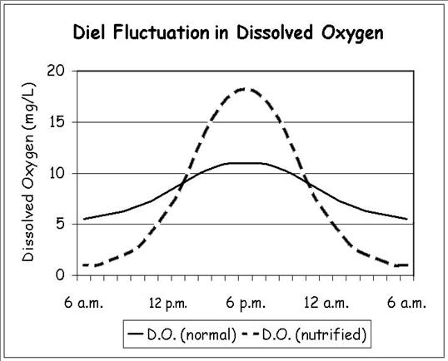
DIEL (DAILY) FLUCTUATION IN D.O
Understanding Water Chemistry
Temperature
Dissolved Oxygen
pH
Dissolved Solids
Nutrients
Turbidity
Data Sheet & Methods
Notes:
Diel Fluctuation in Dissolved Oxygen
Diel means daily, so this graph represents the daily fluctuation of dissolved oxygen values in the summer.
Why is the D.O. lower at 6 a.m. than at 6 p.m.?
It is lower because algae and other aquatic plants switch from photosynthesis to respiration at night and are therefore using oxygen, not producing it. At night, the only source of dissolved oxygen may be a result of physical aeration as the water tumbles over rocks and other obstructions.
What if it’s a slow moving stream and there is not much aeration?
Also consider when it is summer and the stream water may get quite warm. Warm water cannot hold as much D.O. as cool water, and simultaneously, warm water results in the metabolic rates or organisms being increased. The higher the metabolic rate, the greater the demand for oxygen in order for organisms to function.
This applies to bacteria that are constantly (day and night) decomposing the dead plant and animal matter falls to the bottom of the stream. The constant decomposition process requires oxygen. All of these factors together result in more oxygen being used at night that is physically added to the stream via aeration during the night. Therefore, it’s normal for the amount of D.O. in the water to decrease as night goes on, only to increase once the sun comes out and photosynthesis starts again.
However, if these processes occur to extreme levels, subsequent extreme fluctuations in dissolved oxygen, represented by the dashed lie on the graph can occur. Many factors could contribute to this occurrence, including:
Removal of trees from the riparian zone that would normally provide shade for the water and help control erosion.
If streams receive excess nutrients (N, P) from fertilizers running off the watershed, it may result in the excessive production of algae. Excessive production is often called a “bloom” and can cause extreme diel fluctuations in D.O.
If the previously mentioned factors result in a large dip in D.O. at night, you may have problems first thing in the morning. Note that the graph, the D.O. levels at 6:00 A.M. is within lethal limits for aquatic life – in other words, organisms requiring oxygen could begin to die! This may especially be true if night is followed by a cloudy day!
This is why water quality professionals try to take D.O. readings early in the morning.

Slide 21
D.O. PERCENT SATURATION
D.O. concentration tells us how much oxygen is in the water
How do we know whether there is enough oxygen in the water?
DO Percent Saturation: Ratio of amount of oxygen present in water to the maximum the water could hold at that temperature in the absence of other influences
More meaningful indicator than a D.O. reading alone
Understanding Water Chemistry
Temperature
Dissolved Oxygen
pH
Dissolved Solids
Nutrients
Turbidity
Data Sheet & Methods
Notes:
Concentration= mg/L
Like finding percentage score on a test

Slide 22
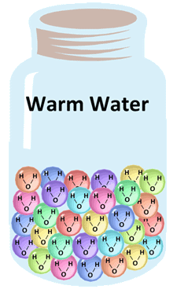
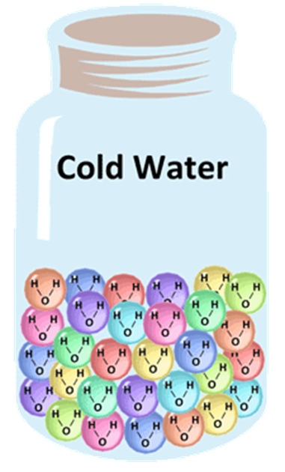
HOW DOES TEMPERATURE INFLUENCE D.O. SATURATION?
*Due to more energy in warm water, water molecules move faster resulting in a lower ability to hold on to oxygen molecules
*Cold water has lower energy and slower moving water molecules, allowing it to retain oxygen molecules
Understanding Water Chemistry
Temperature
Dissolved Oxygen
pH
Dissolved Solids
Nutrients
Turbidity
Data Sheet & Methods
Notes:
Why does cold water hold more oxygen than warm water?
Warm water allows for larger spaces between molecules where oxygen can readily escape.
Cold water is more closely packed together with smaller spaces between molecules holding oxygen tighter

Slide 23
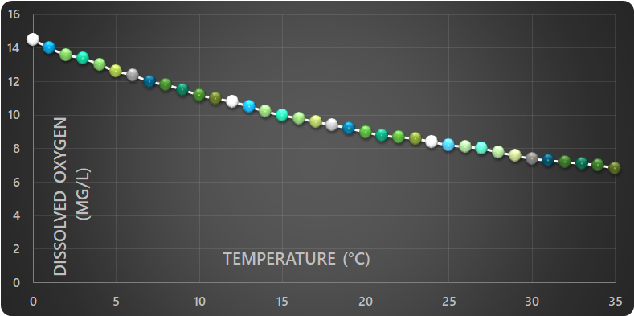
D.O. SATURATION
As water temperature increases, the amount of oxygen it takes to saturate the water decreases
Cold water can hold more oxygen than warmer water
Understanding Water Chemistry
Temperature
Dissolved Oxygen
pH
Dissolved Solids
Nutrients
Turbidity
Data Sheet & Methods
Notes:
Dissolved Oxygen Saturation
D.O. Saturation = maximum level of dissolved oxygen that would be present in the water at a specific temperature, in the absence of other influences.
Percent Saturation = a more meaningful water quality indicator than a DO reading alone, because it tells us whether a D.O. measurement is good or bad.

Slide 24
D.O. PERCENT SATURATION
Example: a D.O. of 8 mg/L
In the summer, when water temperatures are high, could be an excellent result
In winter, when water temperatures are low, could indicate problems
D.O. Saturation takes the guesswork out of interpreting D.O. measurements
Understanding Water Chemistry
Temperature
Dissolved Oxygen
pH
Dissolved Solids
Nutrients
Turbidity
Data Sheet & Methods
Notes:
D.O. Saturation
What is good or bad D.O. measurement?
Remember that D.O. depends on water temperature.
Example: A D.O. of 8 mg/L in the summer, when water temperatures are high, could be an excellent result.
Where a D.O. reading of 8 mg/L in winter, when water temperatures are low, could indicate problems.

Slide 25
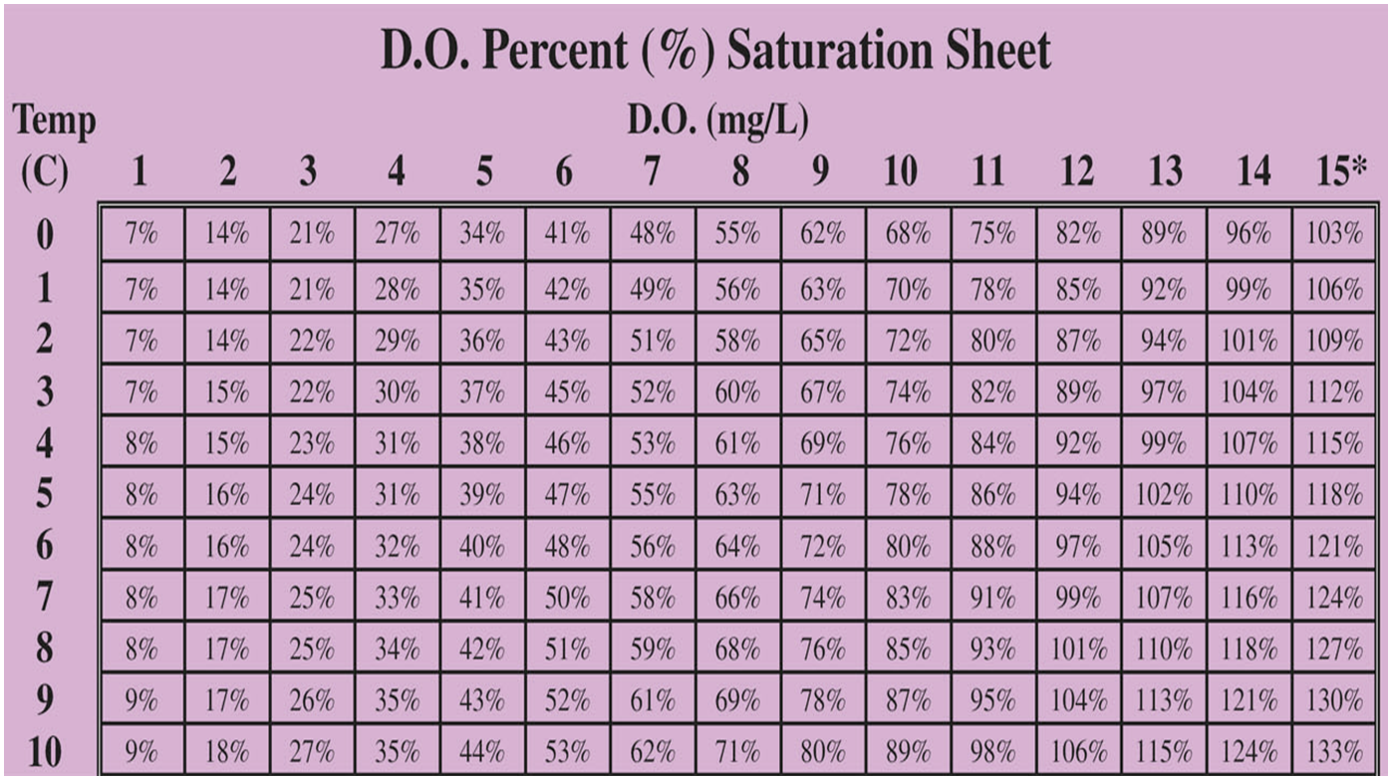



D.O. PERCENT SATURATION CHART
Understanding Water Chemistry
Temperature
Dissolved Oxygen
pH
Dissolved Solids
Nutrients
Turbidity
Data Sheet & Methods
Notes:
D.O. Percent Saturation Chart
For example, you collected data at your stream site; the water temperature was 9º and the D.O. was 10 mg/L. To determine the percent saturation find your D.O. reading on the top axis and your temperature reading on vertical axis and cross reference to find the saturation. Therefore the saturation would be 87%.
What would the saturation be if the water temperature was 6º and the D.O. was 8mg/L? Answer: 64%
Remember that since D.O. is a gas it can supersaturate water and be more than 100%.

Slide 26
D.O. PERCENT SATURATION
The introduction of oxygen into the water can exceed what is being taken up by organisms or released into the atmosphere.
Understanding Water Chemistry
Temperature
Dissolved Oxygen
pH
Dissolved Solids
Nutrients
Turbidity
Data Sheet & Methods
Notes:
DO Saturation (cont.) – General Rule for Ozark Streams
A General Rule for Ozark Streams
>80% D.O. saturation reflects healthy D.O. levels
<80% D.O. saturation reflects water quality impairment

Slide 27
D.O. PERCENT SATURATION
Acceptable D.O. Percent Saturation Levels
Ozark Stream (high gradient, rocky bottom) | >80% D.O. Saturation
Prairie Streams (Low-gradient or slow moving) | >60% D. O. Saturation
Understanding Water Chemistry
Temperature
Dissolved Oxygen
pH
Dissolved Solids
Nutrients
Turbidity
Data Sheet & Methods
Notes:
DO Saturation (cont.) – General Rule for Ozark Streams
A General Rule for Ozark Streams
>80% D.O. saturation reflects healthy D.O. levels
<80% D.O. saturation reflects water quality impairment

Slide 28
pH

Slide 29
pH = PARTS HYDROGEN IONS (H⁺)
Water contains both Hydrogen (H⁺) and Hydroxide (OH⁻) ions
pH measures the H⁺ concentration on a scale from 0 to 14
Water that contains equal numbers of H⁺ and OH⁻ is considered neutral (pH 7)
14
Neutral
7
0
Understanding Water Chemistry
Temperature
Dissolved Oxygen
pH
Dissolved Solids
Nutrients
Turbidity
Data Sheet & Methods
Notes:
pH ↔ Potential (or parts) Hydrogen Ions (H⁺)
Water contains both Hydrogen (H⁺) and Hydroxyl (OH⁻) ions. pH measures the H⁺ concentration on a scale from 0 to 14.
Water that contains equal numbers of H⁺ and OH⁻ is considered neutral (pH 7).

Slide 30
pH = PARTS H⁺ IONS
Water that contains more H⁺ ions than OH⁻ ions is acidic and has a pH less than 7
Water that contains more OH⁻ ions than H⁺ ions is basic and has a pH greater than 7
14
Base
Neutral
7
Acid
0
Understanding Water Chemistry
Temperature
Dissolved Oxygen
pH
Dissolved Solids
Nutrients
Turbidity
Data Sheet & Methods
Notes:
Water that contains more H⁺ ions than OH⁻ ions is acidic and has a pH less than 7
Water that contains more OH⁻ ions than H⁺ ions is basic and has a pH greater than 7

Slide 31
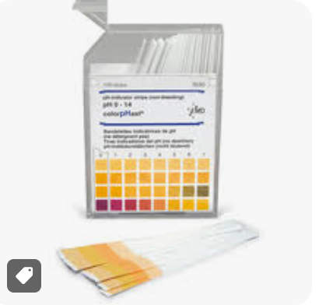
pH = PARTS H⁺ IONS
One unit on the pH scale is a ten-fold H⁺ ion change
Examples:
Increase from 7 to 8 =
10 times more basic
Increase from 7 to 9 =
100 times more basic
Understanding Water Chemistry
Temperature
Dissolved Oxygen
pH
Dissolved Solids
Nutrients
Turbidity
Data Sheet & Methods
Notes:
Picture: pH meters we give to volunteers
The pH scale is interesting because 1 unit of change in pH represents a ten-fold change in hydrogen ion concentration.
One unit on the pH scale is a ten-fold H⁺ ion change
Rounding and averaging pH makes a difference because of the nature of the log scale.

Slide 32
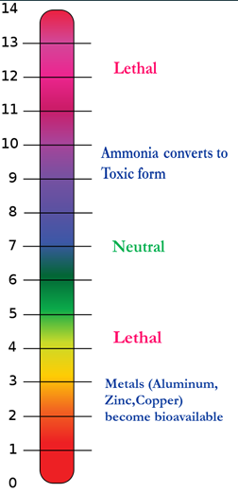
pH SCALE
Normal stream water pH ranges from 7.0 to 8.0
The Water Quality Standard in Missouri for pH is a range of 6.5-9.0
pH outside this range is toxic to most aquatic life
Understanding Water Chemistry
Temperature
Dissolved Oxygen
pH
Dissolved Solids
Nutrients
Turbidity
Data Sheet & Methods

Slide 33
DISSOLVED SOLIDS

Slide 34
CONDUCTIVITY
Measure of the potential electrical current passing through water
General indicator of dissolved solids in a stream (more dissolved solids=higher electrical conductivity)
Measured in microsiemens per centimeter (μS/cm)
Understanding Water Chemistry
Temperature
Dissolved Oxygen
pH
Dissolved Solids
Nutrients
Turbidity
Data Sheet & Methods

Slide 35

CONDUCTIVITY
Common dissolved solids:
  Bicarbonate Chloride
  Calcium Sodium
  Magnesium Potassium
  Sulfate
  There is currently no Water Quality Standard for conductivity in Missouri streams
Understanding Water Chemistry
Temperature
Dissolved Oxygen
pH
Dissolved Solids
Nutrients
Turbidity
Data Sheet & Methods
Notes:
Conductivity (cont.) seven common substances make up 99% of the Dissolved Solids in streams
Here are some common substances that make up dissolved solids in a stream.
Since conductivity is a general indicator of water quality, any substance that adds to the electrical conductance in the water can be represented in a conductivity reading.
Therefore, conductivity is often used as a screening tool to determine how much solids are dissolved in the water. So again, keep in mind that a conductivity measurement does not tell us what specific dissolved substances are in the water, just how much.
Small amounts of certain dissolved solids, such as some metals, can cause significant changes in conductivity.
There is currently no Water Quality Standard for Conductivity in Missouri waters

Slide 36
CONDUCTIVITY READINGS
Stream | Conductivity Range
Pickle Creek | 40 – 60 μS/cm
Big Piney River | 200 – 350 μS/cm
Grand River | 350 – 550 μS/cm
Missouri River | 400 – 750 μS/cm
Wastewater Effluent | 800 – 2000 μS/cm
N. MO Groundwater | 800 – 2000 μS/cm
Understanding Water Chemistry
Temperature
Dissolved Oxygen
pH
Dissolved Solids
Nutrients
Turbidity
Data Sheet & Methods
Notes:
Different streams have a variety of natural background conductivity
Pickle Creek – geology has igneous rhyolite and granite – less dissolvable than limestone
Big Piney – geology – dolomite/karst topography – dissolves more readily
The larger the waterbody the increase in point & nonpoint source impacts that can influence conductivity

Slide 37
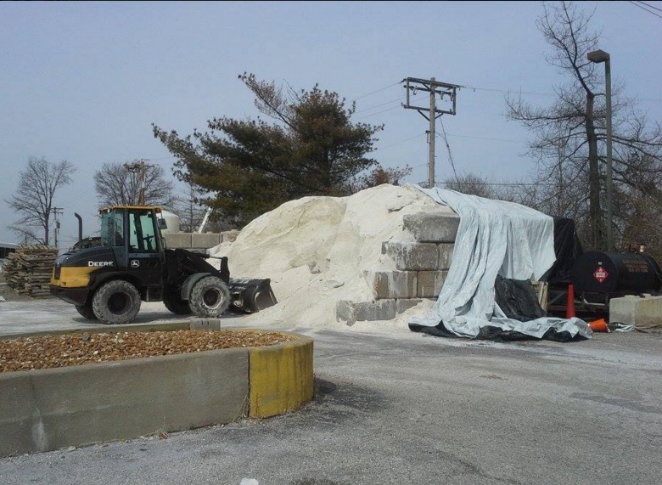
CHLORIDES
Chlorides are salts resulting from the combination of gas chlorine and various metals
Sources:
Road salt (NaCl)
Fertilizers
Underground aquifers
Water softeners
Storm sewers
Animal feed
Wastewater treatment discharges
Understanding Water Chemistry
Temperature
Dissolved Oxygen
pH
Dissolved Solids
Nutrients
Turbidity
Data Sheet & Methods
Notes:
Road Salts
Road salts often have heavy metal additives so other harmful substances may be present.
As you can imagine, as vehicles travel at higher speeds the distance these salts can travel increases – up to 130 ft!

Slide 38
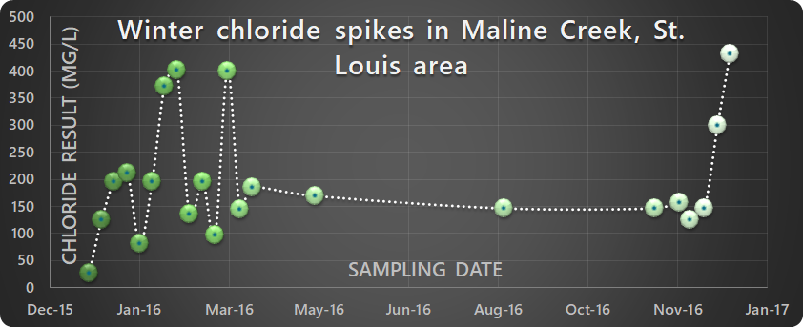
CHLORIDE SPIKES
Spikes can occur:
  Summer when Evaporation > Precipitation
  Spring/fall with Fertilizer application
  Winter with snow and ice melt, rain
Notes:
Here is a graph depicting chloride spikes on an urban stream in St. Louis called Maline Cr.
Spikes can occur during summer during low flows when evaporation exceeds precipitation

Slide 39
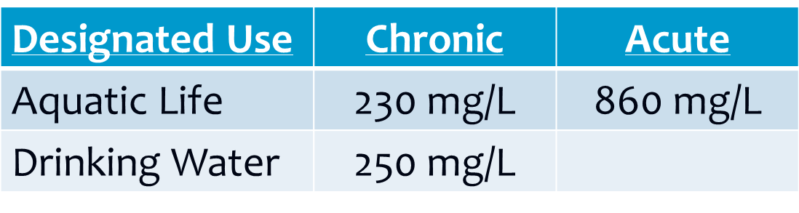
PROBLEMS WITH CHLORIDES
High levels are toxic to aquatic life
Invasive species can be more tolerant, and outcompete native aquatic species
The Water Quality Standard for Missouri
Understanding Water Chemistry
Temperature
Dissolved Oxygen
pH
Dissolved Solids
Nutrients
Turbidity
Data Sheet & Methods
Notes:
High chloride levels interfere with osmoregulation in freshwater organisms
Some invasives (e.g. Eurasian water milfoil) are more tolerant of high chloride levels and can outcompete native organisms

Slide 40
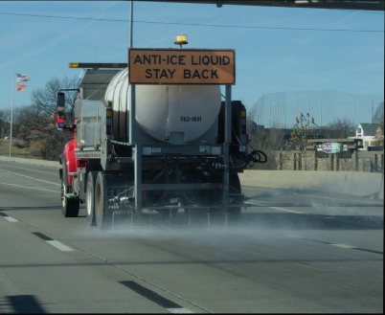
Best Management Practices for
ROAD SALT
Rate adjustments on salt spreaders
Brine pre-treatment
(St. Louis University
research project)
**Not a problem for all
streams; must be
Level 2 to monitor
Understanding Water Chemistry
Temperature
Dissolved Oxygen
pH
Dissolved Solids
Nutrients
Turbidity
Data Sheet & Methods
Notes:
Comparison of Contributions to Chloride in Urban Stormwater from Winter Brine and Rock Salt Application | Environmental Science & Technology (acs.org)
Because Chloride can become an issure for AQL and drinking water sources, cities have developed some best management practices to help mitigate these issues–
Rate adjustments on salt spreaders will help cities save money from not over-applying salt, and decrease the amount of chlordies potentially running off into surrounding streams.
Brine- pre treatment is when a salt solution is spread on the surface of roads, rather than salt crystals. A project was conducted in the St. Louis area in the winters of 2016 and 2017 describes how this method of road salt application can be more affective way to reduce chloride runoff.
**Not a problem for all
streams; must be
Level 2 to monitor

Slide 41
NUTRIENTS
Notes:
Now we’re going to talk about nutrients and how they affect stream systems

Slide 42
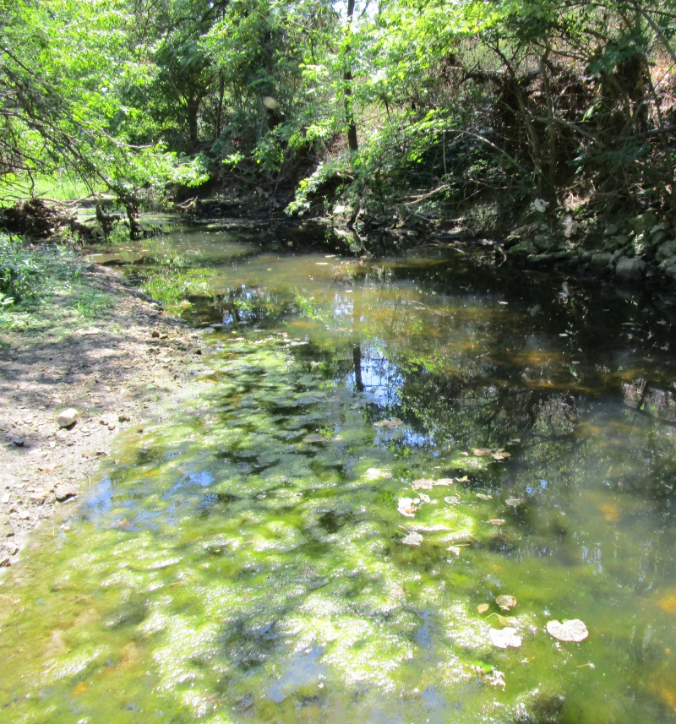
EUTROPHICATION PROCESS
Nutrient-rich runoff enters streams and lakes
Plants and algae grow abundantly
Algae blooms decrease oxygen in stream/lake
Wears Creek, Jefferson City
Fish and other aquatic life suffer or die
Understanding Water Chemistry
Temperature
Dissolved Oxygen
pH
Dissolved Solids
Nutrients
Transparency
Data Sheet & Methods
Notes:
Eutrophication Process
Man’s activities which introduce excess nutrients, along with other pollutants into water bodies can cause signification changes in aquatic environments.
Excess nutrients accelerate the process of eutrophication. Eutrophic means “well nourished”.
Artificial addition of nutrients can cause a cycle of algal blooms which in turn may cause diminished DO levels, fish kills, and water to become “unsightly.”

Slide 43
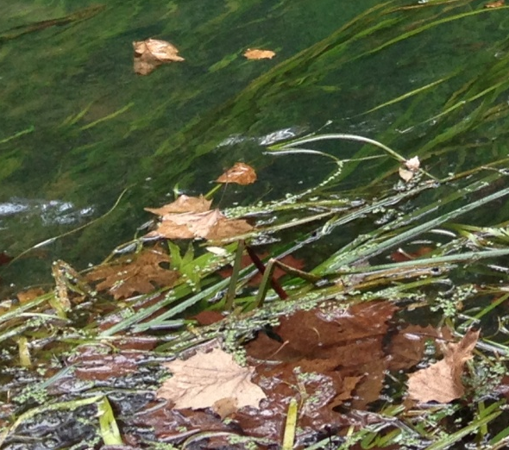
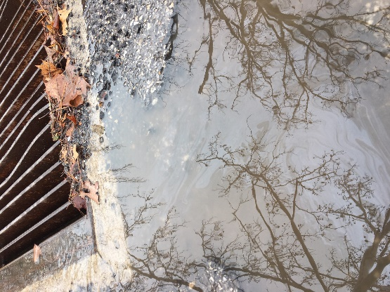
SOURCES OF NUTRIENTS
Natural Sources
Leaf fall
Organic Decay
Rocks and Soil (Phosphorous)
Anthropogenic Sources
Runoff from animal production
Runoff from fertilized fields/lawns
Wastewater from treatment plants
Poorly functioning septic systems
Storm drains
Combined sewer overflows (CSO)
Understanding Water Chemistry
Temperature
Dissolved Oxygen
pH
Dissolved Solids
Nutrients
Turbidity
Data Sheet & Methods

Slide 44
NITROGEN
Essential nutrient required by all living plants and animals (found in fertilizer)
All organic (living) matter contains nitrogen
Bacteria break down organic matter
Ammonia
(NH₃)
Nitrite
(NO₂)
Nitrate
(NO₃)
Understanding Water Chemistry
Temperature
Dissolved Oxygen
pH
Dissolved Solids
Nutrients
Turbidity
Data Sheet & Methods
Notes:
Nitrogen
Essential nutrient required by all living plants and animals (found in fertilizer)
[Click] All organic (living) matter contains nitrogen
[Click] Bacteria break down organic matter
NH₃ → NO₂ → NO₃-N
Ammonia → Nitrite → Nitrate

Slide 45
NITRATE
Expressed as nitrate-nitrogen (NO₃-N)
  “Nitrogen in the form of nitrate”
Nitrate is most stable nitrogen compound
  Indicator of excess nitrogen loading
VWQM’s measure nitrate
Ammonia
(NH₃)
Nitrite
(NO₂)
Nitrate
(NO₃)
Understanding Water Chemistry
Temperature
Dissolved Oxygen
pH
Dissolved Solids
Nutrients
Turbidity
Data Sheet & Methods
Notes:
Nitrogen (cont.)
The VWQ monitors measure nitrate. It is expressed as nitrate-nitrogen (NO₃-N), which means nitrogen in the form of nitrate.
Nitrate is the most stable nitrogen compound and is an indicator of excess nitrogen loading.

Slide 46
AVERAGE NITRATE VALUES (NO₃-N)
NITRITE + NITRATE as NITROGEN in mg/L
Stream | Average Value | Range
Mississippi | 2.39 | 0.56 – 4.53
Chariton | 0.73 | 0.38 – 1.43
Pomme de Terre | 0.15 | 0.02 – 0.81
Jacks Fork | 0.35 | 0.31 – 0.39
There is a nitrate Water Quality standard criterion of 10 mg/L only for Missouri streams that have a designated use as a drinking water source
Understanding Water Chemistry
Temperature
Dissolved Oxygen
pH
Dissolved Solids
Nutrients
Turbidity
Data Sheet & Methods
Notes:
Average Nitrate Values (NO₃-N)
Mississippi
The Mississippi is a very large watershed that covers 43% of the US and the basin covers more than 1,245,000 square miles (3,225,000 km²), including all or parts of 31 states and two Canadian provinces. Imagine all of the nitrogen sources that drain into a watershed.
Chariton
Drains approximately 1,870 square miles. Note that this is a channelized, meaning straightened, stream that drains an agricultural area.
Pomme de Terre
Drains an area comprised of pasture hayfields and woods.
Jack’s Fork
The Jack’s Fork’s nitrate values are lower. The watershed has relatively small impacts from point sources and has excellent vegetative cover, including the riparian zone along the stream.
There is currently no Water Quality Standard for Nitrates in Missouri Streams

Slide 47
AMMONIA (NH₃)
PH Scale
The only nutrient directly toxic to aquatic life
Toxicity dependent on the pH and temperature of the stream water
**Not a problem at all streams; must be Level 2 to monitor
Understanding Water Chemistry
Temperature
Dissolved Oxygen
pH
Dissolved Solids
Nutrients
Turbidity
Data Sheet & Methods
Notes:
Ammonia (NH₃)
Ammonia (NH₃) is the only nutrient that is directly toxic to aquatic life.
Toxicity of ammonia is dependent on the pH and temperature of the stream water.
At this point it is important to note that Ammonia levels are not usually a problem in most Missouri streams. Because this is the case, and that Ammonia kits are very expensive ($450 in 2014), the VWQM Program only provides kits to volunteers sampling in areas where ammonia levels could become a problem, like below waste treatment plants or below hog and poultry operations, and to volunteers who are trained through Level 2 of the VWQM Program.

Slide 48
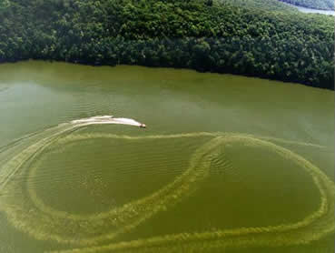
PHOSPHORUS
Occurs through natural weathering of rock and breakdown of organic matter
“Limiting nutrient” for plant growth in a body of water
Very small additions (0.01 mg/L) can cause large algal blooms
**Not a problem for all streams; must be Level 2 to monitor
In 1998 and 1999 two large algal blooms occurred on Table Rock Lake.
Understanding Water Chemistry
Temperature
Dissolved Oxygen
pH
Dissolved Solids
Nutrients
Turbidity
Data Sheet & Methods
Notes:
Phosphorus (cont.)
Phosphate is the nutrient in Missouri that limits plant growth (called “primary productivity”) in a body of water.
In instances where phosphate is the nutrient that limits plant growth, point source and nonpoint source pollution high in phosphate may stimulate the growth of aquatic plants.

Slide 49
TRANSPARENCY

Slide 50
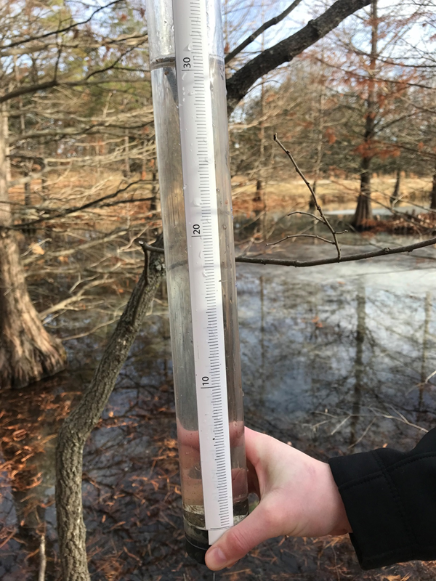
TRANSPARENCY
Measures the clarity of the water
Suspended matter and plankton cause cloudy, murky or very green water
Measured in centimeters
  Measures the depth that light can penetrate water
  The larger the depth reading, the higher the transparency
Understanding Water Chemistry
Temperature
Dissolved Oxygen
pH
Dissolved Solids
Nutrients
Transparency
Data Sheet & Methods
Notes:
Transparency
Transparency measures the clarity of the water.
Suspended matter (such as soil particles) and plankton (especially algae) most often cause cloudy, murky or very green water.
Transparency is measured in centimeter units, which is a measure of the depth that light can penetrate water

Slide 51
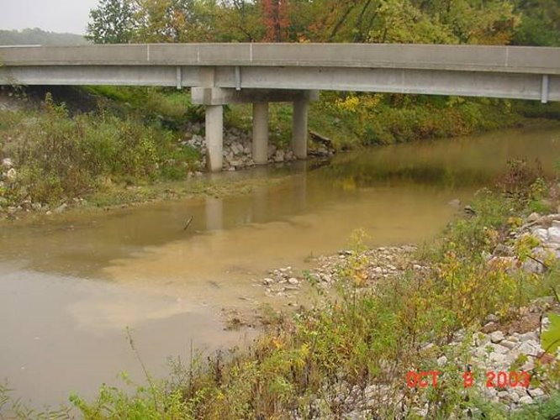
TRANSPARENCY
Impacts from low levels:
  Sediment blocks light needed for vegetation
  Suspended particles
  absorb heat and increase water temperature
  Sediment buries fish eggs and benthic invertebrates
Understanding Water Chemistry
Temperature
Dissolved Oxygen
pH
Dissolved Solids
Nutrients
Transparency
Data Sheet & Methods
Notes:
Transparency
Impacts from Low Transparency Levels
Sediment can block out light needed for vegetation
Suspended particles may absorb heat and thus increase water temperature
Sediment can bury fish eggs and benthic invertebrates

Slide 52
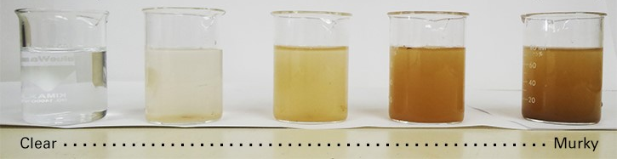
Suspended Sediment from SOIL EROSION = DECREASED TRANSPARENCY
Understanding Water Chemistry
Temperature
Dissolved Oxygen
pH
Dissolved Solids
Nutrients
Transparency
Data Sheet & Methods
Notes:
Soil Erosion – Decreases Transparency
As soil erodes particles suspended in the water column. These suspended particles absorb heat from light - like a black tee-shirt does compared to a white tee-shirt - increasing water temperature.

Slide 53
TRANSPARENCY
Areas where monitoring transparency can be particularly valuable:
  Areas being developed
  Areas not adopting best management practices to prevent soil erosion
  Downstream from quarries and gravel mining operations
Understanding Water Chemistry
Temperature
Dissolved Oxygen
pH
Dissolved Solids
Nutrients
Transparency
Data Sheet & Methods
Notes:
Transparency
Areas where monitoring turbidity can be particularly valuable:
Areas being developed where a great deal of construction and land disturbance is occurring.
Agricultural areas that have not adopted best management practices to prevent soil erosion
Downstream from quarries and gravel mining operations These activities can result in fines entering a stream and smothering habitat.

Slide 54
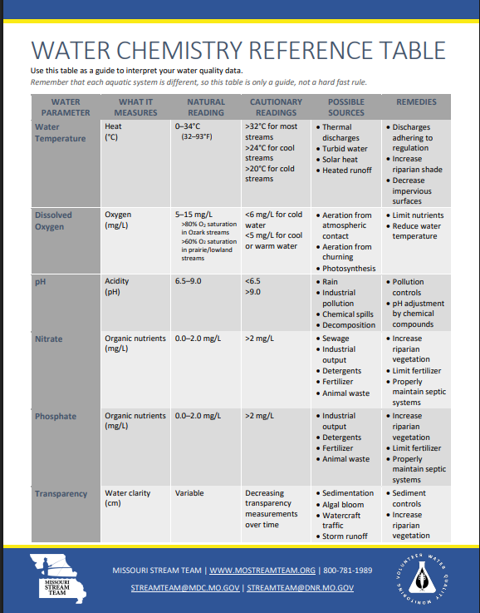
Understanding Water Chemistry
Temperature
Dissolved Oxygen
pH
Dissolved Solids
Nutrients
Transparency
Data Sheet & Methods
Notes:
Water Chemistry Reference Table
This is the water chemistry reference table, it is the yellow chart in the back of your chemistry chapter. It is a reference to tell you what are natural readings for each parameter, cautionary readings, possible sources/influences that may be affecting your reading and remedies.
Please remember this is a guide and not hard and fast rules!

Slide 55
DATA SHEETS & METHODS

Slide 56
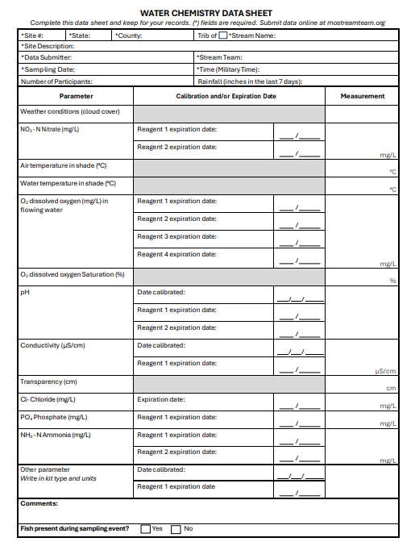
Header Information
Cloud cover
Nitrate result
Temperatures
D.O. result
pH result
Conductivity
For Level 2 and above monitors
Transparency
Understanding Water Chemistry
Temperature
Dissolved Oxygen
pH
Dissolved Solids
Nutrients
Turbidity
Data Sheet & Methods
Notes:
Water Chemistry Data Sheet
First fill out the heading of the data sheet found in the appendix of your notebook and in your packet.
Site number
Be consistent with your site numbers. If it is a new site check the box and be sure to include a map with a dot or a mark pinpointing your site. Remember, if we can’t locate your site and don’t know where you are the data will not do anyone any good!
Stream Name
Use the name that shows on a map, please don’t use local names
County
Site Description
Be consistent with your site description. For example, if your site description is “ 200 yards upstream from Highway K bridge” it should remain the same for each monitoring event. If you collect data on later monitoring trips and write “Highway K bridge”, then “50 yards upstream from Highway K bridge”, on data sheets following we can’t really tell if you are monitoring the same site since a site is 300ft/100 yards.
Trained Data Submitter This is the person that is responsible for the data that has attended the workshop
Also, tell us when your reagents expire.

Slide 57
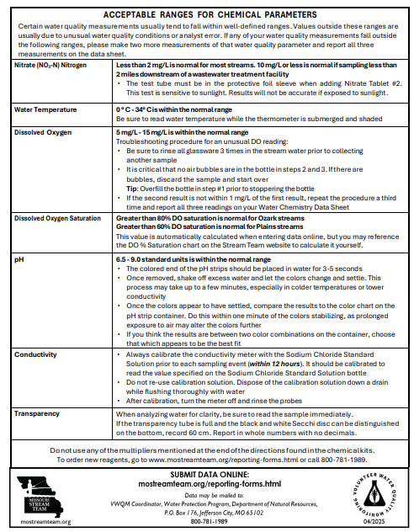
Understanding Water Chemistry
Temperature
Dissolved Oxygen
pH
Dissolved Solids
Nutrients
Turbidity
Data Sheet & Methods
Notes:
Water Chemistry Data Sheet
On the back of the data sheet you will find Acceptable Ranges for Chemical Parameters. These ranges are considered to be the normal ranges for the chemical parameters you measure. If you are out side of these ranges for any of these parameters you will find trouble shooting directions for the chemical kits. If you go through these trouble shooting directions and find that you readings are still outside of normal ranges please repeat the measurement two more times and report all three measurement on you data sheet.
If something seems very unusual such as a D.O. of 2 mg/L or a pH of 10.2, please call the program immediately

Slide 58
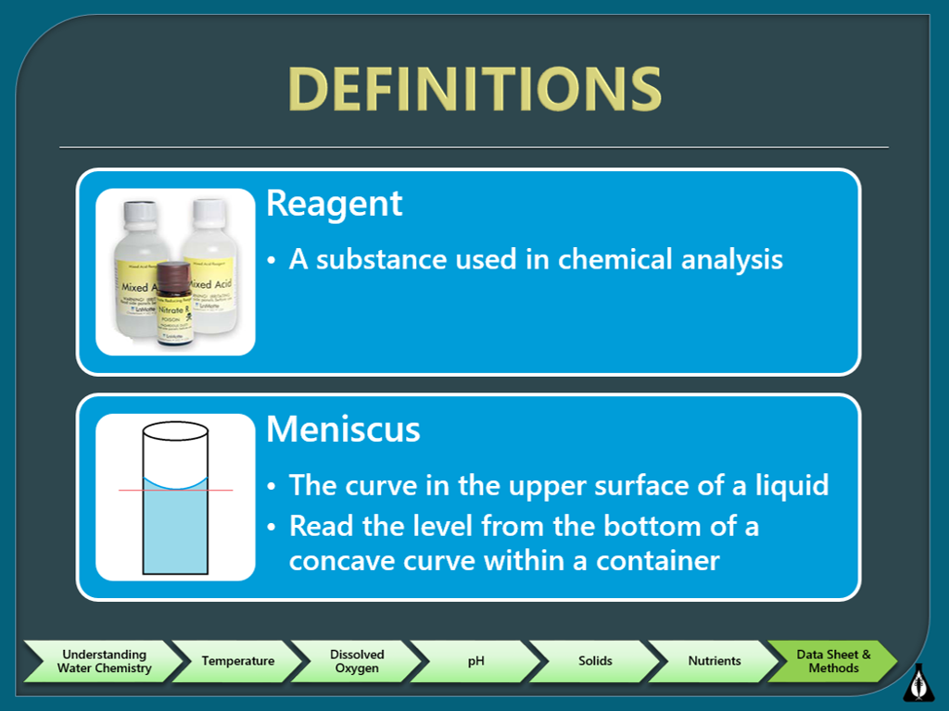

Slide 59
Temperature
Air
Place in shade
Water
Place in stream in shade
Read thermometer while it's in the water
Allow to acclimate several minutes
Allow to acclimate several minutes
Take reading while still in shade
Understanding Water Chemistry
Temperature
Dissolved Oxygen
pH
Solids
Nutrients
Data Sheet & Methods
Notes:
After the Introductory workshop, we provided you with a simple armor case thermometer. Use this for measuring temperature, not the pH or conductivity meters.
It’s important to measure air temperature first as water residue on the thermometer will affect the air reading.
Always take the readings in the shade and allow several minutes for the thermometer to acclimate.
The thermometers used by our program use an alcohol or citrus based liquid. If this liquid becomes separated, please request a new thermometer from the program. The defective thermometer may be discarded in the trash.

Slide 60
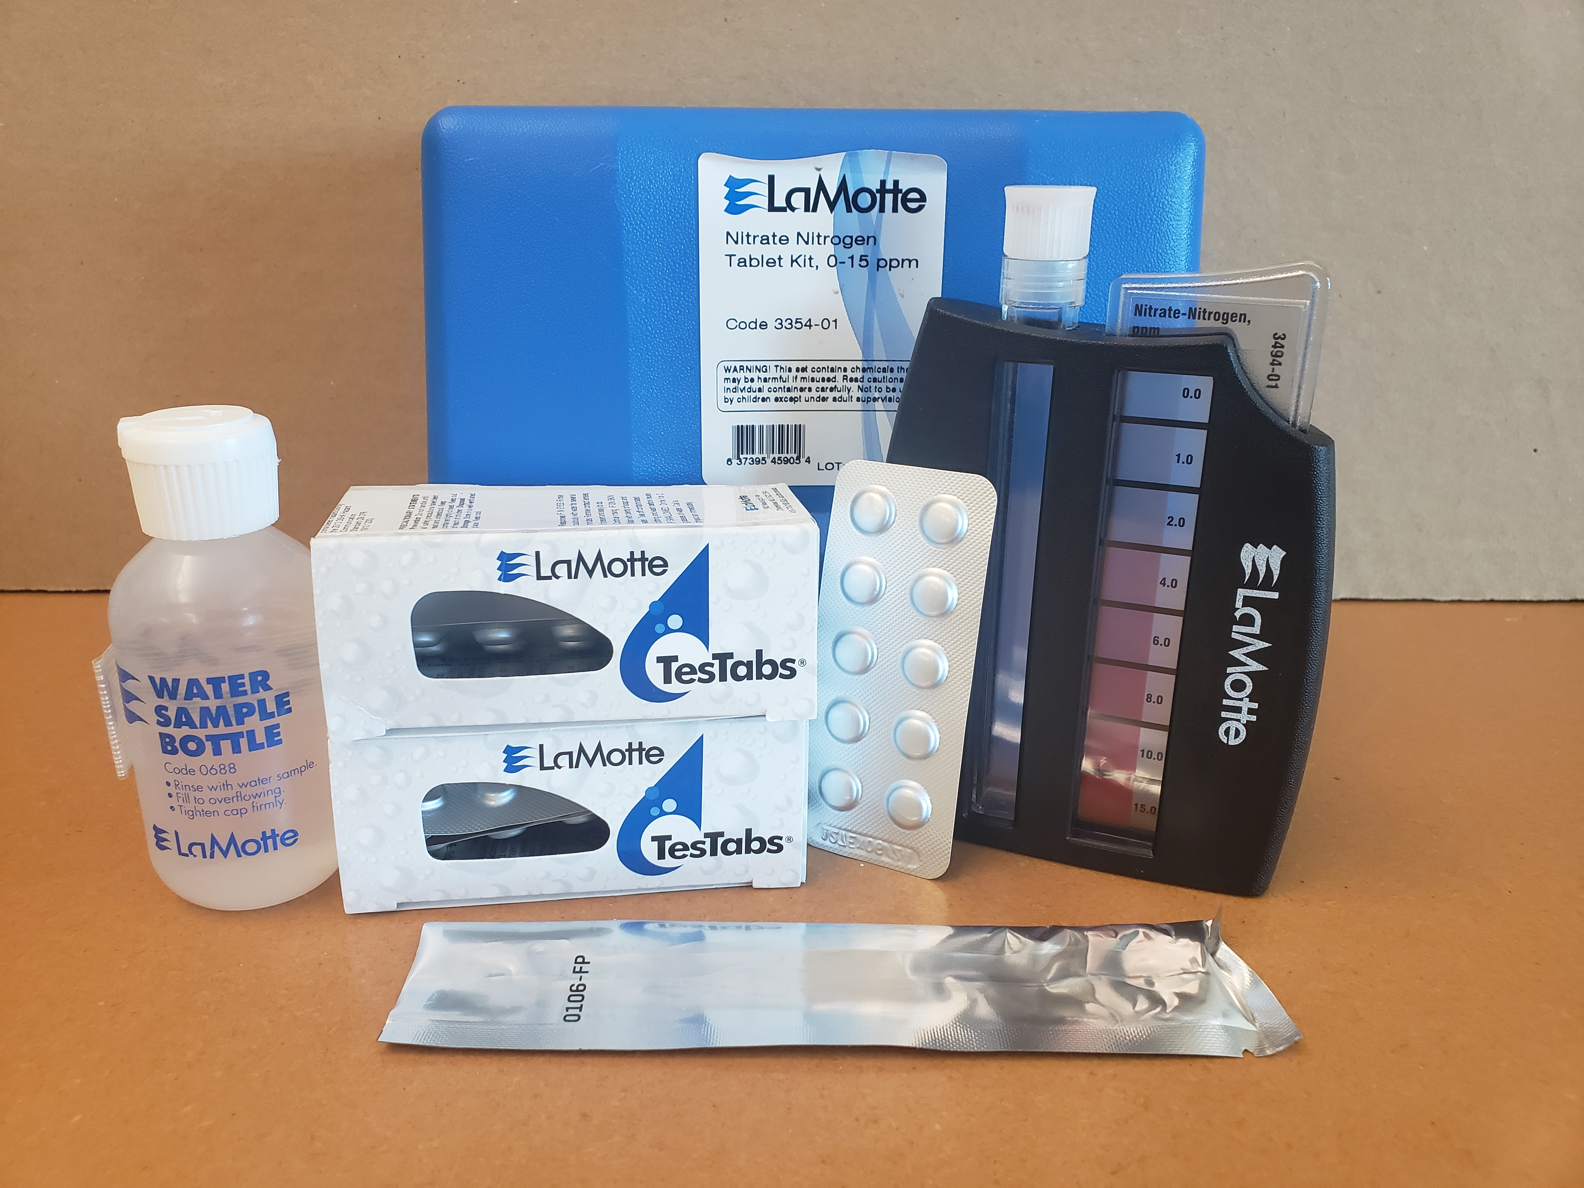
Nitrate Test kit
Notes:
Steps:
Fill test tube to 5 mL line with sample water
2) Add one Nitrate #1 Tablet
Cap and mix until tablet disintegrates
Add one Nitrate #2 Tablet and immediately slide test tube into the protective sleeve
Cap and mix for 2 minutes to disintegrate the tablet
Wait 5 minutes. Remove the tube from the protective sleeve
Compare sample color to color standard.

Slide 61
NITRATE TEST
Color Comparator
Time-sensitive
Normal range
Light Sensitive
<1.0-2.0 mg/L
Understanding Water Chemistry
Temperature
Dissolved Oxygen
pH
Solids
Nutrients
Data Sheet & Methods
Notes:
The Nitrate test kit is a color-comparator test kit—meaning the solution will change color when a certain amount of nitrate is present in the sample. We will compare this reading to the color standard
It’s also time sensitive and light sensitive– the sample will need to be kept in a sleeve during the reaction to protect it from becoming discolored and affecting the reading.
Do not use the multiplier at the end of the instructions
A Normal range for Nitrate is <1-2mg/L

Slide 62
pH Strips
MQuant® Indicator Strips
Understanding Water Chemistry
Temperature
Dissolved Oxygen
pH
Solids
Nutrients
Data Sheet & Methods
Notes:
62
We use pH strips that have a range of 5 – 10 pH units. They come in packages of 100 and are quite easy to use.

Slide 63
pH Strips
Replace pH strips every 3 years
Avoid exposure of strips and color charts to direct moisture or direct sunlight
Read test strip within 3 minutes
Normal range for most streams
Compare test strip to color chart in indirect sunlight
6.5 - 9
Understanding Water Chemistry
Temperature
Dissolved Oxygen
pH
Solids
Nutrients
Data Sheet & Methods

Slide 64
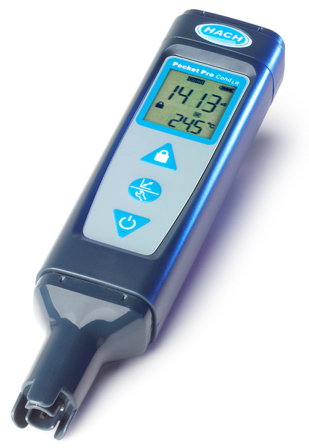
Conductivity Meter
Pocket Pro LR Conductivity Meter
Hach photo
Understanding Water Chemistry
Temperature
Dissolved Oxygen
pH
Solids
Nutrients
Data Sheet & Methods
Notes:
64
The conductivity meter used by the program is the Hach Pocket Pro Low Range Conductivity Meter. You will notice it looks identical to the pH meter. Feel free to use stickers or a sharpie to help differentiate the two meters in your monitoring kit.
Again, we will calibrate this meter as a group to use in the field today.
Calibration:
1. Set the power to on and remove the cap from the sensor.
2. Push the calibration button to go to calibration mode. The auto-recognition standard (1413 or 147 μS/cm) the tester expects to measure shows on the bottom line.
3. Pour the 1413 μS/cm calibration standard shown into the cap to the fill line.
4. Put the sensor fully into the cap.
5. When the measurement is stable, push the calibration button to save the calibration and go to continuous measurement mode. The measured value will flash 3 times and then stop. Then, "END" shows on the display.
6. Rinse the sensor and cap with deionized water and blot dry.
Measurement:
1. Set the power to on.
2. Remove the cap from the sensor.
3. If the lock icon shows on the display, push the lock button to go to continuous measurement mode.
4. Pour the water sample into the cap to the fill line.
5. Put the sensor fully into the cap. The measured value shows on the top line.

Slide 65
Conductivity meter
If meter does not calibrate, soak in water with one drop of dish soap
Calibrate within 12 hours of sampling
If “_ _ _ _” displays, the sample is over range
Wait until reading stabilizes in the stream and record
Understanding Water Chemistry
Temperature
Dissolved Oxygen
pH
Solids
Nutrients
Data Sheet & Methods
Notes:
New conductivity meters tend to accumulate residue on the probes. If you are finding that your meter is reading too low while calibrating, the probes may need to be cleaned. Soak the probes in water with one drop of dish soap. You can also use a cotton swab to gently wipe the residue off the probes. Rinse thoroughly before calibrating or measuring.
Make sure to calibrate your meter within 12 hours of when you’re planning to sample.
If _ _ _ _ displays on the top line during measurement, the sample is out of range. The upper range for the low range meter is 1999 µS/cm. If the sample is over range, record it as “over range” on the data sheet and contact program staff by email or phone.
Again, discard used calibration solution after calibration. Do not pour it back into the bottle or reuse. Used or expired calibration solution is safe to pour down the drain while flushing with ample cold water.
Take the conductivity reading directly in the stream but do not submerge the meter over the cap line. Wait until the reading has stabilized before recording the measurement.
Specf. Cond. > 1600 microsemens/cm is relatively concerning

Slide 66
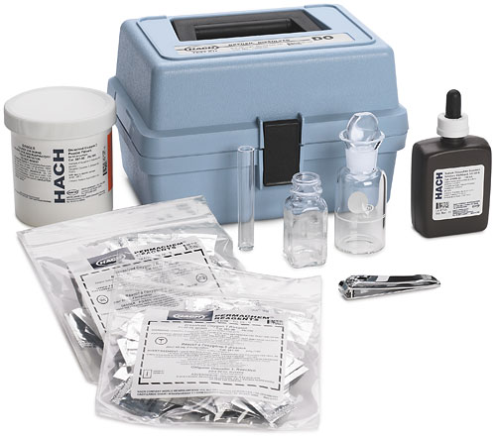
Dissolved Oxygen Kit
Hach photo
Understanding Water Chemistry
Temperature
Dissolved Oxygen
pH
Solids
Nutrients
Data Sheet & Methods
Notes:
The dissolved oxygen test kit comes with DO 1, 2, and 3 powder pillows, clippers for opening the powder pillows, sodium thiosulfate, a glass water sample bottle, and a test tube and square bottle for titration. This kit uses Winkler’s titration, which essentially creates an iodine solution which is removed during titration. The amount of iodine present is equivalent to the amount of oxygen in the sample.
Gloves and protective eyewear are recommended while using this kit.
To use the kit:
1. Fill the dissolved oxygen bottle with sample water to the middle of the frosted area by submerging it in the stream.
2. Add the contents of one Dissolved Oxygen Reagent 1packet and one Dissolved Oxygen Reagent 2 packet.
3. Stopper the bottle without trapping air bubbles.
4. Shake the bottle vigorously to mix.
5. Wait for flocculent to settle to approximately half the bottle volume.
6. Shake the bottle vigorously again.
7. Wait for the flocculent to settle to approximately half the bottle volume.
8. Remove the stopper and add the contents of one Dissolved Oxygen 3 Reagent powder pillow.
9. Stopper the bottle and shake the bottle vigorously (flocculent will dissolve and sample will turn yellow if oxygen is present).
10. Fill the plastic tube to the top with sample from dissolved oxygen bottle.
11. Place the square bottle over the full plastic tube and invert to pour the contents into the square bottle.
12. Add Sodium Thiosulfate Standard Solution one drop at a time to the mixing bottle (making sure to hold the dropper vertical). Count each drop. Swirl to mix after each drop. Add drops until the sample becomes colorless.
13. Record the number of drops used in Step 12. One drop equals one mg/L.

Slide 67
Dissolved oxygen kit
Unused DO packets can go in trash. Other waste can be collected and poured down the drain
Final reaction is a titration indicated by a color change.
Normal Range for DO
Understanding Water Chemistry
Temperature
Dissolved Oxygen
pH
Solids
Nutrients
Data Sheet & Methods
Notes:
The waste from this kit is fully reacted. You may also containerize the waste (separate from the nitrate waste) and discard down a drain while flushing with ample water.
If water temperature is very cold or if chloride levels are high, the flock may not readily settle out. If the floc in your sample bottle does not settle after ten minutes, go ahead and shake vigorously the second time.
Chemical waste from this kit and the sodium thiosulfate may be discarded down a drain while flushing with ample cold water. The DO 1 and DO 3 may be discarded unopened in the trash.

Slide 68
Data Reminders
Check your reagents expiration dates well before monitoring
  Reagents can be ordered online
Double Check your data sheet and data entry before submitting
Hach photo
Understanding Water Chemistry
Temperature
Dissolved Oxygen
pH
Solids
Nutrients
Data Sheet & Methods
Notes:
The dissolved oxygen test kit comes with DO 1, 2, and 3 powder pillows, clippers for opening the powder pillows, sodium thiosulfate, a glass water sample bottle, and a test tube and square bottle for titration. This kit uses Winkler’s titration, which essentially creates an iodine solution which is removed during titration. The amount of iodine present is equivalent to the amount of oxygen in the sample.
Gloves and protective eyewear are recommended while using this kit. The DO 2 packets are hazardous and the only reagent from this kit that needs to be returned to program staff.
To use the kit:
1. Fill the dissolved oxygen bottle with sample water to the middle of the frosted area by submerging it in the stream.
2. Add the contents of one Dissolved Oxygen Reagent 1packet and one Dissolved Oxygen Reagent 2 packet.
3. Stopper the bottle without trapping air bubbles.
4. Shake the bottle vigorously to mix.
5. Wait for flocculent to settle to approximately half the bottle volume.
6. Shake the bottle vigorously again.
7. Wait for the flocculent to settle to approximately half the bottle volume.
8. Remove the stopper and add the contents of one Dissolved Oxygen 3 Reagent powder pillow.
9. Stopper the bottle and shake the bottle vigorously (flocculent will dissolve and sample will turn yellow if oxygen is present).
10. Fill the plastic tube to the top with sample from dissolved oxygen bottle.
11. Place the square bottle over the full plastic tube and invert to pour the contents into the square bottle.
12. Add Sodium Thiosulfate Standard Solution one drop at a time to the mixing bottle (making sure to hold the dropper vertical). Count each drop. Swirl to mix after each drop. Add drops until the sample becomes colorless.
13. Record the number of drops used in Step 12. One drop equals one mg/L.

Slide 69
STREAMSIDE CHEMICAL WASTE/ EXPIRED REAGENTS
Liquid waste from the D.O. and Nitrate test kits can be stored and poured down the sink after testing.
Expired liquid reagents from D.O. and Nitrate kits, and conductivity solutions can be poured down the drain while flushing with ample cold water (Other D.O. packets, pH strips and nitrate tablets can be thrown in trash)
Understanding Water Chemistry
Temperature
Dissolved Oxygen
pH
Dissolved Solids
Nutrients
Turbidity
Data Sheet & Methods
Notes:
Chemical Waste
Waste from D.O. and pH and conductivity buffer solutions can be poured down the drain while flushing with ample cold water.

Slide 70
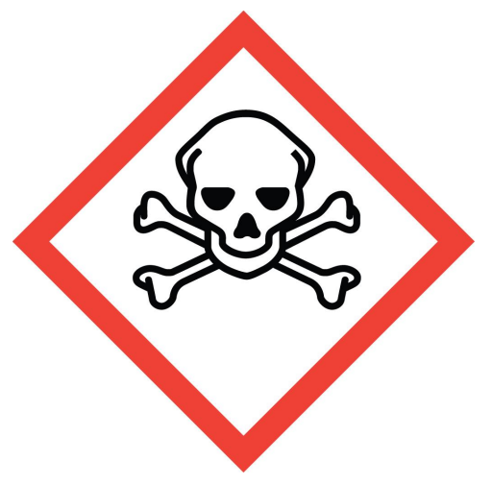
KEEP ALL CHEMICALS AND CHEMICAL WASTE OUT OF REACH OF CHILDREN!
Understanding Water Chemistry
Temperature
Dissolved Oxygen
pH
Dissolved Solids
Nutrients
Turbidity
Data Sheet & Methods
Notes:
Chemical Waste (cont.)
Keep All Chemicals and Chemical Waste Out of Reach of Children!

Slide 71
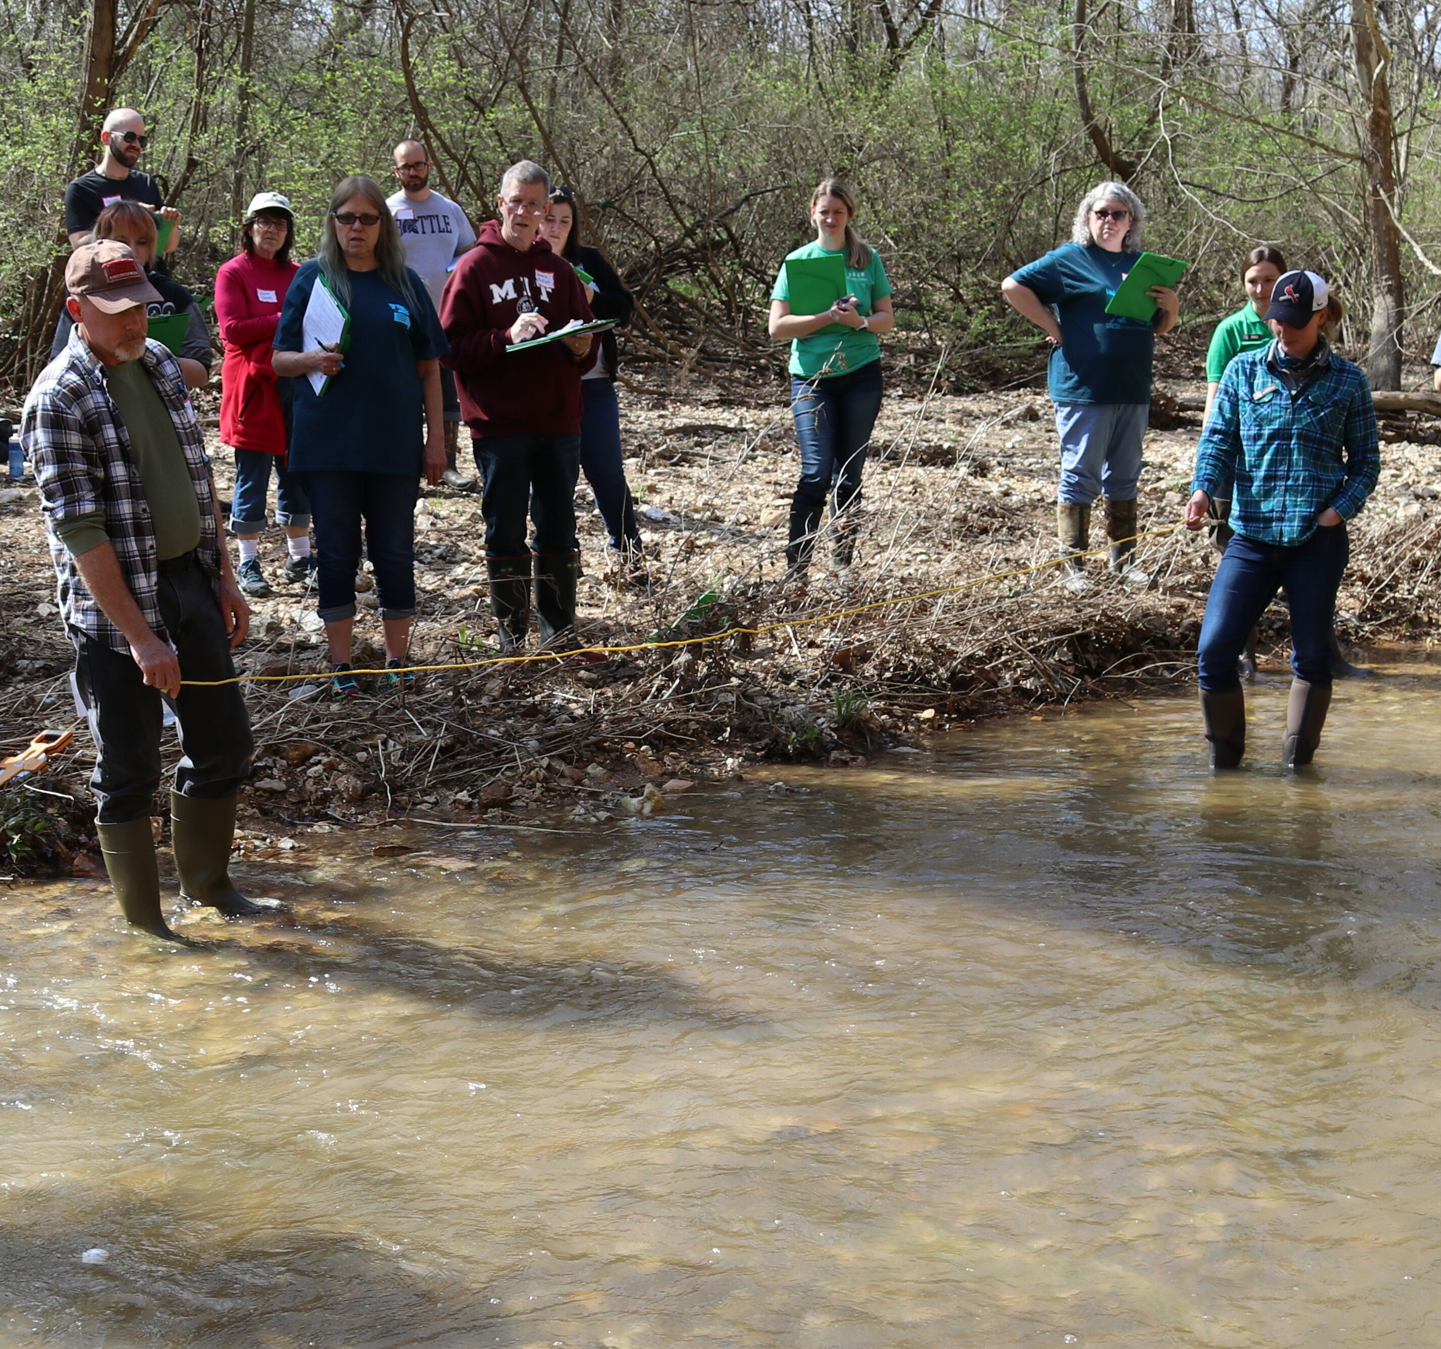
Next Steps
Register for field training
  Visit mostreamteam.org
Equipment will be provided for folks who attend Level 1 field training
Hach photo
Understanding Water Chemistry
Temperature
Dissolved Oxygen
pH
Solids
Nutrients
Data Sheet & Methods
Notes:
The dissolved oxygen test kit comes with DO 1, 2, and 3 powder pillows, clippers for opening the powder pillows, sodium thiosulfate, a glass water sample bottle, and a test tube and square bottle for titration. This kit uses Winkler’s titration, which essentially creates an iodine solution which is removed during titration. The amount of iodine present is equivalent to the amount of oxygen in the sample.
Gloves and protective eyewear are recommended while using this kit. The DO 2 packets are hazardous and the only reagent from this kit that needs to be returned to program staff.
To use the kit:
1. Fill the dissolved oxygen bottle with sample water to the middle of the frosted area by submerging it in the stream.
2. Add the contents of one Dissolved Oxygen Reagent 1packet and one Dissolved Oxygen Reagent 2 packet.
3. Stopper the bottle without trapping air bubbles.
4. Shake the bottle vigorously to mix.
5. Wait for flocculent to settle to approximately half the bottle volume.
6. Shake the bottle vigorously again.
7. Wait for the flocculent to settle to approximately half the bottle volume.
8. Remove the stopper and add the contents of one Dissolved Oxygen 3 Reagent powder pillow.
9. Stopper the bottle and shake the bottle vigorously (flocculent will dissolve and sample will turn yellow if oxygen is present).
10. Fill the plastic tube to the top with sample from dissolved oxygen bottle.
11. Place the square bottle over the full plastic tube and invert to pour the contents into the square bottle.
12. Add Sodium Thiosulfate Standard Solution one drop at a time to the mixing bottle (making sure to hold the dropper vertical). Count each drop. Swirl to mix after each drop. Add drops until the sample becomes colorless.
13. Record the number of drops used in Step 12. One drop equals one mg/L.

Slide 72





Contact us
mostreamteam.org
Streamteam@dnr.mo.gov
Streamteam@mdc.mo.gov
youtube.com/@MissouriStreamTeam
facebook.com/mostreamteams/
800-781-1989
Notes:
Additional resources and training videos can be found online. Contact us if you have any questions.

