Slide 1

Visual Survey
Notes:
Chapter 3: Visual Survey (45 mins)
Visual Survey is the physical assessment of a stream site.
In this chapter, you’ll learn how to characterize the environment through which your stream flows.
This assessment helps to interpret water quality data and determine if there are observable problems in or around the stream.

Slide 2
Overview
Floodplain
Riparian Cover
Streambank
Streambed
Other Assessments
Notes:
The Visual Survey is a detailed look at the physical characteristics of your stream site.
We will cover characteristics of the floodplain, riparian zone, streambank, and streambed that influence the water quality of your stream.
Finally, we will look at a few other ways to assess the health of your stream site.

Slide 3
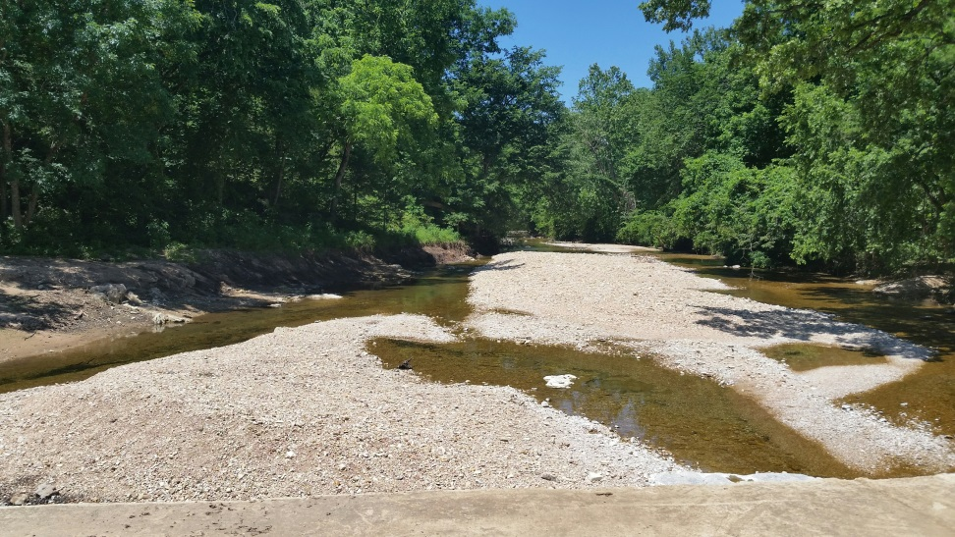
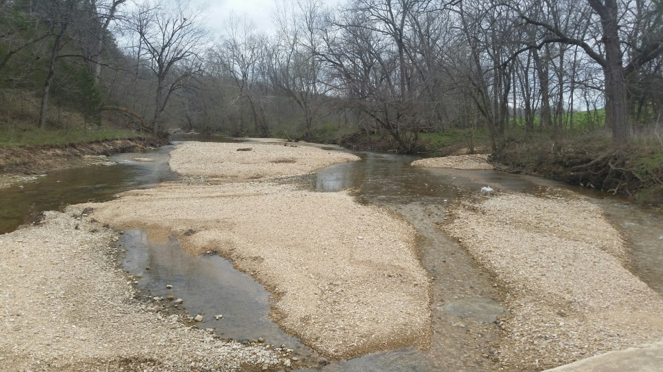
Visual survey
Observations of the environment through which a stream flows
Water quality is dependent on local conditions
Conducted twice per year
  Once with foliage present
  Once with foliage absent
OWWP photo
OWWP photo
Overview
Floodplain
Riparian Cover
Streambank
Streambed
Other Assessments
Notes:
The purpose of visual survey is to record observations of the environment in and around the stream.
These characteristics have a large affect on the water quality of your stream.
By documenting conditions using Visual Survey, we can look at changes in the watershed and stream over time, which help get a better understanding of how water quality responds to those changes.
Visual survey is conducted two times per year.
Once with foliage present, around September or early October, and once with foliage absent, around February or March
These are also the times we recommend doing biological monitoring.

Slide 4
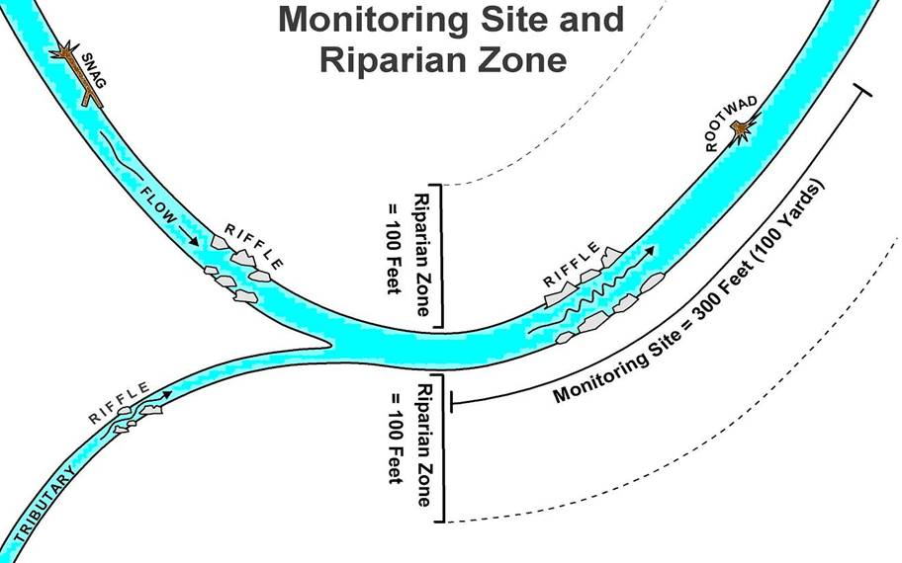
Overview
Floodplain
Riparian Cover
Streambank
Streambed
Other Assessments
Notes:
This image is a hypothetical monitoring site and the area on which the visual survey should be conducted.
Remember to always use the same 300 foot stretch at your stream site.
Consistency in reporting is key, because it allows us to capture changes over time.

Slide 5
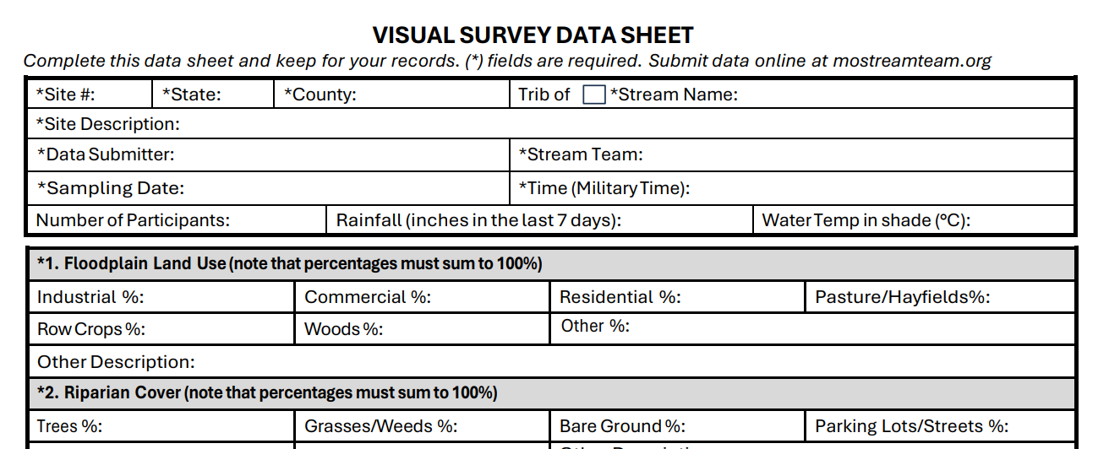
Header information
Overview
Floodplain
Riparian Cover
Streambank
Streambed
Other Assessments
Notes:
Here is the Visual Survey data sheet.
This data sheet is subjective. If you monitor with a team, have the same person make the determination for the values for every monitoring trip.
We will work through the sections, defining each physical parameter and explain exactly what to look for.
As with all data sheets, the first section is the header information. This section is covered in the Site Selection chapter.

Slide 6
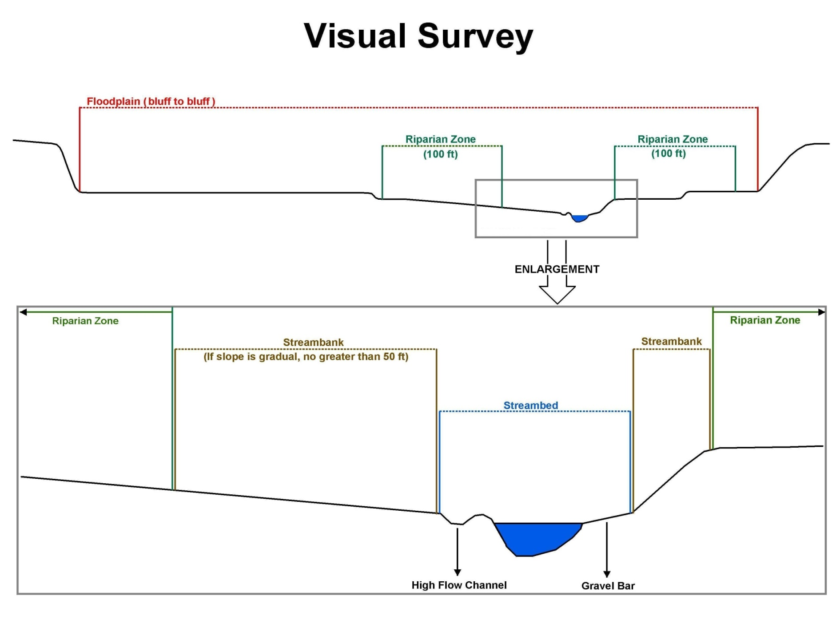
Floodplain (bluff to bluff)
Riparian Zone
Riparian Zone
100 (ft)
100 (ft)
Riparian Zone
Streambank
Streambank
Riparian Zone
(If slope is gradual,
no more than 50 ft)
Streambed
High flow Channel
Gravel Bar
Overview
Floodplain
Riparian Cover
Streambank
Streambed
Other Assessments
Notes:
This image is a cross-section of a stream site, from bluff to bluff. It also shows a closer look, from riparian zone to riparian zone.
We will use this diagram to describe the different parts of the visual survey we are discussing.
First, we will look at the floodplain.
This is the flattened portion of the stream valley, susceptible to flooding.
The floodplain stretches from the riparian zone to the bluff on each side of the stream.
In many streams, you will not be able to see the bluffs from the stream.

Slide 7
Floodplain
Must add up to 100%
Overview
Floodplain
Riparian Cover
Streambank
Streambed
Other Assessments
Notes:
On the Visual Survey data sheet, it lists options of land use including industrial, commercial, residential, pasture/hayfields, row crops, woods, or other.
If you select other as a land use in your site’s floodplain, be sure to specify or describe that land use. An example of Other is city park or golf course.
You will estimate the percentages for each land use. All percentages under Floodplain land use should add up to 100%.

Slide 8
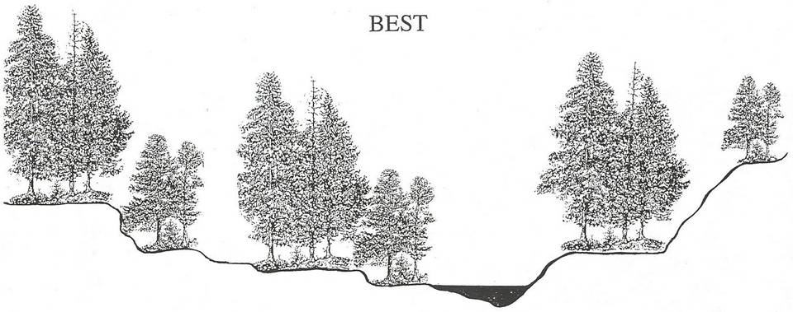
Unimpacted Floodplain
No negative impact on water quality
Stair-stepped floodplain due to normal high water events
Riparian corridor is vegetated
Gently sloping banks
Streambed is narrow with varying water depths
Overview
Floodplain
Riparian Cover
Streambank
Streambed
Other Assessments
Notes:
Let’s take a look at some examples of floodplain use.
In this illustration of an “unimpacted” floodplain, land use has not negatively impacted water quality.
The floodplain has a stair-stepped appearance due to normal intensity high water events.
The riparian corridor is vegetated.
Streambanks are gently sloping.
Streambed is narrow with varying water depths.

Slide 9
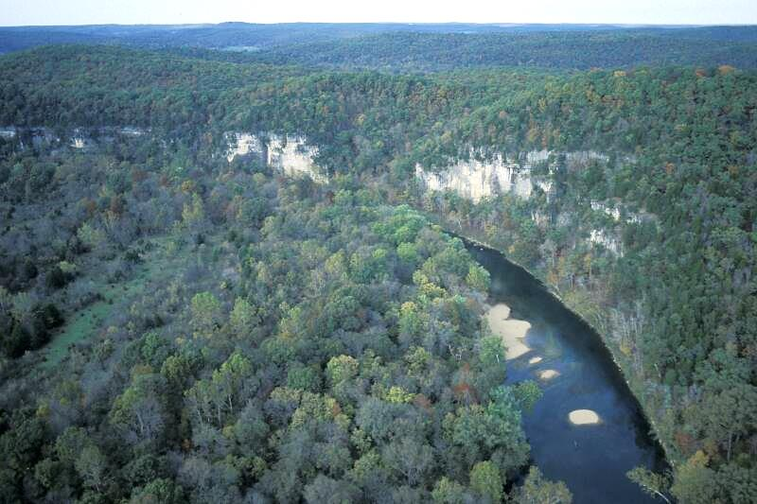
Meramec River
Overview
Floodplain
Riparian Cover
Streambank
Streambed
Other Assessments
Notes:
Here we have a photo of an unaltered or unimpacted Floodplain of the Meramec River.
The floodplain is limited on one side by the bluff, so if it floods, the river will rise on the side opposite of the bluff.
The floodplain is narrow and is in a natural state with forest and grasses.

Slide 10
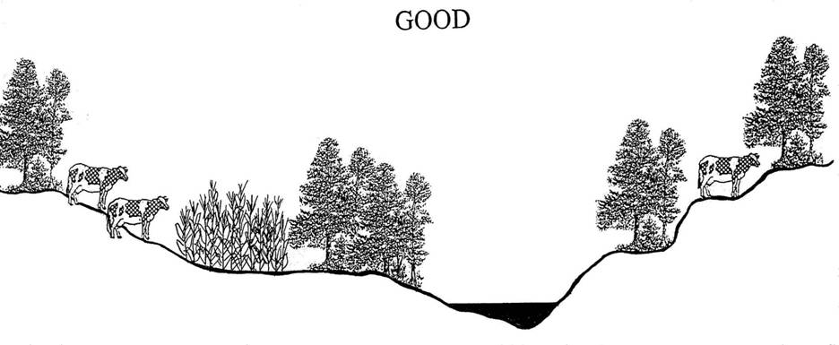
Moderately Impacted Floodplain
Increased possibility of nutrient (N & P) and sediment loading
Functional riparian corridor prevents erosion and takes up excess nutrients
Streambank still has a gentle slope
Streambed remains unaltered
Overview
Floodplain
Riparian Cover
Streambank
Streambed
Other Assessments
Notes:
This illustration shows a moderately impacted floodplain.
Land use may affect the water quality of the stream, but the floodplain is still in good condition.
The possibility of nutrient and sediment loading is increased by crop management practices and animal production activities.
A vegetated riparian corridor mediates these threats to some extent by preventing erosion and taking up excess nutrients.
The streambank is moderately changed but still has a gentle slope.
The streambed remains unaltered.

Slide 11
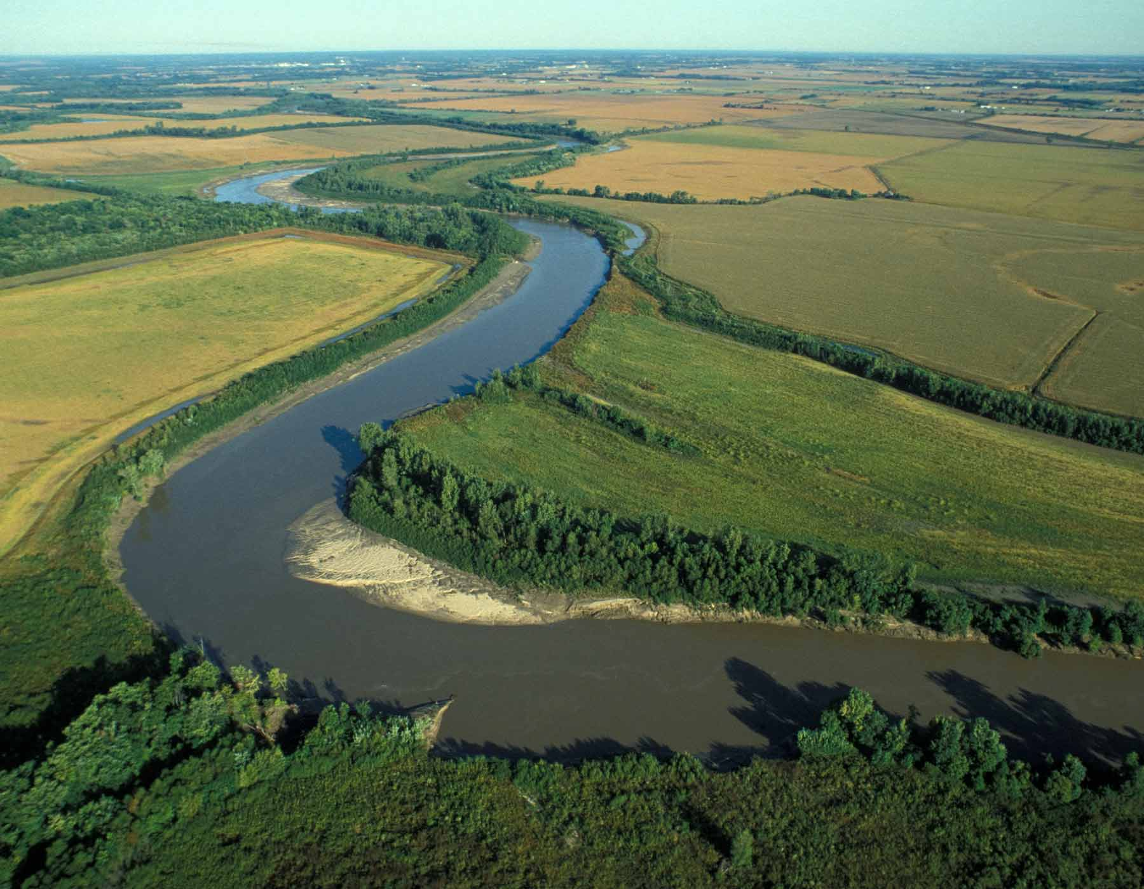
Thompson River
Overview
Floodplain
Riparian Cover
Streambank
Streambed
Other Assessments
Notes:
This is a photo of a moderately impacted floodplain of the Thompson River near Trenton.
Even with agricultural land use, this floodplain is in good condition because the riparian corridor is mostly intact.
The vegetated riparian zone will slow water running over the land during precipitation events and prevents erosion.
The vegetation will absorb nutrients and sediment before they enter the stream.
The streambanks still have a gentle slope and the streambed is unaltered.

Slide 12
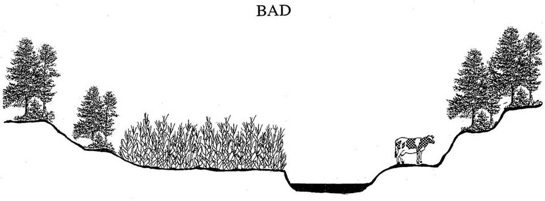
Heavily Impacted Floodplain
Activities of economic value could be lost during a flood event
Riparian corridor is absent. Nutrients and sediment now directly enter the stream
Streambanks are now degraded
Wider, shallower streambed
Overview
Floodplain
Riparian Cover
Streambank
Streambed
Other Assessments
Notes:
This illustration shows a heavily impacted floodplain.
In this example, the floodplain contains land uses that have economic value and could be lost during a flood.
Nutrient and sediment loading are a greater threat.
Permanent vegetation in riparian corridor is absent along with its benefits. Nutrients and sediment now directly enter stream.
Streambanks are steeper and more vertical due to erosion or downcutting.
They are vulnerable to severe erosion because there are no roots to stabilize the banks.
Streambed is wider, shallower and more uniform due to sediment filling in the stream.

Slide 13
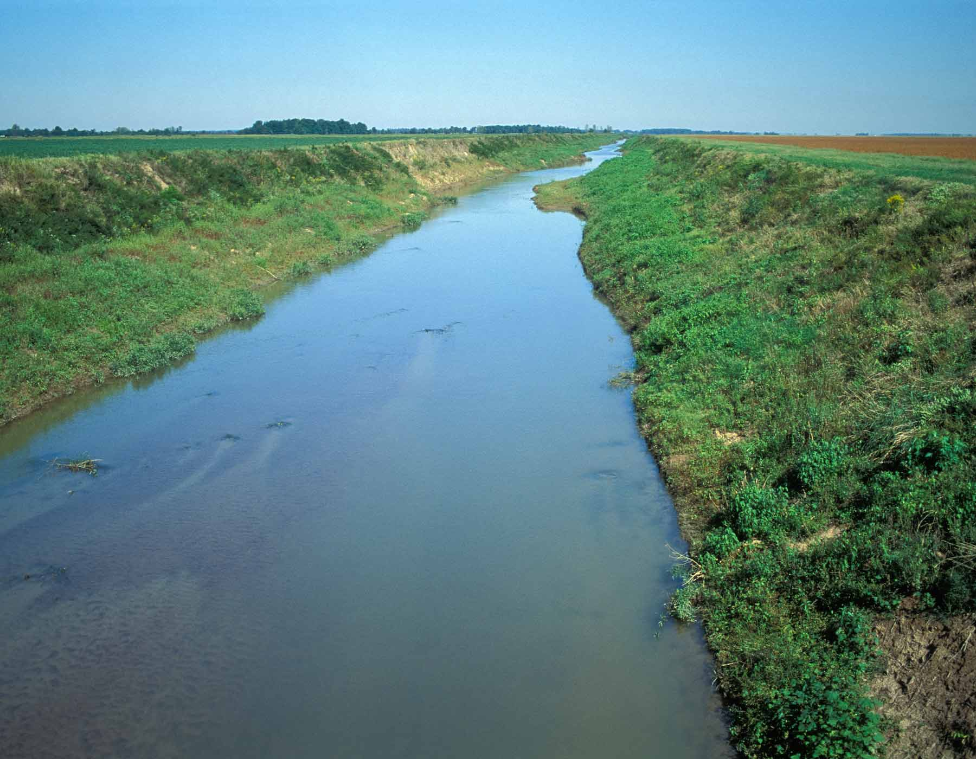
Cane Creek Ditch
Overview
Floodplain
Riparian Cover
Streambank
Streambed
Other Assessments
Notes:
This is a photo of a heavily impacted floodplain of Cane Creek Ditch Neelyville.
The stream has been channelized and the primary land use in the floodplain is row crops.
Water flowing over the cropland will pick up excess nutrients and sediment.
Since the riparian corridor is completely absent, these pollutants will directly enter the stream.
The streambed is wide and shallow, and the streambanks will be easily eroded if the stream floods.

Slide 14
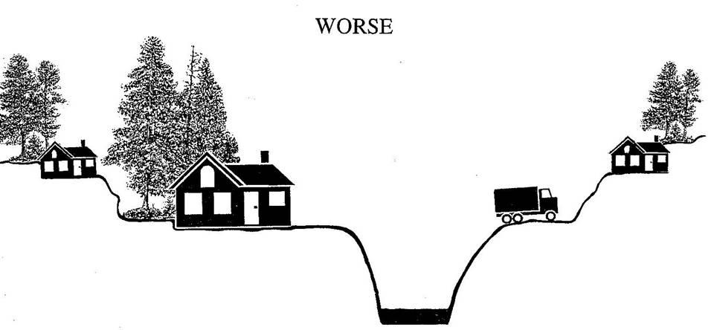
Urban Floodplain
Floodplain development threatened by flood events
No riparian corridor
Streambanks are steep and vertical
Streambed is downcut and requires erosion control
Overview
Floodplain
Riparian Cover
Streambank
Streambed
Other Assessments
Notes:
This illustration shows a urban development of a floodplain.
Land uses including residential, roads, and other developments that will be threatened by flood events.
The riparian corridor lacks vegetation.
Streambanks are very steep and vertical. These banks will be prone to erosion.
Streambed is down-cut and uniform. Downcutting is a process of erosion that causes deepening of the stream.
All developments in this floodplain are at risk if there is a flood event.

Slide 15
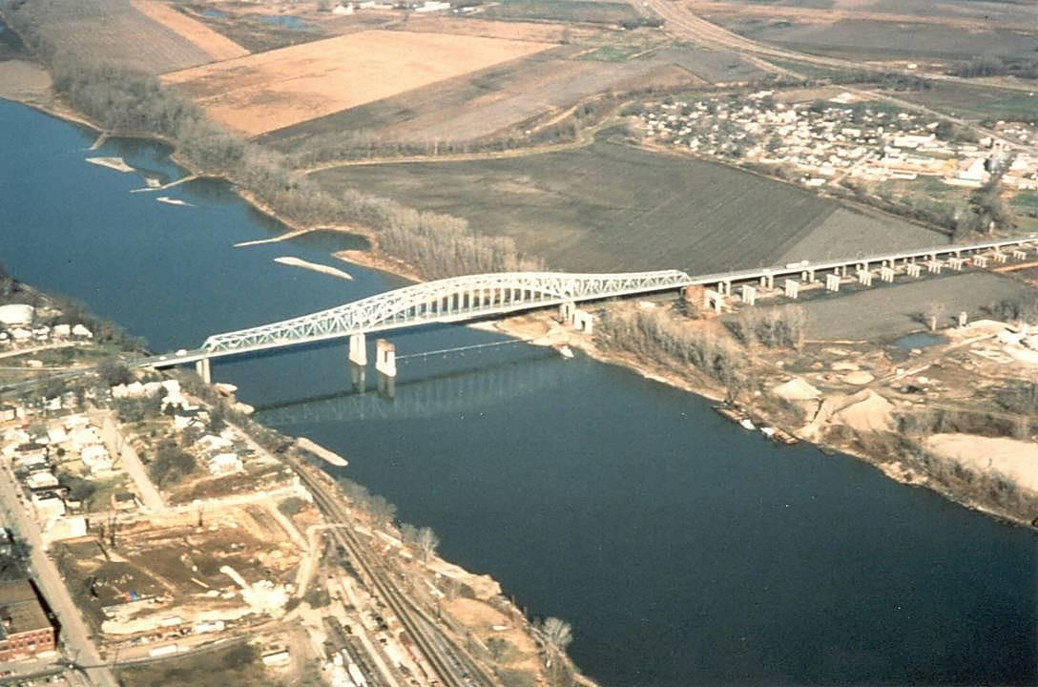
Missouri River at Jefferson City
Overview
Floodplain
Riparian Cover
Streambank
Streambed
Other Assessments
Notes:
This photo of the Missouri River at Jefferson City shows mixed land use.
This was taken before the flood of 1993.
There is a bluff on the lower left side of the slide with railroad tracks at the base of the bluff.
On the opposite side of the river there was commercial, industrial, residential and agricultural land use.
The flood of 1993 damaged almost all of the land uses you see in this photo, and the floodplain now looks quite a bit different. The town of Cedar City in the upper right corner was completely inundated, and has since been converted parks and businesses that have to comply with flood plain regulations.

Slide 16
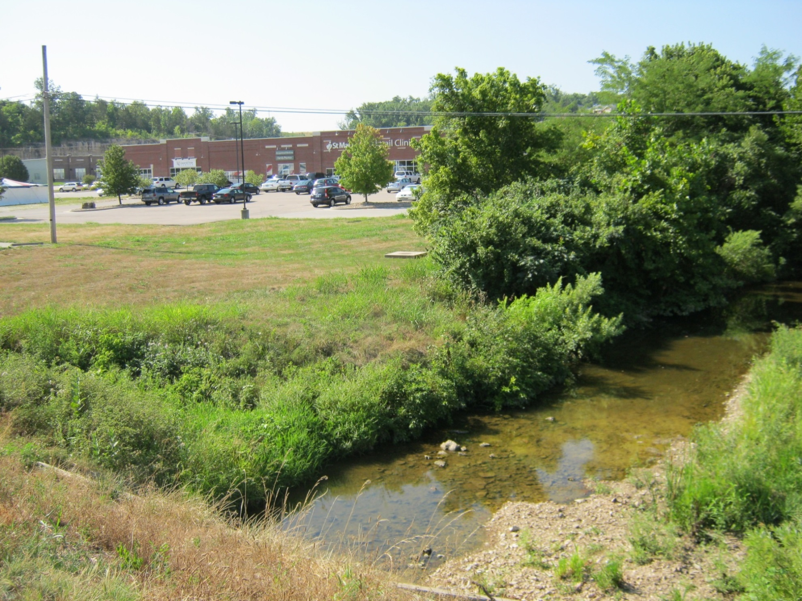
Wears Creek, Cole County
Overview
Floodplain
Riparian Cover
Streambank
Streambed
Other Assessments
Notes:
Here we have another example of floodplain use.
Just out of shot of the photo is a neighborhood to the right and a small cattle pasture to the left.
For this site, land use includes commercial, residential, pasture/hayfields, and woods.
When filling out the datasheet, all these land uses must add up to 100 percent.

Slide 17
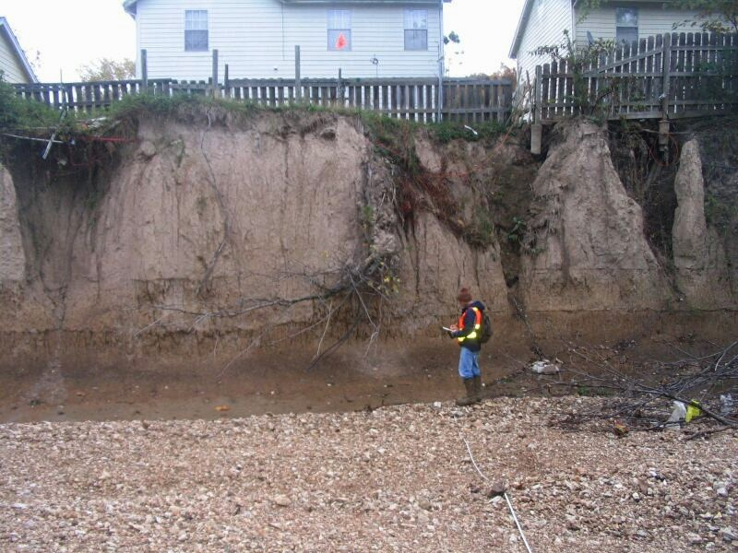
Overview
Floodplain
Riparian Cover
Streambank
Streambed
Other Assessments
Notes:
Let’s take a look at one more example of developments in a floodplain.
This image is Fishpot Creek in St. Louis County.
This shows what can happen when buildings are too close to a stream in a flood plain.
Storm drains were redirected just upstream of this residential area. This resulted in higher flow through this section of stream and significant erosion of the streambanks.

Slide 18
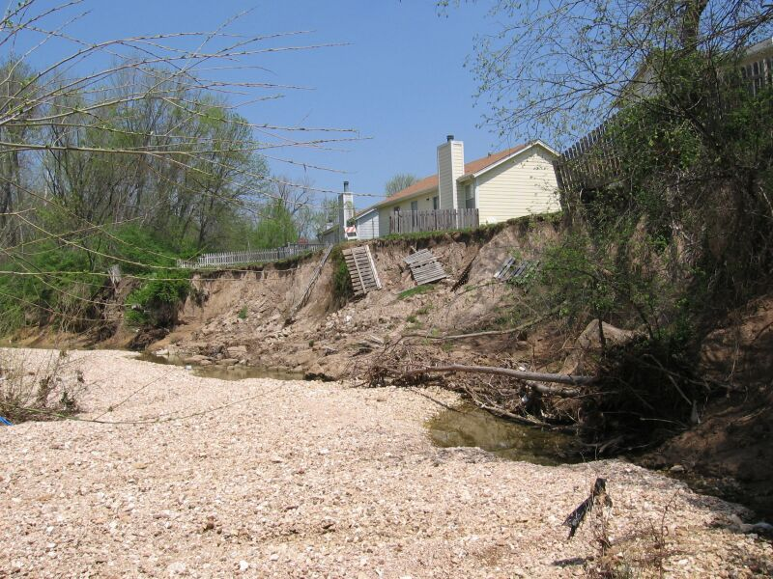
Fishpot Creek, St. Louis Co.
Overview
Floodplain
Riparian Cover
Streambank
Streambed
Other Assessments
Notes:
Here is the same section of stream on Fishpot Creek.
The damage shown only took a few months to occur.

Slide 19
Floodplain (bluff to bluff)
Riparian Zone
Riparian Zone
100 (ft)
100 (ft)
Riparian Zone
Streambank
Streambank
Riparian Zone
(If slope is gradual,
no more than 50 ft)
Streambed
High flow Channel
Gravel Bar
Overview
Floodplain
Riparian Cover
Streambank
Streambed
Other Assessments
Notes:
Now that we have looked at floodplains, we will move in to the riparian zone.
The riparian zone or riparian corridor is the strip of land on each side of the stream.
This starts from the top of the streambank to 100 ft back from the stream on both sides of the stream.
You will be evaluating the riparian zone for the full 300-foot monitoring site.

Slide 20
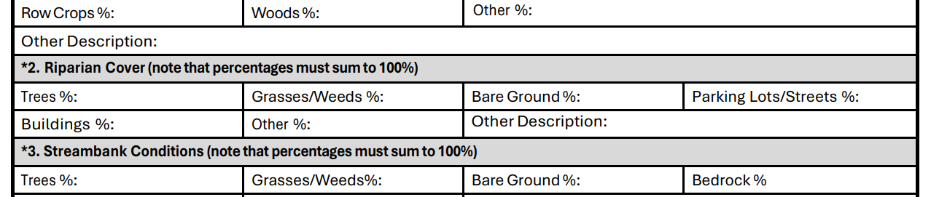
Riparian cover
Must add up to 100%
Overview
Floodplain
Riparian Cover
Streambank
Streambed
Other Assessments
Notes:
The riparian cover is the different types of land use within the riparian zone of your stream site.
You will estimate percentages of various types of riparian cover, including trees, grasses or weeds, bare ground, parking lots or streets, buildings, and other.
If a value is entered under “Other”, describe the cover and enter a percentage.
Total of percentage for Riparian Cover should equal 100%.

Slide 21
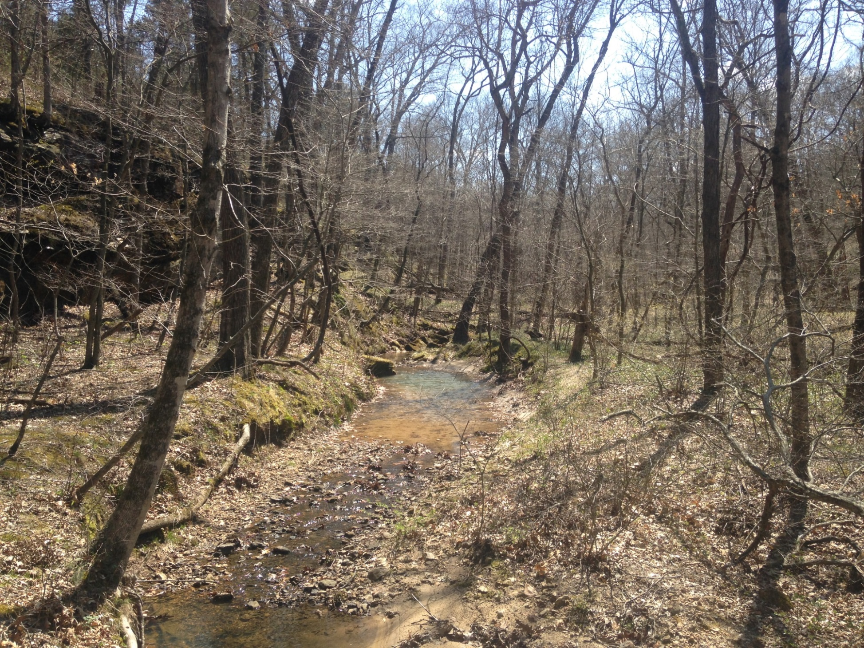
LaBarque Creek
Overview
Floodplain
Riparian Cover
Streambank
Streambed
Other Assessments
Notes:
This is a healthy riparian corridor along LaBarque Creek in Jefferson County.
The riparian zone is in excellent condition with 100% trees and shrubs.
Remember, the riparian corridor extends 100 feet away from the edge of the streambank on both sides of the stream.

Slide 22
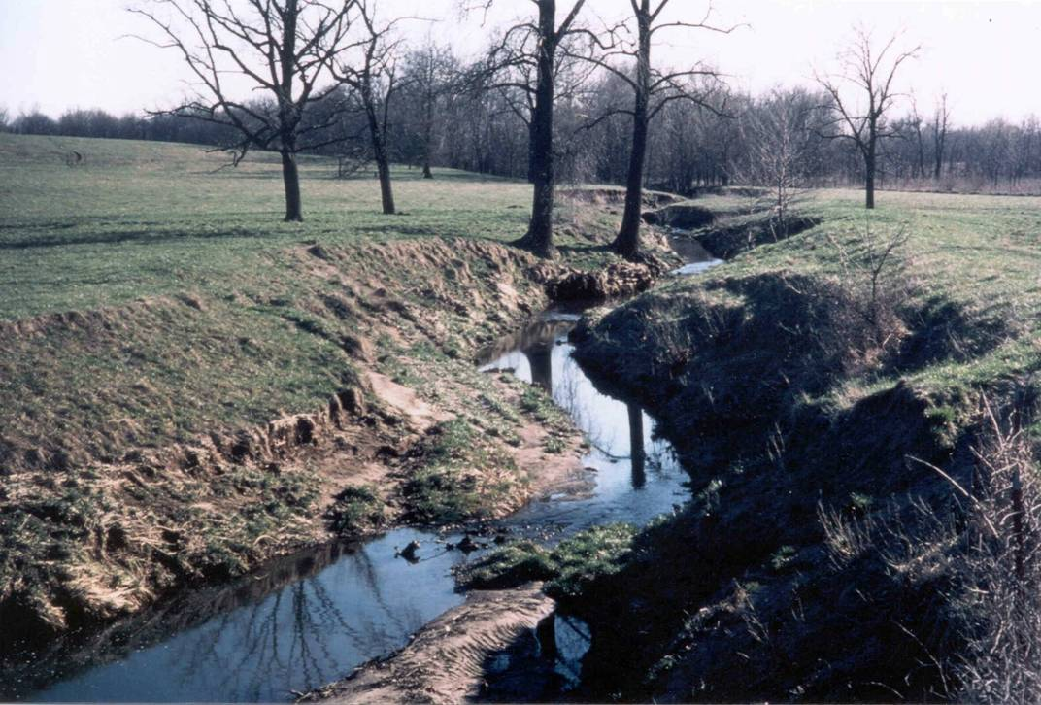
Howard Co.
Overview
Floodplain
Riparian Cover
Streambank
Streambed
Other Assessments
Notes:
This photo shows a highly altered riparian corridor along a stream in Howard County.
There are only a few isolated trees along this stream reach.
99% of the corridor is over-grazed pasture.
Note the eroding streambanks and the lack of any type of filter strip, or vegetated buffer, along this stream.

Slide 23
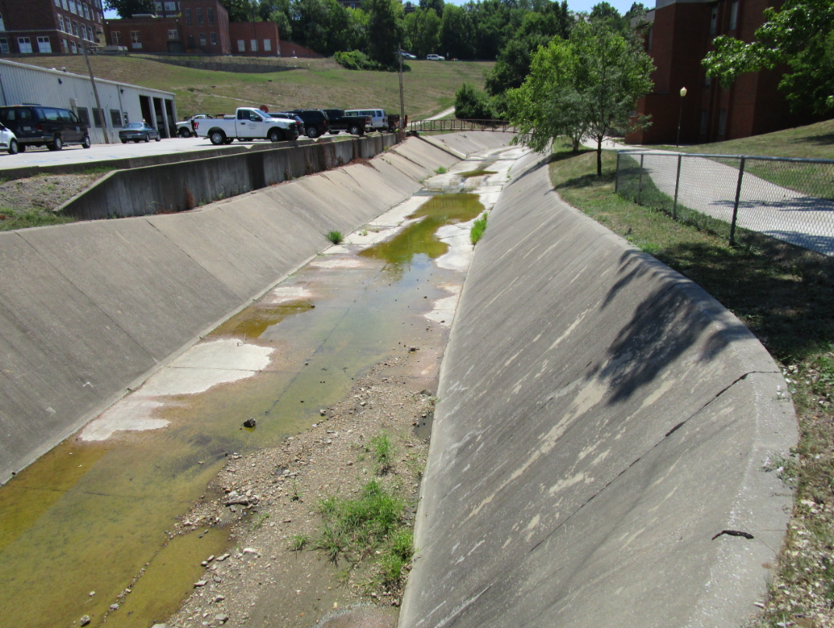
Wears Creek, Jefferson City
Overview
Floodplain
Riparian Cover
Streambank
Streambed
Other Assessments
Notes:
This photo shows an urban stream in Jefferson City.
Note the paved sidewalk, parking lot, and paved streambed.
Although there are a few trees along the stream, most of the riparian corridor is paved.
We refer to this as impervious surfaces.
There are also buildings in the riparian zone.

Slide 24
Floodplain (bluff to bluff)
Riparian Zone
Riparian Zone
100 (ft)
100 (ft)
Riparian Zone
Streambank
Streambank
Riparian Zone
(If slope is gradual,
no more than 50 ft)
Streambed
High flow Channel
Gravel Bar
Overview
Floodplain
Riparian Cover
Streambank
Streambed
Other Assessments
Notes:
Now that we have looked at the riparian zone, we will move in a little more to the streambank.
The streambank is the portion of the stream area that rises from the streambed and reaches a crest.
If there is no noticeable crest and the slope of the streambank is very gradual, consider the streambank to extend no more than 50 feet from the edge of the streambed.

Slide 25
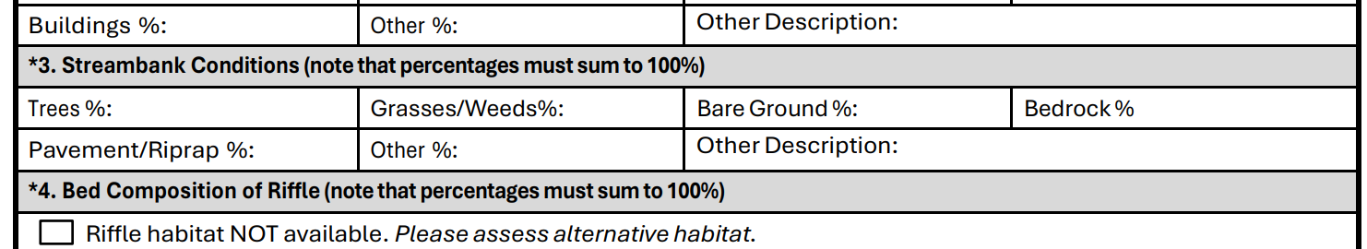
Stream bank conditions
Must add up to 100%
Overview
Floodplain
Riparian Cover
Streambank
Streambed
Other Assessments
Notes:
You will estimate percentages for streambank conditions, including trees, grasses or weeds, bare ground, bedrock, pavement or riprap, and other.
If a value is entered under “Other”, describe the conditions and enter a percentage.
The total percentage for Streambank conditions should equal 100%.

Slide 26
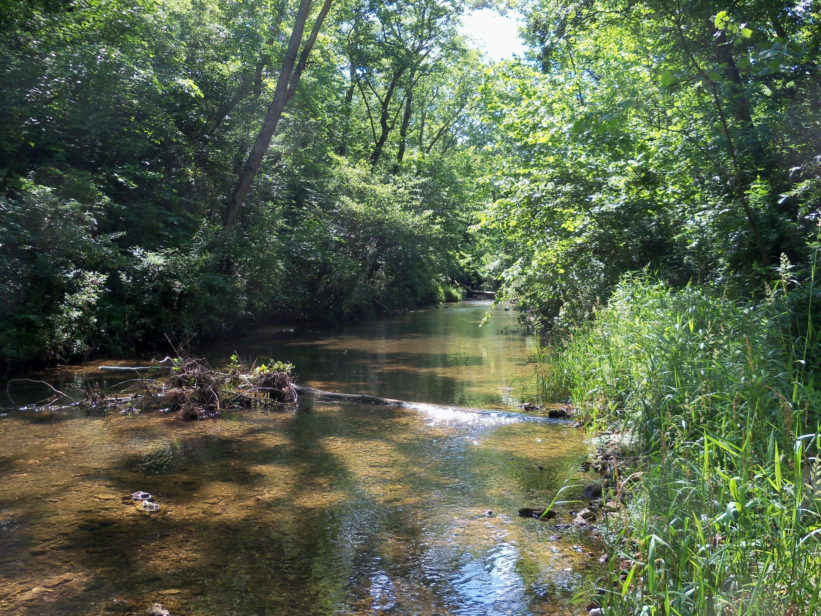
Blue Springs Creek
Overview
Floodplain
Riparian Cover
Streambank
Streambed
Other Assessments
Notes:
Here is an example of stable streambanks with trees and grasses along Blue Springs Creek.
Vegetation covers the entire streambank.
There is no bare ground or eroding banks.

Slide 27
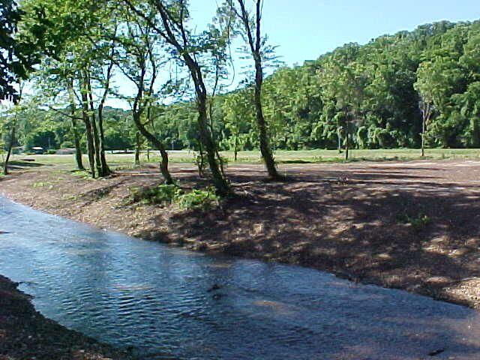
Lost Creek, Seneca MO City Park, Newton Co., photo by D. Miller
Overview
Floodplain
Riparian Cover
Streambank
Streambed
Other Assessments
Notes:
This photo shows a streambank along Lost Creek with bareground and sparse trees.
Trees were removed from the riparian corridor at this city park.

Slide 28
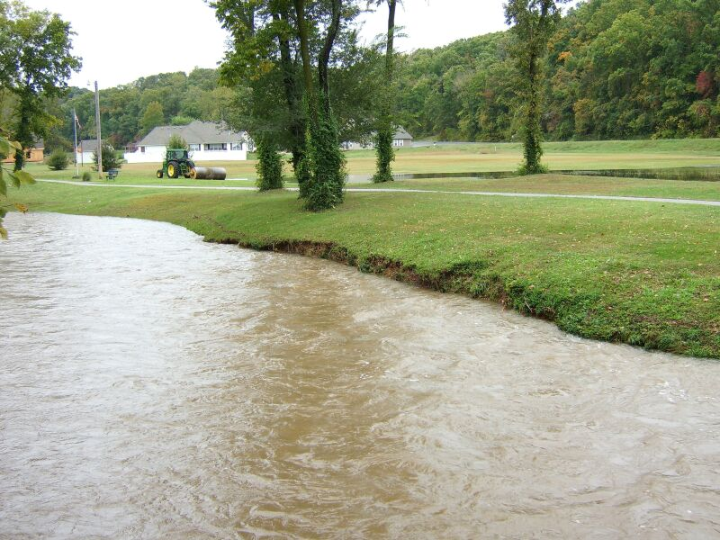
Lost Creek, Seneca MO City Park, Newton Co.
Overview
Floodplain
Riparian Cover
Streambank
Streambed
Other Assessments
Notes:
This photo is the same park and same location as the previous photo.
After 10 years, the stream is wider and the banks are eroded.
The loss of vegetation in the riparian zone and streambanks has contributed to severe erosion of the streambanks.

Slide 29
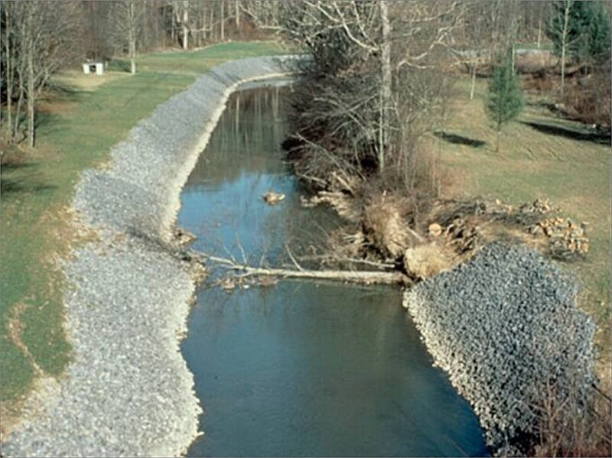
Overview
Floodplain
Riparian Cover
Streambank
Streambed
Other Assessments
Notes:
In this stream, riprap has been used to line the streambanks.
Riprap is rocky material used to stabilize streambanks and protect against erosion.
This is often used where a large portion of a watershed is covered with impervious surfaces which causes fast, high-volume runoff.
The size of the rock needed depends on how steep the streambanks are, and the volume and velocity of water that the stream transports.
As you can see from the trees collapsing into the stream, riprap may not solve all of a stream’s erosion problems.

Slide 30
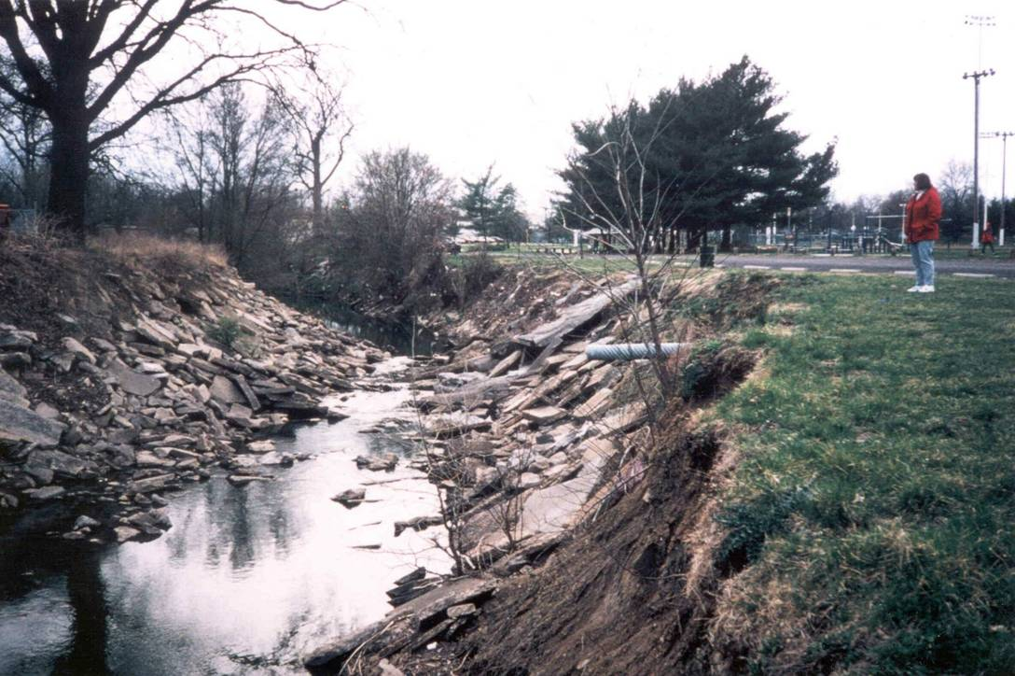
Maline Creek, St. Louis
Overview
Floodplain
Riparian Cover
Streambank
Streambed
Other Assessments
Notes:
This is an urban stream with old pavement used as riprap.
This is not an acceptable method of streambank stabilization.
Riprap must be engineered to fit the stream, and the appropriate material must be used so that it stays in place.
As you can see, some of these concrete pieces have slid off the bank and the bare soil is exposed, which may increase erosion.
Note the stormwater pipe at the edge of the stream. When it was routed to the stream, it would have been placed flush with the streambank and streambed. It is now sticking out about 4 feet into the stream, indicating much of the streambed and banks have eroded since the pipe was placed.

Slide 31
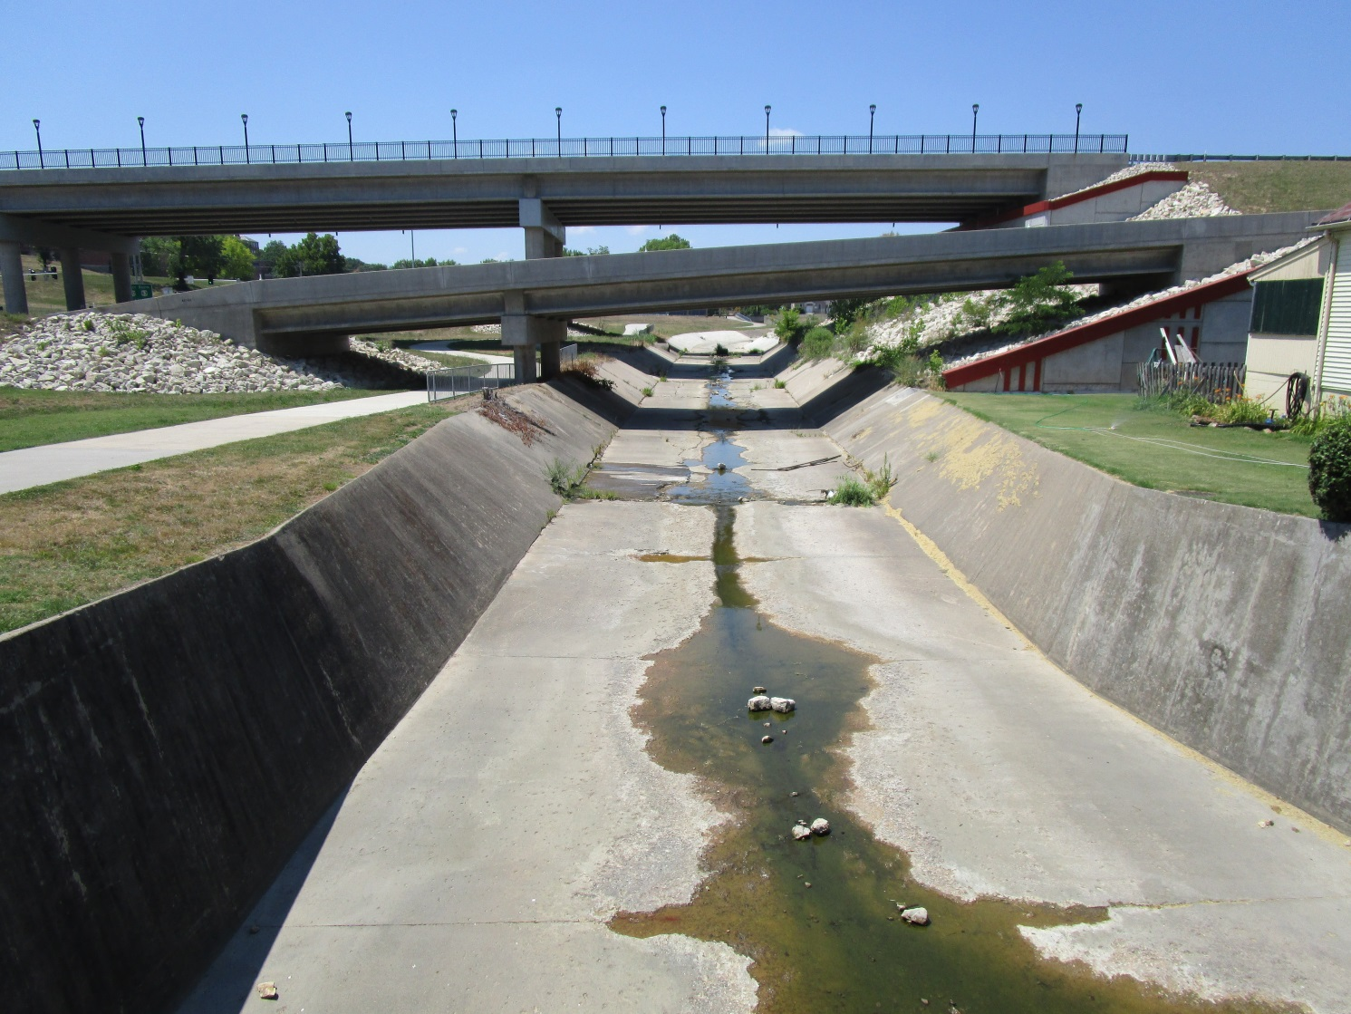
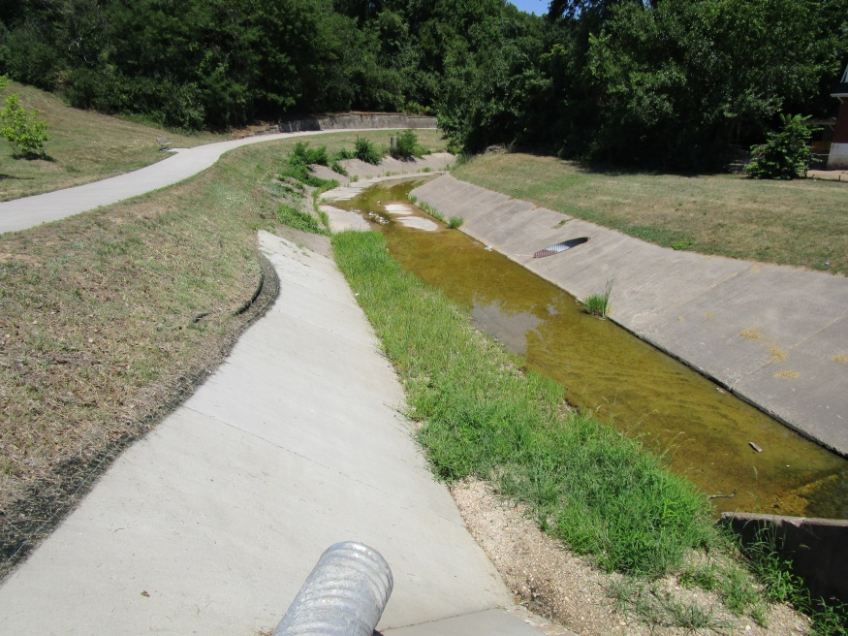
Why does this negatively impact habitat?
Wears Creek, Jefferson City
Overview
Floodplain
Riparian Cover
Streambank
Streambed
Other Assessments
Notes:
An alternative to riprap is paving the streambed and streambanks, which is even worse for habitat.
Impervious surfaces lack interstitial spaces needed for macroinvertebrates.

Slide 32
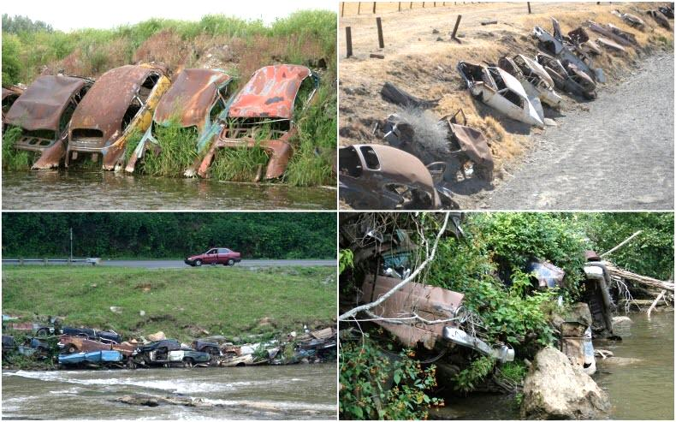
Overview
Floodplain
Riparian Cover
Streambank
Streambed
Other Assessments
Notes:
This is called Detroit riprap.
Vehicles were cabled together, and then anchored to the streambank.
This used to be an accepted way to control streambank erosion in the 1950’s throughout the U.S., but is no longer used.

Slide 33
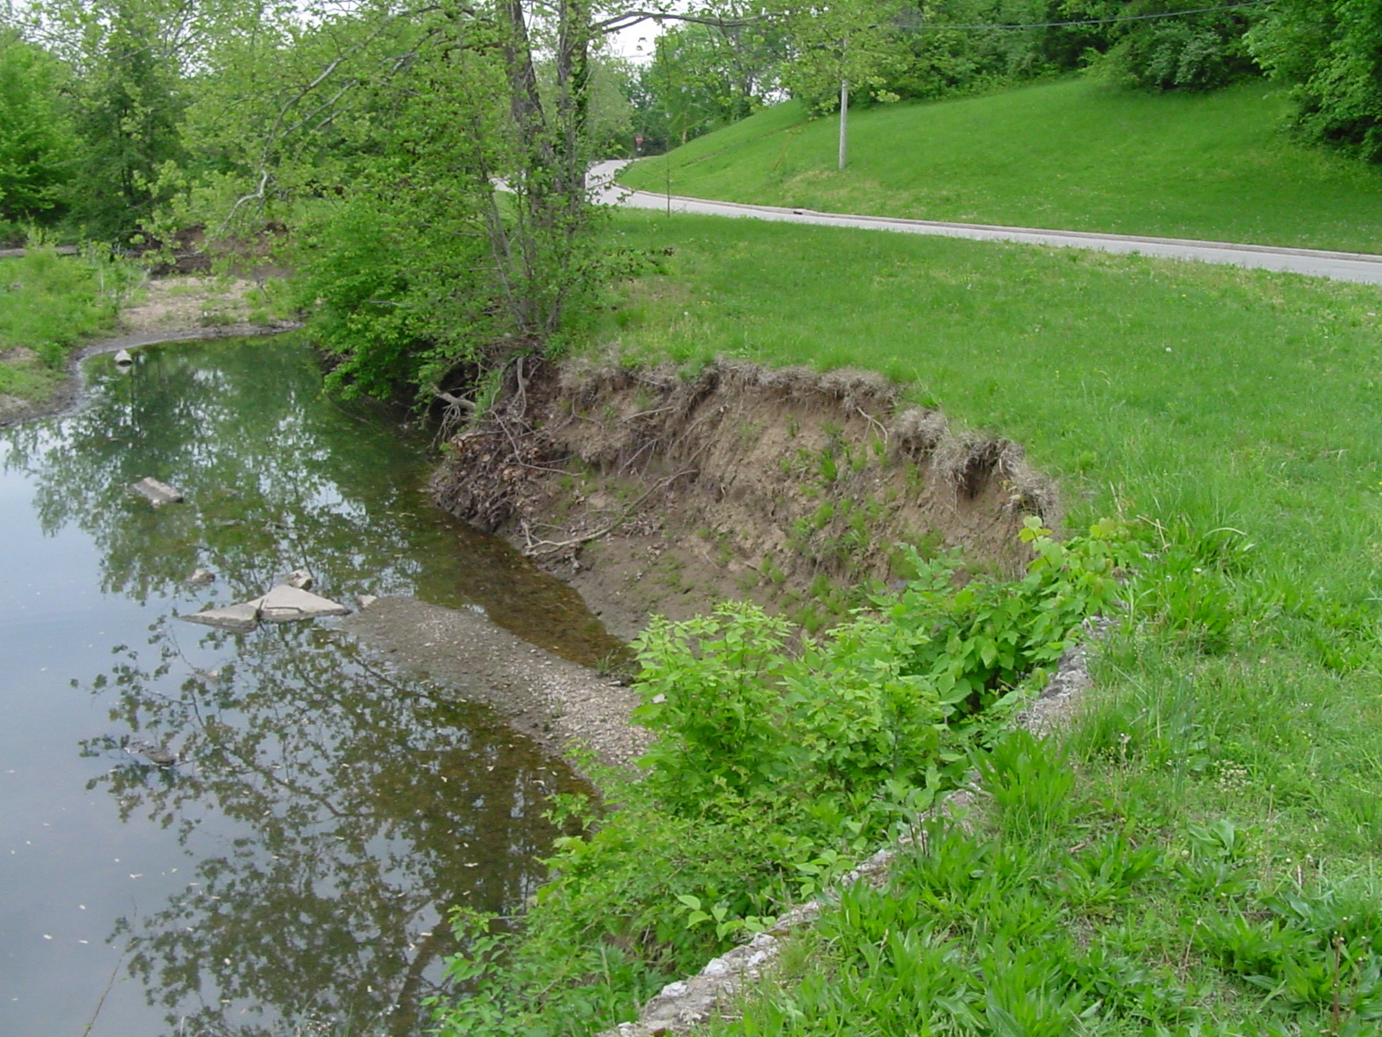
Grindstone Creek, Boone Co.
Overview
Floodplain
Riparian Cover
Streambank
Streambed
Other Assessments
Notes:
This image of Grindstone Creek shows mixed bare ground and vegetated streambanks.
It contains trees, grasses or weeds, and bare ground.
Note the lack of riparian corridor and proximity of the road to the stream.

Slide 34
Floodplain (bluff to bluff)
Riparian Zone
Riparian Zone
100 (ft)
100 (ft)
Riparian Zone
Streambank
Streambank
Riparian Zone
(If slope is gradual,
no more than 50 ft)
Streambed
High flow Channel
Gravel Bar
Overview
Floodplain
Riparian Cover
Streambank
Streambed
Other Assessments
Notes:
Now we will look at the streambed. This is the portion of the stream where water flows under normal conditions. You can usually tell a difference in substrate and vegetation between the streambank and the streambed.
Gravel bars are considered to be part of the streambed, since they are covered by flowing water for at least part of the year.

Slide 35
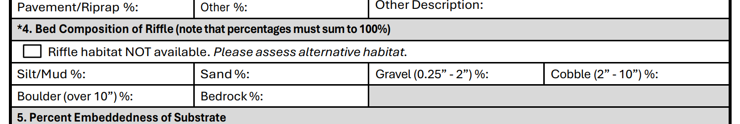
Bed composition of riffle
Must add up to 100%
Overview
Floodplain
Riparian Cover
Streambank
Streambed
Other Assessments
Notes:
You will estimate percentages of streambed composition within a riffle, including silt or mud, sand, gravel, cobble, boulder, and bedrock.
Gravel is substrate that is larger than sand, but less than two inches in size. Cobble is substate that is two to ten inches. A boulder is substrate larger than ten inches.
If you do not have a riffle at your site, check the box for alternative habitat.
The total percentages for streambed composition should equal 100%.

Slide 36
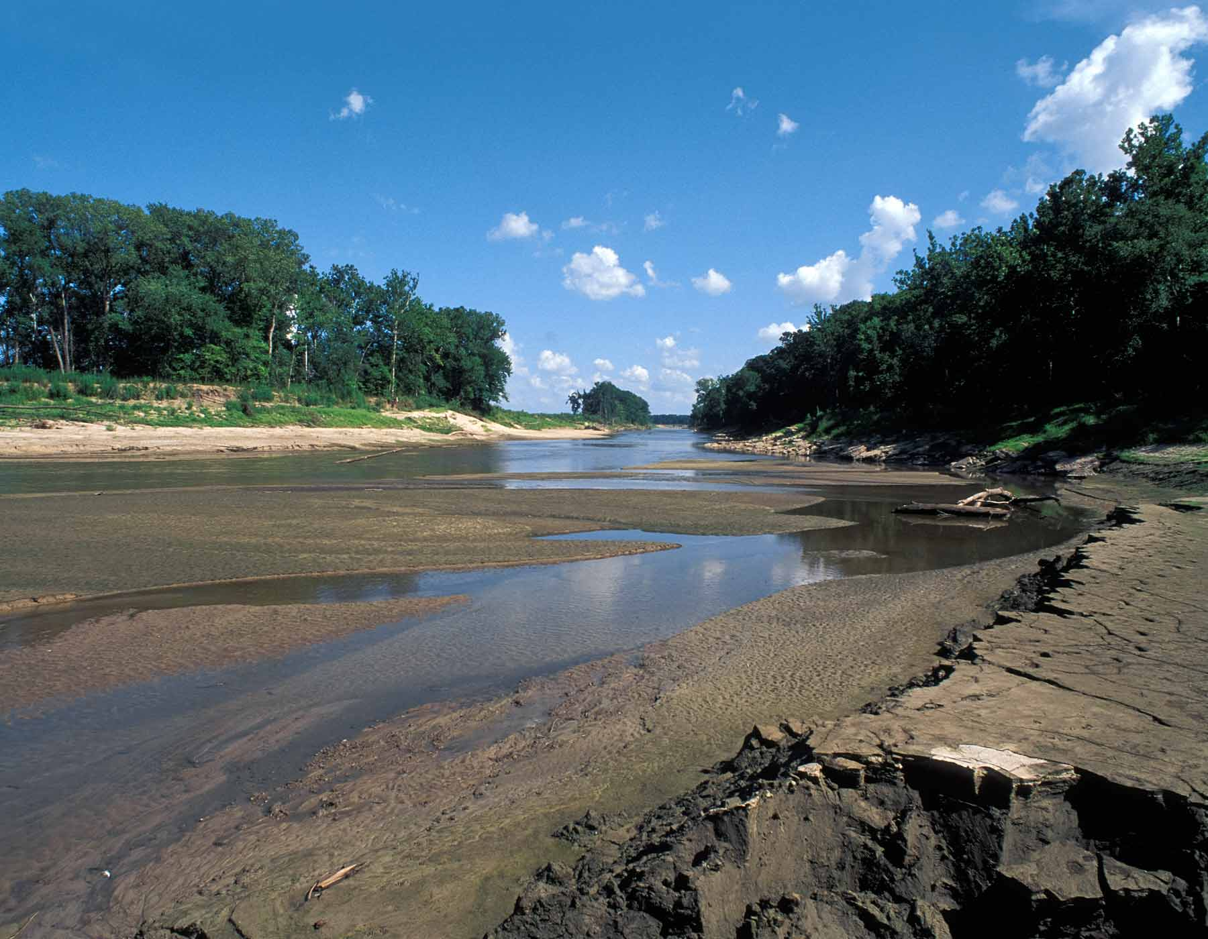
Silt or Mud Streambed
Overview
Floodplain
Riparian Cover
Streambank
Streambed
Other Assessments
Notes:
Let’s look at the different types of streambed substrates.
Silt and mud are the smallest substrate.
These fine sediments are smooth to the touch when you rub some between your fingers.
In this photo of the Grand River, you can see that silt makes up a large percentage of the streambed.
Silt does not provide interstitial spaces needed for many aquatic organisms.
This type of sediment is characteristic of streams in northern Missouri.

Slide 37
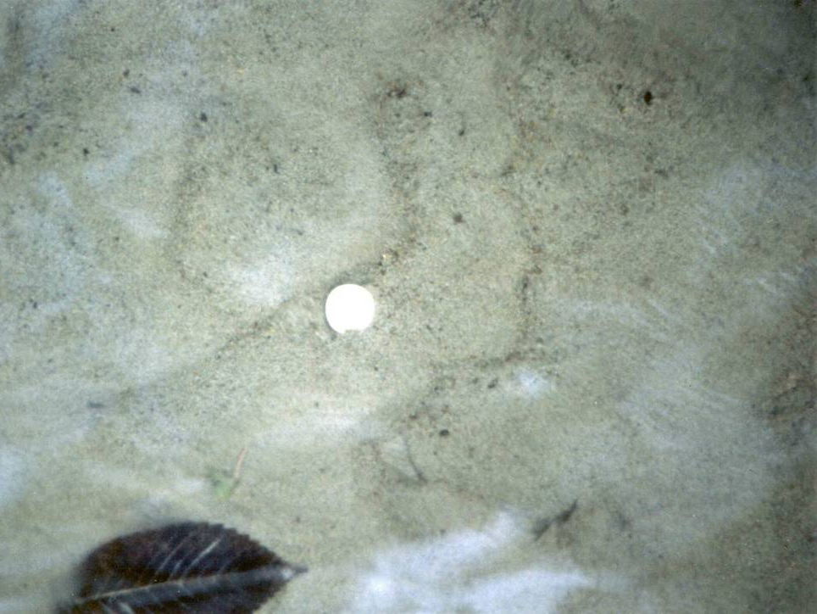
Sand Streambed
Overview
Floodplain
Riparian Cover
Streambank
Streambed
Other Assessments
Notes:
The streambed is 100% sand sediment. Sand will feel grainy and rough when you rub it between your fingers.
The spaces between the sand particles are too small to provide habitat for most invertebrates and small fish.
As a result, it does not support a wide variety of aquatic organisms.

Slide 38
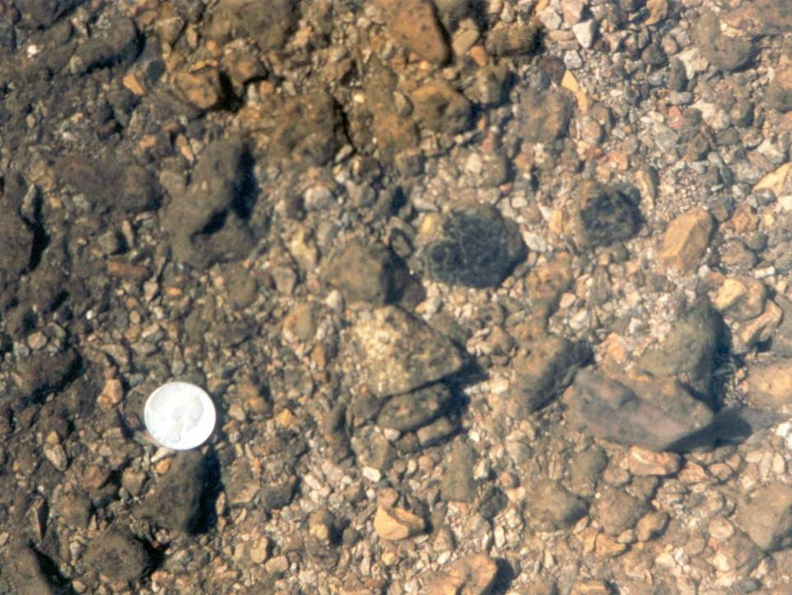
Gravel and Sand Streambed
Overview
Floodplain
Riparian Cover
Streambank
Streambed
Other Assessments
Notes:
This stream bottom is primarily gravel with some sand.
Gravel is defined as sediment larger than sand but less than 2 inches in size.
This is a better substrate than sand for an invertebrate community.
However, most of the interstitial spaces are filled with sand and there is little habitat for aquatic invertebrates.

Slide 39
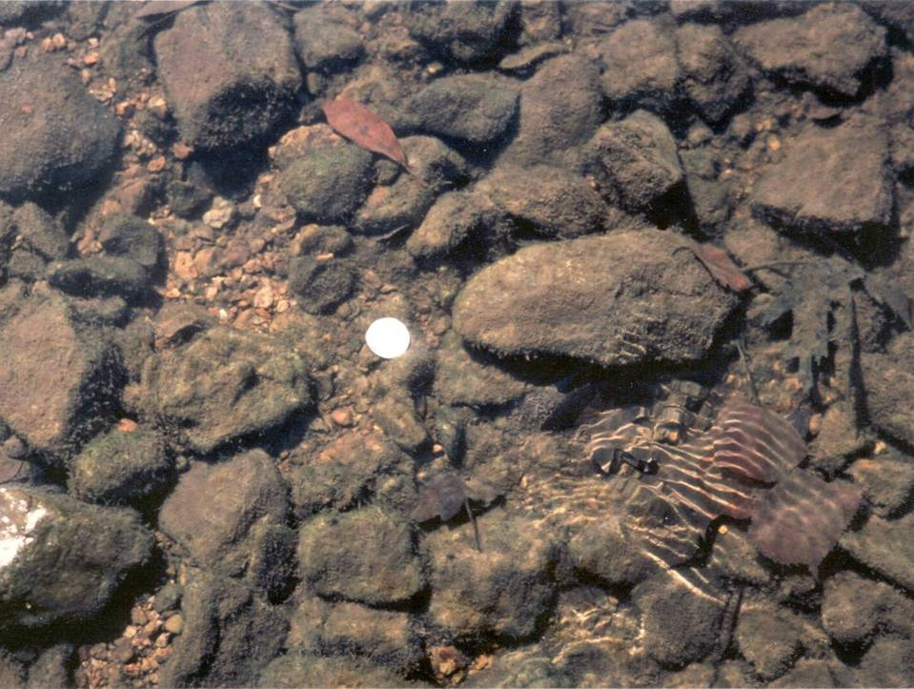
Cobble and Gravel Streambed
Overview
Floodplain
Riparian Cover
Streambank
Streambed
Other Assessments
Notes:
A large part of this streambed is cobble, with some gravel and sand.
Cobble ranges from 2 to 10 inches in size.
It provides lots of interstitial spaces for aquatic invertebrates.
This is the type of substrate that supports a diverse aquatic community.

Slide 40
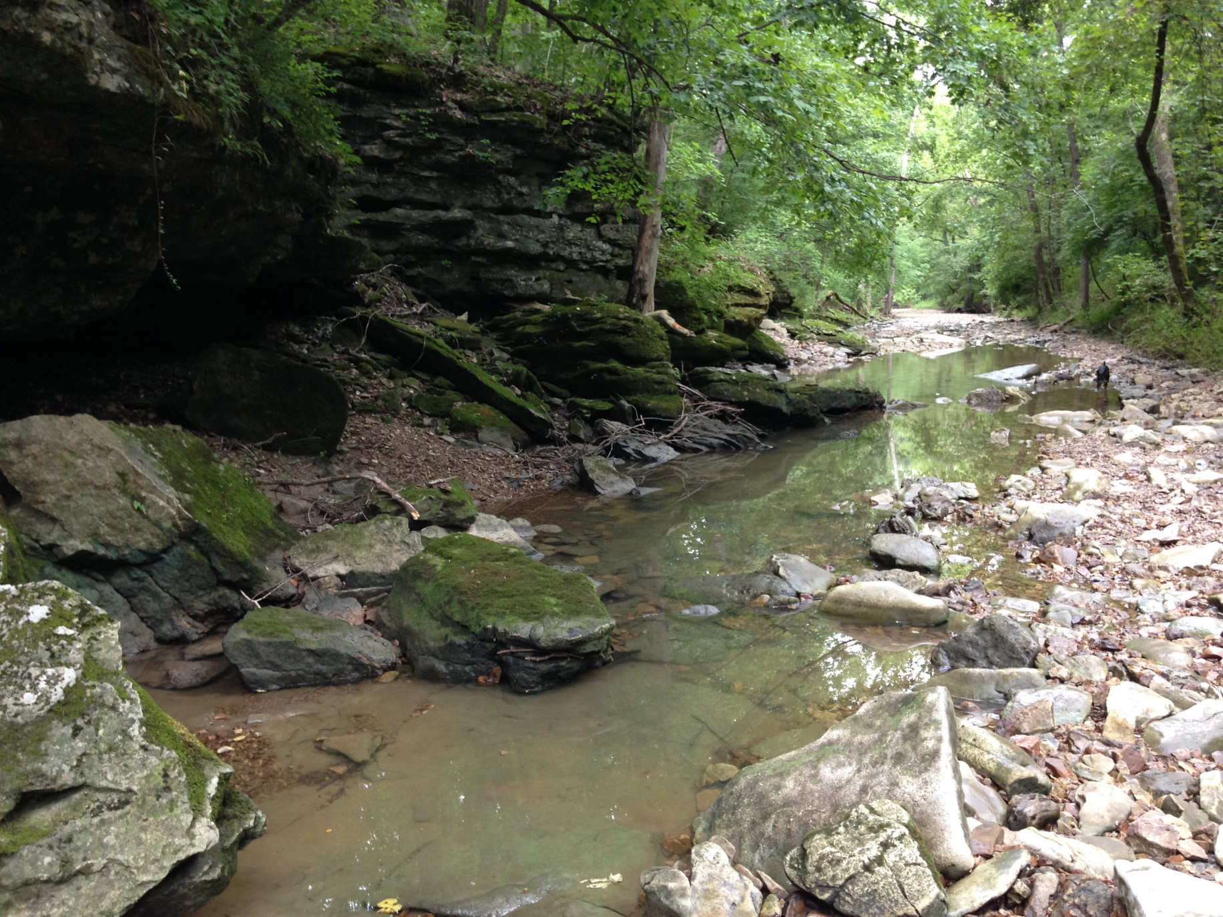
Boulder and Bedrock Streambed
Overview
Floodplain
Riparian Cover
Streambank
Streambed
Other Assessments
Notes:
This streambed is mostly composed of boulder substrate, with some bedrock.
Boulders are defined as any rocks over 10 inches in diameter.
Bedrock is large solid rock that lies beneath other substrate.
There are still many places for macroinvertebrates to live, although the size of the boulders and the bedrock may limit some species.

Slide 41
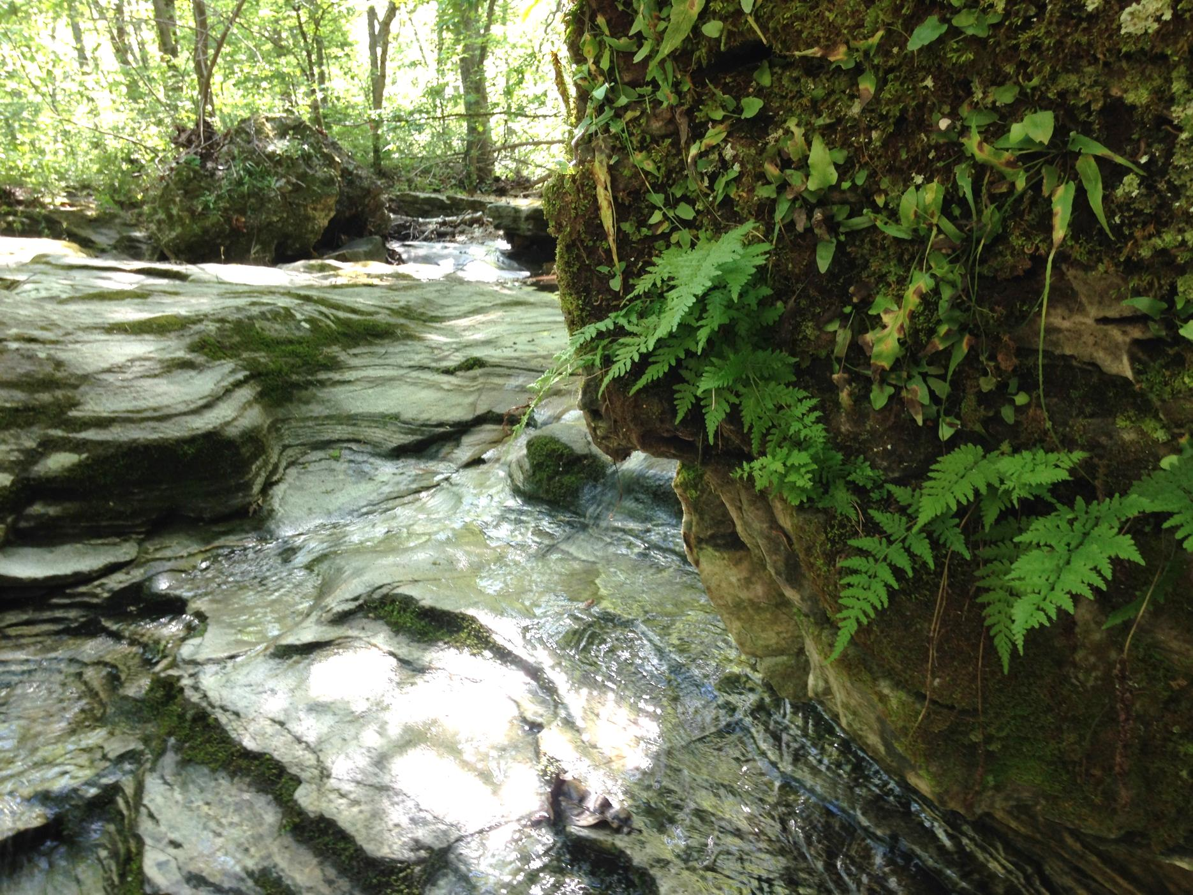
Bedrock streambed
Overview
Floodplain
Riparian Cover
Streambank
Streambed
Other Assessments
Notes:
This streambed is 100% bedrock.
Bedrock resists erosion, but since it is usually smooth, it provides little habitat for aquatic invertebrates.

Slide 42

Embeddedness of cobble substrate
Overview
Floodplain
Riparian Cover
Streambank
Streambed
Other Assessments
Notes:
The last thing to look at within the streambed is the percent embeddedness of cobble substrate.
You will pick up five cobble stones from the streambed, ideally a riffle, and determine the average embeddedness from all five rocks.
If there is no cobble at the stream site, just check the box on the data sheet that cobble substrate is not present.

Slide 43
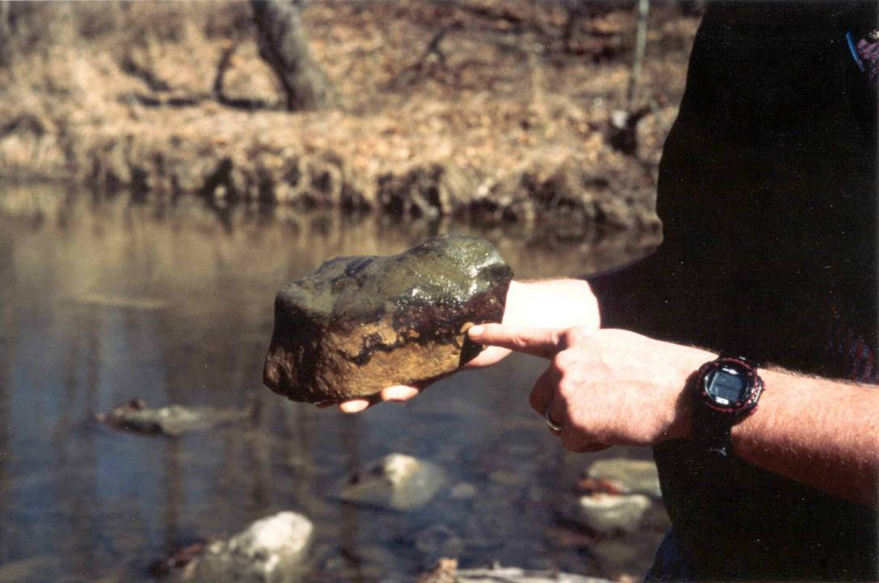
Overview
Floodplain
Riparian Cover
Streambank
Streambed
Other Assessments
Notes:
Embeddedness can be determined by looking at oxidation or algae on a rock.
In this photo, you can see the algal growth above the embedded line.
This cobble was about 30% embedded.

Slide 44
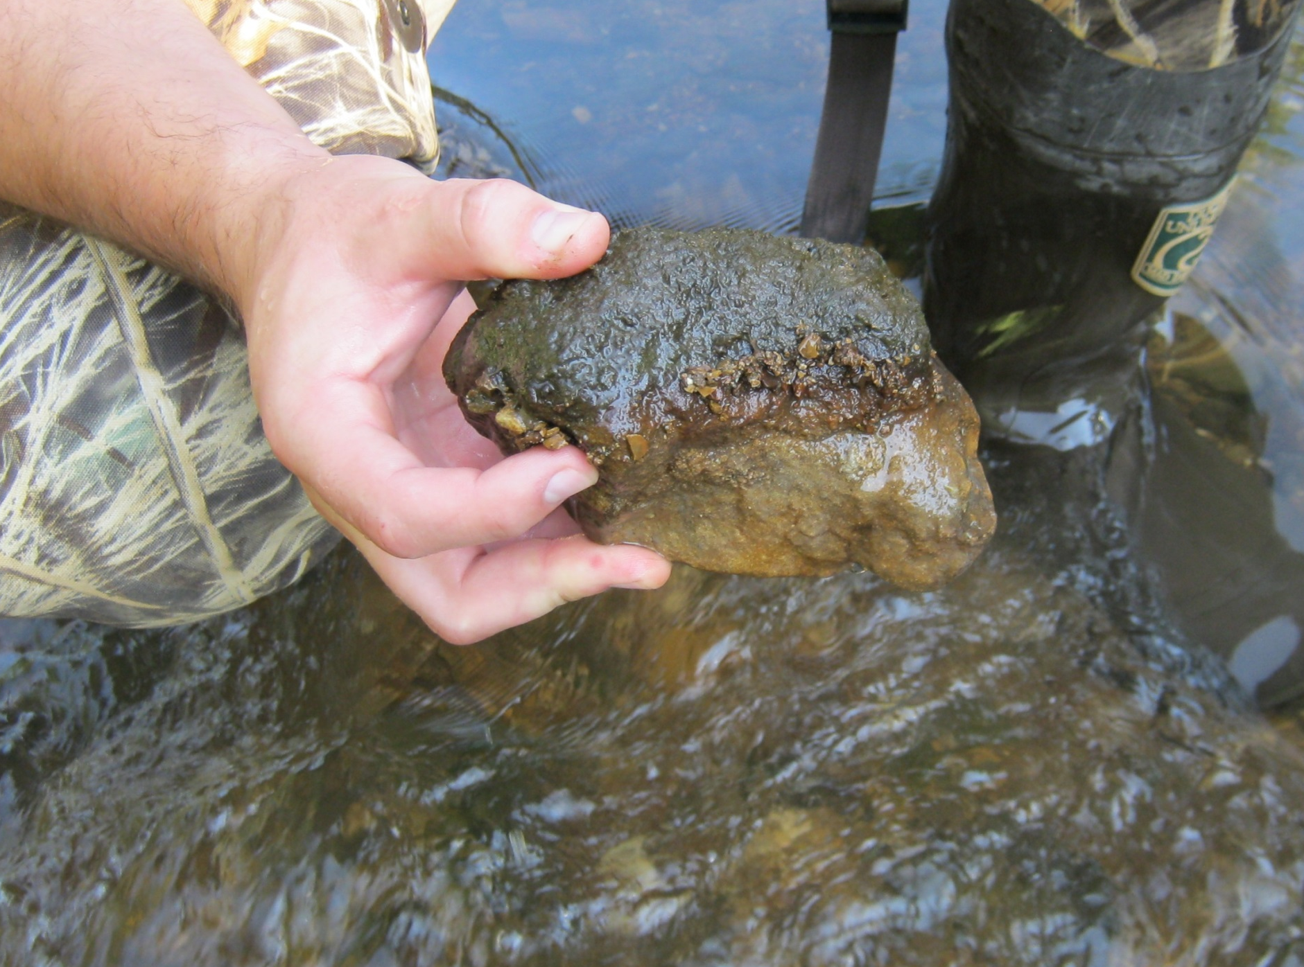
Overview
Floodplain
Riparian Cover
Streambank
Streambed
Other Assessments
Notes:
This rock also has algae where the top was exposed.
This was about 80% embedded.
You would continue this evaluation for a total of 5 rocks.
The data sheet provides easy instructions on how to calculate the average embeddedness.

Slide 45
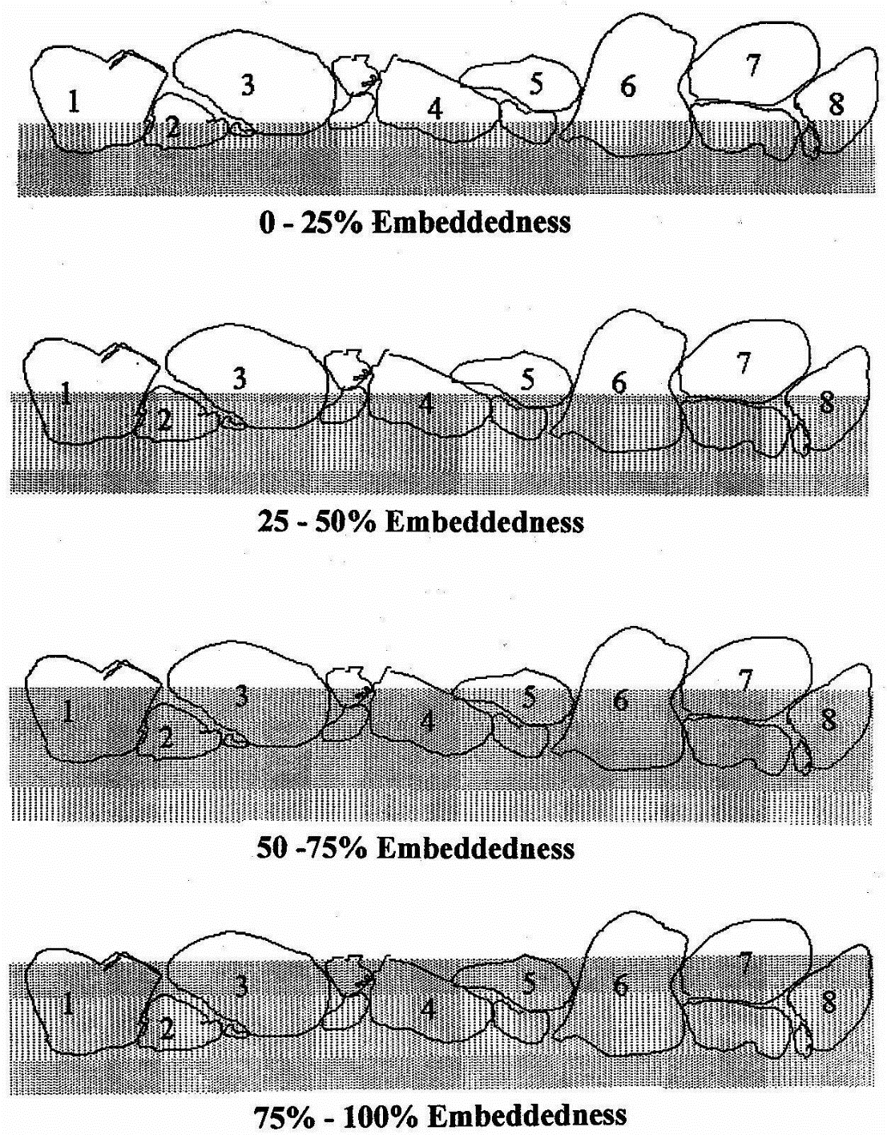
Overview
Floodplain
Riparian Cover
Streambank
Streambed
Other Assessments
Notes:
Here is an illustration to visualize embeddedness.
Embeddedness refers to how much of the rock is embedded or buried in sand or silt.
This is an indication of soil erosion. Greater embeddedness equals greater erosion or sedimentation.
An embeddedness greater than 50% will negatively affect most pollution sensitive species.

Slide 46
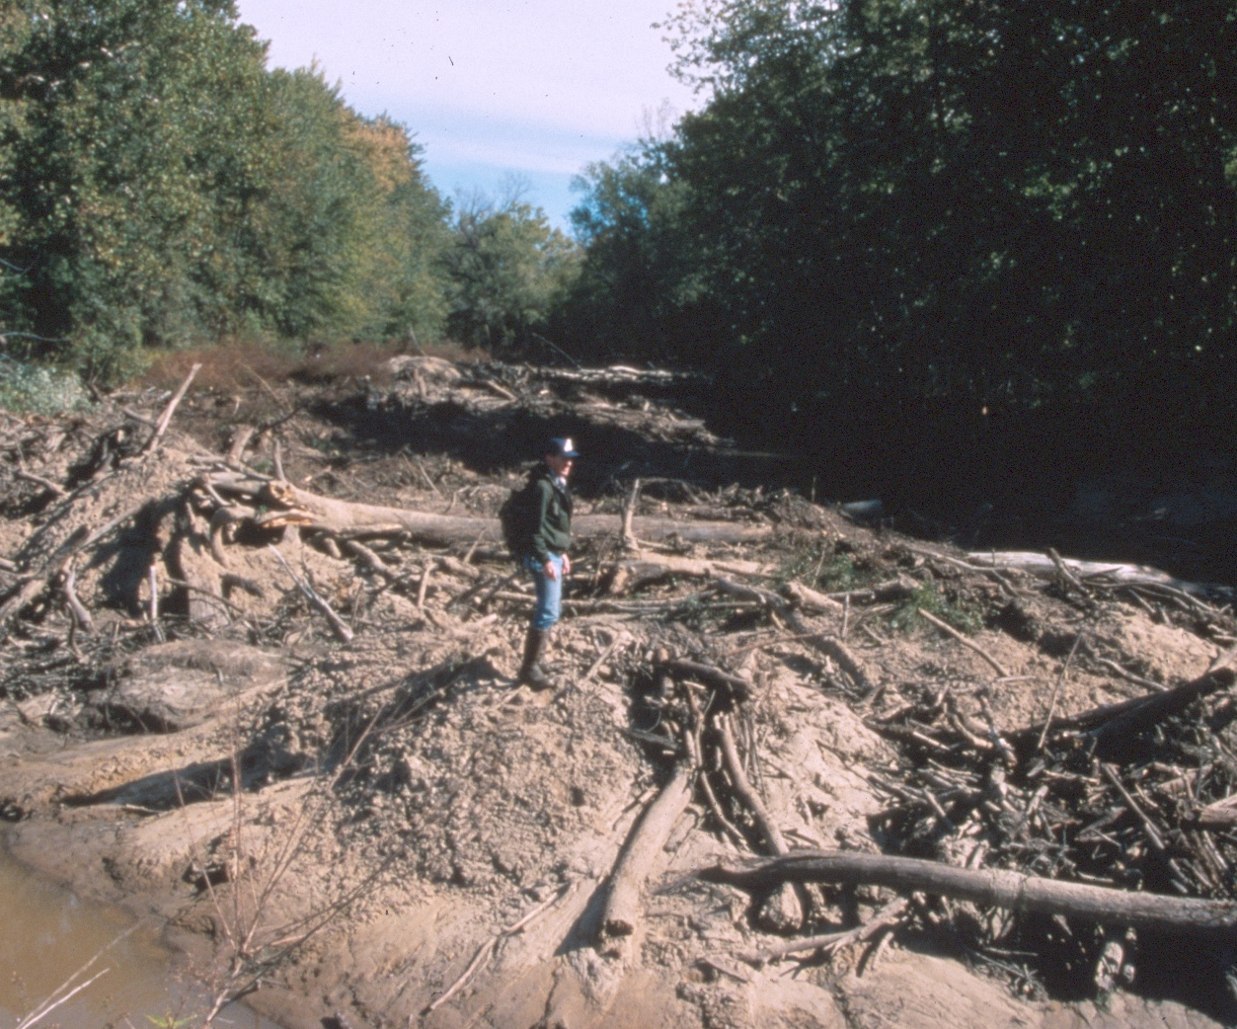
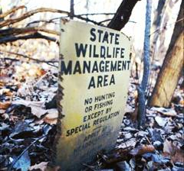
Sedimentation
EPA region 7 reports:
Single largest cause of impaired water quality in rivers
Third largest cause of impaired water quality in lakes
Sediment runoff rates:
  Construction sites:
~ 20-150 tons/ac/yr
  Ag. Fields with BMPs:
~5 tons/ac/yr
Overview
Floodplain
Riparian Cover
Streambank
Streambed
Other Assessments
Locust Creek at Grove CA
Notes:
Sedimentation contributes to impaired water quality in both rivers and lakes.
Not only does sediment fill in interstitial spaces in the stream, but it also brings other contaminants into the water.
High sediment loads can increase the turbidity, or “murkiness” of the water, which influences water temperature and other chemical parameters.
Best management practices has reduced sediment runoff rates from 5 ton per acre per year to about half a ton per acre per year.
Both of the images show severe cases of sedimentation, both along Locust Creek.
The top image is in Persing State Park. Channelization upstream of this site destabilized the stream and accelerated bank erosion.
The bottom image at Fountain Grove Conservation Area shows the sedimentation around a sign that was once four feet off the ground.

Slide 47
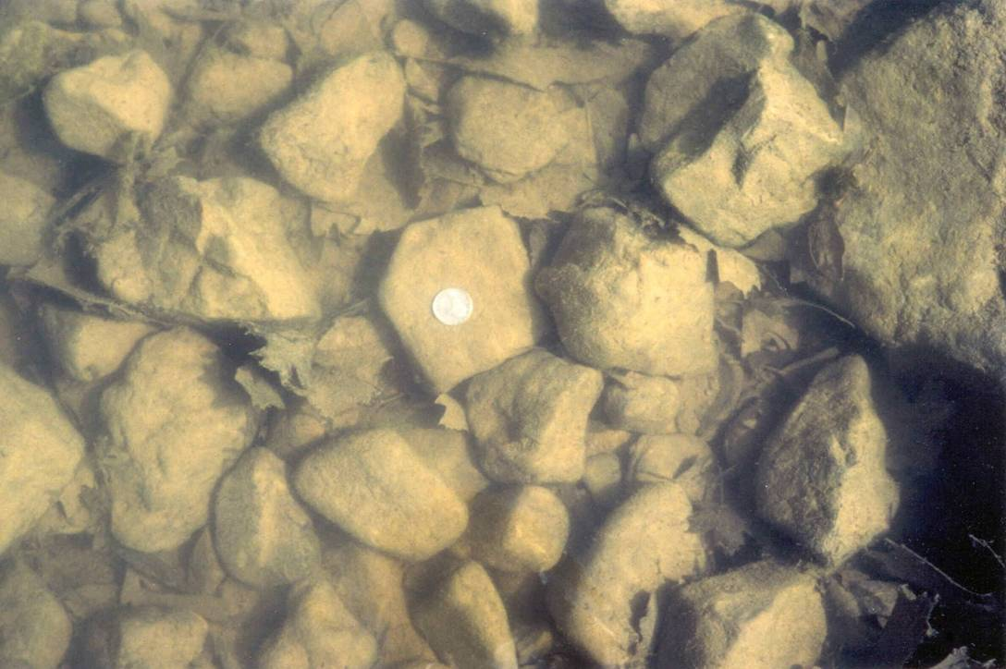
Low Embeddedness
Overview
Floodplain
Riparian Cover
Streambank
Streambed
Other Assessments
Notes:
Let’s look at some examples of embeddedness.
A surface view of this substrate in Hinkson Creek shows low embeddedness and relatively clean cobble substrate with interstitial spaces for aquatic invertebrates.

Slide 48
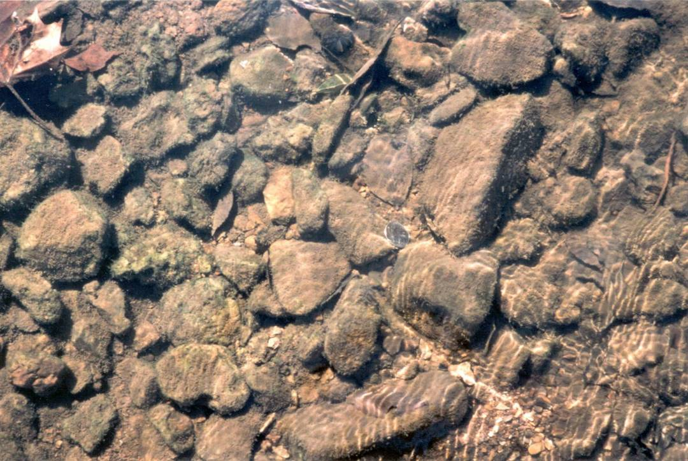
Some Embeddedness
Overview
Floodplain
Riparian Cover
Streambank
Streambed
Other Assessments
Notes:
This substrate shows about 25% embeddedness from fine gravel.

Slide 49
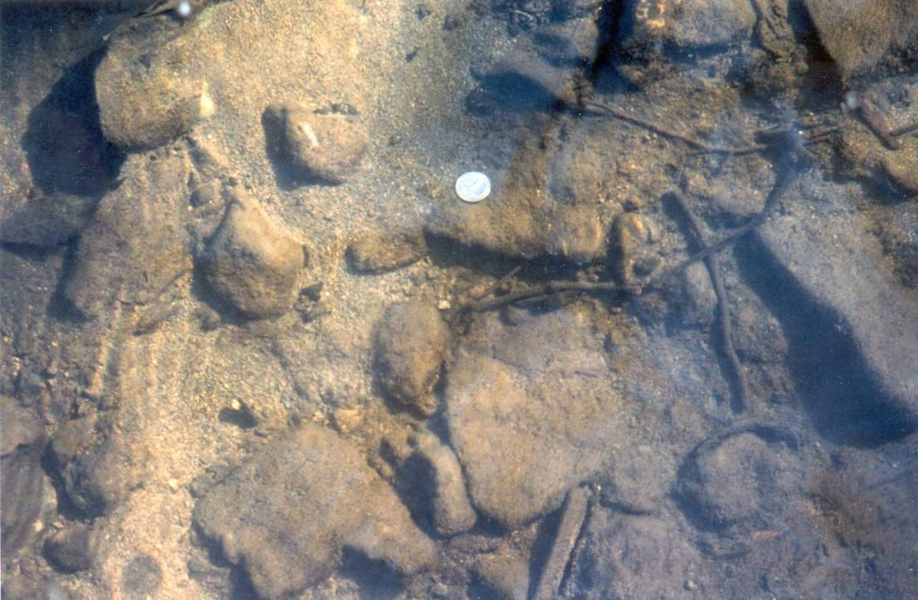
High Embeddedness, MDC photo
Overview
Floodplain
Riparian Cover
Streambank
Streambed
Other Assessments
Notes:
This cobble substrate has very high embeddedness from sand-sized particles.

Slide 50
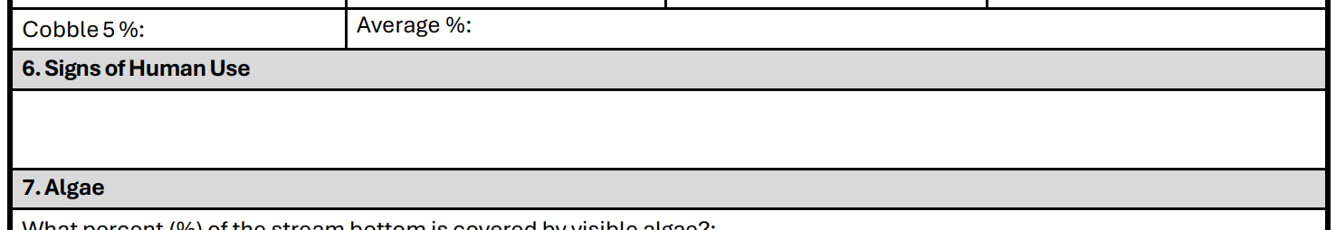
Signs of human use
Overview
Floodplain
Riparian Cover
Streambank
Streambed
Other Assessments
Notes:
The next section of the data sheet is signs of human use.
For your site, look around for any evidence of how people are using the area.
Some examples include campfires, litter, fishing tackle, ATV tracks, horse trail, etc.

Slide 51
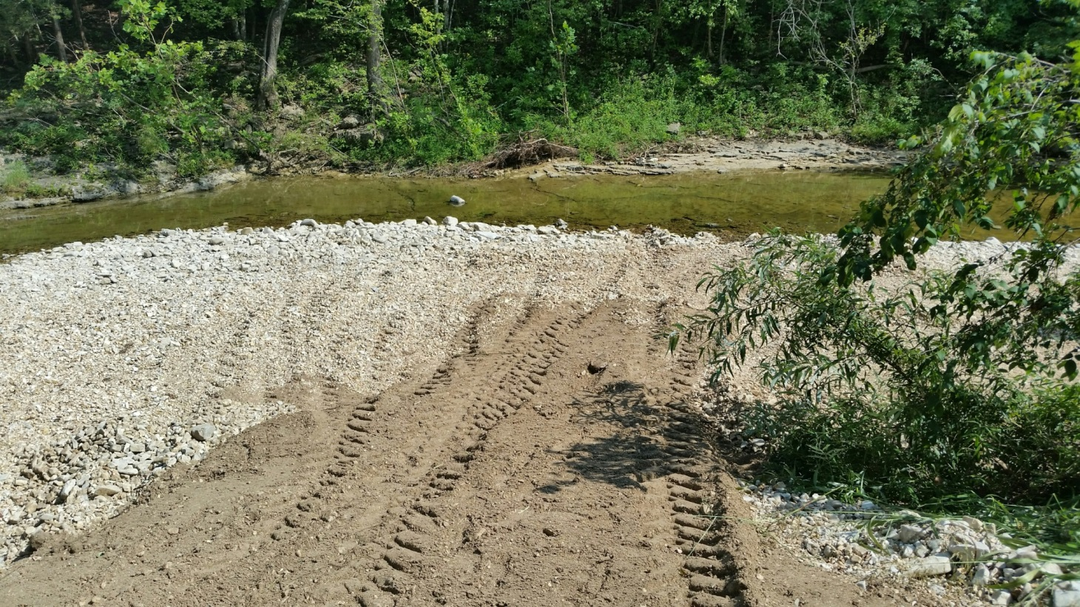
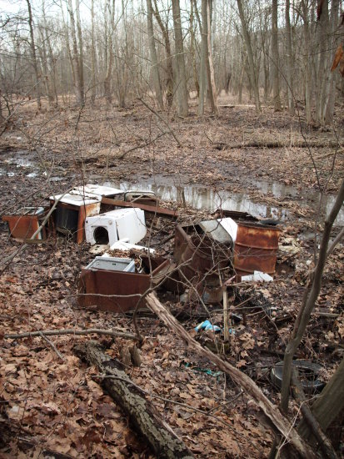
OWWP Photo
DNR Solid Waste Management Program: 573-634-2436
Overview
Floodplain
Riparian Cover
Streambank
Streambed
Other Assessments
Notes:
In the image on the left Roark Creek, we can see ATV tracks which are an obvious sign of human use.
Sometimes you’ll come across signs of human use that may need to be reported, like illegal dumping.
In such a case, this dumping should be reported to the Missouri Department of Natural Resources’ Solid Waste Management Program.

Slide 52
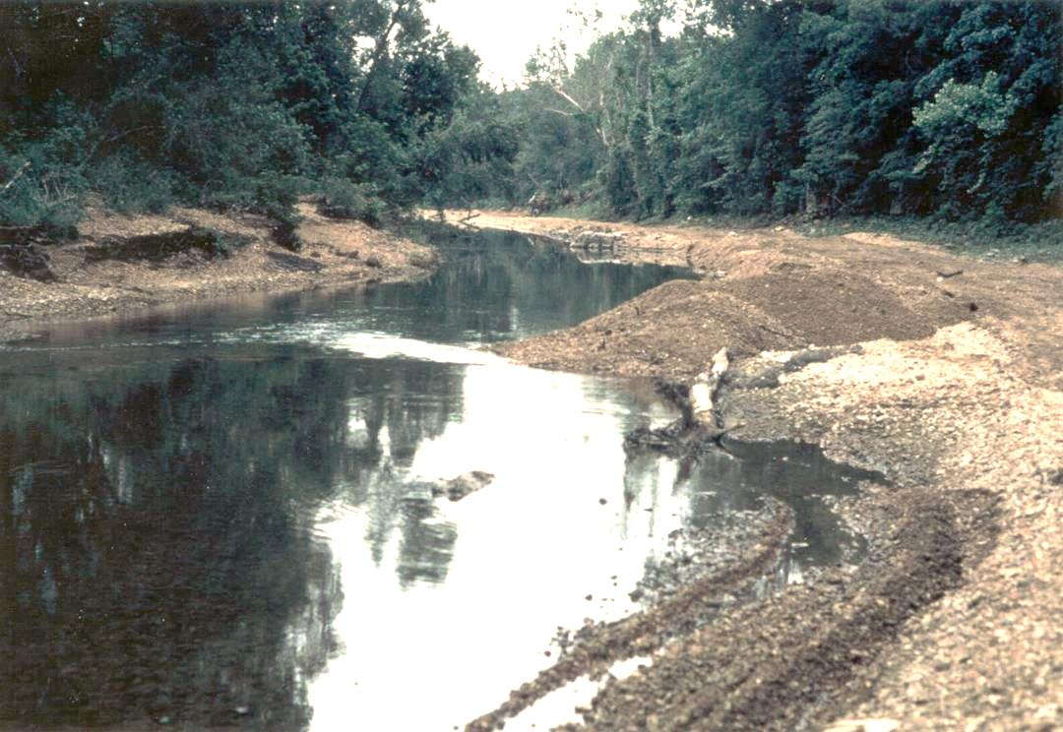
Gravel Mining
Overview
Floodplain
Riparian Cover
Streambank
Streambed
Other Assessments
Notes:
A sometimes less obvious sign of human use is gravel mining.
Some gravel mining doesn’t require a permit. Some gravel mining does require a permit.
This photo is an example of how gravel mining should NOT be done.
We can see gravel is piled in the water and vehicles have driven in the streambed.
More information on sand and gravel mining can be found on the Department of Natural Resources website.

Slide 53
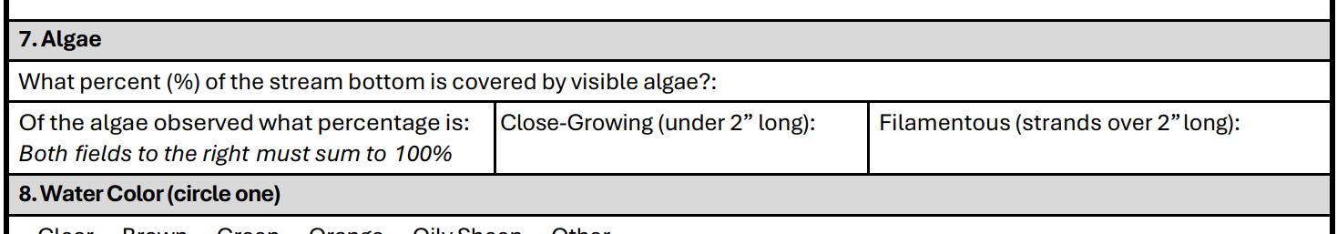
algae
Must add up to 100%
Overview
Floodplain
Riparian Cover
Streambank
Streambed
Other Assessments
Notes:
Next on the data sheet is looking at algae within the stream.
First, estimate the percentage of the stream bottom that is covered with algae. You may have to walk up and down your 300-foot site to see where all the algae is.
Next, of the algae observed, enter the percentage of algae that is close-growing and the percentage that is filamentous.
Close growing algae is short in length and can sometimes look fuzzy. Filamentous algae is longer than 2 inches and can typically wave back and forth in flowing water.
The sum of the percentage of close-growing and filamentous algae should equal 100%.

Slide 54

Close-Growing Algae
Overview
Floodplain
Riparian Cover
Streambank
Streambed
Other Assessments
Notes:
This photo shows close-growing algae on the larger substrate. Close-growing algae can be described as the rocks wearing a “sweater”, because it usually looks like a fuzzy, soft covering on the rocks.
It may appear to be a uniform color, often greenish-brown.

Slide 55

Filamentous Algae
Overview
Floodplain
Riparian Cover
Streambank
Streambed
Other Assessments
Notes:
In this photo of the Big Piney River, we can see filamentous algae.
This was just downstream of a wastewater treatment plant where nutrients are high.

Slide 56




Filamentous algae vs. aquatic plants
Filamentous Algae: No leaves
Aquatic Plant:
Has Leaves
Hydrilla
Duckweed
Overview
Floodplain
Riparian Cover
Streambank
Streambed
Other Assessments
Notes:
Sometimes it’s difficult to distinguish between algae and aquatic plants.
Filamentous green algae consists of fine, green filaments that have no leaves, roots, stems, or flowers.
It forms green, cottony masses that are free-floating or attached to rocks, debris, or other plants.
Sometimes bubbles, generated by the plant or created by its decay, get trapped in the mats and make them buoyant.
It grows in practically any water that can support life and receives good light.
As a general rule, if you don’t see leaves, it’s probably algae.
If you can see leaves, it’s an aquatic plant.

Slide 57


Harmful Algal Blooms
(HAB’s)
Caused by warm temperatures + high nutrient load
Cyanobacteria can produce
harmful toxins
Often looks like spilled paint
or pea soup
Overview
Floodplain
Riparian Cover
Streambank
Streambed
Other Assessments
Notes:
Harmful algal blooms, or HABs, are becoming more prevalent, and we encourage volunteers to report them.
They are usually caused by warm temperatures combined with a high nutrient load in a water body, and are formed by blue-green algae, or cyanobacteria, which can produce cyanotoxins.
These toxins can cause illness and death in humans and animals.
They often look like green or blue paint has been spilled on the surface of the water, or like pea soup.
They are most common in lakes and ponds, but can be also be found in streams, especially in slow moving water or water that is pooled.
If you are unsure whether or not a water body has a harmful algal bloom, remember: “When in doubt, Stay Out!”
More information on HABs, including the reporting form, can be found on DNR’s website.

Slide 58

HAB Reporting
1
Visit dnr.mo.gov
2
Type “HAB Notification Form” in search bar
3
Click on the result: “Suspected Harmful Algal Bloom Notification Form MO 780-2827”
4
Fill out form and email to moHABreport@dnr.mo.gov
Overview
Floodplain
Riparian Cover
Streambank
Streambed
Other Assessments
Notes:
If you think you have found a harmful algal bloom, please report this concern.
The easiest way to report a suspected HAB is to follow these instructions.
This email goes to the HAB response team, and a member of this team may contact you for more information.
It’s always a good idea to snap some photos of the algae at the site to send with the form.

Slide 59

Water color and odor
Overview
Floodplain
Riparian Cover
Streambank
Streambed
Other Assessments
Notes:
Next on the data sheet are water color and odor.
It’s easiest to evaluate these by scooping up some stream water in a clear container.
Water can be a variety of colors. If there is algae in the water, it might be green. With high sediment load, it could be brown. It could even appear milky or have an oily sheen.
In many streams, the water will have no odor.
In others, it may smell musty, organic, or even smell like sewage. You might smell chemicals or oil.
Circle the color and odor that best describes what you’re seeing. If you circle “Other” describe what you saw in the comments at the bottom of the datasheet.

Slide 60

Overview
Floodplain
Riparian Cover
Streambank
Streambed
Other Assessments
Notes:
When you look at the water in the stream it can appear to be the color of the stream bottom, which is misleading.
Even though the water in this stream looks green, that is just the algae growing on the bottom, not the water itself.
Scoop water in a clear plastic container to check the true color of the water.

Slide 61

Overview
Floodplain
Riparian Cover
Streambank
Streambed
Other Assessments
Notes:
Using a container to smell your water will help you to determine if the smell is the actual water or the environment around the stream.

Slide 62

Cloud cover
Overview
Floodplain
Riparian Cover
Streambank
Streambed
Other Assessments
Notes:
The last section in the Visual Survey data sheet is Weather Conditions, specifically cloud cover.
Please denote if the skies above your site at the time that you’re sampling are clear, partly cloudy, or cloudy, by circling one of the options available.
Knowing these conditions can help us interpret other kinds of data that you collect at your site.

Slide 63


Overview
Floodplain
Riparian Cover
Streambank
Streambed
Other Assessments
Notes:
On all data sheets, there is a section for Comments and Fish Present.
In the comments section, add any observations you think might be important or of interest.
Examples include: “Lowest flow ever observed,” or “Trees recently cleared from banks.”
If you observe dead fish or other evidence of a pollution event, it is fine to write it here, but please call the emergency numbers for the Environmental Emergency Response hotline.
Under Fish Present, Simply check the yes or no box if you saw a fish in your site.
We don’t need to know species or quantities. We just care to know that the stream supports aquatic vertebrates.

Slide 64


comments
Iron-oxidizing bacteria
Organic foam
Lamine River, Cooper Co.
Overview
Floodplain
Riparian Cover
Streambank
Streambed
Other Assessments
Notes:
Something else you may want to mention in the comments section is the observation of foam or iron-oxidizing bacteria.
Foam in a stream can be caused naturally by decomposition. To determine if it is natural, use the stick test. If the foam breaks apart when wacked with a stick, it is natural. If it doesn’t break apart it could be a detergent or another chemical. This would be a concern.
It’s somewhat common to see bright orange slime, often accompanied what appears to be an oily sheen on the water. This is caused by naturally occurring iron-oxidizing bacteria, which get energy from the iron minerals leaching out of the soil. If you can break the sheen with a stick, it is organic and not a cause for concern.

Slide 65

Overview
Floodplain
Riparian Cover
Streambank
Streambed
Other Assessments
Notes:
If you need guidance or definitions, more information can be found on the back of the data sheet.

Slide 66





Contact us
mostreamteam.org
Streamteam@dnr.mo.gov
Streamteam@mdc.mo.gov
youtube.com/@MissouriStreamTeam
facebook.com/mostreamteams/
800-781-1989
Notes:
Additional resources and training videos can be found online. Contact us if you have any questions.

