Slide 1

Safety and Trespassing Overview
Personal Health
Sampling Safety
Trespassing
Notes:
Safety is the most important consideration for water quality monitoring, so we will be reviewing the following safety categories: How to ensure your personal health when sampling, how to collect data safely, and trespassing laws that concern volunteer monitors.

Slide 2
Personal Health
Notes:
First, we’ll talk about things to consider to ensure your personal health.

Slide 3


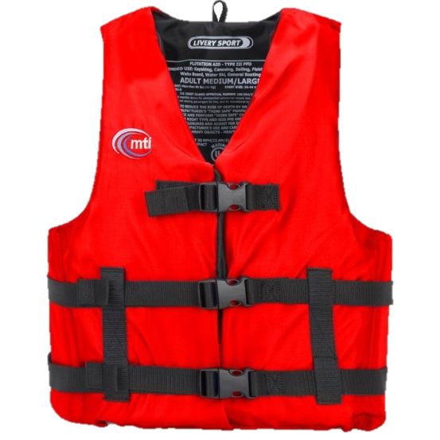
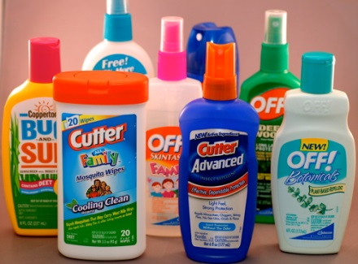
Personal Health Precautions
Check with your doctor or local health department for appropriate immunizations and health/safety guidelines
Foot Protection
Life Jacket
Bug repellent
Personal Health
Sampling Safety
Trespassing
Notes:
It’s recommended that you check with your family physician or county health department to discuss appropriate immunizations and learn about any health and safety guidelines.
You should always wear some type of foot protection.
Never go bare foot or wear sandals in a stream while doing volunteer monitoring.
Boots, old tennis shoes, and waders all provide good protection from sharp objects.
Wearing a life jacket is important when the depth of the stream is unknown.
Better yet, don’t enter a stream with an unknown depth! If you have young children with you while monitoring, they should also have a life jacket on.
In order to protect yourself from insect bites, having bug repellent on hand is a good idea.

Slide 4

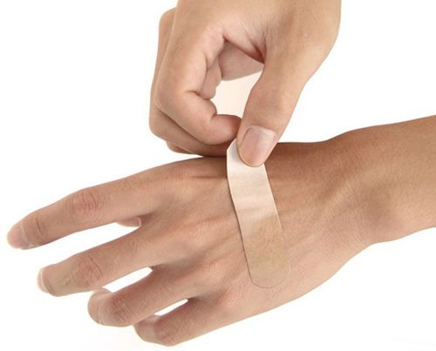
Guard against pathogens
Avoid water contact with:
  Eyes
  Nose
  Mouth
  Open cuts
Personal Health
Sampling Safety
Trespassing
Notes:
In order to protect yourself from disease-causing pathogens that could possibly be in the stream you are monitoring, avoid water contact with your eyes, nose, and mouth.
Also, try to avoid letting water get into any breaks in your skin, such as blisters, cuts, and sores.
Do not rub your eyes or bring your hands to your mouth until after you have washed them with soap and warm water.

Slide 5
Sampling safety
Notes:
Next, we’ll discuss how to safely collect data while you are sampling at your stream site.

Slide 6
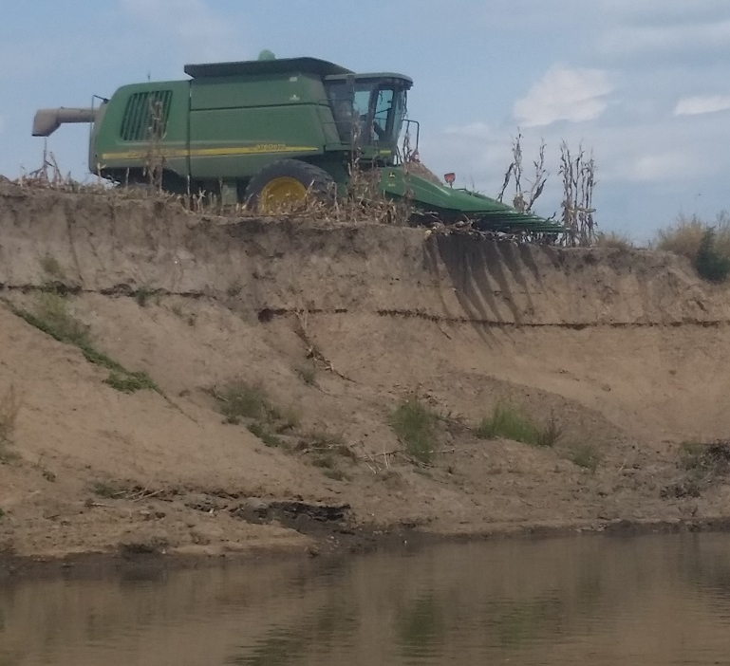
Think safe
Use common sense and be aware of your surroundings
DO NOT put yourself or anyone else in jeopardy
DO NOT enter a stream when the current is swift from flooding
Bring a buddy! Make sure you tell someone where you are sampling and when you will return
Personal Health
Sampling Safety
Trespassing
Notes:
Use common sense, unlike the person in this photo, who’s using an expensive 30,000 plus pound machine over the streambank.
Your safety is far more important than any data you might collect, so do not enter the stream when the current is swift and the depth of the water is above you knees.
It is hard to maintain your balance, and the force of water can even knock over a strong adult.
The Buddy System should also be used when possible.
If you have to go out alone, make sure to tell someone where you are going to sample and when you plan on returning.

Slide 7
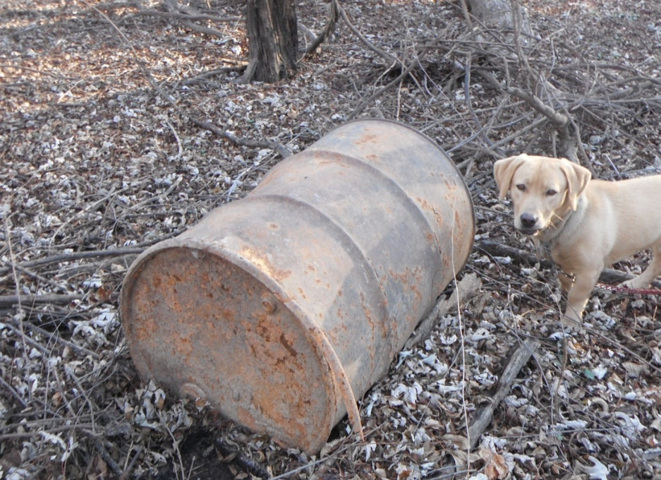
Hazardous waste drums
Contact the 24 hr. Environmental Emergency Response Hotline:
573-634-2436
DO NOT MOVE DRUMS
Personal Health
Sampling Safety
Trespassing
Notes:
You may come across chemical storage drums or tanks while in the field.
It’s very important that you do not touch, open, move, or relocate a drum until it’s verified to not contain hazardous waste.
First, look for an identifier label, which should list a manufacturer, contents, and hazards.
If a label isn’t present, assume it’s hazardous. Again, do not move or touch the drum.
Next, check to see if the drum is leaking, off-gassing at the seams or lid, or bulging.
Lastly, take photographs, note the location and coordinates if possible, and mark the area with a bright flag and “Do Not Disturb” sign.
The reason we say to not remove a drum from the site is because if you do, you now assume all responsibility for the drum and its contents.
This includes fees for disposal and environmental risks.
This will also interfere with locating and holding those responsible for leaving the drum or tank accountable.
You should contact the Environmental Emergency Response Hotline so they can investigate and dispose of the drums.
Now would be a perfect time to put this number into your phone!

Slide 8
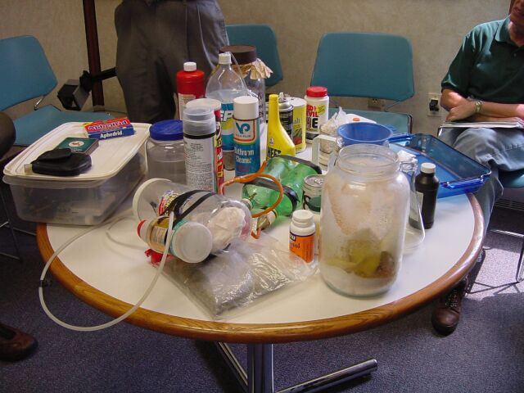
Meth waste
Soda bottles, gas cylinders, coffee filters, batteries, matches, aluminum foil, decongestant pill packets, bags of salt
Personal Health
Sampling Safety
Trespassing
Notes:
Another danger you could run into in the field is meth waste.
A wide variety of items can be used to make meth, and many of them are common household items.
Be extremely cautious if you come across any of the following at or near your stream site, because they can be extremely hazardous.
If you find any of the above items, do not touch or remove them.
The best thing to do is to leave the items alone.

Slide 9
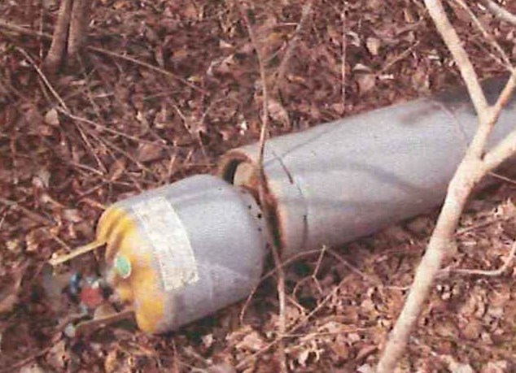
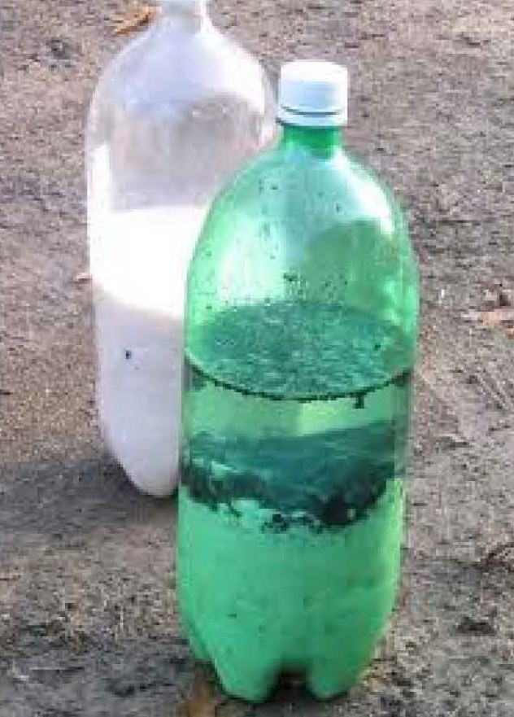
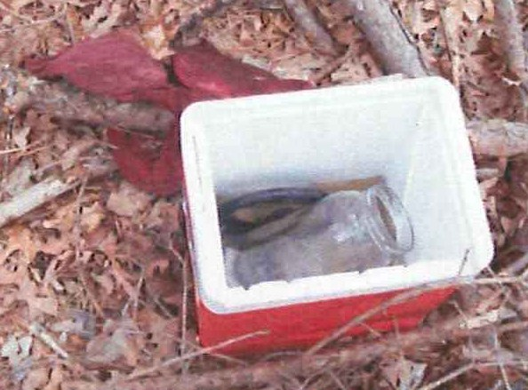
Contact local law enforcement
Personal Health
Sampling Safety
Trespassing
Notes:
Slide 9
If you come across what you believe to be meth waste, identify and document the location, call law enforcement, and take pictures.
Meth can be made in a single pot or shake-and-bake kits, which makes it easy to make meth in more secluded, wooded areas.
Pictured here are different kinds of meth waste.
On the left is a gas cylinder, which may have a blue-green valve, and can be extremely unstable and dangerous.
In the middle is a cooler that can hold shake-and-bake kits or separate ingredients.
Other containers like duffel bags can also contain these items.
Lastly, pictured on the right are soda bottles being used as shake-and-bake kits, which are highly reactive and can explode.

Slide 10
CHEMICAL SAFETY
Notes:
Now we’re going to talk about chemical safety.

Slide 11
Safety data sheet
(SDS)
Information on chemical composition, hazards, disposal, ecological information, etc.
Always keep SDS in an easily accessible location
http://mostreamteam.org/training-materials-and-resources.html
Chemical Safety
Water Safety
Trespass
Methamphetamine Waste
Waste Drums
Notes:
Safety Data Sheets, or SDSs, are documents that can be found on the Stream Team website. They are also included with every chemical kit and chemical order you receive.
Information about chemical composition, hazards, disposal, and ecological information can be found on the SDS, as well as other information.
Make sure to keep the SDSs for your chemicals somewhere you can easily access them for reference.

Slide 12
Chemical precautions
Keep all chemicals out of reach of children and pets
Wear gloves and safety glasses when handling chemicals
Store chemicals in a temperature controlled setting
Expired powders can be thrown away and liquids can be poured down the drain
Chemical Safety
Water Safety
Trespass
Methamphetamine Waste
Waste Drums
Notes:
All of your chemicals should be kept out of reach of children and pets.
While not completely necessary, it is recommended to wear safety glasses and gloves while handling any water quality monitoring chemicals.
Store chemicals in a safe, cool place away from moisture.
The chemicals used for water quality monitoring can be disposed of at home.
Expired powders and tablets should be thrown away in the trash, and expired liquids should be flushed down a drain with cold water.
Liquid waste from the nitrate and dissolved oxygen kits should also be flushed down a drain with cold water.

Slide 13
trespassing
Notes:
Lastly, we’ll cover the laws regarding trespassing and how to avoid unintentional trespassing.

Slide 14

Trespass
Volunteers do not have the right to trespass
Program staff do not have the right to trespass
Do not be tempted to enter land without the owner’s permission
Personal Health
Sampling Safety
Trespassing
Notes:
Volunteers and program staff do not have a right to trespass just because they are monitoring water quality.
You have to ask for permission to monitor on both private and public lands too.

Slide 15
The law
The law for 1st degree trespass:
  Land is posted, fenced, marked and/or you were told you were trespassing, but you still trespassed
Class B Misdemeanor Penalty
  Up to 6 months jail
  Fine not to exceed $1,000
Personal Health
Sampling Safety
Trespassing
Notes:
There are two different kinds of trespassing.
The more serious of the two is first degree trespass, and it occurs when a person knowingly enters and remains unlawfully on private property.
The property must be fenced or enclosed in a manner designed to exclude intruders and notice of trespass is given either by actual communication or if the property is posted.
First degree trespass is a class B misdemeanor, and the penalty for this can be up to 6 months jail time and/or a fine not to exceed $1,000.

Slide 16
The law
The law for 2nd degree trespass:
  You were not aware you were on private property, but you still trespassed
Infraction Penalty
  Fine possible
  No jail time
Personal Health
Sampling Safety
Trespassing
Notes:
The second, less serious kind of trespassing is second degree trespass, and it occurs when a person trespasses unknowingly on private property.
It is an offense of absolute liability, and because of this, the land does not have to be posted or fenced.
Second degree trespass is an infraction, and the penalty for this could be a possible fine, but will not result in any jail time.

Slide 17

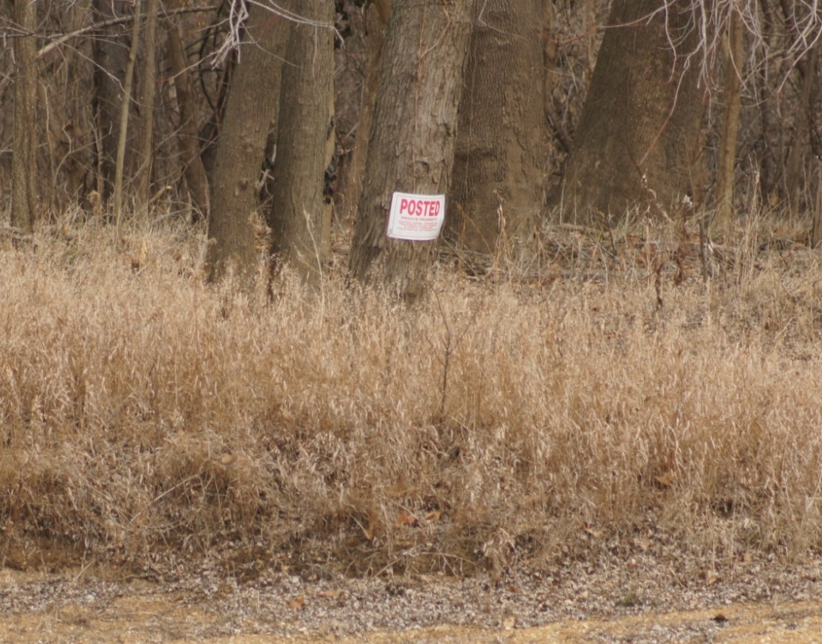
Posted Property
Signs
Purple Paint
Ask permission and explain what you are doing
Carry your Stream Team ID card*
*This is sent by email when you first join Stream Team. Responsibility to print it out falls onto the volunteer
Personal Health
Sampling Safety
Trespassing
Notes:
When in the field, you should heed any signs such as “no trespassing”, “no hunting”, “posted”, or “keep out”.
Trespassing is illegal and dangerous.
The Purple Paint Statute specifies how purple paint can be used by landowners to protect their property from trespassers.
The law specifies a purple post cap or a vertical line on a tree, but keep a look out for any purple, including things like bandanas and flags.
When you see purple assume it means, “Keep out!”
You can monitor on private property, but make sure to ask for permission from the landowner.
When getting permission to monitor, visit the landowner and explain your objectives.
If they don’t want you to monitor on their property, look for a different site.
If you choose to monitor in a park or on any state land, ask for permission from the park or area manager.
It’s good practice to carry your Stream Team Identification Card to show landowners so they know what you’re telling them is true.

Slide 18
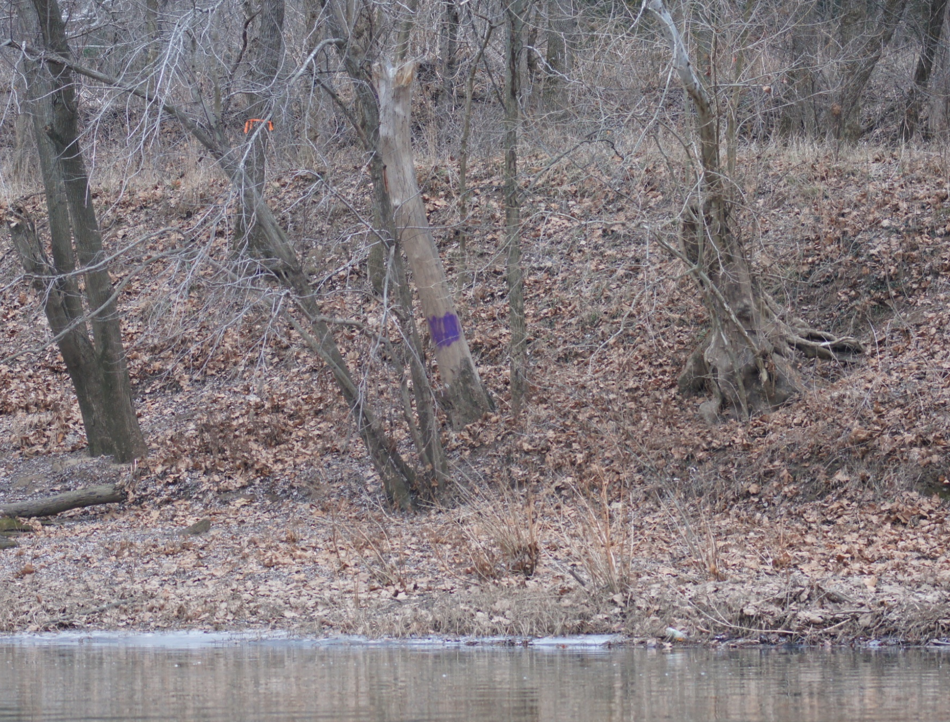
Personal Health
Sampling Safety
Trespassing
Notes:
Here is an example of the use of purple paint on a tree.
The statute states the paint must be a vertical line of at least eight inches in length, and the bottom of the mark should be no less than three feet and no more than five feet high.
The marks are also supposed to be placed no more than one hundred feet apart and need to be be readily visible to any person approaching the property.
Even if the painting markings don’t meet the legal requirements, they still mean no trespassing.

Slide 19
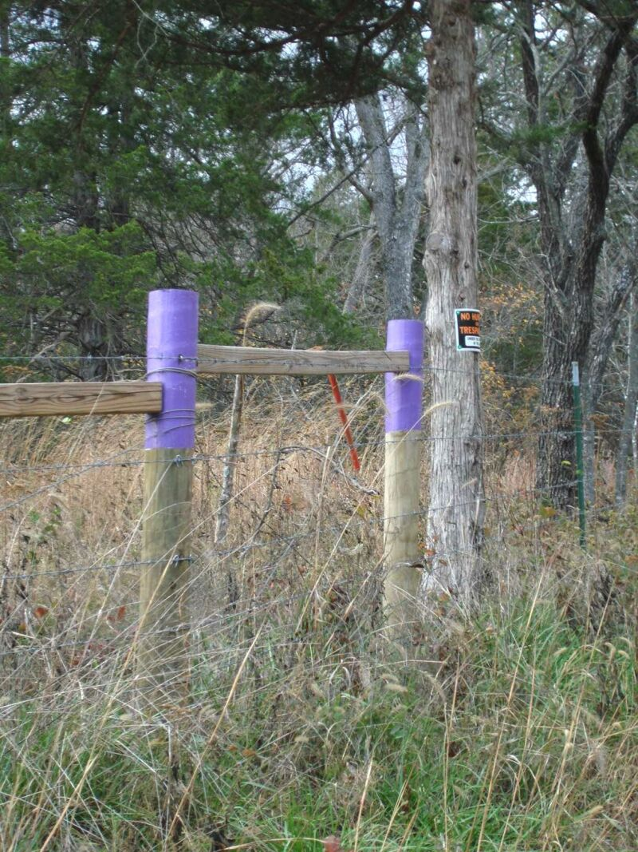
Personal Health
Sampling Safety
Trespassing
Notes:
Here is an example of the use of purple paint as post caps, which can also be sprayed onto trees.
The statute states that a post capped needs to be marked on at least its top two inches.
The bottom of the cap or mark should be between three feet and five feet six inches high.
Marked posts should be placed no more than thirty-six feet apart and must be readily visible to any person approaching the property.
Other examples of “purple paint” found on properties are purple pieces of fabric, bandanas, flags, simple purple signs, and haphazardly sprayed or brushed purple paint.
If you see the color purple, treat it as a no trespassing warning.

Slide 20

How to find property owners
Contact the County Assessor at the County Seat
Contact Staff
Plat Maps
  Some counties are now available online
  A list of County Assessors can be found at:
  www.countyoffice.org/mo-assessor/
Personal Health
Sampling Safety
Trespassing
Notes:
If you’re looking to ask permission to monitor in a certain area, you can contact your County Assessor and use a plat map to figure out who owns the property and have a discussion with them about monitoring.
Some counties have interactive GIS mapping software online, but not all of them.

Slide 21

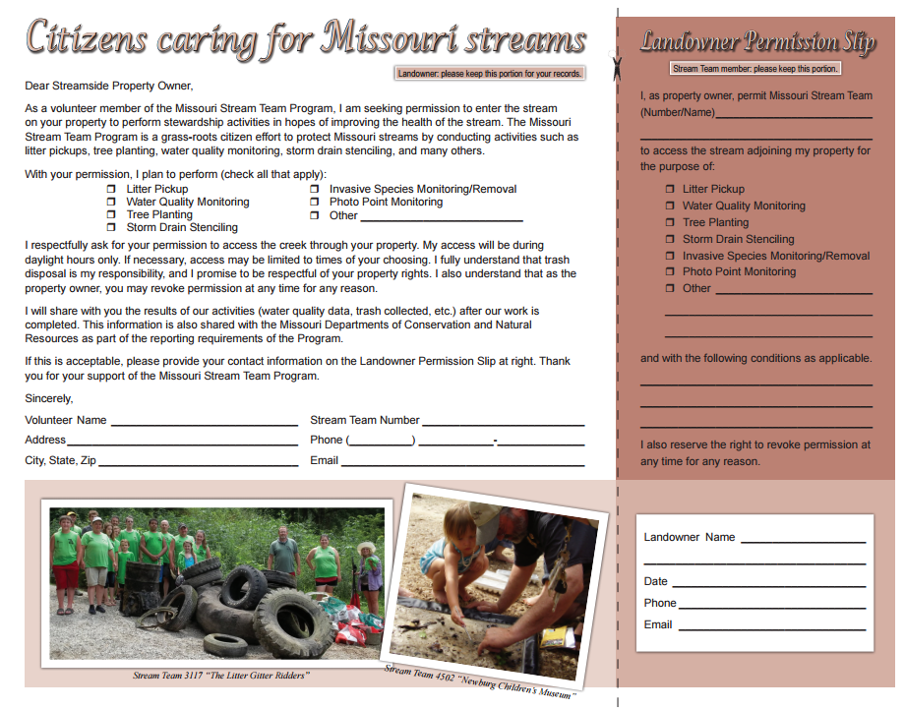
Land owner permission
Personal Health
Sampling Safety
Trespassing
Notes:
This is the landowner permission form, which is a great tool to explain who you are and why you are asking for permission for access to someone’s property.
Taking one of these with you if you are having a conversation with a property owner is very beneficial.

Slide 22
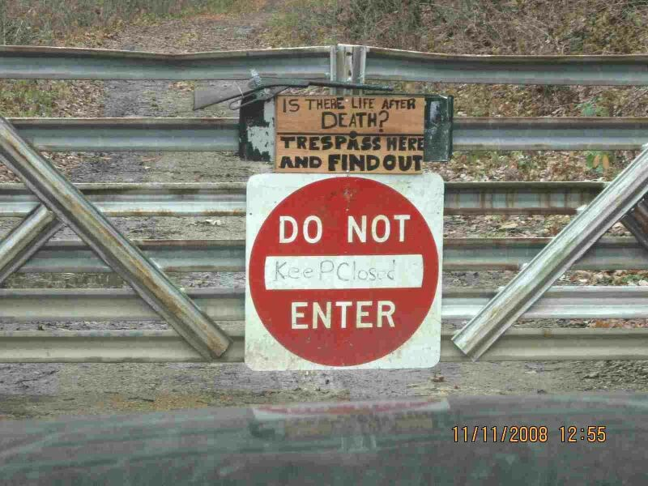
Notes:
In conclusion, please make sure to take going across someone’s private property seriously, and make sure to be cautious while monitoring.

Slide 23





Contact us
mostreamteam.org
Streamteam@dnr.mo.gov
Streamteam@mdc.mo.gov
youtube.com/@MissouriStreamTeam
facebook.com/mostreamteams/
800-781-1989
Notes:
Here is a list of some links that can be used to find additional resources and training videos. If you have any questions, please contact us either by email or phone!

