Slide 1

STREAM DISCHARGE
Notes:
Chapter 4-Stream Discharge
Time: 45 minutes to 1 hour
In the Stream Discharge chapter, we explain how stream discharge plays an important role in determining the characteristics of a stream and why measuring flow is a critical part of data collection. Our goal is to provide the background and methodologies that you need to understand and measure discharge at your stream site.

Slide 2
Objectives
Definition of Discharge
Factors Influencing Discharge
Importance of Discharge
Measuring
USGS Gaging Stations
Notes:
We will define stream discharge, what factors influence stream discharge, the importance of measuring it, how to measure it, and how to use USGS gaging station to gather discharge data.

Slide 3
WHAT IS STREAM DISCHARGE?
Notes:
Now let’s define stream discharge.

Slide 4
What is Discharge?
The volume of water flowing past a given point in a given period of time
Cross Sectional Area
  (square feet)
Surface Velocity
  (feet per second)
Stream Discharge
  (cubic feet per second or cfs)
Definition
Factors
Importance
Measuring
Gaging Stations
Notes:
Discharge, also referred to as flow, is a measure of how much water is flowing in a stream at a particular point in time.
Discharge is a product of cross-sectional area and velocity. It is expressed in cubic feet per second or CFS.
Later in this chapter we will cover how to calculate each step in finding stream discharge.

Slide 5
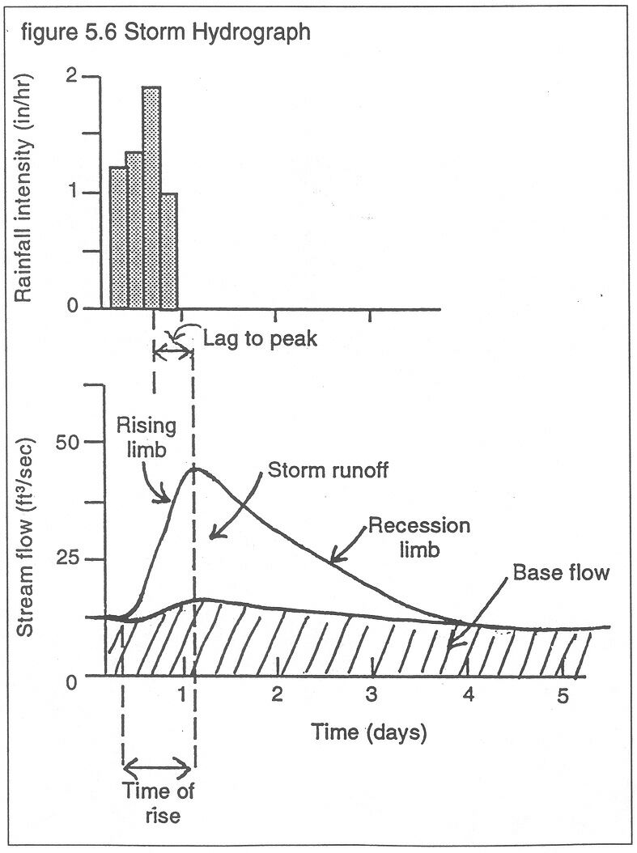
Storm Hydrograph
A hydrograph shows variation in stream discharge over time
Definition
Factors
Importance
Measuring
Gaging Stations
Notes:
A hydrograph is a visualization of stream discharge, showing the variation over time.
The top graph in this image shows the intensity of the rainfall and the bottom graph is the hydrograph for the same time period. This shows the stream’s response to the precipitation.
In the hydrograph, the x-axis is time in days, and the y-axis is discharge in cfs.
Shortly after the peak in rainfall intensity, there is a lag to peak in stream discharge. After this peak, stream flow tapers off until it reaches baseflow. This is represented by the recession limb.

Slide 6
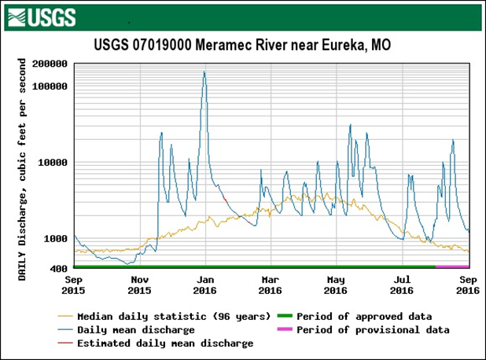
Hydrograph
Jan 2016
170,000 cfs
Nov 2015
600 cfs
Definition
Factors
Importance
Measuring
Gaging Stations
Notes:
Discharge changes naturally with the seasons throughout the year. Higher flows occur in the wet seasons of winter and spring, while lower, or base flows, usually occur in the drier seasons of summer and early fall.
Here we see a hydrograph for the Meramec River near Eureka.
Not only does this show variation in discharge for different seasons of the year, but we can also see there was a high flow event at the very end of December 2015. The St. Louis area had 10 inches of rain which took the stream discharge from 600 CFS to 170,000 CFS which caused flooding.
Hydrographs can be found on the USGS website. It’s always a good idea to reference this before visiting your stream site to make sure flow conditions are safe.

Slide 7
FACTORS AFFECTING STREAM DISCHARGE
Notes:
Next, we will talk about the factors that affect stream discharge.

Slide 8
What Affects Discharge and Hydrograph Shape?
Anything that affects water velocity and/or volume
Natural
Precipitation
Gradient
Anthropogenic
Land Use
Channelization
Streambank Slope
Vegetation
Soil type and Geology
Dams
Groundwater and Tributaries
Definition
Factors
Importance
Measuring
Gaging Stations
Notes:
Anything that affects velocity or volume of water can affect a stream’s discharge and the shape of its hydrograph.
This includes geology and soil type, gradient of the valley sides/streambanks, vegetation in the surrounding floodplain, type and amount of precipitation, channelization, dams, and overall land use.
Groundwater, springs, adjacent wetlands, and tributaries also affects the total flow in a stream..
Anthropogenic, or human-made, effects on discharge include land use, channelization, and dams.

Slide 9
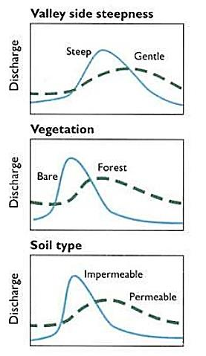
Natural factors that affect discharge
Precipitation amount and type
Streambank Slope
Vegetation
Soil Type and Geology
Gradient
Ground water and Tributaries
Definition
Factors
Importance
Measuring
Gaging Stations
Notes:
Let’s take a look at how natural characteristics of a stream can affect discharge.
In the image of hydrographs, the dashed line is under natural conditions. The blue line shows how a stream would change if there was development, like in an urban area.
Stream discharge varies according to how much precipitation is received, over what length of time, and what type of precipitation is received, such as rain, ice, or snow.
If the streambanks are steep, water will be confined to a smaller stream channel and will travel faster to and through the channel. This results in a faster increase in discharge after a storm event.
With gently sloping streambanks, the influx of water after a storm event has more room to spread out and slow down, resulting in a slower increase in discharge.
Vegetation affects the amount of water entering a stream and how fast it gets there.
Not only do plants take up water, they also increase the water storage capacity of soil. This allows the soil to store water during dry periods will increases base flow. Vegetation also adds surface roughness which slows down the water enter the stream channel.
Removing vegetation or having concrete in the stream system, removes that surface roughness and the absorption of water. This results in flashy streams.
Permeable soils, such as gravel and sand, allow greater absorption of water into the ground, regulating increased discharges and smoothing out the shape of the hydrograph.
Impermeable soils, such as clay or bedrock, do not allow for absorption and act more like concrete.
High-gradient streams occur in steep topography, like in the Ozarks.
Since water moves faster with a higher gradient, rain will run off the land faster, through the stream system, and out of the watershed.
Lower gradient streams tend to move water more slowly.
If a stream is connected to the ground water table, this will buffer the discharge and provide a base flow year-round.
If there are no groundwater inputs, the stream may have no discharge at some times of the year.
Tributaries can also provide additional stream flow to a particular stream.

Slide 10
Anthropogenic factors that affect discharge
Land Use
  Influences volume and rate of runoff
Channelization
  Increases water velocity
Dams
  Regulate water released
  Amount and duration
Urban storm flow
Definition
Factors
Importance
Measuring
Gaging Stations
Notes:
Humans can also influence stream discharge.
When vegetated areas and wetlands are converted to bare soil or impervious surfaces, the volume and rate of runoff increase dramatically during storm events.
This leads to flashy streams.
Channelization is the straitening of a stream channel. This, along with the removal of woody debris, causes increased water velocity and erosional force.
Water around dams can fluctuate quite a bit, altering physical and chemical conditions both upstream and downstream of the dam.

Slide 11
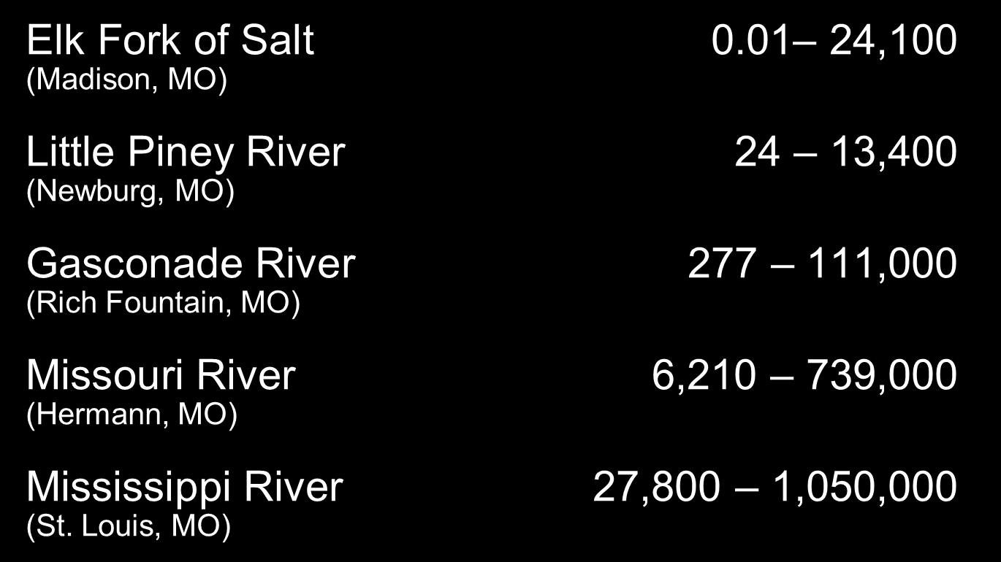
Discharge Ranges from
Selected Stream Hydrographs (cfs)
Definition
Factors
Importance
Measuring
Gaging Stations
Notes:
Here is a list of streams in Missouri and their range of flows.
The differences in flow within a stream can vary due to seasonality.
The differences between the streams can vary due to stream and watershed size.
However, the Elk Fork and the Little Piney River are approximately the same size, but have different flow ranges.
The difference here has to do with the topography. The Little Piney is in a karst area and receives groundwater recharge from springs. Its base flow is higher than that of the Elk Fork because the Elk Fork receives no groundwater recharge.
The maximum discharge is lower in the Little Piney because it is a heavily forested watershed, which reduces overland flow and increases infiltration into the soil, so less water ends up in the stream channel. The Elk Fork in Northern MO is mostly agricultural land use, so runoff from cleared, non-forested land is higher and contributes to a higher discharge.

Slide 12
IMPORTANCE OF STREAM DISCHARGE
Notes:
Let’s talk about why we are interested in measuring stream discharge. Why is it important to the stream ecosystem?

Slide 13
Stream quality
Physical Features
Chemistry
Biology
Definition
Factors
Importance
Measuring
Gaging Stations
Notes:
Stream discharge is an important part of a stream system to understand, because it has a large effect on the physical, chemical, and biological characteristics of a stream. We’ll briefly go over how discharge effects each of these components of a stream’s water quality.

Slide 14
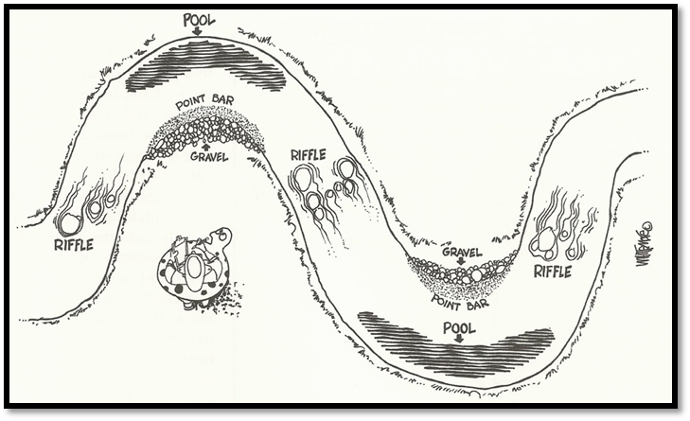
How Discharge Affects a Stream’s Physical Features
Habitat
Substrate
Vegetation
Stream shape
The Streamkeeper’s Field Guide
Definition
Factors
Importance
Measuring
Gaging Stations
Notes:
Stream flow has a big role in determining a stream’s physical features.
The movement of water and material changes the shape of the stream channel, the size of substrate in the streambed, and the types of riparian vegetation that can grow in/near the stream.
As water moves substrate in the streambed, erodes streambanks, and deposits material downstream, it shapes the stream channel.
Finally, variability in discharge influences the migration of the stream channel over time.

Slide 15
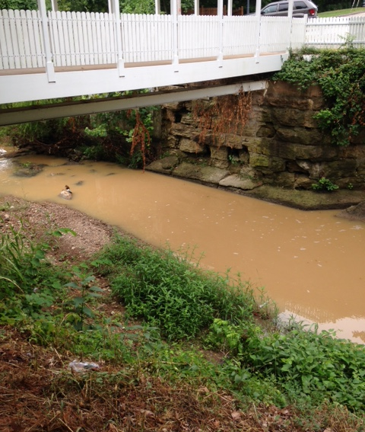
How Discharge Affects Stream Chemistry
Chemical concentration
Sediment transport
Dissolved oxygen & temperature
GGCAP Photo
Definition
Factors
Importance
Measuring
Gaging Stations
Notes:
Stream discharge affects the water chemistry in a stream in a few different ways.
First, large volumes of water can dilute pollutants such as chemicals and sediment.
Sediment and debris can be moved by water. Larger volumes of water have the ability to move greater amounts or larger sediment.
When water slows, like in a bend of a stream, sediment is deposited.
Moving water tends to have more oxygen and a lower temperature than slow or non-moving water.
Flowing water incorporates oxygen as it tumbles over rocks, increasing dissolved oxygen.
In addition, flowing water is cooler than pooled water which absorbs more sunlight. The lower temps can also result in higher dissolved oxygen.

Slide 16
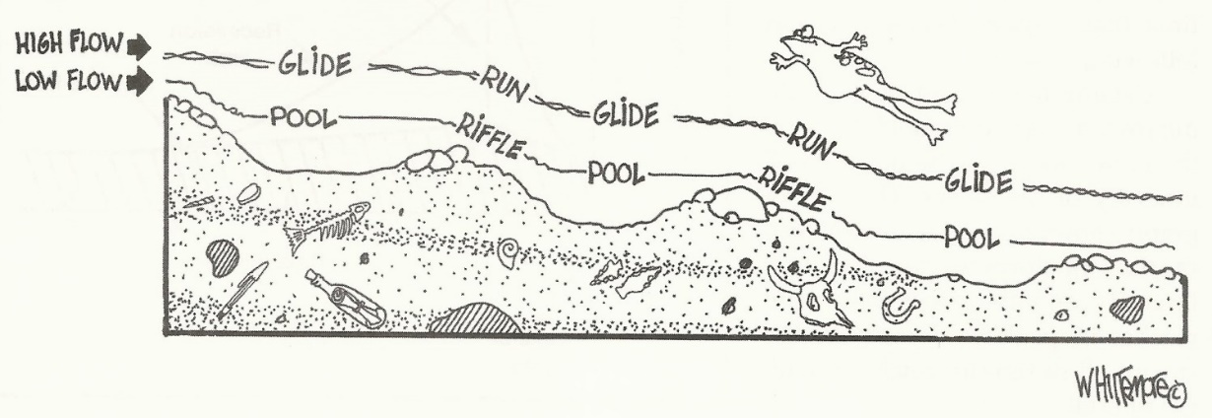
How discharge Affects Stream Biology
Plant and animal communities
Biological cues
Habitat diversity
The Streamkeeper’s Field Guide
Definition
Factors
Importance
Measuring
Gaging Stations
Notes:
Stream discharge also has effects on stream biology.
Since flow affects the chemical and physical nature of streams, it also determines what can live there.
Fish like salmonids and pollution sensitive macroinvertebrates require high concentrations of dissolved oxygen, low water temperatures, and gravel substrates for egg laying. Flowing water is essential for these communities.
Fish such as carp and catfish, and pollution tolerant macroinvertebrates can survive in warmer water and softer substrates.
Specific flow volumes and velocities contribute to a group of cues that combine to trigger egg laying in many aquatic animals, such as spawning in fish.
Flow can be just as much a spawning cue as day length and temperature.
Stream discharge also determines the types of habitat available for aquatic plants and animals.
Streams with a variety of velocities can support a more diverse aquatic community.

Slide 17
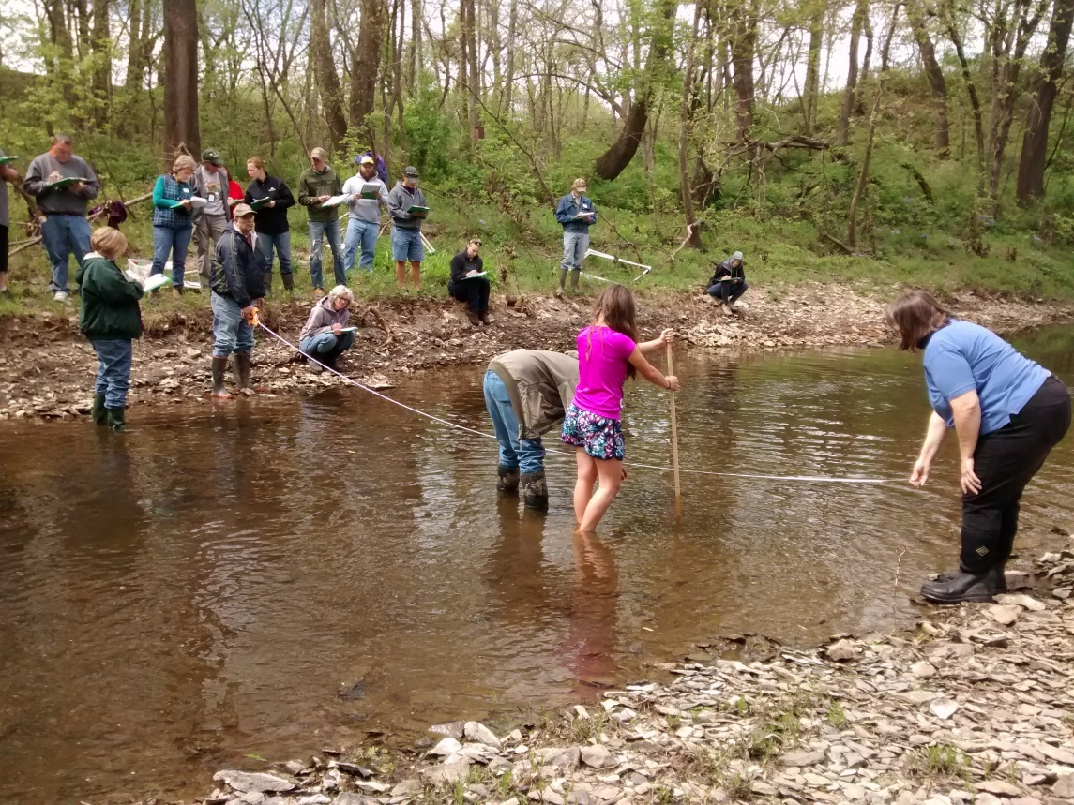
Importance of Discharge data
Influences water chemistry and aquatic life
Helps interpret data
Pollutant loading
Definition
Factors
Importance
Measuring
Gaging Stations
Notes:
Stream discharge plays a big role in determining the shape of a stream and the aquatic community. It also affects the water chemistry and pollutant loading.
This one parameter allows us to interpret the other water quality data submitted at a stream.
It could explain why we are getting certain values for other data.
For example, if stream discharge is low for a stream this could explain why so few invertebrates were found in biological sampling when normally the quantities are much higher.
Stream discharge should be collected during each monitoring trip. This will allow us to better interpret and extrapolate the water quality data.

Slide 18
MEASURING STREAM DISCHARGE
Notes:
Next, we’ll look at the specific steps to measure stream discharge.

Slide 19
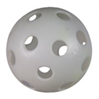
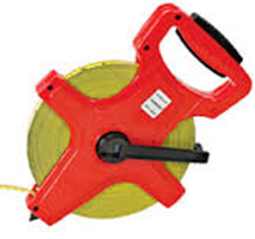
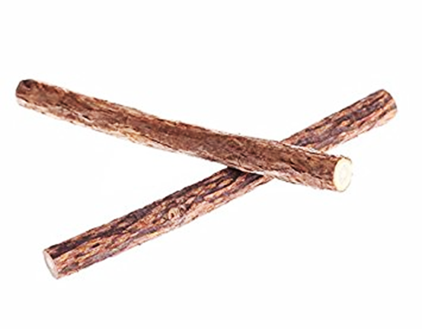
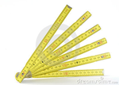
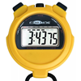
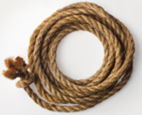
Measuring Discharge: Materials needed
A float (whiffle golf ball)*
100-ft. tape measure (10^{ths} of a foot)*
2 sticks/metal stakes
Depth stick (10^{ths} of a foot)
Stopwatch or watch with second hand
10 foot rope
* Provided by the Program
Definition
Factors
Importance
Measuring
Gaging Stations
Notes:
The Stream Team program measures stream discharge with the float ball method.
The equipment is simple and some is provided by the program.
When you receive monitoring equipment, you will receive the float balls and a 100 foot measure tape.
The only item you will have to provide yourself is the depth measuring stick.
This can be made from a dowel rod or small PVC pipe. Stretch the measure tape across the stick and make marks at each tenth of a foot. This same stick could be used as a handle for the kick net used in biological monitoring.
The metal stakes and rope are optional, but may make measurements a little easier.

Slide 20
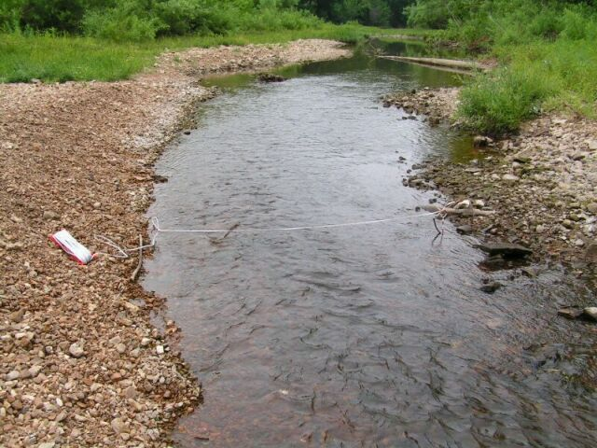
Selecting a Location
Find a spot in your stream that is:
Straight
Free of obstacles
  Islands, logs
Noticeable current
Uniform depth
**Safety note: If stream
flow is high, DO NOT
measure discharge
Definition
Factors
Importance
Measuring
Gaging Stations
Notes:
The first step in measuring discharge is selecting an appropriate location.
The ideal location is straight, free of obstacles like gravel bars and large rocks or trees, and has a noticeable flow.
If you cannot find such a location in your 300-foot stream stretch, this is the ONLY parameter that we allow monitors to venture outside their designated stream stretch to find a good spot to measure discharge, as long as there are no inputs/outputs (such as tributaries) between the site location and the discharge measurement location.

Slide 21
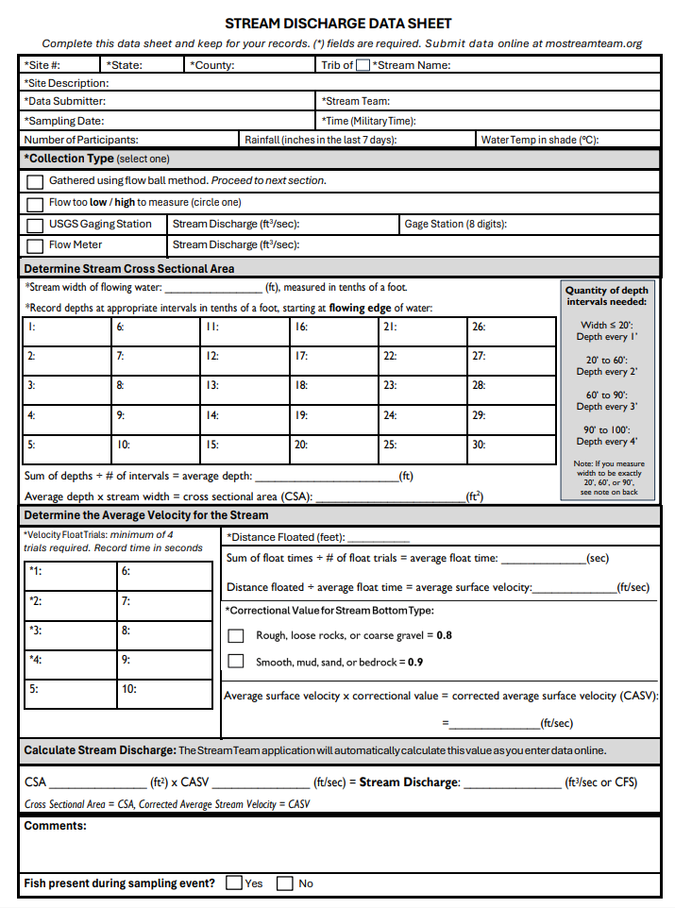
Stream Discharge
Data Sheet
Header information at top
Instructions for each step on data sheet
Definition
Factors
Importance
Measuring
Gaging Stations
Notes:
Here is an example Stream Discharge Data Sheet. These can be found and printed on the mostreamteam.org website.
The header information was covered in the Site Selection chapter. Be sure to have this section filled out in its entirety for all data sheets collected.
For this data sheet, there are detailed instructions for each step. We will work through these together over the next slides.

Slide 22
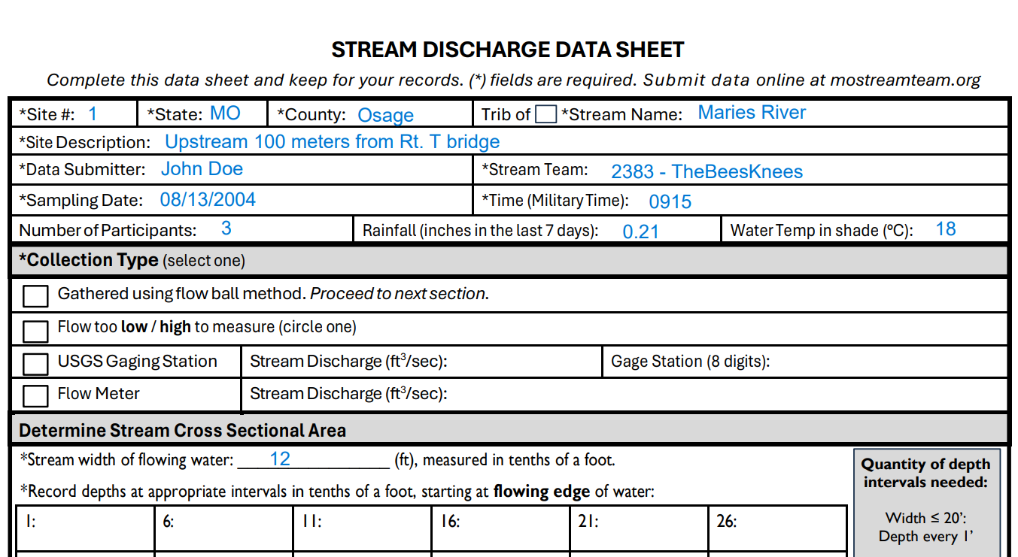
Flow too low or high?
Submit data sheet even if flow is too low or too high to measure
If wiffle ball doesn’t move, flow is too low to measure!
Definition
Factors
Importance
Measuring
Gaging Stations
Notes:
The first section for data in this data sheet is a place to indicate if the stream flow is too high or too low to measure.
If the flow is swift or if the depth is above your knees, please indicate the stream flow is too high to measure.
If there is not observable flow to the stream or if it is too shallow, you can indicate stream flow is too low.
If your stream site is within one-half mile of a USGS gaging station with no inputs or outputs, you can simply report the discharge data from that station.
If you select that stream is too high or too low, or if you report the USGS flow data, your data sheet is now complete and you will not fill out any other fields on this form.

Slide 23
Measuring Discharge
Step 1
Step 2
Step 3
Final Calculation
Stream Width
Cross-sectional
Area
Surface Velocity
Discharge
Notes:
Stream discharge can be measured in 4 basic steps. Let’s break these down.

Slide 24
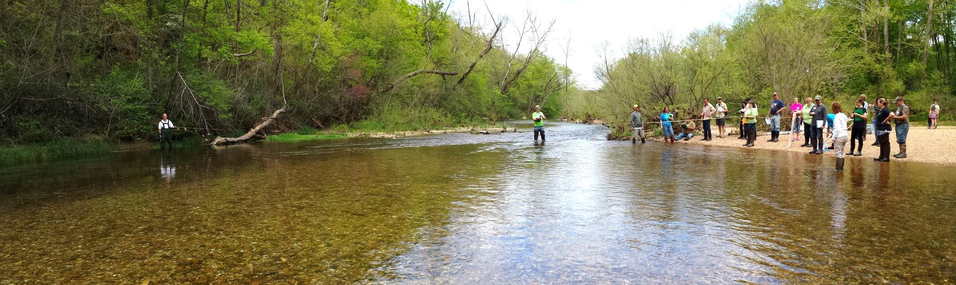
Stream Width
Step 1
Step 2
Step 3
Final Calculation
Stream Width
Cross-sectional
Area
Surface Velocity
Discharge
Notes:
The first step is to determine stream width.

Slide 25
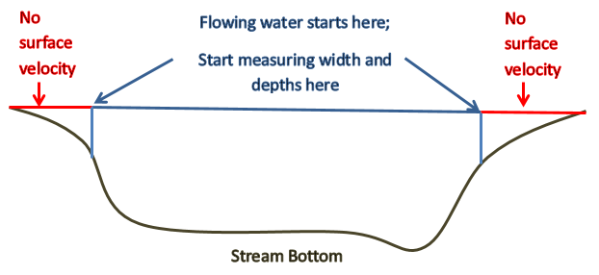
Stream Width
Place stakes at edges of flowing water on both sides of stream
Only measure width of flowing water (DO NOT measure non-flowing water)
Definition
Factors
Importance
Measuring
Gaging Stations
Notes:
Stream width should be measured from flowing edge to flowing edge. If there is dead water at the edge of your stream, begin your measurements where water is moving.
Stretch the program provided measure tape from one side of the stream to the other. It may help to anchor the measure tape with a stake or have friends to help hold it taught.

Slide 26
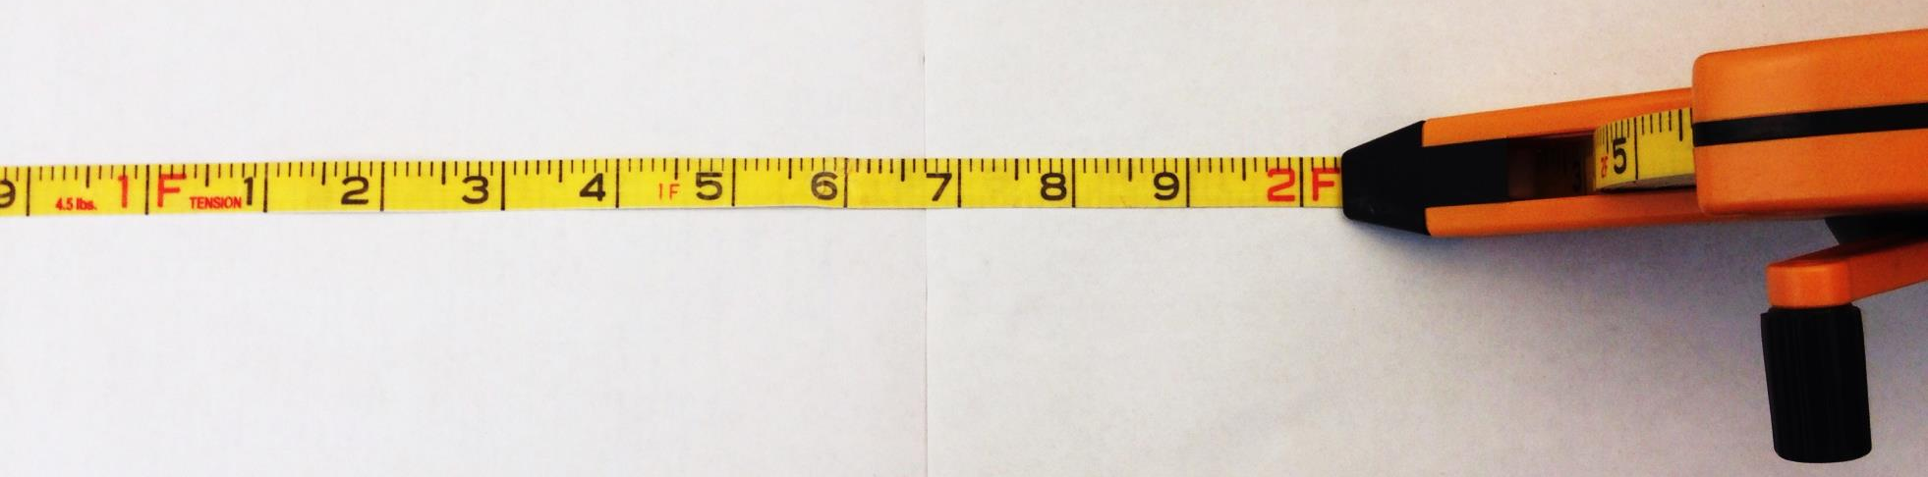

Units of measure
Measure in feet to the 10th of a foot, not inches
1.5 feet
One side of your measuring tape is labeled “TENTHS”, and the other side is “INCHES”.
Make sure you use the TENTHS side!
Make a depth stick out of a dowel rod using the Program provided measuring tape
Definition
Factors
Importance
Measuring
Gaging Stations
Notes:
Record the width measurement is tenths of a foot. Do not report in inches.

Slide 27
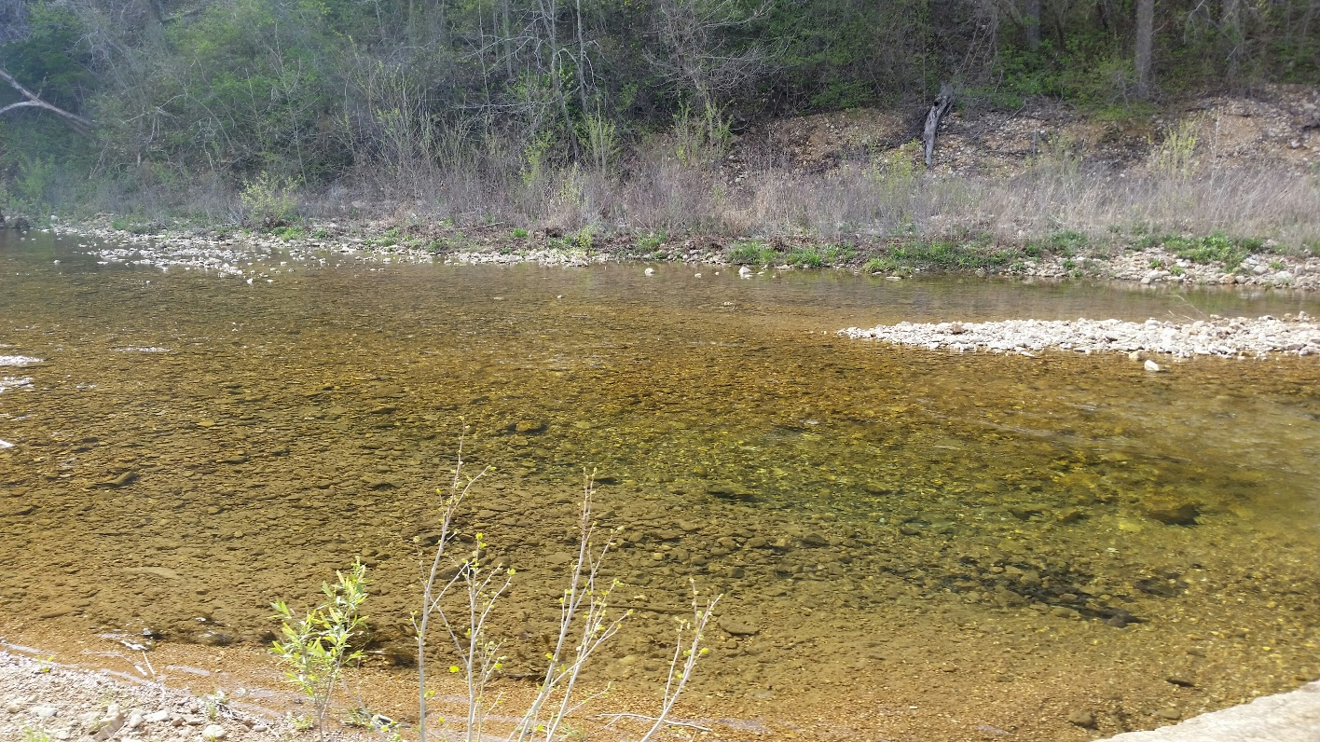
Stream Width
Move large rocks/debris obstructing flow
Measure stream width in feet to the 10th of a foot (DO NOT measure in inches)
OWWP photo
Definition
Factors
Importance
Measuring
Gaging Stations
Notes:
As a reminder do not measure stream width across a gravel bar.
If there are obstacles such as a boulder, you can move that out of the section you are measuring.

Slide 28
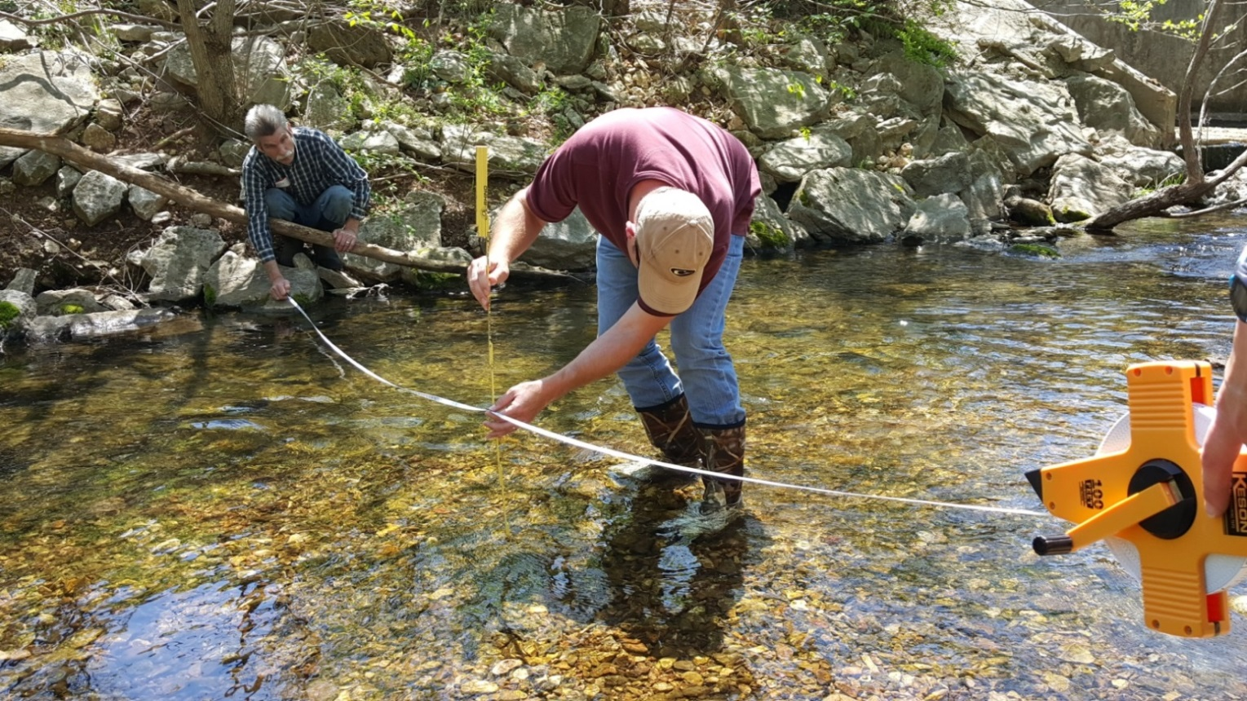
Cross-Sectional Area
DNR photo
Step 1
Step 2
Step 3
Final Calculation
Stream Width
Cross-Sectional
Area
Surface Velocity
Discharge
Notes:
The next step is to measure and calculate the cross-sectional area of the stream.

Slide 29
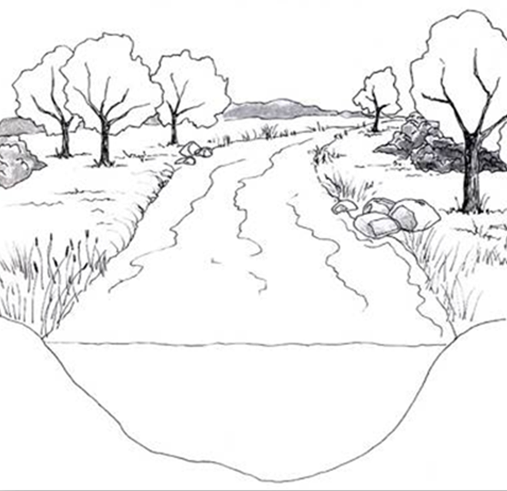
Cross-Sectional Area
Area = Average Depth x Width
Area = Depth X Width
Need to take several depths and calculate an Average Depth
Width
Cross-Sectional Area
Stream depth varies along bottom of stream!
Depth
Definition
Factors
Importance
Measuring
Gaging Stations
Notes:
This part may seem complicated, but it’s not.
I’ll also mention that we will explain the calculations, but these are done automatically when data is submitted online.
So you really only need to collect and report the measured values.
To find a cross sectional area, we need to have width and depth. We already have width, so our next step is finding depth.
However, stream depth varies along the bottom of the stream. It’s usually shallower at the edges and deeper in the middle.
So, we need to take several depths and calculate an average depth to use for our calculation.

Slide 30
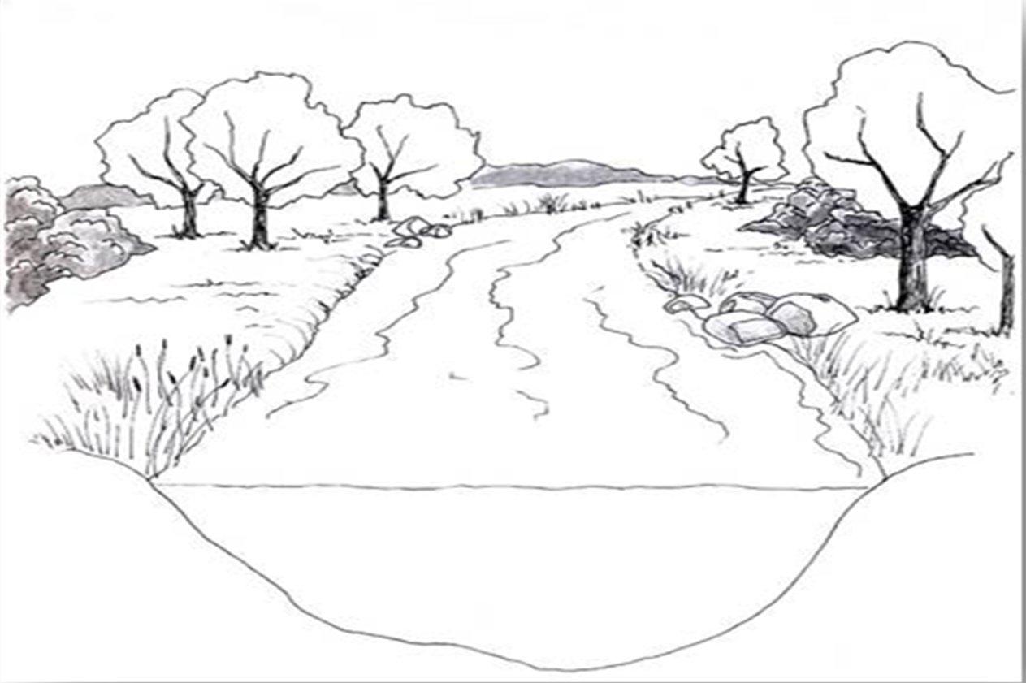
Cross-Sectional Area
Use stream width to determine how many stream depths you need to measure
< 20 ft. wide:
  measure every 1 foot
> 20 ft. wide:
  measure every 2 feet
Width = 12 ft
Definition
Factors
Importance
Measuring
Gaging Stations
Notes:
To determine how many depth measurements are needed, use the stream width measured in the first step.
For streams less than 20 feet wide, measure depth at one-foot intervals across the stream.
For streams greater than 20 feet wide, measure the depth every two feet.
For streams >60 feet wide, measure every 3 feet.
It’s very important to get the correct number of stream depths. If too few are collected, data will not be accepted.

Slide 31
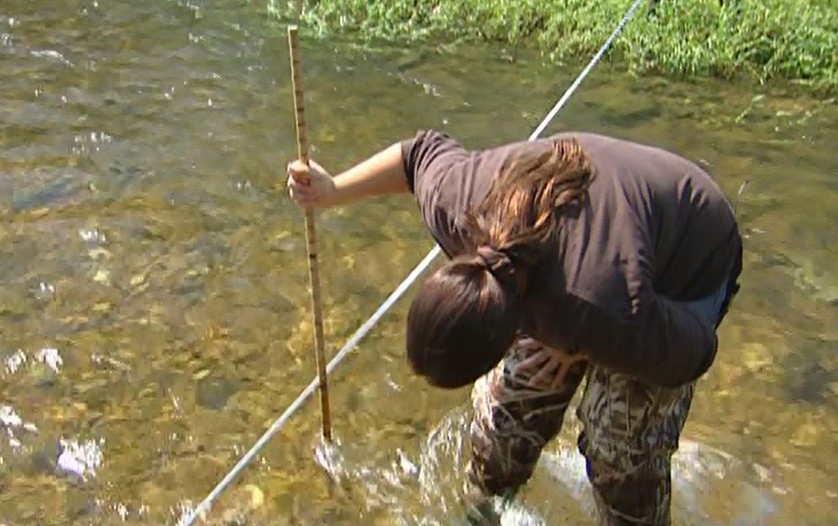
Cross-Sectional Area
Stand downstream of measuring tape to measure depths
Definition
Factors
Importance
Measuring
Gaging Stations
Notes:
When measuring the depth, always stand downstream of the measure tape, so that your legs don’t impede stream flow.

Slide 32
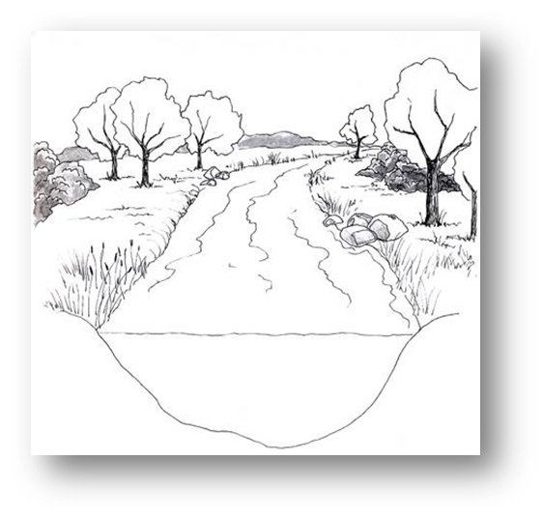

Cross-Sectional Area
Sum of Depths = 7.7 ft.
7.7 ft. ÷ 12 depths = 0.64 ft.
Average Depth = 0.64 ft.
0.1
0.2
0.4
0.9
1.1
0.9
1.2
1.1
0.6
0.7
0.3
0.2
Definition
Factors
Importance
Measuring
Gaging Stations
Notes:
Since our example has a 12 foot stream width, we will measure at one-foot increments for a total of 12 depth measurements.
With the measure tape still anchored at the stream banks, measure the stream depth at 1-foot increments across the transect beginning at the flowing edge.
Do not measure on top of large rocks or other objects. Be sure to measure the stream bottom.
Record this information in the columns on the front of your data sheet.
After all depths are recorded, these will be added to record the sum.
In this example, the sum of the depths is 7.7 feet. We will divide this by 12 to get average depth, which is 0.64 feet.
There are fields on the data sheet to record each of these values.

Slide 33
Cross-Sectional Area
Cross-Sectional Area = Average Depth x Stream Width
=0.64 ft x 12 ft = 7.7 ft.²
Width = 12 feet
Average Depth = 0.64 ft.
Cross-Sectional Area =
7.7 ft²
Definition
Factors
Importance
Measuring
Gaging Stations
Notes:
Next we can calculate the cross-sectional area.
To do this, we multiply the stream width of 12 feet by the average depth of 0.64 feet.
The cross-sectional area of our example is 7.7 square feet.

Slide 34
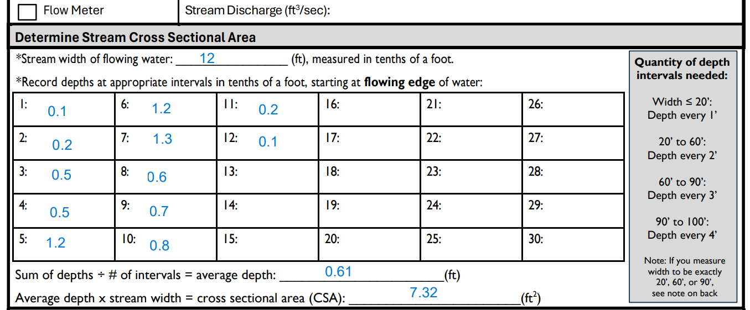
Cross-Sectional Area
Stream depths
Average depth
Cross sectional area
Stream width
Definition
Factors
Importance
Measuring
Gaging Stations
Notes:
Again, here is the data sheet showing the fields to record your values.
The steps are explained in case you forget what to do next.

Slide 35
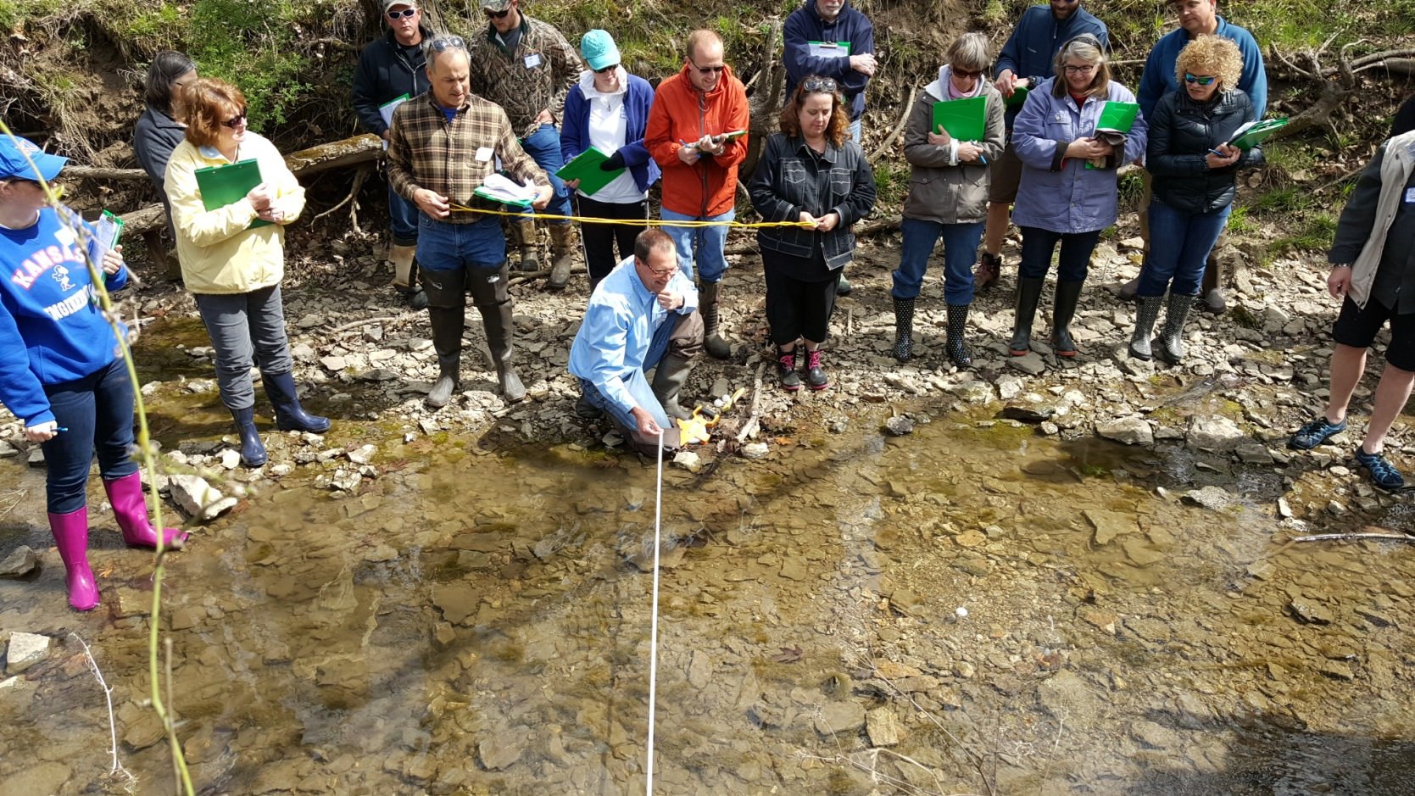
Surface Velocity
DNR photo
Step 1
Step 2
Step 3
Final Calculation
Stream Width
Cross-sectional
Area
Surface Velocity
Discharge
Notes:
The third step in calculating stream discharge is to determine surface velocity.
For this step, it’s easiest to have at least two or three people.

Slide 36
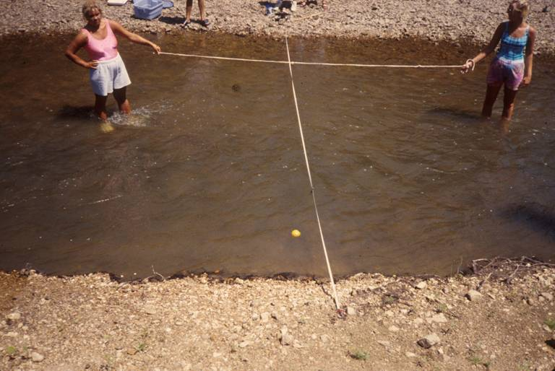
Surface Velocity
  Measure the time it takes for the float ball to move downstream a certain distance
10 ft
Drop Ball
Here
Start
Stop
Definition
Factors
Importance
Measuring
Gaging Stations
Notes:
We calculate surface velocity by timing how long it takes a mutually buoyant object, or float ball, to float a short distance.
The measure tape that was spread across the stream to measure stream width will be the middle of your float distance.
A 10 foot float distance is standard, but you can lengthen or shorten as needed for the stream flow.
Use a rope or other markers to identify the start and stop points of the float distance.
One person will stand above the start point, out of the way of the stream flow where the ball will be floated.
They will toss the ball in the water about a foot or two above the start point so it can reach maximum velocity before it hits the float distance.
Time how long it takes the ball from start point to stop point.
Repeat this for at least four total float trials at equal increments across the stream.
If the ball hits the substrate or any obstacle, the float trial must be repeated.

Slide 37
Surface Velocity
  Need at least 4 velocity float trials
  Floats should be at equal increments across stream width
22 sec.
16 sec.
10 ft.
13 sec.
16 sec.
22 sec.
Tape Measure
Definition
Factors
Importance
Measuring
Gaging Stations
Notes:
Similar to the depth measurements, we need to find an average for velocity.
The velocity will be quicker towards the middle of the stream where the water is deeper, and slower along the edges.
At least four float trials are required, but you can collect up to ten.

Slide 38
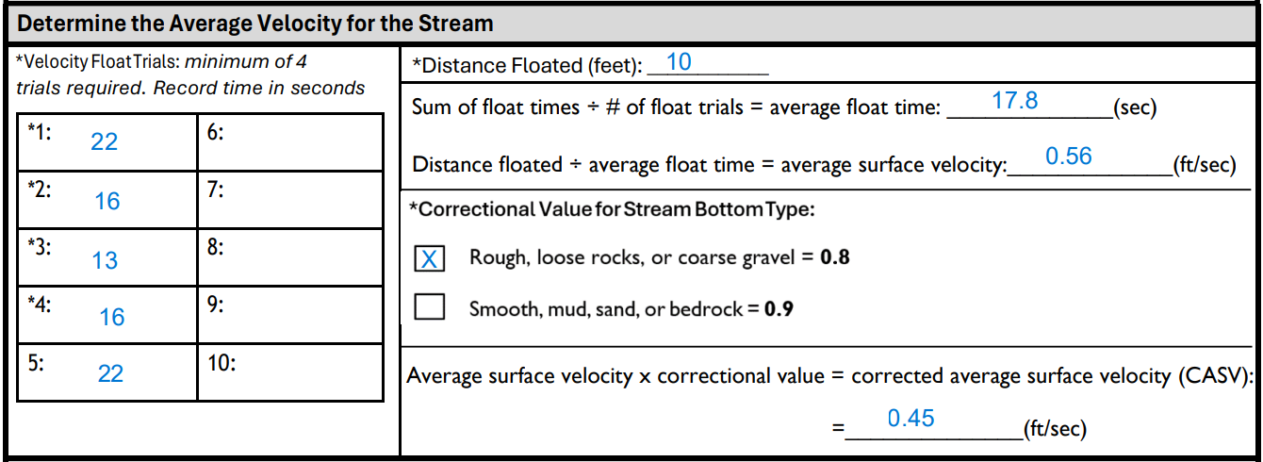
Stream Velocity
Velocity float trials
Distance floated
Average float time
Average surface velocity
Definition
Factors
Importance
Measuring
Gaging Stations
Notes:
Let’s look back at the data sheet where the data is recorded.
For this example, our average float time was 17.8 seconds.
We will divide this by the 10 foot float distance to get the average surface velocity of 0.56 feet per second.
Since the velocity is quicker at the surface than it is at the bottom where there is friction from the substrate, we use a correctional value to determine the actual stream velocity.
The correctional value considers the substrate material.
Loose rocks or gravel is considered rough substrate, which is a correction value of 0.8. Most streams fall under this category.
Mud, sand, bedrock, or concrete is considered smooth substrate, which is a correction value of 0.9.
Select the correction value appropriate for your stream site.
For our example we use 0.8 correction value to get the corrected average stream velocity of 0.45 feet per second.

Slide 39
Final Calculation
Step 1
Step 2
Step 3
Final Calculation
Stream Width
Cross-sectional
Area
Surface Velocity
Discharge
Notes:
The last step is multiplying the cross-sectional area and surface velocity to get stream discharge.

Slide 40
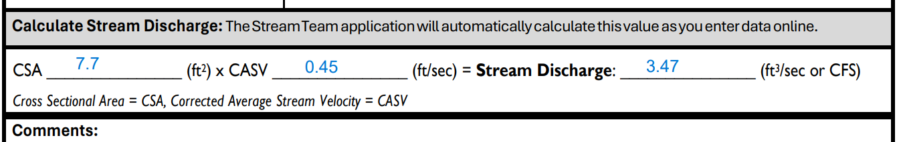
Final Calculation
Cross-Sectional Area
Corrected Average Stream Velocity
Discharge (cfs)
Definition
Factors
Importance
Measuring
Gaging Stations
Notes:
This is the final calculation shown on the data sheet.
Find your cross-sectional area from the top portion of the data sheet, and multiply that by the corrected average stream velocity from the lower portion of the data sheet.
The answer is recorded in cubic feet per second.
For our example of a 7.7 foot wide stream with a surface velocity of 0.45, the stream discharge is 3.47 cubic feet per second.
Congrats, you just calculated your first stream discharge!

Slide 41
Measure depths in feet to the TENTHS OF A FOOT.
NO ZERO DEPTHS OR FLOAT TIMES.
Measure flowing water only.
Reminders!
STREAM WIDTH DEPTHS NEEDED
<20’ depth every 1’
20’- 60’ depth every 2’
>60’ depth every 3’
Definition
Factors
Importance
Measuring
Gaging Stations
Notes:
There are a few common errors we see with stream discharge.
All width and depth measurements must be in tenths of a foot, not inches.
Do not report any zeros. If a zero is reported in depth, that means there is no water. If a zero is reported in a velocity float trial, that means the water is not flowing. Please adjust where you are measuring if you are getting zeros.
Double-check to make sure you have recorded enough depths for your stream’s width. If too few depth measurements are recorded, the data cannot be used.

Slide 42
You don’t have to use a float distance of 10’
Slow flow?
shorten distance (must be at least
2 feet)
Fast flow?
lengthen distance
At least 4 float trials needed
Reminders!
Definition
Factors
Importance
Measuring
Gaging Stations
Notes:
The distance floated does not have to be 10 feet, and can be as low as 2 feet, but remember to record whatever distance you decided to use!
Finally, remember to collect at least four float trials.

Slide 43
USGS GAGING STATIONS
Notes:
We’ve covered how to collect stream discharge using the float ball method. Some monitors may be able to use data from a USGS gaging station instead.

Slide 44
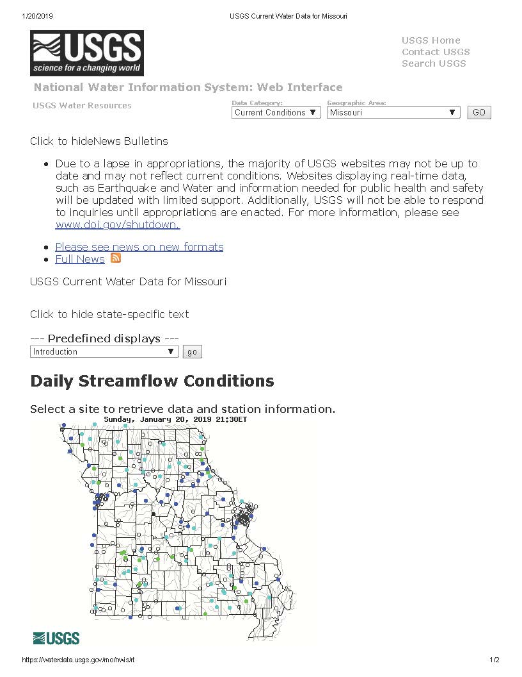
USGS gaging Stations
Over 200 gaging stations in MO
Can use if site is
  within ½ mile of gaging station
  no other inputs
waterdata.usgs.gov/mo/nwis/rt
Definition
Factors
Importance
Measuring
Gaging Stations
Notes:
The United States Geological Survey maintains over 200 Gaging Stations on streams throughout Missouri.
Many of these record stream discharge every day.
These gaging stations may have data on stream discharge, gage height, and precipitation.
If your monitoring site is within one-half mile of a USGS gaging station and there are no inputs or outputs between your site and the station, you can use the stream discharge data from USGS.
As a reminder, this field is just under the header on the Stream Discharge Data Sheet.

Slide 45


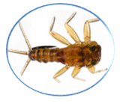
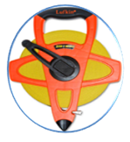

Discharge Questions
What is the definition of stream discharge?
Which factors affect discharge?
Is discharge important to stream biology?
Is calculating cross-sectional area of a stream the first step in measuring stream discharge?
How close must your site be to a USGS gaging station to use it for discharge data?
Notes:
To recap what we learned in this chapter, you can pause this video and review these questions.

Slide 46
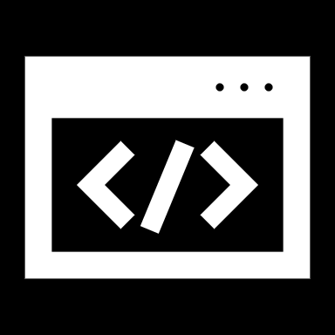
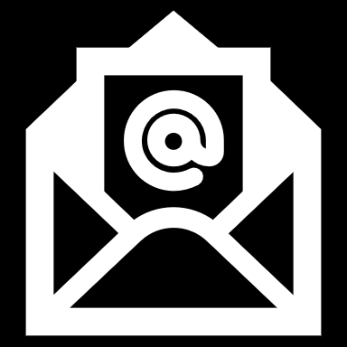
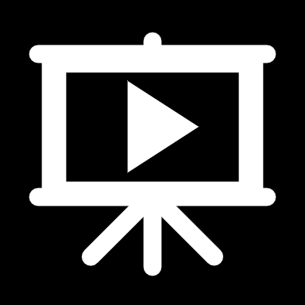
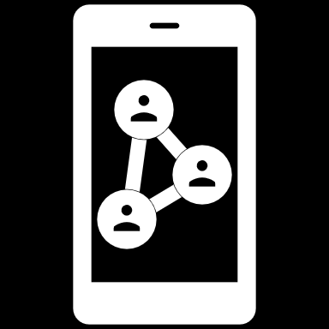
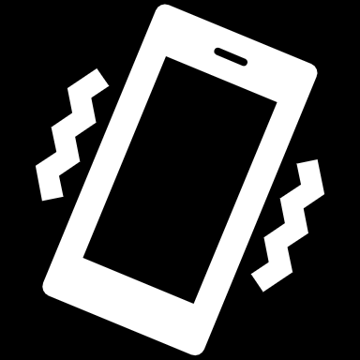
Contact us
mostreamteam.org
Streamteam@dnr.mo.gov
Streamteam@mdc.mo.gov
youtube.com/@MissouriStreamTeam
facebook.com/mostreamteams/
800-781-1989
Notes:
Additional resources and training videos can be found online. Contact us if you have any questions.

