Slide 1


Introduction to Volunteer water quality Monitoring training: Level 1
Notes:
Welcome to Introduction to Volunteer Water Quality Monitoring, also referred to as VWQM Intro level.
INTRODUCE YOURSELF

Slide 2
Educational Resources
Available on the Mo Stream Team Website
  Events and Activities > Water Quality Monitoring
  > Training Materials and Resources
    https://www.mostreamteam.org/training-materials-and-resources
  Notebook
  PowerPoint
  Macroinvertebrate References
Notes:
If you have not already downloaded materials, they can be found on the Stream Team website at MOStreamTeam.org under VWQM, Training Materials and Resources. The Introduction to VWQM notebook includes the PowerPoint slides and may be used to follow along. We have made some edits to the PowerPoints for this virtual format.

Slide 3
introduction
Stream Team
& VWQM
Watersheds
Water Quality
VWQM Data Uses
Notes:
In the Welcome and Introduction chapter, we’ll give a background on the Stream Team program and Volunteer Water Quality Monitoring program. We will also discuss what watersheds are and how they influence water quality.

Slide 4
MISSOURI STREAM TEAM
Volunteer Water Quality Monitoring (VWQM)
Notes:
First, we’ll provide a quick overview of the Stream Team program.

Slide 5
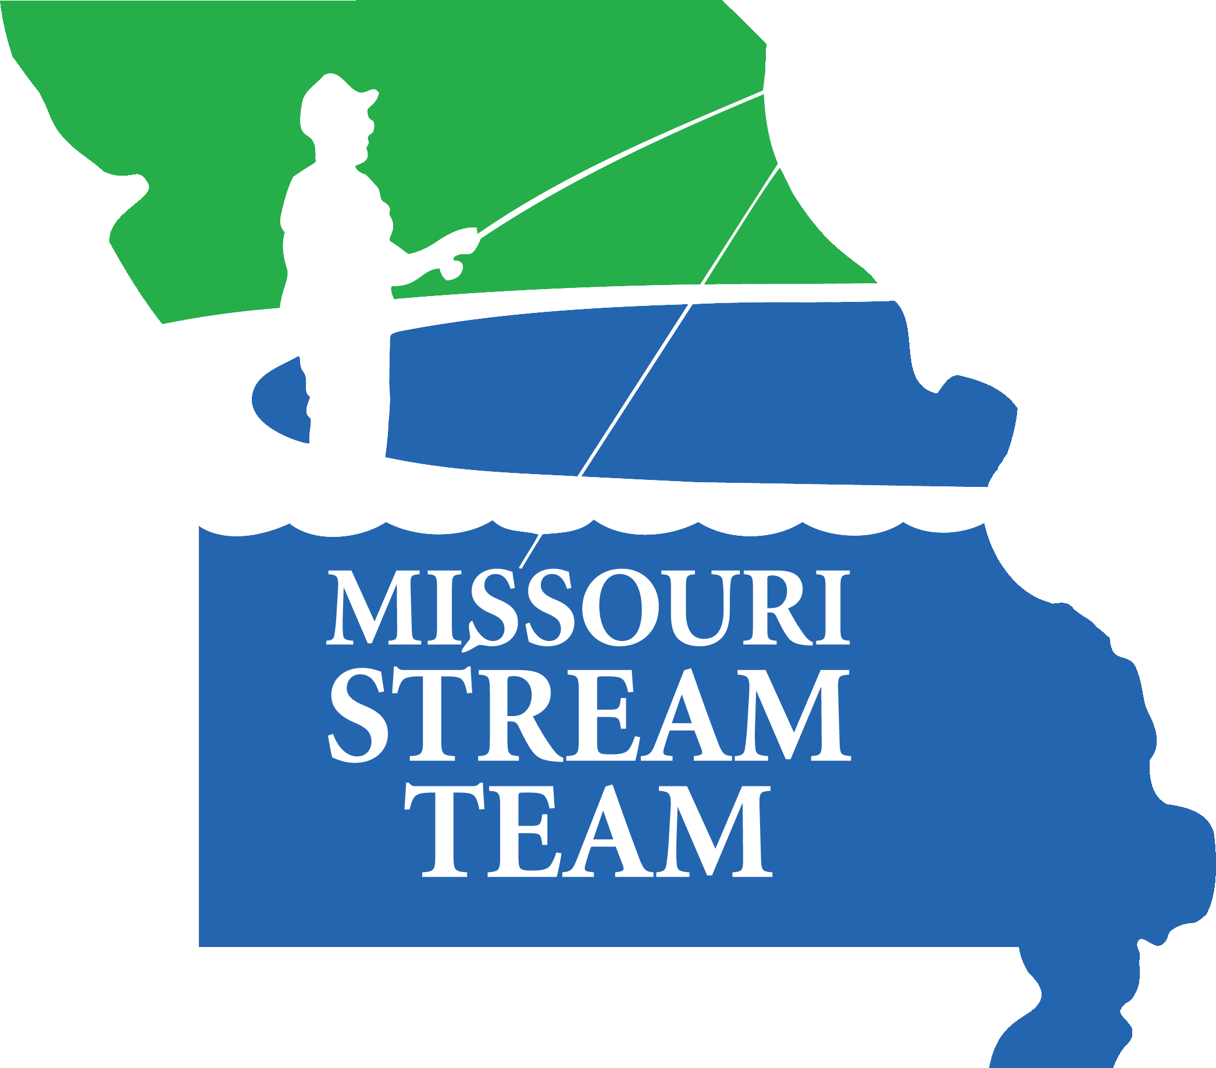




Missouri Stream Team
Stream
Team & VWQM
Watersheds
Water Quality
VWQM Data Uses
Notes:
ST began in 1988 with the first Rivers and Streams Conference in Jefferson City. The first ST was formed in 1989 on the Roubidoux River with a group of fly fishers who were interested in stream conservation.
The Stream Team Program is a partnership between MDC, CFM, DNR (INSTRUCTORS: explain acronyms the first time they are used).
CFM is an organization for citizens concerned about our natural resources and environmental issues and is the Missouri affiliate of the National Wildlife Federation.
MDC is responsible for managing the forest, fish and wildlife resources and is concerned about water pollution because it impacts these resources.
DNR is the regulatory agency in Missouri and has authority over water, air, solid waste, environmental hazardous waste and mining. DNR also has responsibility for parks, energy and geology & land survey.

Slide 6
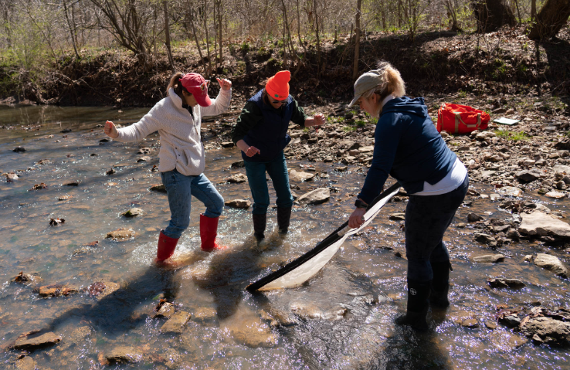
Missouri Stream Team
…and citizens!
Stream
Team & VWQM
Watersheds
Water Quality
VWQM Data Uses
Notes:
This program would not be possible without our volunteers.
Citizen efforts help care for and protect our Missouri Streams

Slide 7
Stream team goals
Stewardship
Stream Team
Education
Advocacy
Stream
Team & VWQM
Watersheds
Water Quality
VWQM Data Uses
Notes:
Missouri Stream Team has three goals:
Education: providing workshops, resources, and materials for citizens to learn more about stream conservation.
Stewardship: providing opportunities and supporting citizens’ work in hands-on stream conservation activities.
Advocacy: enabling citizens to voice their concerns and opinions on water topics in Missouri and the nation.
-> Stream Teams United is the advocacy arm of the program; their contact information is in the front of the notebook.

Slide 8
Stream team Activities
Adopt-An-Access
Advocacy
Education Projects
Greenway Development
Habitat Improvement
Litter Pickup
Media Contact
Mentoring
Presentations
Photo-point Monitoring
Recruitment
Stream Team Associations
Stream Team Displays
Storm Drain Stenciling
Planting Trees
Watershed Mapping
Water Quality Monitoring
Workshops
Stream
Team & VWQM
Watersheds
Water Quality
VWQM Data Uses
Notes:
Missouri Stream Team offers a multitude of activities on a wide array of stream-related topics.
Some activities, such as education projects, mentoring, and workshops, are geared towards our “Education” goal.
Others, such as stream cleanups and water quality monitoring, are geared towards our “Stewardship” goal.
Advocacy and Stream Team Associations provide ways for citizens to advocate for stream resources to fulfill our “Advocacy” goal.
The only Stream Team activity that requires training is Water Quality Monitoring.

Slide 9

Stream
Team & VWQM
Watersheds
Water Quality
VWQM Data Uses
Notes:
One of the most popular ST activities is water quality monitoring. This activity was added in 1993 at the request of stream team volunteers who wanted to participate in stream monitoring.
Again, this is the only activity which requires training.
As the name implies, this portion of the Program teaches citizens about the physical, chemical, and biological aspects of streams with relation to stream health.

Slide 10
VWQM Program Goals
Inform and Educate
Establish a Monitoring Network
Enable Informed Decision Making
Halt Water Quality Degradation
Stream
Team & VWQM
Watersheds
Water Quality
VWQM Data Uses
Notes:
Program Goals:
To inform about the conditions of MO streams.
To establish a group of trained volunteers to provide data statewide, and connect citizens to work towards a common goal.
To help halt degradations of water resources.
To enable citizens to make informed decisions

Slide 11
VWQM Levels of Training
Level 1
Virtual
Field Training
  Video Chapters:
    Introduction to VWQM
    Site Selection
    Stream Discharge
    Biological Monitoring
    Watershed Mapping & Online Tools
    Safety
    Water Chemistry
    Visual Survey
  Sampling Methods/Practice
    Macroinvertebrates
    Discharge
    Water Chemistry
    Visual Survey
Stream
Team & VWQM
Watersheds
Water Quality
VWQM Data Uses
Notes:
After today, you will have learned all of the VWQM sampling protocols – so why should you proceed to Level 2 and 3? These are the program’s Quality Assurance/Quality Control (QA/QC) workshops that help ensure and document that volunteers’ monitoring technique is sound, their equipment is in good shape, and they are up-to-date on program policies. This gives us confidence that the volunteer data is of a high quality and providing valuable data on the stream. Volunteers also report that THEY feel more confident in their monitoring after taking these advanced workshops.
Since we have greater confidence in data quality from Level 2/3 volunteers:
We are able to use Level 2 and above data at a higher level to help protect our streams
And Level 2/3 volunteers are eligible to participate in special projects such as Cooperative Stream Investigations and Advanced Monitoring Projects
VWQM Level 2
To be eligible to attend a Level 2 workshop, volunteers must successfully complete the Level 1 workshop AND submit at least 2 seasons worth of all 4 data types.
This is our first QA/QC workshop. It allows the volunteer to check their equipment and monitoring techniques and will improve their ability to identify macroinvertebrates.
It also allows the volunteer to get assistance identifying unknown invertebrates from their streams and confirm identification of invertebrates in their reference collection.
These classes are offered during the winter of each year.
VWQM Level 3
Level 3 is for VERY experienced monitors who have attended a Level 2 workshop AND have submitted at least 12 sets of all four data types.
This is more of a QA/QC AUDIT than a regular workshop.
These are by appointment only by contacting our VWQM QA/QC Officer, Randy Sarver, to accompany a volunteer to their own monitoring site to conduct WQM streamside – a field audit that:
Demonstrates that the volunteer can analyze all chemical parameters correctly.
The volunteer can identify all EPT taxa correctly and may only miss one non EPT taxa.
The volunteer follows the proper protocol for the Stream Discharge and Visual Survey assessments.
Another of the program’s QA/QC procedures is that Level 2 and above volunteers must validate their higher level QA/QC status at least once every 3 years by returning for a Level 2 workshop or attending a special Validation workshop offered every summer.

Slide 12
VWQM Levels of Training
Level 2
Level 3
  QA/QC
    Chemistry
    Biological Monitoring
  Prerequisites
    Level 1
    Data: 2 Seasons each -
      Stream Discharge
      Biological
      Visual Survey
      Chemistry
  Stream - side QA/QC Audit
    Stream Discharge
    Biological Monitoring
    Visual Survey
    Water Chemistry
  Prerequisites
    Level 2
    12 data collections of all 4 data types
Levels 2 and 3:
Higher level of data use
Need validation every 3 years
Cooperative Stream Investigations & Advanced Monitoring Projects
Stream
Team & VWQM
Watersheds
Water Quality
VWQM Data Uses
Notes:
After today, you will have learned all of the VWQM sampling protocols – so why should you proceed to Level 2 and 3? These are the program’s Quality Assurance/Quality Control (QA/QC) workshops that help ensure and document that volunteers’ monitoring technique is sound, their equipment is in good shape, and they are up-to-date on program policies. This gives us confidence that the volunteer data is of a high quality and providing valuable data on the stream. Volunteers also report that THEY feel more confident in their monitoring after taking these advanced workshops.
Since we have greater confidence in data quality from Level 2/3 volunteers:
We are able to use Level 2 and above data at a higher level to help protect our streams
And Level 2/3 volunteers are eligible to participate in special projects such as Cooperative Stream Investigations and Advanced Monitoring Projects
VWQM Level 2
To be eligible to attend a Level 2 workshop, volunteers must successfully complete the Level 1 workshop AND submit at least 2 seasons worth of all 4 data types.
This is our first QA/QC workshop. It allows the volunteer to check their equipment and monitoring techniques and will improve their ability to identify macroinvertebrates.
It also allows the volunteer to get assistance identifying unknown invertebrates from their streams and confirm identification of invertebrates in their reference collection.
These classes are offered during the winter of each year.
VWQM Level 3
Level 3 is for VERY experienced monitors who have attended a Level 2 workshop AND have submitted at least 12 sets of all four data types.
This is more of a QA/QC AUDIT than a regular workshop.
These are by appointment only by contacting our VWQM QA/QC Officer, Randy Sarver, to accompany a volunteer to their own monitoring site to conduct WQM streamside – a field audit that:
Demonstrates that the volunteer can analyze all chemical parameters correctly.
The volunteer can identify all EPT taxa correctly and may only miss one non EPT taxa.
The volunteer follows the proper protocol for the Stream Discharge and Visual Survey assessments.
Another of the program’s QA/QC procedures is that Level 2 and above volunteers must validate their higher level QA/QC status at least once every 3 years by returning for a Level 2 workshop or attending a special Validation workshop offered every summer.

Slide 13
WATERSHEDS
Notes:
Let’s take a look at what a watershed actually is, and how it functions on the landscape to influence stream health.

Slide 14
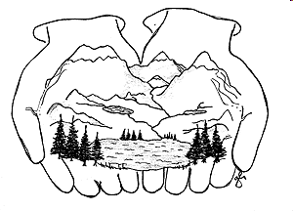
What is a Watershed?
A topographically-defined area of land that drains into a particular body of water
  Drainage basin
  Catchment area
Stream Team & VWQM
Watersheds
Water Quality
VWQM Data Uses
Notes:
A watershed is a topographically-defined area of land that drains to a particular body of water. Since water always runs downhill, the boundaries of any watershed are based on the topography of the land (the elevation). If you know the topography, you can easily see which direction is downhill, and which way the water will drain! If you cup your hands, you’ve just created a mini watershed: if you were outside, rainfall would run down the “ridges” of your thumbs, into the “streams” between your fingers, and into your palms to create a small “lake.”
Watersheds are called different names in different parts of the world, but they all mean the same thing.

Slide 15
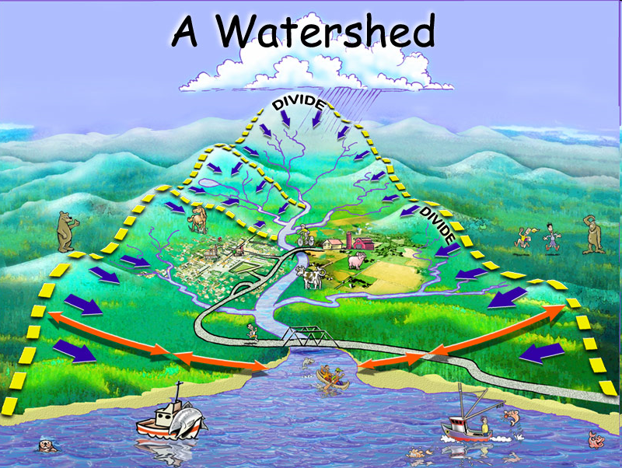
Watersheds affect stream quality
Stream Team & VWQM
Watersheds
Water Quality
VWQM Data Uses
Notes:
The streams and rivers within a watershed are interconnected, and form a network. This means that everything upstream (at higher elevations in the watershed) affects everything downstream (lower elevations). As water flows across urban areas or pastures it can pick up sediment, pollutants and even heat. These contaminants eventually flow into a stream or lake, altering WQ. When you flush, do laundry, fertilize your lawn or spill oil on the ground you are impacting water in your watershed.
The biggest threat to WQ is sedimentation via runoff and erosion. Sedimentation refers to soil particles that are picked up by water and deposited into streams, rivers, and lakes. Land use, slope and soil type are some factors that affect sediment loads. Steeper=faster water=more energy to erode soil and soil type determines how fast the water is absorbed.

Slide 16
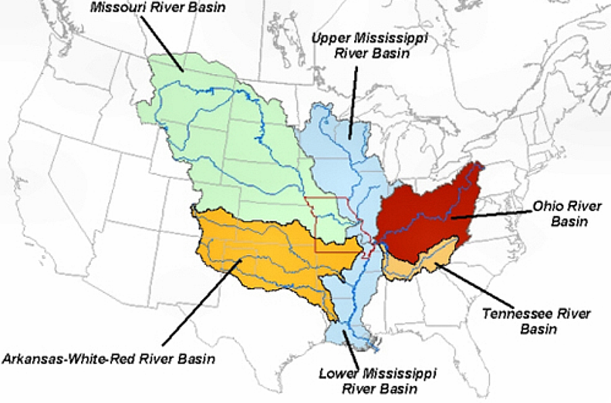
Major watersheds in the U.s.
Stream Team & VWQM
Watersheds
Water Quality
VWQM Data Uses
Notes:
Here is a look at the major watersheds in the United States which flow through Missouri.

Slide 17
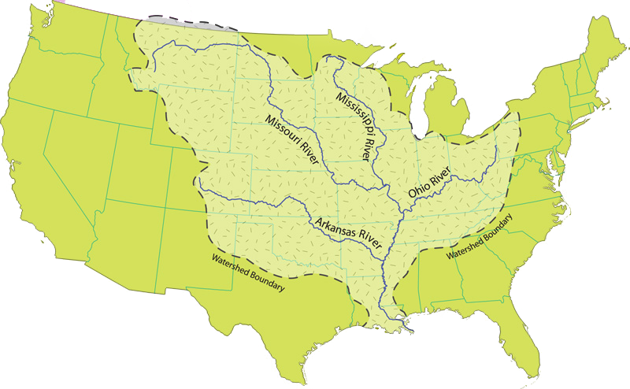
Mississippi River Watershed
Drains 1.2 M sq. miles
30 states & part of Canada
4th largest watershed in world
Stream Team & VWQM
Watersheds
Water Quality
VWQM Data Uses
Notes:
Watersheds can range in size from less than an acre to millions of square miles.
1) Exactly 1,236,000 square miles.
2) Mississippi is the 4th largest watershed – 1) Amazon (2.3million sq. mi.) 2) Congo (1.4 million sq. mi.) 3) Nile 1.25 million sq mi. 4) Mississippi 1.23 million sq mi. 5) Rio de la Plata (1.22 million sq. mi)
3) Streams cross political boundaries. Mississippi's watershed includes 30 states and a small part of Canada.
Large drainage basins are made up of smaller watersheds and sub watersheds

Slide 18
Missouri River Watershed
10 states & part of Canada
Longest River in North America 2,341 mi
Drains 529,350 sq. miles
Stream Team & VWQM
Watersheds
Water Quality
VWQM Data Uses
Notes:
The Missouri River watershed is a sub-watershed of the Mississippi River watershed.
1) It’s the largest tributary to the Mississippi River covering 530,000 sq. mi. (1/6th of the US). This includes 10 states and a small portion of Canada. It is the longest river in North America
2) It has the largest reservoir system in North America. At normal water levels this system stores approximately 55 times the amount of water stored in Truman Reservoir (Missouri’s largest reservoir).
3) It is one of the most altered rivers in the world (35% impounded, 32% channelized, 33% unchannelized). The lower system has extensive levees. There are also levees, major reservoirs and channelizations on its major tributaries.
More than half of Missourians get drinking water from the Missouri or its underground aquifer that it is tied to.

Slide 19
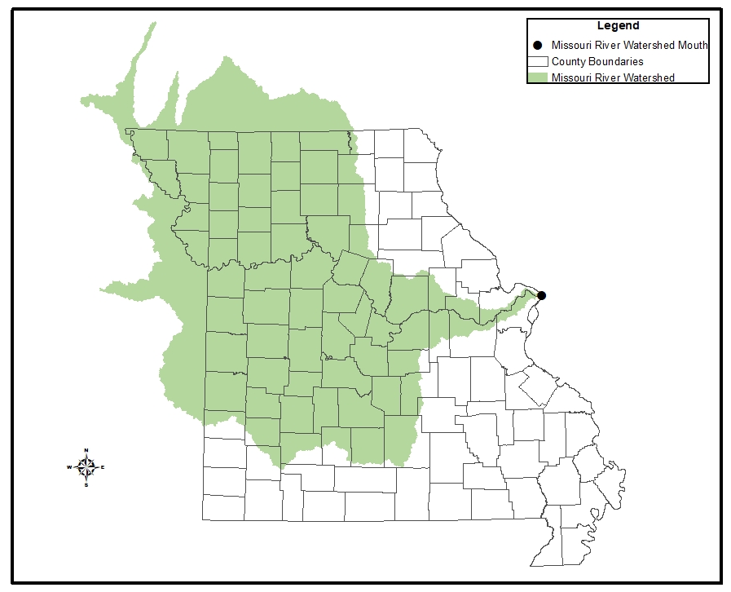
Watersheds in missouri
Stream Team & VWQM
Watersheds
Water Quality
VWQM Data Uses
Notes:
The portions of Missouri that drain to the Missouri River Watershed (sub-watershed of the Mississippi) are shown in green.
Optional: Point out that political boundaries and watershed boundaries do not necessarily match.
When looking at the location of rivers and the amount of streamflow in rivers, the key concept is the river's "watershed". What is a watershed? Easy, if you are standing on ground right now, just look down. You're standing, and everyone is standing, in a watershed. A watershed is the area of land where all of the water that falls in it and drains off of it goes to a common outlet. Watersheds can be as small as a footprint or large enough to encompass all the land that drains water into the Missouri River. The mouth of the Missouri River watershed is on the east side of Missouri near St. Louis. The watershed area at this point is approximately 529, 350 square miles.

Slide 20
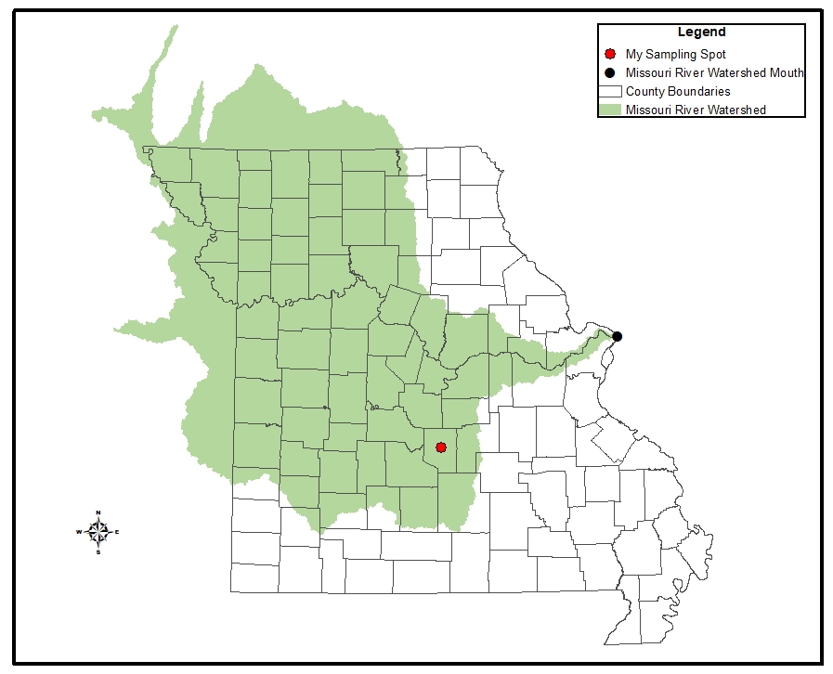
Watersheds in missouri
Stream Team & VWQM
Watersheds
Water Quality
VWQM Data Uses
Notes:
Most VWQM volunteers sample much smaller streams than the Missouri River.
For example: the sampling spot shown on the map (red dot) is within the greater Missouri River drainage, but represents a much smaller watershed (not shown). It all depends on the outflow point; all of the land that drains water to the outflow point is the watershed for that outflow location.

Slide 21
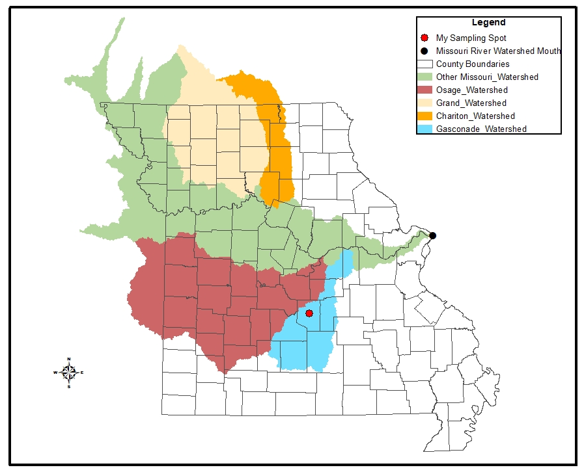
Watersheds in Missouri
Stream Team & VWQM
Watersheds
Water Quality
VWQM Data Uses
Notes:
There are many sub-watersheds within the greater Missouri watershed. The sampling spot is located within the Gasconade River watershed.

Slide 22
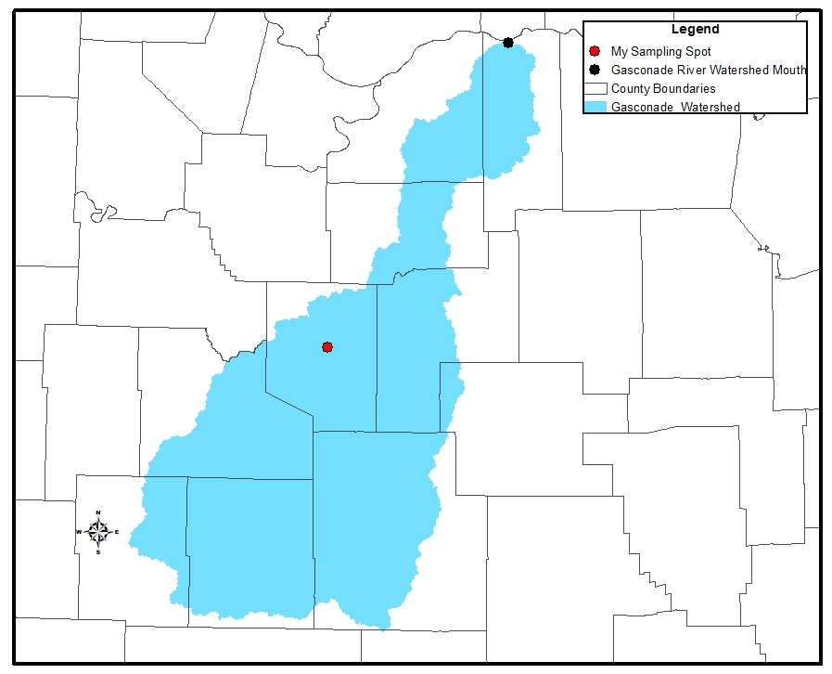
Watersheds in Missouri
Stream Team & VWQM
Watersheds
Water Quality
VWQM Data Uses
Notes:
The mouth of the Gasconade River watershed is at the extreme north end of the map where the Gasconade River enters the Missouri River. The watershed area at the mouth of the Gasconade River is approximately 3,574 square miles. The sampling spot is located within the greater Gasconade River drainage, but represents a much smaller sub-watershed (not shown).

Slide 23
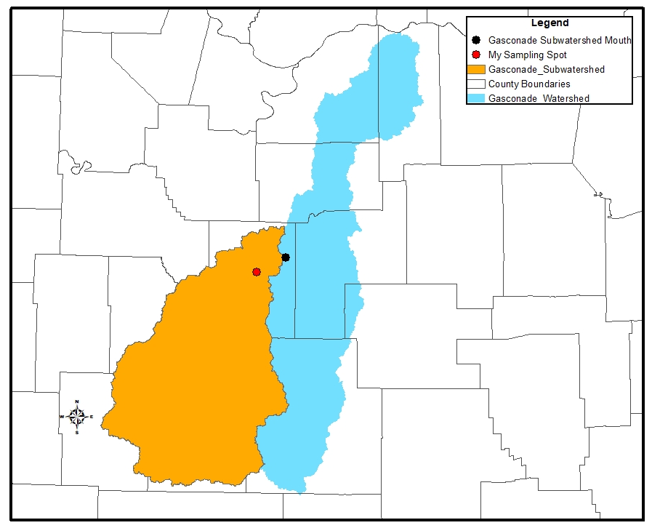
Watersheds in Missouri
Stream Team & VWQM
Watersheds
Water Quality
VWQM Data Uses
Notes:
The sampling spot is within a sub-watershed of the Gasconade River. The mouth of the sub-watershed is at the northeast end and the drainage and is approximately 1786 square miles. The sampling spot represents a smaller sub-watershed (not shown).

Slide 24
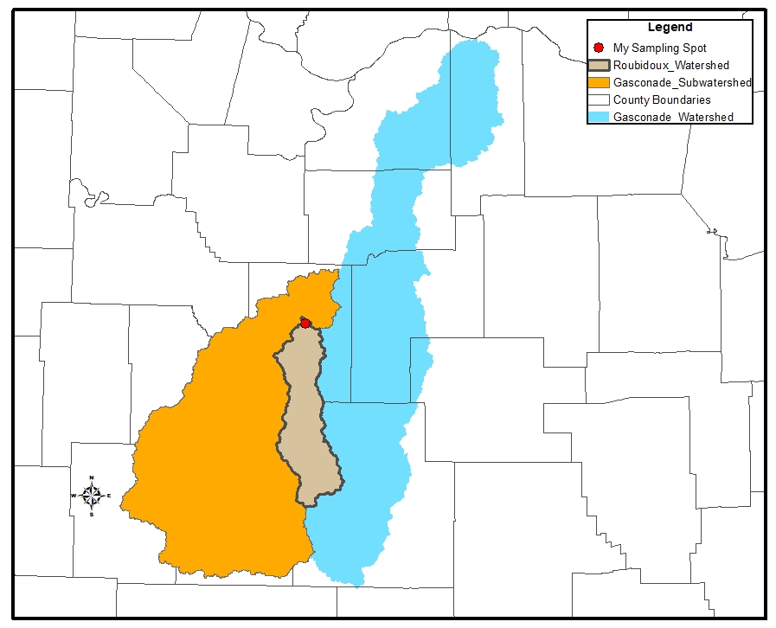
Watersheds in Missouri
Stream Team & VWQM
Watersheds
Water Quality
VWQM Data Uses
Notes:
The watershed (Rubidoux Watershed) for the sampling spot is in the southcentral part of the Gasconade River drainage; the area that drains to the sampling spot is approximately 290 square miles.

Slide 25
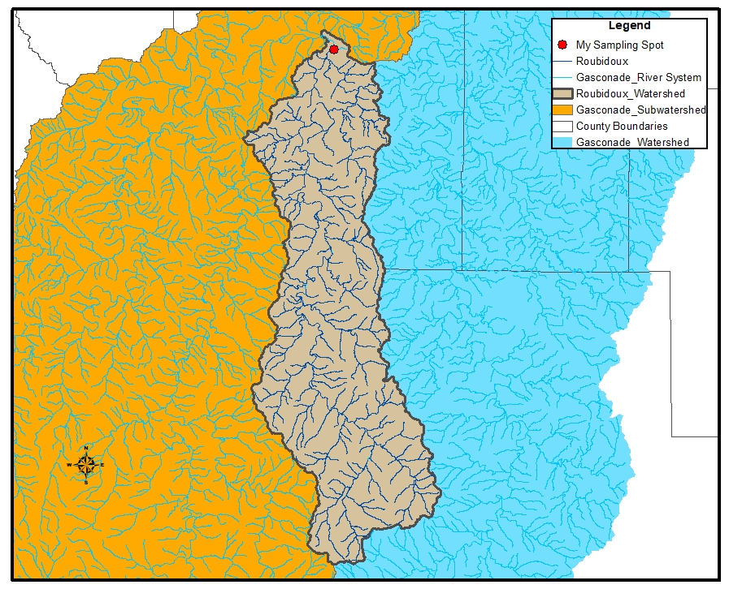
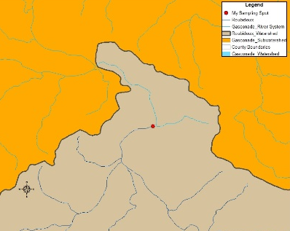
Watersheds in missouri
Stream Team & VWQM
Watersheds
Water Quality
VWQM Data Uses
Notes:
The stream network for the sampling spot is shown in the map. It is near the mouth of Rubidoux Creek, as shown by inset. If you move your sampling spot upstream or downstream the watershed area will change.

Slide 26
We all live in a Watershed
Water quality in a stream is a reflection of its watershed
Important to look at the big picture
Healthy watersheds have healthy streams
Stream Team & VWQM
Watersheds
Water Quality
VWQM Data Uses
Notes:
We all live, work, and play in a watershed. It is important to remember to take a big picture view since all of our activities will be reflected in the water quality of its stream. Healthy watersheds have healthy streams!

Slide 27
Water Quality (WQ)
Notes:
Let’s take a look at what a watershed actually is, and how it functions on the landscape to influence stream health.

Slide 28
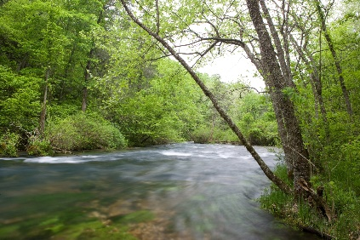
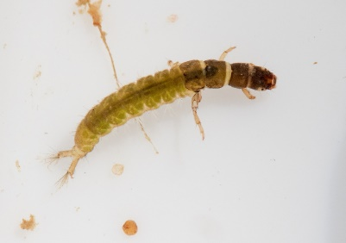
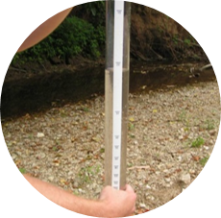
What is water quality?
Physical
  Characteristics of the watershed and stream channel
Biological
  Aquatic organisms
Chemical
  Temperature, dissolved oxygen, pH, nutrients, suspended and dissolved solids
Stream Team & VWQM
Watersheds
Water Quality
VWQM Data Uses
Notes:
Water quality is comprised of physical, chemical, and biological aspects.
The physical component includes characteristics of all the land area within a watershed, the streambanks, stream channel and stream bed that contribute to the health of the stream ecosystem.
The biological component includes the aquatic organisms living in the stream like plants, fish, and macroinvertebrates.
The chemical component includes characteristics of the water itself like temperature, dissolved oxygen, pH, nutrients, and others, that influence the biology of the stream and provide clues about the health of the stream ecosystem and surrounding watershed.

Slide 29
Water quality concerns
Clean Water Act (CWA) passed in 1972
Main goal: ensure water quality that is “fishable and swimmable”
Structure for water quality improvement:
  Regulates discharge of pollutants into waters of the US
  Financial assistance for Wastewater Treatment Facilities
  Grants for to address nonpoint source runoff
    319 Program
  Sets water quality standards for surface waters
Stream Team & VWQM
Watersheds
Water Quality
VWQM Data Uses
Notes:
Prior to the 1970s, there was little regulation to protect water quality – industrial facilities and wastewater treatment plants were free to discharge their wastes into the nation’s waters.
[CLICK] The primary goal of the Clean Water Act, enacted in 1972, was to ensure water quality that is fishable and swimmable – meaning aquatic life can thrive, fish from the waters can be consumed without harming human health, and people can swim in it without negative effects.
[CLICK] To achieve that goal, it established a structure for improving the nation’s water quality
Provides financial assistance for municipal sewage treatment plant construction and improvement
Regulates industrial and municipal point source discharges – must be permitted under the National Pollution Discharge Elimination System (NPDES)
Establishes Water Quality Standards, and a system of WQ assessment for the nation’s surface waters
Includes provisions for addressing non-point source pollution through the 319 grant program

Slide 30
CWA goals in Missouri
Designated Uses (DU's):
Human Health Protection (fish consumption) | Livestock & Wildlife Watering
Aquatic Life Protection | Irrigation
Drinking Water Supply | Industrial
Swimming | Recreation (boating/fishing)
Water Quality Standards (WQS): to protect waters for DU's
General Rules
No unsightly color, cloudiness
No oil, scum, floating debris
No offensive odor
Specific Numbers
Temperature, pH, oxygen minimums
Chemical, nutrient, and metal limits
Stream Team & VWQM
Watersheds
Water Quality
VWQM Data Uses
Notes:
- All state waters have presumptive uses of human health protection, swimming, and aquatic life protection – these uses directly reflect the main goal of the CWA to ensure water quality that is fishable and swimmable. Examples of other uses that may be assigned to waters, dependent on how those waters are actually used, include drinking water supply, livestock and wildlife watering, irrigation, and industrial uses – among others.
- WQ standards provide protection standards to streams with the narrative and numeric criteria. The goal of water quality standards are to protect the streams for their designated uses.

Slide 31
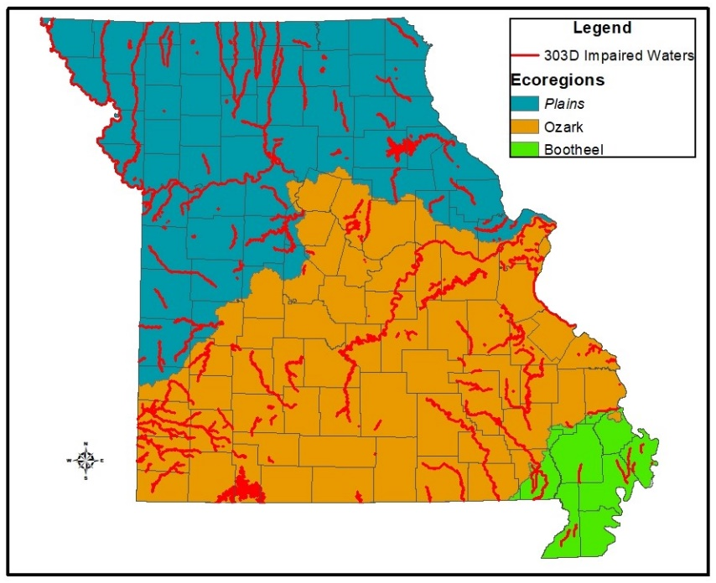
Missouri water quality
Impairment=Contaminated by one or more
pollutants
Data from various agency monitoring sites is analyzed for:
1) Impairment
2) Reason for
impairment
3) Extent of
impairment
Intro
Stream
Team
VWQM
Watersheds
Notes:
Every 2 years, Missouri assesses the condition of our state’s streams and reports the information to EPA. This map is based on that assessment, and shows another way to look at statewide water quality trends. In all regions of the state, we have some streams with impairments (shown in red on the map), which means they are contaminated by one or more specific pollutants. The state’s 2016 report indicates that approximately 8,860 miles of stream and 287,800 acres of lakes are impaired (2016 305(b) Report).
When data from agency monitoring sites is analyzed, we are trying to find out 3 things: 1) whether or not the stream is impaired by any pollutants, 2) if it is impaired, what specific pollutants are present and where they could be coming from, and 3) how many stream miles are affected by the impairment. As we try to determine these factors, it’s imperative to consider how all streams are connected to other streams within a watershed (which we’ll talk about more in just a few minutes), and how a pollutant in one part of the stream could affect a much larger network of streams. This information helps us write a plan for how to improve the water quality of the stream sections (the plan is called a TMDL-Total Maximum Daily Load).
While agency data helps us determine where there are water quality problems, we are not able to assess all the streams in the state because we have over 115,000 miles of streams in Missouri! Volunteer data can help us learn more about the water quality of streams for which we have little or no data.

Slide 32
Reasons For
Water Quality Declines
Point Source Pollution
Nonpoint Source Pollution
Pipe discharge
Variety of runoff sources
Requires a permit
Hard to identify, difficult to control
Stream Team & VWQM
Watersheds
Water Quality
VWQM Data Uses
Notes:
There are two major sources of water quality declines as outlined by the Clean Water Act. Both of these sources contribute to stream impairments in Missouri and nationwide.
Point Source Pollution is the result of discharges from a pipe and require a permit for the material discharged. Point source discharges are regulated through the permitting process.
More challenging are nonpoint source pollutants, which enter a stream from a variety of different sources across the landscape through runoff. These are harder to identify than point sources, and much more challenging to control.

Slide 33
Nonpoint Source pollution
Agricultural
Urban
Sediment
Sediment
Fertilizers/pesticides
Fertilizers
Impervious surface runoff
Pesticides
Pet waste
Animal waste
Cleaning products
Stream Team & VWQM
Watersheds
Water Quality
VWQM Data Uses
Notes:
Nonpoint sources can be both Agricultural and/or Urban in nature. Many of these are similar, and can have substantial effects on the stream resource.
Sediment refers to soil particles that are captured in runoff water and transported to streams; the particles then usually settle on the bottom of a stream and can alter habitat needed for aquatic creatures.
Fertilizers and pesticides (from crop fields or urban lawns/parks) can wash into streams if they are not properly applied.
Impervious surfaces (parking lots, roads, sidewalks), can accumulate all sorts of pollutants that are picked up by storm water and washed into streams.
Animal waste can come from agricultural production or from pet waste in urban areas.
Cleaning products such as detergents can have a negative effect on stream water quality.

Slide 34
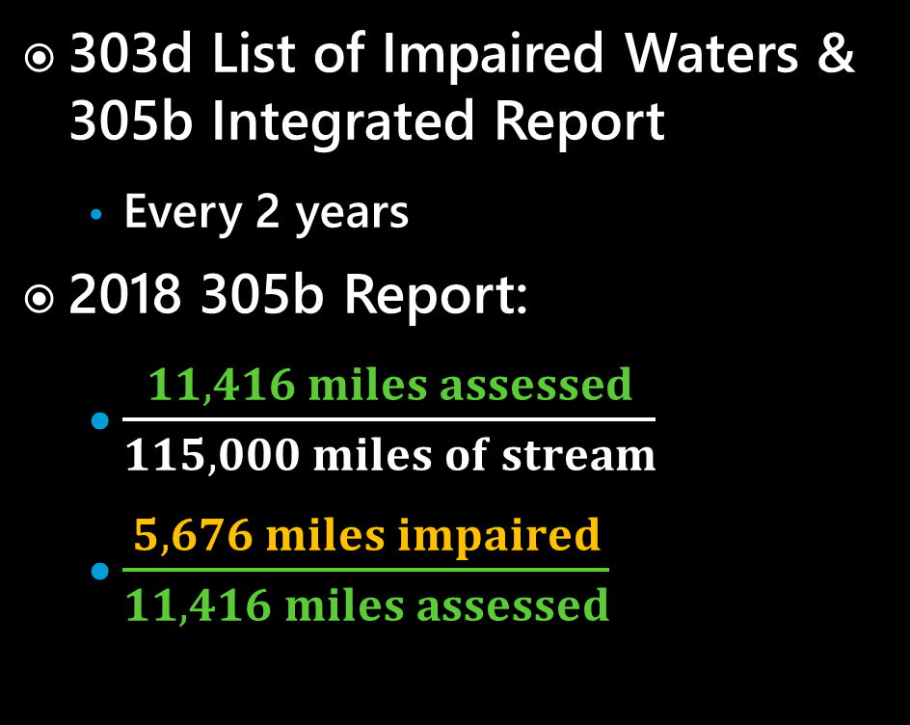
Assessing the condition of Missouri’s waters
303d List of Impaired Waters & 305b Integrated Report
  Every 2 years
2018 305b Report:
  $\frac{11,416 miles assessed}{115,000 miles of stream}$
  $\frac{5,676 miles impaired}{11,416 miles assessed}$
90%
10%
50%
Stream Team & VWQM
Watersheds
Water Quality
VWQM Data Uses
Notes:
-The CWA requires all states to assess their waters every 2 years and report findings to EPA in the form of the 305b Integrated Report that describes the overall status of the state’s waters and includes the 303d list of impaired waters
The 303d list is developed by using available data collected using EPA approved methods to assess the state’s waters against specific Water Quality Standards that are codified in state water law for a variety of designated uses for a given stream.
For the 2018 303d list, there were roughly 11,000 miles of streams with enough eligible data for assessment – which is only about 10% of all classified streams in Missouri. The total number of stream miles in MO is roughly 115,000. Of the stream miles assessed, about 5600 were found to be impaired according to the WQ Standards for their designated uses. This seems like a striking ratio of impaired to assessed stream miles, but keep in mind that much of the data that is available for assessment is the result of targeted monitoring – that is, monitoring resources are focused on waters where there is a suspected WQ issue or where there are permitted facilities that need to be inspected for compliance.
VWQM methods are typical of, and appropriate for, a volunteer monitoring program and provide valuable data, but our methods are not EPA-approved and so cannot be used for these 303d assessments. BUT, VWQM data CAN and IS used to screen for WQ problems that can then be flagged for follow up by professional staff that DO use EPA approved sampling methods – and THAT data can then be used for assessment. Fortunately, we are blessed in Missouri with an abundance of high quality streams and most of your data reflects that. When your data shows otherwise, we will follow up with you.
2018-08-24: INSTRUCTORS NOTE: Do NOT share this with current volunteers – but be aware that there is a POSSIBILITY that DNR will be able to use Level 2/3 data to assess for MEETING designated uses in the future – which would increase the number of stream miles officially assessed in the state. We would still NOT be able to impair a stream using volunteer data, but as stated in the current PPT, we can use volunteer data to screen for impairments and follow up with professional monitoring to capture those WQ issues. Stay tuned!!

Slide 35
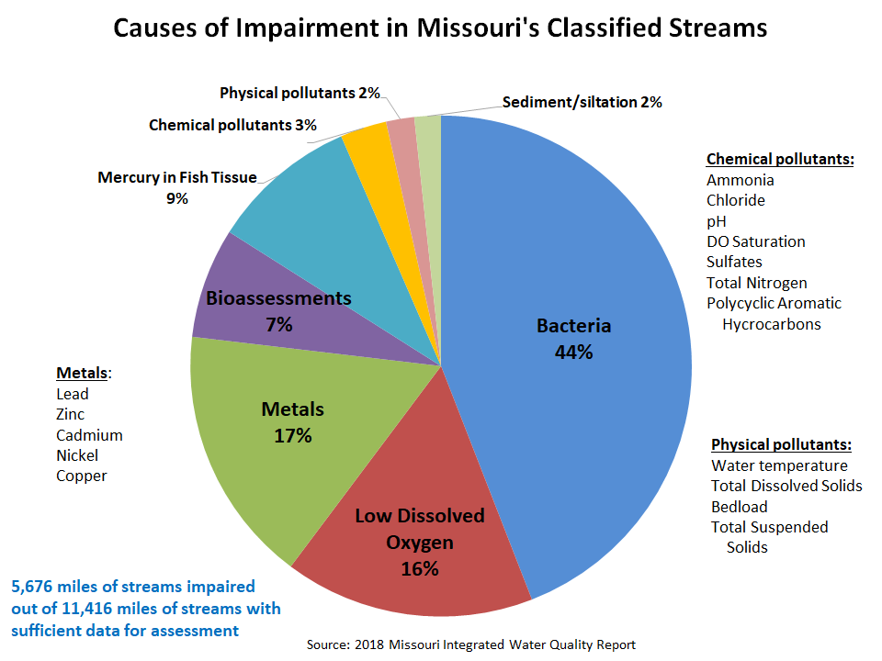
Notes:
This chart shows the distribution of causes of impairment for streams on the 2018 303d list of impaired waters. FYI, rather than an entire stream being impaired, only segments of a stream that are non-supporting of its designated use is considered impaired.
-You can see that the contaminant causing the most stream impairments is E. coli. E. coli is a bacteria found in the feces from warm-blooded animals and its presence is an indicator of pathogen loading that could be a threat to human health. Sources of E. coli include human wastewater, livestock, wildlife, and pets. Wastewater treatment plants must treat their wastewater to eliminate bacteria, but failing septic systems, combined-sewer-overflows, and sewer line breaks can all be sources of E. coli. Manure runoff from Missouri’s large animal agriculture sector can also be an important source of E. coli. And in urban areas, pets can be a significant source of E. coli – for example, in Springfield, there are about 45,000 dogs each producing about ¾ pound of waste a day!
-Low DO can create an environment in which aquatic life cannot survive and is frequently caused by an overabundance of nutrients added to a stream system.
-Contamination by metals is a legacy of Missouri’s mining heritage; metals are toxic to aquatic life.
-Bioassessment impairments result when sampling shows that aquatic life is impaired, but the cause for that impairment is unknown.
-Mercury is a potent neurotoxin in fish, wildlife, and humans. Mercury in fish tissue occurs because it bioaccumulates in aquatic organisms, and consequently is found at its highest concentrations in the fish that are at the top of the food web in aquatic systems. Atmospheric deposition is the primary source of mercury to most aquatic ecosystems; emissions from coal-fired power plants are the largest source of mercury to the atmosphere.
-The remaining causes of impairment include discrete chemical and physical pollutants and sedimentation.
It’s important to note that each contaminant may compound the effects of other contaminants. For example, animal manure contributes to E. coli contamination, but is also high in organic matter content, so also contributes to higher nutrient loading which can create low DO conditions.

Slide 36
Introduction
Water Quality Concerns
Data Use
What’s Next
Packet & Paperwork
Discussion
Notes:
This chart shows the breakdown of the SOURCES of the contaminants impairing streams on the 303d list shown on the previous slide.
Contaminants that impair designated uses originate from numerous sources. In some cases, a single source is responsible for providing multiple contaminants to the same water body. While contaminants can usually be identified, diverse contaminant sources and monitoring limitations can sometimes make it difficult to pinpoint exact sources.
If you remember from your Intro class, there are two broad categories of pollution – point source and nonpoint source. This chart shows that the contaminant source for 79% of the stream miles on the impaired waters list is from a NONPOINT source – which means that its caused by stormwater runoff and so a discrete source is difficult to identify – and harder to address.

Slide 37
Introduction
Water Quality Concerns
Data Use
What’s Next
Packet & Paperwork
Discussion
Notes:
This chart shows the breakdown of the SOURCES of the contaminants impairing streams on the 303d list shown on the previous slide.
Contaminants that impair designated uses originate from numerous sources. In some cases, a single source is responsible for providing multiple contaminants to the same water body. While contaminants can usually be identified, diverse contaminant sources and monitoring limitations can sometimes make it difficult to pinpoint exact sources.
If you remember from your Intro class, there are two broad categories of pollution – point source and nonpoint source. This chart shows that the contaminant source for 79% of the stream miles on the impaired waters list is from a NONPOINT source – which means that its caused by stormwater runoff and so a discrete source is difficult to identify – and harder to address.

Slide 38
WQ Improvements
Total Maximum Daily Load (TMDL)
  Planning tool required for impaired streams
  Calculates the maximum amount of a pollutant that waterbody can assimilate and not exceed WQS
  Sets pollution targets for effluent limits (point source) and citizen watershed groups for drafting plans to implement management practices (for nonpoint source) to restore WQ
  319 – Nonpoint Source Funding
Stream Team & VWQM
Watersheds
Water Quality
VWQM Data Uses
Notes:
Once a stream is listed as impaired a total maximum daily load (TMDL) is written to provide a framework for identifying and improving impaired waters. TMDLs will include allocations of the acceptable load for all sources of the pollutant. It will also include an implementation plan to identify how the load will be reduced to a level that will protect water quality.

Slide 39
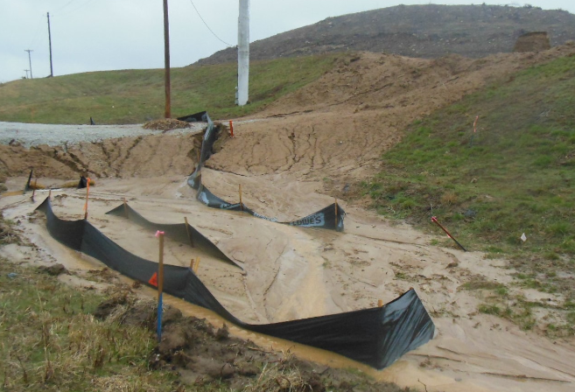
Sediment
Eroded soil deposited into water bodies
  Causes habitat degradation
  Vector to carry other contaminants into waters
  Responsible for majority of water quality concerns
Stream Team & VWQM
Watersheds
Water Quality
VWQM Data Uses
Notes:
Sediment is eroded soil that is deposited into water bodies. Sediment enters water bodies from improperly managed crop and forest lands and construction sites, and eroding streambanks.
The 303d list shows that only about 2% of Missouri stream miles are impaired by sediment; the reason for this low number is that sediment is considered habitat degradation as an impairment– which is very difficult to monitor and assess for. But sediment ACTUALLY has a very significant role in a majority of WQ impairments because it acts as a vector to carry OTHER contaminants into receiving water bodies – including pesticides, fertilizer, bacteria, and others.
The NRCS estimates that 62 million tons of soil was lost from Missouri’s cultivated cropland in 2012 due to water erosion!
Again, this shows how even though pollutants and stressors are listed separately on the impaired waters list, in reality, water quality usually suffers from the combined effects of several pollutants and processes.

Slide 40
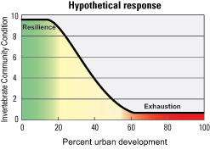
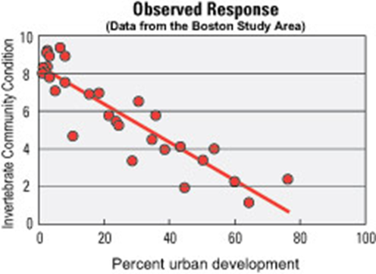
Urban Development
As little as 10% impervious cover
  Impacts aquatic communities (up to 33% degradation)
  Degradation begins as soon as landcover is disturbed
Stream Team & VWQM
Watersheds
Water Quality
VWQM Data Uses
Notes:
Urban Development
In a 1999-2004 US Geological Survey (USGS) study, 9 major metropolitan areas were sampled to assess the physical, chemical, and biological responses of stream systems to a gradient of increasing urban intensity. They specifically looked at how urbanization affected the benthic macroinvertebrates of these stream systems.
The expected, or hypothetical response (top graph) was that biological communities would have an initial resistance to degradation at low levels of urbanization, and would not begin to experience harm until the surrounding land cover was over 10% impervious surface.
The study revealed that this was not the case: benthic macroinvertebrates did not exhibit an initial threshold of resilience, but began to experience degradation as soon as the land cover was disturbed (bottom graph). By the time a watershed reaches 10% impervious cover in urban areas (data from the Boston Study Area), aquatic invertebrate communities were already degraded by as much as 33% versus those in forested watersheds.

Slide 41
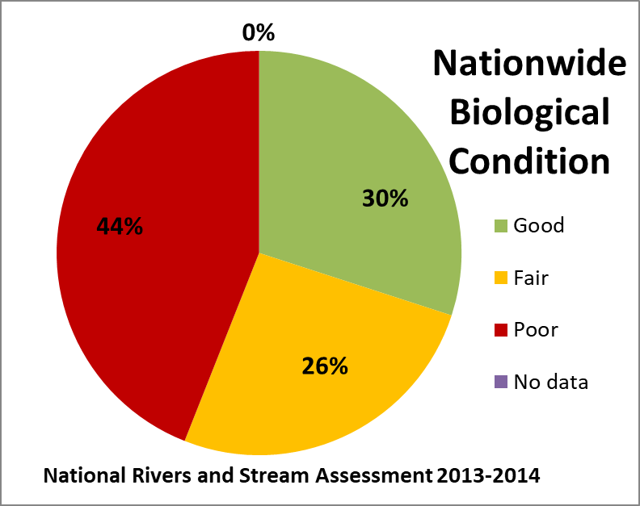
Water quality conditions
- Nationwide -
Stream Team & VWQM
Watersheds
Water Quality
VWQM Data Uses
Notes:
So how are we doing on CWA WQ goals?
The 2013-2014 National Rivers and Streams Assessment found that 44% of rivers and streams nationwide – almost half! – were in poor biological condition.
This data suggests that there is certainly room for water quality improvement in the nation.
https://www.epa.gov/sites/default/files/2020-12/documents/nrsa_2013-14_final_report_2020-12-17.pdf

Slide 42
VWQM DATA USES
Notes:
Let’s take a look at what a watershed actually is, and how it functions on the landscape to influence stream health.

Slide 43
Use of volunteer data
Inform & educate
Baseline data
Identify concerns
Long-term trends
Supplement agency data (LV 2 & 3)
Evaluate Best Management Practices (BMPS) (LV 2 & 3)
Stream Team & VWQM
Watersheds
Water Quality
VWQM Data Uses
Notes:
Volunteer data is used to inform and educate people about the condition of streams, gather baseline data, and to locate and identify potential problems.
Volunteers are encouraged to collect long-term data at a single site, which can be more meaningful than a single sampling event at a site. Data collected for at least five years can start to establish long-term trends.
Data collected by Level 2 and Level 3 volunteer water quality monitors can be used to supplement agency collected data by helping to target follow-up monitoring at potentially impaired locations to provide data for 303d assessments.
Data collected by Level 2 and Level 3 volunteers can also be used to evaluate Best Management Practices or BMPs.

Slide 44
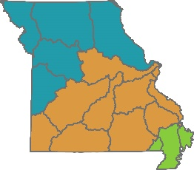
Missouri water quality
Missouri Stream Team VWQM Summary of Data: 1993-2016
Stream Team & VWQM
Watersheds
Water Quality
VWQM Data Uses
Notes:
Let’s take a quick look at water quality in Missouri. Missouri topography, soils, and land use differ considerably between the northern/western regions of the state (Plains region; blue color) and the southern/eastern region (Ozarks; orange color). This is shown in the map at the top of the slide (the Bootheel region is shown in green, and it’s not included in this graph because we have very few streams monitored by volunteers in this region, so the sample size was very low). We usually consider water quality trends for the Plains and Ozarks regions separately when we look at statewide data. In this graph (which was generated based on volunteer data), you can see the percentage of Missouri streams in both the Ozarks and Plains regions that fell in 3 different water quality categories based on their macroinvertebrate scores.
You can see that the Ozarks region has a higher percentage of streams with “Excellent” water quality, 41%, compared with only 14% of Plains region streams in the “Excellent” category. Both regions have similar percentages of streams with “Good” water quality, while about 50% of Plains region streams have “Fair/Poor” water quality. These differences probably reflect a combination of actual differences in water quality and variations in habitat between the two regions. We’ll talk more about how to use macroinvertebrate samples to rate the water quality of a stream in the “Biological Monitoring” Chapter today, and we’ll also practice in the field.
This data was part of the recently published VWQM Data Summary for all volunteer data collected from 1993-2016, and is available online on the Stream Teams United website!

Slide 45
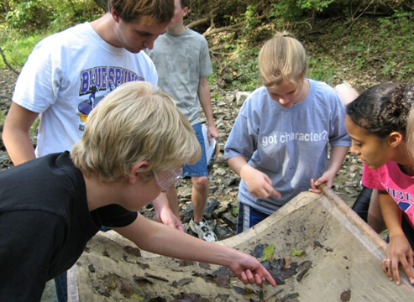
Benefits of Monitoring
Establish baseline water quality info
ID long-term trends
Locate issues
Generate baseline data
Watershed protection
Aquatic Education
Stream Team & VWQM
Watersheds
Water Quality
VWQM Data Uses
Notes:
There are several benefits to monitoring the water quality of your selected stream:
Missouri has more than 115,000 classified miles of streams, many of which have little or no additional information, so volunteers can contribute by providing information on these streams. This can be very important in case a pollution event occurs. “Pre-event” data will go a long way in establishing what conditions were like before the pollution entered the stream.
Submitting consistent data over multiple years will allow you to see if conditions are improving, declining, or staying the same. The Program currently has over 50 volunteers that have been collecting data from the same location for over 10 years, and that number keeps growing. We’d rather someone adopt one site and monitor for 10 years, than adopt 10 sites and monitor for a year
With over 9,000 trained volunteers, there are a lot of examples of volunteers finding pollution events and alerting the appropriate authorities.
Monitoring a stream can provide you with valuable information that will help you and your community protect the land and water resources in your local watershed.
VWQM data is helpful to the state of Missouri when we assess stream conditions.

Slide 46
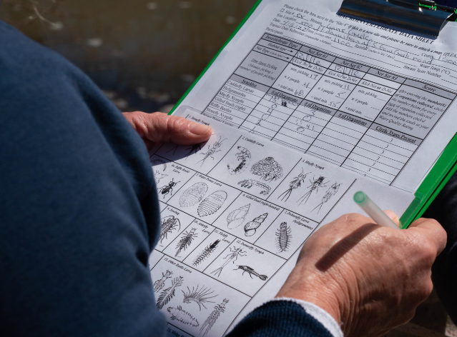
Data uses
Citizen education and advocacy
Screening for potential problems
303(d) list of impaired waters
305(b) water quality report to EPA
Projects in priority watersheds
Stream Team & VWQM
Watersheds
Water Quality
VWQM Data Uses
Notes:
There are many ways VWQM data is used.
The most important way data is used is by YOU-citizens who monitor a stream are able to learn more about how streams and watersheds function and what factors might be influencing the water quality at their site, and can use this information to advocate for clean streams in their communities.
Volunteers can gather baseline data for streams where we have little or no water quality information.
Sites that are monitored for at least 5 years can help us begin to look at long-term water quality trends and how the surrounding watershed may be affecting WQ.
Monitors that visit their stream often are the “boots-on-the-ground”, able to locate problems in the stream that authorities may not know about.
VWQM data is used by DNR to screen for potential WQ problems as streams are assessed.
As DNR looks at data to form the 305(b) Report and 303(d) List of Impaired Waters, higher levels of VWQM data are used to provide modeling data, delist and assess waters, and provide data for TMDL plans.
VWQM data is used to educate citizens on aquatic resources.
MDC’s Priority Watershed initiative is able to utilize citizen data to look at watershed-wide trends and determine where action should be taken to improve WQ.

Slide 47
Stream protections
ST #346 Francis Howell HS Environmental Studies discovered a sewer line break
ST #2893 The Clark Family Farm discovered the local pool draining into stream
ST #2760 and #4707 in St Louis area monitor chloride in urban streams to advocate for new methods for road salt application
Stream Team & VWQM
Watersheds
Water Quality
VWQM Data Uses
Notes:
[Update regional examples if needed, with county information]
Stream Team 346 (the Francis Howell High School Environmental Studies group) found a sewer line that had burst and was discharging raw sewage directly into a stream. A significant amount, but not enough for the sewer district to notice.
Stream Team 2893 (The Clark Family Farm) noticed higher than normal flows in their little creek and discovered the local pool was draining the pool for the winter. It killed off most of the inverts but prevented a fish kill.
ST #2760 Litzinger Road Ecology Center has done winter chloride monitoring for several years and is using the information they collected not only to send to DNR but to also work with St. Louis MSD to advocate for new methods of using road salt to decrease its effect on streams in their area.

Slide 48
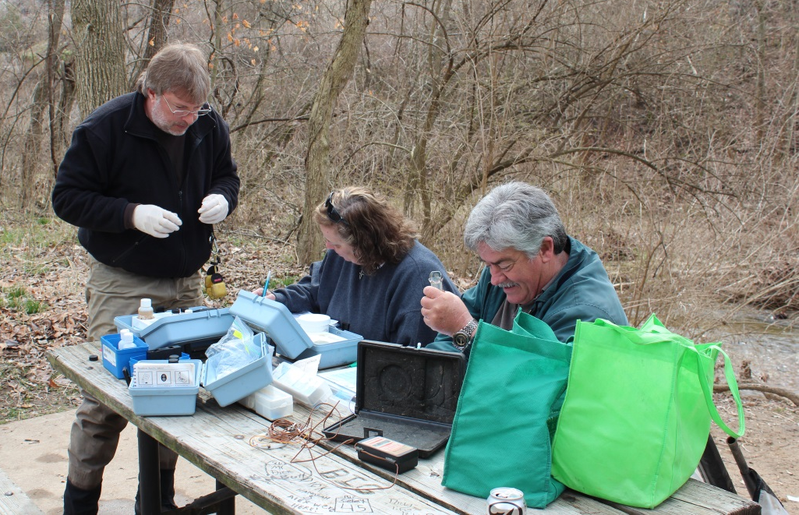
Expectations from Volunteers
Share knowledge and information
Periodically monitor stream
Submit data
Stream Team & VWQM
Watersheds
Water Quality
VWQM Data Uses
Notes:
We hope that volunteer monitors will:
Share knowledge about water quality and information gleaned from monitoring with others
Periodically monitor a stream – remember consistent monitoring is SO important! Twice a year would be GREAT if possible!
And please, once you have done your monitoring, don’t forget to submit your data!

Slide 49





Contact us
mostreamteam.org
Streamteam@dnr.mo.gov
Streamteam@mdc.mo.gov
youtube.com/@MissouriStreamTeam
facebook.com/mostreamteams/
800-781-1989
Notes:
Additional resources and training videos can be found online. Contact us if you have any questions.

