Slide 1

Ghost Tours:
Start to Finish
Paul Prater

Slide 2
Download Link
https://tinyurl.com/ybrac276

Slide 3
Overview
Started in Argenta in 2017
Put together in two weeks
Argenta has 66,044. Metro has 500,000
Not a tourist destination
$0 spent on marketing
Sold out all tours and grossed $5k in two weeks
Notes:
Talk about usually booked but not in 2017, so put together tour.

Slide 4
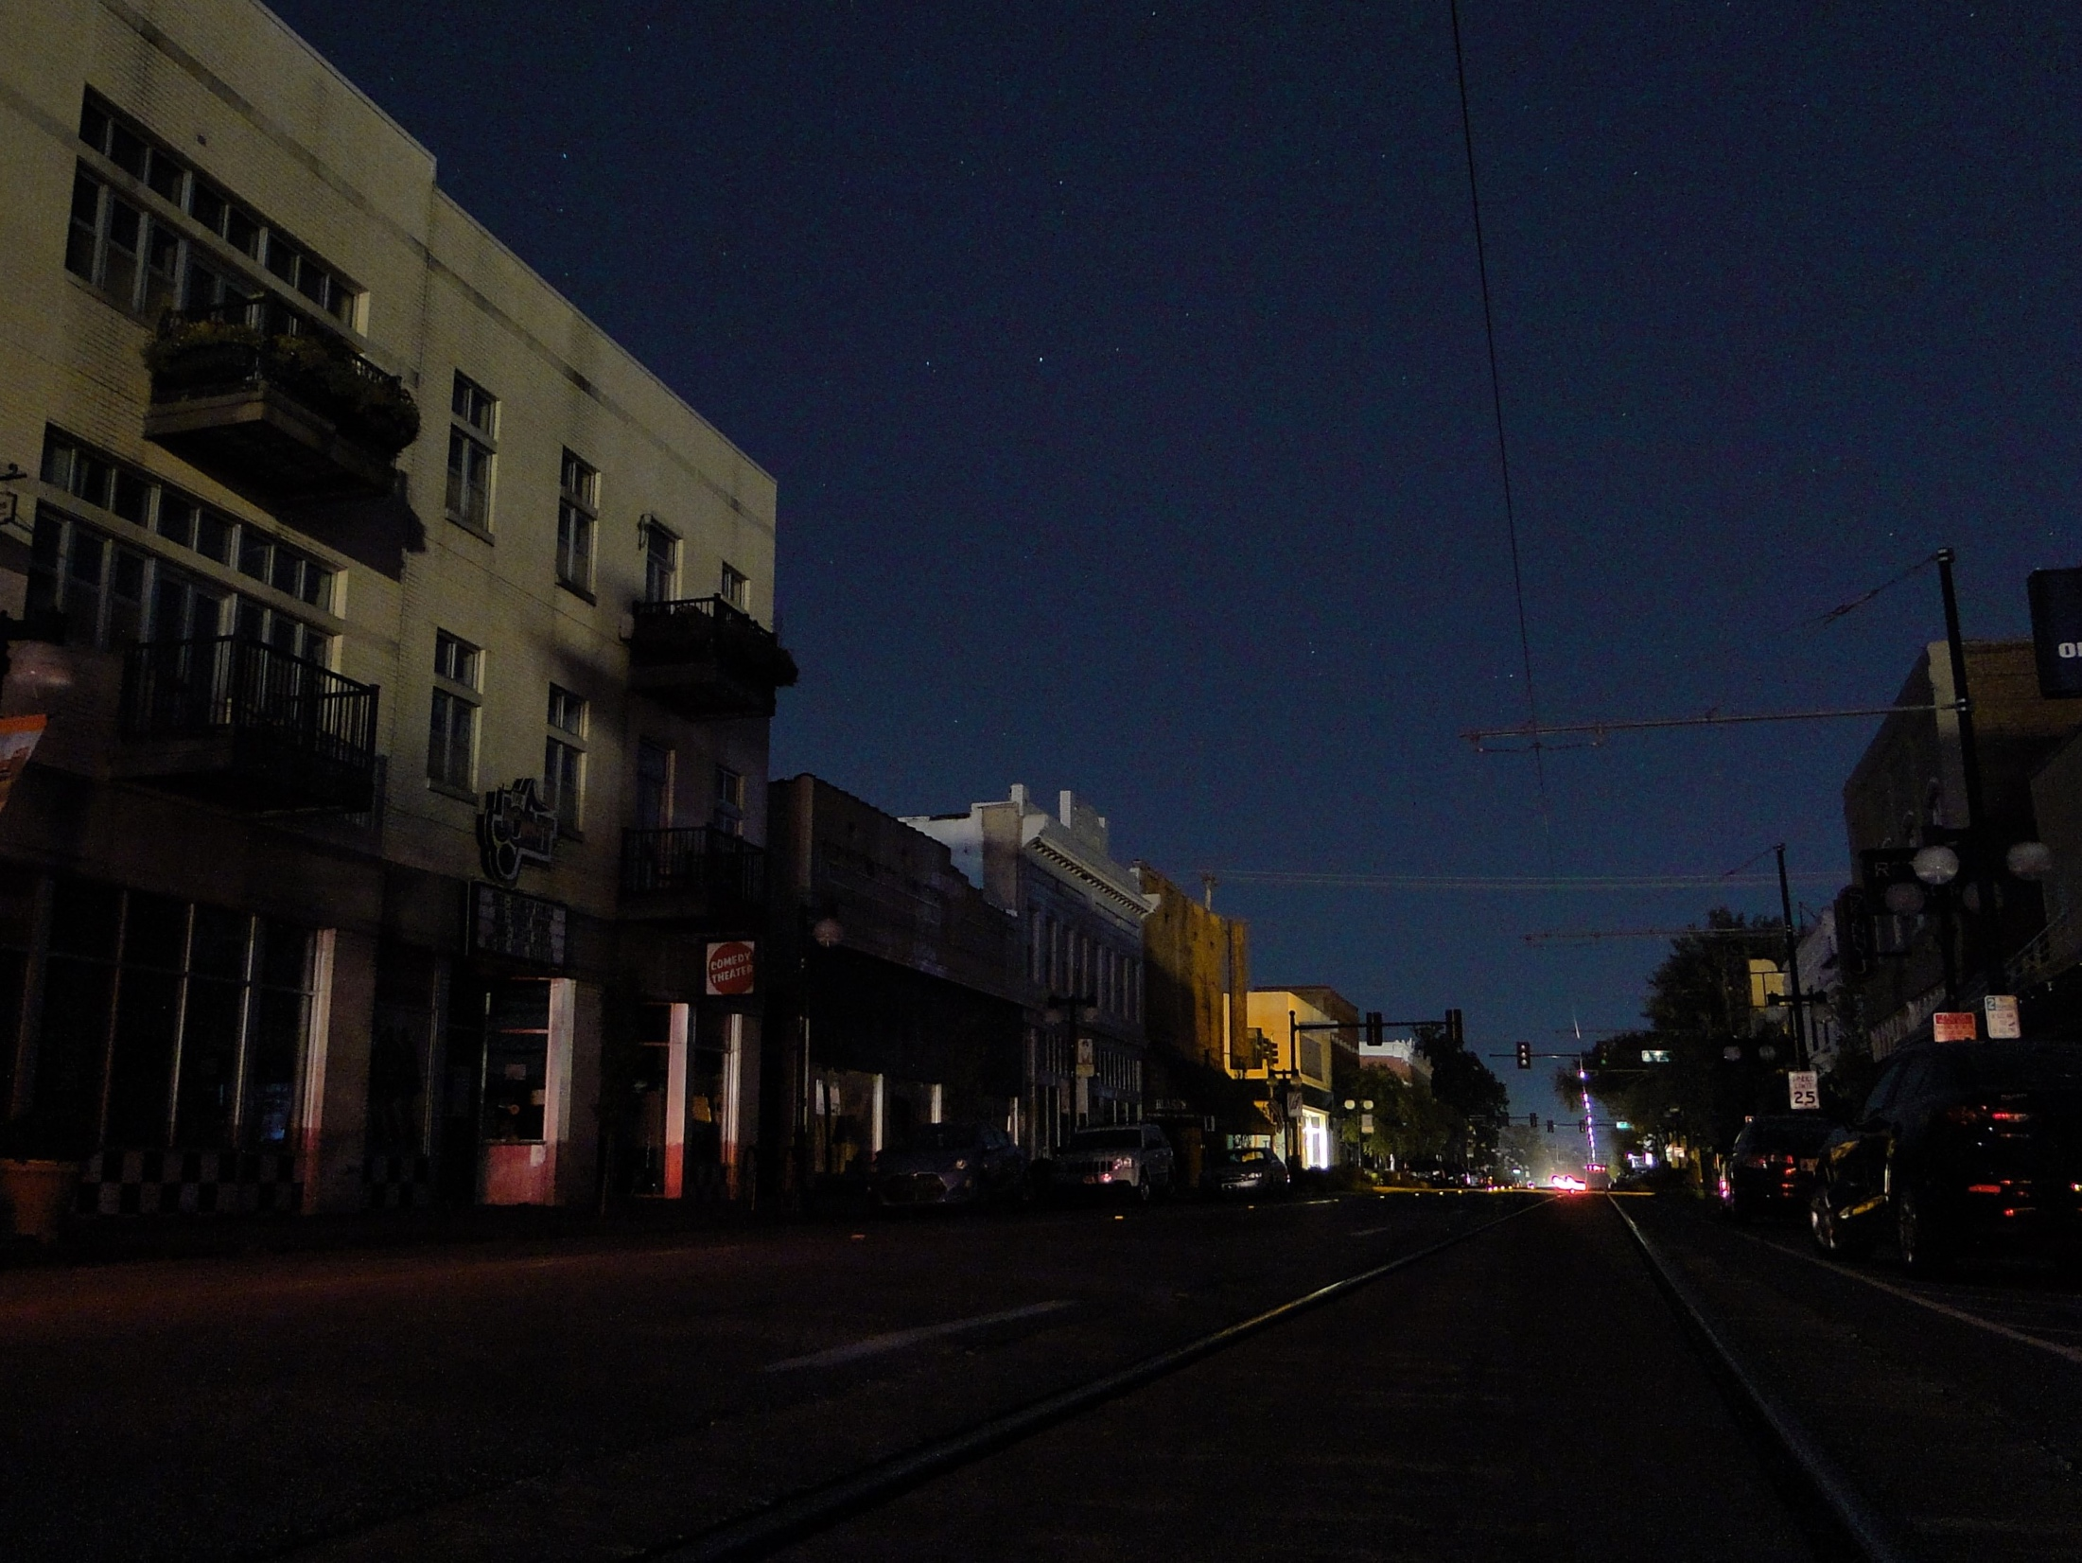
Location
Walkability
Accessibility
Flow
Stories
Safety
Permits/Licensing
Notes:
Walkability- Can people access it? Wheelchair accessible? Is the ground even?
Accessibility-Parking, big events nearby, entrance to locations? Bands, etc…
Flow-Where do you start and where do you end? Is it far from parking? Getting back to start a new tour
Ghost stories-Need to be local legends/stories, interesting history
Avoid the recent
Address Belivers and Non-Believers
Keep owners happy
Safety-Lighting, uneven or broken ground, homeless and/or crime
Permits/Licensing-Make sure you are legal!
Give examples of all of this in Argenta.

Slide 5
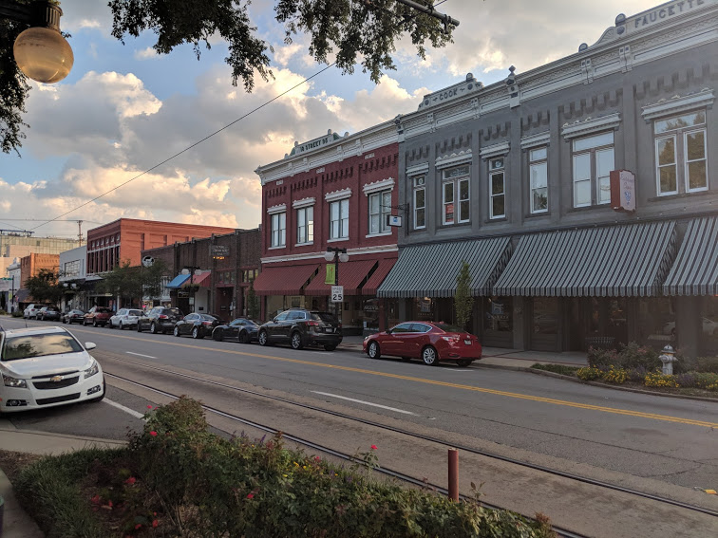
Argenta
Notes:
Here is where I do tours.
Only about 5 blocks long
Lighted
Sidewalks
Safety Ambassadors
Lots of foot traffic

Slide 6
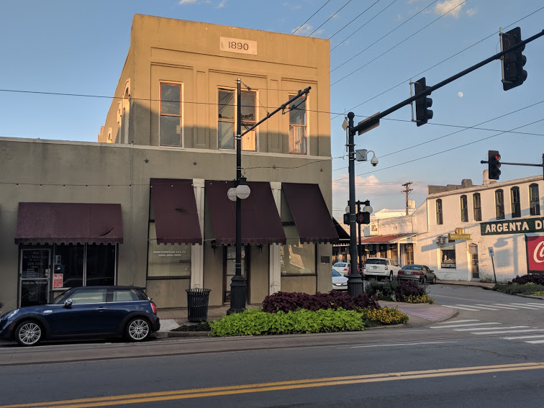
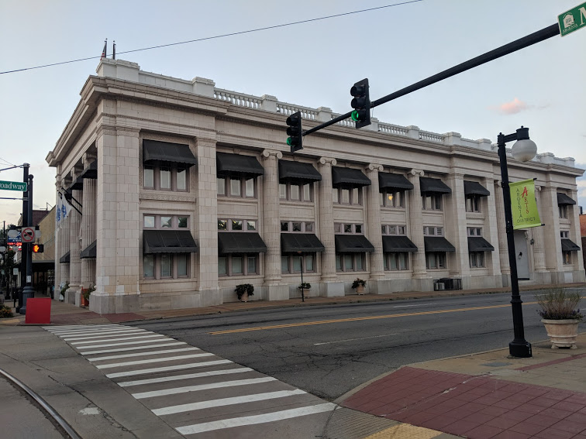
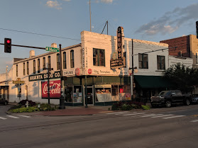
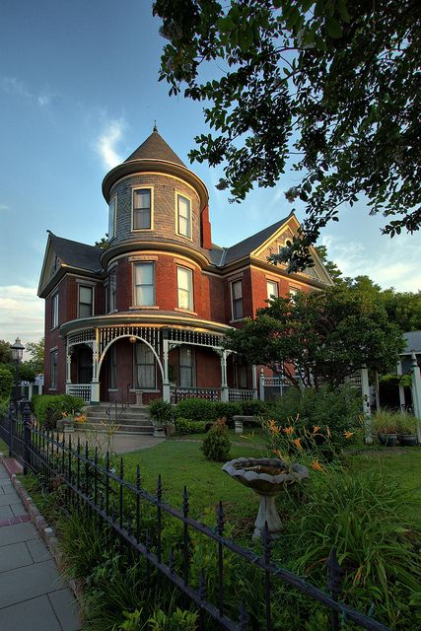
Argenta
Notes:
Here is where I do tours.
Only about 5 blocks long
Lighted
Sidewalks
Safety Ambassadors
Lots of foot traffic

Slide 7

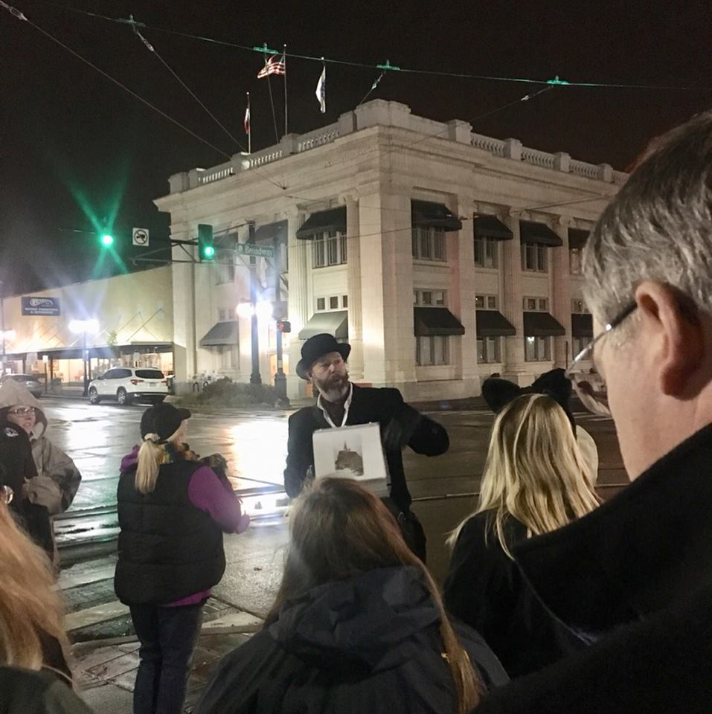
Building the Tour
Start with History
Find the Ghosts
Visuals
Notes:
History:
The internet
Books
History Commission
Newspapers
Newspapers.com-History & Newspapers often wrong
Find the ghost stories:
1. Ask the people who live there-Talk about Conan
2. Ask the history commission
3. Search the internet
4. Make them up.
5. Get them from tour attendees
Visuals:
Folder-Show and give practical example
Dates and names on back.
Goes over arm.
Ipad for video

Slide 8
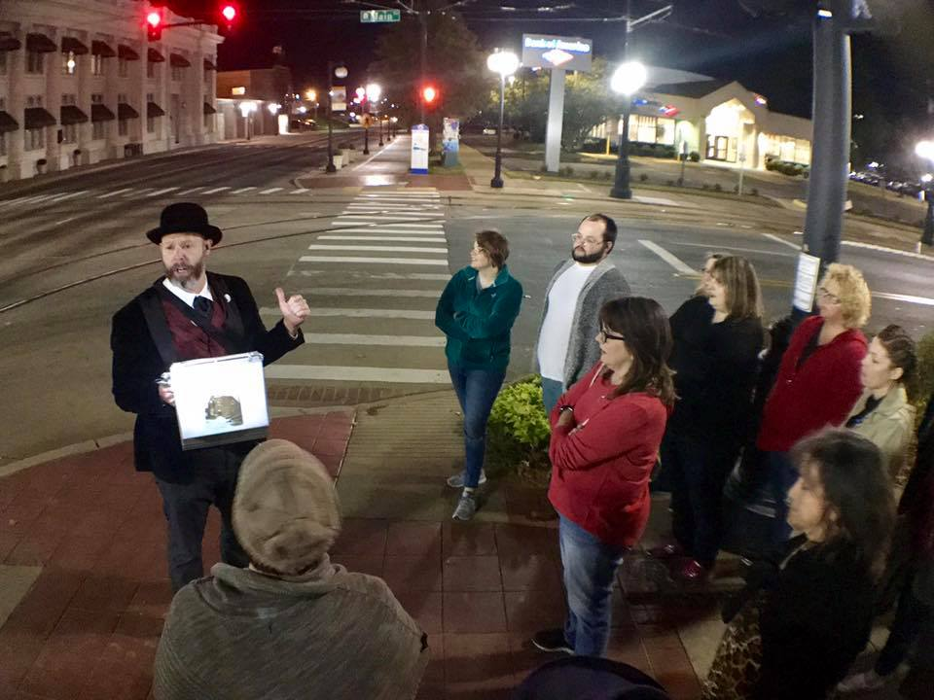
Performance
Costuming
Magic?
Notes:
Costuming-Makes You Stand out. Easy to see and recognize and adds to the “price point.” Look good! Talk about Apple products.
Be authentic for era! Wasn’t around in mid 1800s. 1885 is oldest building.
Magic-Should you perform?
No-If fake, then everything is fake. Casts doubt on it all.
Caveat: Make it look real and bring in things from tour. Perform piece from tour.
Props-YES!! Bring pieces from History! Make them UP.

Slide 9
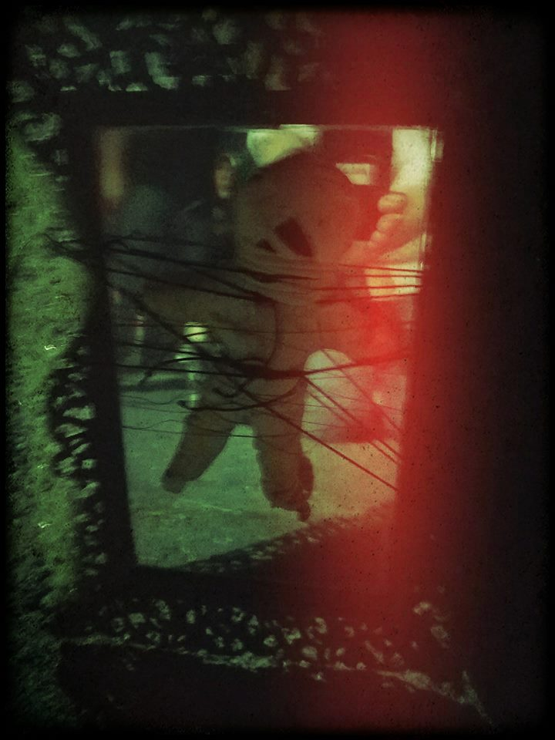
The Prop
Notes:
Use a Mirror! Social proof of ghosts.

Slide 10
Marketing
Website
City/State Listings
Facebook & Instagram
Radio
Newspapers
Television
Giveaways
Posters & Flyers
Social Proof
Notes:
Website-Do you need it? YES. Selling tickets, remarketing, collecting emails, branding, establishing your presence, legitimacy.
Ipage
ThemeForest-Get a theme and easy to do.
Use Plug Ins-Plug Ins for Twitter, Ticket Sales, Instagram, Email marketing, etc…
Pull up Haunted Argenta
City State Listings-Single most important place.
Google: Halloween Things in ___________. Be broad and specific.
Single best marketing thing aside from FB.
Facebook & Instagram-Critical! Tell story about FB.
Set up a FB page for the tours. Pictures!
Create a FB event-Keep dates updated!
Create posts and have your friends comment & like & then boost
Advertising on FB an Instagram-Call to action-where do they go?
A/B marketing-Which does better?
Defining Your Market
FB and Instagram provide info on demographics.
Who do they think it is? Most likely middle aged women. Latest is 59.8% women, 40.2%men18-44 is 75% of the looks. $15.05 with (4,075 total) With paid, 1,714 people reached and 208 engagement. 22 Shares.
Radio: Easy to get on. Offer tickets in exchange for radio time.
Newspapers: Send them info about the tours. Do a press release. It is in packet
Television: Get them to come out on the tour.
Giveaways: Radio, television etc..
Posters and Flyers: Limited use in that. Put in high traffic areas. Don’t waste money.
Social Proof: Testimonials, Reviews and Photos of Ghosts.

Slide 11
Video
https://www.youtube.com/watch?v=dFQg19SNYMk
https://www.thv11.com/video/news/local/argenta-ghost-tour-highlights-districts-haunted-history/91-2783123

Slide 12
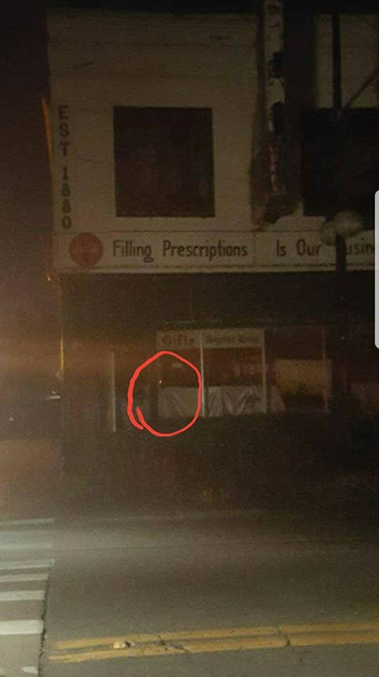
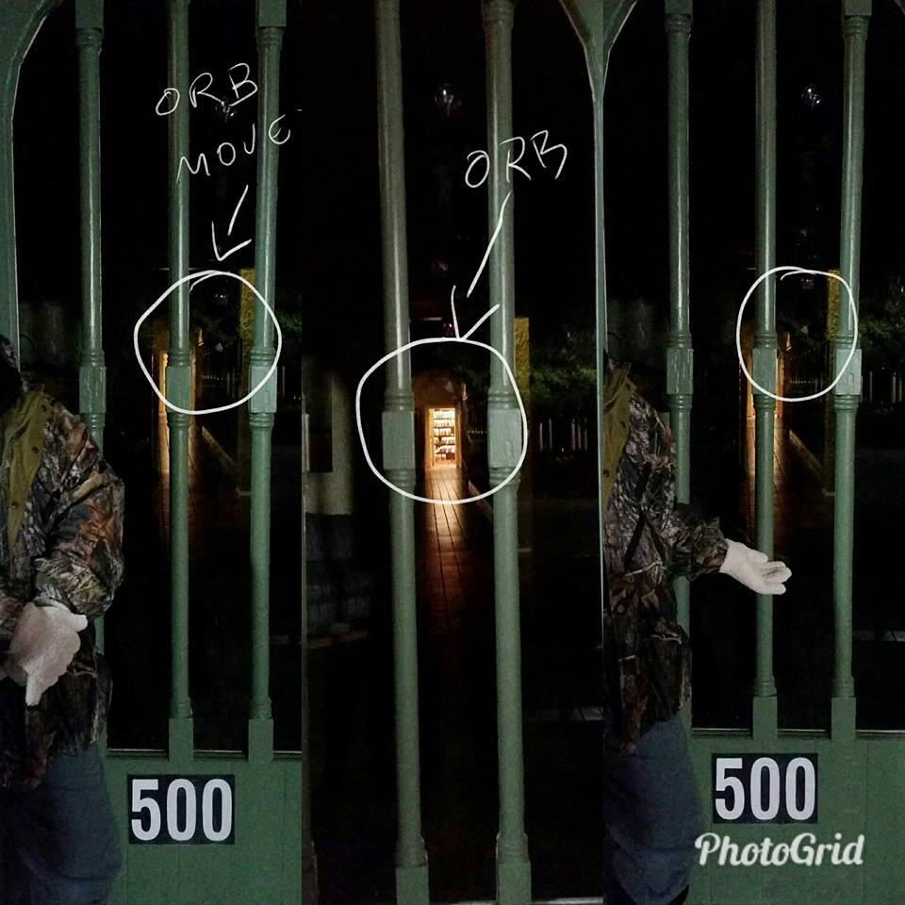
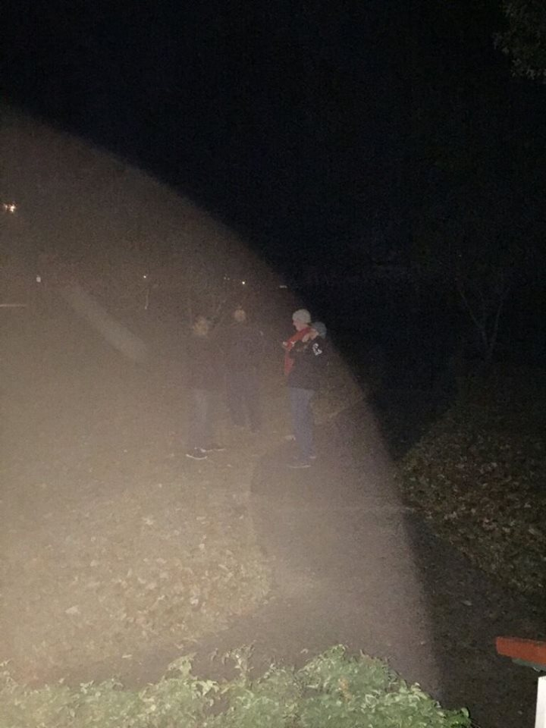
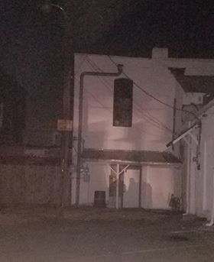
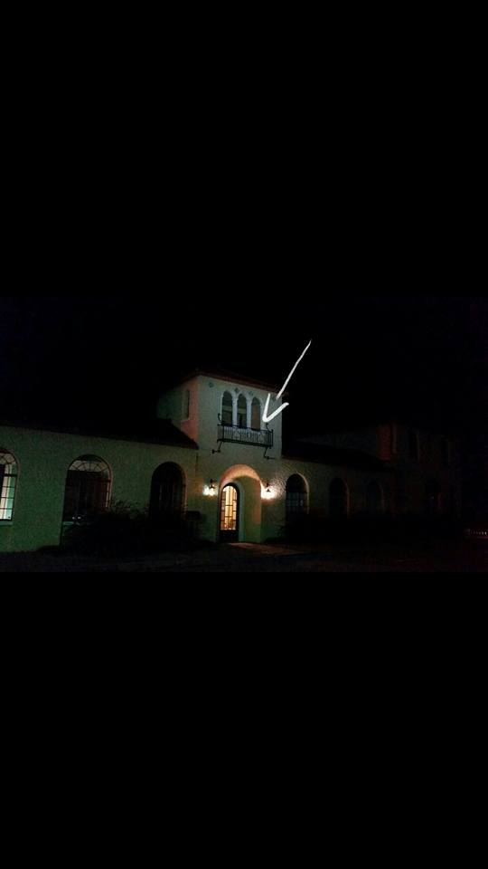
Ghost Photos
Notes:
All photos taken by attendees.
Put them on Instagram and on your website. Instagram has a widget to work with your Wordpress site.
Talk about SEO briefly.

Slide 13
Practical Issues
Ticketing
Check in
Where to Meet
Size
Price
Sound
BOR Sales
Notes:
Ticketing: Universe.com
Find an online ticket vendor.
Don’t take away from your fees.
Universe is what I use.
Needs to integrate with website.
Make sure they have an app.
Check In: Paper tickets? Electronic tickets?
Where to Meet? Is it in a public place? Is it safe? Are you easy to find?
BOR Sales-What are you going to sell? Is it going to further your marketing? T Shirts, stickers, books, etc./.

Slide 14
Additional Revenue
Private Tours
Hotel Group Tours
Séance Nights
City Bus Tours
Readings

Slide 15
Wrap Up/Q&A
THANK YOU!

