Slide 1
Adding a Little Bizarre to Your Performance
Paul Prater

Slide 2
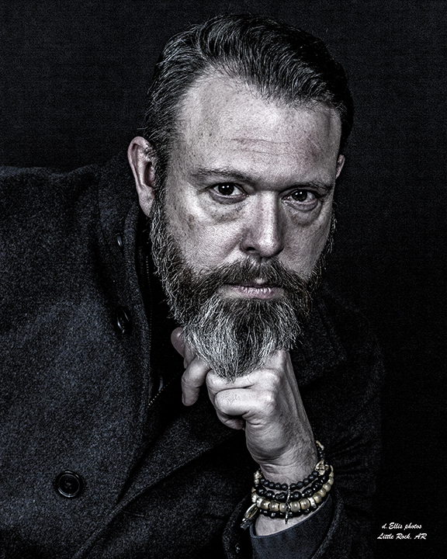
WH0?
Notes:
Thank everyone for coming.
Play Pecha Kucha

Slide 3
Origins of Bizarre Magic
Shamanism
Contact with the Spirit World
Entertainment
Special Gifts
Notes:
Shamanic Practice- Shamanism is not region specific. All over the world. Usually involved healing, dance, trance, and spirit communication. Known to know magic tricks as well.
Contacting spirit world-Séance is as old as religion and people.
Westcar Papyrus- 1782 BCE -An ancient Egyptian text containing five stories about miracles performed by priests and magicians. Each stories is told by one of Cheops’ sons.
Christ the Magician-The earliest known reference to Christ, engraved on a bowl.

Slide 4
What is Bizarre Magic?
Magic that moves people in some manner.
  Scary
  Humorous
  Sad
Notes:
Brainstorm: What is bizarre?
Not going to engage in a debate.
Doesn’t have to be scary
Isn’t just a story-needs to be a bizarre story.
Needs to evoke an emotion of some kind.

Slide 5
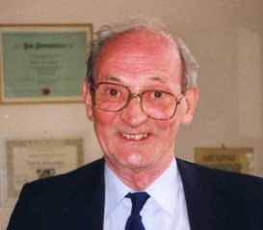
Charles Cameron
1927-2001
Handbook of Horror
Witches Brew
Devil’s Diary
Castle Dracula Mentalism
Notes:
Charles Cameron –Godfather of bizarre magic. He was Scottish and was the owner and curator of a wax museum. This is when he started Castle Dracula, making a theater upstairs.
Campy and tongue in cheek.

Slide 6
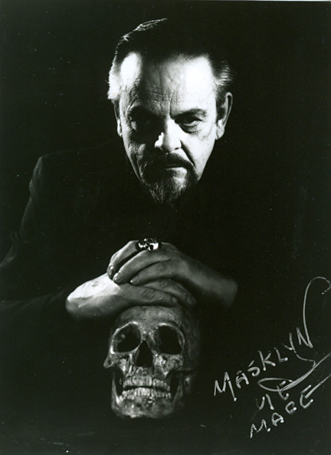
Tony Andruzzi
1925-1991
Negronomicon of Masklyn Ye Mage
Daemon’s Dairy
Scroll of the Mages
The Invocation
Notes:
Tony Andruzzi- Originally Tom Palmer and was a comedy magician. He took it seriously and lived as a bizarre magician day in and day out.
He handwrote manuscripts and really brought bizarre magic forward. Organized the first bizarre magic gathering.
Super interesting life. Jim Magus wrote Unspeakable Acts about Andruzzi’s life.
Goetic magic-very ceremonial.

Slide 7
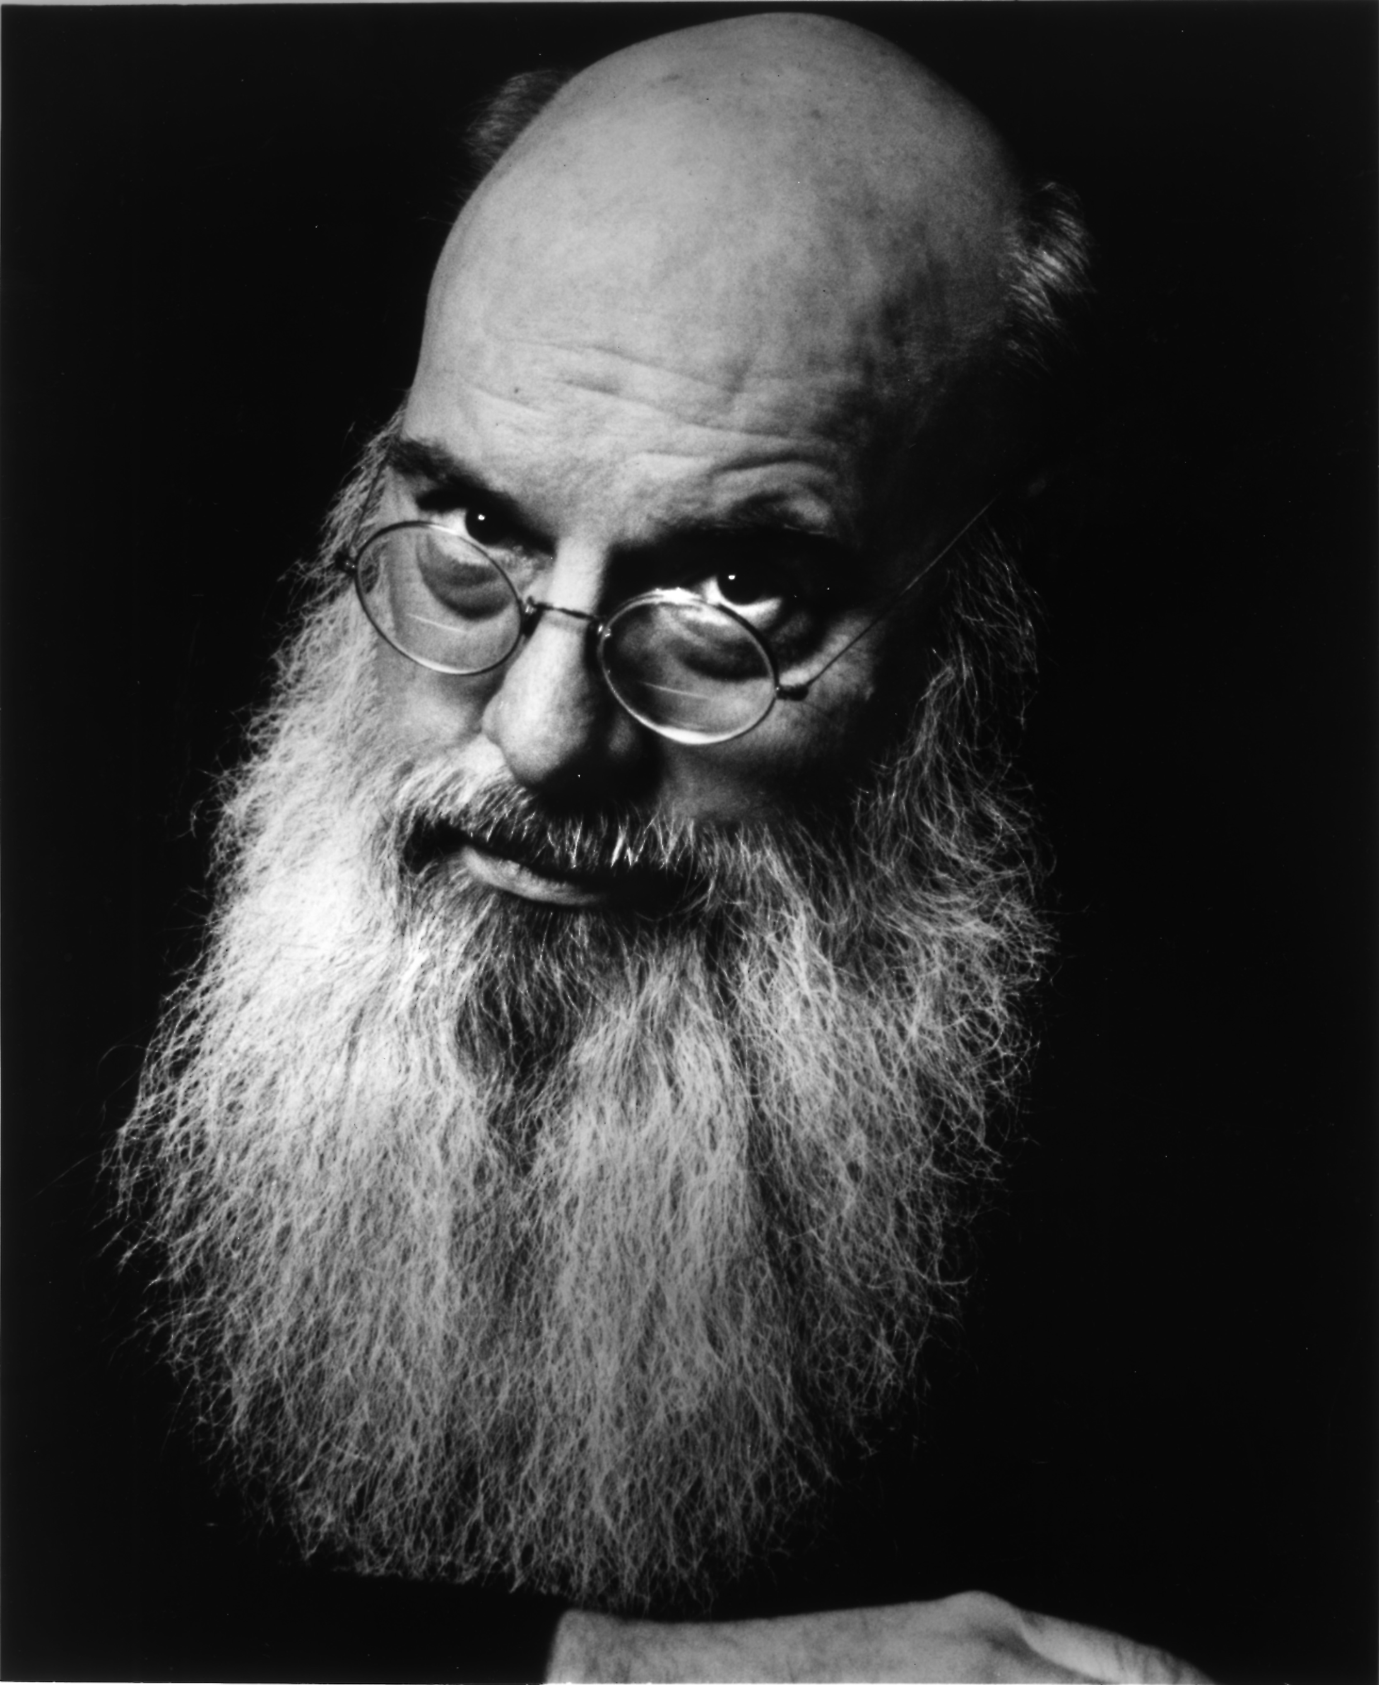
Eugene Burger
1939-2017
Spirit Theater
Strange Ceremonies
Meaning and Magic
Notes:
Spirit Theater was an excellent work on séance type, “Creepy” or bizarre magic.
Kinder, gentler side of bizarre. More connection with the audience.

Slide 8
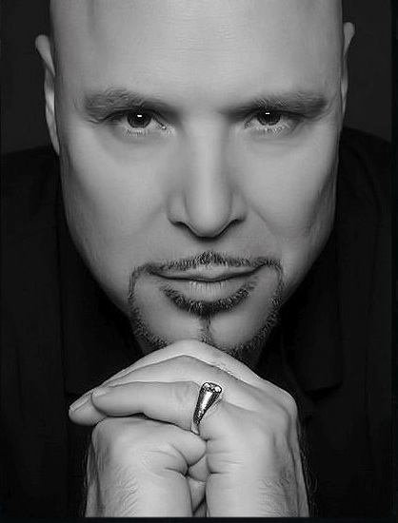
Docc Hilford
Too many to name!
Notes:
Kept the Invocational going and renamed it Weerd Weekend.

Slide 9
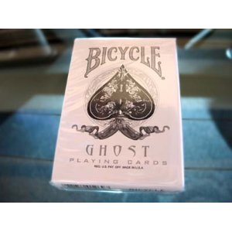
What Bizarre is Not
“Creepy” decks of cards.
Card Tricks with tarot cards.
Notes:
Always a loophole: Entire books of card tricks with Tarot cards. That does not make it bizarre. It helps.
What is the story? Why is a tarot card needed?
Perform Witch of Glastonbury.
Perform Fate & Freewill.

Slide 10
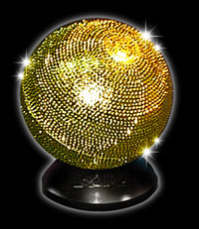
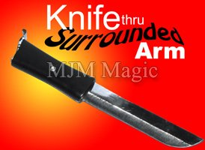
What Bizarre is Not
A Zombie ball with a skull.
Gore for the sake of gore.
A ghost story. Especially if it involved a silk and a thumb tip.

Slide 11
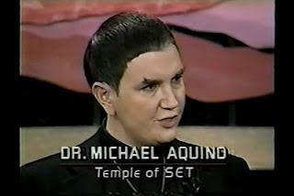
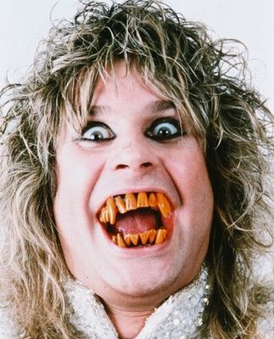
What Bizarre is Not
Required to deal with Dark or Occult Themes
Notes:
Often it DOES deal with the occult, but absolutely is not necessary.

Slide 12
Criticisms of Bizarre
It is self indulgent.
It is cheesy.
It is too long.
  Really? You ever heard a short cups and balls routine?
  Edit, Edit, Edit.
Notes:
You don’t think cardistry is self indulgent? What is the point? Mentalism? Often self indulgent too.
Doesn’t have to be. Up to you.
Don’t act if you can’t
Don’t be one dimensional.
The focus IS on storytelling, but it is not to be a rambling aimless tale.
Spend time learning how to build good stories and good plots.

Slide 13
Rule Number 1
Have a good story!
  Have an emotion hook. A punch.
  Your story needs to be good enough to stand on its own.
  You need to be believable.
Notes:
Perform Witch of Glastonbury
Story Only
Story and Routine

Slide 14
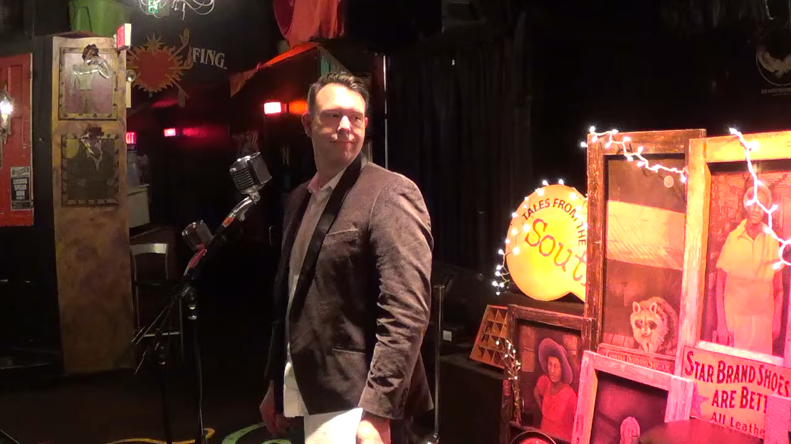
Rule Number 1
Notes:
The End of Summer

Slide 15
Rule Number 2
Involve Your Audience!
  Let the magic happen in their hands.
Notes:
Perform Fate & Freewill

Slide 16
Rule Number 3
Make the spectator the focus.
  Talk about them.
  YOU are the most interesting thing in the room.
Notes:
Perform Magic Square

Slide 17
Do You Need a Character?
You already are a magician. You are the character.
Notes:
How many here have taken acting classes? Take them!
I do not believe a character is necessary and, in fact, can be detrimental.
If you can’t act, leave the characters alone
3. I do not have a character per se.
Explain how I am a skeptic but my great aunt was a believer.

Slide 18
Creating Routines
Work from a story.
  Sometimes you stumble across one. –READ!
  Sometimes you have had one for a long time.
Notes:
Story of David O. Dodd

Slide 19
Creating Routines
Work from a technique or trick.
  Hand in Trap
  Pendulum Routine

Slide 20
Creating Routines
Work from a feeling
  Music, Movies, Books, Images
  Witches Do Burn
  Alamo

Slide 21
Creating Routines
Work from found objects
  Location Inspiration
Notes:
Iron spikes, bricks, shells

Slide 22
INCORPORATING BIZARRE
  Kids shows? Heck yeah! Kids love creepy things and ghost stories.
  Corporate-Absolutely! Just stay away from controversy.
  Theater-Obviously! You have free reign
Notes:
Do worksheet FIRST!
What can you add in? (Perform Cuss Cards)
How to script to allow for odd routines.
Talk about Magic Square example.

Slide 23
HOW TO IDENTIFY YOUR MARKET
Do you know your market? How?
Business is data driven.
Notes:
Who bought the tickets?
How do you know your market?
Facebook ads
Instagram Ads
Email lists
Attendance lists.
Discuss CAN-SPAM

Slide 24
CREATING A MARKET
What markets align with yours?
Where are those people?
How do you reach those people?
Notes:
Not from scratch but tapping into an existing one that you are not in.
Ghost hunters, psychics, general weirdos.
Where are they? Need to be where they are.
Email lists, events, bars, advertising sources.

Slide 25
CREATING YOUR SHOW
Often easier. Focus
Cater to your identified market.
Notes:
Develop Your Show
Create a show that caters to your market. You have done the research. Apply it! Needs to be adapted.
Give example of Haunted Argenta Christmas.

Slide 26
FINDING YOUR VENUE
Theaters
Lodges/Clubs
B&Bs
Hotels
Streets
Bars
Empty Spaces
Existing businesses
Notes:
Leverage Your Fans
If you have fans, ask them for contacts.
Have them request you.
Give example of Elks Lodge.
Use a venues fans
Find a place that has a compatible fan base.
Leverage the power of money-How can you make a business owner money?
Discuss getting bar cuts.

Slide 27
LEGAL ISSUES
Business License
Observing Local Laws
Getting Permission
Waivers/Insurance
Notes:
Do you need a business license?
Fire safety
Number of people
Selling food/beverage

Slide 28
GETTING THE WORD OUT
CVB
Venue
Existing customer list
FB and IG ads
Posters
Radio and Television

Slide 29
CLOSING & Q&A
THANK YOU!
Any Questions: paul@paulprater.com

