Slide 1
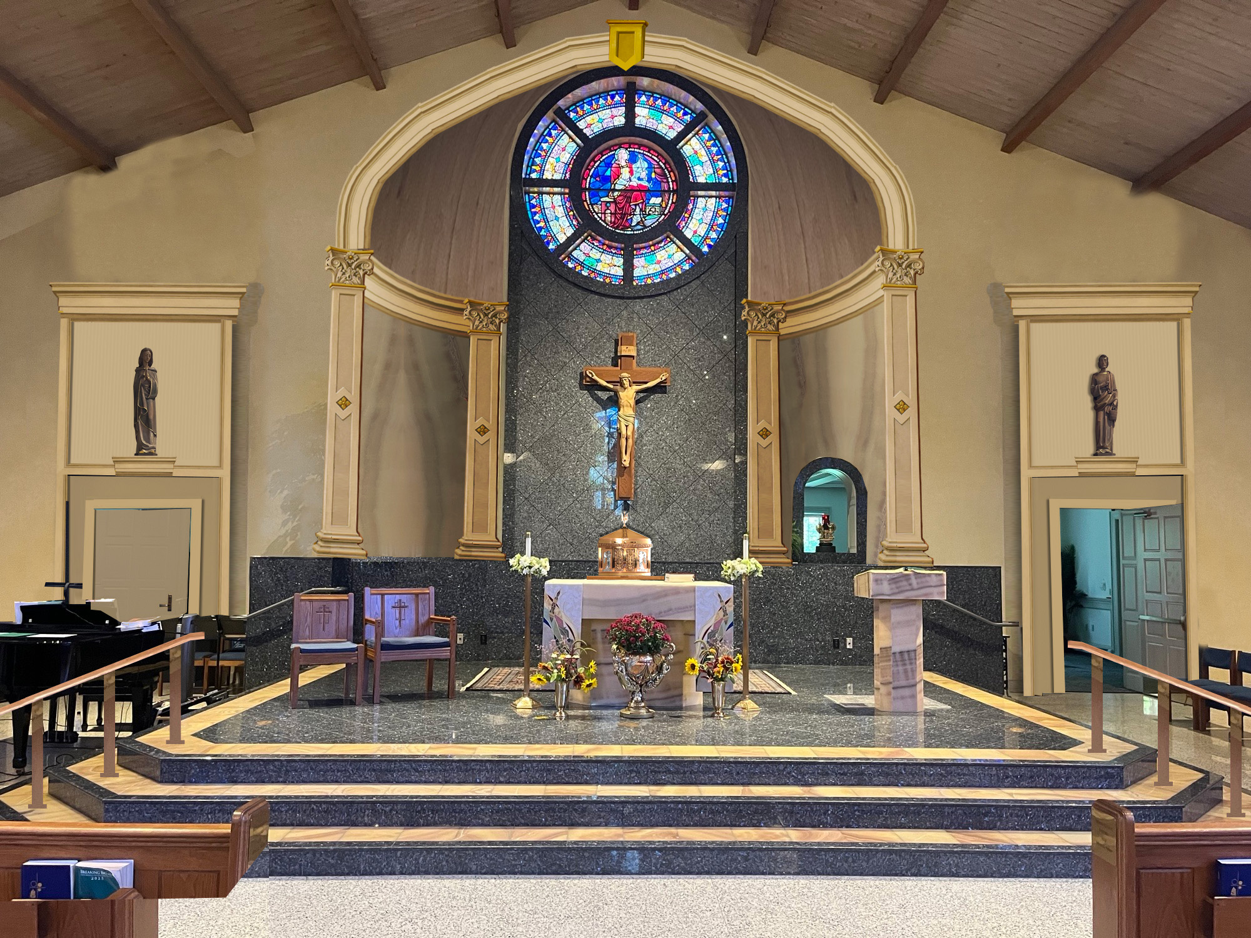
PROPOSED SANCTUARY INTERIOR

Slide 2
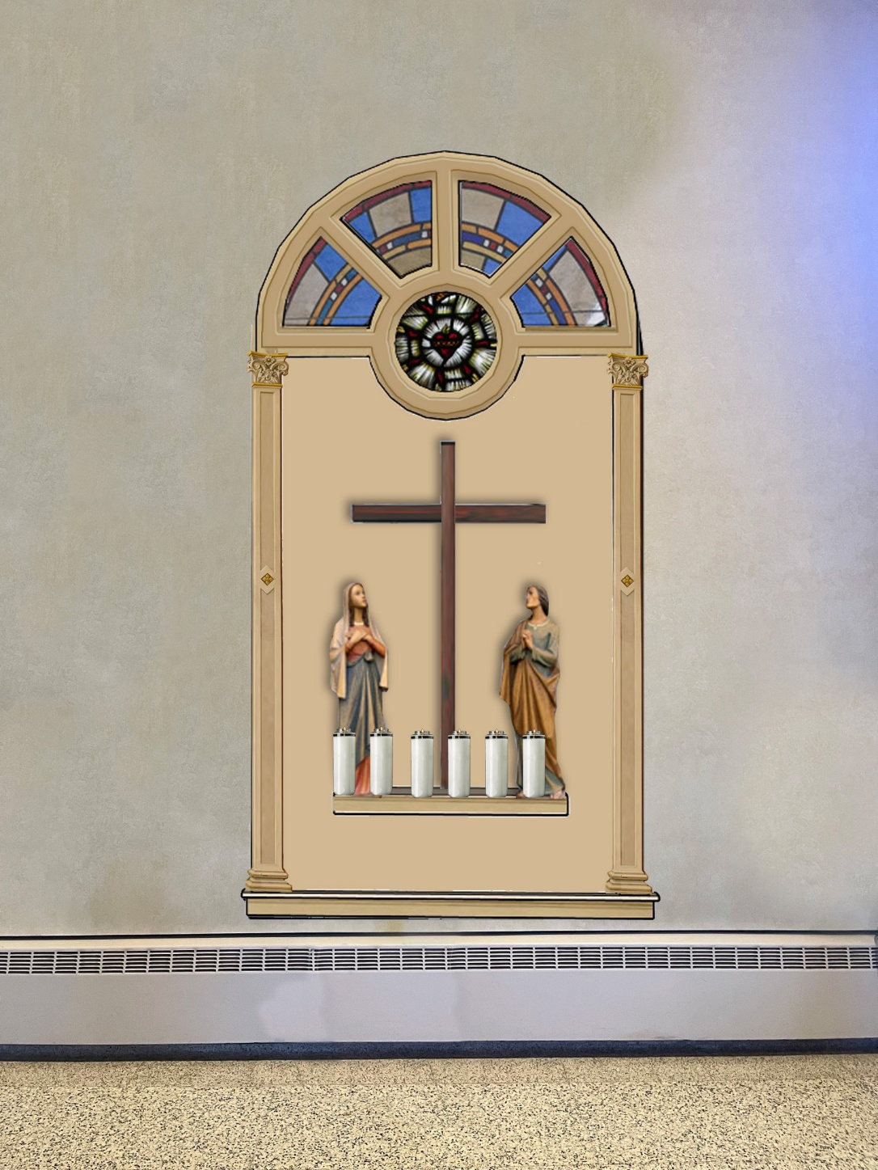
PROPOSED STATUE NICHE

