Slide 1
Virginia Beach CIP Conference
Alfred Steward, VBDHS Child Welfare Administrator
Christianna Dougherty-Cunningham, Esq., VB Associate City Attorney
January 16,2026

Slide 2
INTRODUCTIONS & AGENDA
BUILDING A KIN FIRST CULTURE IN VIRGINIA
OUTCOMES & DATA FOR KINSHIP PLACEMENTS
KIN FIRST NOW OVERVIEW
THREE PRACTICE ELEMENTS
PARENTAL CHILD SAFETY PLACEMENT PROGRAM
JUDICIAL TIP SHEET
SUPPORT FROM COURT COMMUNITY PARTNERS
QUESTIONS/DISCUSSION

Slide 3

Virginia Children’s Services Practice Model
We believe that all children and communities deserve to be safe
We believe in family, child, and youth-driven practice
We believe that children do best when raised in families
We believe that all children and youth need and deserve a permanent family
We believe in partnering with others to support child and family success that is family-focused, child-centered, and community-based
We believe that how we do our work is as important as the work we do
Notes:
The Virginia Children’s Services Practice Model are the values that are the foundational elements of VDSS’ Kin First Culture and Kin First Now.
It's important for VDSS to affirm these values as they form the basis of our Kinship practice.

Slide 4

Kin First Culture
In Virginia’s Kin First Culture, we recognize families as the experts in their own lives, value family-driven decision making, and affirm families’ desire to rely on one another for support
Notes:
In Virginia’s Kin First culture, we recognize that families are the experts.
They should always be included in decision-making and should be empowered to rely on one another for support.
These are important values.
We need to encompass these values when working with our families in anything we do.

Slide 5










Building a Kin First Culture
Permanency Assessment Tool
Motivational Interviewing
Family
First
Out of Home
Staffing
Parental Child Safety Placement Program
Family Partnership Meetings
Fatherhood Engagement
Kin First
Now
Kin First Culture
Prioritizing Family Connections
Family Driven Decision Making
Family Engagement
Collaboration Across Systems
Notes:
There are many aspects of Kin First Culture in Virginia.
We are talking specifically about Kin First Now today, but it is important to understand all the ways that LDSSs contribute to Kin First Culture through their daily work.

Slide 6
Outcomes
Placement with Relatives/Fictive Kin
Kinship reduces the trauma of separation from parents.
Children placed with relatives/fictive kin experience fewer placements.
Children placed with relatives/fictive kin are more likely to stay in their schools & communities of origin.
Relatives/Fictive Kin can facilitate more natural family time opportunities.
Kinship caregivers are more likely to accept challenging behaviors & maintain sibling groups.
Notes:
The next few slides show positive outcomes for children and youth when they are placed in relative/fictive kin placements.

Slide 7
Number of Placements by First Placement (Statewide)
*Other includes Independent Living, Hospitals, Detention/Correctional Facility, and Unapproved.
Source: Kin First Now Dashboard (OASIS, KFN06, refreshed 8/20/2025). Data includes children under 18 that were in foster care during SFY2023-SFY2025. The data is based on their most recent information in their foster care episode(s). New entries is based on the child’s removal date
Notes:
This slide shows the number of placements counted by first placement, segmented by Care Type for children under 18 in foster care at one point in SFY2023-SFY2025 that entered in SFY2023-SFY2025
Placement Category Definitions:
Congregate Care includes QRTP, Group Home, Residential (CRF), Pregnant/Parenting Youth Program, and Family Based Substance Abuse Treatment.
LDSS Foster Home
LCPA Foster Home
Other includes Independent Living (IL/Supervised Program and Independent Living), DJJ or Hospital (Hospital (Psychiatric), Hospital (Medical), and Detention/Correctional Facility), and unapproved
Kinship includes LDSS Foster Home Relative or Fictive Kin and LCPA Foster Home Relative or Fictive Kin.

Slide 8
Time in Care by First Placement (Statewide)
*Other includes Independent Living, Hospitals, Detention/Correctional Facility, and Unapproved
Source: Kin First Now Dashboard (OASIS, KFN06, refreshed 8/20/2025). Data includes children under 18 that were in foster care during SFY2023-SFY2025. The data is based on their most recent information in their foster care episode(s). New entries is based on the child’s removal date
Notes:
During SFY23-SFY25, LCPA Foster Home as first placement for new entries spent the most time in care (22.5 months)
Time in care is calculated based on the time between the child’s removal date and their discharge date or end of the most recent report month, whichever is first. It includes children that are still in foster care and is not limited to children who discharged.
Placement Category Definitions:
Congregate Care includes QRTP, Group Home, Residential (CRF), Pregnant/Parenting Youth Program, and Family Based Substance Abuse Treatment.
LDSS Foster Home
LCPA Foster Home
Other includes Independent Living (IL/Supervised Program and Independent Living), DJJ or Hospital (Hospital (Psychiatric), Hospital (Medical), and Detention/Correctional Facility), and unapproved
Kinship includes LDSS Foster Home Relative or Fictive Kin and LCPA Foster Home Relative or Fictive Kin.

Slide 9
Kinship Foster Care Goal
By the end of 2025, 35% of all foster care placements for children/youth under the age of 18 will be in a kinship placement
Notes:
We have a goal! With the support of the Governor and our VDSS Commissioner, kinship is a priority and we have a goal to have 35% of all youth in foster care in a kinship placement by end of 2025.
35% is the national average -- we can achieve this together with the help of all of YOU!

Slide 10
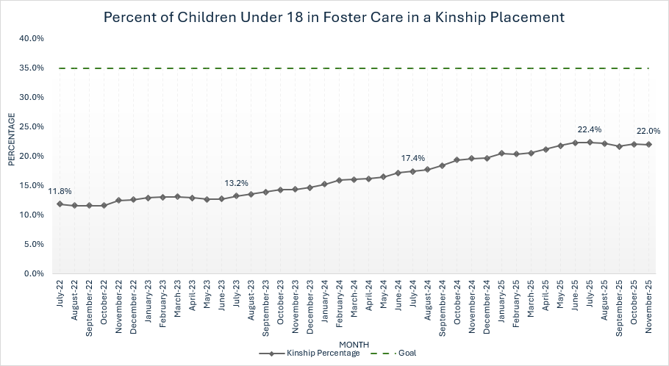
Kinship Placements (Statewide)
Source: KFN Dashboard>KFN05 – Placements for Children in Foster Care (Under 18) (extract date: 12/30/2025)

Slide 11
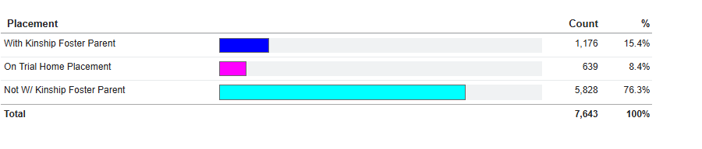
Kinship Placements: Virginia Beach
Source: SafeMeasures Care Types (Subsets: 0 - 17 Years Old; Case Type: Foster Care and Dual In-Home and Foster Care).

Slide 12
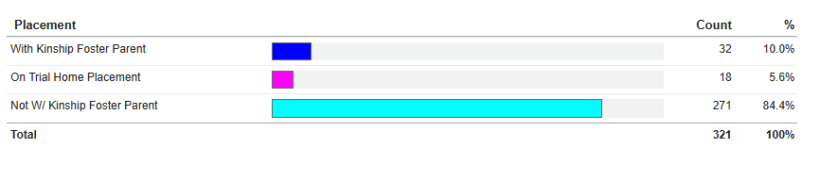
Kinship as First Placement for New Entries: Virginia Beach
Source: SafeMeasures

Slide 13
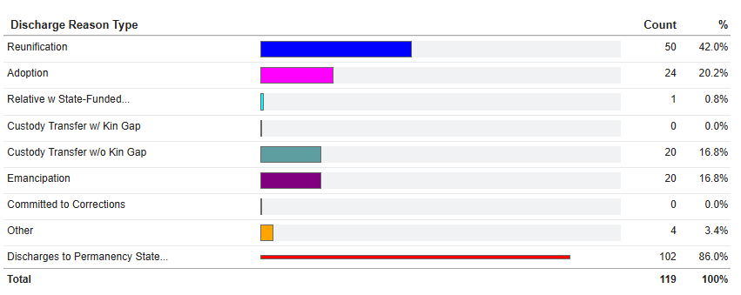
Discharges from Foster Care over past 12 months: Virginia Beach
SafeMeasures: Critical Outcomes>Scorecard: Discharges to Permanency

Slide 14
Kin First Now Overview
Intentional collaboration between VDSS (Home Office & Regional Offices) and Local DSS to enhance and/or create internal processes that reinvest and prioritize staff's time spent on Search, Discovery, and Assessment of relatives/fictive kin through a teaming approach
Focus on using Three Practice Elements (Out-of-Home Staffing, FPMs, and Permanency Assessment Tool) to guide development of an Agency Action Plan that focuses on:
Urgent discovery of and transparent engagement with family at first point of contact.
Involvement and assessment of family and other natural supports in planning for permanency
Notes:
Kin First Now focuses on collaboration at all levels and is intended to enhance or create internal processes that focus on search, discovery and assessment of kinship placements that provide adequate support to the kinship caregivers – all along the continuum of an informal or formal kinship placement
We want to ensure that there is coordinated effort and involvement of all members of the child welfare team to ensure a connection with family for all youth.
Through Kin First Now, each local Department is guided through the development of an Agency Action Plan that details how they will use the 3 Practice Elements listed on this slide to coordinate efforts and involve every member of their child welfare team

Slide 15
KIN FIRST NOW AGENCY SUPPORT
Pre-Agency Visit
In-person with all agency staff
First 4-6 weeks
VDSS provides virtual support and coaching around use of the 3 practice elements
Months 2-12
Peer to Peer learning with all participating LDSS on kinship-related topics
Review internal process
Provide support designing action plan that incorporates 3 practice elements
Continued coaching & technical assistance through review of Agency goals and action plan
Actionable steps to engage, assess & support kinship placements
Review data related to kinship practice with agency leadership
Days 1 & 2
Agency staff completes self-assessment via “Rate Your Kin First Agency”
Discussion of inclusion of community partners & stakeholders
Establish performance and data outcomes to track monthly through implementation of Agency Action Plan
Notes:
LDSS was one of 19 local DSS agencies invited to participate in an in-person KFN agency visit where staff from Home Office and the Regional Office partner with the agency leadership to develop an action plan based on staff feedback that incorporates the three practice elements.

Slide 16

KFN Points of Consideration
“Mis-Messaging”
VDSS shifting away from prior message about keeping kids out of foster care "at all costs"
Didn’t always provide adequate support for non-foster care kinship caregivers
Parental Child Safety Placement Program
Tracking Alternative Living Arrangement (ALA) data
Relative Maintenance Payment now available when a Parental Child Safety Placement Agreement is signed
Barrier Crimes
Tracking impact of barrier crimes on kinship families’ approval as a licensed foster home
Key consideration for the Parental Child Safety Placement Program
Notes:
It's important for VDSS to acknowledge the "mis-messaging" that grew out of the transformation work referenced earlier- when too many kids were being separated from their families and were growing up in foster care without achieving permanency.
At that time, the state was focused on ensuring that children didn't come into care when there were alternatives, but that message evolved over time so that it became 'keep kids out of care at all cost' and –even more problematic- the state didn't provide a lot of guidance or structure for how LDSS should support those alternative caregivers to ensure that there would be good long term outcomes for the child and family.
We're very fortunate to have a General Assembly that is interested in providing supports to kinship caregivers. In recent years, the RMP was established, and this year the PCSSP. With the advent of the PCSPP, VDSS will be better able to track the work that is happening to support kinship caregiver who keep children out of care, and the outcomes of those arrangements.
We acknowledge that barriers crimes are a significant challenge for many relatives, especially for those in minority communities who are impacted by discrimination within the community and policing. We're hopeful that we will continue to see efforts at the legislative level to reduce the number of barrier crimes which prevent relatives from being approved as foster parents. While it is not absolutely prohibited for a kinship caregiver with a barrier crimes to be approved for the PCSPP, there is extra consideration and documentation required, so barrier crimes also provide an obstacle there.

Slide 17
PERSONS WITH LEGITIMATE INTEREST
9.7.1 Authority to release information when disclosure is not mandated
The VAC summarizes the authority to release information to persons when that release is not mandated.
(22 VAC 40-705-160 B). The local department may use discretion in disclosing or releasing child protective services case record information, investigative and on-going services to parties having a legitimate interest when the local department deems disclosure to be in the best interest of the child.
The local department may disclose such information without a court order and without a written release pursuant to § 63.2-105 of the Code of Virginia.
Each request for or act of disclosure must be individually evaluated. Evaluating the request for information is a two-step process. The first consideration is whether disclosure of the requested information is in the best interest of the child. The second consideration is whether the party requesting the information has a legitimate interest.
9.7.3 Identify parties with legitimate interest
A parent, grandparent, or any other person when they would be considered by the LDSS as a potential caretaker of the child in the event the department has to remove the child from his current custodian.
Notes:
The next two slides show the authority and guidance under which local departments engage kin in ensuring they are a part of the family-driven decision making process.
It’s important to note that VA Code mandates the use of family search and engagement practices for local departments when they are considering removal of a child from their current custodian.

Slide 18
FAMILY ENGAGEMENT GUIDANCE
2.2.3 Requirements
Federal and state laws require the involvement of both parents and extended family for children who are at-risk of entering or have entered foster care. The LDSS shall diligently search for adult relatives and other individuals who have significant relationships with the child, including those adult relatives suggested by the child, birth parents or prior custodians (Social Security Act, Title IV, § 471 (a) (29) [42 USC 671]).
CPS may contact relatives without the family’s consent, written release, or court order when the LDSS determines that disclosure of information is in the child’s best interest and the person has a legitimate interest. The LDSS has authority to contact parents, grandparents, or any other individuals that the LDSS considers a potential caretaker for the child who is involved with child protective services, if the child has to be removed from the parent or custodian (§ 63.2-105; 22 VAC 40-705-160 B; 22 VAC 40-705-10).
For additional information, see the Child Protective Services Manual, Section 9 - Confidentiality (Link here) and the Foster Care Manual, Section 2 Engaging the Child, Family, and Significant Adults – Notifying and informing relatives of child removal (Link here)

Slide 19
Essential Practice Elements
Out of Home Staffing
Permanency Assessment Tool
Family Partnership Meeting
Notes:
The next few slides provide an overview of the Essential Practice Elements that should be used when working with families where there is a risk of removal of a child from their current custodian.
KFN is an opportunity for agencies to review how they can build upon these practice elements through their agency's processes and procedures to further explore and engage relatives and fictive kin and continue to increase their kinship rate.

Slide 20

Out of Home Staffing
Review circumstances that led to the child being placed or is at risk of being placed outside the home
Identify how and who will prepare natural supports to participate in the FPM
Identify how and who will inform natural supports of ALL their options
Identify how and who will prepare the youth for the FPM
Identify who will complete the Permanency Assessment Tool
Internal LDSS meeting
Convened when there is a risk of a child being placed outside of their home
Structured approach designed to prioritize family search and engagement
Notes:
The OOH Staffing is an internal meeting that occurs as soon as possible when a child is placed out of the home OR at risk of being placed out of the home.
During the meeting, as many agency staff as possible get together to discuss how to implement a trauma informed approach to identify tasks, clarify roles, and prepare for a successful FPM and planning experience for the family. While the meeting structure and topics may vary from locality to locality, the recommended topics to cover include those on the slide.
One way to think about the OOH Staffing is like an agency "huddle“
*Provide opportunity for LDSS to share how they are implementing this Practice Element

Slide 21

Family Partnership Meetings
Present All Options
Parental Child Safety Placement Program
Foster care
Custody transfer
Financial resources across the child welfare continuum
Prepare for FPM
Family Finding
Prepare the family
Invite support network
Prepare for FPM
Present
All Options
Consider the Triad
Parent needs and strengths
Child’s needs and strengths
Caregiver’s needs and strengths
Develop
Action
Plan
ENGAGEMENT
Develop Action Plan
Steps moving forward
(Ex. Permanency Assessment Tool
Schedule next FPM and any follow-up meetings
Consider the
Triad
Family Driven Decision
Family Driven Decision
Having necessary family members at the table
Creating a space for the family to decide
Notes:
Family Partnership Meetings (FPMs) are not a new concept and some of you may have participated in one.
They are the foundation for prioritizing family engagement where family-decision making is the driver to ensure families are provided ample opportunities to make decisions.
FPMs are most effective when families are prepped prior to the meeting and can come to the table ready to make decisions that lead to safely, wellbeing and permanency for the child.
In order to have robust FPMs, we need to prioritize discovery and engagement of kin so they are involved from the onset. In particular, we are trying to focus more intentionally on engaging fathers and paternal relatives to attend.
We also want to make sure we have more family members present than professionals to try and limit families feeling overwhelmed or ‘on trial’ at an FPM. This is part of the prep work to discuss what professionals need to be present and if one professional can appropriately represent other professionals so the focus is on family driven practice.
Provide opportunity for LDSS to share how they are implementing this Practice Element

Slide 22
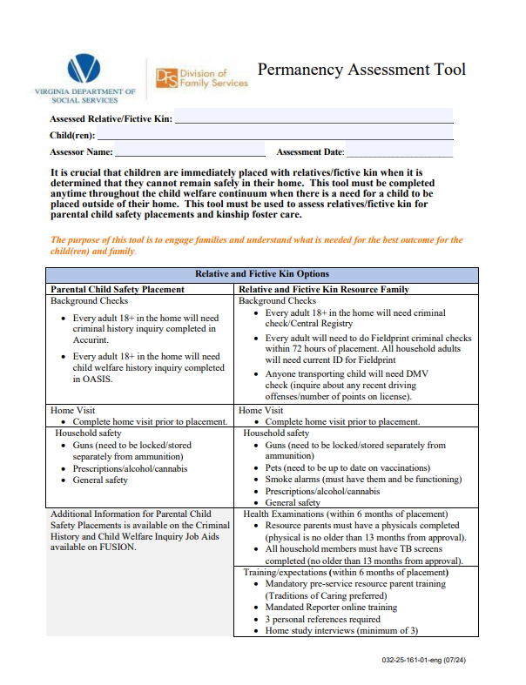
Permanency Assessment Tool (PAT)
Household Configuration
Prospective Kinship Caregiver
Parenting
Conflict
Management
Notes:
The Permanency Assessment Tool (PAT) is the assessment guide that should be used across all child welfare units to assess and inform prospective relative caregivers.
It provides a framework to facilitate an open dialogue with potential kinship caregivers about what is needed to ensure the best outcome for the child and family.
It should be completed any time, throughout the child welfare continuum, when a potential kinship placement has been identified
It provides guidance on the required elements of the caregiver assessment (such as criminal and child welfare history and home visit) as well as questions that need to be asked before the child’s placement.
It ensures that kinship placements are adequately supported to be able to safely care for a child.
Provide opportunity for LDSS to share how they are implementing this Practice Element

Slide 23
Parental Child Safety Placement Program Legislation
Ensuring Safety and Stability
Establishing guardrails to protect children and families by addressing immediate safety issues, CPS referral closures, and inconsistent practices. Increasing placements with kin and fictive kin to provide stability and resolve safety plans.
Supporting Family-Centered Reunification
Promoting family-driven decisions to enhance family involvement in planning. Fostering child-focused and family-centered practices by addressing unclear pathways for reunification and visitation challenges. Preserving parental rights to overcome visitation challenges and maintain parental connections.
Improving Prevention and System Efficiency
Transforming prevention services for families by addressing gaps in economic and concrete assistance. Streamlining LDSS processes to establish clear reunification pathways and ensure consistent caregiver assessments.
Notes:
The basis and goals of the Parental Child Safety Placement Program legislation (effective 7/1/24) hinge on three significant components:
Ensuring Safety and Stability
By establishing guardrails to protect children and families by addressing immediate safety issues, CPS referral closures, and inconsistent practices.
Increasing placements with kin and fictive kin to provide stability and resolve safety plans.
2) Supporting Family-Centered Reunification
By promoting family-driven decisions to enhance family involvement in planning.
Fostering child-focused and family-centered practices by addressing unclear pathways for reunification and visitation challenges
Preserving parental rights to overcome visitation challenges and maintain parental connections.
3) Improving Prevention and System Efficiency
By transforming prevention services for families by addressing gaps in economic and concrete assistance.
Streamlining LDSS processes to establish clear reunification pathways and ensure consistent caregiver assessments.

Slide 24
Safety Planning to Permanency
PCSPP Timeline
Child Returns Home (with or without PO)
Return Home
In-Home case
Out of Home Staffing
Family Partnership Meeting
Court Intervention
Court Ordered Living Arrangement
Parental Child Safety Placement Program (PCSPP)
Alternate Living Arrangement
Kinship Foster Care
In-Home case
Kinship Foster Care/Foster Care
Removal
Permanency Assessment Tool
Notes:
This slide emphasizes various pathways and outcomes to prioritize kinship placements, offering a supportive environment for the child's safety and stability whenever feasible.

Slide 25
Judicial Tip Sheet
Identifying, Engaging & Informing Kin
The Role of the Court
Questions for judges to create a Kin First culture in court:
Judicial Considerations
Parents can be asked to share family information
ALL options to be involved in the child’s life MUST be explained early.
Does the current arrangement allow for all services and supports needed to meet the child’s needs?
Do relatives understand their placement options?
What is preventing a kinship placement now?
What efforts have been made to engage kin, beyond a notice letter?
Has the agency explained ALL possible placement options to kin?
Identification, location and engagement of kin starts as soon as the agency begins work with the family
Judicial Tip Sheet on Kinship Care - NCJFCJ
Notes:
This tip sheet was developed by the National Council of Juvenile and Family Court Judges and provides some ways that Judges – and other members of the court community – can help with identifying, engaging and supporting kinship
Judicial Tip Sheet on Kinship Care - NCJFCJ

Slide 26
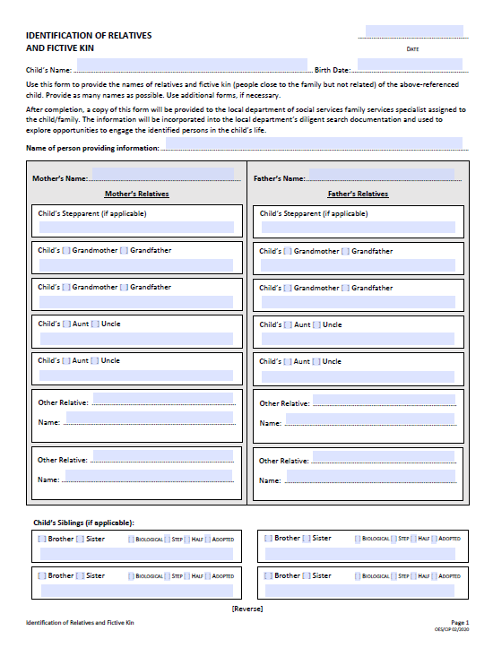
SUPPORT FROM COURT COMMUNITY PARTNERS
“Identification of Relatives and Fictive Kin” form
Use this form to guide discussions with those knowledgeable about the family to identify relatives and fictive kin
Attorneys who represent parents and children discuss and complete this form with their clients prior to all scheduled court hearings
Source: https://www.vacourts.gov/courtadmin/aoc/cip/home.html
Notes:
The next two slides provide examples of some of the ways in which our court community partners can help us support this work by using some available forms.
This first one is the “Identification of Relatives and Fictive Kin” form.
It can be used to guide discussions with those knowledgeable about the family to identify relatives and fictive kin to be used by attorneys representing parents and children.

Slide 27
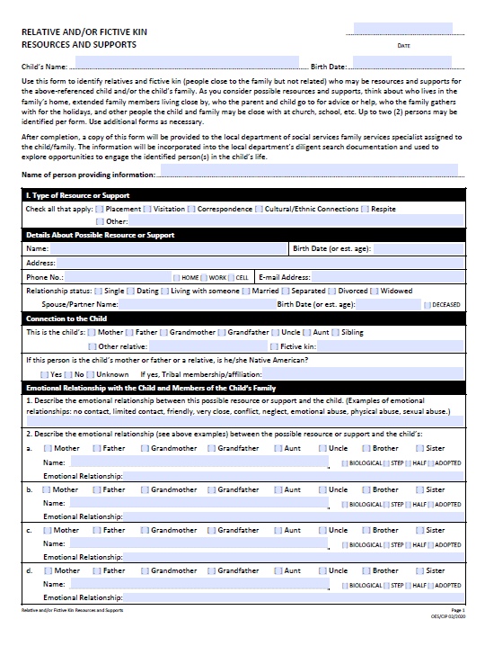
SUPPORT FROM COURT COMMUNITY PARTNERS
“Relative and/or Fictive Kin Resources and Supports” form
Use this form to guide discussions about relatives and fictive kin who may be resources and supports for a child who is in foster care and the child’s family. This form is designed to complement and be compatible with the development of a genogram.
Attorneys who represent parents and children discuss possible resources and supports for the child and the child’s family with their clients prior to all scheduled court hearing and complete additional forms as necessary.
Source: https://www.vacourts.gov/courtadmin/aoc/cip/home.html
Notes:
This next form is the “Relative and/or Fictive Kin Resources and Supports” form which can be used by attorneys representing parents and children to guide discussions about relatives and fictive kin who may be resources and supports for a child who is in foster care and the child’s family.

Slide 28

Connections for Youth in Foster Care
Notes:
In this video, Shawn & Curtis Winfrey, Lived Experience Consultants with VDSS – and former foster youth – talk about why they feel it is important to maintain connections between children and their families.
They were in foster care in VA many years ago and we are grateful that they are willing to share their experience to help us make sure we are serving our children and families in the best way possible.

Slide 29
Questions/Discussion

