Slide 1





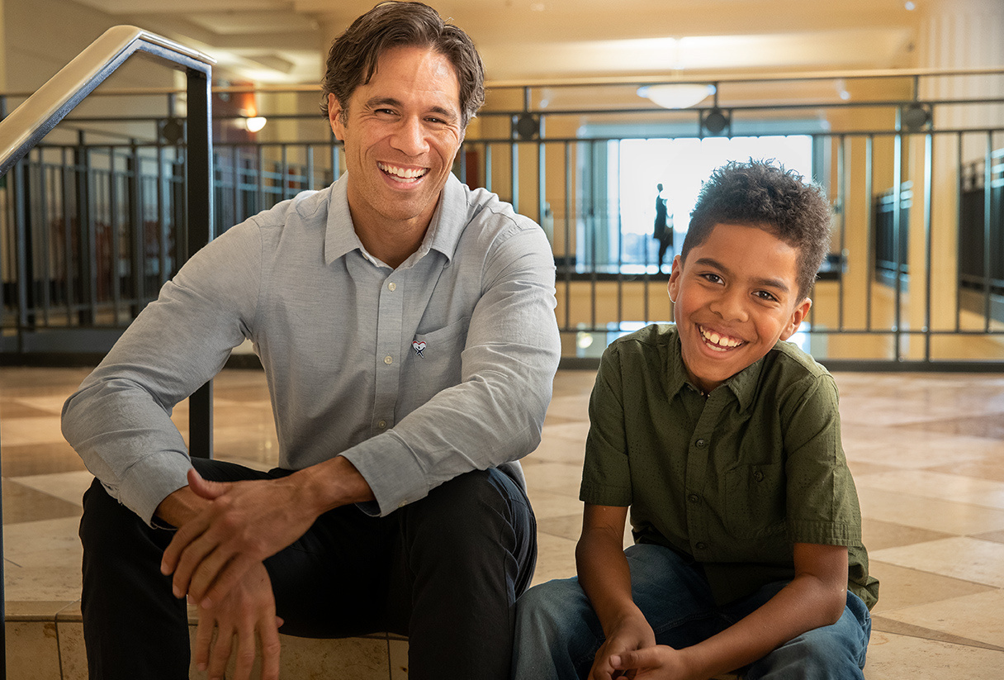
The CASA Advantage: Impacting Cases with Advocacy
Presenter:
Kate Kosky
CEO, Virginia Beach CASA

Slide 2





AGENDA
AGENDA
History
The Benefit of CASA involvement
What is a CASA?
F.A.Qs
Our Role in a Dependency Case
Q & A
Get Appointed!

Slide 3
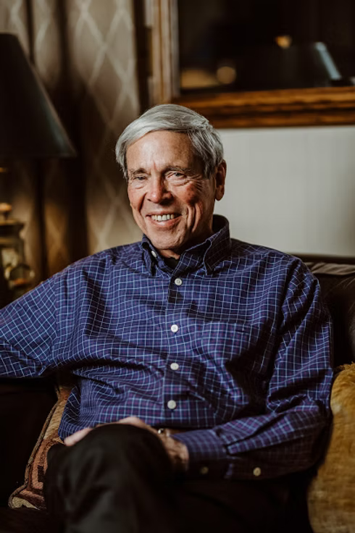




HISTORY OF THE NATIONAL CASA/GAL PROGRAM
1977
1994
Virginia Beach CASA became incorporated in May 1994 and is recognized as a 501(c)3 Non-Profit Organization
Seattle Judge David W. Soukup founded the first CASA program.
1982
2025
Growth: Now includes over 939 local programs in 49 states across the U.S. serving more than 270,000 children annually.
National Expansion: National CASA Association established.
1985
First CASA Programs launched in Virginia -Roanoke and Norfolk.
Today
Virginia Beach CASA served 160 children in FY25 with over 70 CASA volunteers. Has served over 3,300 children since conception.

Slide 4


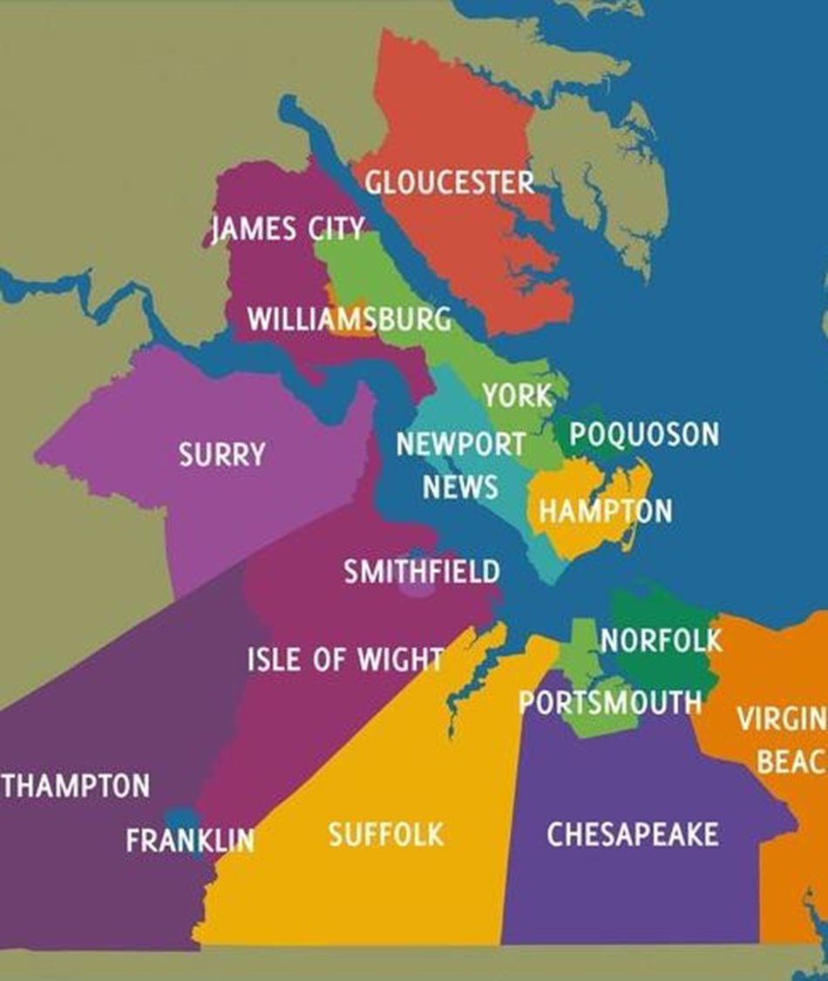

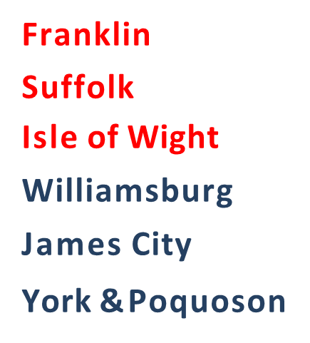

PROGRAMS IN HAMPTON ROADS

Slide 5


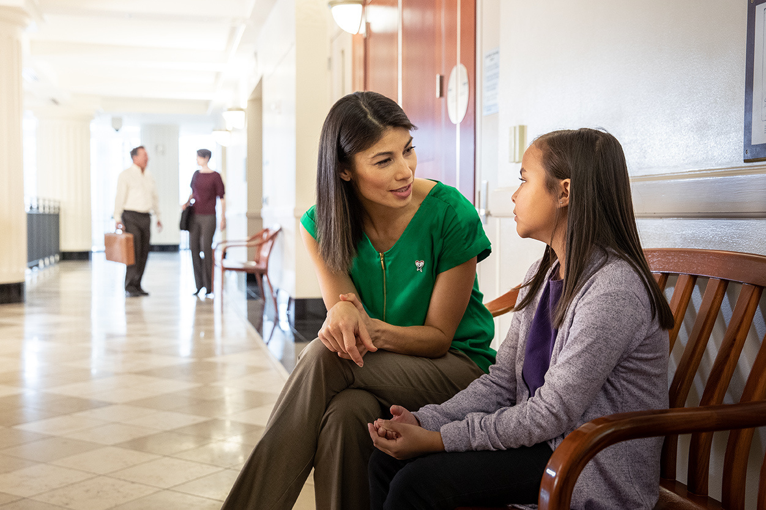

WHAT IS A CASA?
Court Appointed Special Advocate
Trained and sworn volunteer appointed by the court
Independent investigator
Provides unbiased representation for the best interest of the child
Specifically advocate for abused and neglected children ages 0 to18 (or 21*) until permanency is established.
Mission Statement
Virginia Beach Court Appointed Special Advocates (VB CASA) recruits, trains, and supports volunteers to champion the best interests of abused or neglected children in the local court system.

Slide 6



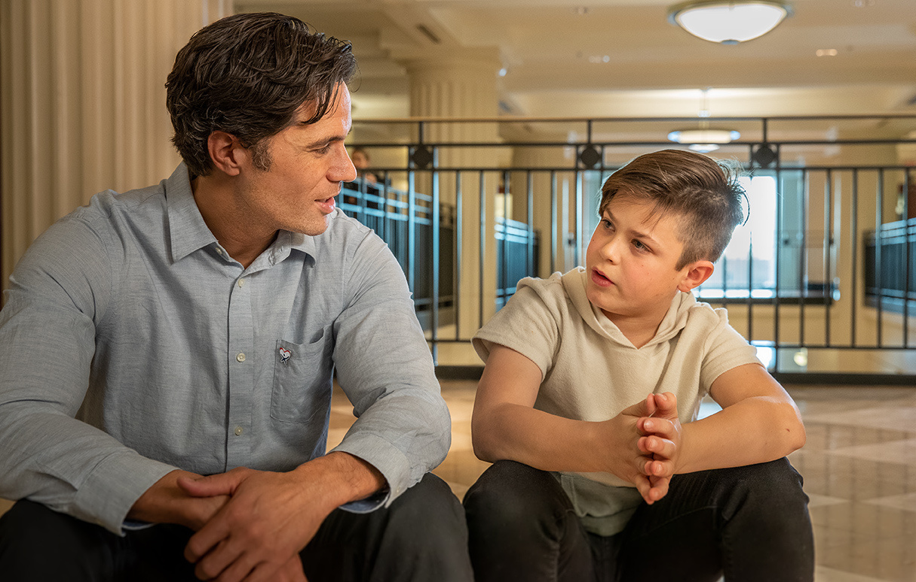
CORE FUNCTIONS OF
THE CASA VOLUNTEER
Per the Code of Virginia § 9.1-153, the five core
duties of the volunteer are as follows:
Investigate - Investigating the case assigned to provide independent factual information to the court. Talking with the child, family, school officials, healthcare providers, daycares, etc. and review records
Facilitate - Assisting the appointed GAL to represent the child in providing effective representation of the child's needs and best interests. Collaborating with the parties to identify resources and services for the child.
Advocate – Speaking up for the needs of the child by submitting to the court a written report of the investigation in compliance with the provisions of § 16.1-274. The report will include recommendations as to the child's welfare.
Monitor- Monitoring the case assigned to ensure compliance with the court's orders and services to be provided to the child and family.
Reporting a suspected abused or neglected child pursuant
to § 63.1-248.3.

Slide 7


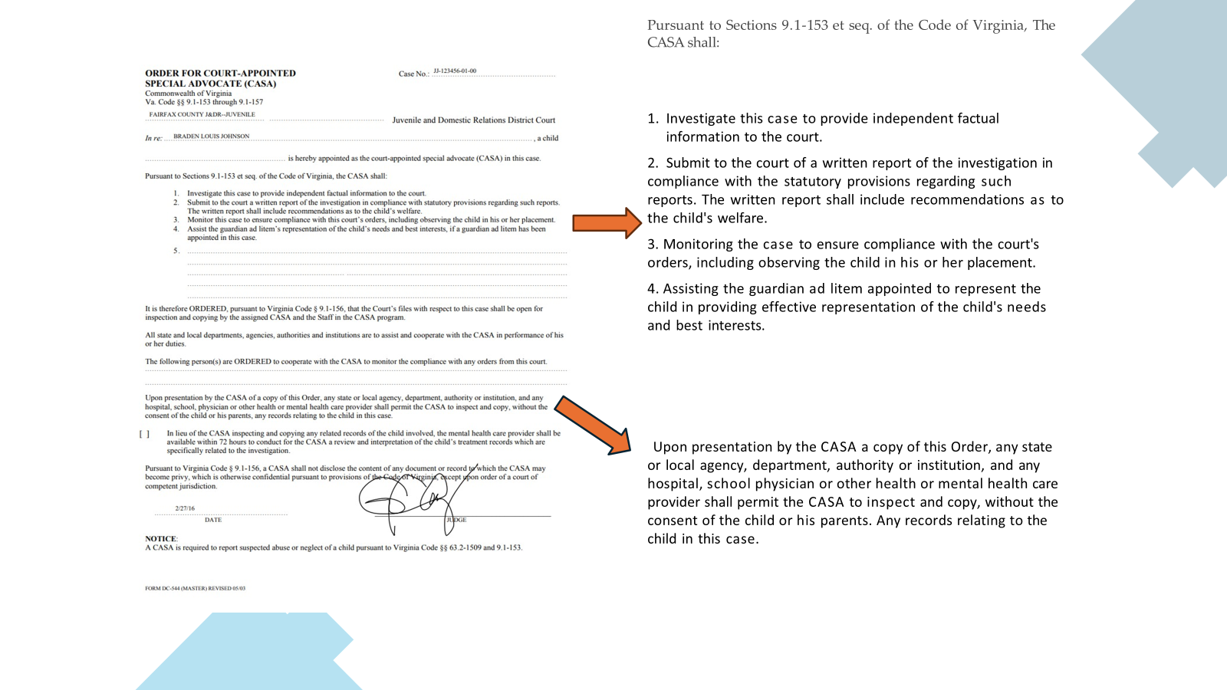





Slide 8





“I WANT CASA ON THE CASE!”
Abuse & Neglect
Custody & Visitation
Protective Order
CHINS
Relief of Custody
Child Protective Orders
The Program shall provide services in accordance with this article to children who are subjects of judicial proceedings (i)involving allegations that the child is abused, neglected, in need of services, or in need of supervision or(ii) for the restoration of parental rights pursuant to §16.1-283.2 and for whom the juvenile and domestic relations court judge determines such services are appropriate.

Slide 9


BENEFIT OF CASA INVOLVEMENT
Guardian Ad Litem
Counsel for the Parents or DHS
Independent perspective on the family
Monitoring and accountability of other parties
Volunteers can be called as witnesses
Support for reunification when appropriate
Valuable information for case strategy
Collaboration can reduce conflict
Additional set of eyes and ears
Collaboration during the investigation
Thorough reports to the court
Enhanced Advocacy
Independent, consistent support for the child.
Notes:
CASAs keep GALs informed and know when it may be necessary to file motions when there are safety concerns for the child.
Counsels can help CASAs be effective by encouraging their clients to communicate with them.

Slide 10

F.A.Q.s
What background and training do
CASAs receive?
How many cases can a CASA receive at one time?
Can a CASA volunteer be appointed in Circuit Court?
If a case is transferred to another jurisdiction can the CASA volunteer remain?

Slide 11






