Slide 1

Truancy & Use of Multi-Tier Systems of Support
Simone Boothe, Esquire
&
Damion Wilson, MSW

Slide 2

MTSS
Attendance Response
01
02
TABLE OF CONTENTS
Truancy Background
Tier Level Attendance
03
04
Interventions
Questions
05
06
You can describe the topic of the section here
You can describe the topic of the section here
You can describe the topic of the section here
You can describe the topic of the section here
You can describe the topic of the section here
You can describe the topic of the section here

Slide 3


Compulsory Attendance Virginia
Children in the Commonwealth who have reached their fifth birthday and not passed their eighteenth birthday shall attend public schools during session. When a pupil fails to report to school regularly and no indication has been received by school personnel that the pupils parent is aware of and supports the absence, a reasonable effort is to be made by school personnel.
Section 22.1-258 details how school divisions shall proceed with addressing truancy.
Compulsory Attendance

Slide 4
Why are students truant??
  Socioeconomic status
  Mental Health
  Academic Performance (historical)
  Trauma/Abuse/Neglect
  Low Motivation
  School Climate
  Parenting Capacity

Slide 5
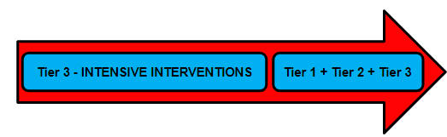
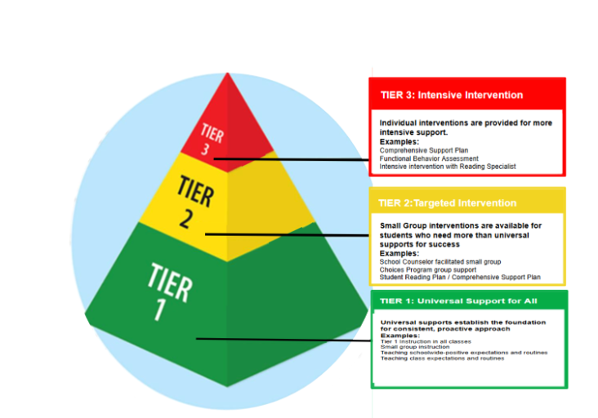
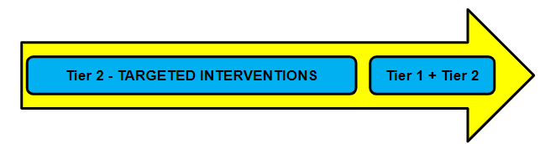

Multi- Tiered System of Support
Notes:
The purpose of the Student Response Team (SRT) remains on assisting students in being successful in the classroom (K-12). This process is structured with a tiered system of support and begins at Tier 1 with teacher and administrator collaboration to ensure all students benefit from strong instructional practices and behavioral/ social-emotional supports.
Student Movement through the Tiers:
Student movement through the tiers is a fluid process. Students who receive interventions based on their needs for academic, social-emotional, and/or behavioral intervention and make sufficient progress are gradually released from upper tiers while continuing to provide Tier 1/ Tier 2 systems of support.
Tier 1
Responding to the Needs of All Students Differentiated classroom instruction is the heart of Tier 1. This refers to learning experiences provided by teachers which are matched to or respond to the needs of their students. This must occur so that all students will:
• Be challenged and supported to achieve a high standard of academic performance and growth;
• Experience personalized learning opportunities to prepare them for enrollment, employment or enlistment; and,
• Benefit from an educational experience that fosters their social and emotional development
CLICK Tier 2:
Strategic, Targeted Intervention
This tier is for those students who require further support and additional instruction to achieve grade-level expectations or behavioral goals. The Student Response Team (SRT) can serve as a resource for responding to students’ specific needs. Students receiving Tier 2 support are identified by monitoring the data, in conjunction with teacher and parent recommendations. Students are provided supplemental, targeted instruction; intervention; and/or strategies in homogeneous small groups delivered by a variety of instructional personnel (e.g. teachers, specialists, counselors), and are based on student needs as determined by assessment data. These efforts are implemented are in addition to Tier 1 instruction. The duration of this level of support varies based on student assessment and progress monitoring data that measures student response to intervention.
CLICK Tier 3: Strategic, Targeted Intensive Intervention
Intensive Targeted Interventions - Tier 3 consists of students who are in need of individualized interventions along with continued support provided in Tiers 1 and 2. This is addressed and monitored through the Student Response Team (SRT) process. Interventions suggested by the SRT may be delivered and monitored by a variety of school personnel. The duration varies based on student assessment and progress monitoring data.
“What’s one thing your school has done — big or small — that helped a student or group of students start showing up more consistently?”

Slide 6
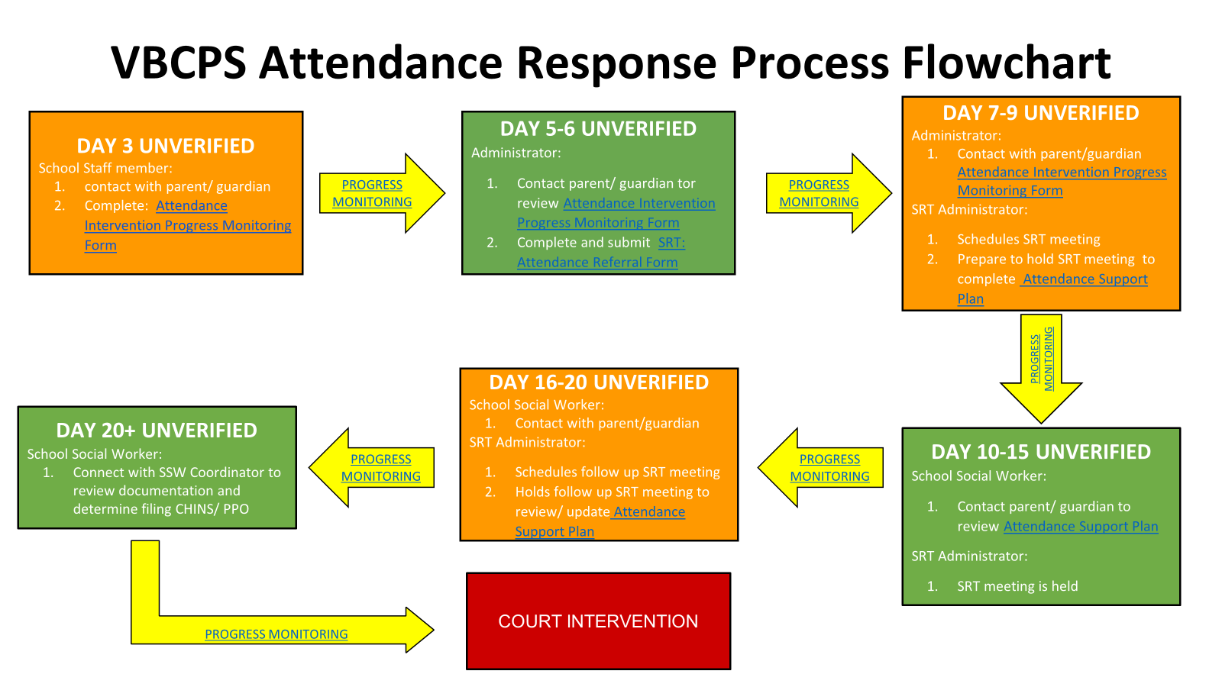

Slide 7
Tier Level Support
1-4 Unverified Absences
5-9 Unverified Absences
10+ Unverified Absences
Tier 1
Tier 2
Tier 3
School teams should be moving toward an SRT process. Included should be teachers, counselors, and administrators
A follow-up meeting is required including administrators and social workers. Interventions become more intense.
Before initiating SRT, responsible stakeholders should include teachers and administrators.

Slide 8
Tier 1 Attendance
Foundation of the SRT Attendance Process.
Serve as prevention of chronic absenteeism and truancy.
Tier 1 interventions are available to all students in your building.
Considerations, Resources, & Actions:
What systems and tools are available and used in your building?
How would you describe your school climate as it relates to attendance?
Attendance Teams, resources, and data
Examples and recommendations for Tier 1 Supports
Notes:
Tier 1 overview of Attendance supports currently for ALL
Relationships which support positive school culture - cues to remind and inform attendance, PTA meetings, positive phone call home - teacher - attendance works - monthly attendance review meetings
Example of Tier 1 attendance support, what does it look like and what is the success?
Faculty and Staff welcoming at ES level
Teacher at doors welcoming students to class.
Initial positive call from teacher
What systems at your school support Tier 1 attendance and what is the accountability for monitoring expectations?
What tools are you using?
What initial steps are made?

Slide 9
Tier 1 Attendance
Considerations | Resources | Actions
Is there a team to address attendance School Climate Community climate Ongoing monitoring of attendance data Community Involvement Systems Positive reinforcement Professional Learning for building positive relationships with students and stakeholders | VA compulsory attendance law VBCPS attendance policy and regulations EveryDay Labs Attendance Works PTA | Automated attendance calls Monthly PLC to review attendance data and determine next steps Identifying students who have 5% absences PSA on attendance Celebrations for attendance Community engagement Assignment of mentor
Notes:
Relationship Building, making direct contacts, using PTA meetings, tools and resources to communicate early. Everyday Labs, monthly attendance review meetings to review data. FACE Center, Attendance Works. (achievable dreams?)
What systems are in place that transcend administration?
What tools are you using?
Is there a system that initial steps are made. / data management
How do you withdraw for 15 consecutive days? (accountability)
Culture and climate. (accountability systems and culture)
Build/Use community within and outside of the school. (PTA)
Parenting strategies built in.
Teacher training on building relationships, trauma-informed classroom environments.
Beginning of the school year. Parent teacher conference within 1st 9 weeks (admin approved) builds the relationship with the parent/student, engages them in what is going on in the classroom, learns more about the student. (might just be for elementary level)
Example: High fiving kids, greeting kids, music in the morning, PE teams doing drop off! Principal’s deskside chats, newsletters (attendance news)
Consider having an attendance PLC.
5% interventions
Attendance letters - what do you do for students who receive these letters?
Notifications throughout the school year. - NO Shows, Sept 30 membership, Report Cards, 50% of the school year membership
** Give graphic organizers **
DOCUMENTATION

Slide 10
Tier 2 Attendance
Tier 2 Interventions target groups of students
IEP and 504 Students
Students who have previous attendance concerns from previous school years or previous schools.
Targeted programs like CHOICES
Utilize attendance letters to gauge groups
Utilize school calendars, such as no-show as groups
What are the decision rules for addressing and determining who receives additional assistance?
Tier 2 supports go into effect when a students’ attendance accounts for a certain percentage based on days of enrollment.
Notes:
Tier 2 overview of Attendance supports
Example of Tier 2 attendance support, what does it look like and what is the success?
Requests for support, interventions, need to include all the efforts that have been done.
Begin to use the module to hold SRT meetings.
Document contacts and interventions from tier 1 and 2. Use contact log. Timeline should be set by ADMIN.
Consult a student support services professional (counselors, social workers, psychologists) Assess needs
-Administrative Contact with parent/student
-SRT Referral
-Daily Check-Ins
-Progress Monitoring
-Assigned Mentors or Mentoring
-Academic Remediation (Tutoring)
-Service Coordination (Resources, Counseling, Care Solace)
-Home Visitations

Slide 11
Tier 2 Attendance
Considerations | Resources | Actions
Decision Rules for Tier 2 Attendance What tool will be used by the team to monitor Tier 2 interventions? What is a reasonable timeline for interventions and progress monitoring? When is a home visit determined? Who supports a home visit? MTSS Module for documentation Continued Attendance Barriers School Staff Roles and Responsibilities Student with Section 504 Plan or IEP | EveryDay Labs/Synergy Virginia Compulsory Attendance Law VBCPS attendance policies and regulations Parent/Family Communication | Routine Attendance PLC meetings Documentation of tier 2 intervention in place Progress monitoring Automated letters for unverified absences Administrator or designee establishes contact to notify attendance Parent/Teacher Conference Attendance Contract Referral for additional support Student Response Team Meeting

Slide 12
Tier 3 Attendance
Tier 3 Interventions are the most intense and serve as a last course of actions when past methods have proven ineffective. Schools should still ensure Tier 1 interventions remain in place even when implementation of Tier 3 is necessary.
Notes:
CLICK Tier 3: Strategic, Targeted Intensive Intervention
Intensive Targeted Interventions - Tier 3 consists of students who are in need of individualized interventions along with continued support provided in Tiers 1 and 2. This is addressed and monitored through the Student Response Team (SRT) process. Interventions suggested by the SRT may be delivered and monitored by a variety of school personnel. The duration varies based on student assessment and progress monitoring data.
Tier 3 overview of Attendance supports
Example of Tier 3 attendance support, what does it look like and what is the success?
Consult social worker, home visits, require doctor notes (admin discretion), court, parent teacher conference, SRT meeting,

Slide 13
Tier 3 Attendance
Considerations | Resources | Actions
Service Coordination Decision Rules for Tier 3 Attendance What tool will be used by the team to monitor Tier 3 interventions? What is a reasonable timeline for interventions and progress monitoring? Has a home visit been completed? MTSS Module for documentation Continued Attendance Barriers Referral to Student Response Team Previous attendance history Academic Performance | MTSS Module in Synergy for SRT Attendance Meeting Care Solace Everyday Labs School Social Worker Alternative Education Programming Court Intervention | Documentation of Tier 1 and Tier 2 interventions, progress monitoring and outcomes. Student Response Team Meeting Comprehensive Support Plan Home visit Identified Mentor Current list of absences Referral to Court Intervention CHINS Assessment Financial Fines Detention
Notes:
-SRT Meeting
-Progress Monitoring
-Increased Academic Support
-Court Intervention: CHINS/PPO
CHINS Assessment
Financial Fine
Service Coordination: Human Services, Court Probation, Guardian Ad Litem
Detention
Alternative education programs - ISAEP, Job Corp, Commonwealth Challenge, Home School, Virtual VA, etc.

Slide 14
Presenters Contact Information
Simone Boothe,
Associate School Board Attorney
Simone.Boothe@vbschools.com
Damion Wilson
Coordinator School Social Work Services
Damion.Wilson@vbschools.com

Slide 15

QUESTIONS
QUESTIONS

