Slide 1
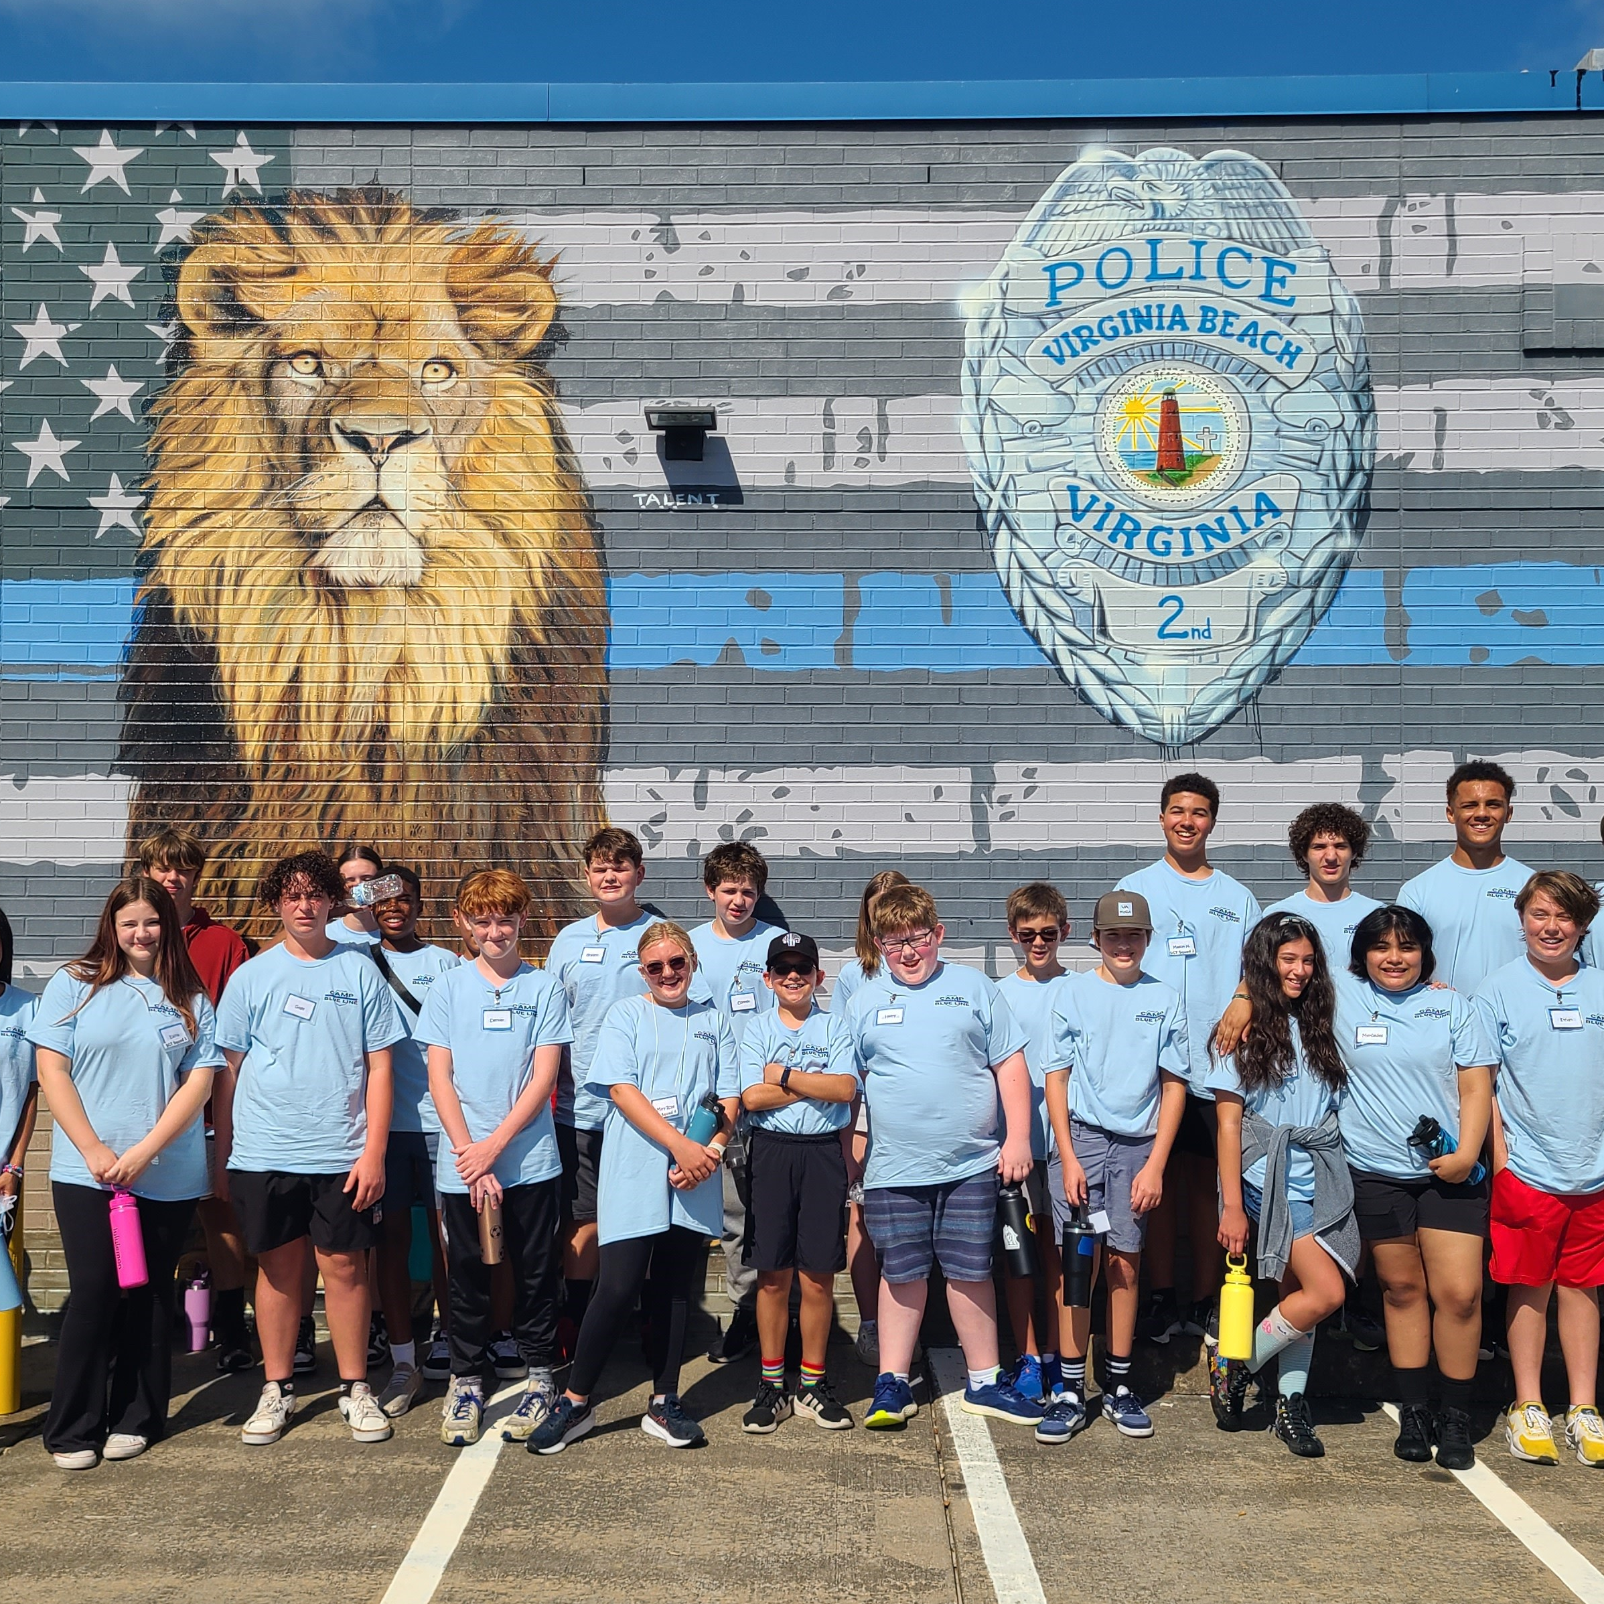
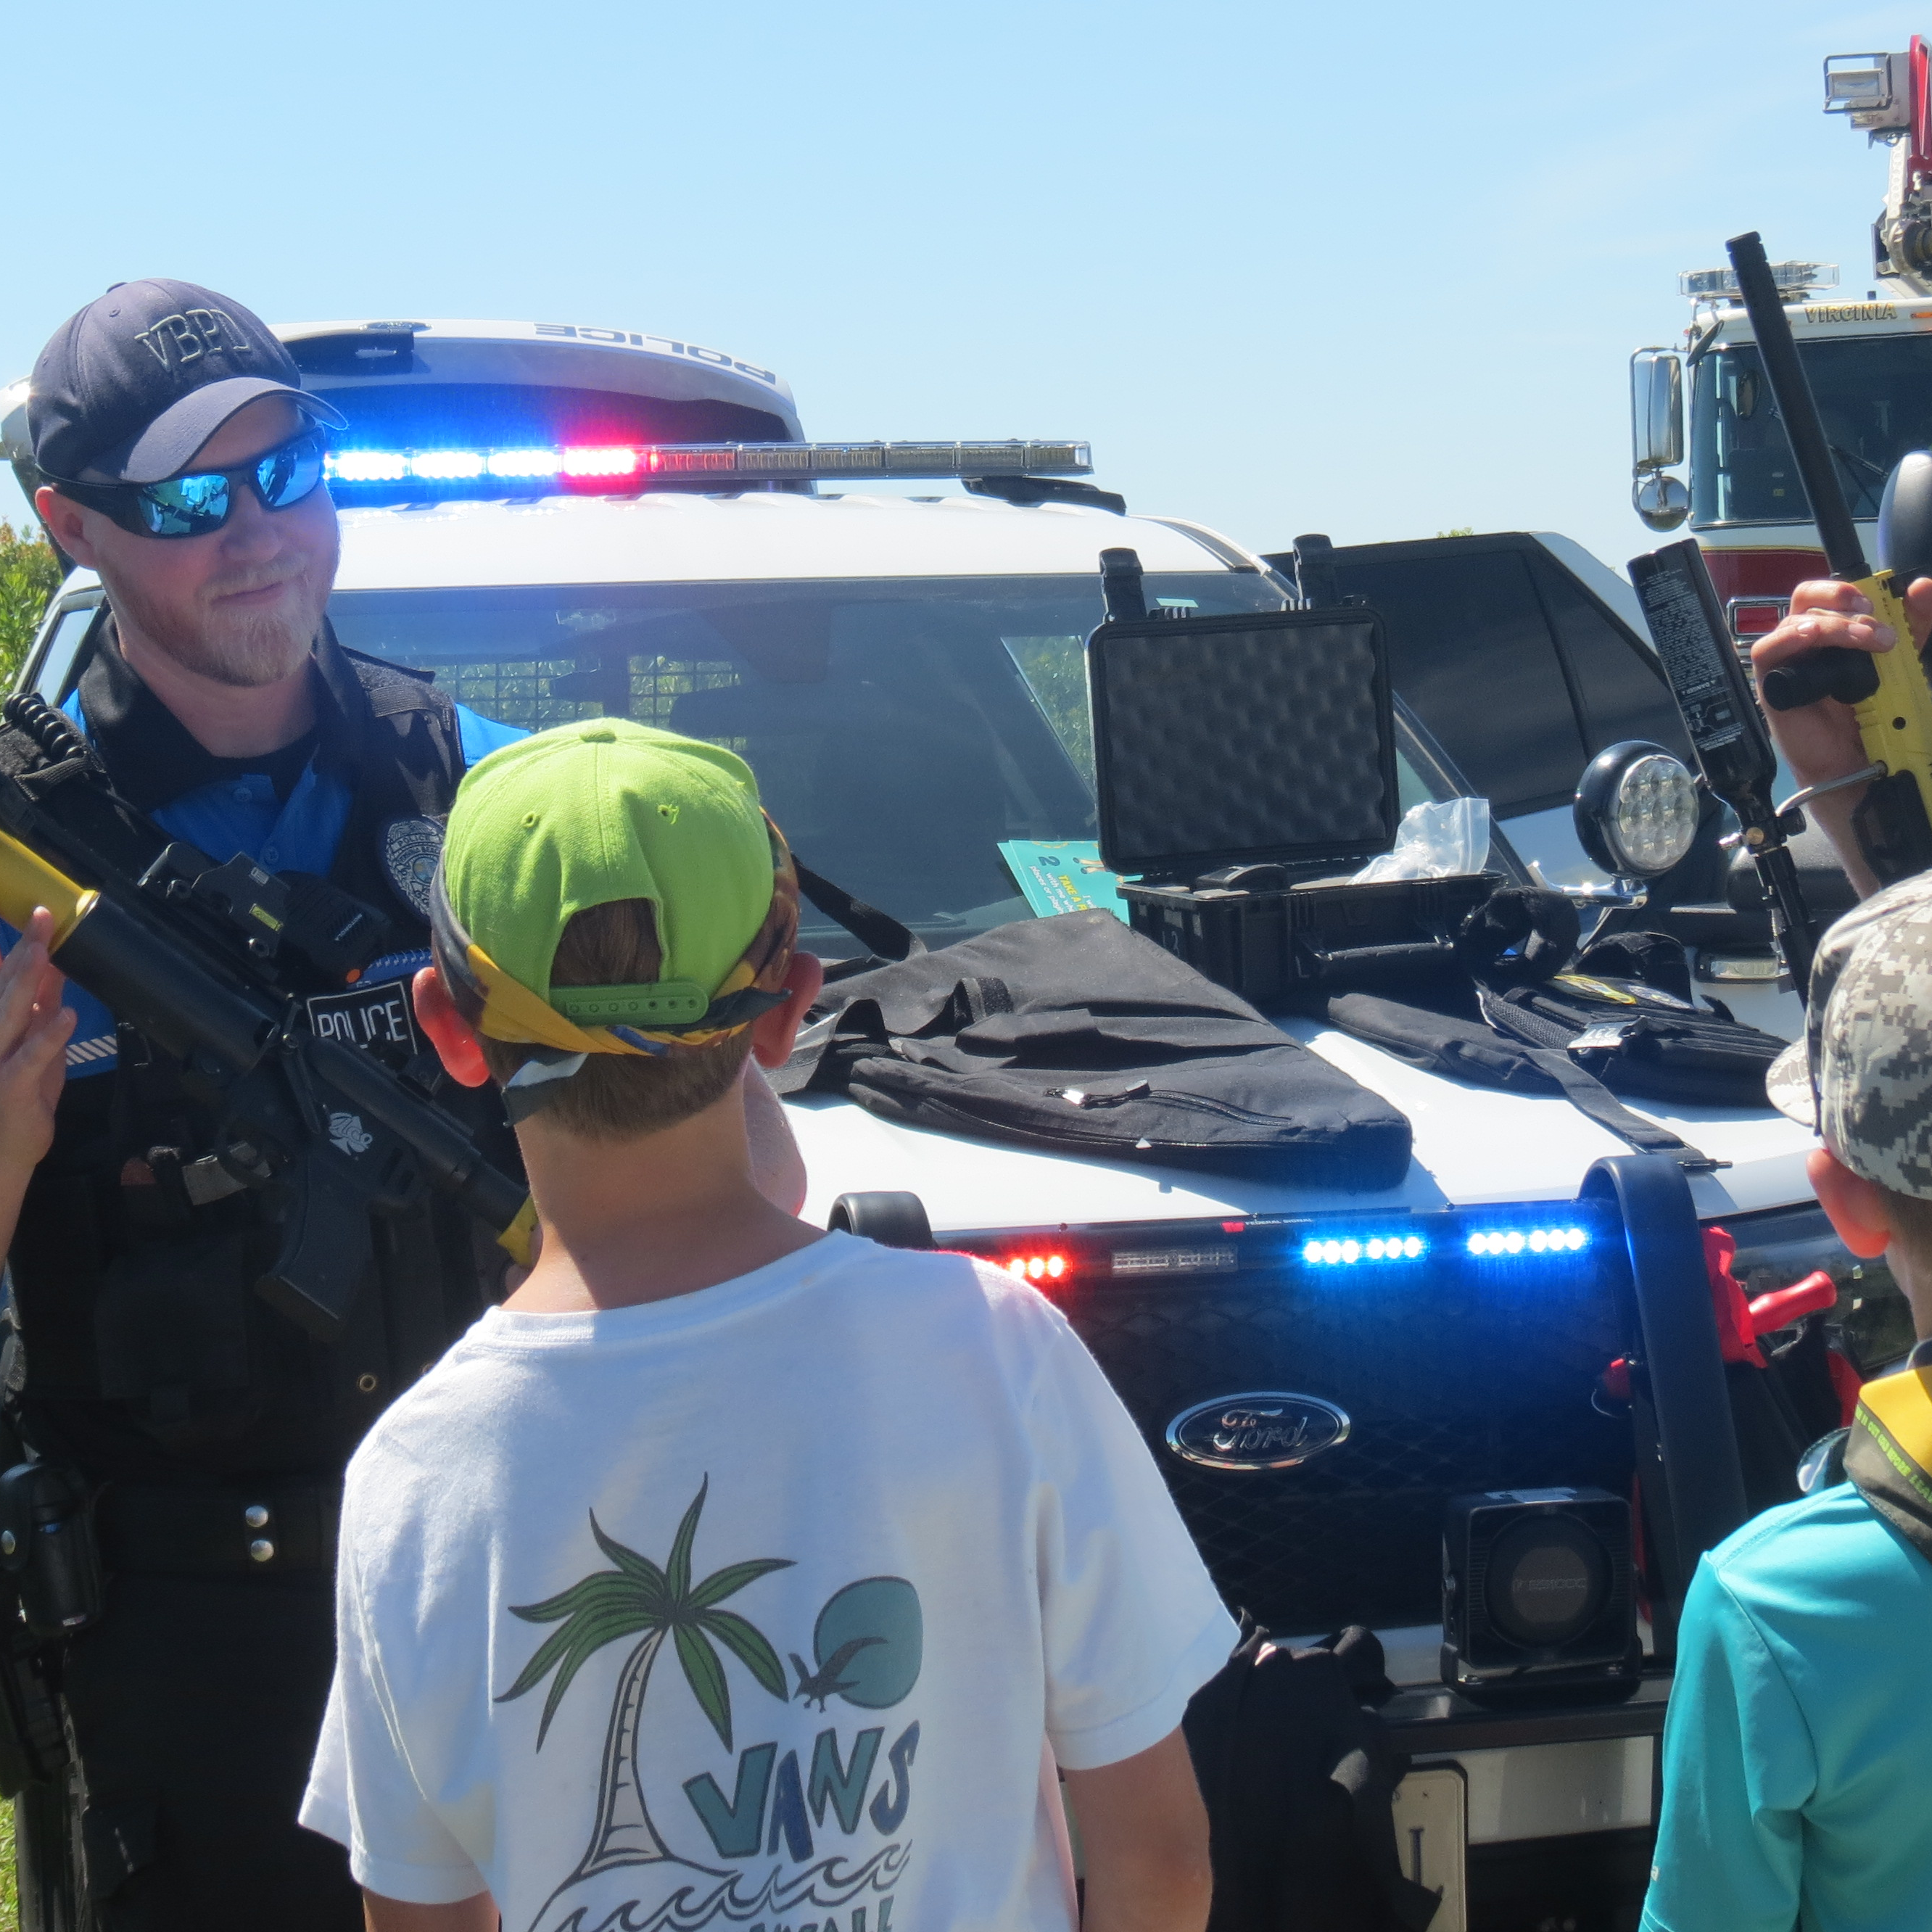
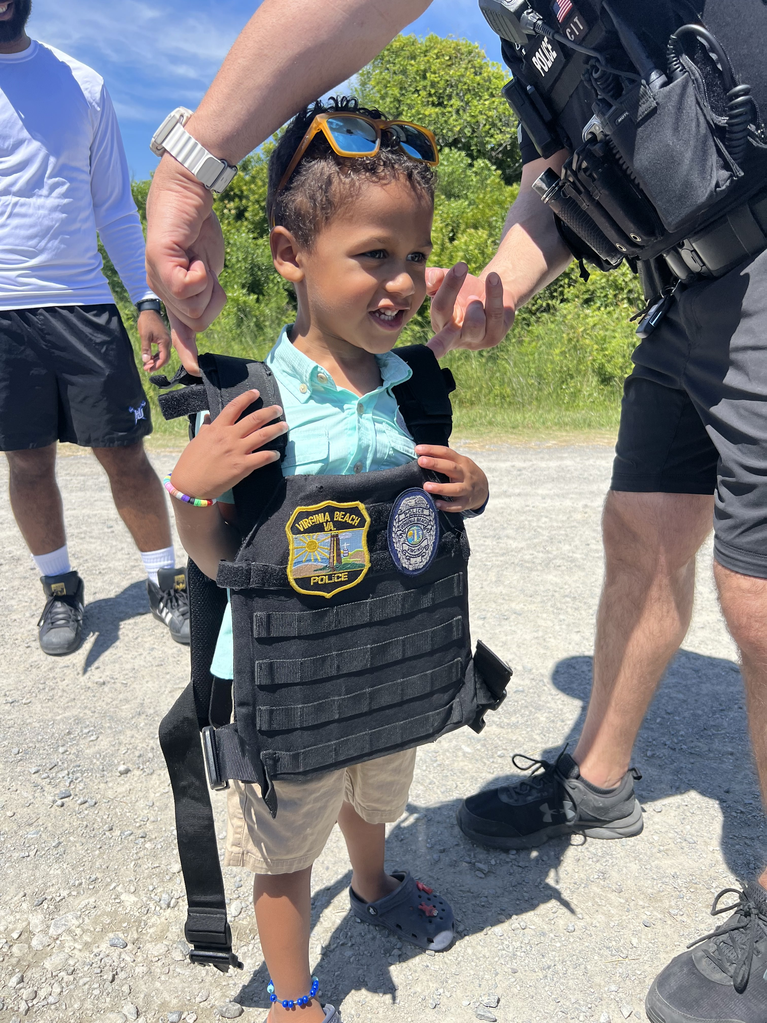
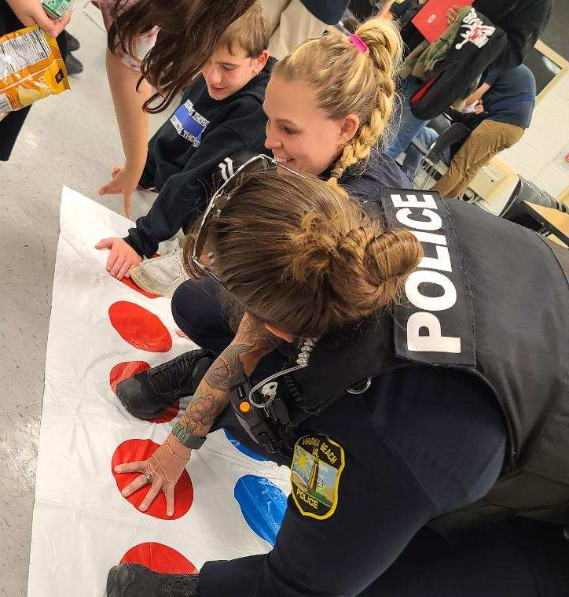
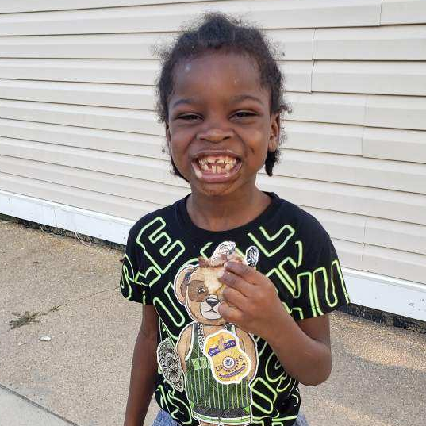
VBPD & SCHOOLS
Lieutenant Kevin Lokey
Commanding Officer, Youth Services Unit

Slide 2
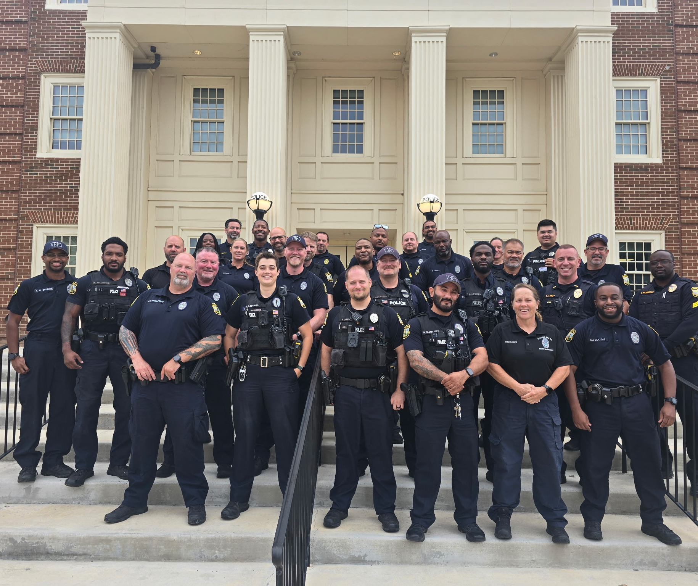
SCHOOL RESOURCE OFFICER PROGRAM
28 SROs & 4 SRO Sergeants
Assigned to all middle and high schools
Augmented by School Security Officers
YSU lieutenant oversees the SRO program
Ensures consistency throughout each precinct
Serves as liaison with VBCPS
85 schools
Point of contact for any issues with schools, students, & teachers (arrests, serious injuries, deaths, etc.)
Develops training for the SROs
Annual in-service in August
Active Threat training 3x/year
Works with DCJS & Training Bureau to ensure SROs meet certification requirements
Monitor school threats & investigations
Works closely with VBCPS OSEM to ensure safety of students, staff, and visitors

Slide 3
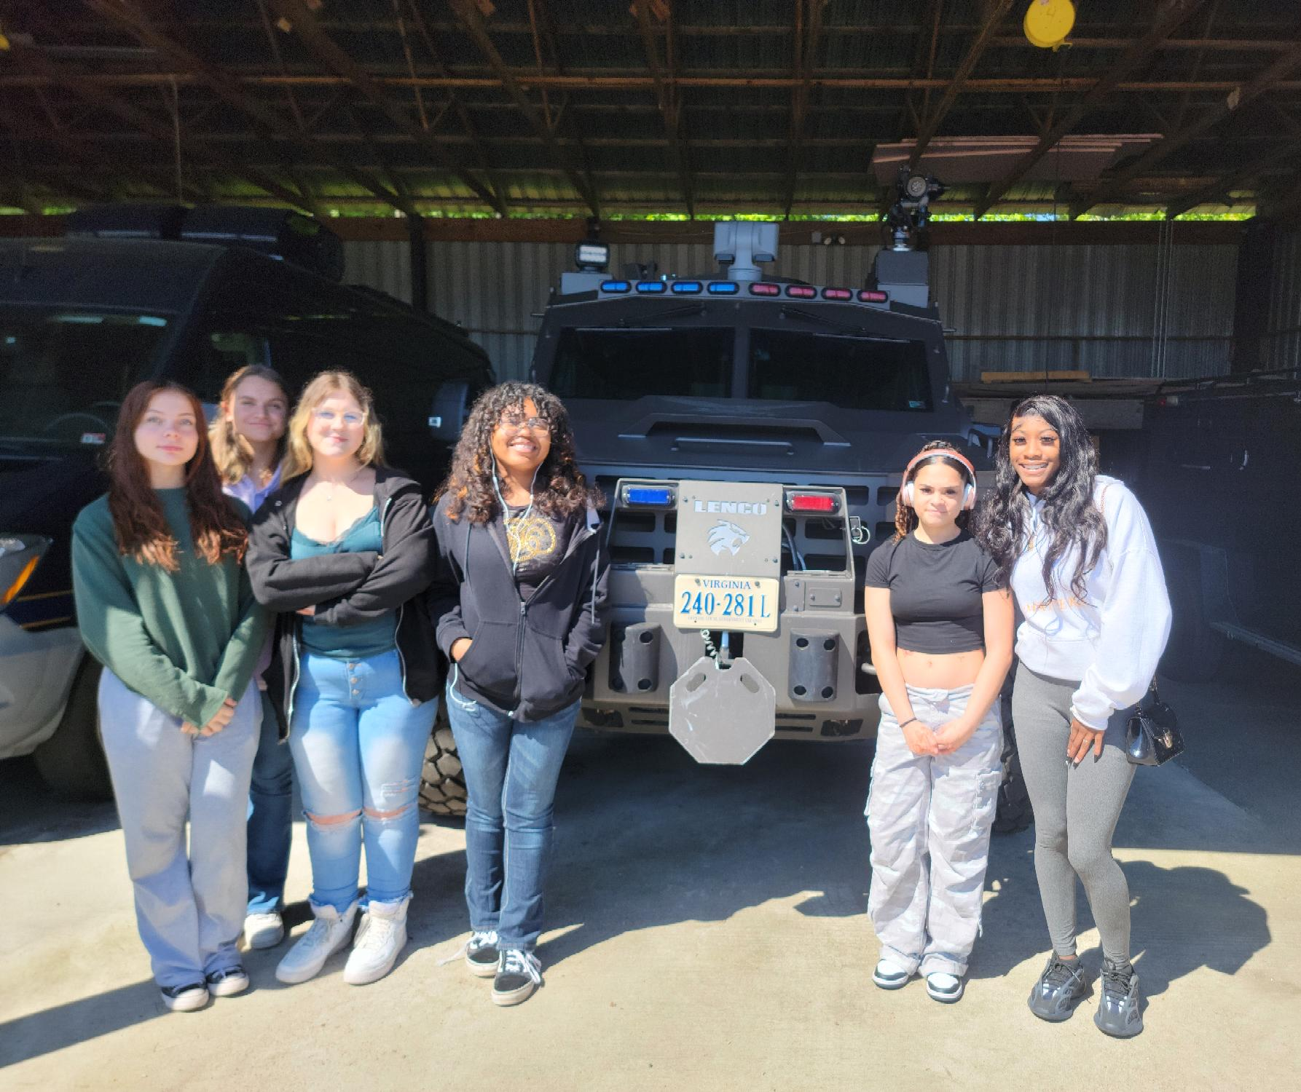
VBCPS PUBLIC SAFETY CLASSES
Public Safety Program at Technical & Career Education Center
YSU coordinates with VBCPS
Schedule instructors from PD
Assist with competitions
Facilitate field trips to PD sites
Scenario training
Goal is to have students graduate & work as Patrol Aides until they are old enough for the Police Academy

Slide 4
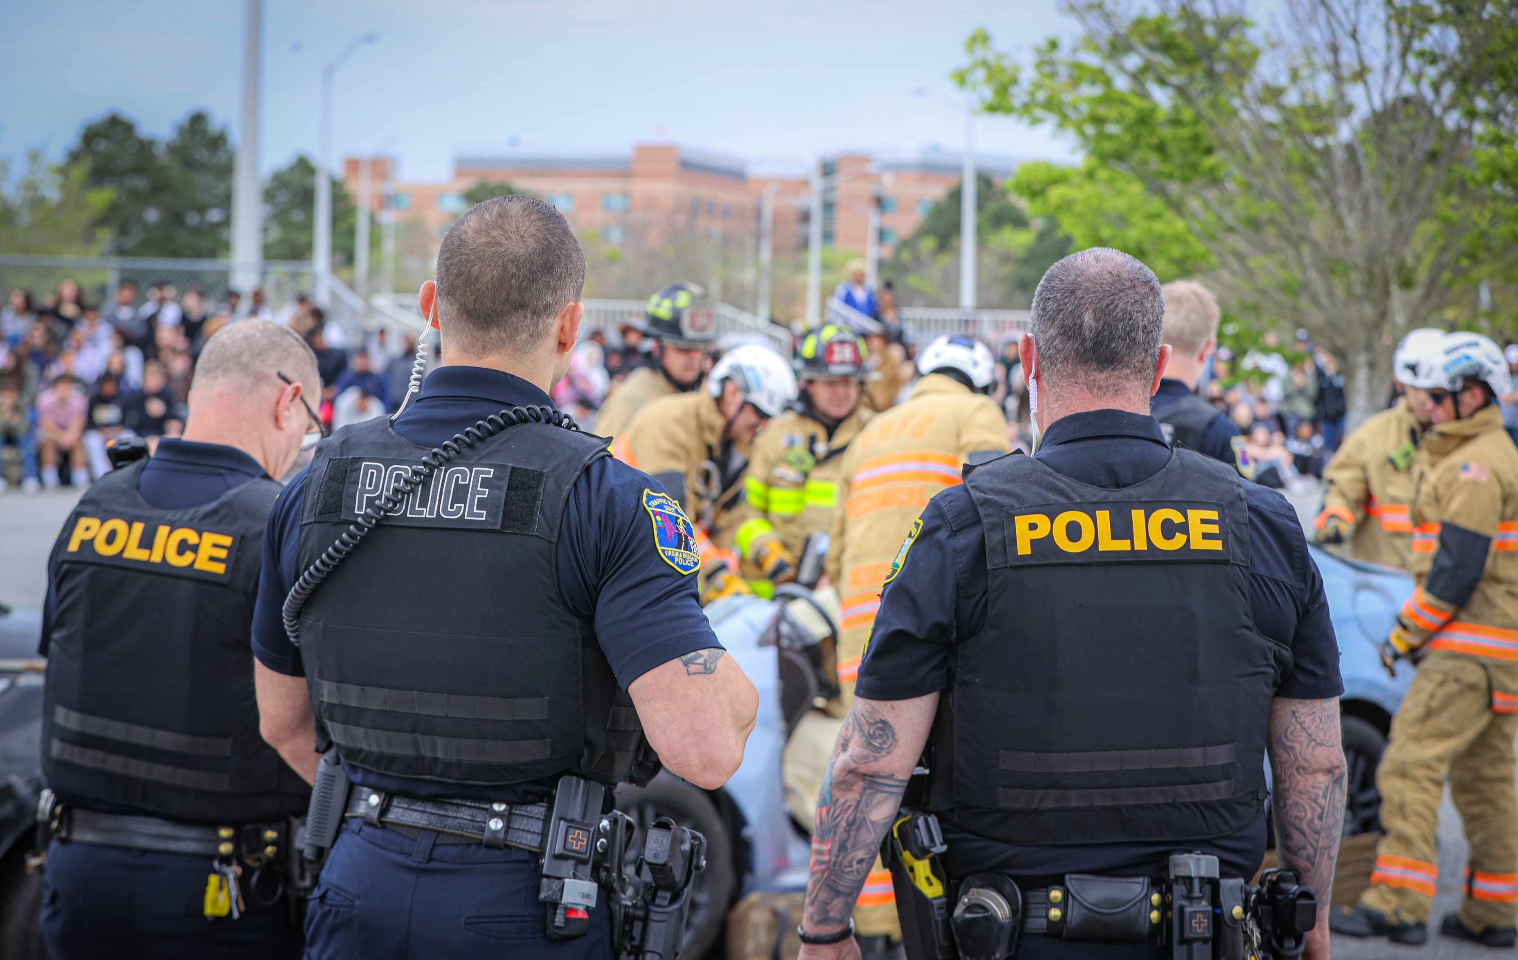
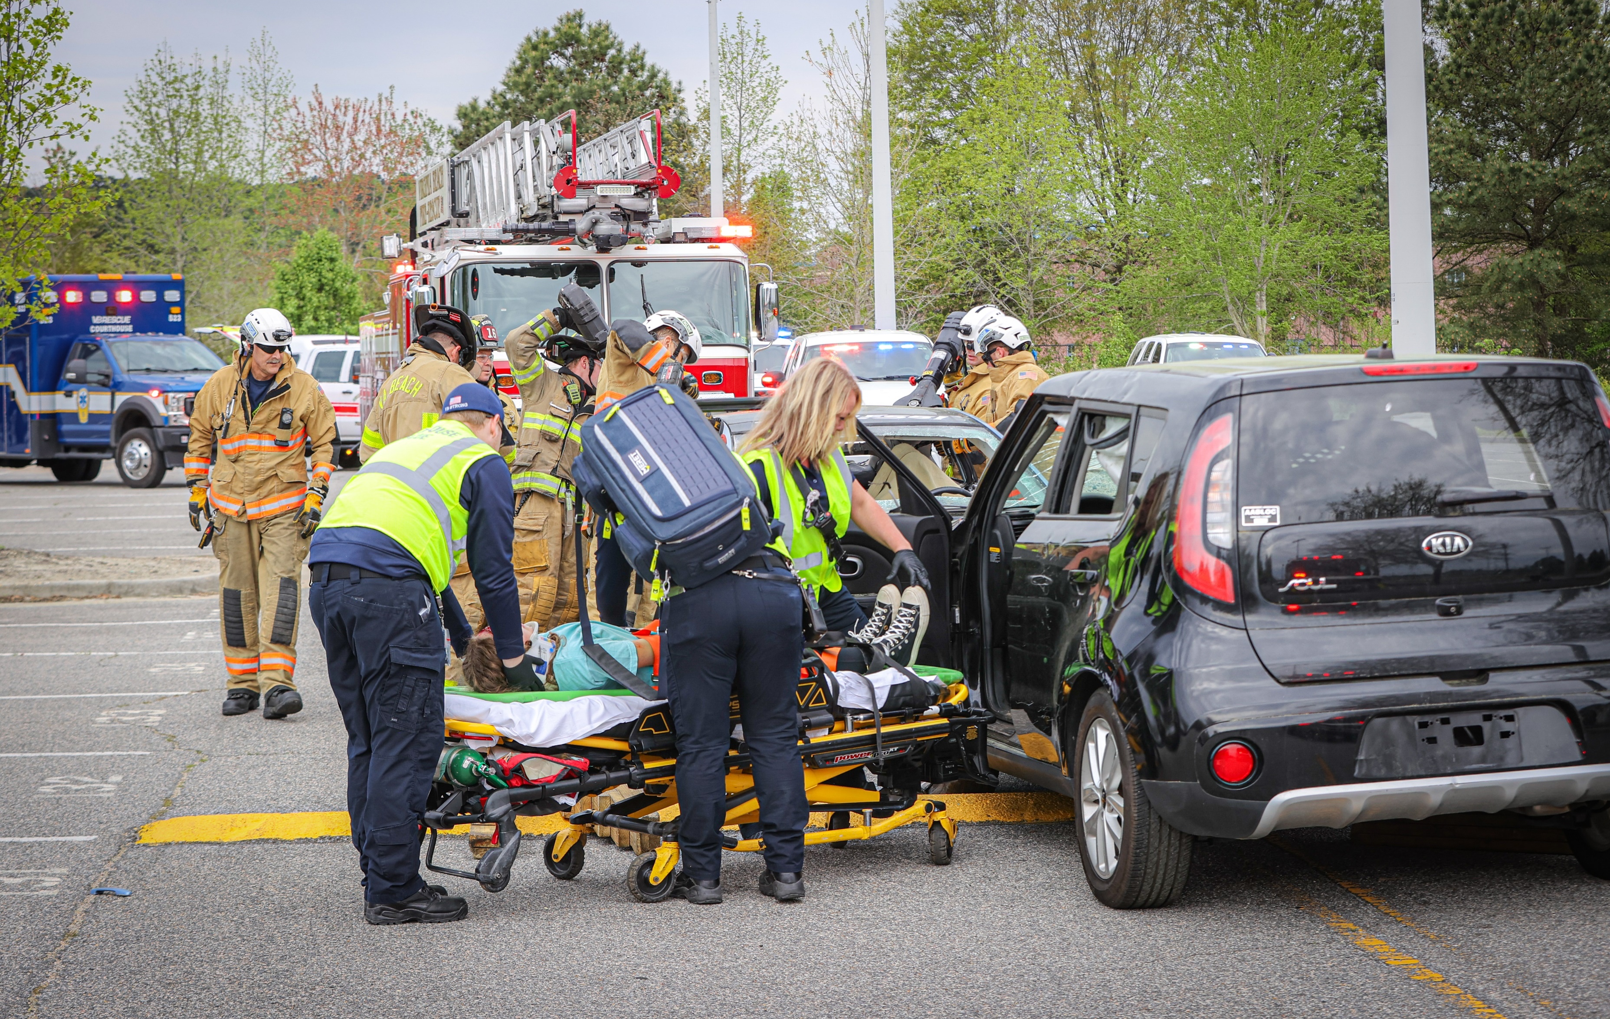
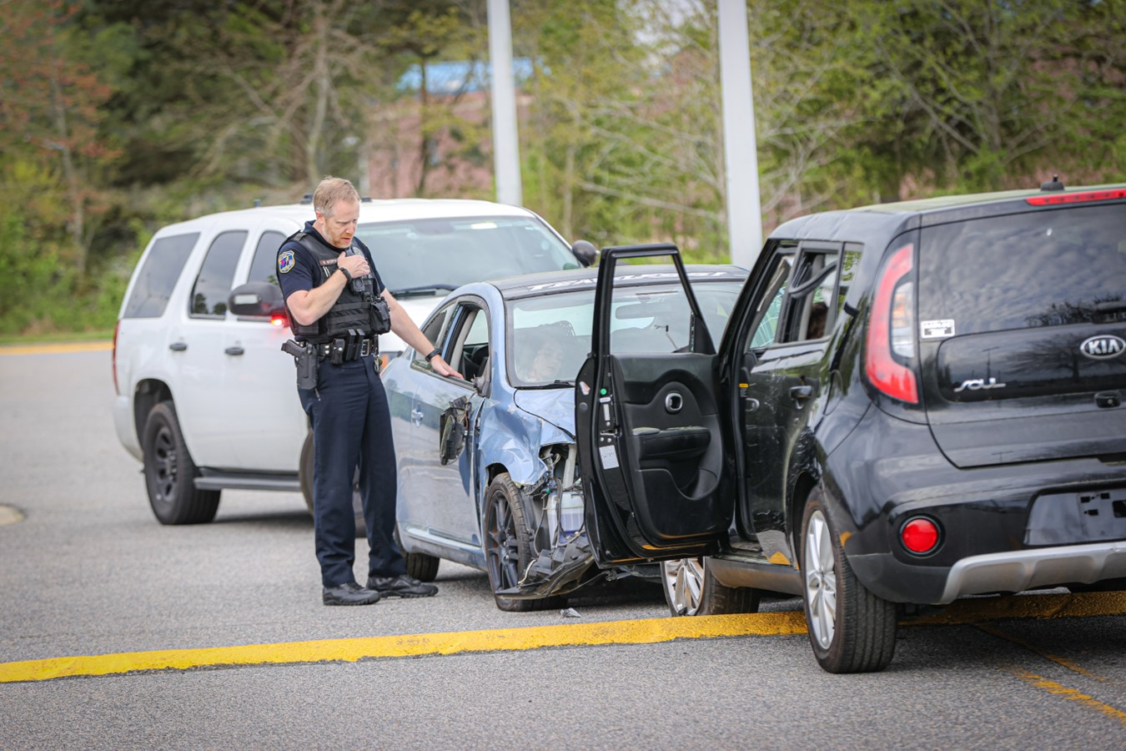
ARRIVE ALIVE VB
Safe driving program for HS students
Focus on dangers of drinking and driving, distracted driving (texting), speeding, and drugged driving (marijuana)
Mock crash scene at high school
Students volunteer to play critical roles to demonstrate the gravity of the situation and the investigative process
Assembly with mock funeral the next day
Held at different high school each year
Partnership with multiple agencies: VBFD, VBEMS, Sentara, funeral home, towing company, AAA, VBSO, VBCPS, etc.

Slide 5

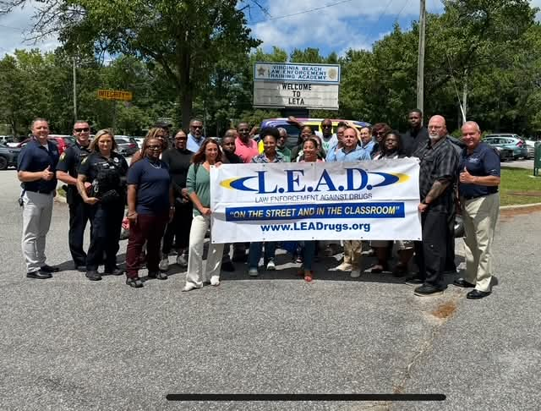
L.E.A.D.
Law Enforcement Against Drugs and Violence
K-12 Program
10-15-week program
Taught by SROs and YSU officers
Curriculum includes:
Drug and alcohol awareness
Decision making
Goal setting
Communication
Conflict resolution
Taught during summer camps, evening classes, and YPA
Will be taught to students in select middle schools (6th grade) and Renaissance Academy starting in February
Expanded to additional schools next year

Slide 6
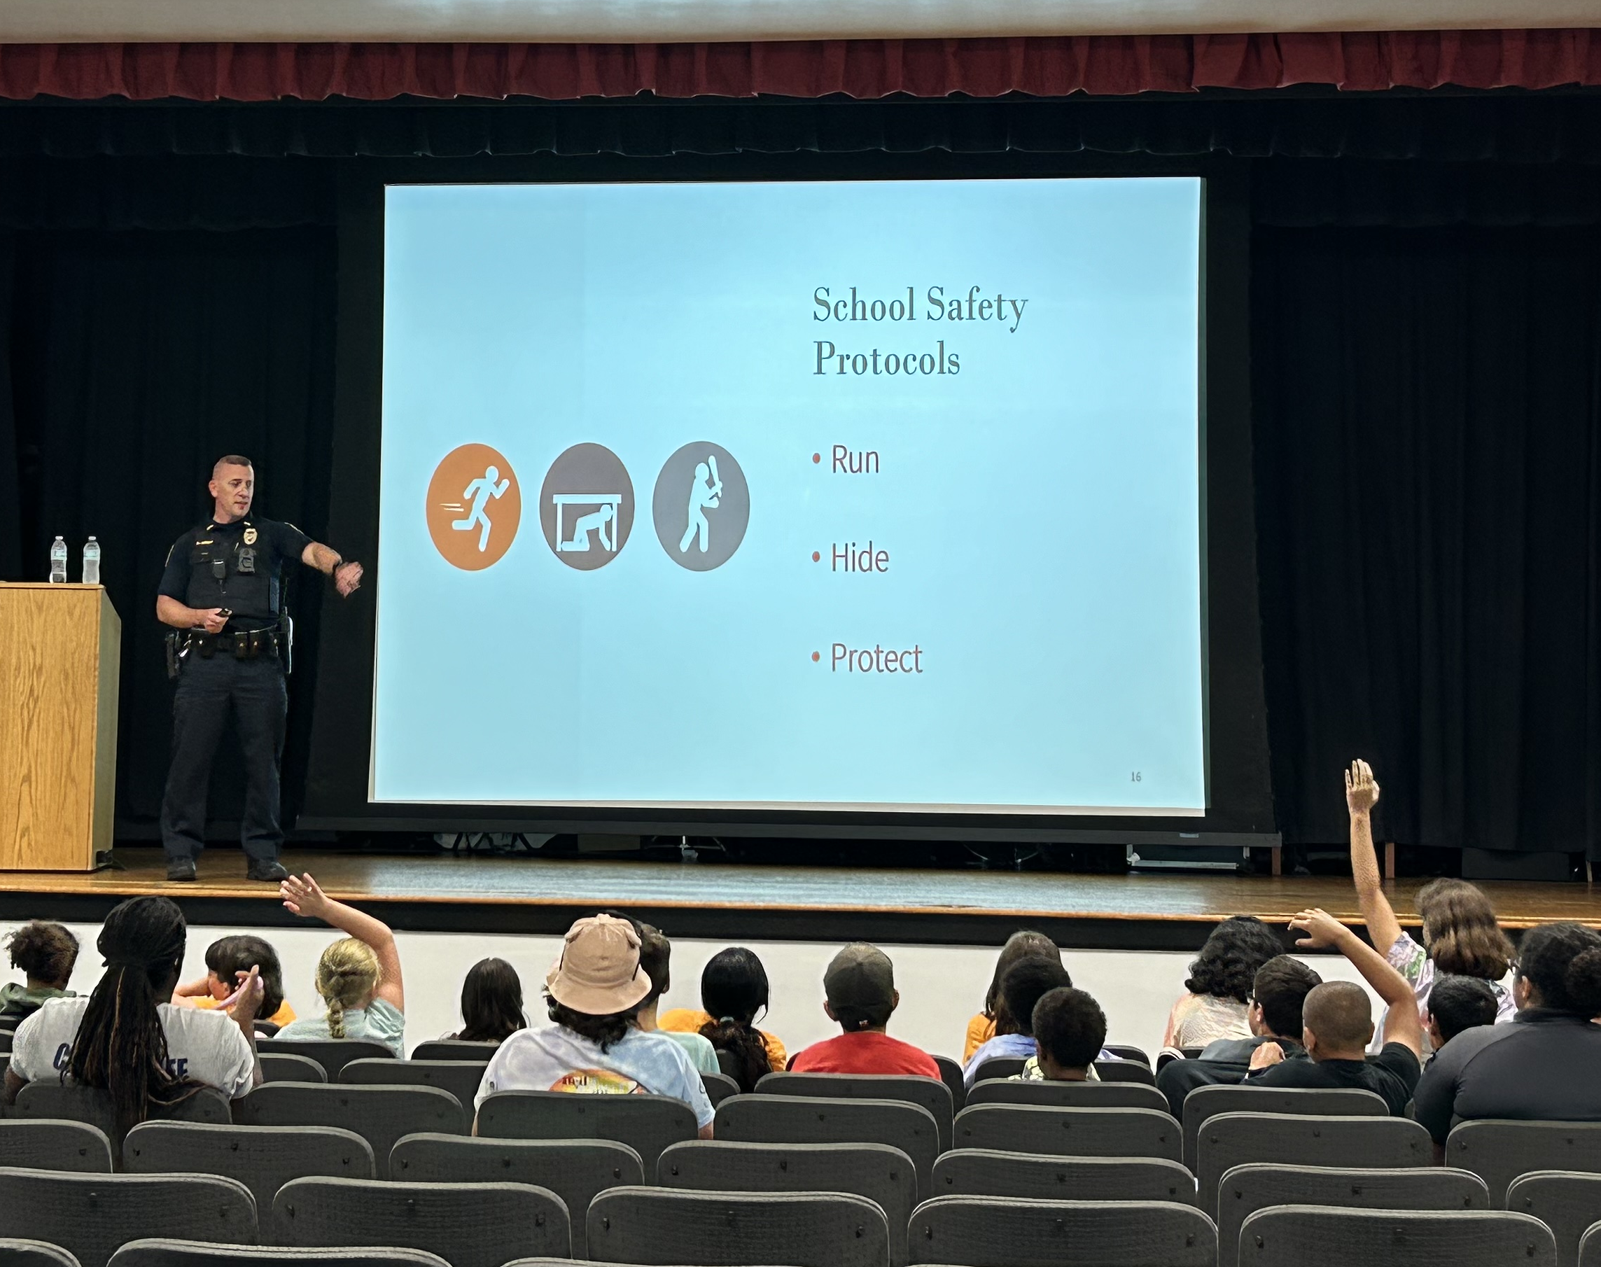
IT’S NOT A JOKE
School safety and school threat awareness program
Curriculum developed by VBPD, VBCPS, Court Services, and Commonwealth’s Attorney
Hour-long class
Taught by YSU personnel or SROs
Covers roles and responsibilities, warning signs, school safety protocols, school threat investigations, laws, consequences, and available resources
Will be taught in public schools (primarily MS)
Currently taught in camps and community meetings

Slide 7

STOP
School Threat Offenses Program
Collaboration with Court Services Unit
Court-ordered program that addresses school threat cases
5-week program
Parental involvement required
Topics include bullying, laws, school rules, conflict resolution, and making good choices
Final project
Middle school students charged with misdemeanor offenses
Weapons charges and felonies are not eligible

Slide 8
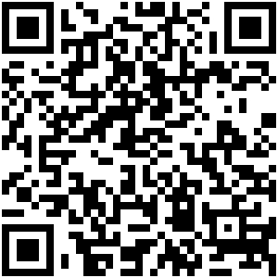
THANK YOU
Questions?
Lt. Kevin Lokey Youth Services Unit
kalokey@vbgov.com
(757) 385-7214
police.virginiabeach.gov/community/youth-services

