Slide 1






Child and Youth Behavioral Health Evidence-Based Services January 16, 2026
Jim Thornton, LPC, Clinical Services Administrator

Slide 2

Child & Youth Behavioral Health
Pembroke 6
297 Independence Blvd., Suite 300
Virginia Beach, VA 23462
Same Day Access Walk-in Assessments
Monday-Friday, 8am-12pm
Intake Information Line:
(757) 385-0850
Hours of Operation
Monday – Thursday
8:00 am – 7:00 pm
Friday
8:00 am – 5 pm

Slide 3

Overview of CYBH
CYBH serves approximately 400 youth per month
CYBH provides Outpatient, Psychiatric Evaluation and Medication Management, Case Management, Intensive Care Coordination, Crisis Response, and School-based services
Recently added Outpatient within the CSU
Many evidence-based practices are used. CYBH has invested heavily in getting staff certified in EBPs.
EBPs include PCIT, EMDR, TF-CBT, and RPT

Slide 4
Parent Child Interaction Therapy
PCIT is an evidence-based treatment for young children ages 2.5-6.5 with significant behavioral problems.
Negative behavior has been rewarded, the youth have trained the parents through tantruming, outbursts, and aggression
Conducted through "coaching" sessions
Parent & child are in a playroom while the therapist is in an observation room
Parent wears a "bug-in-the-ear" device through which the therapist provides in-the-moment coaching on skills to manage child's behavior

Slide 5
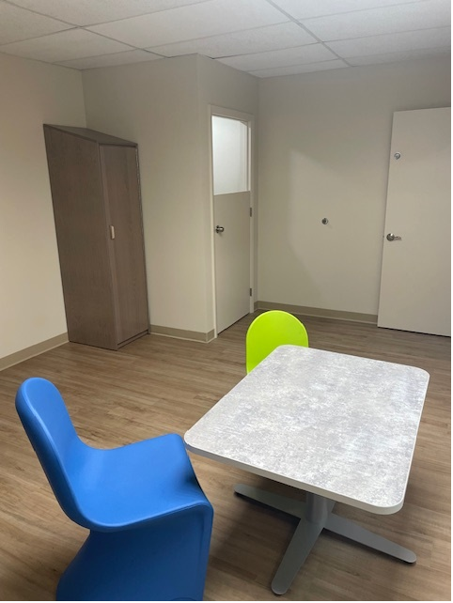
Two phases of treatment
Child-Directed Interaction (CDI)
Parent-Directed Interaction (PDI)
Notes:
Quick Slide

Slide 6
During Child directed interaction
The Parent will
Learn play therapy skills
Manage their child's behavior with positive attention alone
Learn to communicate with their child
Teach their child new things without frustration
The CHILD will
Improve their self-esteem
Improve their social skills
Feel safe and calm
The RELATIONSHIP will
Become stronger
Be more mutually enjoyable
Become warmer
Improve their frustration tolerance
Attend longer to activities

Slide 7
“don’t skills”
Commands
“Build me a house”
Questions
“What color is that?” Do you want to draw?
Criticisms
“It doesn’t go that way” “You did that wrong”

Slide 8
“Do skills”
Praise Labeled to share what is liked about the specific behavior
Reflect Repeat back desired words that the child says
Imitate the desired/appropriate behaviors
Describe the desired/appropriate behaviors
Enjoy Show warmth and ENJOY the play

Slide 9
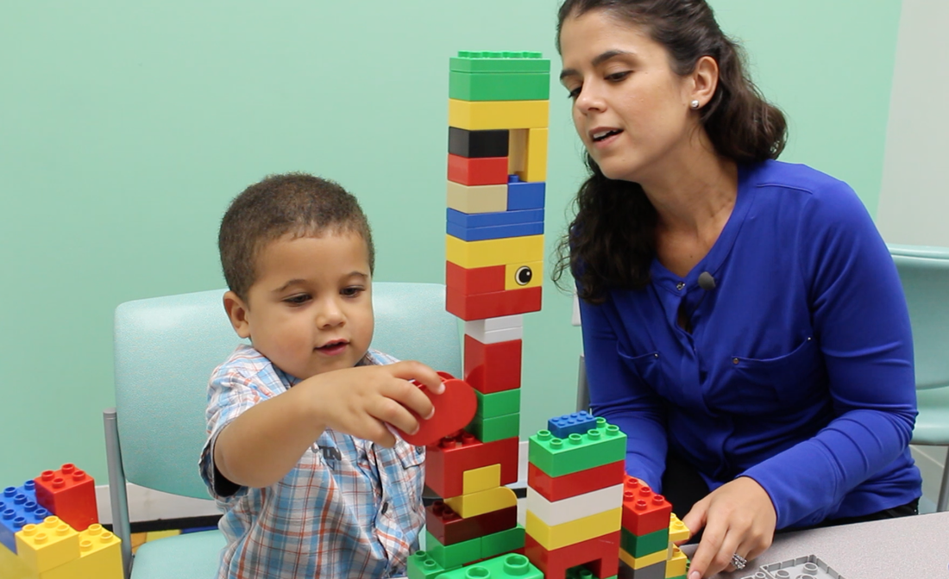
Parent directed interaction (pdi)
Second Phase of PCIT
Gives steps to help the parent direct the behavior when they need to be in charge
Consistent & Predictable
Rules are so clear, kids learn not to test parents

Slide 10
Parent Directed interaction
In PDI, parents learn proven strategies to help children
accept limits
comply with directions
respect house rules
demonstrate appropriate behavior in public
Parents are equipped with skills to help manage the behaviors that CDI did not decrease
Parents increase their confidence, remain calm, and approach discipline with consistency

Slide 11
Global outcome
With consistent attendance and homework completion, PCIT is typically completed within 12-20 weekly sessions
Treatment is considered complete when:
Parents have mastered both sets of CDI and PDI skills
The child's behavior is rated within normal limits on a behavior rating scale (ECBI)
The parent feels confident in managing the child’s behaviors on their own

Slide 12
Eye Movement Desensitization and Reprocessing (EMDR)
Proven method to help people recover from trauma and PTSD symptoms
One of the most highly researched and supported treatments in the world
Has been proven better than common pharmaceuticals for people with trauma
Within CYBH, majority of OP therapists are certified
Works well for youth 10-18

Slide 13
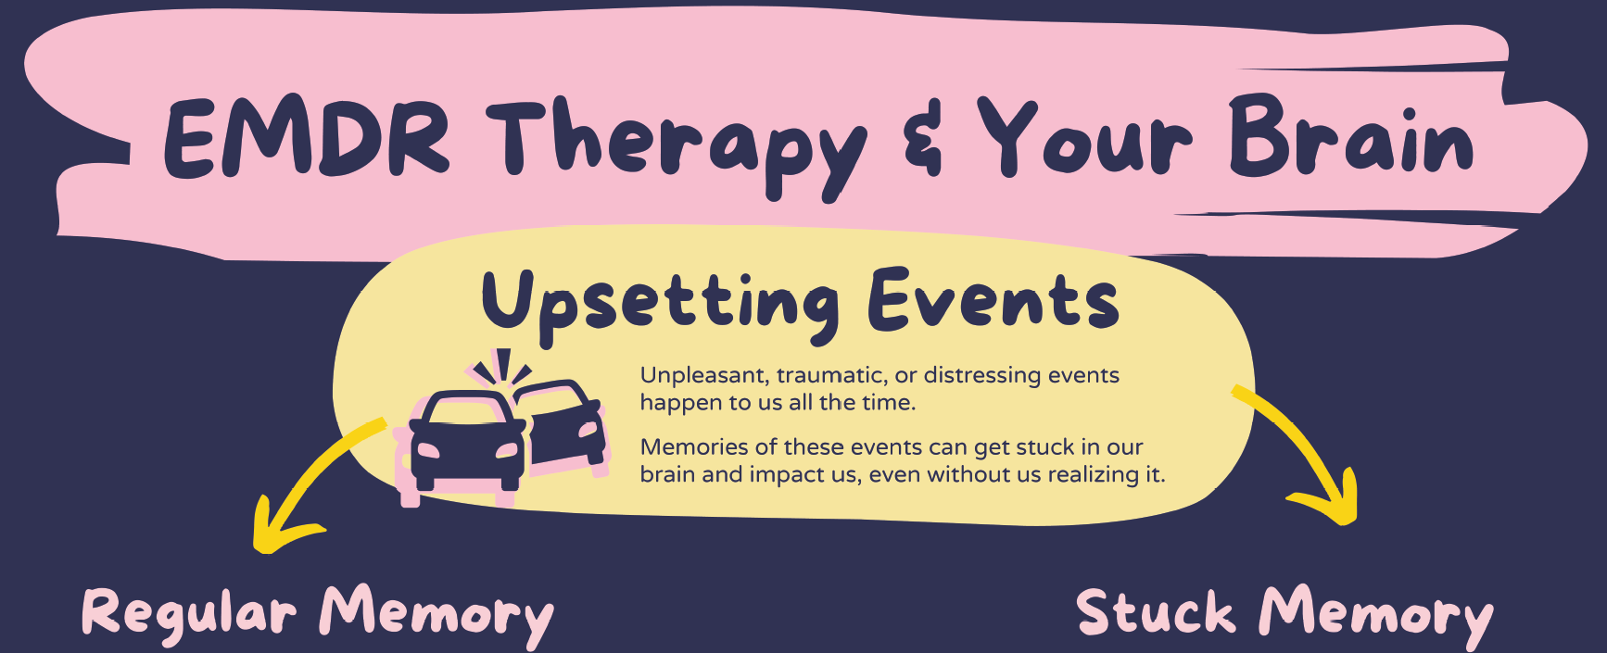
How EMDR works:
A traumatic event can cause the memory of it to get “stuck” due to the fight, flight or freeze response
Multiple events can build on each other and can become more damaging than one single traumatic event
This stuck memory gets “triggered” and results in a repeat of the fight, flight or freeze response
This can be debilitating, impacting every area of the person’s life
EMDR helps “rewire” the brain through bilateral stimulation

Slide 14
EMDR Protocol
The therapist must establish a trusting, therapeutic alliance. EMDR cannot be successful without this.
Coping skills need to be developed prior to reprocessing the trauma
The traumatic event is identified, including images of the event that are stuck in memory, beliefs about the event, feelings that result
Bilateral stimulation is introduced while the traumatic event is being reprocessed
Stereo headphones, “tappers”, eye movement
This is done multiple times during an EMDR session, and takes multiple sessions to effectively lower the subjective distress of the client
A new, positive belief is introduced to associate with the target event, and reiterated after each reprocessing until it feels completely true

Slide 15
Trauma-Focused Cognitive Behavioral Therapy
Designed specifically for children and adolescents who have experienced trauma
Has been evaluated and refined for over 30 years
TF-CBT is a structured treatment model that effectively improves trauma-related outcomes in 8-25 sessions
Sessions include both the child/adolescent and caregiver
Improves the parent’s or caregiver’s personal distress about the child’s traumatic experience
More effective parenting skills and supportive interactions with the child.

Slide 16
TF-CBT Protocol
Psychoeducation regarding trauma and its effects are given to both the child and caregiver
Common psychosocial and behavioral reactions following a trauma, symptoms and diagnosis related to traumatic events
Why children may not like to talk about traumatic events
Parenting skills to improve their ability to manage child behavior problems
Fears; sleep problems; inappropriate sexual behaviors
Caregivers may feel guilty about disciplining children who have experienced traumatic events
Coping skills are taught
Challenging negative thoughts, introducing alternative replacement thoughts
Trauma Narration and Processing
Help children create a story, or narrative, of the traumatic events that will help them approach rather than avoid memories, thoughts, and feelings associated with the traumatic experiences,
Modify thinking errors or unhelpful thoughts as they come up during the creation and discussion of the narratives
Process the trauma events with their therapist and eventually share with caregiver to reduce trauma-related problems as they gain a sense of mastery and control over their experiences and their reactions

Slide 17
Registered Play Therapy
Play therapy differs from regular play in that the therapist helps children to address and resolve their own problems.
Through play therapy, children learn to communicate with others, express feelings, modify behavior, develop problem-solving skills, and learn a variety of ways of relating to others.
Therapist uses tracking, reflecting, and limit setting to help the child explore and imitate real life events in a low-risk, trusting environment through play, including toys and activities.
Increases functioning in pre-frontal cortex: regulates emotions,
Helps children plan ahead, problem solve
Play activates the ENTIRE neocortex (logical/new brain)
Improves memory
Increases attention span & language development
Inoculates them to stress = Small amounts of risk
Arena to practice certain behaviours with minimal risk
Play can reveal hidden worries and concerns and allows the therapist to gain insight into the child’s feelings and experiences

