Slide 1

Civil Rights
Annual Civil Rights Training for TEFAP Agencies
Notes:
Annual Civil Rights training is required for all staff and volunteers who work with The Emergency Food Assistance Program (TEFAP). Ensure that every person who attends the training is documented and the training record is kept for at least three years after the close of the current fiscal year.
Photo credit: https://www.flickr.com/photos/84568447@N00/25128122112 Fred Selbert

Slide 2
Agenda
What is Discrimination?
Collection and Use of Client Data
Effective Public Notification Systems
Requirements for Language Assistance
Reasonable Accommodation of Persons with Disabilities
Notes:
Today we will go over all the areas required by USDA to complete annual Civil Rights training. The goals of this training are to learn:
How the federal government defines discrimination in TEFAP
What racial and ethnic data is required to be collected;
How to notify clients and potential clients of our programs and their civil rights as it relates to them;
The requirements for communicating with clients and potential clients who do not speak English;
How to ensure our facilities and outreach tools do not discriminate against persons with disabilities;
How to identify and process a civil rights complaint;
The process for monitoring agencies for civil rights compliance;
What happens when an agency is not in compliance;
And effective customer service and conflict resolution techniques.

Slide 3
Agenda
Complaint Procedures
Compliance Reviews
Resolution of
Non-Compliance
Customer Service
Conflict Resolution
Notes:
This is todays agenda for the Civil rights portion of our training.

Slide 4
What is discrimination?
The act of distinguishing one person or group of persons from others, either intentionally, by neglect or by the effect of actions or lack of actions based on their protected classes.
Notes:
Discrimination happens when a person is treated differently than others for reasons outside of their control, such as their age, race, disability, etc. Sometimes discrimination happens on purpose- and sometimes it happens because organizations were not properly prepared to meet the needs of all program participants.

Slide 5
Protected Classes
For civil rights in TEFAP, the protected classes are:
  Disability
  National Origin
  Age
  Race
  Color
  Sex
People are also protected from retaliation
Notes:
TEFAP recipients are protected from being treated differently because of any of the following reasons – disability, national origin, age, race, color and sex. These are called the protected classes. If someone files a civil rights complaint, they are also protected from retaliation. Retaliation happens when they are treated differently because they filed a complaint.
Do you think this scenario could be discriminatory? A food pantry that distributes TEFAP foods is located on the second floor of a building that does not have an elevator. Is this discriminatory? Why or why not?
The answer is yes, it could be discriminatory against people with disabilities. The pantry should attempt to make their building handicap accessible. If that is not possible, some other options would be bringing distribution for USDA programs downstairs or providing home delivery service for people with disabilities.

Slide 6
Unintentional Discrimination
Unintentional - refers to policies, practices, rules or other systems that appear to be neutral, but result in a disproportionate impact on protected groups.
Notes:
Unintentional discrimination can be combated by making sure everyone in the organization understands Civil Rights. Review your polices and procedures for any unintentional discriminatory actions. It is important to ensure that all participants in your program have equal opportunities to access and receive food.

Slide 7
Intentional Discrimination
Intentional - to treat people differently based on their race or other protected characteristics
Reprisal/Retaliation – Negative treatment due to prior civil rights activity by an individual or his/her family or known associates or for cooperating with an investigation
Notes:
Intentional discrimination is more obvious. Denying someone food because they are of a certain descent is an example of intentional discrimination. Retaliation is also a form of intentional discrimination. If you witness anyone in your organization practice discrimination, you should report it immediately.

Slide 8

Non-Discrimination Statement
“In accordance with Federal civil rights law and U.S. Department of Agriculture (USDA) civil rights regulations and policies, the USDA, its Agencies, offices, and employees, and institutions participating in or administering USDA programs are prohibited from discriminating based on race, color, national origin, sex, disability, age, or reprisal or retaliation for prior civil rights activity in any program or activity conducted or funded by USDA.
Persons with disabilities who require alternative means of communication for program information (e.g. Braille, large print, audiotape, American Sign Language, etc.), should contact the Agency (State or local) where they applied for benefits. Individuals who are deaf, hard of hearing or have speech disabilities may contact USDA through the Federal Relay Service at (800) 877-8339. Additionally, program information may be made available in languages other than English.
To file a program complaint of discrimination, complete the USDA Program Discrimination Complaint Form, (AD-3027) found online at: http://www.ascr.usda.gov/complaint_filing_cust.html, and at any USDA office, or write a letter addressed to USDA and provide in the letter all of the information requested in the form. To request a copy of the complaint form, call (866) 632-9992. Submit your completed form or letter to USDA by:
(1) mail: U.S. Department of Agriculture
Office of the Assistant Secretary for Civil Rights
1400 Independence Avenue, SW
Washington, D.C. 20250-9410;
(2) fax: (202) 690-7442; or
(3) email: program.intake@usda.gov.
This institution is an equal opportunity provider.”
Notes:
This is the full Non-Discrimination Statement from USDA. The statement tells clients what their civil rights are and how to report a complaint.

Slide 9
Non-Discrimination Statement
All public information related to TEFAP must contain the Non-Discrimination Statement
Long version vs short version
  “This institution is an equal opportunity provider.”
Notes:
The “USDA Non-Discrimination Statement” must be included on all materials that mentions TEFAP.
There is both a “long’ and “short’ version. If there is room on your document, please use the long version. It is ok to use the short version when you do not have room for the full version. However, client eligibility forms or any materials explaining client rights and responsibilities must have the long version.
Any public program material must have the non-discrimination statement printed on it. This includes handouts, signs, web sites, forms, etc.
Web sites must have the statement on the first page only. It is not required to be on each page of the site
The font size should not be any smaller than the rest of your text to ensure that participants can read it.

Slide 10
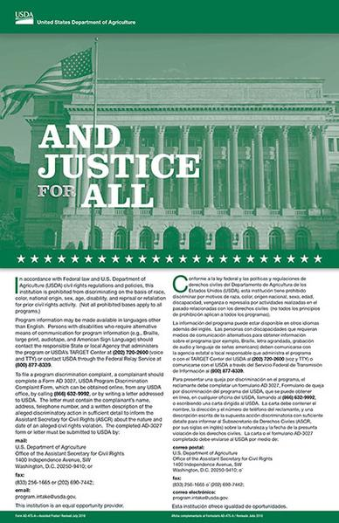
And Justice for All Poster
This is the most current poster
Must be posted where eligibility forms are completed and/or where food or meals are being distributed
Should be visible for all to see
Notes:
It is required that every agency participating in TEFAP or have the And Justice for All Poster. Ensure a current copy is posted in your facility at the client or sub-distributor point of service (where the eligibility forms are completed or where the food/meals are being distributed/served). This is the most current And Justice for All poster.

Slide 11
Data Collection
Race and ethnicity are not required for TEFAP
  Self-declared on forms
  If not declared, they must be advised that the information will be collected based on observation
  Secure and confidential
  Maintain records
  Applicants shall be assured that the information has no effect on eligibility criteria
Notes:
It is important that all client information collected by staff or volunteers be kept secure and confidential.
USDA does not require the annual reporting of the race and ethnicity of for TEFAP clients. This information should be used by agencies to identify underserved populations in their program service area. Similar information could be used by an agency to evaluate TEFAP participation, though collection of the data is not required at this time.
Participants may self-declare racial/ethnic data.
If a participant refuses to provide data they are to be advised that the information will be collected based on observation.
Maintain all records for three years after the close of the current fiscal year
Applicants shall be assured that the information is required for and used for statistical purposes only and has no effect on eligibility criteria.

Slide 12
Reaching Prospective Clients
Public Notification/Outreach Methods
  Press releases – newspaper, TV station, online
  Advertisements – newspaper, social media, TV
  Signs – outside your facility, post serving times
  Flyers – clinics, public assistance offices, schools, libraries, etc.
Notes:
Convey the message of equal opportunity through photos and graphics in program-related information.

Slide 13
What would you do?
There is small Italian community in your service area that may benefit from TEFAP. Your organization wants to create a flyer in Italian to distribute.
You have paid a translator, created and printed the flyer, but realized that you forgot the non-discrimination statement.
Is it still okay to distribute the flyer?
Notes:
The answer is no. It is never okay to distribute program information without the non-discrimination statement.

Slide 14
Limited English Proficiency
Persons with LEP are those who have the limited ability to read, speak, write or understand English
Agencies must take reasonable steps to ensure meaningful access to services
Consider the possible LEP clients in your area for both outreach and food distribution
Interpreters
Notes:
Agencies must take into consideration individuals who do not speak English as their primary language and who have a limited ability to read, speak, write, or understand English. If someone came to your agency and they only spoke Creole, would you be prepared to offer them service? If not, there is a potential for a “National Origin” civil rights complaint.
All agencies participating in TEFAP and have the responsibility to take reasonable steps to ensure meaningful access to their programs and activities by persons with limited English proficiency (LEP).
Interpreters: Volunteers may be used as interpreters and must maintain participant confidentiality. Children should not be used as interpreters.

Slide 15
Limited English Proficiency
Factors to consider:
Number or proportion of LEP persons served or encountered in the eligible population
Frequency with which LEP individuals come in contact with the program
Nature and importance of the program, activity, or service provided by the program
Resources available to the recipient
Costs
Notes:
Service must be provided, but there is some flexibility on methods used.
Factors to consider with addressing Limited English Proficiency are
Number or proportion of LEP persons served or encountered in the eligible population
Frequency with which LEP individuals come in contact with the program
Nature and importance of the program, activity, or service provided by the program
Resources available to the recipient
Costs
If an agency has a need for a language translation other than the ones provided by FDACS, please contact our office for assistance.

Slide 16

Persons with Disabilities
Disabled person
A person who has a physical or mental impairment which substantially limits one or more major life activities, has a record of such an impairment, or is regarded as having such an impairment.
Major life activity means functions such as caring for one’s self, performing manual tasks, walking, seeing, hearing, speaking, breathing, learning and working.
Notes:
Americans with Disabilities Act
• Section 504 of the Rehabilitation Act of 1973
• 7CFR Part 15b
Prohibits discrimination on the basis of disability in all services, programs and activities provided to the public by state and local governments. Reasonable accommodations that do not cause undue hardship must be provided.
A person with disability is defined as a person who has a physical or mental impairment which substantially limits one or more major life activities, has a record of such an impairment, or is regarded as having such an impairment.
Major life activity means functions such as caring for one’s self, performing manual tasks, walking, seeing, hearing, speaking, breathing, learning and working.

Slide 17
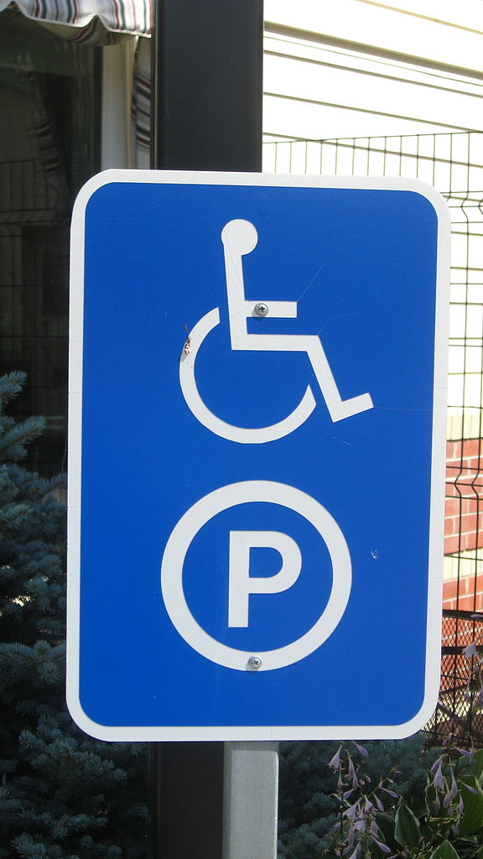
Persons with Disabilities
Reasonable accommodations that do not cause undue hardship must be provided.
A handicap accessible facility considers:
  Parking lot
  Entrances
  Exits
  Hallways
  Elevators
  Restrooms
  Braille signage
Notes:
There is an obligation to ensure that members of the public are provided accommodations in order to access program information, applications and assistance (i.e. Braille, large print, and audio tape)
Handicap Accessible Facilities: This should include the parking lot, entrances, exits, hallways, elevators, restrooms, and Braille signage.

Slide 18
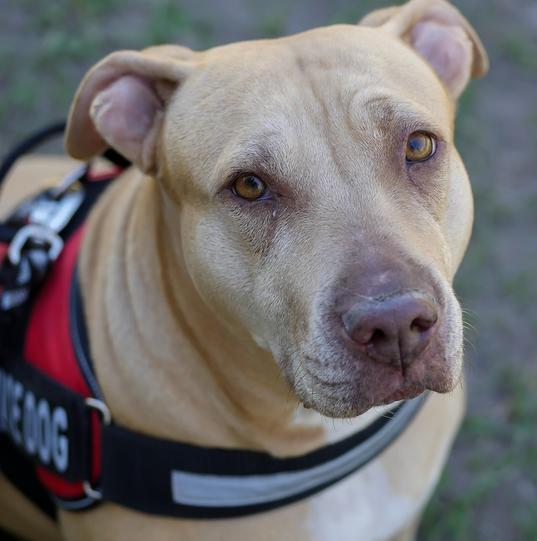
Persons with Disabilities
Always have assistance available for people with disabilities
Provide alternative arrangements for service
Sign language interpreters
Service animals
Notes:
Always have assistance available for people with disabilities
Provide alternative arrangements for service
Sign language interpreters may be needed: Providing American Sign Language (ASL) interpreters for persons with hearing disabilities may be necessary to be able to adequately communicate with these applicants and participants.
Service animals must be allowed in facilities

Slide 19
Civil Rights Complaints
Verbal, written or anonymous
Can be made to any person at any level
Civil rights complaint is based on the 6 protected classes
Other complaints are program complaints
Have specific process and procedures for your agency
Notes:
Can be verbal or written
Must be discrimination based on one or more of the 6 protected classes
Can be made to any volunteer or staff member at the sub-distributor/agency, the RA/food ban, the Florida Department of Agriculture and Consumer Services or USDA
Agencies should have a specific complaint process and procedure
Make sure to recognize the difference between a program complaint and a civil rights complaint. PROGRAM complaints are not civil rights complaints, although equally important, and are NOT based on one of the 6 protected classes. You should have a different complaint process for handling these.
Examples of program complaints:
Classes NOT protected by the TEFAP program
Food Safety/Quality
Customer Service such as standing in a long line to receive the foods

Slide 20
Program Complaints
Program complaints are still very important
Have a different complaint process for handling these
Examples of program complaints
  Not one of the six protected classes
  Food safety/quality issues
  Customer service, such as standing in a long line to receive food
Notes:
Make sure to recognize the difference between a program complaint and a civil rights complaint. PROGRAM complaints are not civil rights complaints, although equally important, and are NOT based on one of the 6 protected classes. You should have a different complaint process for handling these.
Examples of program complaints:
Classes NOT protected by the TEFAP program
Food Safety/Quality
Customer Service such as standing in a long line to receive the foods

Slide 21
Processing a Civil Rights Complaint
Step 1. Supply client with USDA complaint form or take down all information
Step 2. Complaint is filed direct by client or sent to FDACS by agency
Step 3. FDACS notifies USDA
Step 4. Investigation
Notes:
When processing the Civil Rights Complaint;
Step 1. Refer the client to USDA’s website, supply the client with a copy of the USDA complaint form (or your own version) or take down the complaint with as much information as possible.
Step 2. The client may file the complaint directly with USDA. If not, the agency must send through their RA to FDACS.
Step 3. FDACS notifies USDA within 3 days of receiving the complaint.
Step 4. Complaint is investigated and a resolution is determined by USDA.

Slide 22
Handling a Complaint
Handling a Civil Rights Complaint requires careful attention to detail.
Listen to the person making the complaint
Practice good customer service
Write it down using an established form
Immediately move complaint up to person in charge
Notes:
When handling a complaint it is crucial to follow these steps to ensure that it is handled with the upmost attention to detail.

Slide 23
Compliance Reviews
Compliance reviews examine activities to determine Civil Rights compliance
Three types
  Pre-award compliance review
  Routine compliance review
  Special compliance review
Notes:
The purpose of a compliance review is to examine activities to determine Civil Rights compliance.
There are 3 types
Pre-award Compliance Review
Routine Compliance Review
Special Compliance

Slide 24
Pre-Award Compliance Review
Occurs before you receive any food (or financial assistance, if applicable)
Happens at all levels
Notes:
Pre-award compliance reviews for Local Distributing Agencies are conducted by their Contracted Distributing Agency
The RA ensures the agency is ready to comply with Civil Rights regulations before distributing food

Slide 25
Routine Compliance Review
Scheduled
Part of regular program review
Looks for non-discrimination statement on printed
materials, And Justice for All poster, reasonable
accommodations for people with disabilities, etc.
Notes:
A Routine Compliance Review encompasses the following:
Scheduled
Part of a regular program review
- Looks for non-discrimination statement on printed
materials, And Justice for All poster, reasonable
accommodations for people with disabilities, etc.

Slide 26
Special Compliance Reviews
Follow up on previous findings
Investigate reports of noncompliance
Pattern for complaints of discrimination
May be scheduled or unscheduled
Notes:
To follow-up on previous findings of noncompliance;
To investigate reports of noncompliance by other agencies, media, or grassroots organizations;
May be specific to an incident or policy;
History of statistical underrepresentation of particular group(s);
Pattern of complaints of discrimination.
May be scheduled or unscheduled

Slide 27
Resolution of Noncompliance
A factual finding that any civil rights requirement, as provided by law, regulation, policy, instruction, or guidelines, is not being adhered to by a state agency, local agency or sub-recipient.
You will receive written notice indicating:
  Areas of noncompliance
  Action required to correct the situation
Notes:
Definition of Noncompliance: A factual finding that any civil rights requirement, as provided by law, regulation, policy, instruction, or guidelines, is not being adhered to by a state agency, local agency or sub-recipient.
To achieve voluntary compliance, the state agency must provide immediate written notice to the noncomplying agency indicating:
The areas of noncompliance
The action required to correct the situation
The state agency will collaborate with the local agency to achieve compliance.

Slide 28
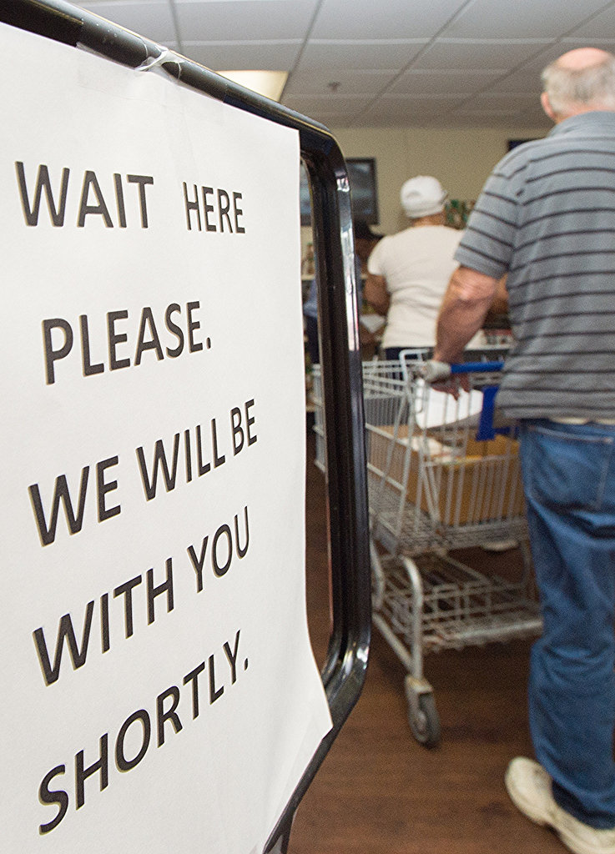
Customer Service
Equal treatment and service for all clients
Make people feel welcomed
Communicate
No special favors
Notes:
Make sure that the clients receive equal treatment and service. “Equal” does not mean “Identical”. For example, one participant can receive corn while another receives green beans.
Make people feel welcomed - Treat everyone with dignity and respect and make people feel welcomed. Be patient and polite.
Communicate – It is important to communicate the clients’ rights as well as the process for picking up food or receiving meals. Respond to any questions in a non-threatening manner.
No special favors - Do not do special favors for anyone that you are not prepared to provide for everyone. Disabilities and Language needs are not considered “special favors” since they are required.

Slide 29
Conflict Resolution
Post your agency’s policy for unacceptable behavior and conflicts
When conflict arises:
  Stay calm
  Don’t interrupt
  Listen, be understanding and do not be judgmental
  Identify the problem and possible solutions
  Follow up with the client
  Get help if you feel threatened or uncomfortable
Notes:
Post your agency’s policy for unacceptable behavior and conflicts
When conflict arises be sure to follow these steps:
Stay calm
Don’t interrupt
Listen, be understanding and do not be judgmental
Identify the problem and possible solutions
Follow up with the client
Get help if you feel threatened or uncomfortable

Slide 30
Beneficiary Protections: Written Notice
Per 7 CFR Part 16.4(f)
Faith-based or religious organizations that receive USDA foods or administrative funds for TEFAP or must give written notice as prescribed by policy FD-138 to prospective participants/applicants of the right to be referred to an alternate provider when available

Slide 31
Beneficiary Protections: Referrals
Religious organizations providing TEFAP services can comply with the federal regulations and meet the requirements of this guidance by posting a written notice, which includes a complete list of beneficiary protections as described, at the distribution locations in a prominent place visible to all participants and prospective participants
This exception applies only to TEFAP
For religious organizations operating , individual written notice of beneficiary protections provided under 7 CFR Part 16, including the right to be referred to another organization, must be given to all applicants at the time that they apply for benefits

Slide 32
Beneficiary Protections: Referrals
If a participant or prospective participant objects to the religious character of an organization that provides TEFAP/, that organization must promptly make reasonable efforts to identify and refer the participant to an alternate provider, if available, to which the prospective participant has no objection
Notes:
In some cases, a referral option may not be available. What constitutes “reasonable efforts” will depend on the situation. Organizations should at a minimum attempt to identify an alternative provider, determine what services the alternative provider offers, and determine whether the alternative provider is accepting new referrals.

Slide 33
Beneficiary Protections: Referrals
The referral must be to an alternate provider, if available, that:
  Is in reasonable geographic proximity
  Offers services that are similar in substance and quality
  Has the capacity to accept additional clients

Slide 34
Beneficiary Protections: Referrals
Recipient Agencies may assist their local distributing agencies by providing them with information regarding alternate providers.
Examples: Websites, hotlines or a list of other agencies in the proximity providing TEFAP, and non-TEFAP foods or .

Slide 35


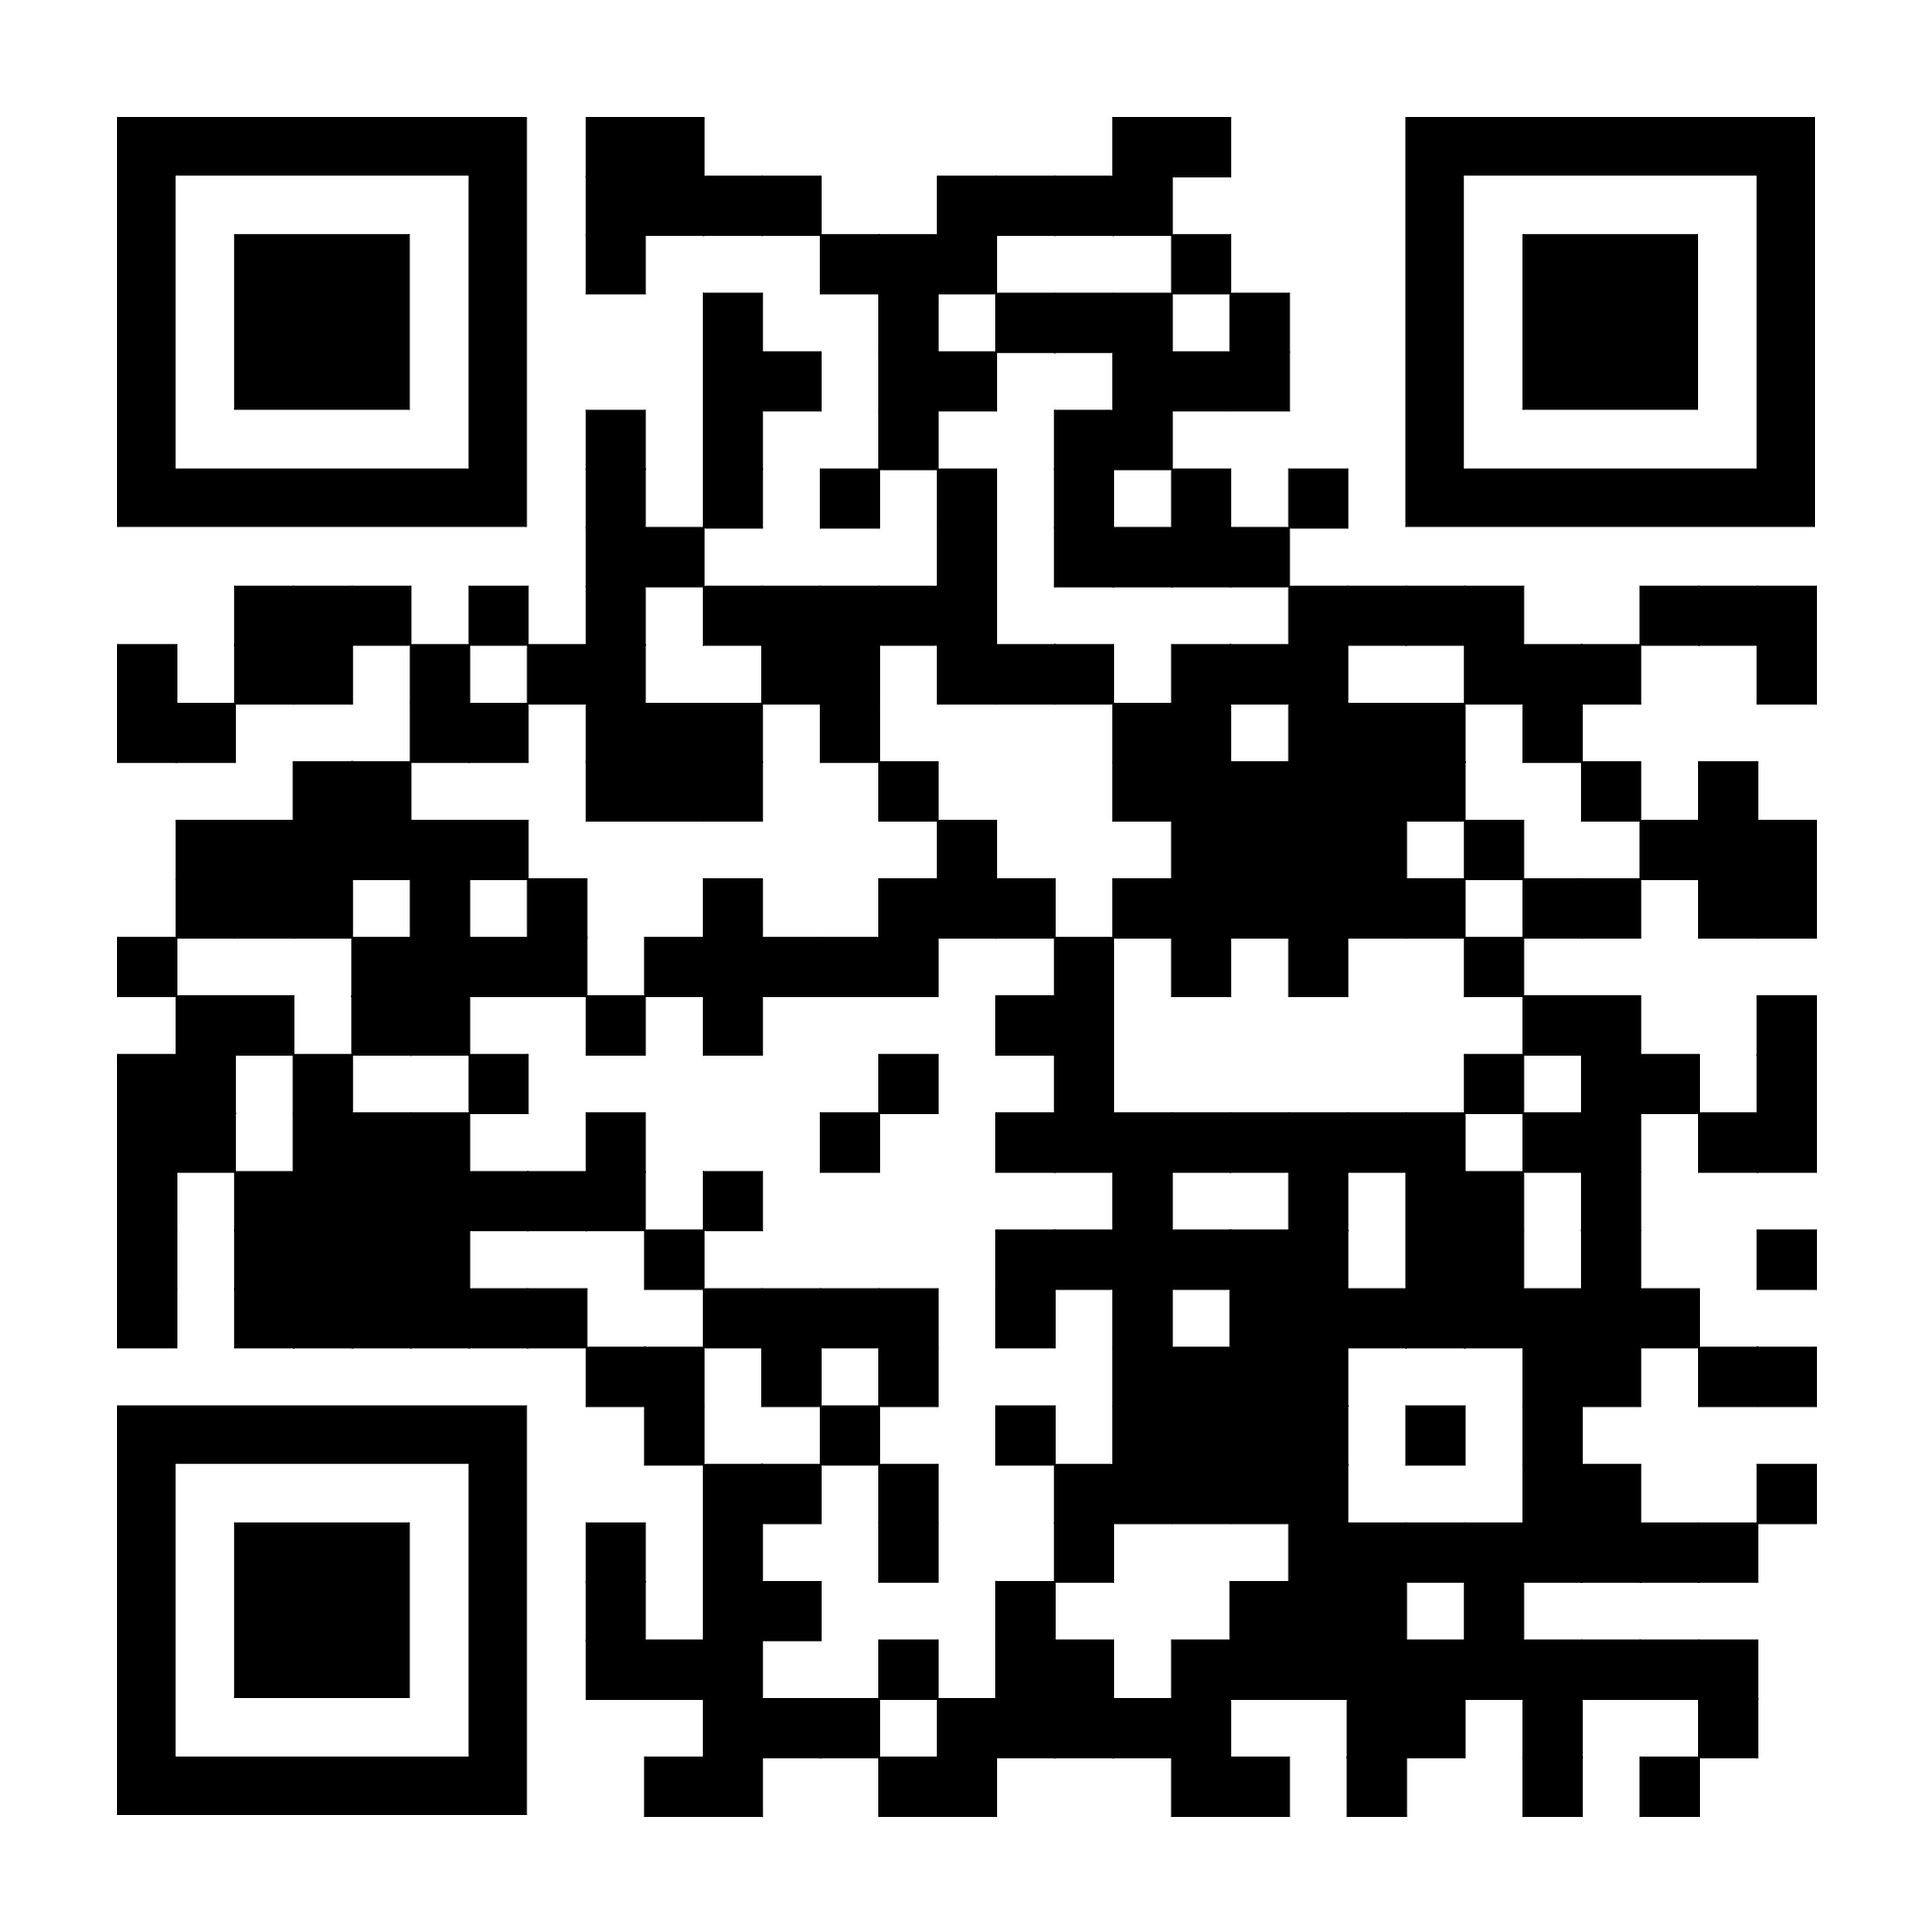

Contact us at:
Email: Agency@pbcfoodbank.org
or
Phone #: 561-670-2518
Liz Cabral (Director of Programs) ext. 304
Johanna Robert (Programs Specialist) ext. 313
PBCFB Partner Marketplace

