Slide 1
Microchipping Media
A collection of media, including videos, regarding the implant location of a nasal microchip.
If the videos do not play, you may have to update your media player.

Slide 2
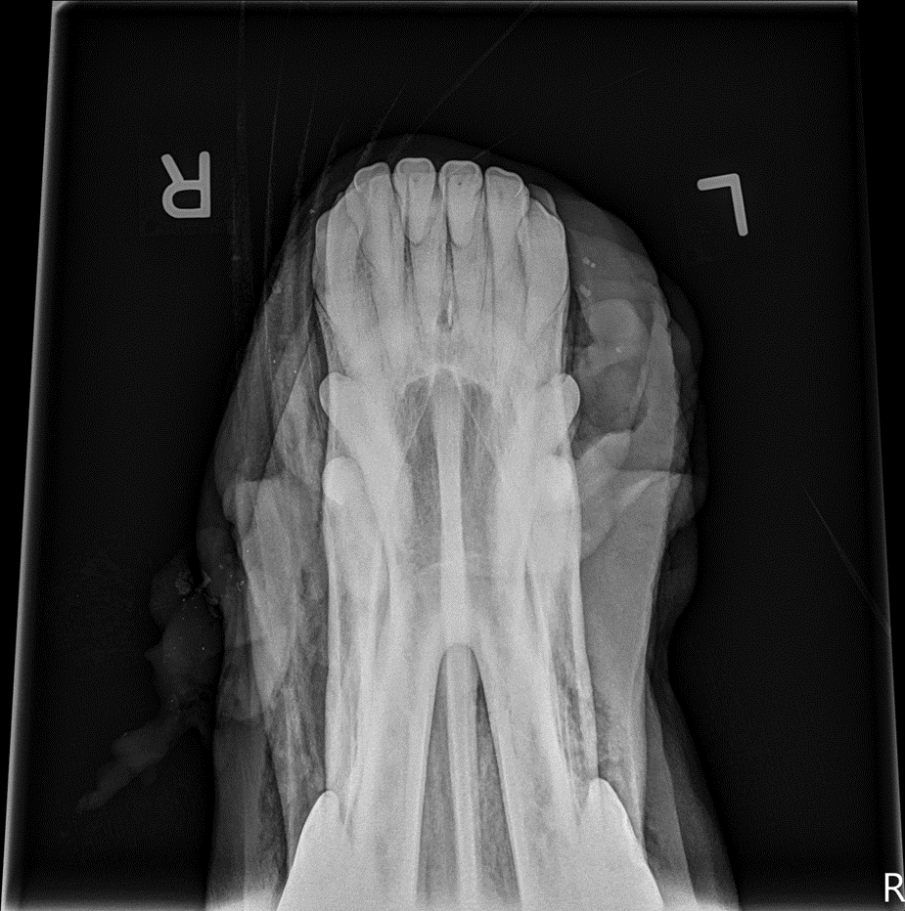
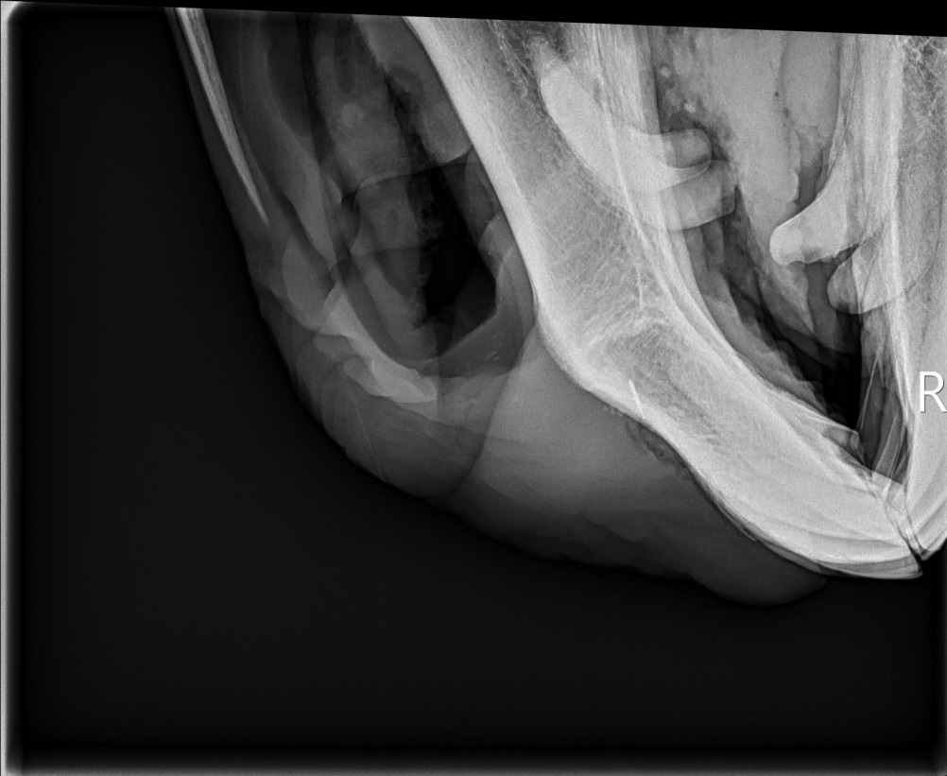
Microchip Location
The implant location of a nasal microchip occurs on the upper midline frenulum with the microchip ending up in the rostral interincisive canal.

Slide 3
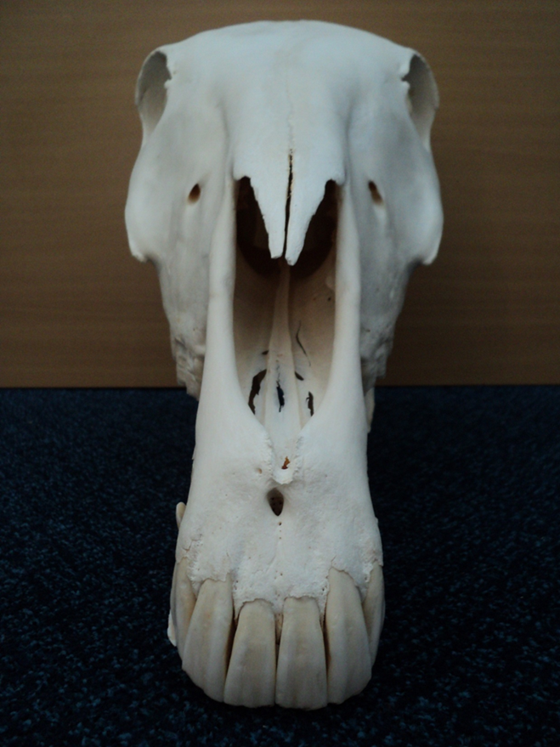
Rostral Interincisive Canal

Slide 4
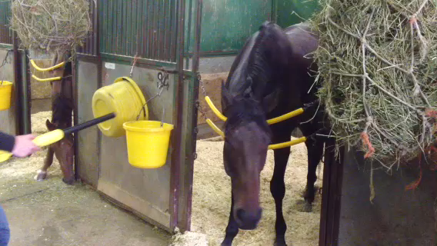
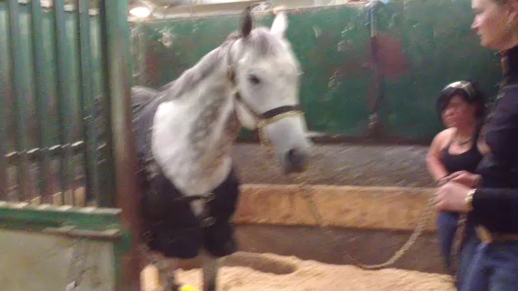
Scanning Horses The videos on the next two slides demonstrate that with a nasal microchip implant, it is easier and safer to scan horses than if the horse had a nuchal ligament microchip implant.
Scanning the neck and nose, on a restrained and unrestrained horse.
With a nasal microchip implant location, we are using the horse’s natural behaviour of investigating new objects with their noses when they are scanned for a microchip number.

Slide 5
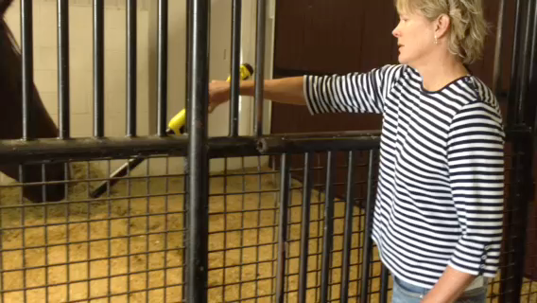
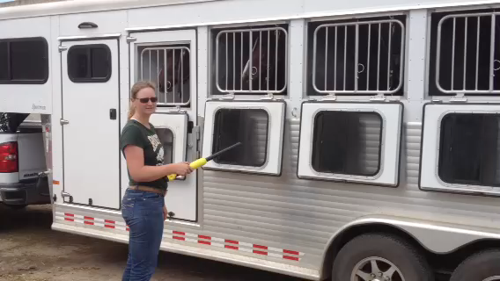
Scanning Horses Nasal microchip implants allow for faster and easier identification of horses.

Slide 6
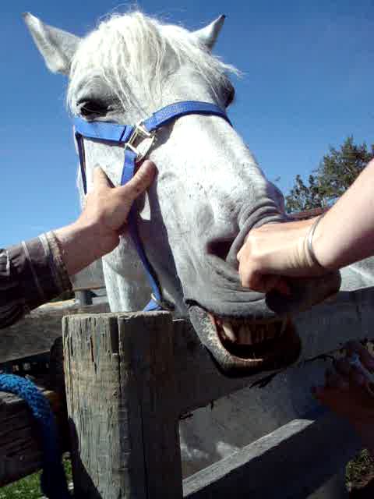
The Nasal Microchip Implant Procedure
There is no need for any preparation of the nasal area prior to implanting the microchip.

Slide 7
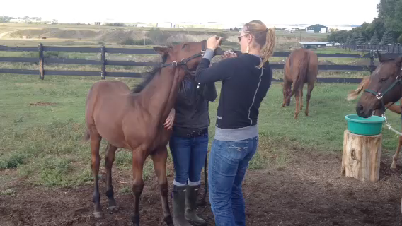
The Nasal Microchip Implant Procedure
It is a quick procedure that may require some restraint, and should not require any sedation.

Slide 8
Conclusion
The new alternative microchip implant location in the nasal area was chosen for several reasons:
First and foremost the ease of scanning the nose and in-turn the safety of horse and handler.
There is no preparation needed for a nasal implant compared to a nuchal ligament implant.
There is no confusion as to the location of a microchip implanted in the nasal area, compared to the “neck area” (poll, withers, mid-neck, my left, the horses left etc…).
There is a next to negligible loss and rate of migration of a microchip implanted in the nasal area.
Oral tissue is ideal for implantation with very rapid healing and lack of scar tissue formation.
The nasal area implant provides an opportunity to work with a horse’s natural behavior, which allows for reading horses in situations without restraint.
Of the nearly 1700 horses chipped so far, with the majority of them being Thoroughbreds on farm and at the track, not one horse as of yet has offered to strike or move towards the person performing the procedure in any aggressive manner.
Chips have been inserted into horses that have a lip twitch as well and this works nicely.

Slide 9
Quick Numbers & Facts
Over 1700 horses (as of January 1, 2017) have been microchipped with a nasal implant since 2014.
All registered Thoroughbreds, starting with the foal crop of 2017 will require a microchip to complete the registration process, either nasal area or nuchal ligament.
Registered Thoroughbred horse born prior to 2017 may or may not have a microchip implant (nasal area or nuchal ligament).
Check the registration papers and scan the nose and the neck for a microchip.
Retention rate is >99% - if the nasal microchip implant remains after 24 hours, there will be negligible migration or loss.
Sedation rate is <99.8% - very few horses require sedation, if at all. It depends on the comfort level of the handler and the one performing the implant procedure.
Animal Health Technologists and farm managers can and have been trained and are successfully using the nasal implant location.
International Standards Organization (ISO) are engaged and interested in this new microchip implant location and technique.

Slide 10
Contact Information
Canadian Thoroughbred Horse Society (National Office)
Phone: 416-675-1370 Fax: 416-675-9405 E-mail: info@cthsnational.com Web Site: www.cthsnational.com
National General Manager: Caitlin Grguric
Canadian Thoroughbred Horse Society (Alberta Division)
Phone: 403-229-3609 Fax: 403-244-6909 E-mail: cthsweb@cthsalta.com Web Site: www.cthsalta.com
General Manager: Jean Kruse
Canadian Thoroughbred Horse Society (British Columbia Division)
Phone: 604-534-0415 Fax: 4604-534-2847 E-mail: cthsbc@cthsbc.org Web Site: www.cthsbc.com
General Manager: Bette-Jean (B-J) Davidson
Canadian Thoroughbred Horse Society (Manitoba Division)
Phone: 204-832-1702 Fax: 204-831-6735 E-mail: cthsmb@mymts.net Web Site: www.cthsmb.com
General Manager: Jill Withers
Canadian Thoroughbred Horse Society (Ontario Division)
Phone: 416-675-3602 Fax: 416-675-9405 E-mail: cthsont@idirect.com Web Site: www.cthsont.com
General Manager: Julie Coulter
Heather Matheson-Bird (Alberta Thoroughbred Microchipping Project Manager)
Cell: 403-554-7542 E-mail: mitchellmatheson@yahoo.ca
Adrienne Herron, Traceability Systems Specialist/Provincial Equine Specialist, Alberta Agriculture and Forestry
Cell: 403-755-2047 E-mail: Adrienne.herron@gov.ab.ca

