Slide 1
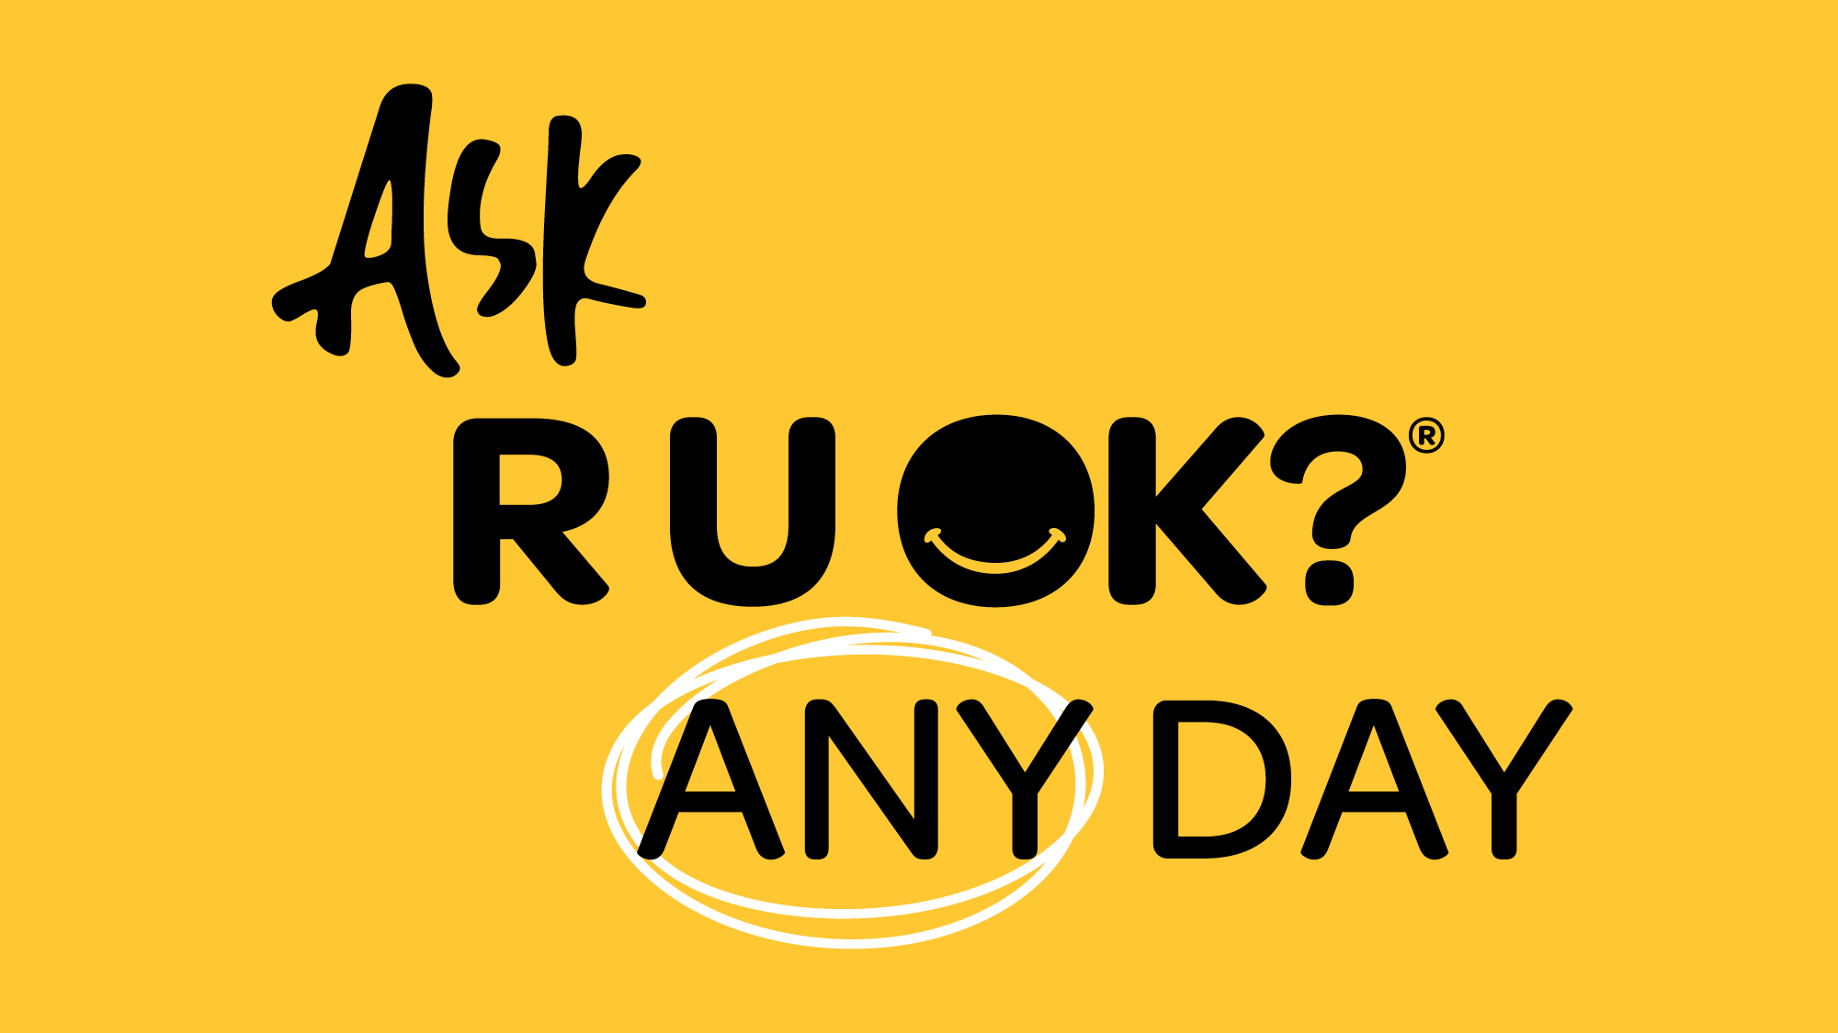
Notes:
Introduce yourself.
Share why the R U OK? message matters to you personally and why you chose to become a Workplace Champion.

Slide 2
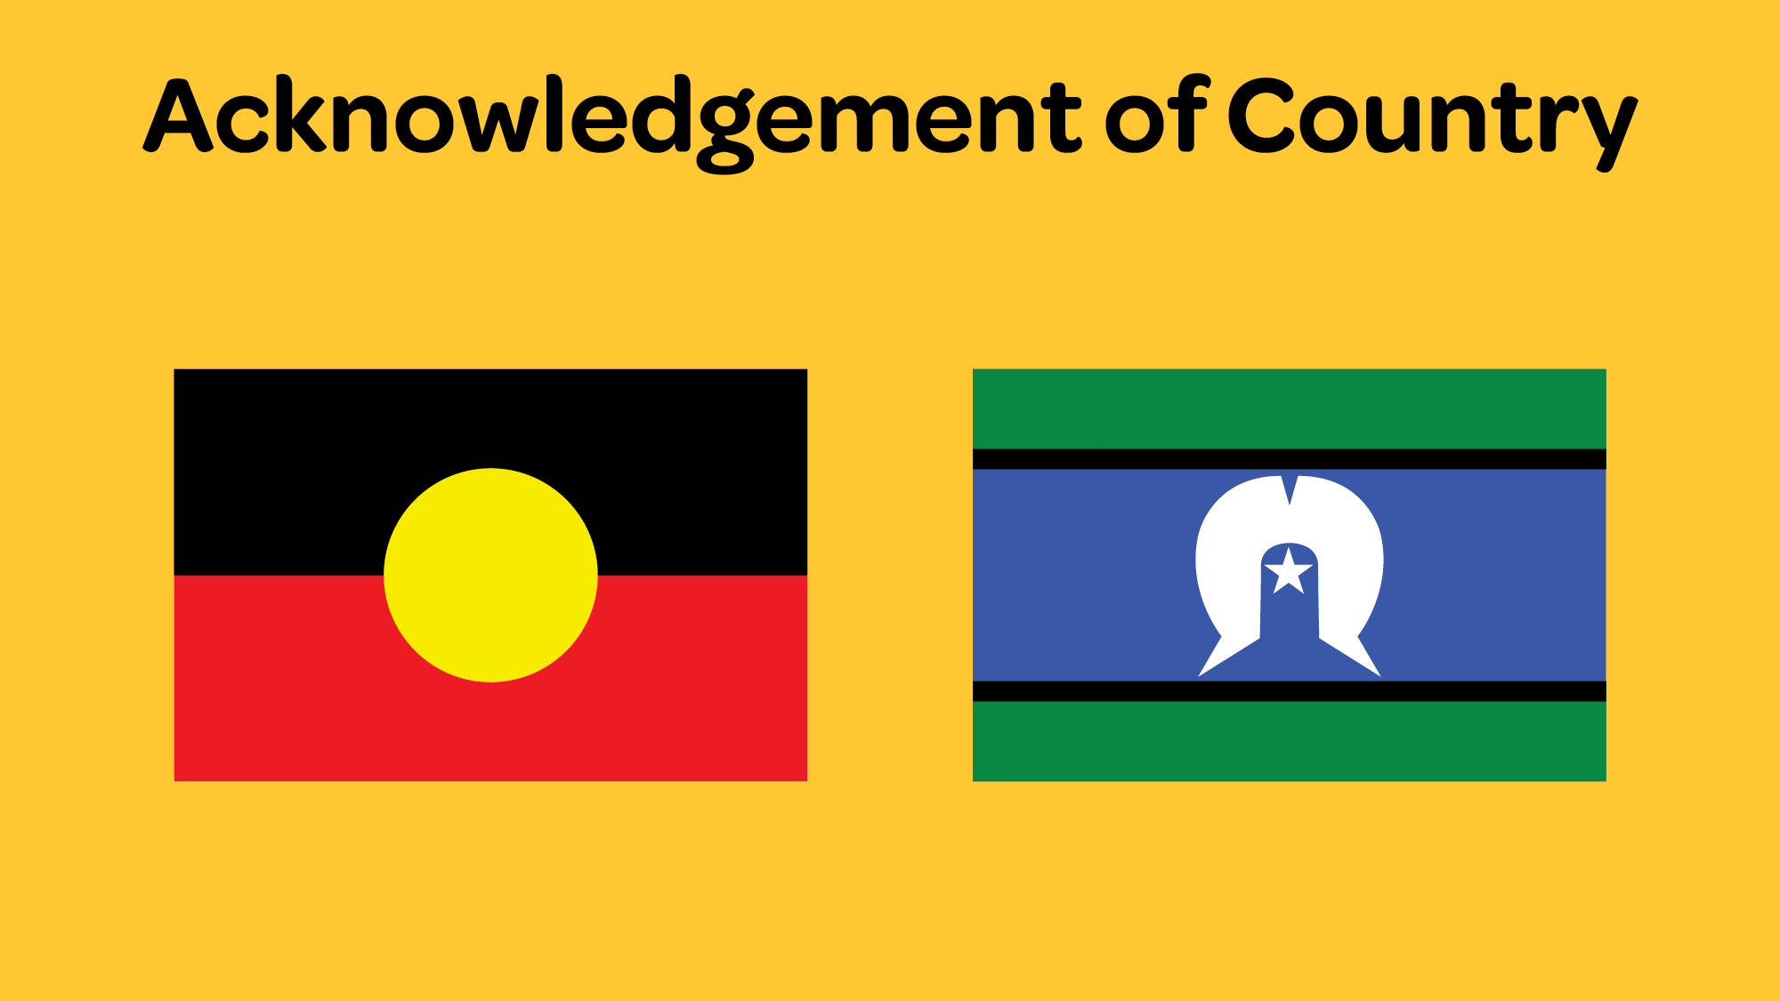
Notes:
Acknowledgement of Country
I acknowledge the Traditional Owners of the land on which we are meeting today and pay my respect to Elders past, present and future.

Slide 3
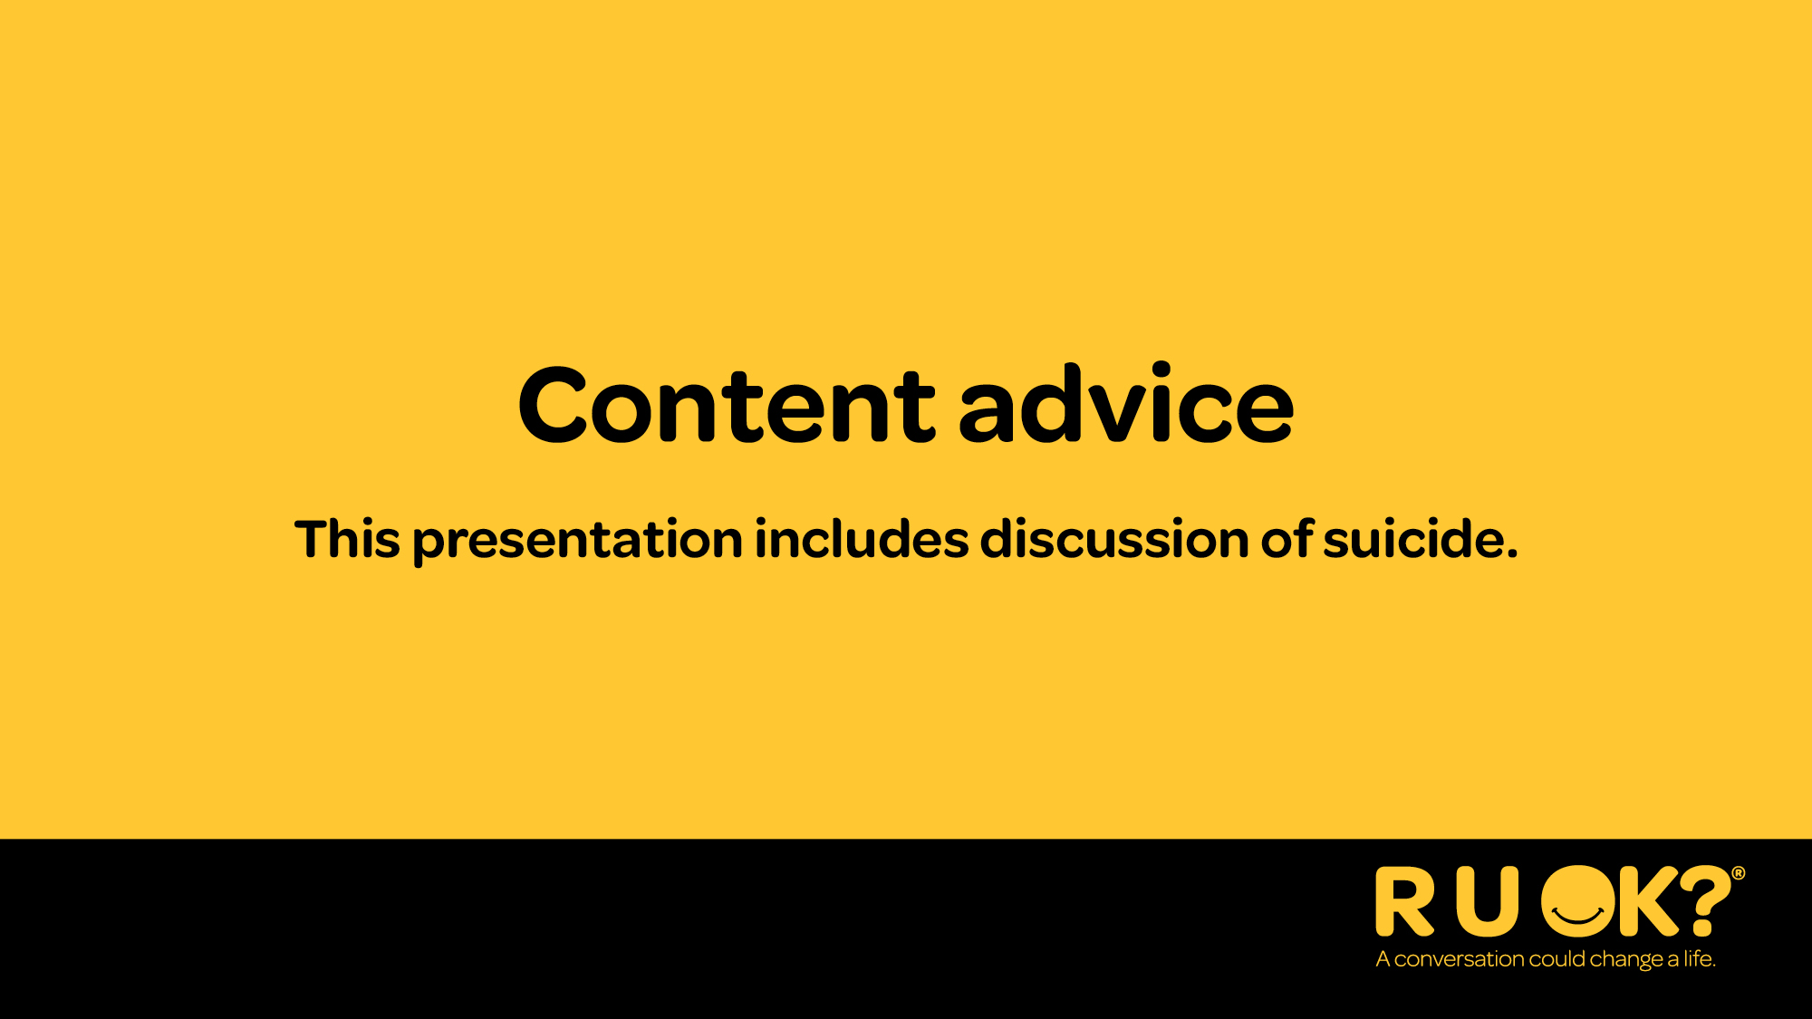
Notes:
Recognise lived experience
I’d also like to take this moment to recognise those with lived or living experience of mental ill-health or suicide.
Sometimes talking about mental health and wellbeing can bring up tough emotions. If today’s talk brings anything up for you, it’s OK to excuse yourself.
If you need some extra support, I strongly encourage you to open-up to someone you trust, connect with a trusted health professional, or access a support service like Lifeline which is available 24/7 on 13 11 14.
You can find other services and support organisations on the R U OK? website at ruok.org.au/findhelp.
If available and relevant you can also:
Identify the location of a quiet/safe space people can go to if they need to excuse themselves.
Mention information about how to access the Employee Assistance Program (EAP) or any other support person/services that may be in attendance.

Slide 4
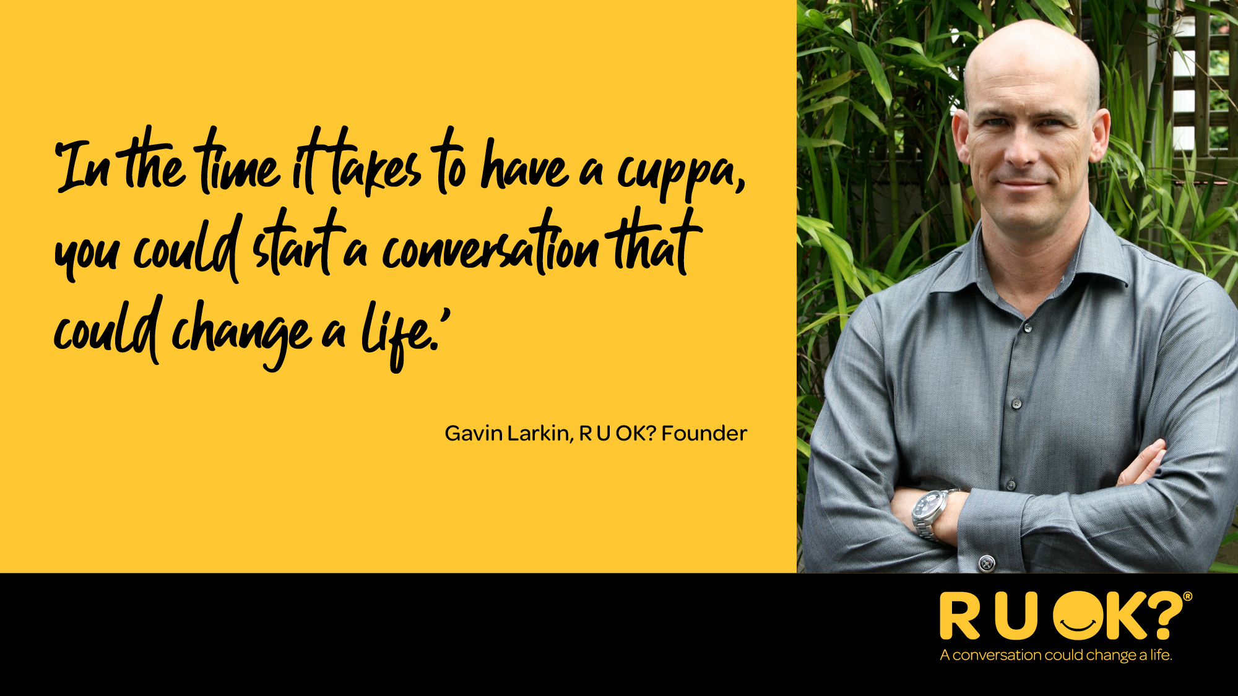
Notes:
R U OK? is a public health promotion and suicide prevention charity.
The late Gavin Larkin started R U OK? in 2009, hoping to protect others from experiencing the pain his family felt when his father died by suicide. (Lived experience).
He believed that ‘in the time it takes to have a cuppa, you could start a conversation that could change a life’.
This belief is backed by academic research that found feelings of connection and belonging are protective factors against suicide.

Slide 5
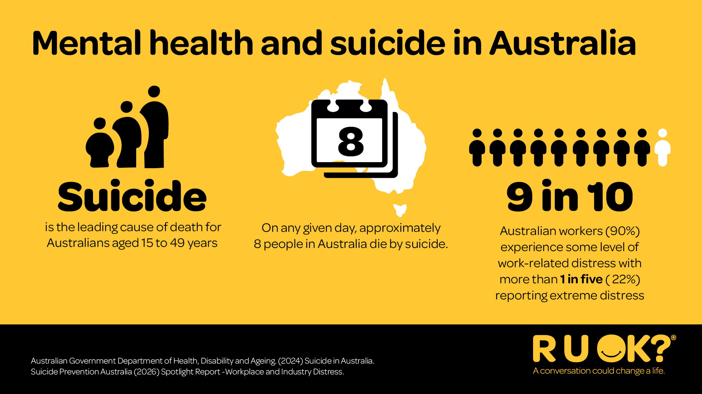
Notes:
Every day, many Australians are dealing with challenges we can’t always see.
Suicide remains the leading cause of death for Australians aged 15–49.
Around 9 in 10 Australian workers experience work-related stress, and one in five report experiencing extreme distress.
Financial pressure, relationship changes, illness, grief, caring responsibilities and work pressures can all affect how someone is coping.
That’s why checking in shouldn’t be reserved for one day of the year.

Slide 6
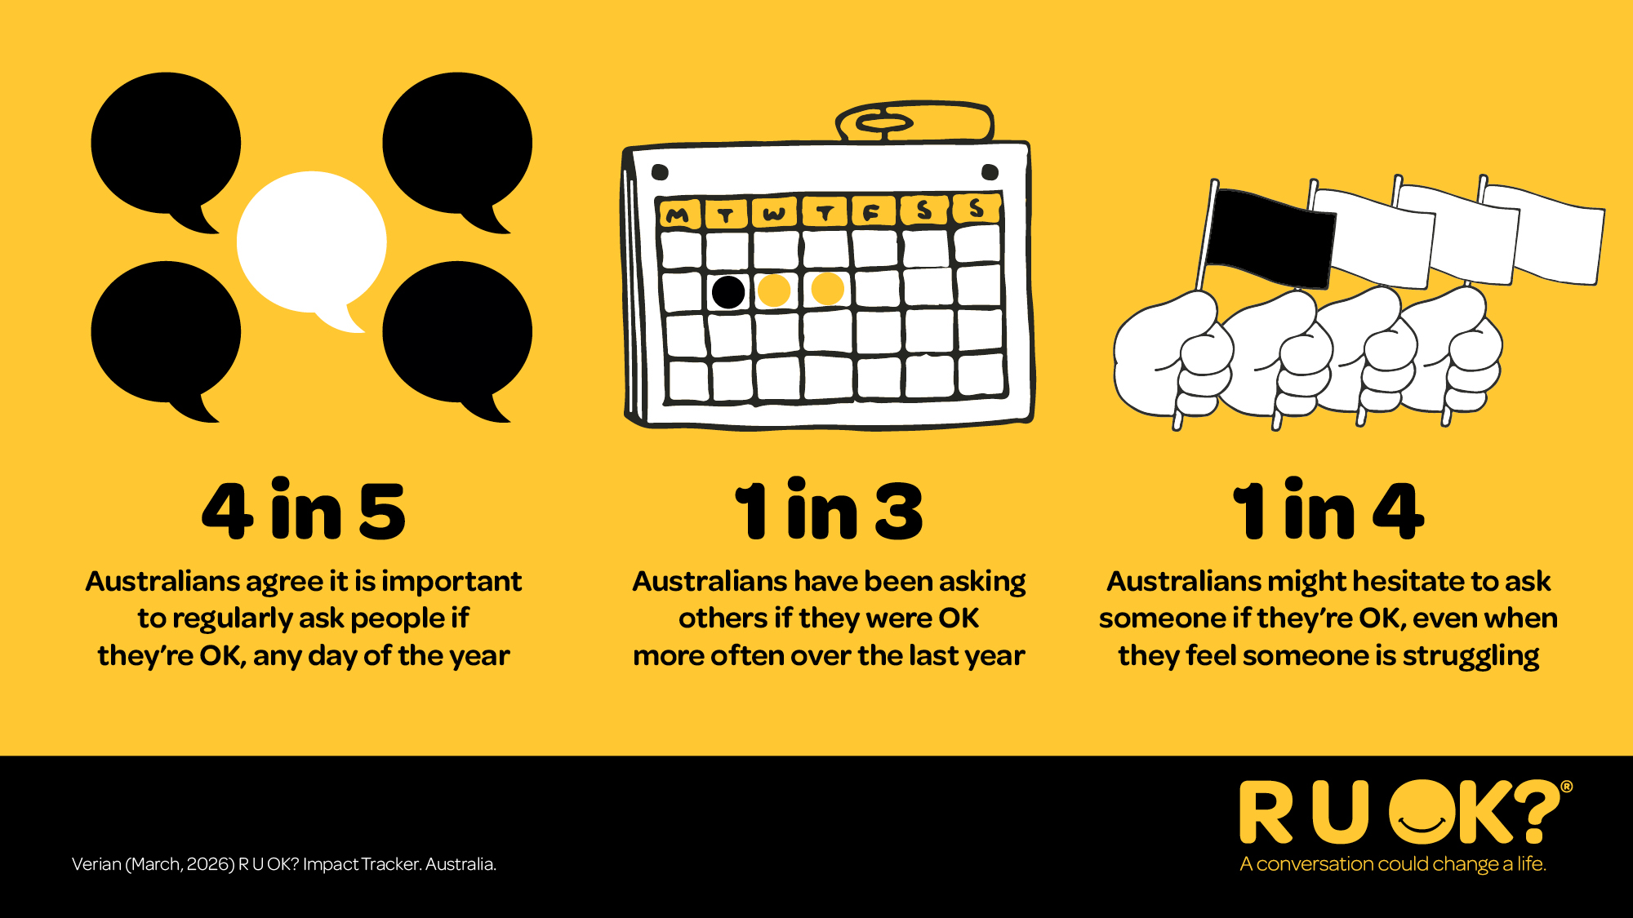
Notes:
The good news is that more Australians understand the importance of checking in with the people around them.
Four in five Australians agree it’s important to ask R U OK? Regularly - not just on R U OK? Day.
One in three Australians say they’ve been asking people if they’re OK more often over the past year.
But one in four still hesitate, even when they think someone might be struggling.
That’s exactly why this year’s message is so simple: If you’re thinking it, ask it.

Slide 7
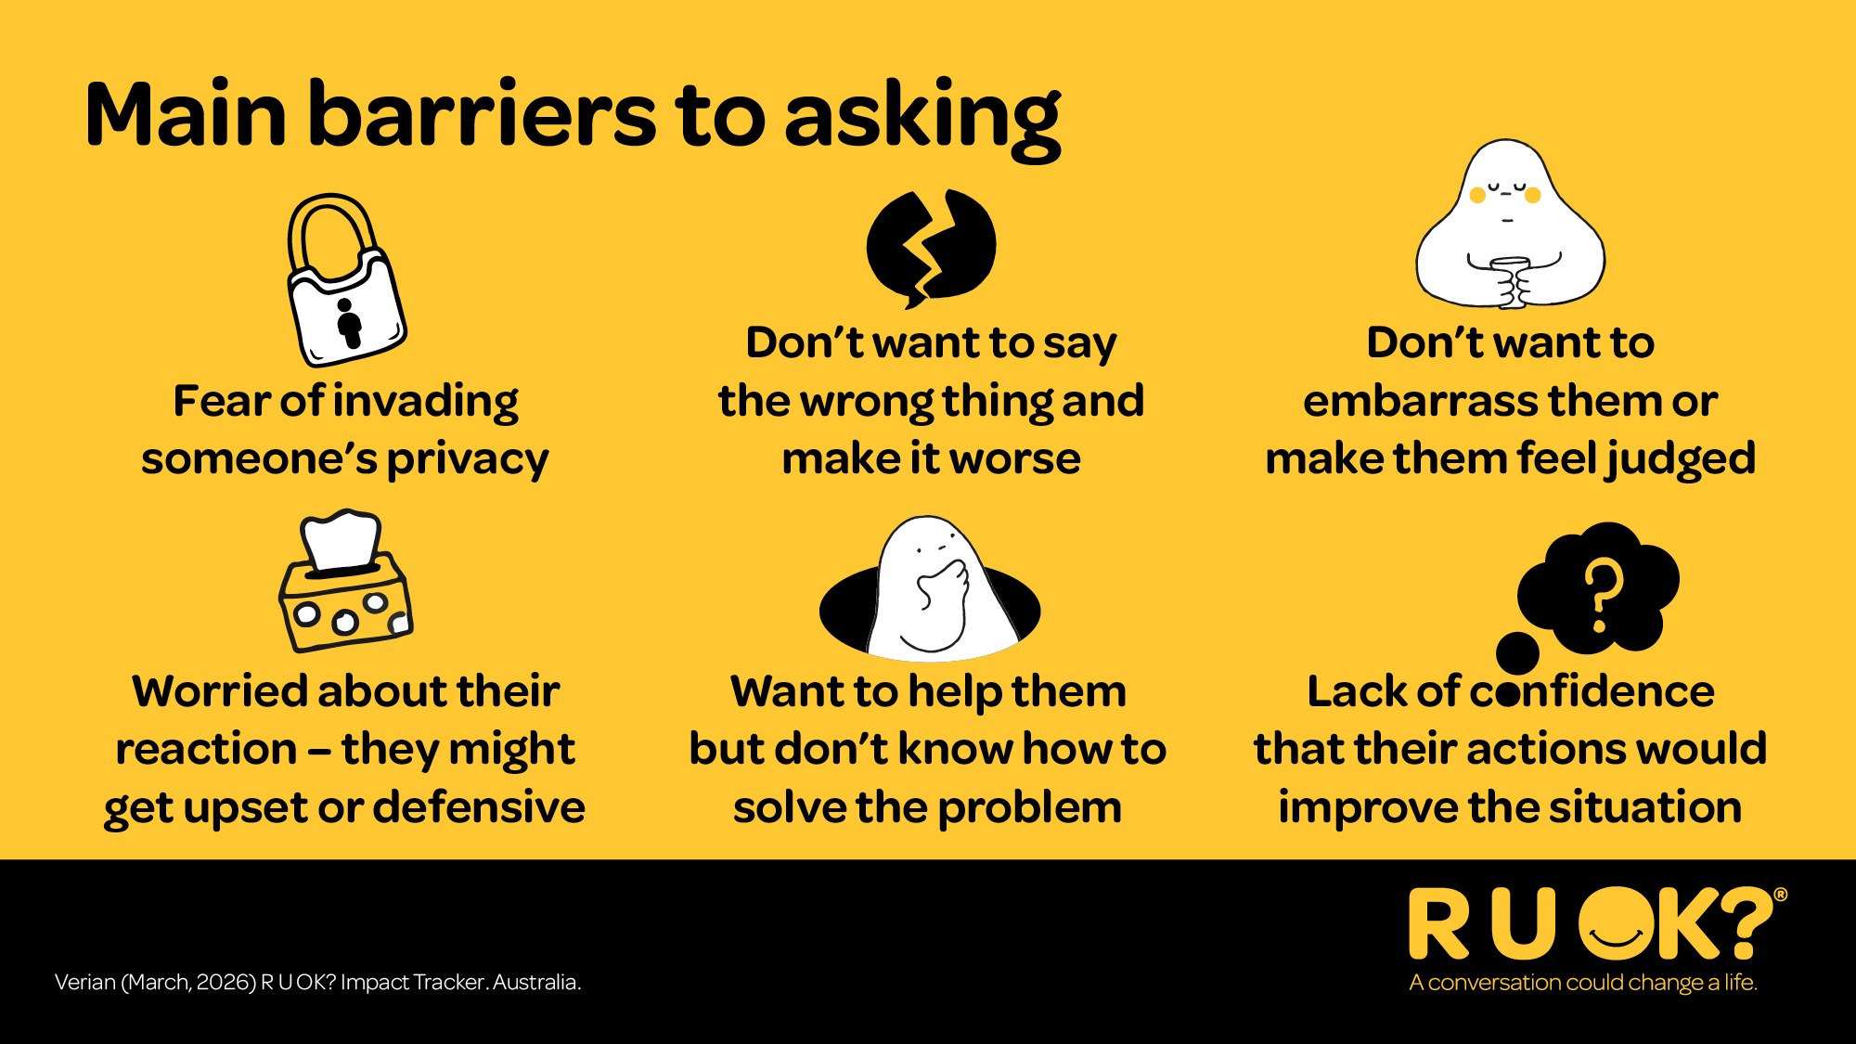
Notes:
If asking “Are you OK?” is so important, why do we sometimes hesitate?
Many of us worry we’ll say the wrong thing, make things worse, invade someone’s privacy or not know what to do next.
Others worry about how the person might respond.
These feelings are completely normal—but they shouldn’t stop us from reaching out.
Audience question
What are some reasons you’ve hesitated to ask someone if they’re OK?

Slide 8
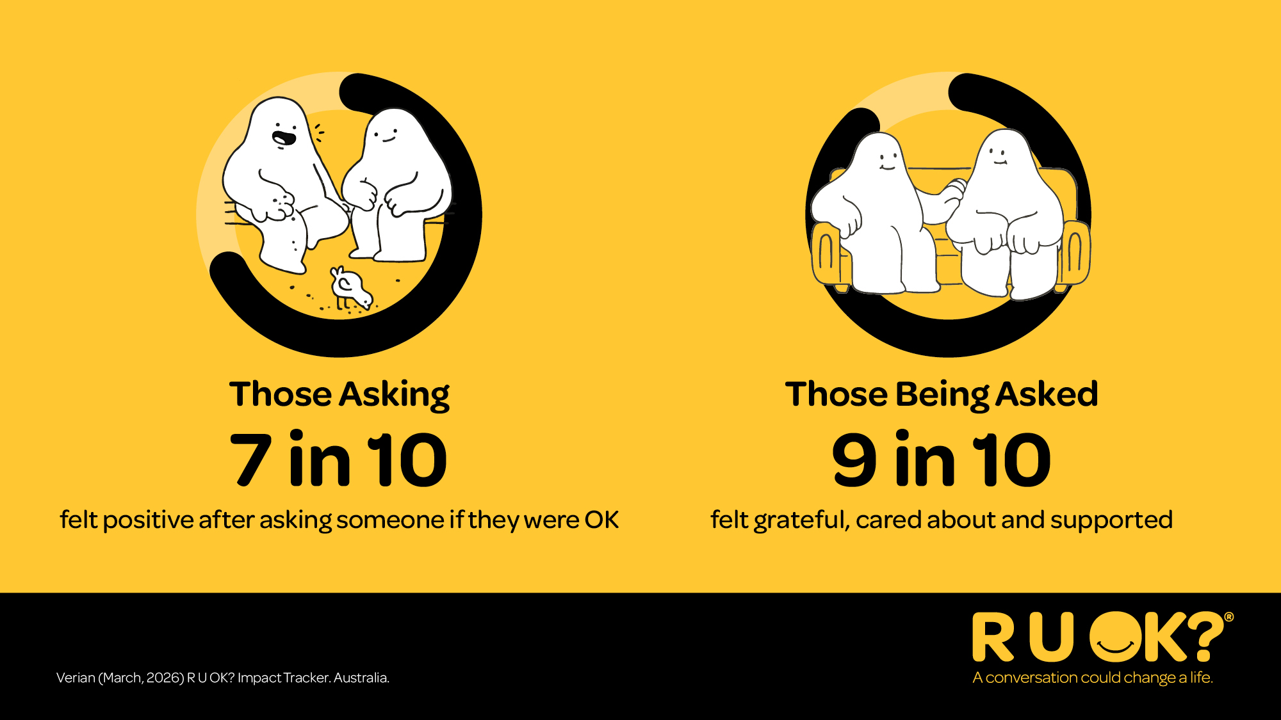
Notes:
We often underestimate how much a simple conversation can mean.
Seven in ten people say they felt positive after asking someone if they were OK.
Nine in ten people say they felt cared for, supported and grateful when someone checked in with them.
You don’t need the perfect words. Simply showing someone you’ve noticed can make a real difference.

Slide 9

Notes:
That’s why R U OK? is calling on all of us to continually: Ask R U OK? Any Day.
R U OK?Day is a reminder but it’s what we do regularly that truly makes a difference.

Slide 10
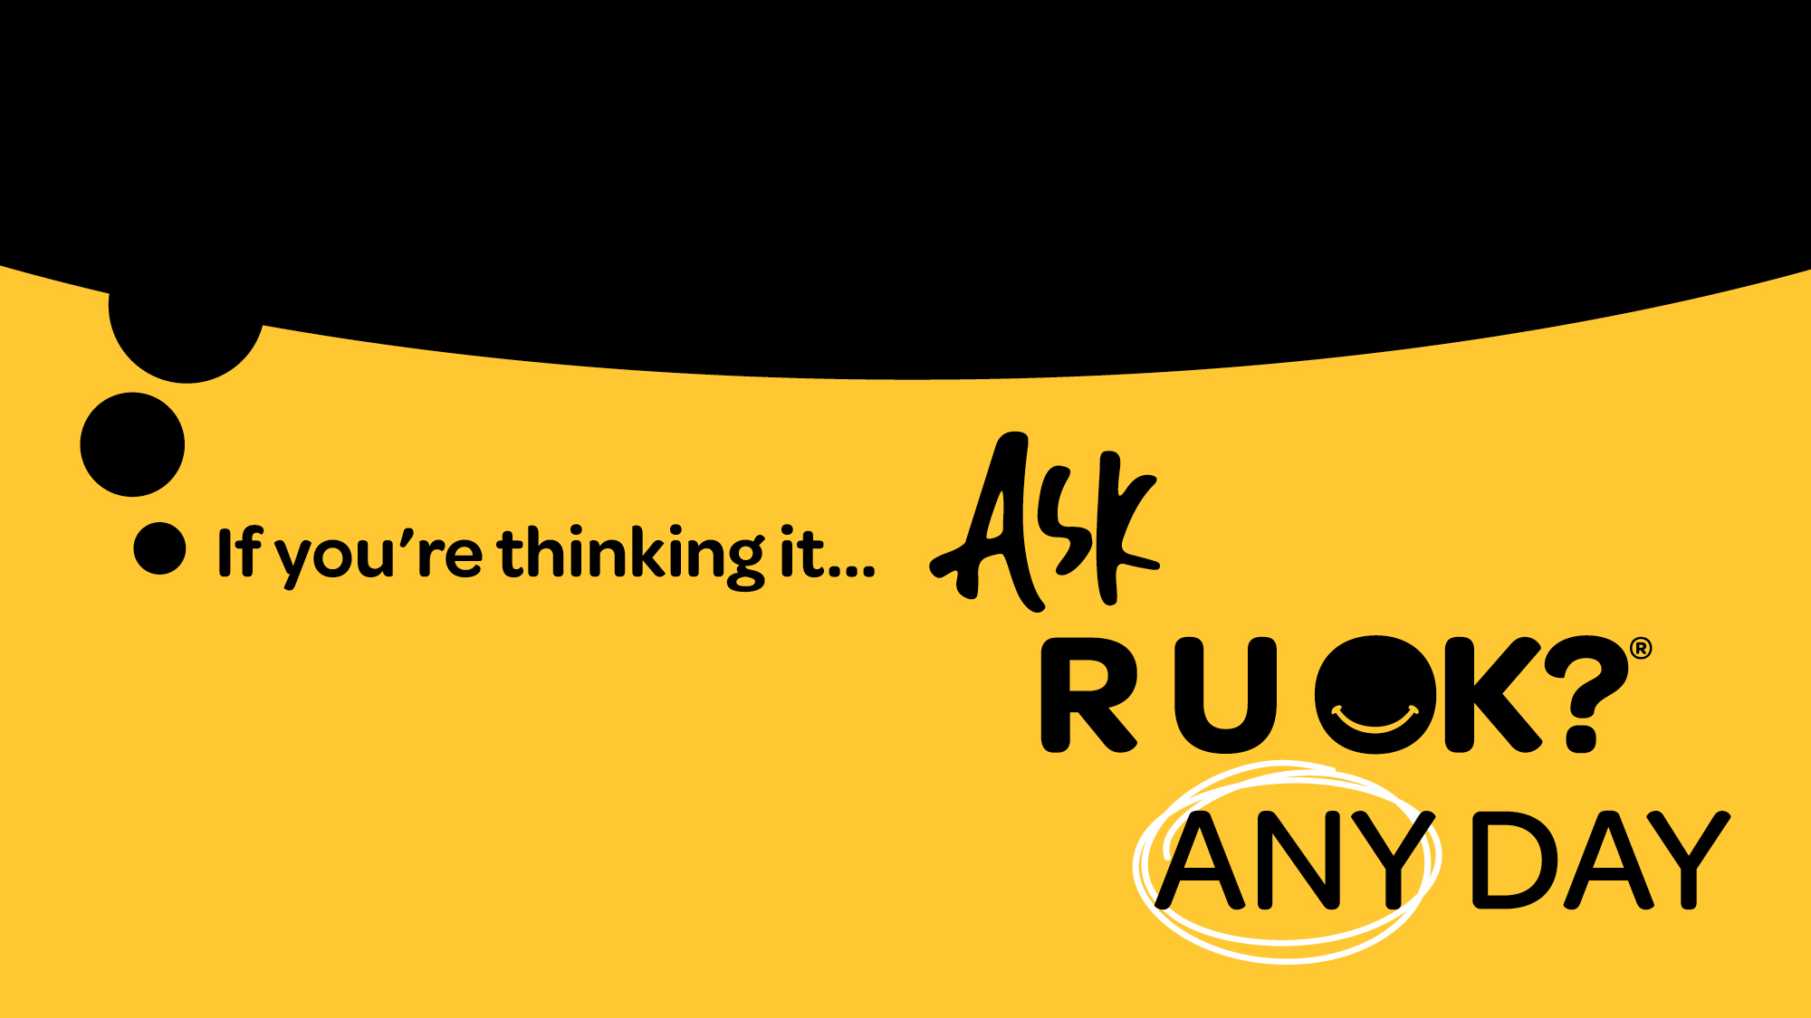
Notes:
This year’s message is simple.
If someone doesn’t seem quite themselves…
If you notice a change…
If you know they’re going through a difficult time…
Don’t wait for the perfect words or the perfect moment. If you’re thinking it, ask R U OK? Any Day.

Slide 11
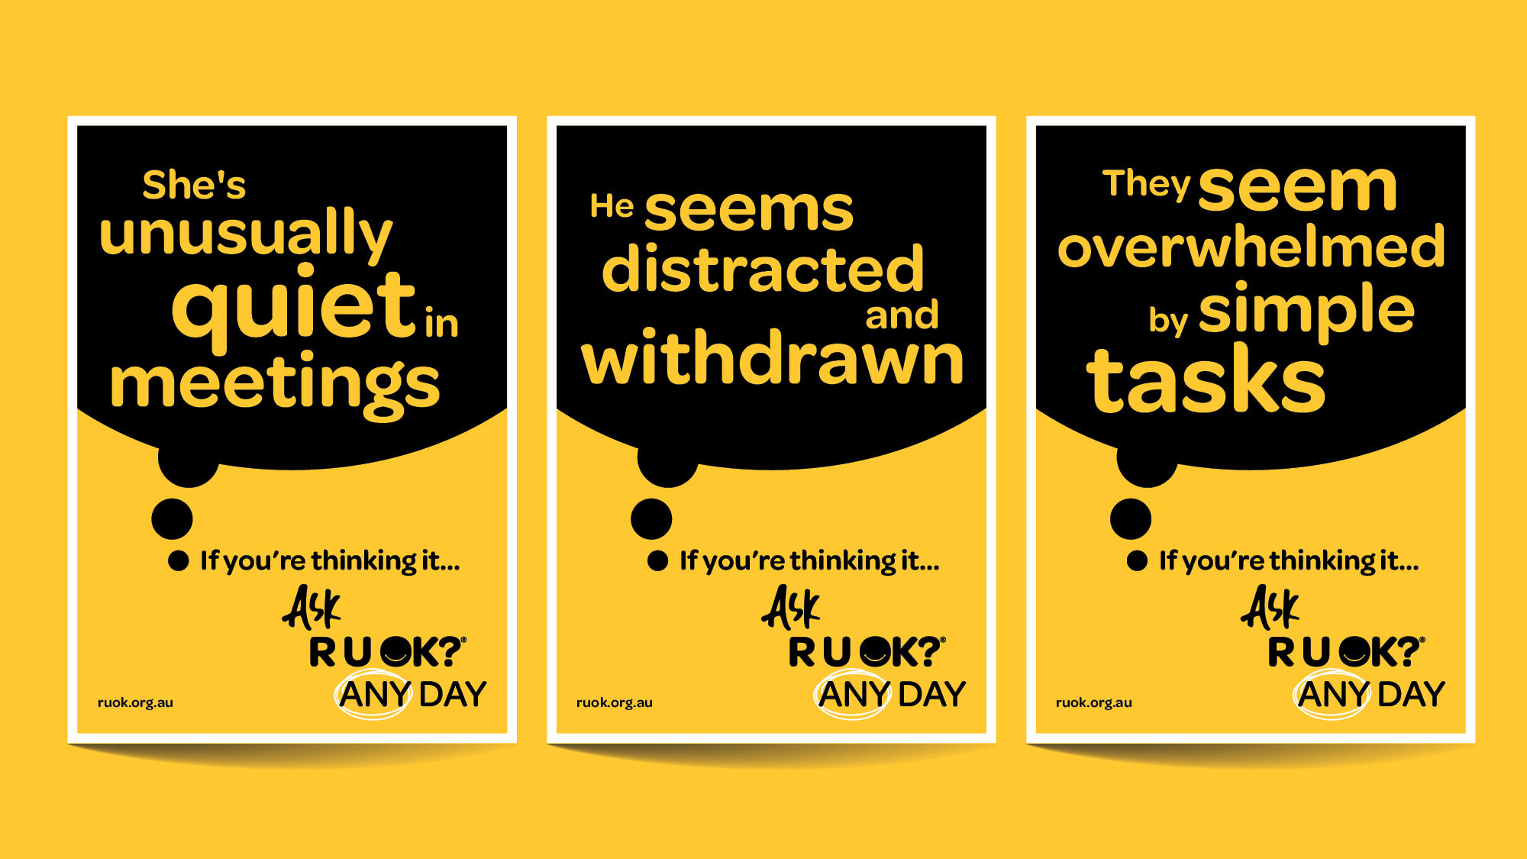
Notes:
There’s no single sign that tells us someone isn’t coping.
Sometimes the changes are obvious. Sometimes they’re subtle.
Someone might seem quieter than usual, more withdrawn, distracted or overwhelmed.
Or maybe nothing obvious has changed - you just have a feeling something isn’t right.
Trust that instinct. If you’re thinking it, ask it.

Slide 12
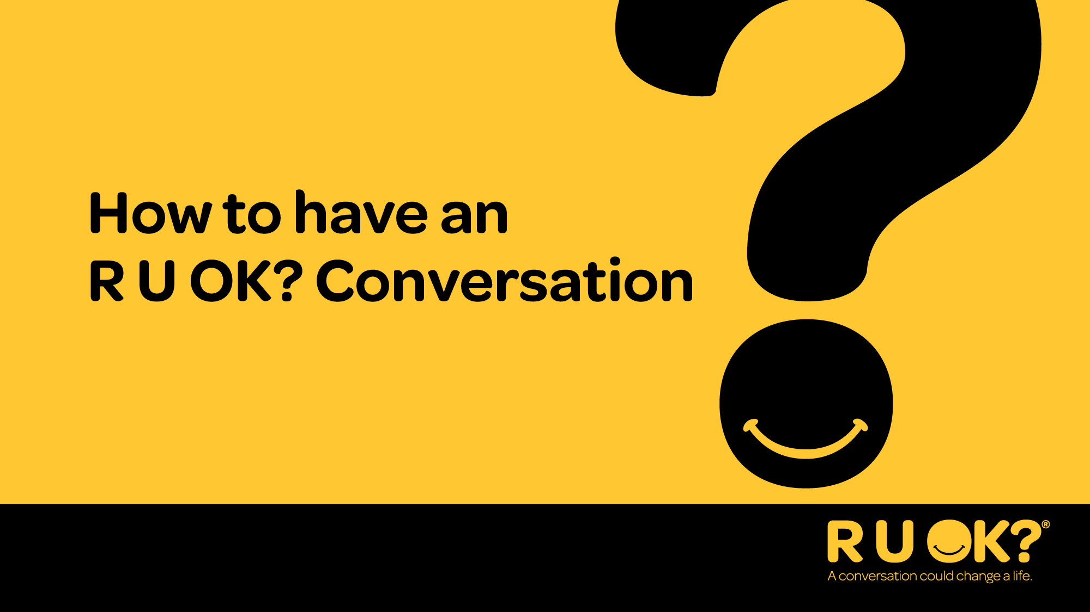
Notes:
Now let’s look at how to have an R U OK? Conversation.
Remember, it’s not about saying everything perfectly. It’s about showing someone you’ve noticed, you care and you’re willing to listen.

Slide 13
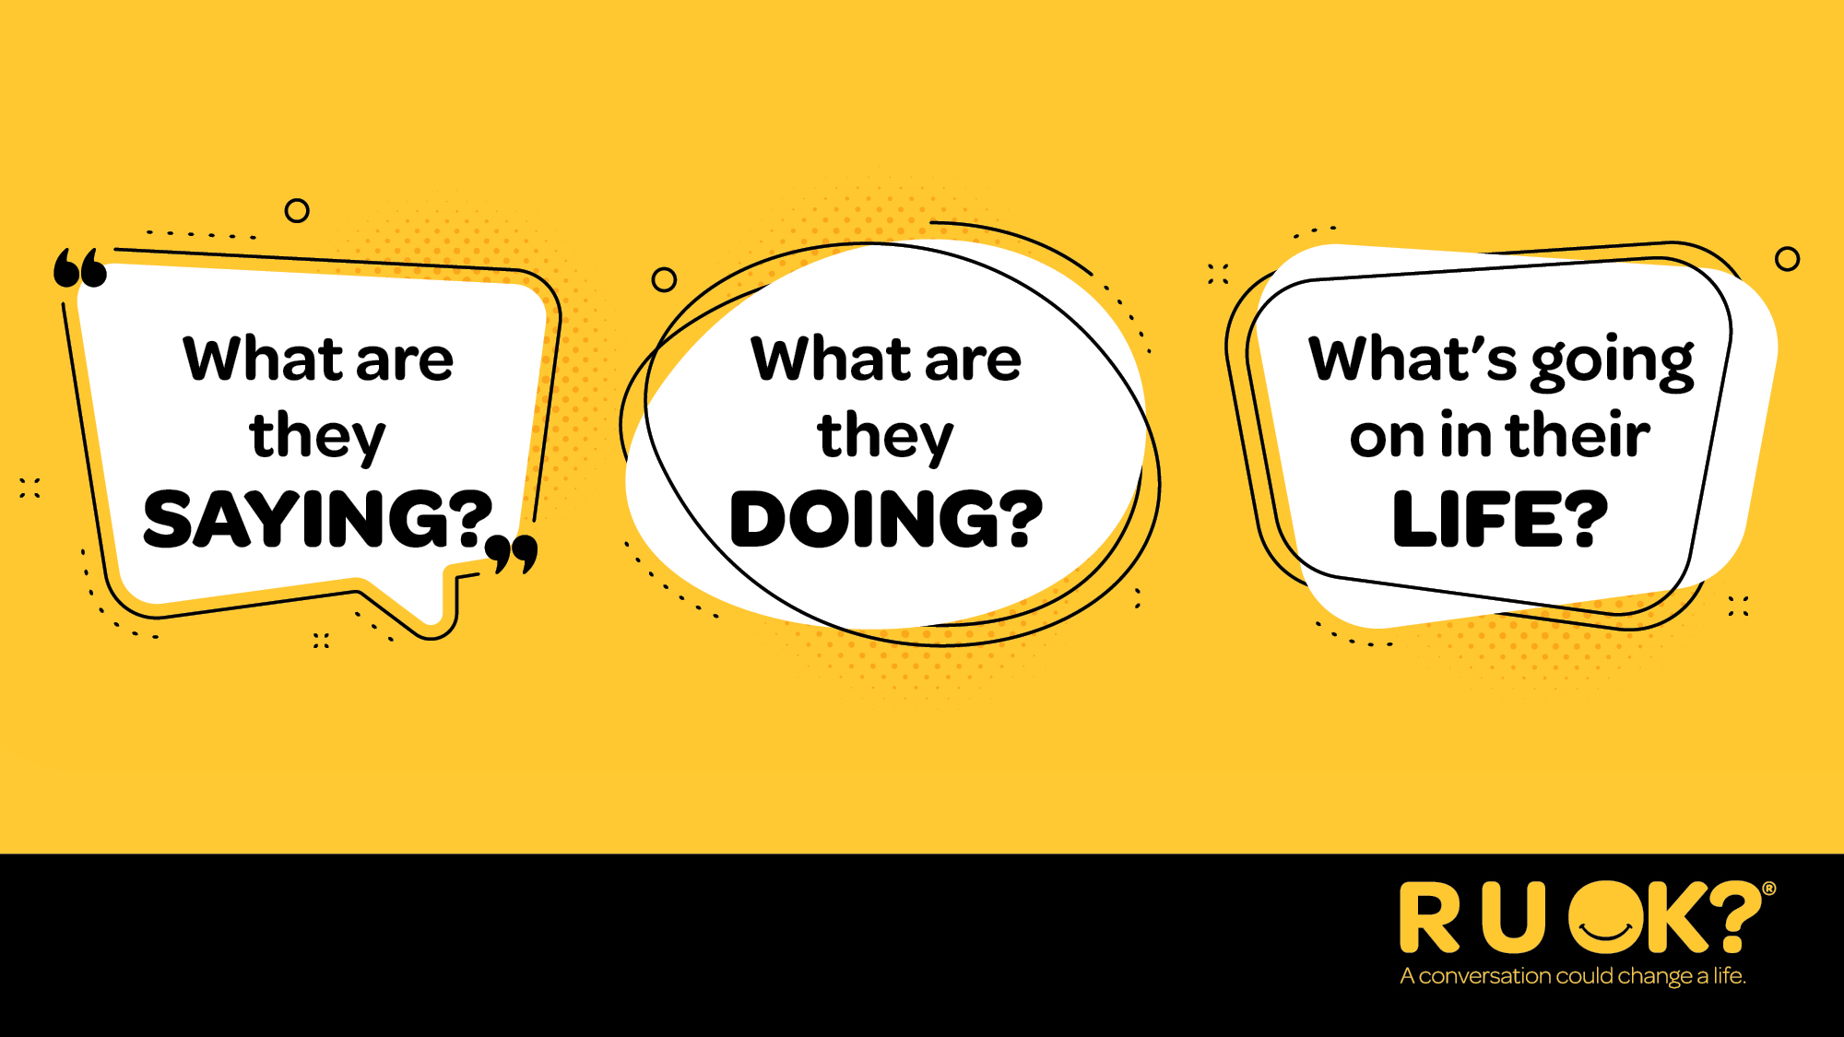
Notes:
So, when should you ask R U OK?
Whenever you notice a change in what someone is saying or doing, or you know they’re dealing with something that could be affecting how they’re coping.
OPTIONAL AUDIENCE ENGAGEMENT QUESTION
What are some examples of signs that could indicate someone needs your support?

Slide 14
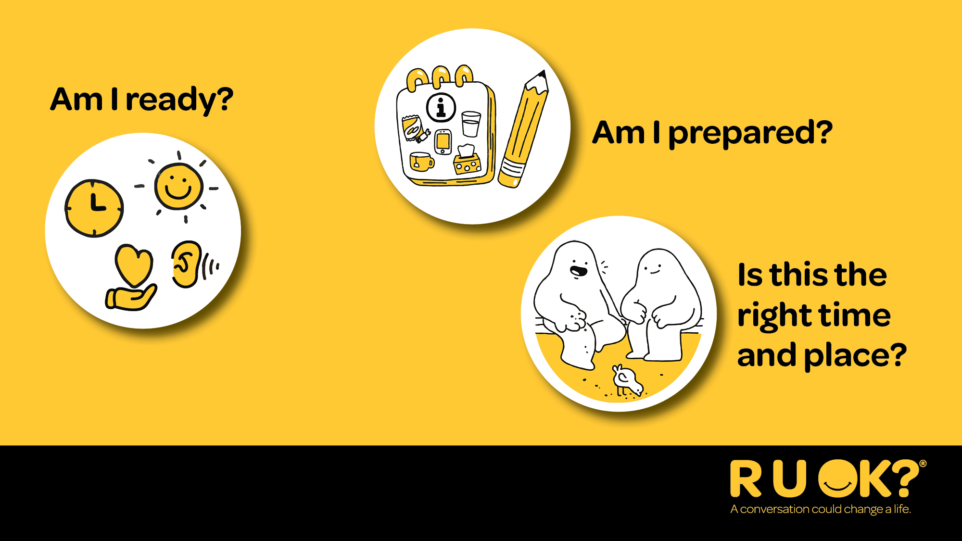
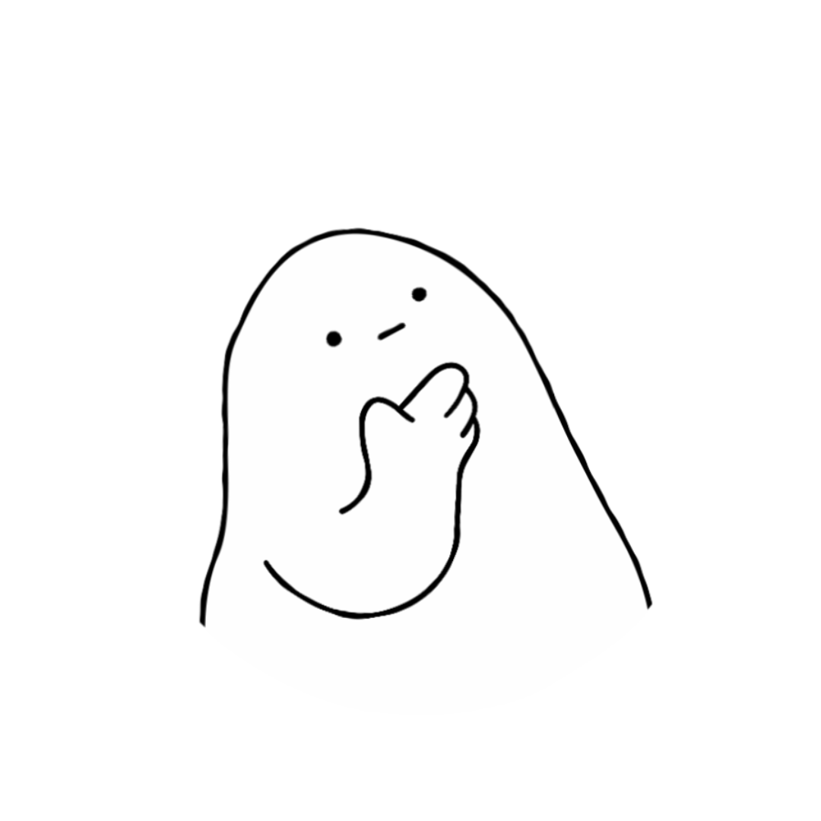
Notes:
Before supporting someone else, take a moment to check in with yourself.
Are you in the right headspace to really listen?
Do you have enough time?
Have you chosen somewhere comfortable and relatively private?
Remember, you don’t need to solve someone’s problems. Your role is to listen, care and help them think about what support might help next.

Slide 15
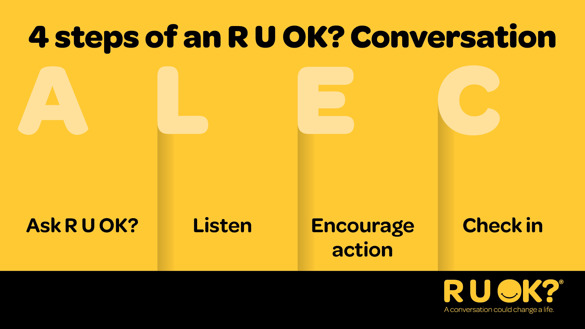
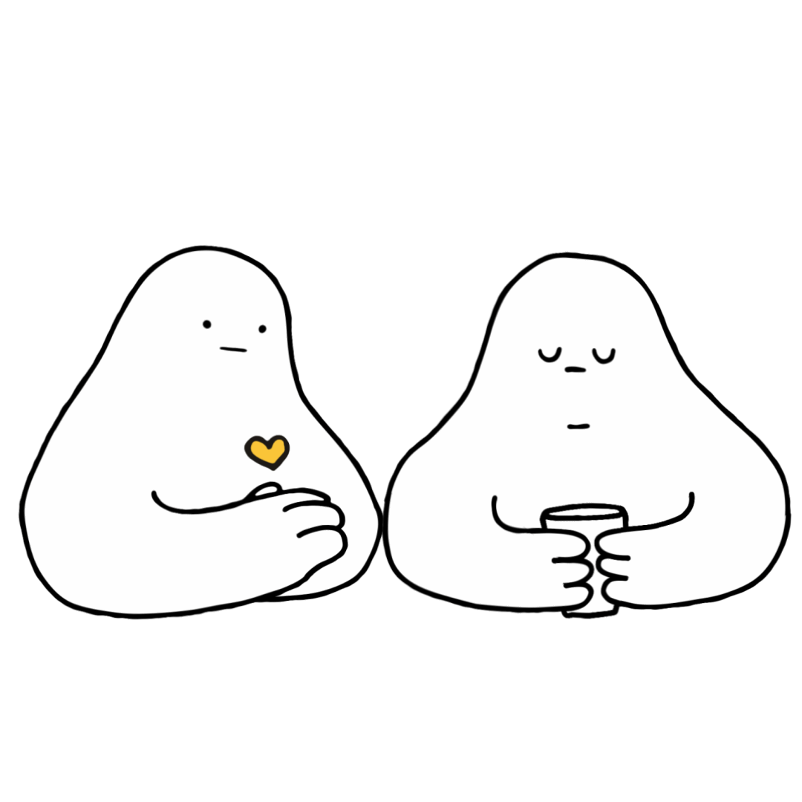
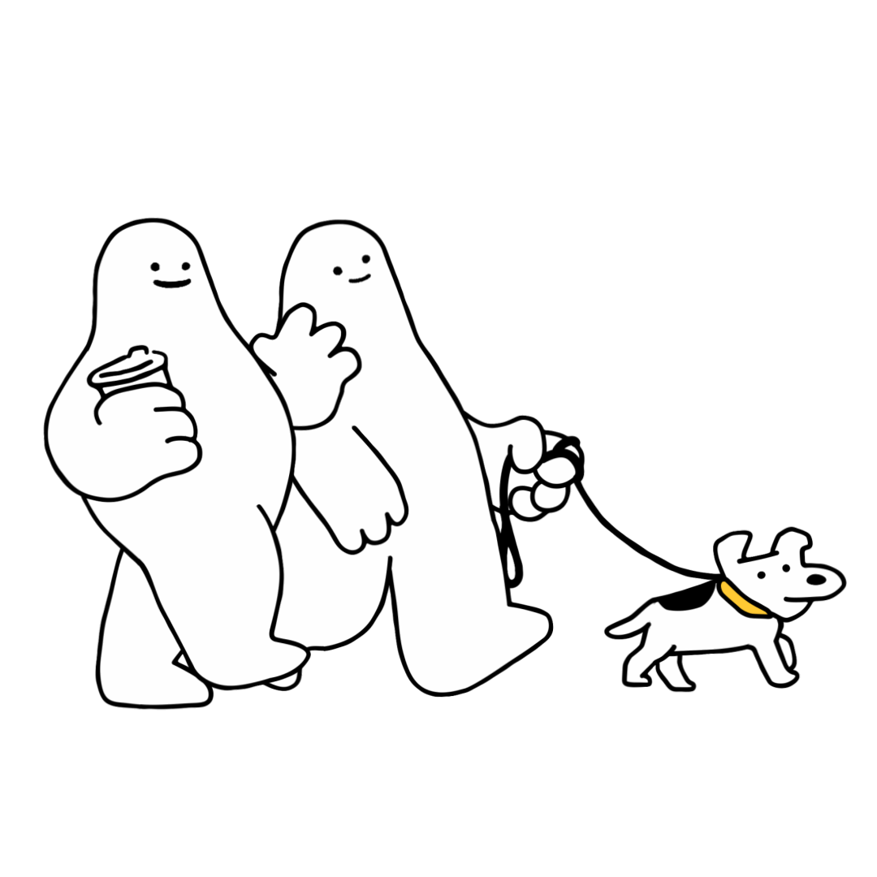
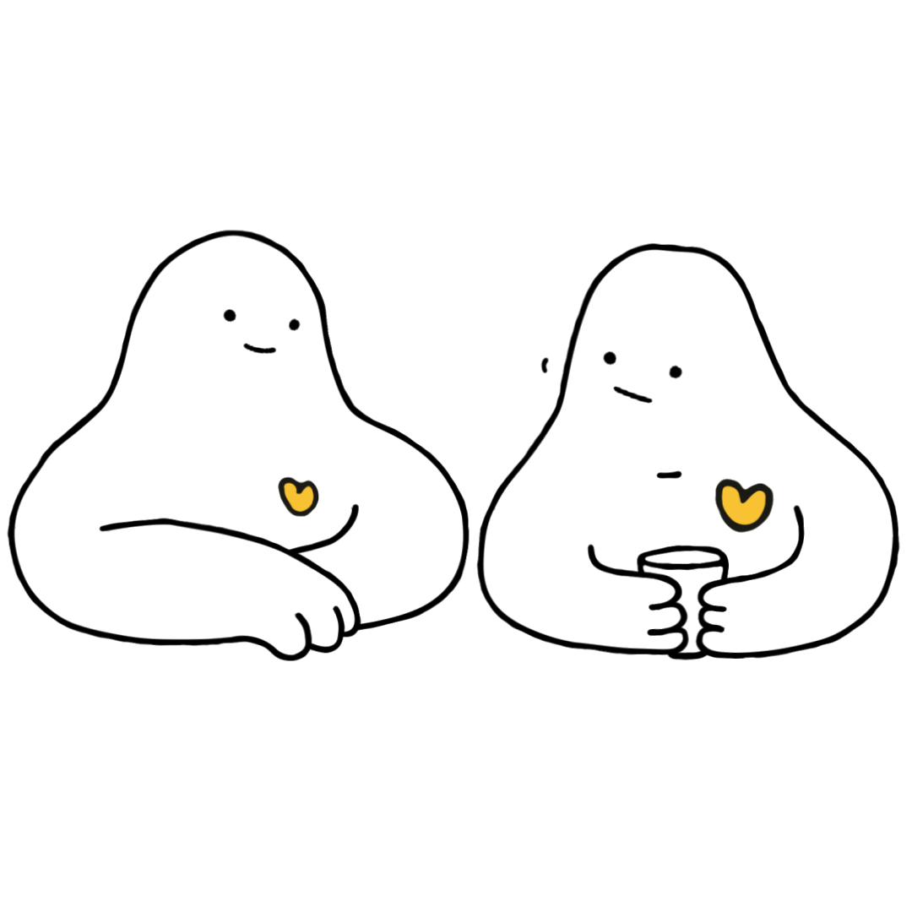
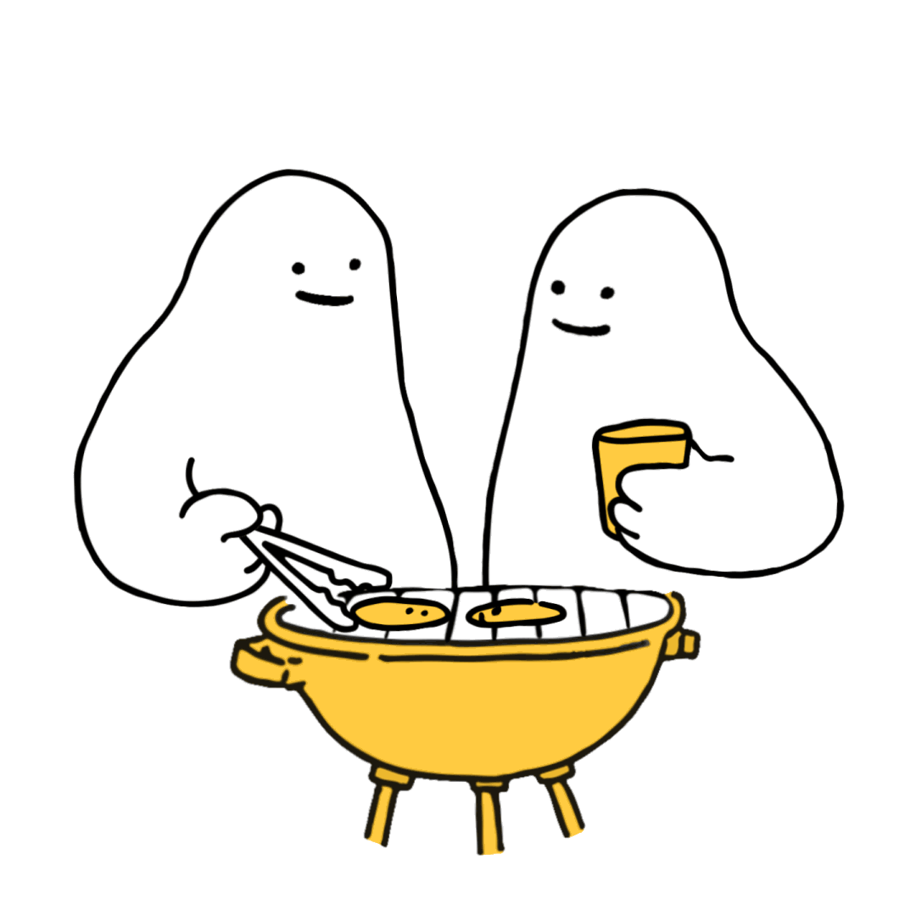
Notes:
R U OK? uses a simple four-step conversation model called ALEC:
Ask R U OK?
Listen
Encourage action
Check in

Slide 16
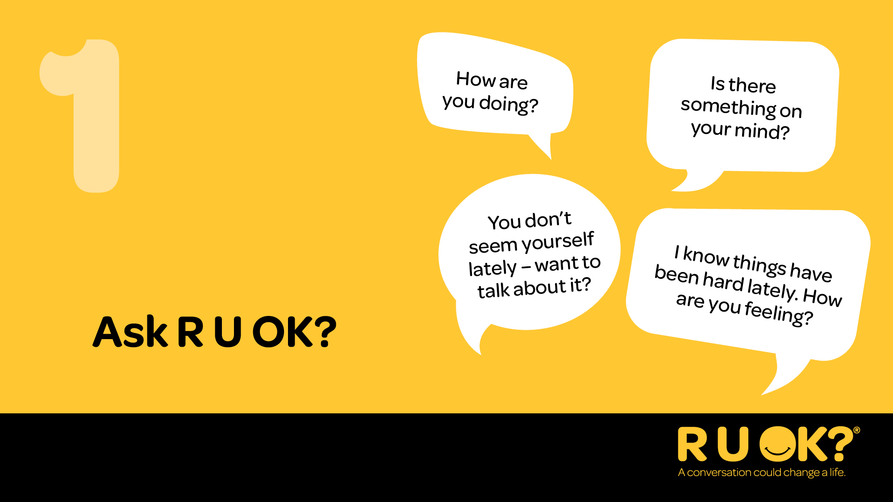
Notes:
Step one is Ask R U OK?
Start by letting the person know you’ve noticed something has changed.
Ask in a way that feels natural for your relationship.
Examples:
“I’ve noticed you don’t seem yourself lately. How are things going?”
“I know there’s been a lot happening for you recently. How are you managing?”
“You seem a bit quieter than usual. Want to talk about it?”
If they don’t want to talk, that’s OK. Let them know you’re there whenever they’re ready.
Remember: if you’re thinking it, ask it.

Slide 17
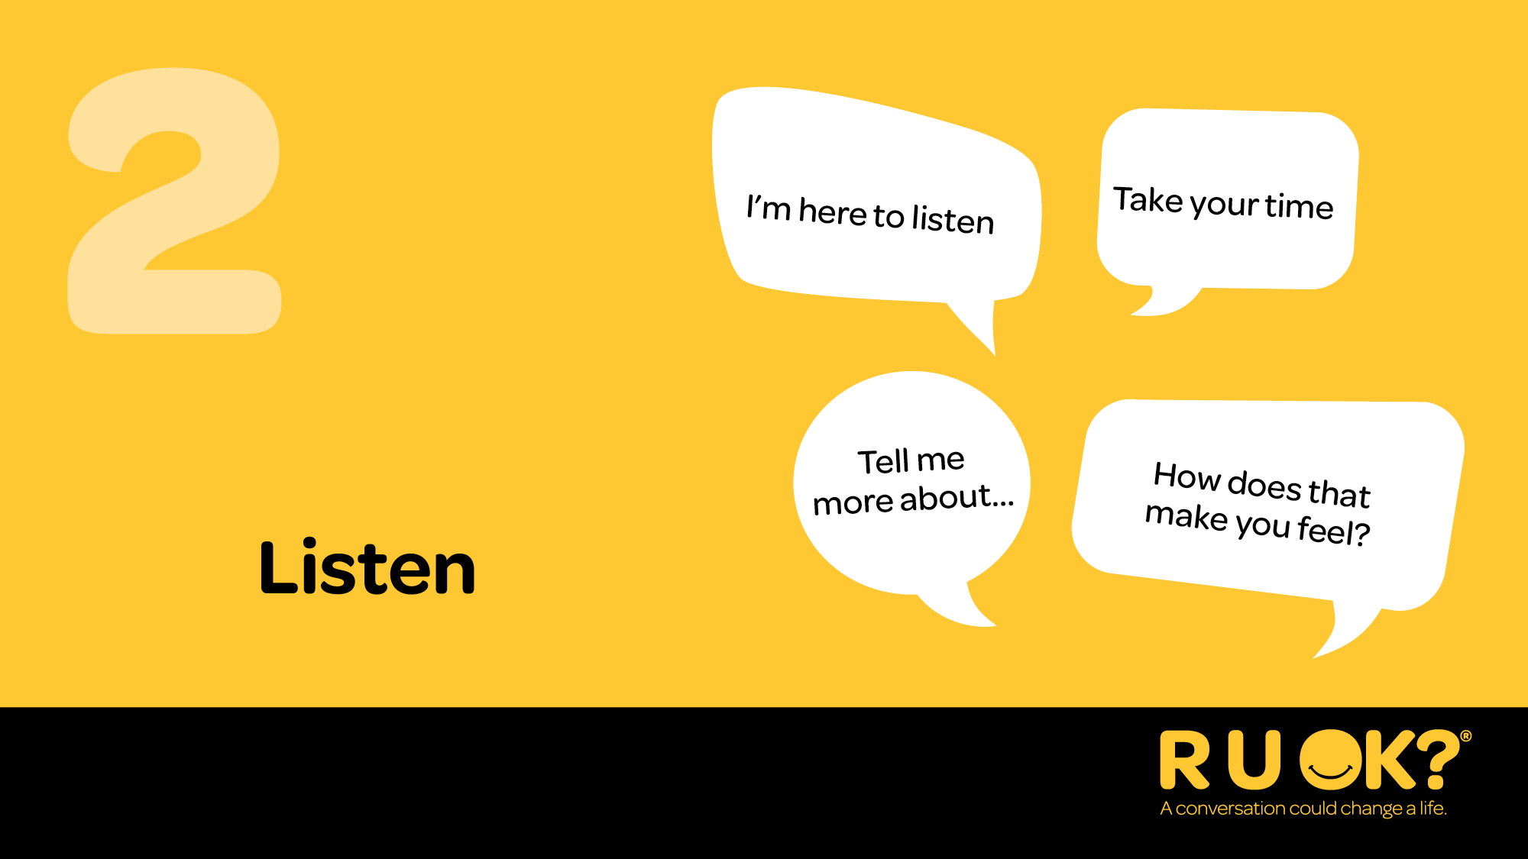
Notes:
Step two is Listen.
Listen with an open mind and without judgement.
Resist the urge to jump straight into fixing the problem.
Give the person time to think, even if that means sitting in silence.
Acknowledge what they’re sharing and let them know you’re there for them.
Listening can feel uncomfortable when someone is hurting. Often, the greatest thing you can offer isn’t advice—it’s your time, your attention and the reassurance that they don’t have to go through it alone.

Slide 18
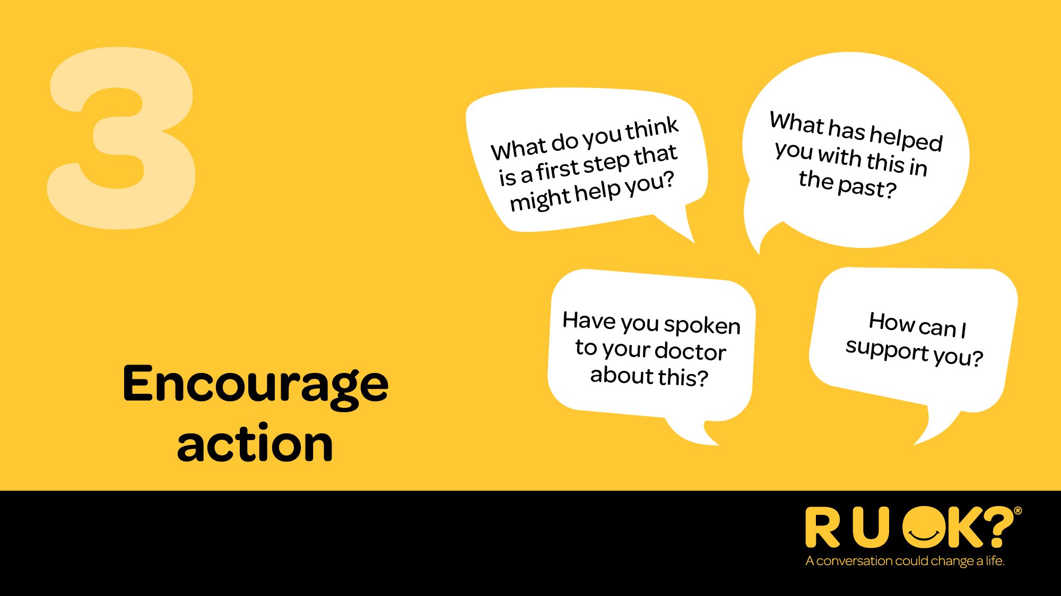
Notes:
Step three is Encourage action.
Help the person think about one small next step.
That could be talking to a trusted friend, family member, manager or health professional.
You don’t need to have the answers - you just need to help them explore what support could look like.

Slide 19
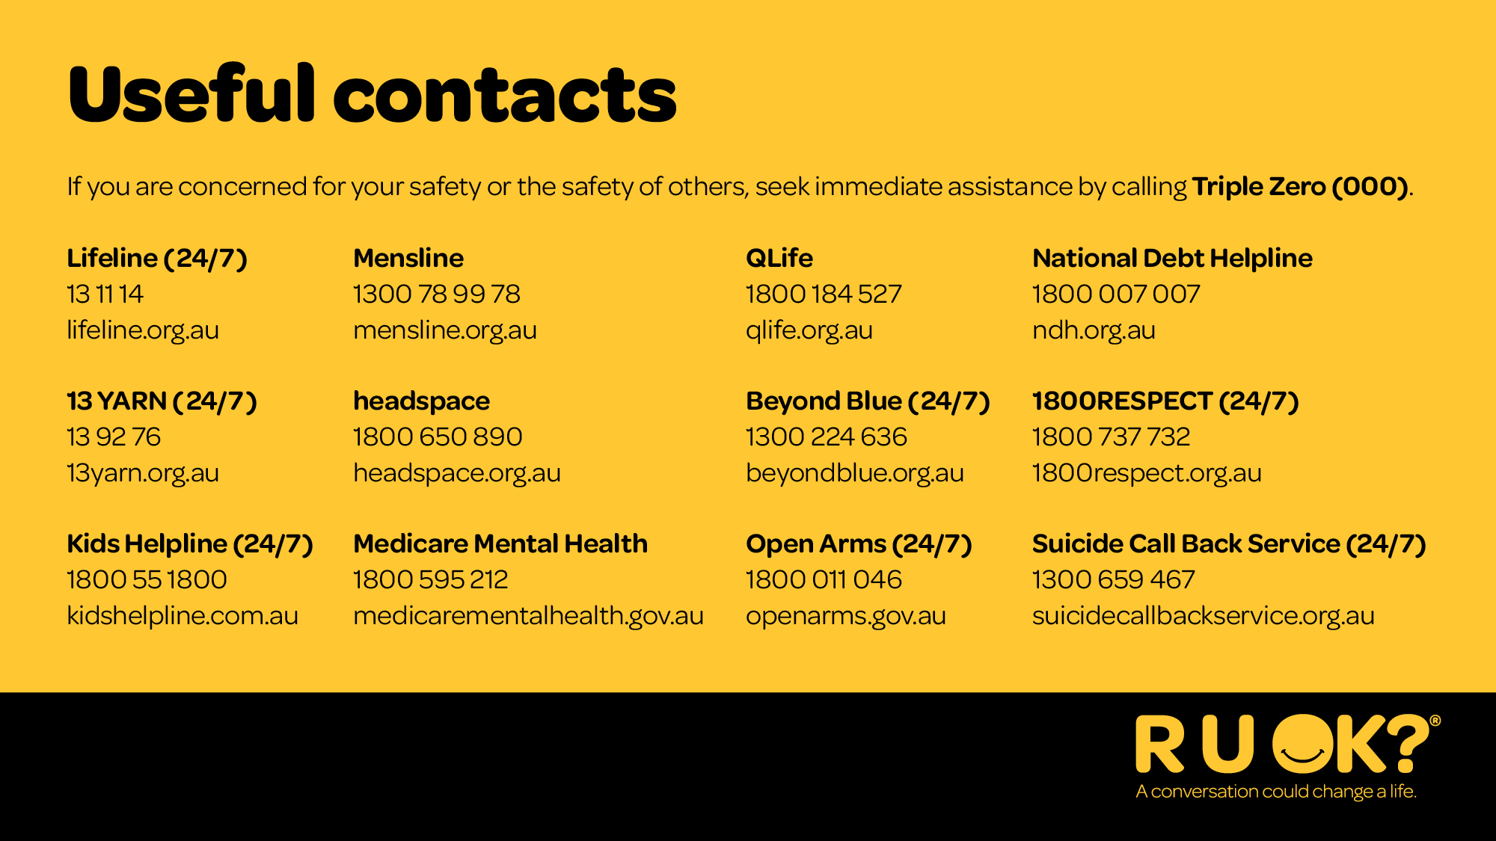
Notes:
If at any time you feel overwhelmed after supporting someone, it’s important to reach out for support yourself.
If someone needs immediate help, these services are available nationally to provide emotional and crisis support.
If you or someone else is in immediate danger, call Triple Zero (000).

Slide 20
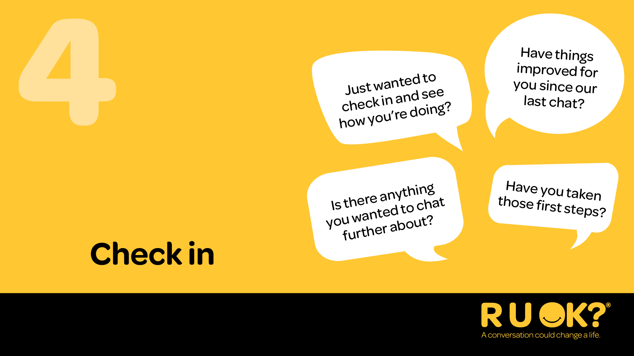
Notes:
The conversation doesn’t end after you ask R U OK?.
Checking back in lets someone know they’re important and that your care wasn’t just for one moment.
A quick message, coffee or chat can make all the difference.
Staying connected is one of the most powerful ways we can support the people around us.

Slide 21
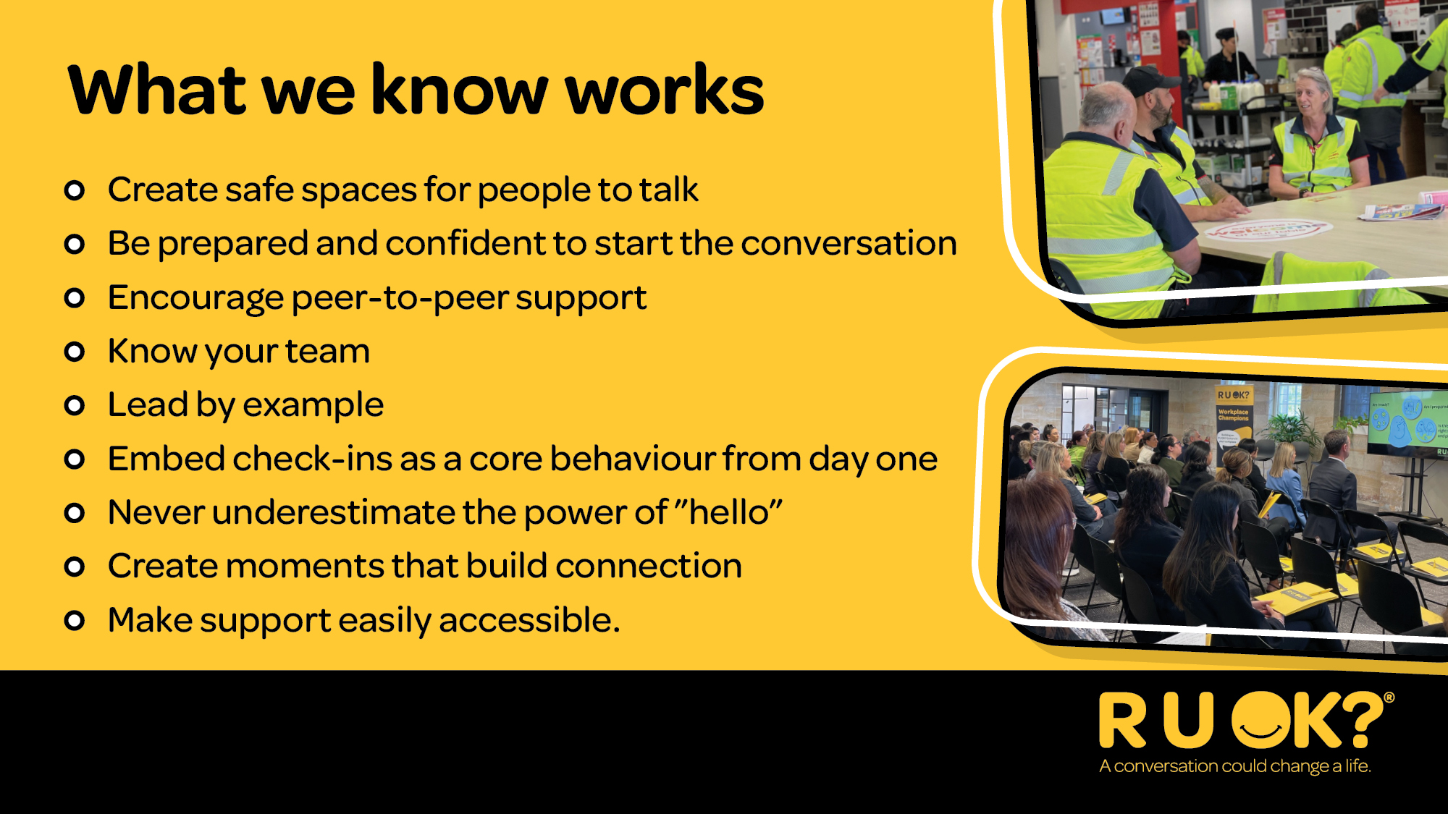
Notes:
There are lots of ways to keep the conversation going beyond R U OK? Day. Knowing the level of distress people are experiencing — what actually helps?
In workplaces, it starts with creating safe spaces where people feel comfortable to talk.
You don’t need to have all the answers — just be willing to listen.
Being prepared to start the conversation matters.
Often, a simple check-in is all it takes.
Peer support is powerful.
Colleagues are often the first people someone will open up to.
Knowing your team helps you notice when something’s not quite right.
And leading by example sets the tone for everyone else.
Embedding regular check-ins — not just when something’s wrong — makes a big difference.
And never underestimate the power of a simple “hello.”
Small moments of connection can go a long way.
Finally, make support easy to access so people know where to go if they need it.
Together, these small actions help create a workplace where people look out for each other.

Slide 22
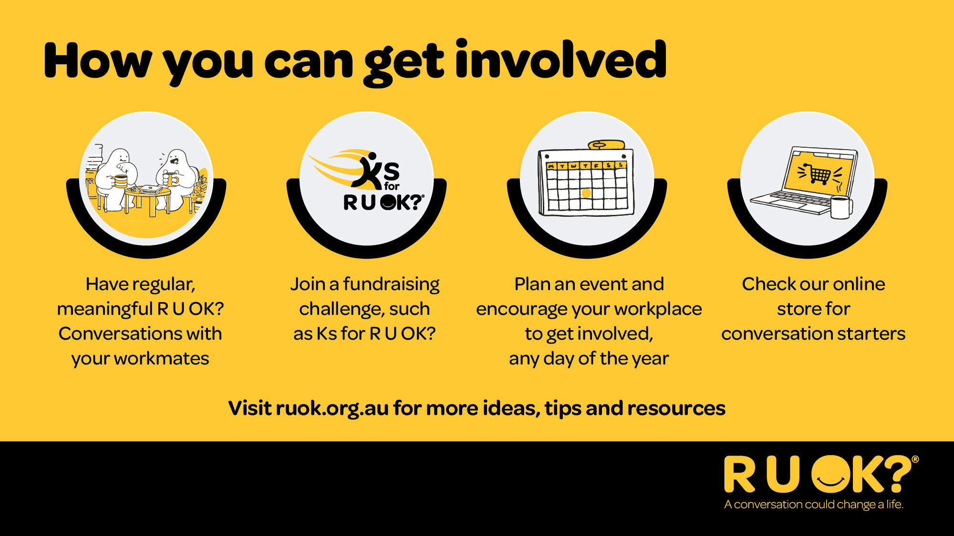
Notes:
You can also support R U OK? by getting involved in fundraising, encouraging your colleagues to participate in Ks for R U OK?, planning workplace activities and helping create a culture where people feel comfortable checking in with one another.

Slide 23
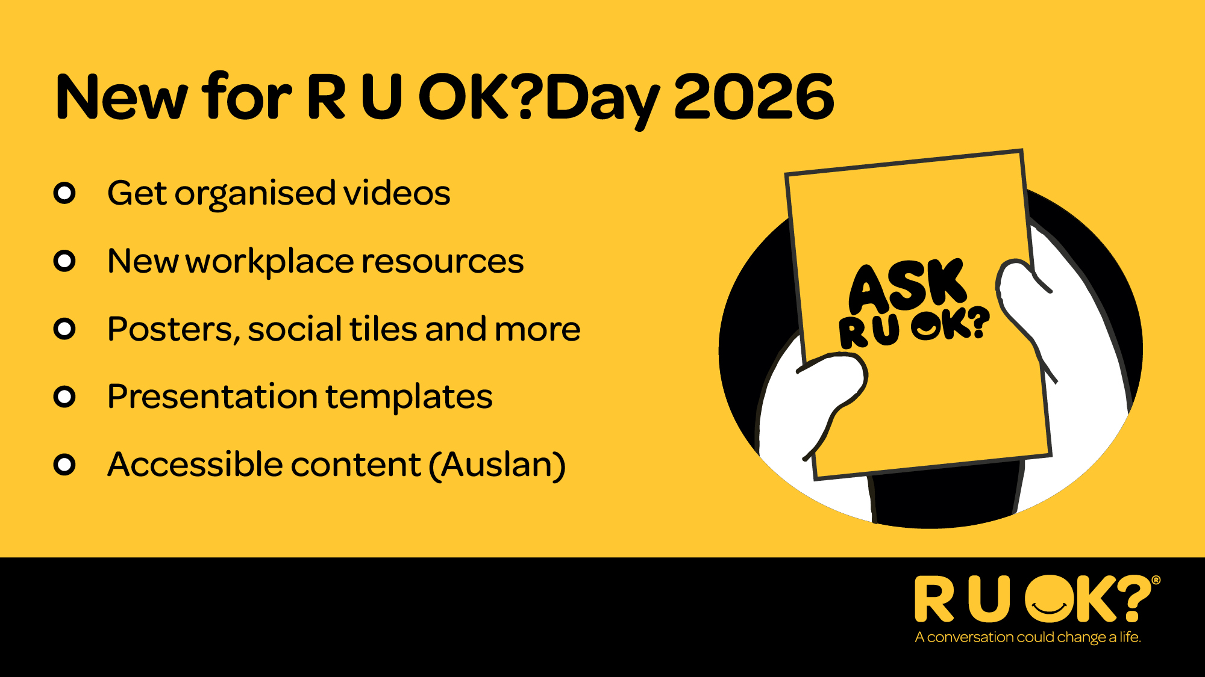
Notes:
R U OK? has a wide range of free workplace resources to help you build a more connected and supportive workplace.
Visit ruok.org.au for conversation tips, team activities, workplace guides and practical tools to help make asking R U OK? feel easier.

Slide 24
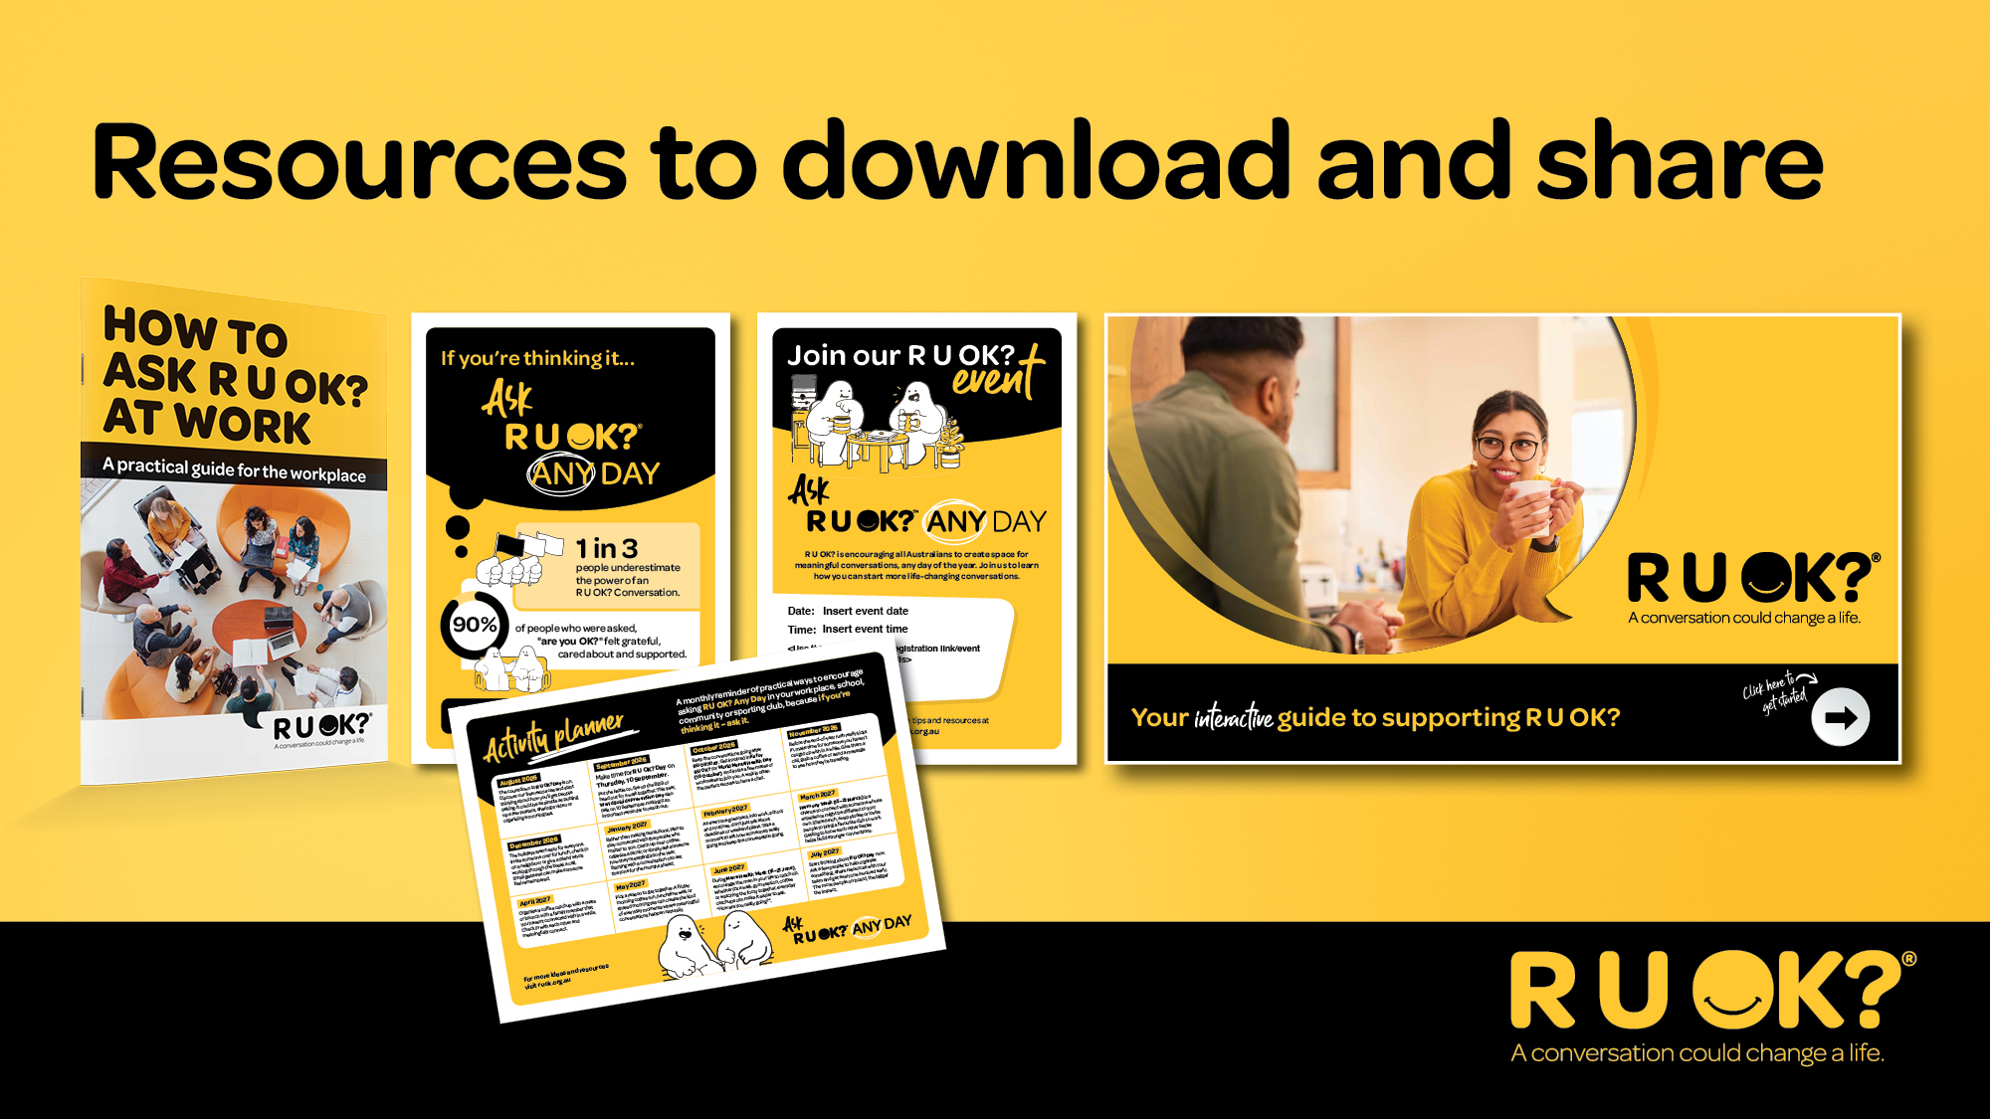
Notes:
Here are some of the workplace resources available, including conversation guides, posters, team meeting notes and activities to help keep the message going all year.

Slide 25

Notes:
Thank you for your time today.
Before you leave, think about one person in your world you could check in with this week.
You don’t need the perfect words. You don’t need certainty.
If you’re thinking it, ask R U OK? Any Day.

