Slide 1
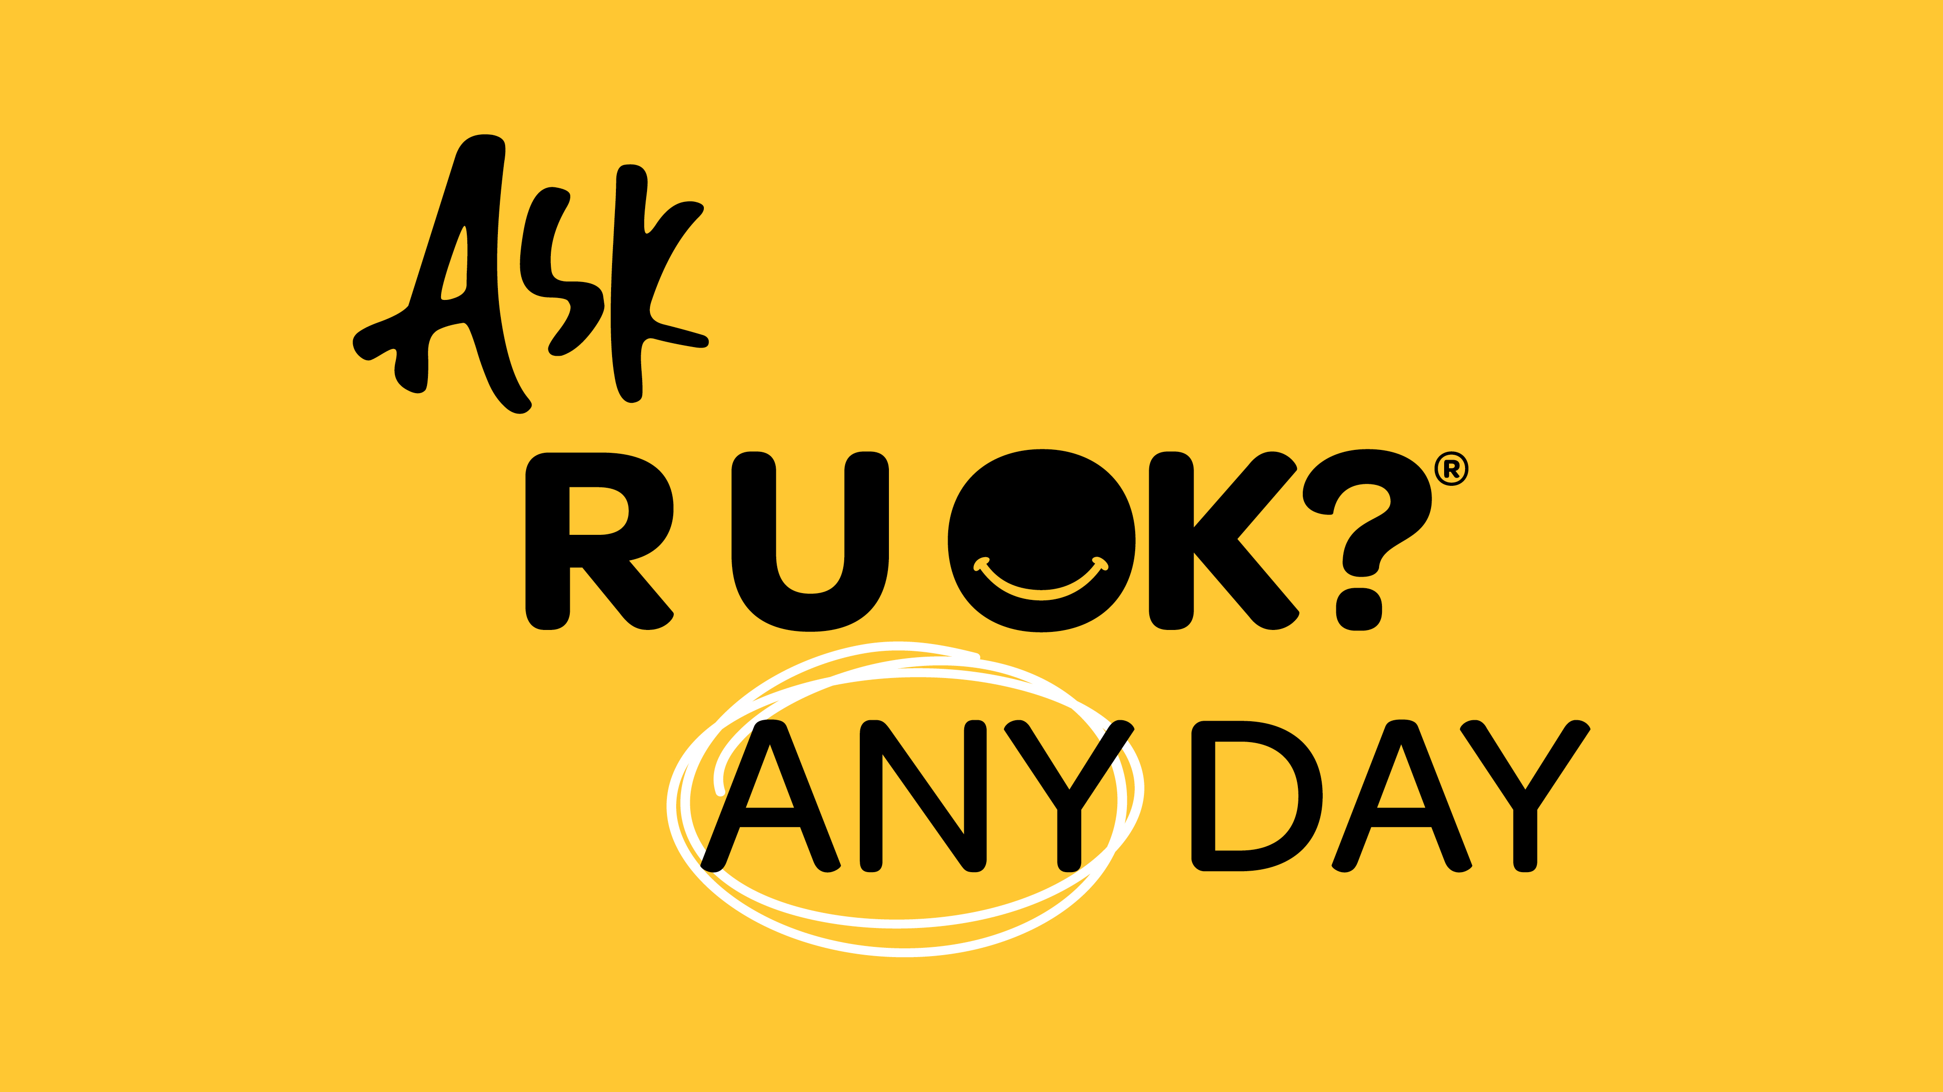
Notes:
Start the presentation by introducing yourself.
When it comes to sharing your own story, it’s completely up to you. You may choose to share it at one point in the presentation or weave it throughout, whichever feels most natural.

Slide 2
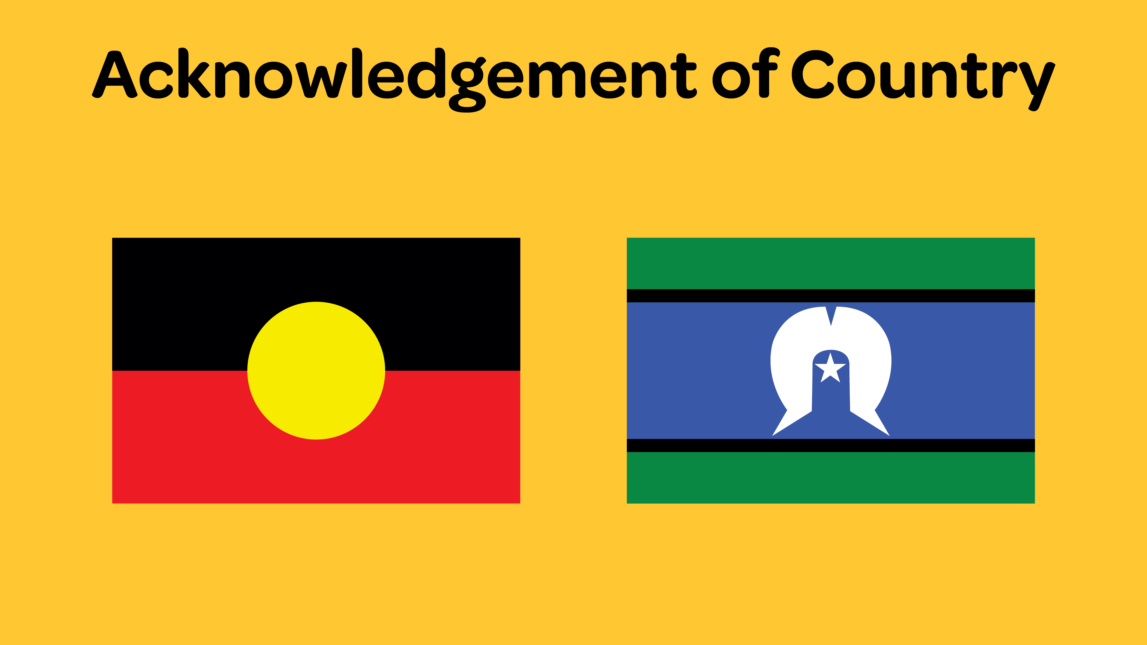
Notes:
Acknowledgement of Country
Before giving the presentation, learn the name/s of the Indigenous peoples and the name of the land in which you're giving your presentation. E.g., In metro-Sydney, the Gadigal People of the Eora Nation.
It doesn’t have to be long, don’t rush and try to deliver with authenticity.
I acknowledge the Traditional Owners of the land on which we are meeting today and pay my respect to Elders past and present.

Slide 3
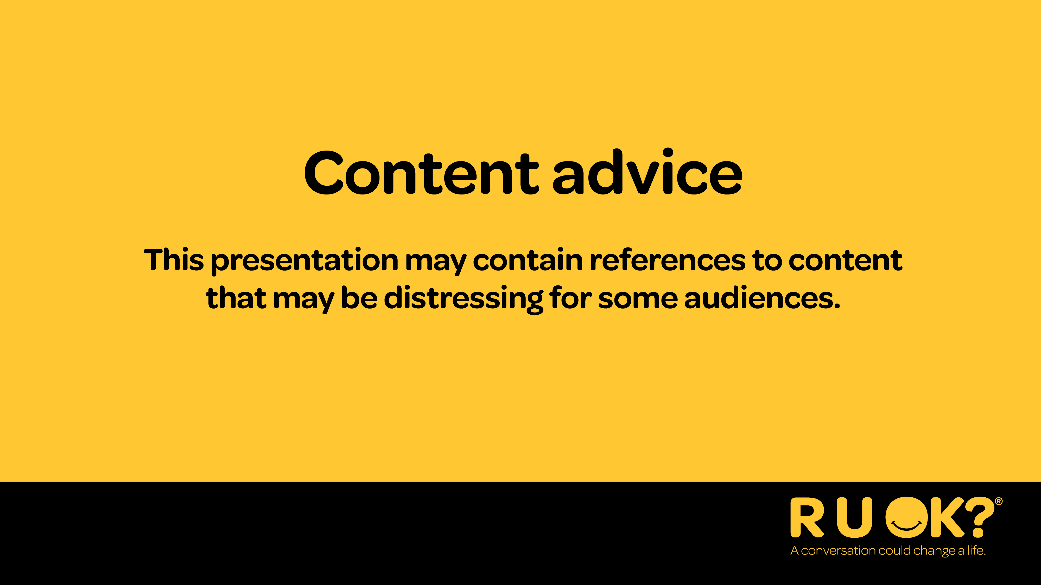
Notes:
Recognition of lived experience
Some people may find presentations that reference mental health and suicide prevention distressing, so let them know as early as possible what you’ll be talking about.
It’s important to recognise that some people in the audience might not be OK and encourage them to access appropriate support.
If today’s talk brings up tough emotions for you it’s OK to excuse yourself. If you need some extra support, I strongly encourage you to open up to someone you trust, connect with a trusted health professional or access a service like Lifeline which is available 24/7 on 13 11 14. You can find other services and support organisations on the R U OK? website at ruok.org.au/findhelp.

Slide 4
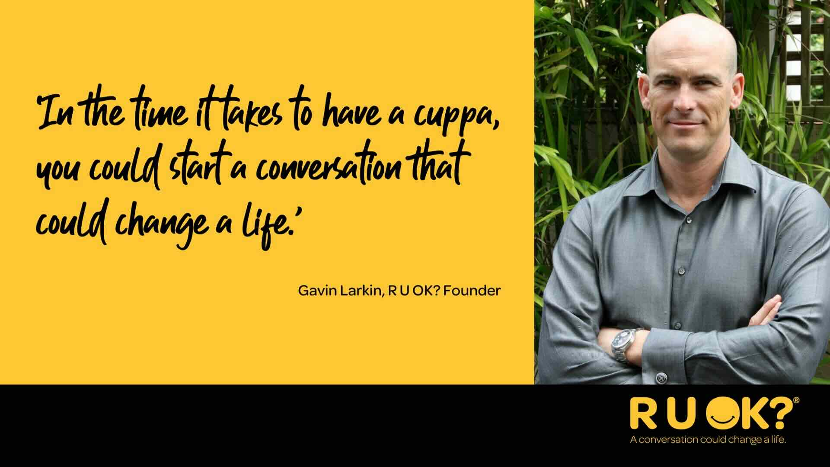
Notes:
R U OK? was founded by Gavin Larkin in 2009 after his family experienced the loss of his father, Barry, to suicide.
Gavin believed that in the time it takes to share a cuppa, you could start a conversation that might change a life.
Today, research continues to show that feeling connected and supported is one of the strongest protective factors against suicide.

Slide 5
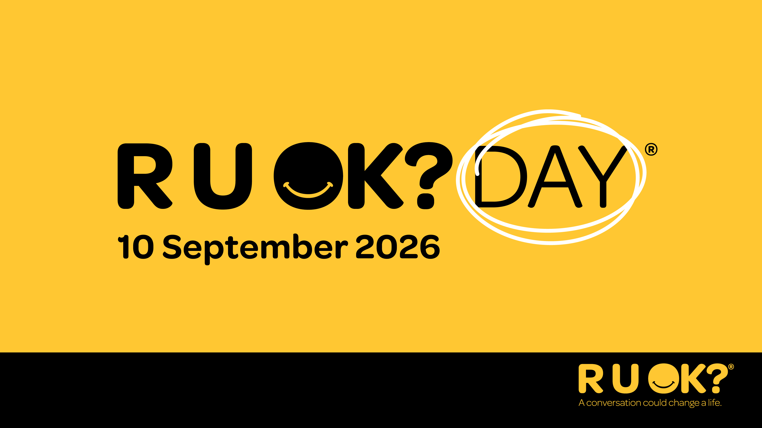
Notes:
Thursday 10 September is R U OK?Day, Australia’s National Day of Action. It’s a reminder that we all have a role to play in helping the people around us feel connected and supported.
While R U OK?Day emphasises on the power of meaningful conversations, the message goes beyond just one day. Life’s ups and downs can happen at any time, which is why we encourage everyone to Ask R U OK? Any Day.
Taking the time to check in, listen and stay connected can make a real difference. By making these conversations part of everyday life, we can help create communities, workplaces and social groups where people feel supported and less alone.

Slide 6
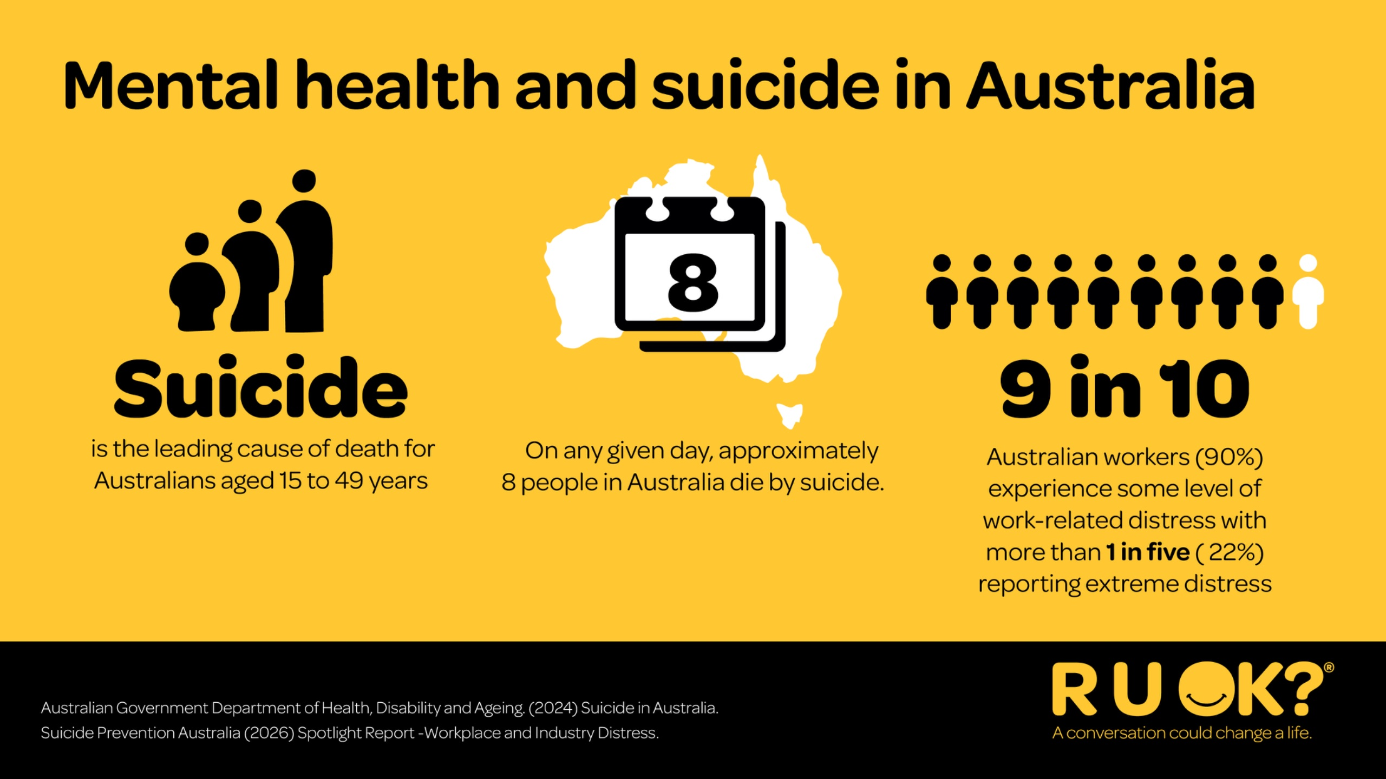
Notes:
Every day, many Australians are dealing with challenges we can’t always see.
Suicide remains the leading cause of death for Australians aged 15–49.
Around nine in ten Australian workers experience work-related stress, and one in five report experiencing extreme distress.
Financial pressure, relationship changes, illness, grief, caring responsibilities and pressure at work can all affect how someone is coping.
That’s why checking in shouldn’t be reserved for one day of the year.

Slide 7
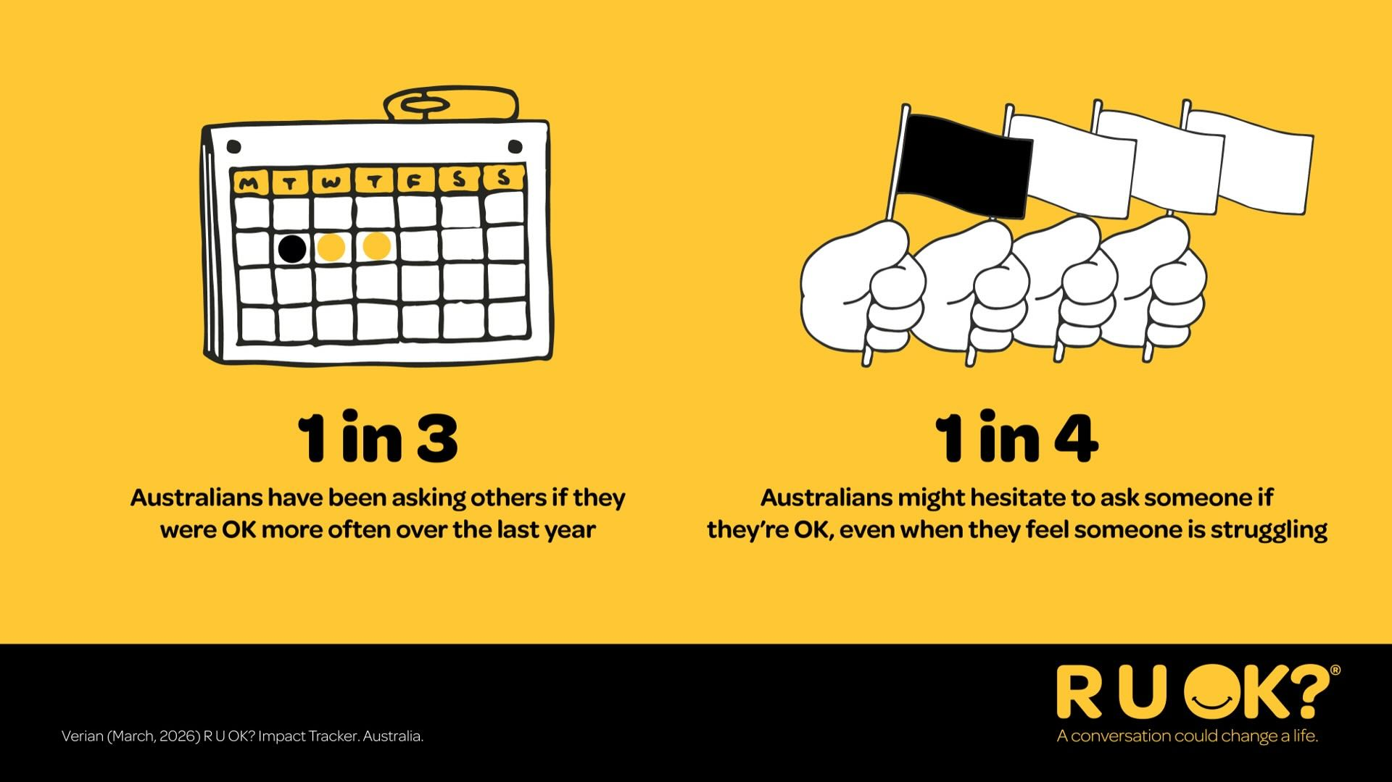
Notes:
The good news is that more Australians understand the importance of checking in with the people around them.
One in three Australians say they’ve been asking people if they’re OK more often over the past year.
But one in four reports that they might still hesitate to ask, even when they think someone might be struggling.
That’s why this year’s message is so simple: If you're thinking it, Ask R U OK? Any Day. Because a conversation can change a life.

Slide 8
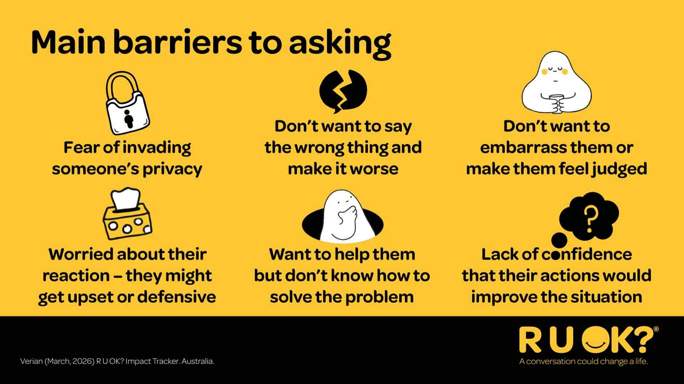
Notes:
If asking “Are you OK?” is so important, why do we sometimes hesitate?
Many of us worry we’ll say the wrong thing, make things worse, invade someone’s privacy or not know what to do next. Others worry about how someone might respond.
These feelings are completely normal, but they shouldn’t stop us from reaching out.
Optional audience question
What are some reasons you’ve hesitated to ask someone if they’re OK?

Slide 9
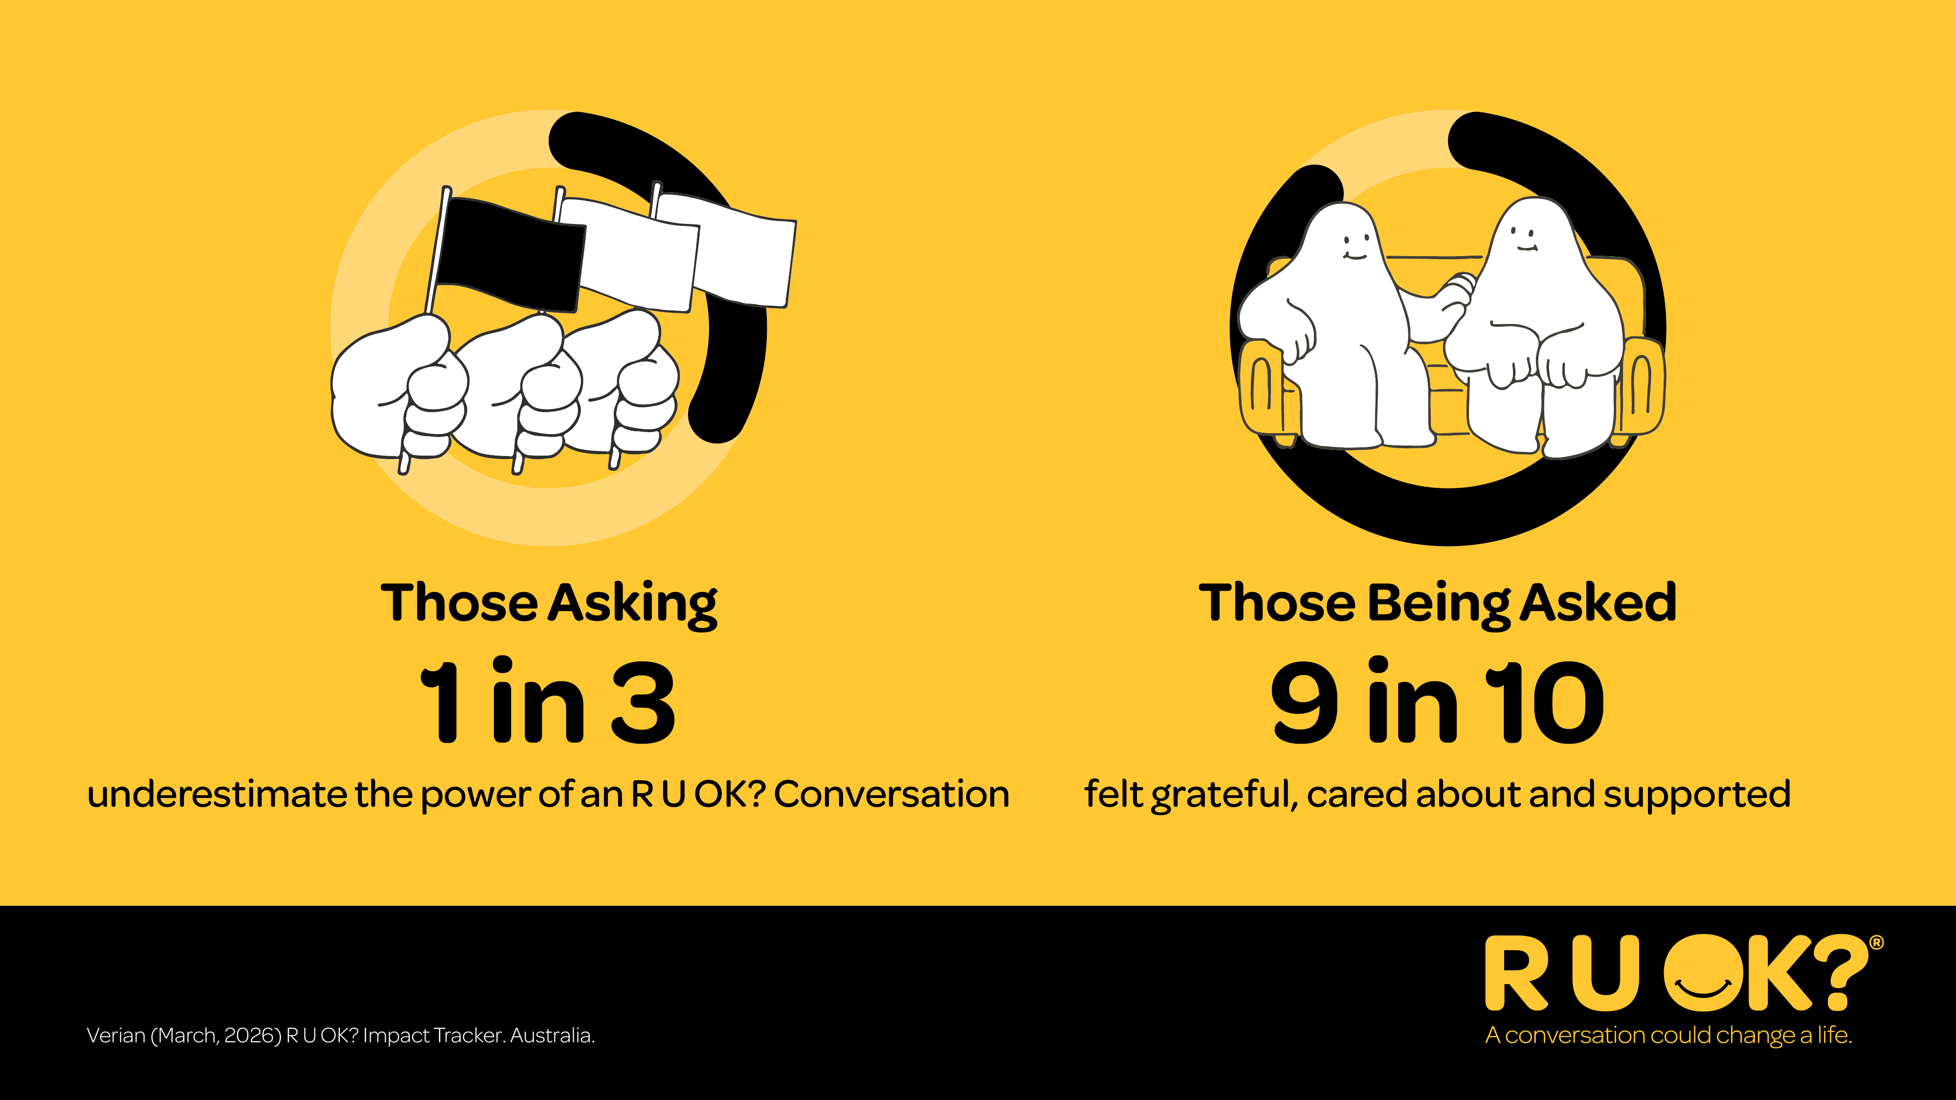
Notes:
We often underestimate the difference a simple conversation can make.
Nine in ten people say they felt cared for, supported and grateful when someone checked in with them.
You don’t need the perfect words. Simply showing someone you’ve noticed can make a real difference.

Slide 10
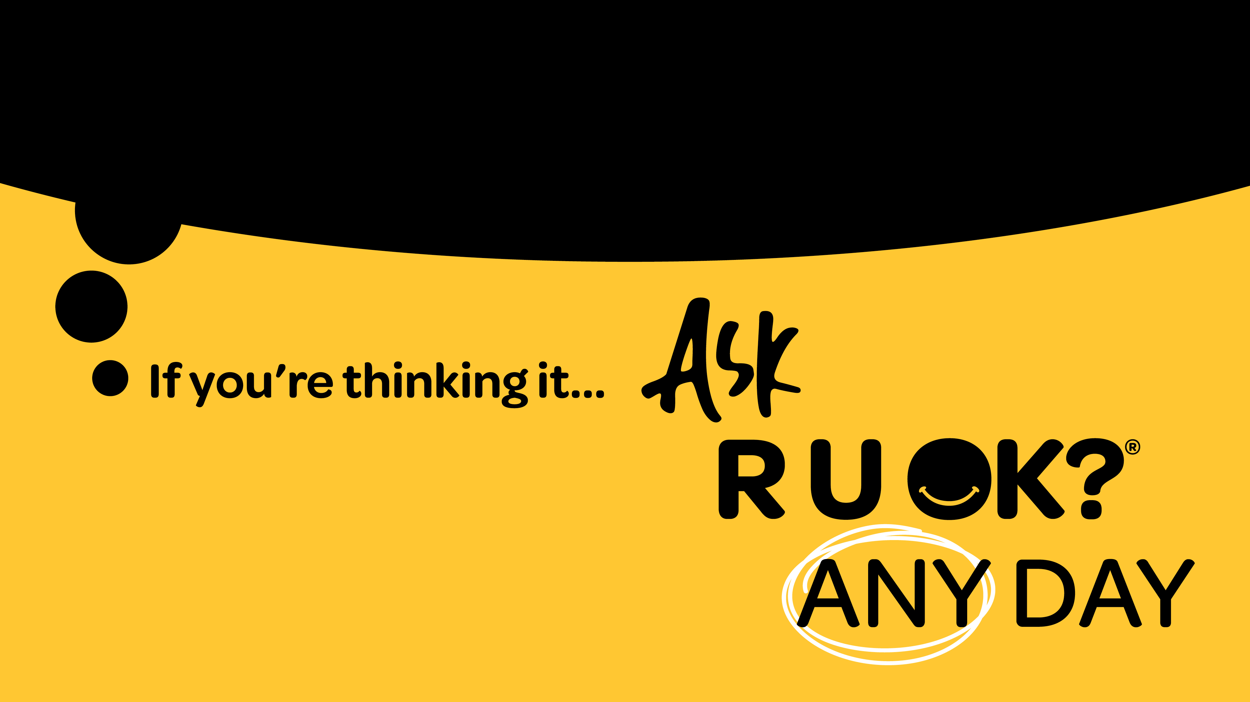
Notes:
The good news is that more Australians understand the importance of checking in with the people around them.
One in three Australians say they’ve been asking people if they’re OK more often over the past year.
But one in four still hesitate, even when they think someone might be struggling.
That’s why this year’s message is so simple: If you’re thinking it, ask R U OK? Any Day.

Slide 11
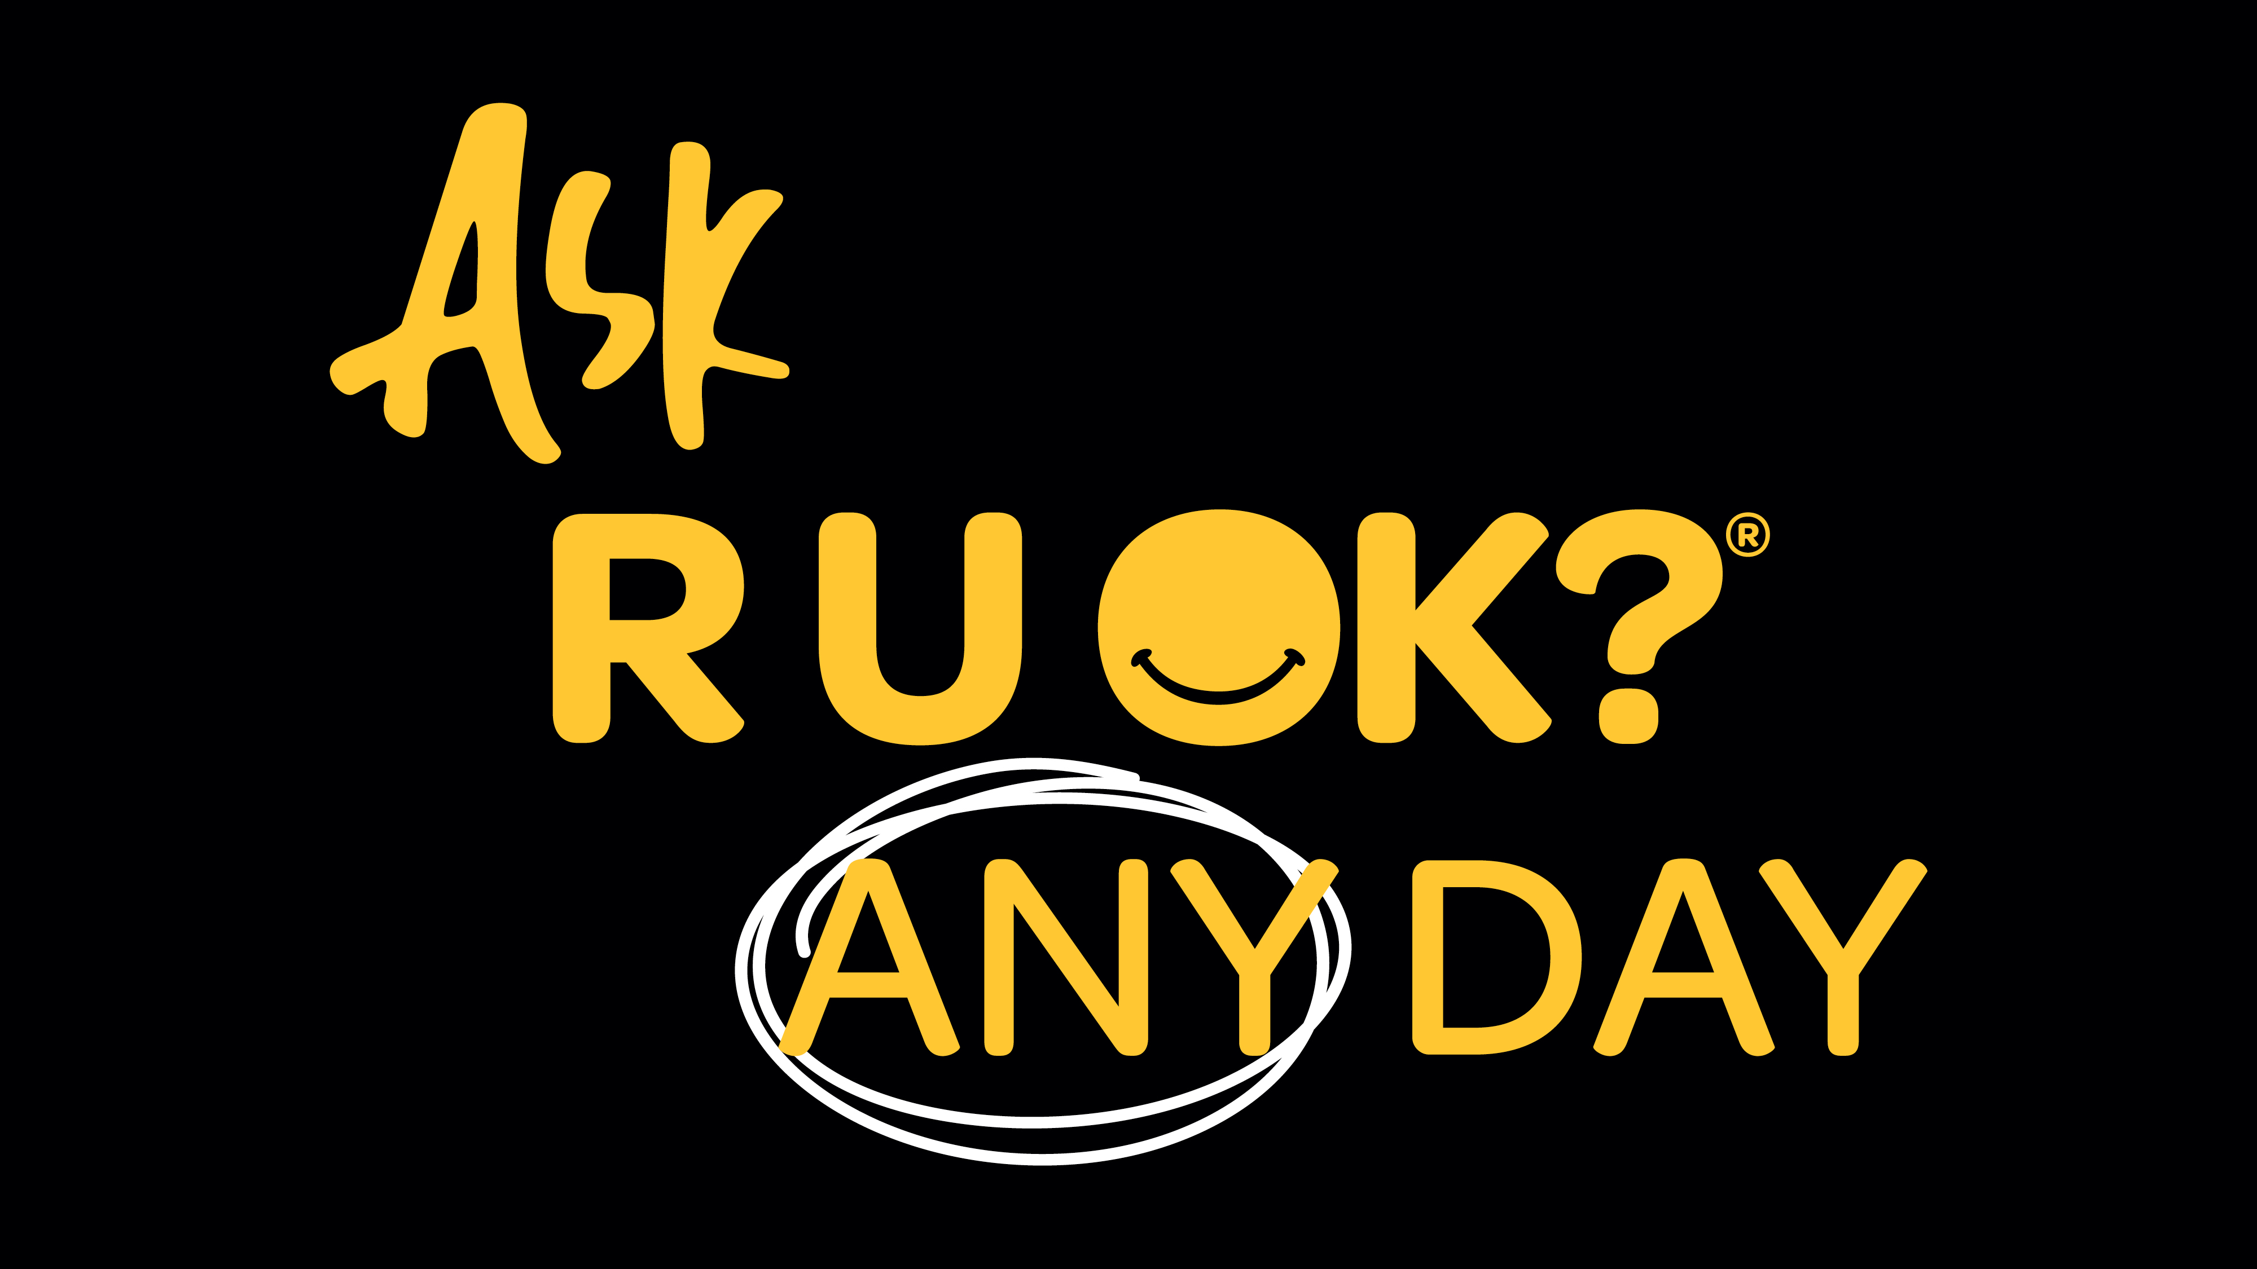
Notes:
There’s not just one sign that tells us someone isn’t coping.
Sometimes the changes are obvious. Sometimes they’re subtle.
Someone might seem quieter than usual, more withdrawn, distracted or overwhelmed. Sometimes it can be the opposite, e.g. they’re going out after work all the time. It’s about looking for a change in their world, words or behaviour.
Or maybe nothing obvious has changed — you just have a feeling something isn’t right.
Trust your instincts. If you’re thinking it, ask it.

Slide 12
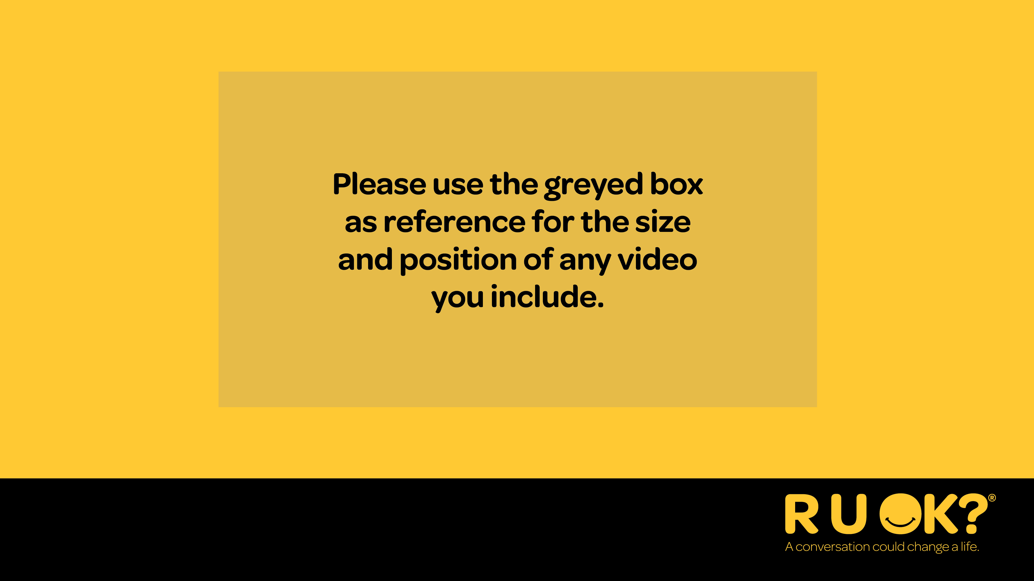
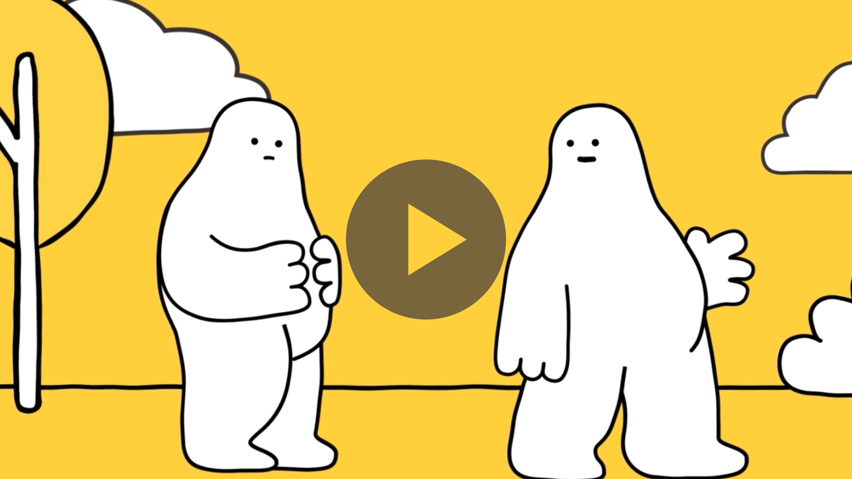
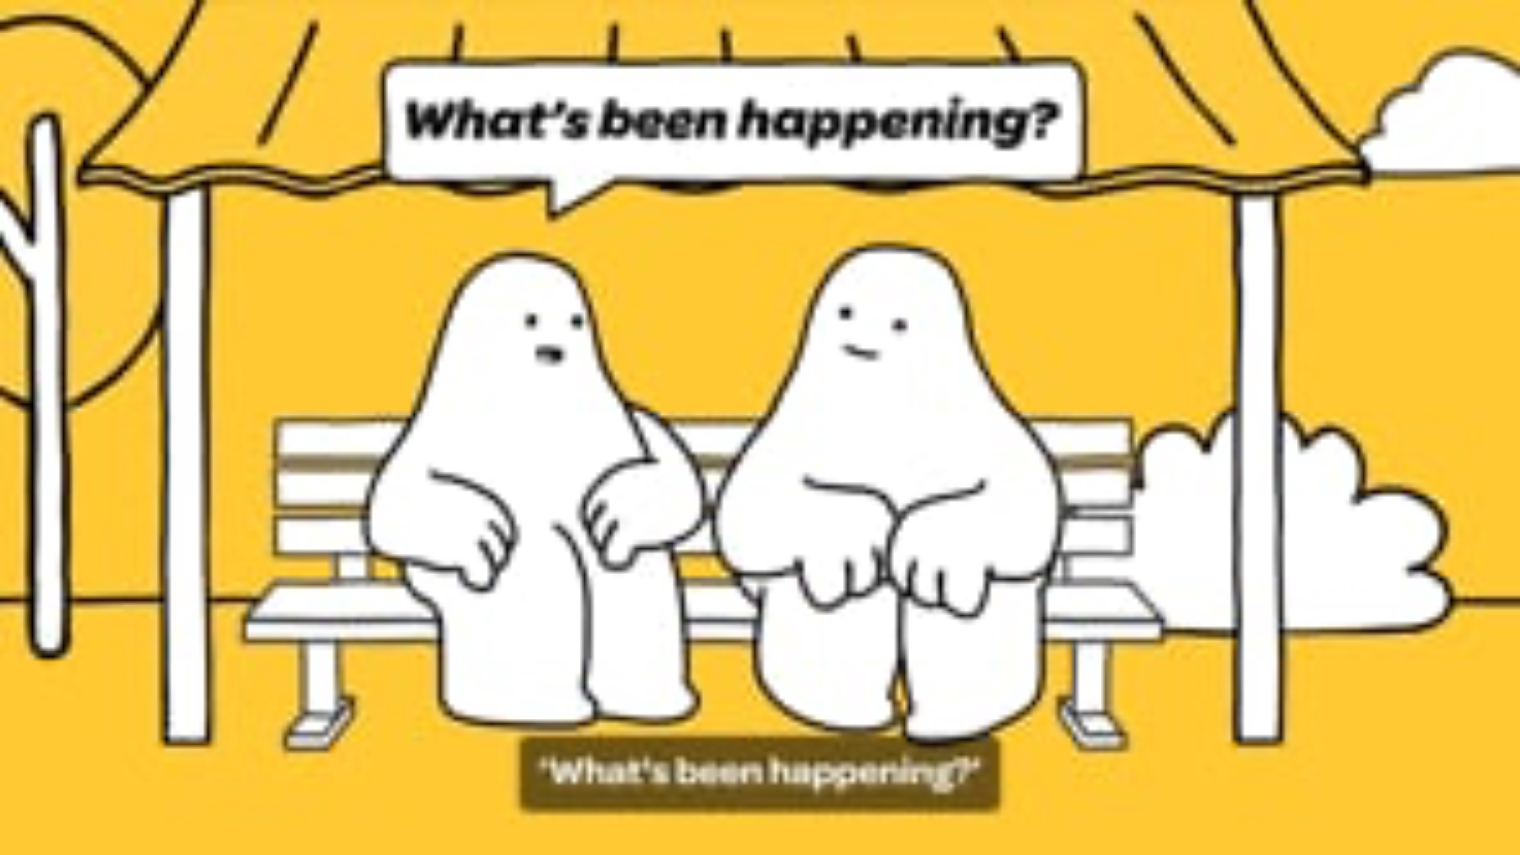
Notes:
OPTIONAL SLIDE
Play this short video explaining the Ask R U OK? Any Day message.
You can find the video here: https://vimeo.com/977187614/38dfbcc58e.
Download it beforehand if you know you won’t have Wi-Fi access.

Slide 13
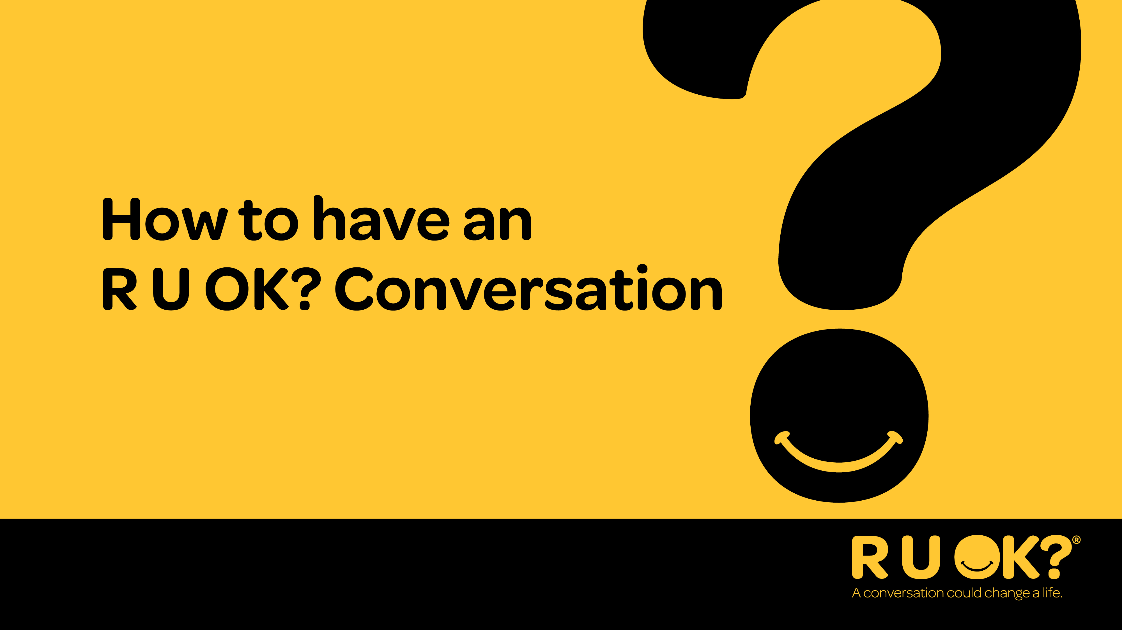
Notes:
So, when should you ask R U OK?
Whenever you notice a change in what someone is saying or doing, or you know they’re going through something that could be affecting how they’re coping.
Optional audience question
What are some examples of signs that could indicate someone needs your support?

Slide 14
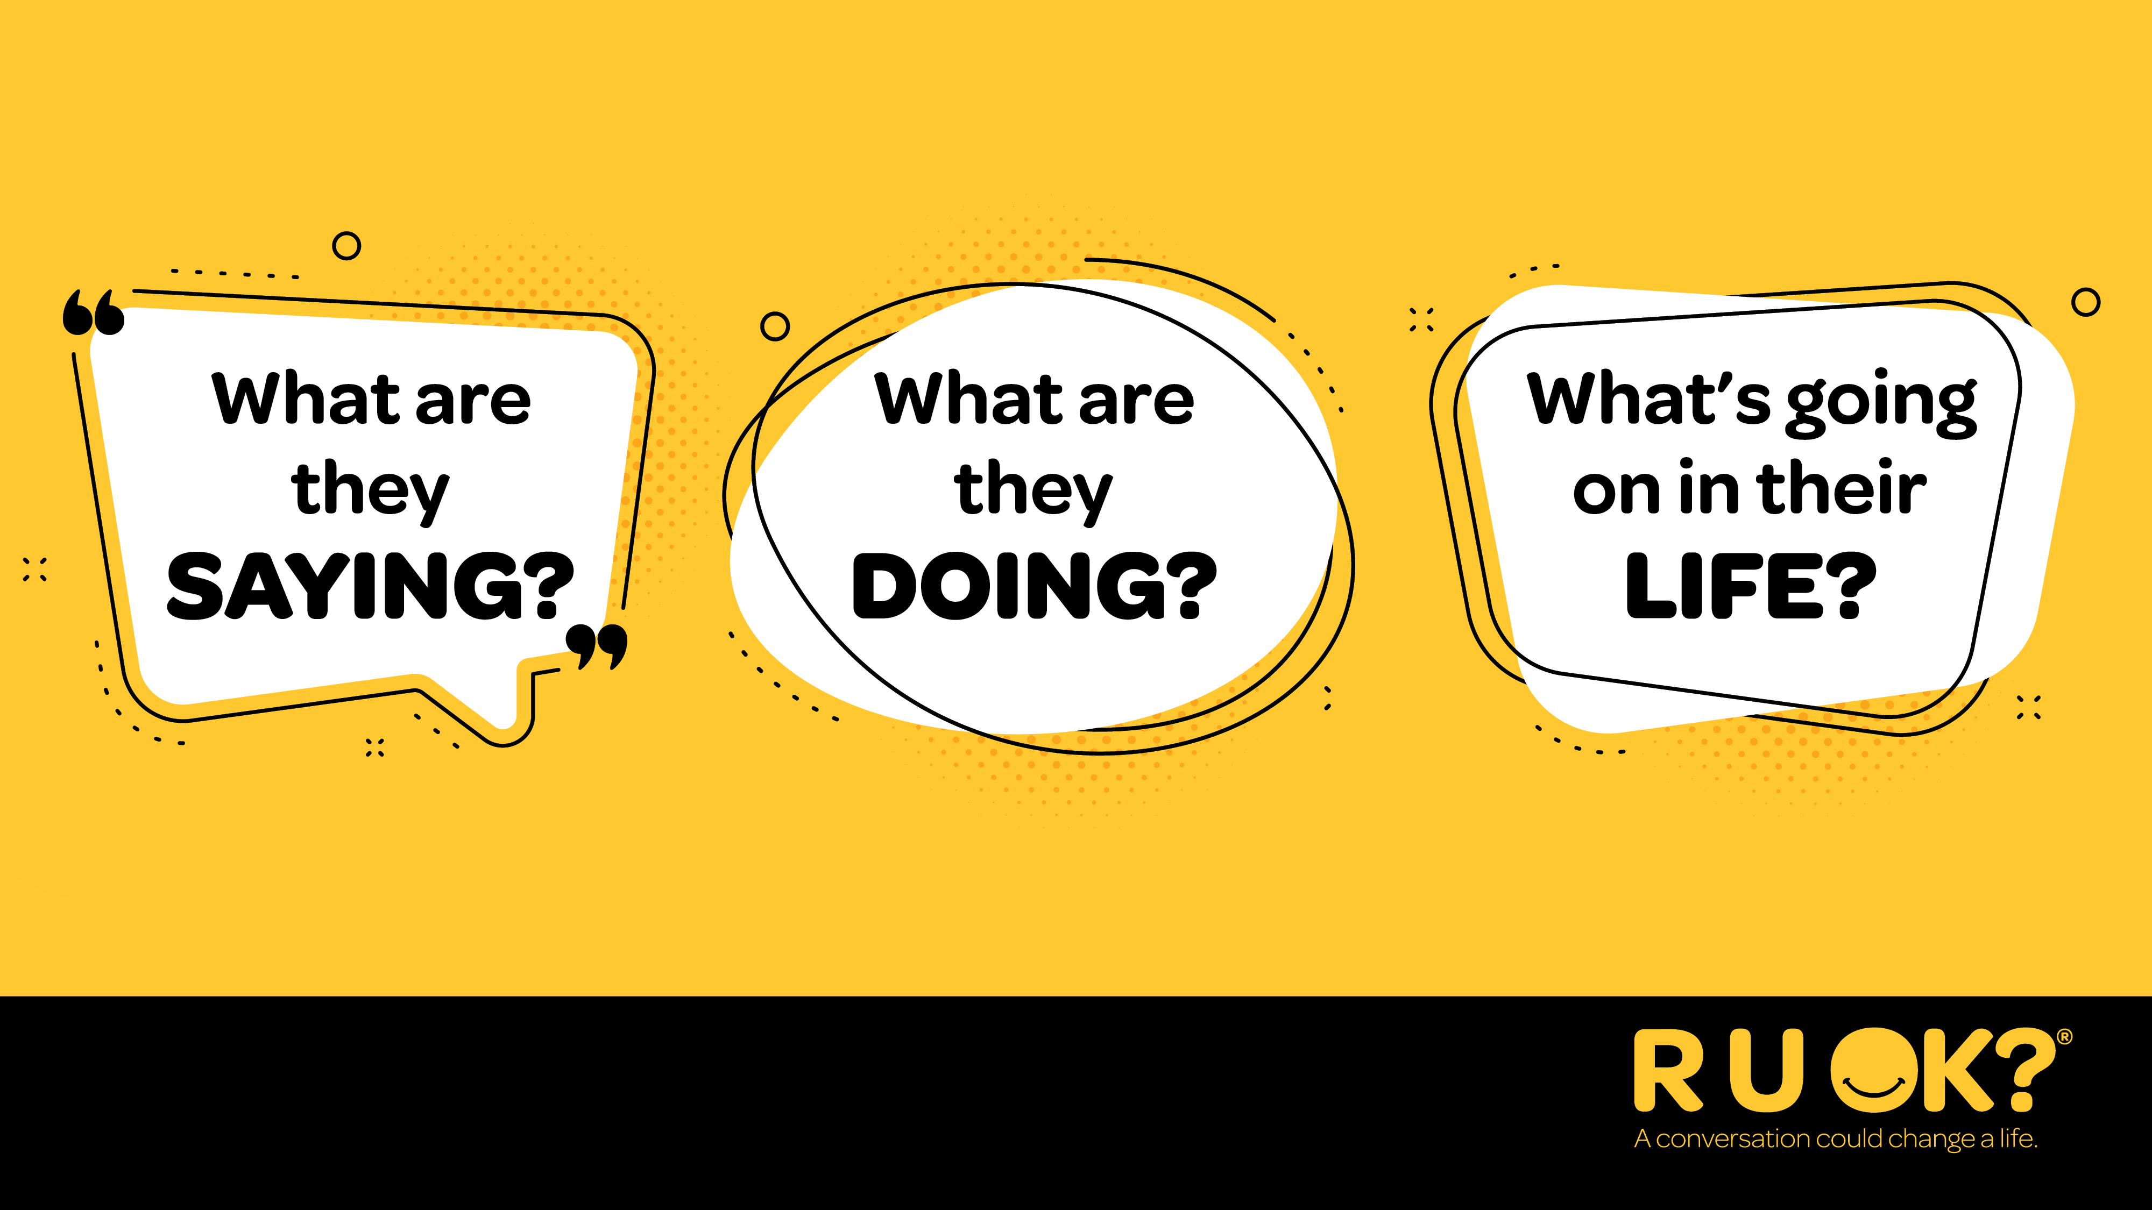
Notes:
So when should you ask R U OK?
Whenever you notice a change in what someone’s saying or doing or if you know there are things happening in their life that might be putting them under pressure or causing stress.
OPTIONAL AUDIENCE ENGAGEMENT QUESTION
What are some examples of signs that could indicate someone needs your support?

Slide 15
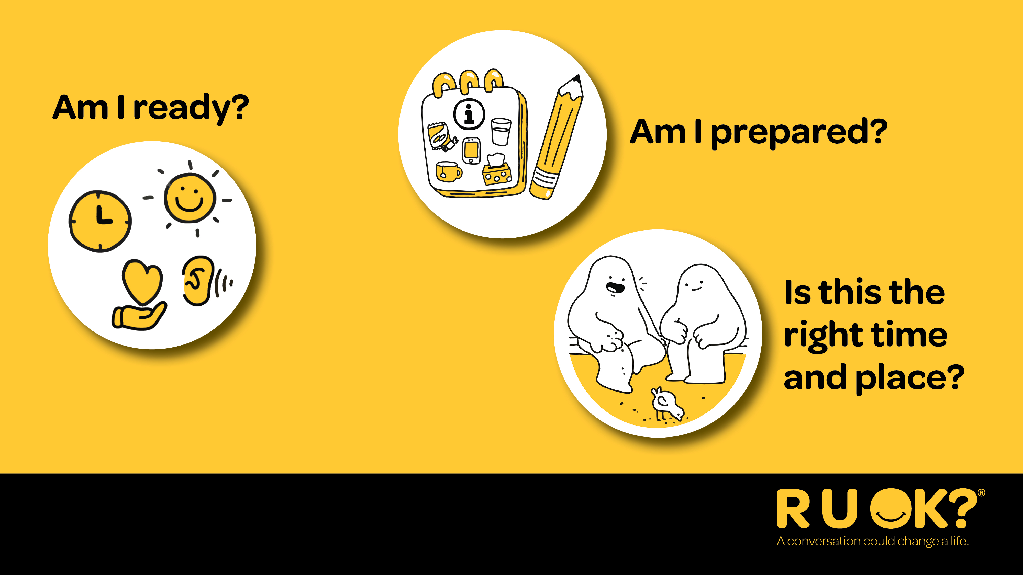
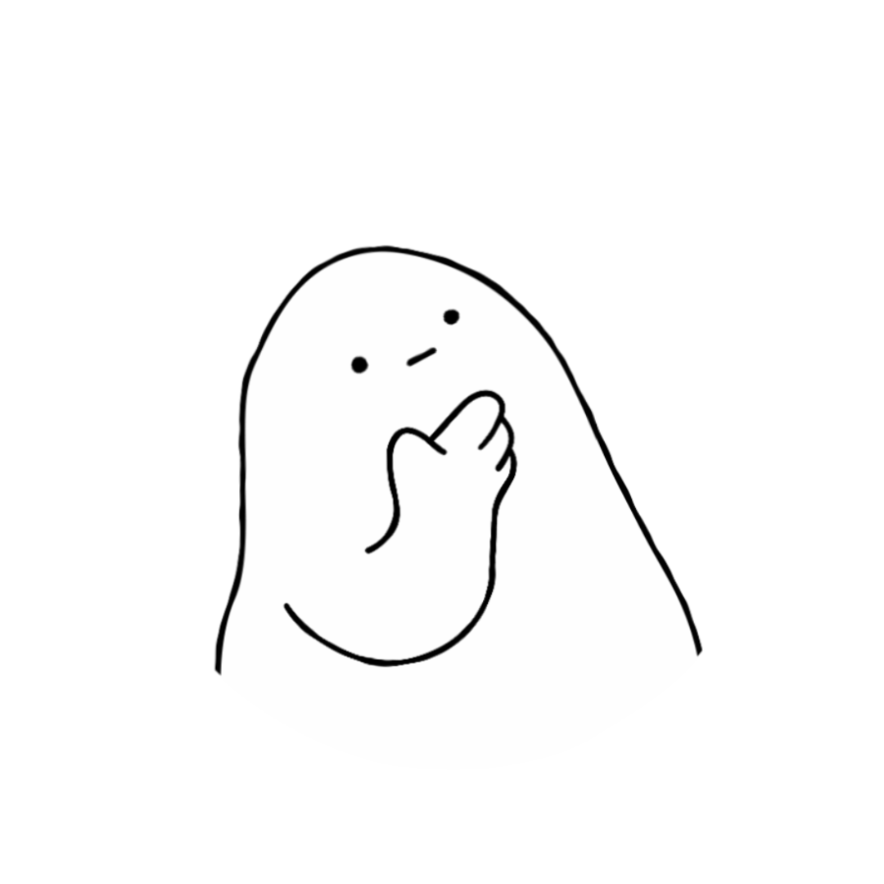
Notes:
Before supporting someone else, take a moment to check in with yourself.
Are you in the right headspace to really listen?
Have you set aside the time you might need for the conversation?
Have you chosen somewhere comfortable and relatively private?
It might be more comfortable for the person to be side-by-side with you (e.g. walking together or sitting in the car) rather than face-to-face.
Remember, you don’t need to solve someone’s problems. Your role is to listen, show you care and help them think about what support might help next.

Slide 16
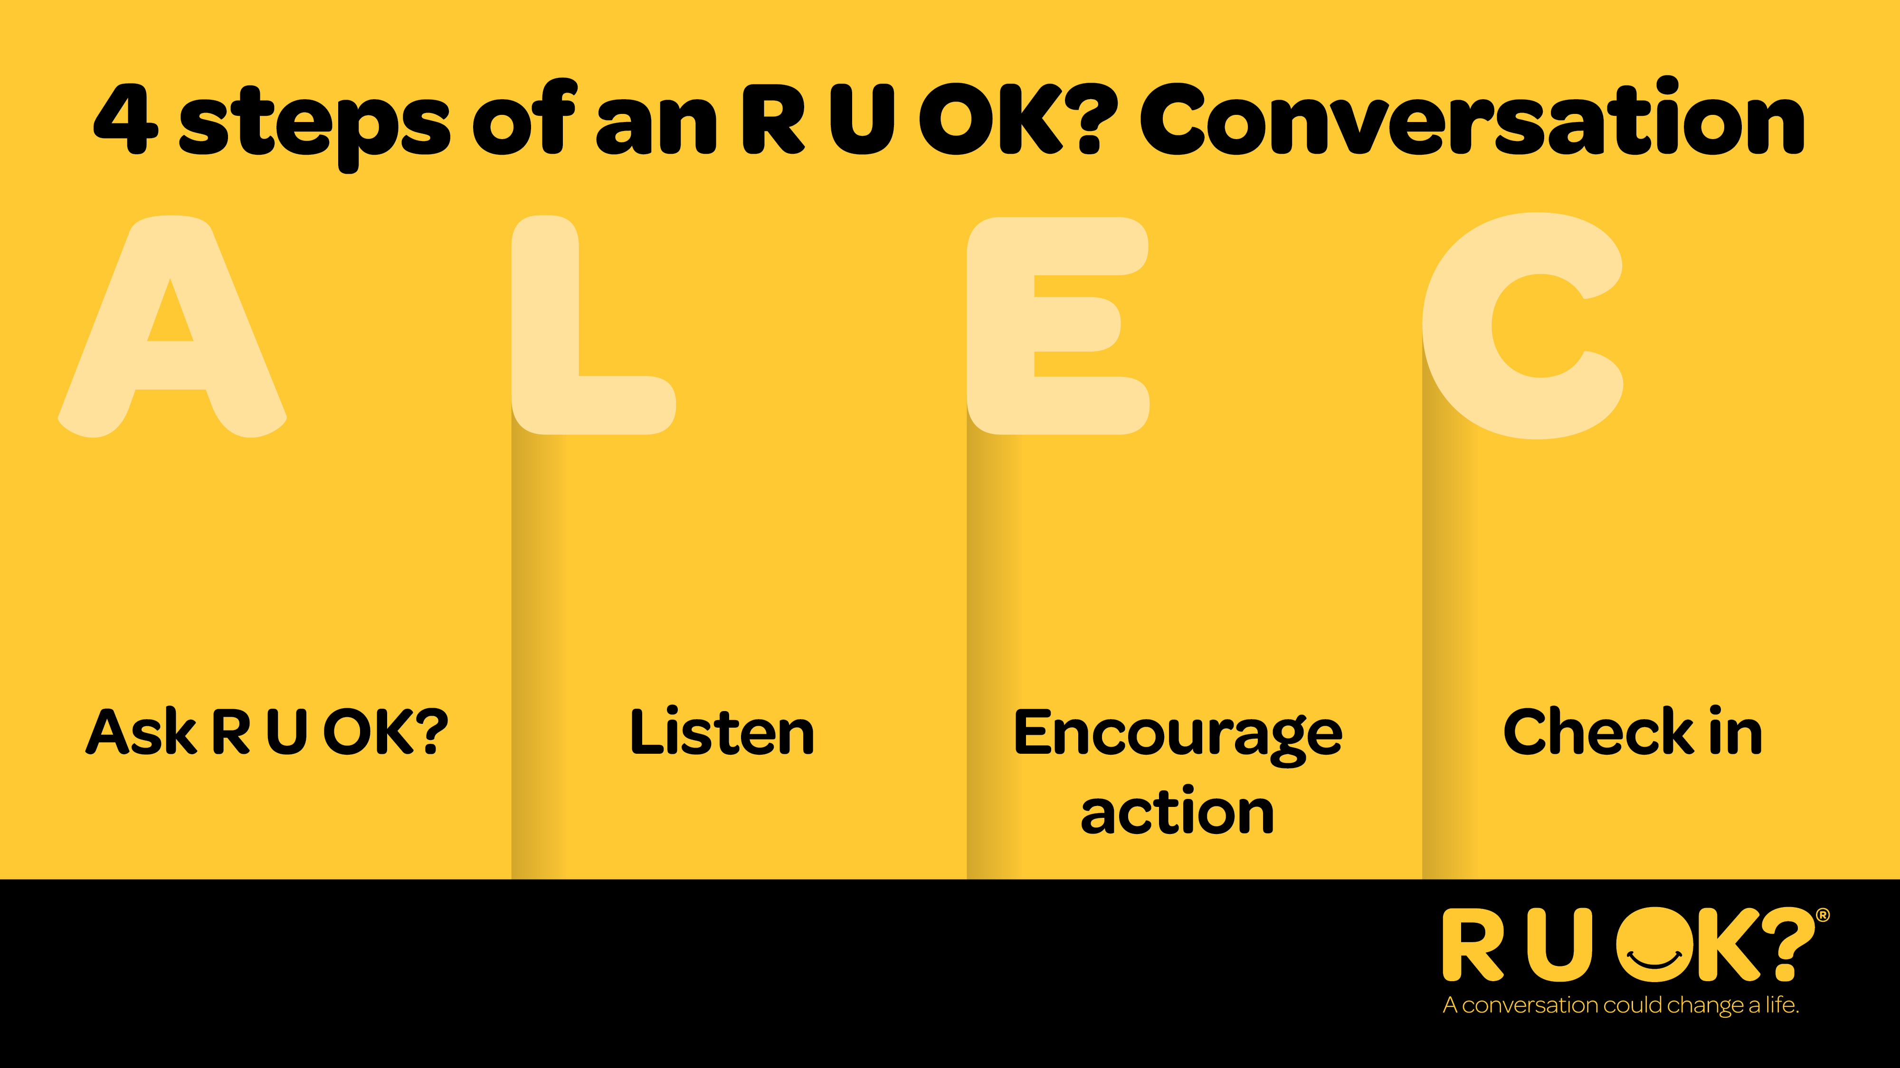
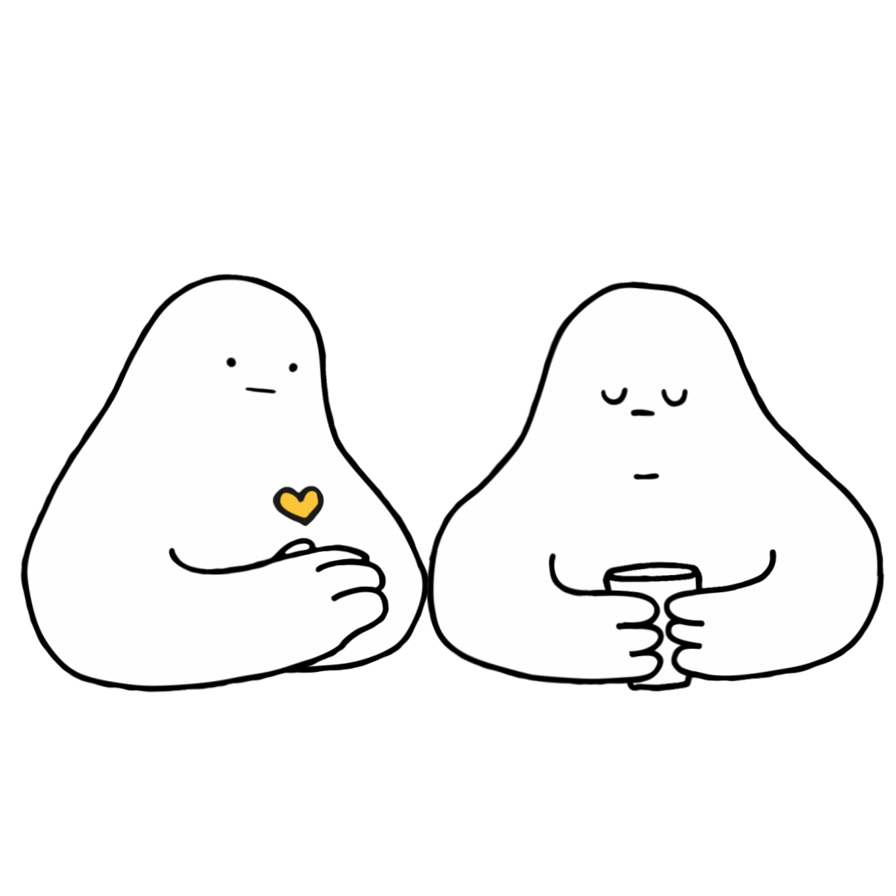
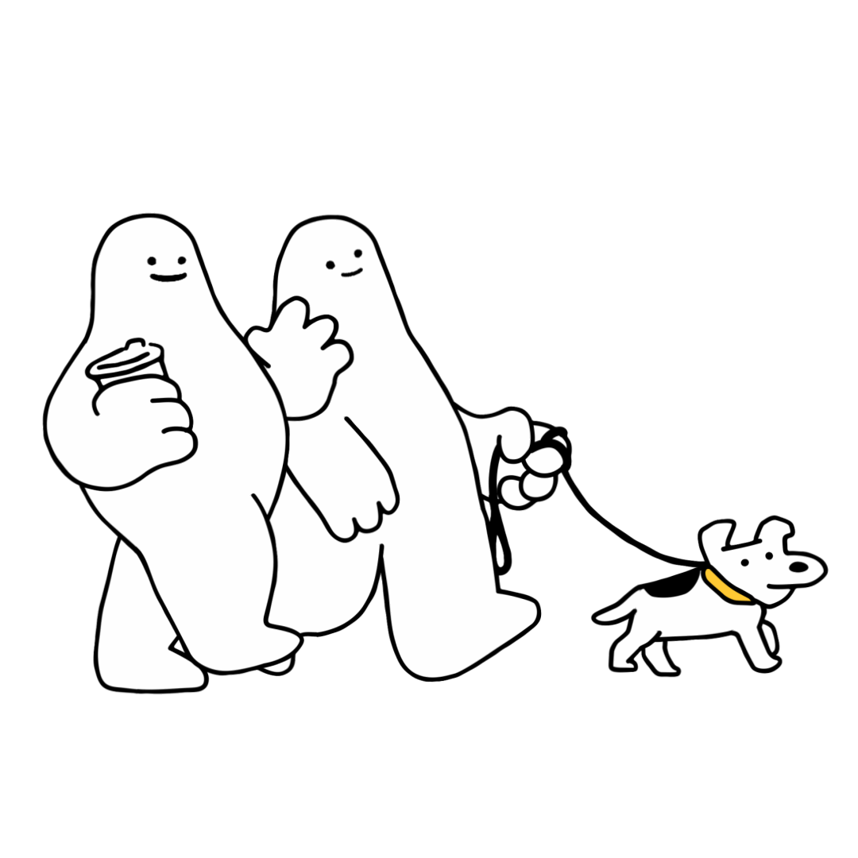
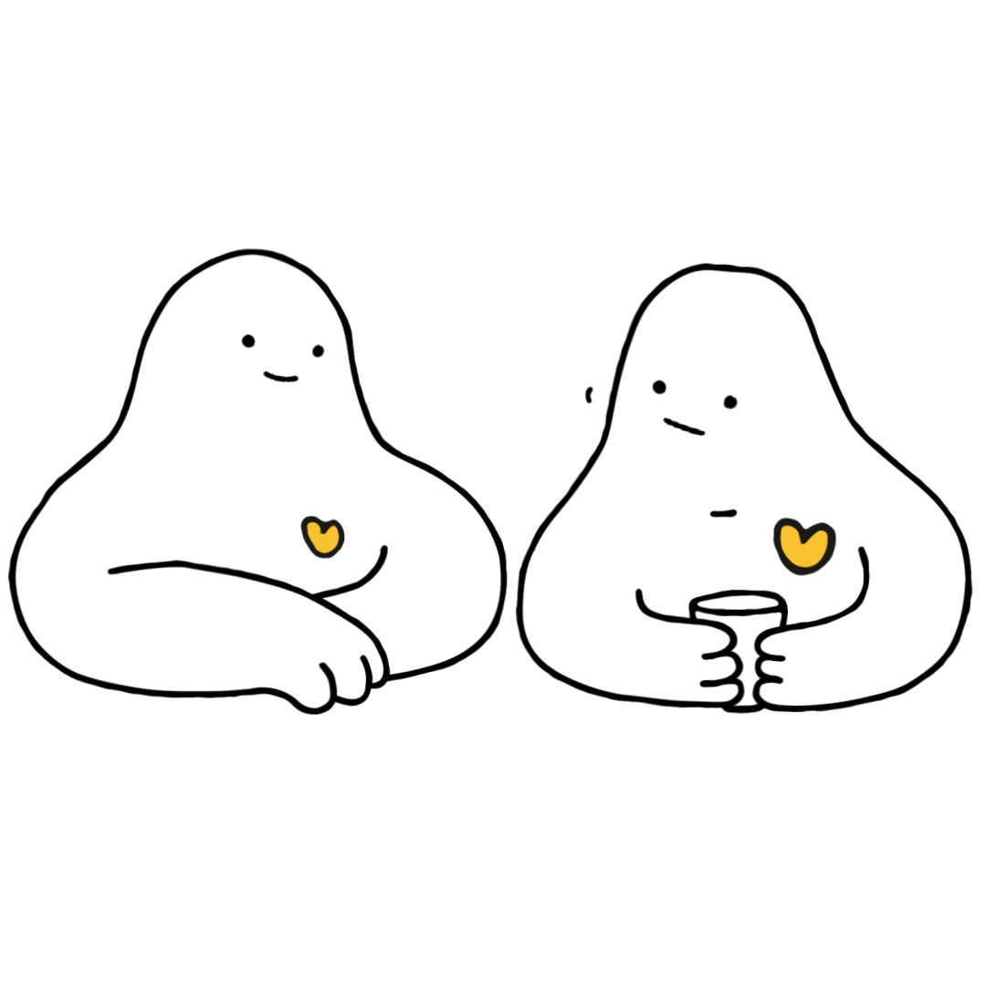
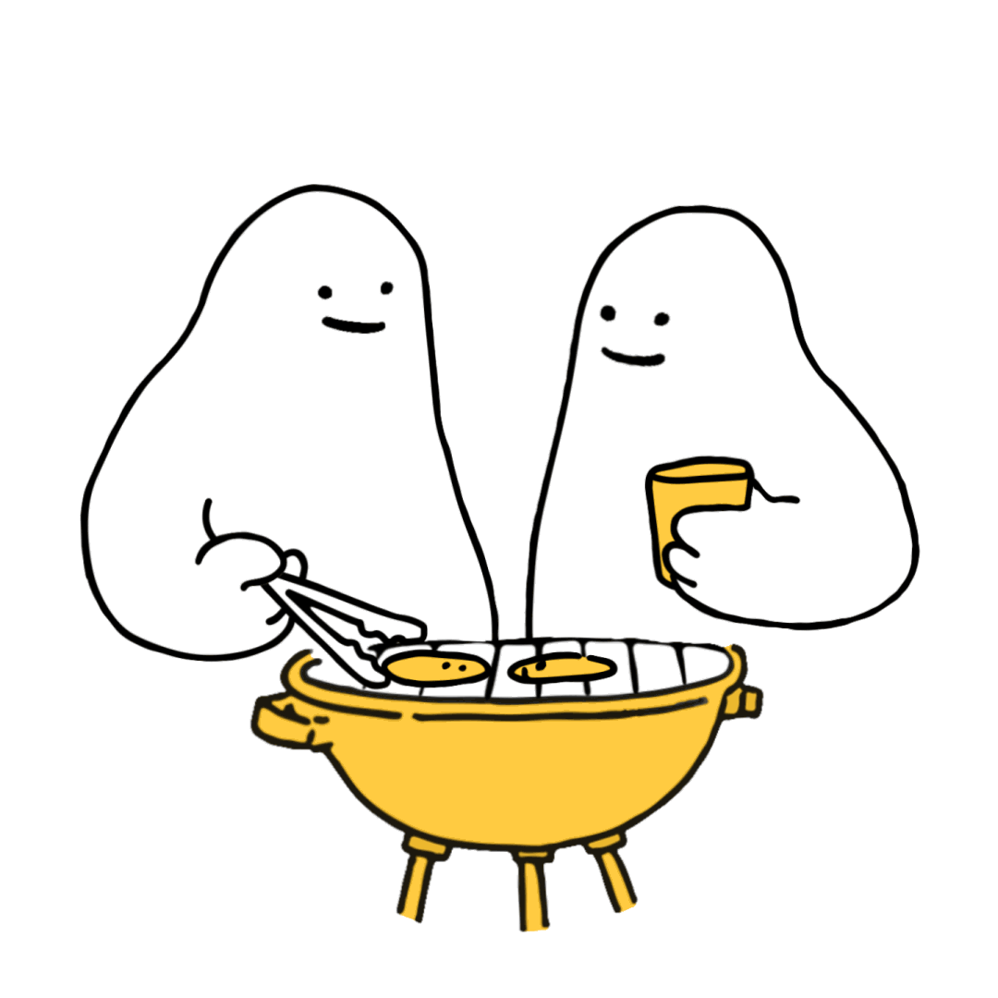
Notes:
R U OK? uses a simple, easy to remember, four-step conversation guide called ALEC:
Ask R U OK?
Listen
Encourage action
Check in

Slide 17
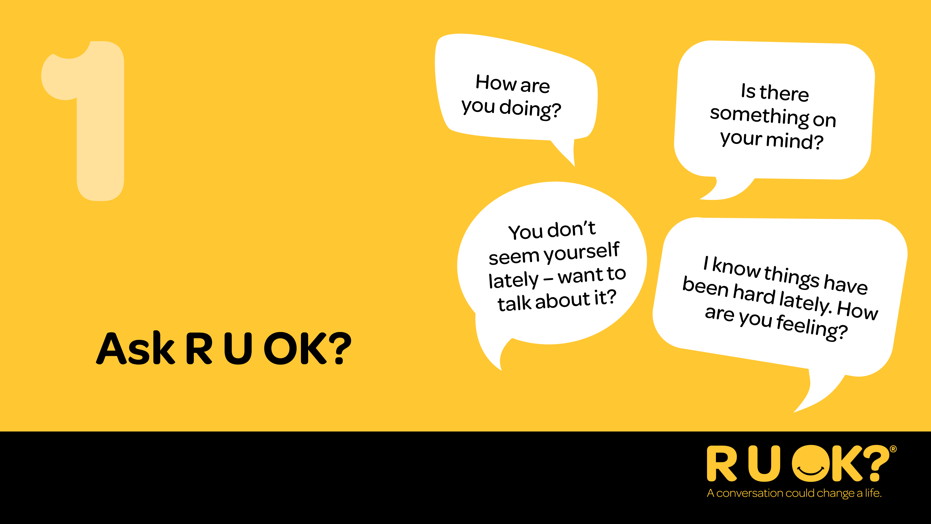
Notes:
Step one: Ask R U OK?
Start by letting the person know you’ve noticed something has changed.
Ask in a way that feels natural for your relationship.
Examples
“I’ve noticed you don’t seem yourself lately. How are things going?”
“I know there’s been a lot happening for you recently. How are you managing?”
“You seem a bit quieter than usual. Want to talk about it?”
If they don’t want to talk, that’s OK. Let them know you’re there whenever they’re ready.
Remember: If you’re thinking it, ask it.

Slide 18
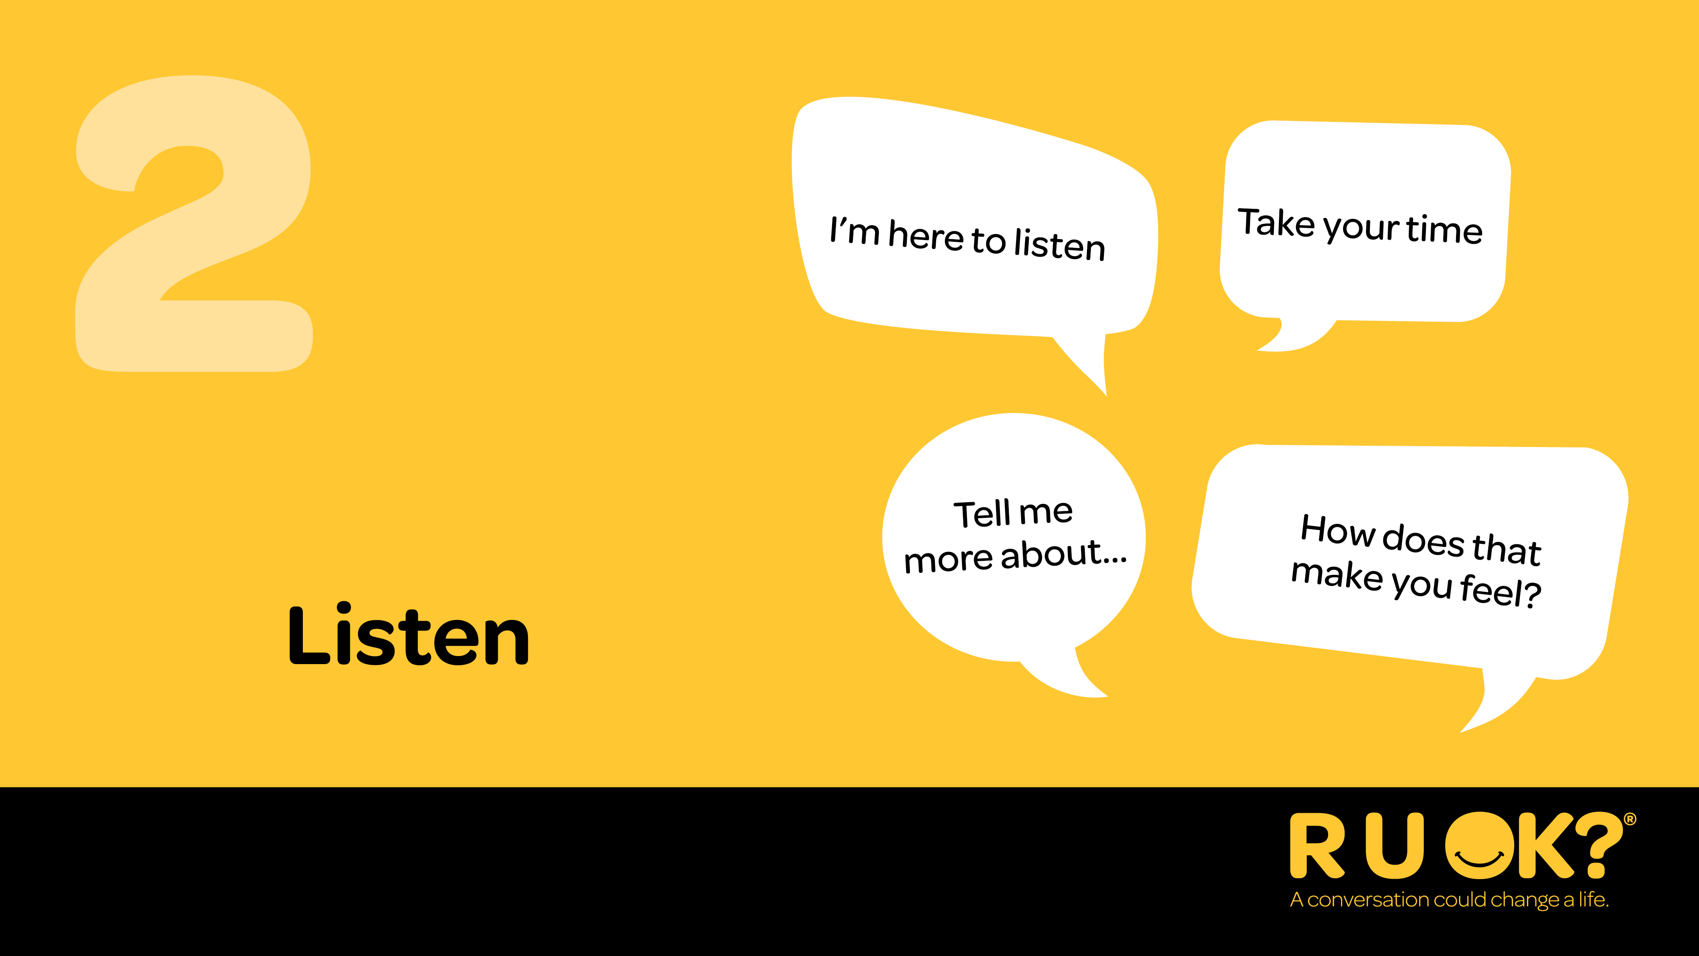
Notes:
Step two: Listen
Listen with an open mind and without judgement.
Resist the urge to jump straight into fixing the problem.
Give the person time to think, even if that means sitting in silence.
If you have had similar experiences, or know someone who has, it can be nice to let them know they are not alone, however keep the converstation about them and try not to ‘take-over.’
Acknowledge what they’re sharing and let them know you’re there for them.
Listening isn’t always easy when someone is hurting. Often, the greatest thing you can offer isn’t advice - it’s your time, your attention and the reassurance that they don’t have to go through it alone.

Slide 19
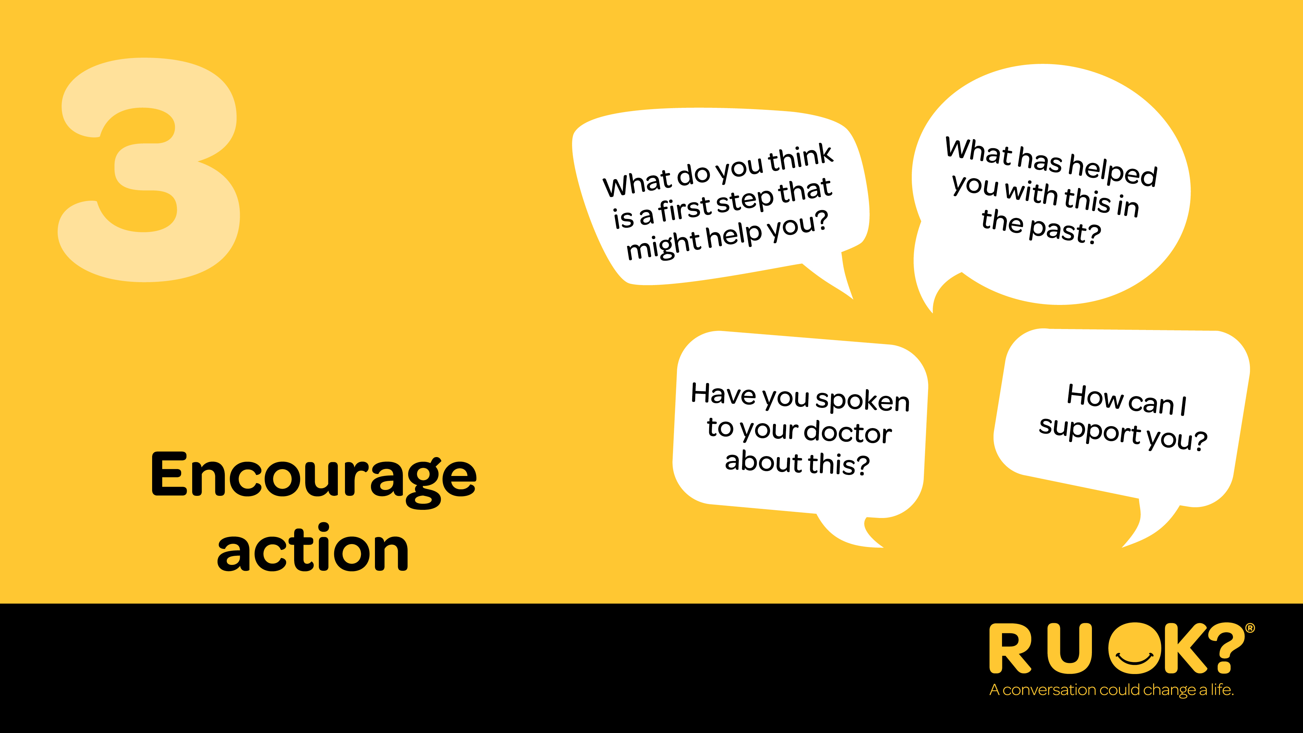
Notes:
Step three: Encourage action
Once they’ve shared what they’re going through, you might suggest to them that they think about one small and immediate step they might be able to take to improve their situation.
That could be talking to a trusted friend, family member, manager or health professional.
You don’t need to have the answers — you just need to help them explore what support might help.
Ask them how you can help, it could be helping them find a good professional support, telling someone else in their life what’s going on if they can’t find the words easily, help them with some life admin or even just ask if you can give them a call next week to check in.

Slide 20
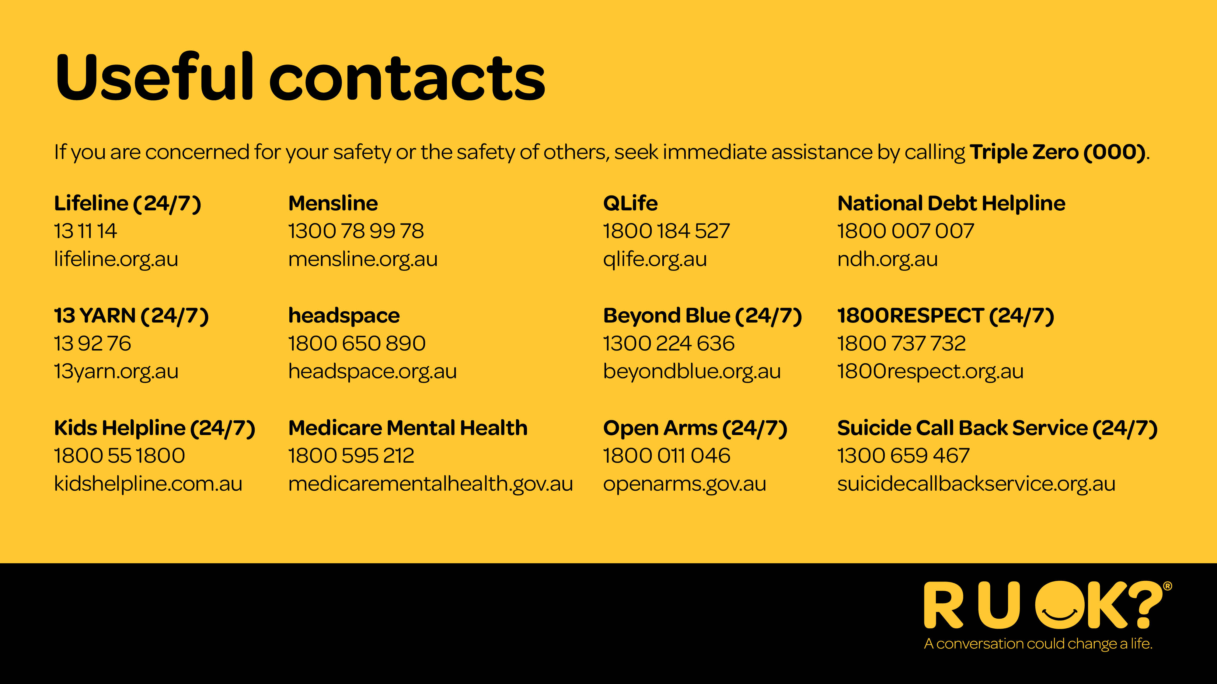
Notes:
If at any time you feel overwhelmed after supporting someone, it’s important to reach out for support yourself.
If someone needs immediate support, these services are available nationally to provide emotional and crisis support.
If you or someone else is in immediate danger, call Triple Zero (000).
OPTIONAL ADDITION
Before we move on, encourage everyone to take a photo of this slide to keep these support services handy. You might find them helpful if a conversation brings up concerns and someone needs extra support.
You could also mention any local services if you are aware of them (e.g. if the workplace has an Employee Assistance Program).

Slide 21
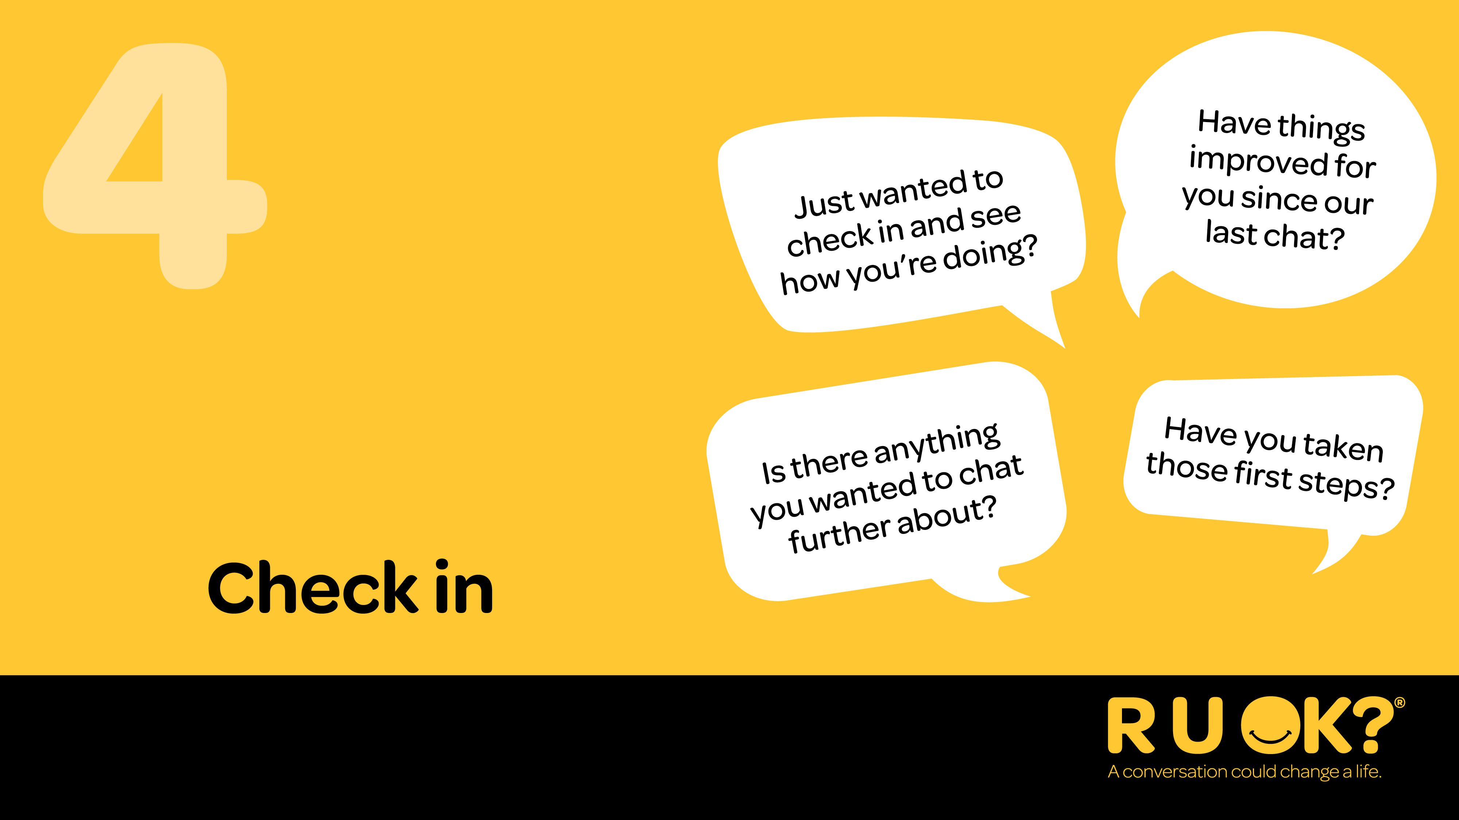
Notes:
The conversation doesn’t end after you ask R U OK?.
Checking back in reminds someone know they’re important and that your care wasn’t just for one moment.
A quick message, coffee or chat can make all the difference.
Staying connected is one of the most powerful ways we can support the people around us.

Slide 22
Notes:
That’s the 4 steps (remember ALEC):
Ask R U OK?
Listen
Encourage action
Check in

Slide 23
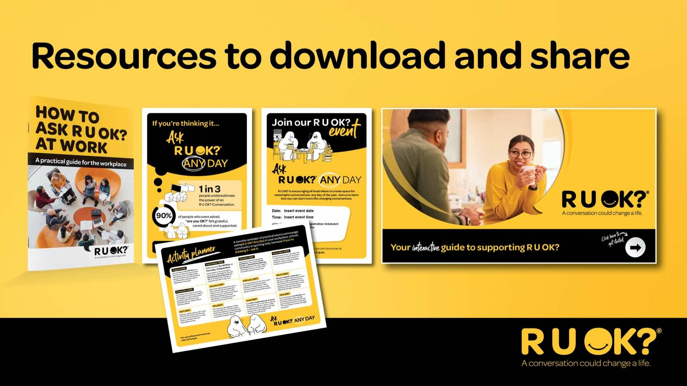
Notes:
Here are some of the resources available, including conversation guides, posters, social tiles and activities to help keep the message going all year.

Slide 24
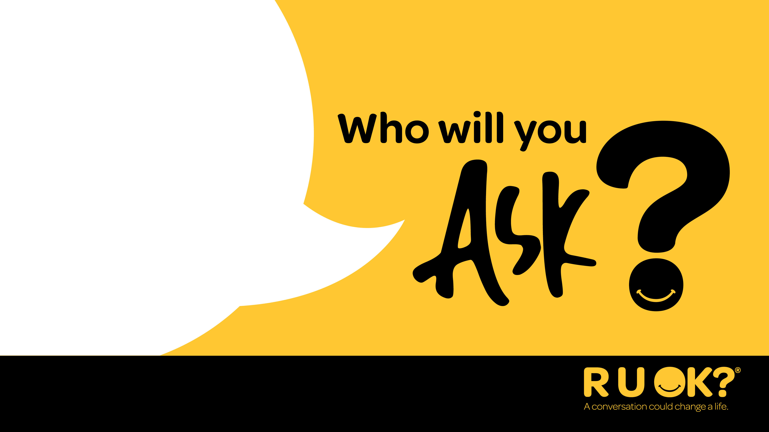
Notes:
Thank you for your time today.
I’d encourage you to think about who you can regularly check in with and ask R U OK? Any Day.

