Slide 1

Notes:
Start the presentation by introducing yourself.

Slide 2

Notes:
Acknowledgement of Country
I acknowledge the Traditional Owners of the land on which we are meeting today and pay my respect to Elders past, present and future.
Recognise lived experience
I’d also like to recognise those with lived experience of mental ill-health or suicide. This can bring up tough emotions for people so it’s OK to excuse yourself at any time.

Slide 3
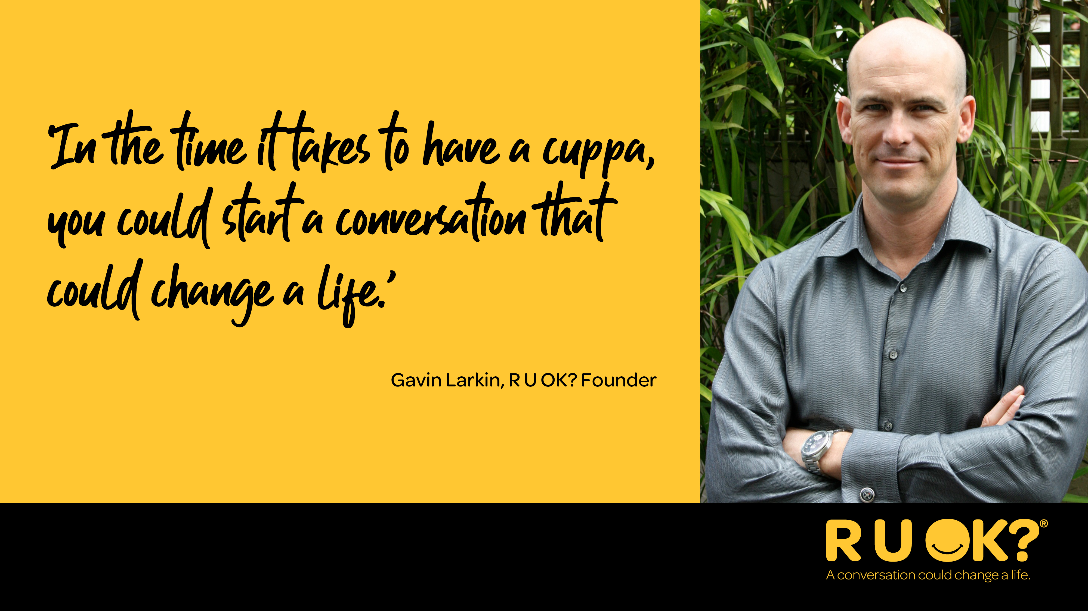
Notes:
The late Gavin Larkin started R U OK? in 2009, hoping to protect others from experiencing the pain his family felt when his father died by suicide.
He believed that ‘in the time it takes to have a cuppa, you could start a conversation that could change a life’.
This belief that is backed by academic research that found that feelings of connection and belonging are a protective factor against suicide.

Slide 4
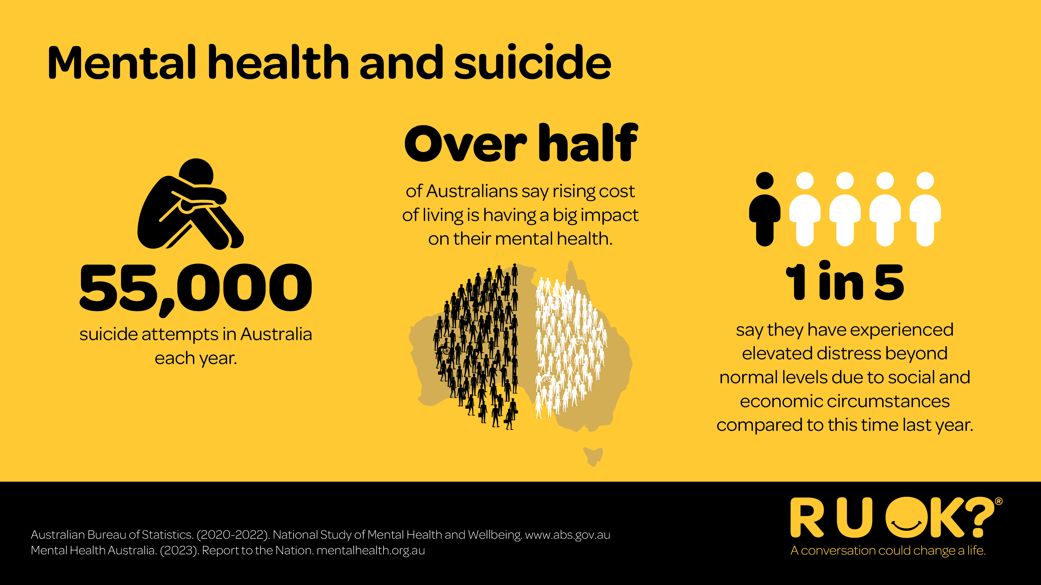
Notes:
It’s estimated more than half of Australians say the rising cost of living is having a big impact on their mental health.
...and around one in five people are experiencing high or very high levels of distress.
This might also be because of things like:
Relationship breakdowns
Financial stress
Illness or injury
Work stress
Mental ill-health
Becoming a parent or family challenges
Grief and loss.
Whether it’s your friend, family member, colleague, partner or teammate… the people you care about go through life’s ups and downs every day.

Slide 5
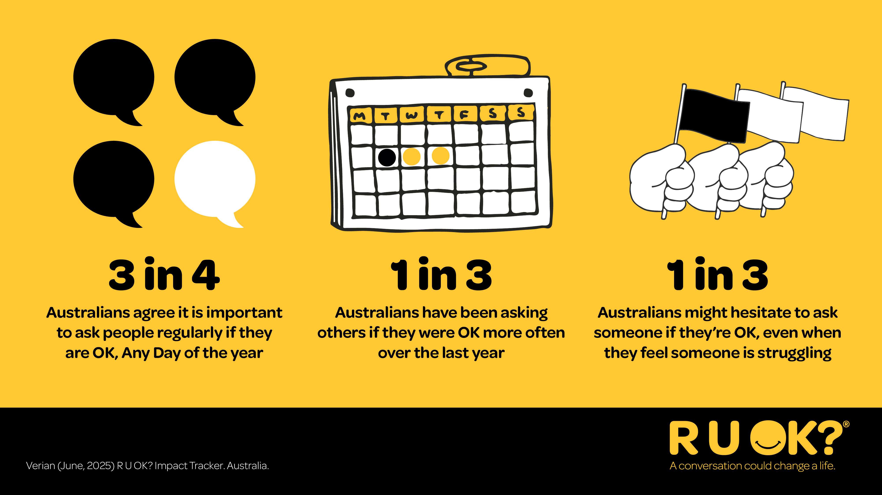
Notes:
Three in four Australians agree, but when it comes to starting those conversations, some people are less confident than others even when they feel someone is struggling.
R U OK? has found that a third of Australians might hesitate to ask someone if they’re OK because they worry about invading someone’s privacy or they’re not confident their actions will help.

Slide 6
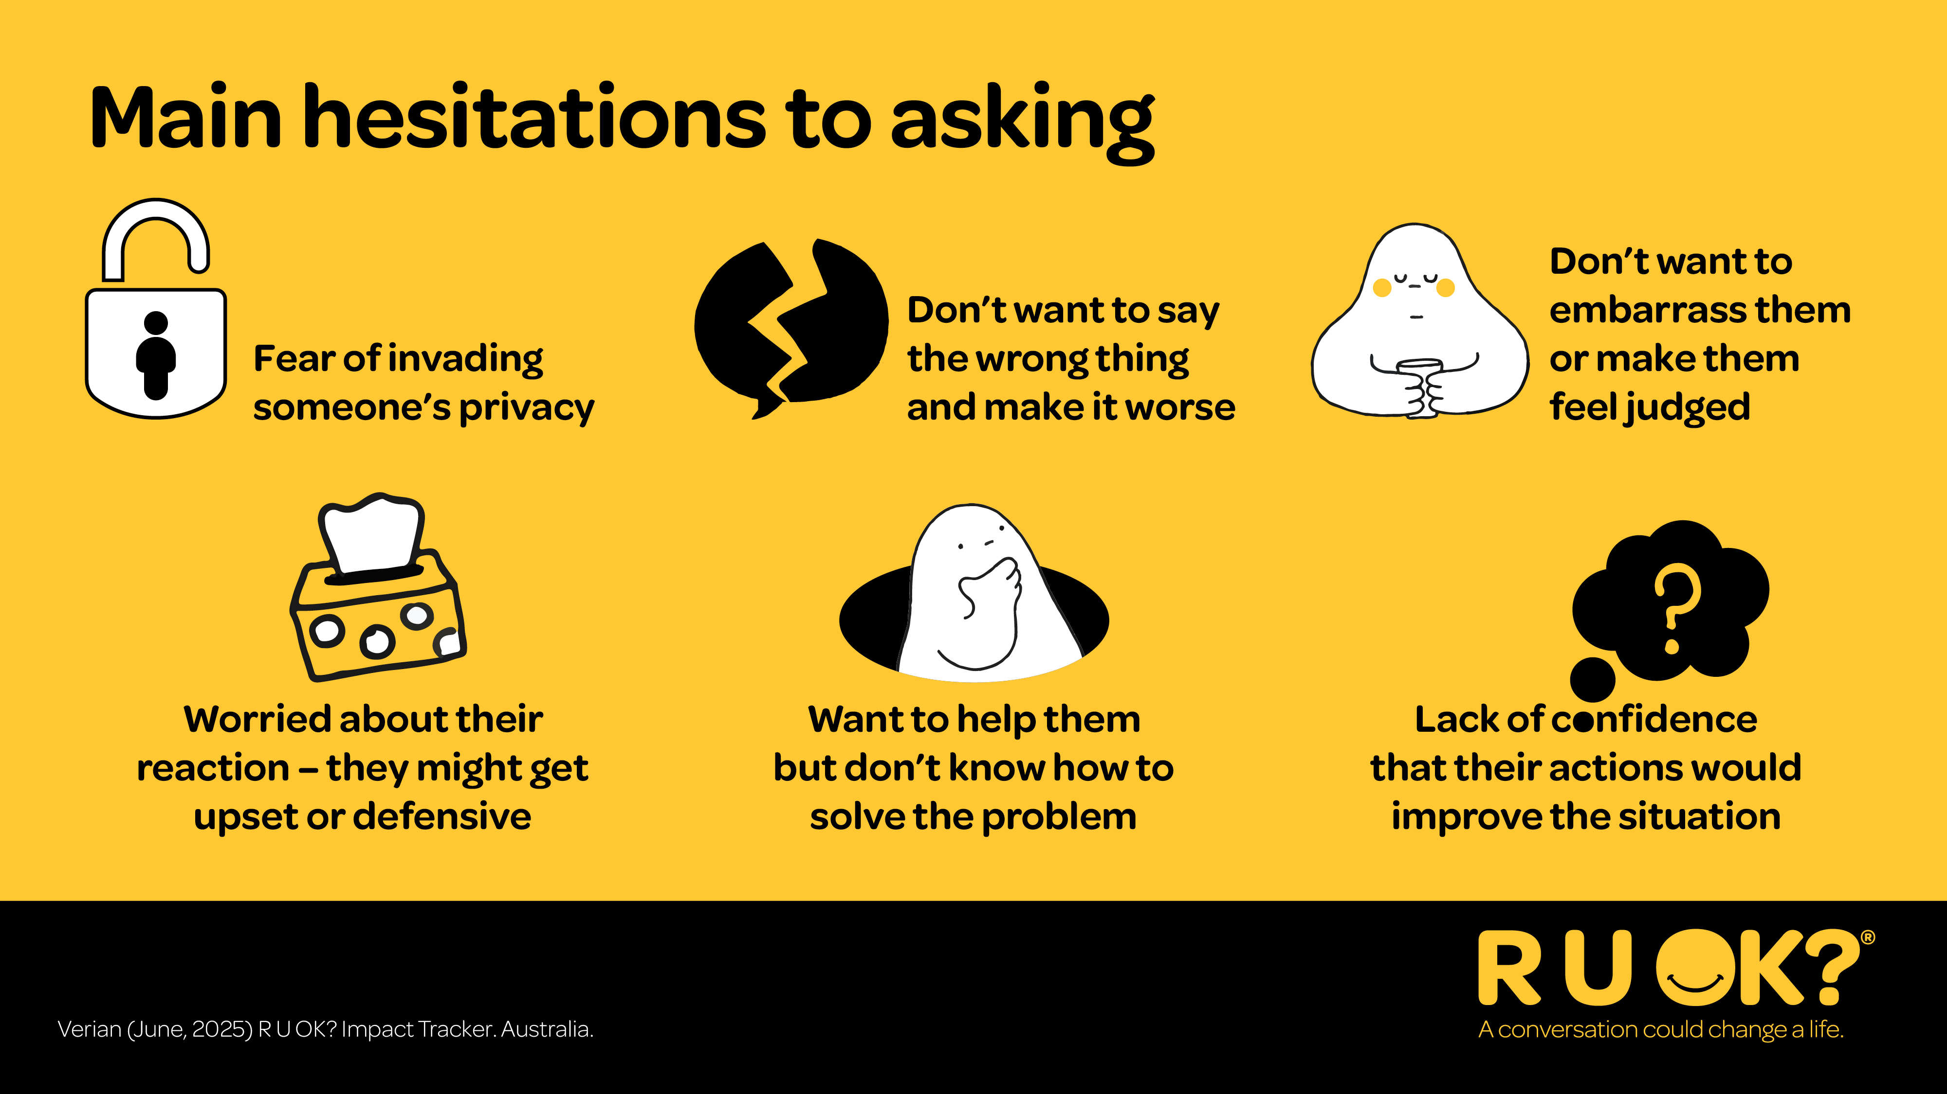
Notes:
There are several hesitations to asking 'are you OK?' These include:
- Fear of invading someone's privacy
- Not wanting to say the wrong thing and make it worse
- Not wanting to embarrass them or make them feel judged
- Worried about their reaction
- Wanting to help but not knowing how to solve the problem
- Lack of confidence
Audience question – what are some other hesitations to asking?

Slide 7
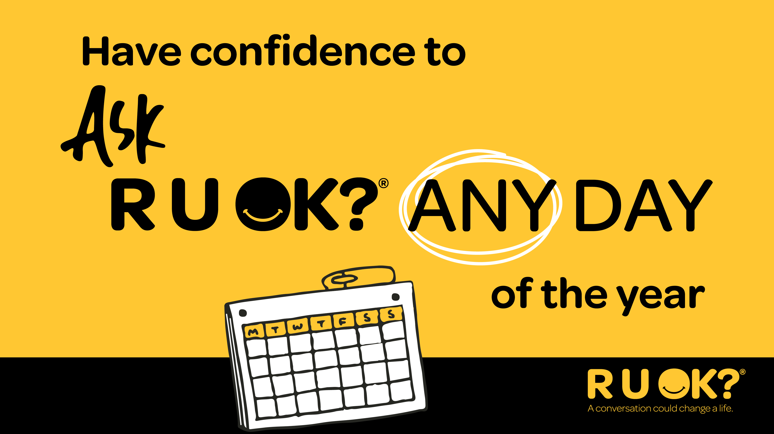
Notes:
Despite any hesitations you may be feeling, have the confidence to ask 'are you OK?'
A conversation really could change a life.

Slide 8

Notes:
That’s why R U OK? is calling on all of us to continually: Ask R U OK? Any Day
R U OK?Day is a reminder but it’s what we do regularly that truly makes a difference.

Slide 9

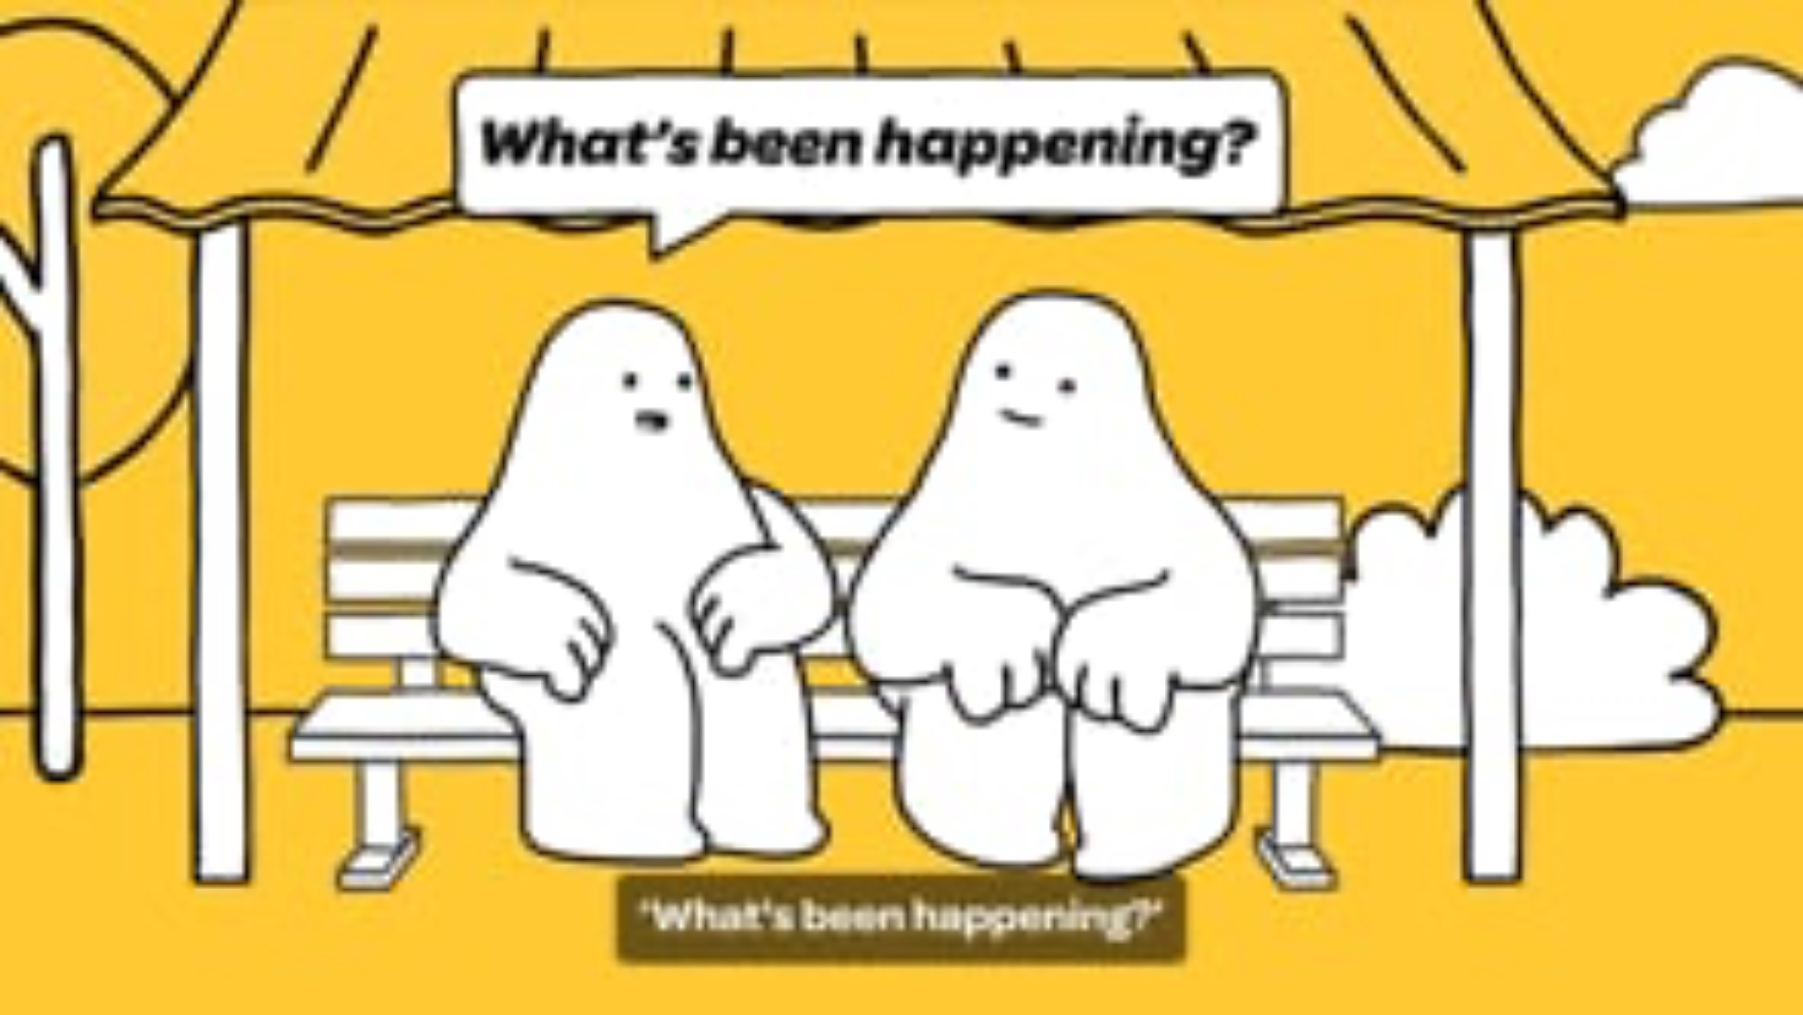
Notes:
Play this short video explaining the ‘Ask R U OK? Any Day’ message.
You can find the video here: https://vimeo.com/977187614/38dfbcc58e

Slide 10
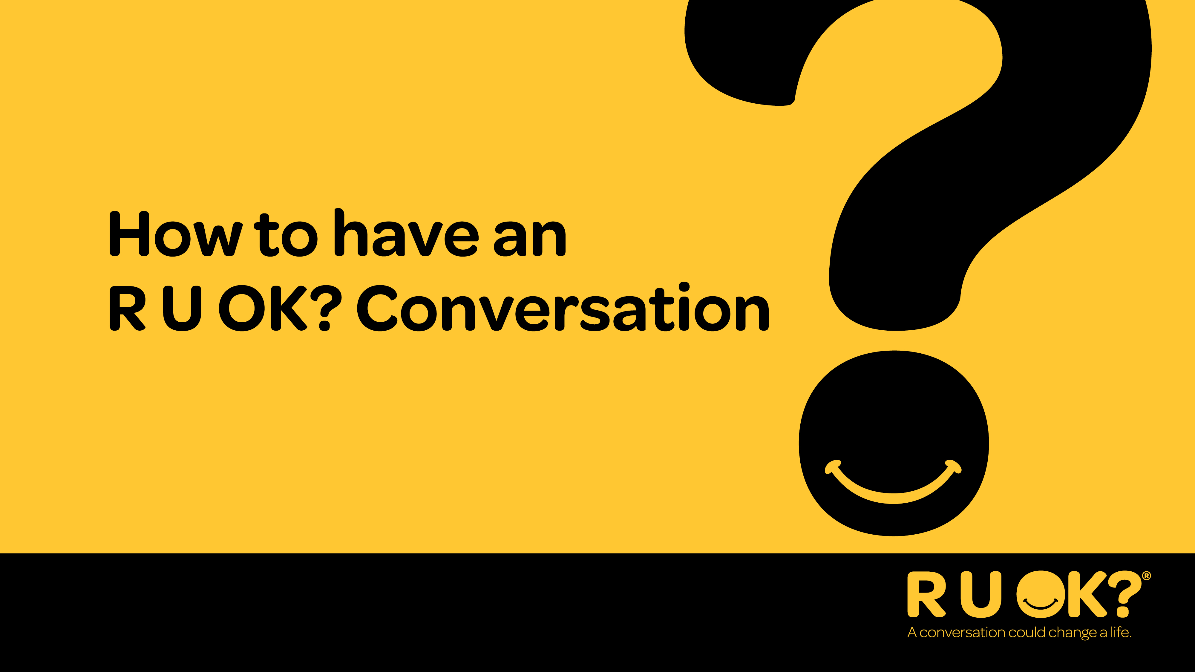
Notes:
Now we’re going to talk through the steps of an R U OK? conversation.

Slide 11
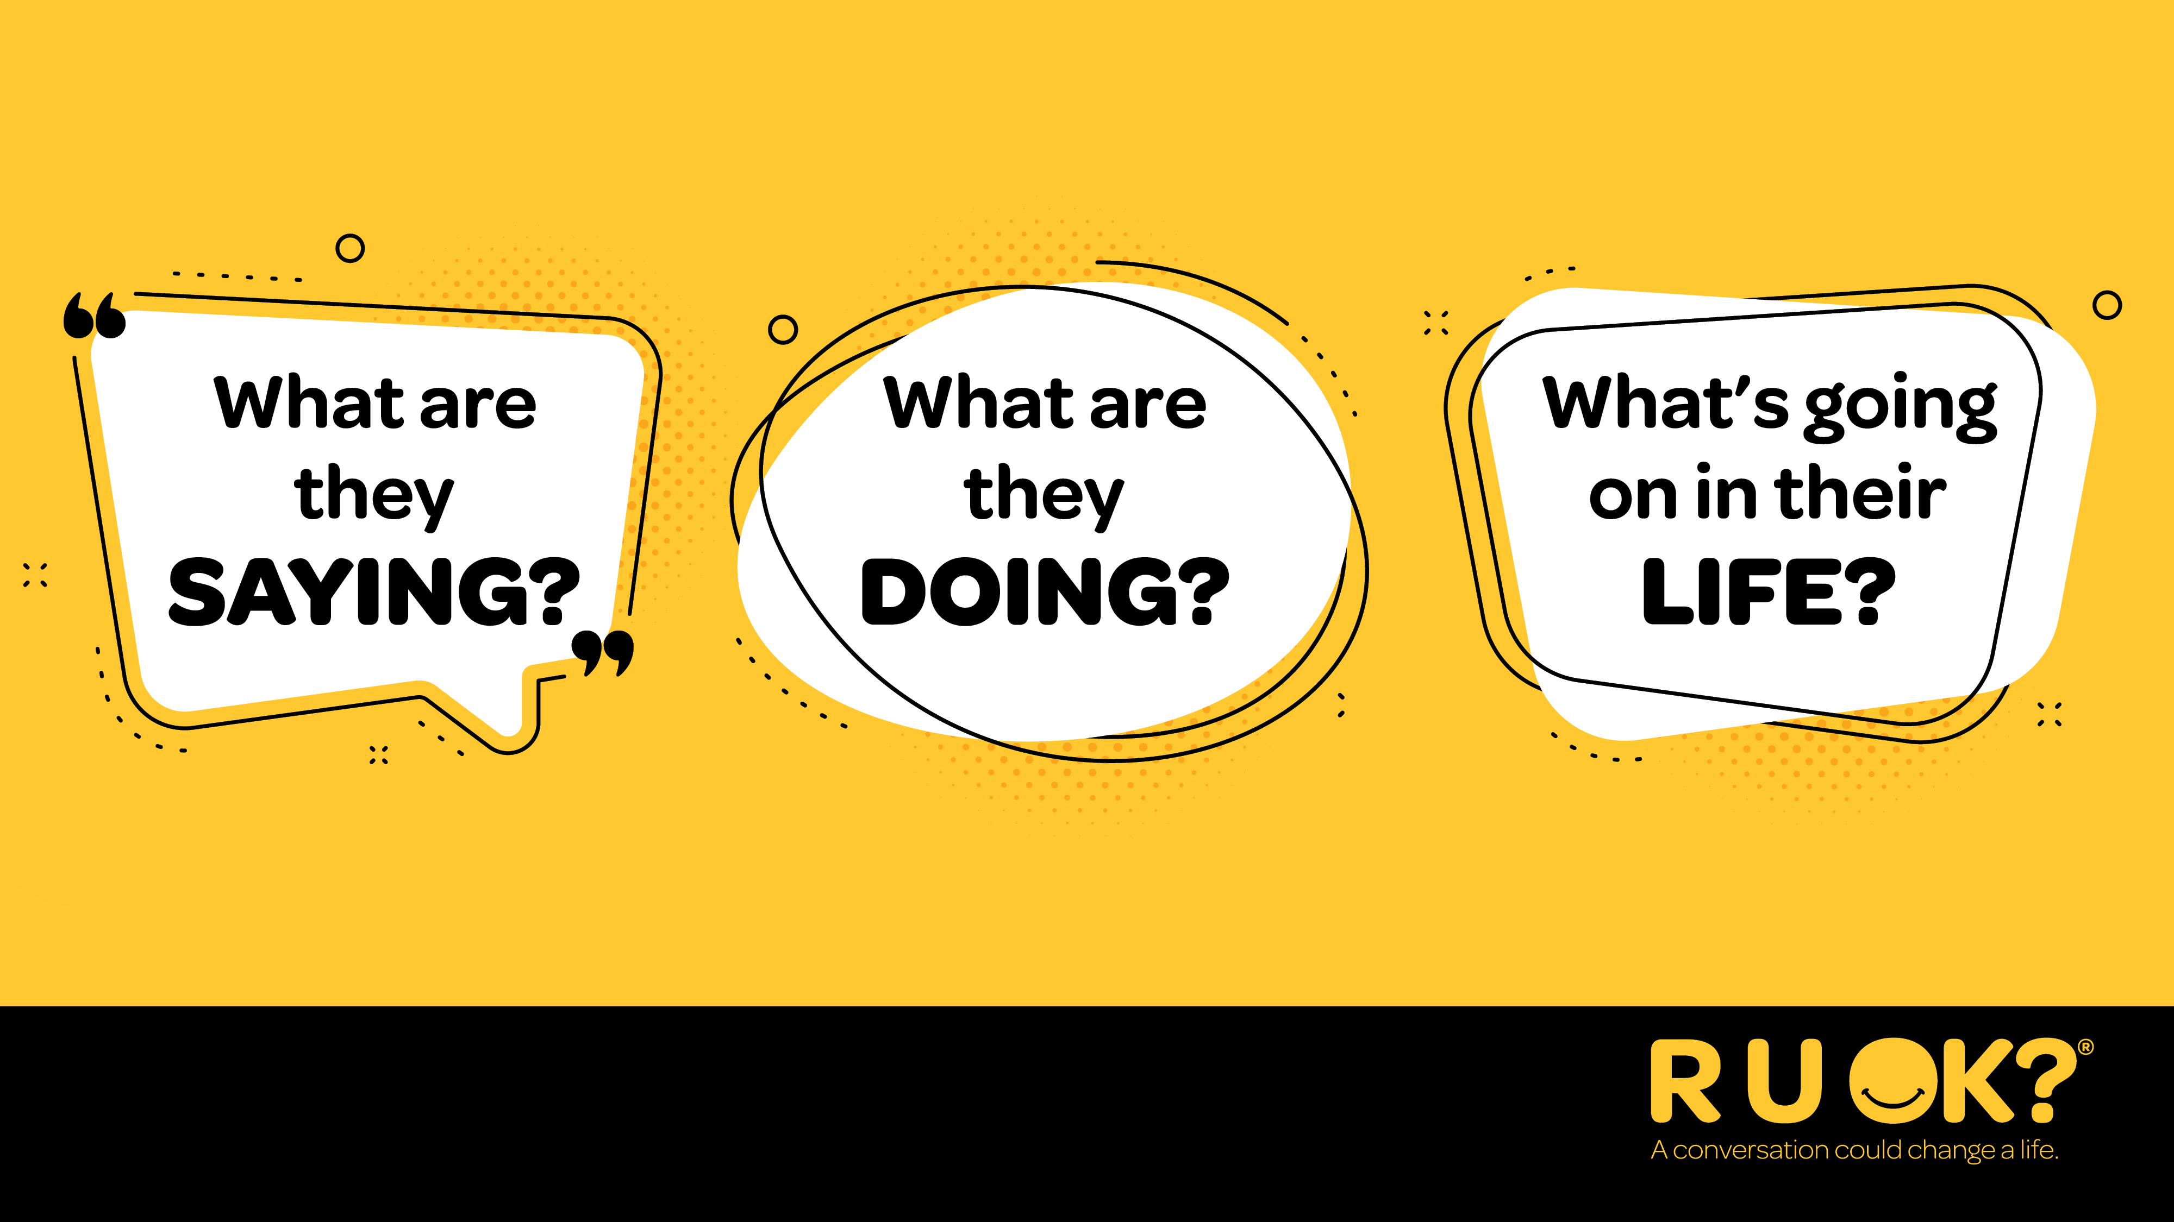
Notes:
So when should you ask R U OK?
Whenever you notice a change in what someone’s saying or doing or if you know there are things happening in their life that might be putting them under pressure or causing stress.
OPTIONAL AUDIENCE ENGAGEMENT QUESTION
What are some examples of signs that could indicate someone needs your support?

Slide 12
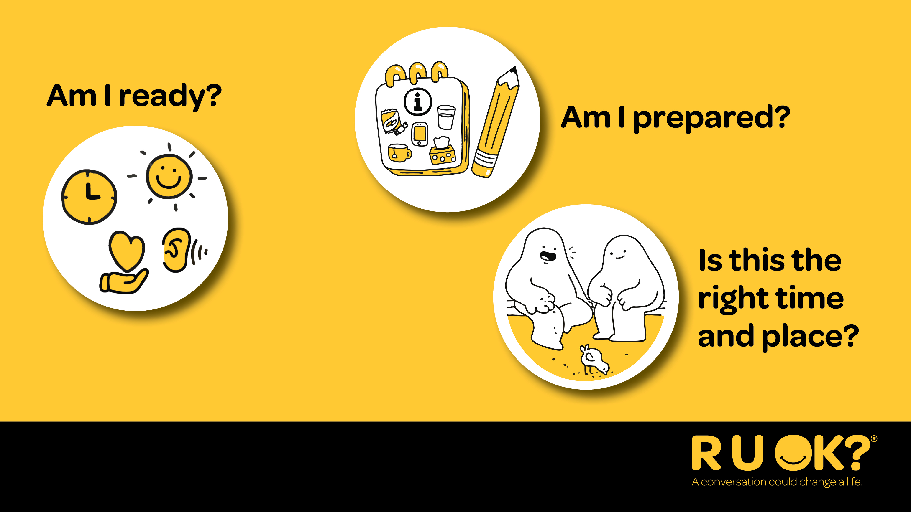
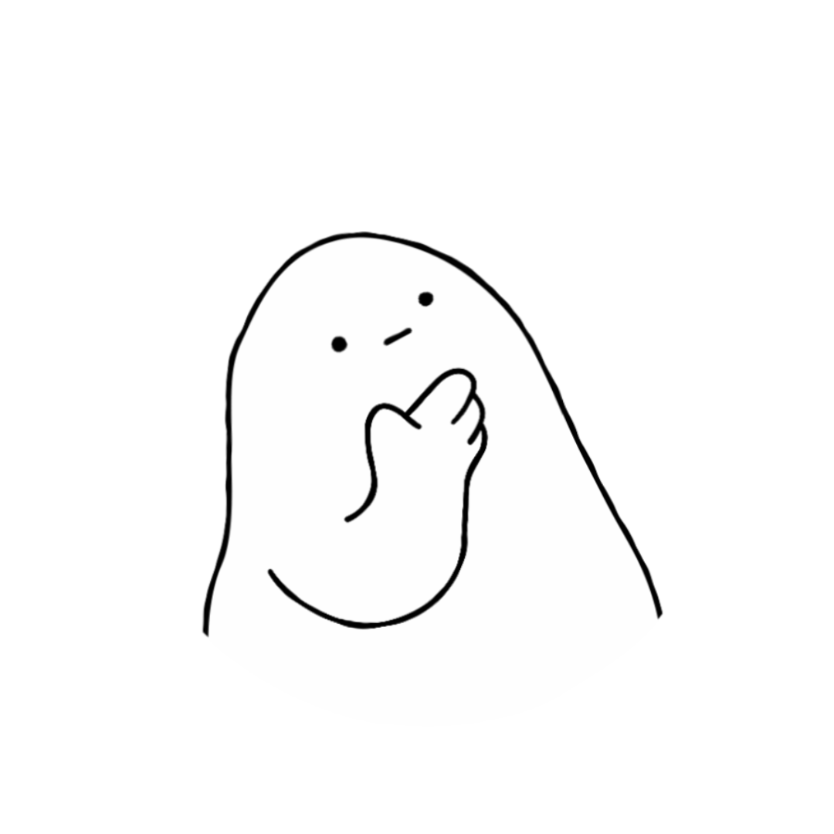
Notes:
Before you can support someone else, you need to make sure you’re in the right headspace. If you don’t feel ready or think you’re not the best person for the conversation then try to think of someone else in their support network who could talk to them.
To help you decide whether you’re ready to start a meaningful conversation, ask yourself:
Are you ready?
Are you in a good headspace?
Are you willing to genuinely listen?
Have you set aside the time you might need for the conversation?
Are you prepared?
Remember that you won’t have all the answers (and that’s OK).
It can be difficult for people to talk about personal struggles, and they might be emotional, embarrassed or upset.
Have you chosen the right time and place?
Have you chosen somewhere relatively private and where you’ll both be comfortable to chat?
Is this time convenient for them?
If they don’t have time when you first approach them, arrange another time for the conversation. It might be more comfortable for the person to be side-by-side with you (e.g. walking together or sitting in the car) rather than face-to-face.

Slide 13
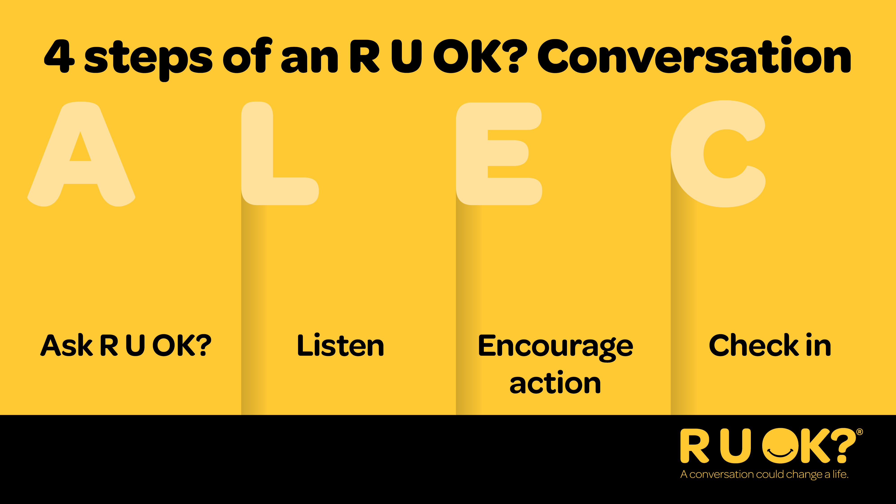
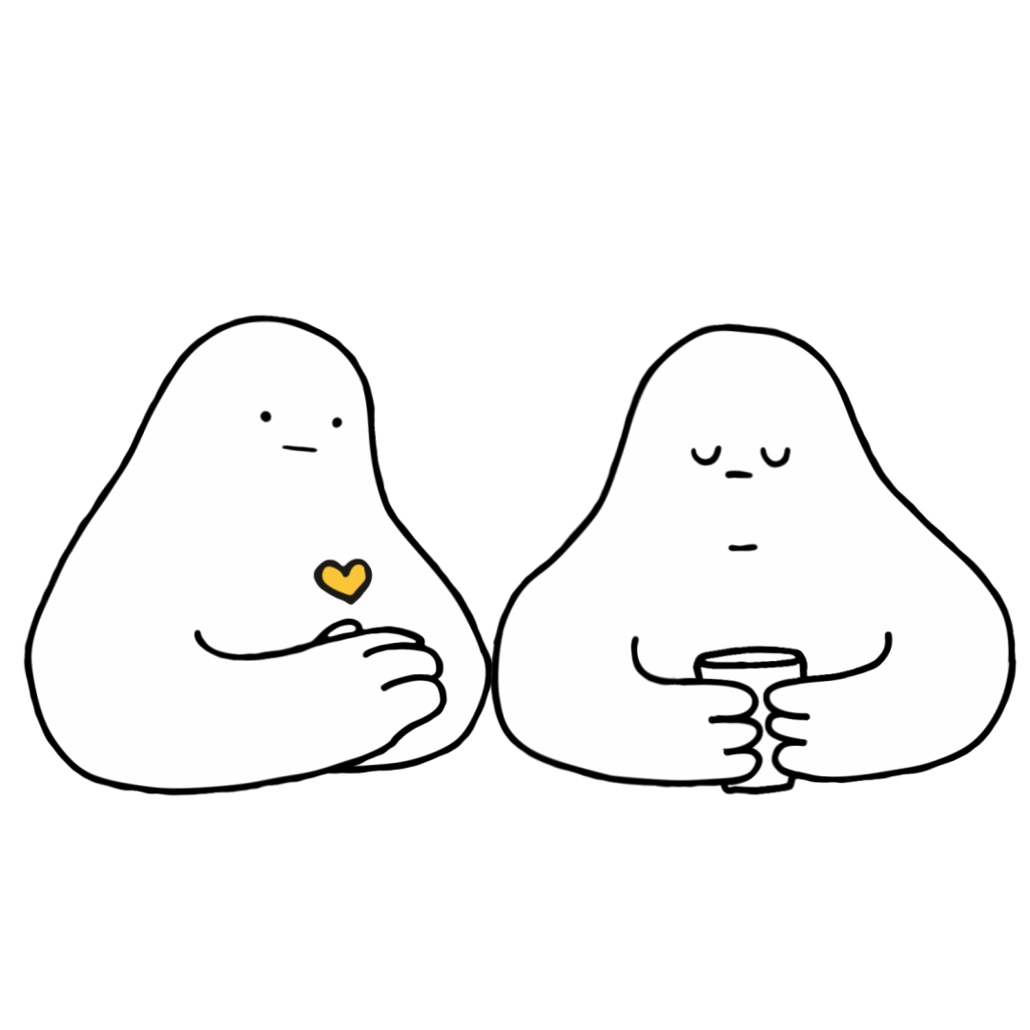
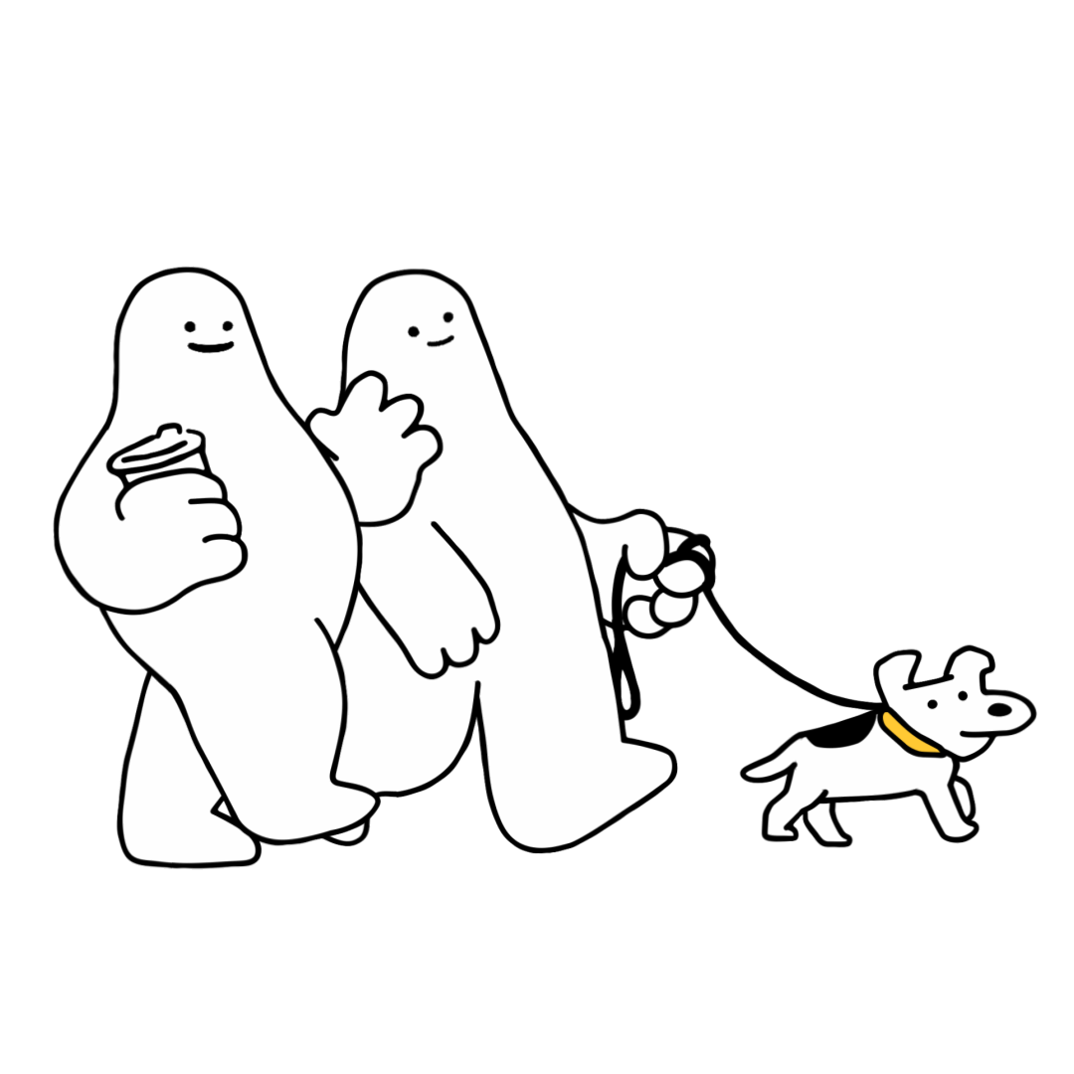
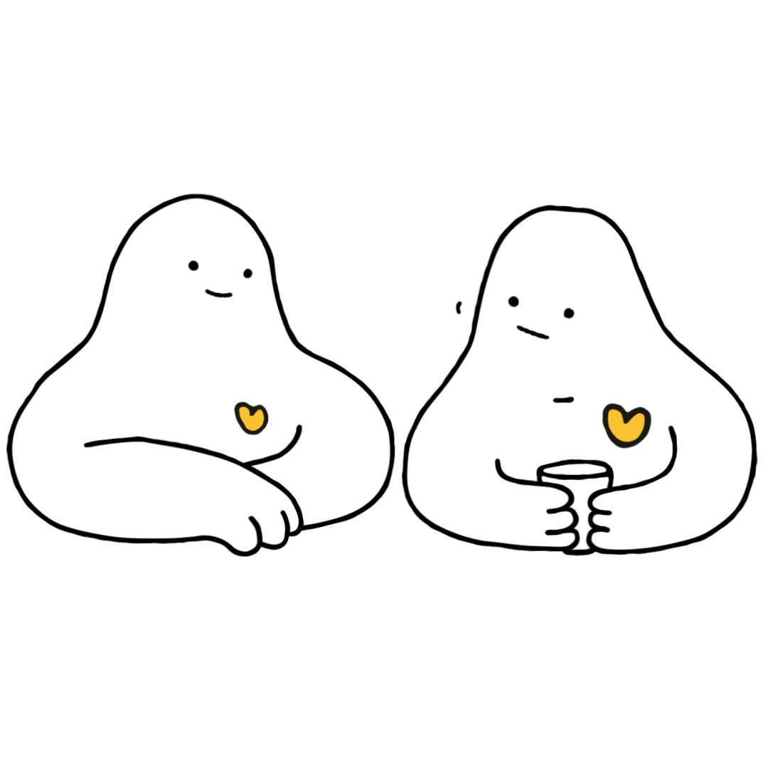
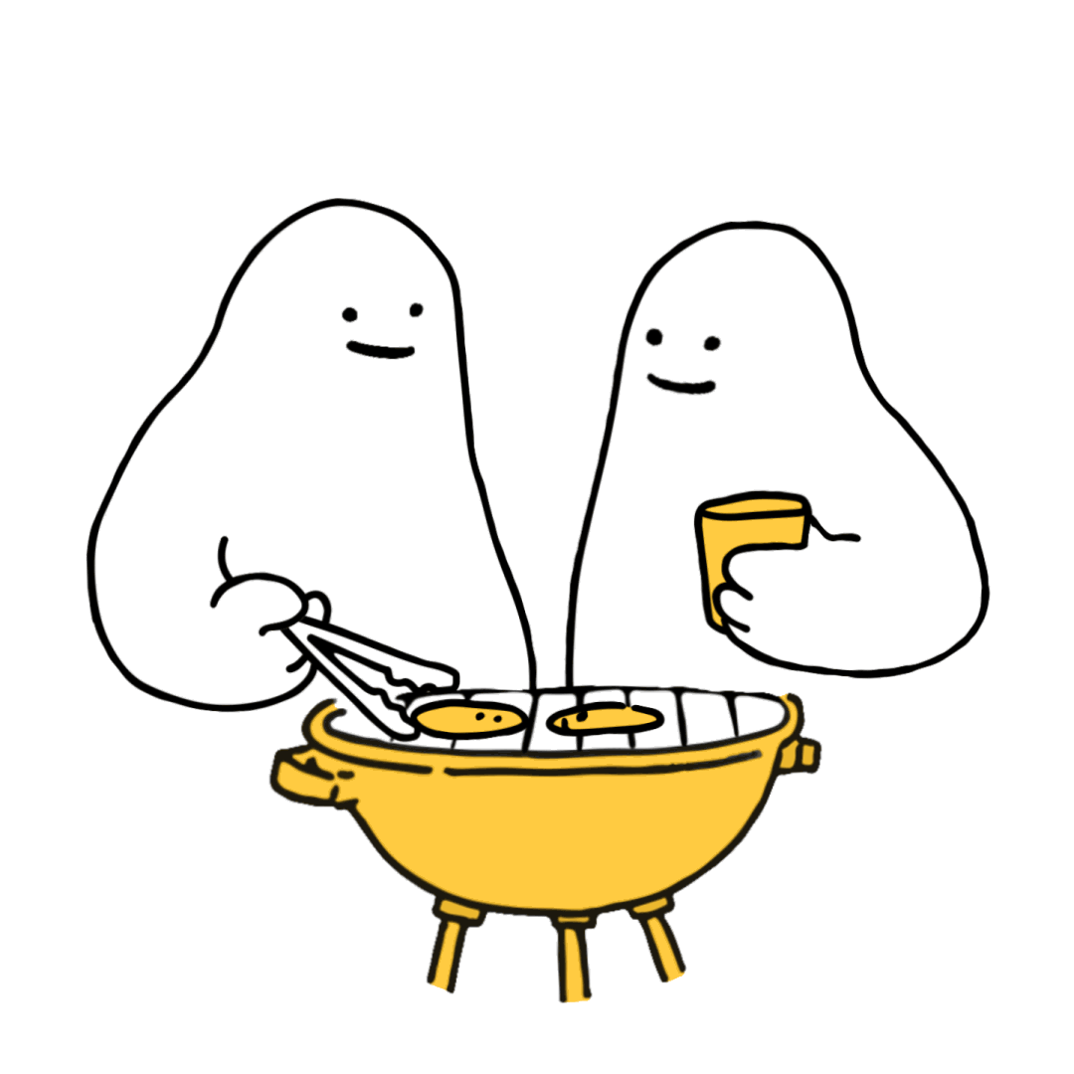
Notes:
R U OK? have developed a 4 step model for a meaningful conversation. The acronym ALEC is a great way to remember these steps:
Ask R U OK?
Listen
Encourage Action
Check in

Slide 14
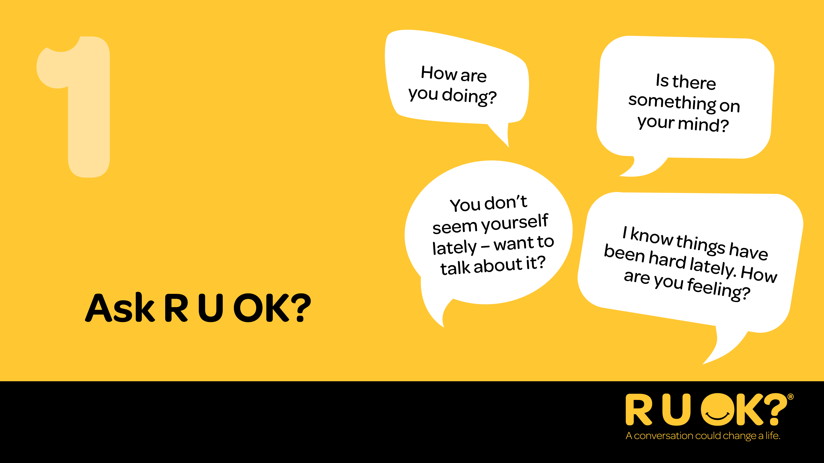
Notes:
Step 1 is ‘Ask R U OK?’.
Start the conversation at a time and in a place where you’ll both be comfortable to chat.
Be relaxed and friendly in your approach. Think about how you can ease into the conversation.
Ask R U OK? in a way that feels natural to you and your relationship with the other person. See some examples of how to ask on the slide.
You can start by letting them know you’ve noticed a change. You could say something like:
I’ve noticed a few changes in what you’ve been saying/doing. How are things going for you?”
“I know there’s been some big life changes for you recently, how are you managing?” OR
“You don’t seem yourself lately – want to talk about it?”
If they don’t want to talk, let them know you’ll be there when they are ready or ask them if there’s someone else they’d be more comfortable chatting to.

Slide 15
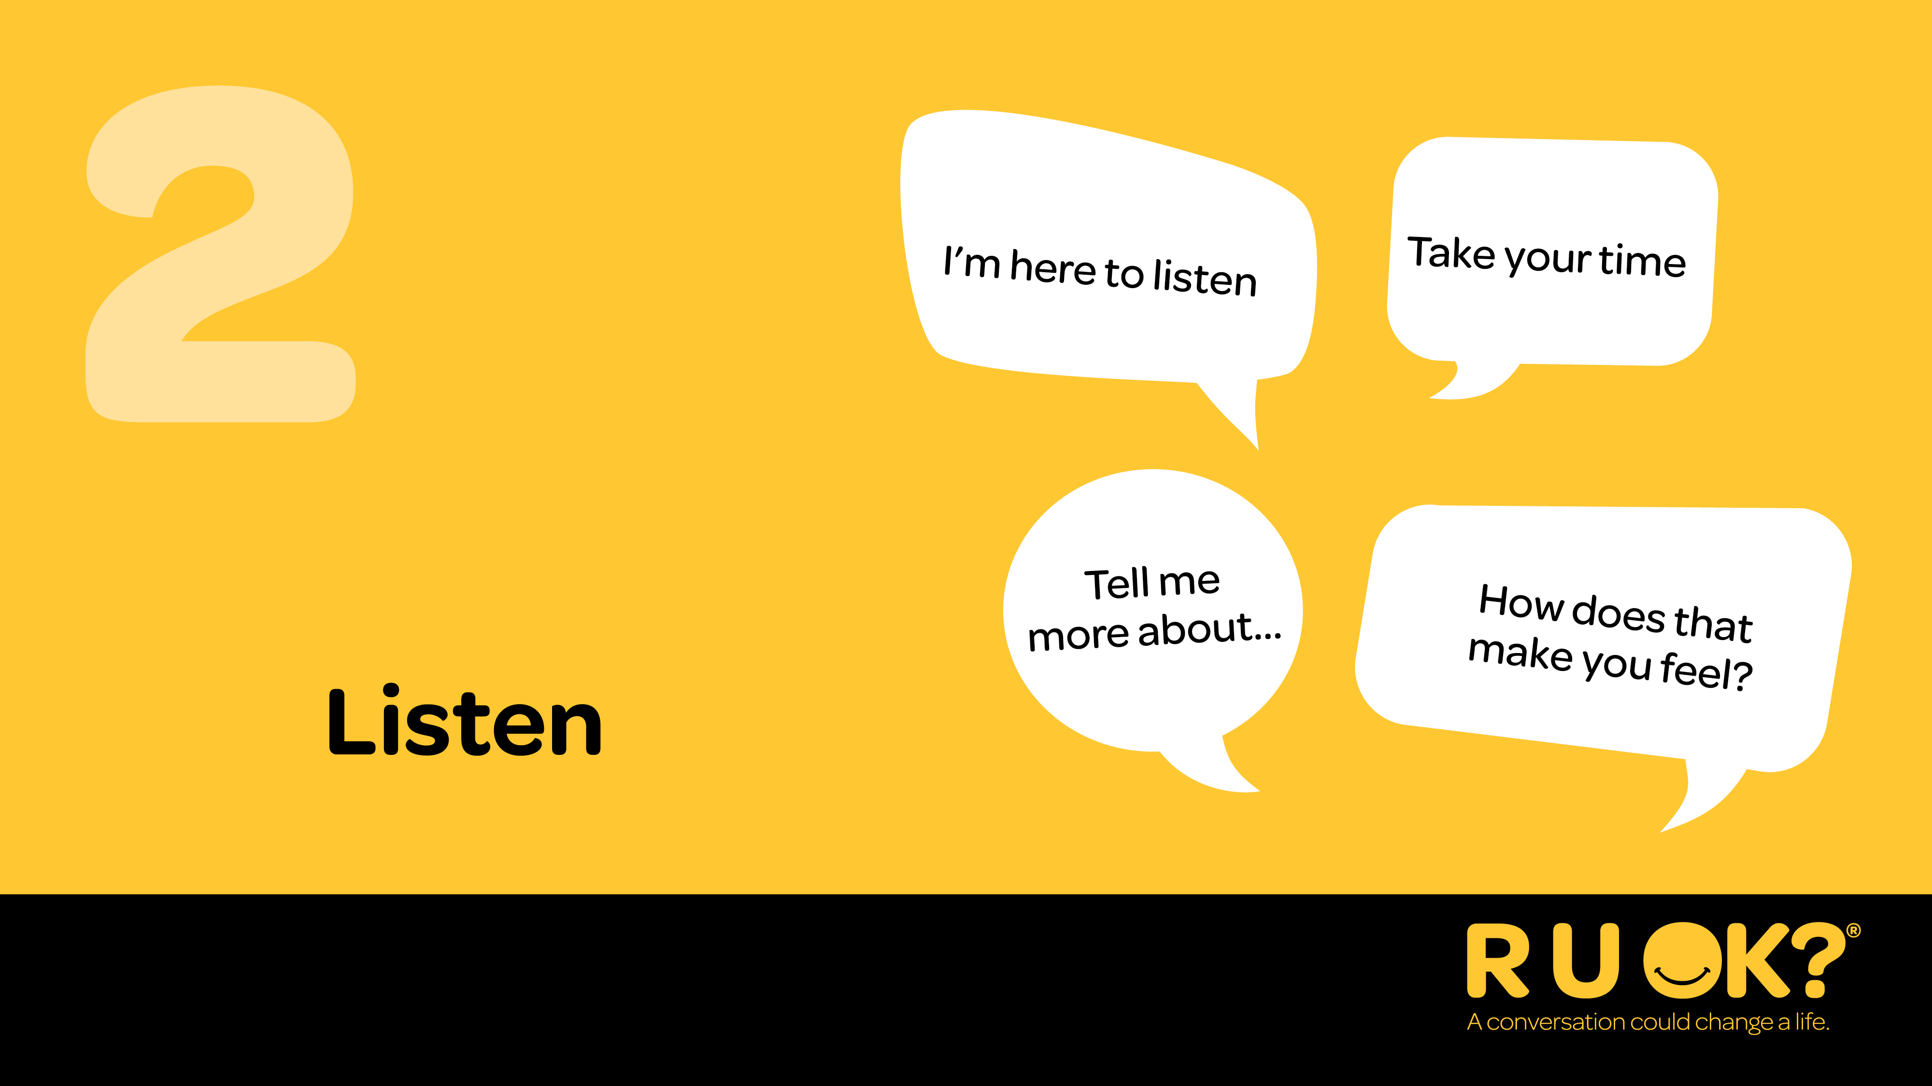
Notes:
Step 2 is ‘Listen’.
It’s important you genuinely listen with an open mind and without judgment.
It can be tempting to jump in and try to push someone’s worries away or offer a ‘quick fix’, but it’s best to avoid rushing the conversation.
Also don’t be afraid to sit in silence and give the person some space and quiet so they can find the words to express what they’re going through.
Acknowledge what they’re going through.
You could say:
“I’m here to listen if you want to talk more”
“How are you feeling about that?” OR
“I’m not going to pretend I know what it’s like for you, but I’m here to listen to why you feel the way you do.”
It can be really hard to hear that someone is in pain or struggling – but try and sit with the discomfort and remind yourself that your support can be crucial.

Slide 16
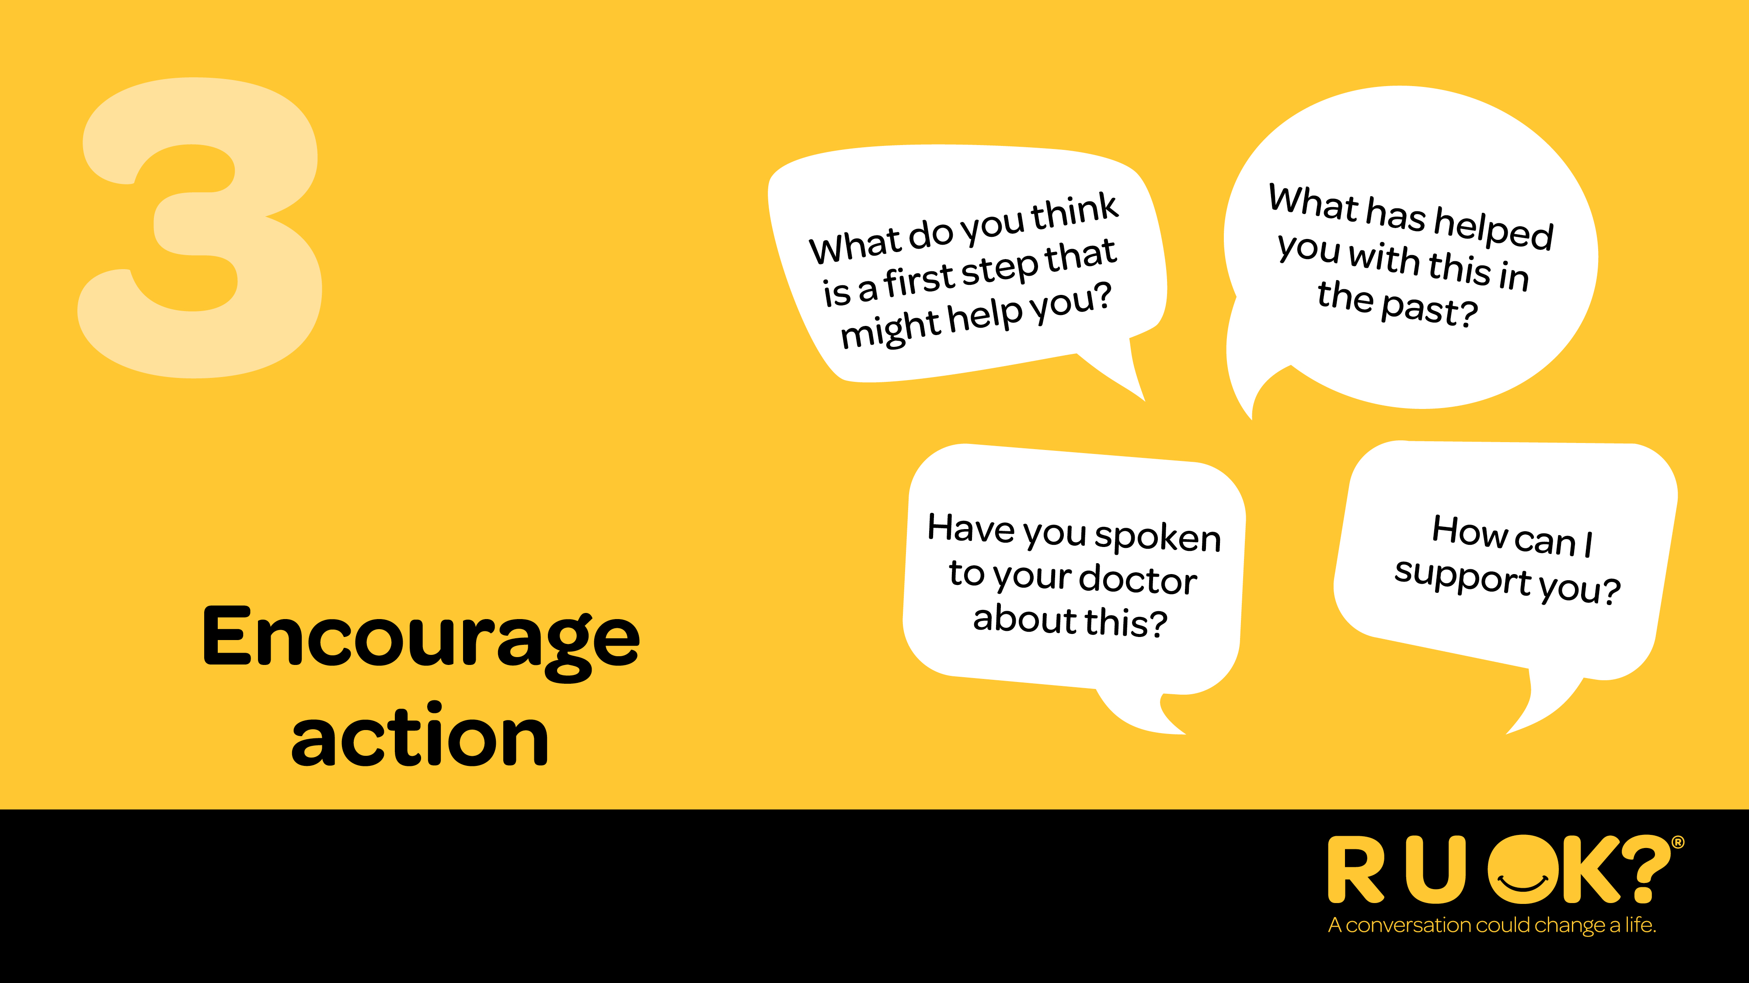
Notes:
Step 3 is ‘Encourage action’.
Once they’ve shared what they’re going through, you might suggest to them that they think about one small step they might be able to take to improve their situation.
You don’t have to have the answers or be able to offer professional health advice, but you can help them consider the next steps and actions they can take to manage their situation.
Some good options might include talking to family or a trusted friend,
If they’ve been feeling this way for a while, they might need to see their doctor or an appropriate health professional.
You could say:
“What do you think is a first step that would help you through this?”
“What can I do right now to support you?”
“Have you spoken to your doctor or a health professional about this? It might be a matter of finding the right fit with someone.” OR
“What’s something you enjoy doing? Making time for that can really help.”

Slide 17
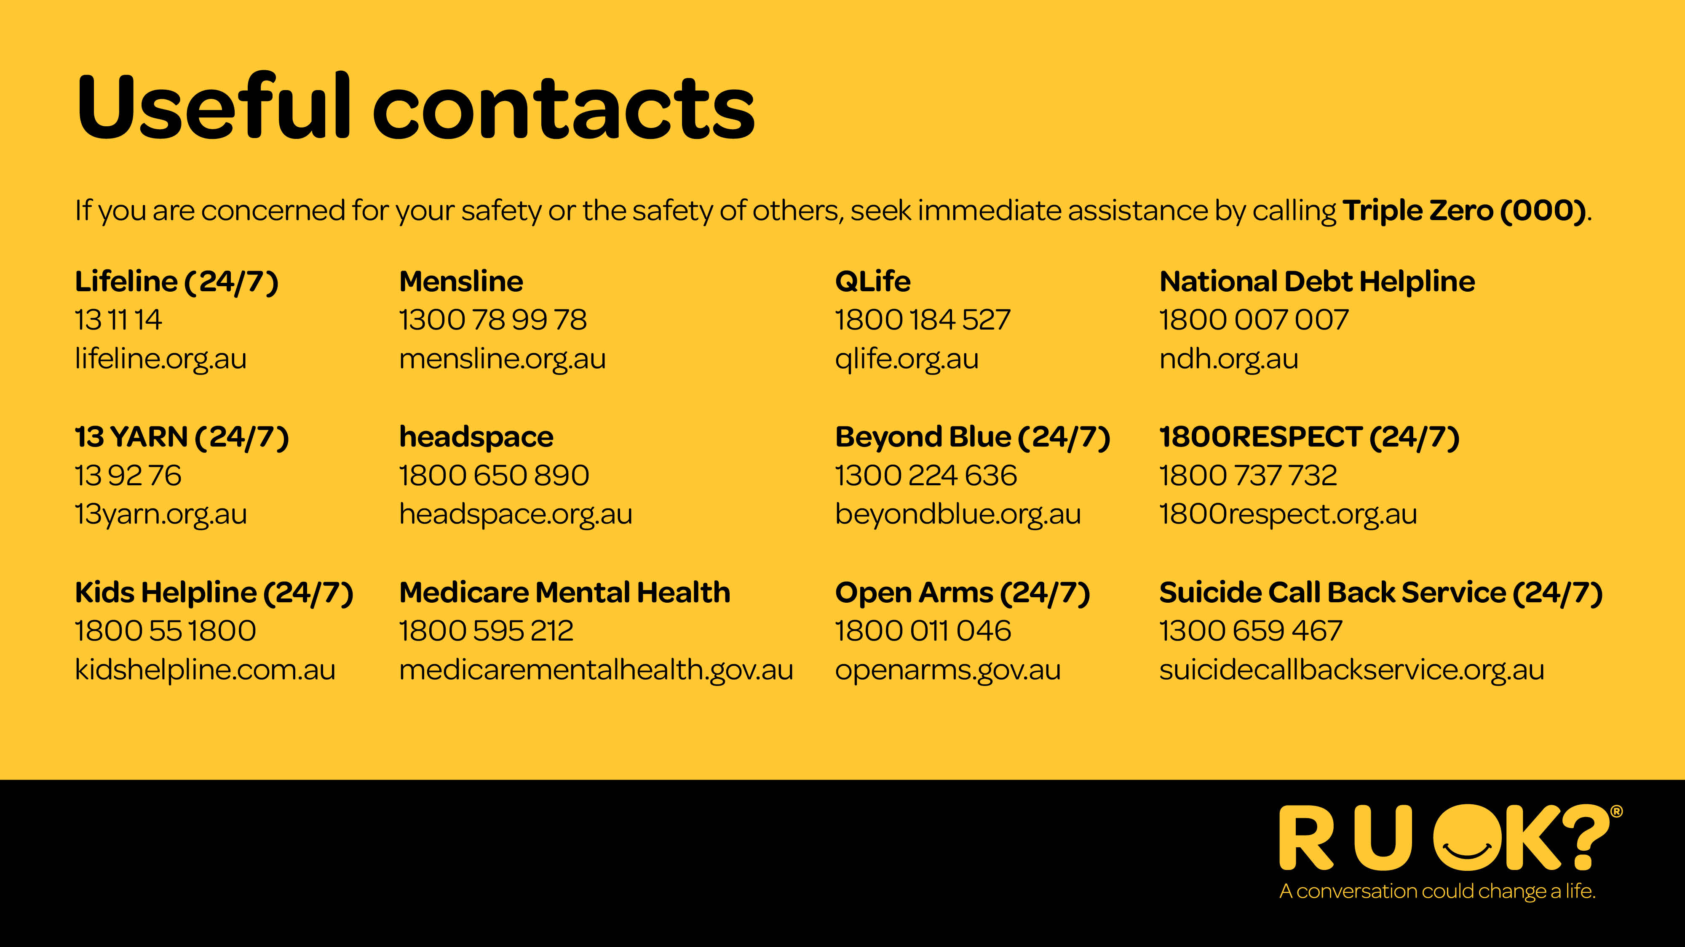
Notes:
If at any time you feel overwhelmed please talk to someone you trust like a doctor, family member or friend.
If someone needs immediate support these are some useful contacts for Australian services that are available nationally and can provide emotional and crisis support.
These services can also provide you with guidance to support someone else.
If you are concerned for your safety or the safety of others, seek immediate assistance by calling Triple Zero (000).

Slide 18
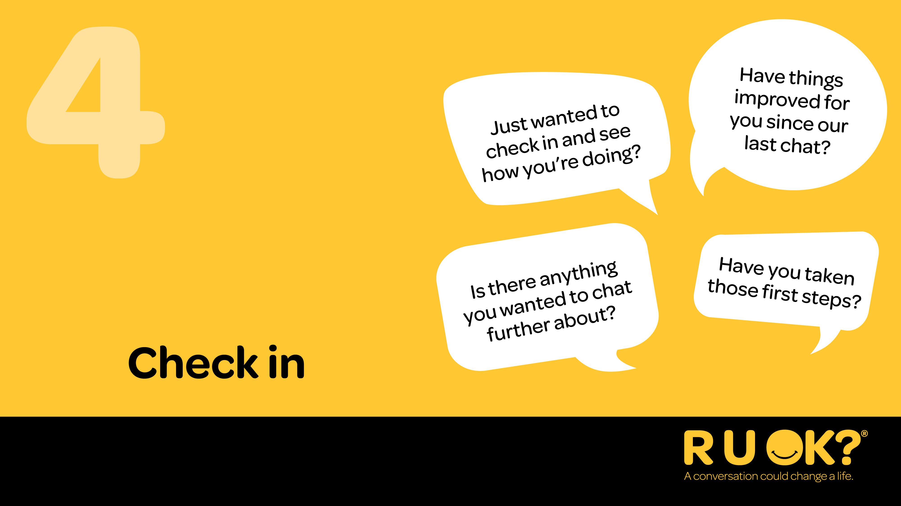
Notes:
After the conversation it’s important you stay connected and keep checking in. Make a joint decision to get back in touch so you can see how they’re going. Your ongoing care and support can make a difference.
When you check in you could:
Lock in a regular catch up and one-on-one time.
Ask them about activities they like to do and help them make plans to do them or arrange to do them together.
Organise group catch-ups to help them connect with others.
When you check in you could say:
“Just wanted to check in and see how you’re doing?”
“Have things improved or changed since we last spoke?”
“What’s been working for you since we last chatted?”
“Do you need more support?”

Slide 19
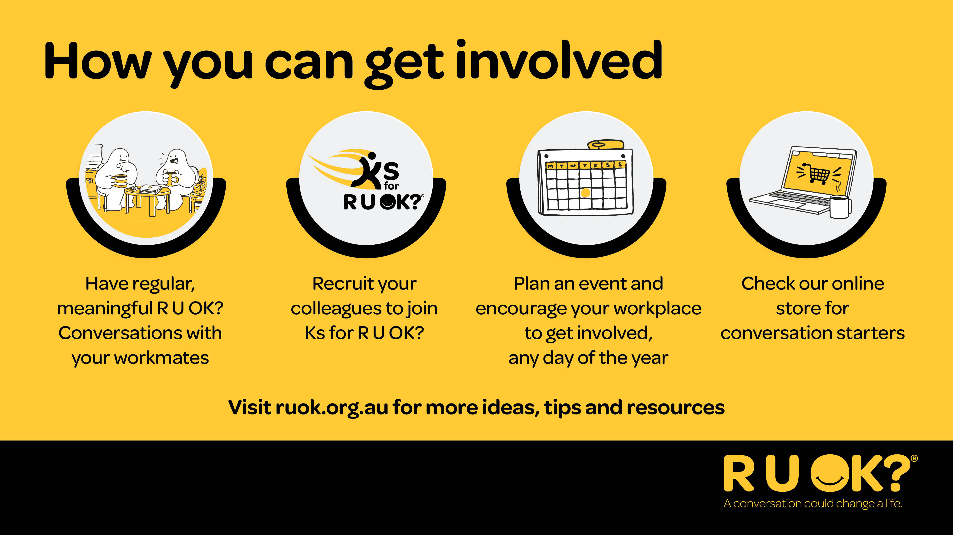
Notes:
There are lots of simple ways we can get involved and share the R U OK? message:
Have regular, meaningful conversations with other co-workers.
Recruit your colleagues to join Ks for R U OK? in October so you can walk, run and roll as you connect over conversations for Mental Health Month.
Plan a workplace event—any day of the year.
And check out our online store for tools and conversation starters.

Slide 20
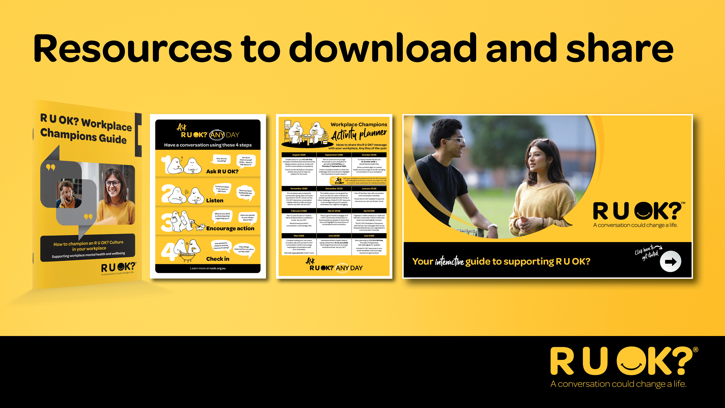
Notes:
R U OK? has a number of free resources available for workplaces.
If you want more information and conversation tips, including interactive activities you can access these FREE resources at ruok.org.au

Slide 21

Notes:
Thank you for your time today.
I’d encourage you to think about who you can regularly check in with and ask R U OK? Any Day.

