Slide 1
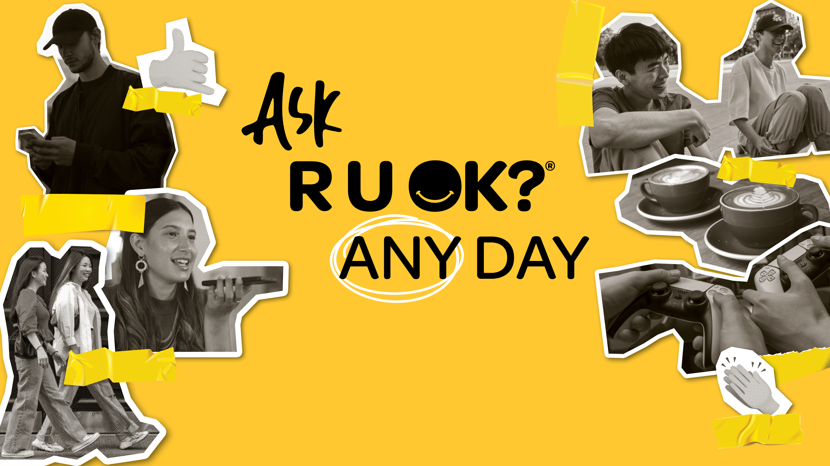
Insert school name
Insert school year
Notes:
Insert your school name and year group into the slide if relevant. If not, you can delete this text from the slide.

Slide 2

Notes:
Acknowledgement of Country
Acknowledge the Traditional Owners of the land on which you’re meeting and pay your respects to Elders past, present.
It doesn’t have to be long, but don’t rush and try to deliver with authenticity.
I acknowledge the Traditional Owners of the land on which we are meeting today and pay my respect to Elders past and present.

Slide 3
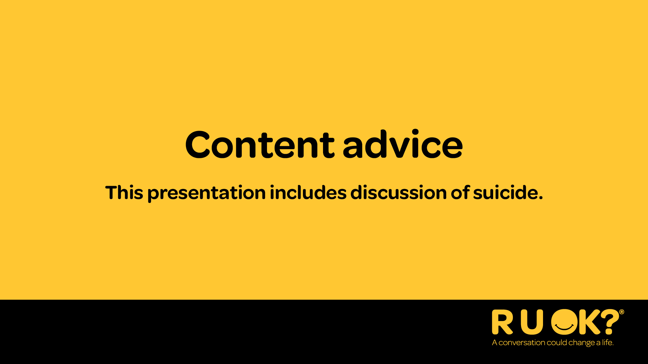
Notes:
Recognise lived experience
I’d also like to take this moment to recognise those with lived or living experience of mental ill-health or suicide.
Sometimes talking about mental health and wellbeing can bring up tough emotions. If today’s talk brings anything up for you, it’s OK to excuse yourself.
If you need some extra support, I strongly encourage you to open-up to someone you trust, connect with a trusted health professional, or access a support service like Kids Helpline which is available 24/7 on 1800 55 1800.
You can find other services and support organisations on the R U OK? website at ruok.org.au/findhelp.
If available and relevant you can also:
Identify the location of a quiet/safe space people can go to if they need to excuse themselves.
Mention information about how to access the Employee Assistance Program (EAP) or any other support person/services that may be in attendance.

Slide 4
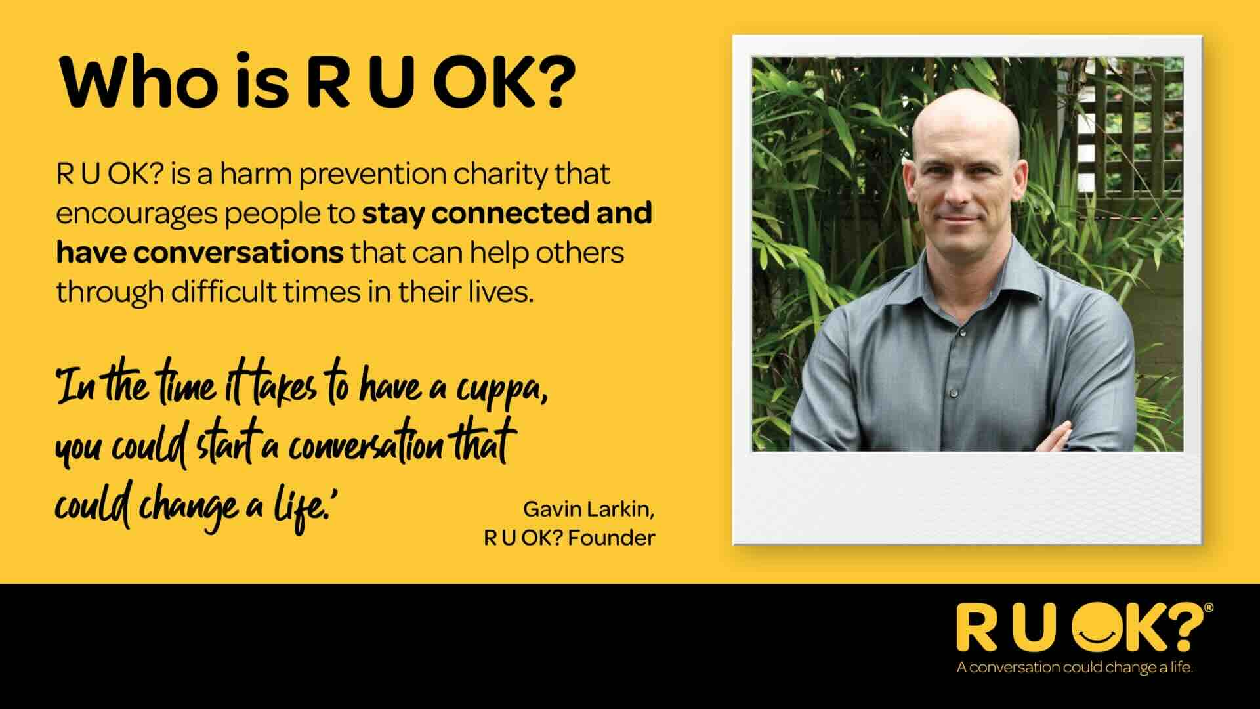
Notes:
R U OK? is all about encouraging people to stay connected and have conversations that can help others through difficult times.
This is a photo of the late Gavin Larkin. He started R U OK? in 2009, hoping to protect others from experiencing the pain his family felt when he lost his father to suicide.
He believed that ‘in the time it takes to have a cuppa, you could start a conversation that could change a life’ – his message is that we can support other people by checking in with them and asking R U OK?

Slide 5
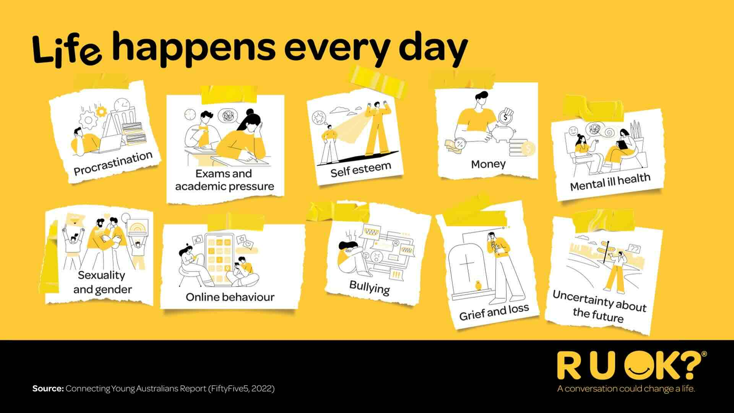
Notes:
These conversations are important because life happens every day.
Some things that your peers might be struggling with include:
Procrastination (finding it hard to be motivated and complete tasks)
Exams and academic pressure
Self-esteem (not feeling confident in yourself)
Money (being able to afford things)
Mental ill health (including conditions such as depression and anxiety)
Sexuality and gender (people might be exploring their sexual or gender identity)
Online behaviour (such as finding it hard to limit time on devices, or dealing with the behaviour of others on social media)
Bullying
Grief and loss (if someone they know has passed away or even moved to another town)
Uncertainty about the future (such as what you might do after school, or world events like climate change)
Question for the class: Can you think of any other things that might be tough to manage?
Whatever it is, it’s important to remember that the people around us – our friends, siblings, classmates, cousins and teammates - go through life’s ups and downs every day.

Slide 6
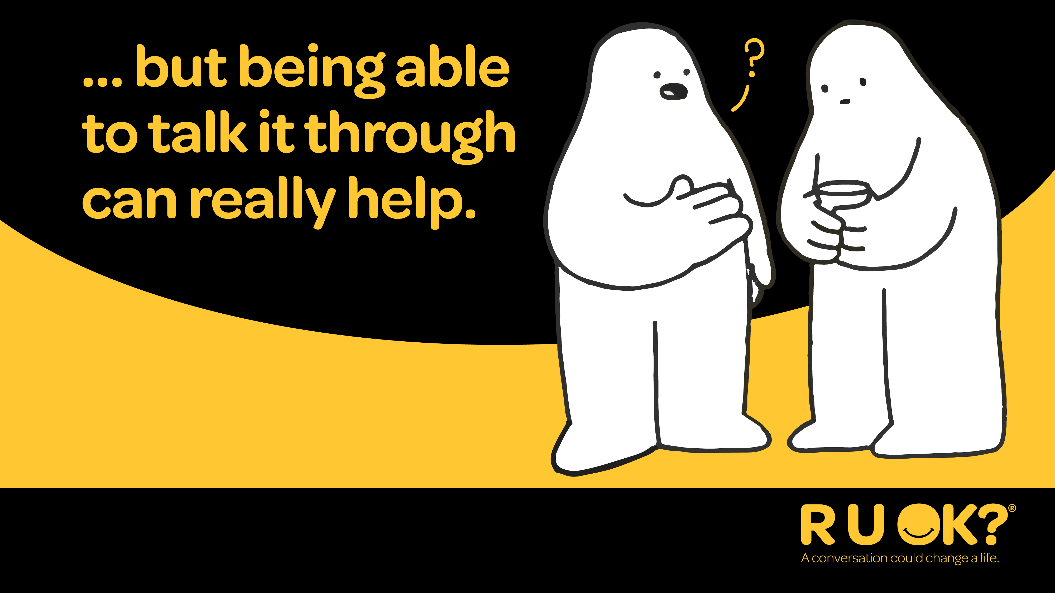
Notes:
But what you can do is have regular R U OK? conversations and check in with each other.
That way you’re providing regular opportunities for them to open up and share what’s going on in their life.
Question for the class: How do conversations make a difference?
Conversations can help them to process and manage what they’re going through, to prevent little things from becoming big things.

Slide 7
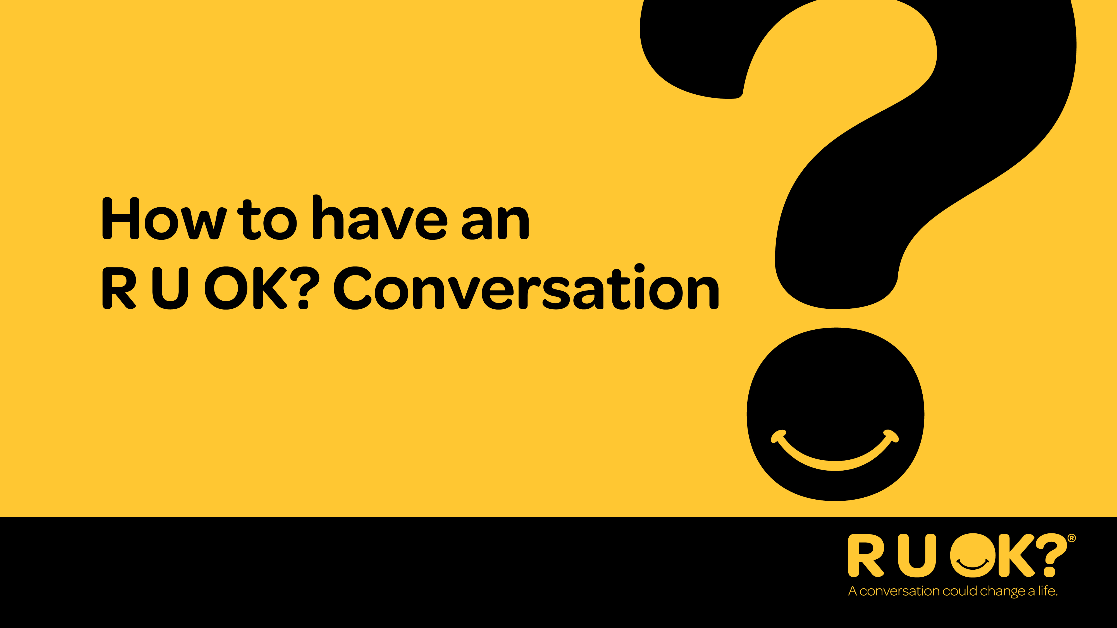
Notes:
Now we’re going to talk through the steps of an R U OK? Conversation.

Slide 8
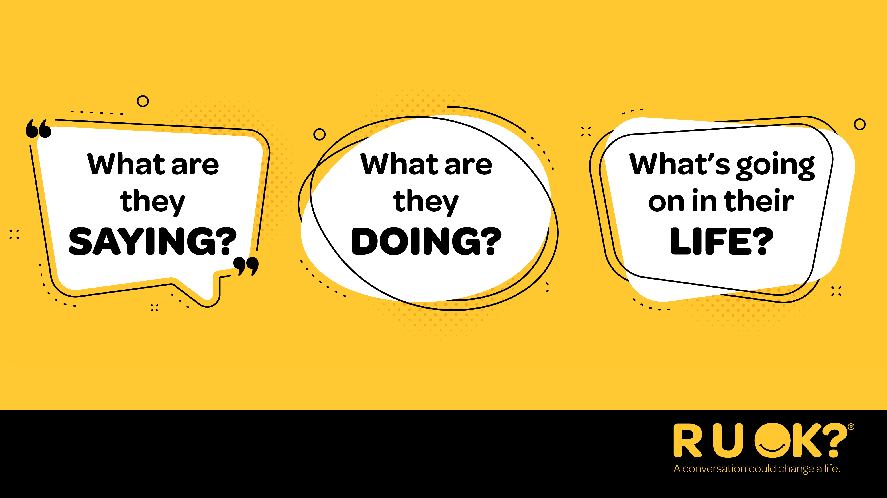
Notes:
So when should you ask R U OK?
Whenever you notice a change in what someone’s saying or doing or if you know there are things happening in their life that might be putting them under pressure or causing stress.
Question for the class: What are some examples of signs that could indicate someone needs your support?
There being more quiet and withdrawn than usual.
You notice a change in their appearance, such as their hair is usually really neat and they’re not brushing it anymore.
They seem confused or distracted
They’re unable to ‘switch off’
They’re having mood swings
They’re no longer interested in things they used to love

Slide 9
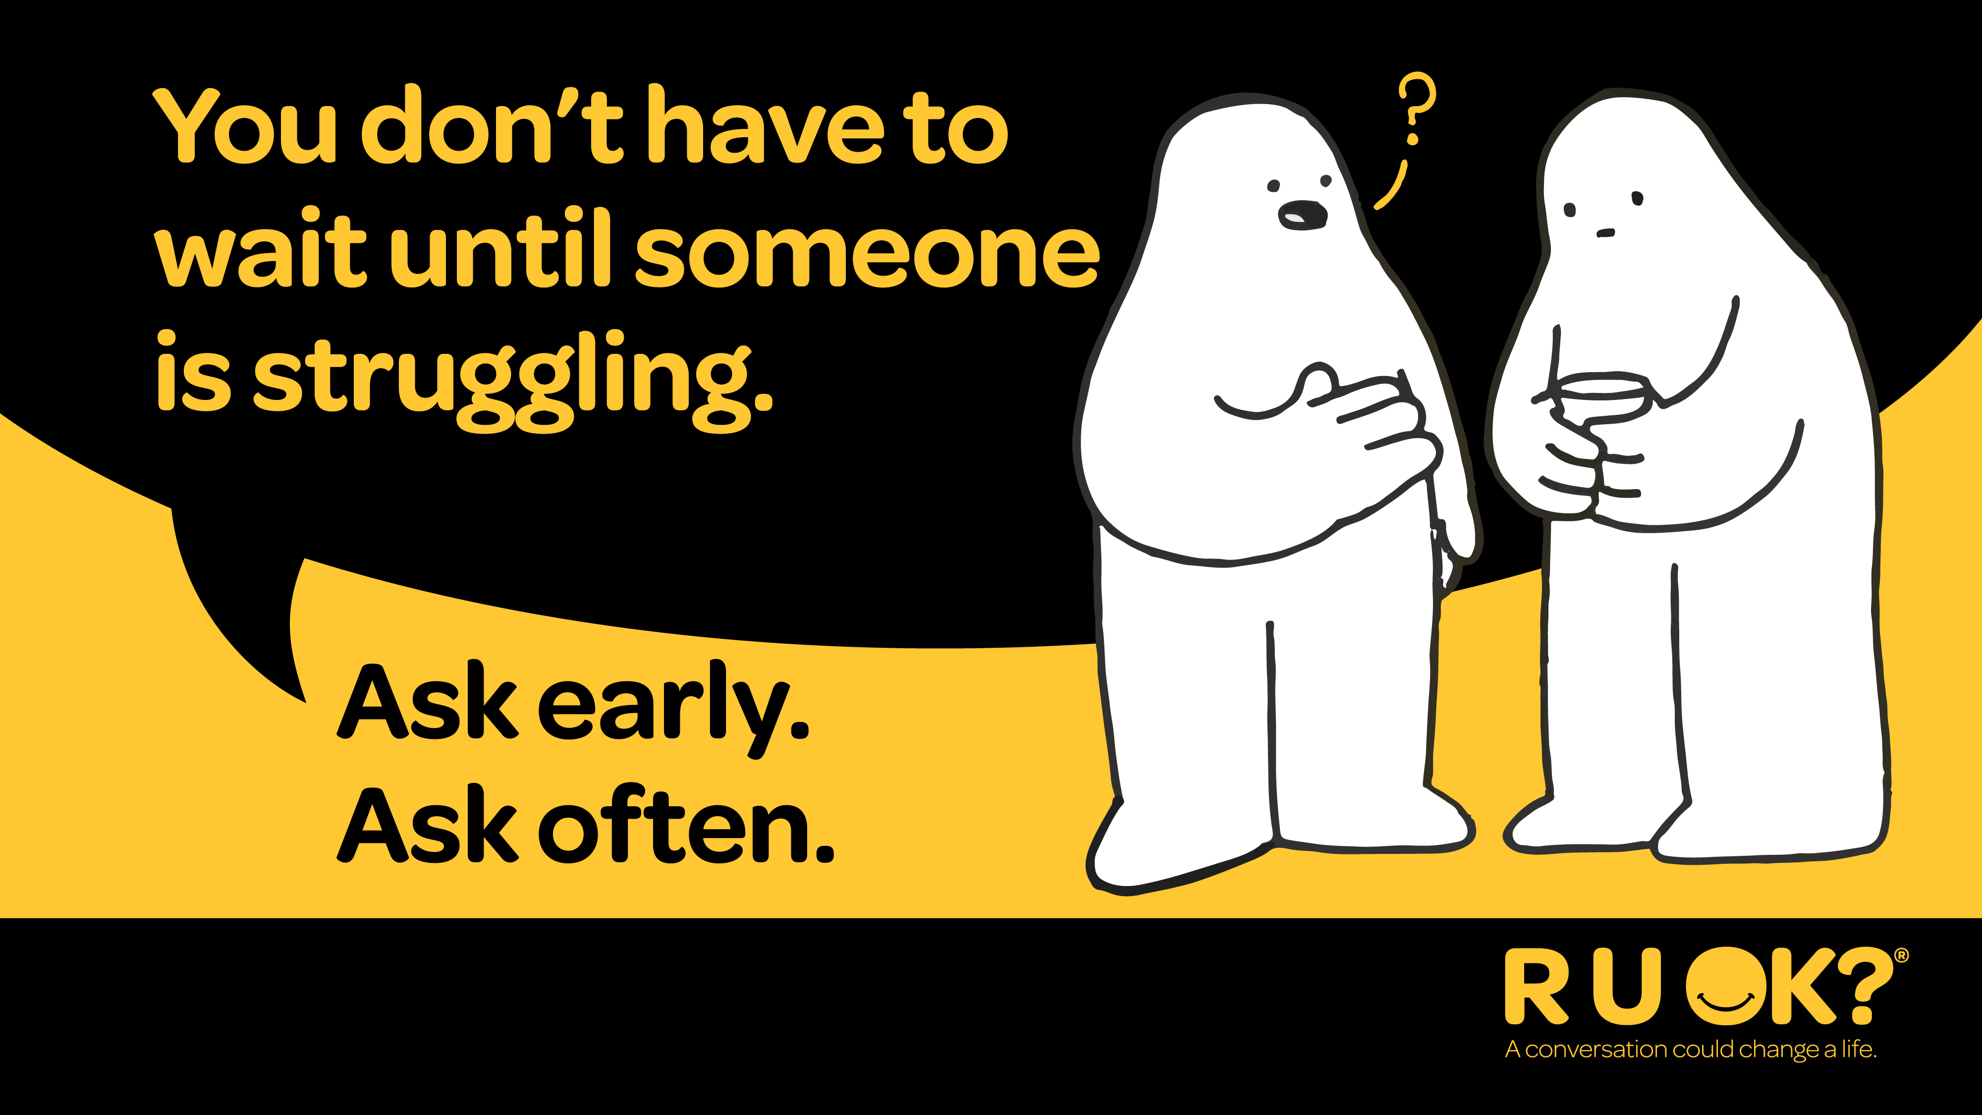
Notes:
It’s also important to remember that you don’t always have to wait until you spot the signs – ask early and ask often. Even if they’re doing OK, it’s good to know someone cares enough to ask.
There’s not just one sign that tells us someone isn’t coping. ​
Sometimes the changes are obvious. Sometimes they’re subtle. ​
Someone might seem quieter than usual, more withdrawn, distracted or overwhelmed. Sometimes it can be the opposite, e.g. they’re going out after work all the time. It’s about looking for a change in their world, words or behaviour. ​
Or maybe nothing obvious has changed — you just have a feeling something isn’t right. ​
Trust your instincts. If you’re thinking it, ask it. ​

Slide 10
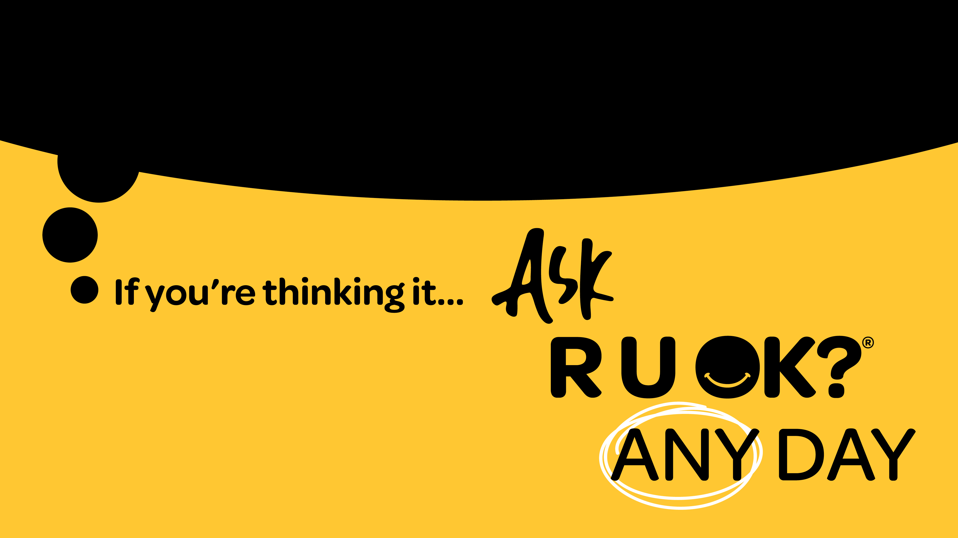
Notes:
The good news is that more Australians understand the importance of checking in with the people around them.
One in three Australians say they’ve been asking people if they’re OK more often over the past year.
But one in four still hesitate, even when they think someone might be struggling.
That’s why this year’s message is so simple: If you’re thinking it, ask R U OK? Any Day.

Slide 11
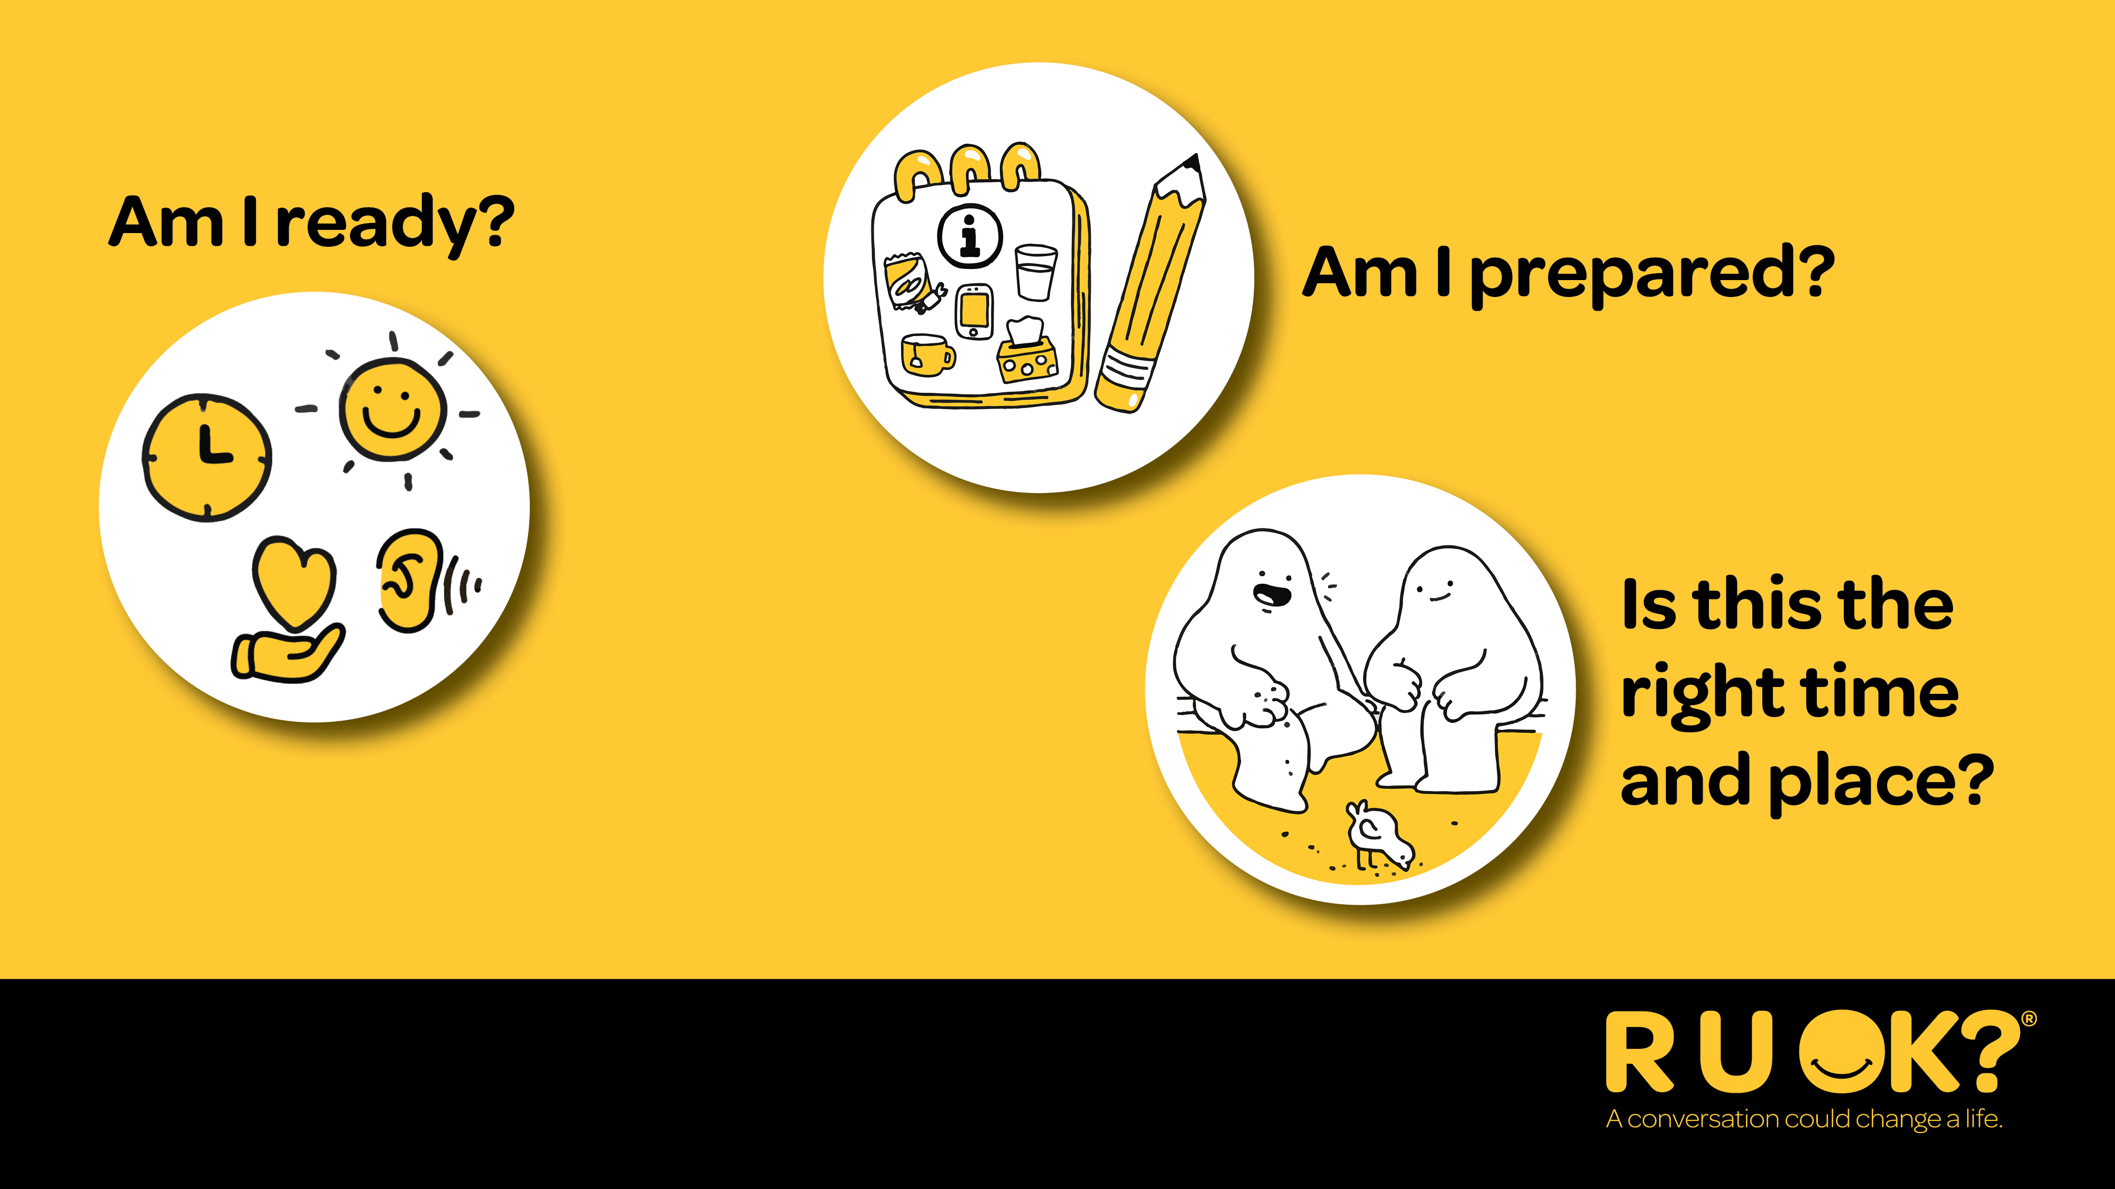
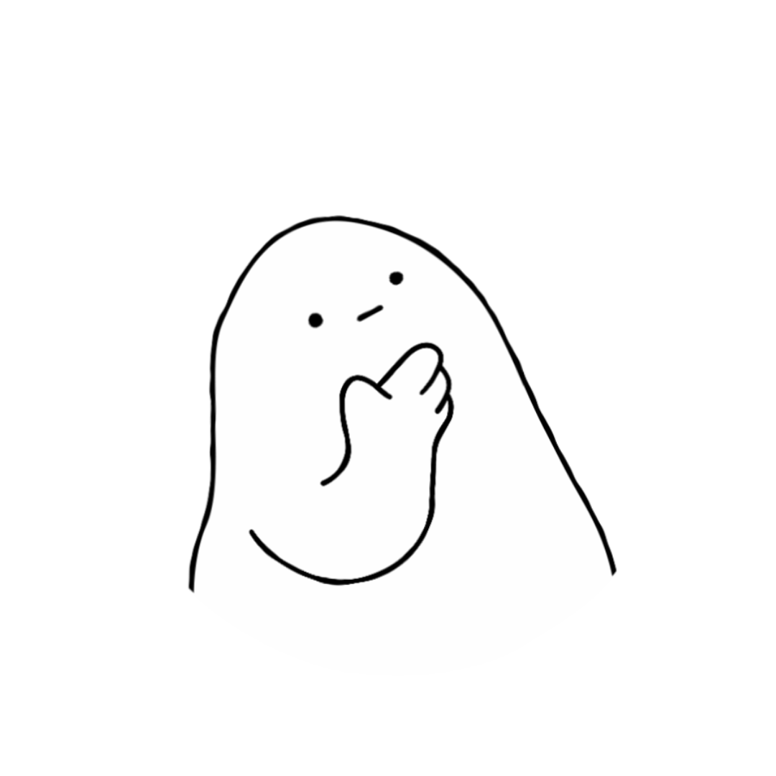
Notes:
Before supporting someone else, take a moment to check in with yourself.
Are you in the right headspace to really listen?
Have you set aside the time you might need for the conversation?
Have you chosen somewhere comfortable and relatively private in the classroom or off the playground?
It might be more comfortable for the person to be side-by-side with you (e.g. walking or sitting at lunchtime together) rather than face-to-face.
Remember, you don’t need to solve someone’s problems. Your role is to listen, show you care and help them think about what support might help next.

Slide 12
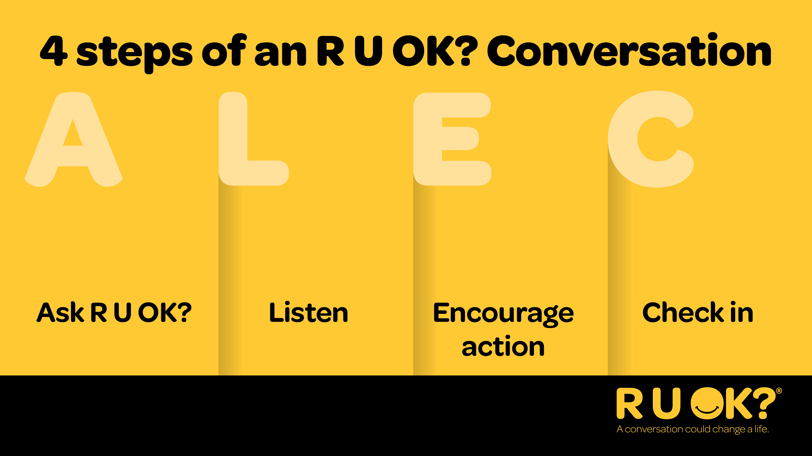
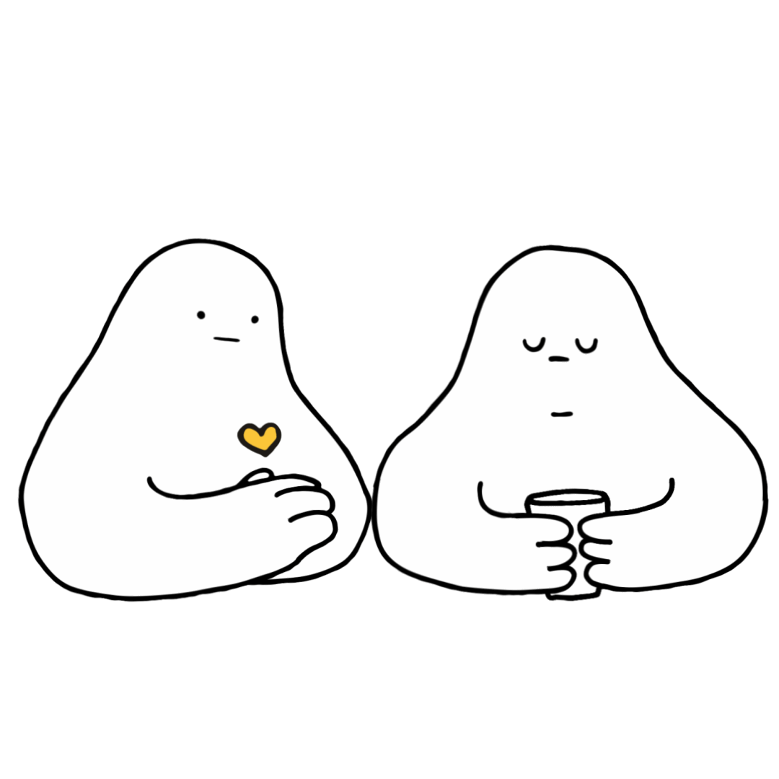
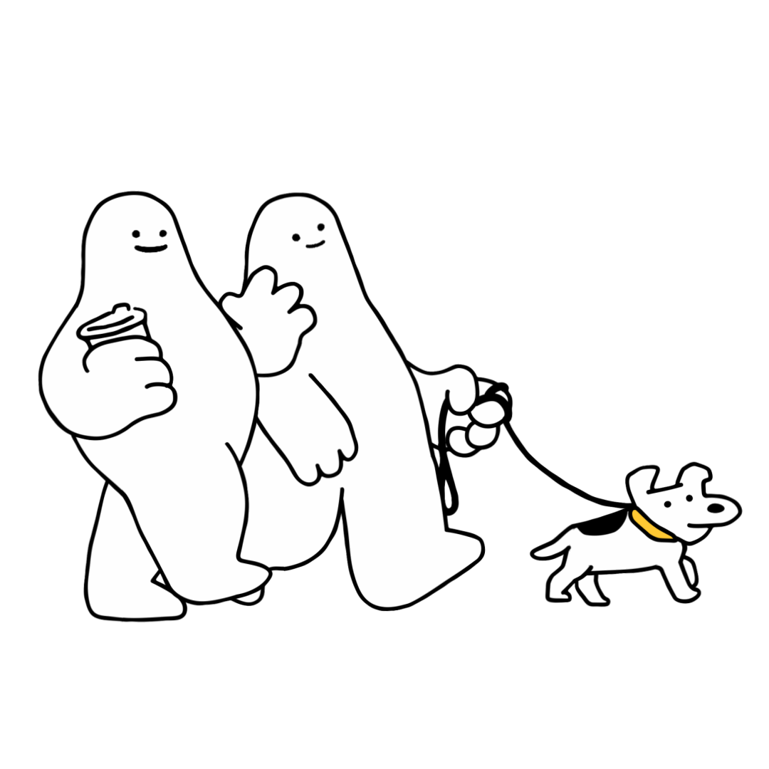
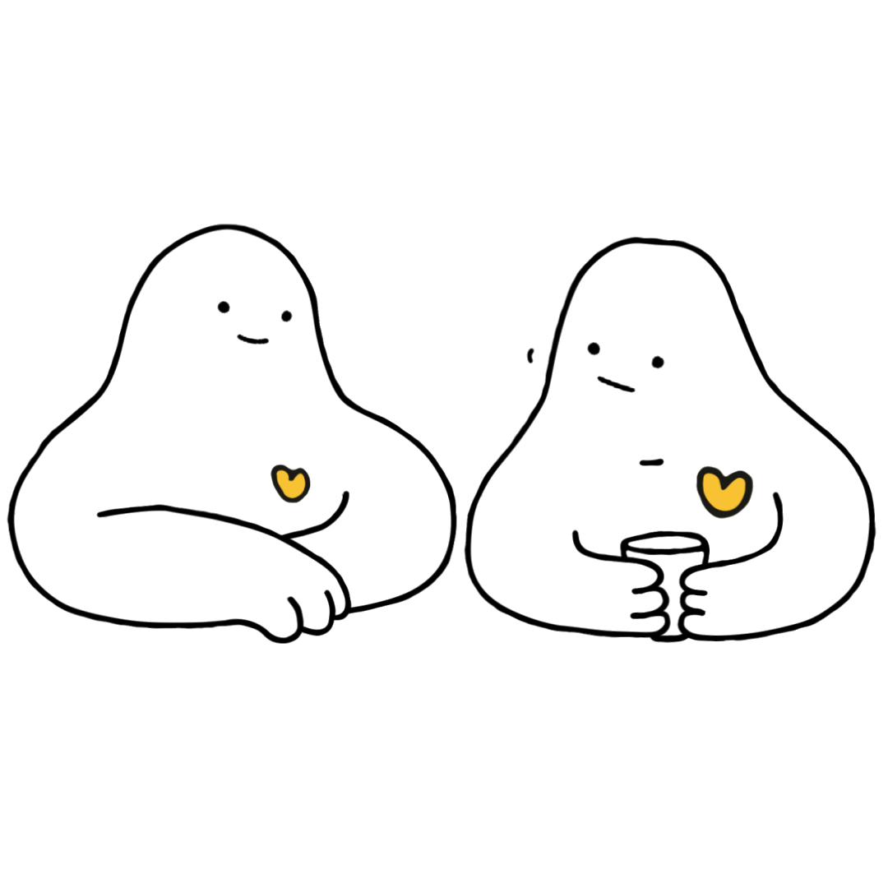
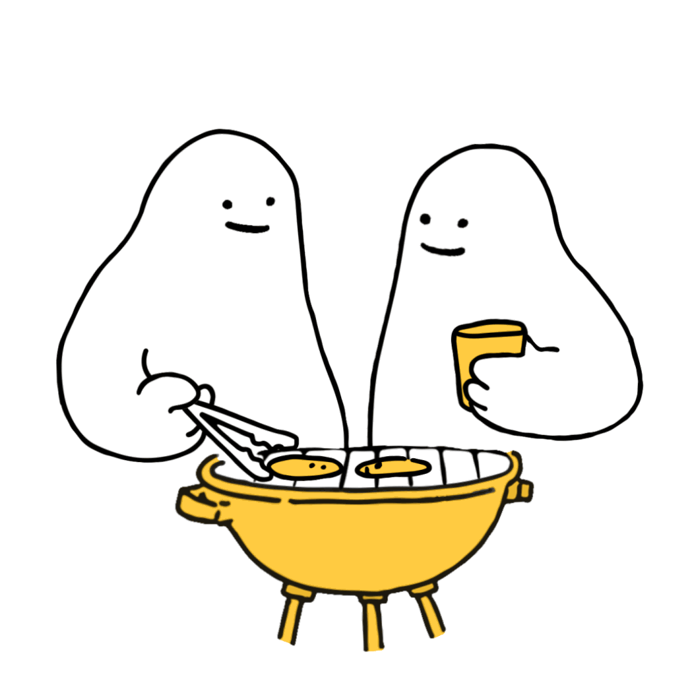
Notes:
R U OK? uses a simple, easy to remember, four-step conversation guide called ALEC:
Ask R U OK?
Listen
Encourage action
Check in

Slide 13
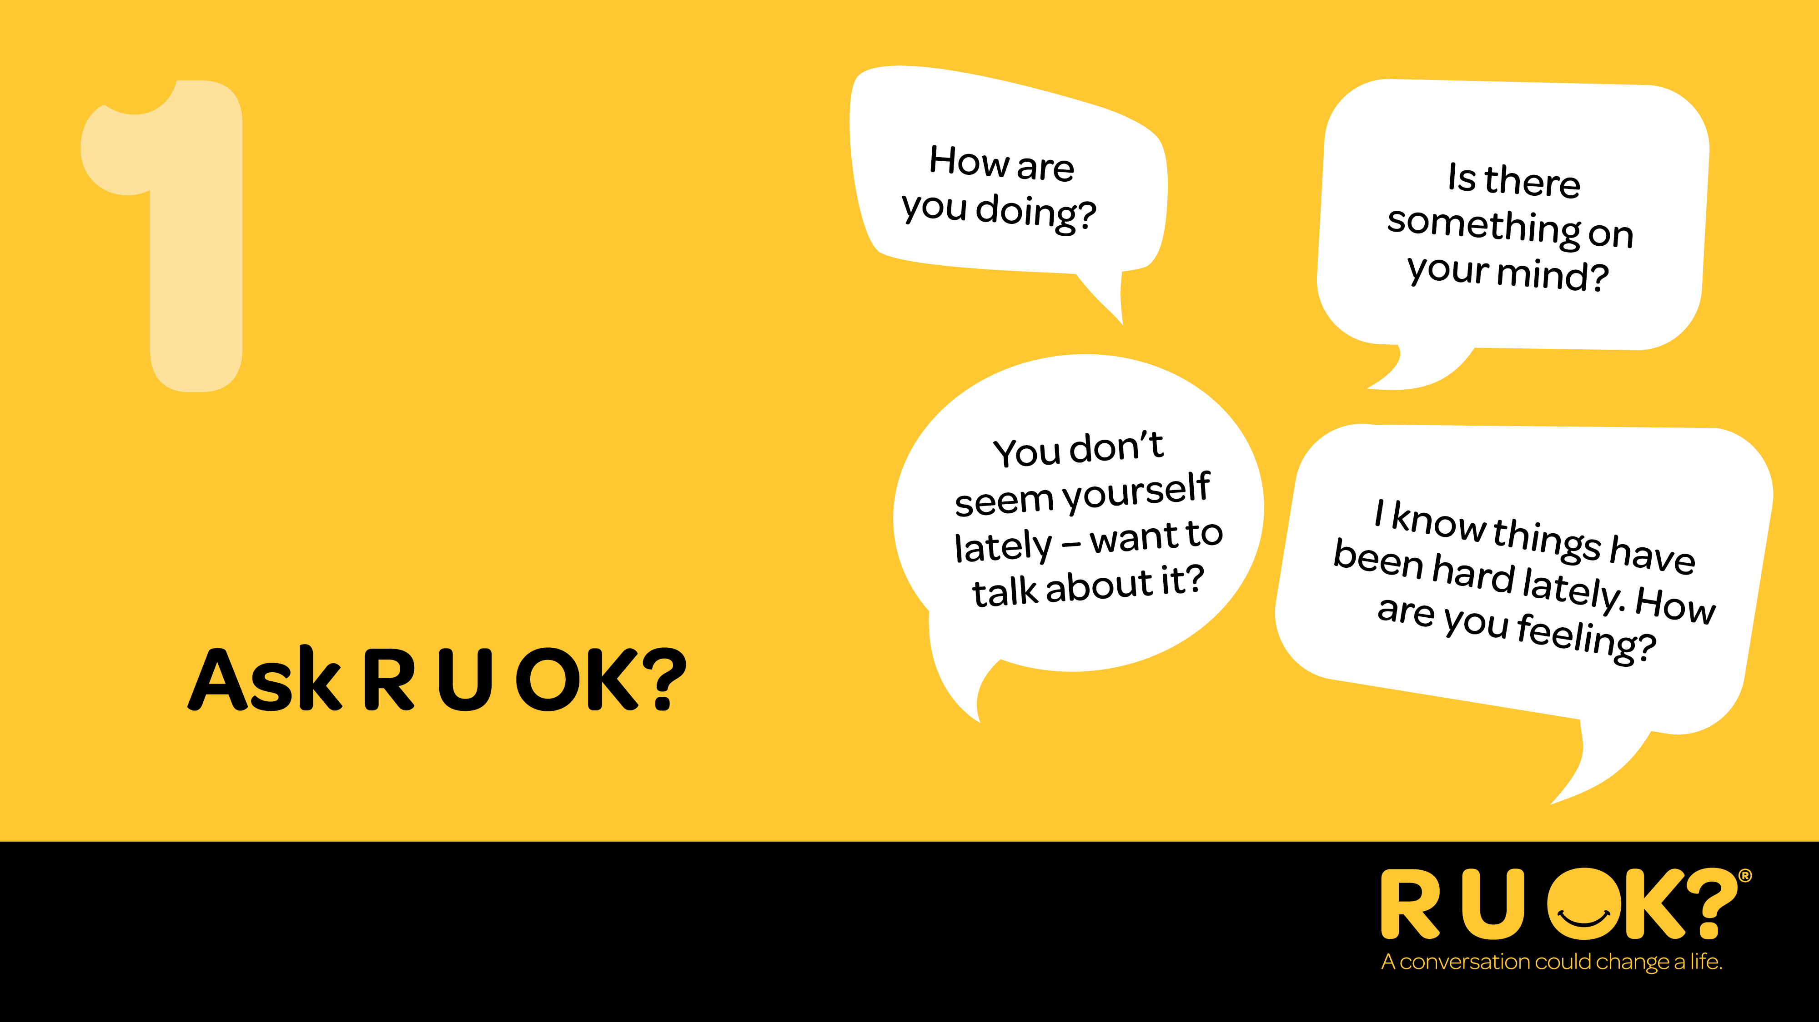
Notes:
Step one: Ask R U OK?
Start the conversation at a time and in a place where you’ll both be comfortable to chat.
Be relaxed and friendly in your approach. Think about how you can ease into the conversation.
Ask R U OK? in a way that feels natural to you and your relationship with the other person. See some examples of how to ask on the slide.
You can start by letting them know you’ve noticed a change. You could say something like: – “I’ve noticed a few changes in what you’ve been saying/doing. How are things going for you?” – “I know there’s been some big life changes for you recently, how are you managing?” OR – “You don’t seem yourself lately – want to talk about it?”
If they don’t want to talk, let them know you’ll be there when they are ready or ask them if there’s someone else they’d be more comfortable chatting to.

Slide 14
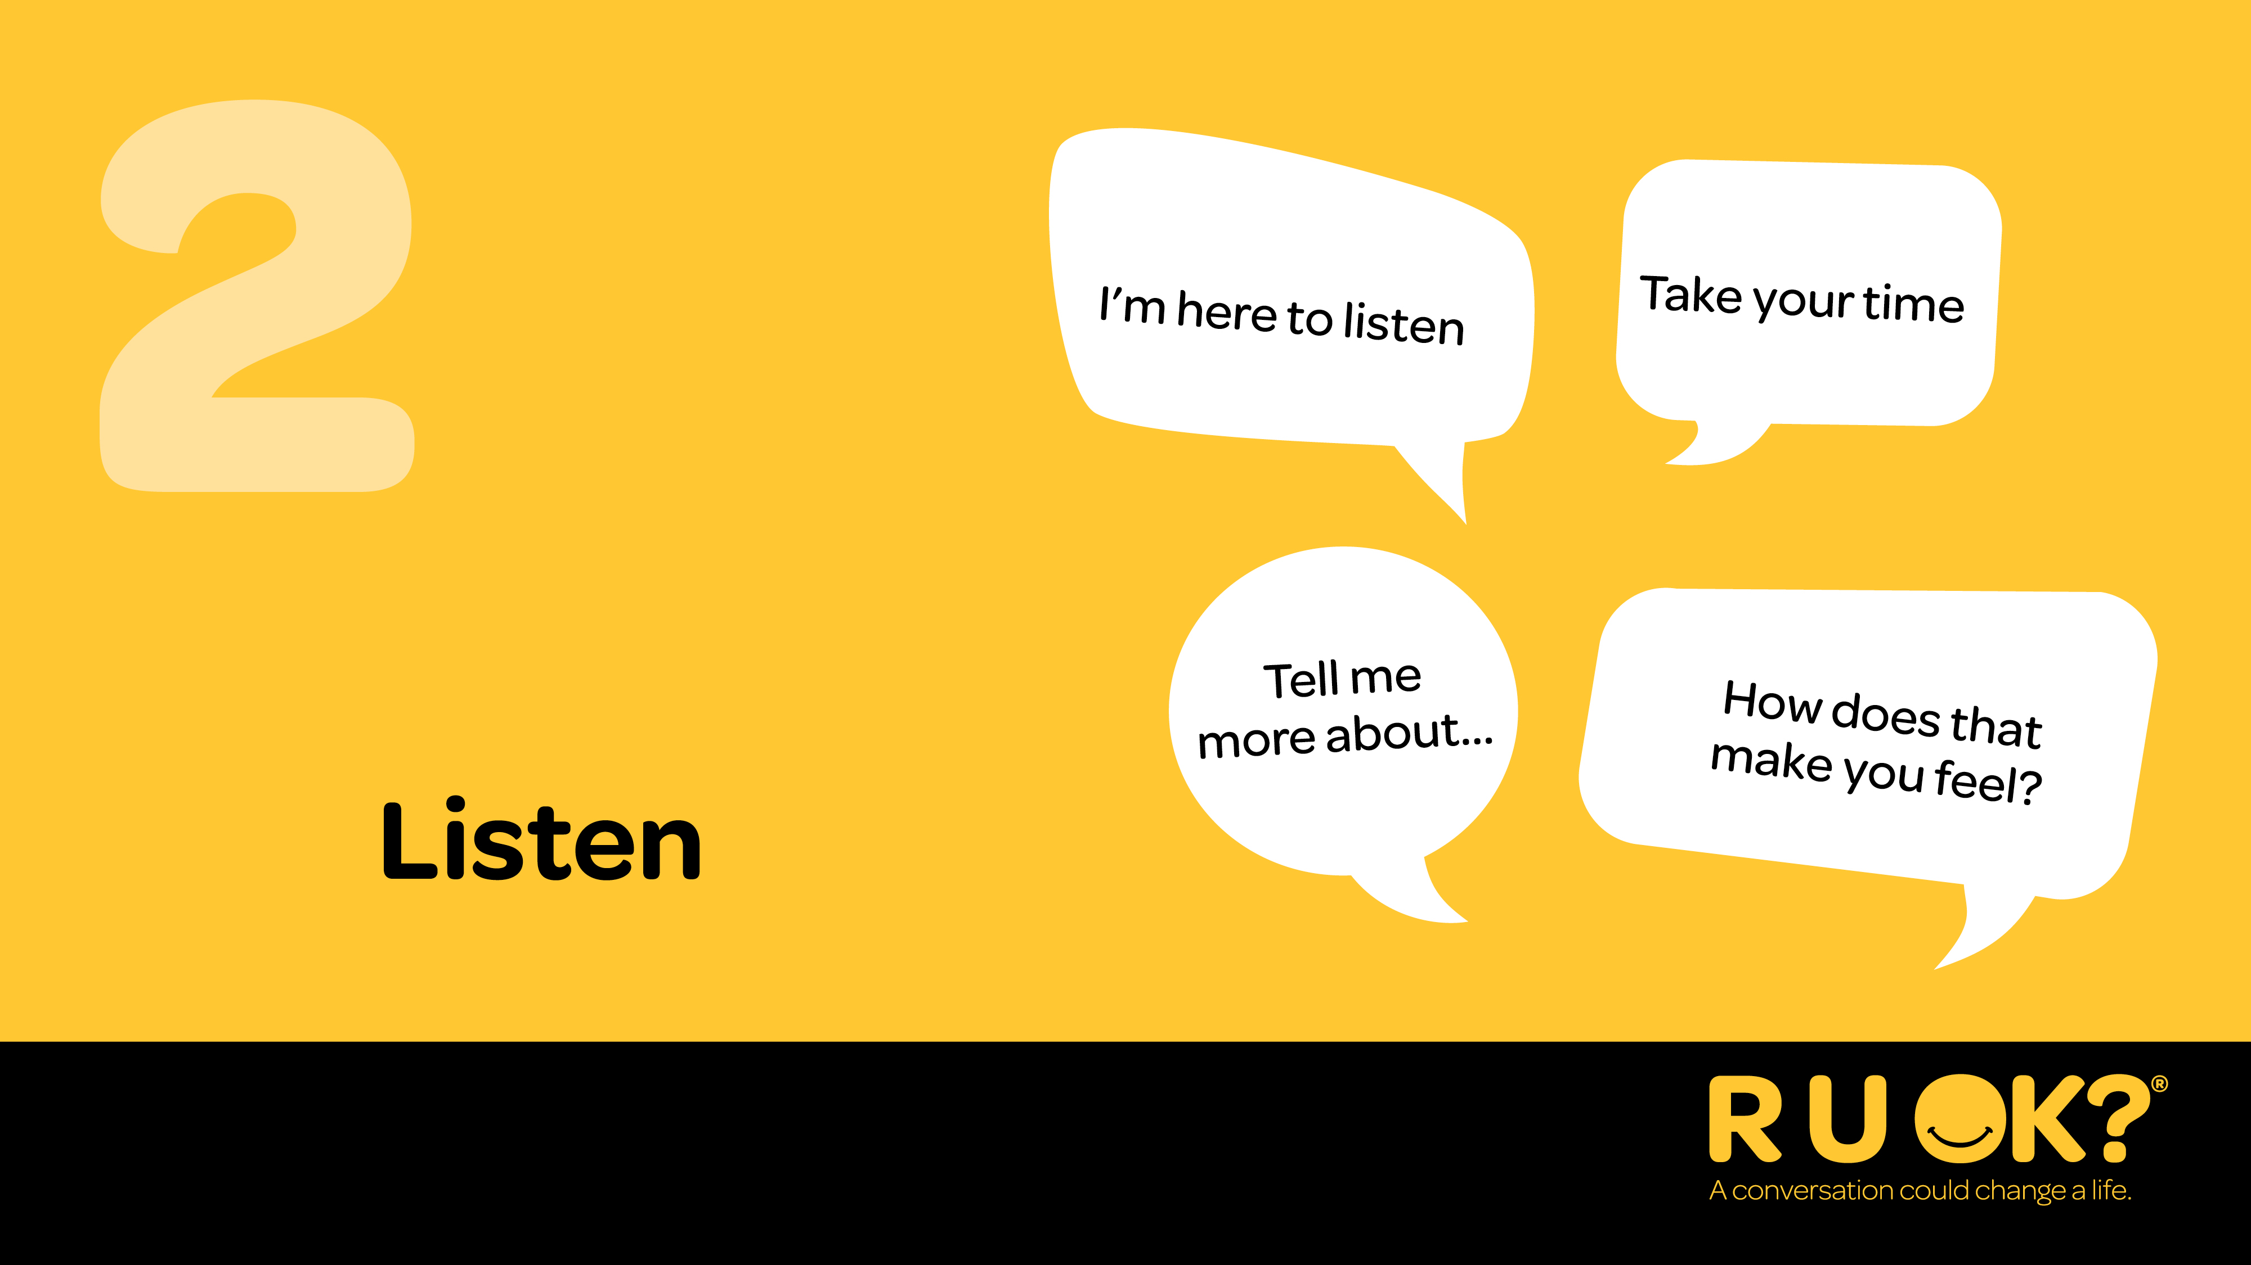
Notes:
Step two: Listen
It’s important you genuinely listen with an open mind and without judgment.
It can be tempting to jump in and try to push someone’s worries away or offer a ‘quick fix’, but it’s best to avoid rushing the conversation.
Don’t be afraid to sit in silence and give the person some space and quiet so they can find the words to express what they’re going through.
Acknowledge what they’re going through.
You could say: – “I’m here to listen if you want to talk more” – “How are you feeling about that?” OR – “I’m not going to pretend I know what it’s like for you, but I’m here to listen to why you feel the way you do.”
It can be really hard to hear that someone is in pain or struggling – but try and sit with the discomfort and remind yourself that your support can be crucial.

Slide 15
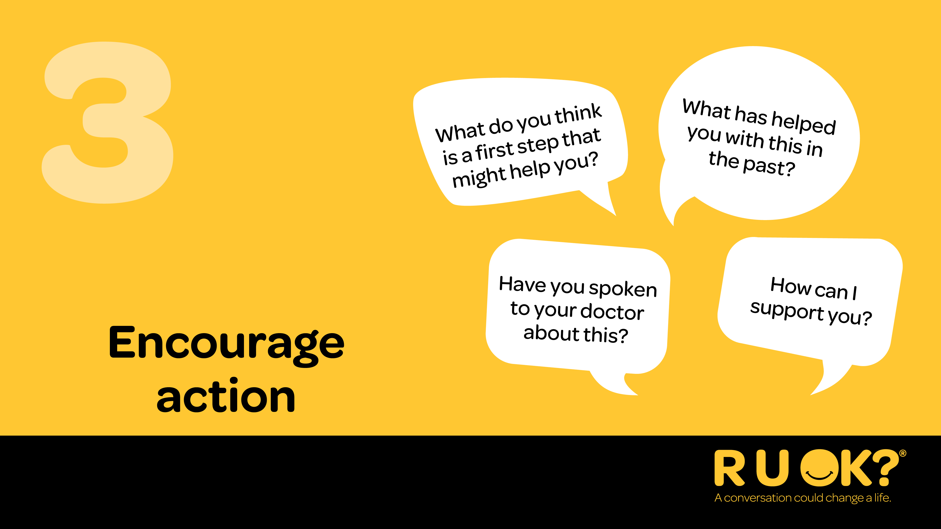
Notes:
Step three: Encourage action
Once they’ve shared what they’re going through, you might suggest to them that they think about one small step they might be able to take to improve their situation.
You don’t have to have the answers or be able to offer professional health advice, but you can help them consider the next steps and actions they can take to manage their situation.
Some good options might include talking to a teacher, the school counsellor, a family member or a trusted friend.
If they’ve been feeling this way for a while, they might need to talk to a trusted adult.
You could say: – “What do you think is a first step that would help you through this?” – “What can I do right now to support you?” – “Have you spoken to the teacher about this?” OR – “What’s something you enjoy doing? Making time for that can really help.”

Slide 16
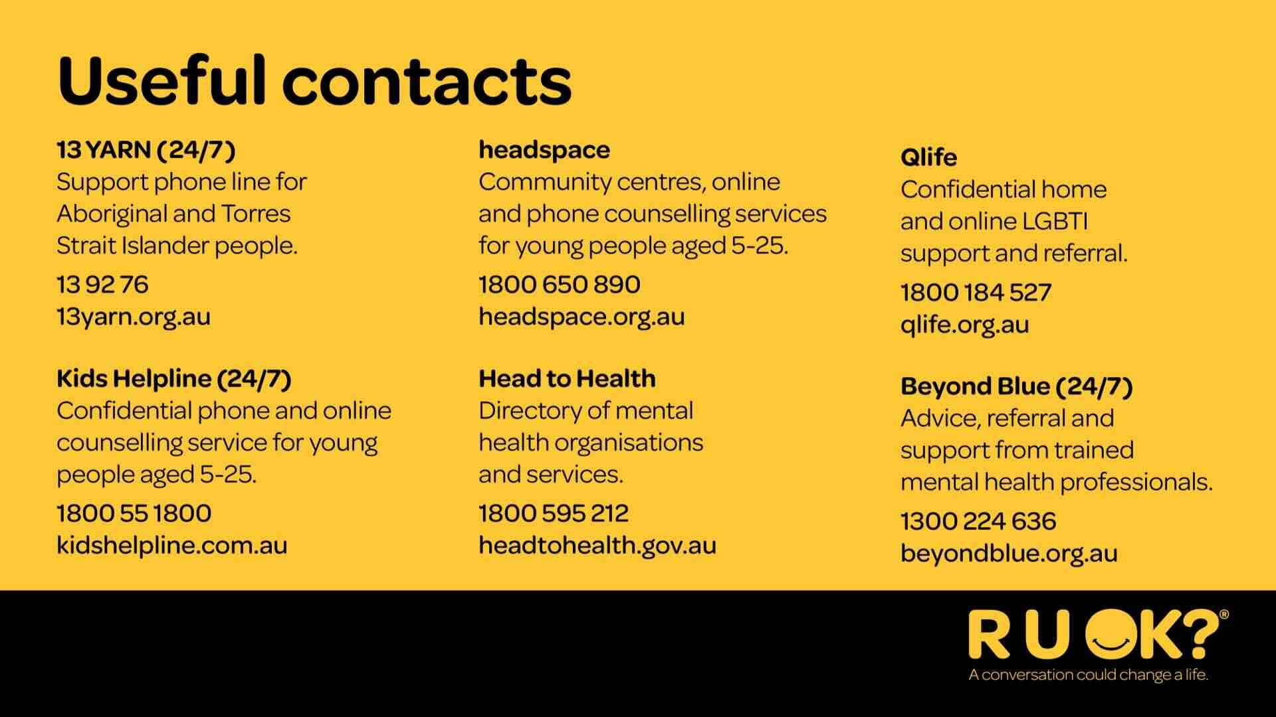
Notes:
Here are some help services that you can call for help as well. These services connect you with a professional who is trained to support you and guide you through whatever you need to talk about. You can call them to ask for advice on how to support your friend or your friend can call them.
Add a slide to include any local support services available at your school or in your local community

Slide 17
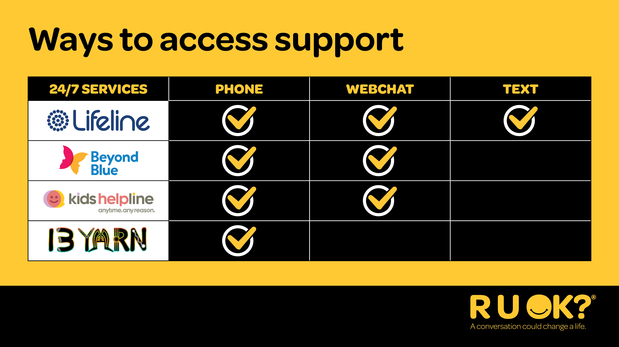
Notes:
If you don’t like speaking on the phone, Lifeline, Beyond Blue, and Kids Helpline all have webchat available.
Lifeline also has a text service available, which is again helpful if people don't feel comfortable having a phone call.
You can also call Lifeline, Beyond Blue, Kids Helpline, and 13 YARN on behalf of someone else, and they will all provide guidance on how to support them.

Slide 18
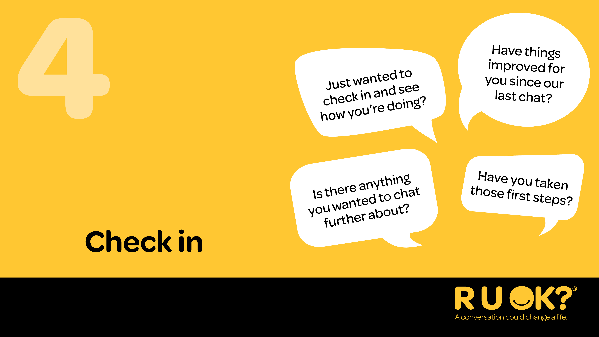
Notes:
The conversation doesn’t end after you ask R U OK?.
Checking back in lets someone know they’re important and that your care wasn’t just for one moment.
A quick message, or chat between subjects can make all the difference.
Staying connected is one of the most powerful ways we can support the people around us.
Having the ALEC slide in here like in last year’s deck is good as an option. It’s good pedogeological practice to reinforce messaging at the end for knowledge retention.

Slide 19
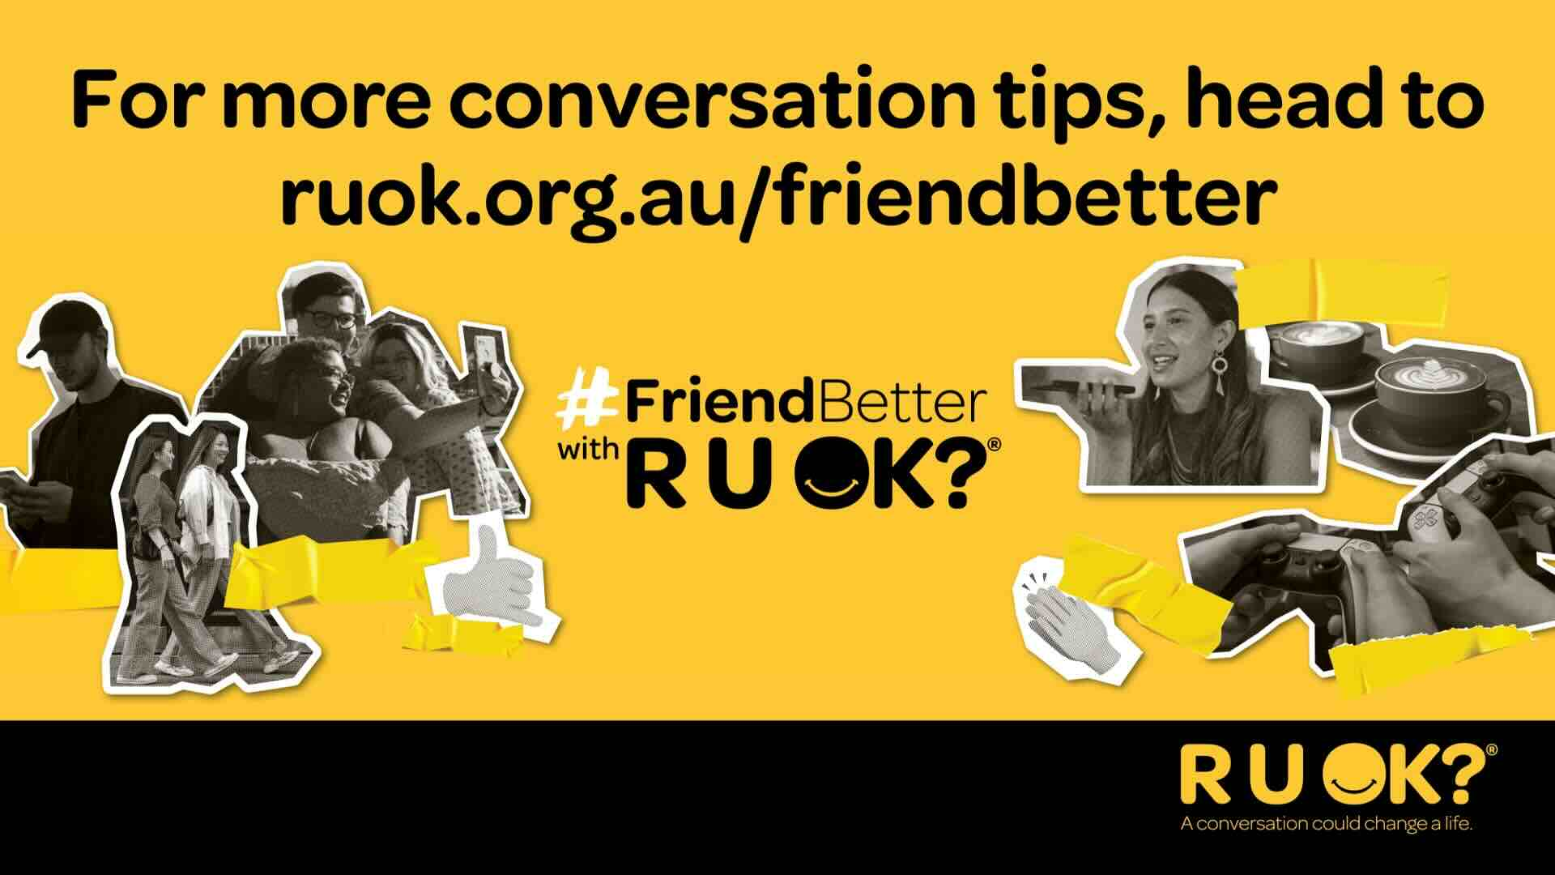
Notes:
For more conversation tips, or advice for how to support your mates through specific struggles, you can always head to ruok.org.au/friendbetter

Slide 20
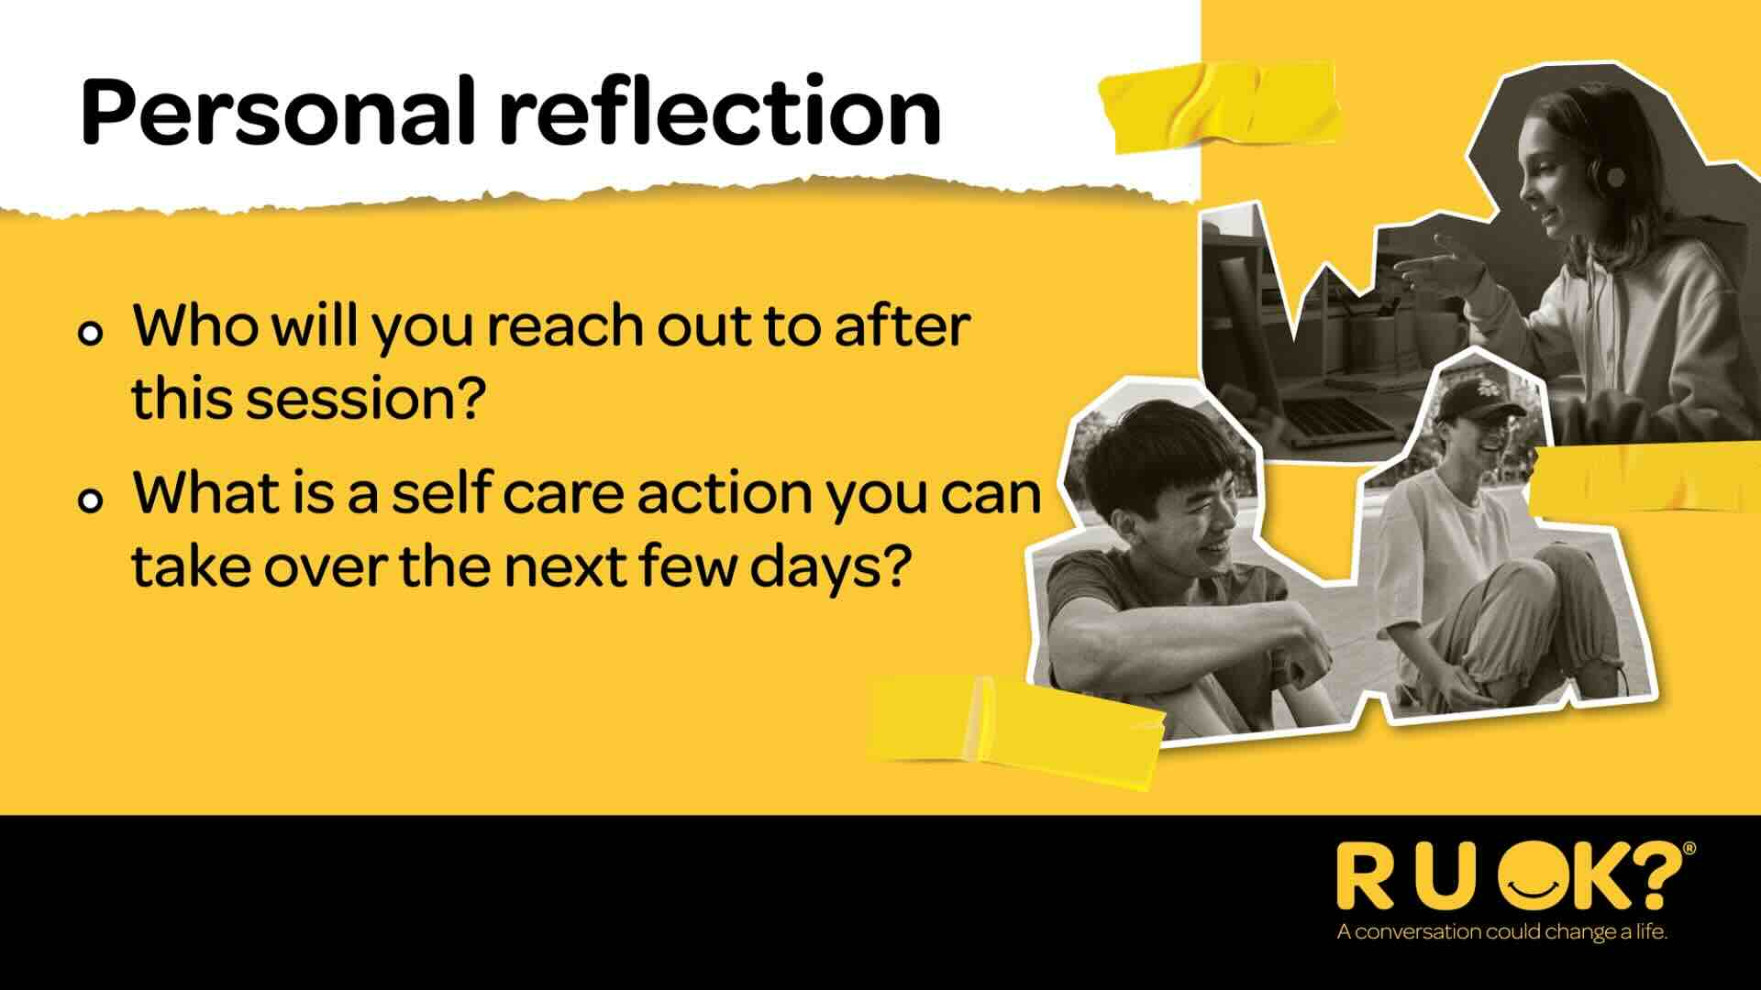
Notes:
I’d encourage you to think about who you can regularly check in with and ask R U OK? Any Day. Or if you are in need of support, I encourage you to reach out to someone today, or even one of the helplines.
Take some time today to do something nice for yourself- to make sure you are refilling your cup and looking after yourself.

