Slide 1

Insert school name
Insert school year
Notes:
Insert your school name and year group into the slide if relevant. If not, you can delete this text from the slide.

Slide 2

Notes:
Acknowledgement of Country
I acknowledge the Traditional Owners of the land on which we are meeting today and pay my respect to Elders past, present and future.

Slide 3
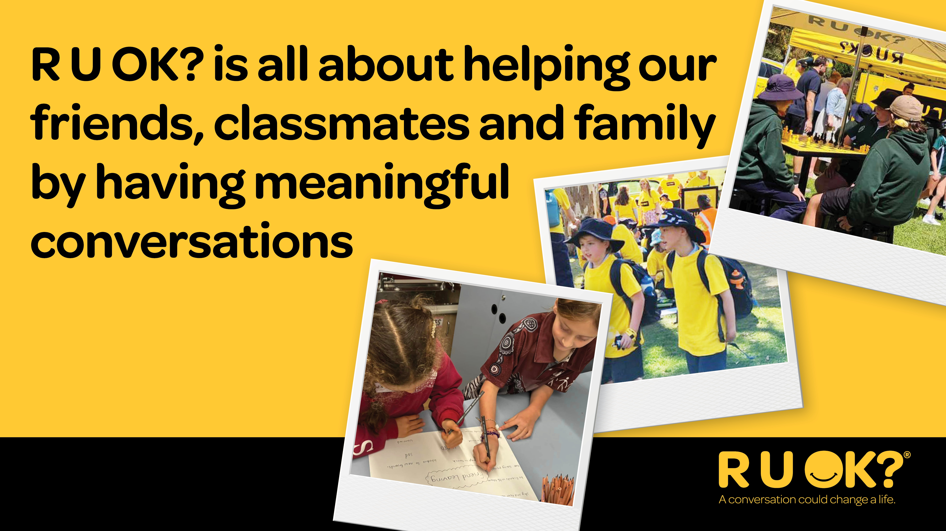
Notes:
Script:
R U OK? is a charity with a mission to get everyone having more conversations to check in with each other to see how they’re doing.
It’s about what we can all do to help our friends, classmates and family to get through tough times.

Slide 4
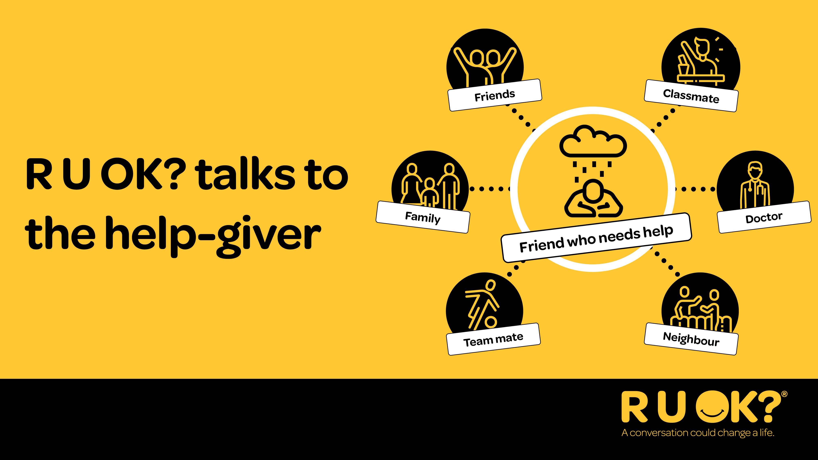
Notes:
Script:
The role of asking ‘R U OK?’ and helping someone who is struggling can be played by lots of different people – in the middle here there’s someone who needs help. This could be any of us at various times of our life. All the people around – friends, family, team-mates, classmates, doctors, neighbours etc can all play that supporting role.
When someone is struggling it can be hard for them to reach out. That’s why we call on those around them who might notice, to start the conversation and encourage them to speak about what might be troubling them. This can help people feel like they have a friend supporting them and prevent small things becoming bigger issues.

Slide 5
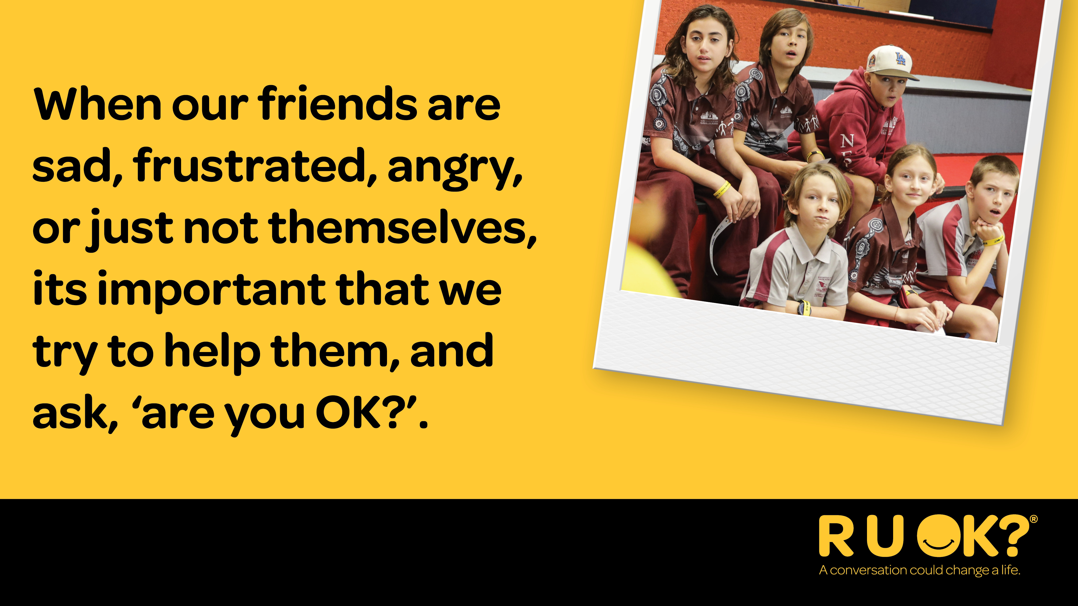
Notes:
Script:
When our friends are sad, frustrated or angry it’s important that we try to help them, and ask: ”Are you OK?”.
Asking this can make a difference when someone is struggling – it can make them feel less alone and more supported. We want everyone to feel like people are there for them.
When someone does need help, it’s often easier for them to talk to someone they know. That’s why we’re going to talk through what to do if they are worried about someone.

Slide 6
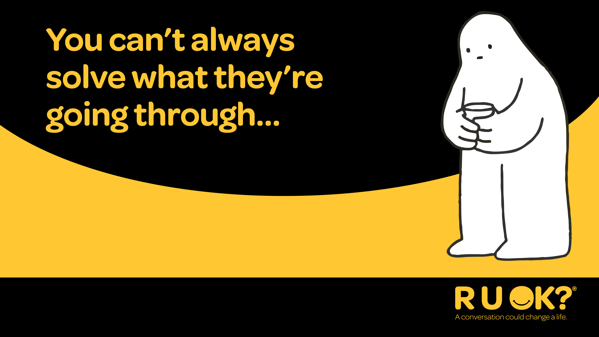
Notes:
It’s important to remember that you can’t always solve or fix what they’re going through.

Slide 7
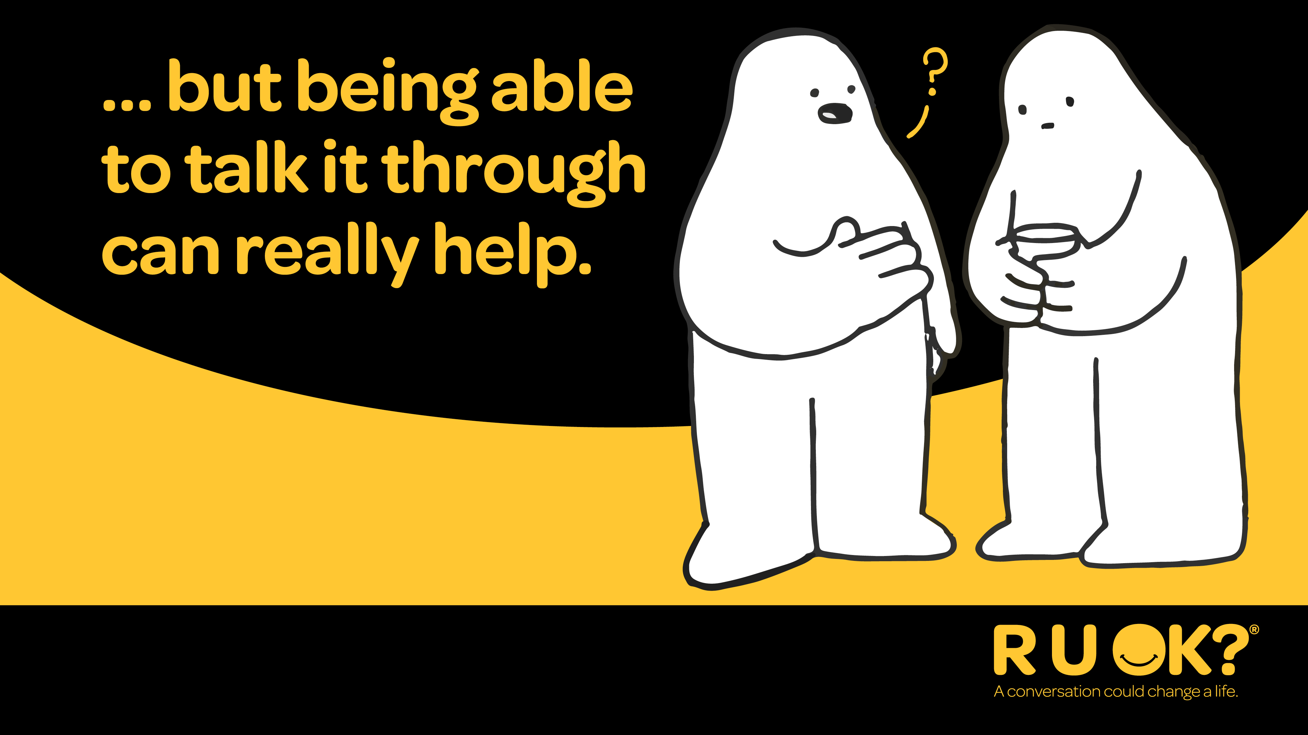
Notes:
But what you can do is have regular R U OK? conversations and check in with each other.
That way you’re providing regular opportunities for them to open up and share what’s going on in their life.
Question for the class: How do conversations make a difference?
Conversations can help them to process and manage what they’re going through, to prevent little things from becoming big things.

Slide 8
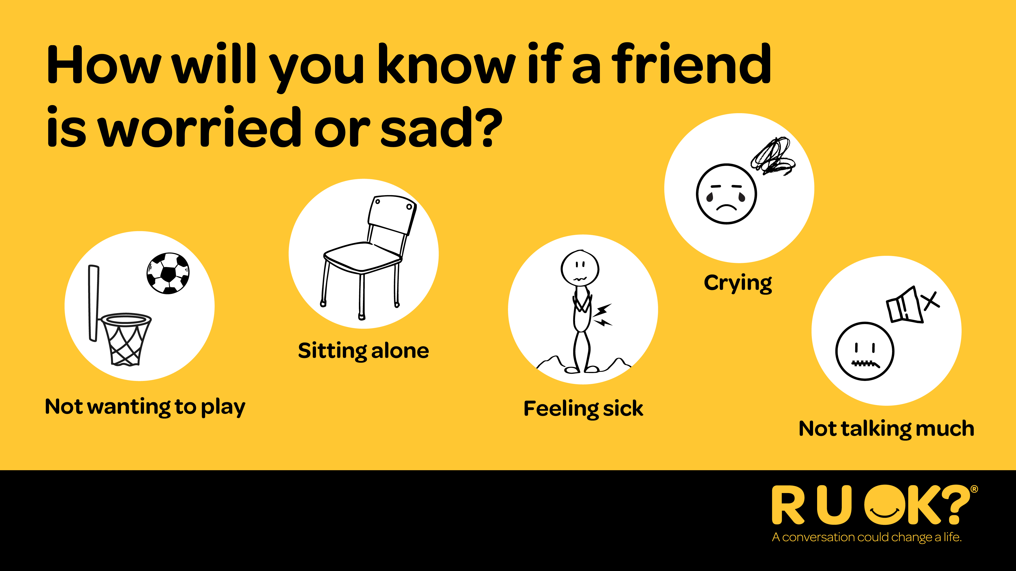
Notes:
Sometimes our friends might feel sad, worried, or upset. It’s important we know how to spot these signs.
You might notice they don’t feel like playing, even if it’s a game they usually love.
They might be sitting by themselves a lot or not talking as much as usual.
Some people say they feel sick when they’re feeling worried.
And sometimes, they might cry or look really upset.
If you notice any of these signs, it could be a good time to check in and ask: “Are you OK?” — or let a trusted adult know.
OPTIONAL AUDIENCE ENGAGEMENT QUESTION
Can you think of some more signs that might mean someone is feeling sad or might need help?

Slide 9

Notes:
R U OK?Day is a great reminder, but we can make a real difference by checking in with our friends all year round.
We can ask: “Are you OK?” any day, not just on R U OK?Day.
R U OK? want Australians to know you don’t have to be an expert, and you don’t have to do it alone.
R U OK? is here to help with their four-step conversation framework, ALEC (Ask, Listen, Encourage Action, and Check In) which we will be going through today to help build your confidence

Slide 10
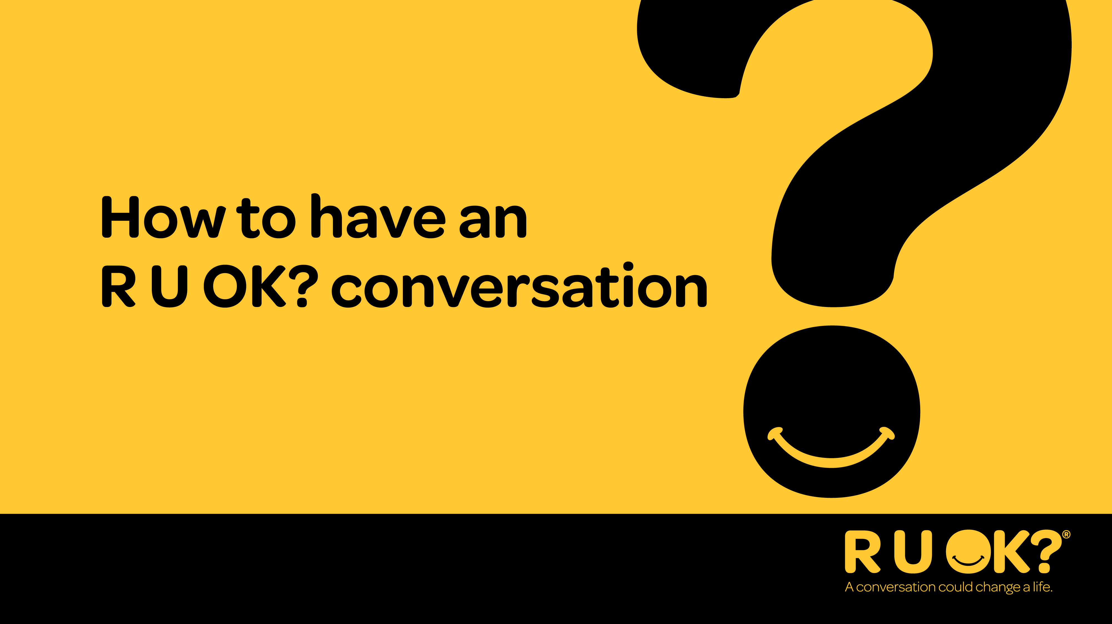
Notes:
Now we’re going to talk through the steps of an R U OK? Conversation.

Slide 11
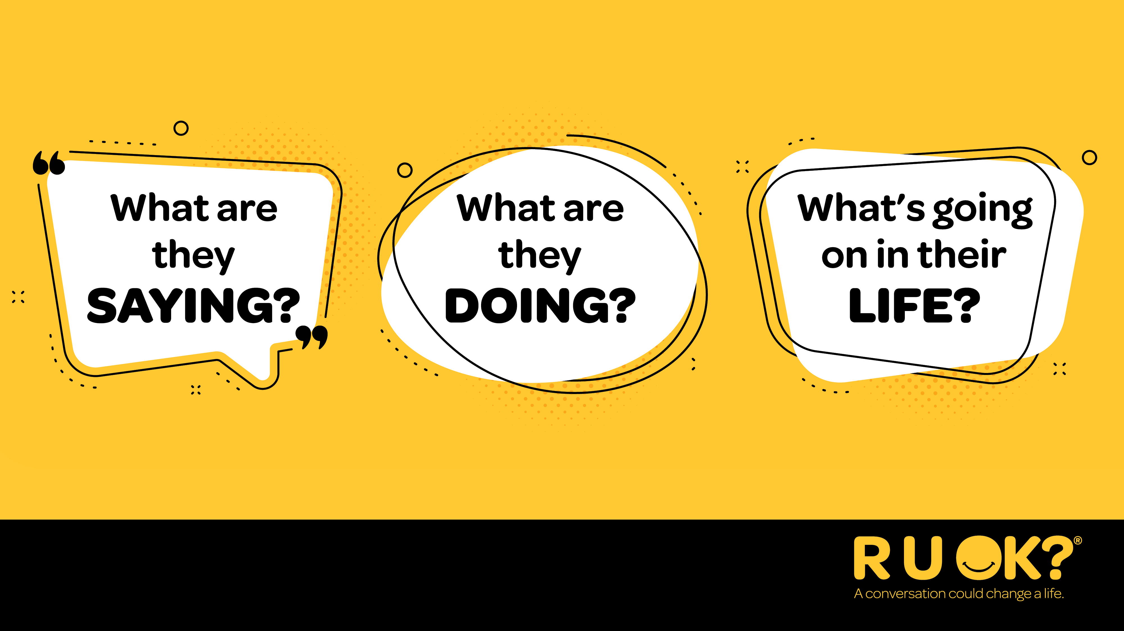
Notes:
So, when should you ask, ‘are you OK?’.
Whenever you notice a change in what someone’s saying or doing, or if you know there are things happening in their life that might be putting them under pressure or causing stress.
Question for the class: What are some examples of signs that could indicate someone needs your support?
They're being quieter and more withdrawn than usual
You notice a change in their appearance, maybe their hair is usually really neat but lately they haven’t been brushing it
They seem confused or distracted
They’re unable to ‘switch off’
They’re having mood swings
They’re no longer interested in things they used to love doing or talking about

Slide 12
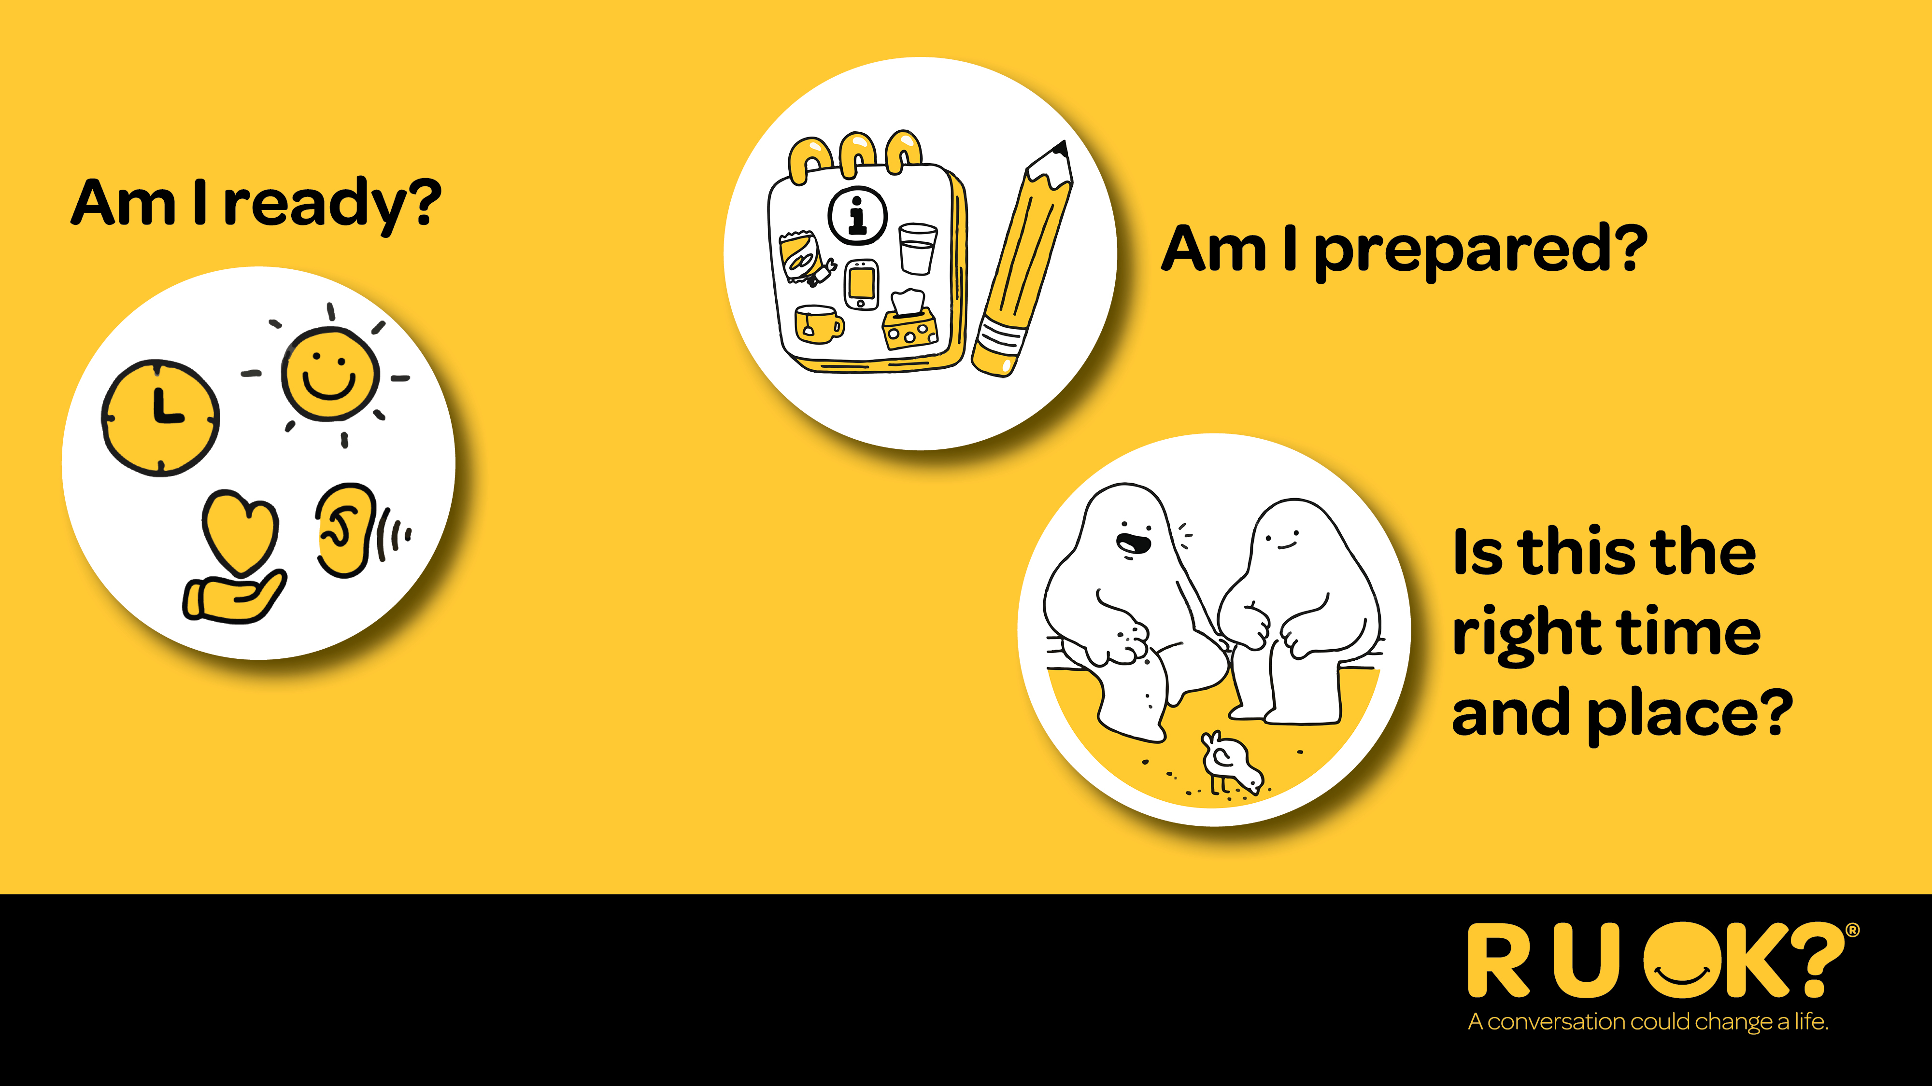
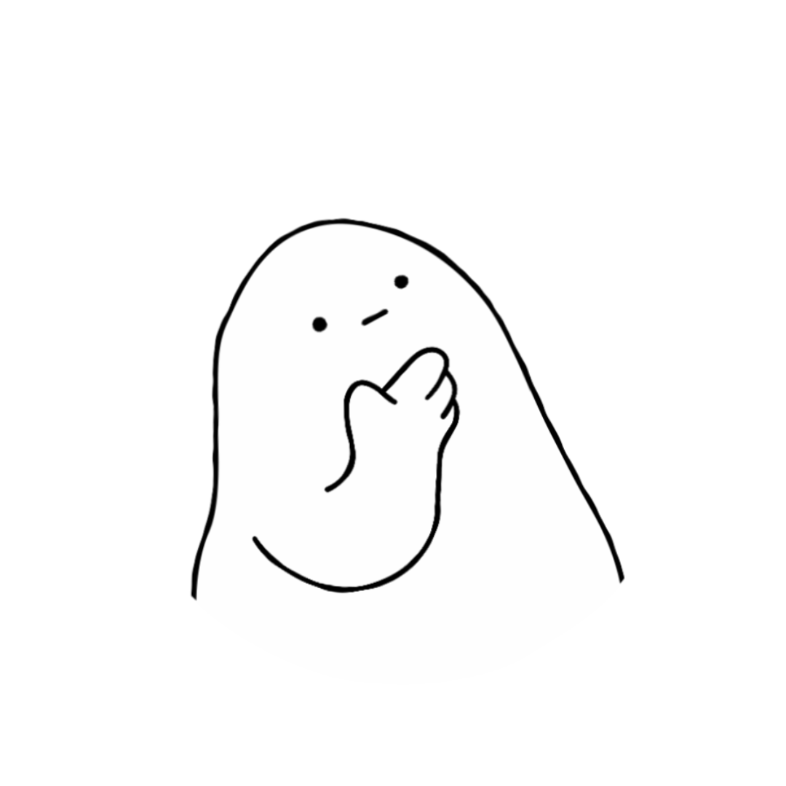
Notes:
Before you check in with a friend, check in with yourself first.
It’s great to care about others, but before you try help someone, ask yourself: Am I feeling okay to do this right now?. If you’re not feeling ready, that’s totally okay. You can let a trusted adult or another friend know instead.
Here are some questions to help decide if you’re ready to talk to someone who might need support:
Are you ready?
Am I feeling calm and in a good mood?
Can I really listen to what they’re saying?
Do I have time to talk, and not rush the conversation?
Are you prepared?
I don’t need to fix everything—they might just need someone to listen.
Talking about tough stuff can be hard, and they might cry or feel upset. That’s okay.
Have I picked a quiet spot where we can talk comfortably, like a bench or a quiet part of the playground?
Is now a good time for them?
If they’re busy or not ready to talk, that’s okay too. You can ask, “Would another time be better?”
Sometimes it’s easier to chat while doing something else—like walking or kicking a ball.
Remember: Being a kind friend means looking after yourself and others. You don’t have to do it alone—ask a teacher, parent, or adult you trust if you’re not sure what to do.

Slide 13
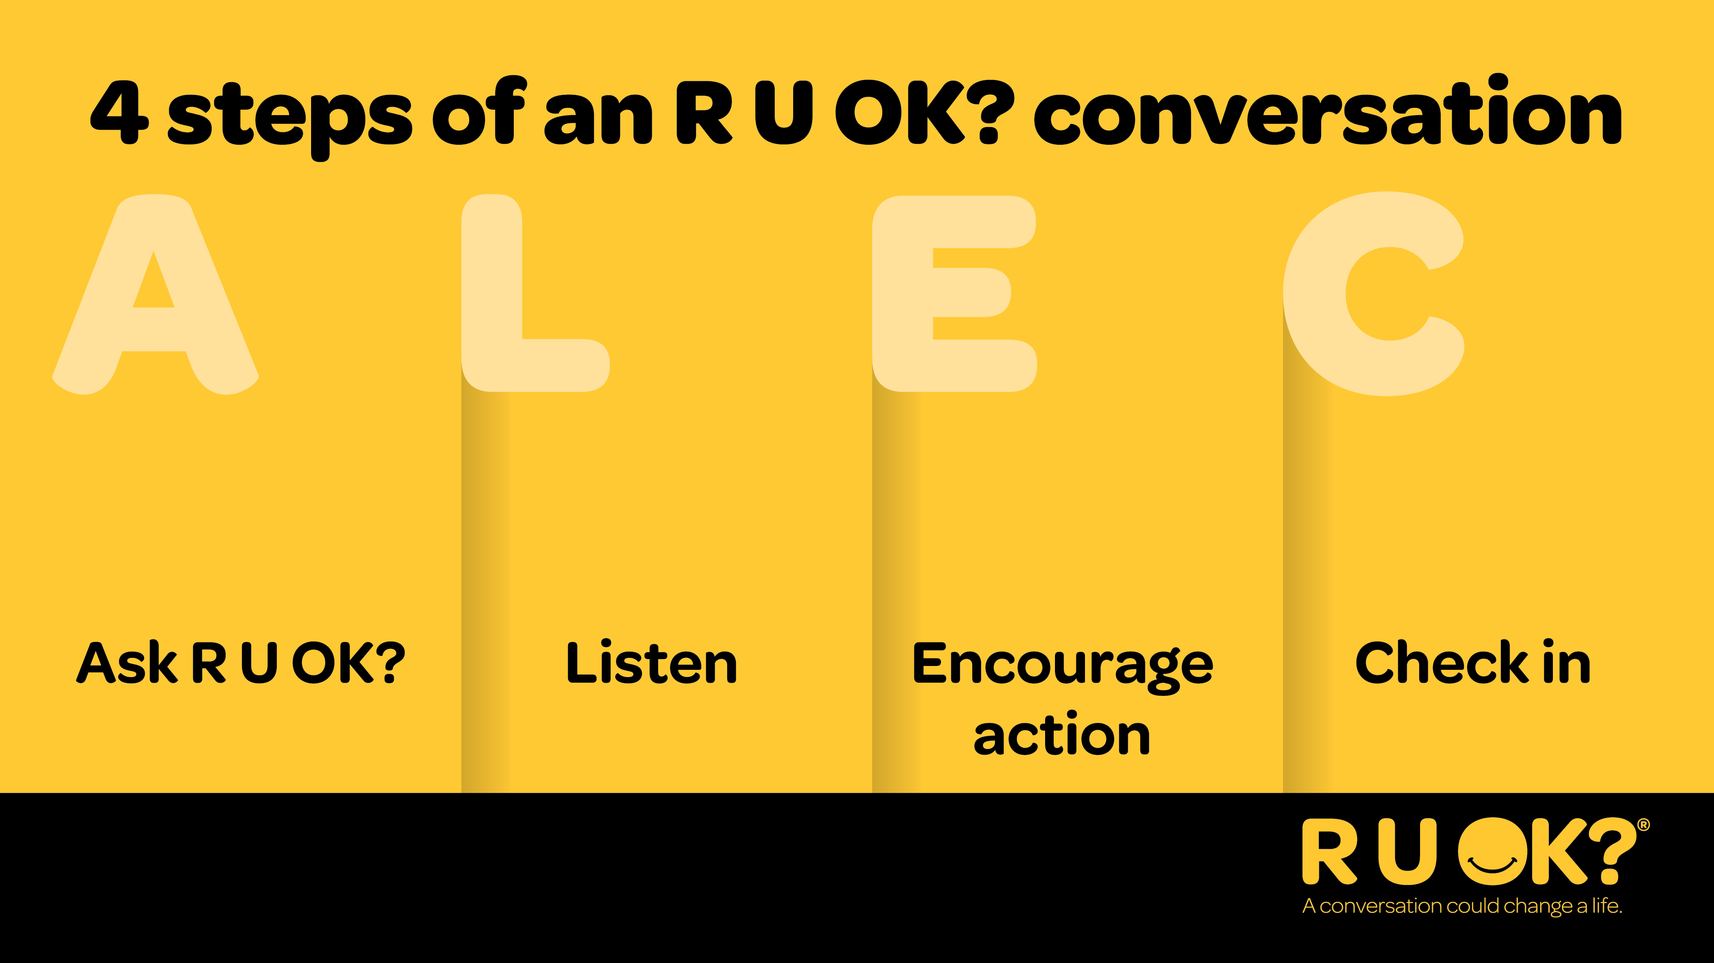
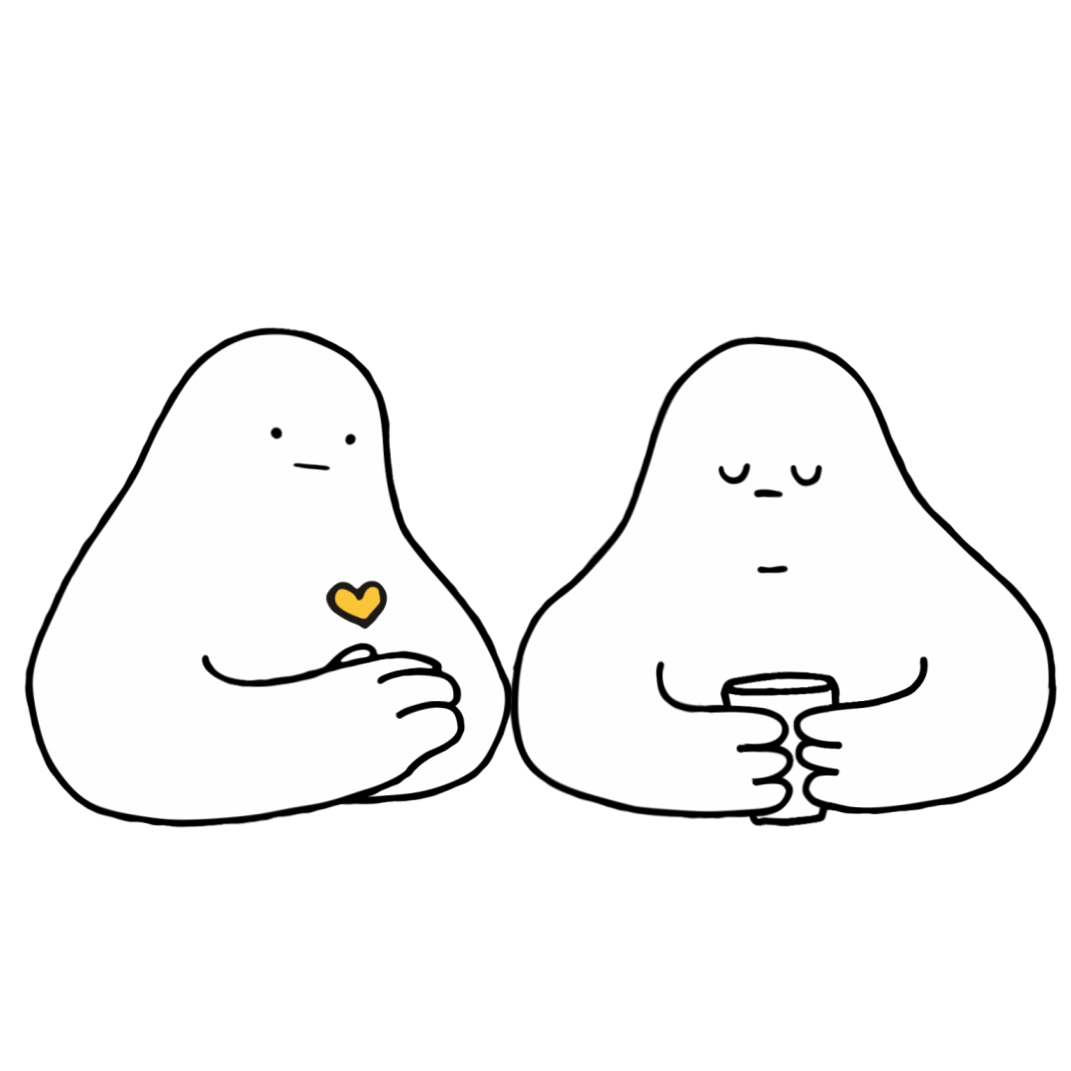
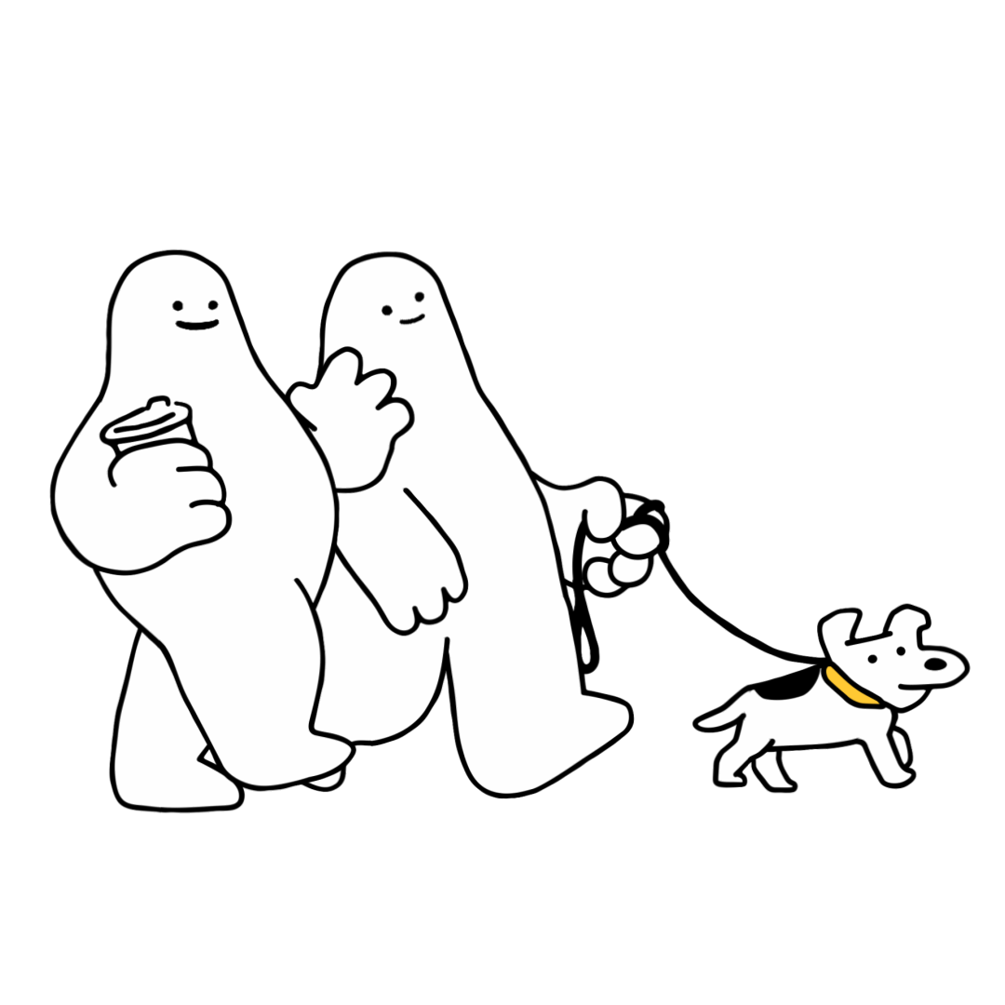
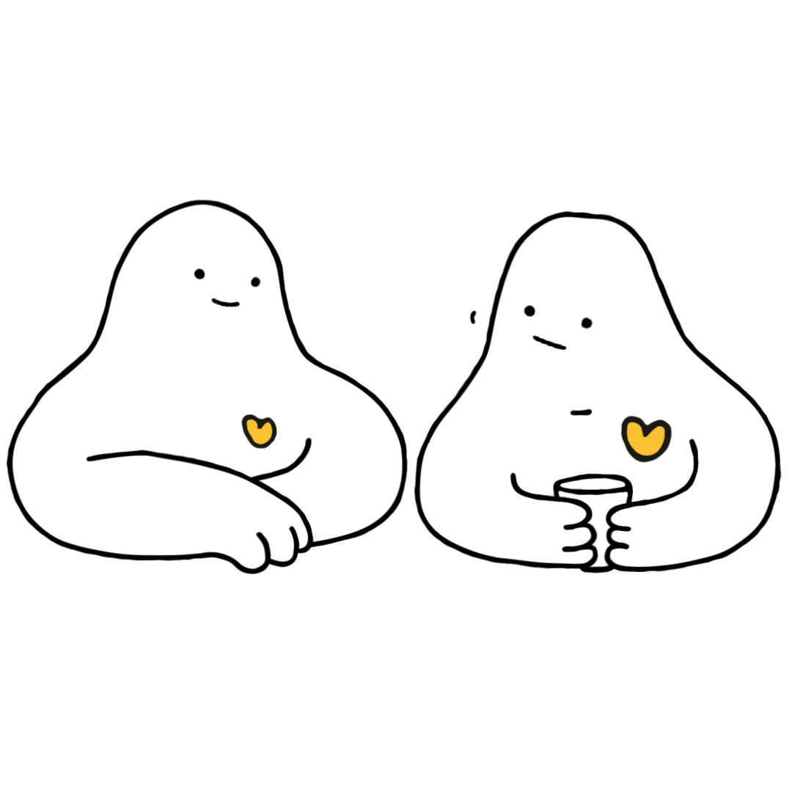
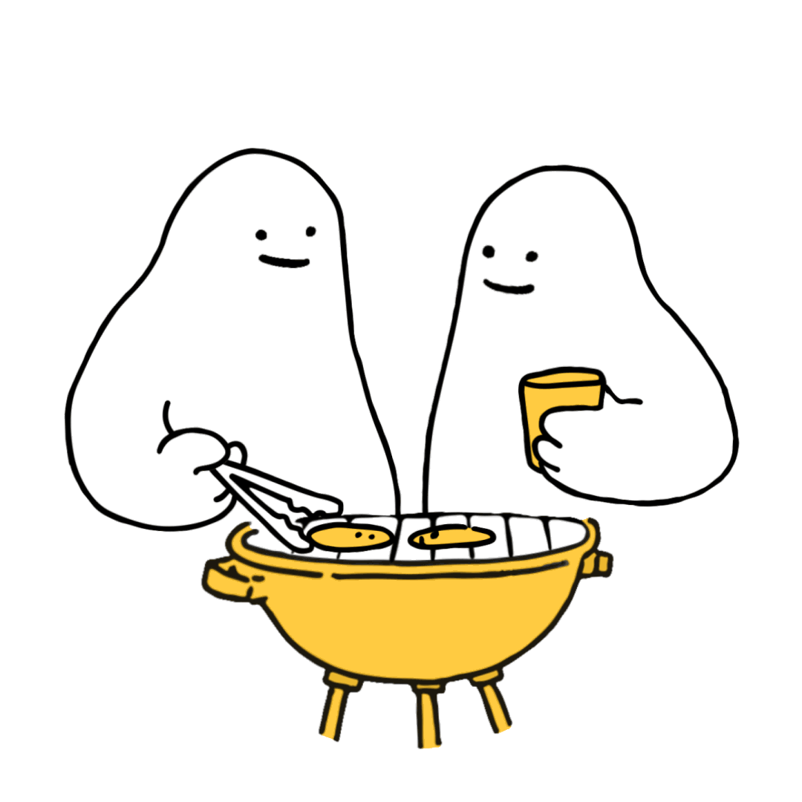
Notes:
The four steps of an R U OK? conversation is a simple guide to help you support your friends.
The acronym ALEC will help you remember :
1. Ask R U OK?
2. Listen
3. Encourage Action
4. Check in

Slide 14
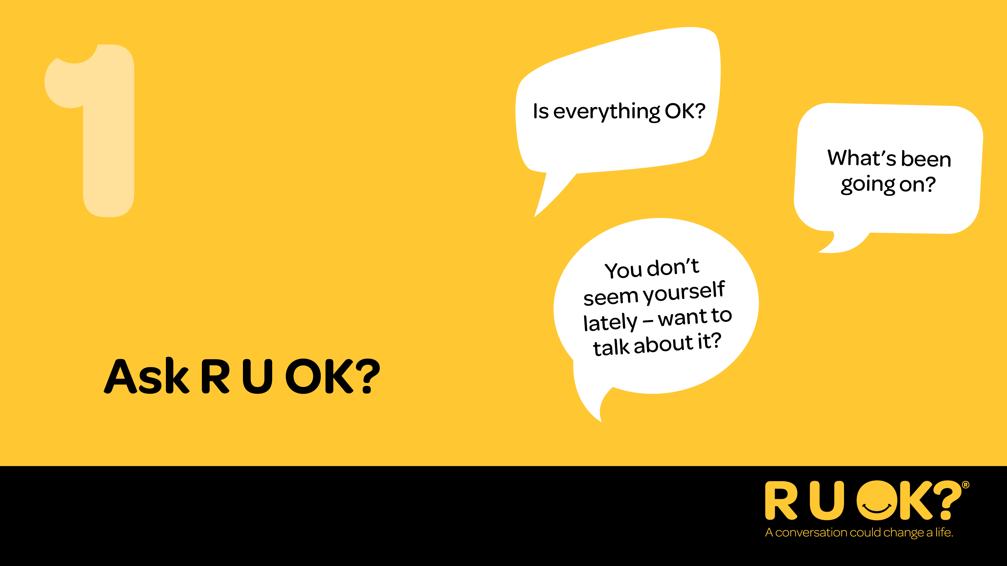
Notes:
Step 1 is ‘Ask R U OK?’.
Start the conversation at a time and in a place where you’ll both be comfortable to chat.
Be relaxed and friendly in your approach. Think about how you can ease into the conversation.
Ask R U OK? in a way that feels natural to you and your relationship with the other person. See some examples of how to ask on the slide.
You can start by letting them know you’ve noticed a change. You could say something like:
– “I’ve noticed a few changes in what you’ve been saying/doing. How are things going for you?”
– “I know there’s been some big life changes for you recently, how are you managing?” OR
– “You don’t seem yourself lately – want to talk about it?”
If they don’t want to talk, let them know you’ll be there when they are ready, or ask them if there’s someone they’d be more comfortable chatting to.

Slide 15
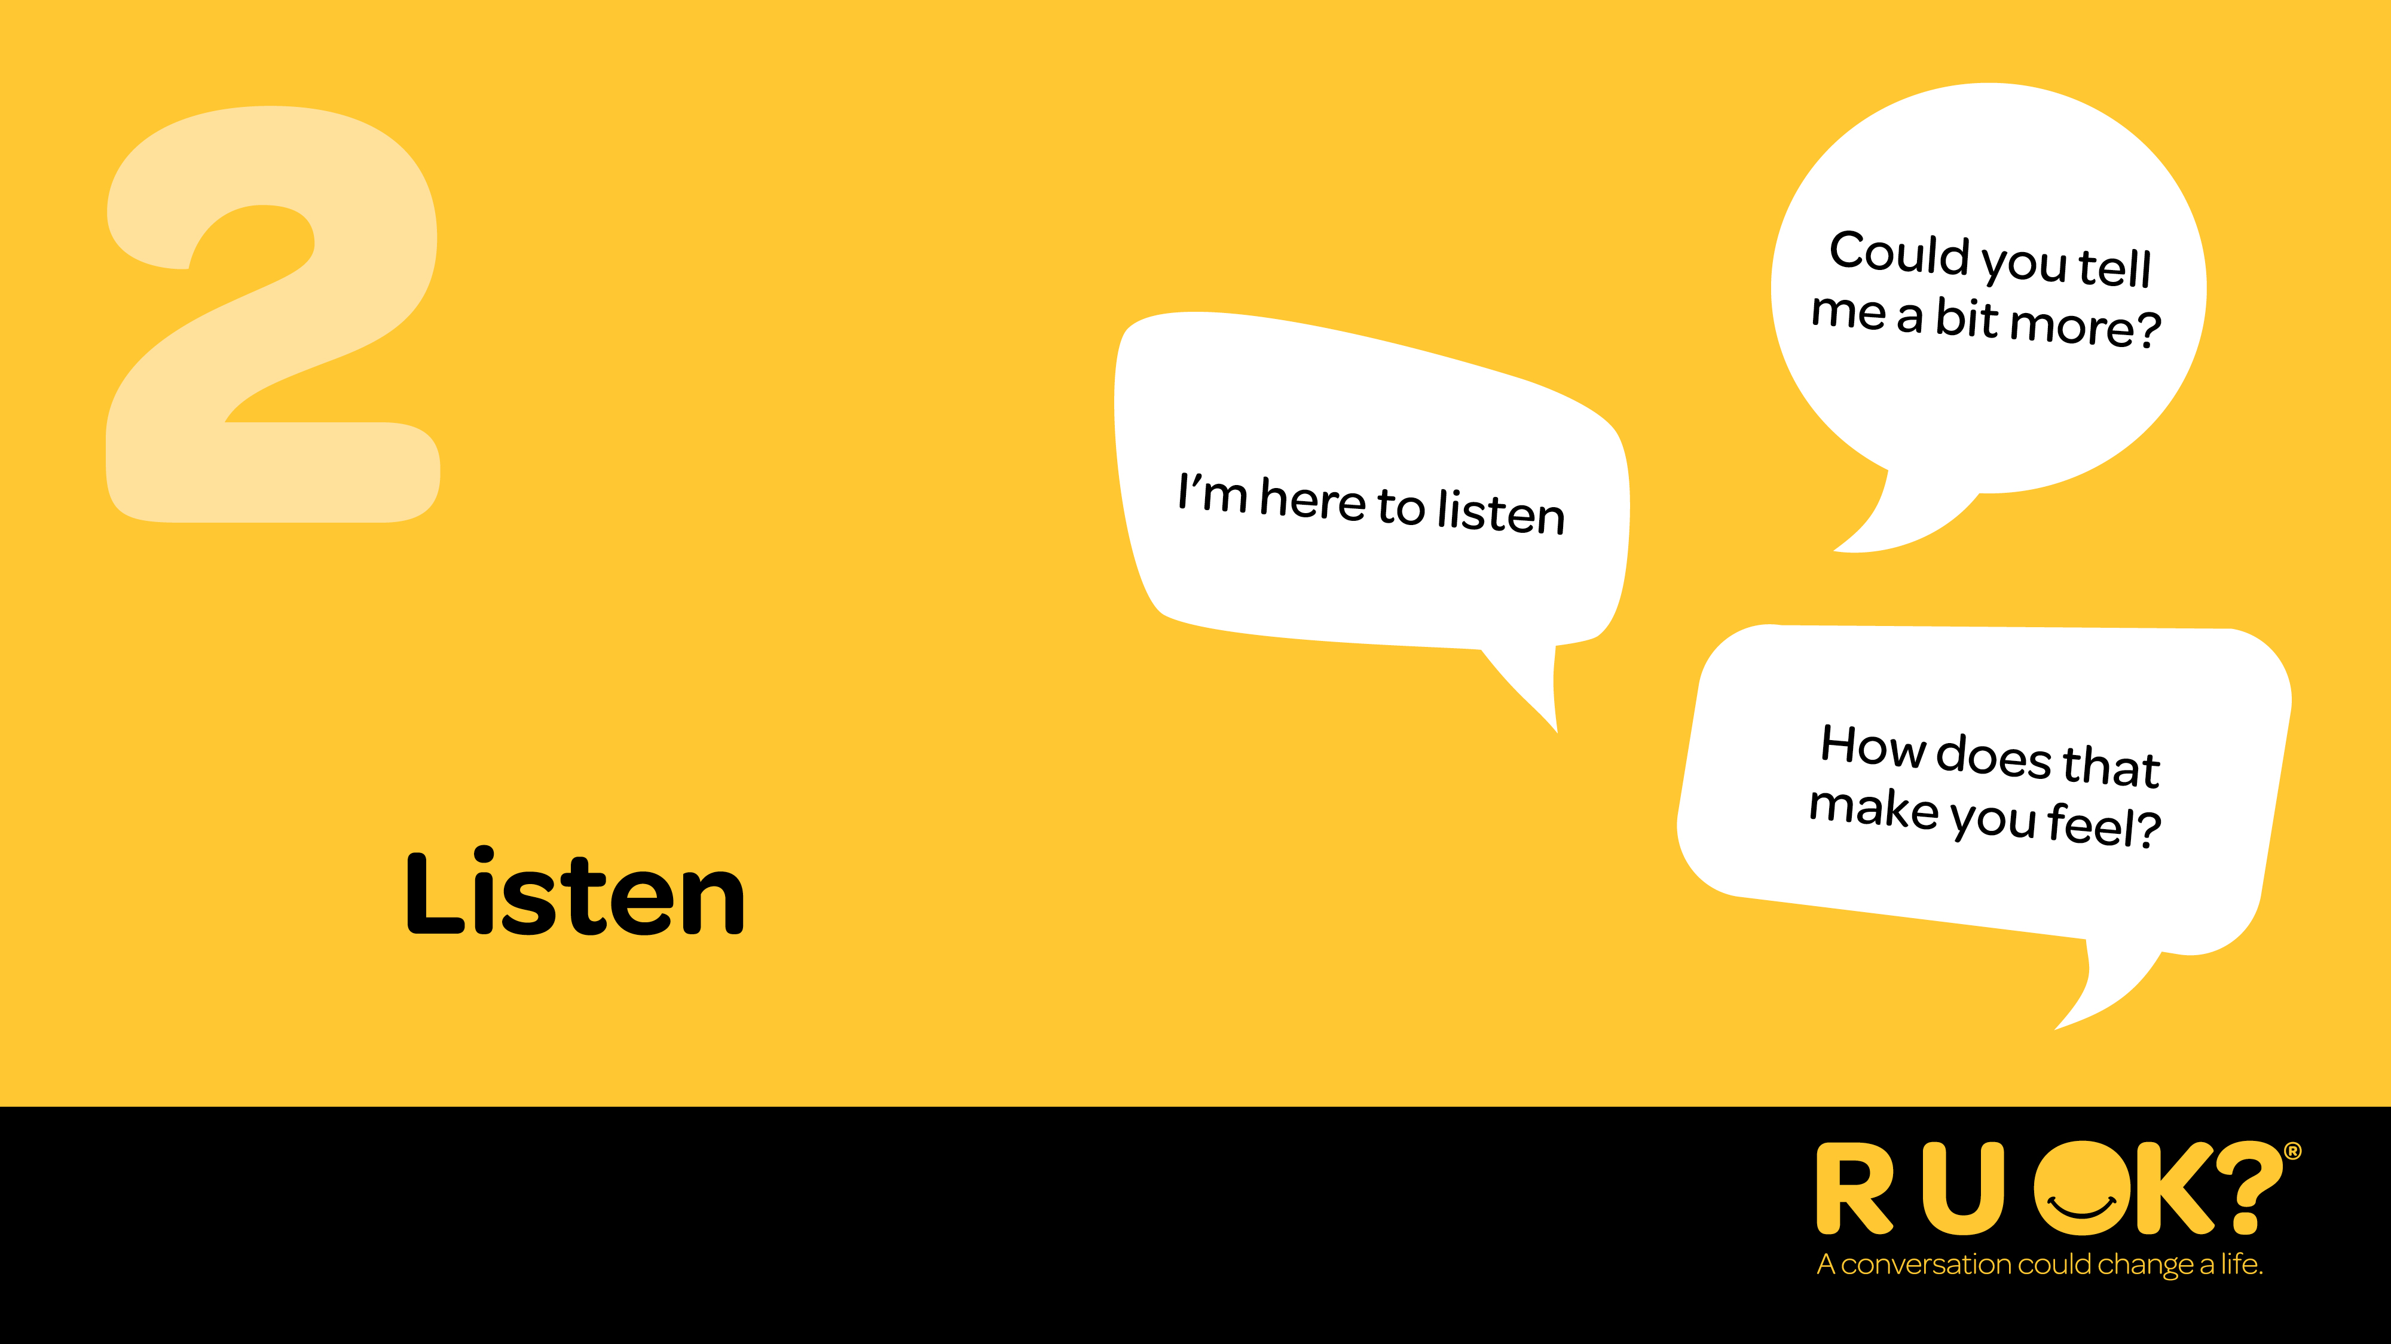
Notes:
Step 2 is ‘Listen’.
It’s important you genuinely listen with an open mind and without judgment.
It can be tempting to jump in and try to push someone’s worries away or offer a ‘quick fix’, but it’s best to avoid rushing the conversation.
Also don’t be afraid to sit in silence and give the person some space and quiet so they can find the words to express what they’re going through.
Acknowledge what they’re going through.
You could say:
– “I’m here to listen if you want to talk more”
– “How are you feeling about that?” OR
– “I’m not going to pretend I know what it’s like for you, but I’m here to listen to why you feel the way you do.”
It can be really hard to hear that someone is in pain or struggling – but try and sit with the discomfort and remind yourself that your support can make a real difference for them.

Slide 16
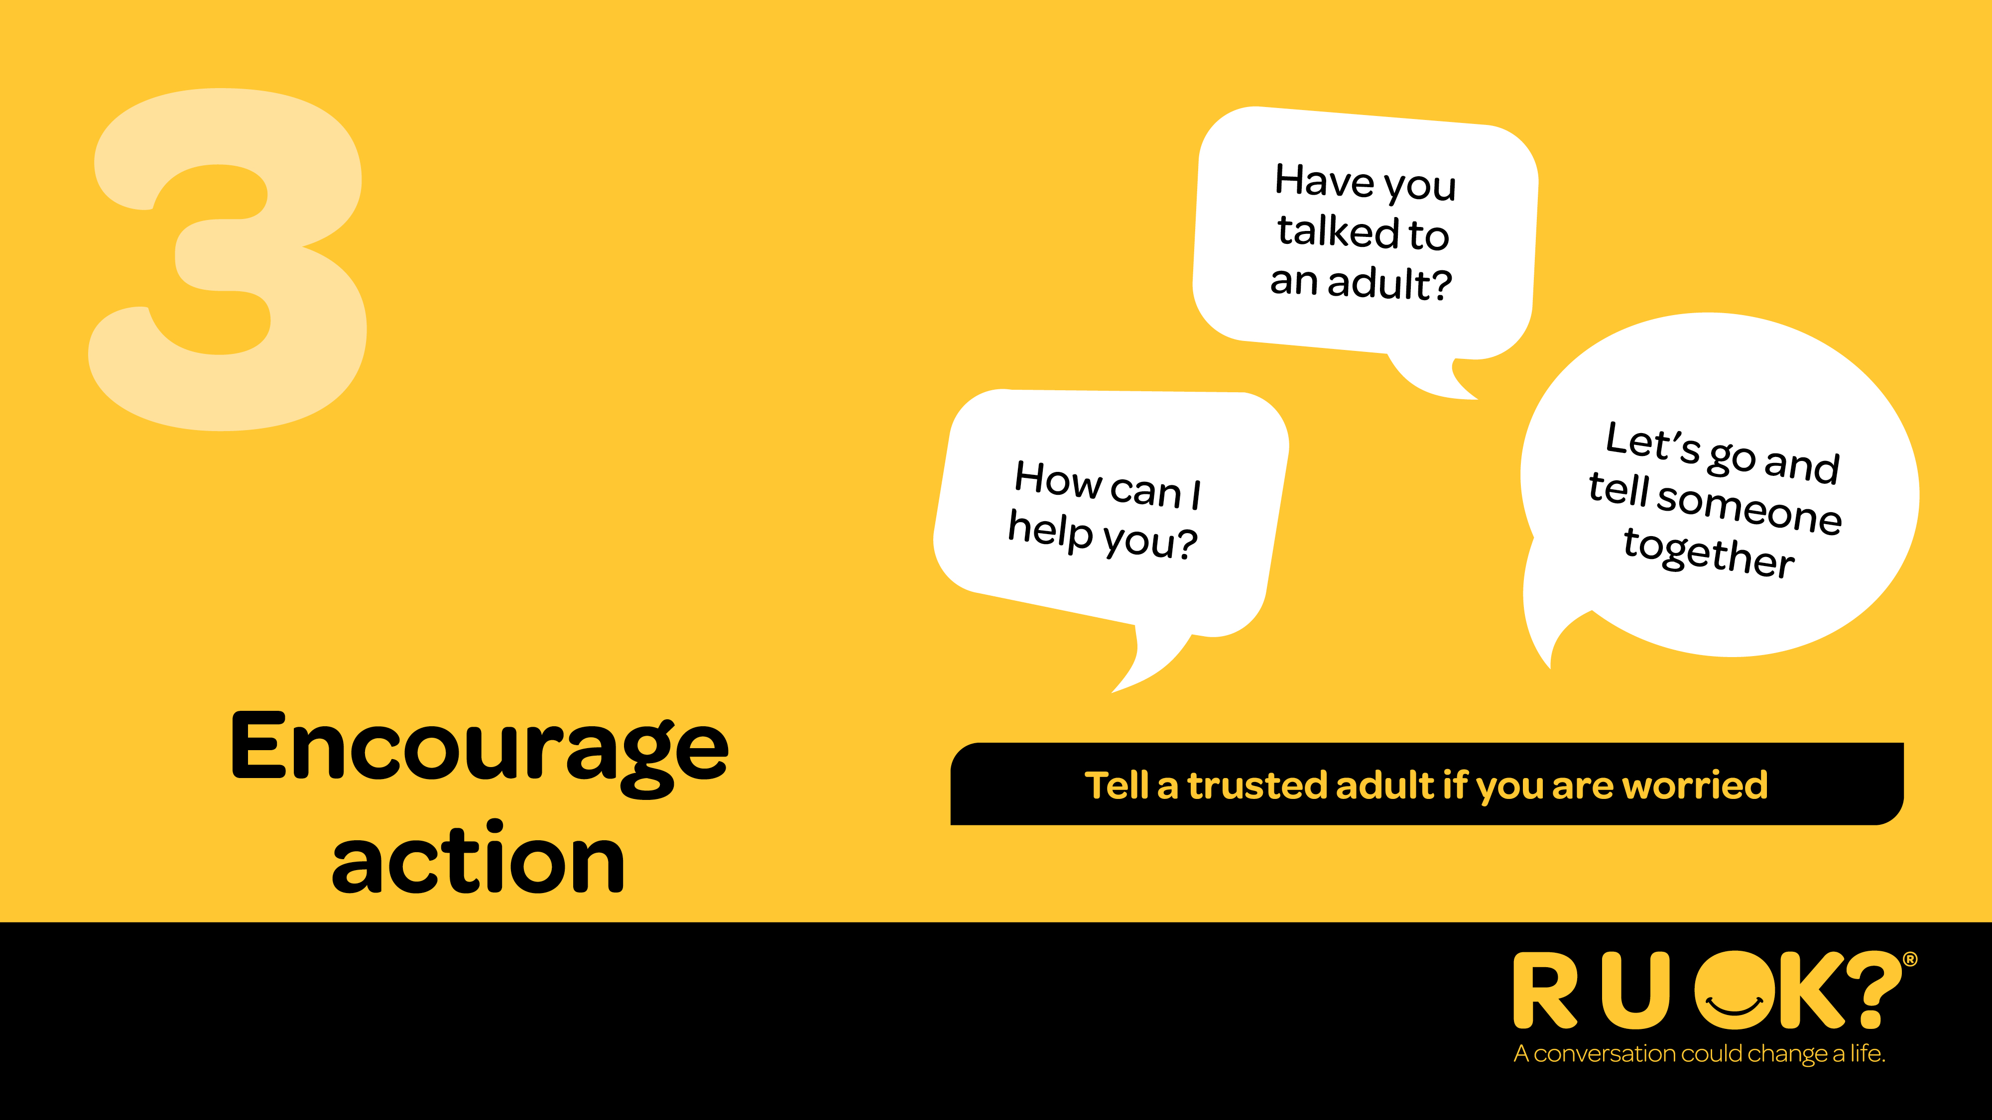
Notes:
Step 3 is ‘Encourage action’.
Once they’ve shared what they’re going through, you might suggest to them that they think about one small step they might be able to take to improve their situation.
You don’t have to have the answers or be able to offer professional health advice, but you can help them consider the next steps and actions they can take.
If they’ve been feeling this way for a while, they might need to talk to a trusted adult.
Some options might include talking to a teacher, the school counsellor, a family member or a trusted friend.
You could say:
– “What do you think is a first step that would help you through this?”
– “What can I do right now to support you?”
– “Have you spoken to your teacher or the school counsellor about this?” OR
– “What’s something you enjoy doing? Making time for that might help.”

Slide 17
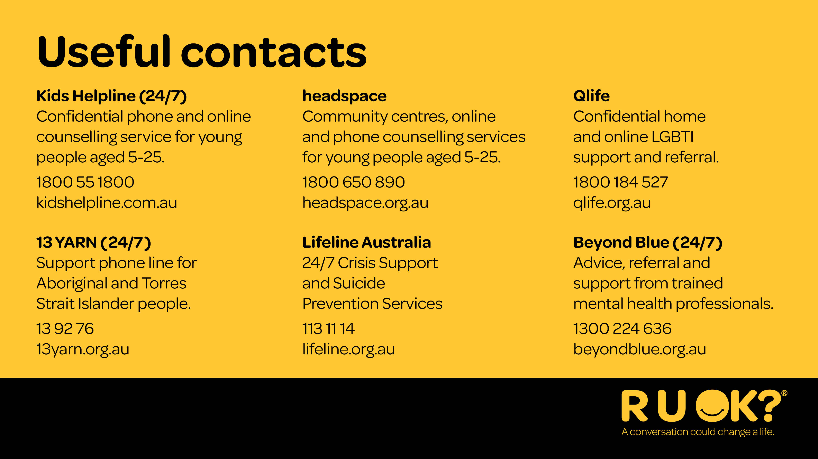
Notes:
Here are some help services that you can call for help as well. These services connect you with a professional who is trained to support you and guide you through whatever you need to talk about. You can call them to ask for advice on how to support your friend or your friend can call them.
Add a slide to include any local support services available at your school or in your local community.

Slide 18
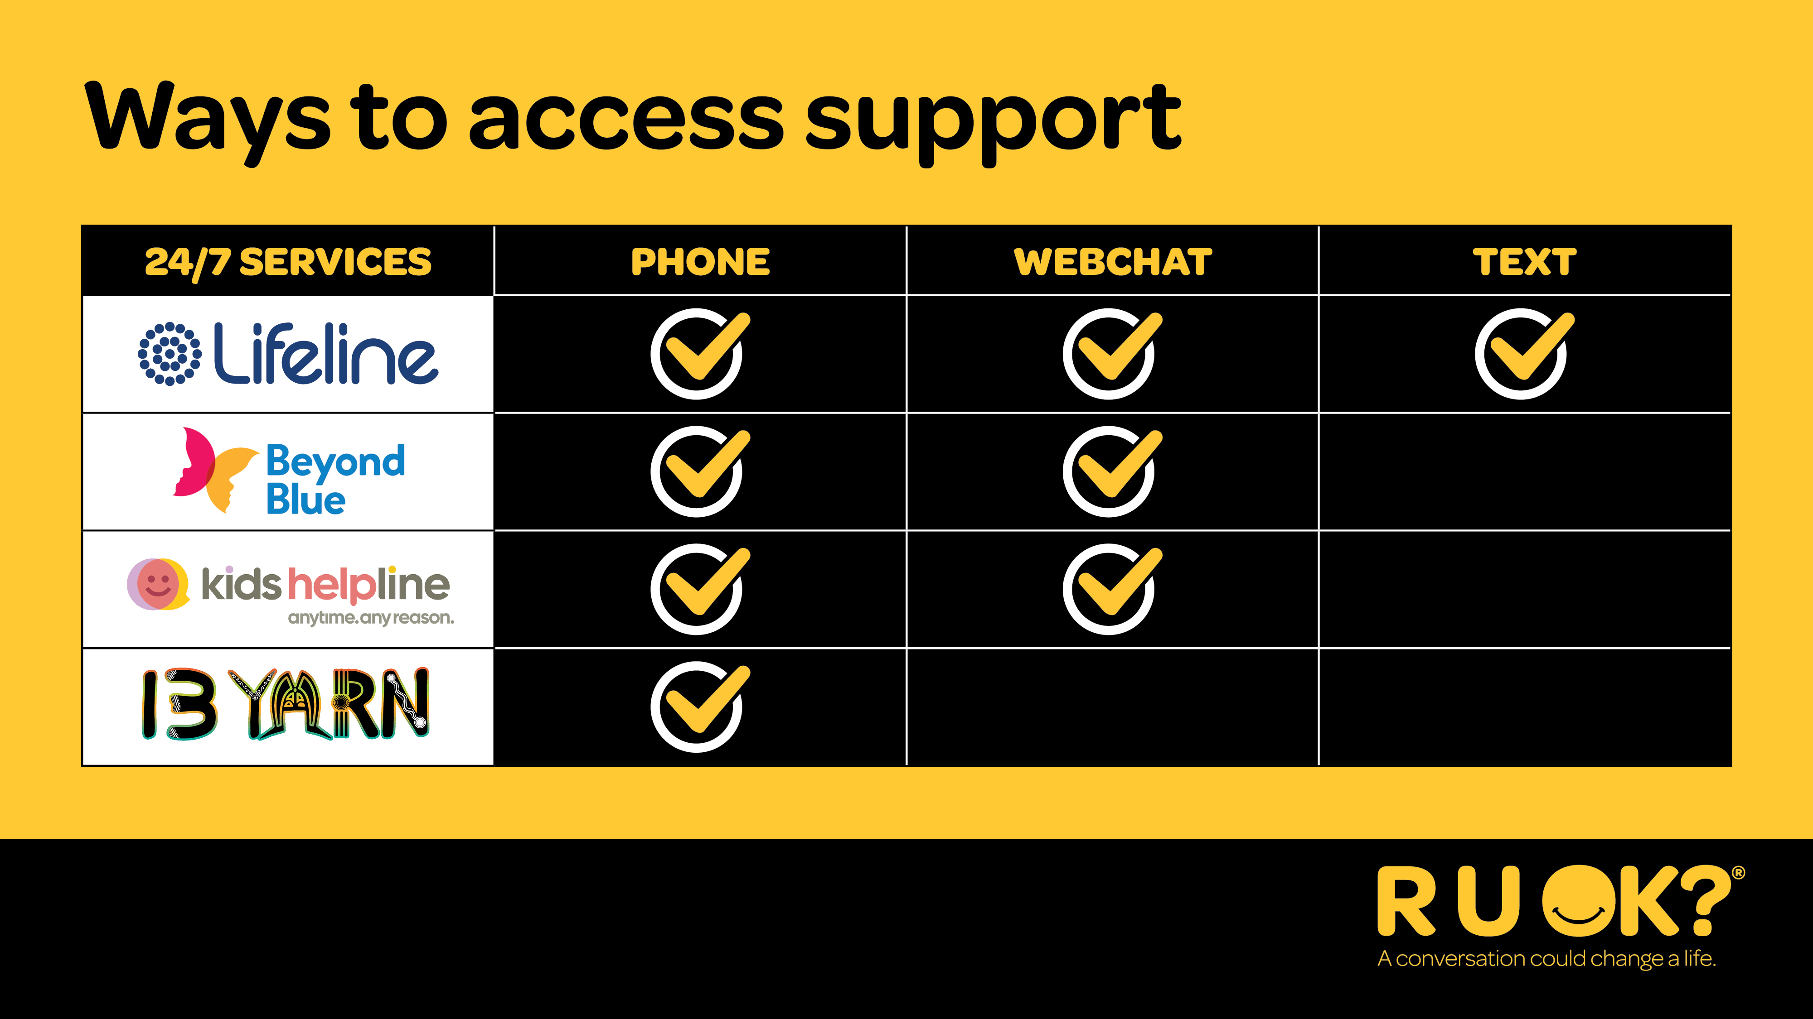
Notes:
If you don’t like speaking on the phone, Lifeline, Beyond Blue, and Kids Helpline all have webchat available.
Lifeline also has a text service available, which is again helpful if people don't feel comfortable having a phone call.
You can also call Lifeline, Beyond Blue, Kids Helpline, and 13 YARN on behalf of someone else, and they will all provide guidance on how to support them.

Slide 19
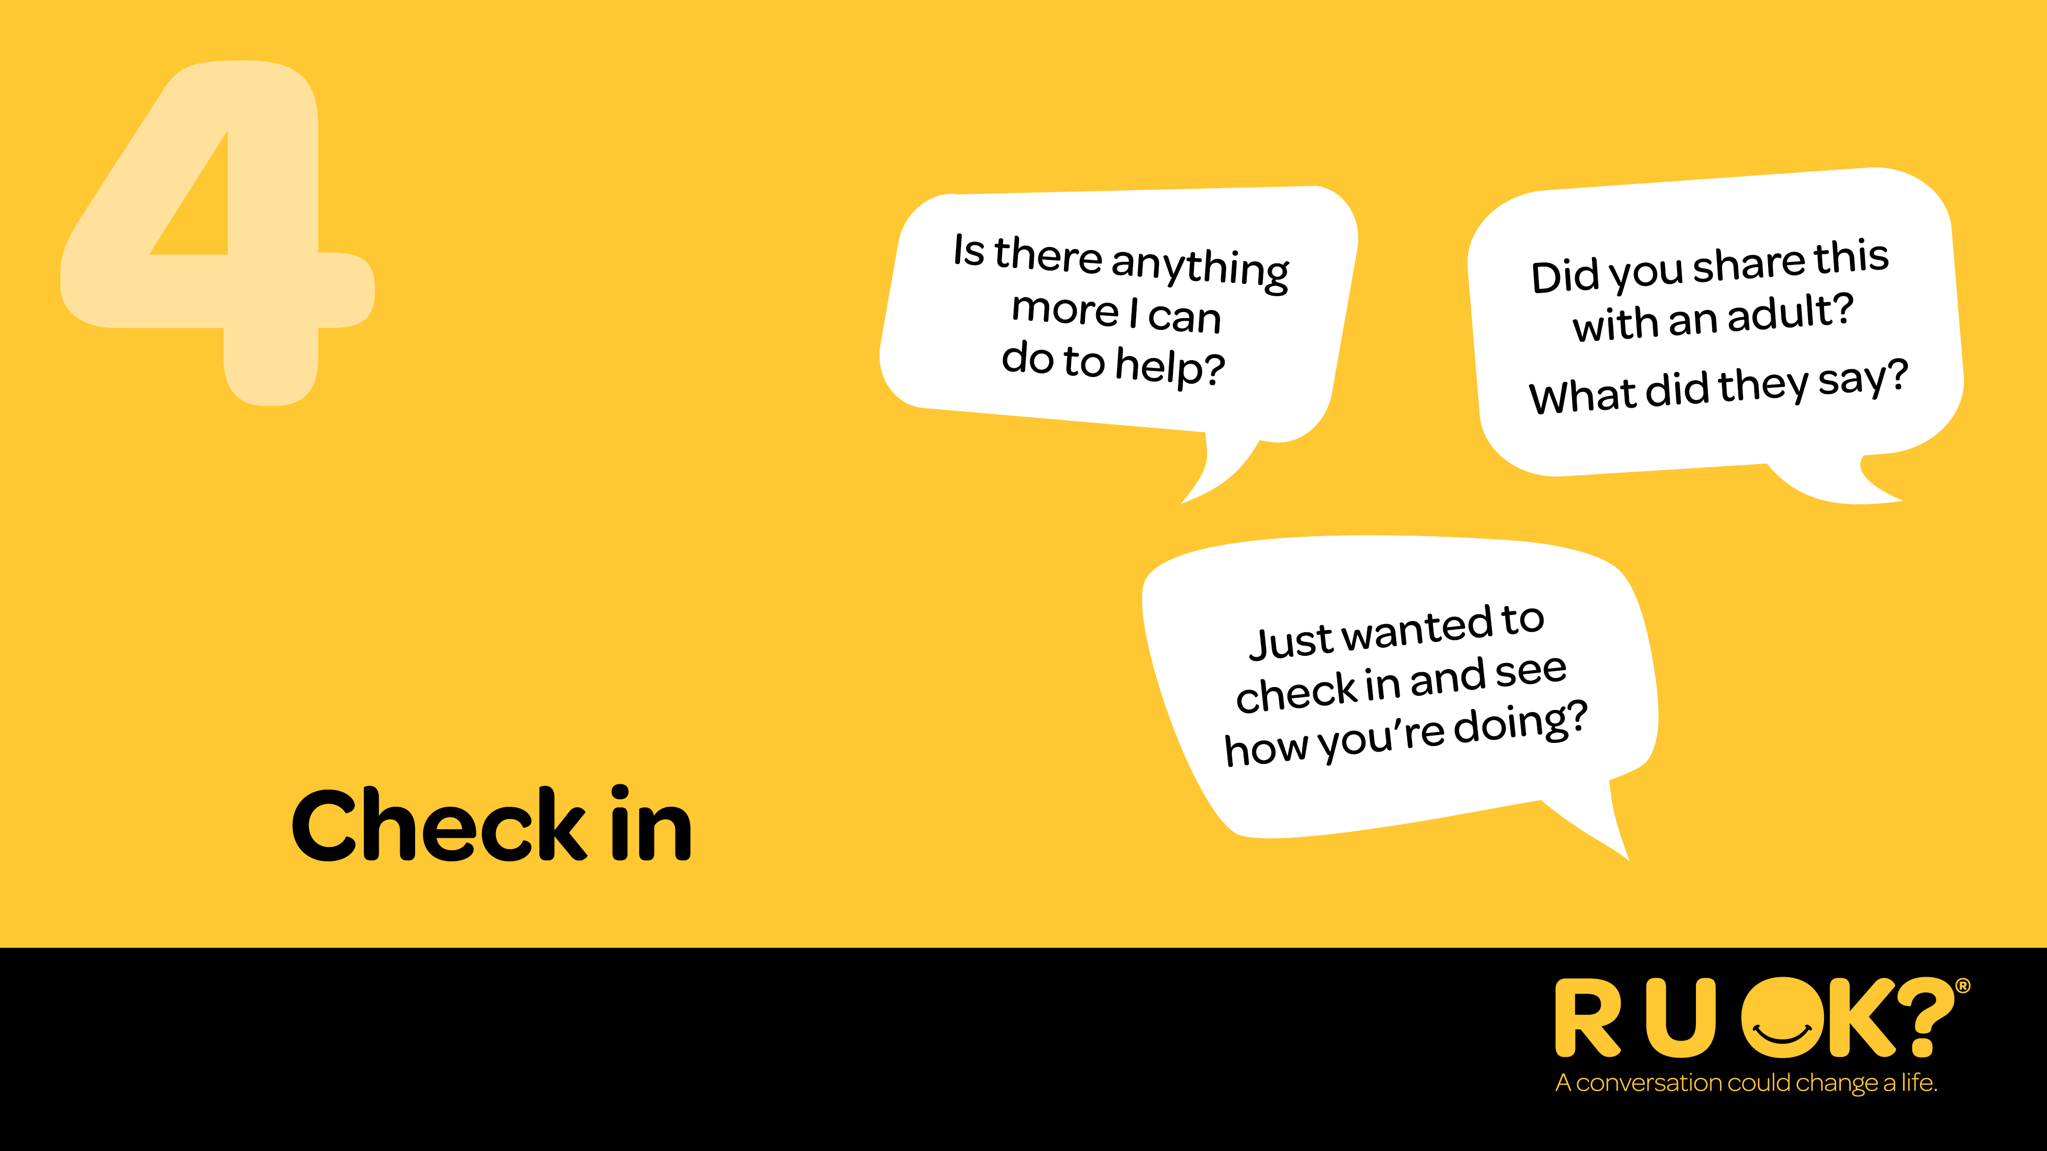
Notes:
After the conversation it’s important you stay connected and keep checking in. Plan together to get back in touch so you can see how they’re going. Your ongoing care and support can make a difference.
When you check in you could:
– Lock in a regular catch up and one-on-one time.
– Ask them about activities they like to do and help them make plans to do them or arrange to do them together.
– Organise group catch-ups to help them connect with others.
When you check in you could say:
– “Just wanted to check in and see how you’re doing?”
– “Have things improved or changed since we last spoke?”
– “What’s been working for you since we last chatted?”
– “Do you need more support?”

Slide 20
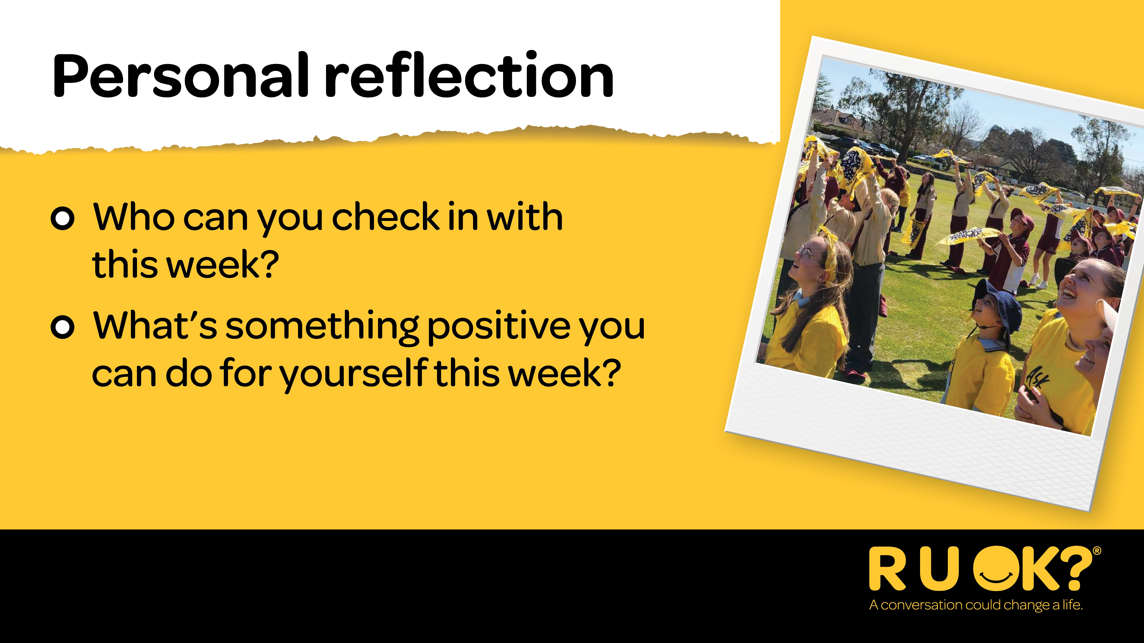
Notes:
I’d encourage everyone to think about who you can regularly check in with and ask R U OK? Any Day. Or if you are in need of support, I encourage you to reach out to someone today or call one of the support lines for help.
Take some time today to do something nice for yourself - to make sure you are refilling your cup and looking after yourself.

Slide 21

Notes:
As we wrap up today I'd encourage you to think about someone you could genuinely ask 'are you OK?'

