Slide 1
How Research Supports Chaplaincy
David Bynum, D.Min.
Sarah Carter, Ph.D.
Notes:
David

Slide 2
DISCLOSURE
Opinions, interpretations, conclusions and recommendations are those of the authors and are not necessarily endorsed by the Department of Defense.

Slide 3

Relationship Education as Primary Prevention
Notes:
Sarah
As you may have noticed, David is the one with the Doctorate in ministry and I am the one with the PhD. That means that I am the nerdy researcher. My goal for today is to share a bit about how we’ve seen research and ministry come together in a beautiful symbiosis. It really mirrors the path that David and I took to becoming a team. My program of research is centered around military couples and interpersonal relationships. So David and I are a bit of an odd couple in terms of our very different backgrounds and areas of focus, but we teamed up because each of us came to the conclusion that while research and chaplaincy may also seem like an odd couple at first blush, but really are a perfect match.
I am going to start with a focus on relationship education because this is what first had me knocking on David’s door.

Slide 4






Primary Prevention Program Wishlist
EVIDENCE-SUPPORTED
NON-CLINICAL
CROSS-CUTTING
FLEXIBLE DELIVERY
EARLY INTERVENTION
HIGH DEMAND
DoDI 6400.09
Notes:
Sarah
In 2020, DoD released DODI 6400.09 which established a formal policy that rather than waiting for service members to experience harmful, readiness-limiting behaviors such as suicidal thoughts and behaviors, alcohol and substance misuse, violence and harassment, the DoD wanted to be proactive in preventing these. The goal is to focus on factors that can help minimize the changes of these behaviors ever occurring, rather than trying to jump in after the damage is done. Basically, An ounce of prevention is worth a pound of cure
The DODI outlined a wish list what prevention should look like.
Evidence-supported, invest in activities that have been shown to give positive outcomes
Cross-cutting, meaning that any prevention activity is expected to show benefits on multiple fronts. The intention is that every dollar, every hour, and every resource invested in prevention yields a multifaceted return, producing a cascading effect of positive outcomes across the spectrum of harmful behaviors.
In order to achieve this, the goal is to get as upstream as possible so that a single degree of change in someone's trajectory can really impact where they end up landing.
Of course, there are also the practical realities of rolling something out in the DoD. So the DoDI emphasizes activities that are not reliant on medical personnel, that there is flexible delivery and that these are activities SMs will actually engage with.
And this DoDI is where my whole career changed. I read this and it was like the heavens opened up and there was a choir of angels singing opus to this DoDI. Because as I read, I saw every one of their boxes being ticked.
What was the thing that perfectly aligned with everyone of these wishlist items?

Slide 5
Chaplain-Delivered Relationship Education Fulfills the Primary Prevention Program Wishlist
EVIDENCE-SUPPORTED
NON-CLINICAL
Research supports reductions in IPV, alcohol use, and distress
Facilitated by chaplains, community members, and/or paraprofessionals
CROSS-CUTTING
FLEXIBLE DELIVERY
Targets a transdiagnostic drivers of multiple harmful behaviors
Delivered as a retreat, workshop, or class
EARLY INTERVENTION
HIGH DEMAND
Versions for any stage of a relationship or single individuals
Chaplain-led enrichments events typically have long waitlists of couples wanting to attend
DoDI 6400.09
Notes:
Sarah
Relationship education. These a group workshops or retreats that are focused on teaching couples skills to create healthier, more fulfilling, more long-lasting romantic relationships. It ticks every single one of these boxes.
Fun fact: According to the people that created the first modern, evidence-based relationship education program, Navy chaplains were the first to bring relationship education to the DoD nearly 40 years ago. And it wasn’t supposed to be that way. A man named Bill Coffin, who was working with Navy Fleet and Family, before it was called that, saw a research article about a relationship education program being created and asked the researchers to train some Navy folks. A chaplain happened to have an office in the same hallway as Bill and asked to join the training. After the training there was enthusiasm for the program, the Fleet and Family folks had full plates and were hesitant to invest the time and resources to champion this. And so the chaplain volunteered. And this is what I’ve seen time and time again. It is our military chaplains who have recognized from the beginning that sustaining a lethal fighting force is dependent on our warfighters being healthy, whole, and fulfilled individuals. Basically, they’ve been doing this primary prevention thing, before it was cool.

Slide 6
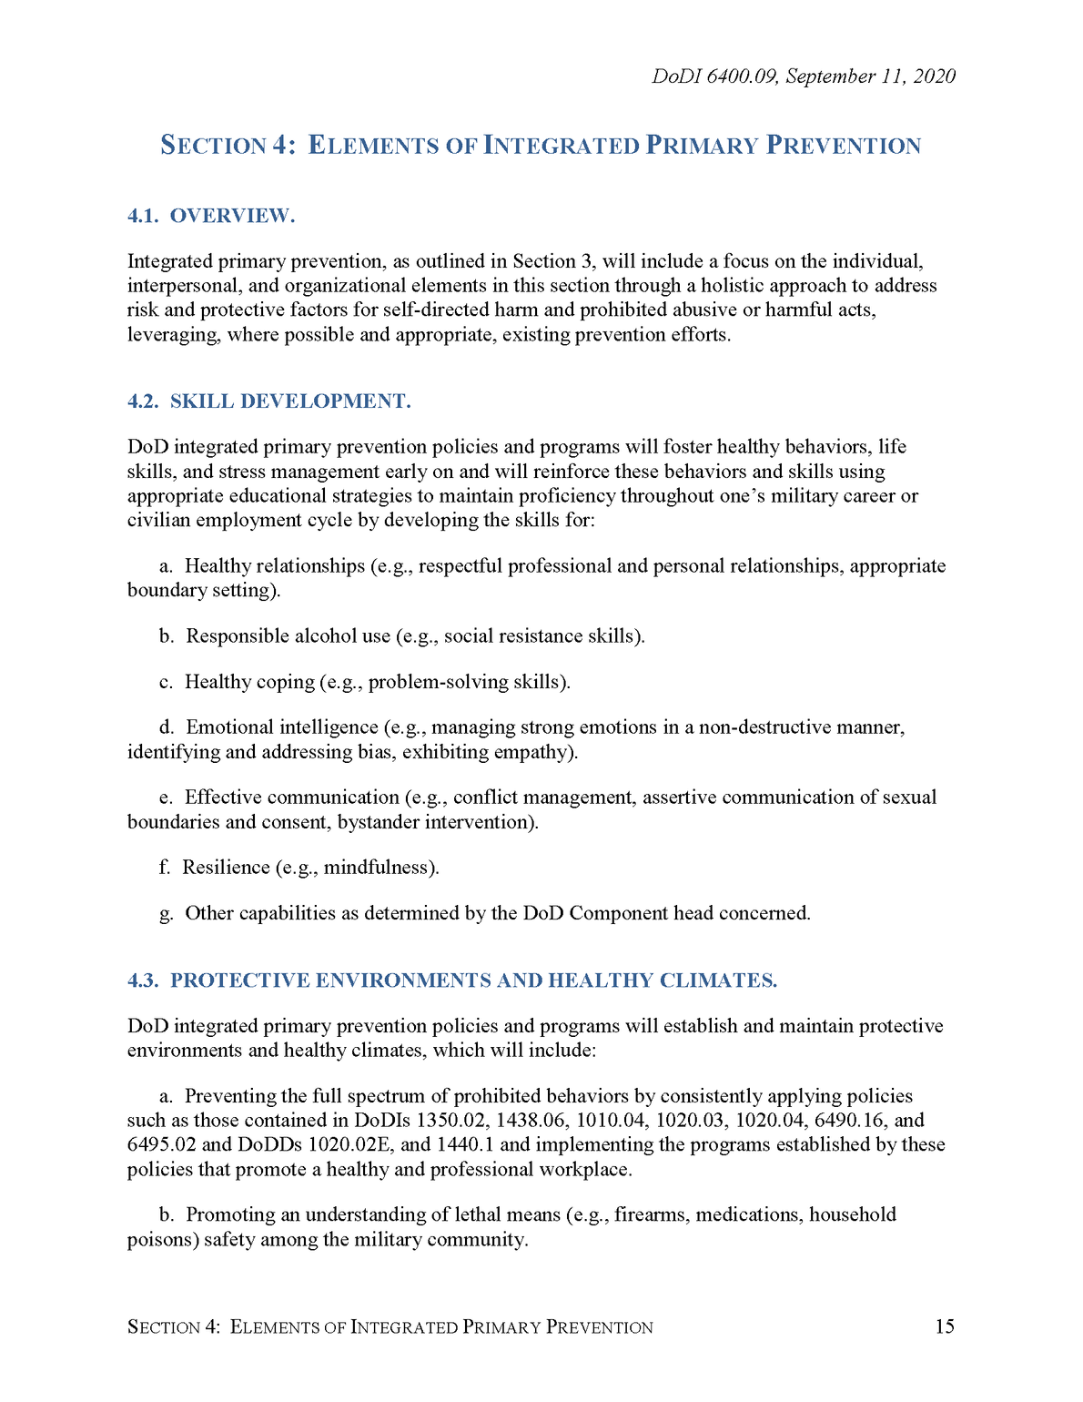

Relationship education aligns with policy
Healthy Relationships
Healthy Coping
Emotional Intelligence
Effective Communication
Resilience
Notes:
Sarah
As an example, this is a page from that DoDI, and the skills development that they wanted are aligned with relationship education programs

Slide 7
Relationship education aligns with Chaplaincy*
COCINST 5351.1, pg 13
Healthy Relationships
CNICINST 1738.1, pg 2
Healthy Coping
NWP 1-05, pg 3, 1-3
Emotional Intelligence
OPNAVINST 1738.1B, pg 1
Effective Communication
Navy Regs Ch8, Sec 0820
Resilience
OPNAVINST 1730.1F, pg 2
Spiritual Well-Being
Connection to the Transcendent
*As illustrated by Navy Policy
Notes:
David

Slide 8
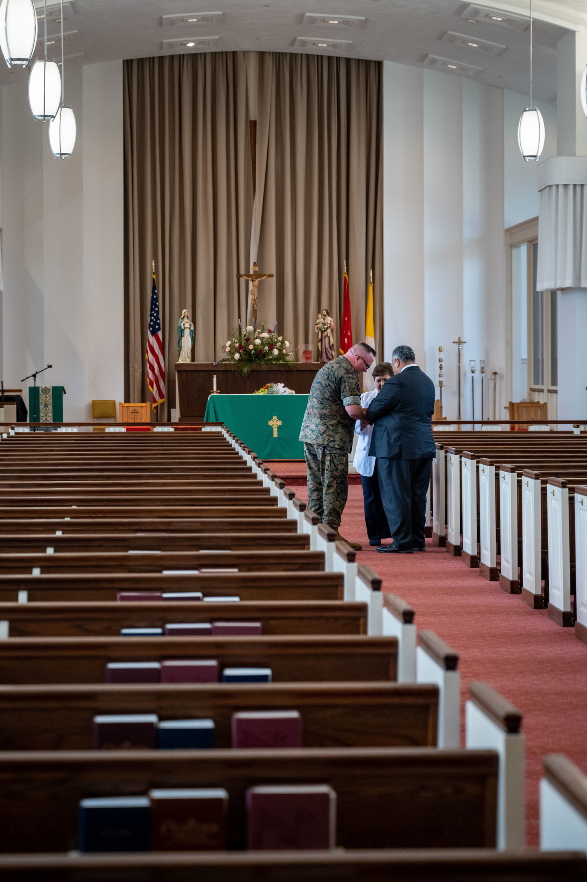





Spiritual Beliefs and Practices Protect Against Harmful Behaviors
With over 20,000 people studied, those that frequently attended services were 67% less likely to die by suicide, predicting suicide up to 16 years later
Suicide Risk
Suicide Risk
Those with strong spirituality, half as likely to experience moderate depression when looking at 5,000 in 3 countries
Depression
Religiosity linked with lower alcohol consumption; Spirituality associated with decreased cravings for alcohol and substances while in treatment
Alcohol & Substance Misuse
Physical & Sexual Aggression
Meta-analysis of 43 studies showed religiosity and spirituality was protective against physical and sexual aggression
Miller et al. (2012); Barton, Miller et al., (2013), Kleiman & Liu (2014); Piasseschi de Bernardin Gonçalves et al (2023); Portnof et al. (2017); Chagas et al. (2022); Mason et al. (2009)
Notes:
Sarah
But relationship education of course is only one of the areas chaplains work to support our warfighters. More broadly the goal is to support spiritual health. And this as well, fits within the primary prevention frame work. Spiritual health is cross cutting, associated with lower frequency or severity of harmful, readiness-limiting behaviors

Slide 9
Two powerful predictors of functioning
01
Depression
01
01
Depression
02
Suicide
02
02
Suicide
03
Spiritual Beliefs & Behaviors
Aggression
03
03
Aggression
Relationship Functioning
04
Alcohol & Substance Misuse
04
04
Alcohol & Substance Misuse
05
Resiliency
05
05
Resiliency
Notes:
Sarah
So when look at primary prevention we see two incredibly powerful predictors of functioning, that cut-across all of the various harmful behaviors the DoD wants to prevent.

Slide 10
Chaplains as Force Multipliers
01
01
01
Depression
Chaplain-Led Events
01
Depression
02
02
02
Suicide
02
Suicide
03
03
03
Aggression
03
Aggression
04
04
04
Alcohol & Substance Misuse
04
Alcohol & Substance Misuse
05
05
05
Resiliency
Spiritual Beliefs
& Behaviors
Relationship Functioning
05
Resiliency
Notes:
Sarah
And these overlap with our chaplains. Chaplain led events are an existing, staffed and funded avenue for reducing harmful behaviors and increasing warfighter readiness.
And this venn diagram here is why David and I found ourselves teaming up.

Slide 11


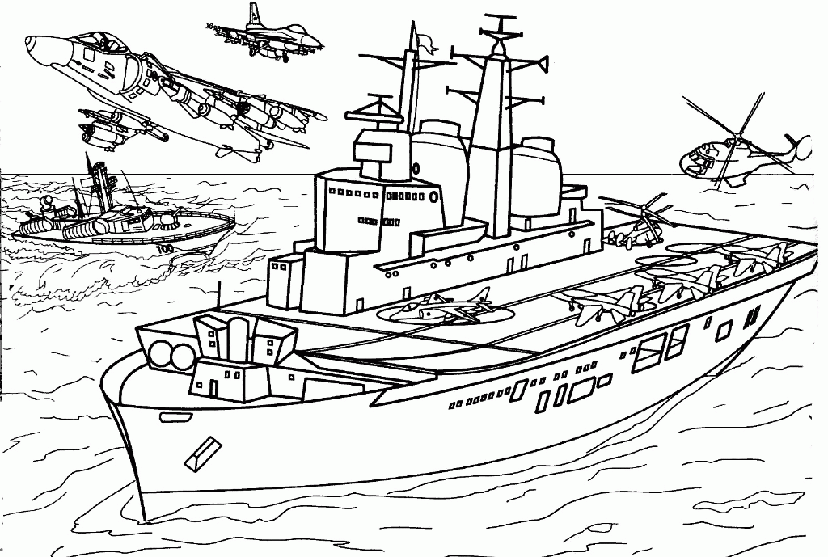

Family to Force Readiness Cycle
Operational Readiness
Family Readiness
Stable
Supported
Secure
Cohesive
Capable
Effective
Focused
Ready
Deployable
Confidence
in Family
Wellbeing
Mission Readiness
Notes:
David
Our work is really all about this cycle here. And I will turn it over to David, the one with actual military service on this.

Slide 12

Get Better Together
This work was supported by the Department of Defense through the Congressionally Directed Medical Research Programs (CDMRP) Traumatic Brain Injury and Psychological Health Research Program under Award No. HT94252410843.
Notes:
Sarah
I’m going to go quickly through these next slides, with the goal of sharing a few of the efforts our team is making making to equip chaplains with evidence-based tools and validate the benefits on the areas the DoD cares about most.

Slide 13




Get Better Together is a couple-based primary prevention program
Prevention Intervention
Targets emotion dysregulation and relationship conflict-transdiagnostic drivers of suicide, alcohol abuse, and aggression
Evidence Informed
Built on PREP, the most researched couples education program
Designed With and For the
Military Community
Developed by experts and a team of
active duty service members, reservists, veterans, & spouses
Notes:
Sarah

Slide 14
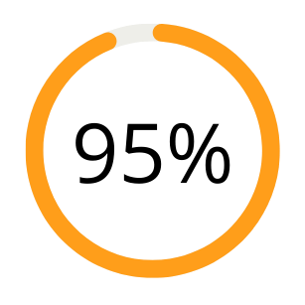
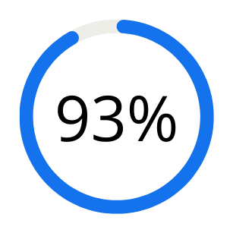
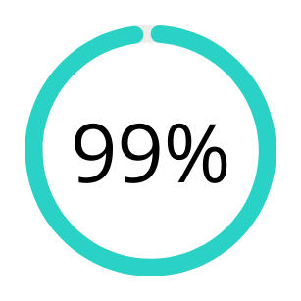
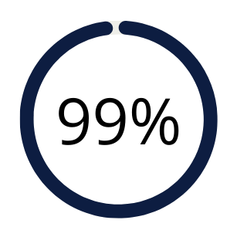
Get Better Together has high acceptability
Pilot trial with 44 military couples
Satisfied
Relevant
Helpful
Will Use
Overall, I am satisfied with
Get Better Together
Get Better Together content is relevant to me and my life
Get Better Together covered helpful information
I intend to use the strategies from Get Better Together
Notes:
Sarah
GBT piloted among 44 couples
happy to share more details
For now give a snapshot of the feedback they gave us about GBT

Slide 15

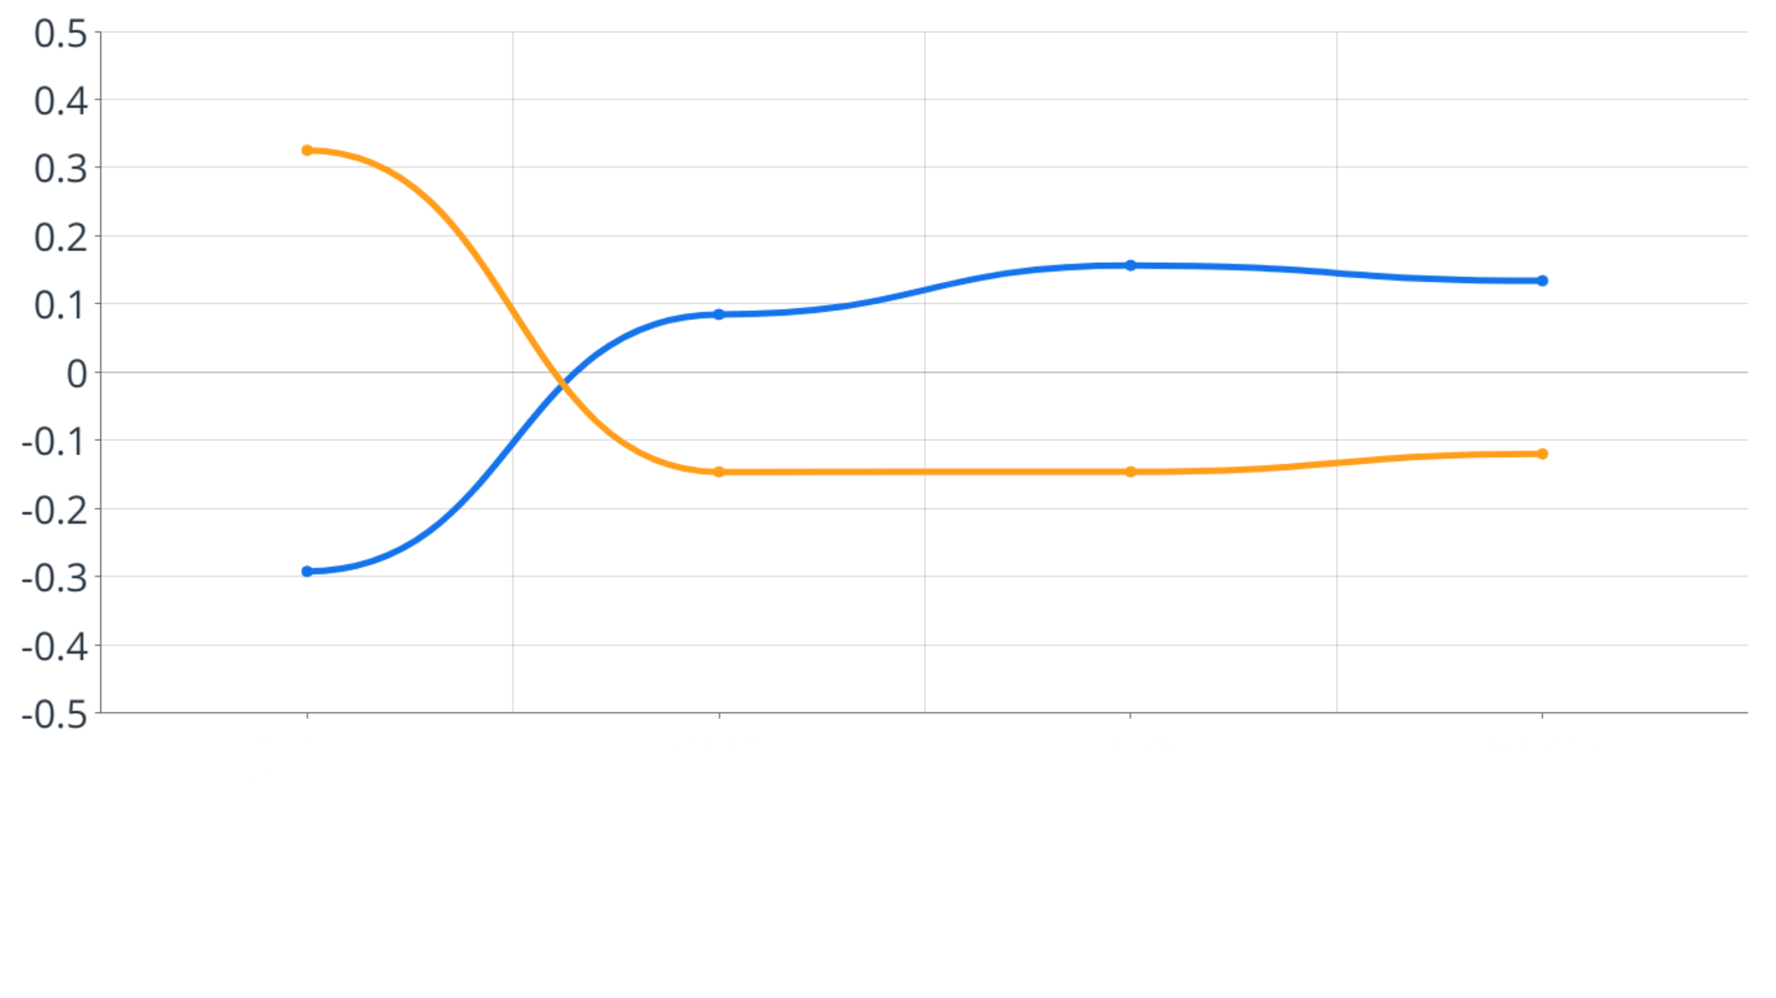
Significant improvements in relationship conflict and interpersonal emotion regulation
Pre-Retreat
1-Month
2-Month
3-Month
Coping with Stress as a Team
Relationship Conflict
Notes:
Sarah

Slide 16
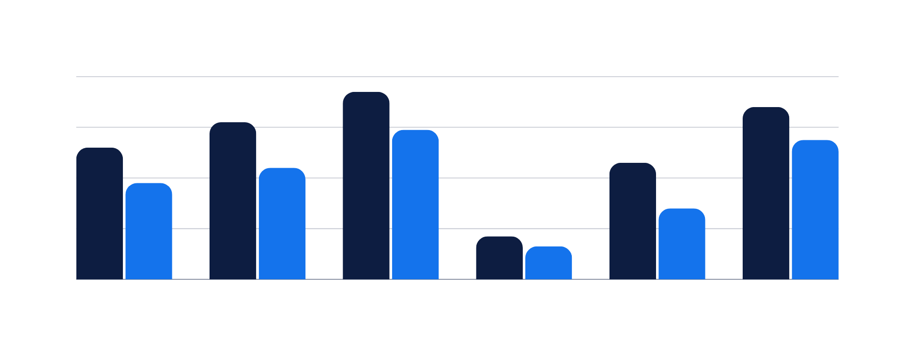
Significantly fewer participants reported symptoms related to harmful behaviors at follow-up
100%
80%
**
*
*
60%
*
*
40%
74%
62%
68%
52%
42%
60%
46%
55%
20%
38%
17%
28%
13%
Suicide Cognitions
Depression Symptoms
Hazardous Drinking
Negative Consequences of Alcohol
Physical Aggression
Verbal Aggression
Pre-Retreat
3-Month Follow-Up
Notes:
Sarah

Slide 17




Next Step: Large-Scale Randomized Trial
500 Military Couples
Testing Program Effects
Assessing cross-cutting drivers of and key indicators of harmful behaviors
Stakeholder Advisory Board
Funding set aside to generate supportive materials needed to aid implementation
www.GetBetterTogetherStudy.com
Notes:
Sarah
Gold standard science design for establishing a program’s effectiveness, which adheres to the recent executive order, requiring gold standard science practices

Slide 18
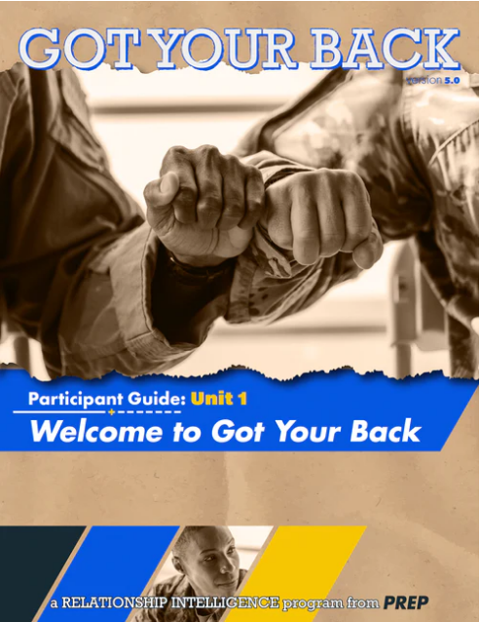
8-Hour Relationship Education Curriculum
For all Service Members, regardless of relationship status
Targets relationship functioning, which can be either a protective factor or a risk factor for suicide, domestic violence, and alcohol misuse
Delivered in groups by non-clinicians
Tailored to the military community
Notes:
Sarah
Fun one because it

Slide 19
WHAT THE RESEARCH WILL DELIVER
Provide answers leaders need
Does Got Your Back reduce behaviors that harm self, others, and readiness?
Does the delivery format matter? Are workshops just as effective as retreats?
What is the real impact on Soldier wellbeing and performance?
Notes:
Sarah

Slide 20
‘ilities
Adaptability | Easily adaptable across Services or venues, is modular, can change to fit context
Affordability | Unit cost per user and training costs are not expensive by comparison
Desirability | Popular at the unit level, with Command leadership, and the DoD
Feasibility | Suitable to achieve the intended results, product will remain viable for long period
Flexibility | No proprietary restrictions on use of the material or manner of presentation
Scalability | Can be delivered to large or small groups or in parts
Sustainability | Does not require retraining/recertification, stable cost
Trainability | Does not require formal Train-the-Trainer, can be trained to in short period
Transportability | Does not require significant logistics to deliver training across non-traditional sites (deployed, field)
Notes:
David

Slide 21
Chaplain-Led Enrichment Activities Study
BLUF: Conduct a study to evaluate the effectiveness of chaplain-led marriage, family, and personal enrichment activities in improving outcomes for military members and families while establishing a framework to support scalable, low-burden program evaluation.
Chaplain-led Programs
Over 50 years of primary prevention
Unique within the military support system
Implemented across military branches in various formats
Strengthen military marriages and enhance family and individual resilience amid deployments, relocations, and operational demands
The Requirement
DoD mandates evidence-based programs
To meet DoD priorities, program evaluation frameworks must be practical, scalable, and compatible with military operational demands
Military evaluations must minimize burdens on Service Members and program staff while still generating meaningful insights into program effectiveness
Notes:
Sarah
This is a grant proposal we are working on right now, so you all are among the first to get to see it.
This proposal is really based on everything we’ve been talking about. We know that chaplains have been doing primary prevention before that term even existed. But to quote my research partner here, You don’t count if you don’t count. Chaplains aren’t often are not getting credit for the benefits they are bringing to the table. Which means when budgets are being tightened, it is these sorts of programs often most feeling the squeeze.
So this study is looking to use existing administrative and medical data to compare those that attended a Navy chaplain-led event to a matched group that didn’t attend

Slide 22
Chaplain-Led Enrichment Activities Study
The Problem
Very few family and individual enrichment-based activities have been systematically evaluated in military settings, leaving significant gaps in understanding their impact on Service Member and family readiness
Traditional research trials relying on surveys and intensive data collection are impractical
The Solution
Leverage existing administrative data to conduct a large-scale, retrospective matched cohort study to generate critical insights into family and Service Member readiness
Specific aims:
Evaluate the role of chaplain-led marriage, family, and individual enrichment
Examine the role of chaplain-led enrichment activities in promoting healthier families and mission-ready Service Members
Establish a scalable, low-burden evaluation framework for military support programs
Notes:
Sarah
So again, wanting to use my nerdy research knowledge that I spent way too many years in school for to validate the what our service members are telling chaplains day in and day out: that these programs are changing lives.

Slide 23
Our Research Motto
Help Us | Help You | Help Us | Help You
Tell Us What You Want to Know or Validate | We Will Identify If and How We Can Help You | You Request Our Help and Support the Research | We apply our expertise to deliver actionable, mission-aligned insights
Notes:
David

Slide 24
CONTACT INFORMATION: Dr. Sarah Carter Research Assistant Professor Center for the Study of Traumatic Stress Department of Psychiatry, USUHS Sarah.Carter.ctr@usuhs.edu Office: (301) 295-0087, Cell: (208) 353-0361 Dr. David Bynum Military Research Scientist Center for the Study of Traumatic Stress Department of Psychiatry, USUHS david.bynum.ctr@usuhs.edu Cell: (619) 944-9506

