Slide 1

Who we are:
Federal Bureau of Prisons Chaplains are individuals called by God to engage in the vital work of correctional ministry.
BOP Chaplains draw upon robust correctional training and best practices, relying on their faith to courageously face challenging situations with professionalism and effectiveness, guided by God's grace.
The spiritual care provided by Chaplains fosters healing, connection, empowerment, nurturing, and transformation in the face of brokenness, division, and despair.
Responding to the Divine calling empowers Chaplains to act with courage and care towards others.

Slide 2

What we do:
The core principles of the Federal Bureau of Prisons Chaplaincy Services focus on Reaching, Reconciling, and Restoring the lives of those affected by crime and incarceration. Chaplains provide quality pastoral care and presence to inmates by reaching out through pastoral and professional relationships nurtured by daily interactions.
Chaplains provide religious accommodation through the administration of religious services and reentry programing that leads to reconciling inmates to their respective faiths and beliefs. Chaplains provide hope, spiritual guidance, counsel, religious expertise, and reentry preparation during incarceration that leads to restoring inmates as law abiding citizens. Chaplains provide an overall ministry that promotes the harmonious working together of justice and mercy leading to redemption in the lives of inmates, families, and society.

Slide 3
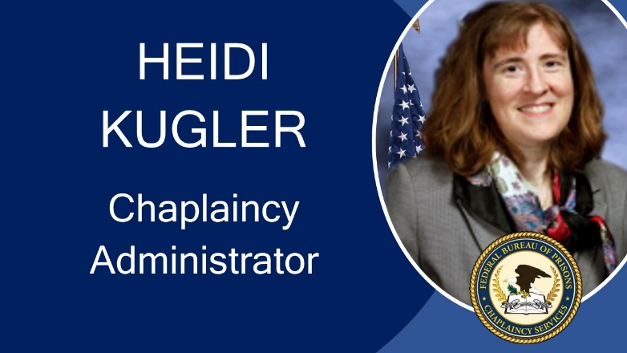

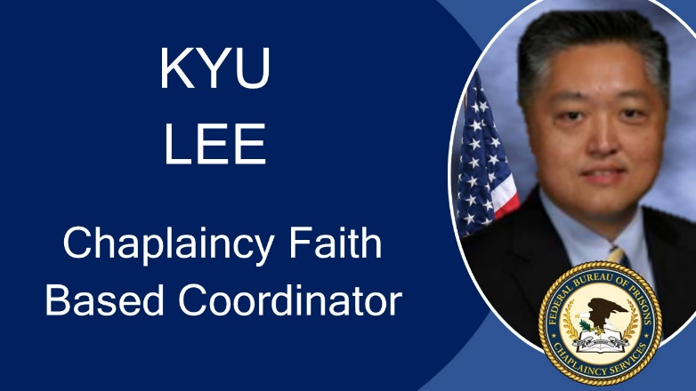
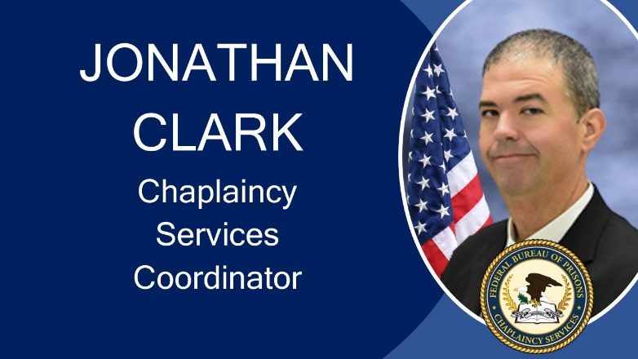
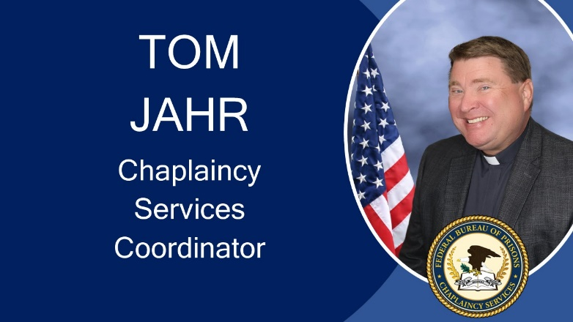
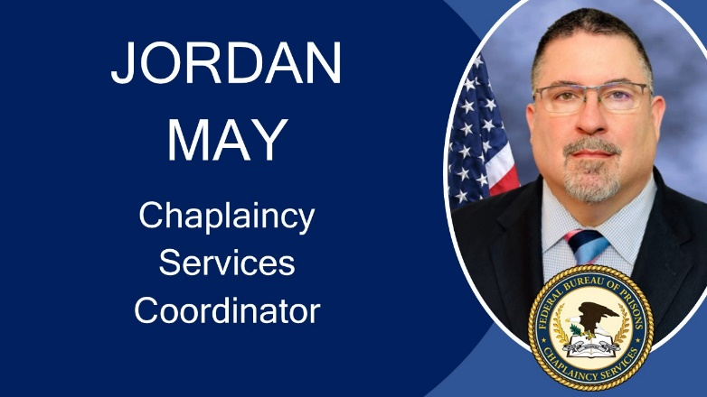
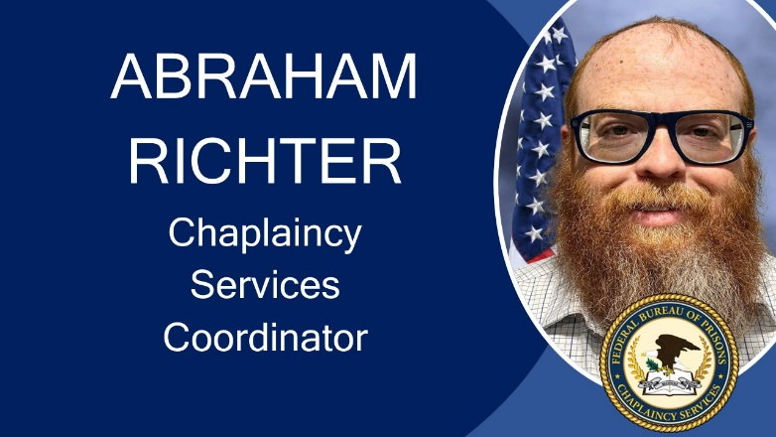
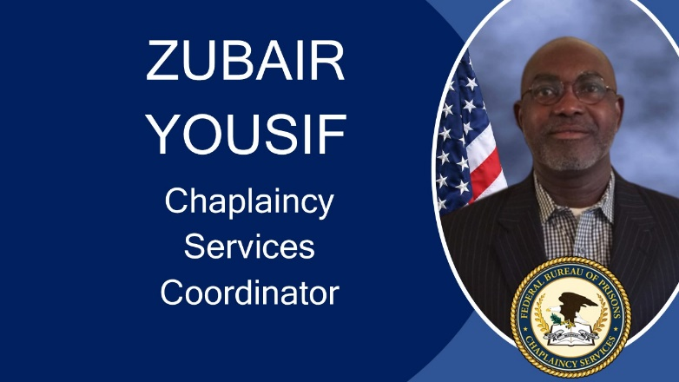
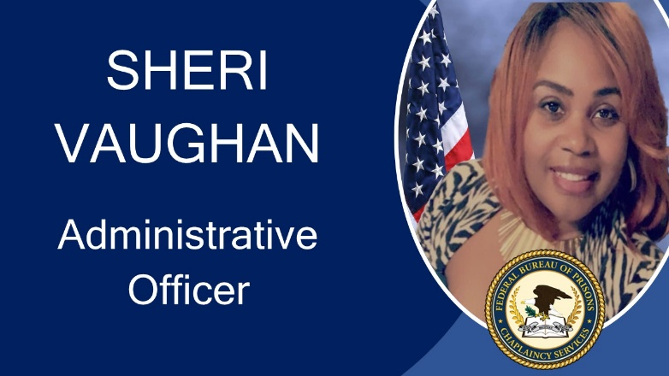

Slide 4
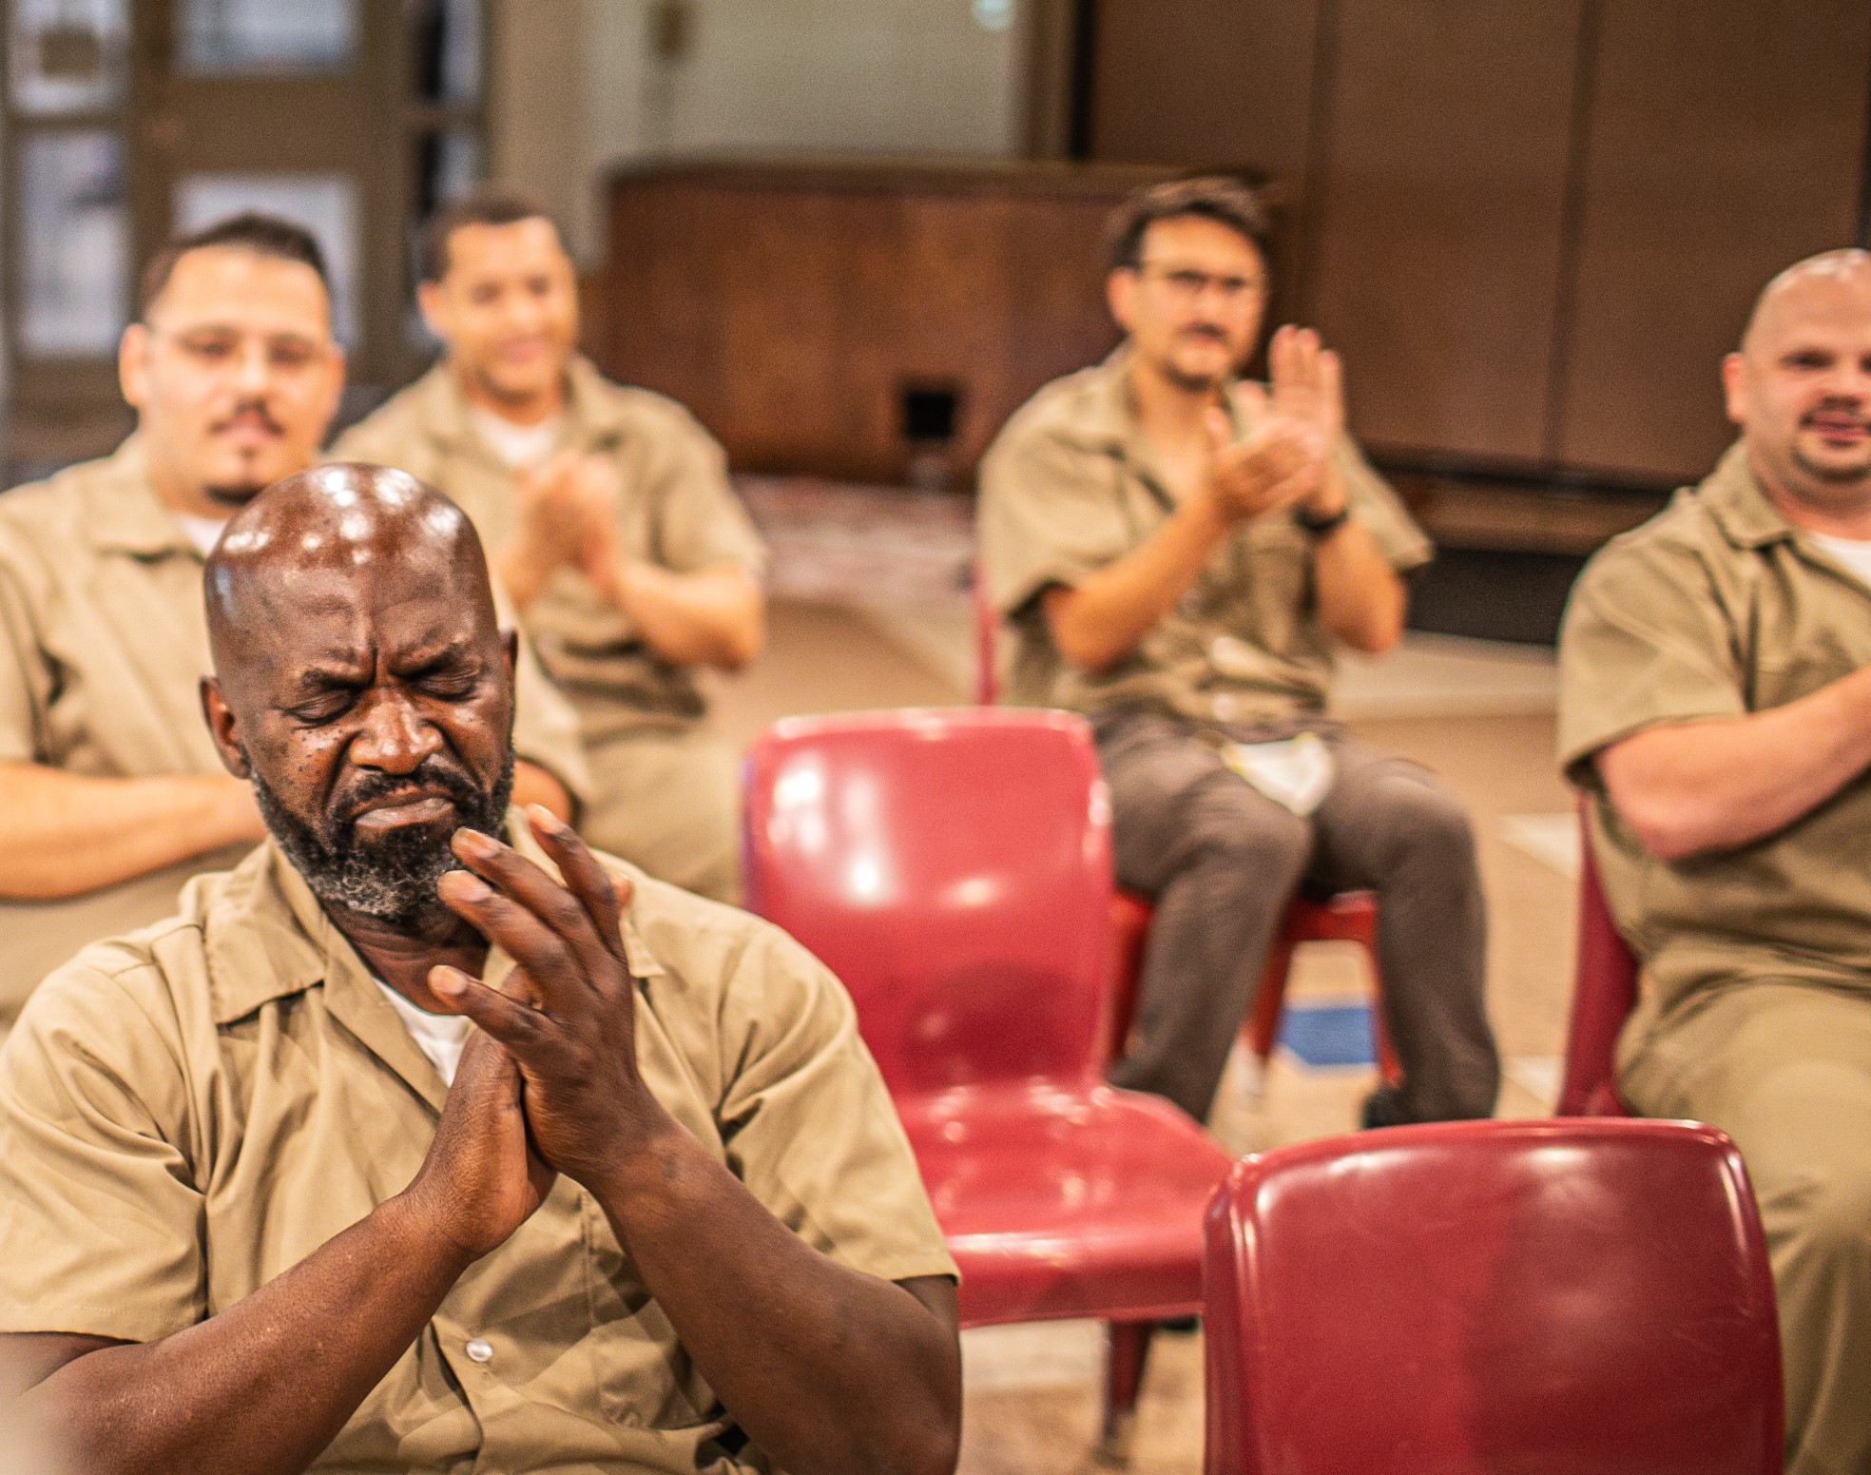
Chaplaincy Services Branch
The theologically trained Chaplains, vetted religious contractors, and chapel volunteers provide worship and sacred scripture studies in support of the inmates’ Constitutional First Amendment Religious Rights and the Religious Freedom Restoration Act (RFRA).
PS 5360.10, Religious Beliefs and Practices and PS 3939.08 CN-2
Chaplains’ Employment, Responsibilities, and Endorsement guide us.
We provide religious accommodations to 28 inmate faith groups and individual religious practitioners.
We also pastoral care, crisis intervention and to foster spiritual wellness for inmates, staff, and the public.
Our office spearheaded end of life spiritual care, access to spiritual advisors, trauma informed grief care to inmates, staff, Executive Staff, CSTs, as well as responded to the wider religious communities prior to and following the federal executions under the first Trump Administration.

Slide 5
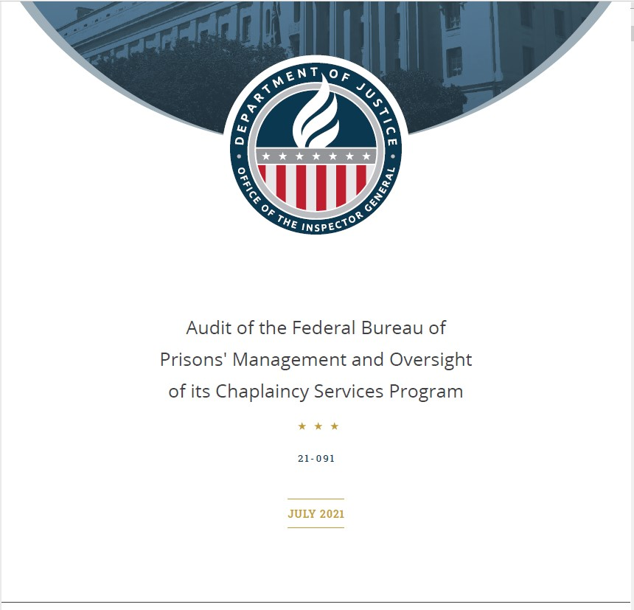
We are the agency’s religious experts and work with the Intelligence and Counter Terrorism Branch to strengthen chapel security and prevent inmate radicalization post 9-11.
In 2021, the OIG found a lack of staffing and adequate resourcing to prevent inmate radicalization under the guise of religion.
Increased staffing, chapel monitoring cameras, and an updated Religious Media Library System contracts remain needed.
Chaplain staffing is at 55% of the recommended levels for Chaplains and funding for the other security contracts has been requested but not allocated.

Slide 6
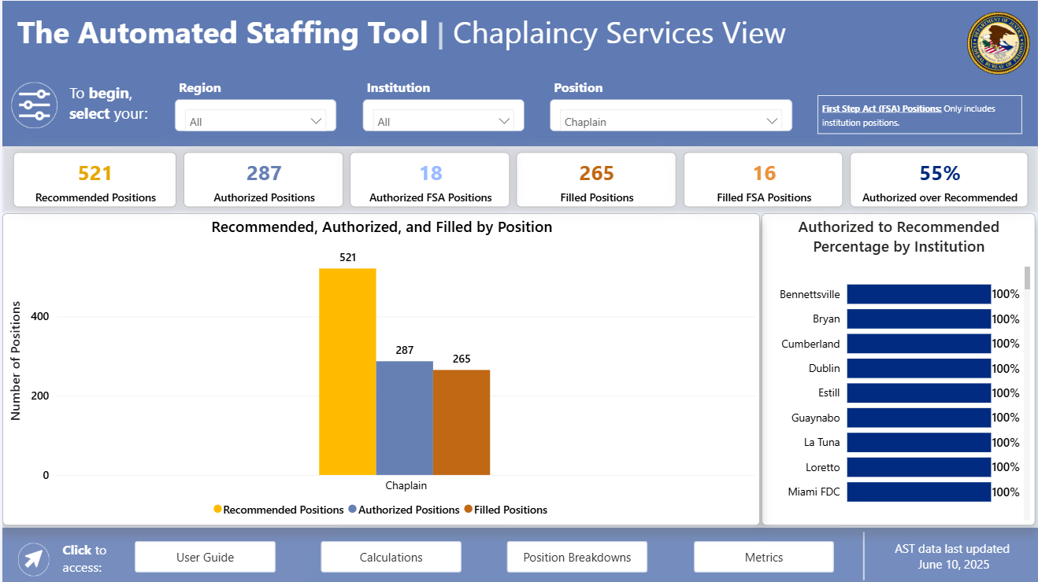

Slide 7
Faith-Based Reentry under the First Step Act (FSA)
We offer FSA faith-based evidence-based recidivism reduction (EBRR) programs including the residential Life Connections Program (LCP), non-residential Threshold Program, the Faith-Based Conflict Management, and other approved chapel Productive Activities (PA).
We partner with external faith-based organizations to advance FSA chapel offerings.
We developed the FSA initiative, the Community Reentry Network (CRN), a national faith-based reentry database to connect inmates with community resources to enhance reentry success.

Slide 8


Community Reentry Network
Those in custody and returning citizens can find more than 5,500 vetted faith-based community resources through the CRN’s national database and interactive map.
https://crn.reentry.gov/crn/s/
The CRN should provide reentry resources to meet returning citizens with more organizations.
How you can help:
Share the CRN website with those may benefit and/or prospective potential organizations.
Connect with non-profits and faith-based organizations (FBOs) and invite them to participate.
If you’re a FBO that can meet a reentry need(s), sign up to become a part of the CRN.

Slide 9
Opportunities Needing Further Support
Pray for your endorsed BOP Chaplains and engage them about the joys of their ministry and how we can further support them through resourcing, training, and care for the care givers.
Consider visiting your BOP Chaplains at their institutions to affirm the importance of their ministry and experience ministry in a correctional environment personally.
Encourage your endorsed BOP Chaplains to practice good self care body, mind, and spirit as correctional ministry is not for the faint of heart.
Provide annual retreats or renewal experiences for them to attend upon request following the process in our policy, PS 3939.08 CN-2.
Join us virtually for one of the Chaplaincy Familiarization national training sessions for our newest Chaplains in August or September.
Partner with us to strengthen BOP Chaplains’ clinical, pastoral, and ministry skills through continuing education opportunities.

