Slide 1
Help Students
Accelerate their future
Automotive careers provide a rapid path to success with strong income and endless employment options
Notes:
This template uses Lato Font. You can download for free here: http://www.latofonts.com/lato-free-fonts/. For information on how to embed fonts in the presentation go to: https://support.microsoft.com/en-us/kb/826832

Slide 2
Redefining the auto industry
Notes:
Use this as a section or call out quote slide.

Slide 3

Today’s automotive careers
Technology-focused
  High-end vehicles today incorporate 100 million lines of software code—4x as many as a fighter jet
Perfect for problem-solvers
  Working on repairs or working with customers, students are always challenged to find solutions
Fast-paced and varied
  Many possible career paths, constant technological change, portable skills students can take anywhere

Slide 4
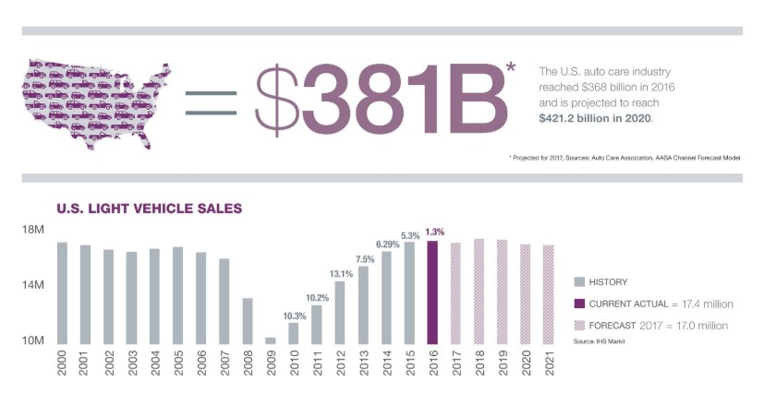
Huge Industry potential

Slide 5
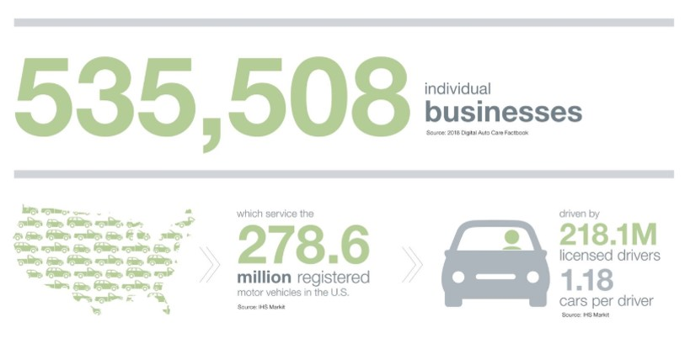

Slide 6
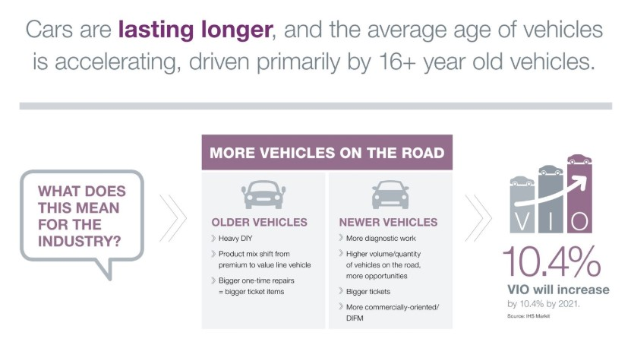

Slide 7
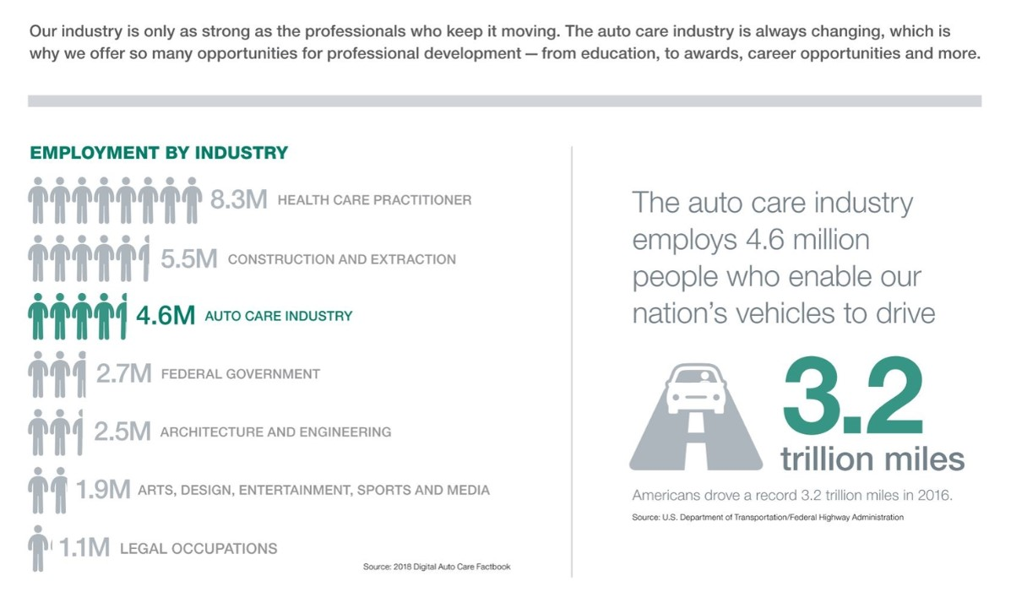

Slide 8




Variety of career options
Auto service tech
Collision tech
Paint tech
Service advisor
Collision estimator
Auto shop owner
Parts professional
Automotive machinist
Manager
Sales representative
Instructor
Descriptions and salary information at CarCareers.org

Slide 9
Automotive Careers Provide Lifelong Success
Notes:
Use this as a section or call out quote slide.

Slide 10
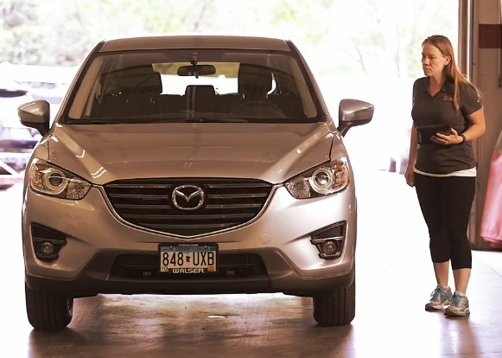
What Automotive Professionals Love About Their Jobs
Turning their love of cars into a career
Keeping up with constantly-changing technology
Finding satisfaction in helping customers get their vehicles back on the road
Exploring opportunities for advancement
Enjoying variety and challenge

Slide 11
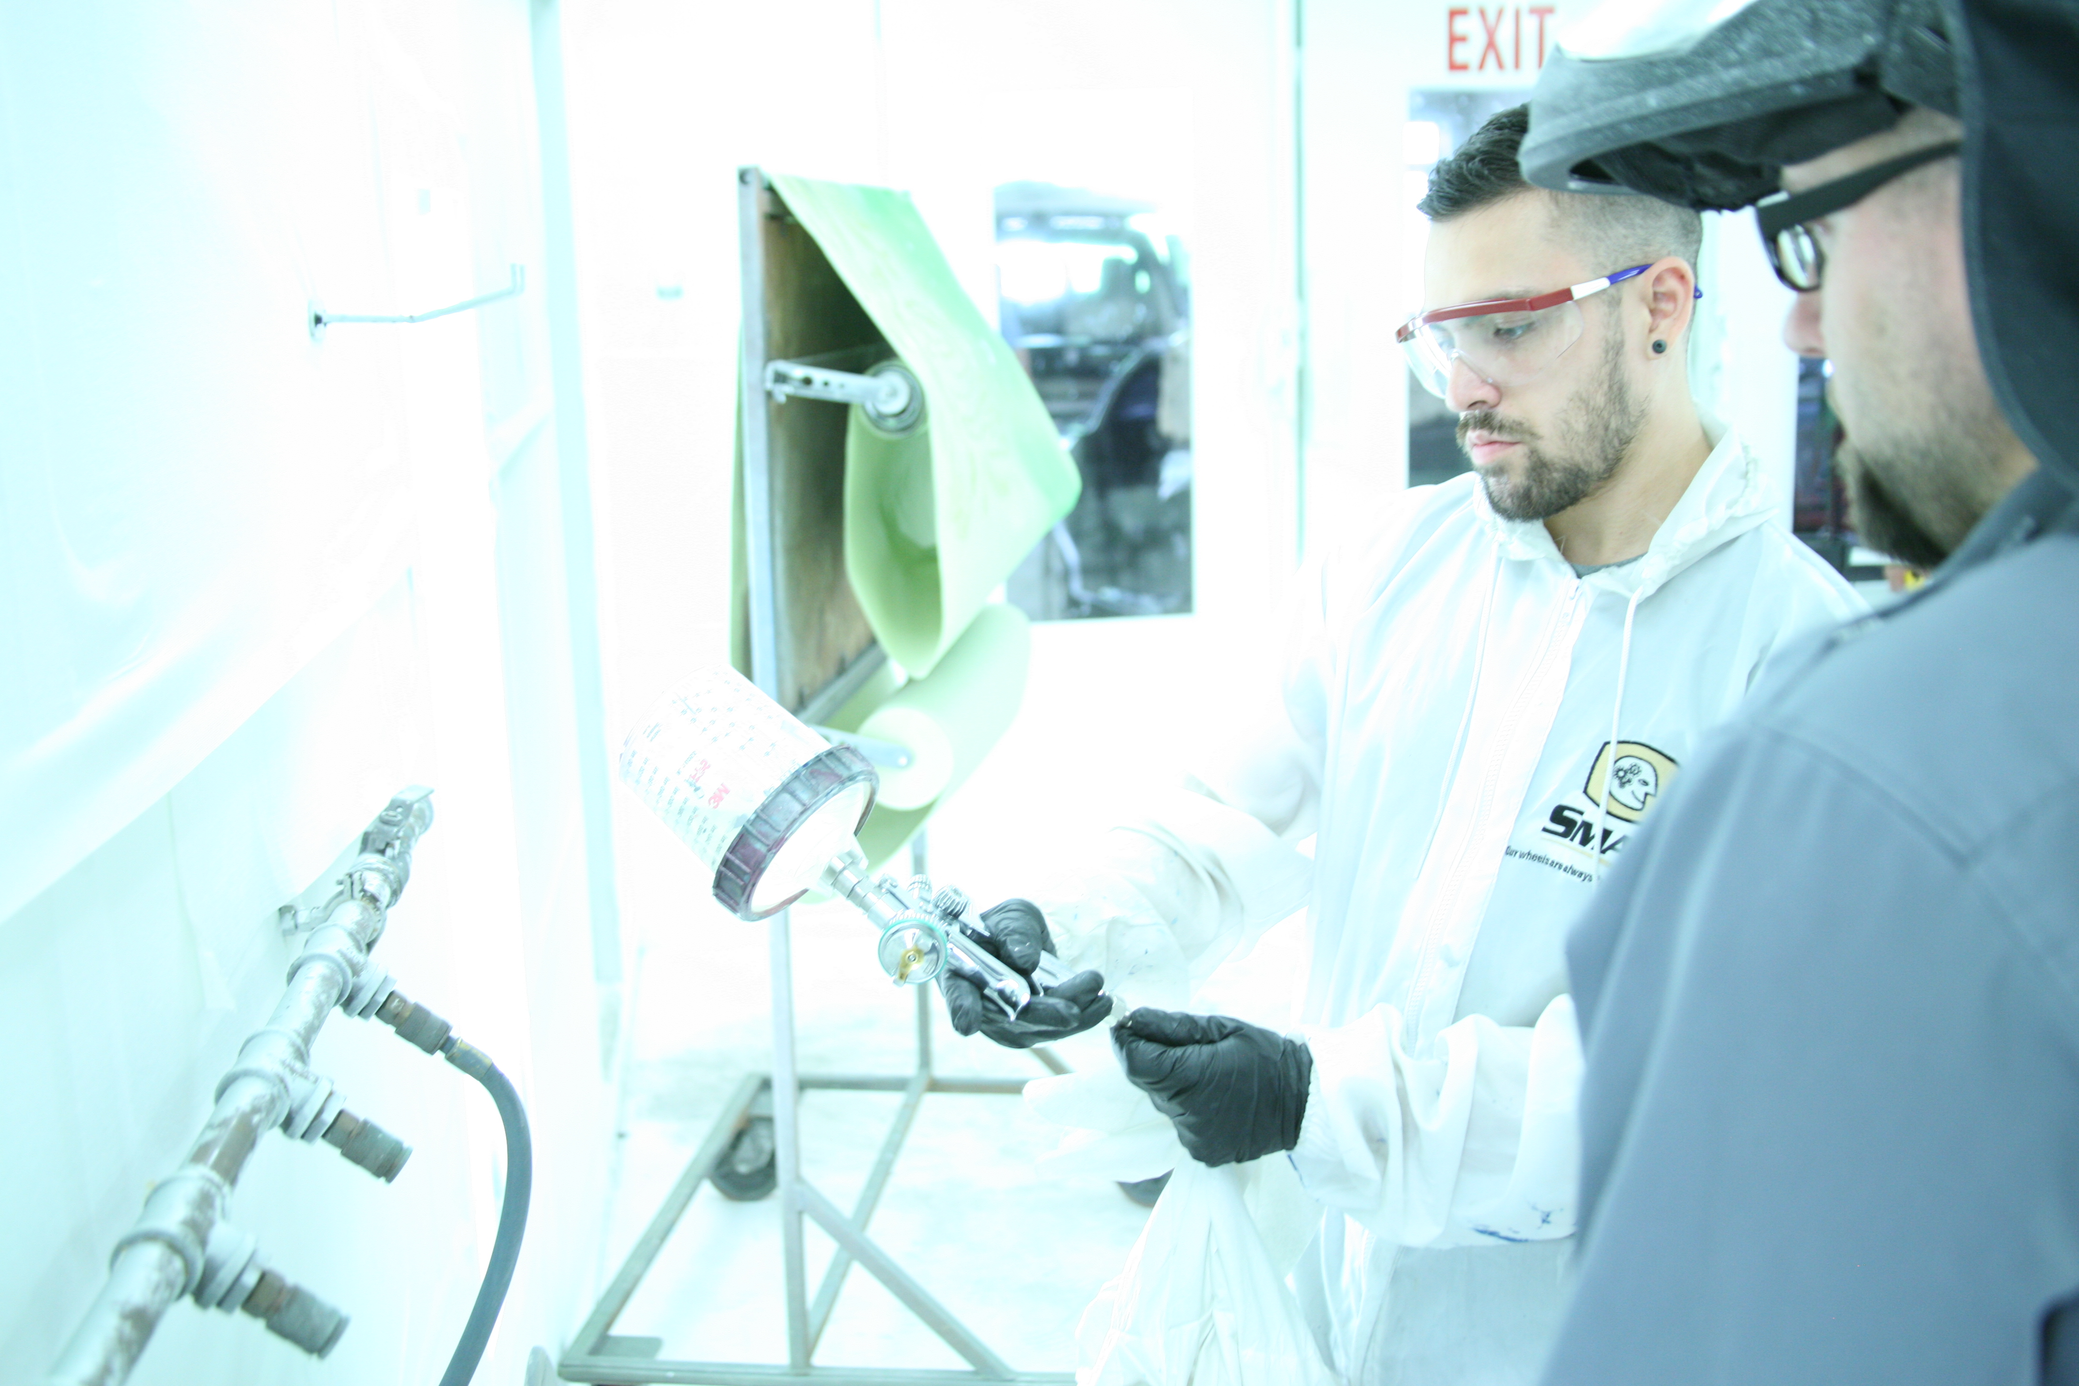
What it takes to succeed
Technical savvy
Problem-solving abilities
Solid background in English, math and computers
Strong communication skills
Ability to work as part of a team – and independently
Commitment to continuing education

Slide 12

Automotive Earning Potential
In high demand: students are likely to land a job while still in school
Many entry-level jobs start at $30,000
Professionals with experience: over $60,000
Top Performers: earning over six-figure annual incomes

Slide 13
Automotive Education
Notes:
Use this as a section or call out quote slide.

Slide 14
Automotive Education
Affordability
(Two-year programs)
Passion
(Career where students do what they love)
Industry Demand
(Openings now with strong earning potential)

Slide 15
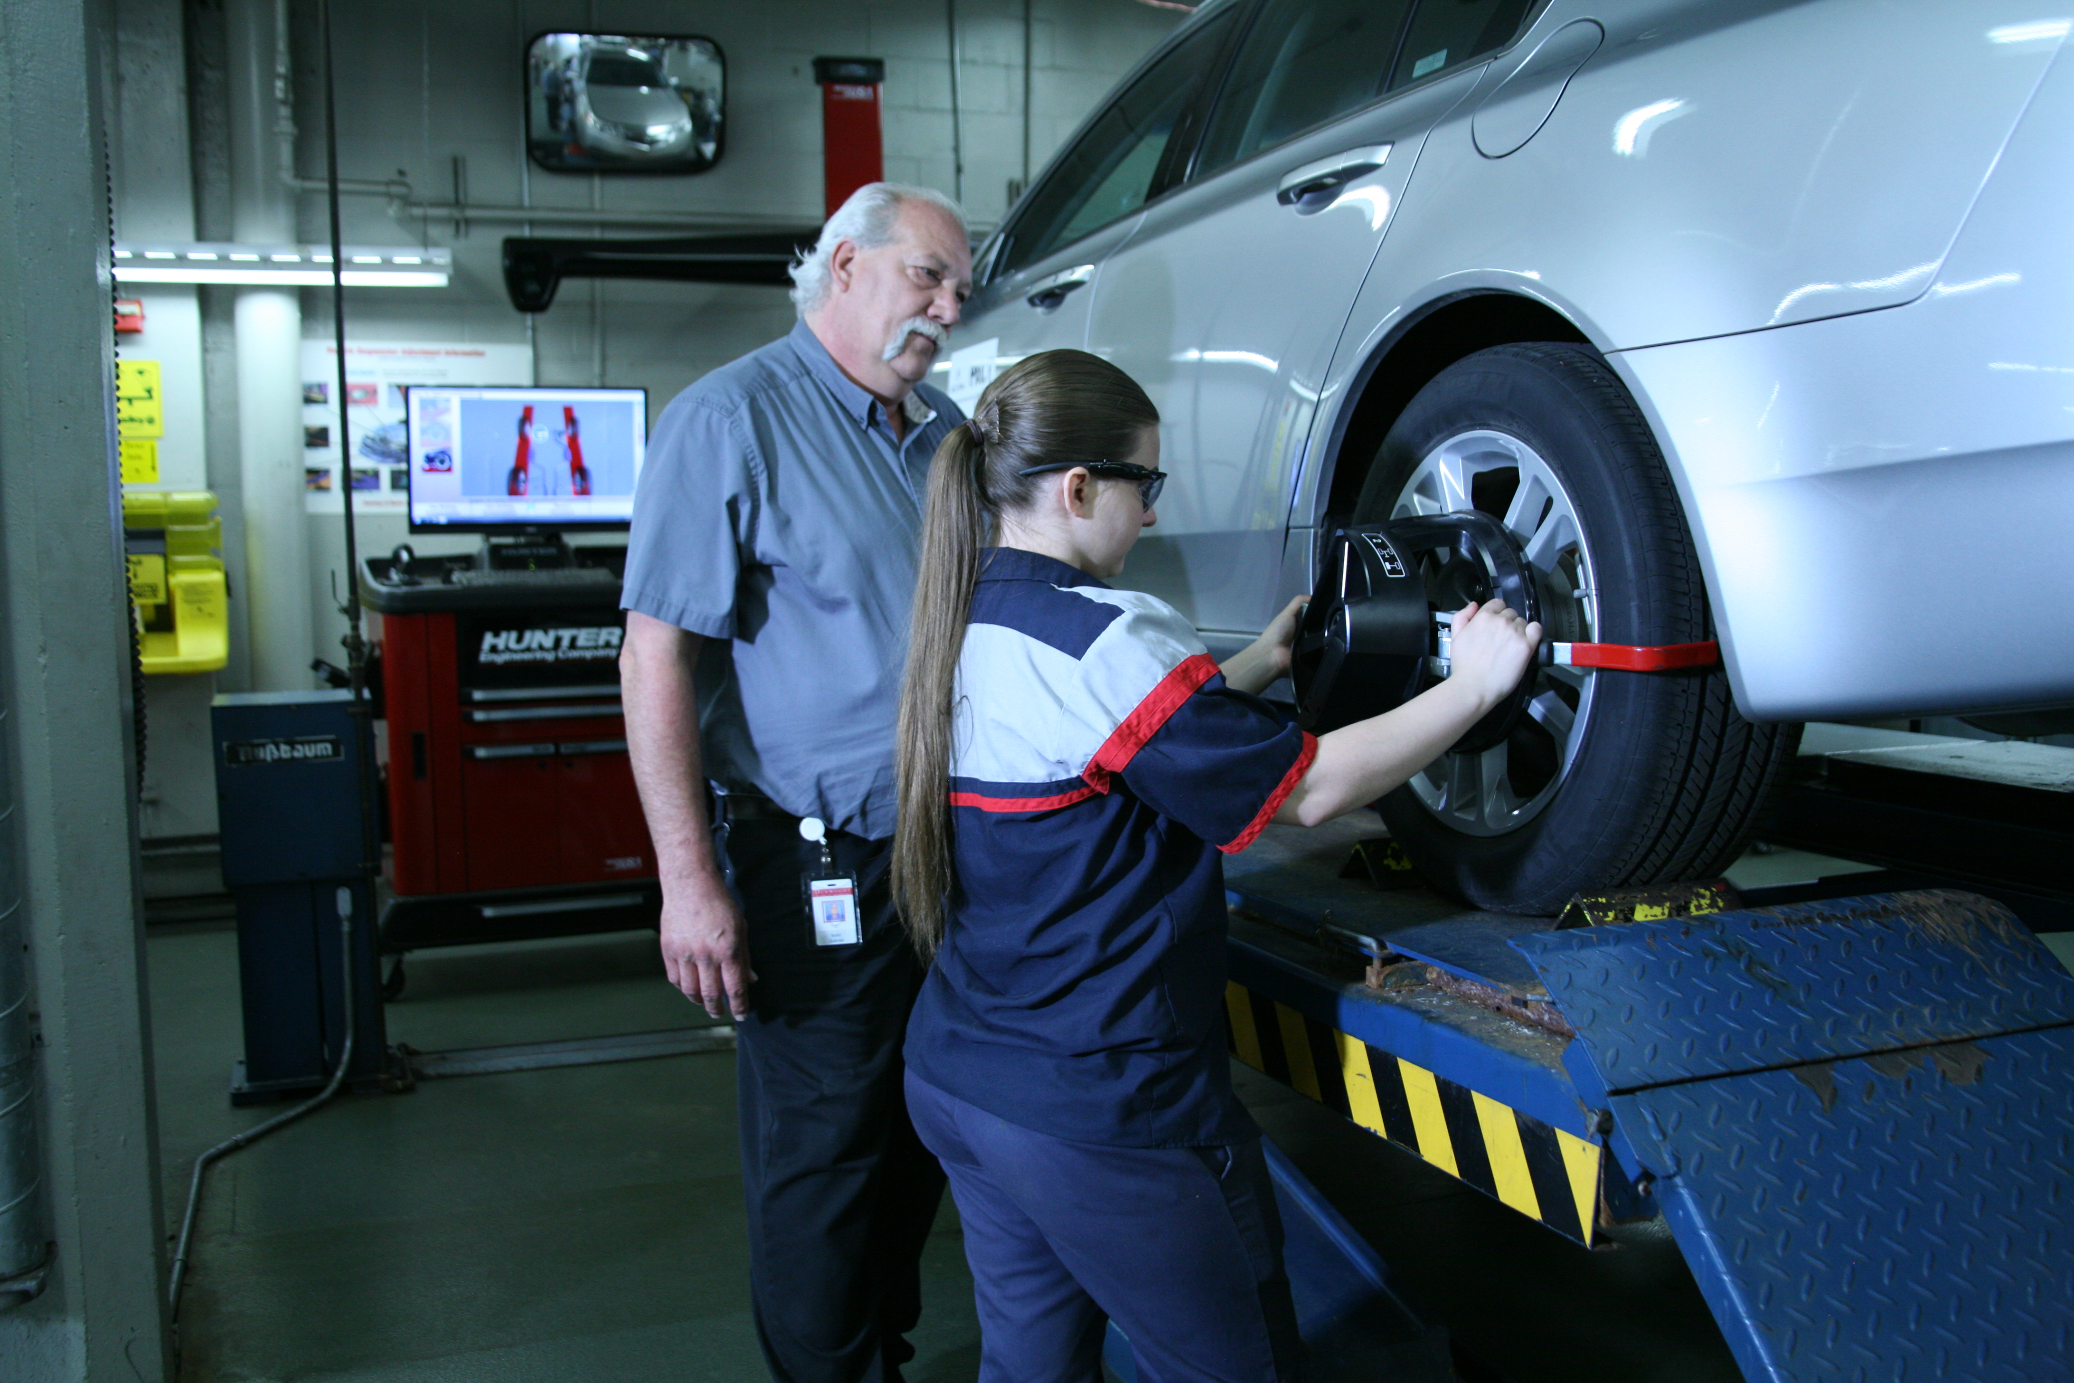
Automotive Programs in Minnesota
Over 30 programs statewide
Most are in public two-year community and technical colleges
Automotive service or collision repair programs to fit students’ interest
Click
“Get Started” CarCareers.org
for a full list.

Slide 16
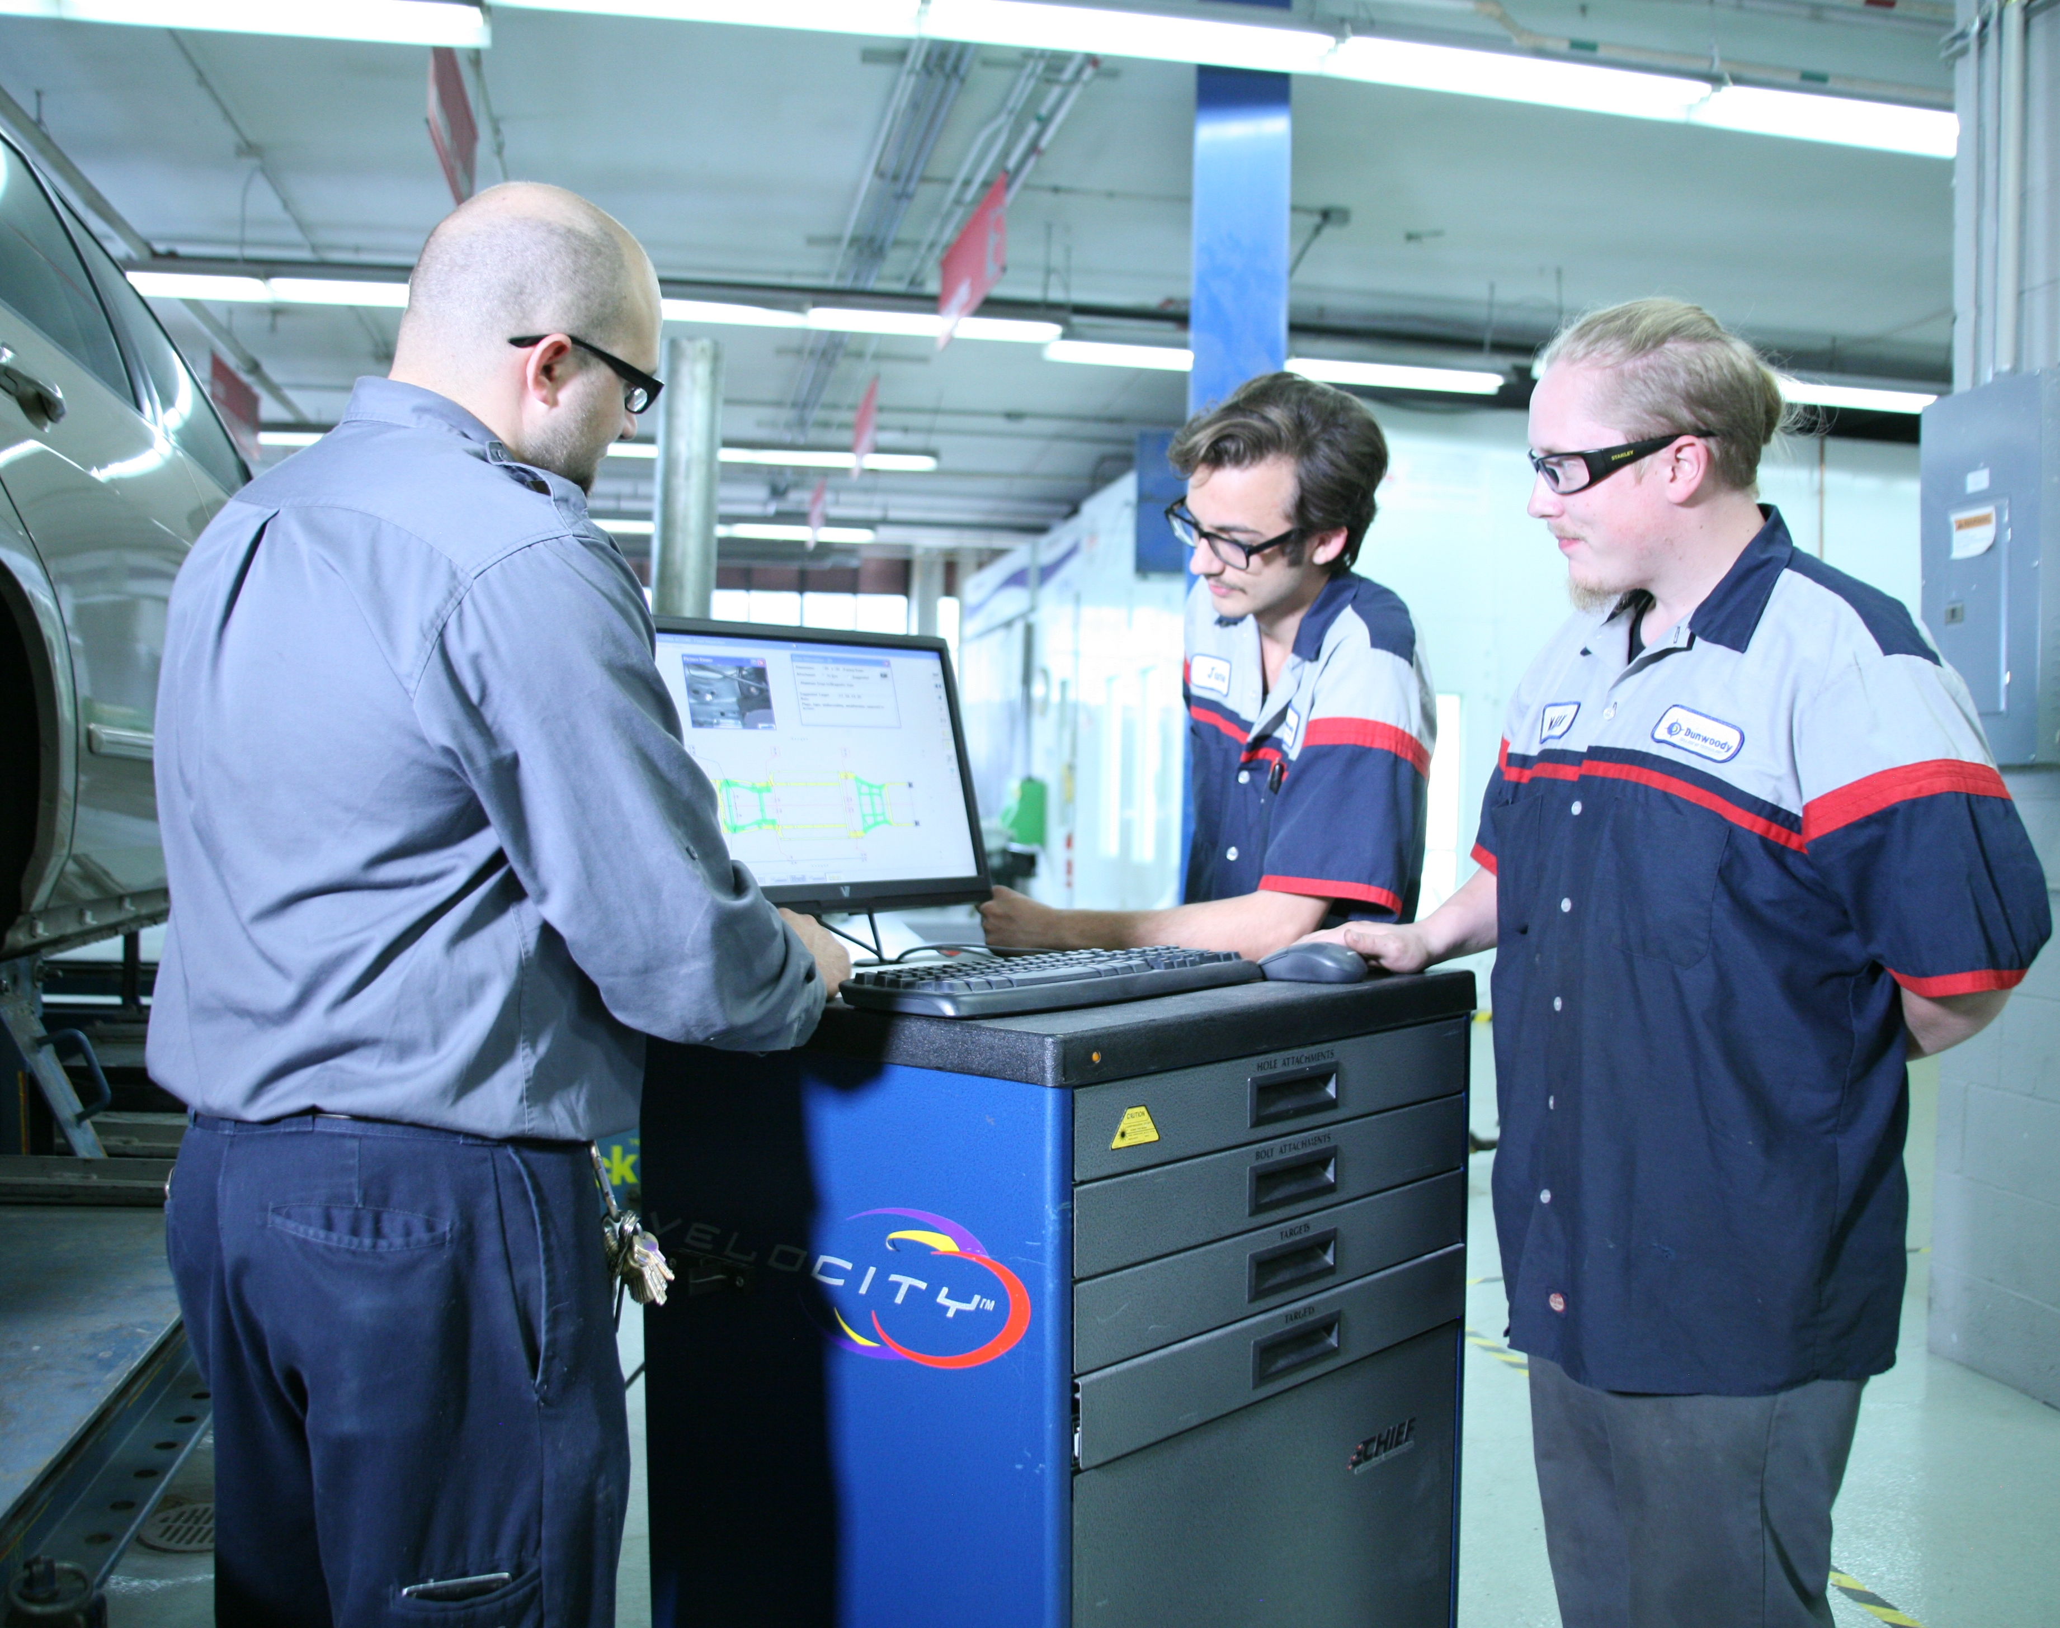
Scholarships
An automotive scholarship can help pave the way to a rewarding career. Numerous companies and organizations in the automotive service and collision repair industry offer scholarships for students training to enter the industry.
Visit
Automotivescholarships.com
for more info.

Slide 17

Success in the new economy
Technical education equips students with highly marketable, real-world skills that land them jobs as soon as they graduate. This compelling video encourages a post-high school credential for everyone, not necessarily a university education for everyone. Double click the video to play or view it online here.

Slide 18



How you can help
Connect students to local professionals (tours, interviews, job shadowing) via MNCARS at info@carcareers.org.
Encourage students to visit CarCareers.org, facebook.com/CarCareers and connect with us on Instagram @CarCareers
Assist parents in understanding the tremendous opportunities in the automotive industry
Contact MNCARS at info@carcareers.org to have a professional come to your school to speak with students

Slide 19
About MNcars
Minnesota Careers in Automotive Repair and Service (MNCARS) is a workforce initiative created by a cross-section of automotive industry representatives, including independent repair shops, multiple-shop operators, suppliers, technical college administrators and other industry organizations.
Its goal is to ensure a future workforce for Minnesota’s automotive service industry by raising awareness and recruiting people into technical college automotive education programs (collision and mechanical) and industry careers.

Slide 20


Help Students Accelerate Their Future at carcareers.org
Notes:
To add a full page image: Crop image to 10x7.5 and Insert Picture. Copy/paste the graphic from this page on top of picture.

