Slide 1

Sleep Deprivation, Insomnia and
Posture
“When you maximize your sleep cycle, you create more ENERGY!”

Slide 2

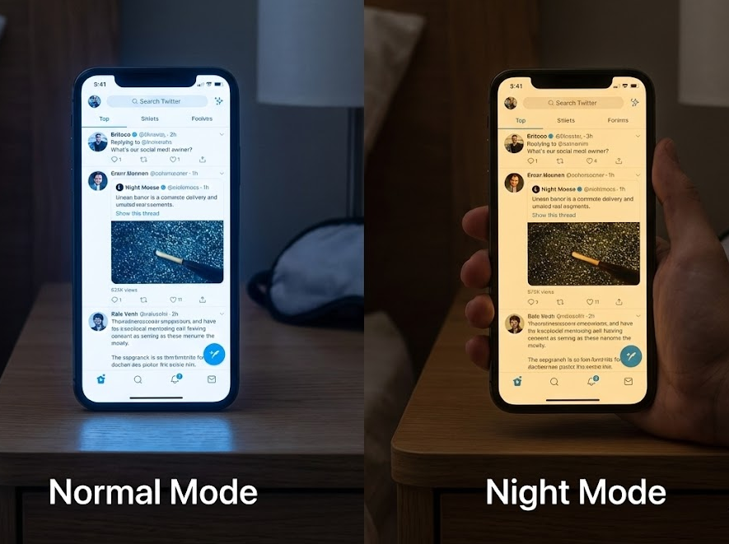
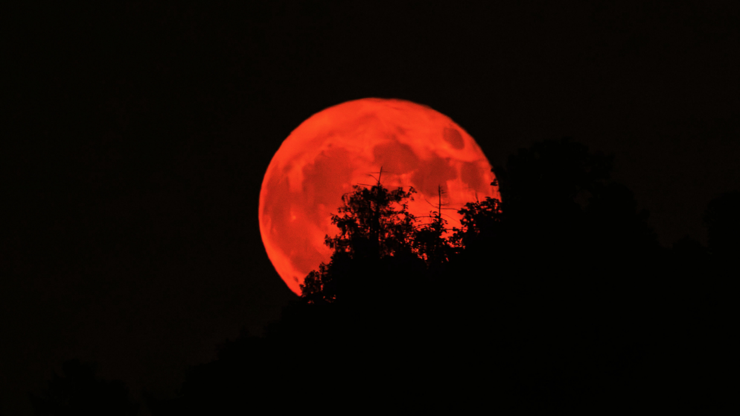

Melatonin?
The darkness hormone
-We’re “diurnal” or “daywalkers”
-Darkness stimulates pineal gland melatonin release 1-2 hours later
-ANY amount of light, even through our eyelids stops the flow

Slide 3
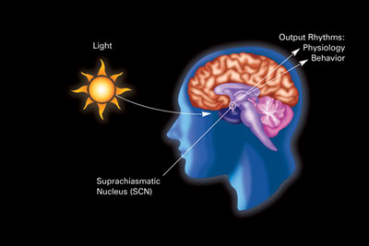
Understanding Sleep and the Circadian Rhythm
Internal body clock
Influences when, how much, and how well people sleep
“Clock hormones” slowly respond to light and darkness
Notes:
Circadian rhythm- physical, mental, and behavioral changes that follow a roughly 24-hour cycle.
There are patterns of brain wave activity, hormone production, cell regeneration, and other biological activities linked to this 24-hour cycle.
The circadian rhythm is important in determining sleeping patterns such as when we sleep and when we wake, every 24 hours. The normal circadian clock is set by the light-dark cycle over 24 hours.

Slide 4


Slide 5


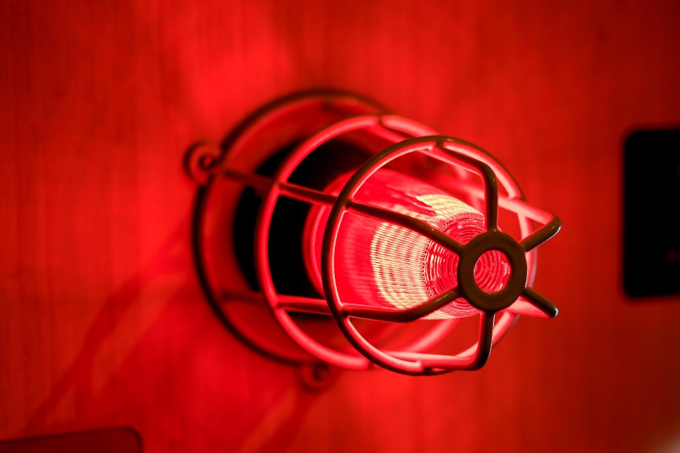
Waking up:
Sunrise
Cortisol
Startle
Red nucleus
O2 deprivation
White noise?

Slide 6
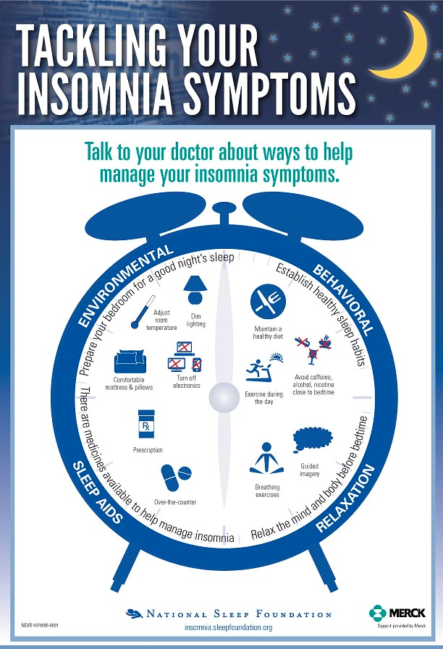
Environmental
Behavioral
Obstructive Sleep Apnea
Relaxation
Notes:
People with severe insomnia take more meds, undergo more tests, and are hospitalized twice as often over a 12-month period than those without insomnia

Slide 7
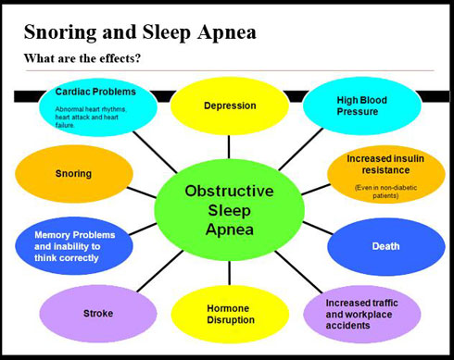

Slide 8
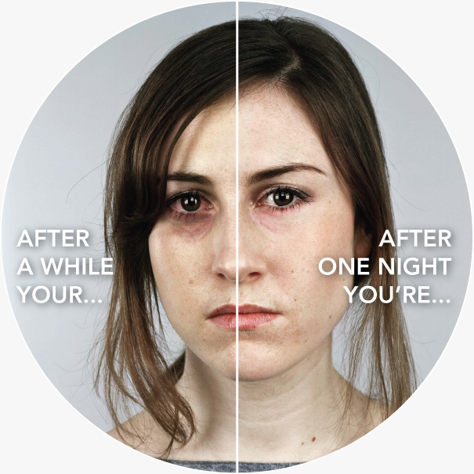
Stroke risk quadruples
Obesity risk jumps
Risk of some cancers may increase
Diabetes risk goes up
Heart disease risk increases
Sperm count decreases
Risk of death goes up
Hungrier & tend to eat more
More likely to have an accident
Not looking your best or your most approachable
More likely to catch a cold
Losing brain tissue
More likely to get emotional
Less focused and having memory problems

Slide 9

Black Box Warning: Side Effects
Ambien, Restoril, Lunesta, Rozerem, Halcion,
Mixed with anti-anxiety drugs which are extremely addictive, reduce pulse/breathing rate, and cause sleep-walking.
Warning: “Strange Behavior, Abnormal Thinking, Sleep Driving, Sleep Eating, Sleep Shopping”
According to FDA, these drugs also cause:
Burning or tingling in the hands, arms, feet, or legs
Changes in appetite
Constipation
Diarrhea
Difficulty keeping balance
Dizziness
Drowsiness
Dry mouth or throat
Gas
Headache
Heartburn
Stomach pain or tenderness
Uncontrollable shaking of a part of the body
Unusual dreams
Weakness
Muscle Pain
Mirrored Cabinet Question

Slide 10
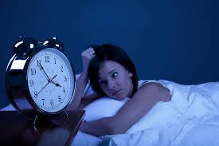
1 out of 3 adults have Insomnia
A disorder that can make it hard to fall asleep, stay asleep or get restful sleep
2 Types:
Primary Insomnia - Related to a 1)Relaxation 2)Behavior 3)Environment
Secondary Insomnia - Due to health, Most Common, Structural Obstruction
    Asthma
    Allergies
    Depression
    Heart burn
    Joint Pain
Headaches
Low Back Pain
Stress
Numbness/Tingling
Medications
Notes:
There are many sleep conditions but the most common are: insomnia, sleep apnea, and restless leg syndrome
Someone with insomnia will often take 30 minutes or more to fall asleep and may get only six or fewer hours of sleep for three or more nights a week over a month or more.
Acute insomnia is brief and often happens because of life circumstances (for example, when you can't fall asleep the night before an exam, or after receiving stressful or bad news).
Chronic insomnia is disrupted sleep that occurs at least three nights per week and lasts at least three months.

Slide 11
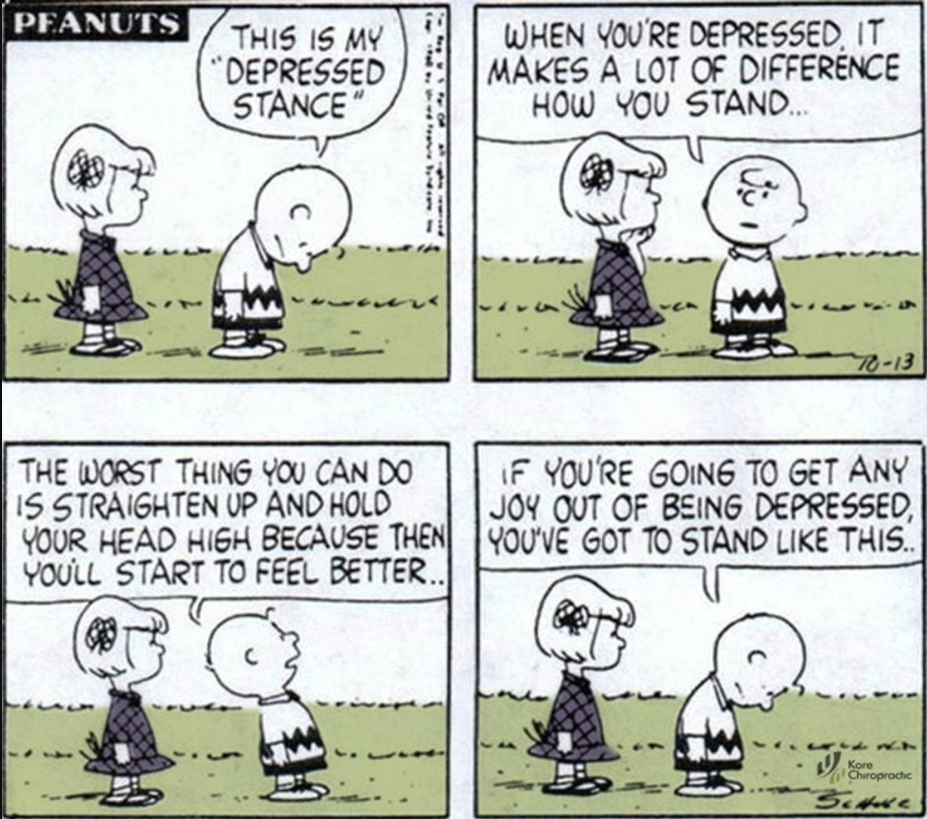

Slide 12
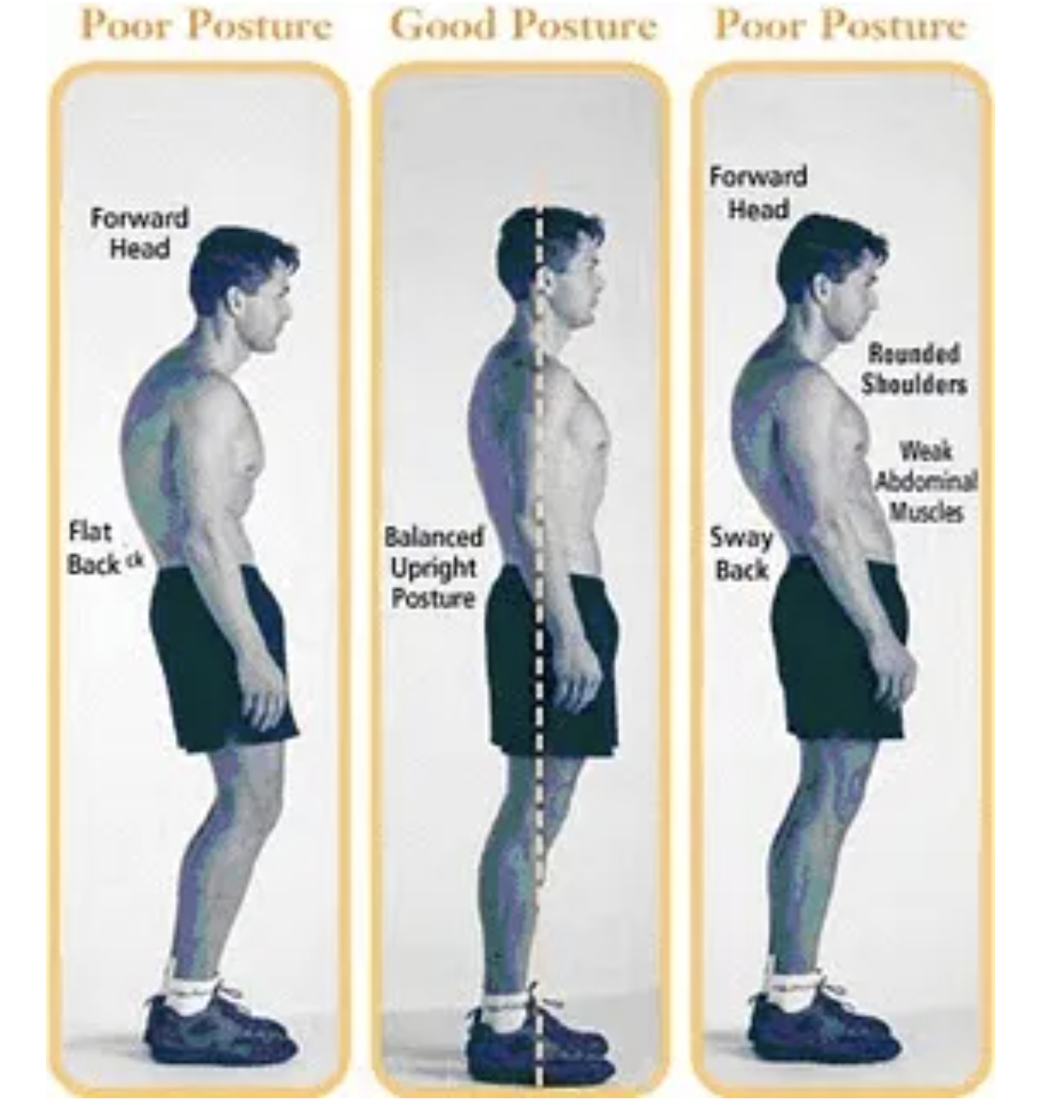

Slide 13
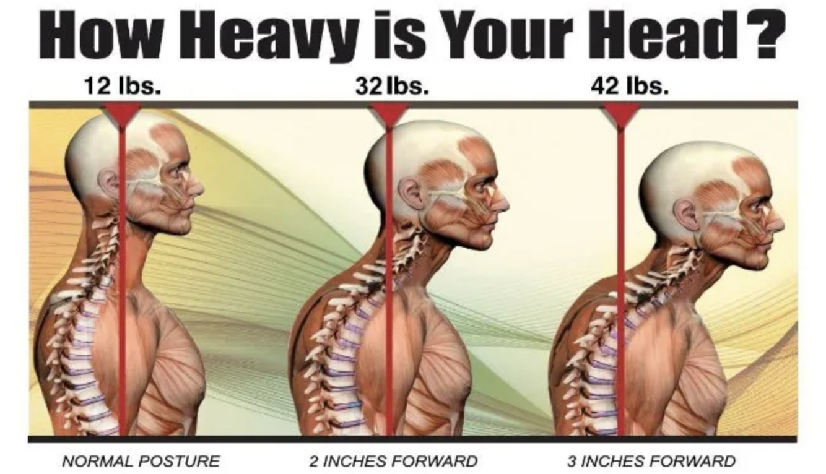

Slide 14
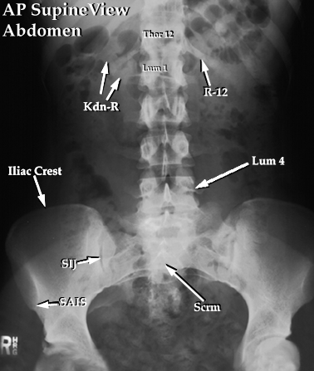
Today’s Offer…
Today only we are offering a complete exam, 1 set of x-rays as needed, and consultation.
This offer is good for family members, spouses, and co-workers not in attendance, but appointments must be made today.
Non Medicare - $20 offer Today Only!!
Medicare - $100

