Slide 1


RAC-R Perinatal Committee Meeting
6.9.26

Slide 2
Attendance
Baptist Beaumont
Maternal: Rebekah Landry, Mallory Defee
Neonatal: Amie Coble
Christus St. Elizabeth
Maternal: April Waguespack
Neonatal: Kelli Huebel
Medical Center of SE Texas- **OB Services suspended May 1.2026
Maternal:
Neonatal:
UTMB Angleton Danbury
Maternal: Casi Delacruz
Neonatal: Casi Delacruz
UTMB Galveston
Maternal: Kim Stewart
Neonatal: Amy Shapley

Slide 3
TCHMB Neo Committee Updates
LASSO Learning Session 2 was June 4th and 5th
Onboarding enrolled hospitals into the IAMOnline data system
Guest presentation on NRP 9th edition updates
Algorithm changes on umbilical cord management, routine suction de-emphasized in the initial steps, oxygen saturation table, ventilation rate

Slide 4
TCHMB Maternal Committee Updates
PPED project was highlighted in the national AIM newsletter in April
G. Delgado will retire from co-chair position in June and the position will be open for applicants
The committee will select bundle elements from the Sepsis initiative and share tools with the RACs to further support implementation; Learning Session 3 marked the completion of the AIM bundle

Slide 5

Upcoming DSHS Calls
Maternal Surveyor Training 6/11 3-4:30 pm
Level II-IV 6/17 2-3 pm
Perinatal QAPI Overview 6/25 3-4:30 pm
Level I 7/1 2-3 pm

Slide 6
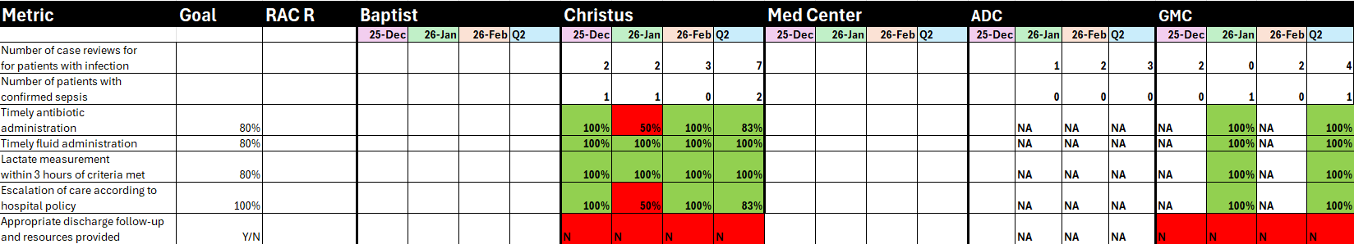
Maternal Sepsis Project

Slide 7
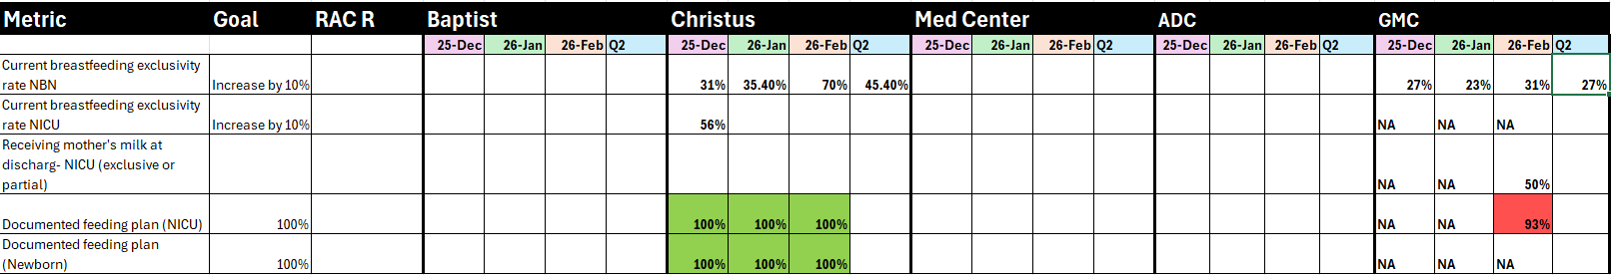
Neonatal LASSO Project
Q1 Christus: 55.6 % for NBN
Q1 GMC 27.6% for NBN

Slide 8


Slide 9
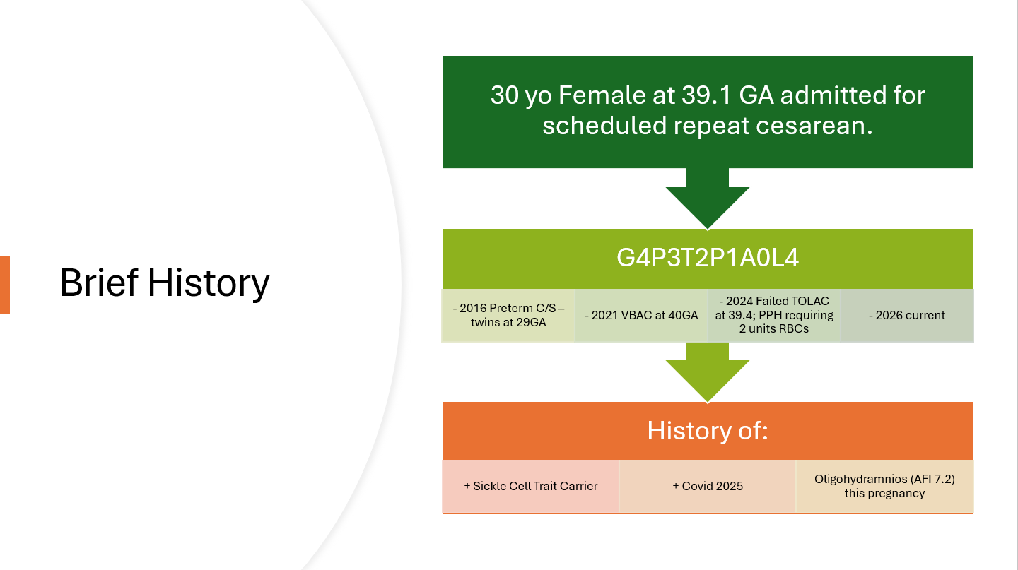

Slide 10
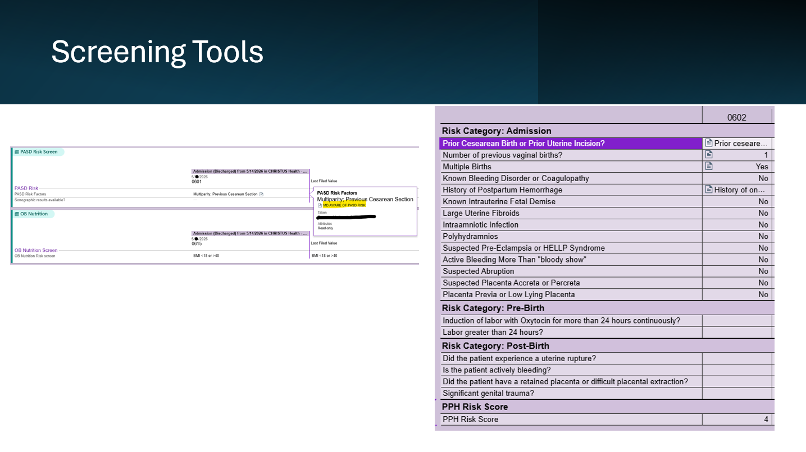

Slide 11
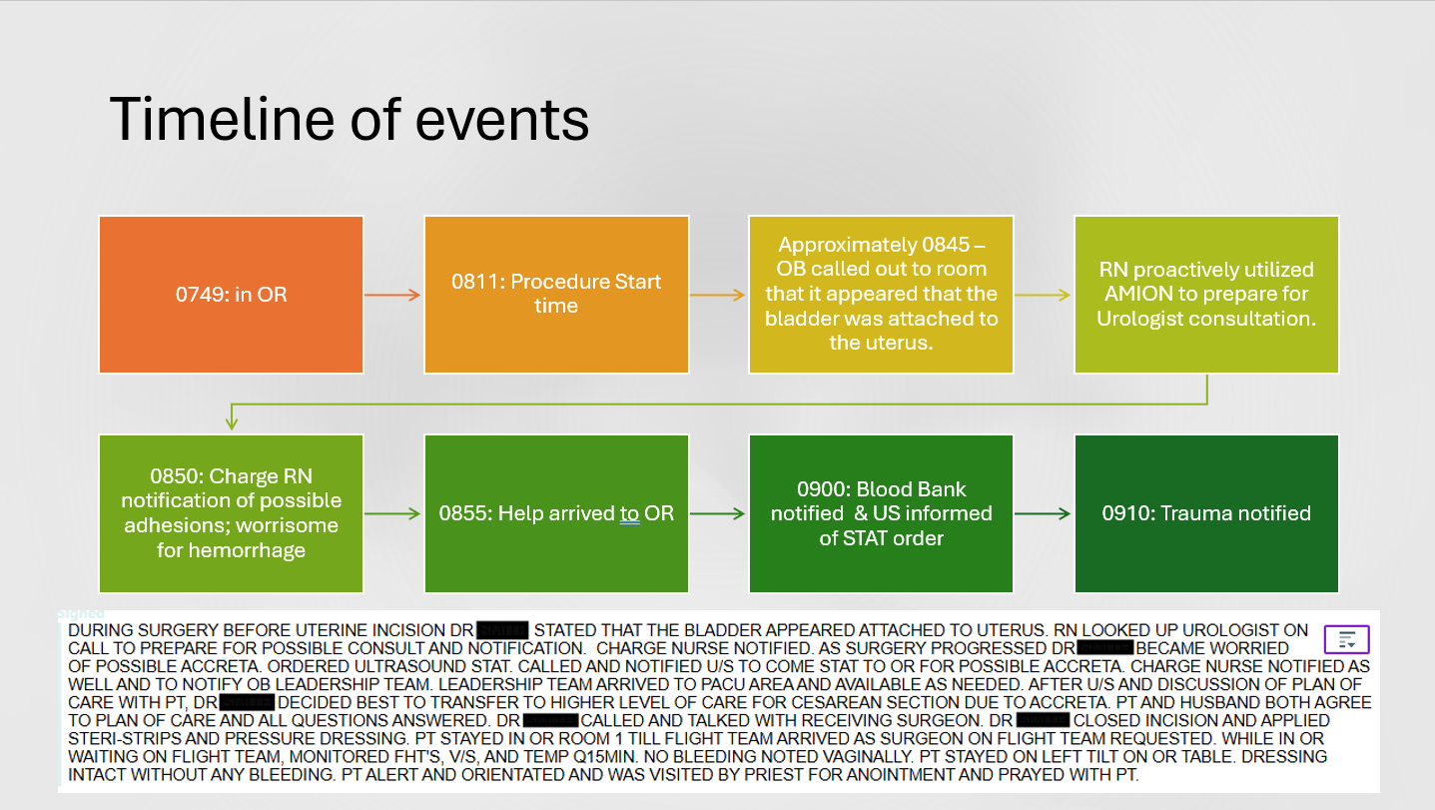
Notes:
MD notes that there came a point that it became clear that there was no access to the lower segment of the uterus being completed covered by the bladder. Lateral dissection on the bladder particularly the left hand side revealed large vessels all alongside the lower segment uterus and bladder. The entire lower segment of the uterus was inseparable from the posterior sheath of the rectus fascia except for over the bladder where there was a palpable defect in the anterior wall of the uterus in the lower segment where the fetal head could be palpated through the bladder and an apparent defect in the lower uterine segment wall. This prompted significant concern for possible placenta accreta spectrum disorder and the need for at least urology and possibly and accreta team.

Slide 12
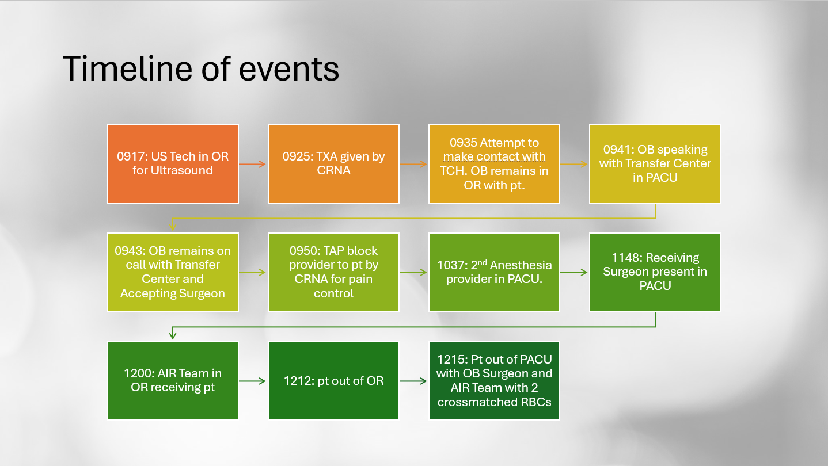

Slide 13
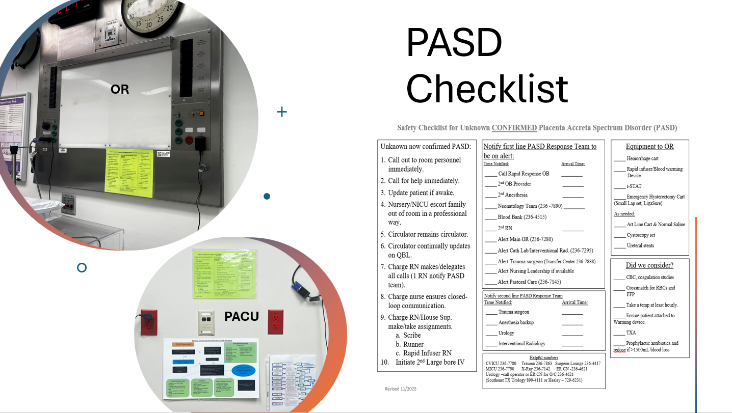

Slide 14
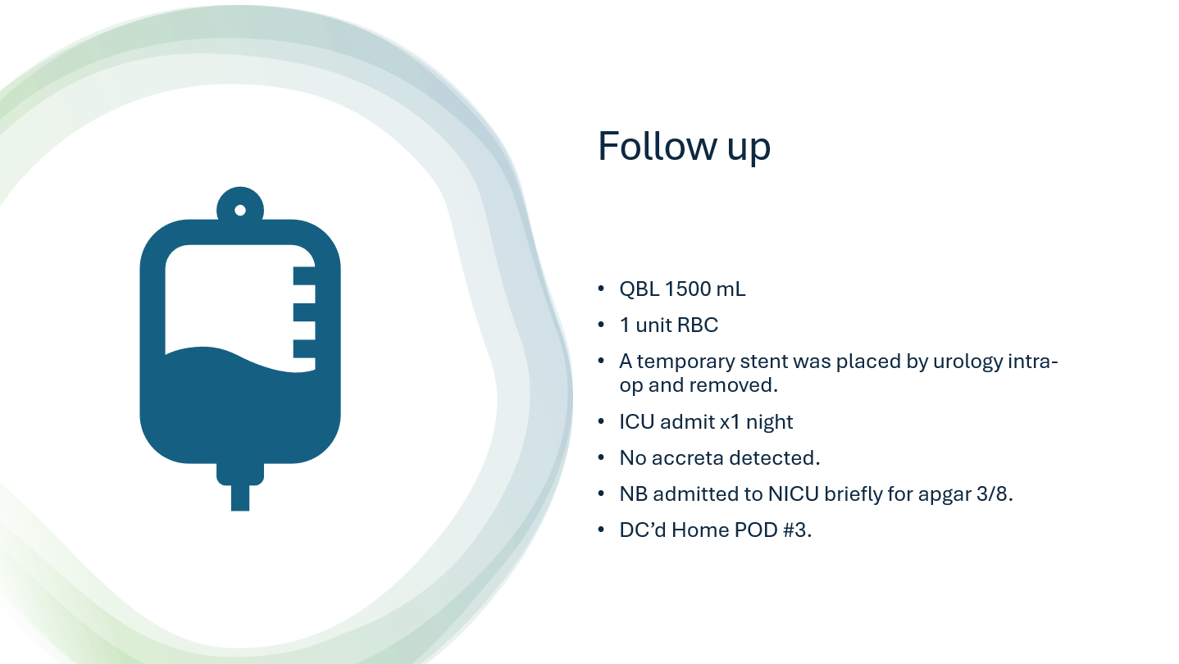

Slide 15

When we meet again:
General Assembly and Perinatal Committee meeting 9.8.26
RAC R Medical Directors Meeting 9.11.26

